Slide 1
Progress of Helium Refrigerators in TIPC
Qing LI
Technical Institute of Physics & Chemistry (TIPC)
June 7th, 2018

Slide 2
Contents
Brief Introduction of TIPC
Series Helium Refrigerators

Slide 3
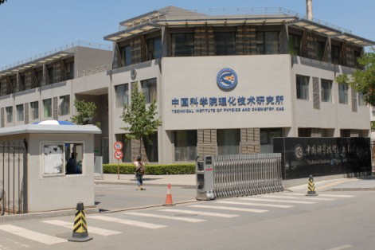
Introduction of TIPC
Founded in 1999; Former Cryogenic Laboratory and Institute of Photographic Chemistry;
510 staffs, including 5 Members of CAS, 1 Members of CAE, 86 professors and 149 associate professors, over 500 enrollment of graduate students
Cryogenics parts is the Only national synthetic institute of cryogenics

Slide 4
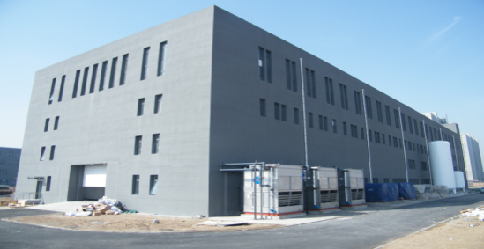
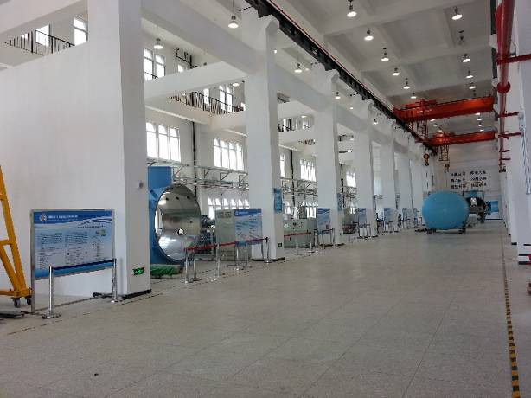
1. Brief Introduction of TIPC
Campus of LANG FANG (in Hebei Provence)
93380 square meter (140 Mu)
Building of base for large scale refrigerator
7000 m2

Slide 5
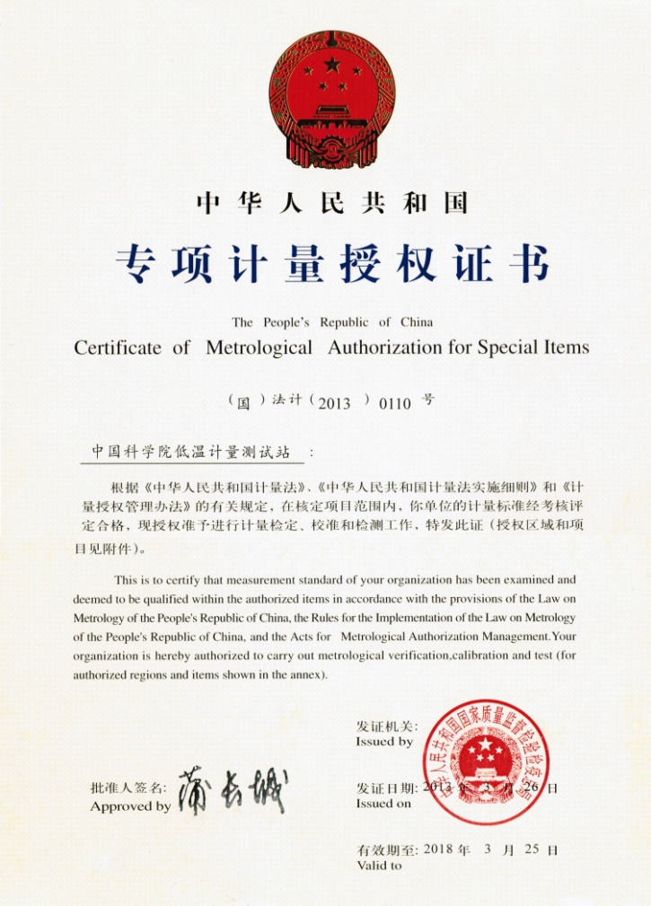
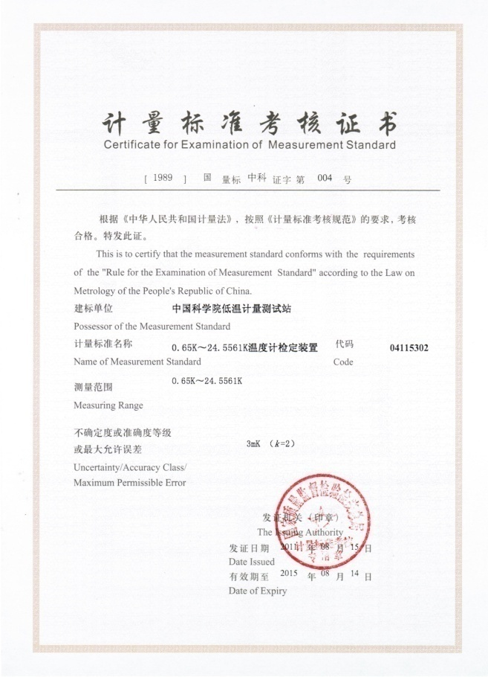
National low temperature calibration system

Slide 6
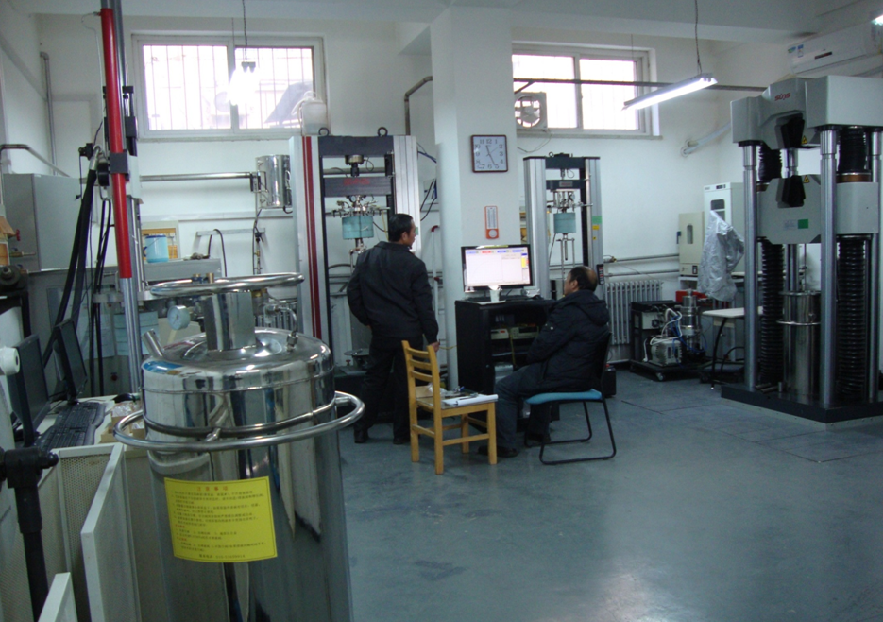
Content
Synthetic low temp. test system
In TIPC

Slide 7
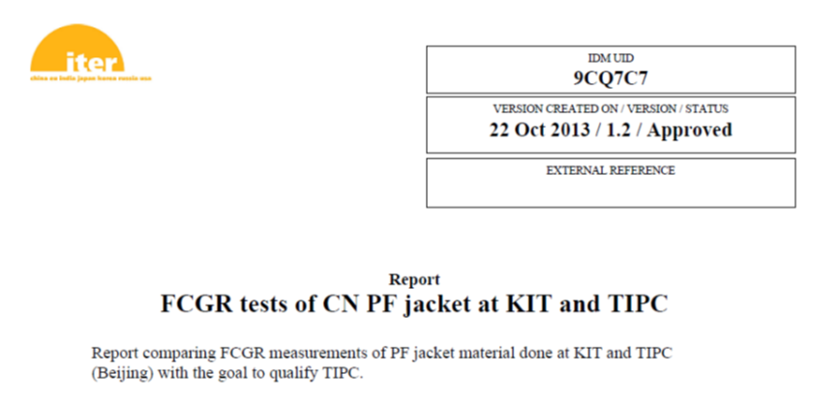
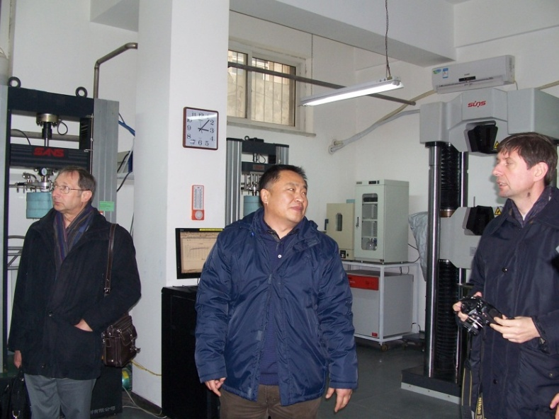
ITER authorized on low temperature material in 2013
ITER Org. Prof. Libeyre,
CERN Prof.Sgobba
Visit TIPC
To check the cryogenic test facility
and quality system
Notes:
90x120x35mm,2387g
7

Slide 8
Contents
Brief Introduction of TIPC
Progress of Helium Refrigerators

Slide 9
Helium Refrigerator
Helium Refrigerators
    2kW@20K
    10kW@20K
    250W@4.5K
    Helium liquefier L40 (40l/h)(L40A, L40B)
    2.5kW@4.5K/500W@2K

Slide 10
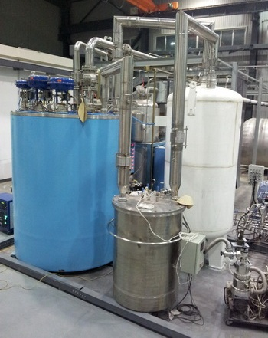
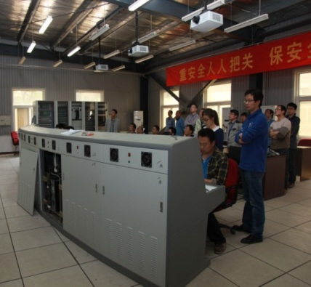
Helium Refrigerator – 2kW@20K
2009-2012: 2 kW@20K: Remote control, 30 days stable operation, no any problem even after one power net stop
Move to environmental Simulation system for launch vehicle material test

Slide 11
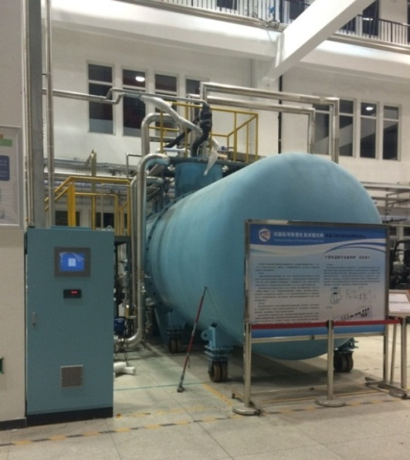
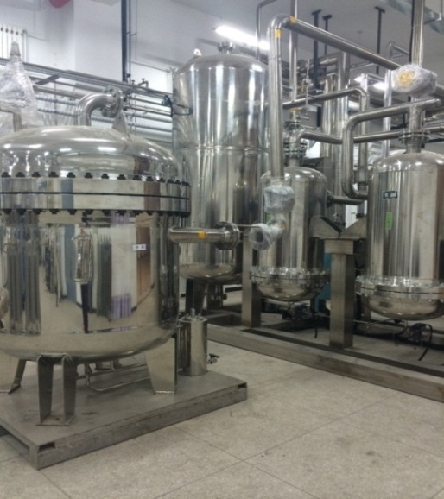
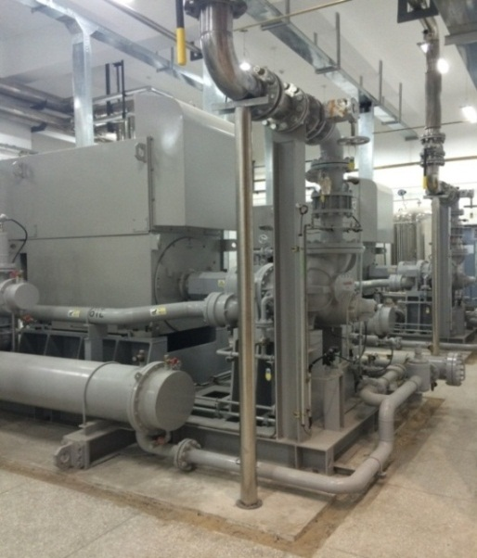
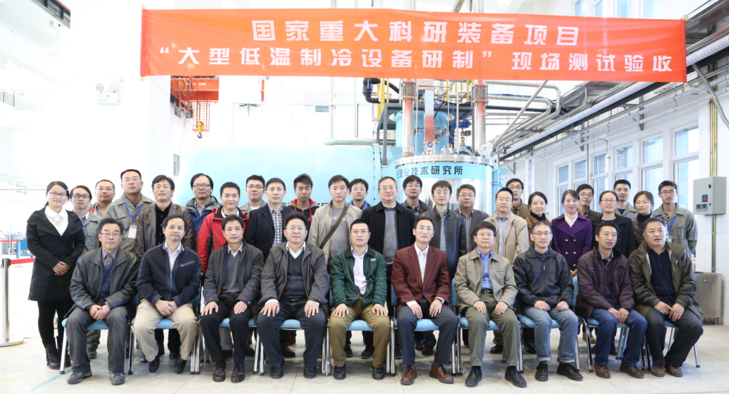
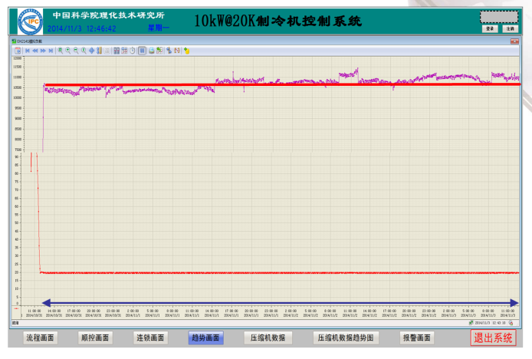
Helium Refrigerator – 10kW@20K
2010-2014: 10kW@20K
72h operating test:
Cooling capacity: 10.8kW@19.7K
Turbine isentropic efficiency: ≥76%
Cold box (turbo-expander)
Oil remover subsystem
Helium compressor

Slide 12
Helium Refrigerator – 2500W@4.5/500W@2K
Content |  |  | Targets
System | Cooling power | Large one | 2.5kW@4.5K
 |  |  | 500W@2K
 |  | Small one | 250W@4.5K
Key technology | Turbine Expender |  | 250 krpm Eff.: 75%
 | Cold Compressor |  | 60 krpm Eff.: 60%

Slide 13
Helium Refrigerator – 2500W@4.5/500W@2K
4 K key technology
2 K key technology
4 K + 2 K system
4 K system
4 K system
2015
2016
2017
2018
2019
Middle
Point
250W@4.5K

Slide 14
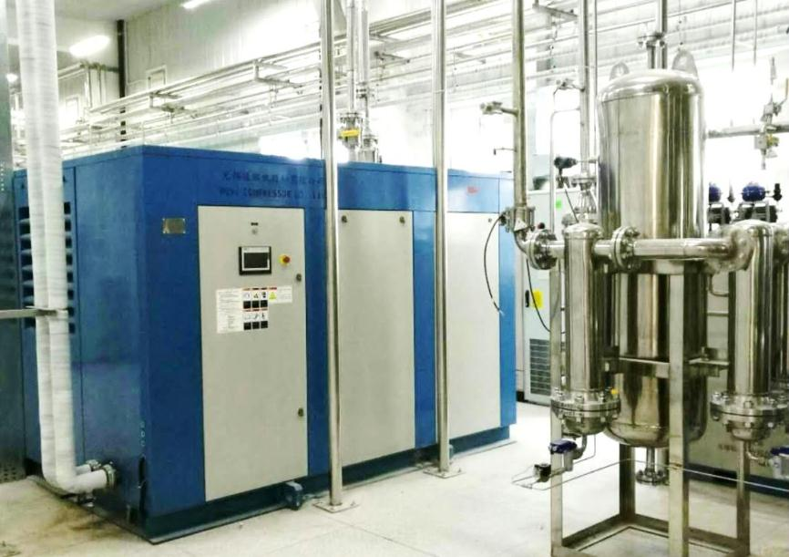
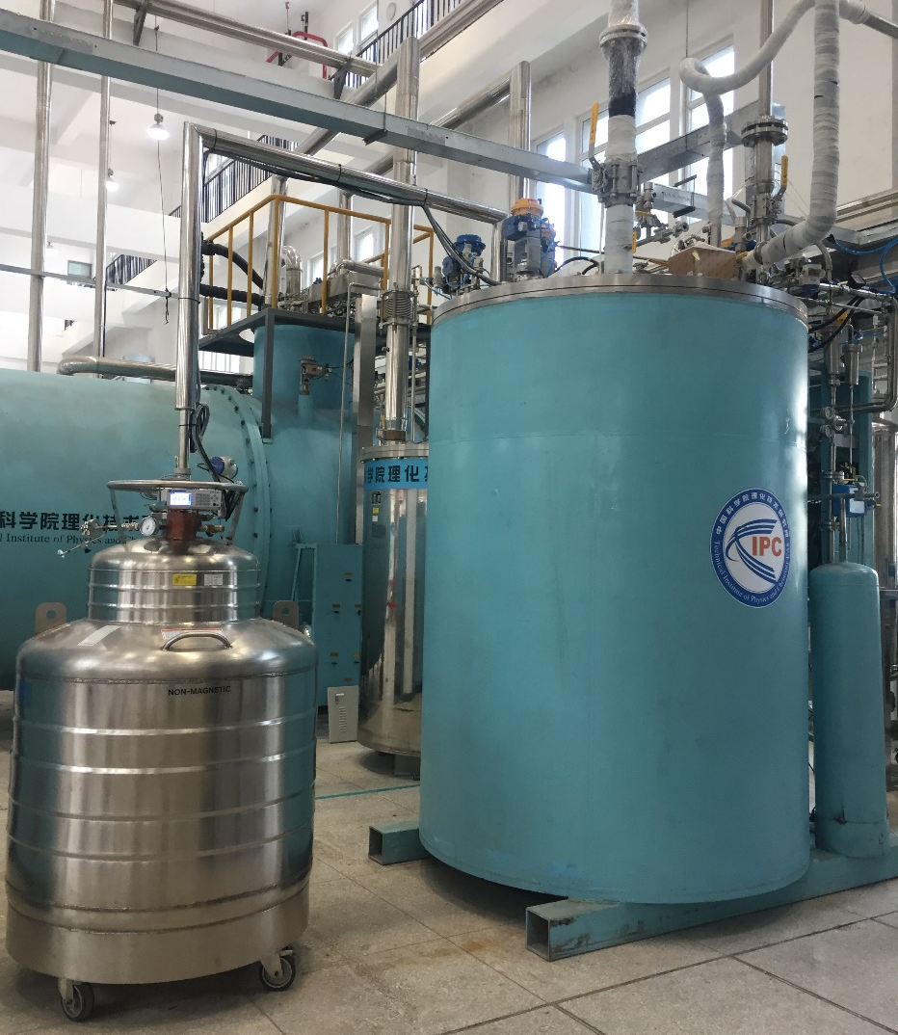
Helium Refrigerator – 250W@4.5K
2015-2017: 250W@4.5K (All key components were domestics.)
Compressor & Cold Box
Turbine expender speed: 250krpm

Slide 15
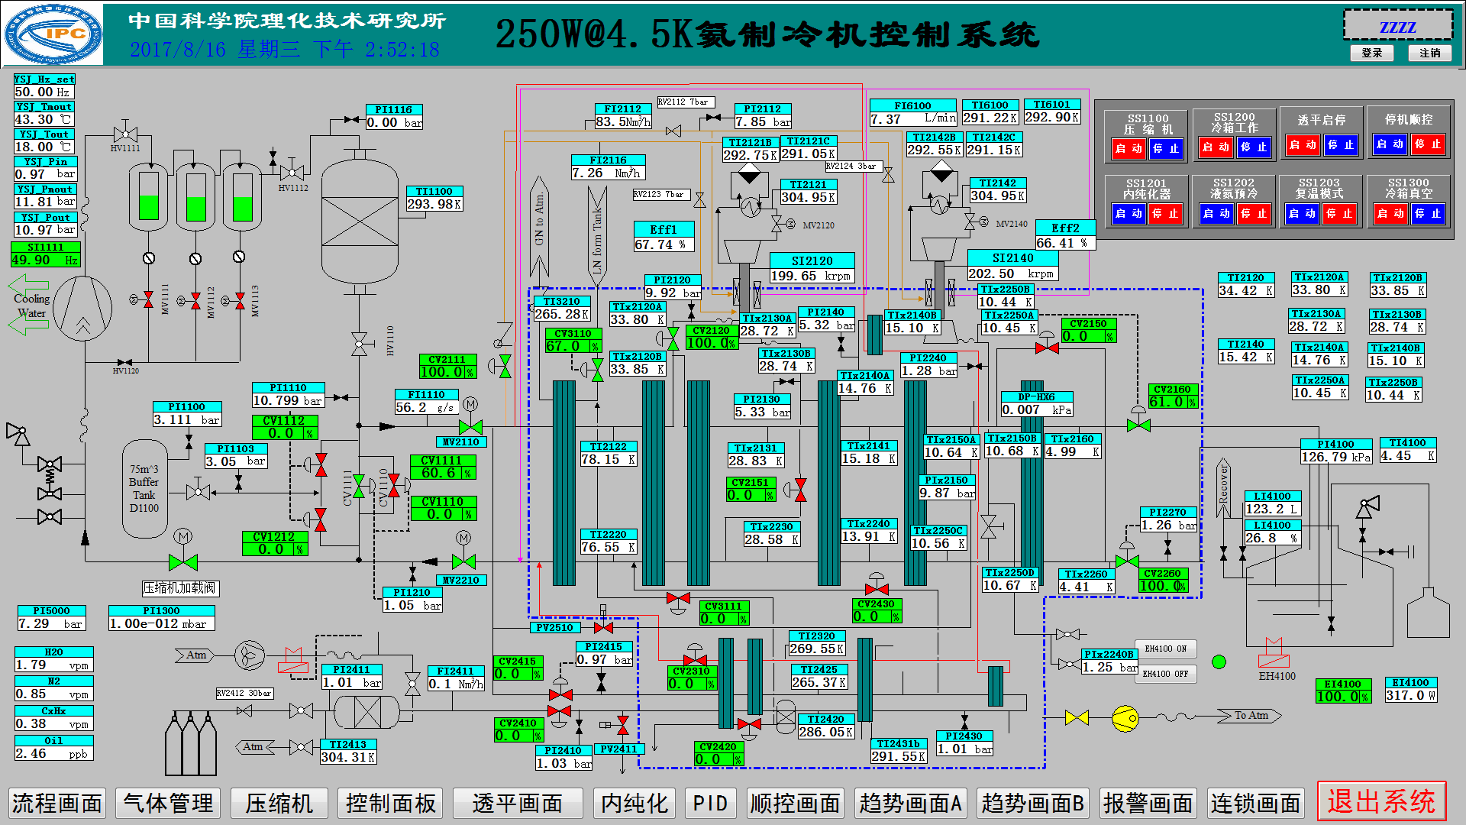
Helium Refrigerator – 250W@4.5K
Maximal cooling capacity: 317W@4.4K
turbine thermal efficiency: η_{T1}=67.7%, η_{T2}=66.4%

Slide 16
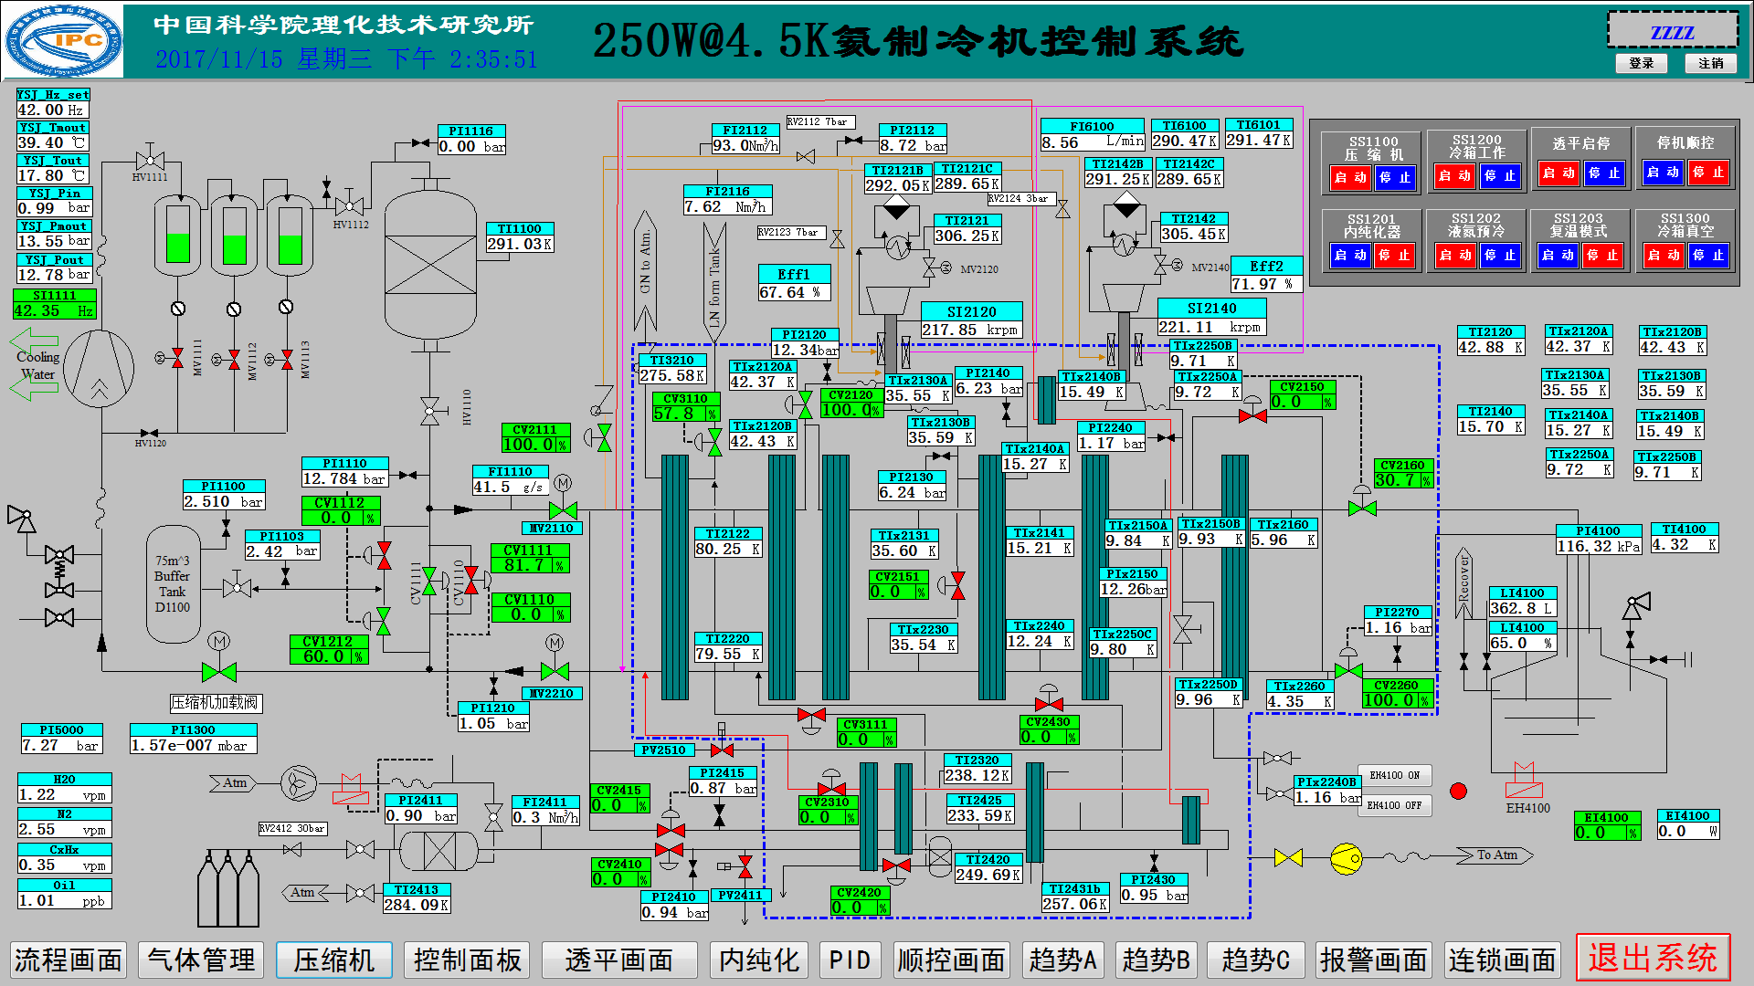
Helium Refrigerator – 250W@4.5K
Maximal liquefaction rate: 83 L/h
Turbine thermal efficiency: η_{T1}=67.6%, η_{T2}=72%

Slide 17
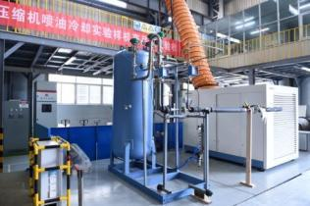
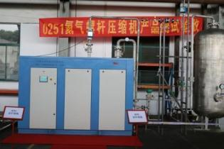
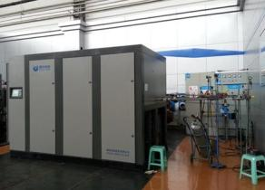
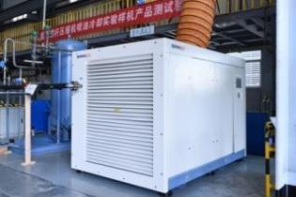
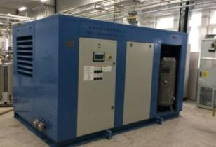
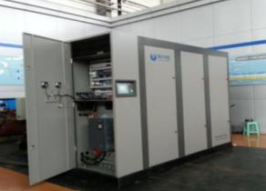
Helium Refrigerator – 250W@4.5K
Development of Helium Screw Compressor
Fujian Snowkey Co.Ltd Wuxi Compressor Co.Ltd Yantai Moon Co.Ltd

Slide 18
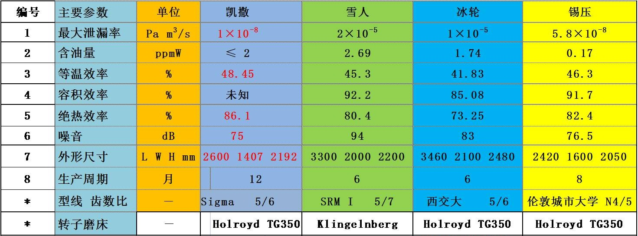
Helium Refrigerator – 250W@4.5K
1-14 bara helium compressors (25g/s)
Kaesser Snowkey Moon Wuxi
Isothermal
Volumetric
Adiabatic
The performance: close to the level of international products

Slide 19
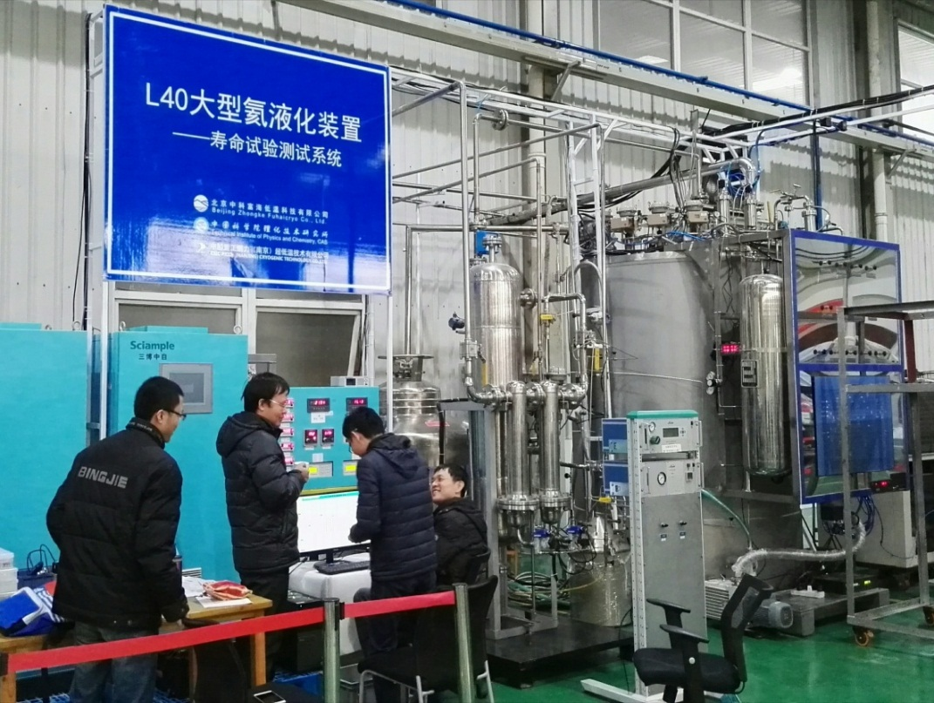
Helium Refrigerator – L40A
Systems for 4 K Tech. validation
40L/h He Liquefier A：48 L/h;
Tested for one years;
Applied in Ningbo Jansen NMR Technology Co., Ltd. for helium extraction

Slide 20
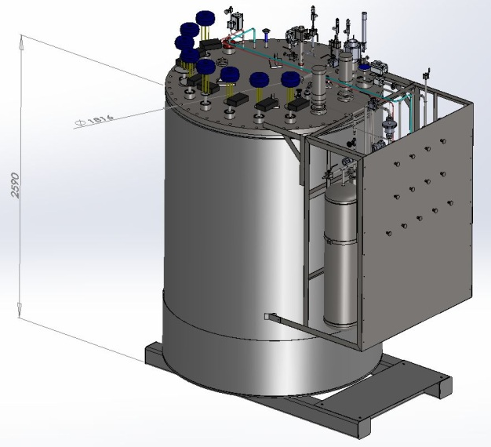
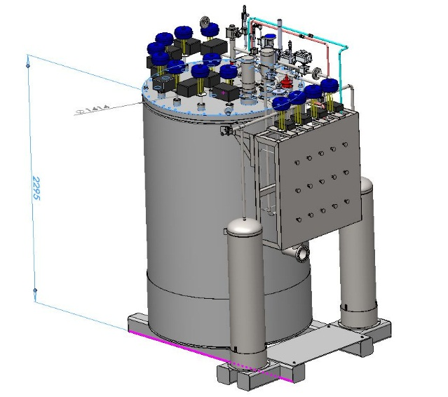
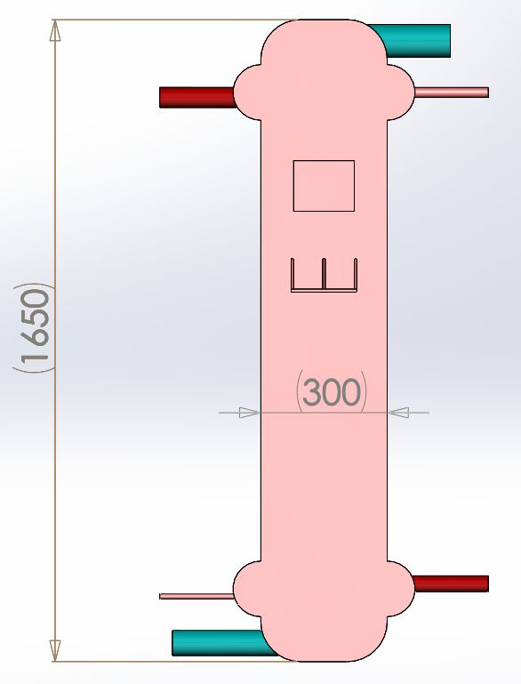
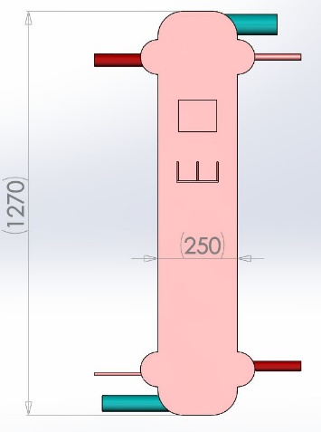
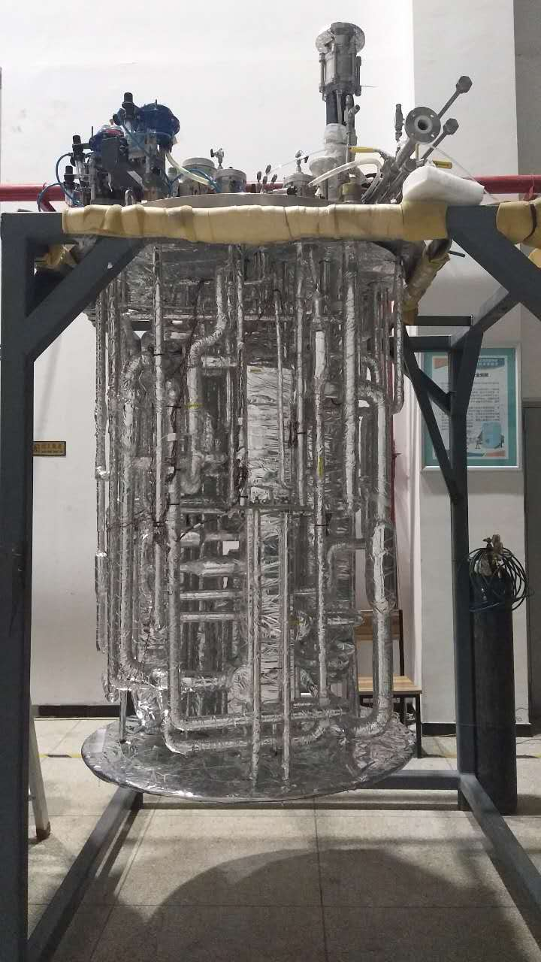
Helium Refrigerator – L40B
Re-design the new L40B
L40A vs.L40B coldbox
L40A vs. L40B size of HX
 | Dim.(mm) | High (mm)
L40A | 1816 | 2590
L40B | 1414 | 2295
Redesign HX and tubes，L40B is smaller than L40A about 53%。

Slide 21
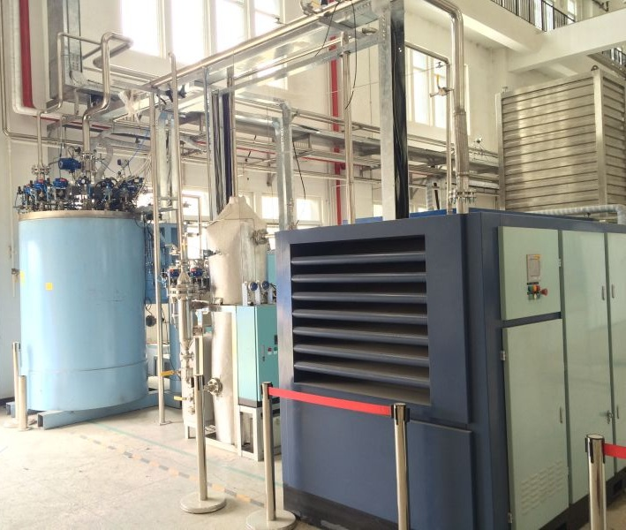
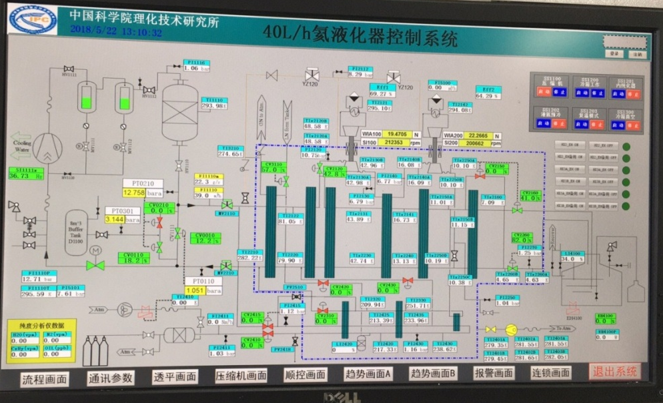
Helium Refrigerator – L40B
Systems for 4 K Tech. validation
  Turbine isentropic efficiency: 66%, 64%;
  Applied in helium liquefaction workshop in TIPC
Condition | T1 eff. | T2 eff. | Mass flou | liquify（L/h）
1 | 67.07 | 65.69 | 19.9 | 42
2 | 69.27 | 65.74 | 22.4 | 56
3 | 68.86 | 65.99 | 22.2 | 58

Slide 22
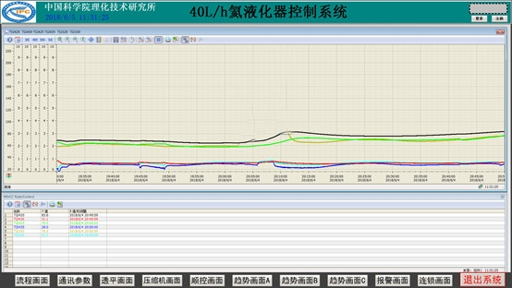
Helium Refrigerator – L40B
Temperature curve of purifier processes at 95.7% input

Slide 23
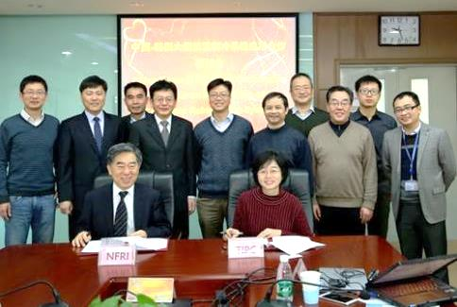
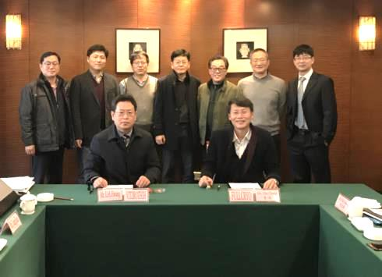
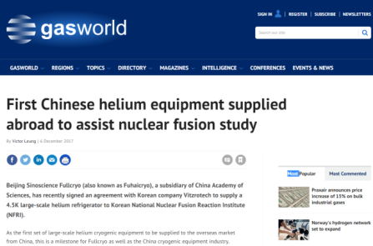
Helium Refrigerator – 250W@4.5
    The key technology : matured and gradually broken the international company monopoly.
    FuhaiCryo Co.Ltd: order of 120 million RMB in 2017
    The first international contract: Korean company Vitzrotech to supply a 200W@4.5K helium refrigerator to Korean National Nuclear Fusion Reaction Institute (NFRI)
Strategic cooperation agreement-"large scale cryogenic refrigeration of China and South Korea " (Jan. 10th, 2017)
Signature of “200W@4.5K helium refrigerator” export contract (Nov. 21th 2017)
British gasworld website releases news (Dec. 6th, 2017)

Slide 24
Helium Refrigerator – 2500W@4.5/500W@2K
LN
Turbine expender
50KGHe
Compressor
and filter
Gas control
1
5KSHe
4K2PHe
purifier
7
8
4KGHe
2
3
4
5
6
低温阀门
4-80K
GHe
4K coldbox
70KGHe
HX
20KGHe
4KLHe
2KLHe
9
10
11
2KGHe
Vacume Pump
Vacume HX
4K dewar
Cold Compressor
2K ColdBox
Overall design finished & key parts are under development
2K dewar

Slide 25
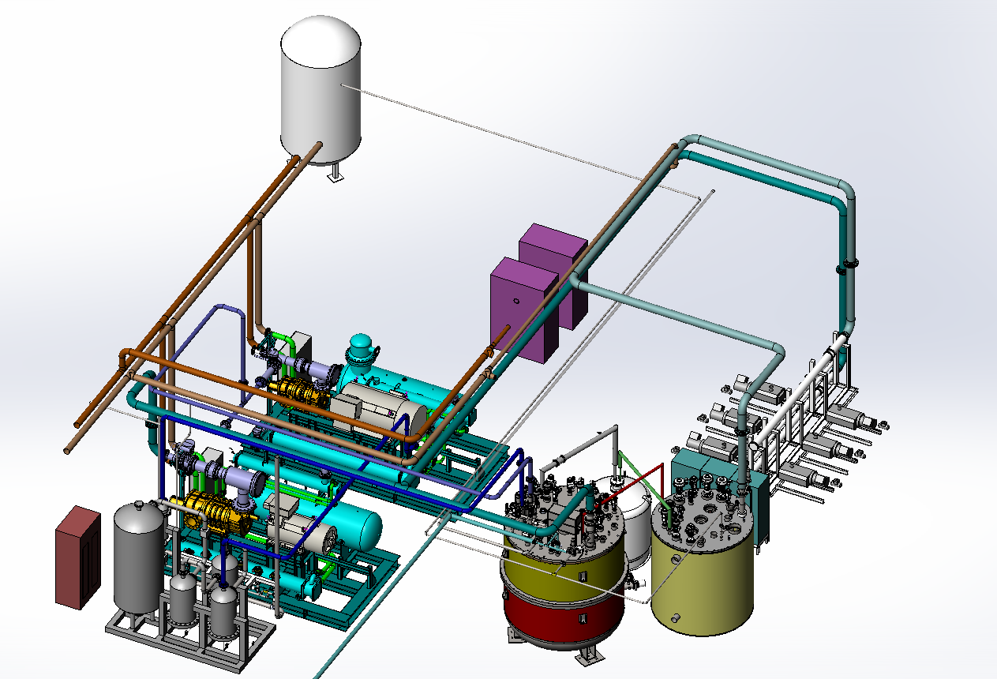
Helium Refrigerator – 2500W@4.5K
Helium compressor
Vacuum pumps
2K cold box
(cold compressor)
Oil remover subsystem
4K cold box (turbo-expander)
3D configuration of system

Slide 26
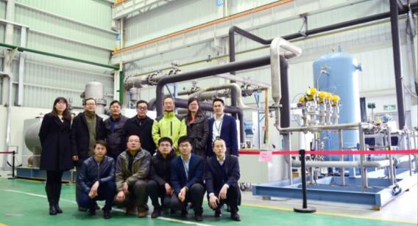
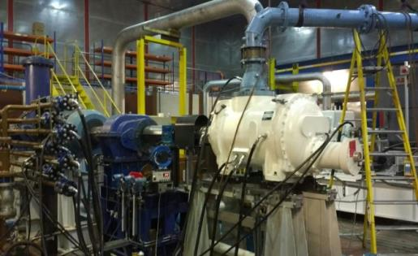
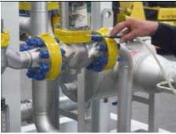
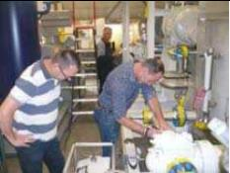
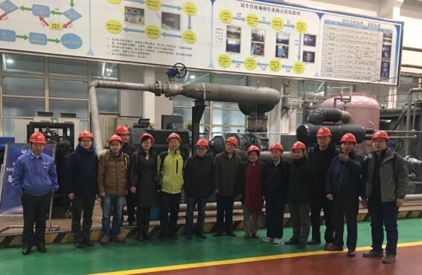
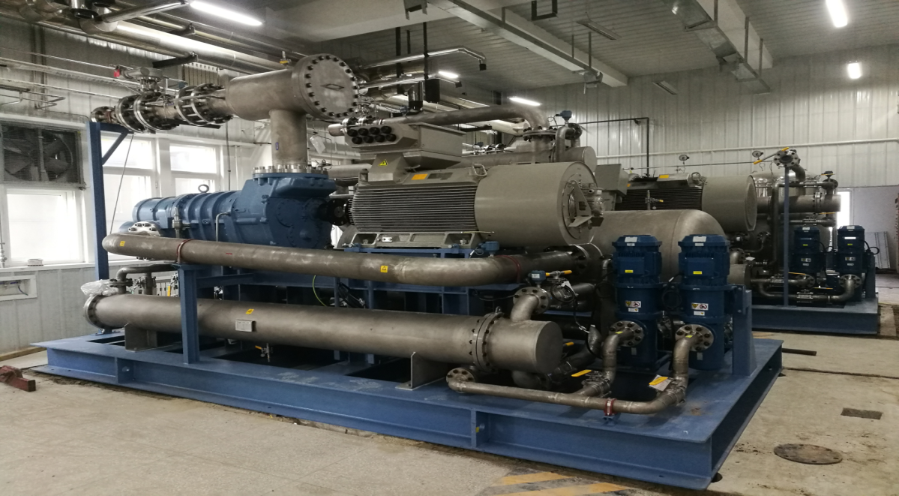
Helium Refrigerator – 2500W@4.5K
Development of Helium Screw Compressor
UK Houghton compressor
Fujian Snowkey Co.Ltd
Yantai Moon Co.Ltd

Slide 27
Helium Refrigerator – 2500W@4.5K
1-20 bara helium compressors
Parameter | Unit | Japan Kawasakawa | UK Houghton | Yantai Moon | Snowkey
Volumetric efficiency | % | 83.0 | 81.06 | 93.7 | 92.4
Isothermal efficiency | % | 52.9 | 53.1 | 63.1 | 61.0
Adiabatic efficiency | % | - | 74.4 | 88.4 | 84.9
Mass flow rate | g/s | - | 380.8 | 439.3 | 422.9
oil content | ppmW | - | - | 2 | 20.9
Oil leakage of shaft seal | ml/day | - | - | 50 | 94.3
Leakage rate | Pam³/s | - | - | 8.0×10⁻⁷ | 7.6×10⁻⁶
Noise level | dB | - | - | 97.4 | 97.8
Performance : beyond the level of international products (tested by helium gas)

Slide 28
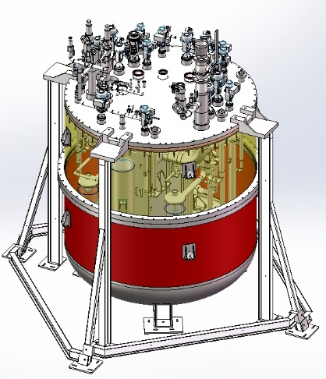
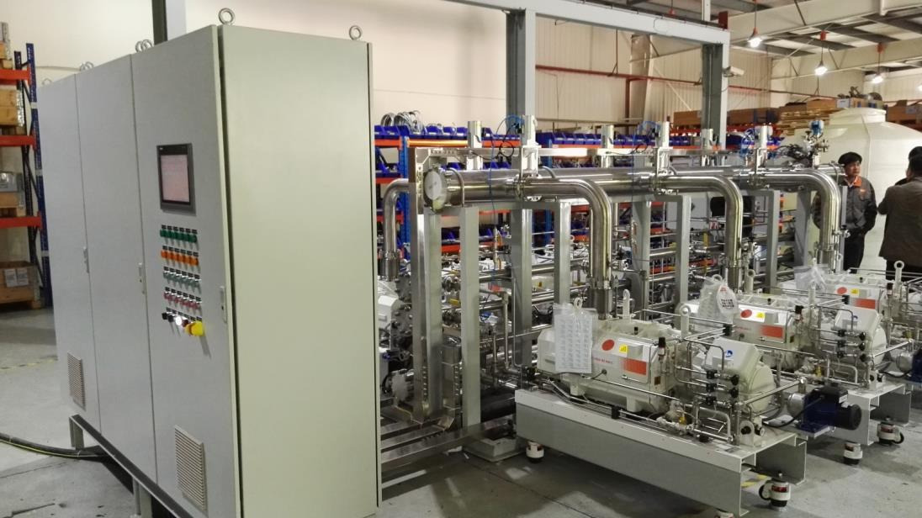
Helium Refrigerator – 500W@2K
Cold box
Vacuum pump
Integration of 2.5kW@4.5K cryo-plant will be finished at the end of this year

Slide 29
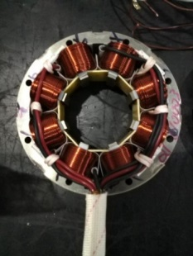
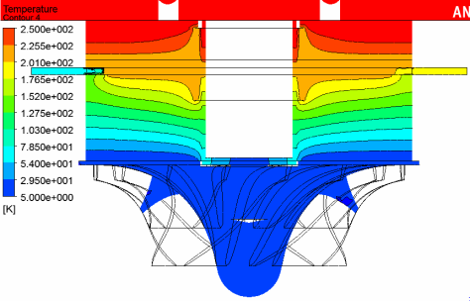
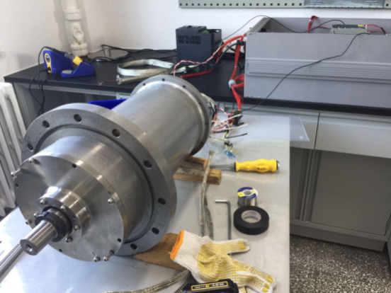


Helium Refrigerator – 500W@2K
Main challenge cold compressor
    Magnet bearing
    High speed motor speed: 60 krpm
    Test rig will be finished in next month
电磁悬浮轴承
15krpm冷压缩机样机
叶轮和长轴设计
60krpm冷压缩机实验样机

Slide 30

Helium Refrigerator – 500W@2K
Cold compressor (developed by Czech company)
    Finished 60krpm speed test in the room temperature

Slide 31
Helium Refrigerator – commercialization
Products & Engineering
（Fuhai Cryo Co.Ltd and Zhongshan Fuhai Cryo Co.Ltd ）:
1) Products: Helium liquefiers and Refrigerators;
2) Engineering: Cryogenic system for Large Scientific Facilities;
3) Helium resource (helium extraction from BOG of LNG)
4) Products: Hydrogen liquefiers and refrigerator

Slide 32
Helium Refrigerator – Near future
LN
2-4K coldbox
70KGHe
1
Turbine expenders
50KGHe
Compressor and filter
Gas system
内纯
化器
7
8
2
3
4
5
6
9
4K
SHe
HX
valve
Cold compressor
Vacumm pump
2KGHe
4-300KGHe
≥10kW@4.5K Cryo-plant key technologies development (for ADS-HIAF)
Performance improvement of Key Components (TB, CC, MC, HX, etc. )

Slide 33
Thanks for your attention

