Slide 1
Radiation control of
J-PARC superconducting neutrino cryogenic facility
Yasuhiro Makida (KEK) & J-PARC cryogenic section member
Introduction
500 kW & 30 GeV proton beam has been transported through a superconducting neutrino beam line in J-PARC.
After 3 years operation, tritium ³H has been detected in refrigerant He. Even a just detectable quantity, releasing He from cryogenic system became strongly regulated and troublesome.
I’d like to gather instances in other cryogenic facilities.
Notes:
Yasuhiro Makida from KEK. I’d like to talk about “Radiation control of J-PARC superconducting neutrino cryogenic facility”.
500 kW & 30 GeV proton beam has been transported through a superconducting neutrino beam line in J-PARC since 2009.
After 3 years operation, tritium ³H has been detected in refrigerant He. Even a just detectable quantity, releasing He from cryogenic system during maintenances became strongly regulated and troublesome.
I’d like to gather instances in other cryogenic facilities during this workshop.

Slide 2
Contents
Introduction
  J-PARC, T2K project, T2K SC magnets system
Operation History
Tritium Problem
Summary
Notes:
These are contents of my presentation

Slide 3
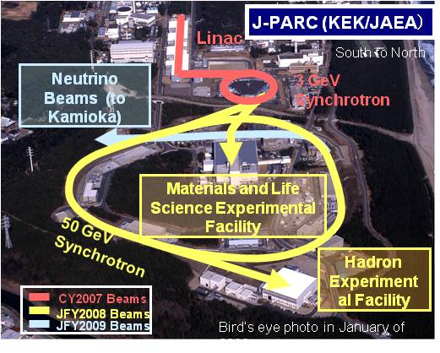
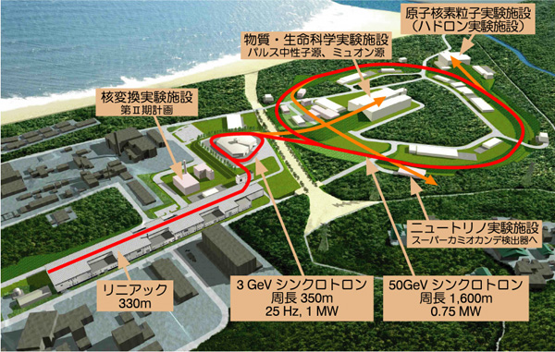
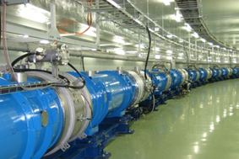
Japan Proton Accelerator Research Complex
330 m
Jan, 2007, 181 MeV
350 m circ. , 25 Hz
Nov, 2007 3 GeV
Apr., 2009 Neutrino Beam
1500 m circ., 25 Hz
Dec, 2008 MR beam
Notes:
The J-PARC accelerator complex consists of a linear accelerator, 3GeV rapid cycle synchrotron (RCS,) and a 50 GeV (now 30 ) synchrotron.
J-PARC accelerator provides a high intensity proton beam of 500 kW for the experimental facilities (materials and life science, hadron physics, neutrino physics).
My talk is about this neutrino beam line superconducting magnet system.
3

Slide 4
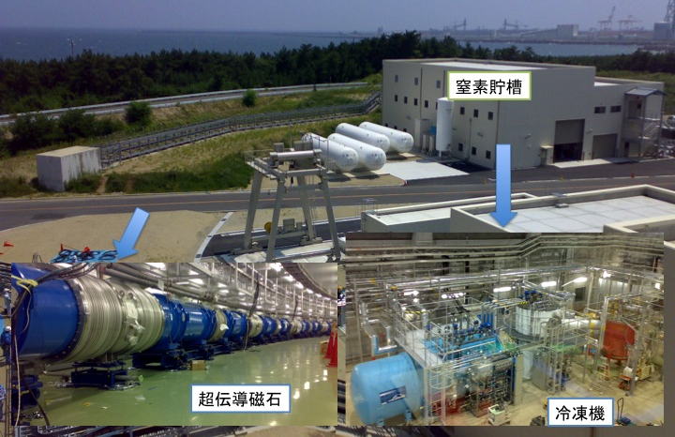
Cryogenic Plant Bird View
Pacific Ocean (5m Tsunami arrived @ 11 March 2011 )
LN2 CE
He Tank
S.C. Magnet
MCP, CB,
Sub-cooler, CLB
Notes:
Bird view of the cryogenic system for neutrino beam line near by the pacific ocean.
Cryogenic devices, 4 He tanks, 1 LN2 CE, a compressor, a cold box, a sub-cooler and a current lead box, are set on surface.
28 superconducting magnets are lined under ground and are cooled by SHE from the surface plant.
By the way 5m tsunami arrived after east Japan earthquake on 11 March 2011
4

Slide 5
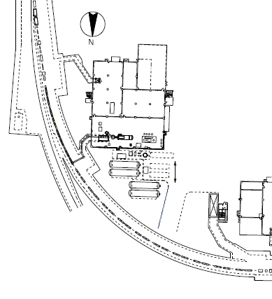
Overall Layout (Overview)
Neutrino Beam Line
28 Superconducting Magnets
Level -12m, Radius 105m, Length 150m
2.6 T(dipole), 19.6 T/m(quad)
Magnet String & Transfer Line
Inventory 3900 ℓ, Cold mass 225 ton(Fe)
90 m transfer line with SC bus
Heat Leak 220 W + Beam Loss max 150 W
Main Synchrotron
Recovery Vessel (for Quench)
As Storage Vessel for Inventory
Volume 100m³×3
Cold Box、Subcooler
Cooling Cap. : 1500 W 4.5 K
SHE : 300 g/s 4.5 K
LHe pot : 800 ℓ
C/L flow : 1 g/s
Superconducting Magnet
10 m
Main Compressor (MCP) :
570 kW, 1.4 MPa, 150g/s
LN₂: 20000 ℓ
Only pre-cooling & cold purification 18000 ℓ/day @ pre-cool 300 – 100 K
Buffer Vessel (for MCP)
Volume 100m³×1
Notes:
This figure shows layout of the superconducting magnet system.
28 superconducting magnets were set in the arc section of neutrino beam tunnel with a level of -12 m, a radius of 105m and a length of 150 m.
The magnet string is connected with cryogenic system on surface through 90 m transfer line, which includes superconducting bus line. This cold mass has a inventory of 3900 L, a weight of 225 ton and heat leak of 220 W.
In the worst case, beam loss is predicted 150 W, but now it is negligible.
Cryogenic system has a cooling capacity of 1500 W at 4.5K, and supplies 300 g/s SHE flow through magnets.

Slide 6
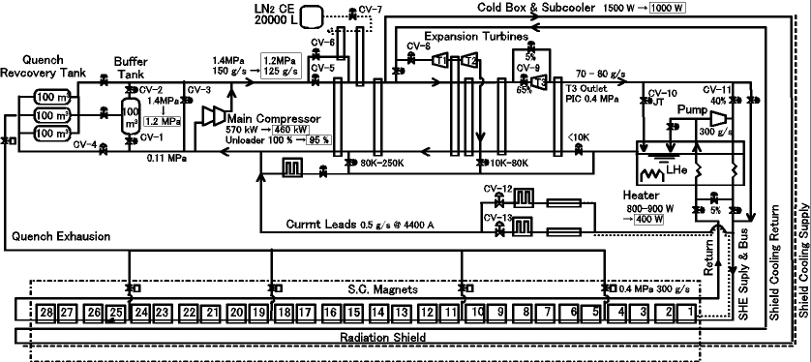
Conceptual Flow Diagram @ excitation
LN₂ is consumed for pre-cooling and gas purification.
A cascade refrigerating system , composed a Claude cycle refrigerator with a centrifugal pump , supplys 4.5 K, 0.4 MPa, 300 g/s She.
Turbine flow goes through radiation shield cooling line in the magnet .
1.4MPa, 150 g/s He gas is supplied by the compressor. 70 g/s flow expands and works at turbines, and the rest expand at JT valve in the sub-cooler.
Notes:
This figure shows a conceptual flow diagram.
The refrigerator is basically Claude type with three turbines. A part of pressurized helium with a flow rate of 150 g/s is divided into a two-stage expansion turbine unit, where the helium gas with a flow rate of 70 g/s works adiabatically with a pressure release from 1.4 MPa to 0.13 MPa. Before reaching the turbine unit, the divided helium gas goes the long way around the radiation shield line in the magnets. At third expansion turbine, the rest part of pressurized helium gas with a flow rate about 80 g/s adiabatically expands to SHE region with a pressure of 0.4 MPa. The SHE is transferred into a sub-cooler, where the SHE is liquefied with a expansion to 0.13 MPa through the JT valve.
A centrifugal pump installed into the sub-cooler circulates SHE flow with a nominal rate of 300 g/s through the magnet as coolant. Its maximum pressure head is 0.1 MPa. The pumped SHE stream is after-cooled down to 4.5 K in heat exchanger with liquid helium in the reservoir tank and the magnets can be kept under 4.8 K. The return SHE stream from the magnets is pre-cooled for stable pump inlet condition. The pressure in the connection line among the SHE turbine outlet, SHE pump outlet and the JT valve inlet was kept at 0.4 MPa by the JT valve feed-back operation. This control scheme spontaneously complements the current leads cooling gas which falls out from the pumped circulation. And base pressure in pumped SHE circulation is controlled by the JT valve, too.

Slide 7
Contents
Introduction
  J-PARC, T2K project, T2K SC magnets system
Operation History
Tritium Problem
Summary
Notes:
Next is operation history

Slide 8
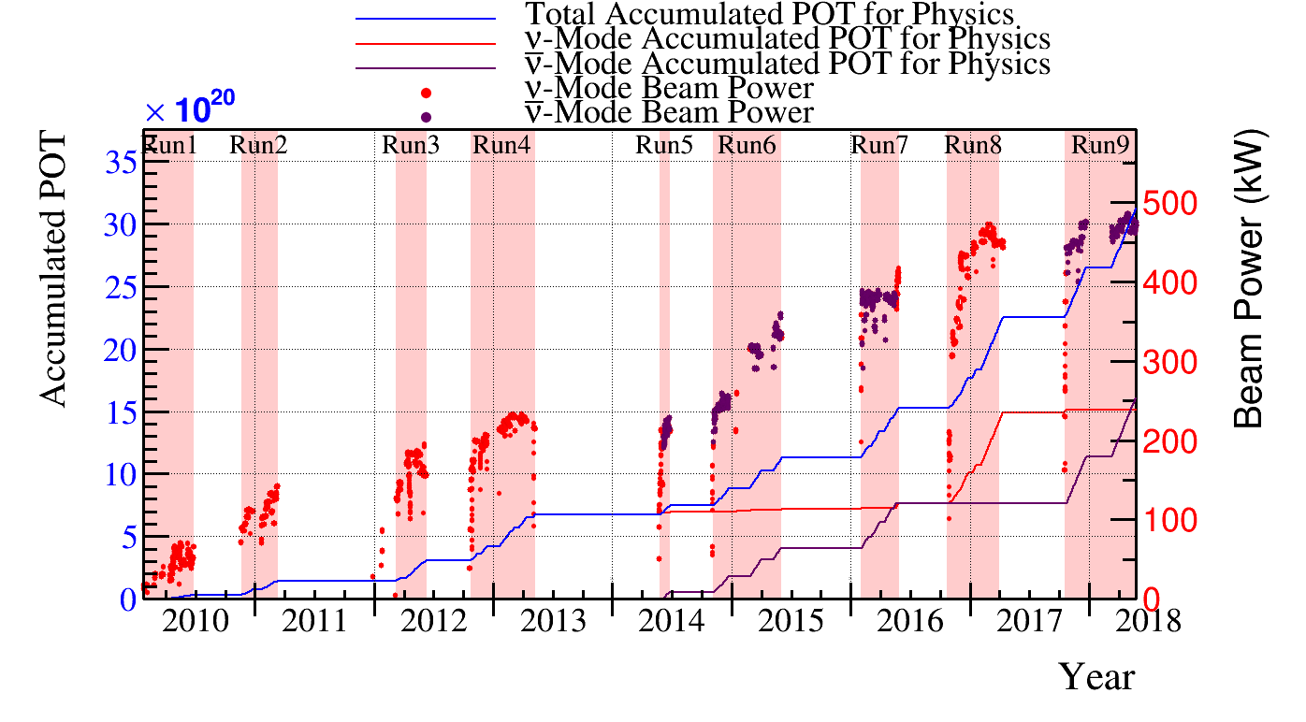
Integrated POT (Proton on Target)
23 Jan 2010 – 24 May 2018
Maximum beam power achieved: 493 kW
Full T2K integrated POT: 3.12x10²¹
East Japan Earth-quake
HD hall radiation accident
Electron-neutrino candidate in Super Kamiokande
Operation integration time of Cryogenic system : 42000 H
Although two long shut-down periods due to an earthquake and a radiation accident, T2K resumed data taking. Statistic of P beam became enough to announce its experimental result.
The international T2K collaboration announced a definitive observation of muon neutrino to electron neutrino transformation on July 2013.
T2K saw its first event in antineutrino beam mode on June 2014.
Notes:
This graph shows a history of neutrino beam line from 2009.
Effort by accelerator part has increased beam power gradually. Now it is almost 500 kW.
Even if two long interval, number of POT, proton on target, has been integrated.
The cryogenic system has been running well without suspending beam line operation and has been contributing the successful physics results.
Operation integration time of the cryogenic system is 42000 hours now.

Slide 9
Contents
Introduction
  J-PARC, T2K project, T2K SC magnets system
Operation History
Tritium Problem
Summary

Slide 10

Tritium Production in Helium
Tritium is a radioactive isotope of hydrogen.
β-decay
12.3 Year
n
n
n
p
e⁻
$$\overline{γ}$$
18 keV
p
p
electron
antineutrino
Tritium(³H )
³He
Helium 3 has a very large cross section for reacting with thermal neutrons.
n
n
p
764 keV
p
n
p
p
In the worst beam loss 1 W/m case,
54 Bq/cm³ (SHE 400 kPa, 4.5 K) ³H production is predicted.
³H in He has been checked at 25 K after beam time.
³He
n
from
Beam loss
T (³H )
Atomic ratio of ³He is ~1.4 ppm.
Reaction cross section of ³He is 5.3 X 10³ barn >> 0.87 barn in ⁴He
Notes:
Tritium is well known radioactive isotope of hydrogen.
It decays into helium-3 by beta decay as in this nuclear equation.
Conversely, helium 3 is transmuted into tritium in nuclear reaction, because helium 3 has a large cross section with thermal neutrons, which expel proton from helium 3.
It is said that atomic ration of helium 3 in usual helium gas is about 1.4 ppm.
Reaction cross section of helium 4 is 0.87 barn, which value is very small as compared to that of helium 3.
In the design work, we predicted tritium transmutation in helium gas may be 54 Bq/cm3 in the worst beam loss, 1 W/m along the magnet, case.
So, after every beam operations and magnet temperature over 25 K, tritium has been checked. Fortunately, actual beam loss in the operation is negligible.

Slide 11
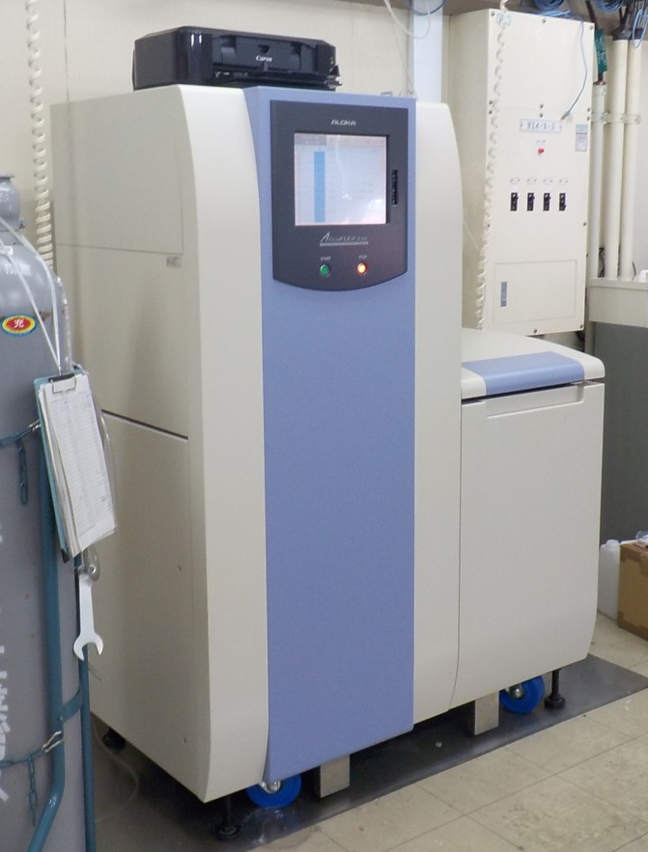
Measurement Record of Tritium (HT & HTO)
 | HT (Bq/L) | HTO (Bq/L) | Beam P (kW)
May/2010 | 0 | 0.082 | ~ 80
July/2010 | 0 | 0 | ~ 80
Sep./2012 | 48.2 | 2.4 | ~ 200
Dec./2012 | 28 | 0 | ~ 220
Aug./2013 | 37.5 | 0 | ~ 230
July/2014 | 40.5 | 0 | ~ 250
Aug./2015 | 33.0 | 0 | ~ 300
July./2016 | 22.0 | 0 | ~ 400
 | HT | HTO
Boiling Point (K) | 25 | 373
Melting Point (K) | 20.4 | 277.5
A. Limit * (Bq/L) | 70000 | 5
<< A. Limit, ~ Precision
HTO （Water) has not been detected.
HT (Hydrogen gas) has been detected.
HT value is independent of beam power.
  He has not been exchanged. HT accumulates.
  Well beam focus.
Hitachi-Aloka LSC-LB7
Specimen is analyzed
by Liquid scintillator
with precision of 5 Bq/L.
Notes:
Tritium exists as hydrogen HT or water HTO elements. These boiling point and melting points are summarized in this list.
Tritium is checked by liquid scintillator supplied by Hitachi-Aloka. Its precision is 5 Bq/L
Measurement are summarized in this list. T2K experiment started in 2009
After 3 years operation, HT has been detected. But these values are much smaller than exhaustion limit and near by precision of the detector.
And concerning that helium gas has not been exchanged and measured values are independent of beam power, neutrino beam has been focused well.

Slide 12
Requirement by Radiation Management in J-PARC
Regulation
³H allowable limit (Bq/L) in discharging gaseous waste
Hydrogen (HT) | 70000
Methane | 700
Water (HTO) | 5
Organic Matter | 3
Law Concerning Prevention from Radiation Hazards due to Radio‐Isotopes, etc. (≈ ICRP90)
Measured HT < 50 Bq /L , but…
Radiation Management in J-PARC requires
Gaseous waste must be vent through authorized vent stack with radiation monitor. Even small gas vent from maintained equipment must follow the guideline.
The work place, where gaseous waste is vent, is set as a radiation management area temporally.
→ COST, POSE, DELAY, INEFFICENCY,,,,DISCONTENT
2018/6/5
Cryo-Ops 2018
Notes:
Regulation in Japan, its name is Law Concerning Prevention from Radiation Hazards due to Radio‐Isotopes, etc, is almost same with ICRP90.
It shows that tritium allowable limit in discharging gaseous waste in several elements are these numbers.
Measured HT of less than 50 Bq/L, but radiation management in J-PARC requires,
Gaseous waste must be vent through authorized vent stack with radiation monitor. Even small gas vent from maintained equipment must follow the guideline. The work place, where gaseous waste is vent, is set as a radiation management area temporally.
I think everybody who make maintenance work of cryogenic plant can image what these requirements result in.

Slide 13
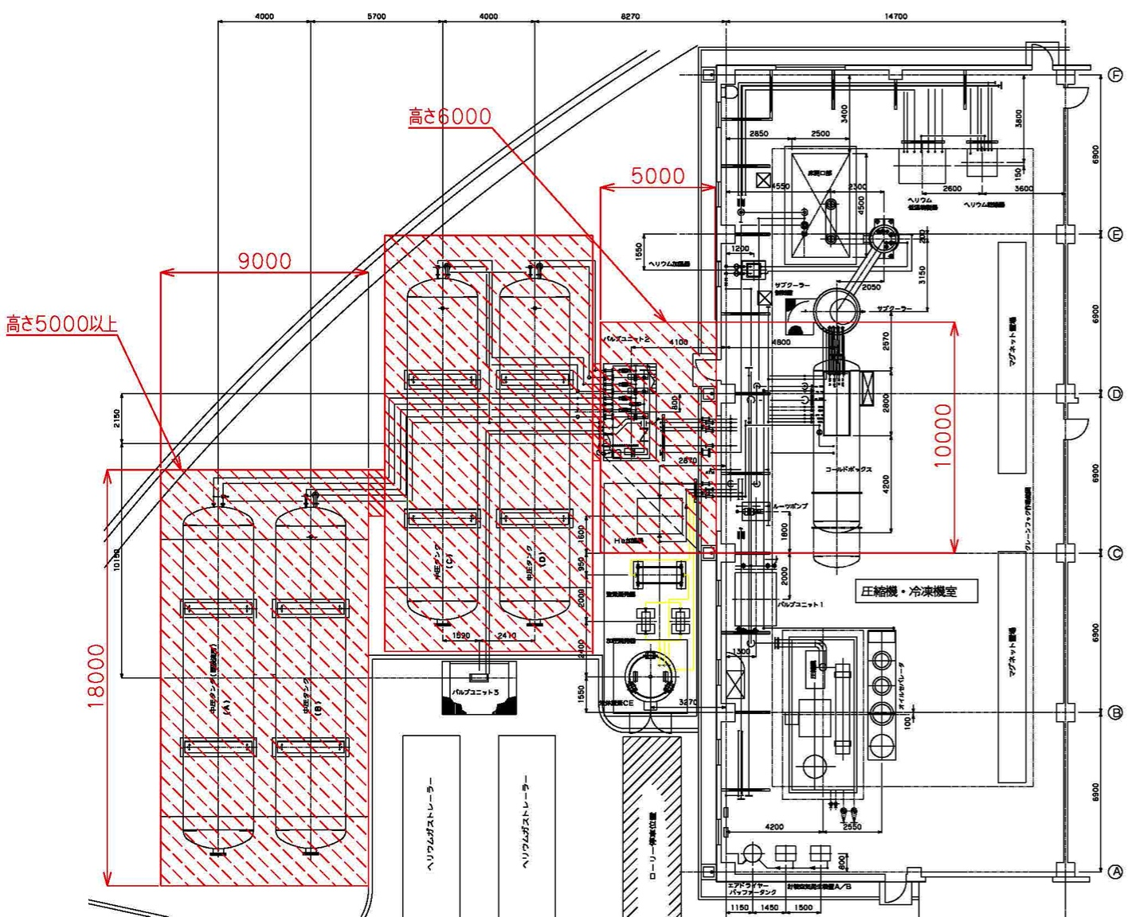
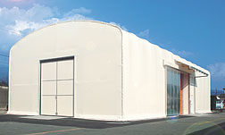
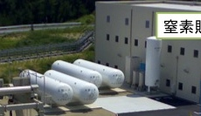
Same Operation & Modified Maintenance
Kindly Radiation Management in J-PARC accept
Nu cryogenic system
is designed and is inspected by High Pressure Gas Regulation.
holds enough air-tightness to prevent tritium leakage.
need not in a radiation management area at operation.
Otherwise
Temporal Radiation Management Area
New Vent Stack
Air
C/L Box
Tank
Subcooler
Evaporator
Tank
CB
Evaporator
Air
Tank
Oil Separator
Tank Yard Cover
Cryo. Room
MCP
Notes:
On the other hand, management kindly treat
Nu cryogenic system, which is designed and is inspected by High Pressure Gas Regulation, holds enough air-tightness to prevent tritium leakage.
Consequently, Nu cryogenic area on surface need not become radiation management area permanently.
Radiation management area is only set, when the helium gas part is exposed.

Slide 14
Temporal Radiation Management
Cryogenics Room
= Temporal Backup Seal
Temporal Vent Line
Existing Vent Stack
Temporal 1st Seal
Backup
Seal
Radiation Monitor
Vac.
Pump
CL
BOX
Sub-
Cooler
CB
MCP
Tank
Surface
Under Ground
Radiation Management
Magnet
He Vent Line
Beam Pipe
Vacuum Vessel
1 mm Metal Mesh
0.1 mm Metal Mesh
Notes:
This figure shows the schematic radiation management at maintenance.
Radiation management area needs double sealing.
Backup boundary surrounds main management area.
In the main, 1st, management area needs ventilation flow which goes from atmosphere to official vent stack with radiation monitor.
We make ventilation flow by using a vacuum pumping lines.
Of course every exhaust gas flows from relief valves are lined to the vent stack.

Slide 15
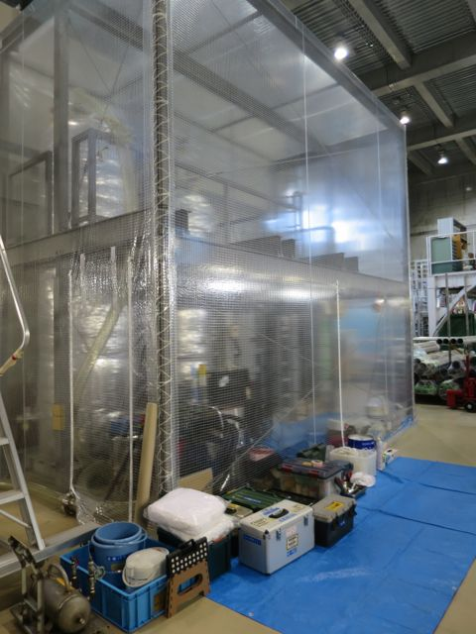
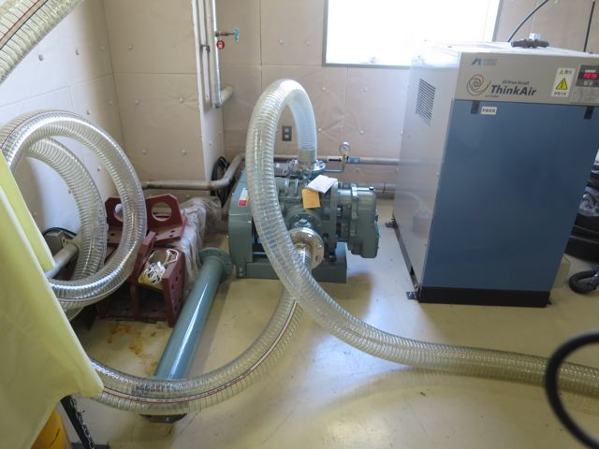
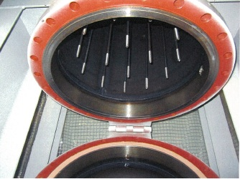
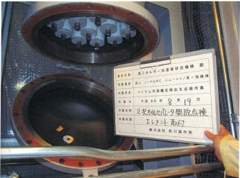
Actual Method : Filter Exchange at 2nd,3rd Oil Separator
Setting Management Area
Radiation Safety Check
By gas sampling and smearing. Analysis takes 1day
400 m³/h blower exhausts air from the room to the vent line.
Oil Filter Exchange
1st seal
Oil Separator Unit is covered by an air-tight plastic sheet room.
Backup seal
Cryogenic Room becomes radiation management area.
Radiation Safety Check
By smearing. Analysis takes 1day
Cancel Management Area
Notes:
Filter elements or charcoal in oil separators are regularly exchanged.
As main seal, a large plastic room covering separators was constructed. Which is ventilated by 400 m3/h blower.
And cryogenic room becomes backup radiation area, where workers change shoes and wear additional cloths and sign their name at the entrance,
Pre and post processes are also required.

Slide 16
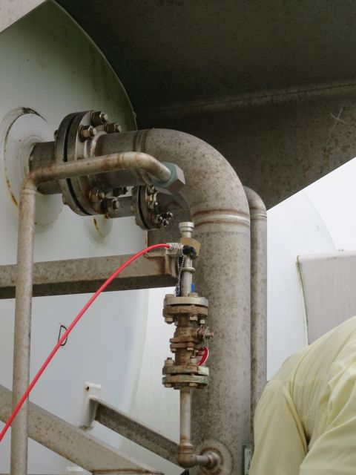
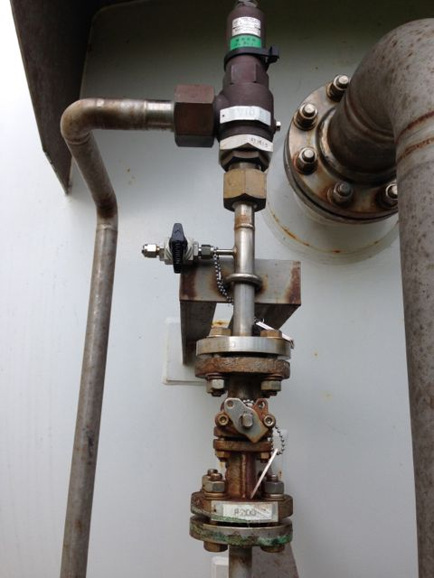
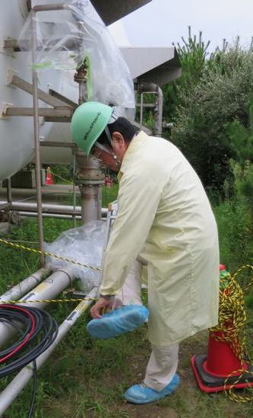
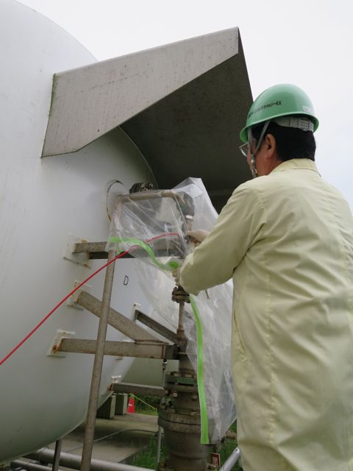
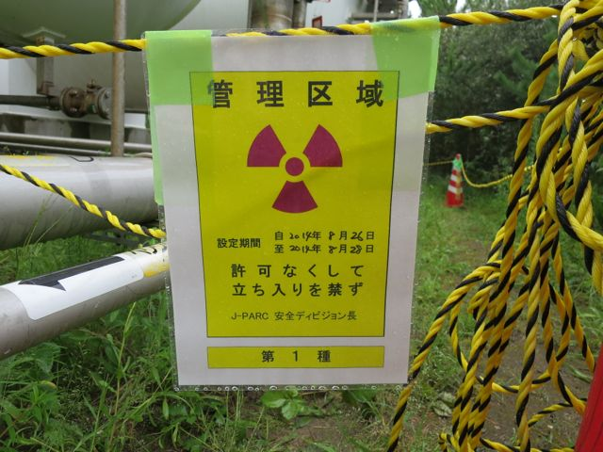
Actual Method : Relief Valve Exchange at outdoor Tanks
RV vent
RV
Setting Management Area
Radiation Safety Check
By smearing. Analysis takes 1day
Stop Valve
He must be vent
before RV removal
Rope set management area
Rope is back-up seal ???
Wrench is kept inside plastic bag as 1st seal.
Removed RV Smear Inspection
Radiation Safety Check
By smearing. Analysis takes 1day
Send RV to maker for calibration
Cancel Management Area
Notes:
Every summer, all relief valves are to be checked and corrected.
Outside, relief valves of tanks are removed, too.
For this work, boundary of backup sealed are made by rope.
Radiation management staffs smear this area.
Connect vacuum vent line to the pipe between a relief valve and stop valve for it. And venting
Worker, who dresses protection wear covers a plastic back as a main seal.
He uses wrench to disconnect the relief valve over the plastic bag.
Removed relief valve is kept inside the bag until smear inspection.
I introduces two example, please understand why I told “pose” “inefficiency” and “discontent”

Slide 17
Problems
Quick repair is obstructed.
Some makers refuse to treat equipment from radio-active area.
Radioactive(???) wastes are increasing.
Heatstroke due to layering a protective clothing.
Discontents of cryogenic workers due to obstructions for radiation(???) safety.
Notes:
I summarize the problems of radiation management following later.
Quick repair is obstructed.
Some makers refuse to treat equipment from radio-active area.
Radioactive(???) wastes are increasing.
Heatstroke due to layering a protective clothing.
Discontents of cryogenic workers due to obstructions for radiation(???) safety. Every summer I must calm cryogenic workers’ discontents.

Slide 18
Summary & Questionnaires
Since 2009, the neutrino cryogenic system has contributed to T2K experiment in J-PARC without any troubles.
Very few HT(tritium) has been detected in cryogen He. But maintenance process became strongly regulated and troublesome.
I’d like to know how manage tritium in refrigerator in other laboratories.
  Is tritium in your refrigerator checked?
  If tritium is detected, how is it managed ?
Notes:
Since 2009, the neutrino cryogenic system has contributed to T2K experiment in J-PARC without any troubles.
Very few HT(tritium) has been detected in cryogen He. But maintenance process became strongly regulated and troublesome.
I’d like to know how manage tritium in refrigerator in other laboratories.
Is tritium in your refrigerator checked?
If tritium is detected, how is it managed ?

Slide 19
Thank you
for hearing my complaint.

Slide 20
Backup

Slide 21
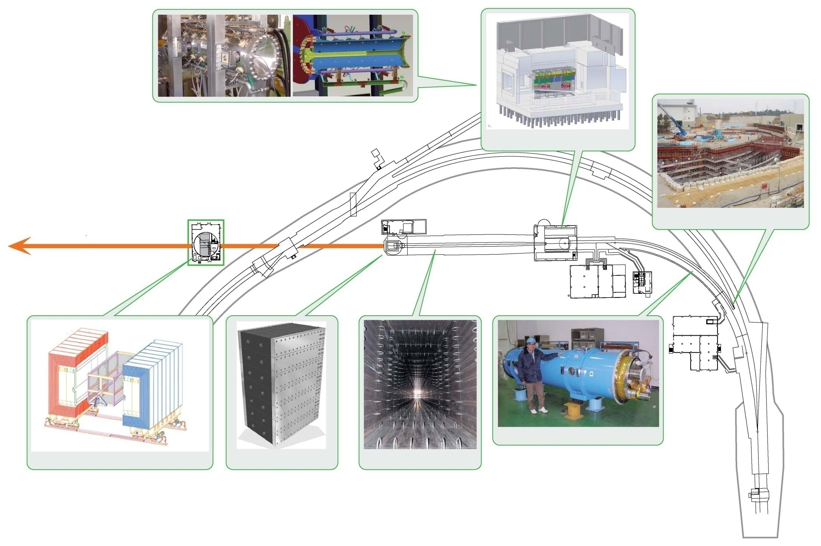
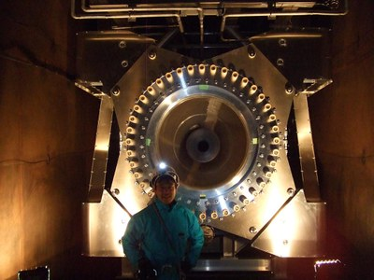
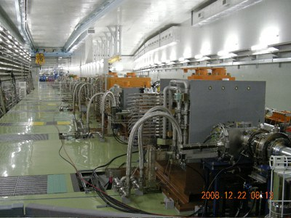
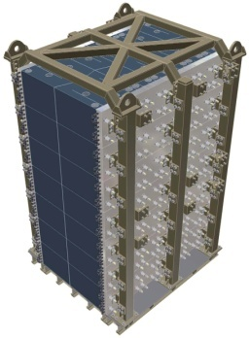
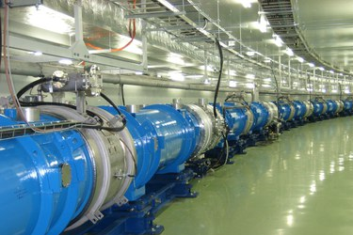
T2K neutrino facility in J-PARC http://j-parc.jp/Neutrino/en/nu-facility.html
Target-Horn System
MR
Target Station
Muon Monitoring Pit
Final Focusing
Section
295km to
Super-Kamiokande
Nu
Preparation Section
100m
30 GeV
(50 GeV)
SC combined func mags
Near Neutrino Detector
Beam Dump
Decay Volume
21
P beams accelerated up to 30 GeV are directed westward through the Primary Part .
A string of SC. Mag is a core part in the Primary Part.
P collide with a graphite target and produce π-mesons, which decay into neutrinos.
Notes:
The proton beams emitted by the Main Ring synchrotron are directed westward through the primary beam line, where many normal-conducting / super-conducting magnets and beam monitors are placed along the trajectory. At the target station the protons collide with a target composed of graphite rods and produce numerous daughter particles. Among these particles, the positively charged π-mesons –the parents of muon neutrinos– converge in the forward direction under the effect of magnetic horns.Magnetic horns are magnets designed to focus charged π-mesons by applying a few hundred thousand amperes of pulsed current synchronized with each beam shot. The π-mesons then decay into pairs, each comprising a muon and muon neutrino, during the flight in a 100-m-long tunnel (decay volume). All the neutrinos (and a small fraction of muons) escape from the facility, whereas all the other particles such as the remaining protons and undecayed π-mesons are absorbed by a beam dump composed of large graphite blocks.

Slide 22
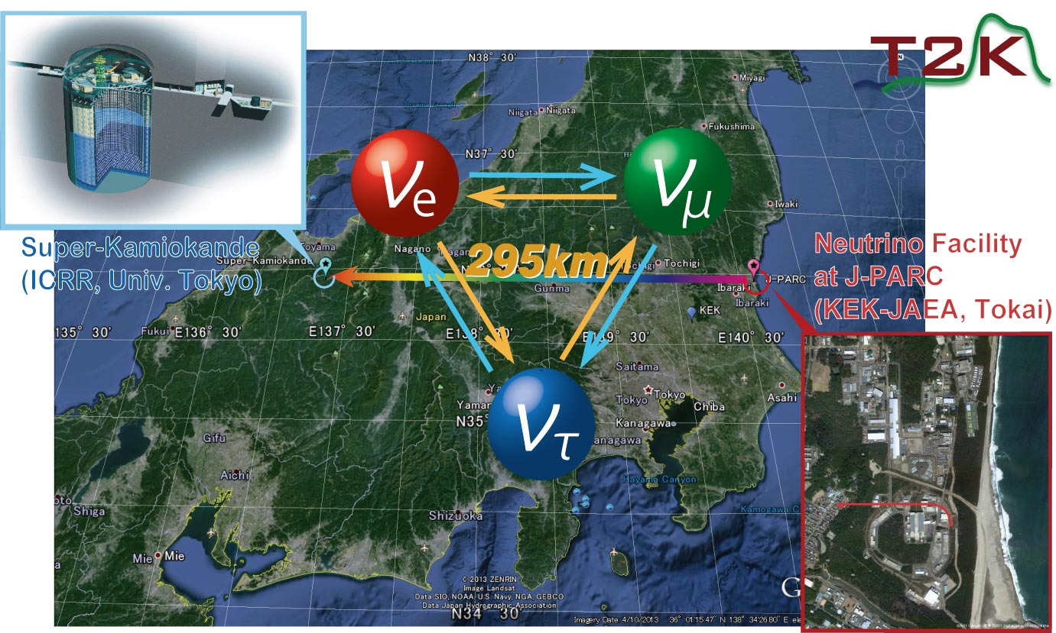
T2K experiment
http://j-parc.jp/Neutrino/en/index.html
Artificial neutrino beam generated in the J-PARC is shoot toward the 50kton water Cherenkov detector, Super-Kamiomande, which is located about 1000m underground in Kamioka mine (Gifu) and is 295km away from Tokai.
The T2K (Tokai to Kamioka) experiment is a neutrino-oscillation experiment to study nature of neutrinos
Notes:
The T2K (Tokai to Kamioka) experiment is a neutrino-oscillation experiment to study nature of neutrinos.
Artificial neutrino beam generated in the J-PARC is shoot toward the 50kton water Cherenkov detector, Super-Kamiomande, which is located about 1000m underground in Kamioka mine (Gifu) and is 295km away from Tokai.
http://j-parc.jp/Neutrino/en/index.html
22

Slide 23
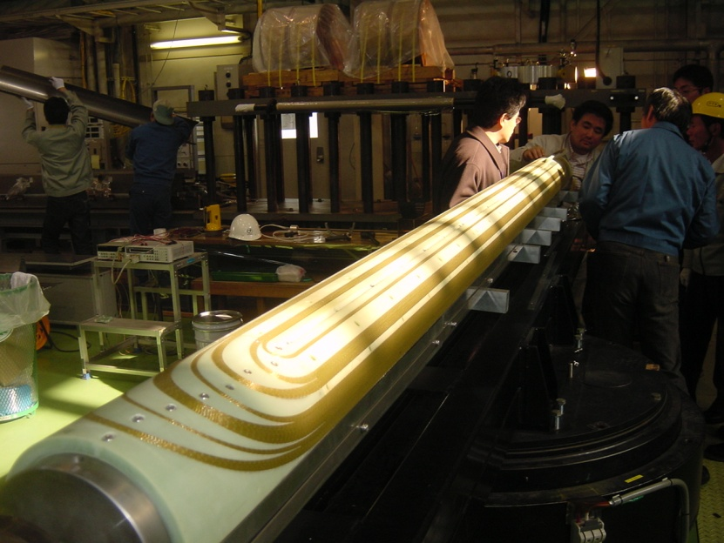
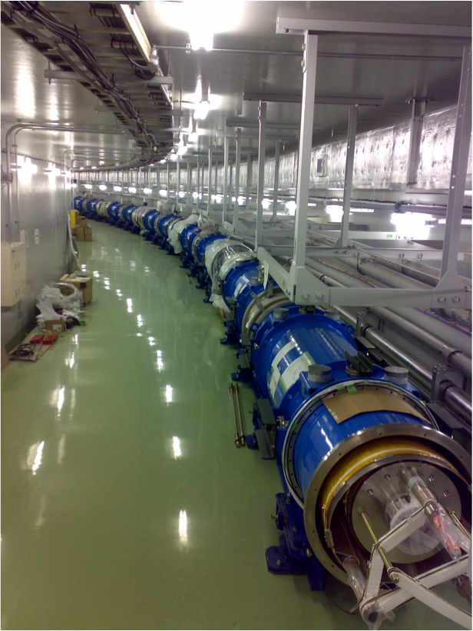
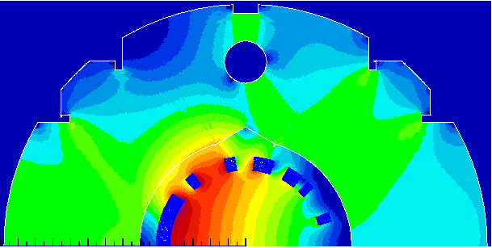
Primary line components
- One string of Superconducting Magnets -
The neutrino beam line has a bending section with a radius of 105 m, where single string of 28 superconducting magnets has been installed.
The magnet design is very unique. It has a combined function of 2.6 T dipole field with 19.6 T/m quadrupole field gradient by a left-right asymmetric distribution of conductors.
23

