Slide 2




LHC Cryogenics Operation
Main achievements of Run 2 from low to high energy beam.
Gerard FERLIN on behalf of Cryogenic group
Head of Cryogenic operation for LHC Accelerator and its detectors section
CERN, Technology Department, Cryogenic Group
With contributions from Benjamin Bradu & Krzysztof Brodzinski
The 8th International Workshop on Cryogenics Operations (Cryo-Ops 2018), IHEP, CAS, Beijing

Slide 3
Agenda
Recall on LHC cryogenics
Evolution of the global LHC cryogenic system
Operational adaptation to LHC present behavior
Benefits of adjustments and remaining issues during Run 2
Conclusions & Perspectives
Recall on LHC cryogenics
Evolution of the global LHC cryogenic system
Operational adaptation to LHC present behavior
Benefits of adjustments and remaining issues during Run 2
Some words about LHC results
Conclusions & Perspectives
The 8th International Workshop on Cryogenics Operations (Cryo-Ops 2018), IHEP, CAS, Beijing

Slide 4
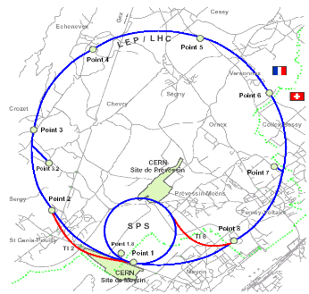
Layout of LHC cryogenics
LHC cryogenics is constituted with:
  24 km of high-field superconducting magnets operating in superfluid helium at 1.9 K or 4.5 K
  SRF cavities operating in helium at 4.5 K
  LHC experiments ATLAS & CMS with magnets operating at 4.5 K
CMS
SRF
8 x 18kW @ 4.5 K
1’800 sc magnets
24 km & 20 kW @ 1.8 K
36’000 t @ 1.9K
130 t He inventory
ALICE
LHCb
Magnets
Two LHC experiments ALICE & LHCB operating at room temperature
Distribution
ATLAS
The 8th International Workshop on Cryogenics Operations (Cryo-Ops 2018), IHEP, CAS, Beijing

Slide 5
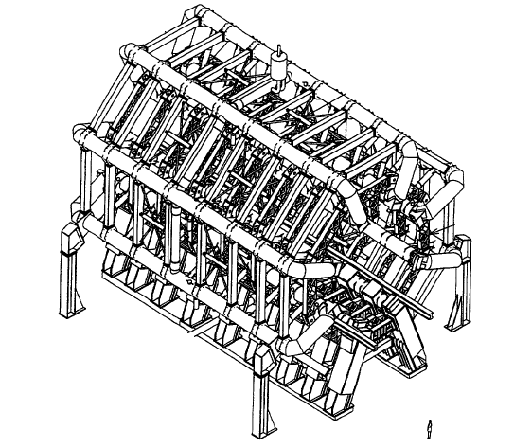
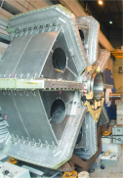
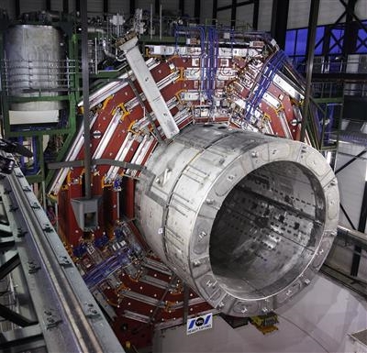
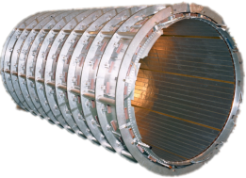
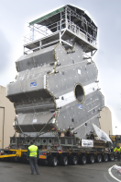
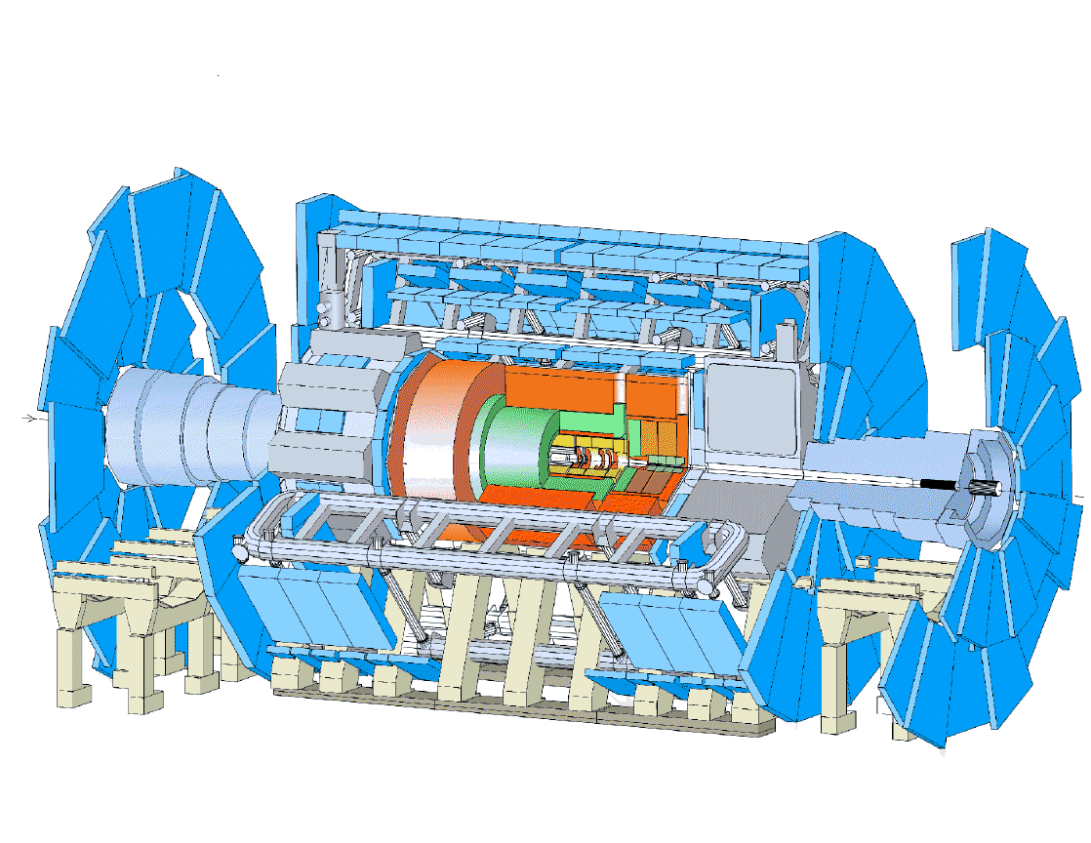
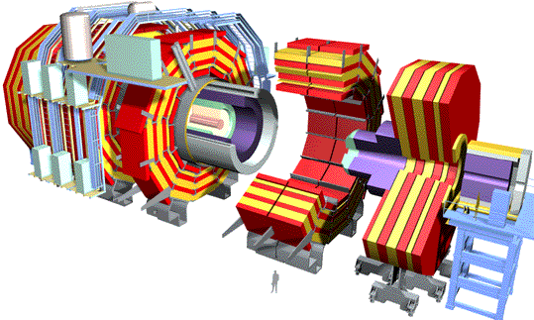
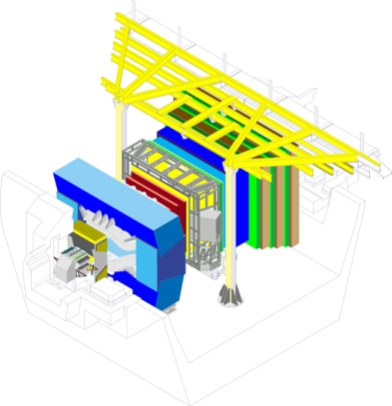
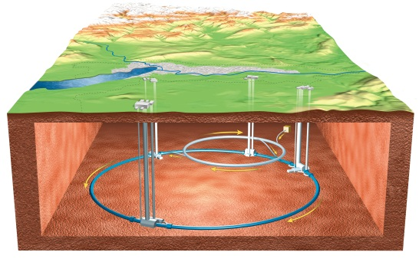
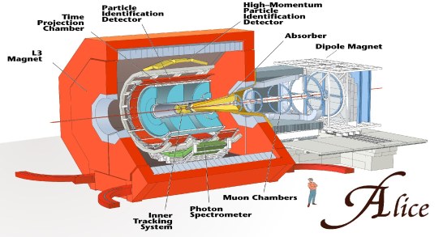
Layout of LHC Experiments system
BT
ECT
CS
25 m
5.3 m
20 m
11 m
12.5 m
2.5 m
6.3 m
CMS
ATLAS
ALICE
LHC-b
The 8th International Workshop on Cryogenics Operations (Cryo-Ops 2018), IHEP, CAS, Beijing

Slide 6
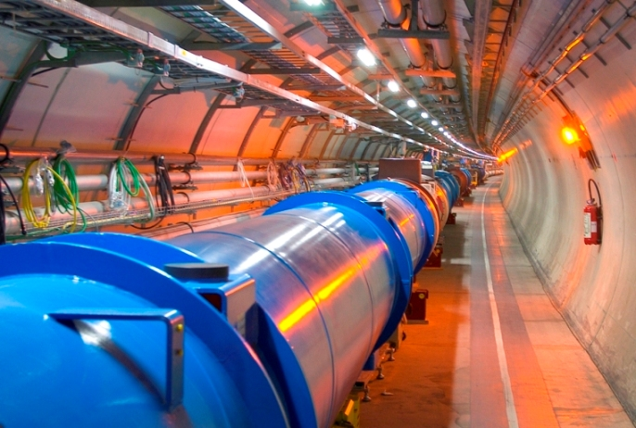

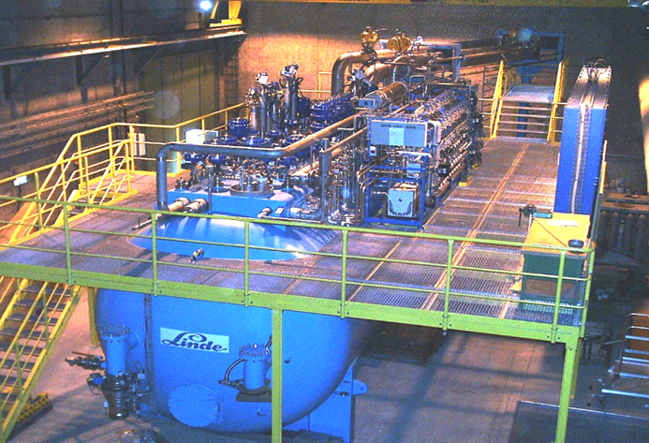
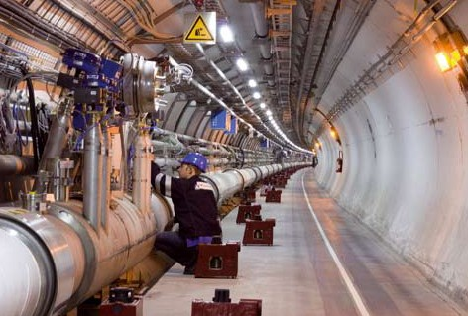

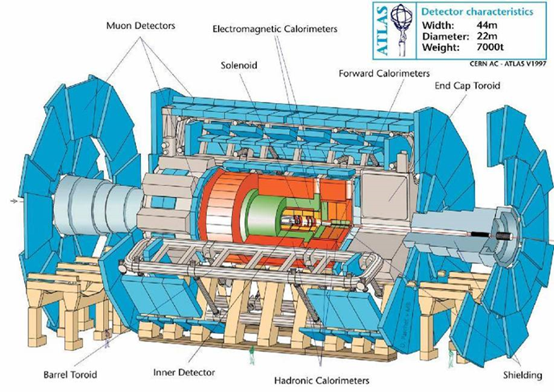
Layout of LHC cooling system
LHC cryogenics for accelerator: 8 independents sectors
LHC cryomagnets
1 eighth of LHC
Cryogenics equipment
4.5 K
1.8 K
Basic
LHC sector
scheme
Interconnection
Distribution line 3.3 km
LHC is a complex cryo system with 7 Cryo islands (5 for accelerator and 2 for experiments)
LHC cryogenics for experiments: 2 experiments with cryogenic system
The 8th International Workshop on Cryogenics Operations (Cryo-Ops 2018), IHEP, CAS, Beijing

Slide 7
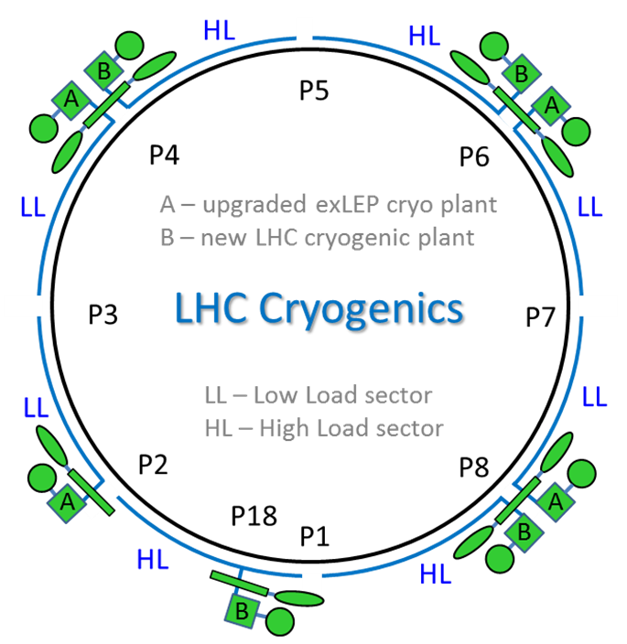
LHC cryogenic hardware configuration
4 New Cryoplants dedicated to high load sectors
4 Former LEP Cryoplants dedicated to low load sectors
LHC Cryogenics architecture
LHC Cryoplants initial distribution
At design level, the cooling capacity of cryoplant were adapted to cover nominal and ultimate LHC operation with equal margins on LL and HL sectors.
Thanks to build-in interplant connections some special configurations are possible for hardware issue mitigations, lower power consumption and availability optimization.
The 8th International Workshop on Cryogenics Operations (Cryo-Ops 2018), IHEP, CAS, Beijing

Slide 8
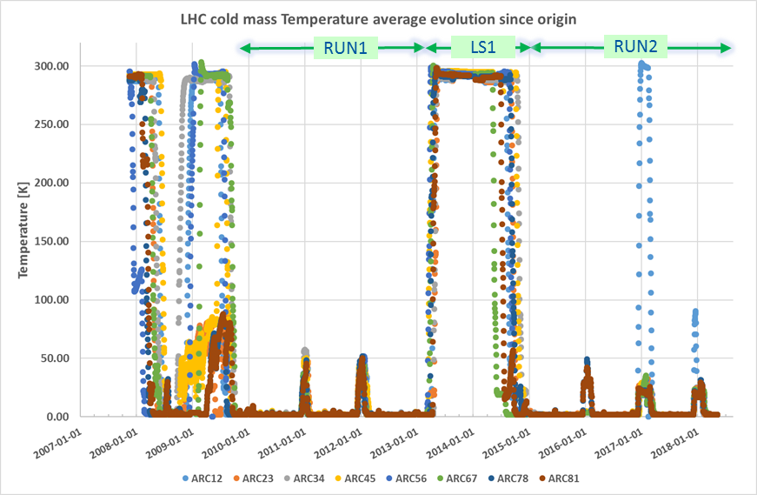
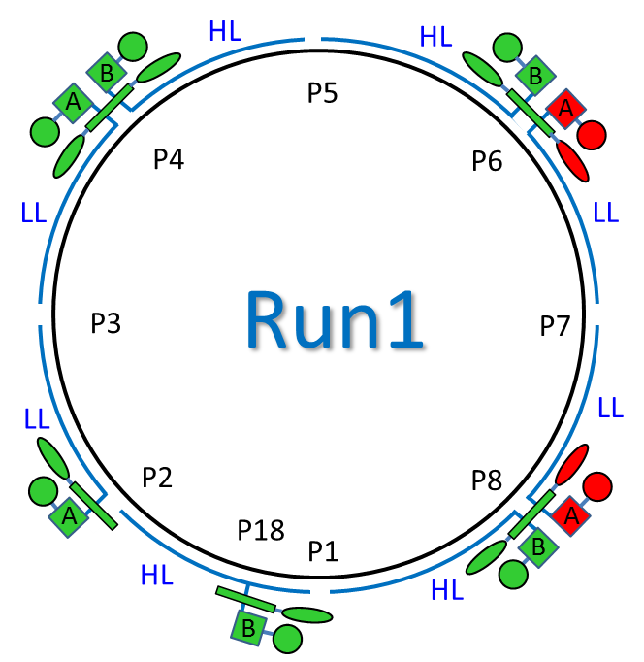
Operational adaptation of configuration Run 1
During Run 1 (2010/2013) thanks to the low beam intensity mode, the total heat load deposited on the non-isothermal 4.6-20K level was low enough to allow the stop of two 4.5K-refrigerators. The same model could be applied for the 1.9K level and consequently two 1.8K-units were stopped.
Run 1 has been used to the first operational adaptation of the Cryo cooling configuration
The 8th International Workshop on Cryogenics Operations (Cryo-Ops 2018), IHEP, CAS, Beijing

Slide 9
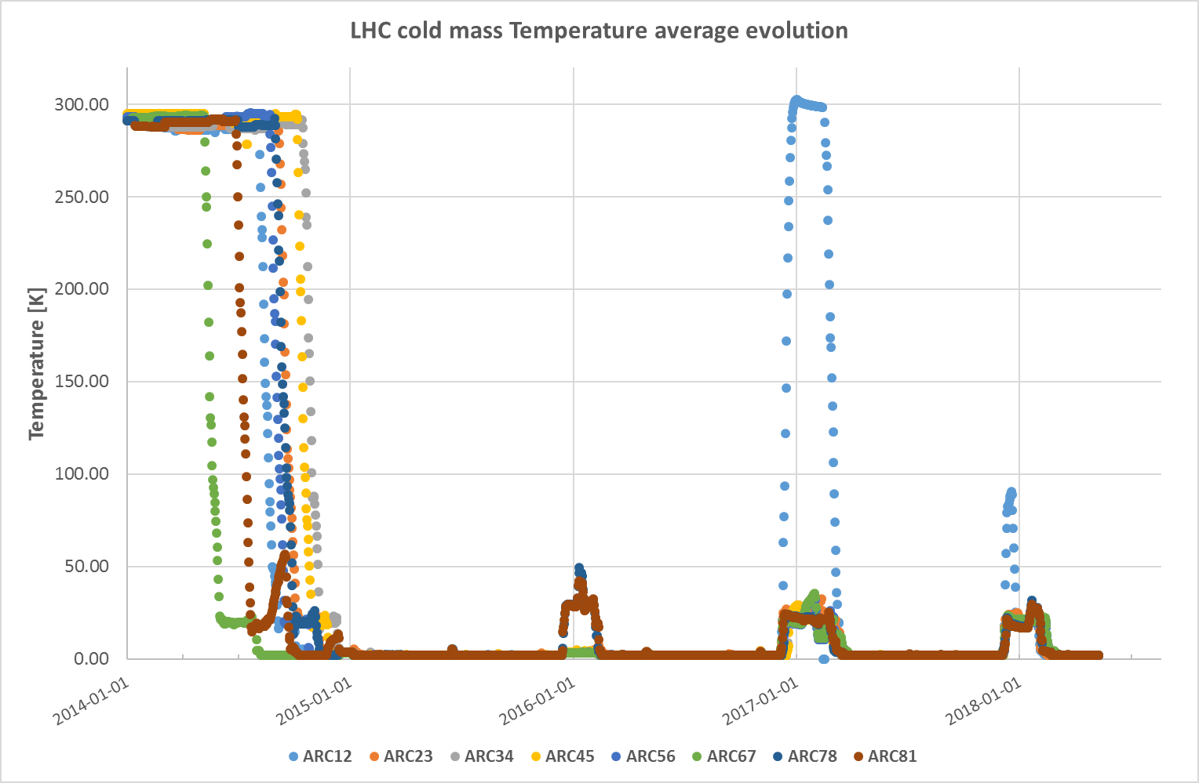
Temperature evolution of cryomagnet during LHC run 2
LS1
RUN2
YETS : Year End Technical Stop
2016: Sector S12 warmed up for cryomagnet exchange
YETS
YETS
LHC Run 2 will end in December 2018 for physics but Cryo system will be stopped only after full accelerator warming-up (May 2019)
2017: Sector S12 warmed up to 100 K for air release
The 8th International Workshop on Cryogenics Operations (Cryo-Ops 2018), IHEP, CAS, Beijing

Slide 10
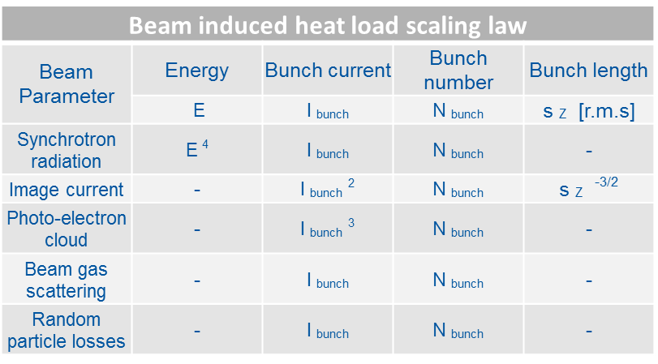
Evolution of the LHC thermal load during Run 2
Run 2 is characterized by the increase of beam energy from 4 to 6.5 TeV.
Seen from Cryogenic point of view, more thermal energy will be deposited on Inner-Triplets, Arc Cryomagnets and Beam Screen cooling circuits.
The 8th International Workshop on Cryogenics Operations (Cryo-Ops 2018), IHEP, CAS, Beijing

Slide 11
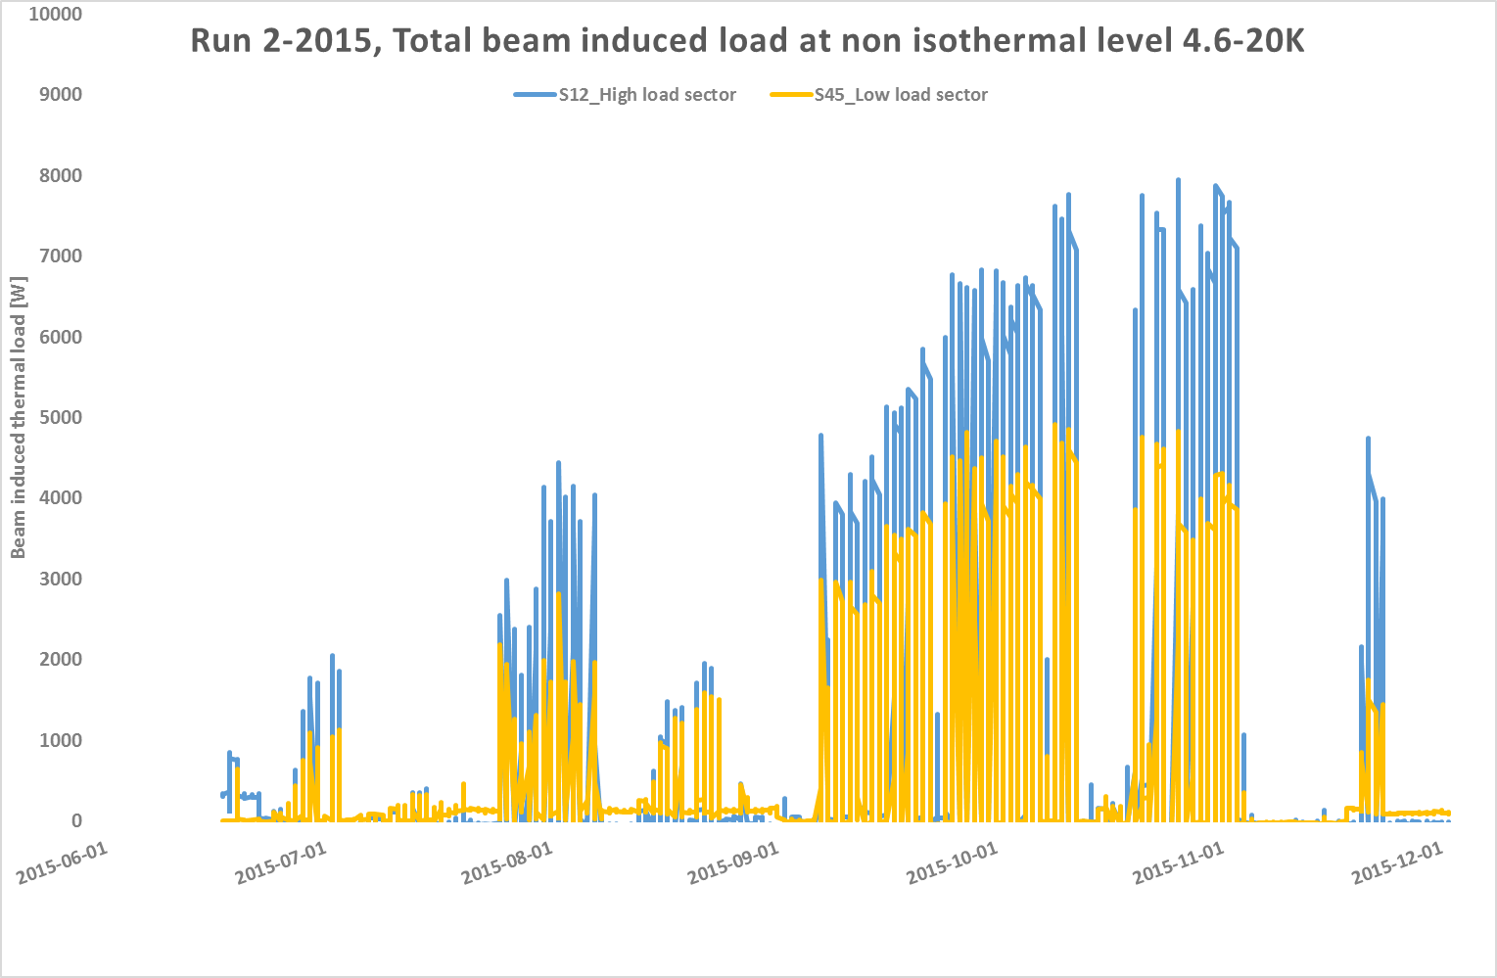
Beam induced heat load on Beam Screen @ 4.6-20K
Major part of Beam Induced Heat Load (BIHL) is deposited, trough several processes, on the Beam Screen at the temperature level of 4.6-20K.
From the beginning of run 2, it quickly became obvious that the beam induced heat loads would exceed the installed powers on the Beam Screen cooling circuit of high load sectors.
BS cooling circuits
Installed power
Run2 extra load
Main beam induced heat load according to LHC design report
The 8th International Workshop on Cryogenics Operations (Cryo-Ops 2018), IHEP, CAS, Beijing

Slide 12
Evolution of the LHC thermal load during Run 2
To cope with the available non-isothermal cooling capacity @ 4.6-20 K there is 2 possibilities:
  Re-arrange the 4.5 K helium refrigerators configuration in order to optimize the available cooling power in steady-state mode.
  Adapt, tune and optimize the control system of the cooling circuits to cope with the transient modes generated by discontinuous presence of beam
  Modify the beam filling scheme in order to keep the same overall luminosity delivered for LHC experiments
These adaptations were put in place progressively throughout the run2
The 8th International Workshop on Cryogenics Operations (Cryo-Ops 2018), IHEP, CAS, Beijing

Slide 13
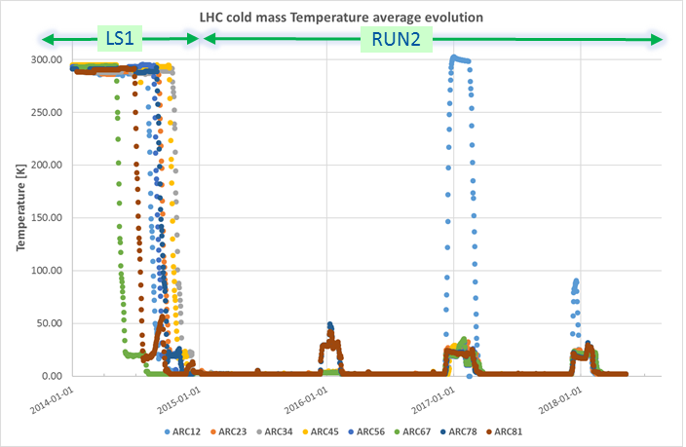
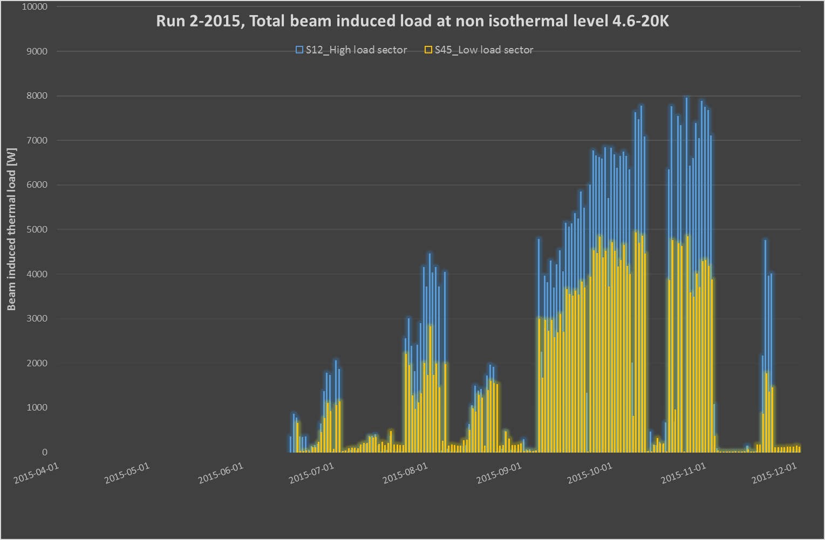
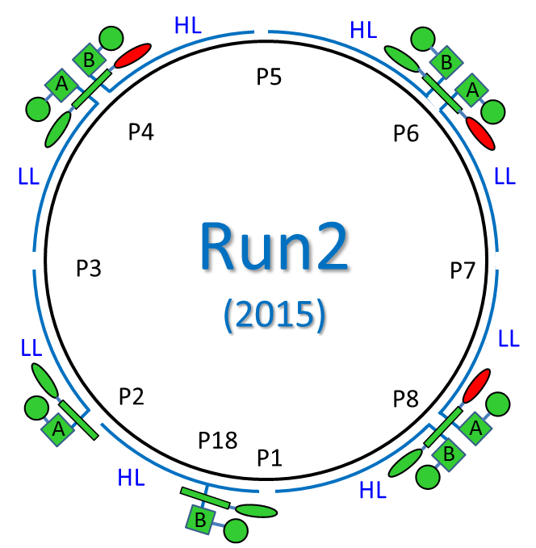
Operational adaptation of configuration Run 2_2015
2015 : cryoplant re-arrangement, No beam modification
25ns_2244b_144bpi
25ns_1825b_144bpi
25ns_0889b_144bpi
Thermal load on 1.8K units was low enough to stop one plant per island.
A configuration of two 4.5K units & one 1.8K unit was deployed during the Run 2_2015.
Design Report (DR) defines the total beam induced load at non isothermal level 4.6-20K , respectively 7.7 KW for high load sectors and 7.6 KW for low load sector.
The 8th International Workshop on Cryogenics Operations (Cryo-Ops 2018), IHEP, CAS, Beijing

Slide 14
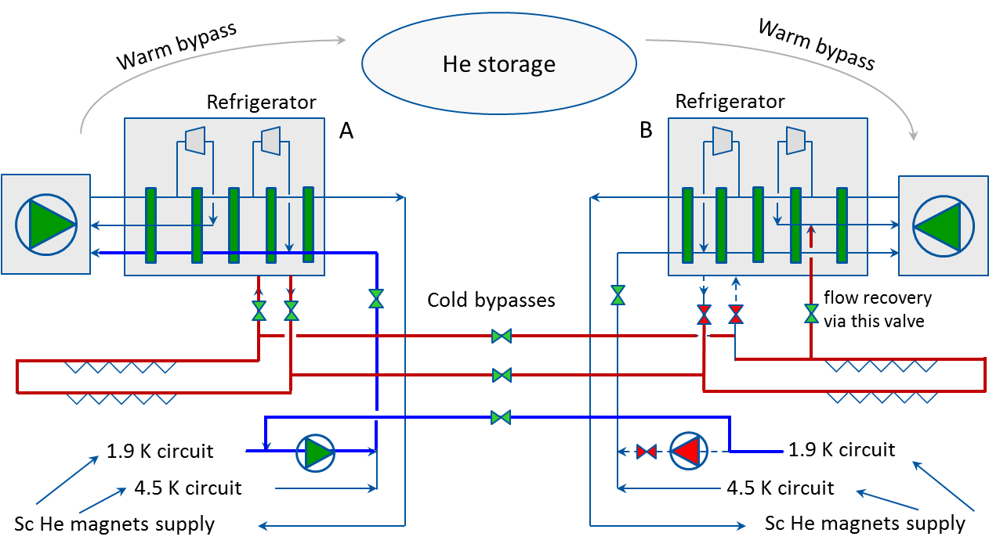
Optimization of cryogenic capacity during Run2 in 2016
The cooling power requested by the Beam induced heat load @ 4.6/20K was exceeding significantly the design value.
Oppositely, the dynamic heat load @ 1.9K was lower than the design value.
To re-attribute cooling power to the 4.6-20K level, a deactivation of units @ 1.9K was successfully tested. This requires equilibration of the return flow. The estimated gain of this solution is in the range 1500 W per sector. To be compared to the design value of 7700 W @ 4.6-20 K / sector.
Transfer of 1.9K cooling power toward 4.6-20K level put in service in 2016 and used until now
The 8th International Workshop on Cryogenics Operations (Cryo-Ops 2018), IHEP, CAS, Beijing

Slide 15
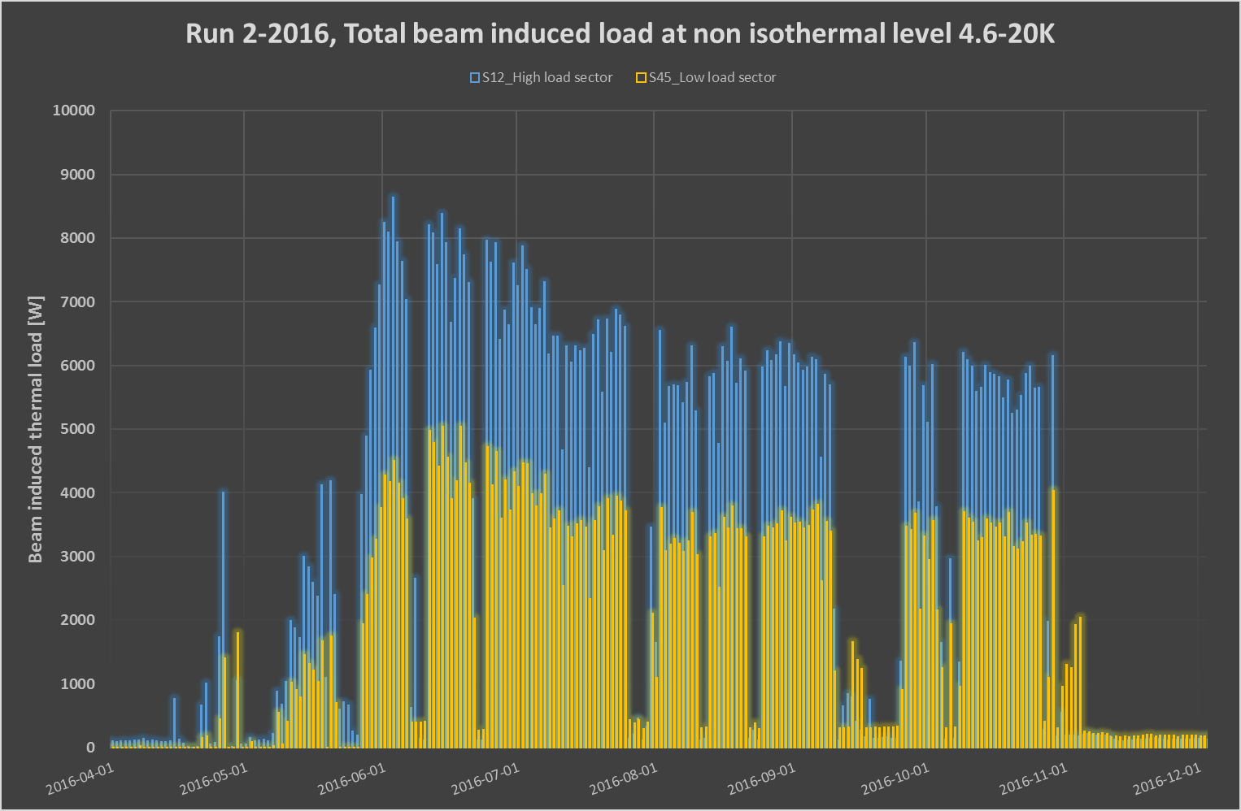
Operational adaptation of configuration Run 2_2016
2016 : cryoplant re-arrangement, beam optimization
HL
HL
B
P5
B
25ns_2040b_72bpi
A
A
25ns_2040b_72bpi
25ns_2076b_96bpi
25ns_2220b_96bpi
P4
P6
LL
Run2
(2016)
LL
P3
P7
LL
LL
P2
P8
A
P18
A
HL
P1
B
B
HL
A new filling scheme, so called BCMS, has been introduced in 2016 to keep under control the beam induced heat load.
The other important parameter is the beam intensity moving from 9*10¹³ up to 3*10¹⁴ p+
Thanks to the cooling power optimization and to new beam parameters, the run 2_2016 has been successful.
The 8th International Workshop on Cryogenics Operations (Cryo-Ops 2018), IHEP, CAS, Beijing

Slide 16
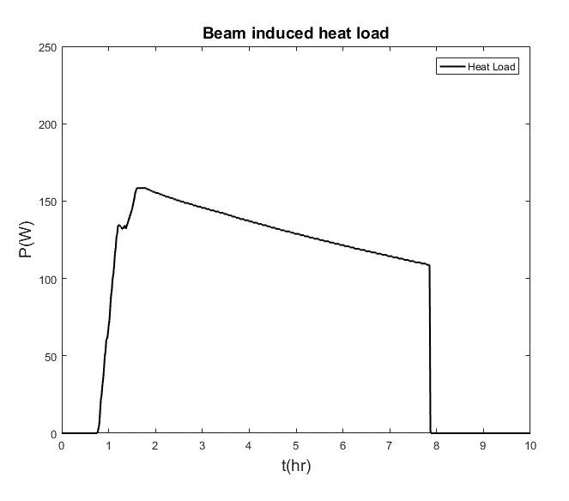
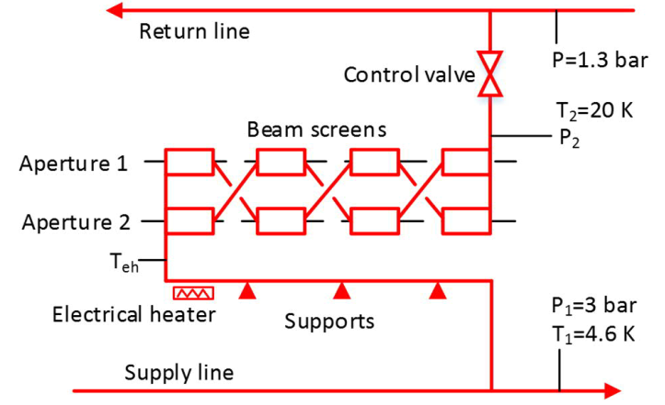
Adapt, tune and optimize the control system used for beam screen cooling 1/3
Typical Beam induced heat load for High Load cell
ramp
physics
Injection
dump
The classical PID control loop with regulation of the outlet temperature by the control valve was first implemented during Run 1. Using this method, the LHC struggled with unacceptable temperature oscillations and refrigeration capacity limitation. This method is not compatible in terms of reactivity with the heat load transients generated by the beam injection, current ramp-up and beam dump.
The 8th International Workshop on Cryogenics Operations (Cryo-Ops 2018), IHEP, CAS, Beijing

Slide 17
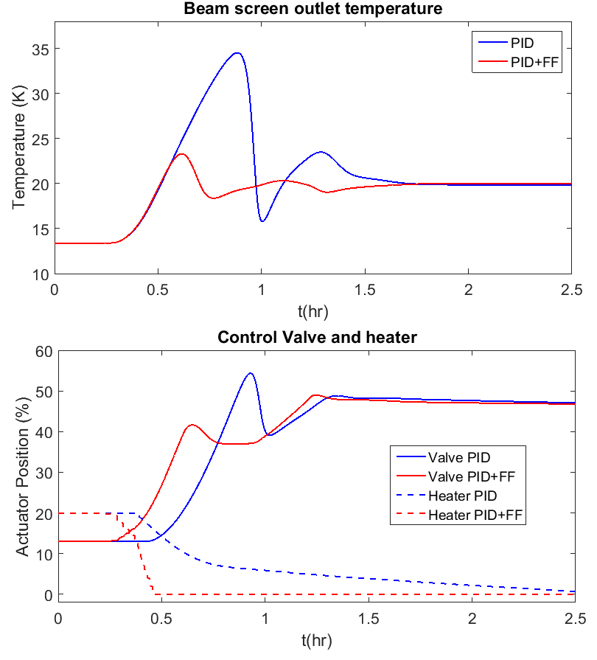
Adapt, tune and optimize the control system used for beam screen cooling 2/3
CERN has developed a more efficient control system using FeedForward (FF) action. The FF calculation utilize beam parameters to calculate the average power deposited on the Beam screen and drive, in a parallel way, the outlet control valves & inlet heaters.
This FF method allows a smooth cold gas return to the cryoplant, necessary guarantee for a smooth evolution of the refrigerator cooling capacity.
This method was fully deployed in Run2-2017
The 8th International Workshop on Cryogenics Operations (Cryo-Ops 2018), IHEP, CAS, Beijing

Slide 18
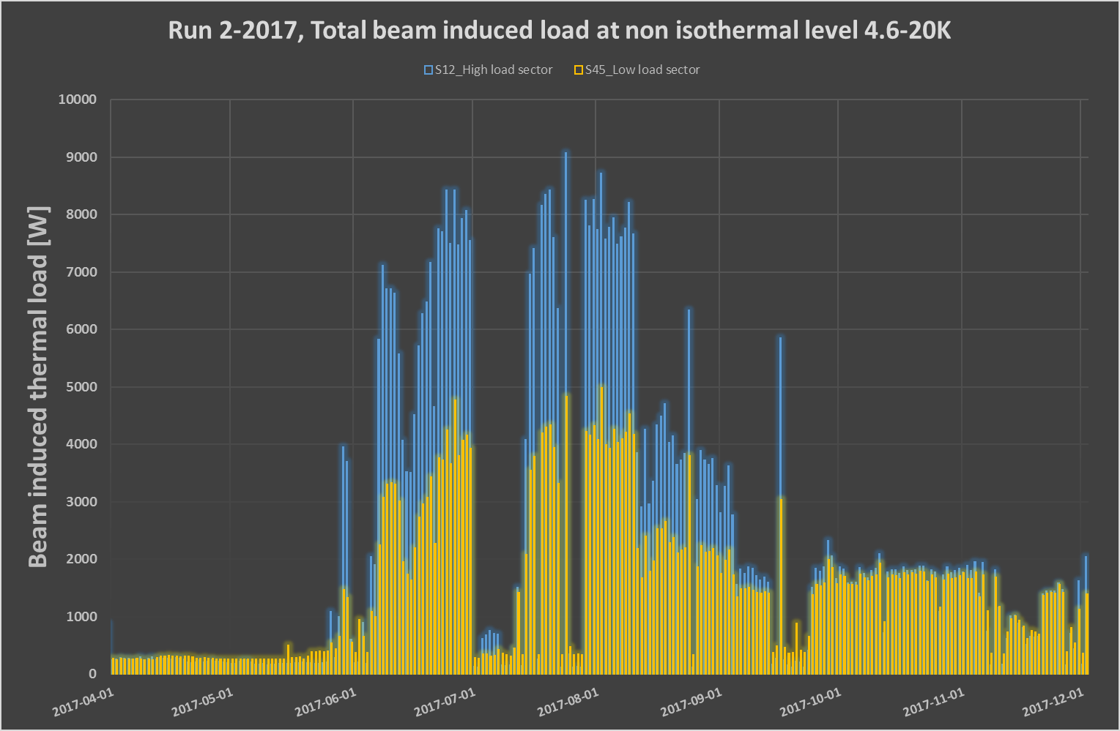
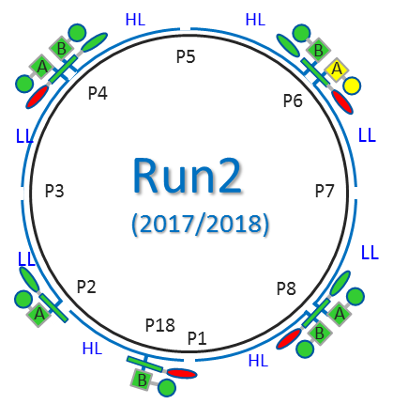
Operational adaptation of configuration Run 2_2017
2017 : cryoplant re-arrangement, beam optimization & Feed forward Beam Screen control
25ns_1868b_128bpi_8b4e
25ns_1868b_128bpi_8b4e
25ns_2460b_144bpi
25ns_2556b_144bpi
25ns_2460b_144bpi
25ns_2556b_144bpi
During the second semester 2017, the LHC filling scheme was modified to adapt LHC beam to a local air pollution. The chosen filling scheme so called 8b4e generate a low thermal load ,best for cryogenic point of view, but not optimized on luminosity point of view.
Operational scheme of Run 2_2017 & 2018 is mainly the same than the operational scheme of 2016. The only adaptation is the use of the Feed-Forward control (global drive in 2017 then individual drive in 2018)
The 8th International Workshop on Cryogenics Operations (Cryo-Ops 2018), IHEP, CAS, Beijing

Slide 19
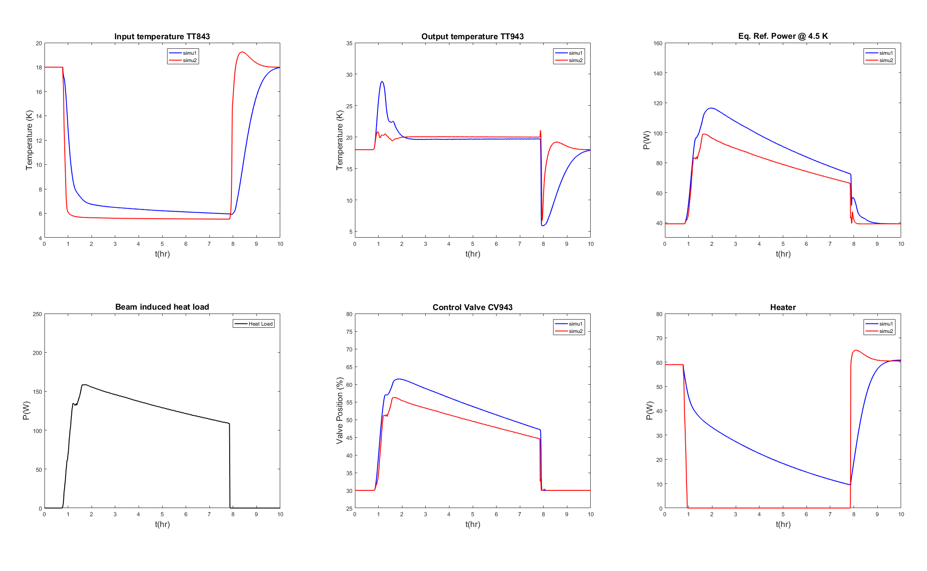
Adapt, tune and optimize the control system used for beam screen cooling 3/3
The FF method used as average to drive all the cooling valves of a sector was much better than the classical PID controller was. However, linked to the massive parallel controlled valves & heaters (53 circuits), some inconstancy appears with some subcooled circuits and some overheated circuit. This is mainly due to the spread of beam induced heat load not linearly distributed in the sector neither between sectors.
Typical high load sector
Simu 1: PID controller, Simu 2: FF controller
As final step, FF control has been individually applied on every singular circuit. This method is currently deployed on all LHC cooling circuits (53 / sector) for RUN2-2018. The equivalent cooling power recovered is in the range 250-300W / sector.
The 8th International Workshop on Cryogenics Operations (Cryo-Ops 2018), IHEP, CAS, Beijing

Slide 20
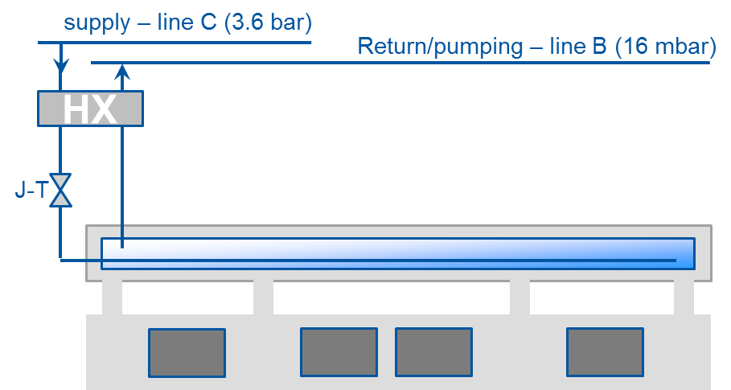
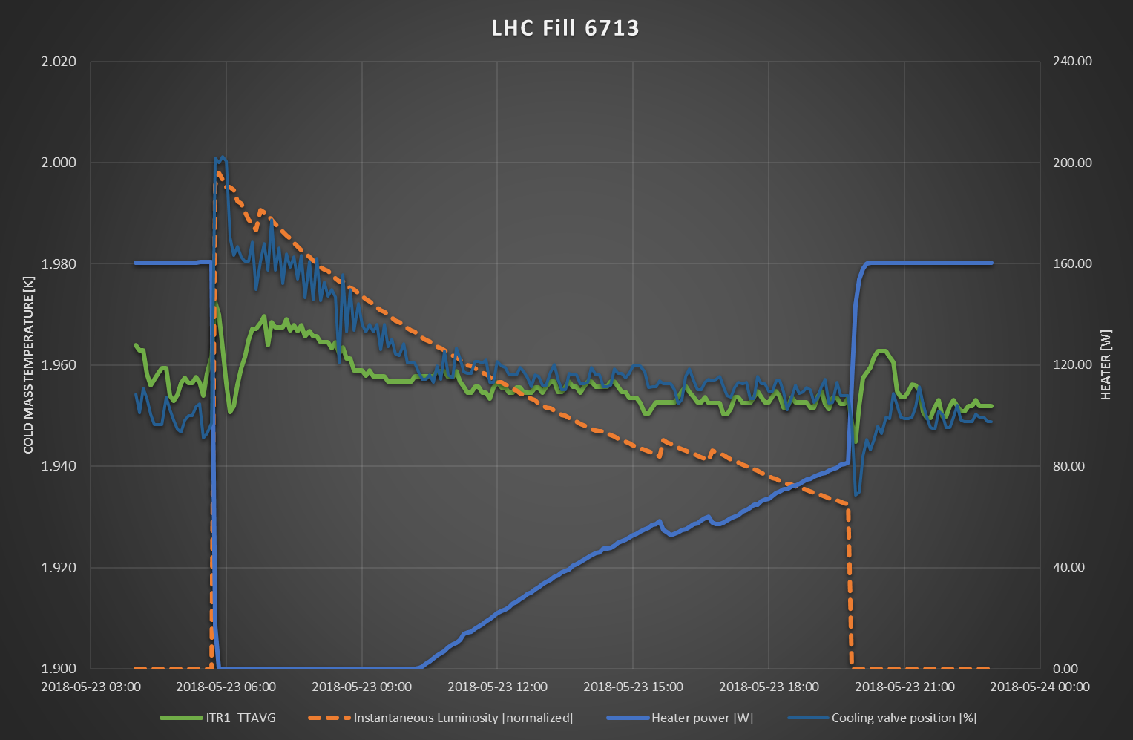
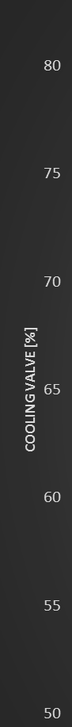

Beam induced heat load on Inner Triplet @ 1.9K
Beam induced dynamic heat load on Inner Triplet (IT) comes mainly from shower of secondary particles ejected from experiments. The energy deposited is proportional with :
where L_{nom}= 1.0e^34 Hz/cm^2 , Q_{sec,nom}= 152 W
HX is able to extract the equivalent of 280 W of dynamic load W to which we must add 40 W of static load
$$Q_{deposited}=\frac{L_{red}}{L_{nom}}∙\frac{E_{red}}{E_{nom}}∙Q_{sec,nom}$$
A dedicated FF control loop has been developed to comply with the specific beam induced load of the Inner Triplets.
The 8th International Workshop on Cryogenics Operations (Cryo-Ops 2018), IHEP, CAS, Beijing

Slide 21

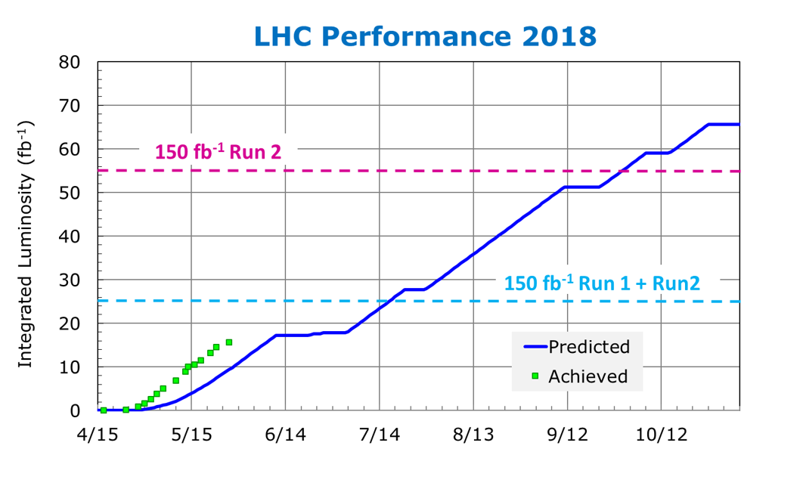
LHC Operation outlook for 2018 and beyond
The present operation scenario 2018 is foreseen until the end of Run2 2018. This scenario is based on the most optimized operation configuration using existing hardware.
During this period, LHC should produce 55 fb⁻¹ to reach the Run 2 target of 150 fb⁻¹
At the end of Year 2018, Run 2 will end. After warming up, a period of 1.5 years will be used to maintenance & Upgrade tasks.
Next cooling down is foreseen in Spring 2020
The 8th International Workshop on Cryogenics Operations (Cryo-Ops 2018), IHEP, CAS, Beijing

Slide 22
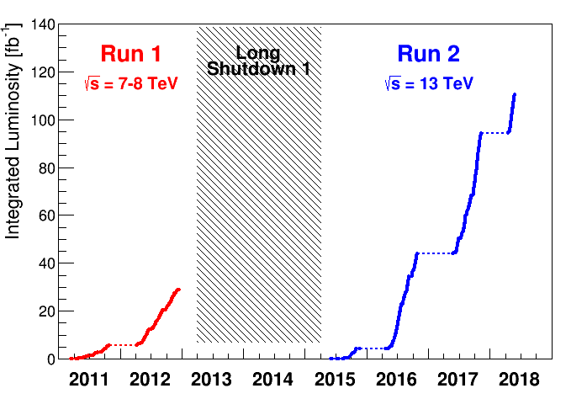
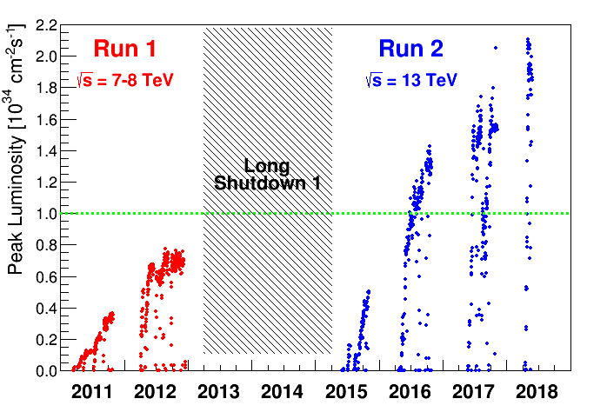
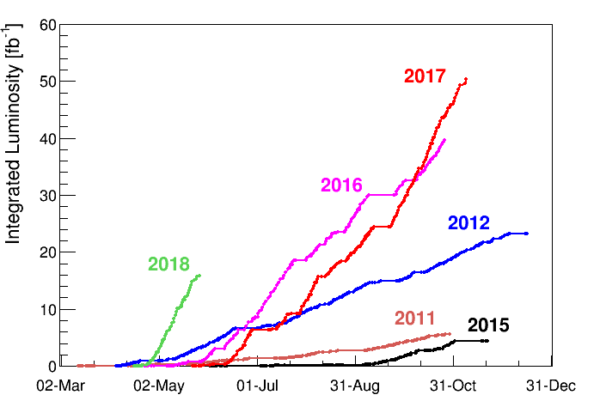
LHC luminosity
The total integrated luminosity since the start of LHC is today beyond 100 fb⁻¹. The target of 150 fb⁻¹ is reachable if no major issue appears in 2018.
LHC is able operating well above design peak luminosity 2*10 34 cm⁻²s⁻¹. Levelling has been put in place to cap peak luminosity.
The 8th International Workshop on Cryogenics Operations (Cryo-Ops 2018), IHEP, CAS, Beijing

Slide 23
Remaining topics on which a constant effort is requested
Oil Removing System of cryoplants is still a potential issue. A permanent monitoring is mandatory to prevent any massive pollution of the cold boxes. Concerning LHC cryoplants, 8 refrigerators 18 kW @ 4.5K are continuously running during 5 years with a annual stop of 2 to 3 weeks. A rough estimation gives 40000 running hours between maintenance. Some oil pollution pre-alerts are pending.
In order to maintain good availability, anticipating potential problems is essential. Thanks to the huge amount of data available, we try by constant effort to detect the accumulation of weak signals in order to turn them into pre-alarm information.
The aging effect on PLC, electronic components and cables insulation (Dedicated presentation by Dr M. Pezzetti) could be an issue in the coming years. This should imply a major overhaul of the concerned equipment during the coming maintenance periods.
Linked to CERN general policy for staff, a permanent turn-over of cryogenic operators generate a knowledge uncertainty. A dedicated training scheme is now on track with more than 25 sequences of training and with use of in-house simulator developed for this need.
The 8th International Workshop on Cryogenics Operations (Cryo-Ops 2018), IHEP, CAS, Beijing

Slide 24
Conclusions and perspectives
The experience gained during Run1 and early Run2 was used to optimize the non-isothermal refrigeration capacity @ 4.6-20 K that is beyond the Design Report. In particular the refrigeration capacity transfer from the 1.9 K level to 4.6-20 K has been developed and put into service while maintaining an overall availability equivalent to Run 1.
Our cryogenic team uses its analysis, process-calculation and simulation capabilities to develop and optimize the Feed Forward advanced control. On the other hand, these capabilities are widely exploited for the simulator tool used to train operators. The next step, already well advanced, will be to generate early warnings based on data mining.
No solution described above would be possible without the complete control of the daily operation of multiple cryoplants. This must also include to permanently repeat unexciting but essential tasks such as helium and oil leak check, vibrations monitoring, visual and remote inspection. This list is non-exhaustive!
The 8th International Workshop on Cryogenics Operations (Cryo-Ops 2018), IHEP, CAS, Beijing

Slide 25
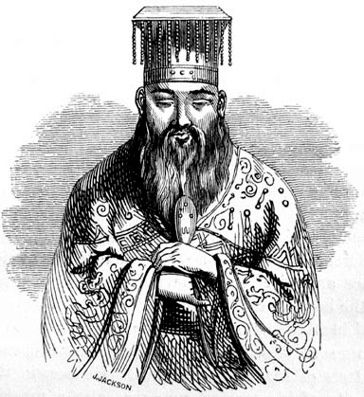
The following points were not addressed during this presentation. They will be the subject of a specific presentation.
LHC cryogenics control system at CERN; Dr Marco Pezzetti
LHC Cryogenics availability and helium inventory management during Run 2; Mr Laurent Delprat
General cryogenic maintenance policy and recent updates for CERN equipment; Mr Frederic Ferrand
The LHC Cryogenics Availability Calculation Tool; Mr Laurent Delprat
For the one who is persevering and firm, there is nothing difficult ; Confucius
对于坚持和坚定的人来说，没有什么困难
孔子
The 8th International Workshop on Cryogenics Operations (Cryo-Ops 2018), IHEP, CAS, Beijing

Slide 26
Thank you 谢谢

