Slide 1
Phase shifter design for Macro Pixel ASIC
Jian Wang wangjian@ustc.edu.cn
State Key Laboratory of Particle Detection and Electronics
University of Science and Technology of China
Southern Methodist University

Slide 2
Outline
Background
Interface
Digital flow
Phase shifter custom design for 320 MHz clock
Post-simulation results
Summary

Slide 3
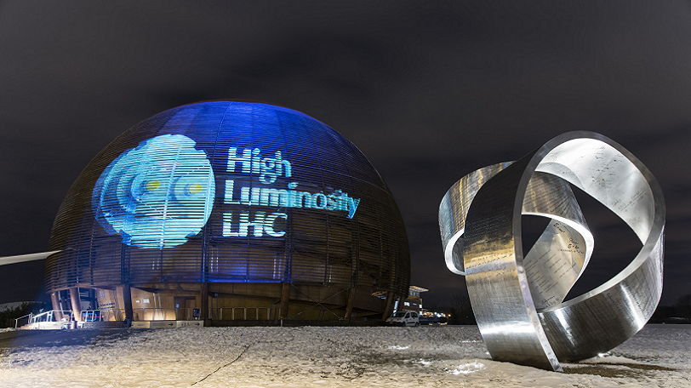
CMS Tracker will be upgraded during Phase II
HL-LHC will operate at 14 TeV centre of mass energy with a peak luminosity of 5x10^34cm-2s-1
To exploit the very high interaction rate and integrated luminosity, reaching 3000 fb-1, major upgrades to CMS are necessary

Slide 4
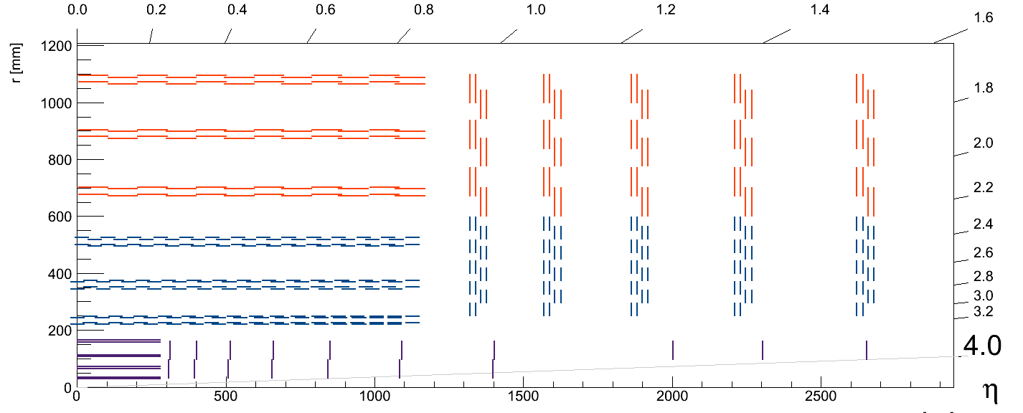
Pt modules and Pixels compose the Tracker
Ф
70 mm
140 mm
130 mm
Pixel + Strip module
Pixels 1.5mm x 100um
Strip 2.5cm x 100um
r < 20 cm
TID ~ 100 Mrad
130 mm
Z
2 Strip module
Strips 5 cm x 90 um
r > 40 cm
TID ~ 40 Mrad
Pixel Detector (RD53)
Pixels 50um x 50um or 100um x 100um
r < 20 cm
TID ~ 1 Grad
No high-pT information
Tracker Layout by G.Bianchi, N.De Maio and S.Mersi

Slide 5
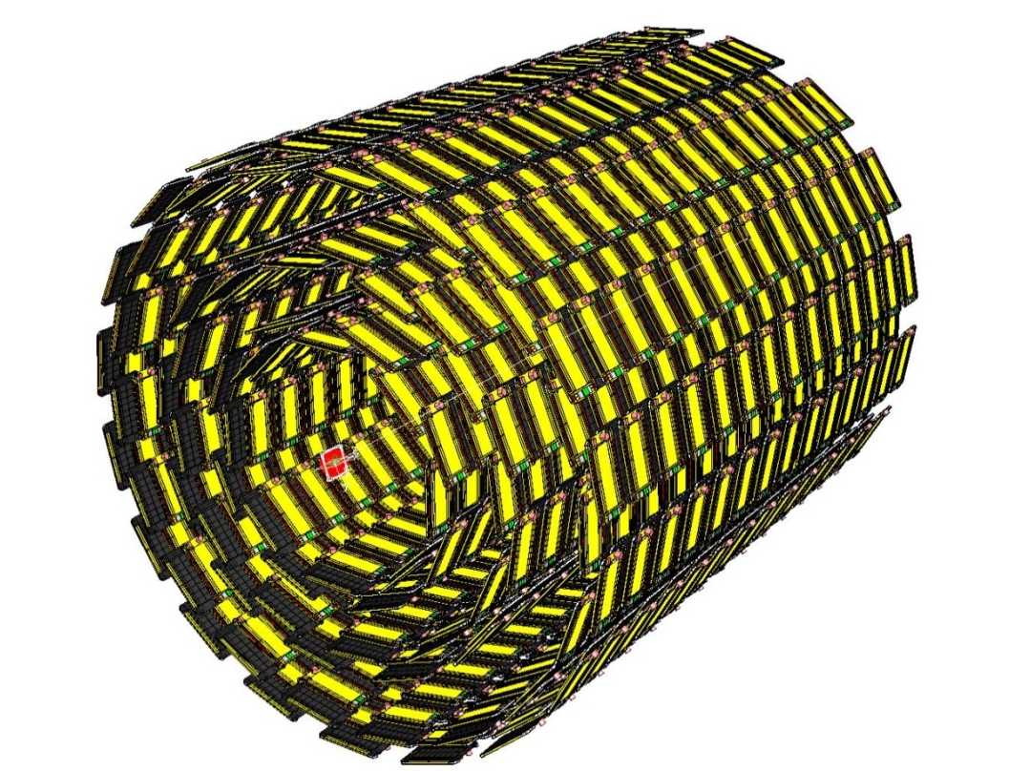
Pixel + Strip module readout scheme
ShortStrip ASIC (SSA):
Strip Readout only
wire bonds
STRIP
PIXEL
Front-End Hybrid
bump bonds
wire bonds
MacroPixel ASIC (MPA):
Pixel readout +
Correlation +
Data storage
3x
Barrel Layers

Slide 6
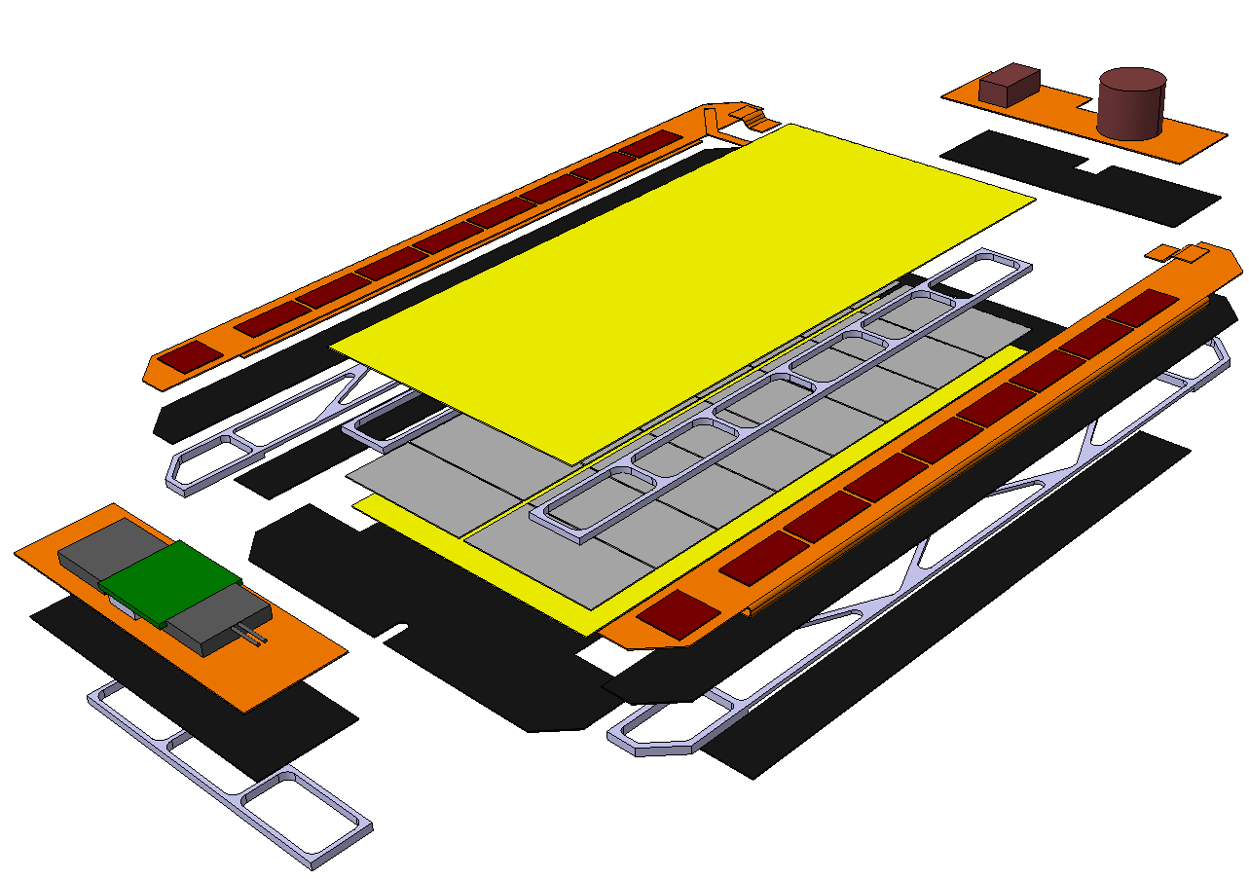
Pixel + Strip module exploded view
PS module is fully integrate entity
DC-DC converters
ShortStripASIC x 8
Concentrator IC (CIC)
Data aggregation
Strip Layer
MacroPixelASIC x 16
Pixelated Layer
LP-GBT and VTRx+
Data transmission through the optical link

Slide 7
Data Readout block diagram of SSA + MPA
SSA
MPA
@ Bunch crossing frequency (40 MHz)
STRIP
FE
Binary
Readout
@ L1 trigger rate (1 MHz)
PIXEL
SRAM
Memories
L1 Data
Encoders
All tracks
information
FE
Binary
Readout
Stub Finding
Logic
High pT
information

Slide 8
Tracker Back-end data transmission optimization
Data transmission frequency 320 MHz with differential lines
320 Mbps
Macro
Pixel
ASIC
1600 Mbps
Concentrator
IC
(sends out data every 8 BX)
LP-GBT
.
.
.
.
.
1600 Mbps
SPECIFICATION DEFINITION ON GOING
1600 Mbps
Total of 8 MPAs
(send out data every 2 BX)
320 Mbps
All tracks
Information
Macro
Pixel
ASIC
1600 Mbps
High pT
Information

Slide 9
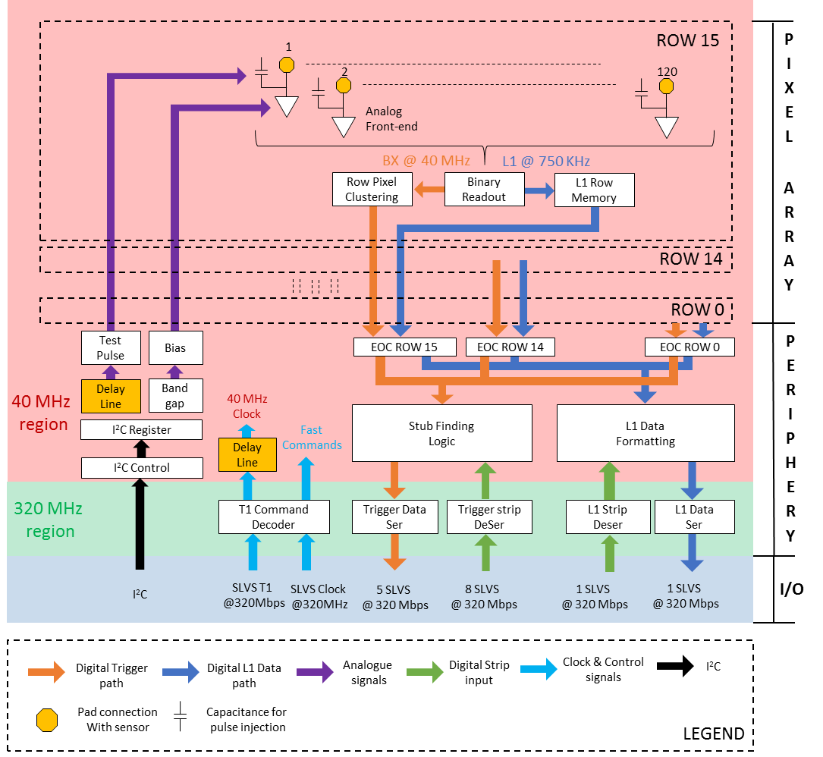
MPA Block Diagram
The Macro Pixel ASIC (MPA) is a pixel readout ASIC for the Phase II Outer Tracker upgrade of CMS.
It features the novel technique for high-pT particle recognition which allows the generation of data for the Trigger.
The design requires two Delay Lines highlighted in the picture on the right and described in the next slides.

Slide 10
Phase Shiter for Clock Deskew
Application: Remove the skew on the event sampling clock among the chips in the same module.
Specifications:
Resolution = 200-400 ps
Input Frequency = 320 MHz
Jitter < 10 ps
Closed-Loop (Delay-locked loop)

Slide 11
Phase Shifter integration
Sampling CLK40
Phase Shifter
CLK320
Command Decoder
T1 commands
CLK40
The delayed 320 MHz clock is used to sample the 40 MHz clock. The clock generated is the 40 MHz clock for the event sampling. A re-sampling is carried out on the data output with the not-delayed 40 MHz clock to be realigned with the input 320 MHz used for data transmission.

Slide 12
Interface
clock @320 MHz
Phase Shifter
(analog part)
Control Logics
(digital part)
dllEnable
dllForcedown
dllReset
clkOut
dllChargePumpCurrent[3:0]
dllClockSelect[3:0]
dllLateA
dllLateB
dllLateC
The Control Logics initialize the Phase Shifter and select which phase to output.
The Phase Shifter generates 16 equally-spaced phases with a resolution of 208.3 ps at 320 MHz

Slide 13
Digital flow
After power on, digital logics should reset LPF to VDD by disabling the whole
custom part, i.e. pulling down the “dllEnable” signal. The reset time is less than
200 ns. After resetting, delay cell has a minimal delay.
Then the logics gives a low level “dllForceDown” to force the charge pump to discharge the LPF. Thus the delay will increase.
After the control voltage on the LPF drops to a value that dllLate changes its
level from high to low, release the “dllForceDown” signal and give the loop
control back to DLL.
The control voltage will continue to drop until DLL is locked. Then it will change
according to the switching of up and down signals.

Slide 14
Phase Shifter custom design for 320 MHz clock
Voltage controlled delay line
Reference
clock
[0]
[1]
[2]
[3]
[4]
[5]
[6]
[7]
[8]
[9]
[10]
[11]
[12]
[13]
[14]
[15]
[16]
clockSelect[3:0]
16:1 MUX
clkOut
Phase
detector
D
down
Charge
Pump
CLK
up
dllLateA
LPF
dllLateB
dllLateC
clkDelay
dllEnable
dllForceDown
dllChargePumpCurrent[3:0]
dllReset
The delay line is composed of 17 delay cells. The last one is dummy.
The delay resolution is T/15 that is $\frac{3.125}{15}≈208. 3 ps.$

Slide 15
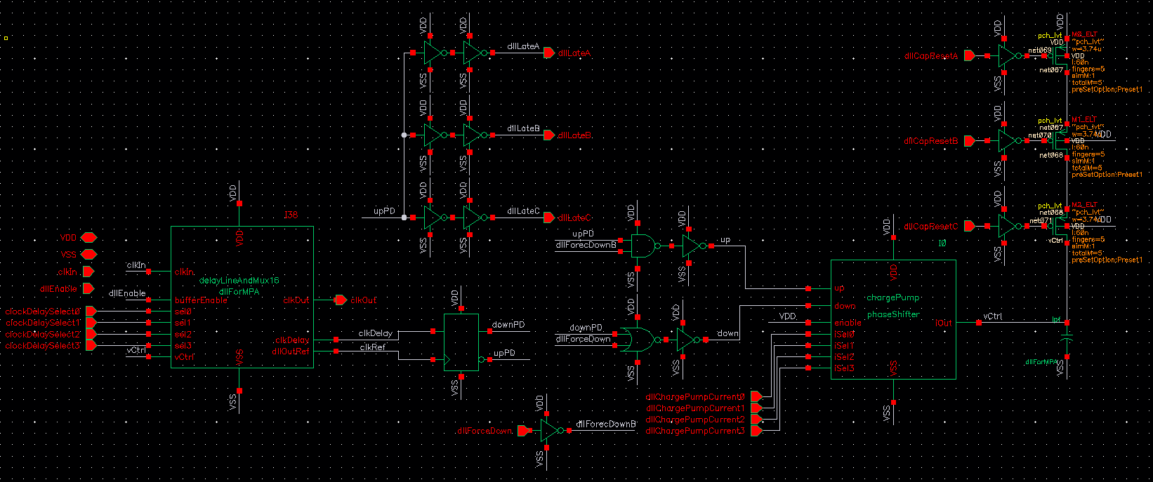
Schematic and layout
Schematic:
Delay line
And
16:1 MUX
Phase
detector
Charge
Pump
LPF
layout:
~100um x 400um

Slide 16
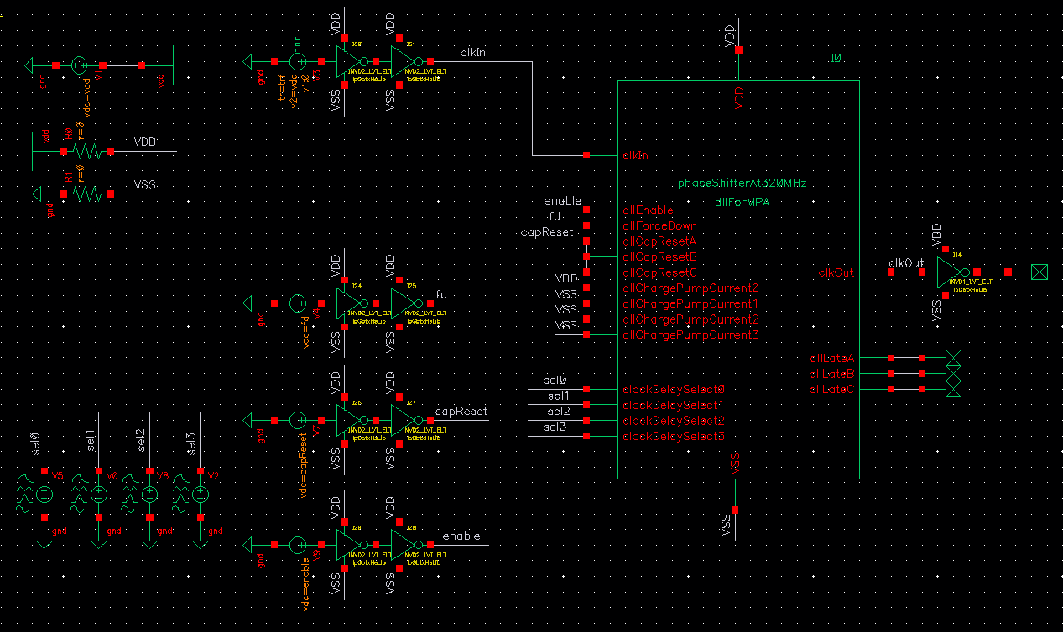
Test bench
320 MHz clock inputs. Run post-simulations in three corners: nominal corner, fastest corner—C2, slowest corner—C15. Minimal current setting.
The control voltage is initialized to a value to make DLL locked at the beginning of simulation.
The clockDelaySelect[3:0] change in turns so that the clkOut comes from tap0 to tap15 successively.

Slide 17
Corner definition of MPA
TYPICAL: TT, 1 V, 25 C
FAST: FF, 1.1 V 0 C
SLOW LOW TEMPERATURE: SS, 0.9 V, -40 C
SLOW HIGH TEMPERATURE: SS, 0.9 V, 50 C

Slide 18
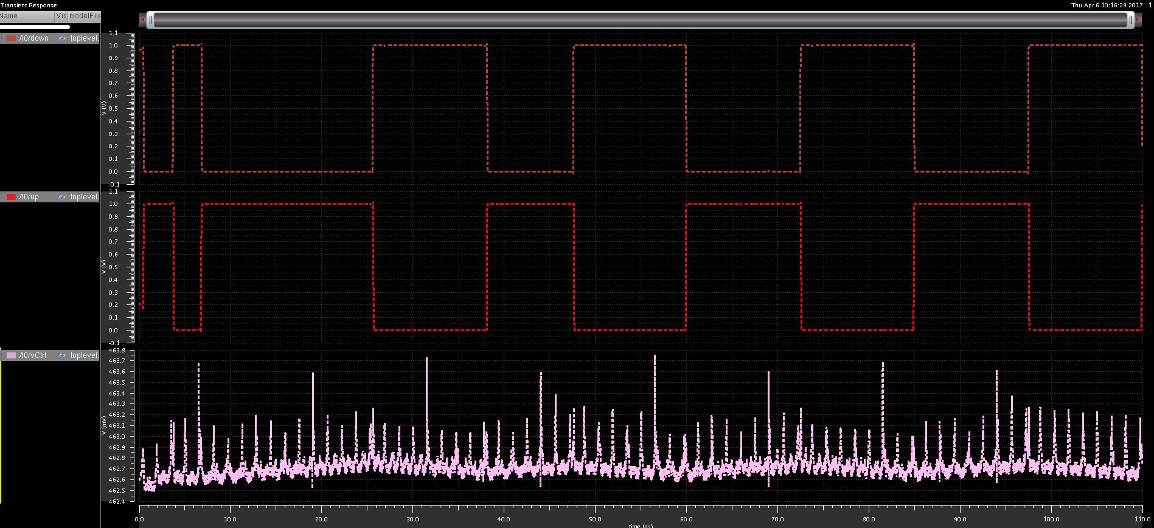
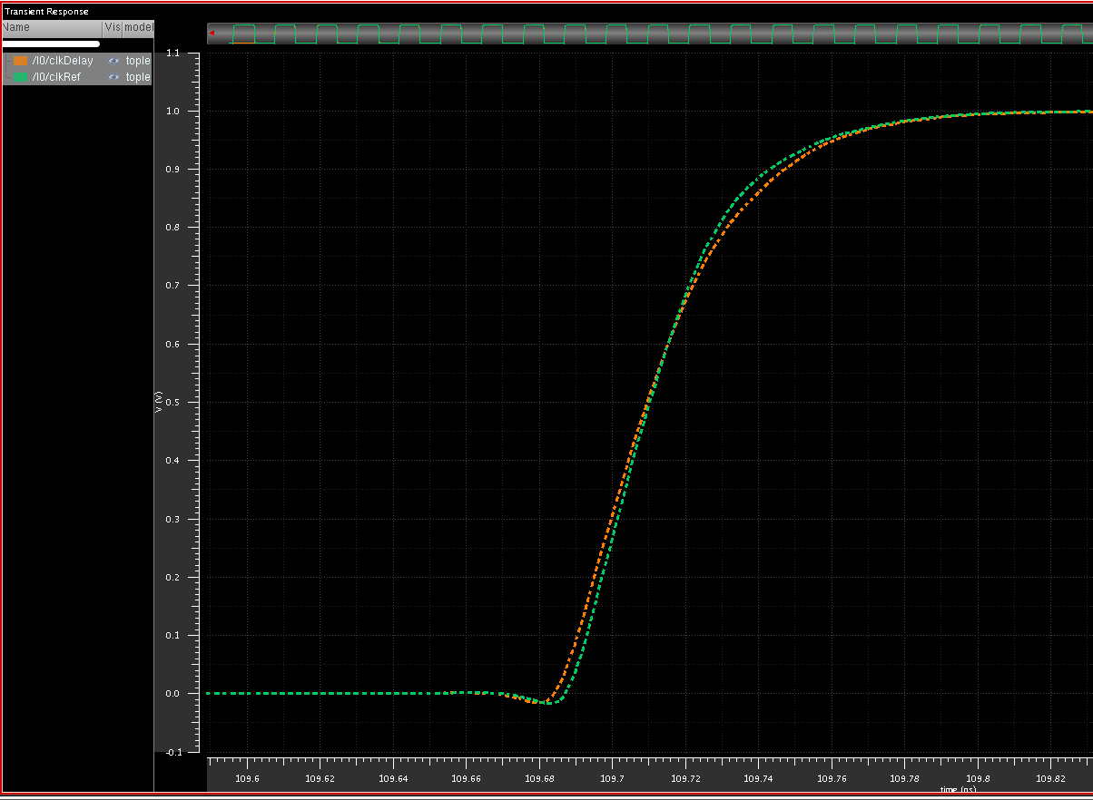
Results in Typical corner
DLL functionality:
dn
clkDelay
And
clkRef
up
vCtrl
DLL is locked. The rising edges of two inputs of the phase detector are very close to each other.
Phase shifting:
1 LSB = 208.3 ps.
DNL = 0.008 LSB.
INL = 0.01 LSB.
Jitter =2.99 ps.
Power dissipation
is 1.007 mW.

Slide 19
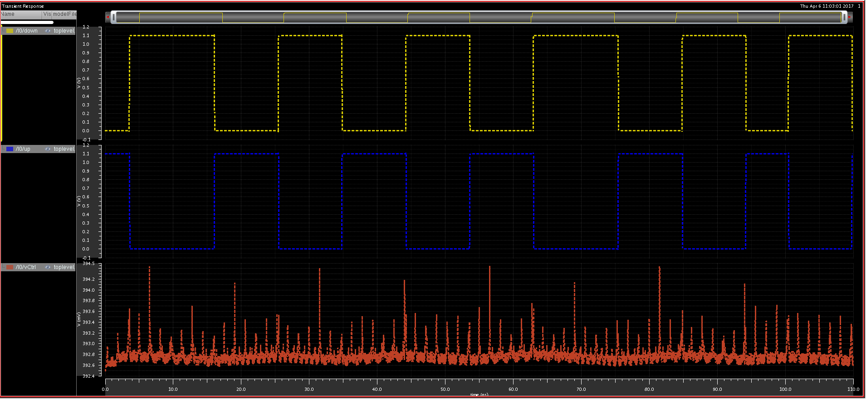
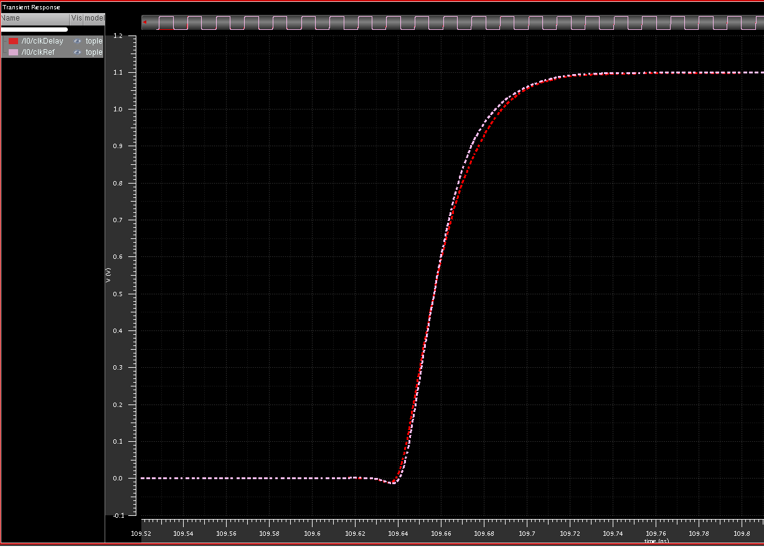
Results in Fast corner
DLL functionality:
dn
clkDelay
And
clkRef
up
vCtrl
DLL is locked. The rising edges of two inputs of the phase detector are very close to each other.
Phase shifting:
1 LSB = 208.3 ps.
DNL = 0.008 LSB.
INL = 0.009 LSB.
Jitter = 3.03ps.
Power dissipation
is 1.447 mW.

Slide 20
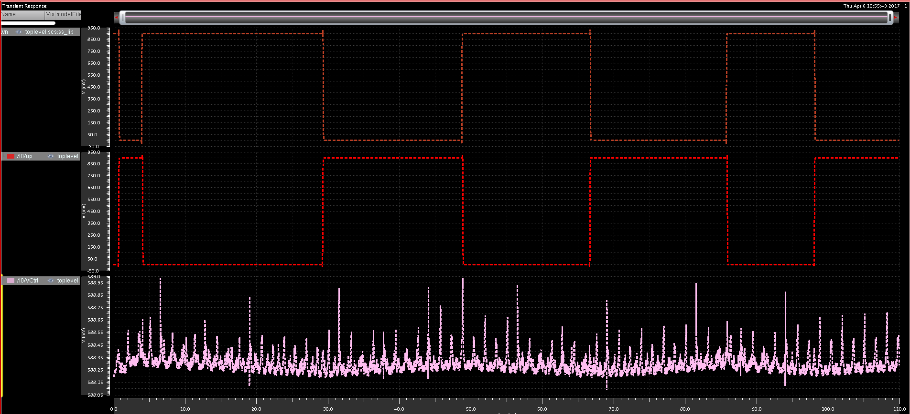
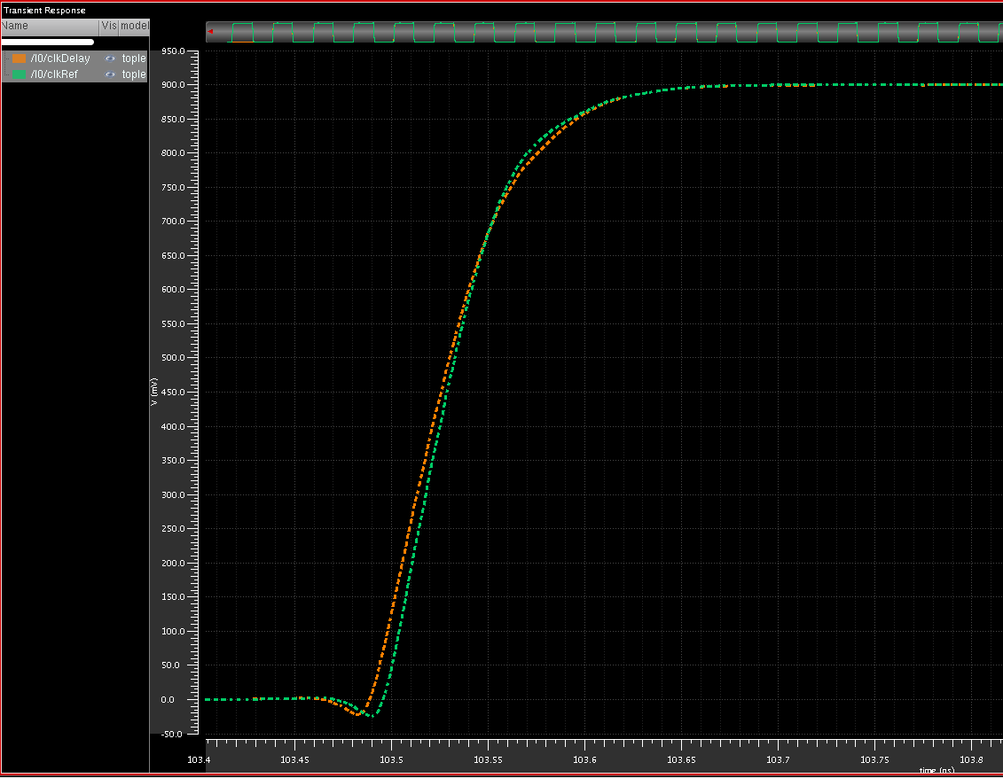
Results in slow low temperature corner
DLL functionality:
dn
clkDelay
And
clkRef
up
vCtrl
DLL is locked. The rising edges of two inputs of the phase detector are very close to each other.
Phase shifting:
1 LSB = 208.3 ps.
DNL = 0.01 LSB.
INL = 0.03 LSB.
Jitter = 2.93ps.
Power dissipation
is 0.68mW.

Slide 21
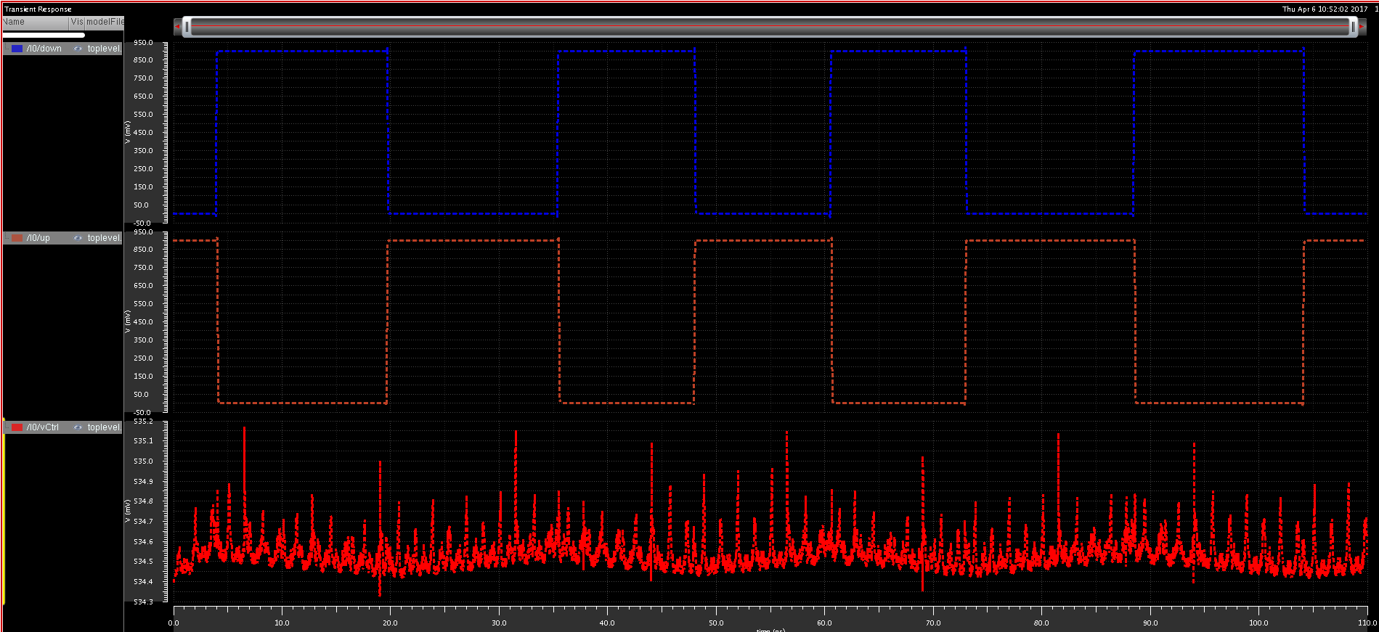
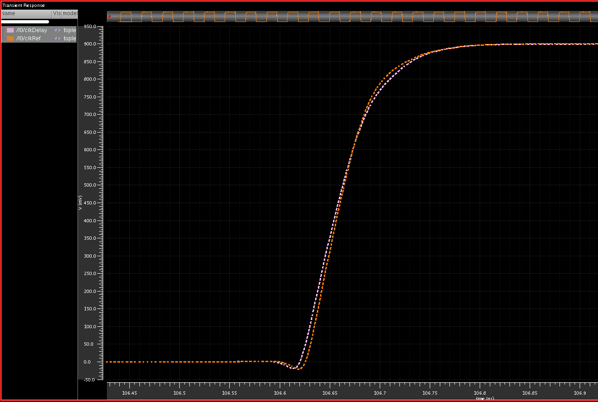
Results in slow high temperature corner
DLL functionality:
dn
clkDelay
And
clkRef
up
vCtrl
DLL is locked. The rising edges of two inputs of the phase detector are very close to each other.
Phase shifting:
1 LSB = 208.3 ps.
DNL = 0.01 LSB.
INL = 0.04 LSB.
Jitter = 2.38ps.
Power dissipation
is 0.75mW.

Slide 22
Summary
Phase shifter for 320 MHz :
Resolution: $208.3 ps$
Power dissipation: $<2 mW$
DNL: $<0.01 LSB$
INL: $<0.03LSB$
Jitter: $<4 ps$
Lock time: $<$150 us
Layout size: $\sim 100 um ×430 um$

