Slide 1
TID Radiation Characterization of a Readout ASIC for Time Projection Chamber
X. Y. Zhao, Z. Deng, Y. N. Liu,
Department of Engineering Physics, Tsinghua University,
Key Laboratory of Particle & Radiation Imaging, Ministry of Education,
X. Y. Zhao ：denniso@163.com

Slide 2
Content
Introduction
Radiation test
Test results
Summary and future plan

Slide 3
Content
Introduction
Radiation test
Test results
Summary and future plan

Slide 4
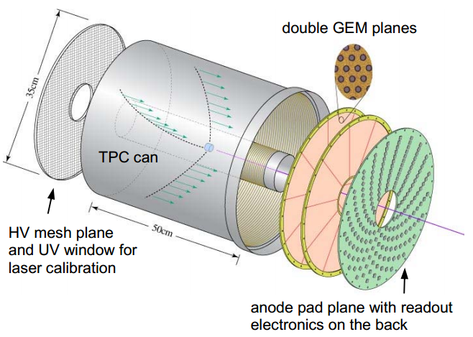
Introduction
TPC (Time Project Chamber) has been demonstrated in recent years for its main advantage of performing a three-dimensional reconstruction of a particle trajectory or interaction.
The CASCA (Charge pre-Amplifier and Switched Capacitor Array) with high density and low power has been developed for the readout of TPC, which integrated 32 channels with full signal processing function and was fabricated in a 0.18μm commercial CMOS process.
SCA : Switched Capacitor Array
Notes:
The CASCA (Charge pre-Amplifier and Switched Capacitor Array) with high density and low power has been developed [1] for the readout of TPC (Time Project Chamber), which integrated 32 channels with full signal processing function and was fabricated in a 0.18μm commercial CMOS process.
A dedicated ASIC named CASCA (Charge pre-Amplifier and Switched Capacitor Array) with high density and low power has been developed [1]. The CASCA integrated 32 channels with full-chain signal processing circuits and was fabricated in a 0.18μm CMOS process. SCA was widely used in the readout ASIC with application of low counter ate, while its radiation performance has not been well stuied.Radiation tests including TID

Slide 5
Content
Introduction
Radiation test
Test results
Summary and future plan

Slide 6
Radiation test
Tested ASIC
Experiment setup
TID test

Slide 7
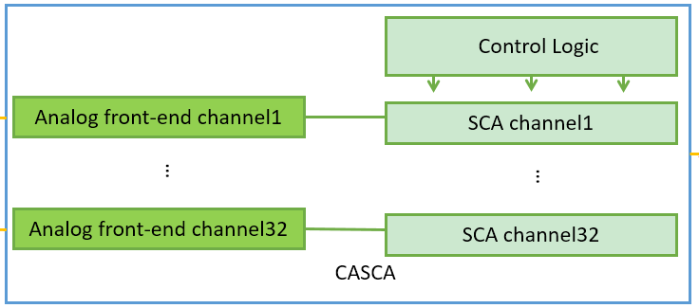
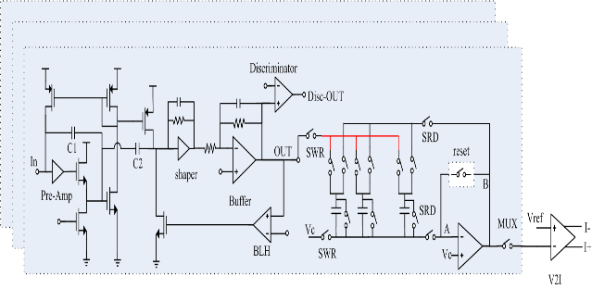
Radiation test
Tested ASIC
32 channels
The ASIC fulfills the function of pre-amplification, wave sampling, storing and readout serially while without radiation hardening.
Each channel integrates mainly: a charge sensitive preamplifier, a CR-RC shaper, a baseline holder, a discriminator for self-trigger and a 64-cell switched capacitor array (SCA）
Notes:
32 channels
each channel integrates mainly: a charge sensitive
preamplifier, a CR-RC shaper, a baseline holder, a discriminator for self-trigger and a 64-cell switched capacitor array (SCA). The native MOS capacitor, which has almost zero threshold voltage, is adopted for the switched capacitor array because of high capacitance density and large dynamic range. The ASIC fulfills the function of pre-amplification, wave sampling, storing and readout serially while without radiation hardening. Doing radiation test of it will not only verify its performance against radiation effects, but also be meaningful for study the performance against radiation of the commercial structures involved in the ASIC, such as analogue front-end and native MOS capacitor in SCA.

Slide 8
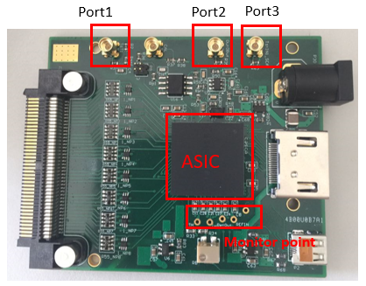
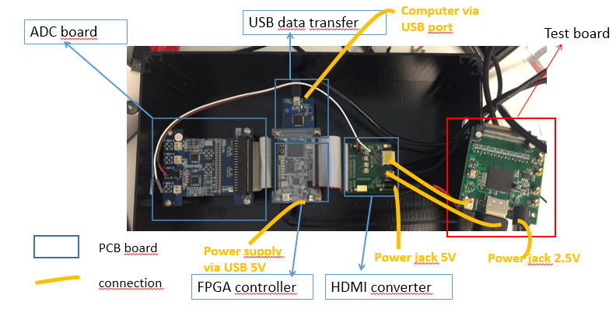
Radiation test
Tested ASIC
Access to the input and output of the analog front-end, input of the SCA part of the 1st channel.
Test system with other 4 PCB boards.
Notes:
Port
Description
1
Input of the analog front-end of the first channel. Connected to a 1pf capacitor in serial, the injected pulse would be transferred as injected charge.
2
Output of the analog front-end of the first channel, all the electrical tests of analog front-end is token through it instand of the readout data from SCA.
3
Input of th SCA of the first channel. Different wave forms are injected through it as the sampling target of SCA instand of the ouput wave from the analog front-end.
PCB board
Functions
FPGA board
Receive the configuration from PC, provide control signals to the AISC to be tested and send the converted digital data to the PC.
USB board
Enable the communication between PC and FPGA board.
ADC board
Convert the analog output to digital ones
HDMI board
Realize the communication between the Test board and the test system over long distance.

Slide 9
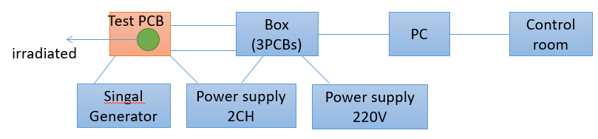
Radiation test
Experiment setup.
The ASIC have been irradiated at Paul Scherer Institute (PSI) with protons.
200MeV protons with a dose rate of 10rad (Si)/s
62.8MeV protons with a dose rate of 8rad (Si)/s
All the ASICs were irradiated with a regular 1.8V core.
Notes:
A test PCB board was designed for the radiation test, as shown in Fig.2, with separate input and output ports of the analog front-end and the SCA, which would exclude the impact of each other during radiation test. The ASIC was irradiated with a regular 1.8V core voltage and 3.3V IO voltage at room temperature. The electrical tests of the analogue front-end part were realized by injecting a pulse through the port 1 (which connecting to the input of the analogue front-end) while monitoring the port 2 of the test board with a oscilloscope, and that of the SCA part were realized by injecting different waveform through the port 3 (which connecting to the input of the SCA) and analyzing the data got on PC. The ASIC have been irradiated at Paul Scherer Institute (PSI) with protons. With shielding, only the ASIC was exposed to the proton radiation. For the SEE test, which hasn’t finished yet, samples will be irradiated by protons with different energies as well as different fluxes.

Slide 10
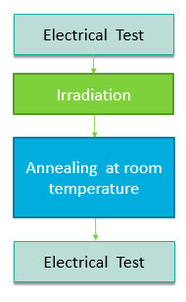
Radiation test
TID test.
The electrical tests.
analogue front-end: offset voltage, noise, gain
SCA part : leakage current, gain, noise
Static TID tests.
Dynamic TID tests.
After irradiation the samples were stored at room temperature without power supply. (passive annealing at room temperature)
Notes:
During irradiation the ASIC was powered and its supply current was monitored. Three samples (1 to 3) were
irradiated by 200MeV protons with a dose rate of 10rad (Si)/s to the dose of 10Krad (Si), 20Krad (Si) and 100Krad (Si) respectively. The samples were stored at room temperature and without power supply after irradiation. Electrical tests were token before and after irradiation, of which comparisons were made to check how it was affected by different irradiation dose. The electrical tests including tests of analogue front-end as well as SCA part, and details can be found in Table I, which shows the parameters compared as index
The ASIC have been irradiated at Paul Scherer Institute (PSI) with protons for static TID and dynamic TID test. During the static TID tests, the ASIC was only powered. Three samples (S1~S3) were irradiated by 200MeV protons with a dose rate of 10rad (Si)/s to the dose of 10Krad (Si), 20Krad (Si) and 100Krad (Si) respectively. In the dynamic TID test, the ASIC was powered as well as triggered, working in normal sampling and reading out under self-trigger mode. Two samples were irradiated by 62.8MeV protons with a dose rate of 8rad (Si)/s to the total dose of 10Krad (Si). All the ASICs were irradiated with a regular 1.8V core voltage and 3.3V IO voltage at room temperature. After irradiation the samples were stored at room temperature without power supply. The electrical tests including tests of analogue front-end as well as SCA part, such as offset voltage, noise, gain of analogue front-end and leakage current, gain, noise for SCA were token both before and after radiation to compare how they were affected by the radiation.

Slide 11
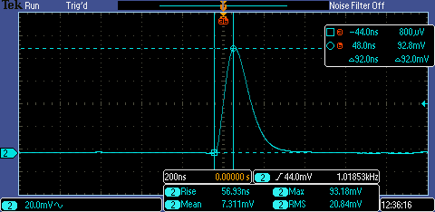
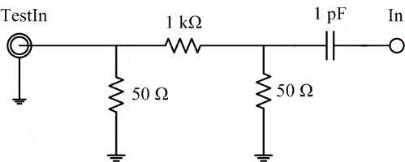
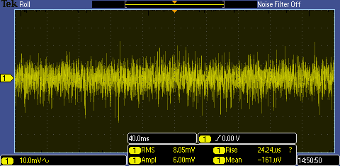
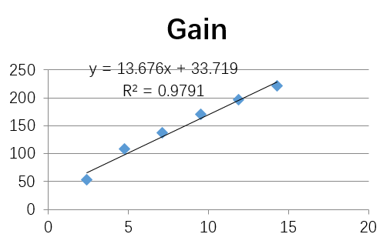
Radiation test
The electrical tests.
analogue front-end:
offset voltage
gain and INL
noise(ENC)
Notes:
During irradiation the ASIC was powered and its supply current was monitored. Three samples (1 to 3) were
irradiated by 200MeV protons with a dose rate of 10rad (Si)/s to the dose of 10Krad (Si), 20Krad (Si) and 100Krad (Si) respectively. The samples were stored at room temperature and without power supply after irradiation. Electrical tests were token before and after irradiation, of which comparisons were made to check how it was affected by different irradiation dose. The electrical tests including tests of analogue front-end as well as SCA part, and details can be found in Table I, which shows the parameters compared as index
The ASIC have been irradiated at Paul Scherer Institute (PSI) with protons for static TID and dynamic TID test. During the static TID tests, the ASIC was only powered. Three samples (S1~S3) were irradiated by 200MeV protons with a dose rate of 10rad (Si)/s to the dose of 10Krad (Si), 20Krad (Si) and 100Krad (Si) respectively. In the dynamic TID test, the ASIC was powered as well as triggered, working in normal sampling and reading out under self-trigger mode. Two samples were irradiated by 62.8MeV protons with a dose rate of 8rad (Si)/s to the total dose of 10Krad (Si). All the ASICs were irradiated with a regular 1.8V core voltage and 3.3V IO voltage at room temperature. After irradiation the samples were stored at room temperature without power supply. The electrical tests including tests of analogue front-end as well as SCA part, such as offset voltage, noise, gain of analogue front-end and leakage current, gain, noise for SCA were token both before and after radiation to compare how they were affected by the radiation.

Slide 12
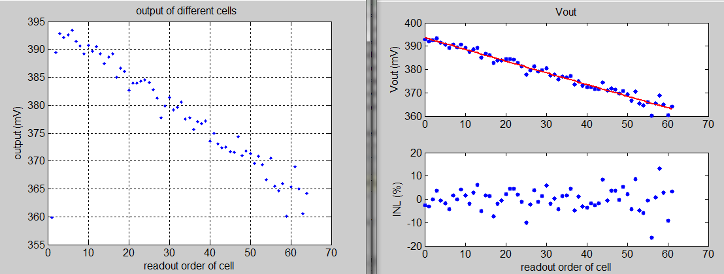
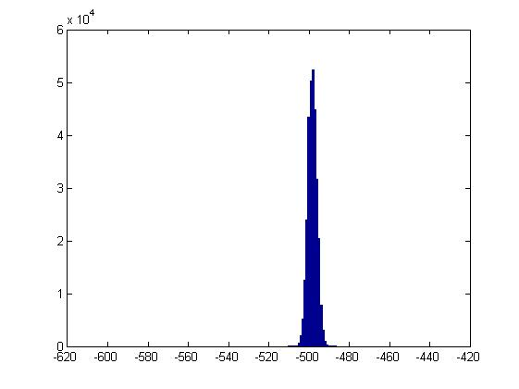
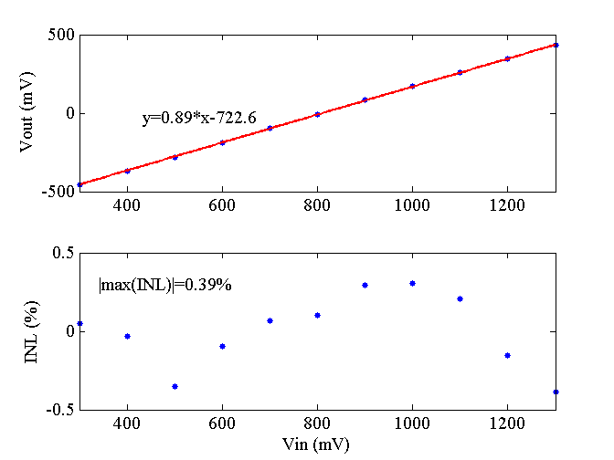
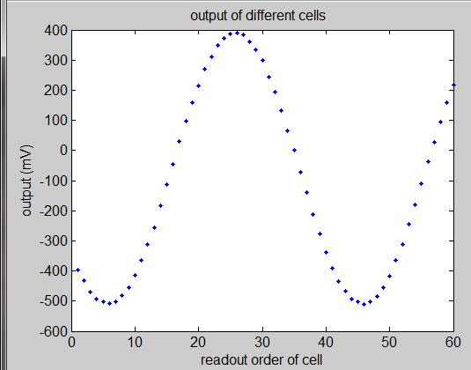
Radiation test
The electrical tests.
SCA part :
leakage current
gain and INL
noise
Notes:
漏电流：
第一通道SCA部分对直流电平采样，采样频率50MHz，用很慢的读出率（40 kHz）进行读出，这样对于第一通道的第一个和最后一个单元读出的时间间隔约59 ms；由于漏电流的影响，可以较明显地看到不同的单元读出了不同的数据，并且几乎是线性变化的，拟合之后的斜率表征了漏电流的大小。下图显示的是采样1.3 V输入电压时，64个单元上读出的数据，根据这个数据，得到漏电流的大小为242 fA。改变不同的输入电压值，会得到不同的漏电流值。 10个事例。
静态噪声：
对0.3V直流电平采样，统计5000个事例，统计得到的平均值，以及统计的标准差。标准差即为输出端对应的噪声电压。按照图5‑34中的增益折合至SCA的输入端。以每次事例第64个单元采样值统计，
每个输入电压采样了10个事例，将64个电容10次事例的采样值求平均，作为该输入电压下的实测值。对不同输入电压下的实测值进行线性拟合并求最大积分非线性。
有效位数：
用信发生器产生满幅度的正弦信号，0.3 V -1.3 V，经SCA采样之后得到64个模拟值，通过ADC数字化输出，并对输出值进行正弦拟合图5‑36显示的是输入0.625 MHz满幅度的正弦波， 为了更加细致地评估SCA在采样正弦波时的噪声和畸变情况，将每一点的采样值和拟合值进行作差比较，统计两者之差的均方根值。由于每个采样波形只有64个点，为了增加统计量，测量100个事例，共得到6400个采样点，然后按照公式(5‑18)^{[95]}计算均方根值，该值可用于衡量SCA采样正弦波时的噪声和畸变。为表述方便，下文将该值表达为动态噪声。
由于输入输出还有一定的增益，式(5‑18)得到的动态噪声应除以增益得到折合到SCA输入端的噪声。

Slide 13
Radiation test
Static TID tests.
The ASIC was only powered. Three samples (S1~S3) were irradiated by 200MeV protons with a dose rate of 10rad (Si)/s to the dose of 10Krad (Si), 20Krad (Si) and 100Krad (Si) respectively.
Dynamic TID tests.
The ASIC was powered and triggered，working in self-trigger mode. Two samples (D1，D2) were irradiated by 62.8MeV protons with a dose rate of 8rad (Si)/s to the dose of 10Krad (Si).

Slide 14
Content
Introduction
Radiation test
Test results
Summary and future plan

Slide 15
Test result
Static TID tests.
power supply
analogue front-end:
offset voltage
TID(rad(Si)/s) | Pre （mA） | 156H （mA） | change
10K | 48 | 50 | 4.2%
20K | 49 | 54 | 10%
100K | 48 | 50 | 4.2%
TID(rad(Si)/s) | Pre （mA） | 156H （mA） | change
10K | 802 | 798.6 | 0.4%
20K | 782 | 780.2 | 0.2%
100K | 792 | 790 | 0.3%
Notes:
The power supply voltage and bias voltages monitored had only changed slightly, which would be due to measurement error.
The offset voltages (regard as the baseline of the output waveform) of the three
samples after irradiation only changed slightly, within 0.3%.
gain which is more apparently at larger dose irradiation. After fitting those dots into a line, it was found out that the gain (slope of the fitted line) of the sample 3 increased from 16.2mV/fC to 16.4mV/fC after irradiation.
The test results of the rms of the three samples, which is regard as index of noise are listed in Table II.
TID Test results of the analogue front-end.
The offset voltages (regard as the baseline of the output waveform) of the three
samples after irradiation only changed slightly, within 0.3%.
Pulses of different amplitude were injected into Port 1, which were converted into charge by the capacitor of 1pF connecting in serial between the port and the input of the analogue front-end. The output amplitude of different samples with different injected charge are shown in Fig.3, there was an increase of the gain which is more apparently at larger dose irradiation. After fitting those dots into a line, it was found out that the gain (slope of the fitted line) of the sample 3 increased from 16.2mV/fC to 16.4mV/fC after irradiation. The test results of the rms of the three samples, which is regard as index of noise are listed in Table II. It is reasonable to draw the conclusion that the performance of analogue front-end was not affected much after irradiation.
TID Test results of the SCA. The leakage current of sample 3 when sampling 1.3V dc voltage changed from 231fA to
361fA after irradiation. Other two samples haven’t seen such big increase of the leakage current. The largest increase of static noise was found in the sample 3 with an increase of 10%. Both the gain and the INL were stable, while the sampled voltage had a negative shift after irradiation, which is -10mV of sample 2 and nearly -20mV of sample 3 (Fig.4).

Slide 16
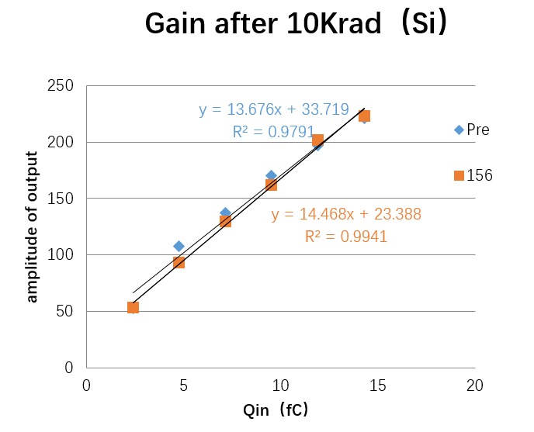
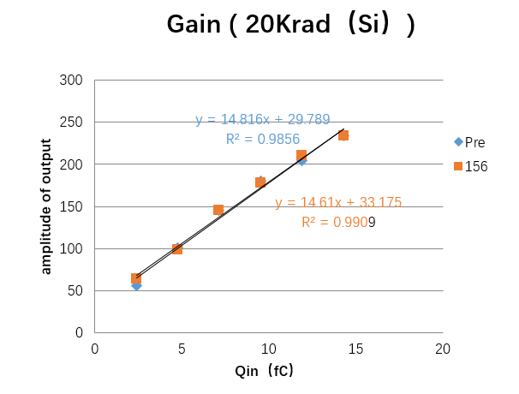
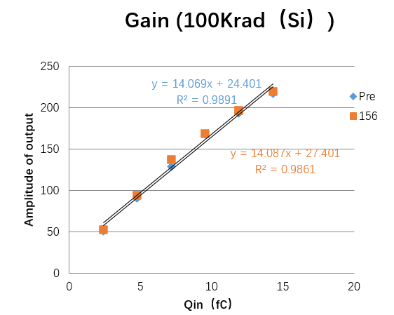
Test result
Static TID tests.
analogue front-end:
gain and INL
Notes:
The power supply voltage and bias voltages monitored had only changed slightly, which would be due to measurement error.
The offset voltages (regard as the baseline of the output waveform) of the three
samples after irradiation only changed slightly, within 0.3%.
gain which is more apparently at larger dose irradiation. After fitting those dots into a line, it was found out that the gain (slope of the fitted line) of the sample 3 increased from 16.2mV/fC to 16.4mV/fC after irradiation.
The test results of the rms of the three samples, which is regard as index of noise are listed in Table II.
TID Test results of the analogue front-end.
The offset voltages (regard as the baseline of the output waveform) of the three
samples after irradiation only changed slightly, within 0.3%.
Pulses of different amplitude were injected into Port 1, which were converted into charge by the capacitor of 1pF connecting in serial between the port and the input of the analogue front-end. The output amplitude of different samples with different injected charge are shown in Fig.3, there was an increase of the gain which is more apparently at larger dose irradiation. After fitting those dots into a line, it was found out that the gain (slope of the fitted line) of the sample 3 increased from 16.2mV/fC to 16.4mV/fC after irradiation. The test results of the rms of the three samples, which is regard as index of noise are listed in Table II. It is reasonable to draw the conclusion that the performance of analogue front-end was not affected much after irradiation.
TID Test results of the SCA. The leakage current of sample 3 when sampling 1.3V dc voltage changed from 231fA to
361fA after irradiation. Other two samples haven’t seen such big increase of the leakage current. The largest increase of static noise was found in the sample 3 with an increase of 10%. Both the gain and the INL were stable, while the sampled voltage had a negative shift after irradiation, which is -10mV of sample 2 and nearly -20mV of sample 3 (Fig.4).

Slide 17
Test result
Static TID tests.
analogue front-end:
noise(ENC)
TID(rad(Si)/s) | Pre（e） | 156H （e） | change
10K | 3199.0 | 3455.9 | 8%
20K | 3374.7 | 3764.5 | 11%
100K | 3020.8 | 2395.8 | -20%
The performance of analogue front-end was not affected much after static TID irradiation.
Notes:
The power supply voltage and bias voltages monitored had only changed slightly, which would be due to measurement error.
The offset voltages (regard as the baseline of the output waveform) of the three
samples after irradiation only changed slightly, within 0.3%.
gain which is more apparently at larger dose irradiation. After fitting those dots into a line, it was found out that the gain (slope of the fitted line) of the sample 3 increased from 16.2mV/fC to 16.4mV/fC after irradiation.
The test results of the rms of the three samples, which is regard as index of noise are listed in Table II.
TID Test results of the analogue front-end.
The offset voltages (regard as the baseline of the output waveform) of the three
samples after irradiation only changed slightly, within 0.3%.
Pulses of different amplitude were injected into Port 1, which were converted into charge by the capacitor of 1pF connecting in serial between the port and the input of the analogue front-end. The output amplitude of different samples with different injected charge are shown in Fig.3, there was an increase of the gain which is more apparently at larger dose irradiation. After fitting those dots into a line, it was found out that the gain (slope of the fitted line) of the sample 3 increased from 16.2mV/fC to 16.4mV/fC after irradiation. The test results of the rms of the three samples, which is regard as index of noise are listed in Table II. It is reasonable to draw the conclusion that the performance of analogue front-end was not affected much after irradiation.
TID Test results of the SCA. The leakage current of sample 3 when sampling 1.3V dc voltage changed from 231fA to
361fA after irradiation. Other two samples haven’t seen such big increase of the leakage current. The largest increase of static noise was found in the sample 3 with an increase of 10%. Both the gain and the INL were stable, while the sampled voltage had a negative shift after irradiation, which is -10mV of sample 2 and nearly -20mV of sample 3 (Fig.4).

Slide 18
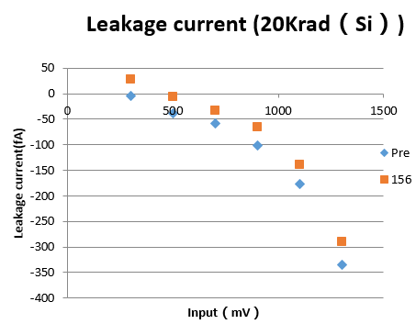
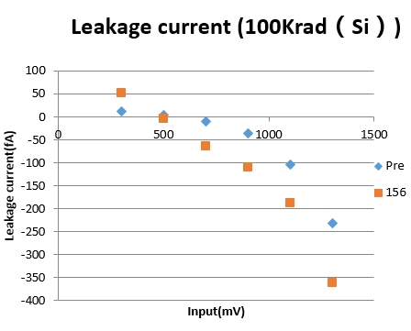
Test result
Static TID tests.
SCA part :
leakage current
Notes:
.
TID Test results of the SCA. The leakage current of sample 3 when sampling 1.3V dc voltage changed from 231fA to
361fA after irradiation. Other two samples haven’t seen such big increase of the leakage current. The largest increase of static noise was found in the sample 3 with an increase of 10%. Both the gain and the INL were stable, while the sampled voltage had a negative shift after irradiation, which is -10mV of sample 2 and nearly -20mV of sample 3 (Fig.4).

Slide 19
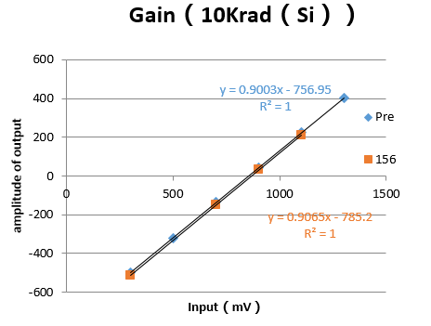
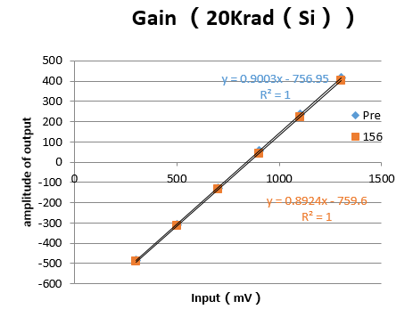
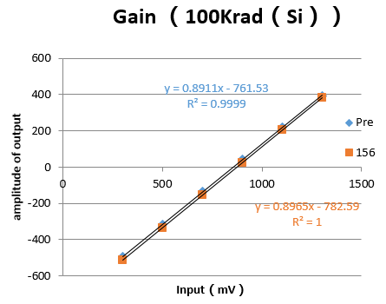
Test result
Static TID tests.
SCA part :
gain and INL
Notes:
.
TID Test results of the SCA. The leakage current of sample 3 when sampling 1.3V dc voltage changed from 231fA to
361fA after irradiation. Other two samples haven’t seen such big increase of the leakage current. The largest increase of static noise was found in the sample 3 with an increase of 10%. Both the gain and the INL were stable, while the sampled voltage had a negative shift after irradiation, which is -10mV of sample 2 and nearly -20mV of sample 3 (Fig.4).

Slide 20
Test result
Static TID tests.
SCA part :
noise
TID(rad(Si)/s) | Pre （mV） | 156H （mV） | change
10K | 3.86 | 3.17 | -26%
20K | 2.47 | 2.76 | 1%
100K | 5.39 | 5.62 | -7%
The SCA compared with analog front-end was even less sensitive towards static TID irradiation.
Notes:
.
TID Test results of the SCA. The leakage current of sample 3 when sampling 1.3V dc voltage changed from 231fA to
361fA after irradiation. Other two samples haven’t seen such big increase of the leakage current. The largest increase of static noise was found in the sample 3 with an increase of 10%. Both the gain and the INL were stable, while the sampled voltage had a negative shift after irradiation, which is -10mV of sample 2 and nearly -20mV of sample 3 (Fig.4).
（YQ01测5000个事例和10000个事例之间差了5%）

Slide 21
Test result
Dynamic TID tests.
power supply
analogue front-end:
offset voltage
TID(rad(Si)/s) | Pre （mA） | 96H nnealing（mA） | change
10K（YQ01） | 51 | 54 | 5.9%
10K（YQ02） | 54 | 57 | 5.5%
TID(rad(Si)/s) | Pre （mV） | 96H nnealing（mV） | Change
10K（YQ01） | 800 | 801.2 | 0.15%
10K（YQ02） | 780 | 781 | 0.12%
Notes:
The power supply voltage and bias voltages monitored had only changed slightly, which would be due to measurement error.
The offset voltages (regard as the baseline of the output waveform) of the three
samples after irradiation only changed slightly, within 0.3%.
gain which is more apparently at larger dose irradiation. After fitting those dots into a line, it was found out that the gain (slope of the fitted line) of the sample 3 increased from 16.2mV/fC to 16.4mV/fC after irradiation.
The test results of the rms of the three samples, which is regard as index of noise are listed in Table II.
TID Test results of the analogue front-end.
The offset voltages (regard as the baseline of the output waveform) of the three
samples after irradiation only changed slightly, within 0.3%.
Pulses of different amplitude were injected into Port 1, which were converted into charge by the capacitor of 1pF connecting in serial between the port and the input of the analogue front-end. The output amplitude of different samples with different injected charge are shown in Fig.3, there was an increase of the gain which is more apparently at larger dose irradiation. After fitting those dots into a line, it was found out that the gain (slope of the fitted line) of the sample 3 increased from 16.2mV/fC to 16.4mV/fC after irradiation. The test results of the rms of the three samples, which is regard as index of noise are listed in Table II. It is reasonable to draw the conclusion that the performance of analogue front-end was not affected much after irradiation.
TID Test results of the SCA. The leakage current of sample 3 when sampling 1.3V dc voltage changed from 231fA to
361fA after irradiation. Other two samples haven’t seen such big increase of the leakage current. The largest increase of static noise was found in the sample 3 with an increase of 10%. Both the gain and the INL were stable, while the sampled voltage had a negative shift after irradiation, which is -10mV of sample 2 and nearly -20mV of sample 3 (Fig.4).

Slide 22
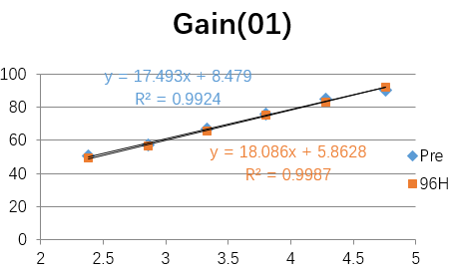
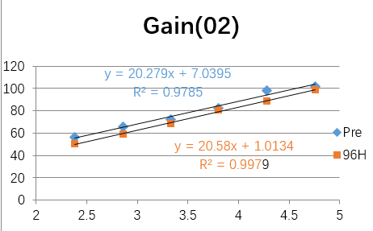
Test result
Dynamic TID tests.
analogue front-end:
gain and INL
Notes:
The power supply voltage and bias voltages monitored had only changed slightly, which would be due to measurement error.
The offset voltages (regard as the baseline of the output waveform) of the three
samples after irradiation only changed slightly, within 0.3%.
gain which is more apparently at larger dose irradiation. After fitting those dots into a line, it was found out that the gain (slope of the fitted line) of the sample 3 increased from 16.2mV/fC to 16.4mV/fC after irradiation.
The test results of the rms of the three samples, which is regard as index of noise are listed in Table II.
TID Test results of the analogue front-end.
The offset voltages (regard as the baseline of the output waveform) of the three
samples after irradiation only changed slightly, within 0.3%.
Pulses of different amplitude were injected into Port 1, which were converted into charge by the capacitor of 1pF connecting in serial between the port and the input of the analogue front-end. The output amplitude of different samples with different injected charge are shown in Fig.3, there was an increase of the gain which is more apparently at larger dose irradiation. After fitting those dots into a line, it was found out that the gain (slope of the fitted line) of the sample 3 increased from 16.2mV/fC to 16.4mV/fC after irradiation. The test results of the rms of the three samples, which is regard as index of noise are listed in Table II. It is reasonable to draw the conclusion that the performance of analogue front-end was not affected much after irradiation.
TID Test results of the SCA. The leakage current of sample 3 when sampling 1.3V dc voltage changed from 231fA to
361fA after irradiation. Other two samples haven’t seen such big increase of the leakage current. The largest increase of static noise was found in the sample 3 with an increase of 10%. Both the gain and the INL were stable, while the sampled voltage had a negative shift after irradiation, which is -10mV of sample 2 and nearly -20mV of sample 3 (Fig.4).

Slide 23
Test result
Dynamic TID tests.
analogue front-end:
noise(ENC)
TID(rad(Si)/s) | Pre（e） | 96H （e） | Change
10K（YQ01） | 2144.1 | 1900.6 | -11%
10K（YQ02） | 2465.6 | 1931.4 | -21%
The analogue front-end had better performance during dynamic TID test compared static TID test.
Notes:
The power supply voltage and bias voltages monitored had only changed slightly, which would be due to measurement error.
The offset voltages (regard as the baseline of the output waveform) of the three
samples after irradiation only changed slightly, within 0.3%.
gain which is more apparently at larger dose irradiation. After fitting those dots into a line, it was found out that the gain (slope of the fitted line) of the sample 3 increased from 16.2mV/fC to 16.4mV/fC after irradiation.
The test results of the rms of the three samples, which is regard as index of noise are listed in Table II.
TID Test results of the analogue front-end.
The offset voltages (regard as the baseline of the output waveform) of the three
samples after irradiation only changed slightly, within 0.3%.
Pulses of different amplitude were injected into Port 1, which were converted into charge by the capacitor of 1pF connecting in serial between the port and the input of the analogue front-end. The output amplitude of different samples with different injected charge are shown in Fig.3, there was an increase of the gain which is more apparently at larger dose irradiation. After fitting those dots into a line, it was found out that the gain (slope of the fitted line) of the sample 3 increased from 16.2mV/fC to 16.4mV/fC after irradiation. The test results of the rms of the three samples, which is regard as index of noise are listed in Table II. It is reasonable to draw the conclusion that the performance of analogue front-end was not affected much after irradiation.
TID Test results of the SCA. The leakage current of sample 3 when sampling 1.3V dc voltage changed from 231fA to
361fA after irradiation. Other two samples haven’t seen such big increase of the leakage current. The largest increase of static noise was found in the sample 3 with an increase of 10%. Both the gain and the INL were stable, while the sampled voltage had a negative shift after irradiation, which is -10mV of sample 2 and nearly -20mV of sample 3 (Fig.4).

Slide 24
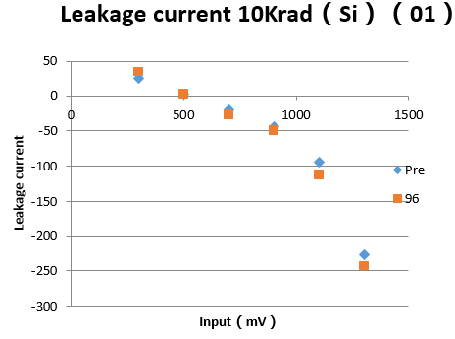
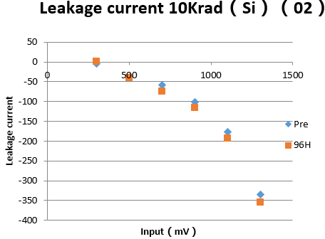
Test result
Dynamic TID tests.
SCA part :
leakage current
Notes:
.
TID Test results of the SCA. The leakage current of sample 3 when sampling 1.3V dc voltage changed from 231fA to
361fA after irradiation. Other two samples haven’t seen such big increase of the leakage current. The largest increase of static noise was found in the sample 3 with an increase of 10%. Both the gain and the INL were stable, while the sampled voltage had a negative shift after irradiation, which is -10mV of sample 2 and nearly -20mV of sample 3 (Fig.4).

Slide 25
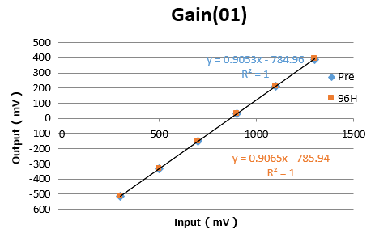
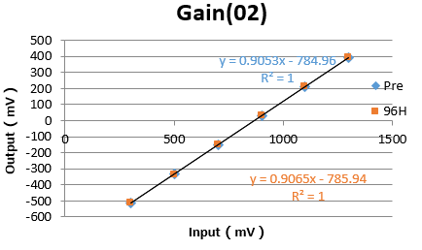
Test result
Dynamic TID tests.
SCA part :
gain and INL
Notes:
.
TID Test results of the SCA. The leakage current of sample 3 when sampling 1.3V dc voltage changed from 231fA to
361fA after irradiation. Other two samples haven’t seen such big increase of the leakage current. The largest increase of static noise was found in the sample 3 with an increase of 10%. Both the gain and the INL were stable, while the sampled voltage had a negative shift after irradiation, which is -10mV of sample 2 and nearly -20mV of sample 3 (Fig.4).

Slide 26
Test result
Dynamic TID tests.
SCA part :
noise
TID(rad(Si)/s) | Pre （mV） | 96H （mV） | change
10K | 3.59 | 2.36 | -34%
10K | 2.74 | 2.43 | -11%
The SCA had good performance against 10Krad（Si）dynamic TID .
Notes:
.
TID Test results of the SCA. The leakage current of sample 3 when sampling 1.3V dc voltage changed from 231fA to
361fA after irradiation. Other two samples haven’t seen such big increase of the leakage current. The largest increase of static noise was found in the sample 3 with an increase of 10%. Both the gain and the INL were stable, while the sampled voltage had a negative shift after irradiation, which is -10mV of sample 2 and nearly -20mV of sample 3 (Fig.4).

Slide 27
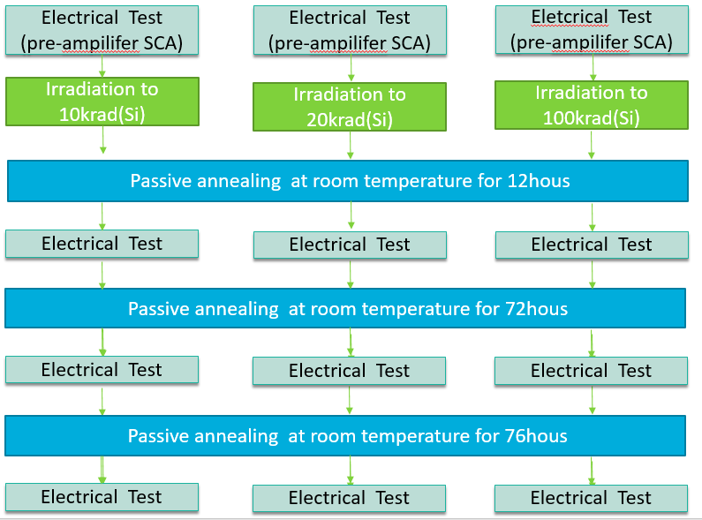
Test result
Annealing time tests.
During the static TID test, electrical tests were token at different annealing time.
Notes:
During irradiation the ASIC was powered and its supply current was monitored. Three samples (1 to 3) were
irradiated by 200MeV protons with a dose rate of 10rad (Si)/s to the dose of 10Krad (Si), 20Krad (Si) and 100Krad (Si) respectively. The samples were stored at room temperature and without power supply after irradiation. Electrical tests were token before and after irradiation, of which comparisons were made to check how it was affected by different irradiation dose. The electrical tests including tests of analogue front-end as well as SCA part, and details can be found in Table I, which shows the parameters compared as index
The ASIC have been irradiated at Paul Scherer Institute (PSI) with protons for static TID and dynamic TID test. During the static TID tests, the ASIC was only powered. Three samples (S1~S3) were irradiated by 200MeV protons with a dose rate of 10rad (Si)/s to the dose of 10Krad (Si), 20Krad (Si) and 100Krad (Si) respectively. In the dynamic TID test, the ASIC was powered as well as triggered, working in normal sampling and reading out under self-trigger mode. Two samples were irradiated by 62.8MeV protons with a dose rate of 8rad (Si)/s to the total dose of 10Krad (Si). All the ASICs were irradiated with a regular 1.8V core voltage and 3.3V IO voltage at room temperature. After irradiation the samples were stored at room temperature without power supply. The electrical tests including tests of analogue front-end as well as SCA part, such as offset voltage, noise, gain of analogue front-end and leakage current, gain, noise for SCA were token both before and after radiation to compare how they were affected by the radiation.

Slide 28
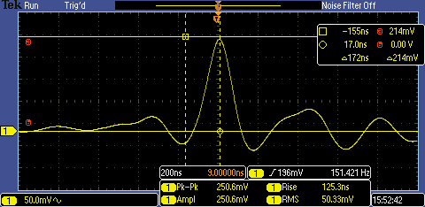
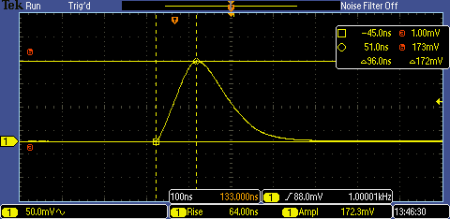
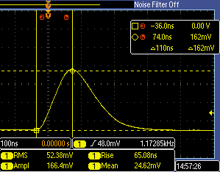
Radiation test
Annealing time tests.
During the static TID test, electrical tests were token at different annealing time.
Output waveform of 100mV input after 15h, 85h, 156h annealing
With the increase of annealing time, the ASIC performs better.
When used at high flux environment， more care should be taken about CASCA.
Notes:
在高剂量率应用中还需考虑总剂量效应

Slide 29
Content
Introduction
Radiation test
Test results
Summary and future plan

Slide 30
Summary and future plan
The TID Radiation test results of a commercial ASIC CASCA been given.
Its performance against TID has been successfully verified, which has good performance with 10Krad(Si) dose, and survived even with 100Krad(Si).
SCA seems to be less sensitive than the analogue front-end.
The dynamic TID seems to be less harmful than the static one.

Slide 31
Summary and future plan
The mechanism of these TID effect will be analyzed and studied in the future.
The SEE Radiation test results of the CASCA will be performed in the future.

Slide 32
Thank You!

Slide 33
Radiation test
TID test.
Electrical Test
(pre-ampilifer SCA)
Electrical Test
(pre-ampilifer SCA)
Eletcrical Test
(pre-ampilifer SCA)
Irradiation to 10krad(Si)
Irradiation to 20krad(Si)
Irradiation to 100krad(Si)
Passive annealing at room temperature for 12hous
Electrical Test
Electrical Test
Electrical Test
Passive annealing at room temperature for 72hous
Electrical Test
Electrical Test
Electrical Test
Passive annealing at room temperature for 76hous
……
Electrical Test
Electrical Test
Electrical Test
Notes:
During irradiation the ASIC was powered and its supply current was monitored. Three samples (1 to 3) were
irradiated by 200MeV protons with a dose rate of 10rad (Si)/s to the dose of 10Krad (Si), 20Krad (Si) and 100Krad (Si) respectively. The samples were stored at room temperature and without power supply after irradiation. Electrical tests were token before and after irradiation, of which comparisons were made to check how it was affected by different irradiation dose. The electrical tests including tests of analogue front-end as well as SCA part, and details can be found in Table I, which shows the parameters compared as index
The ASIC have been irradiated at Paul Scherer Institute (PSI) with protons for static TID and dynamic TID test. During the static TID tests, the ASIC was only powered. Three samples (S1~S3) were irradiated by 200MeV protons with a dose rate of 10rad (Si)/s to the dose of 10Krad (Si), 20Krad (Si) and 100Krad (Si) respectively. In the dynamic TID test, the ASIC was powered as well as triggered, working in normal sampling and reading out under self-trigger mode. Two samples were irradiated by 62.8MeV protons with a dose rate of 8rad (Si)/s to the total dose of 10Krad (Si). All the ASICs were irradiated with a regular 1.8V core voltage and 3.3V IO voltage at room temperature. After irradiation the samples were stored at room temperature without power supply. The electrical tests including tests of analogue front-end as well as SCA part, such as offset voltage, noise, gain of analogue front-end and leakage current, gain, noise for SCA were token both before and after radiation to compare how they were affected by the radiation.

Slide 34
Radiation test
TID test.
Electrical Test
Irradiation
Electrical Test
(pre-ampilifer SCA)
Eletcrical Test
(pre-ampilifer SCA)
Annealing at room temperature
Irradiation to 10krad(Si)
Irradiation to 10krad(Si)
Passive annealing at room temperature for 96hous
Electrical Test
Electrical Test
Electrical Test
Notes:
During irradiation the ASIC was powered and its supply current was monitored. Three samples (1 to 3) were
irradiated by 200MeV protons with a dose rate of 10rad (Si)/s to the dose of 10Krad (Si), 20Krad (Si) and 100Krad (Si) respectively. The samples were stored at room temperature and without power supply after irradiation. Electrical tests were token before and after irradiation, of which comparisons were made to check how it was affected by different irradiation dose. The electrical tests including tests of analogue front-end as well as SCA part, and details can be found in Table I, which shows the parameters compared as index
The ASIC have been irradiated at Paul Scherer Institute (PSI) with protons for static TID and dynamic TID test. During the static TID tests, the ASIC was only powered. Three samples (S1~S3) were irradiated by 200MeV protons with a dose rate of 10rad (Si)/s to the dose of 10Krad (Si), 20Krad (Si) and 100Krad (Si) respectively. In the dynamic TID test, the ASIC was powered as well as triggered, working in normal sampling and reading out under self-trigger mode. Two samples were irradiated by 62.8MeV protons with a dose rate of 8rad (Si)/s to the total dose of 10Krad (Si). All the ASICs were irradiated with a regular 1.8V core voltage and 3.3V IO voltage at room temperature. After irradiation the samples were stored at room temperature without power supply. The electrical tests including tests of analogue front-end as well as SCA part, such as offset voltage, noise, gain of analogue front-end and leakage current, gain, noise for SCA were token both before and after radiation to compare how they were affected by the radiation.

Slide 35
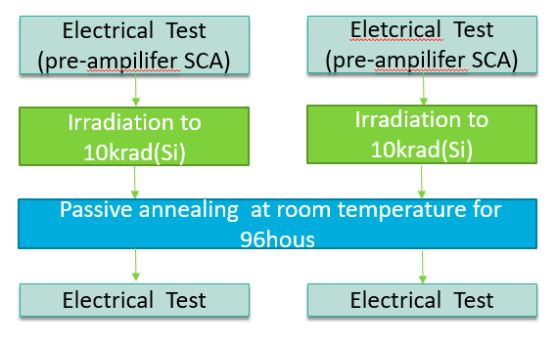
Radiation test
Dynamic TID tests.
The ASIC was powered and triggered，working in self-trigger mode. Two samples (D1，D2) were irradiated by 62.8MeV protons with a dose rate of 8rad (Si)/s to the dose of 10Krad (Si).
Notes:
During irradiation the ASIC was powered and its supply current was monitored. Three samples (1 to 3) were
irradiated by 200MeV protons with a dose rate of 10rad (Si)/s to the dose of 10Krad (Si), 20Krad (Si) and 100Krad (Si) respectively. The samples were stored at room temperature and without power supply after irradiation. Electrical tests were token before and after irradiation, of which comparisons were made to check how it was affected by different irradiation dose. The electrical tests including tests of analogue front-end as well as SCA part, and details can be found in Table I, which shows the parameters compared as index
The ASIC have been irradiated at Paul Scherer Institute (PSI) with protons for static TID and dynamic TID test. During the static TID tests, the ASIC was only powered. Three samples (S1~S3) were irradiated by 200MeV protons with a dose rate of 10rad (Si)/s to the dose of 10Krad (Si), 20Krad (Si) and 100Krad (Si) respectively. In the dynamic TID test, the ASIC was powered as well as triggered, working in normal sampling and reading out under self-trigger mode. Two samples were irradiated by 62.8MeV protons with a dose rate of 8rad (Si)/s to the total dose of 10Krad (Si). All the ASICs were irradiated with a regular 1.8V core voltage and 3.3V IO voltage at room temperature. After irradiation the samples were stored at room temperature without power supply. The electrical tests including tests of analogue front-end as well as SCA part, such as offset voltage, noise, gain of analogue front-end and leakage current, gain, noise for SCA were token both before and after radiation to compare how they were affected by the radiation.

