Slide 1
ATLAS ITk Strip Module Production
Xin SHI
On behalf of the IHEP/THU ATLAS ITk Group
23 December 2017

Slide 2

The Large Hadron Collider at CERN
CMS
27 km
LHCb
ATLAS
ALICE
.
2
Notes:
This presentation is prepared by Helfried Burckhart, based on the presentation from Doris Chromek-Burckhart for the CERN Open Day on 6. April 2008, with contributions from Hans-Peter Beck, Michael Hauschild, Peter Jenni, Steven Goldfarb
V1, 23/02/2009
V2, 08/02/2012

Slide 3
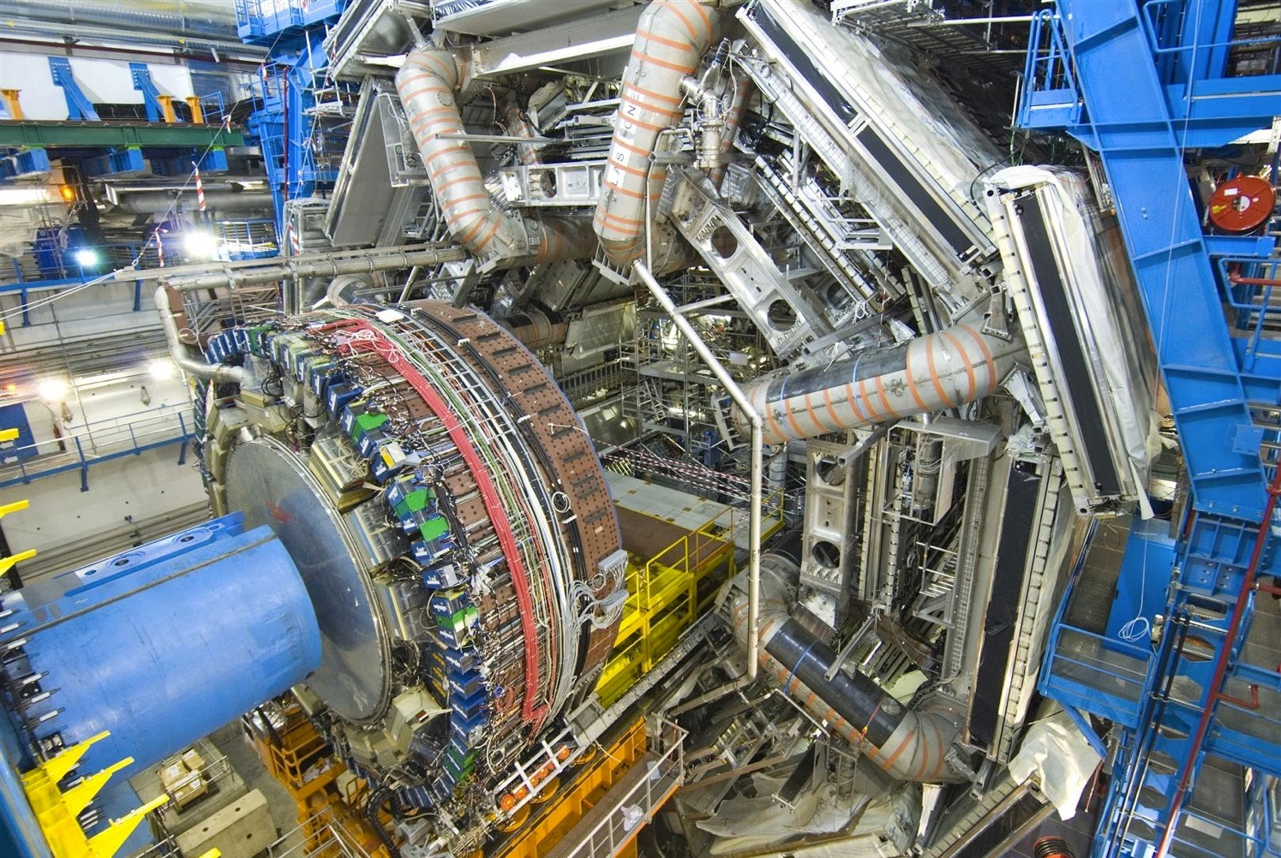
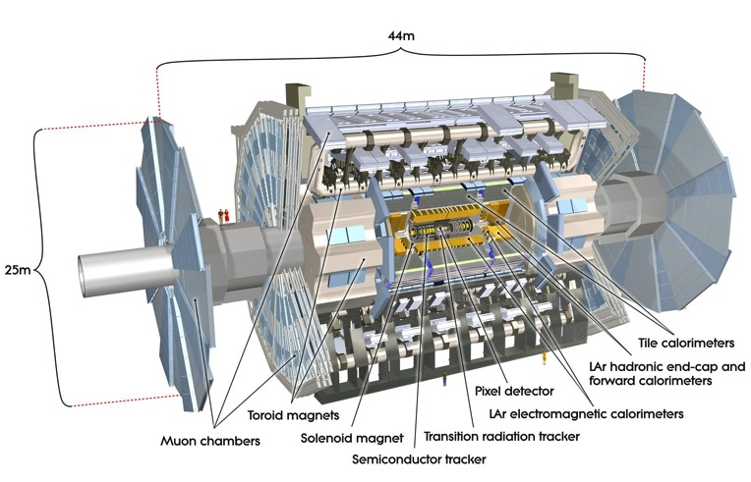
LHC Point 1: The ATLAS Experiment
The ATLAS Collaboration
3000 Members
177 Institutes
38 Countries

Slide 4
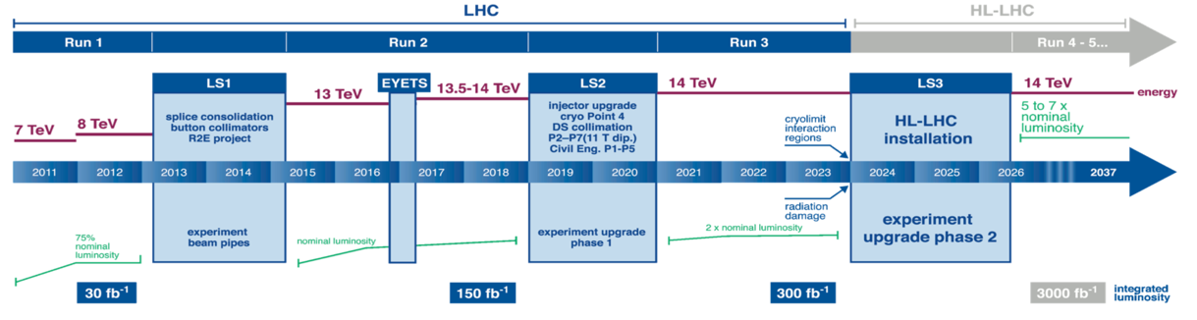
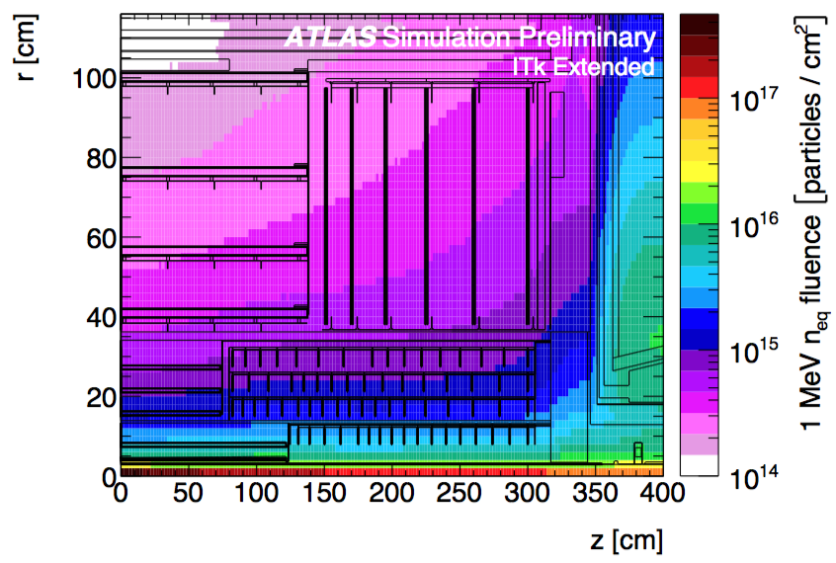
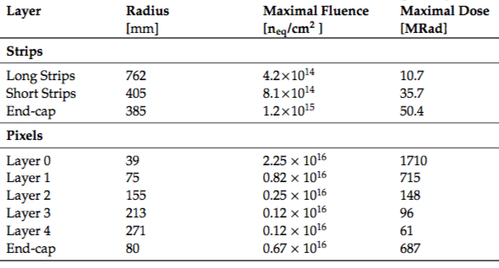
ATLAS ITk Upgrade
ATLAS Detector upgrade for the LHC high luminosity upgrade, all silicon tracking device
Strip
Pixel

Slide 5
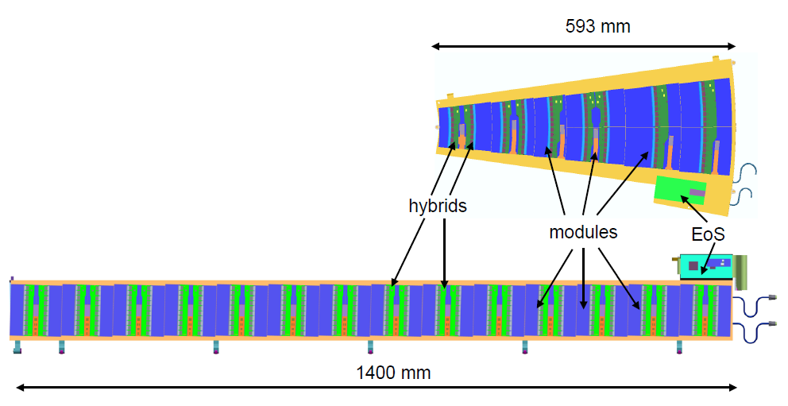
ITk Silicon Strip Detector Concept
Stave/Petal + Mechanics Supported Silicon Modules

Slide 6
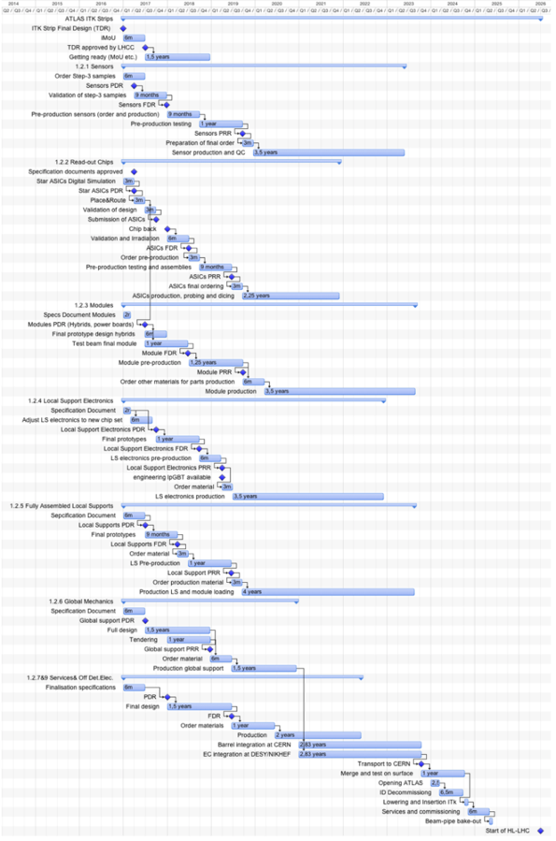
ITk Upgrade Project Timeline
2017: ITk-STRIP TDR
Mid-2018: Pre-Production
2019: Production Readiness Reviews
2024: Detector Install

Slide 7

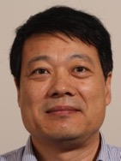


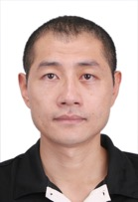

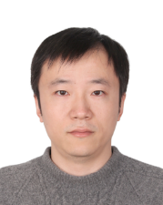
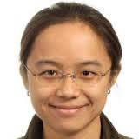
The Team
8 Staff Members (7 IHEP + 1 THU)
Xinchou Lou
Joao da Costa
Hongbo Zhu
Weiguo Lu
Xin Shi
Zhijun Liang
Yiming Li
Xin Chen

Slide 8
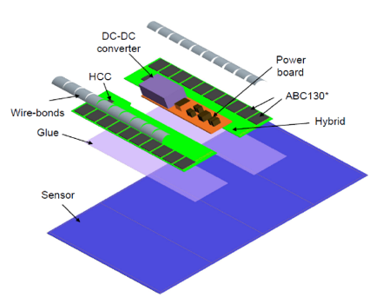
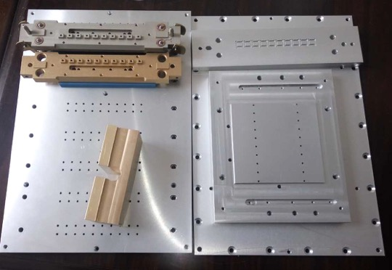
  Assembly and tests of barrel modules
Produce 50 working modules during pre-production
Tooling for module handling
ABC130*
Hybrid
Sensor
Power board
Hybrid Control
Module

Slide 9
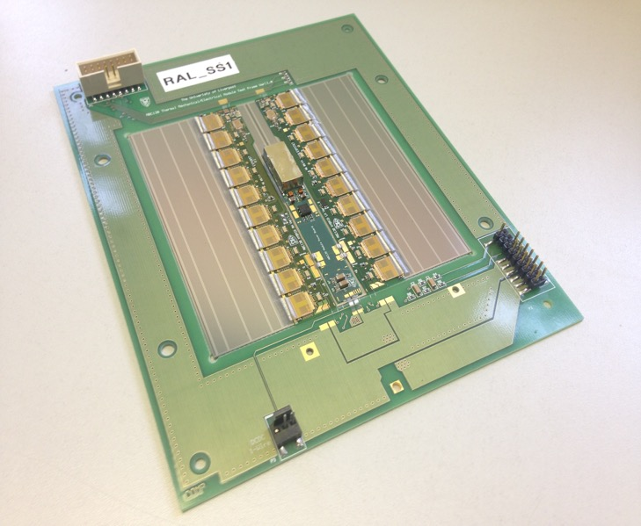
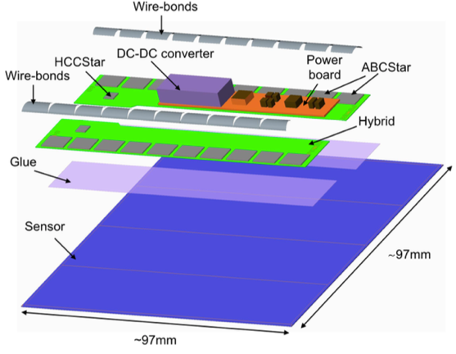
Silicon Strip Detector Module
Silicon Sensor + Hybrid PCB (with Readout ASICs and control chips) + Power board + Glue and Wire-bonds

Slide 10
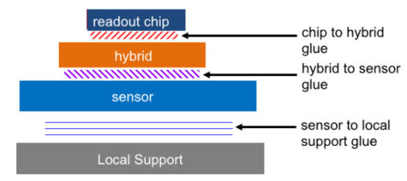
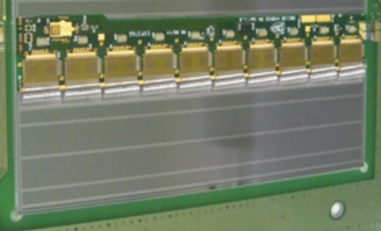
Quality Control
Based on the prototype study, along with the current ATLAS SCT detector experience, improve the quality control (QC) of module production process
Control board QC
Reception and visual inspection of components
Hybrid Metrology
ASIC Attachment
Hybrid Metrology
Thermal Tests
Electrical Confirmation Tests
Wire-bonding
Detector Module QC
Reception and visual inspection of components
Hybrid Electrical Confirmation Tests
Hybrid Attachment
Module Metrology
Thermal Tests
Module I-V Tests
Module Electrical Confirmation Tests
Wire-bonding

Slide 11
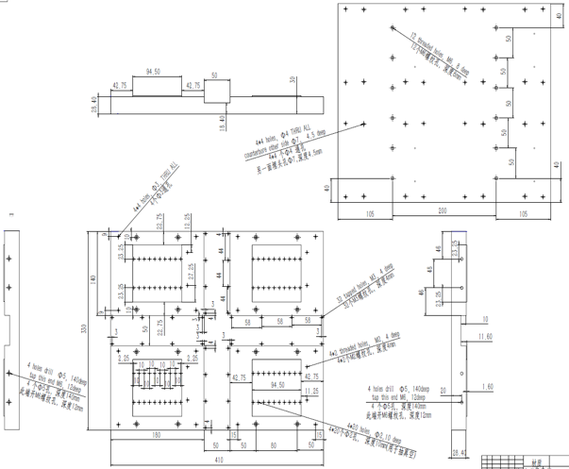
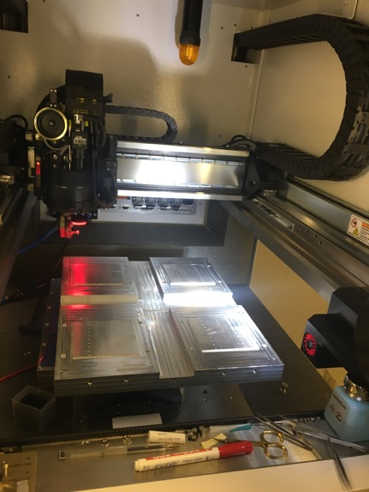
Module QC Task: Evaluate max no. of modules in a bonder – by IHEP
Design and fabricated at IHEP， Polished at RAL
Placed under BondJet820: dimensions fit, bonding head can reach to the four corners.
Next: to evaluate with modules on jig
Production: Fang Chen
Drawing: Yuzhen Yang

Slide 12
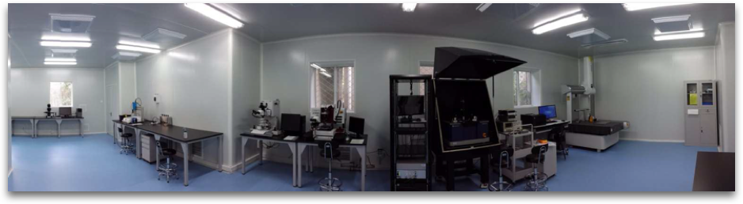
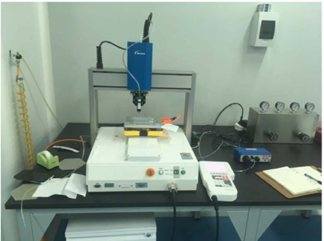
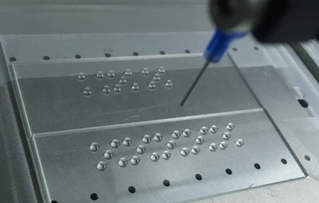
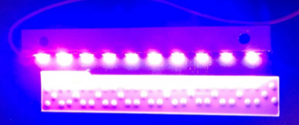
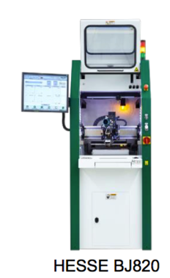
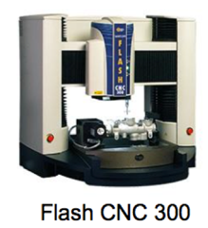
IHEP Lab for ITk Upgrade
An existing class 1000 Cleanroom with 150m²
OGP Flash CNC 300 already purchased
Hesse BondJet820 received

Slide 13
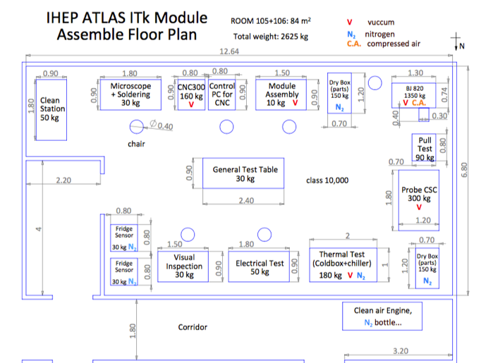
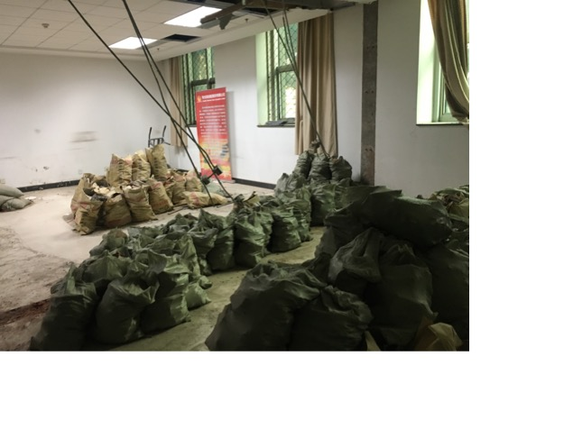
Cleanroom for mass production
A new cleanroom is proposed for the strip production
Yuzhen Yang
Reinforcement of the floor has been completed

Slide 14
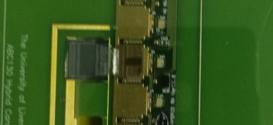
Radiation-hard ASICs Import Issue
Rad-hard ASICs under export control → obstacle for our direct involvement in some high-tech detector projects
Main driving factors: China’s deeper involvements in detector operation , software development, and physics analyses, and continuous investment into various detector upgrade projects (Phase 0/I/II) → increased contributions, higher visibility (across all LHC experiments!)
Discussion over years and official requests to the ATLAS upgrade management, which were escalated to the CERN management → started coordinating between ATLAS/CMS experiments and obtained export license from US DoC
  Overall package (valid for process and ATLAS/CMS projects), valid for seven years
  Much less difficult to apply for SECO (Swiss export license)
Received the first ABC130 (strip readout ASIC) which allows setting up the local module test system
ABC130
Milestone of the project

Slide 15
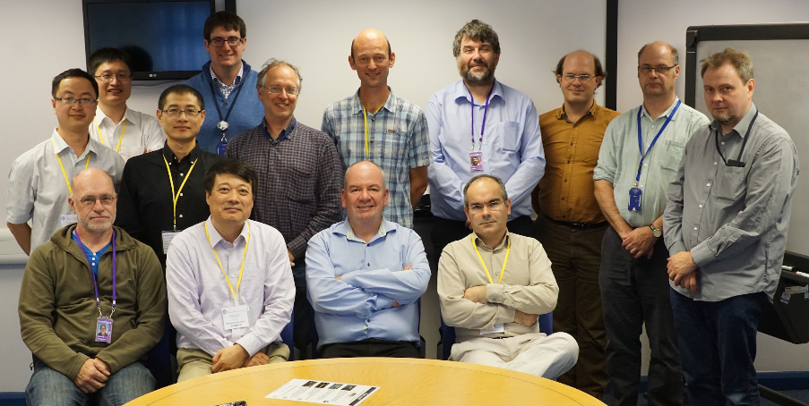
Collaboration with RAL
RAL in UK is the leading institution on ATLAS ITk upgrade.
MoU to be signed with RAL
Staff rotation plan to maintain 2 FTE’s at RAL for the coming years.
Invited RAL collaborators to China.
  Giulio Villani visited IHEP in Dec 2017
  Craig Sawyer will visit IHEP in Jan 2018
IHEP Team visited RAL on September 19, 2016

Slide 16
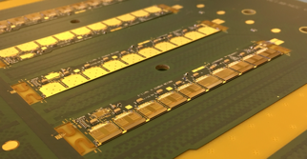
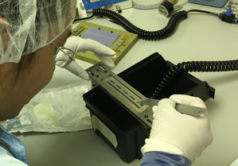
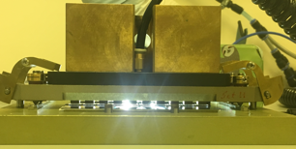
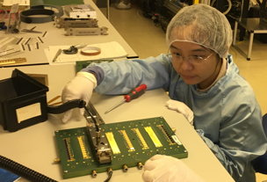
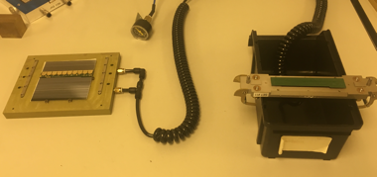
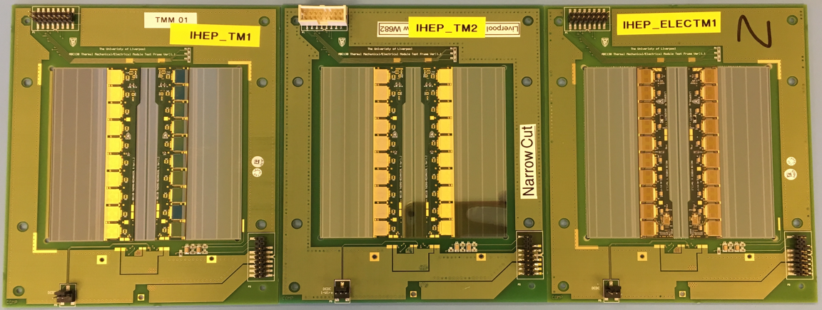
Module Production at RAL
Glued three modules (two thermal mechanical and one electrical)
Passed electrical test after wire bonding.

Slide 17
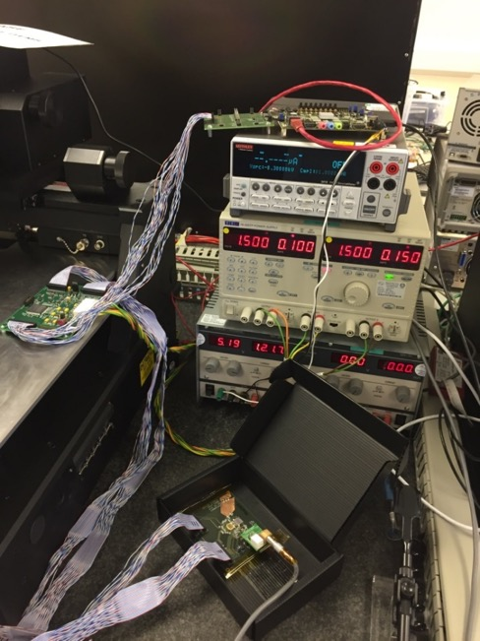
Sensor Electrical test at RAL
ATLAS 07 Mini Sensor + ABC130 , Learn basic silicon strip sensor test, measure I-V and Equivalent Input Noise
偏置电压 | -10 V | -100 V | -300 V
Sensor + ASIC | 597.9e | 565.9e | 563.5e
ASIC | 450.5e | 449.5e | 448.4e

Slide 18
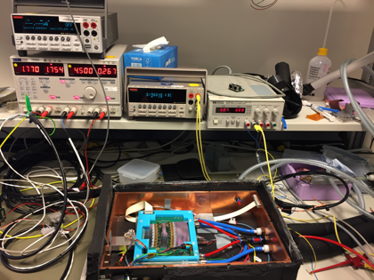
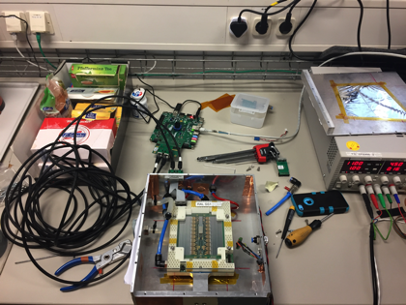
Participation of Module Testbeam at DESY
ATLAS R0 module and SS module test at E-lab in DESY May 2017
Xiaocong Ai, Liejian Chen and Yi Liu

Slide 19
Summary
The HL-LHC upgrade requires ATLAS ITk upgrade to meet the challenge
IHEP/THU ATLAS ITk team is making steady progress on barrel module assembly and tests
More experience will be brought back to China

