Slide 1
Search for single production of T in tZ with 2016 data
Yu Taozhe & Aniello Spiezia & Liao Hongbo
CIHEP, Nanjing 2017.12.22

Slide 2
Introduction
Discovery of Higgs boson motivates search for new physics
Possible extensions given by: little Higgs models, extra dimensions models, composite Higgs models
These theories predict existence of heavy vector-like quarks (VLQ)
Vector-like quarks are hypothetical new spin-1/2 particles: left and right handed chiralities transform in the same way under the standard model symmetry group

Slide 3
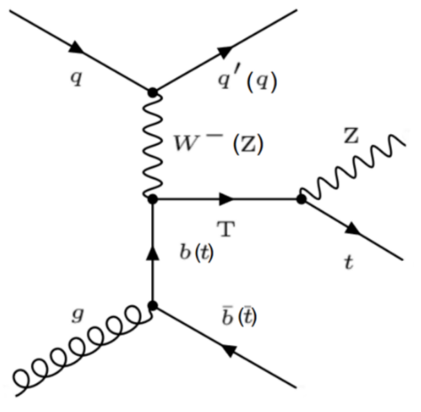
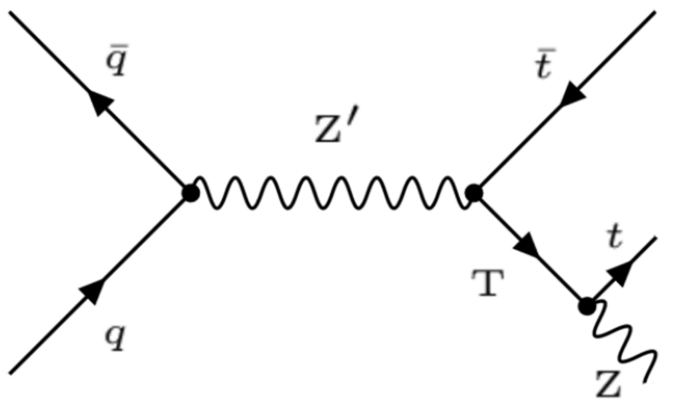
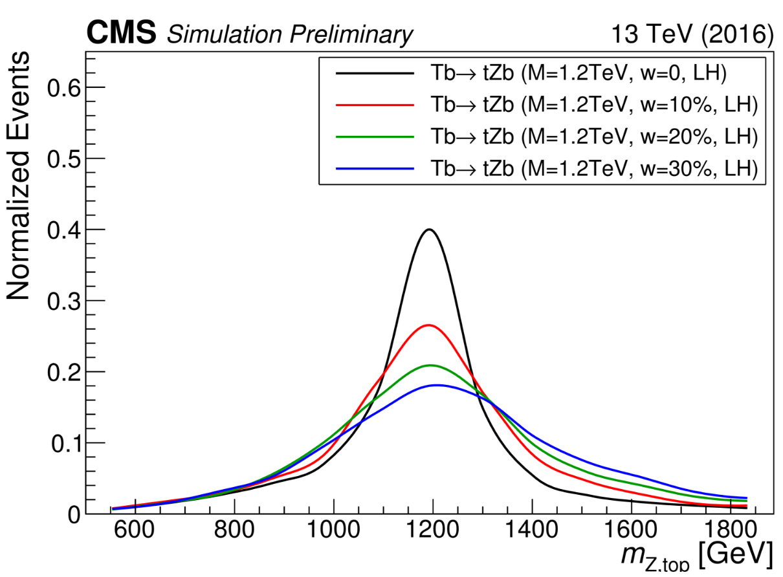
Introduction
T VLQ with a charge of +2/3 has three different decay channels into SM particles: bW, tZ, and tH
We search for a T quark decays to a Z boson and a top quark, and Z decay to two leptons and t→bW→bqq'.
T quark width hypotheses are studied:negligible, 10%, 20% and 30% of the T mass

Slide 4
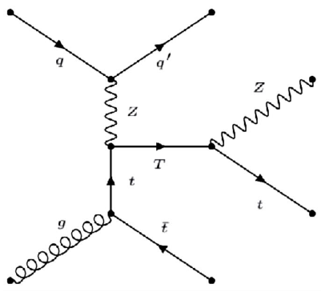
signal Characterization
coupling coefficients C(bW) for the T(b) process
branching fractions 0.5, 0.25, and 0.25 correspanding to three decay channels bW, tZ, and tH
T is singlet
the RH chirality is suppressed
T quark can have both left-handed (LH) and right-handed (RH) couplings to SM particles
branching fractions 0.5 correspanding to two decay channels
tZ and tH
the LH chirality is suppressed
T is doublelet
coupling coefficients C(tZ) for the T(t) process

Slide 5
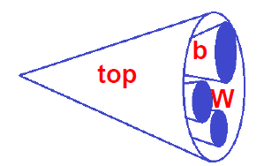
Experimental techniques
Boosted topologies: resonance with high mass (~TeV) → decay products are produced close to each other
Definition of useful variables: mass of the jet/subjets, N-subjetness, mass drop, subjet b-tagging
W-jet ,b-jet and top-jet reconstruction algorithms are defined using these techniques and variables:
W-tagging
  pruned jet mass
  within 65-105GeV
  τ₂₁ = τ₂ / τ₁ lower than 0.6
  P_{t} > 180GeV
  |η| < 2.4
B-tagging
  P_{t} > 20GeV
  |η| < 2.4
  CSVv2 > 0.8484/0.5426
Top-tagging
  soft drop mass
  between 105-220GeV
  τ₃₂ = τ₃ / τ₂ lower than 0.6
  P_{t} > 400GeV
  |η| < 2.4

Slide 6
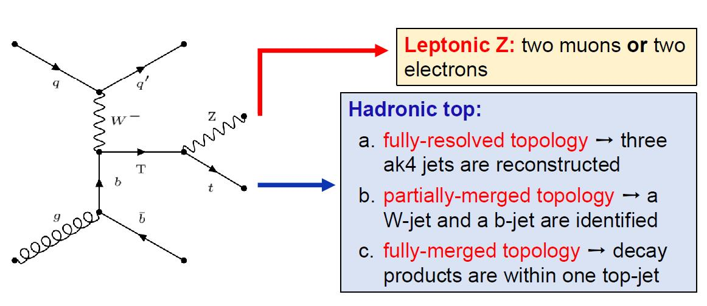
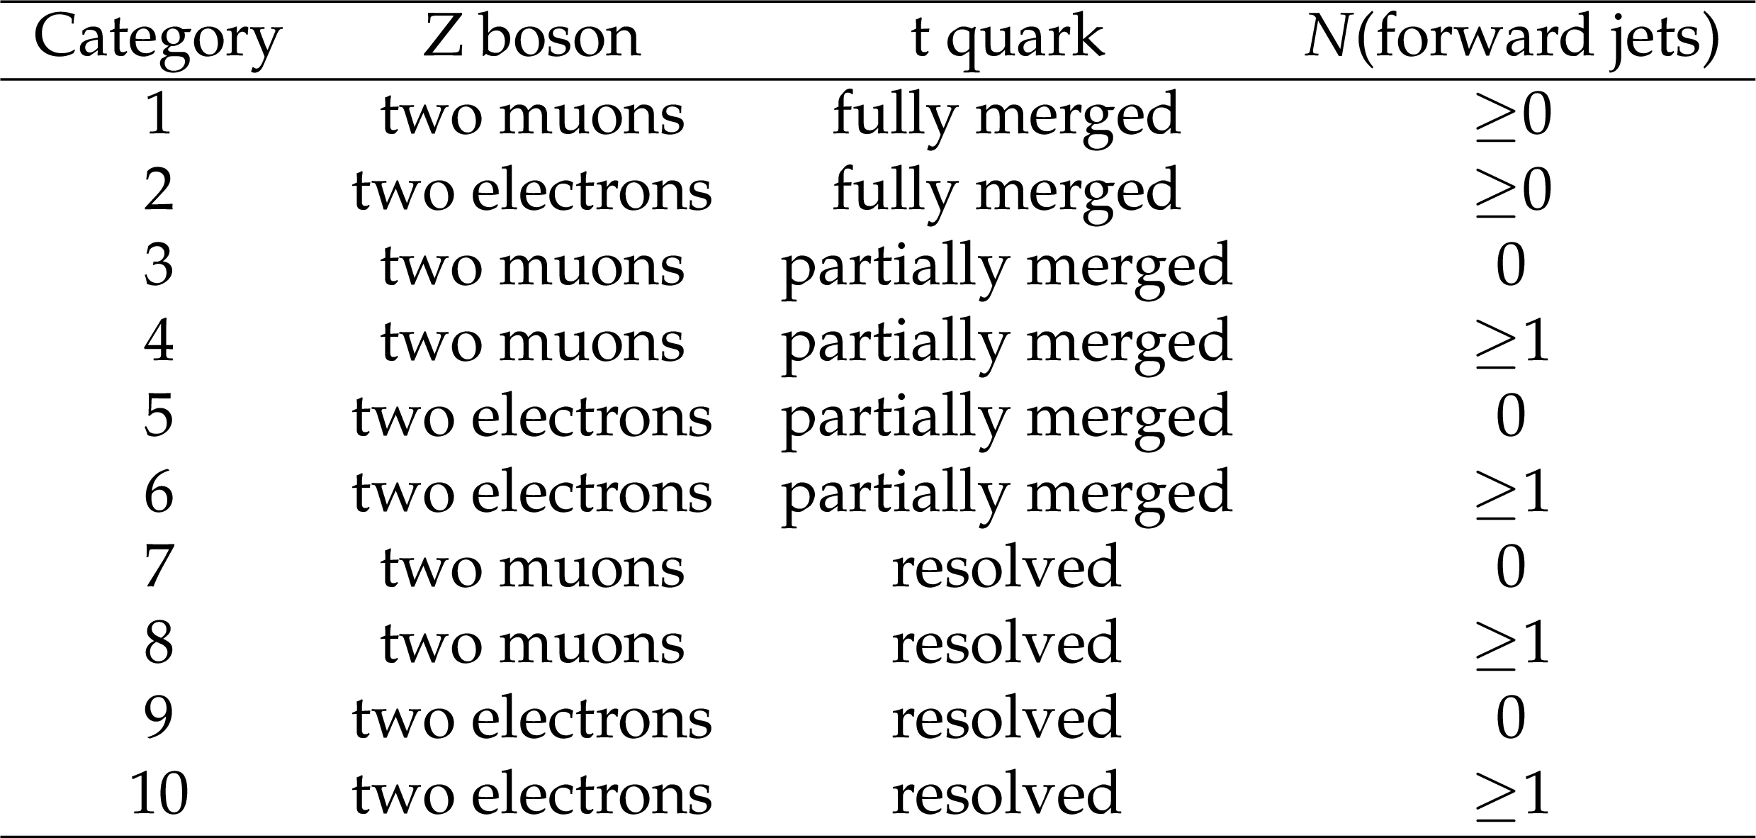
Analysis strategy
We look for a bump in the reconstructed (Z,top) mass
10 categories are defined, depending on the Z decays / top reconstruction / presence of forward jets

Slide 7
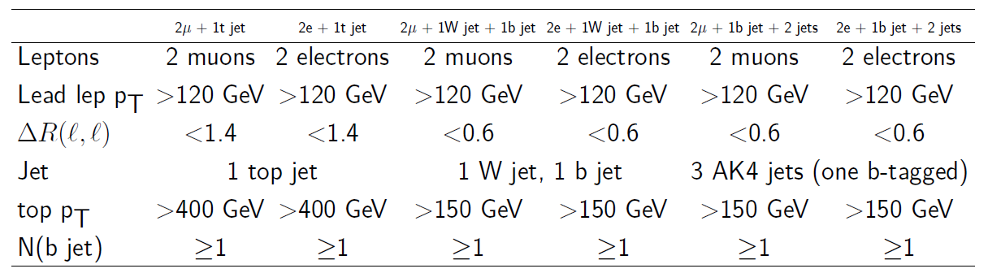
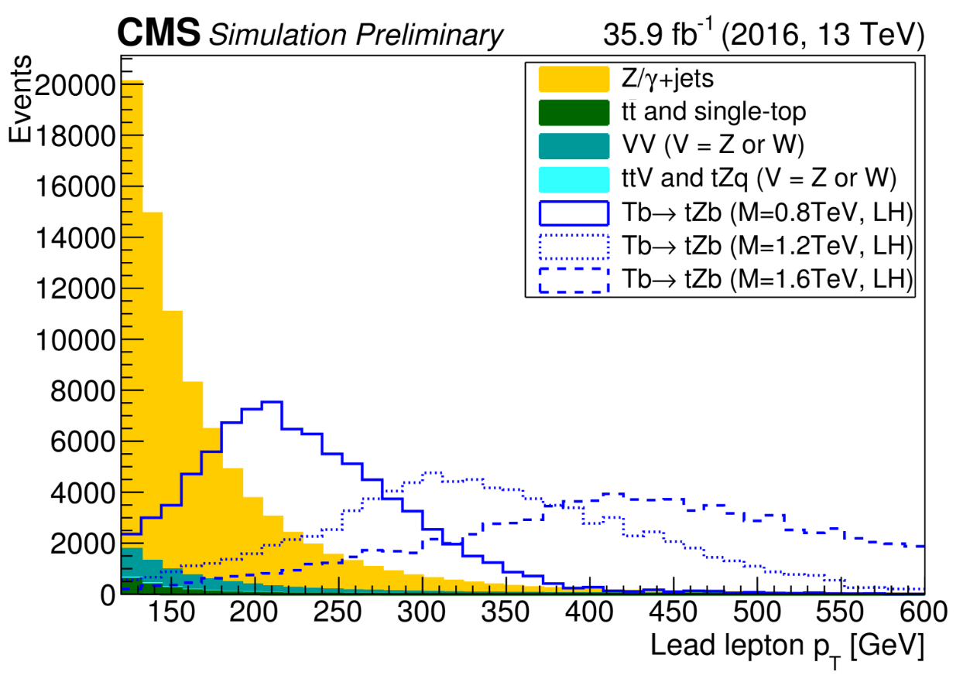
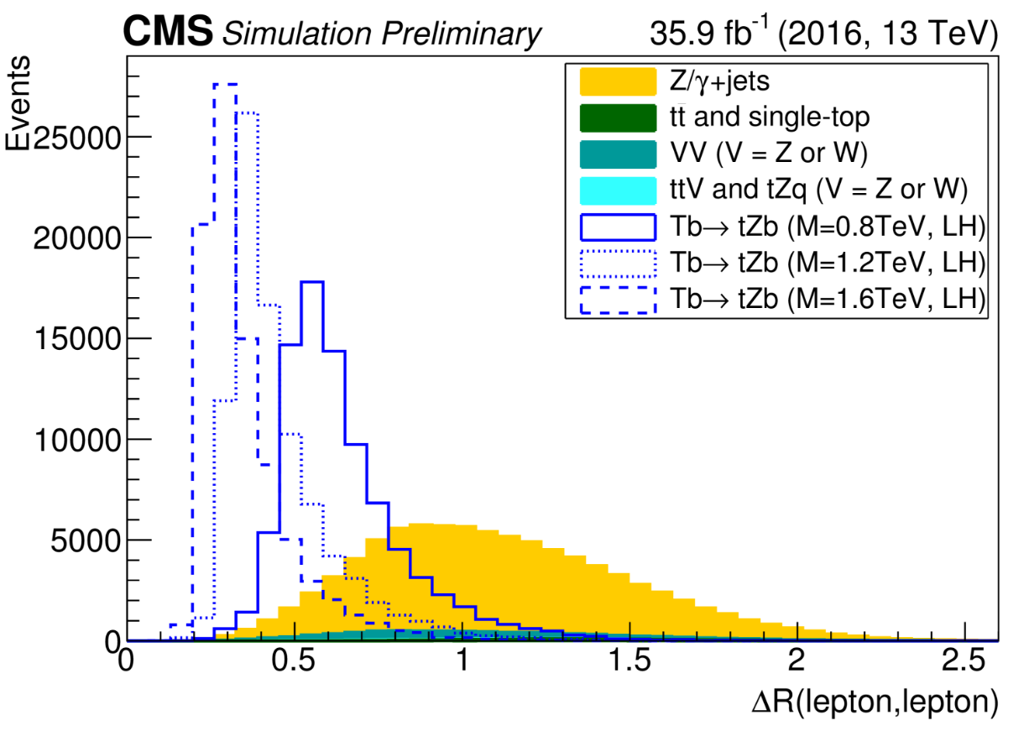
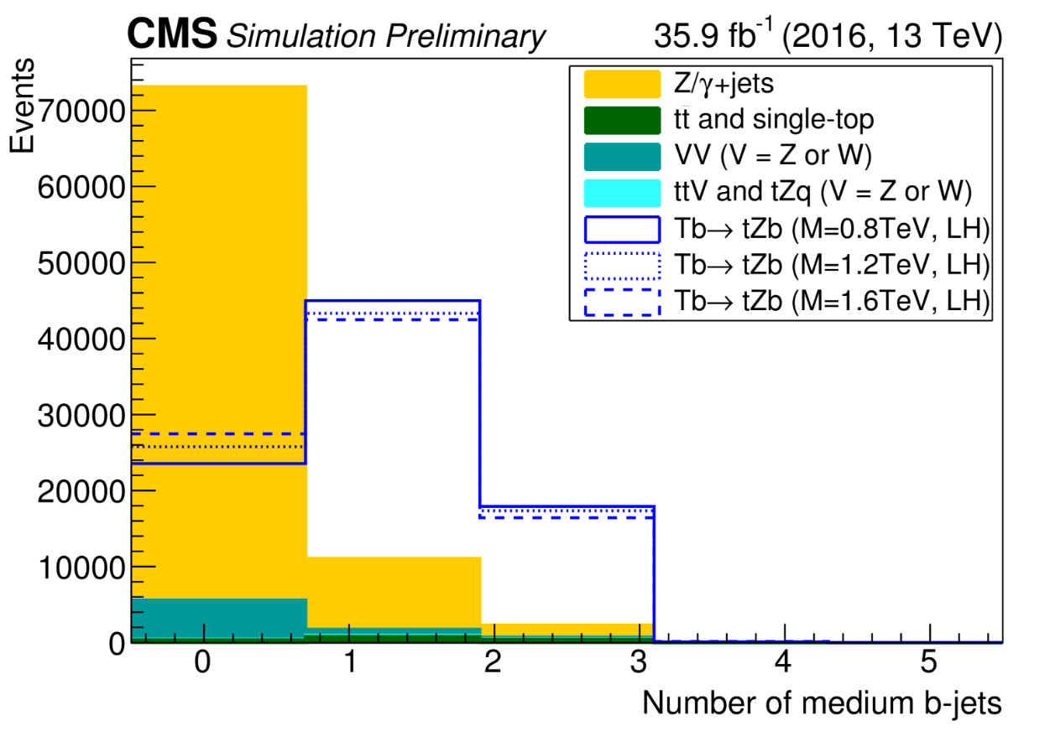
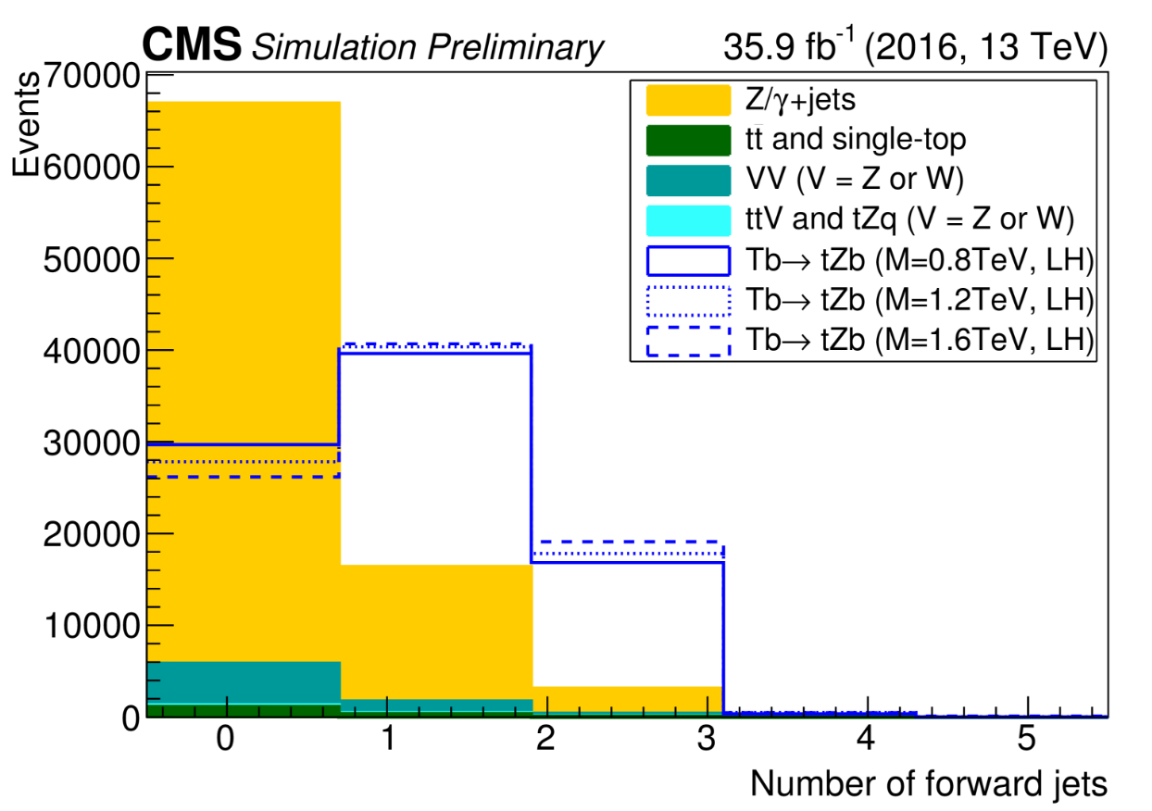
Evnet selection
The following variables have been investigated
  1.pt leading lepton
2.ΔR(lep1,lep2)
3.number of forward jets
4.number of loose/medium/tight b-jets

Slide 8
Background estimation method
In order to rely as little as possible on the MC, a predominantly data-driven prediction will be performed → α-ratio method
we define a signal-free region(sideband region) that is given by events with zero b-jets and the signal region is defined inverted
we evaluated the signal region's background with the fellowing formula:

Slide 9
Systematics
The systematic uncertainties for the signal come from corrections that are applied to the simulation in order to match distributions in data. The uncertainty in the background estimate comes from four sources:
  statistical uncertainties data and simulation in the control region
  The small differences between observation and prediction for a closure test
  the uncertainty related to possible mismodelling of the Z+light quark and Z+b quark fractions in simulation
  uncertainty from the b tagging efficiency differences in data and simulation.

Slide 10
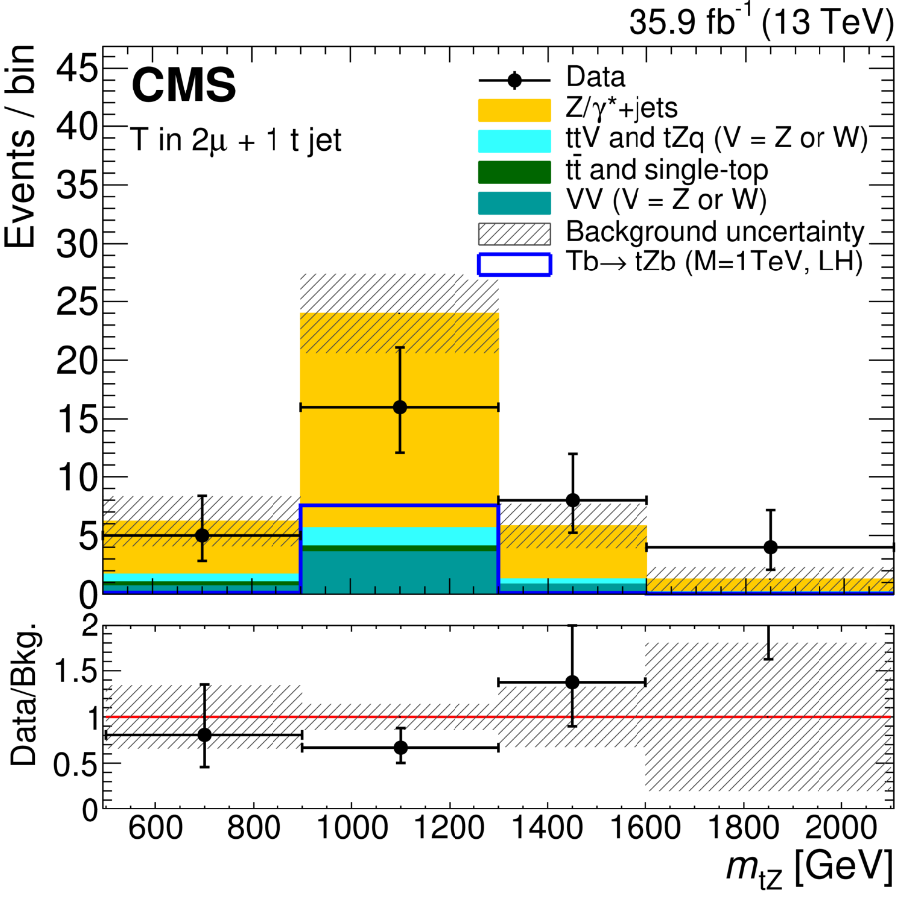
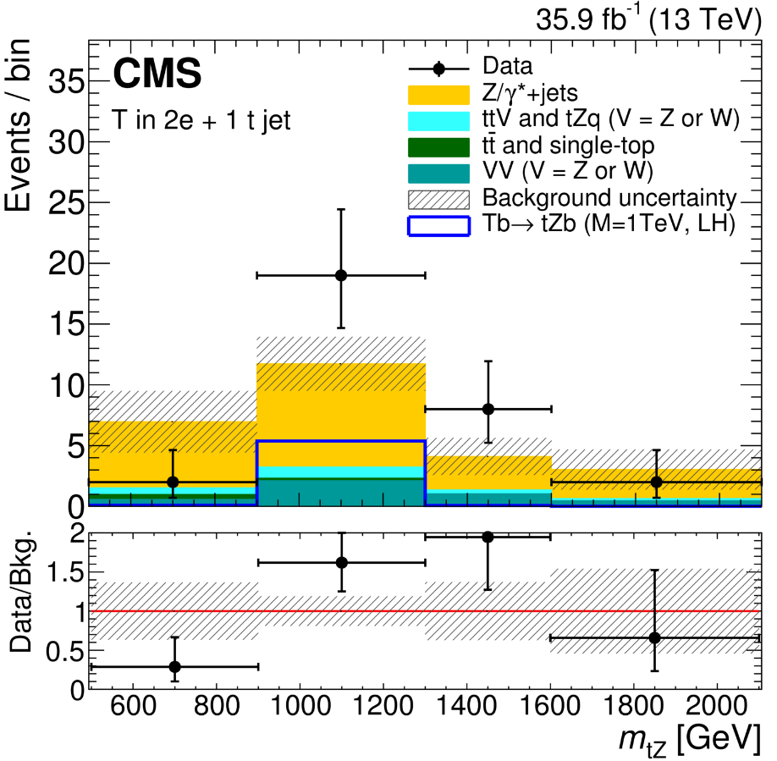
Data/MC comparison: fully merged
Comparison between the data, the background estimate, and the expected signal for the 2 categories where the T quark is reconstructed in the fully merged topology.
Events with the Z boson decaying into muons (left) and electrons (right). The background composition is taken from simulation.
The uncertainties in the background estimate include both statistical and systematic components.

Slide 11
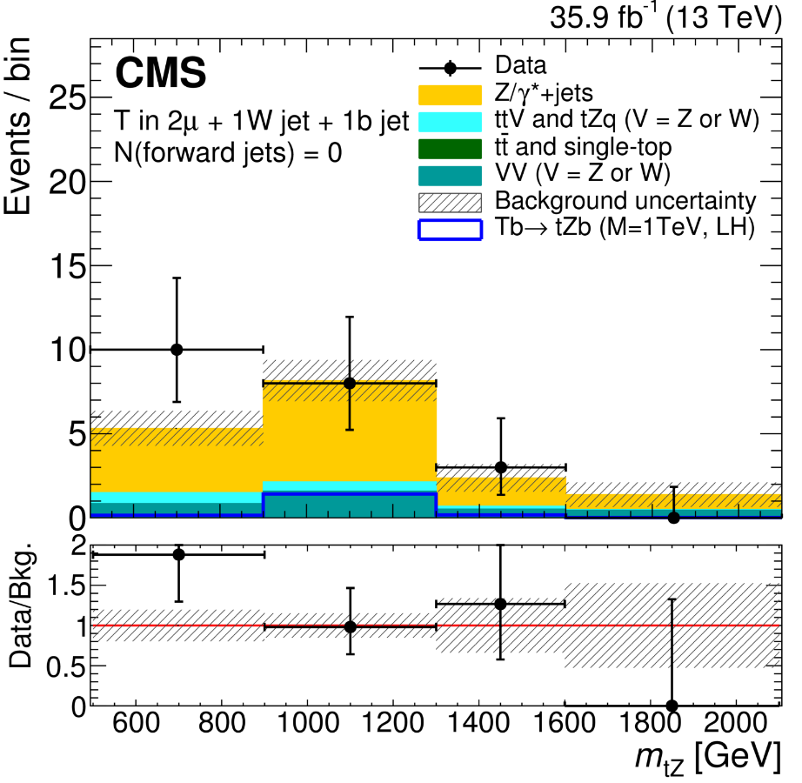
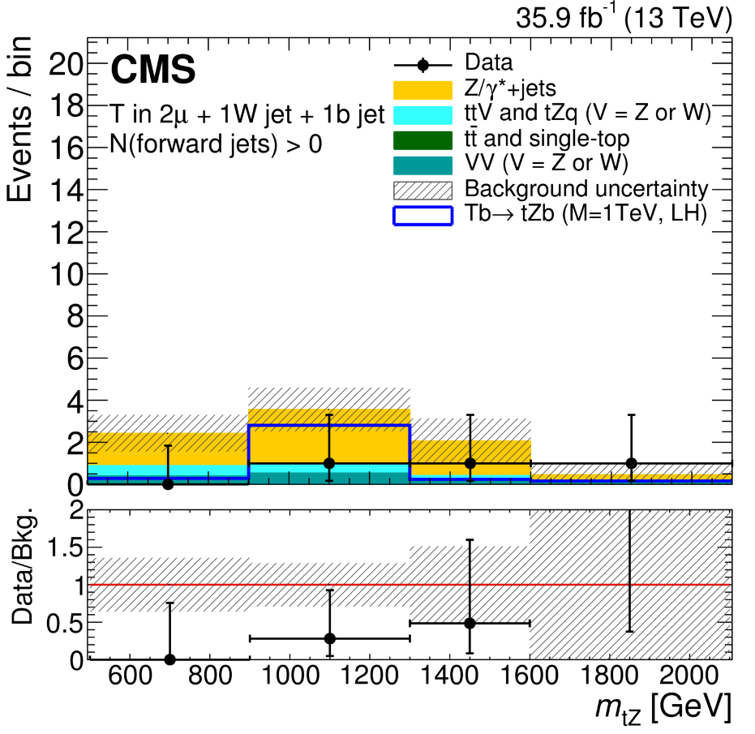
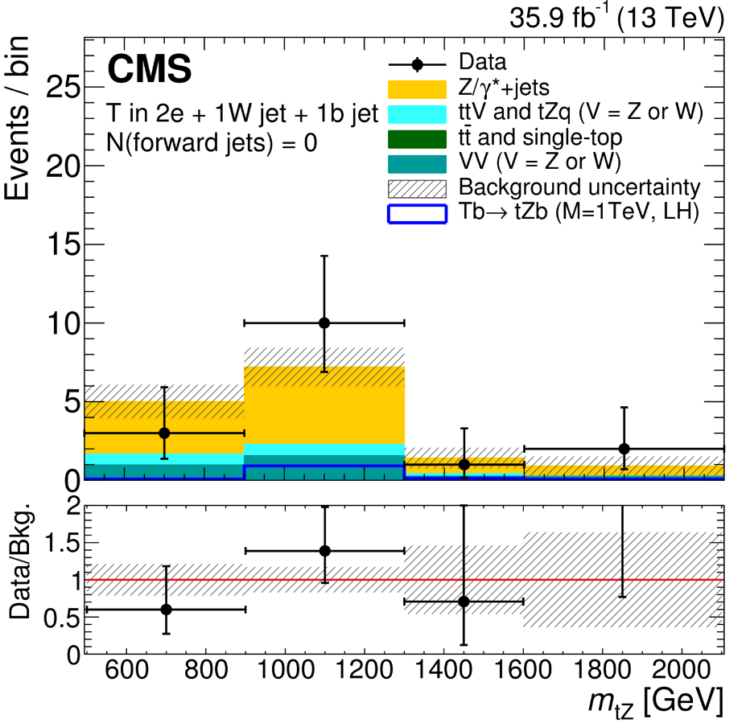
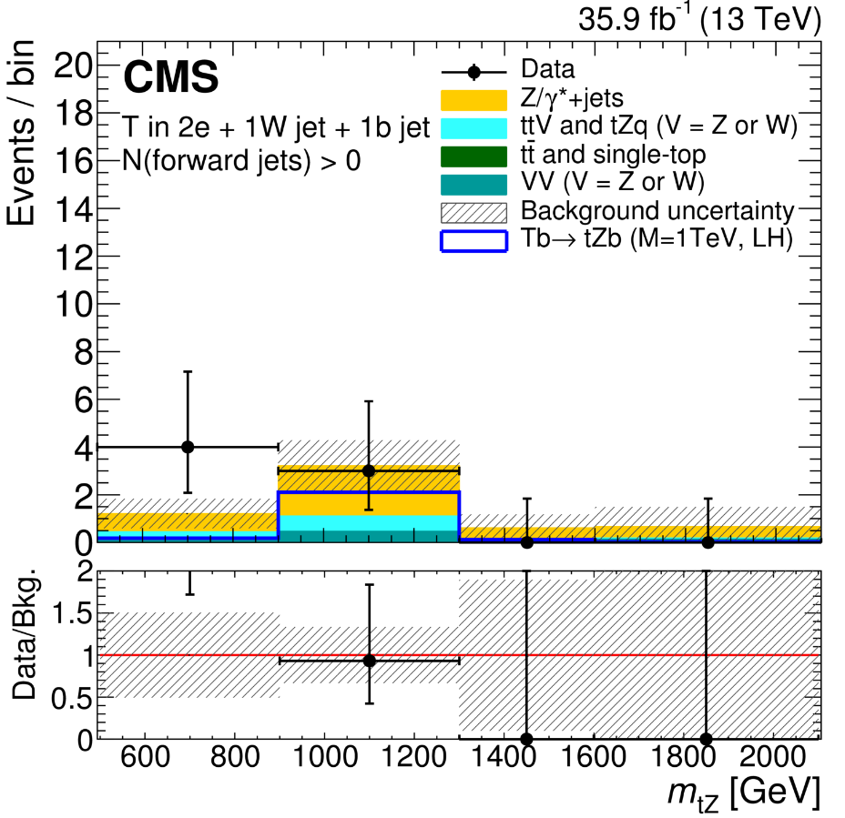
Data/MC comparison: partially merged
Comparison between the data, the background estimate, and the expected signal for the 4 categories where the T quark is reconstructed in the partially merged topology
Events with the Z boson decaying into muons (left) and electrons (right), and zero (at least one) forward jets in the upper (lower) row.
The background composition is taken from simulation. The uncertainties in the background estimate include both statistical and systematic components

Slide 12
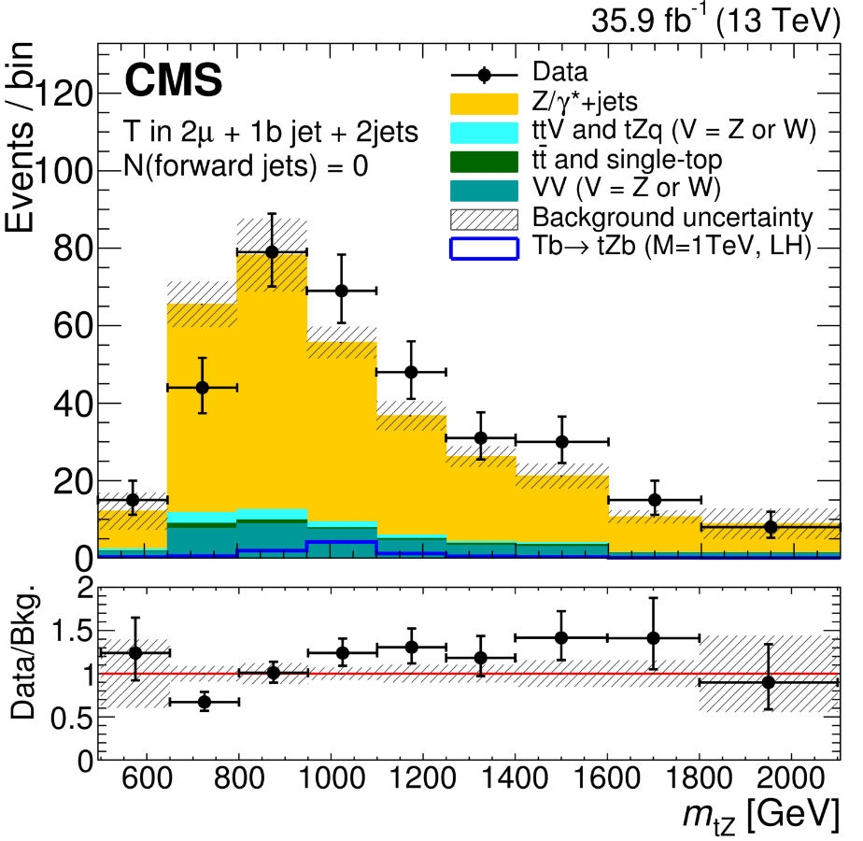
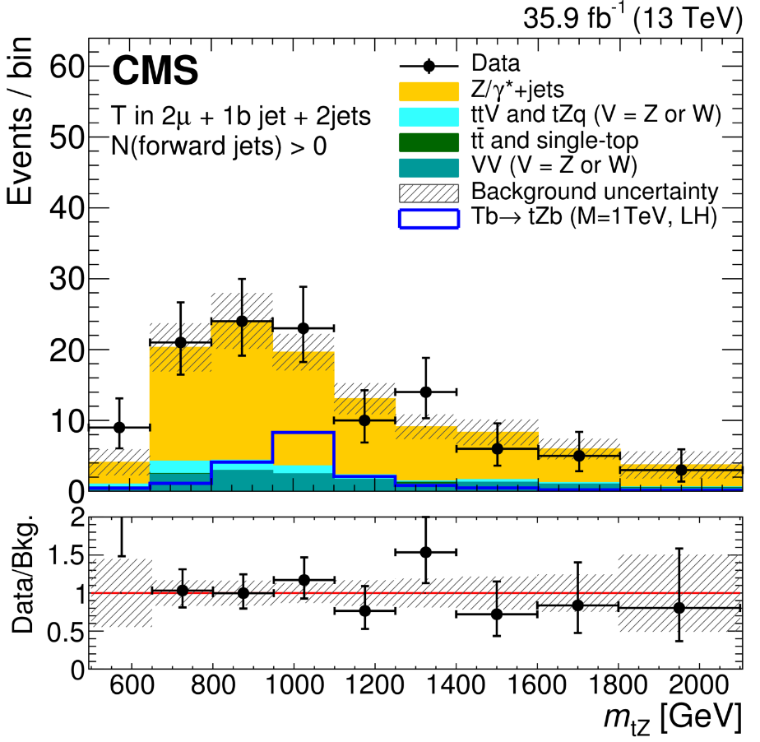
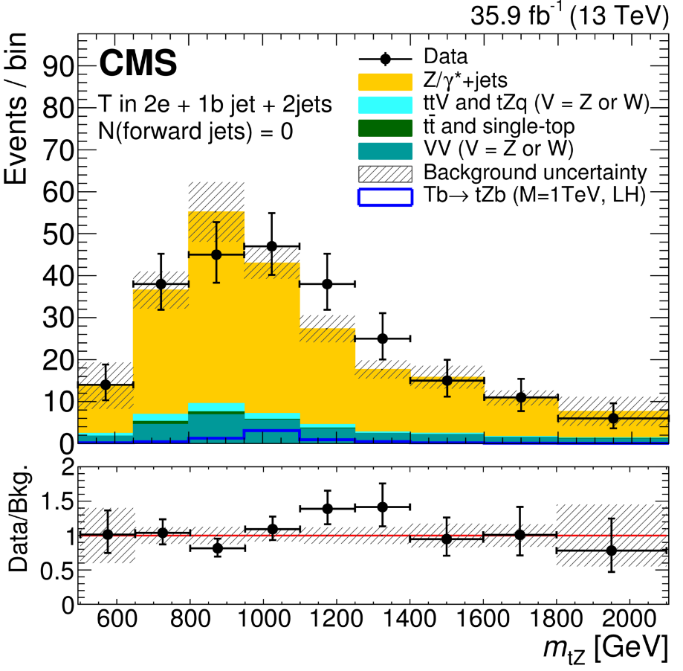
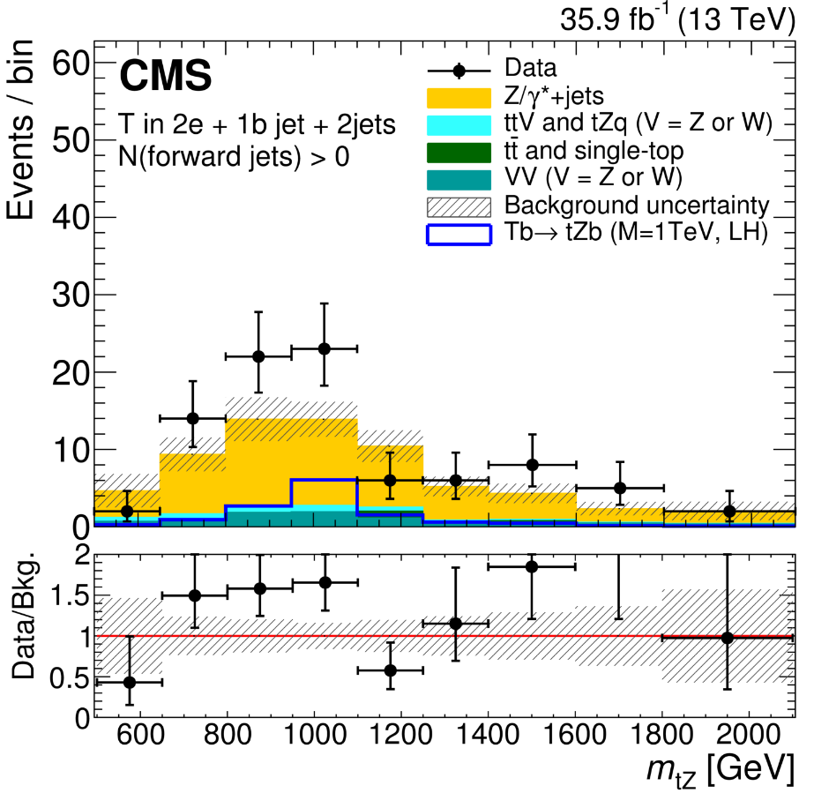
Data/MC comparison: resolved merged
Comparison between the data, the background estimate, and the expected signal for the 4 categories where the T quark is reconstructed in the resolved topology.
Events with the Z boson decaying into muons (left) and electrons (right), and zero (at least one) forward jets in the upper (lower) row.
The background composition is taken from simulation. The uncertainties in the background estimate include both statistical and systematic components.

Slide 13
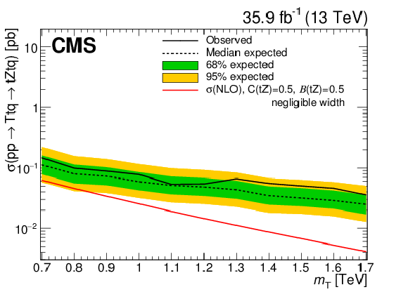
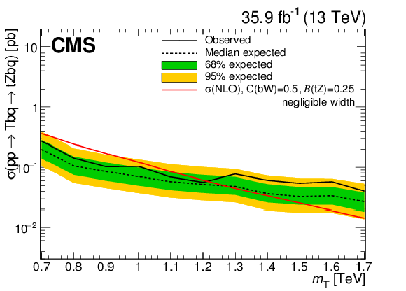
Results
Observed and expected limits at 95% CL on the product of the single production for the singlet LH T quark produced in association with a b quark (left) and for the doublet RH T quark produced in association with a t quark (right)
T quark has a narrow width and decays to tZ.
The red lines indicate theoretical cross sectionsThe branching fraction B(T→ tZ) is 0.25 (0.5) for the left (right) plot.

Slide 14
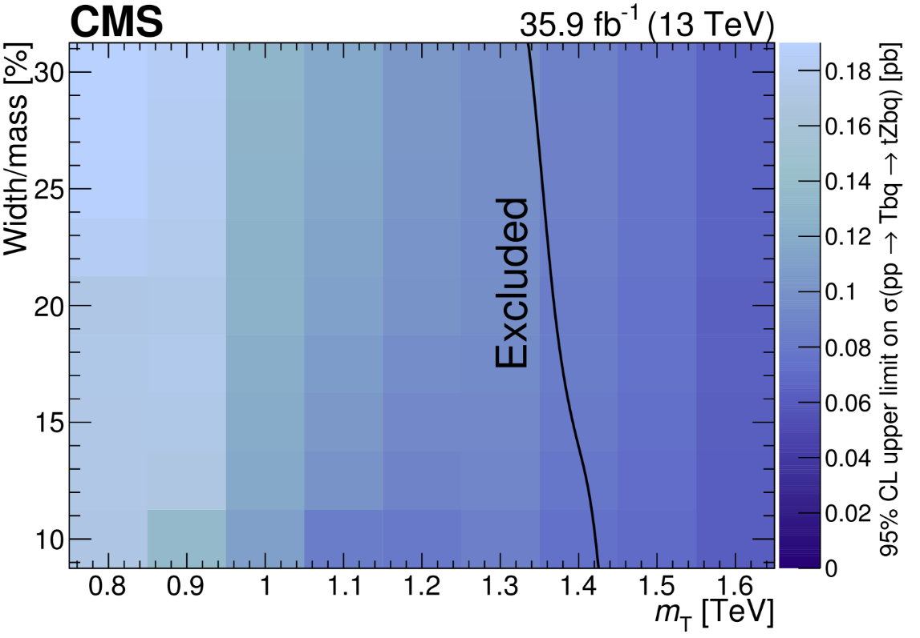
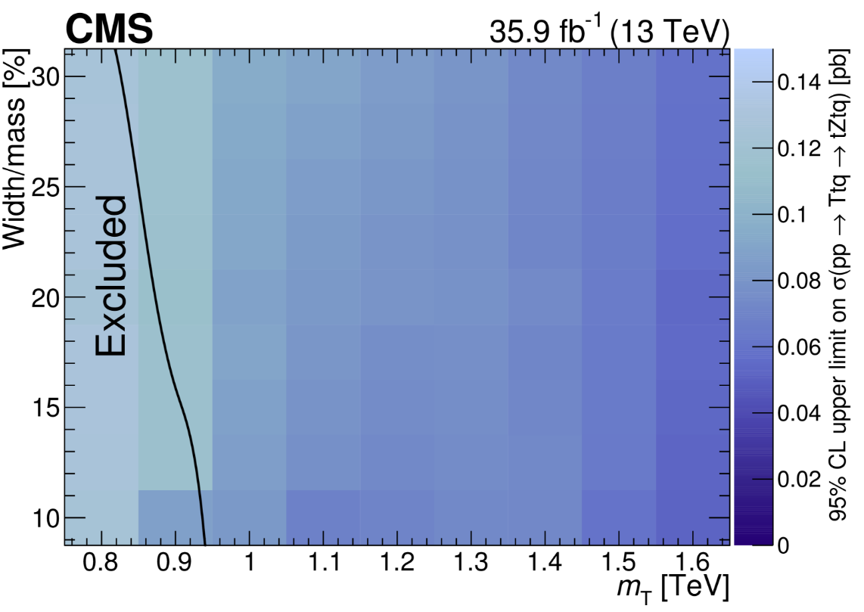
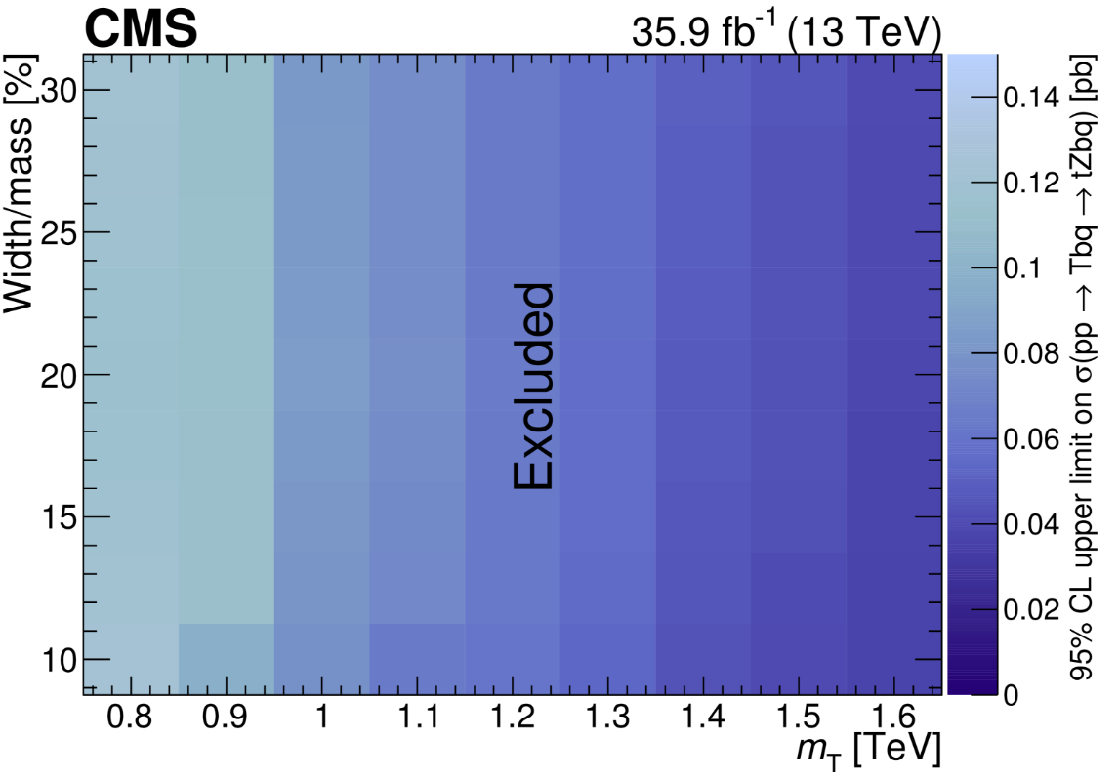
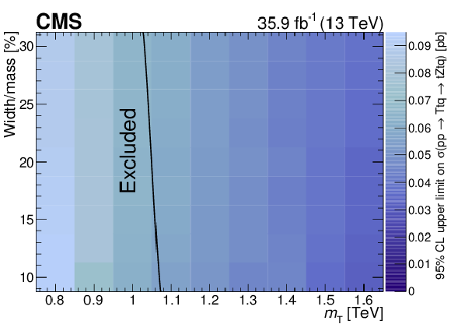
Result
Observed (upper) and expected (lower) limits at 95% CL on the product of the single production for the singlet LH T quark produced in association with a b quark (left) and for the doublet RH T quark produced in association with a t quark (right)
The T quark has a width from 10% to 30% of its mass and decays to tZ.
The solid black lines indicate theoretical cross sections in each plot, the excluded region lies to the left of the line

Slide 15
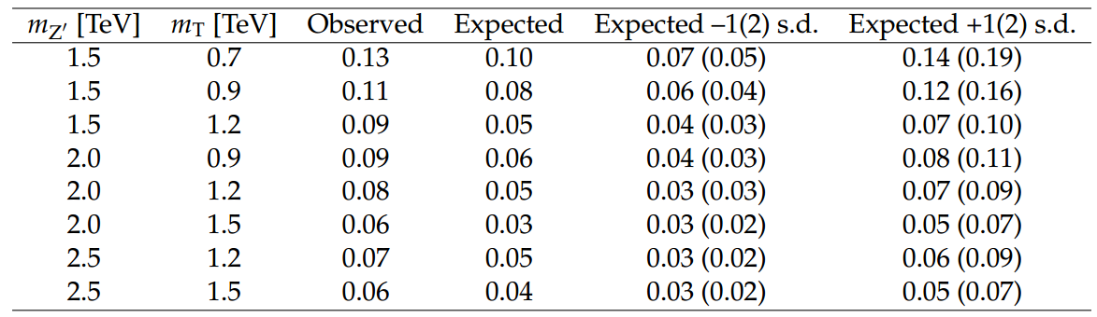
Results
Observed and expected limits for the production of a T quark via the decay of a Z' boson, Z' → Tt and T → tZ, are shown in Table 7. We assume negligible widths for boththe Z' boson and the T quark. The product of cross section and branching fractions is excludedabove 0.13–0.06 pb, for a Z' boson mass in the range from 1.5 to 2.5 TeV and for a T quark mass from 0.7 to 1.5 TeV.
Get from https://arxiv.org/abs/1708.01062,submit to Phys. Lett. B

Slide 16
Conclusion
Search for single T production decaying into a leptonic Z boson and a hadronic top quark
Search done in 10 categories, depending on top reconstruction
Forward jets are studied in the analysis
Limits for the production of single pp→Tbq, pp→Ttq,pp→Z’→Tt
LH T quarks with negligible width produced a b quark and with a coupling of 0.5 are excluded below the mass of 1.2 TeV
Samples with width 10%, 20%, and 30% have similar sensitivity
These are the most-stringent limits to date on the single production of heavy vector-like T quarks and the first to set limits for a variety of resonance widths

Slide 17
backup

Slide 18
Signal Characterization
The three decay channels of the T quark into SM particles are bW, tZ, and tH. If the T is a singlet of the SM, the equivalence theorem [31] implies that the branching fractions for the three decay modes of the T quark are approximately 0.5, 0.25, and 0.25, respectively.
If the T is a doublet of the SM, the decay modes are tZ and tH, each with a branching fraction of 0.5.
The T quark could be singly produced in association with either a t or a b quark and an additional quark would be produced in the forward region of the detector.
The coupling coefficients of the T quark to SM particles are denoted C(bW) for the T(b) process, and C(tZ) for the T(t) process. The production cross section of the T quark depends on its mass and width, as well as on these couplings.
The T quark can have both left-handed (LH) and right-handed (RH) couplings to SM particles. In the case of a singlet T quark, the RH chirality is suppressed by a factor proportional to the SM quark mass divided by the T quark mass. In the case of a doublet T quark, it is the LH chirality that is suppressed

