Slide 1
Rare Fluctuation Effect in NLO QCD
Wenchang Xiang
Guizhou University of Finance and Economics
Daicui Zhou
Central China Normal University
Third China LHC Physics Workshop
江苏 南京, Dec 22nd 2017

Slide 2
Outline
Introduction to CGC
NLO BK equation
Unstable problem for the solutions to BK equation
Double and single logs resummation to all order
Analytic solutions to the BK equations in the saturation region
Numerical solutions to the BK equations and their comparison
Rare fluctuation effect

Slide 3
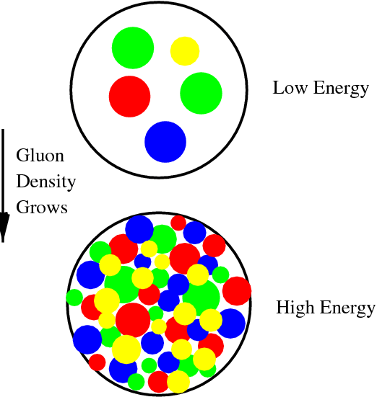
What is the Color Glass Condensate?
High –energy limit of QCD is the Color Glass Condensate (CGC)
Color: gluons have “colors”
Glass: gluons with small longitudinal fractions (x <<1) are
created by long- lived partons that are distributed
randomly on the transverse disk
Condensate: very high gluon density, ~ O( 1/α_{s} )
One of the most advanced theoretical picture of high energy scattering in QCD
Based on QCD unitarity effects; LO and NLO completed around 2000, and 2008;
collinear improved version set up at 2015

Slide 4
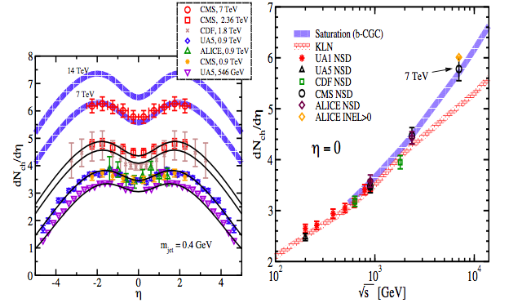
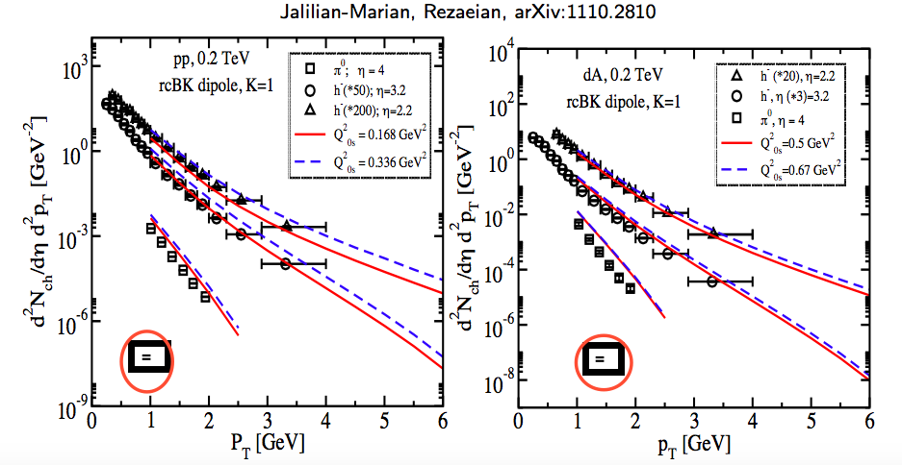
Experimental supports
Levin, Phys.Rev.D82:054003,2010
Geometric scaling observed in
DIS at HERA
Multiplicity and pt distribution
at RHIC and LHC
Stasto, Golec-Biernat, Kwiecinski
PRL 86 (2001) 596

Slide 5
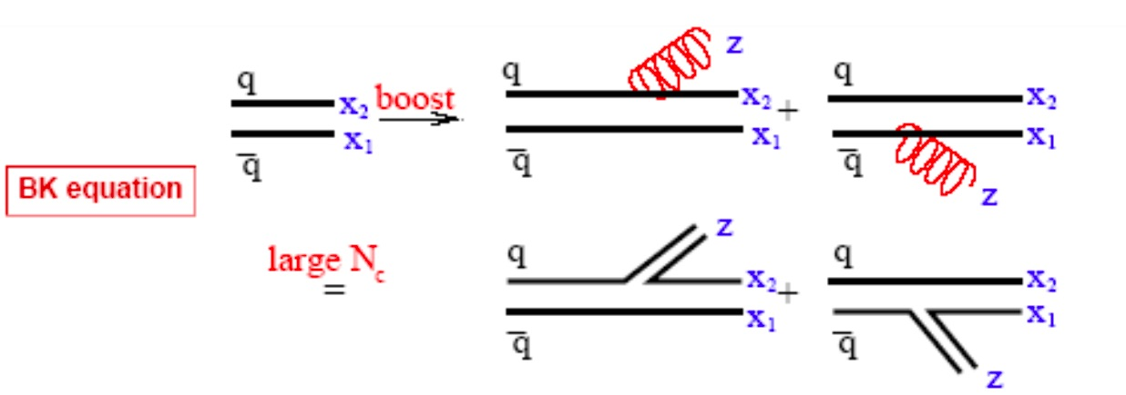
Balitsky-Kovchegov equation
BK equation in coordinate space
Non-linear term stands for two dipole scattering simultaneously
Linear term expresses single dipole scatter
this is a leading-order equation in which the coupling doesn’t run

Slide 6
Solutions to LO BK equation at saturation region
In saturation region, unitarity corrections are important, is small
2 comes from the symmetry of two regions
or
with
Scattering amplitude
Unintegrated gluon distribution
not useful for phenomenology

Slide 7
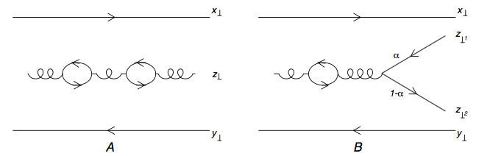
Quark contribution to BK equation at NLO
Running coupling corrections to the BK equation
RC corrections represent most of the NLO contribution
Slow down the evolution speed about 20% compared to LO case
Successfully describe the proton structure function F2 at small x
Kovchegov
Weigert
Balitsky
with

Slide 8
Analytic Solution to rc-BK equation (1)
Neglect quadratic terms
Saturation regions or
Balitsky Kernel
KW Kernel

Slide 9
Analytic Solution to rc-BK equation (2)
Simplified rc-BK equation
Running coupling at one loop accuracy
Solution
In exponent, rapidity changes from quadratic to linear
W.Xiang, Physical Review D79(2009)014012

Slide 10
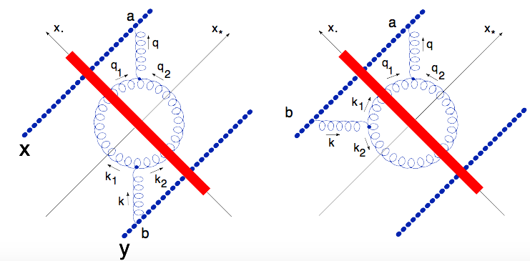
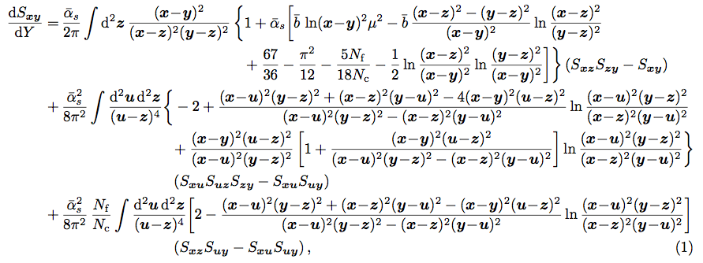
Full NLO BK equation with quark and gluon loop contributions
Include gluon loop contributions
Full NLO BK equation
Balitsky 2007

Slide 11
Analytic solution to Full NLO BK eq. at saturation region
Saturation regions or
Solution:
with
with
In exponent, rapidity changes from linear to 3/2

Slide 12
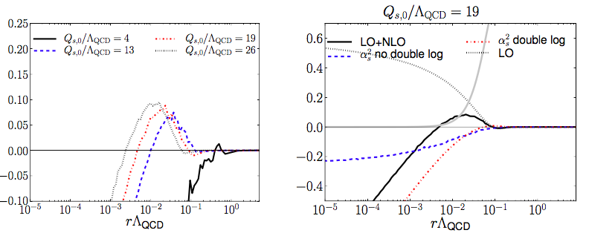
Problematic behavior of Full NLO BK eq.
MV initial conditions
Logarithmic evolution speed is negative at all value r,
Speed diverges as at smaller typical coupling
Divergence comes from double collinear logarithm
Lappi 2015

Slide 13
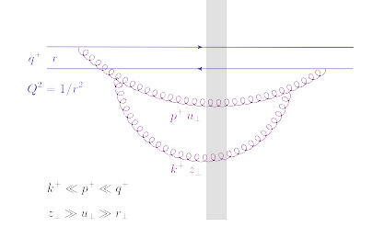
Double collinear logarithm
Two successive emissions which are strongly order in both
Longitudinal momenta and transverse size
Double – collinear logs can be systematically resumed to all order
Iancu et.al 2015
with
and

Slide 14
The collinearly improved BK eq.
Resumes all the powers of and
The kernel changes to
with
The first correction coincides with the NLO double logs
Equation:
Solve the unstable problem
Missing running coupling contribution

Slide 15
Solutions to collinear improved BK eq.
Saturation regions:
or
Double logs modified kernel is negligible,
In saturation region, the analytic solution to collinear improved BK eq. is the same as the leading order BK eq.

Slide 16
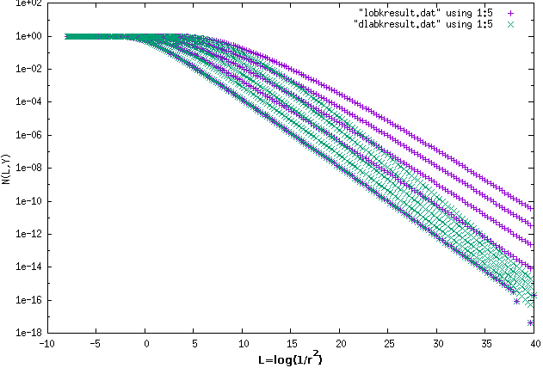
Numerical solutions to BK equations
Y from 0 to 16

Slide 17
Full NLO BK eq. with both RC and DLA

Slide 18
Solution to full NLO BK eq.
Analytic solution is the same as the lowest NLO BK eq.
Numerical solution
W.C. Xiang and D.C. Zhou, Physical Review D, 95,116009, 2017

Slide 19
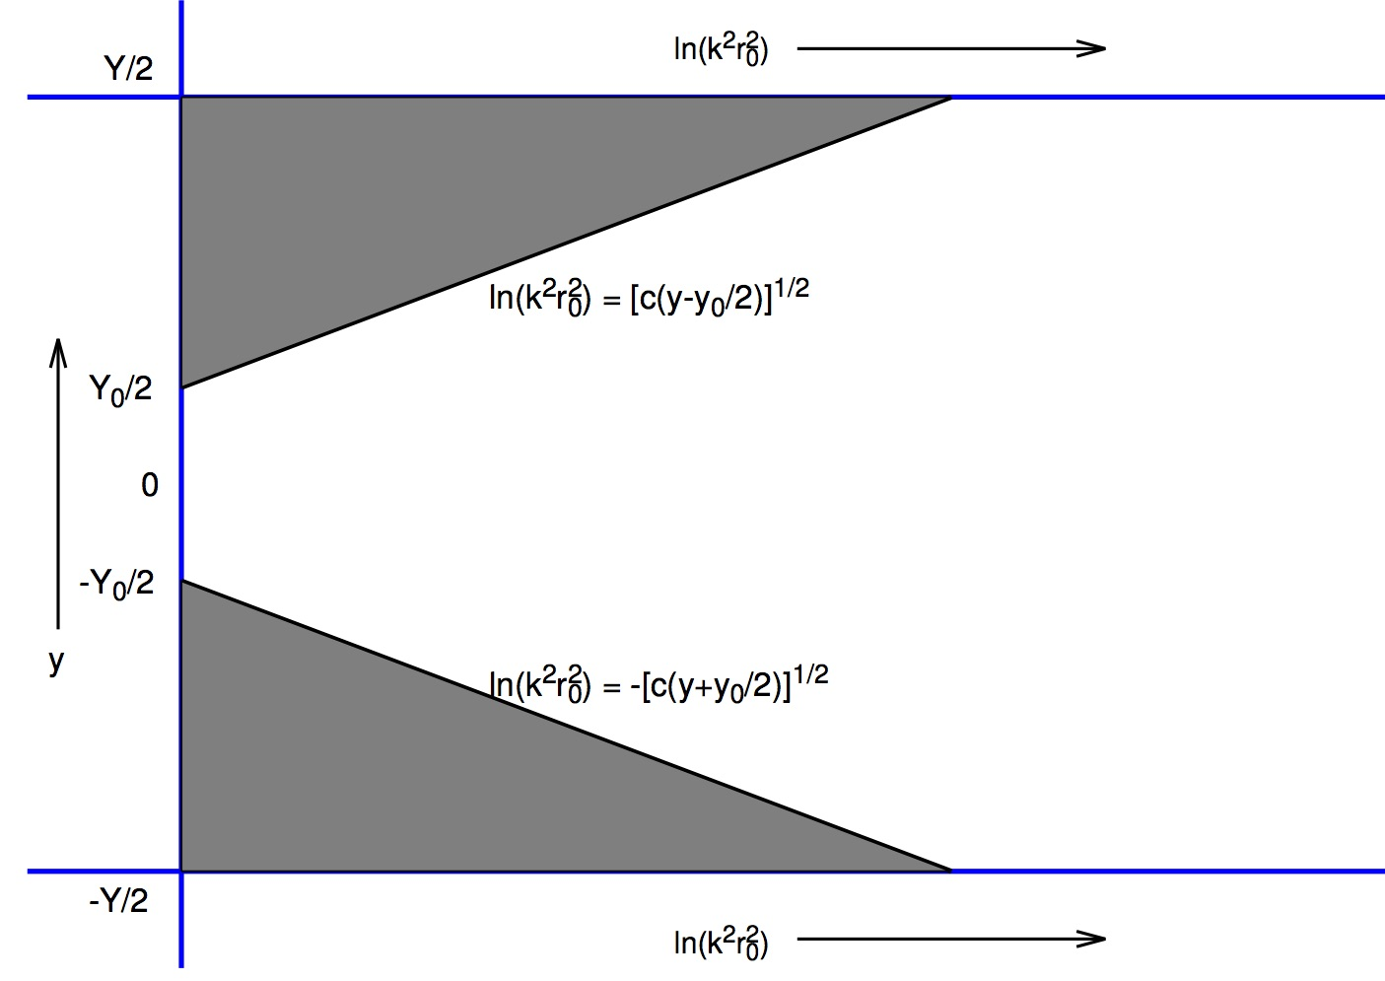
Rare fluctuation
In center of mass frame

Slide 20
Rare fluctuation
In center of mass frame
Submitted to PRD, Dec 2017

Slide 21
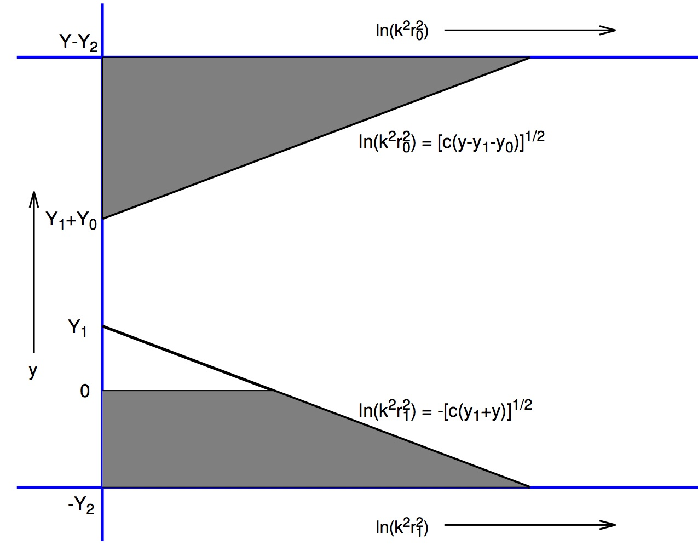
Rare fluctuation
In a general frame

Slide 22
Rare fluctuation
In a general frame

Slide 23
Summary
Running coupling corrections to BK equation
Its analytic solution at saturation region
Full NLO BK equation
Its analytic solution at saturation region
BK equation with double logs resumation
Numerical their solutions
Rare fluctuation effects

