Slide 1
Conserved Charge Fluctuations
in Relativistic Heavy Ion Collisions
Critical and Non-critical Fluctuations
Masayuki Asakawa
Department of Physics, Osaka University

Slide 2
QCD Phase Diagram
T
LHC
RHIC
QGP (quark-gluon plasma)
~160 MeV
CP (critical point)
crossover
1st order
order ?
Hadron Phase
chiral symmetry breaking
confinement
CSC (color superconductivity)
5-10ρ₀
μ_{B}

Slide 3
Why Conserved Charge Fluctuations ?
Their values do not change during the phase transition
Their values in QGP and Hadron Phase are different
They change in Hadron Phase only by diffusion
D measure for electromagnetic charge fluctuation
Heinz, Müller, M.A., Jeon, Koch, 2000
Charge Fluctuation and Baryon Number Fluctuation are
well-defined quantities, and can be measured on the lattice
Ex. Pion number is not a well-defined quantity on lattice
Lattice results and Effective Model results (equilibrium thermodynamics)
are often compared with experimental results

Slide 4
Comparison of Hadron Phase and QGP
Quark-Gluon Plasma
Quark-Gluon Plasma
q = ±1/3, ±2/3 (quark)
or 0 (gluon)
Hadron Phase
q = (± 2), ±1, 0

Slide 5
Why Conserved Charge Fluctuations ?
Their values do not change during the phase transition
Their values in QGP and Hadron Phase are different
They change in Hadron Phase only by diffusion
This is often overlooked
D measure for electromagnetic charge fluctuation
Heinz, Müller, M.A., Jeon, Koch, 2000
Charge Fluctuation and Baryon Number Fluctuation are
well-defined quantities, and can be measured on the lattice
Ex. Pion number is not a well-defined quantity on lattice
Lattice results and Effective Model results (equilibrium thermodynamics)
are often compared with experimental results
Time evolution needs to be taken into account

Slide 6
Definitions, important properties

Slide 7
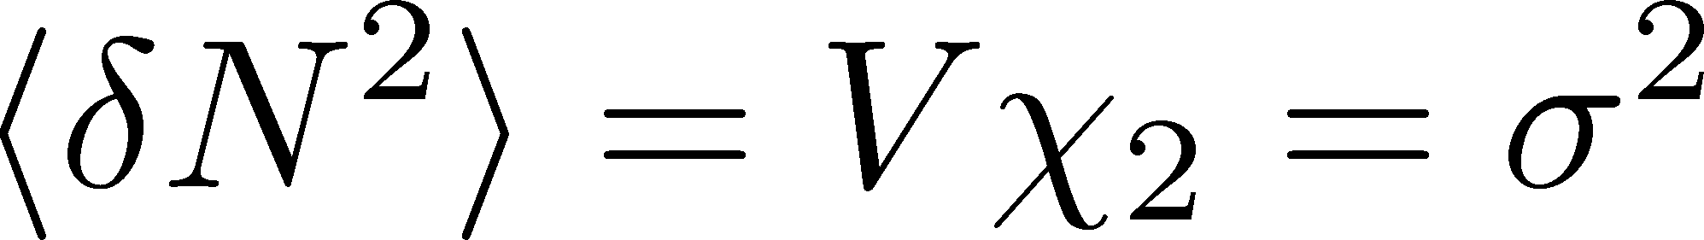
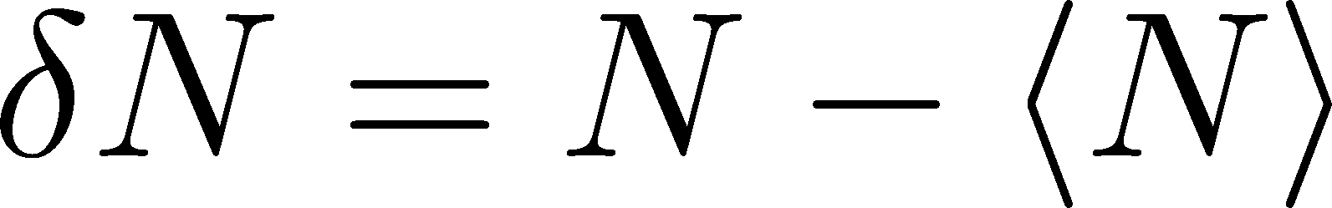
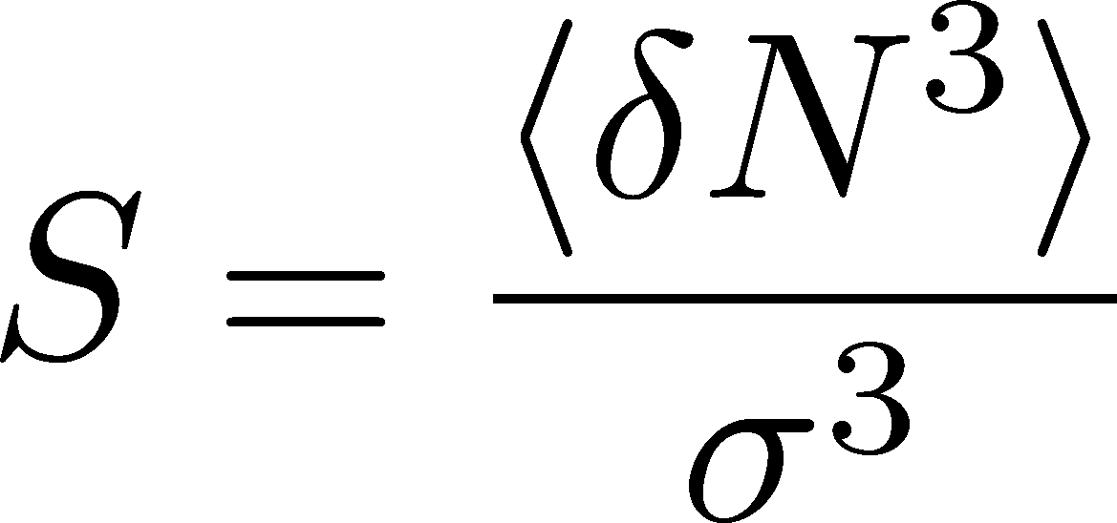
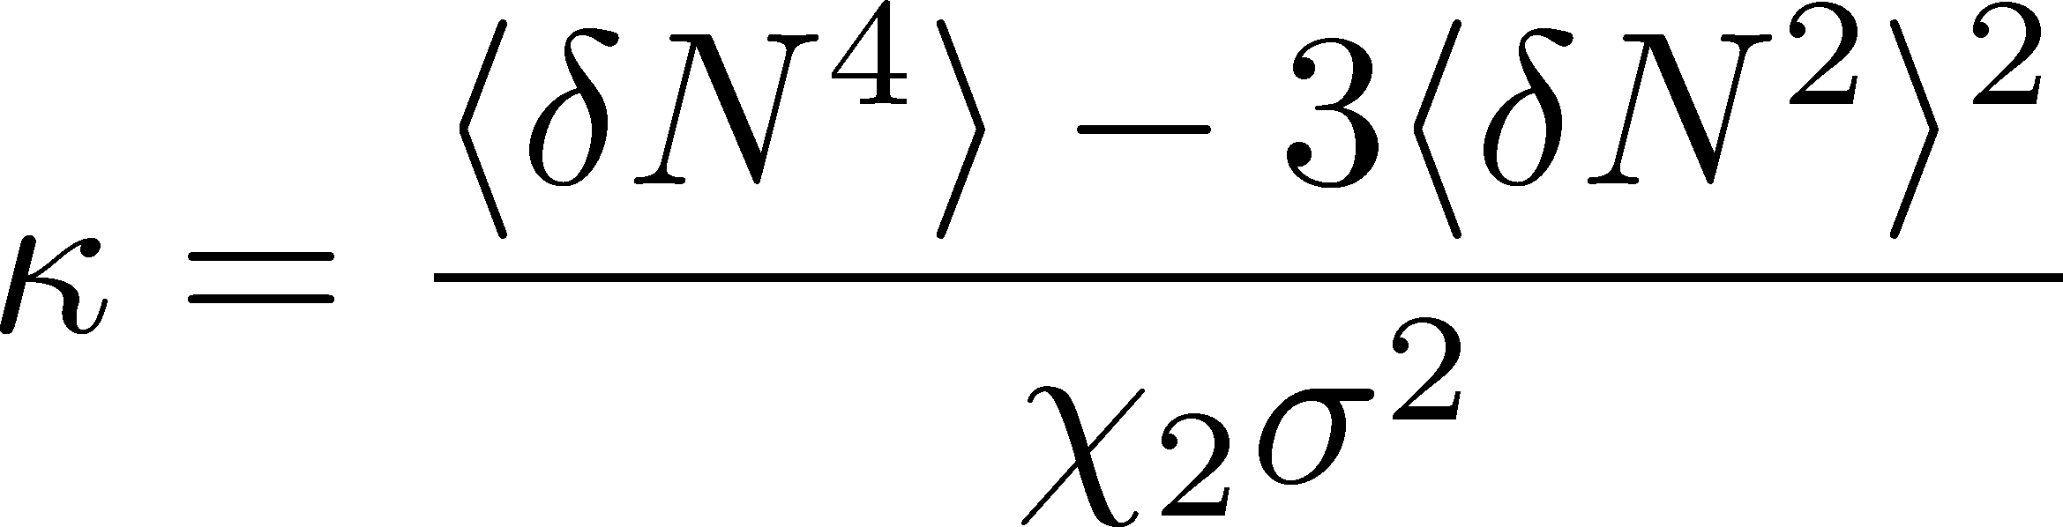

Fluctuations, or Cumulants ${\left\langle N^{n}\right\rangle }_{c}$
Observables in equilibrium are fluctuating.
P(N)
N
V
N
Variance:
Skewness:
Kurtosis:

Slide 8

Variance, Skewness, and Kurtosis
STAR, PRL105 (2010)
Kurtosis (4th)
Skewness (3rd)
Variance (2nd)

Slide 9
Moments and Cumulants
Distribution Function:
n-th order moment:
moment generating function:
Moments are given by the derivatives of G(θ) :

Slide 10
Cumulants
cumulant generating function:
Cumulants are defined by the derivatives of K(θ) :

Slide 11
Cumulants for Gauss Distribution
For Gauss distribution:
Therefore, for Gauss distribution:
measures non-Gaussianity

Slide 12
Fluctuations, or Cumulants ${\left\langle N^{n}\right\rangle }_{c}$
Observables in equilibrium are fluctuating.
P(N)
N
V
N
Variance:
Non-Gaussianity
Skewness:
Kurtosis:

Slide 13
Important Property of Cumulants
Cumulants of conserved charge are extensive quantities:
χ_{n} = const, generalized susceptibility
Thus,
Variance:
Skewness:
Kurtosis:

Slide 14
Cumulants of Conserved Charges
operator for a conserved charge:
partition function:
grand potential:
cumulants:

Slide 15
Cumulants of Conserved Charges
From the relation:
This relation leads to an important relation between cumulants:
An application:
In this lecture, we do not use factorial cumulants in the following

Slide 16
First App. of Conserved Charge Fluct.
Quark-Gluon Plasma
Quark-Gluon Plasma
q = ±1/3, ±2/3 (quark)
or 0 (gluon)
Electric charge :
carried by (anti-)quarks
Hadron Phase
q = (± 2), ±1, 0
Electric charge :
carried by (anti-)baryons
Heinz, Müller, M.A., Jeon, Koch, 2000

Slide 17
Sensitivity to Phase (Naïve Argument)
Hadron Gas Phase
QGP Phase
Electric Charge
~ 2/3 of hadrons carry
electric charge
only ~ 1/2 of d.o.f., i.e., quarks and anti-quarks
carry electric charge
Larger Charge Fluctuation
Baryon Charge
Baryon charge is carried only by
heavy and less abundant baryons
All quarks and anti-quarks carry
baryon charge
But all of them carry
baryon charge
But each of them carries
baryon charge only
Fluctuation is again larger in Hadron Gas

Slide 18
A Bit More Quantitatively
Massless Free gas + Boltzmann approximation
= grand potential
q_{i} = charge of particle i
To cancel V factor, divide by an extensive quantity such as S or N_{ch}

Slide 19
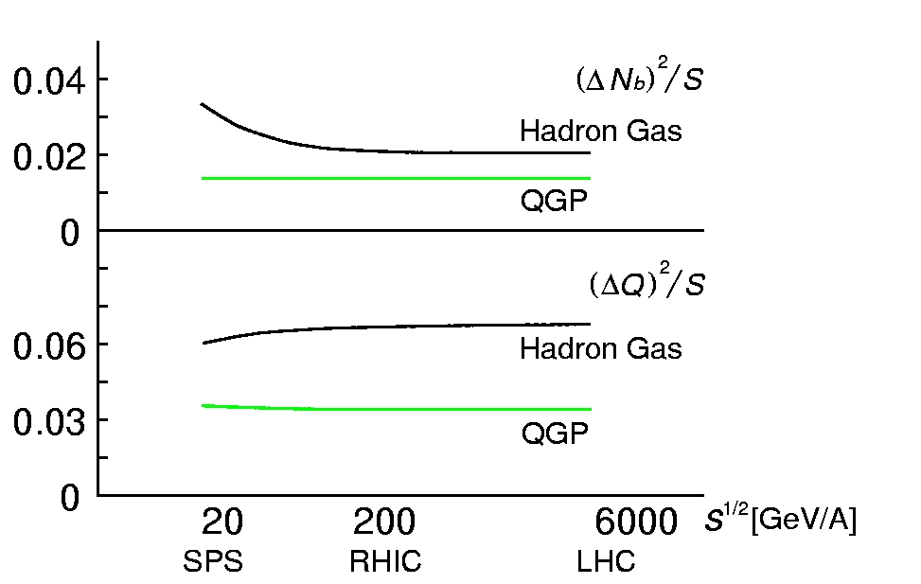
Prediction by Heinz, Müller, and M.A.
Heinz, Müller, and M.A., PRL (2000)

Slide 20
Prediction by Jeon and Koch
They proposed to use = D measure, instead of
Since N_{ch} $∝$S, they are practically same quantities
Jeon and Koch, PRL (2000)
Predictions
QGP phase
Hadron phase
( : hadron resonance gas)
Experimental Value
(STAR)
(PHENIX)
Reason? : Later

Slide 21
Let’s get back to this figure: Conclusion 0
Example of Non-Singular Fluctuations
Heinz, Müller, and M.A., PRL (2000)
Actually, Boltzmann approximation should not be applied to baryons
Nevertheless, a similar conclusion holds also for baryon number fluctuations

Slide 22
Odd Power Fluctuation Moments
even power
Usually fluctuations such as
have been considered
One of exceptions: Stephanov (2008) in conjunction with CEP
Usual Fluctuations such as
: positive definite
Absolute values carry information of states
Asakawa, Heinz, Müller, Jeon, Koch
On the other hand,
Odd power fluctuations :
NOT positive definite
In general, do not vanish (exception, )
Sign also carries information of states

Slide 23

Physical Meaning of 3rd Fluc. Moment
χ_{B}
: Baryon number susceptibility
in general, has a peak along phase transition
changes the sign at QCD
phase boundary !
In the language of fluctuation moments:
more information than
usual fluctuation

Slide 24
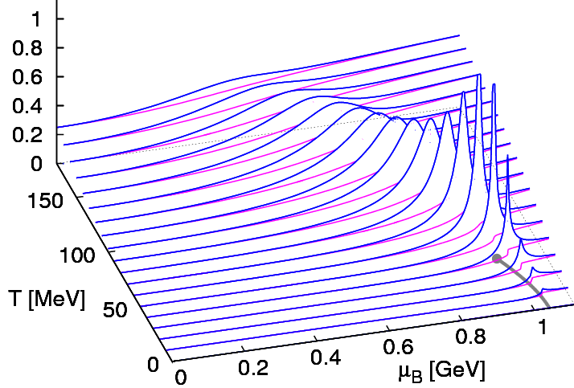
(Hopefully) More Easily Measured Moments
Third Moment of Electric Charge Fluctuation
χ_{B}
χ_{I}/9
singular @CEP
iso-vector susceptibility
nonsingular when Isospin-symm.
Hatta and Stephanov 2002

Slide 25
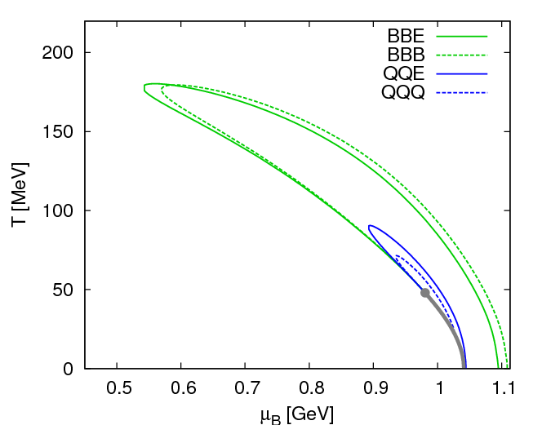
Mixed Moments
Energy is also a conserved charge
and measurable !
T
μ
E : total energy in a subvolume
Regions with Negative
fluctuation moments
Result with the standard
NJL parameters (N_{f}=2)

Slide 26
More and More 3rd Moments
These quantities are expressed concisely
as derivatives of “specific heat” at constant
“specific heat” at constant
T
diverges at critical end point
peaks on phase transition line
μ

Slide 27
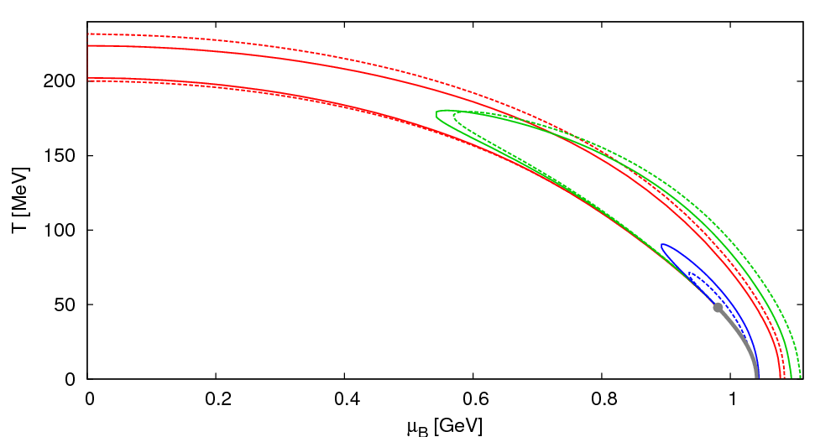
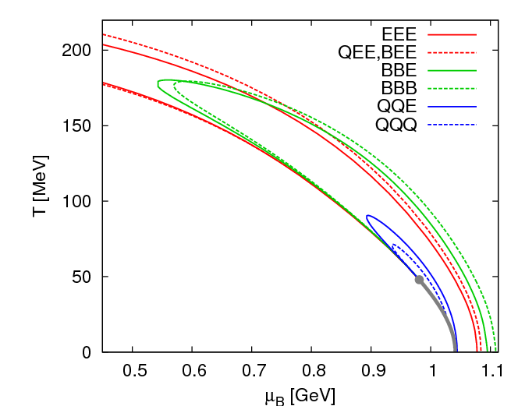
Comparison of Various Moments
2-flavor NJL
with standard
parameters
Far Side
G=5.5GeV⁻²
m_{q}=5.5MeV
Λ=631MeV
Near Side
Different moments have different regions with negative moments
By comparing the signs of various moments,
possible to pin down the origin of moments
Negative m₃(EEE) region extends to T-axis (in this particular model)
Sign of m₃(EEE) may be used to estimate heat conductivity

Slide 28
Conclusion 1
Third moments of conserved charges can become
negative. These carry important information on
second order moments and EOS.
Mixed third moments are also theoretically important

Slide 29



Conserved and Non-Conserved Charge Fluc.
Necessary to consider dynamical evolution of fluctuation!
Conserved Charge
Non-Conserved Charge
V
V
Only diffusion changes
the number of charge
Charge can change
anywhere in the volume
relaxation time
finite
for
for

Slide 30
Proton Number Cumulants
Proton Number Fluctuation has been attracting a lot of interest
because it can be observed experimentally
Proton Number Fluctuation diverges at CP
Hatta and Stephanov, 2003
Comparisons of experimental results and lattice predictions
have been made （e.g. Gupta et al., Science 2011)
STAR, Beam Energy Scan Program
Experiment: Net Proton
Theory: Net Baryon
Is this harmless?

Slide 31
Protons and Baryons
The question here is how these are related to each other:
In free nucleon gas in equilibrium,
Otherwise, in general,

Slide 32
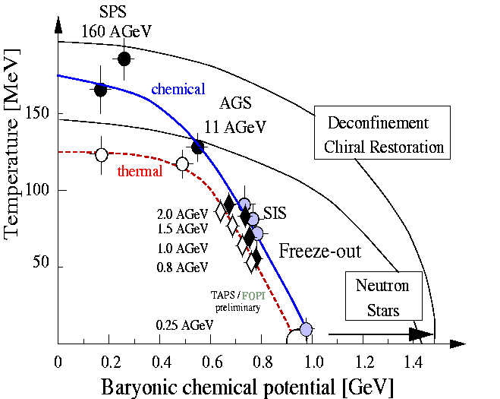

Freezeouts
Net proton number may be considered as
a proxy of net baryon number
Chemical freezeout is close to the
crossover, and (anti)proton number
is expected to be fixed early (?)
But Not all particle numbers and
fluctuations are fixed at chemical freezeout
Collision
Thremalization
Expansion
Hadronization
Kinetic Freezeout

Slide 33

Heavy Ion Physics 101
Time
Initial
state
CGC ?
QGP and
hydrodynamic
expansion
Hadronic phase
and freeze-out
Hadronization
Electromagnetic probes (γ’s, dileptons) leave QGP without interaction
no exceptions
On the other hand, hadrons keep on interacting with each other until
freezeouts
There are two freeze-outs, chemical and thermal
These are (phenomenological) results of dynamics
Some exceptions may exist need to understand physics

Slide 34


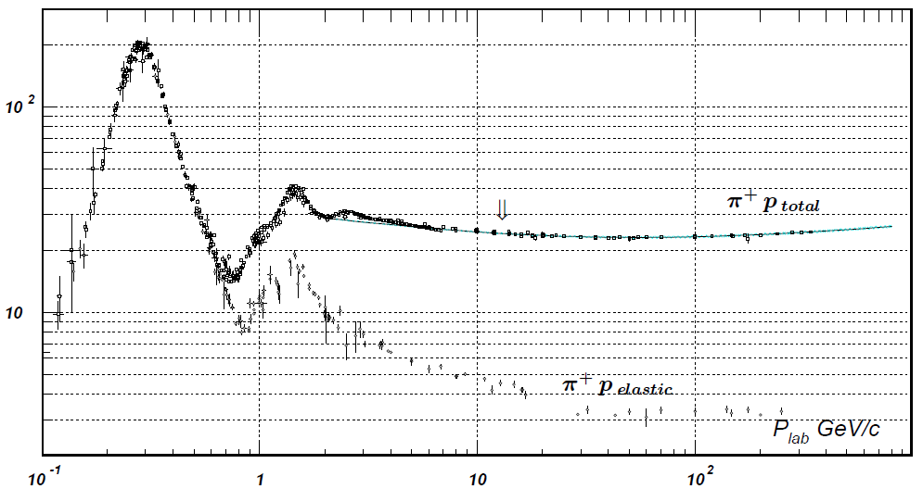
Exception
If there are low mass resonances with large cross sections,
this exception happens
In our case at hand, Δ resonances
200mb=20fm²
cross section

Slide 35
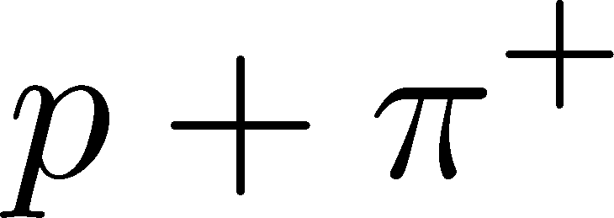
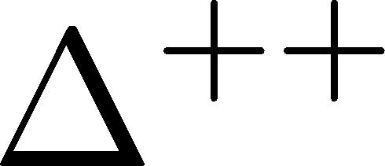
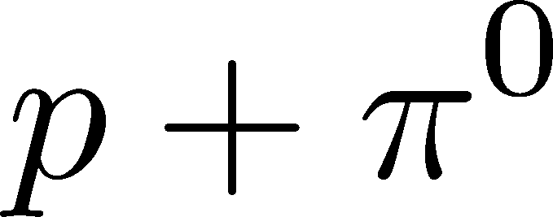
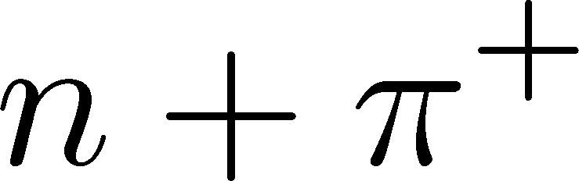

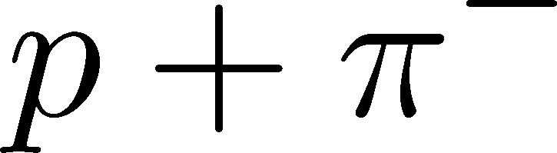

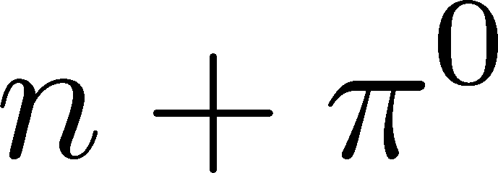


Effect of Δ
ratio of cross sections
3
1
2:1
2
1:2
branching ratio of Δ

Slide 36
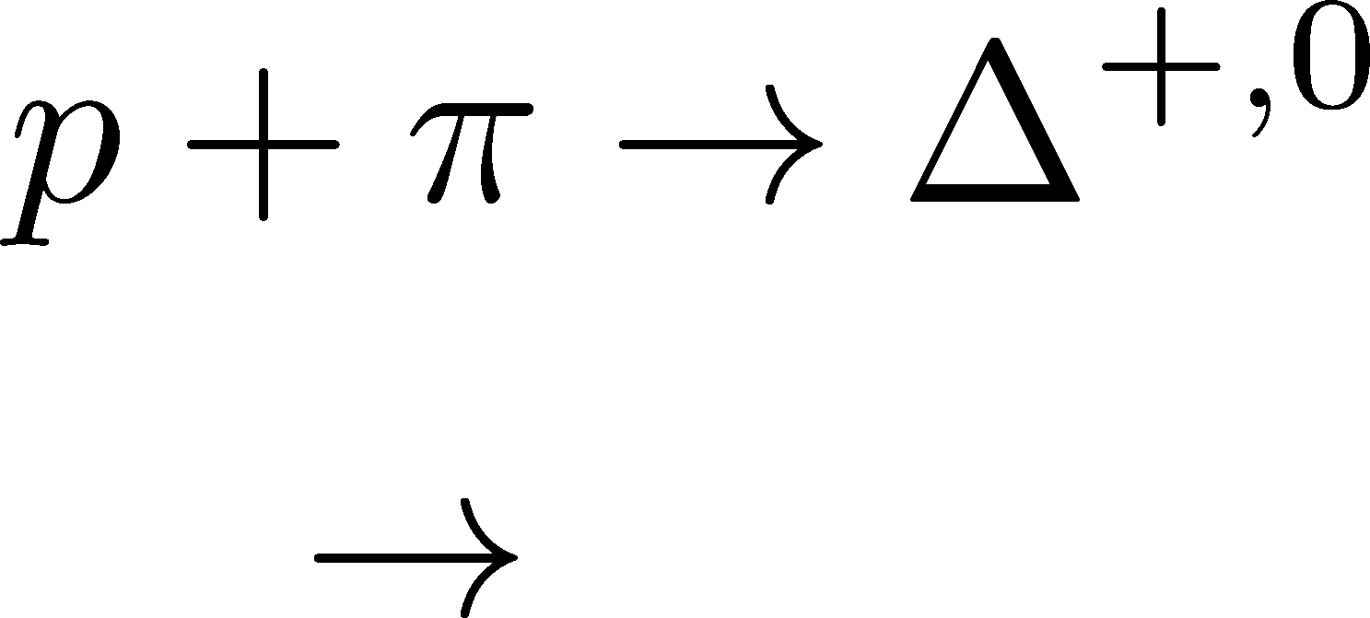


Effect of Δ
ratio of cross sections
3
1
2:1
2
1:2
branching ratio of Δ

Slide 37
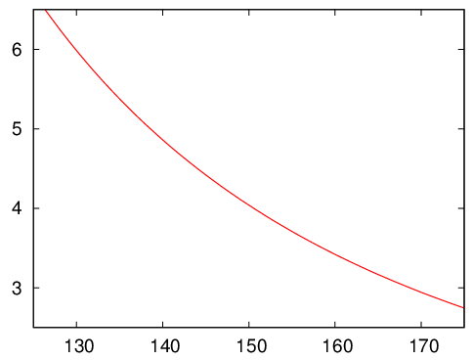
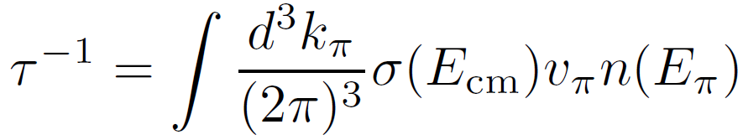


How long is the mean free time?
ratio of cross sections
3
1
2:1
2
1:2
branching ratio of Δ
BW for σ & thermal pion
Meantime to create Δ⁺ or Δ⁰

Slide 38
Time Scales
hadronization
τ_{I} : time scale to realize isospin randomization
τ_{hadron} : time scale of hadron phase duration
τ_{hadron} result of hydro + cascade calculation

Slide 39
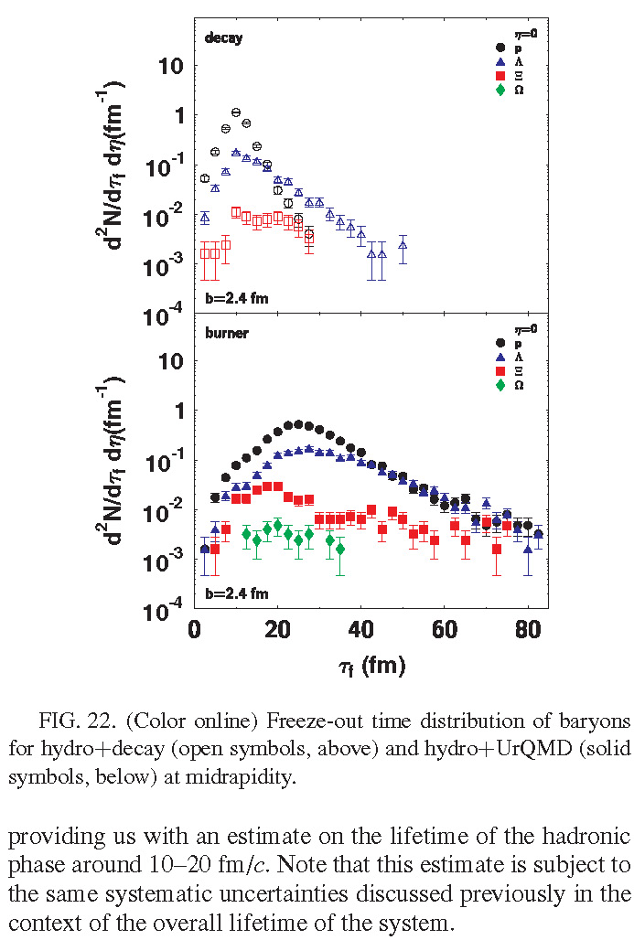
Result of Hydro+Cascade Calculation
Freezeout time distribution
without after-burner
with after-burner
τ_{hadron} : 10 ~ 20 fm
Nonaka and Bass, PRC 2007
isospin: randomized

Slide 40



Nucleon Isospin Randomization in Pion Gas
hadronization
chem. f.o.
a few fm
kinetic f.o.
time
mesons
baryons

Slide 41

Probability Distribution
hadronization
chem. f.o.
kinetic f.o.

Slide 42
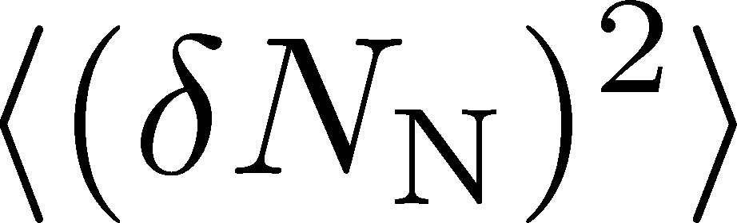

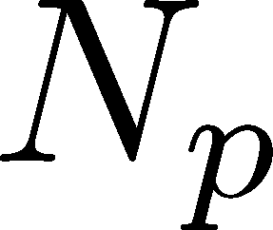

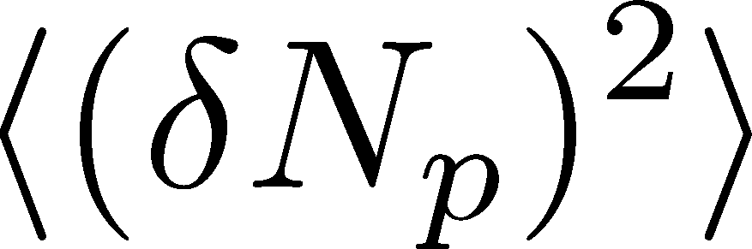
Production of Additional Fluctuation
1. Original
2. Additional (from πN→Δ→πN)
In, general, fluctuations of N_{N} and N_{p} are different
Additional N_{p} fluctuations are created by (thermal) pions

Slide 43
Proton and Nucleon Moments
1. Original
2. Additional (from πN→Δ→πN)
For free nucleon gas
for isospin symmetric matter

Slide 44
Proton and Nucleon Moments
Similarly,
N_{N} → N_{p}
N_{p} → N_{N}

Slide 45
Conclusion 2
Proton number is NOT a proxy of baryon number
This statement is true at least at top RHIC and LHC
At BES energies,
where pion density is small and τ_{hadron} is not large,
proton number could be a proxy of baryon number
approximately

Slide 46

Δη Dependence @ ALICE
t
Δη
z
ALICE, 2013
Freeze-out parameters: lattice meets experiment
In this argument, no rapidity window dependence is taken into account

Slide 47
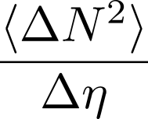
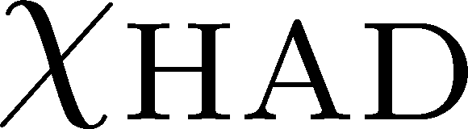
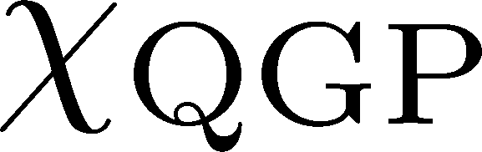


Schematic Evolution of C.C. Fluctuation
Pre-Equilibrium
Quark-Gluon Plasma
Hadronization
Freezeout

Slide 48
Time Evolution of Conserved Charge
t
Δη
N_{Q}
z
Δη
Variation of a conserved charge in Δη is achieved only through diffusion
The larger Δη, the slower diffusion

Slide 49
Time Evolution of C.C. fluctuation
Quark-Gluon Plasma
Hadronization
Freezeout
In the Δη dependence of C.C. Fluctuation, history of system is encoded

Slide 50
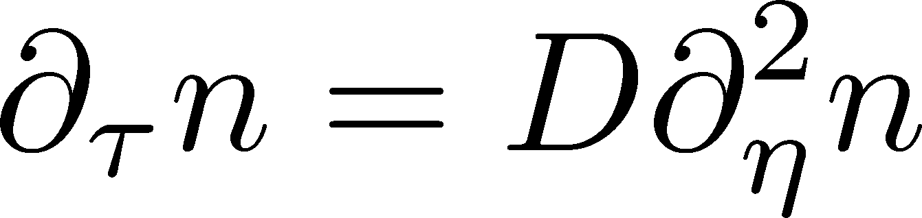

Conservation Charge Transport in Hadron Phase
Naively,
Diffusion Equation,
Plus Fluctuation
But it is known stochastic forces for
“Markov process for continuum variable(s)” are Gaussian
We will use a discrete formulation

Slide 51
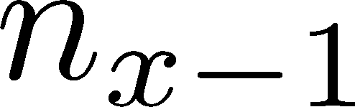






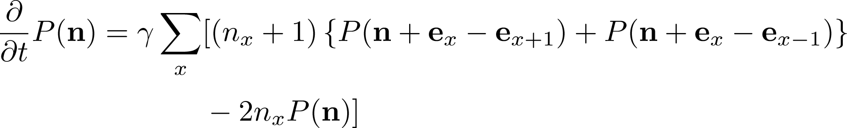
Diffusion Master Equation (DME)
Divide spatial coordinate into discrete cells
probability
Master Equation for P(n)
Solve the DME exactly, and take a→0 limit
No approximation is needed
Ono, Kitazawa, M.A., PLB 2014

Slide 52

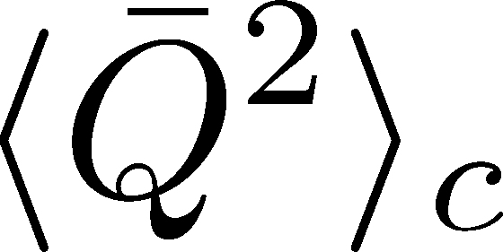
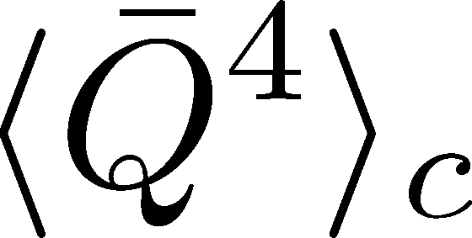
Net Charge Number
Prepare 2 species of (non-interacting) particles
Let us investigate
at freezeout time t

Slide 53
Net and Total Charge Numbers
In the following, it is important to distinguish
“net” and “total” charges
conserved
non-conserved

Slide 54

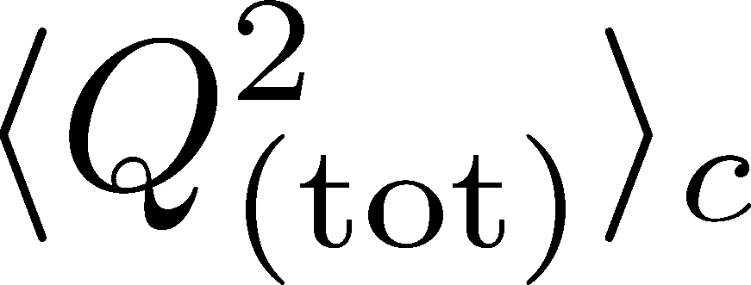
Evolution of C.C. Fluctuation in Hadron Phase
Hadronization (initial condition)
Boost invariance / infinitely long system
Local equilibration / local correlation
Time evolution via DME
suppression owing to
local charge conservation
sensitive to
hadronization mechanism
Freezeout

Slide 55
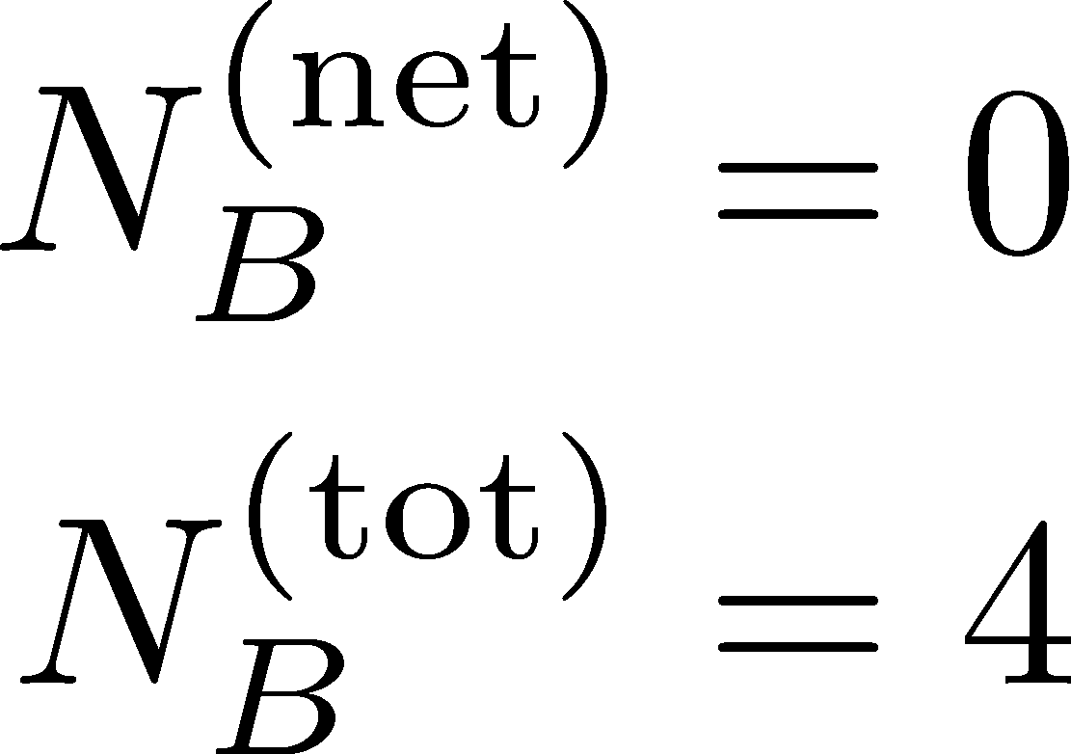
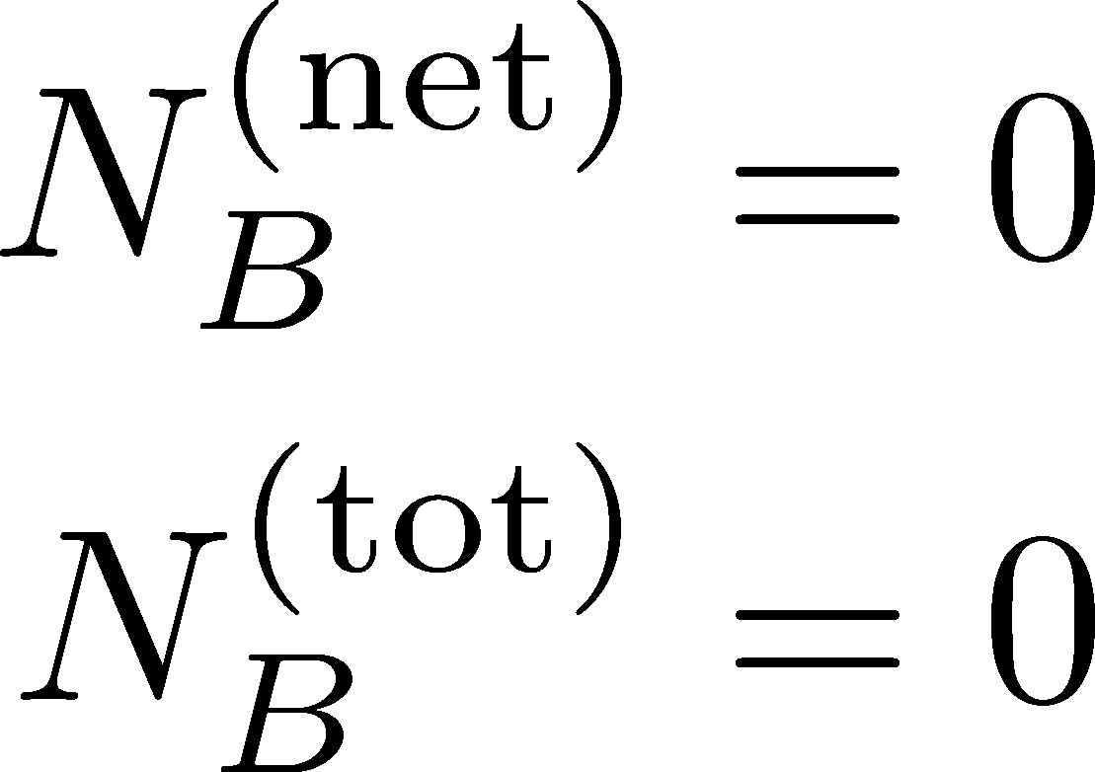
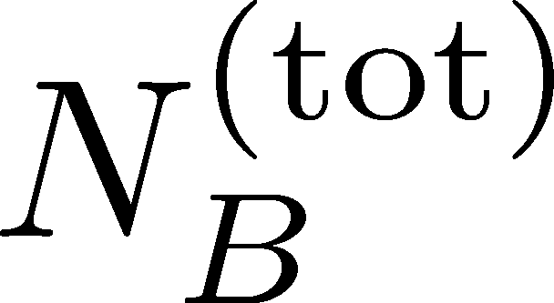
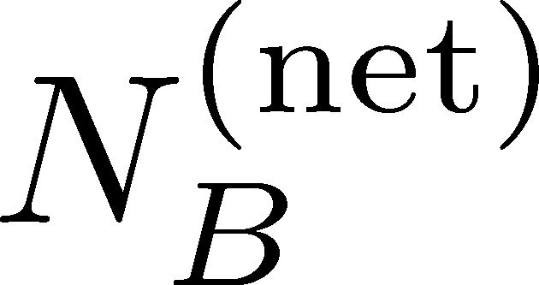
Why Hadronization Mechanism Matters
For example, even within the recombination model,
6 quarks
6 antiquarks
In other mechanisms, may differ, but does not

Slide 56


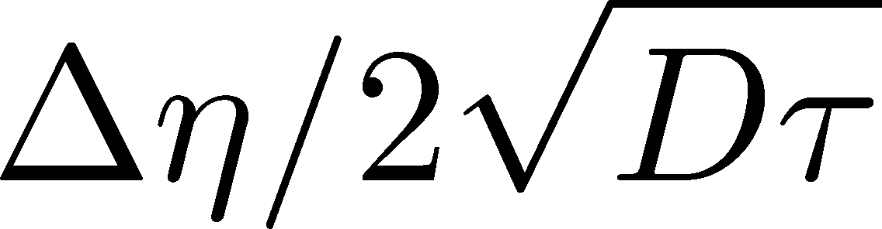
Δη Dependence at Kinetic Freezeout
Initial fluctuations:
parameter
sensitive to
hadronization
2nd
4th
(γa² → D (a→0))

Slide 57
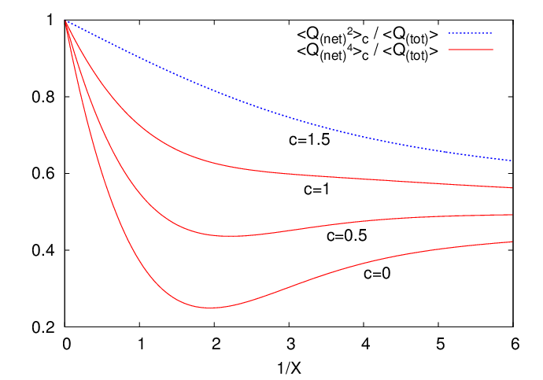
Δη Dependence at Kinetic Freezeout
Initial fluctuations:
2nd
parameter
sensitive to
hadronization
4th
(γa² → D (a→0))

Slide 58
Conclusion 3
Freeze-out parameters: lattice meets experiment
Diffusion effect in the hadron phase is important
(observed fluctuations do not reflect their values
at chemical freezeout)
Necessary to measure Δη dependence of cumulants
4th order cumulant includes information of hadronization
mechanism

Slide 59
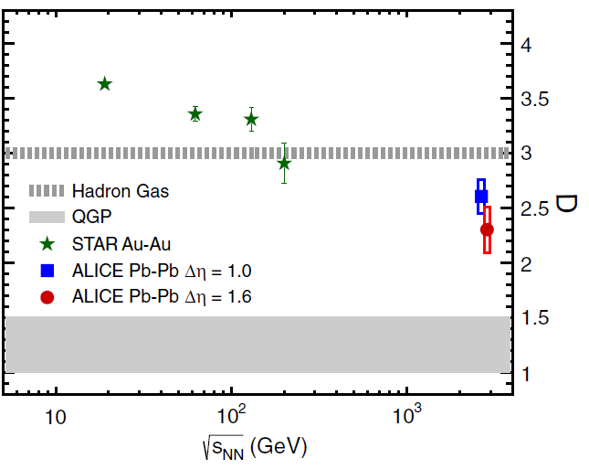

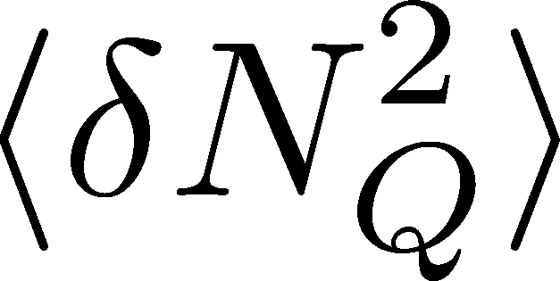
Charge Fluctuation @LHC
ALICE, PRL110,152301(2013)
D-measure
D ~ 3-4 Hadronic
D ~ 1 Quark
significant suppression
from hadronic value
at LHC energy!
is not equilibrated at freeze-out at LHC energy!

Slide 60
Closer Look: Δη dependence
ALICE
PRL 2013
t
Δη
z
rapidity window

Slide 61
Finite Size Effect (Global Charge Conservation)?
N_{Q}
Δη
η_{total}
C. C. Fluctuation: 0 if the whole system is observed
?
if the whole system is equilibrated (Bleicher, Jeon, Koch)

Slide 62
Time Evolution of C.C. fluctuation
Quark-Gluon Plasma
Hadronization
Freezeout
Through diffusion

Slide 63


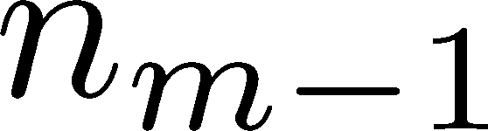

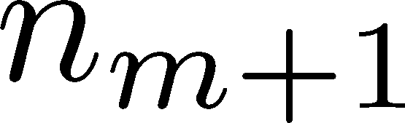
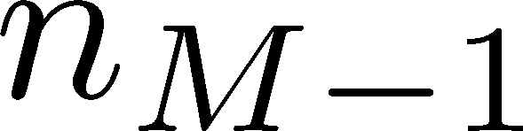


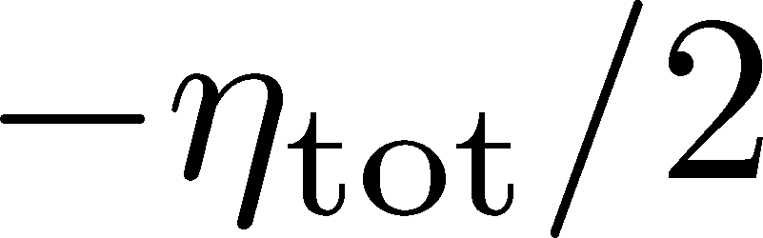
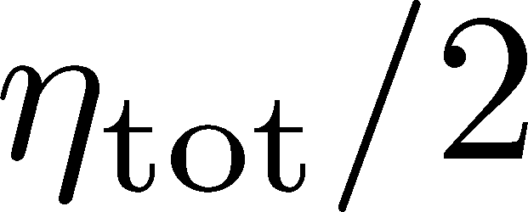
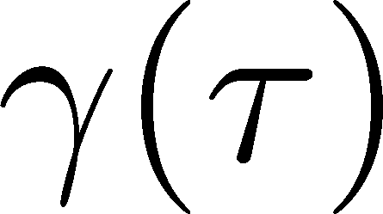

DME with Reflecting Boundaries
Sakaida, Kitazawa, M.A. , PRC 2014
reflecting boundaries
+
Diffusion Master
Equation
Boundary Condition(GCC Effect)
Particles do NOT flow in/out.
＊ Diffusion from Hadronization to Thermal Freeze-out
＊ Initial Condition : No Fluctuations
or Fluctuations in Thermal QGP
Rapidity Window Dependence of Charge Fluctuations

Slide 64
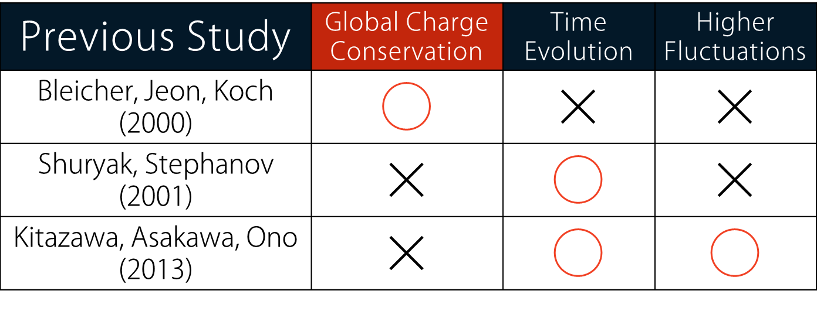


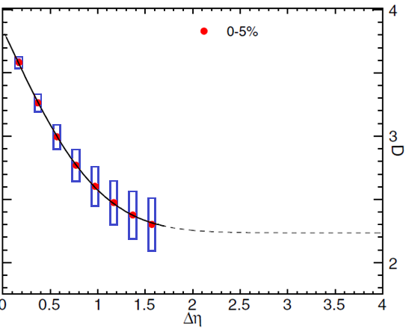
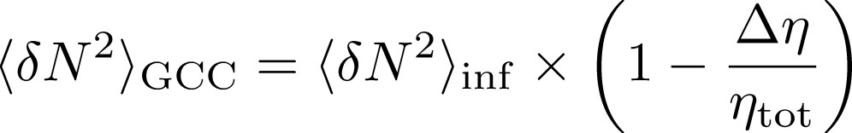



Diffusion + Global Charge Conservation
If one looks at the Total System,
#Conserved Charge
does NOT Fluctuate !!
※GCC Effect also causes Suppression !!
2nd order Fluctuation
Equilibrated Hadronic Value
(NOT Consider GCC Effect)
1
GCC
Naïve Estimate of GCC Effect
0
: Rap. Win.
Bleicher, Jeon, Koch (2000)

Slide 65








Boundary Effect
: Average
Diffusion Length
Infinite Sys.
(No GCC Effect)
: Diffusion
Coefficient
: Total Rapidity
Length

Slide 66
Boundary Effect
: Average
Diffusion Length
Infinite Sys.
(No GCC Effect)
: Diffusion
Coefficient
effect of
GCC
effect of
GCC
: Total Rapidity
Length

Slide 67












Physical Interpretation
: Average Diffusion Distance
: Diffusion Coefficient
: Total Length of Matter
Time Passes…
Condition for effects of the GCC
Effects of the GCC appear
only near the boundaries.

Slide 68





Another View: Time Evolution
: Average
Diffusion Distance
Equilibrium
: Diffusion
Coefficient
↑Time Passes…
: Total Rapidity
Length
Boundaries

Slide 69
Another View: Time Evolution
: Average
Diffusion Distance
Equilibrium
: Diffusion
Coefficient
GCC Effect !!
: Total Rapidity
Length

Slide 70



Comparison with ALICE Data
η_{tot}=8
without initial fluc.
with initial fluc.
GCC Effect is
almost negligible !
: Average
Diffusion Distance
: Diffusion
Coefficient
GCC Effect
Pb-Pb, 2.76TeV

Slide 71


Kurtosis
+ Initial Fluctuation
No Initial Fluctuation
Again, GCC Effect appears ONLY near Boundaries !

Slide 72







Conclusion 4
Global Charge Conservation is important even at LHC
Suppression of Charge Fluctuation observed @ALICE
→ Global Charge Conservation
Fluctuations are NOT Equilibrated!!
Information on
＊Fluctuation in QGP
＊Time Evolution
＊Diffusion Coefficient
…etc.
is encoded
Sakaida, Kitazawa, M.A., PRC 2014

Slide 73
Time Evolution of C.C. fluctuation
Quark-Gluon Plasma
Hadronization
Freezeout
In the Δη dependence of C.C. Fluctuation, history of system is encoded

Slide 74
Theoretical Side
t
Δη
N_{Q}
z
Δη
Fluctuation of conserved charges in Δη (space-time rapidity)
What is usually calculated

Slide 75

Experimental Side
Detectors (usually) cover Δy ((pseudo) rapidity)

Slide 76
Relation between y and η ?

Slide 77
Relation between y and η ?
y =η in Bjorken picture
time t
Rapidity
kinetic freezeout
hadronization
thermal equilibrium
hadron phase
Momentum P_{z}
QGP phase
identified
(in Bjorken picture)
position z
Spacetime Rapidity
position z

Slide 78
Relation between y and η ?
y =η in Bjorken picture
time t
Rapidity
kinetic freezeout
hadronization
thermal equilibrium
hadron phase
Momentum P_{z}
QGP phase
identified
(in Bjorken picture)
position z
Spacetime Rapidity
position z

Slide 79
But this is a relation for FLOW rapidity
y =η in Bjorken picture
time t
Rapidity
kinetic freezeout
hadronization
thermal equilibrium
hadron phase
Momentum P_{z}
QGP phase
identified
(in Bjorken picture)
position z
Spacetime Rapidity
position z

Slide 80
But this is a relation for FLOW rapidity
Blurring
y =η in Bjorken picture
time t
Rapidity
kinetic freezeout
hadronization
thermal equilibrium
hadron phase
Momentum P_{z}
QGP phase
identified
(in Bjorken picture)
position z
Spacetime Rapidity
position z

Slide 81
For a fixed (pseudo)rapidity
Leak
y =η in Bjorken picture
time t
Rapidity
kinetic freezeout
hadronization
thermal equilibrium
hadron phase
Momentum P_{z}
QGP phase
identified
(in Bjorken picture)
position z
Spacetime Rapidity
Blurring or Leak in rapidity
space takes place !
position z

Slide 82
Thermal Blurring or Leak
y =η in Bjorken picture
time t
is blurred in one particle
distribution owing to
thermal motion
kinetic freezeout
hadronization
thermal equilibrium
hadron phase
Accordingly, conserved charge
fluctuation (two particle correlation)
is modified
QGP phase
In the following, we use
boosted Maxwell-Boltzmann
distribution (with radial and
longitudinal flow)
position z
Blurring or Leak in rapidity
space takes place !

Slide 83
Strategy: Chapman-Kolmogorov Equation
Chemical freeze-out
Diffusion
spacetime rapidity space
Kinetic freeze-out
Blurring (Leak)
spacetime rapidity space
→ rapidity space
Observables at (pseudo)rapidity y
Chapman-Kolmogorov Equation

Slide 84

Computing Net Charge Cumulants with Initial Fluc.
1. Assume diffusions of positive and negative charges are independent
2. Assume initial system is uniform and that fluctuation is local (fluctuations at
different points on the timelike initial hypersurface are not correlated)
3. From these assumptions and Chapman-Kolmogorov equation, we obtain

Slide 85
2nd and 4th Cumulants
2nd
4th

Slide 86

Concrete Forms of P₁ and P₂
Diffusion + Blurring(Leak)
Diffusion
Blurring(Leak)
Diffusion
Continuum limit of solution
of Diffusion Master Equation
Blurring(Leak)
Boosted Maxwell-Boltzmann distribution
y: rapidity of a particle, z=m/T, β : transverse flow velocity

Slide 87
2nd Cumulant without Diffusion or Blurring
2nd (full)
diffusion only
blurring only

Slide 88
2nd Cumulant without Diffusion or Blurring
diffusion only
blurring only
none (most papers)

Slide 89
Results

Slide 90

Blurring Effect and Transverse Flow β
Probability that a particle
at η = 0 has rapidity y
1.2
0.8
0.4
0
m = 140 MeV
T = 100 MeV
β = 0
P₂(0→y)
β = 0.2
β = 0.4
β = 0.6
β = 0.8
-3 -2 -1 0 1 2 3
rapidity: y
The larger β, the less blurring. This is a relativistic effect.
transverse
boost by β

Slide 91

Result (with β=0)
Detector coverage
4
3.2
2.4
1.6
0.8
0
(in rapidity space)
D-measure
Diffusion only
Blurring only
0 0.5 1 1.5 2 2.5 3 3.5 4
Diffusion + Blurring
Δy
m = 140 MeV
T = 100 MeV
β = 0
Initial fluctuation
Initial fluctuation
= 0
Thermal fluctuation in hadron phase
( D : diffusion const. )
Sakaida, Asakawa, Kitazawa, PRC 2014

Slide 92


Result (with β≠0): Blurring only
4
3.2
2.4
1.6
0.8
0
β = 0.65, T = 100 MeV
(centrality: 0 – 5 %)
β = 0.57, T= 120MeV
(centrality: 40 – 50 %)
D-measure
peripheral
central
0 0.5 1 1.5 2 2.5 3 3.5 4
Δy
Initial fluctuation
Initial fluctuation
= 0
The more central,
the less blurring
(because of lower T)
Thermal fluctuation in hadron phase

Slide 93

Comparison with ALICE result: Blurring only
Initial fluctuation
Initial fluctuation
Initial fluctuation
= 0
Initial D-measure
= 0.5
Thermal fluctuation in hadron phase
Thermal D-measure in hadron phase
4
4
4
4
3.6
3.6
3.6
3.2
3.2
3.2
3.2
D
2.4
D
2.8
1.6
2.8
2.8
2.4
2.4
2.4
0.8
2
0
2
2
0
0.5
1
1.5
2
2.5
3
3.5
Δy
0
0.5
1
1.5
2
2.5
3
3.5
Δy
Room for other effects
Only with blurring, the result
exceeds the experimental data
This init. cond. is rejected

Slide 94

Comparison with ALICE result: Blurring only
4
3.2
2.4
1.6
0.8
0
calculation, blurring only
β = 0.65, T = 100 MeV
(centrality: 0 – 5 %)
D-measure
β = 0.57, T= 120MeV
(centrality: 40 – 50 %)
peripheral
central
0 0.5 1 1.5 2 2.5 3 3.5 4
Δy
・ Qualitatively similar
・ But note that
diffusion would give
opposite tendency
(more central = longer diffusion)
ALICE (exp)

Slide 95
Conclusion 5
We have developed a formulation to evaluate
the effects of diffusion and thermal blurring (leak)
for conserved charge fluctuation
We have assumed Bjorken scaling
(not essential in the formulation)
At lower energies (e.g., BES energies)
Violation of Bjorken scaling
(lost correspondence between spacetime rapidity and rapidity)
Larger effect of global charge conservation
(smaller system size)
Shorter diffusion duration, still blurring exists
(smaller time scale, but similar temperature scale)

Slide 96

Critical Phenomena + Time Evolution
Experiments cannot observe
critical fluctuation in equilibrium directly.
Generation + Growth
Critical fluctuations tend to develop.
But, relaxation toward equilibration is slow around CP because of the critical slowing down.
Disappearance by diffusion
Fluctuations developed at CP are diffused by the time evolution in later stage.

Slide 97
Example
Time evolution of correlation length
around CP with critical slowing down
Berdnikov, Rajagopal (2000)
Asakawa, Nonaka (2002)
~ distance from CP

Slide 98

Critical Fluctuation and Δη Dependence
CP
Time Evolution in HIC

Slide 99







Critical Phenomena and Diffusive Mode
Effective Potential
Soft mode
Soft mode of QCD CP
σ: fast damping
cf. Onsager relation
Evolution of baryon number density (slow and small k)
:parameters characterizing criticality

Slide 100








Parametrizing D and χ: critical + regular
Berdnikov, Rajagopal (2000)
Stephanov (2011)
Mukherjee, Venugopalan, Yin (2015)
model-H (3d-Ising)
mapping to (T,μ) / time evolution
1D Bjorken expansion
0
(reduced temperature)
crossover (r>0)
QCD CP at T=160MeV
kinetic f.o. at T=100MeV
critical
slowing down

Slide 101


Mapping from 3-d Ising to QCD
3d Ising
T
Hadrons
0
μ

Slide 102



Cumulant and Correlation Function
total charge
charge density
2nd order cumulant
(fluctuation)
correlation function
1-to-1 correspondence
1-dim case

Slide 103




Time Evolution 1, Fluctuation: No CP

Slide 104


Time Evolution 1, Correlation: No CP
[fm]
monotonically decreasing
Analytic
result
monotonically
increasing
monotonically
decreasing

Slide 105







Time Evolution 2, Fluctuation: With CP
[fm]
Non-monotonic Δη dependence manifests itself
Robust experimental evidence of
the existence of a peak in χ(T)

Slide 106






With Narrower Critical Region
[fm]
non-monotonic
behavior
Peak in

Slide 107

Time Evolution 2, Correlation: With CP
[fm]
non-monotonic Δy dep.
Analytic
result
non-monotonic
non-monotonic

Slide 108


Comparison: Fluctuation and Correlation
Non-monotonicity in K(Δy) disappears
But C(y) is still non-monotonic
Analytic
result
no information on
monotonic
C(y) is better to see non-monotonicity.

Slide 109
Away from CP (Crossover)
Signal of the critical enhancement can be clearer along paths away from the CP
Away from the CP: Weaker critical slowing down

Slide 110
Mapping from 3-d Ising to QCD
3d Ising
T
Hadrons
0
μ

Slide 111
Away from CP (Crossover)
Signal of the critical enhancement can be clearer along paths away from the CP
Away from the CP: Weaker critical slowing down

Slide 112


Conclusion 6
K(Δy) or C$(\overline{y}$) is non-monotonic
χ(τ) is non-monotonic
Inverse is NOT necessarily true
C$(\overline{y}$) is more sensitive to CP
This result assumes Bjorken 1d flow
For lower energy, more realistic
set-ups are necessary

Slide 113

Equivalent statements
K(Δy) or C$(\overline{y}$) is non-monotonic
χ(τ) is non-monotonic
Contraposition
χ(τ) is monotonic
K(Δy) or C$(\overline{y}$) is monotonic

Slide 114

Conclusion 6
K(Δy) or C$(\overline{y}$) is non-monotonic
χ(τ) is non-monotonic
Inverse is NOT necessarily true
C$(\overline{y}$) is more sensitive to CP
This result assumes Bjorken 1d flow
For lower energy, more realistic
set-ups are necessary

Slide 115

In Summary
Third moments of conserved charges carry
important information on fluctuation and EOS
Proton number is a proxy of baryon number
Freeze-out parameters: lattice meets experiment
Global Charge Conservation is important even at LHC
Each of these needs to be reconsidered again
Correspondence between space-time distribution
and momentum space observables should be examined
carefully in interpreting experimental results
To understand Critical phenomena, it is necessary to
to understand time evolution
K(Δy) or C$(\overline{y}$) is non-monotonic, then χ(τ) is non-monotonic

Slide 116
Dilute Nucleon Approximation
Nucleons have no correlations
with one another
+ Ignore NN collisions
hadronization
chem. f.o.
kinetic f.o.
rare NN collisions
no Pauli blocking
mesons
baryons
many pions

Slide 117
Probability Distribution
In the dilute nucleon approximation, N_{N}^{(net)} and N_{N}^{(tot)} are conserved, i.e.
are conserved separately
When are fixed
and hadron phase is long enough compared to the mean free
time of (anti)nucleons, the final state (anti)proton distribution is given
by the binomial distribution

Slide 118
Probability Distribution
As a result, the final state distribution is factorized as follows:
The two variable function “F” includes the initial information (correlation)
This form of P_{f} enables to relate proton moments and nucleon moments

Slide 119











N_{N} or N_{B}: Strange Baryon Contribution
Strange baryon contribution is mainly from Λ and Σ
Branching Ratios:
Decay modes:
Λ+Σ go to p and n with approximately
equal probabilities, 1:1
(Anti)protons from these decays can be
incorporated into the binomial distribution,
then, N_{N}→N_{B}
Notes:
119

Slide 120

Theoretical & Experimental Questions
Isn’t the effect of Δ included in theoretical calculations?
STAR, PRL(2010)
 | Final State Interaction
AMPT, URQMD | YES
HRG, THERMINATOR, HIJING | NO
But none of them includes effects of the critical point

Slide 121

Theoretical & Experimental Questions
(HIJING+GEANT) - HIJING < 0
detector efficiency ⇒ Poissonian
κσ² → 1
Poissonian case (no correlation)
STAR PRL(2010)

Slide 122


Cumulants ${\left\langle {\left(δN\right)}^{n}\right\rangle }_{c}$
Quanta characterizing
the Probability Distribution
Kurtosis (4th)
Skewness (3rd)
Variance (2nd)

Slide 123


Stochastic Diffusion Eq. and DME
Stochastic Diffusion Eq.
Diffusion Master Eq.

Slide 124





Parameters
Initial Fluctuation
Small compared with Equilibrated Hadronic Value
Large?
Free Parameter
: Average
Diffusion Distance
: Diffusion
Coefficient
: Total Rapidity
Length

Slide 125

Fluctuation in QGP
QGP
Just after Hadronization
NOT Change!!
Assumption
・Fluctuation does not change just after hadronization
・Thermal Value in the final QGP State

Slide 126







Diffusion Constant
Assuming ,
Const.
In Cartesian Coordinate,
Total Rap. Length:
Hadronization Time:
Freeze-out Time:
Comparison with data→
We can estimate Diffusion Const.

Slide 127
Diffusion + Global Charge Conservation
If one looks at the Total System,
#Conserved Charge
does NOT Fluctuate !!
※GCC Effect also causes Suppression !!
2nd order Fluctuation
Equilibrated Hadronic Value
(NOT Consider GCC Effect)
1
GCC
Naïve Estimate of GCC Effect
0
: Rap. Win.
Bleicher, Jeon, Koch (2000)

Slide 128

Charge Density Distribution @ALICE Pb-Pb 2.76 TeV
ALICE, PRB 276 (2013) 610-622

