Slide 1
Proposal for Construction of the World’s First γγ Collider and Application as a Multi-Beam User Facility
Weiren Chou
For the γγ Collider Study Group
Presentation at the CEPC for Light Source Workshop
December 7, 2017, IHEP

Slide 2
Acknowledgement
IHEP:
    Zhang Chuang, Huang Yongsheng, Zhang Chunlei, Lv Junguang, An Guangpeng, Chi Yunlong, Pei Shilun, Pei Guoxi, Zhang Jingru, Li Jingyi, Liu Weibin, Chen Yuan
Tsinghua U.
Lu Wei, Du Yingchao
Beihang U.
Shen Chengping, Sun Baohua
Japan
T. Takahashi, K. Yokoya, K. Homma
Italy
Luca Serafini, Vittoria Petrillo, Massimo Ferrario
France
Amplitude Technology
USA
Chris Barty, Bob Byer, Almantas Galvanauskas, Russell Wilcox , Mayda Velasco
Russia
V. Telnov

Slide 3
Particle Colliders Built in the Past 50 Years
20+
5
1
0
0
Starting in mid 1960s, we have built more than 20 ee colliders.
We have also built 5 pp and ion-ion colliders as well as one ep collider.
But we never built any muon collider because technically it is very difficult.
We did not built any γγ collider either (for different reason). But today, it is a right time to do so.

Slide 4
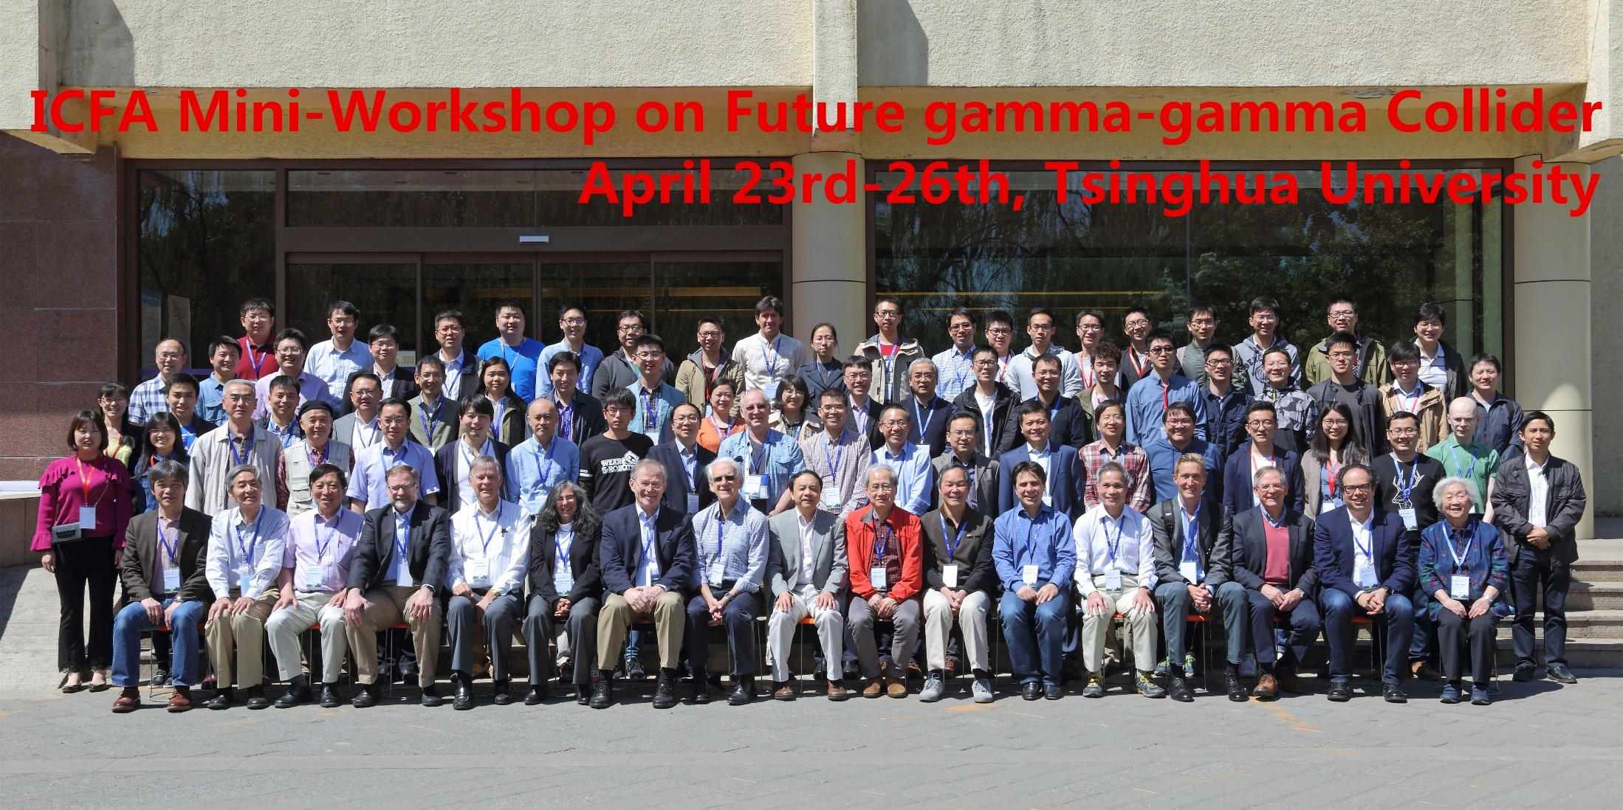
ICFA Mini-Workshop on γγ Collider (April 2017, TU)
~100 participants from 9 countries
A joint stage of several scientific communities: HEP (γγ) + NP (γ-ray) + accelerator + laser

Slide 5
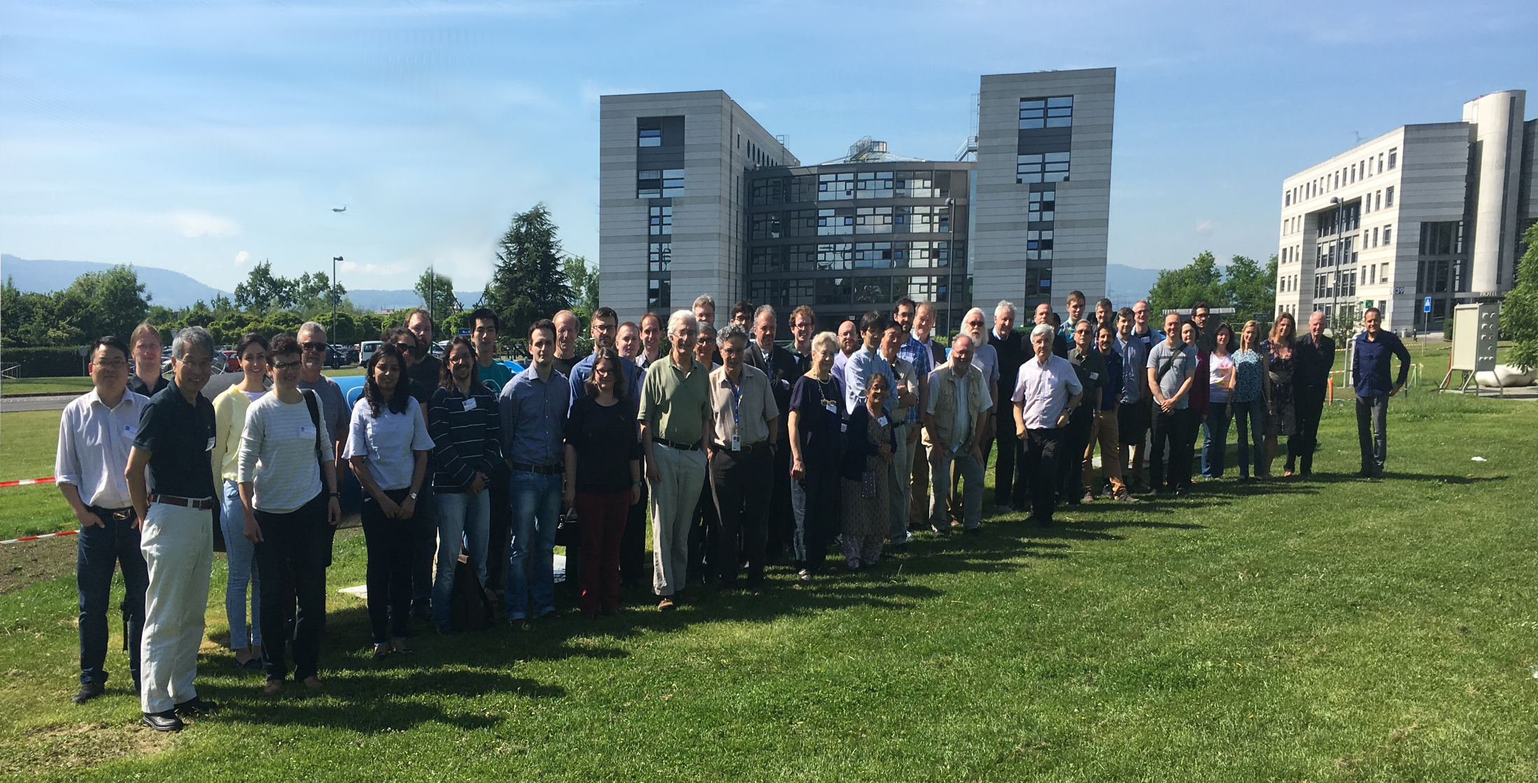
Photon 2017 Workshop (May 2017, CERN)

Slide 6
A Brief History of γγ Collider
1980’s:
  BINP proposed this idea for VLEPP, followed by SLAC for SLC.
1990’s:
  Various linear collider proposals (NLC, JLC, Tesla, etc.)
  Each one included a γγ collider as an add-on.
2000’s:
  All LC proposals consolidated to the ILC.
  In 2007, GDE released the ILC cost estimate (US$ 6.74 billion plus 24 million person-hours). US quickly pulled the plug; Japan also expressed concern about the high cost.
  In 2008, Sugawara (KEK) proposed to build a 90 x 90 GeV ee linac for a γγ collider as a precursor of the ILC.
  But in February 2009, ICFA rejected this proposal for three reasons:
    The physics of a γγ collider is not as strong as an e+e- collider
    The cost saving is not significant enough (US$ 3.52B + 12.5M psn-hrs)
    Need a big laser R&D program, which ICFA is not prepared to initiate

Slide 7
Why the Renewed Interest? (1)
There are three new developments after the 2009 ICFA decision.
No.1 – a new collaboration between ICFA and ICUIL
2010:
  For the first time the laser community came to the accelerator community and offered help to build future HEP colliders together.
  An ICFA-ICUIL Joint Task Force was formed, which organized two workshops and published a White Paper.
  γγ collider is a natural candidate for this collaboration.

Slide 9
ICFA-ICUIL Collaboration
A Marriage between Steel and Mirror

Slide 10
Why the Renewed Interest? (2)
No. 2 – the discovery of a low mass Higgs boson
2012:
  The Higgs boson was discovered at the LHC.
  Because of its low mass (125 GeV), everybody thinks he or she can build a Higgs factory, including:
      Linear collider
      Circular collider
      Muon collider
      Photon collider
  These four options were presented to the ICFA workshop HF2012 at Fermilab and a summary report was published.

Slide 11
Why the Renewed Interest? (3)
No. 3 – making case for a low energy γγ collider
2017:
  First proposed by Telnov at the 2017 γγ collider workshop
  Immediately received positive feedback from theorists, experimentalists, accelerator physicists and laser scientists.
  This would open up a whole new world for building a γγ collider in the near future as we have a number of electron machines working or worked in hundreds MeV, several GeV to tens GeV energy range.

Slide 12
γγ → η_{b} (V. Telnov)

Slide 13
γγ → ττ (M. Velasco)

Slide 14
I. Drebot et. al, PRAB 20, 043402 (2017)

Slide 15
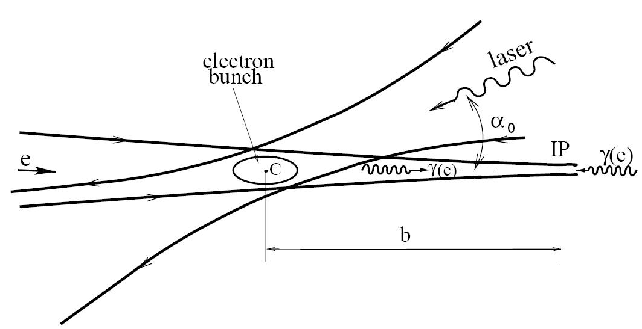
γγ Collider Principle
Two steps:
Inverse Compton Scattering (ICS) → high energy γ
γγ → H (bb, cc, ττ, γγ, e+e-)

Slide 16
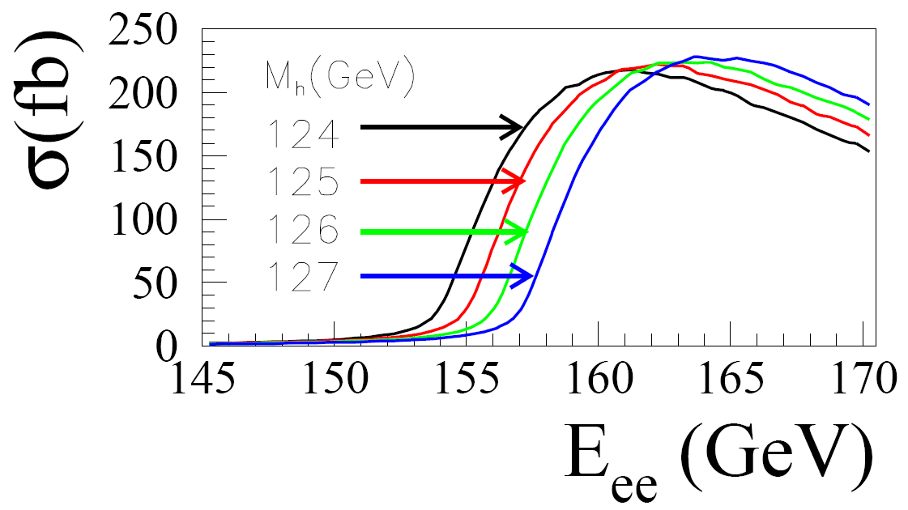
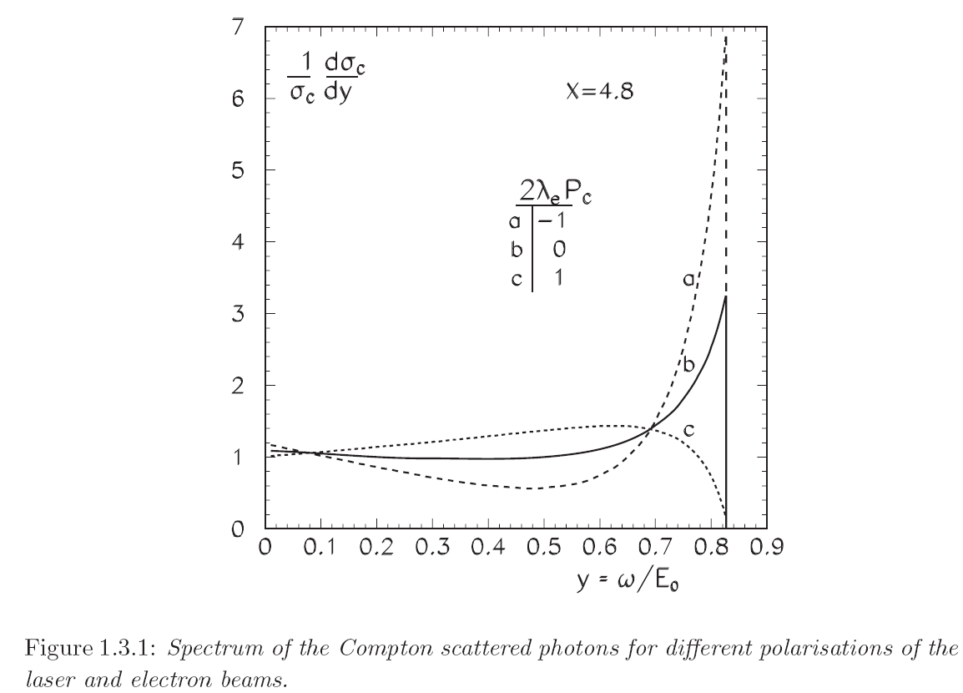

γγ Collider as a Higgs Factory
γγ → H cross section
Dependence of photon spectrum on polarization
Comparable to 240 GeV e+e- → ZH but only need 160 GeV

Slide 17
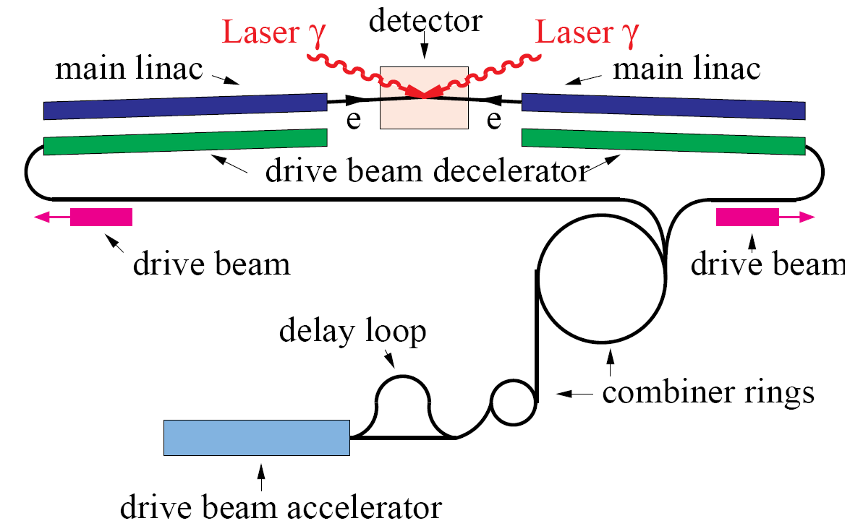
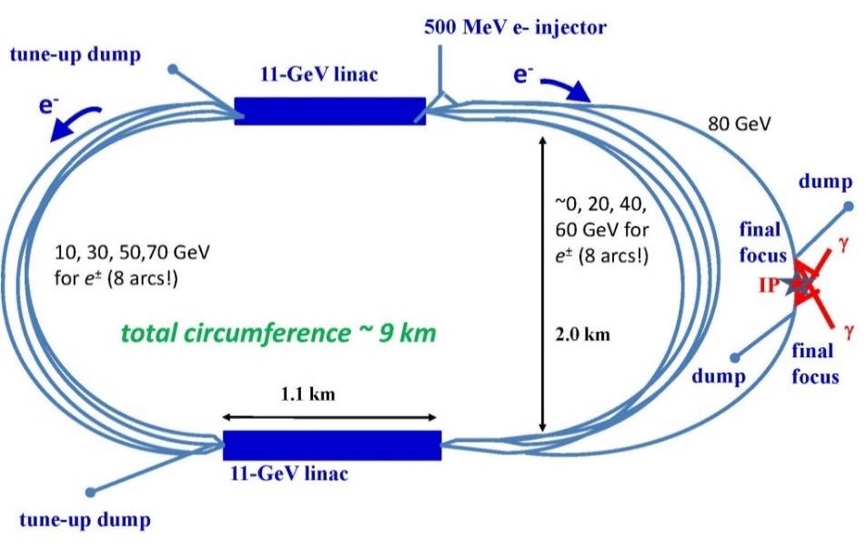
Various Proposals for Photon Collider
HFiTT
CLIC-based
SAPPHiRE
X band-based

Slide 18
CEPC as a γγ Higgs Factory
Goal: 10,000 Higgs/year
RF (650 MHz, 8 sets, 0.5 GV /set)
RF
RF
e‒ (80 GeV)
Fiber Laser
(0.351 μm, 5 J, 3 kHz)
γγ collision
(125 GeV)
e‒ (80 GeV)
RF
RF
e‒
80 GeV Booster
e‒
E = 80 GeV
ρ= 6000 m
U = 0.6 GeV/turn
I = 48 mA x 2
P(rf) = 58 MW
RF
RF
RF

Slide 19
Machine Candidates for a Low Energy γγ Collider
E0 (GeV) | λ (μm) | Eγγ (GeV, c.m.)
26 (HERA e-ring) | 1.064 | 16.6
18 (Euro XFEL) | 0.532 | 14
12 (Jlab) | 0.355 | 9.4
8 (KEKB, Spring-8, Sakura) | 0.355 | 4.8
6 (ESRF, HEPS) | 0.355 | 2.9

Slide 20
Machine Candidtes in China
Institution | Machine | Energy
IHEP | BEPC linac | 0.18 – 2.7 GeV
 | HEPS linac | 300 MeV
 | HEPS ring | 6 GeV
Tsinghua U. | TTX | 50 MeV
 | XGLS photoinjector | 130 MeV
 | XGLS linac | 400 MeV
USTC | Hefei Light Source linac | 800 MeV
Shanghai | SSRF linac | 150 MeV
 | SSRF ring | 3.5 GeV
 | SXFEL linac | 0.8 – 1.3 GeV
 | HXFEL linac | 8 GeV
(red: under construction or approved for construction)

Slide 21
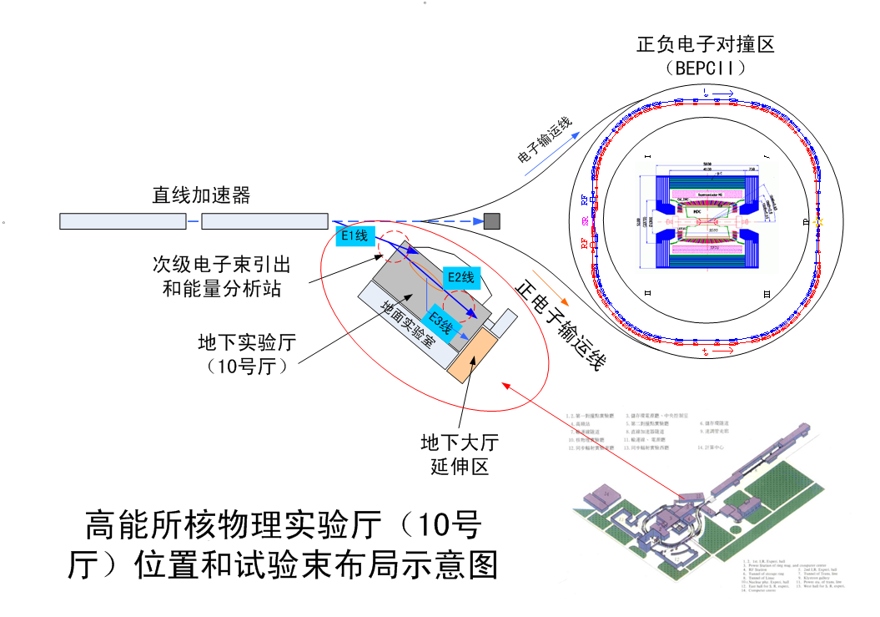
BEPC Ring, Linac and Hall #10
N
S

Slide 22
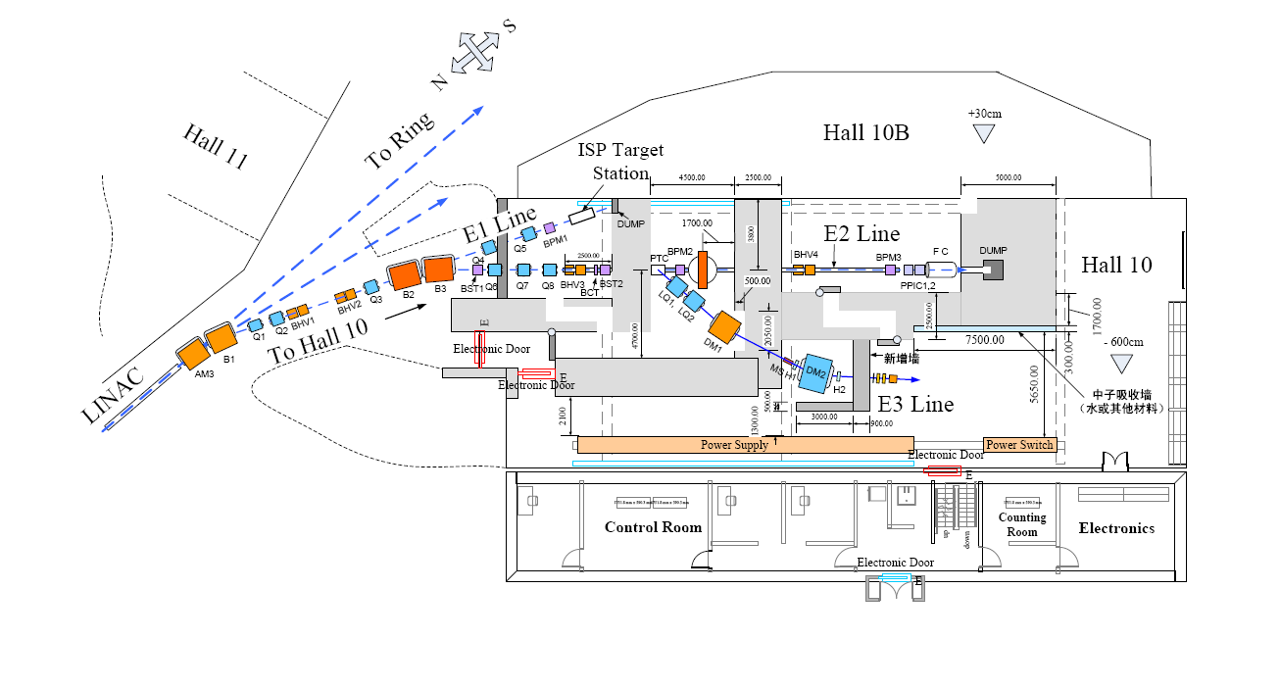
Hall #10 – Present Layout

Slide 23
How to build a γγ Collider in Hall #10
w
3.8m
2 e- pulses from BEPC Linac
200 MeV, 2x2 nC, 50 Hz
e-
Arc A
Bρ = 0.6 T-m
14m
e-
e-
Arc B
Laser
(1 μm, 2 J, 1 ps, 50 Hz)
FFS
e-
γ
γ
e-
FFS
γγ collision
(1 MeV c.m.)
35m
Two unique experiments:
  γγ → γγ scattering: predicted (Halpern) but never observed in the laboratory
  γγ → e⁺e⁻: predicted (Breit-Wheeler) but never observed in the laboratory

Slide 24
γγ → γγ
~E_{γ}⁶
γγ → e⁺e⁻
Edoardo Milotti (LNF-IRIDE)

Slide 25
Photon Spectrum
Unpolarized Electron
Polarized Electron

Slide 26
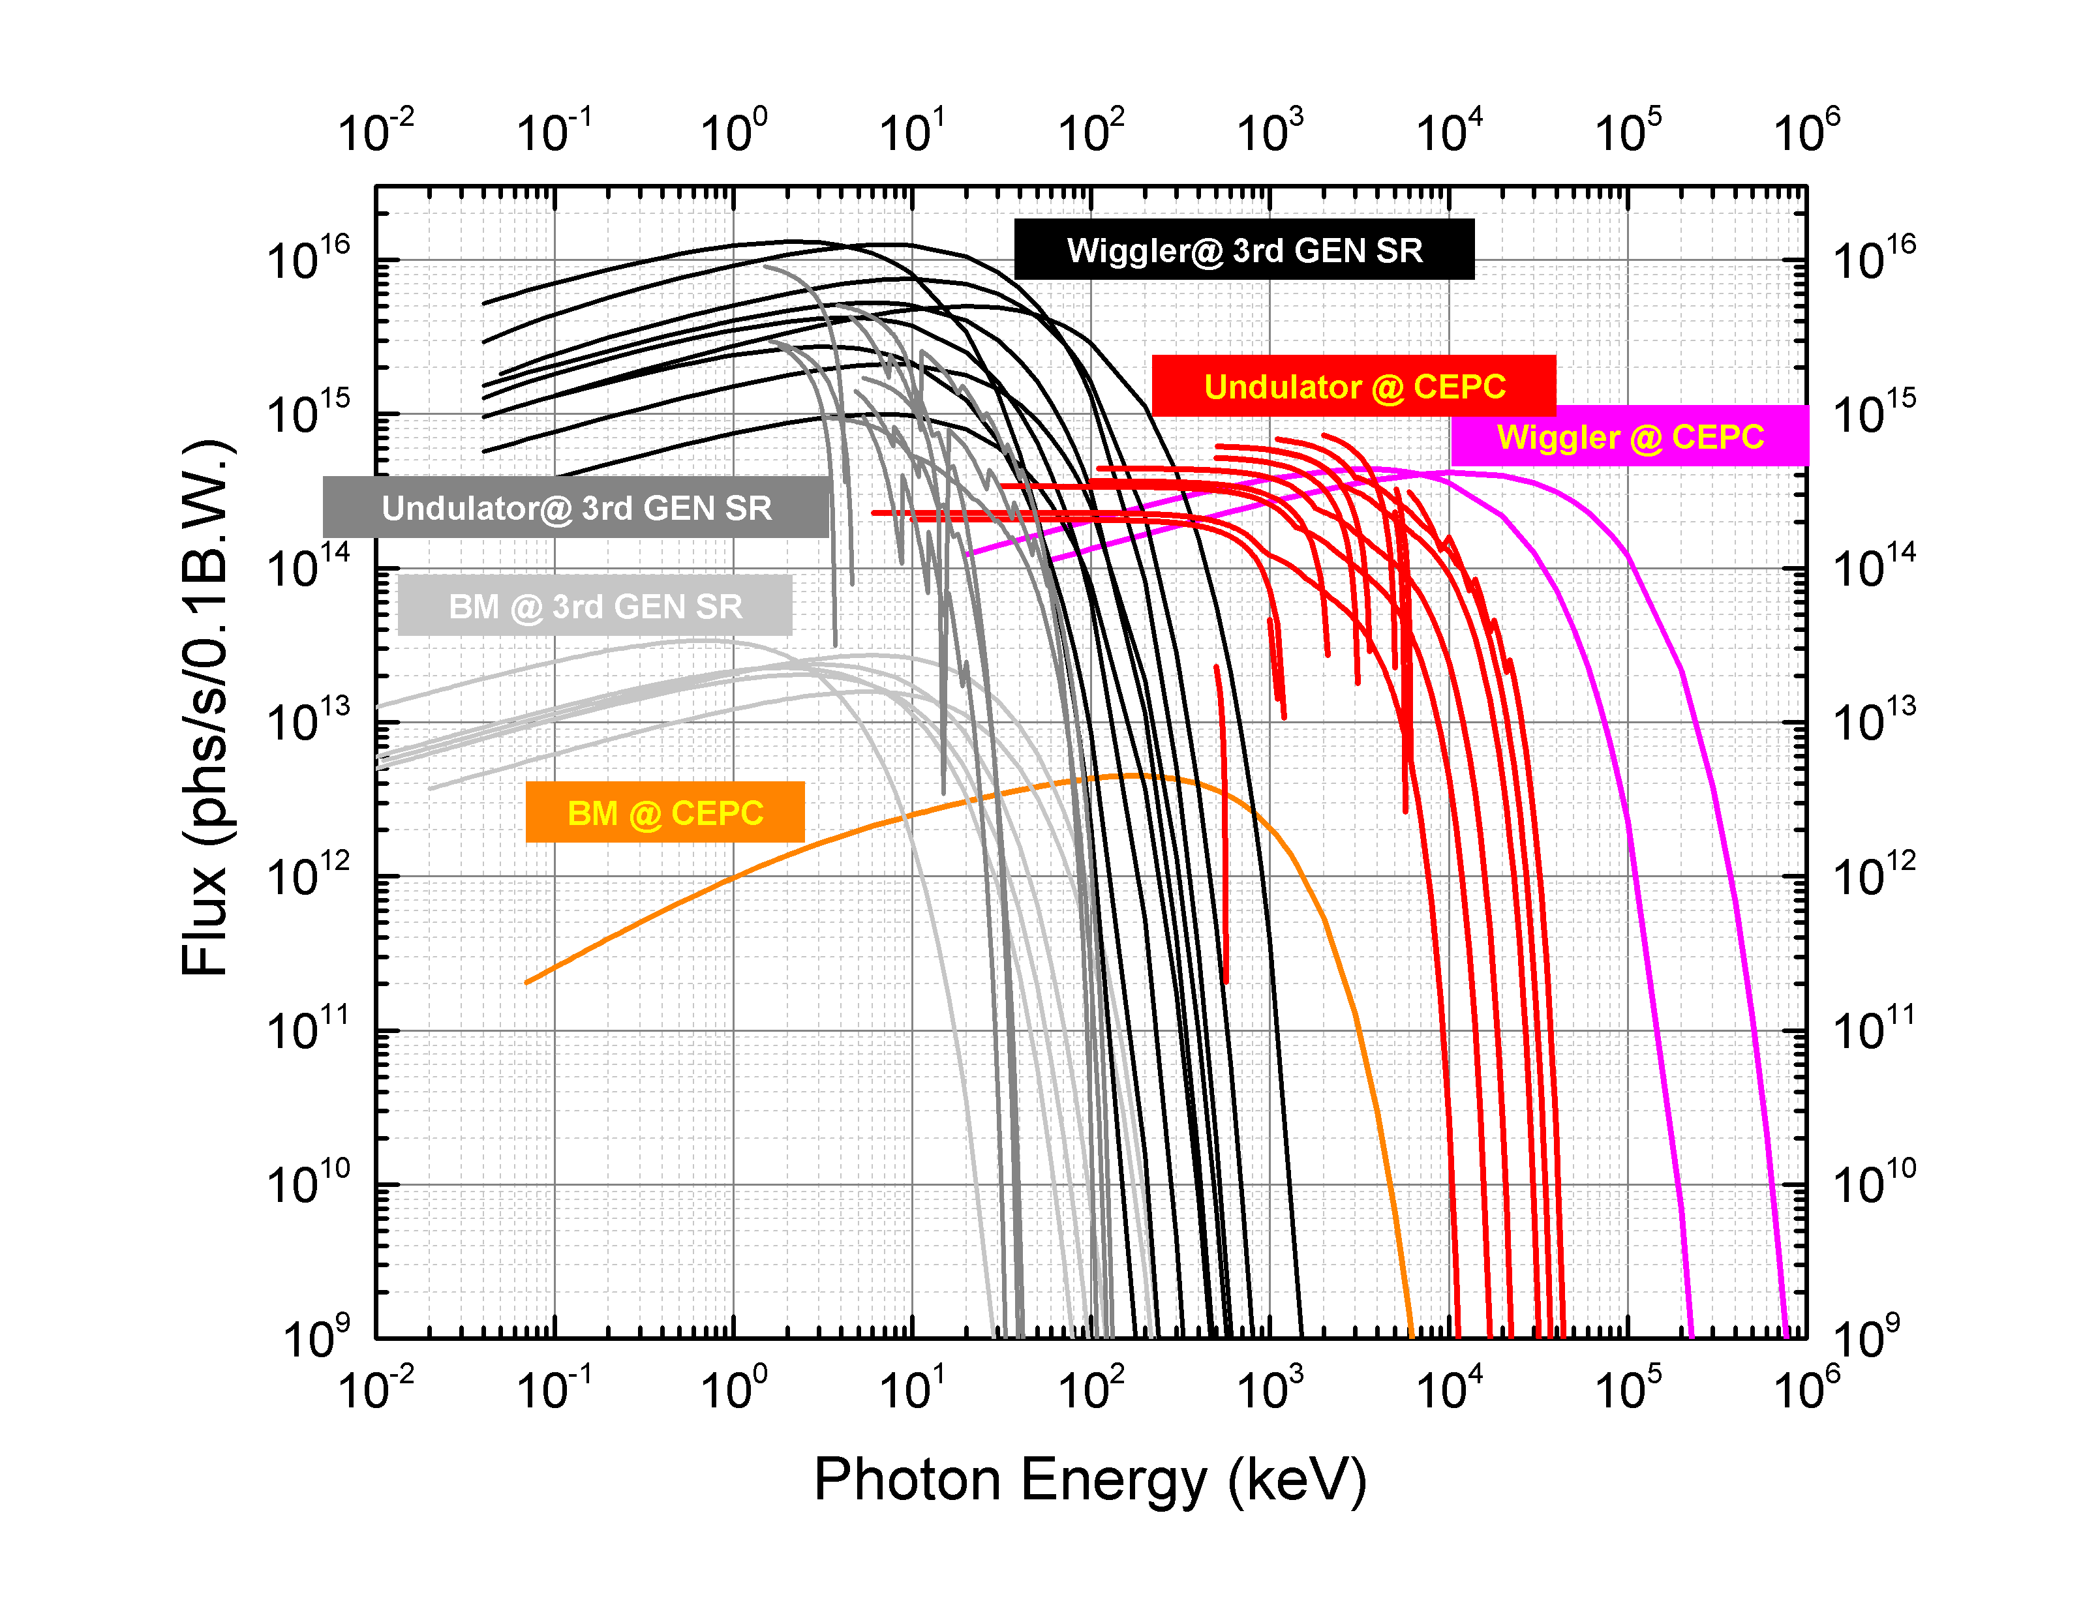
Compared to CEPC Photon Spectrum
Figure A4.2: The flux of bending magnet, wiggler, undulator and Low K undulator of a γ-ray beam at CEPC.

Slide 27
200 MeV Linac with Photo-injector
(T. Takahashi)
L vs σ(x)
L vs θ
Total
Total
E > 0.9 MeV
E > 0.9 MeV
for 0.9MeV < W
for all energy

Slide 28
Preliminary Parameters (T. Takahashi)
Laser |  | Electron
Wave Length(μm) | 1.054 | Energy(MeV) | 200
size at focus RMS (μm) | 5 | bunch charge(nC) | 2
Rayleigh Range(μm) | 298 | size at IP (μm) | 2
Pulse energy (J) | 2 | emittance (μm) | 6.39e-3
Pulse Length(μm) | 300 (1 ps) | beta* (μm) | 626
Repetition (Hz) | 50 | bunch length (mm) | 0.6
crossing angle(mr) | 167 | Repetition (Hz) | 50
IP-CP distance(μm) | 313 | crossing angle (mr) | 0
nonlinear parameter a0 | 0.45 | geometric luminosity | 1.6E28
Event rate:
  γγ → γγ: L = 1 x 10²⁷, σ = 3 μb ⇒ several events per hour (40,000 events/ year)
    (Comparable to the Higgs rate in CEPC, in which the luminosity is higher by 7 orders of magnitude, but cross section is smaller by 7 orders of magnitude)
  γγ → e⁺e⁻: L = 1 x 10²⁷, σ = 100 mb ⇒ 100 events per second

Slide 29
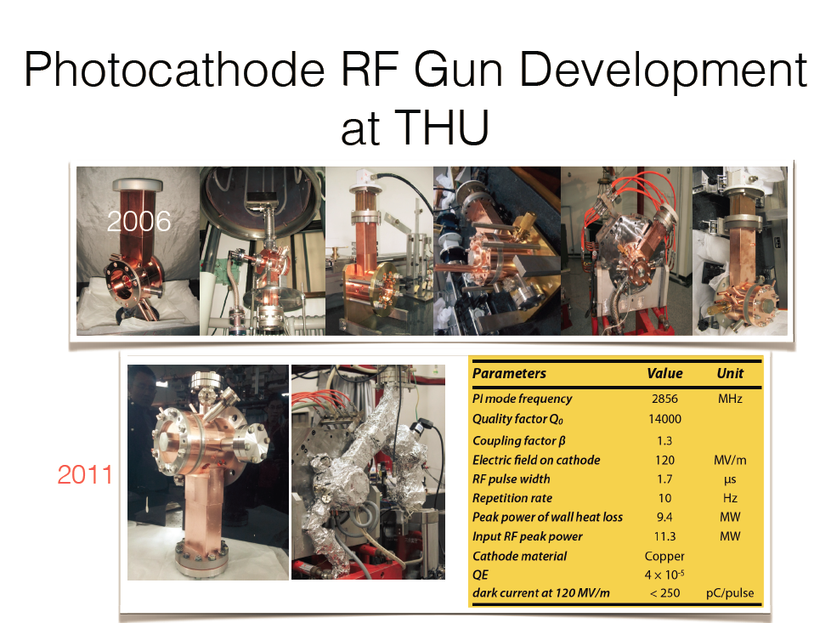
Y. Du

Slide 30
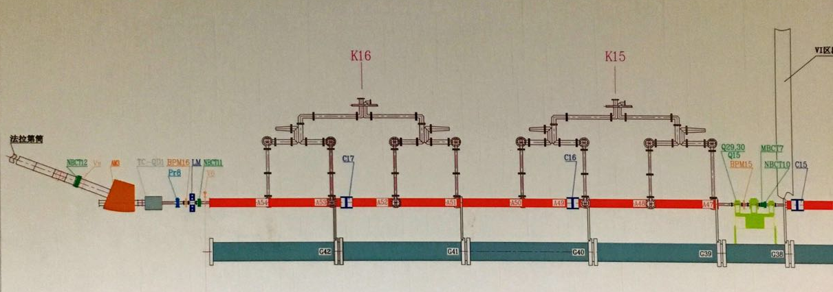
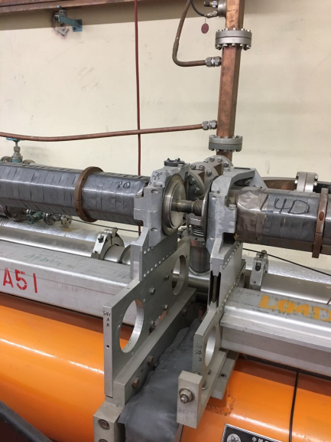
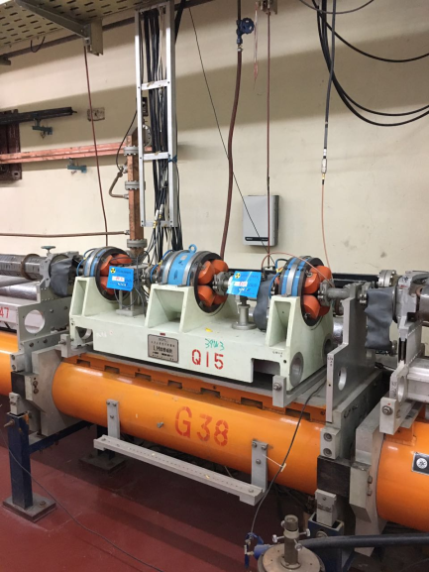
The last ~200MeV section of the BEPCII linac
S. Pei
No space at this location!
Possible injection point for the photoinjector beam!

Slide 31
The possible linac layout #2 for the gg collider
S. Pei
K16
K15
K
B1
A
RF GUN
Photoinjector beam
AM3
A54
A53
A52
A51
A50
A49
A48
A47
B2
A46
Linac beam
The last ~200 section of BEPCII linac
The existing linac
1 RF gun
1 accelerating structure
1 klystron
2 bending magnets
1 laser system
1 solenoid
New compact triplet to replace the old one
……

Slide 32
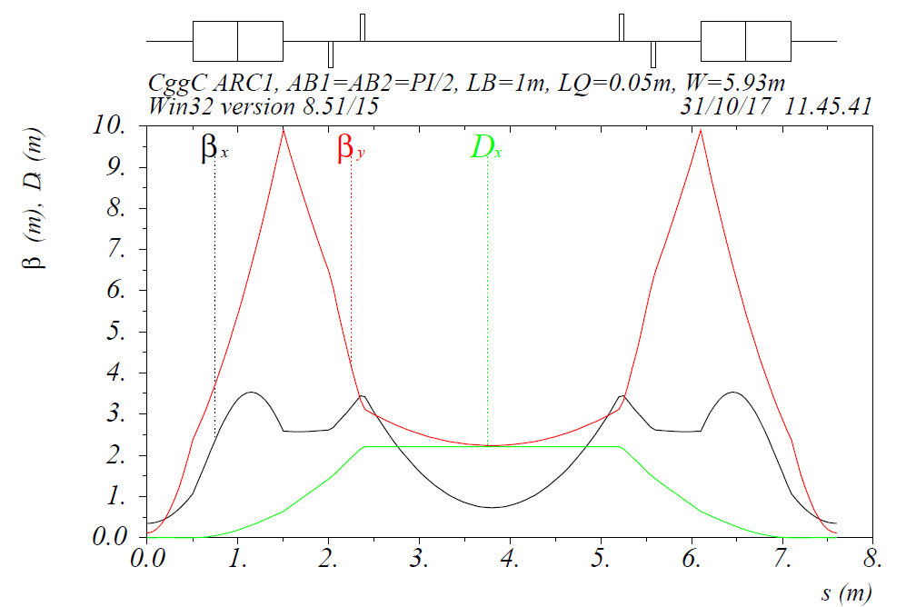
Δμ_{x}=π
C. Zhang
Arc A
μ_{x1}=0.384π
Δμ_{x}=π
μ_{x1}=1.384π
L_{Q}=0.1m
L_{B}=1.0m
D_{x}= 0.0 m

Slide 33
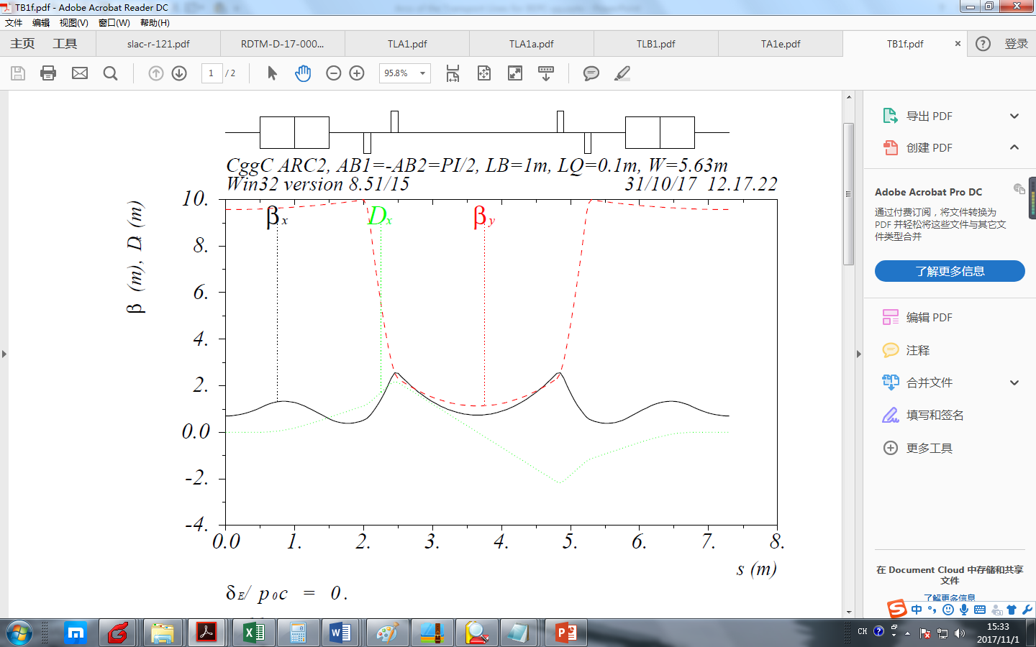
Δμ_{x}=2π
C. Zhang
Arc B
μ_{x1}=0.384π
Δμ_{x}=2π
μ_{x1}=1.384π
L_{Q}=0.1m
L_{B}=1.0m
D_{x}′= 0.0 m

Slide 34
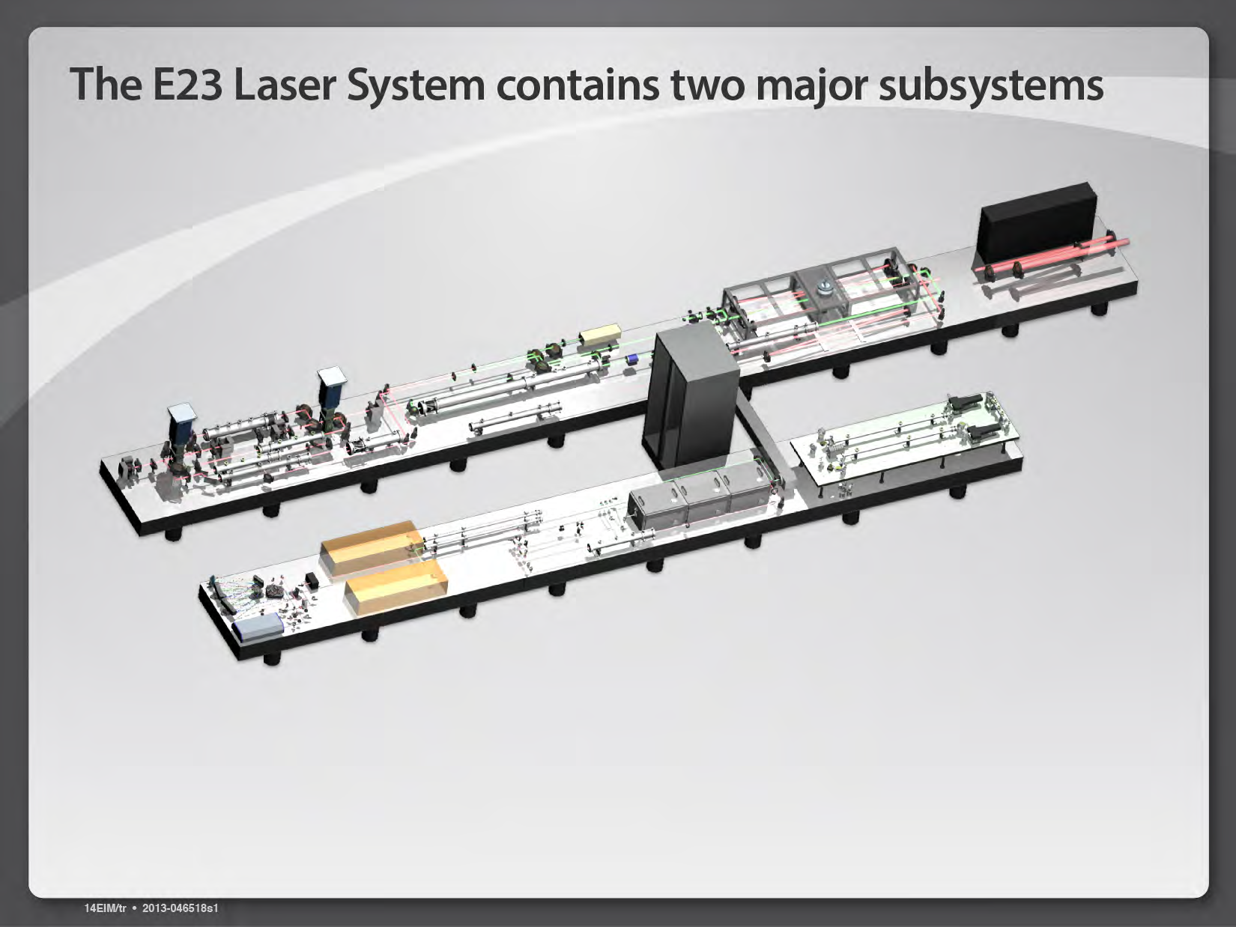
Laser Reference – HAPLS (ELI-E23)
80

Slide 35
Laser Reference – CSU

Slide 36
Laser Reference – Amplitude Technology

Slide 37
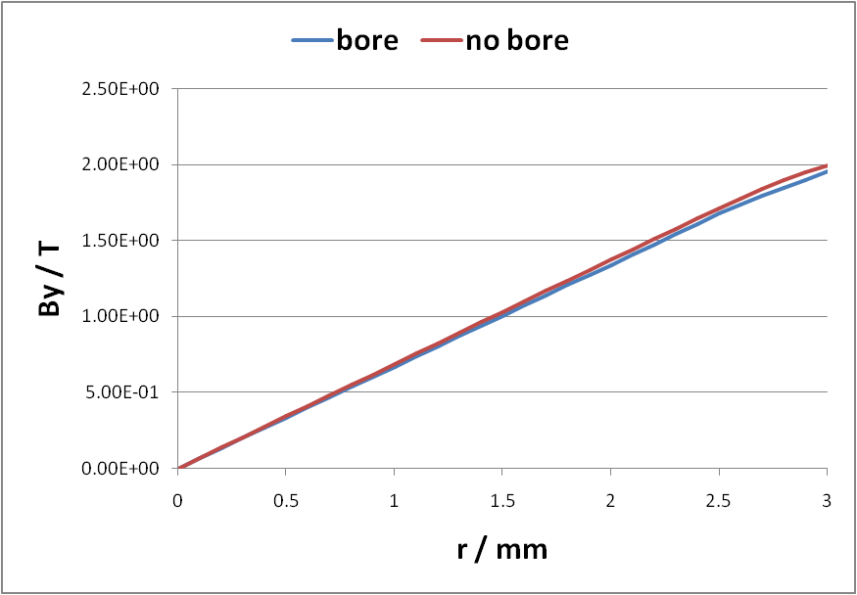
16-piece PMQ Design (Y. Chen, Y. Huang)
2.0 T vs. 1.95T @ 3mm
80

Slide 38
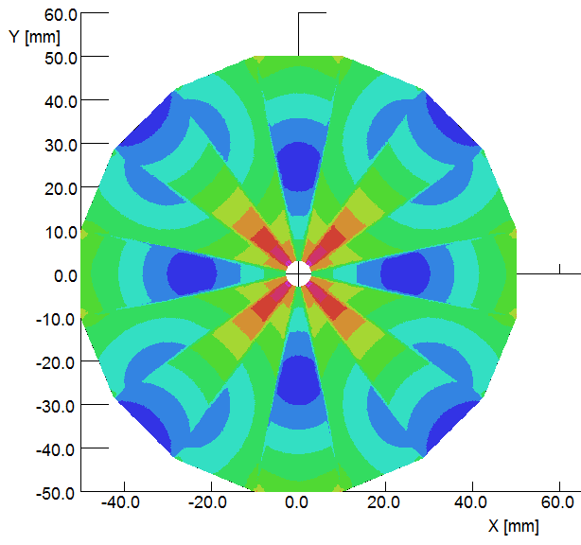
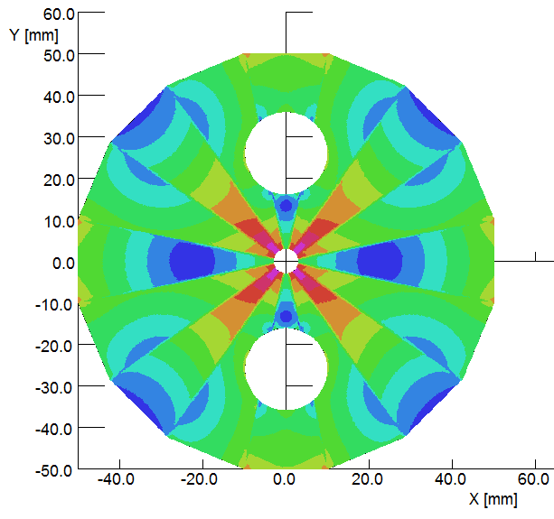
PMQ Field Distribution (Y. Chen, Y. Huang)
1.996T VS 1.952T,
665T/m VS 650T/m

Slide 39
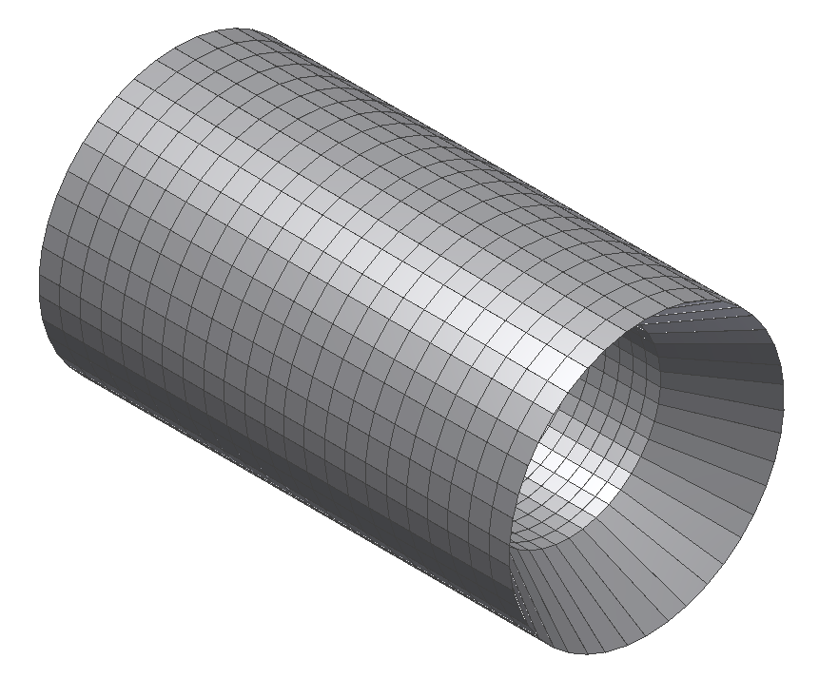
Detector Design (Y. Huang, C. Zhang, J. Lu)
Detector dimension
  Length =76cm
  Inner diameter = 40cm
  Thickness = 6cm
CsI cristal
  46 Lines,
  23 crystals per line
  966 crystals
PS detector
  Attached in front and inner side of the crystal
  Thickness = 1cm .

Slide 40
Detector Simulation (T. Takahashi, B. Sun)
Detection simulations design, resolution, efficiency, background …
Physics simulation γγ→ γγ, γγ→ e⁺e⁻, γe⁻ → γe⁻ …
Shielding design and simulation beam Scattering, collimation design…
  The study gets under way

Slide 41
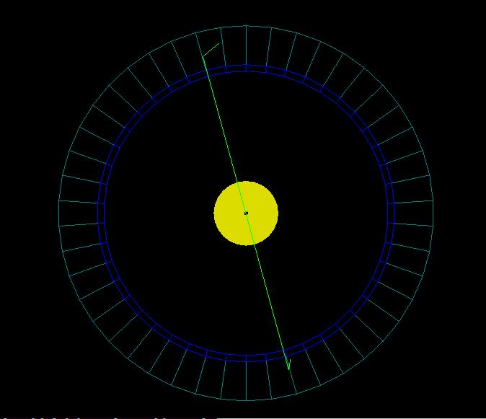
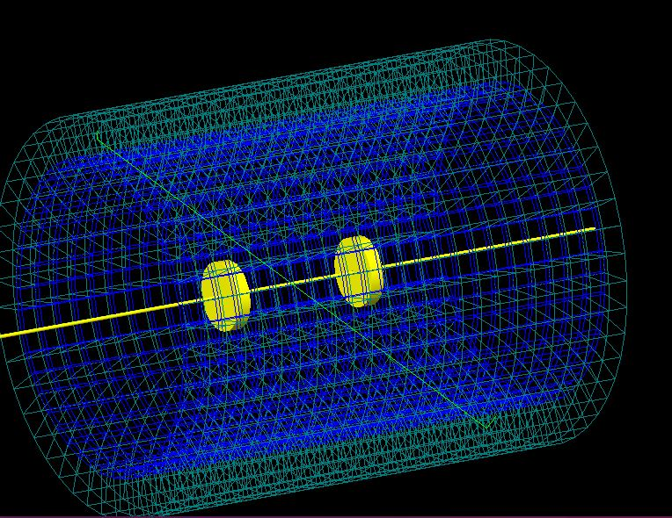
Detector Simulation (T. Takahashi, B. Sun)
Back to back photons 0.0019 events/s

Slide 42
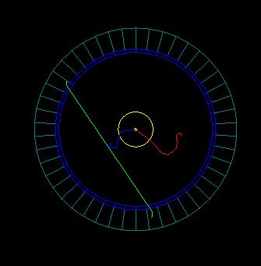
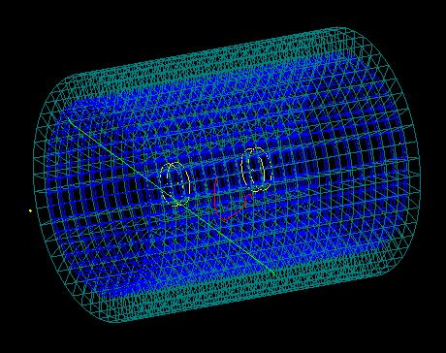
Detector Simulation (T. Takahashi, B. Sun)
Low momentum e⁺ e⁻ not back to back 64 events/s

Slide 43
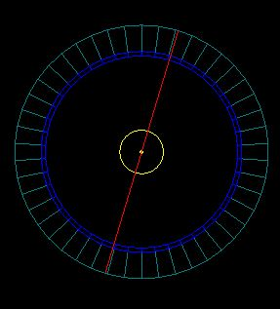
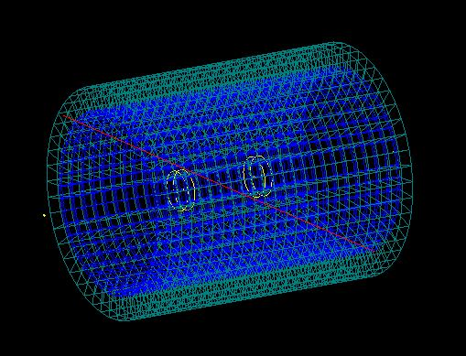
Detector Simulation (T. Takahashi, B. Sun)
Back to back e⁻ e⁻ 0.5 events/s

Slide 44
GEANT4 Simulation (K. Homma et al.)
γγ → γγ
e⁻e⁻ → e⁻e⁻

Slide 45
Interaction Region – CP and IP
The distance between FFS quad to IP is chosen as 10 cm for study.
Needs to be optimized together with crossing angle and FFS design.

Slide 46
Luminosity vs. crossing angle
(T. Takahashi)
Total
167 mrad
E > 0.9 MeV

Slide 47
γγ Collider as a Multi-Beam User Facility
w
3.8m
2 e- pulses from BEPC Linac
200 MeV, 2x2 nC, 50 Hz
e-
Bρ = 0.6 T-m
14m
e-
e-
Laser
(1 μm, 2 J, 1 ps, 50 Hz)
High intensity
γ-ray station
γ
e-
γ
γ
e-
γ
High intensity
γ-ray station
FFS
FFS
γγ collision
(1 MeV c.m.)
e-
e-
High power high rep rate laser station
High power high rep rate laser station
200 MeV, 20 W
high brightness
e- beam station
35m
200 MeV, 20 W
high brightness
e- beam station

Slide 48
Potential Users in China (黄永盛)
高重复频率强激光实验站：
  这个激光器2J，1ps，50Hz，如果激光聚焦条件为4微米（直径），局部功率密度可以达到10的19次方W/cm^2，这个强度可以作激光加速电子，激光驱动产生短脉冲强流中子源，也可以产生10MeV量级的低能质子束，以及研究激光等离子体相互作用，这是目前非常热的研究领域，相关专家：鲁巍、颜学庆（北大重离子所所长）、贺贤土（北大院士）、何民卿（九院九所）、黄永盛（我本人）、沈百飞（上海光机所）、谢柏松（北师大）、余同普（国防科大）等等；
高亮度高重频伽马光源站：
  这里包含了百keV到MeV量级、以及几十MeV（伽马与电子进一步对撞产生的）的伽马光，可用于核物理核结构，核天体物理，核嬗变等研究，这个也是目前新兴研究领域，激光核物理实验平台，相关专家：王乃彦、张焕乔院士、柳卫平（原子能院副院长）、白春林、张春雷、黄永盛等
200MeV中能高亮度电子束实验站：
  吕老师说的凝聚态方面的研究，材料相关应用，束靶相互作用物理，这里需要吕老师帮忙找找。束靶相互作用我可以在问问一些同事。

Slide 49
Stand-alone γγ Collider
w
2 e- pulses
200 MeV, 50 Hz
14m
3.8m
e-
RF GUN
A0
A1
A2
A3
A4
14m
ρ = 3 m
e-
B = 2 – 3 kG
K1
K2
K3
γγ collision
(1 MeV)
e-
e-
35m
Laser
(1 μm, 2 J, 50 Hz)
e-
γ
γ
e-
FFS
FFS

Slide 50
Challenges
Electron beam:
  high charge (2 nC)
  low emittance (6 nm at 200 MeV)
Laser beam:
  high average power (100 W)
  high repetition rate (50 Hz)
  high intensity (2 J)
  short pulse (1 ps)
FFS:
  small size, high gradient PMQ (600 T/m)
Detector:
  to select γγ signal from e+e- signal
  strong background from eγ and e-e- collisions
Timing:
  Jitter requirement: <100 fs
  between e-beam and laser
  between two laser beams

Slide 51
Justifications for a γγ Collider
Several world’s firsts: （世界第一）
    The first γγ collider
    The first lab observation of light-by-light scattering
    The first lab observation of energy-to-matter transformation
A multi-beam user facility with wide range of applications (HEP, nuclear physics, material science, condensed matter, plasma, laser, nuclear astronomy, structural biology, etc.):
    Two laser stations
    Two γ-ray stations
    Two e-beam stations
Compact size (500 m²)
Low cost (100M RMB)
Short construction time (3-5 years)

Slide 52
The fun just began,
come to join us!

