Slide 1
半轻粲味介子衰变
王 伟
上海交通大学
2017年9月24日 南开大学
BESIII-BELLE-LHCb粲强子物理联合研讨会

Slide 2
Wei Wang, Fu-Sheng Yu, Zhen-Xing Zhao
From Prof. Lu’s slides

Slide 4
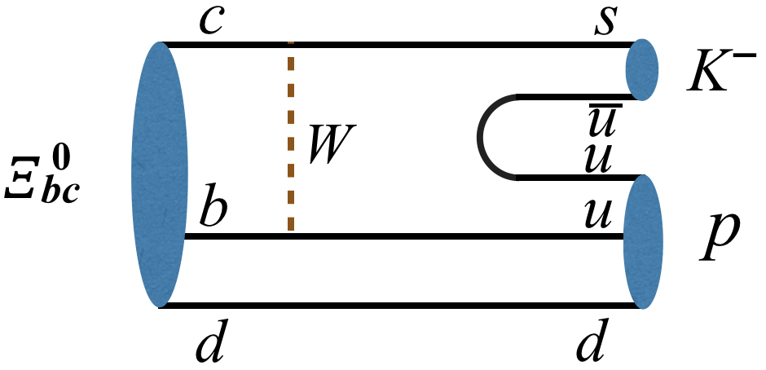
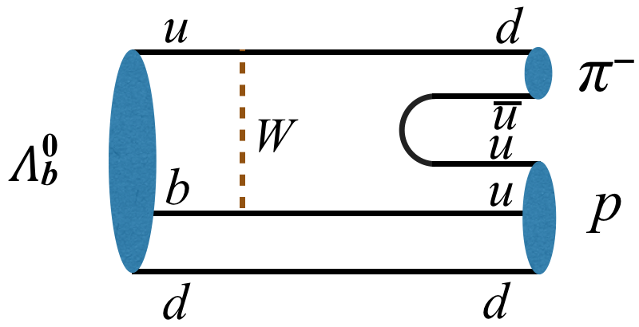

Slide 5
Weak Decays of Doubly Heavy Baryon : Ξ⁰_{bc}→pK⁻ and Ξ⁺_{cc}→Σ_{++c}K⁻
R.H. Li, C.D.Lu, W.Wang, F.S.Yu, Z.T. Zou
Spectroscopy
decay constant
lifetime
SU(3) Analysis
1/2→1/2 case
FCNC channels
1/2→3/2 case
Light quark decay
Weak Decays of Doubly Heavy Baryon :
the sequel

Slide 6
Phys.Rev.Lett. 119, 112001 (2017)

Slide 7
Weak Decays of Doubly Heavy Baryon : Ξ⁰_{bc}→pK⁻ and Ξ⁺_{cc}→Σ_{++c}K⁻
R.H. Li, C.D.Lu, W.Wang, F.S.Yu, Z.T. Zou
Weak Decays of Doubly Heavy Baryons: the 1/2→1/2 case
Weak Decays of Doubly Heavy Baryons: the SU(3) Analysis
Weak Decays of Doubly Heavy Baryons: decay constant
Weak Decays of Doubly Heavy Baryons: lifetime
Weak Decays of Doubly Heavy Baryons: the FCNC channels
Weak Decays of Doubly Heavy Baryons: the 1/2→3/2 case

Slide 8
Quark-diquark picture
1707,02834,W.Wang, F.S.Yu, Z.X. Zhao

Slide 9
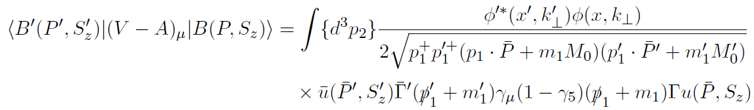
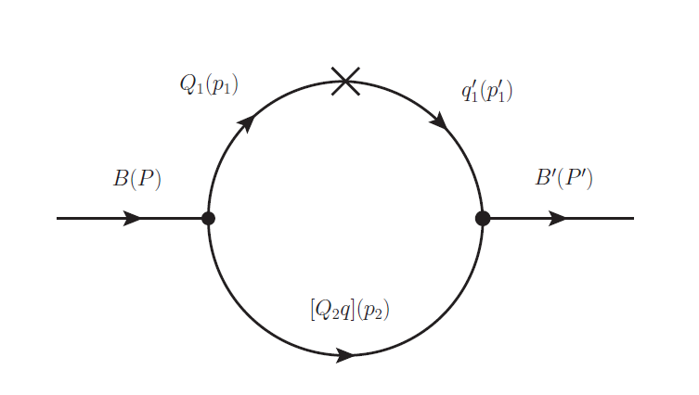
形状因子的计算
1
2
2
1

Slide 10
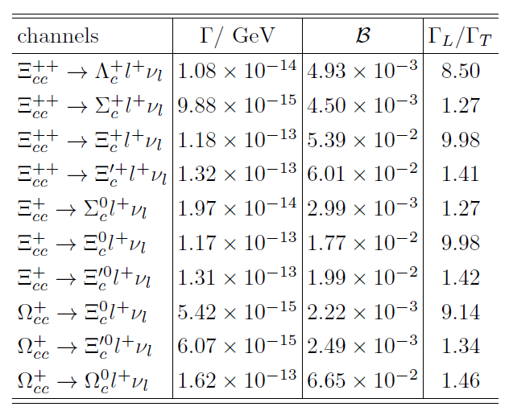
双粲重子的半轻衰变

Slide 11
非轻衰变
Weak Decays of Doubly Heavy Baryons: the SU(3) Analysis
W. Wang, J. Xu, Z.P.Xing, 1707.06570

Slide 12
SU(3)分析
Decays into a charmed baryon and a light meson
Decays into a light octet baryon and a charmed meson
Decays into a light decuplet baryon and a charmed meson

Slide 13
SU(3)分析
宽度关系：
Global fit in future?

Slide 14
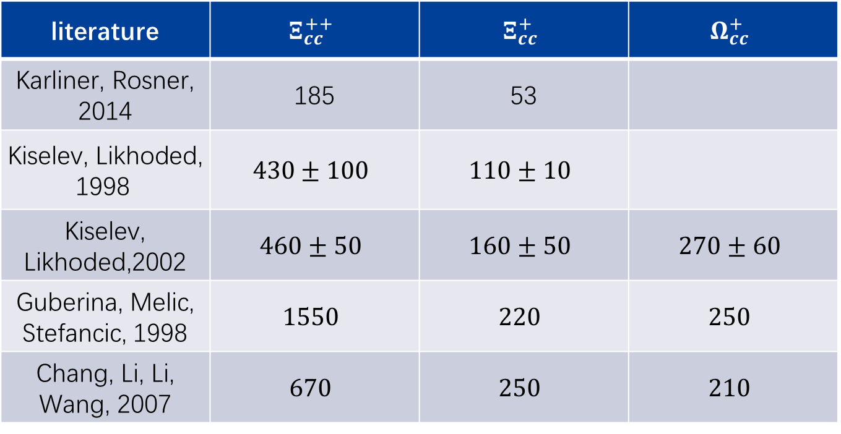
双重重子寿命
literature | $$Ξ_{cc}^{++}$$ | $$Ξ_{cc}^{+}$$ | $$Ω_{cc}^{+}$$
Karliner, Rosner, 2014 | 185 | 53
Kiselev, Likhoded, 1998 | $$430±100$$ | $$110±10$$
Kiselev, Likhoded,2002 | $$460±50$$ | $$160±50$$ | $$270±60$$
Guberina, Melic, Stefancic, 1998 | $$1550$$ | $$220$$ | $$250$$
Chang, Li, Li, Wang, 2007 | $$670$$ | $$250$$ | $$210$$

Slide 15
A. Lenz, T. Rauh, 1305.3588

Slide 16

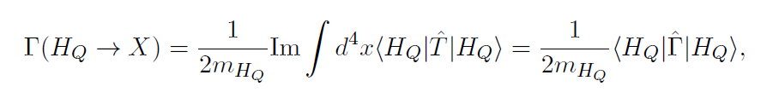

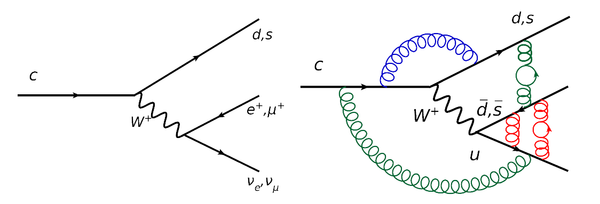
双重重子寿命的计算
算符展开
？

Slide 17
半轻D介子衰变
  D->P₁P₂lν
  Why D->P₁P₂lν？
  Theoretical Analysis

Slide 18
  D->Plν& D->Vlν
见刘朝峰报告

Slide 19
D->P₁P₂lν
c->d: 16
c->s: 14

Slide 20
Scalar Mesons: Two nonets
Notes:
20

Slide 21
标量粒子: 四夸克vs分子态

Slide 22
如何区分两、四夸克态？

Slide 23

Scalar Mesons: Two nonets
Lu, WW, PRD82, 034016 (2010)
ah

Slide 24

Scalar Mesons: Two nonets
ah

Slide 25
分子态：Scalar form factors in χPT
f₀(980):
a bump
f₀(980)
a dip

Slide 26
分子态：D→π⁺π⁻eν
Red: P-wave
Blue：S-wave
Black: Total
Y.J. Shi, WW, S. Zhao 1701.07571

Slide 27
如何区分标量粒子态：D→π⁺π⁻eν
分子态模型：
Red: P-wave Blue：S-wave Black: Total
Y.J. Shi, WW, S. Zhao 1701.07571
Lu, WW, PRD82, 034016 (2010)

Slide 28
角分布与散射相移
Meissner, WW, JHEP 1401 (2014) 107

Slide 29
角分布与散射相移

Slide 30
角分布与散射相移
BaBar:Phys.Rev. D83 (2011) 072001

Slide 31
角分布与散射相移
Chiral PT:
Doring, Meissner, WW,1307.0947
BESIII, 1512.08627
Points with error bars by BESIII
the solid line corresponds to LASS parameterization

Slide 32
角分布与散射相移
BESIII, 1512.08627
BESIII, 1512.08627
Points with error bars by BESIII
the solid line corresponds to LASS parameterization
Chiral PT:
Doring, Meissner, WW,1307.0947

Slide 33
50:1

Slide 34
50:1
Expected data set increase and ~ increase in inst. Luminosity
the energy increase from 7/8 TeV to 13 TeV at the LHC

Slide 35
Summary
  双粲重子
  双粲重子弱衰变：续集
  D->P₁P₂lν
  检验标量粒子内部结构
  测量散射相移
  手征有效理论+QCD微扰理论

Slide 36
谢谢大家！
请批评指正！

