Slide 1
Vibration study of magnet girder of the HEPS-TF
Wang Zihao
GM 2017
11-13 December 2017

Slide 2
Outline
Overview
Design of auto-tuning girder
Modal analysis
Experimental modal analysis
Optimization of girder model
Summary

Slide 3
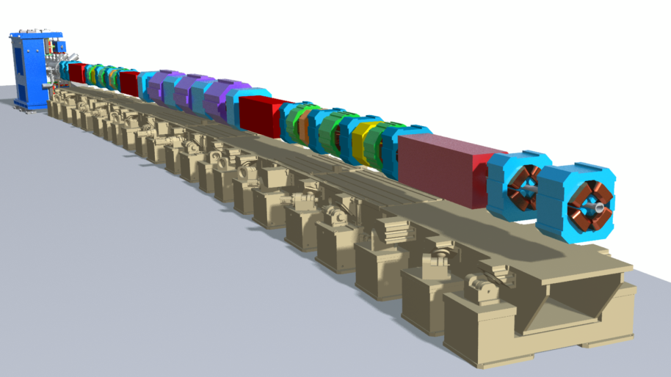
Overview
HEPS Storage ring consists of 48-7BA.
Circumference ~1296m.
Each arc section ~27 m.
Girders provide firm support and
precise positioning for magnets.
7 Magnet-Girder modules with 4 sizes.
Each module pre-assembled,
components aligned, prior to
installation in tunnel.
one arc section
QUAD
DOUBLET
STRAIGHT
MULTIPLET
L-BEND
FODO
SECTION
L-BEND
STRAIGHT
MULTIPLET
L-BEND
QUAD
DOUBLET
L-BEND

Slide 4
Overview
Very Low Emittance Stringent Alignment Requirements
HEPS-TF solve key technical difficulties of HEPS
Positioning Tolerance | Transverse(RMS) | Vertical(RMS)
Magnet to Magnet | ±30μm | ±30μm
Girder to Girder | ±50μm | ±50μm
Girder should be capable of doing beam-based alignment to minimize magnet position error as much as possible.
The study of auto-tuning girder is one of the key techniques of HEPS-TF

Slide 5
Design of Auto-tuning Girder
Specifications:
Parameter | Specification
Resolution | 3μm
Adjusting range | X/Z：4mm Y：10mm
Natural frequency | 30Hz
Motor + Cam
Sensor feedback control adjustment
Multi-point support
Automatic locking
Prototypes :
Girder body
Ball transfer Unit
Electronic Level
Magnet Girder :
6-point supported
3300mm
Length gauge
Cam Mover
Locking
Mechanism
Pedestal
QUAD
DOUBLET
STRAIGHT
MULTIPLET
L-BEND
FODO
SECTION
L-BEND
STRAIGHT
MULTIPLET
L-BEND
QUAD
DOUBLET
L-BEND

Slide 6
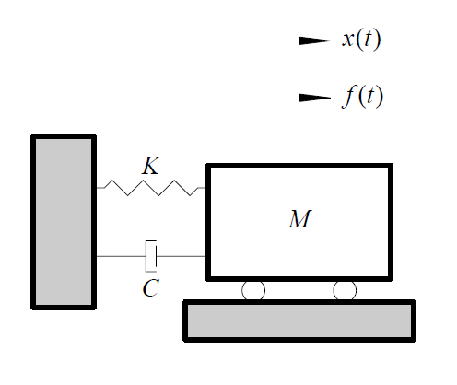
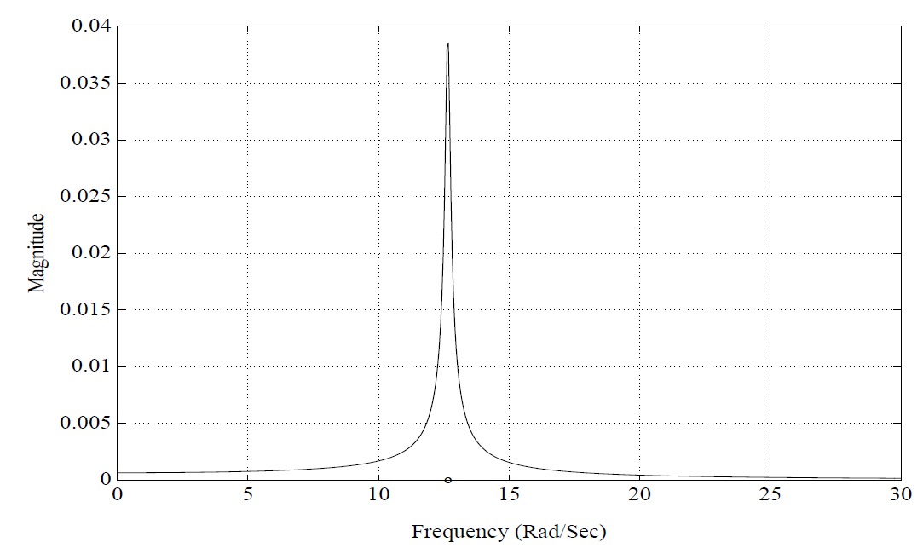
Modal Analysis
(model)
Uncoupled equation
Solving eigenvalue
$$ω_{r}$$
$$r$$
$$ξ_{r}$$
(frequency response function curve)
Single degree of freedom system

Slide 7
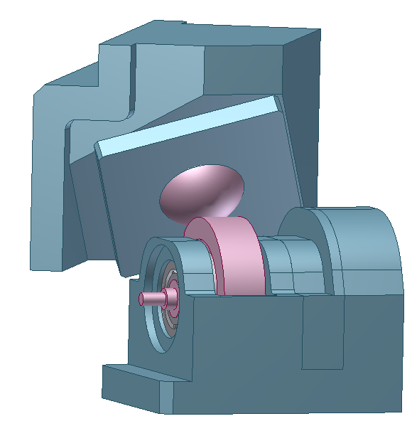
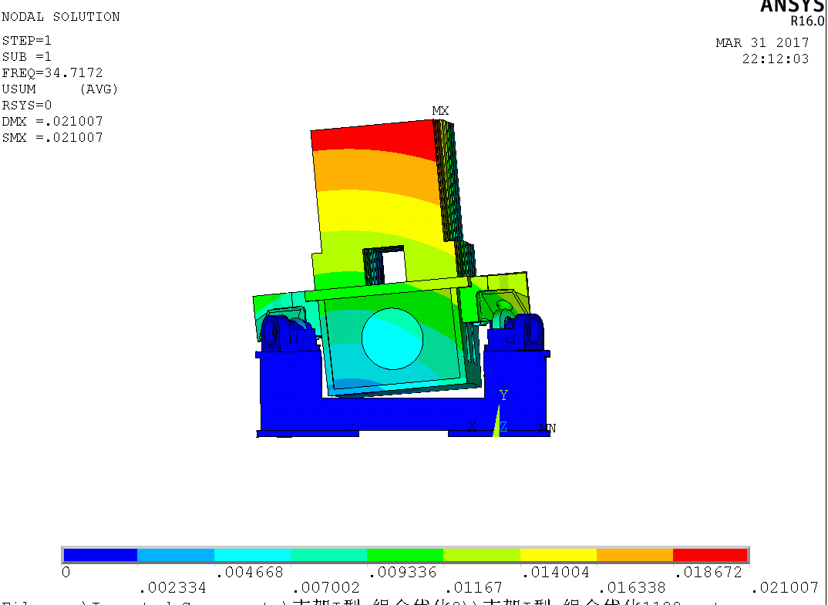
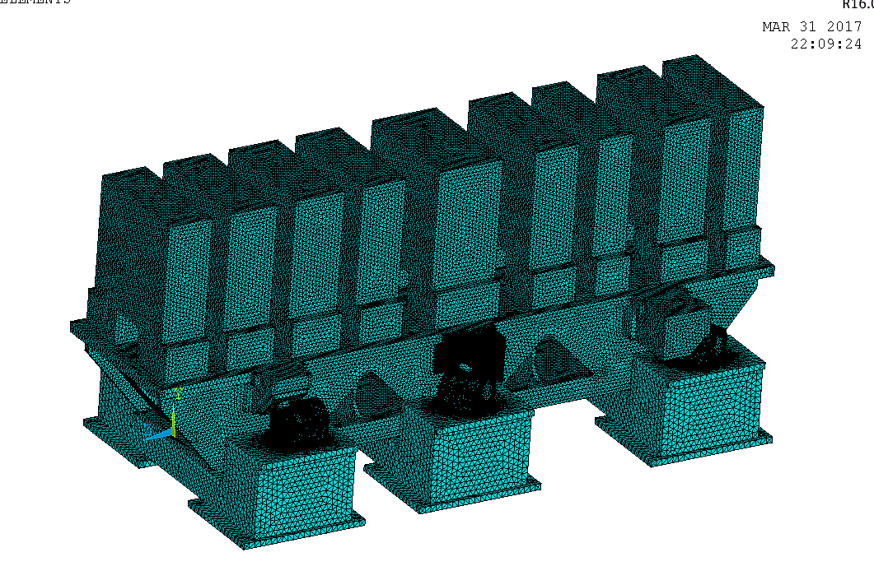
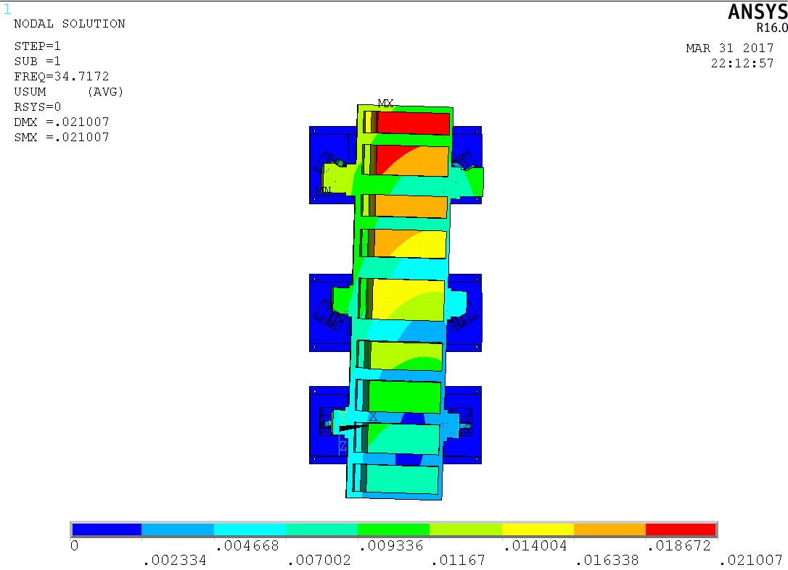
Modal Analysis
Model simplification:
1. remove the bolts
2. contact mode is bonded
Finite element modal analysis results:
The 1st five orders are rigid modes, and the 6th appears elastomer mode.
The frequency range is 30Hz-80Hz.
The 1st natural frequency is larger than the specification. So we use this model to design.
Cam mover & ball transfer unit
order | Natural frequency /HZ | Modal shapes
1 | 34.3 | lateral
2 | 40.1 | pitch
3 | 50.5 | longitudinal
4 | 53.3 | Yaw + pitch
5 | 55.6 | Yaw + pitch (counter to 4th )
6 | 73.7 | Roll (elastomer mode)
Meshing maps
Node displacement map of 1st modal shape

Slide 8
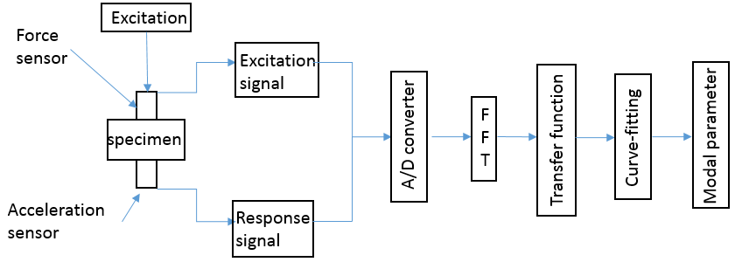
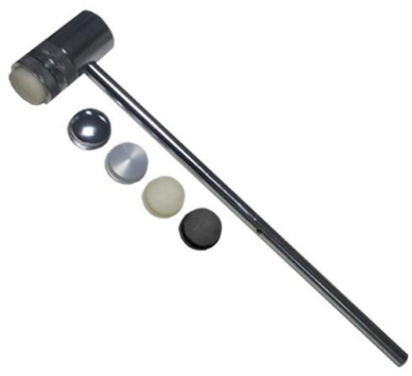
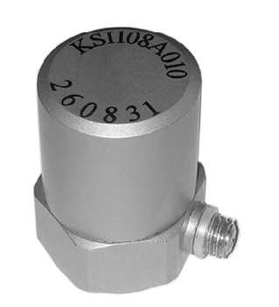
Experimental Modal Analysis
Experimental modal analysis is based on the response and excitation force of system.
Modal shape
$$\left[\begin{aligned}H_{1j} \\ H_{2j} \\ ⋮ \\ H_{Nj}\end{aligned}\right]=\sum_{r=1}^{N}{Y_{r}}\left[\begin{aligned}φ_{1j} \\ φ_{2j} \\ ⋮ \\ φ_{Nj}\end{aligned}\right]φ_{jr}=\sum_{r=1}^{N}{\frac{φ_{jr}}{k_{r}−ω^{2}m_{r}+jωc_{r}}}\left[\begin{aligned}φ_{1r} \\ φ_{2r} \\ ⋮ \\ φ_{Nr}\end{aligned}\right]$$

Slide 9
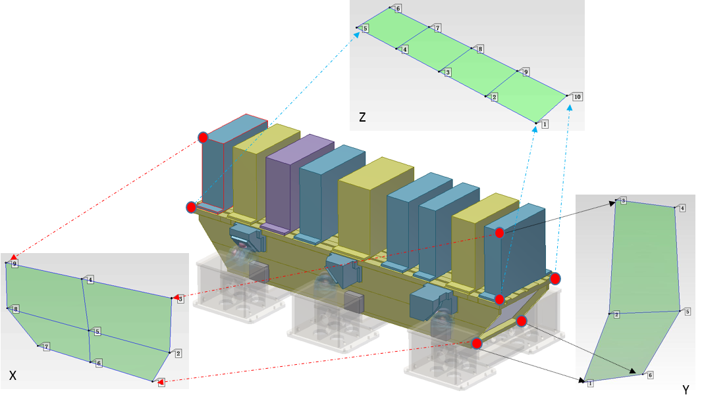
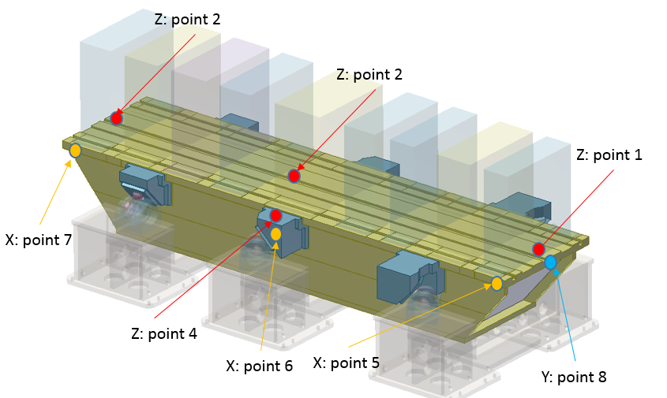
Experimental Modal Analysis
According to modal analysis results:
Natural frequency range
Type of hammer head (rubber)
Simulated modal shape
Position of the hammer & measuring point layout

Slide 10
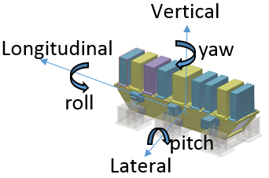
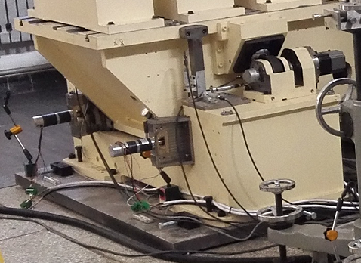
Experimental Modal Analysis
y
z
Tested the natural frequency and modal shapes under different condition.
with/without loads
with/without locking mechanism
Locking mechanism is effective but not enough.
The fixed mode of baseplate has little effect on natural frequency.
x
locking mechanism
axis | without loads unlocked | With loads unlocked | With loads locked
Z | 42.2Hz (pitch) | 23.6Hz (pitch） | 27.2Hz (pitch)
X | 24.2Hz (lateral) | 17.3Hz (lateral) | 22.8Hz (lateral)
Y | 23.6Hz (longitudinal) | 19.7Hz (longitudinal) | 28Hz (longitudinal)
Fixed mode 1
Fixed mode 2

Slide 11
Experimental Modal Analysis VS Modal Analysis
order | Simulation |  | Test |  | Error
 | Natural frequency Hz | Modal shapes | Natural frequency Hz | Modal shapes
1 | 34.3 | lateral | 17.3 | lateral | 98%
2 | 40.1 | pitch | 19.7 | longitudinal | 104%
3 | 50.5 | longitudinal | 21.3 | yaw | 137%
4 | 53.3 | Yaw + pitch | 23.6 | pitch | 126%
5 | 55.6 | Yaw + pitch (counter to 4th ) | 27.8 | vertical | 100%
6 | 73.7 | roll | 42.6 | roll | 73%
Results :
1. Except the 1st and 6th orders, modal shapes are all different.
2. From the experimental results, the first six orders modal shapes are all rigid-body modes.

Slide 12
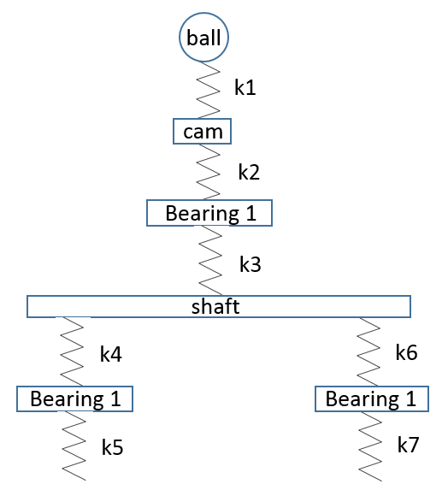
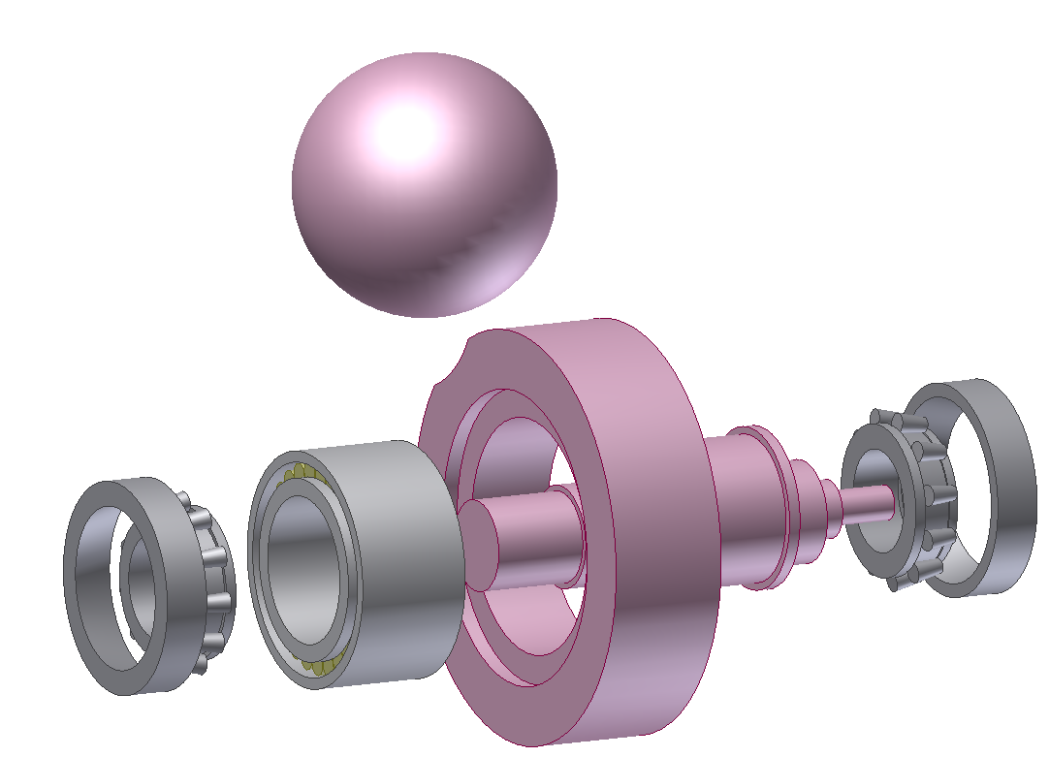
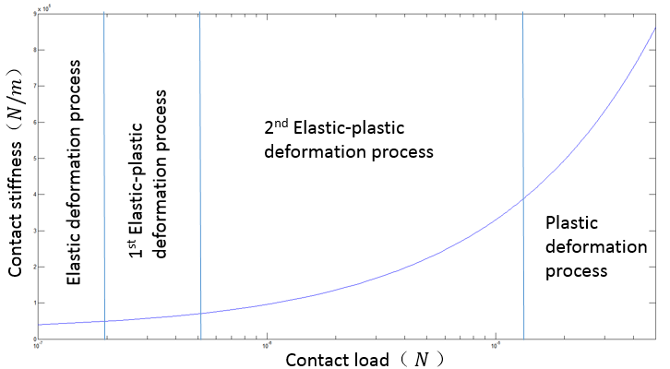
Optimization of girder model
After some work:
gravity load
Contact stiffness
elastic
elastic-plastic
plastic

Slide 13
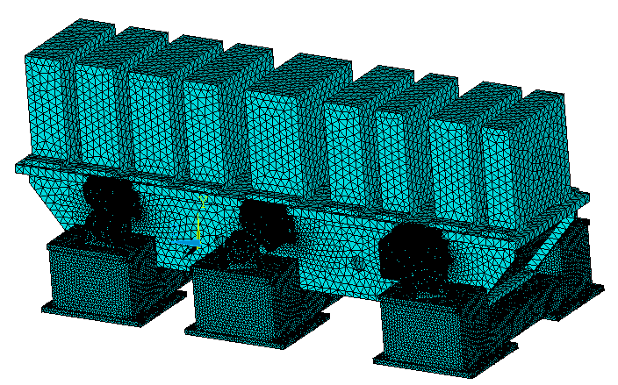
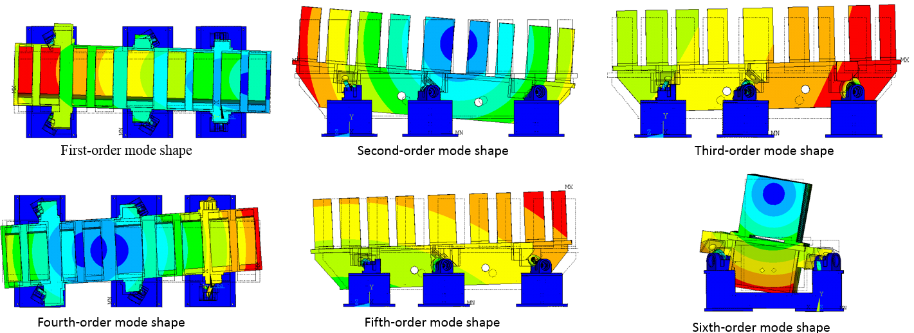
Optimization of girder model
Results:
Vertical
yaw
Mode order | Natural frequency/Hz | Mode shape
1 | 20.179 | Lateral
2 | 22.583 | Pitch
3 | 23.516 | Longitudinal
4 | 26.011 | Yaw
5 | 28.245 | Vertical
6 | 44.427 | Roll
Longitudinal
roll
Lateral
pitch
Direction | Natural frequency/Hz |  | Error | Mode shape
 | Simulation | Test
Z | 22.6 | 23.6 | 4.2% | pitch
X | 20.2 | 17.3 | 16.8% | lateral
Y | 23.5 | 19.7 | 19.3% | longitudinal
1.The modal shapes of two results are agree with each other.
2.The error rate is less than 20%

Slide 14
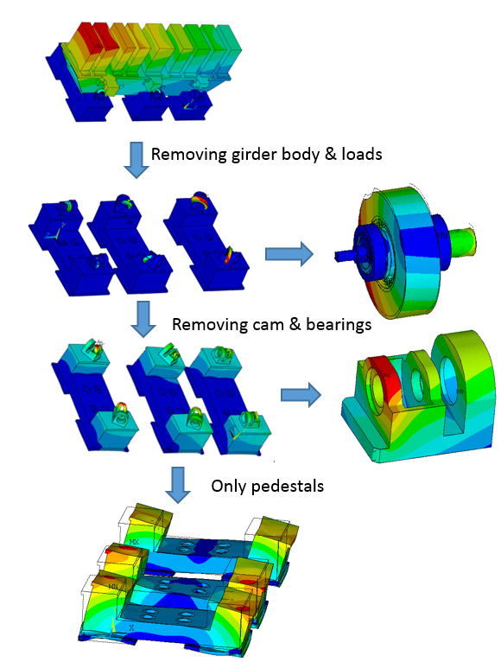
Optimization of girder model
According to simulation results of 1st modal shape
Case 1: removing girder body & loads.
Case 2: removing cam & bearings.
Case 3: only pedestals.
Direction | Original | Case 1 |  | Case 2 |  | Case 3
 | Natural frequency Hz | Natural frequency Hz | improve | Natural frequency Hz | improve | Natural frequency Hz | improve
Z | 20.2 | 50.3 | 149% | 21 | 4% | 20.6 | 2%
Y | 22.6 | 52.7 | 133% | 23.2 | 3% | 22.9 | 1%
X | 23.5 | 64.3 | 173% | 27.3 | 16% | 24 | 2%
Maybe , improving cam structure is a good method to increase the whole
natural frequency.

Slide 15
Summary
1. Modal analysis and experimental modal analysis can interact with each other.
2. The fixed mode of baseplate has little effect on natural.
3. Locking mechanism is effective for increasing natural frequency of girder but not enough .
4. Cam mover is a weaker part than the other parts, improving cam structure is a good method to increase the natural frequency.
Next research plan:
1. we will consider other locking methods.
2. we will be able to match the simulation with the test.

Slide 16
Thanks for your attention！

