Slide 1
Estimation of the orbit feedback performance for HEPS
Zhe Duan
Accelerator Physics Group
2017. 12. 12
Acknowledgement: Lihua Yu and Yuke Tian (BNL), Chongxian Yin (SSRF), Michael Boege (SLS), Michael Borland (ANL), Laurent Nadolski (SOLEIL) and colleagues at HEPS.

Slide 2
Outline
1
Beam stability requirements
2
Simulation in the low frequency limit
Discussion
3
Discussion
3

Slide 3
Beam stability requirements

Slide 4
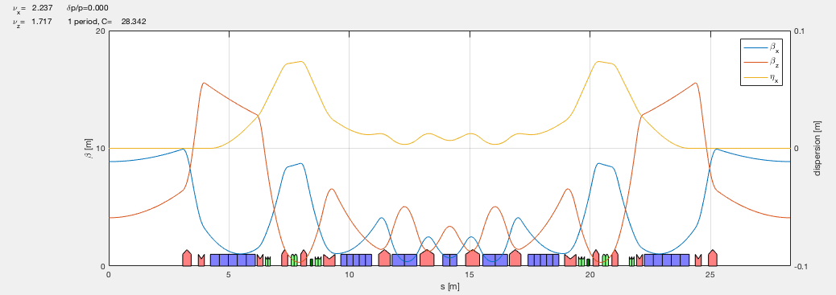
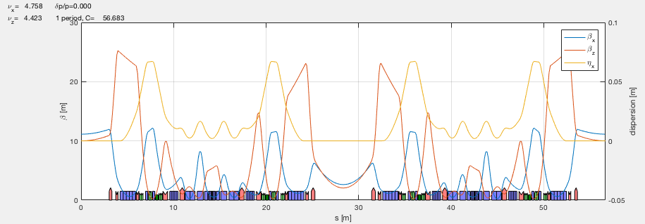
HEPS candidate lattices
The following two candidate lattices are used in this study.
48 period, ESRF-EBS type hybrid-7BA lattice
parameter | value
circumference | 1360.4 m
straight section length | 6 m
periodicity | 48
natural emittance | 58.3 pm
momentum compaction | 3.4e-5
working point | 107.37/82.44
β_{ID} | 8.9/4.1 m
1 cell of T1_P48_58pm
3PW
24 period, hybrid-7BA lattice with anti-bends and super-bends
parameter |  | value
circumference |  | 1360.4 m
straight section length |  | 6 m / 6 m
periodicity |  | 24
natural emittance |  | 32.7 pm
momentum compaction |  | 1.3e-5
working point |  | 114.19/106.17
β_{ID} | high-β straight | 10.8/9.9 m
 | low-β straight | 2.6/2.0 m
1 cell of T3_P24_33pm
super bends

Slide 5
Beam stability requirements
Minimum expected beam size/divergence in IDs and bending magnet sources
assume a vertical emittance ~ 5 pm, diffraction limit for 20 keV photon
lattices | σ_{x} (μm) |  | σ_{px} (μrad) |  | σ_{y} (μm) |  | σ_{py} (μrad)
 | straight section | BM sources | straight section | BM sources | straight section | BM sources | straight section | BM sources
T1_P48_58pm | 24 | 9.6 | 2.6 | 11.7 | 4.5 | 3.2 | 1.1 | 3.0
T3_P24_33pm | 9.3 | 5.2 | 1.72 | 8.61 | 3.2 | 5.1 | 0.7 | 1.1
Beam stability requirements (tentative):
in the frequency range 0.01 Hz ~ 1000 Hz, rms beam position & angular motion < 10% beam size / divergence in both planes for undulators and vertical plane for bending magnet sources. Some critical reference values for the final lattice design are
long-term orbit drift (100 s ~ 1 day or 1 week?): TBD.

Slide 6
Simulation of FOFB in the low frequency limit

Slide 7
Assumptions
ref: L. H. Yu, NSLS-II Stability workshop, 2007
Assume the quadrupole vibration is uncorrelated, while in the presence of girders, quadrupole motion on the same girder is fully correlated, and girder-to-girder vibration is uncorrelated.
Study the max capability of fast orbit feedback system, assuming the feedback system is working at the low frequency limit, with maximum gain. System latency & bandwidth, as well as PID control will lead to a reduced capability of FOFB in suppressing high frequency noises.
BPM signal without feedback
BPM position with feedback:

Slide 8
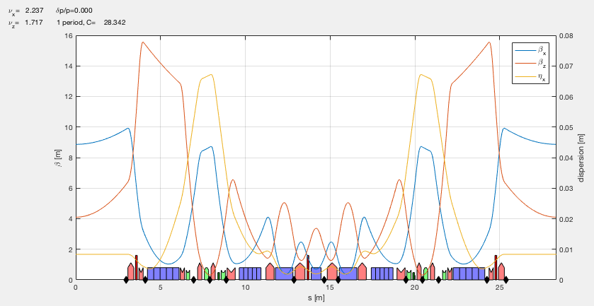
T1_P48_58pm
3 fast correctors
In the simulation, there are 13 BPMs, 3 or 4 fast correctors per cell.
Different sets of fast correctors have been tried to compare the capability of orbit correction.
The choice of 3 fast correctors seems optimal for this lattice.

Slide 9
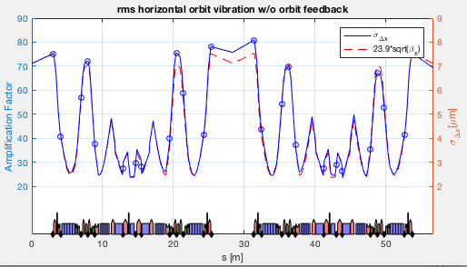
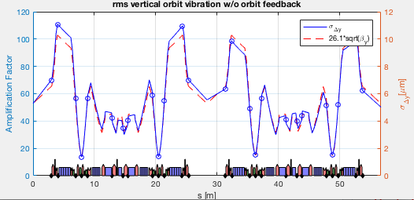
Lattice amplification of quad random vibration
Introduce 0.1 μm rms random
misalignment errors in quadrupoles to obtain the amplification factor.
amplification factor ~ (70, 55 ) at straight section
girders introduce coherence
For the specified girder setting in the plot, the amplification factor can be reduced to ~ 60%.

Slide 10
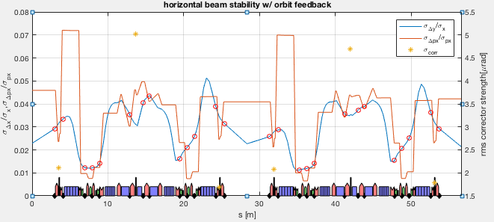
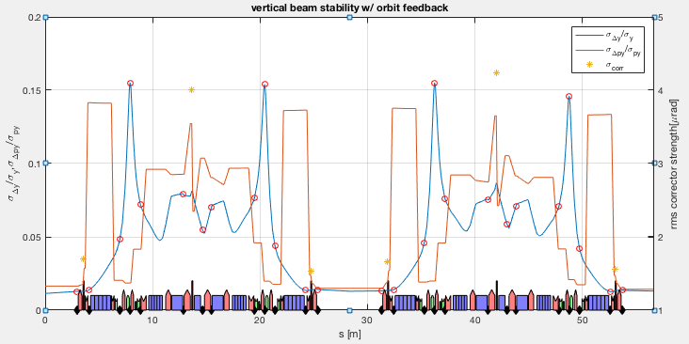
Beam orbit stability with feedback
parameter | value
uncorrelated quadrupole vibration | 0.1 μm rms
uncorrelated BPM vibration | 0.1 μm rms
BPM resolution (FA) | 0.3 μm
number of seed | 200
For the assumed quadrupole & BPM uncorrelated vibration of 0.1 μm, the beam stability requirements are fulfilled with the help of orbit feedback in straight sections and BPM sources, but not all over the ring.

Slide 11
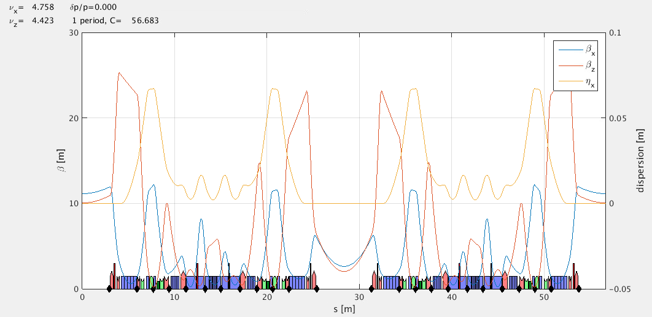
T3_P24_33pm
4 fast correctors
In the simulation, there are 12 BPMs, 4 fast correctors per half cell.
Different sets of fast correctors have been tried to compare the capability of orbit correction.
The choice of 4 fast correctors seems OK for this lattice as a compromise with orbit correction.

Slide 12
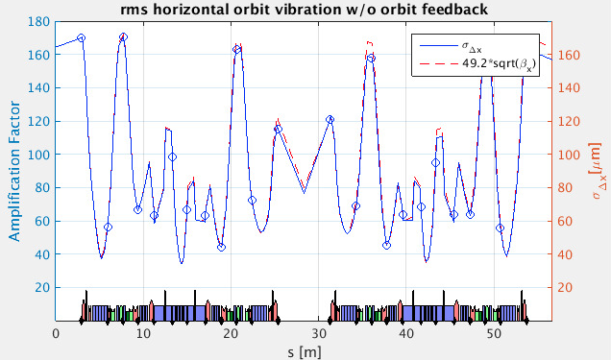
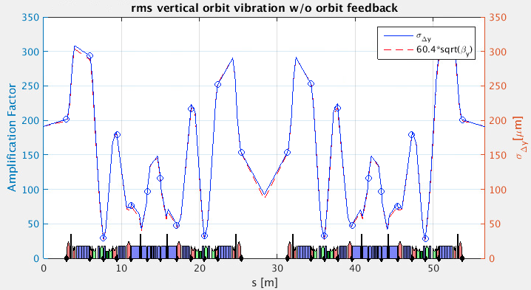
Lattice amplification of quad random vibration
Introduce 0.1 μm rms random
misalignment errors in quadrupoles to obtain the amplification factor.
amplification factor ~ (80, 85 ) at straight section
girders introduce coherence
For the specified girder setting in the plot, the amplification factor can be reduced by half.

Slide 13
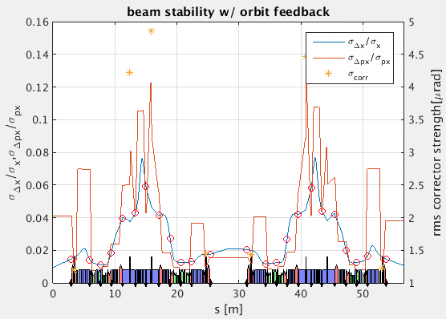
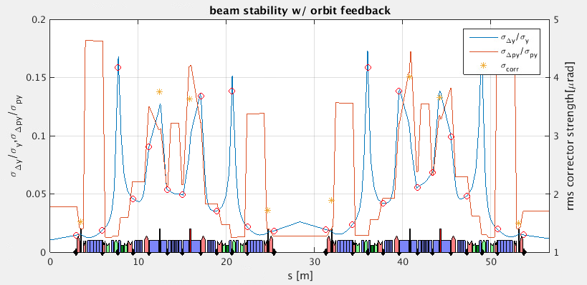
Beam orbit stability with feedback
parameter | value
uncorrelated quadrupole vibration | 0.1 μm rms
uncorrelated BPM vibration | 0.1 μm rms
BPM resolution (FA) | 0.3 μm
number of seed | 200
For the assumed quadrupole & BPM uncorrelated vibration of 0.1 μm, the beam stability requirements are close to be fulfilled with the help of orbit feedback in straight sections and BPM sources, but not all over the ring.

Slide 14
Discussion

Slide 15
On specification of ground vibration tolerances
From Lin Zhang’s slides:
~ 1
each of these tranfer function is
A more precise description is in terms of PSD
each of these “PSDTF” represents
Note that my previous estimation in the low-frequency limit only applies for the frequency range that vibration is uncorrelated and the feedback is at its maximum capacity. The 0.1 μm rms uncorrelated quad vibration is optimistic.
A more precise estimation is required considering the frequency-dependence.

Slide 16
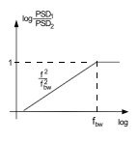
On the feedback attenuation vs. frequency
ref: V. Sajaev, IPAC2015, MOPMA011
“Orbit correction is an integral controller with PSD dependence of f^2 and a bandwidth of f_{bw} .”
However, if for lower frequency, I assume a constant attenuation factor as obtained in my simulation in the low frequency limit, and the vibration PSD scales like ~ 1/f^3 or 1/f^4, then the feedback suppression is much more effective than the ~ 1/3 factor as shown in Lin Zhang’s slides for SOLEIL & ESRF (also agreed by Nick Sereno with APS experience).
Question:
What is the cause of the not-so-effective feedback power at relatively low frequency?
interface of slow-fast feedback? What about fast-only approach?
2. Is there a simple scaling of the feedback suppression capability at relatively low frequency?
3. At relatively low frequency, can we approach the feedback capability in the low-frequency limit?

Slide 17
Thank you!

