Slide 1
Fast Orbit Feedback System for HEPS (Cooperation work among all related systems)
Dapeng Jin
Control System
Dec. 12, 2017

Slide 2
Outline
1
Components involved
2
Preliminary design of the FOFB
3
Preliminary results of simulation
4
Further considerations
5
Summary

Slide 3
Components involved

Slide 4
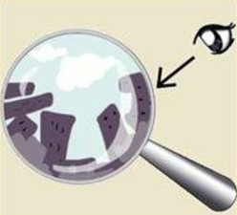
Illustration of the FOFB
BPMs
Physics simulation, feedback logic
Power supplies, fast correctors, vacuum chambers

Slide 5
Further Illustration of the FOFB
Integration && Feedback Logic
Power Supplies
BPMs
Fast Correctors
Vacuum Chambers

Slide 6
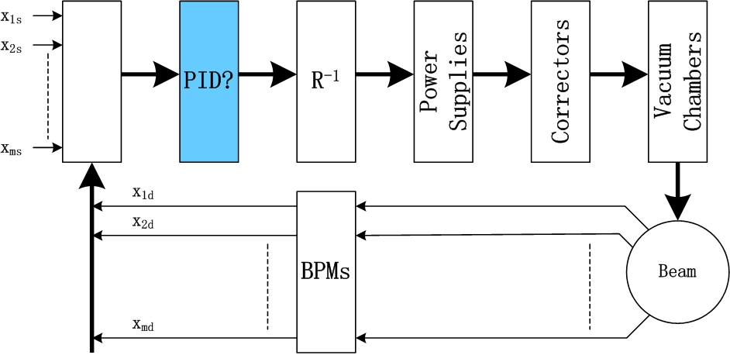
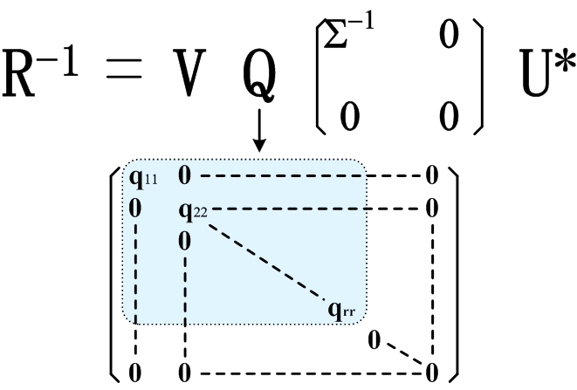
FOFB Control Loop & Algorithm

Slide 7
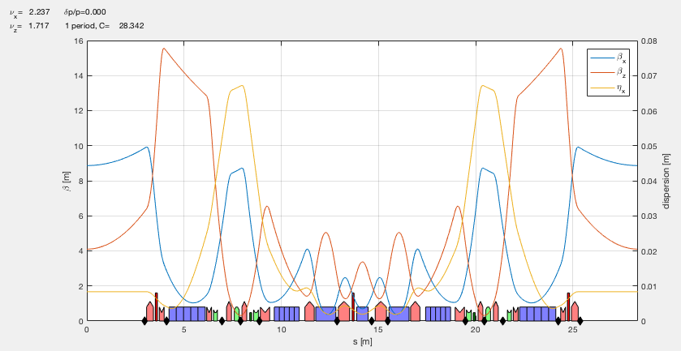
Layout of BPMs and fast correctors
3 fast correctors
There are 13 BPMs, 3 or 4 fast correctors per cell.

Slide 8
Preliminary Design of the FOFB

Slide 9
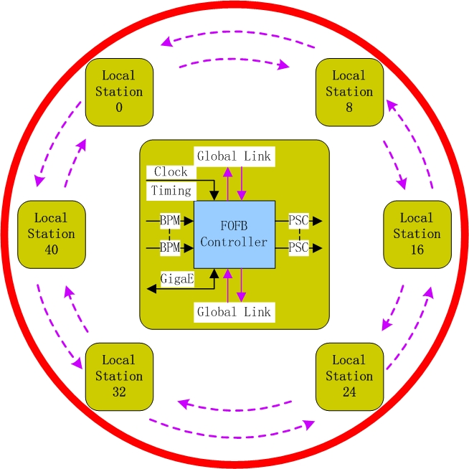
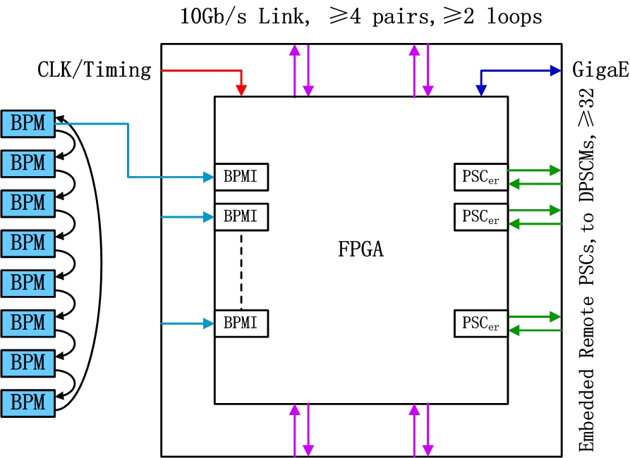
Overall Structure

Slide 10
Design Considerations
Core chip selection : UltraScale+/UltraScale from Xilinx
Clock frequencies of logics and DSPs, up to 1GHz frequency is desired, at least 800MHz. Current level is between 600 MHz to 800MHz.
GTH transceivers together with optical transceivers working above 10Gb/s for global communication, and above 5Gb/s for BPM data collection. Multi channels will be used.
Cable routing around the ring to minimize delay.
Parallel data transmission to PS controllers to minimize delay.

Slide 11
Design Considerations
Global timing synchronized data acquisition, transmission and logics.
Ripple, effective resolution, accuracy and stability of the power supplies are very important.
Parameters consistency for the fast correctors, power supplies and vacuum chambers are very important. The same, the best.
Local linearity and hysteresis error of the fast correctors need to be concerned.

Slide 12
Preliminary Time Consumption Estimate
BPM data acquisition and treatment : ~ 5μs.
Global optical cable delay : ~ 10μs for ~ 2km cables.
Serialization/Deserialization for half the ring : ~ 7.2μs for 24 nodes.
Global data packets transmission : ~ 1 μs.
Matrix calculation : ~ 20μs.
Step response of power supplies : ~ 70μs to 95% amplitude.
Step response of fast correctors : ~ 70μs to 95% amplitude.
Vacuum chambers : Inconnel 625, thickness 0.8mm, step response : ~ 129μs to 95% amplitude.

Slide 13
Preliminary Results of Simulation

Slide 14
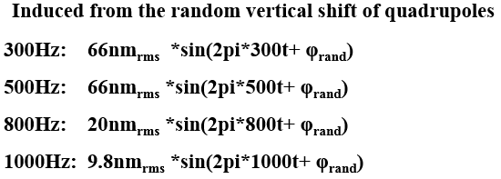
Error Modeling
Ground vibration
Power supply ripple

Slide 15
Feedback Algorithm and Parameters used
n
+
y_{d} +
e
R⁻¹
R
+
y
+
PID
delay
PS
magnet
chamber
+
-
BPM
PID PI controller
R response matrix
Delay calculation delay 40μs
PS step response : 70μs to 95% amplitude
Magnet same as PS
chamber 0.8mm thick Inconnel 625, inner diameter 22mm
n noise
BPM delay 2.5μs

Slide 16
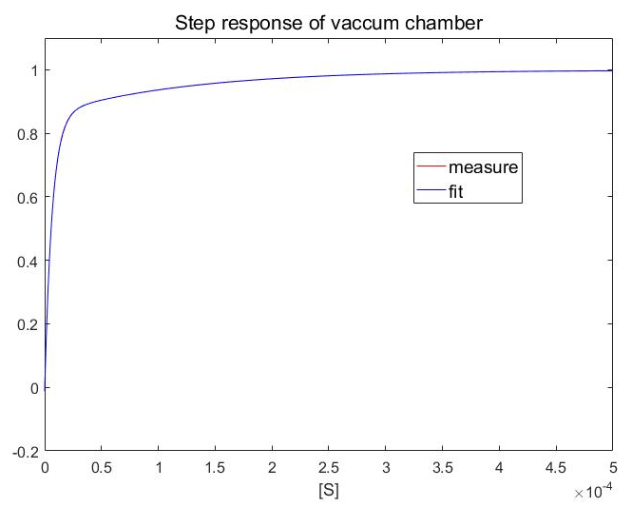
Components Modeling
Vacuum chamber : 0.8mm thick
Inconnel 625,
inner diameter
22mm.
$F={ae}^{−bt}+{ce}^{−dt}$+${fe}^{−gt}$
a = -0.1433;
b = 8.038*1000;
c = 1.001;
d = 0.00307*1000;
f= -0.8693;
g = 152.4*1000;

Slide 17
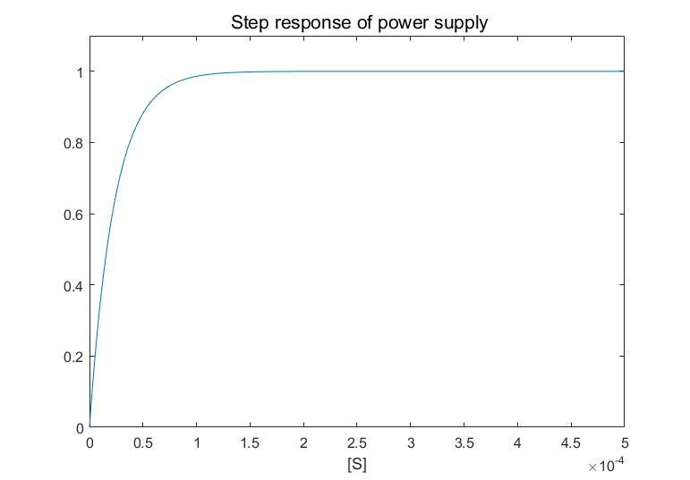
Components Modeling
$$F=1−e^{−at}$$
a=42.8*1000;

Slide 18
Components Modeling
transfer function for PID controller:
System performance:
System performance will be studied by the frequency-amplitude curve of this function.

Slide 19
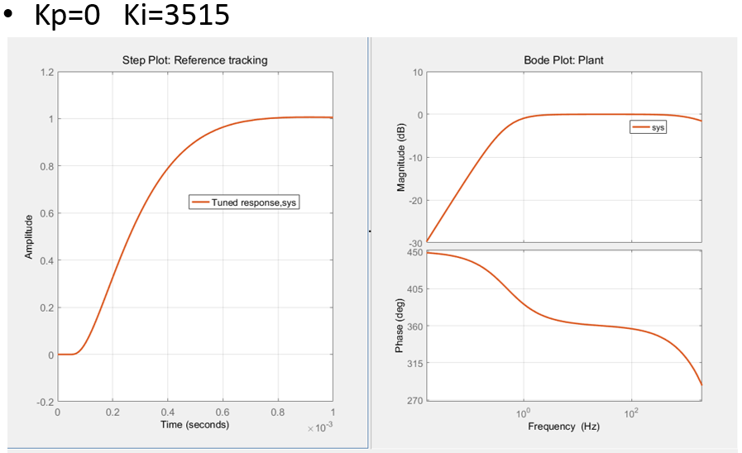
PI Tuning

Slide 20
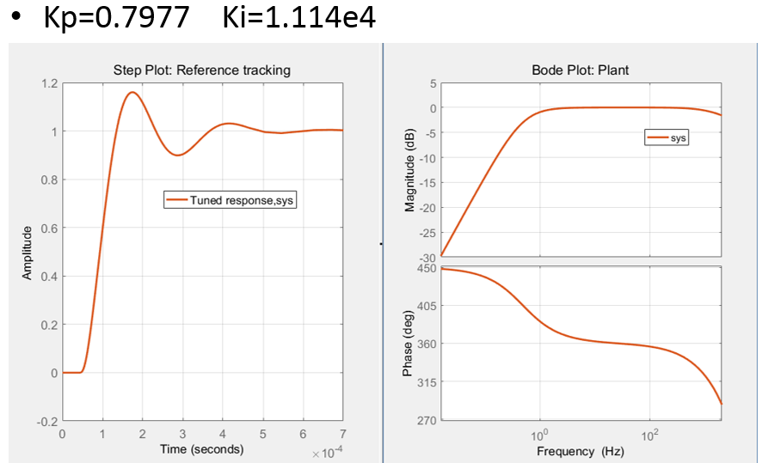
PI Tuning

Slide 21
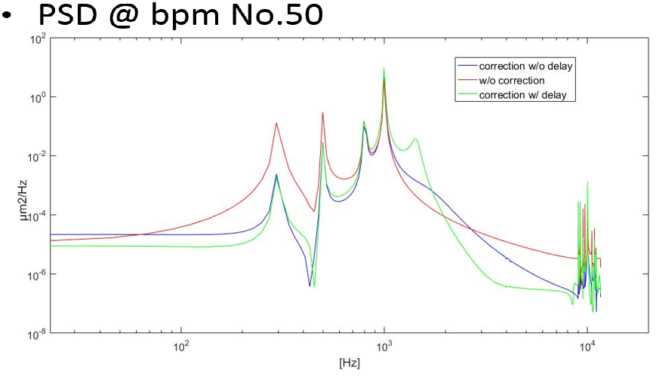
PSD w/ & w/o FOFB

Slide 22
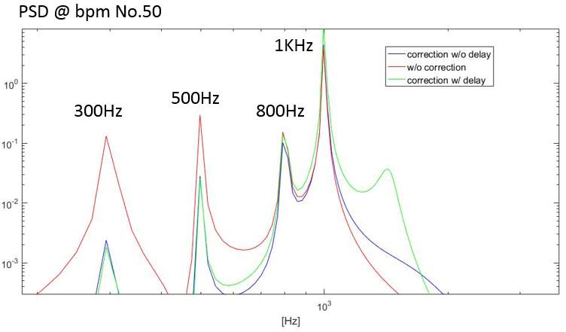
PSD w/ & w/o FOFB : Zoom In

Slide 23
Present Results and Further to Do
Present results with the parameters used
Effective bandwidth up to ~ 500Hz.
Almost no effect to noise ~ 800Hz.
Negative effect to noise ~ 1kHz.
Further to do
Lower thickness of the vacuum chambers down to 0.5mm.
Lower delay of calculations down to 10μs.
Lower conductance fast correctors with less magnetic poles.

Slide 24
Further Considerations

Slide 25
Further Considerations
Control with overshoot is must to increase the response speed.
Possible positions of the control with overshoot : Just before data output to PS controllers or in the PS controller. Parameters should be easily adjustable.
Balance among performance, cost, difficulty, complexity, reliability, availability, scalability and maintainability.

Slide 26
Summary

Slide 27
Summary
Preliminary design and simulation results have been carried out till now.
A bandwidth of 500 Hz can be possibly achieved.
A bandwidth of 800 Hz or higher is desired with some difficulties.
Much further work need to be done to make a good balance.
Tight cooperation among all related systems is the key to success.
Thank you!

