Slide 1
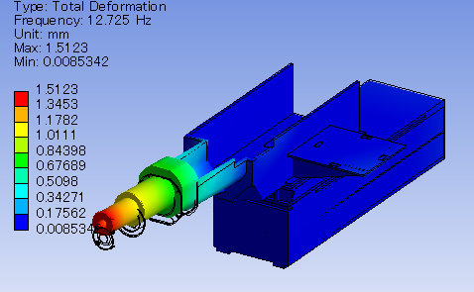
Summary Session 4: Vibration Suppression Techniques: 1
Vibration measurements at KEKB/SuperKEKB, and experience with vibration damping material
Site Vibrations dominated by a 3Hz Eigenmode of the Soil System
Testing the Effect of a Damping Alloy Material
Both by Simulations and Measurements
Characterization of a Cryostat with a Clear Tone at 14Hz
Several Tests, with Damping and Different kinds of Screw Connections with Good Results
Some Analysis Show the possibility of being Saved by Correlated Motions
Real Testing to Commence soon will Show the Results of the Efforts
Notes:
Mika Masuzawa

Slide 2
Summary Session 4: Vibration Suppression Techniques: 2
Ambient Micro-vibration Control Technology for HEPS
Some Ambitious Plans for Systematically Testing Different Configurations of Slap Thicknesses and Foundations
This Provide a Good Collection of Information for Adjusting the FEA Models for the Soil at the Site
Test of Production Techniques, Gain of Experience for Planning Phase
Very Good Questions and Discussions Regarding how to Set and Define Tolerances
Notes:
SUN Ning

Slide 3
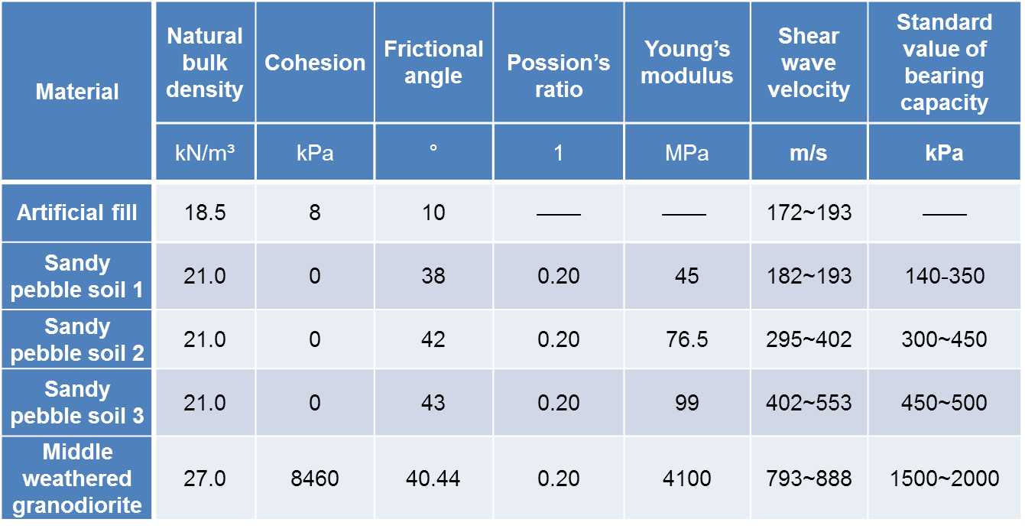
Summary Session 4: Vibration Suppression Techniques: 3
This Work is on Dimensioning for Sufficient Control of Settlements in the Structures due to Loading
Systematic Work Involving both FEA and Tests
The Methods are More Environmental Friendly
All the data is obtained form Geotechnical investigation report!
Cement is Used Instead of Lime Due to its Better Settlement Performance…
Together with The Dynamical Tests: Good Work to Find how You Get Most Stability For Your Money
Notes:
XU ZhaoGang

Slide 4
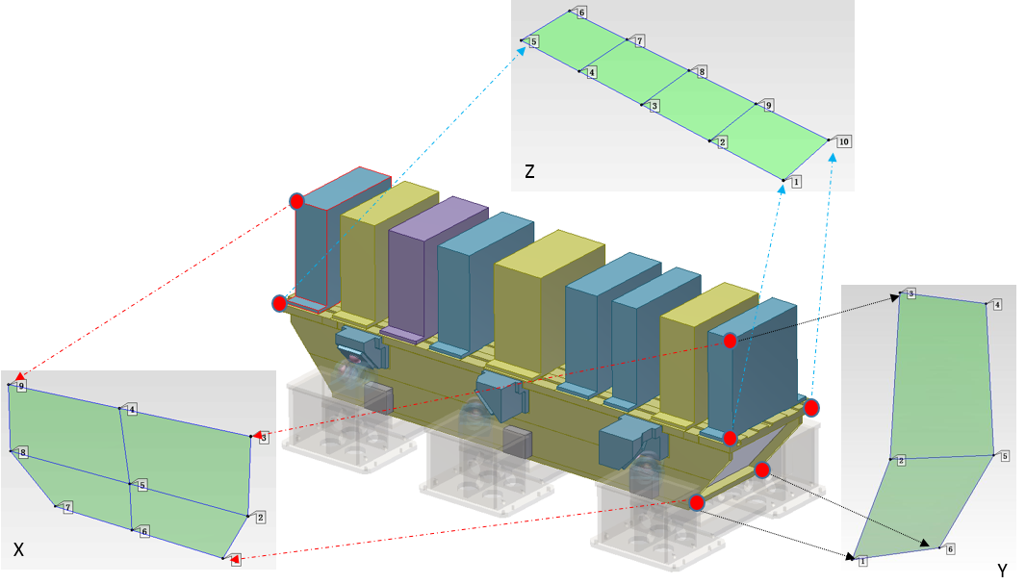
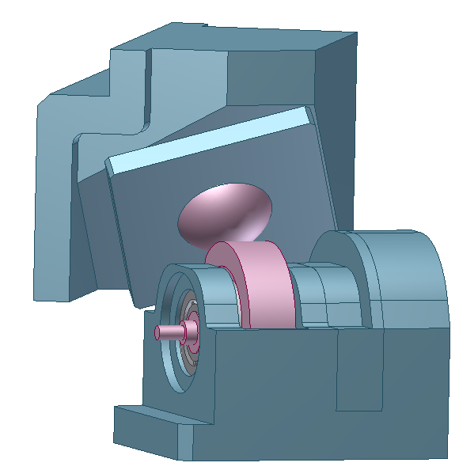
Summary Session 4: Vibration Suppression Techniques: 4
Vibration study of magnet girder of the HEPS-TF
7BA Design, Still Considering Two Different Schemes
Modal Analysis, Both by FEA and Prototype Testing (Goal: 30Hz)
There are some Thoughts on How to Model and to Improve the Design in Order to Increate Stiffness, Especially Contact Stiffness
Cam Structure is the Weakest Link, Work on Improving the Design
Notes:
Wang Zihao

Slide 5
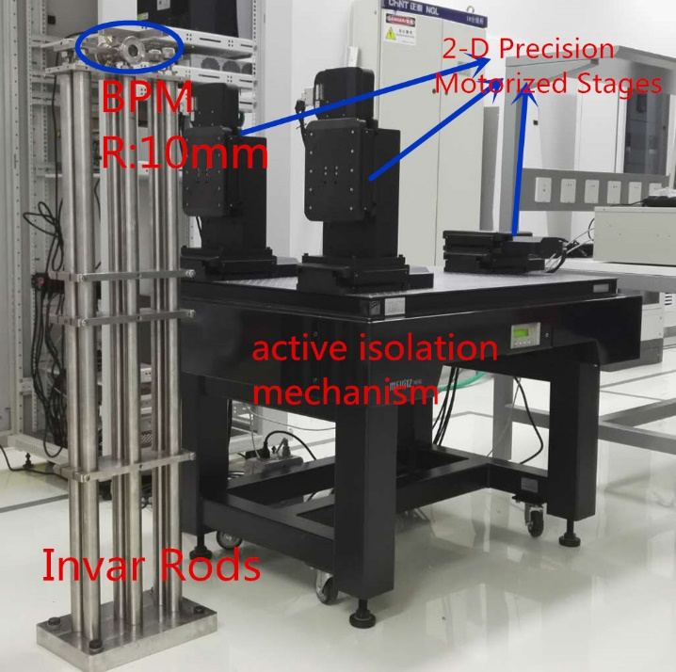
Summary Session 4: Vibration Suppression Techniques: 5
The impact of vibration on BPM measurement, BEPCII
Despite Being in a Busy Area, the Vibration Level is Very Low!
But the Quadrupoles are Still Vibrating a Lot
Different Sensors Used for Testing, Showing Similar Spectral Behavior
Also FA Data from the BPM show this
A New BPM Compact Support was Investigated at a BPM Test Bench
The Importance of Fixing Components to the Floor was Seen

Slide 6
Summary Session 4: Vibration Suppression Techniques: Comments 1
We All have Similar Challenges!
FEA is a Great Tool, but Difficult to Master for Real Life Predictions!
Using Real Testing in order to Adjust FEA Models is a Must
Setting Meaningful and Useable Stability Tolerances is Difficult
Vibration Levels
Frequency Content
Eigenfrequencies
Contact Stiffness Modelling is one of the Key Challenges in FEA
You Need to take Some Reasonable Assumptions, There is No Unambiguous Truth
It is Tempting To Lower Ambitions Regarding Performance, But be Careful – Trust Yourself and Your Calculations
Notes:
Concluding Remarks:

Slide 7
Vibration Suppression Techniques: Comments: 2
The Green Field Vibration Level Should be Considered as a Future Goal
Isolate ALL Your Own Sources and Tell Your Neighbors to do The Same!
Stability Is Vital for Our New Sources!
Make That Clear to Your Colleagues and Surroundings!
Organizing a Workshop Like This was a Really Good Idea!
Sharing Knowledge With other Geeks!
Sparring
New Ideas Popping up
New Contacts…
…
Thank You For A very Well Organized Workshop!

Slide 8
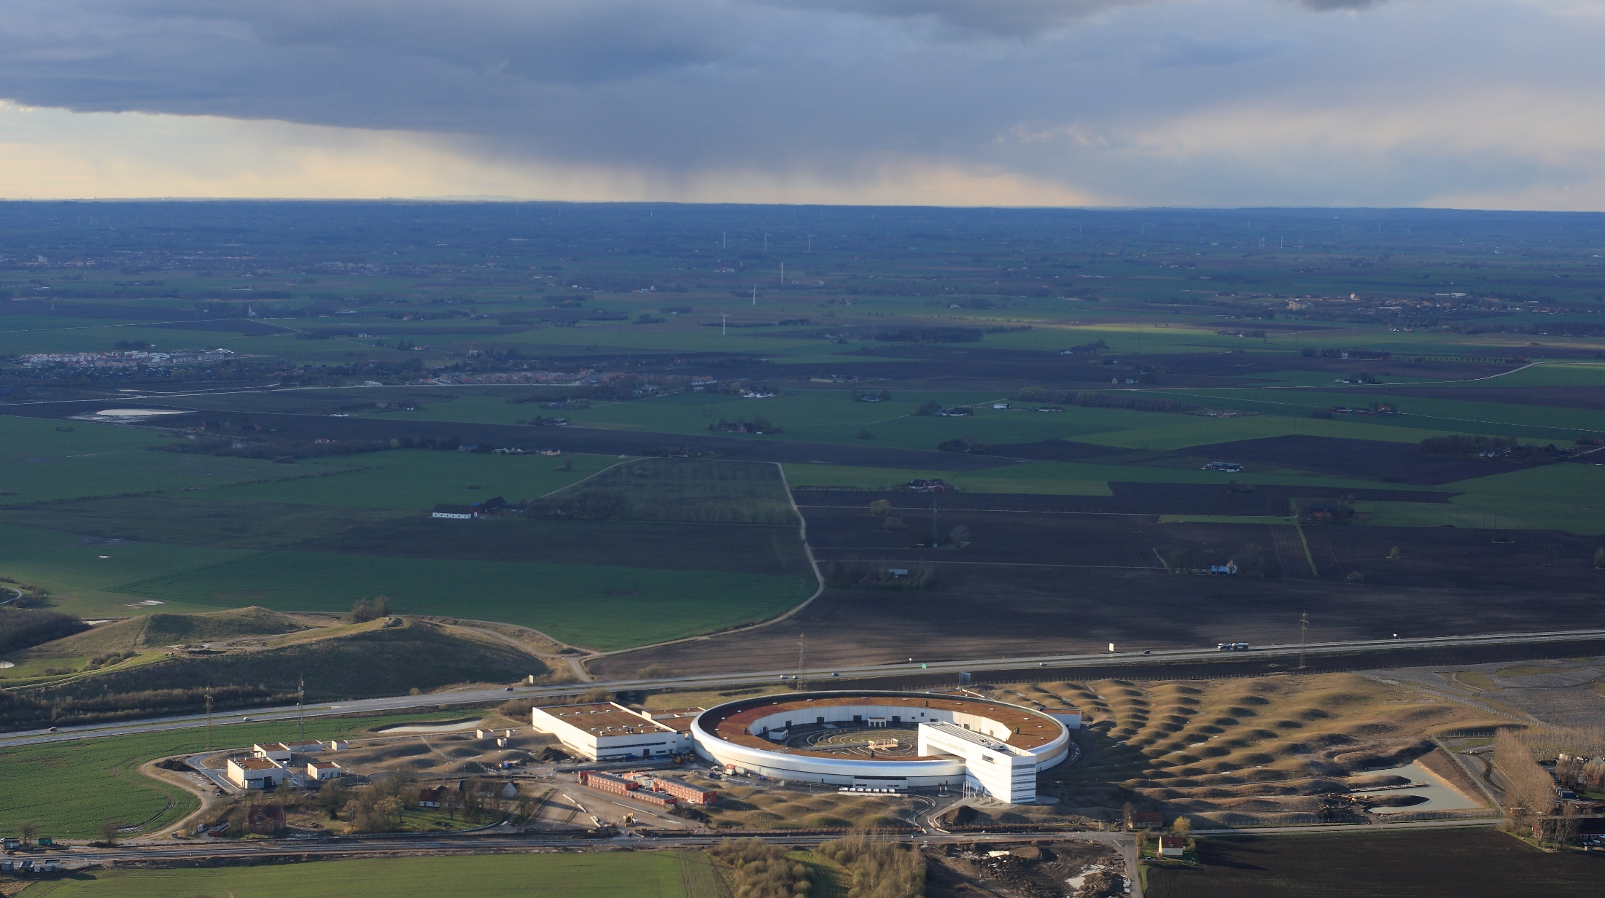
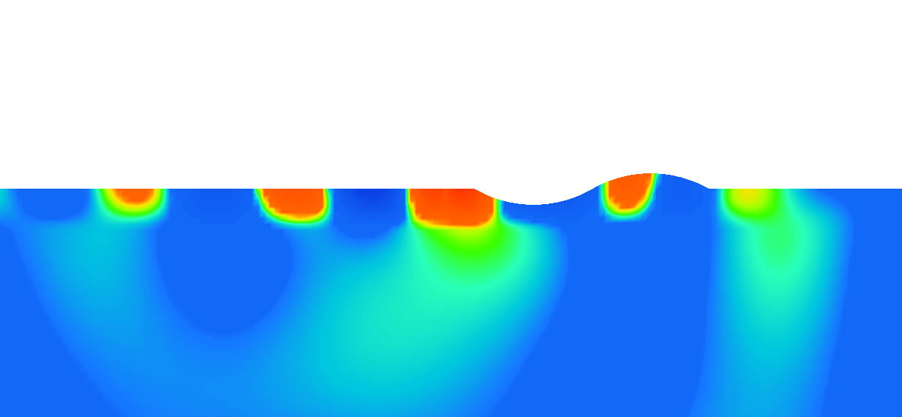
The (true) Story behind the MAX IV Bumps
Calculations: Per Jørstad and Peter Persson, LTH

Slide 9
THANKS!

