Slide 1
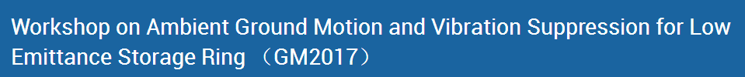
Summary of session 1

Slide 2
5 talks in session1
Qing Qin (IHEP) Progress of the HEPS projects
Lin Zhang(SLAC) Beam stability consideration for low emittance storage ring
Masaru Takao(JASRI) Beam orbit stability issues at the Spring-8 storage ring
Chih-Hsien Huang(NSRRC) Beam orbit stability issues for user operations at TPS
Brian Norsk Jensen(MAX lab) Update for the MAX IV stability task force.

Slide 3
In Qing Qin’s(IHEP) Talk
Parameter | Value | Unit
Beam energy | 6 | GeV
Beam current | 200 | mA
Circumference | 1360.4 | m
Partition number J_{x} /J_{y}/J_{z} | 1.51/1.0/1.49
Horizontal natural emittance | 58.4 | pm∙rad
Transverse tune (x/y) | 107.37/82.43
Natural chromaticity (x/y) | -214/-133
Corrected chromaticity (x/y) | +5/+5
No. of cell / long straight section | 48/48
Length of LSS | 6.15 | m
Beta function @ mid-LSS (x/y) | 8.9/4.1 | m
Damping time (x/y/z) | 18.3/27.8/18.7 | ms
U₀ per turn (w/o ID) | 1.959 | MeV
U₀ per turn (w/10 IDs) | 2.5 | MeV
Natural energy spread | 8.20×10⁻⁴
Momentum compaction factor | 3.43×10⁻⁵
RF frequency | 166.6/499.8 | MHz
RF voltage (swap-out injection) | 2.65/0.575 | MV
Harmonic number | 756
Bunch length with 3rd harm. cavity | 31.6 | mm
The performance of the HEPS is introduced.
The progress of HEPS is given
  01/2016, CDR study & writing
  02/2017, CD0 completed & submitted to CAS
  03/2017, internal review of CD0, modify CD0 report
  05/2017, CD0 submitted to National Development & Reform Commission
  06/2017, CD1 study and report writing started
  26/06/2017, national review of CD0
  12/2017, CD0 approved & CD1 report will be submitted
  02/2017, national review of CD1
  06/2018, national review of CD2
  11/2018, project construction starts, and will completed in 6.5 years

Slide 4
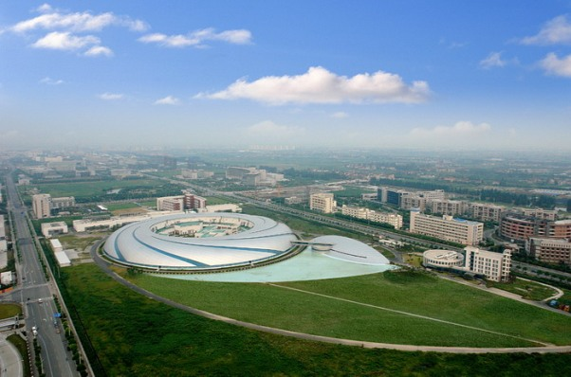
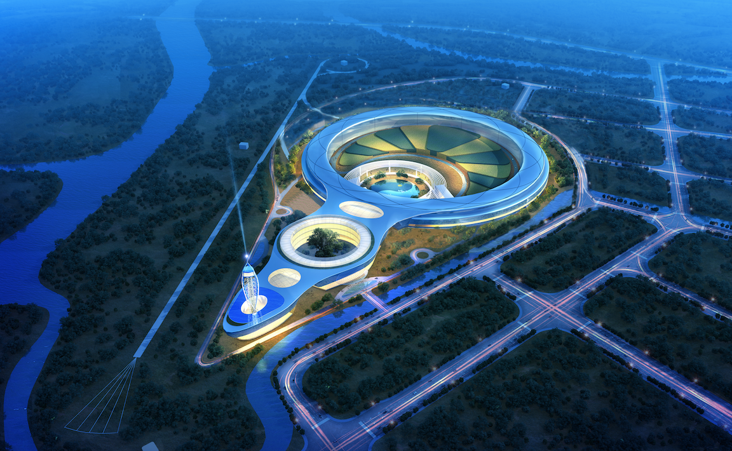
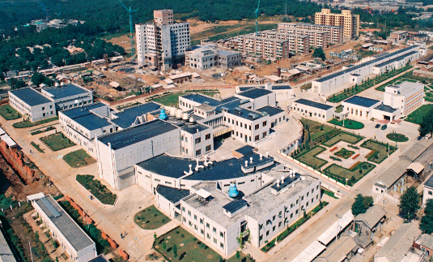
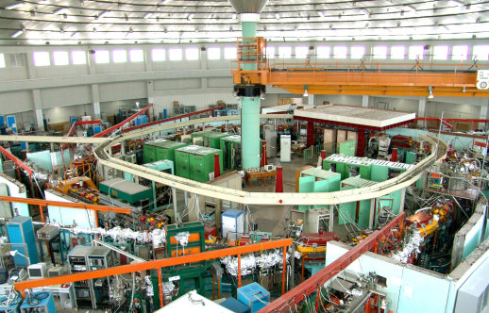
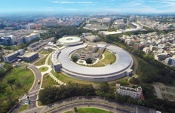
In Qing Qin’s(IHEP) Talk
Light sources in China
BSRF (1st G mid energy) HLS(2nd G low energy) SSRF, TPS(3rd G mid energy） HEPS（4th G high energy）
Shanghai Synchrotron Radiation Facility
Hefei Light source

Slide 5
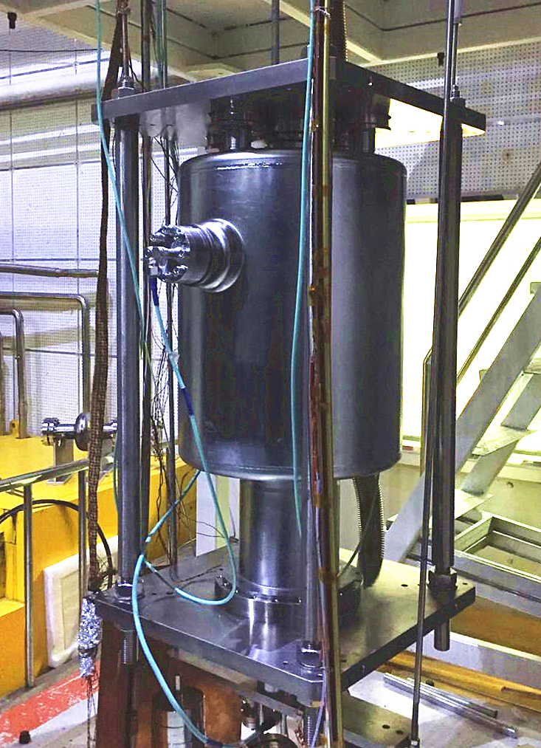
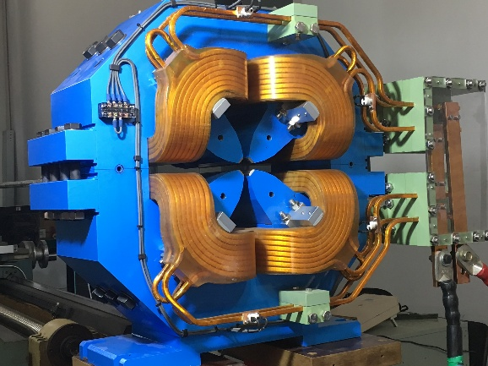
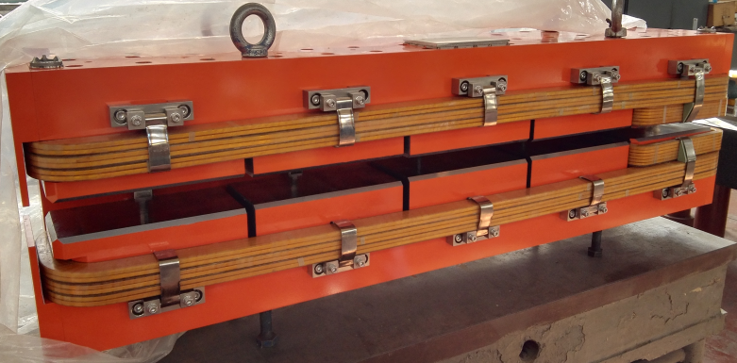
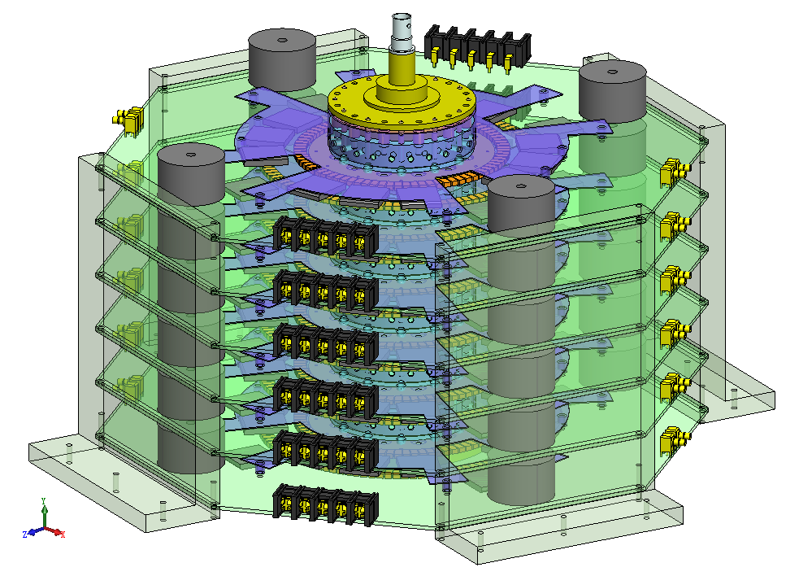
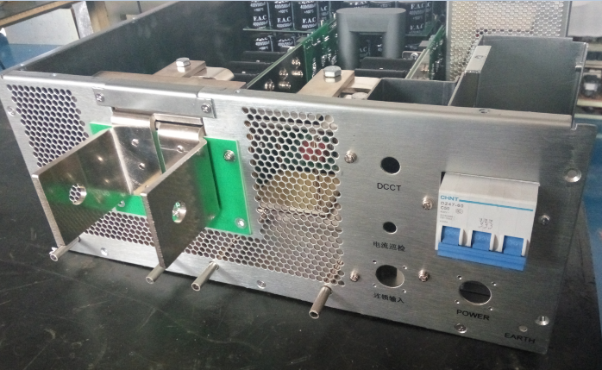
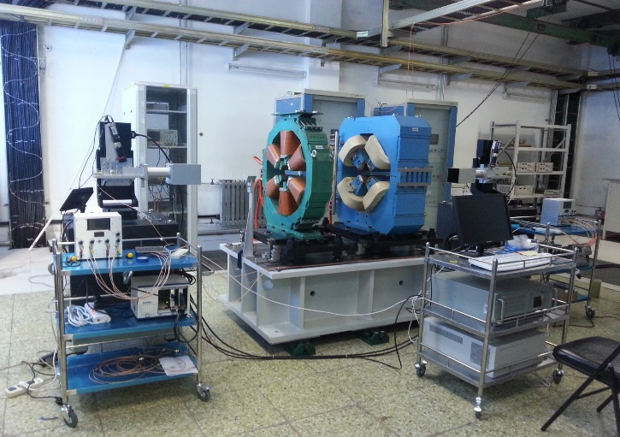
In Qing Qin’s(IHEP) Talk
Key technologies to HEPS
166MHz SC RF
Injection Kicker PS
10ppm high accuracy PS
Oscillating-line alignment tech

Slide 6
Lin Zhang’s (SLAC) Talk
Gives an overview of orbit stability requirement for DLSR. ESRF-EBS as an example.
Gives an overview of ground vibration.
Overview of Magnet-Girder assembly + Damping device
Overview of FOFB

Slide 7
Beam stability requirement
Small emittance → small beam size
Beam size ~ f(emittance, β-function, energy spread σ_{γ} and dispersion function η):
  RMS beam size:
  RMS divergence:
Beam position motion →
  Larger apparent beam
  Macroscopic “emittance growth”
Beam stability requirements
  Emittance growth: Δε/ε₀ < 20%
  Beam position stability:
y
Δσ_{y}
x
Δσ_{x}
Mainly in 0.01Hz ~ 100Hz
3rd Vs 4th GLS
H plane needs a little bit improvement
V plane already satisfied.

Slide 8
Ground vibration
Intermediate frequency is important ：
1、A lot of man made noise in 1<f<100 Hz
2、 Intermediate frequency vibration amplitude is relative large
3、Photon users are sensitive to 1<f<100 Hz vibrations.
3 frequency ranges
Low ( f < 1 Hz)
  Ocean waves
  micro seismic activities
Intermediate (1<f<100 Hz)
  Mechanical resonant frequencies
  Traffic, machine
  operations, water flow, wind,…
High ( f >100 Hz)
  Generated by small electro-mechanical structures
  Cooling flow
  Vibro-acoustic
  Much smaller level
In frequency domain
Low frequency
Intermediate frequency
High frequency

Slide 9
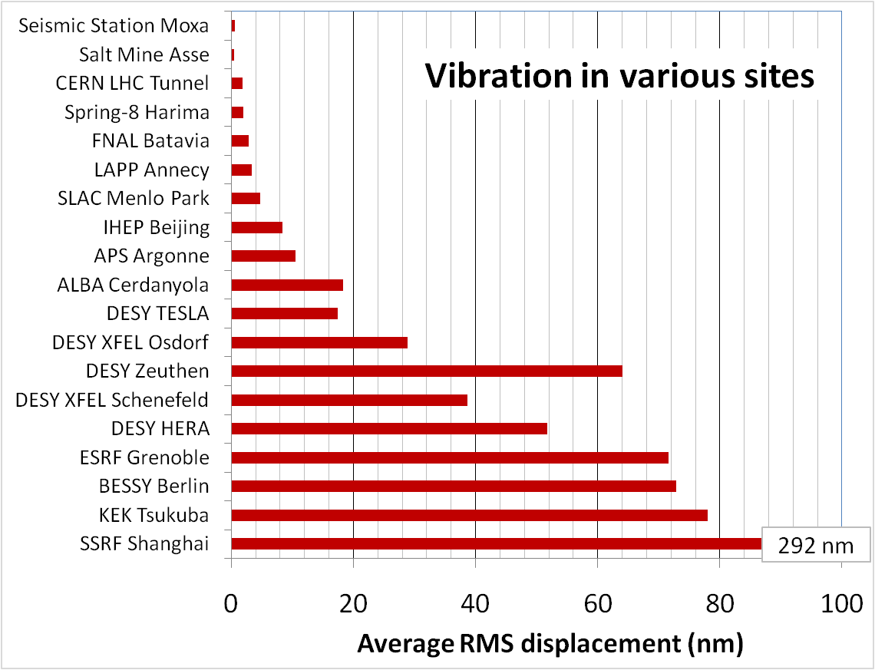
Ground vibration
Data source:
  W. Bialowons & H. Ehrlichmann, DESY, 2006
  R. Bartolini et al., EPAC2008
  Soleil private communication
  L. Zhang
SLAC tunnel
LCLS FEE, day
Soleil, Diamond

Slide 10
Magnet-girder assembly + damping device
Overview on magnet-girder assembly
?
ESRF EBS 4 vertical motorized jacks, stiffer hori. Manual adj. 42 1.0~1.1

Slide 11
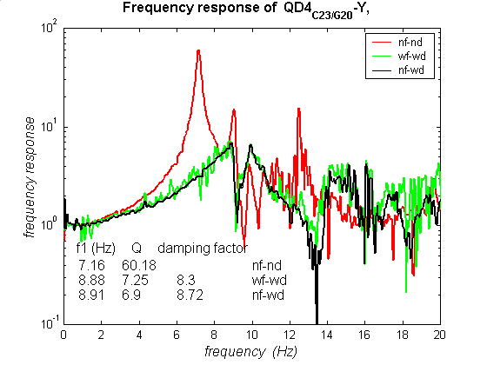
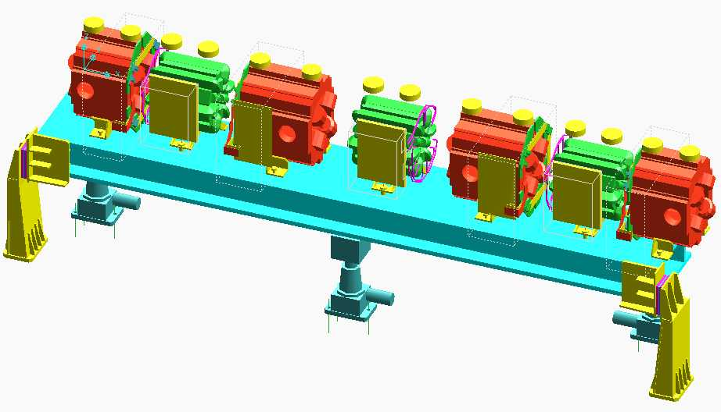
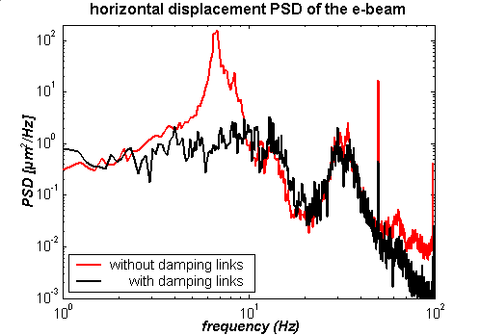
Damping device – damping link
Passive Damping systems can be (effective) used when TF_{s2M&G} > 2 and f₁<20 Hz
  Damping links at ESRF
  TF_{s2M&G} = 2.2
  → TF_{s2M&G} * f_{damping} = 1.3
L. Zhang et al., EPAC2000
L. Zhang et al., PAC2001

Slide 12
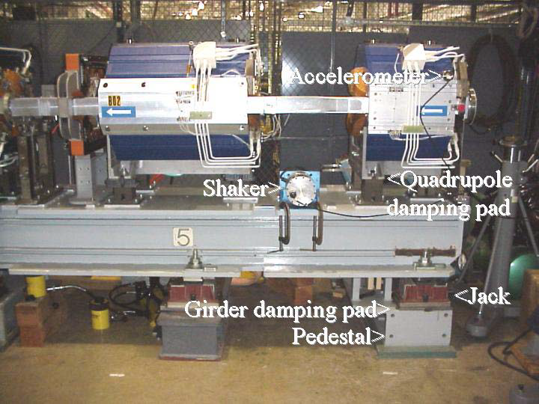
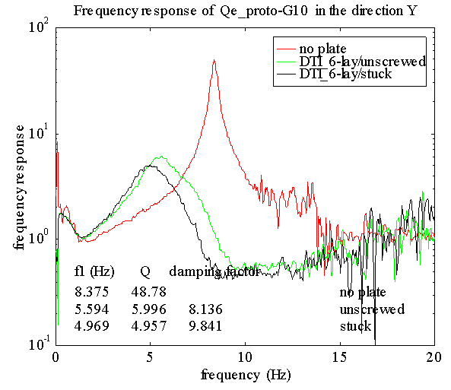
Damping device – damping pad
  Damping pads (shim) at APS
  TF_{s2M&G} = 9
  → TF_{s2M&G} * f_{damping} = 3 →1.5 (+shim)
cross section (not in scale)
0.5mm thin
2mm thick
0.18mm VEM
steel plate
steel plate
C. Doose, S. Sharma, MEDSI 2002
S. Sharma, WAGM 2005
  Magnet-Girder assembly, combining with damping device:
  TF_{s2M&G} * f_{damping} < 1.5 ( ~ 1 is possible)
Thermal drift → not applied

Slide 13
Electron beam stability & Feedback efficiency
Different ground vibration level, and e-beam motion between ESRF and Soleil, but feedback efficiencies are comparable in both vertical and horizontal directions, and both 4000 Hz or 100 Hz band width

Slide 14
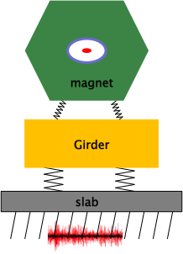
Work can be done to stable the beam
Design and optimization to reach the stability criterion:
Δx =TF_{Q2e} * TF_{G2M} * TF_{s2G} * TF_{gr2s} * x_{gr}
< 0.1σ_{x}
Storage ring Lattice design
Storage ring Lattice design
Magnet girder design
Magnet girder design
Slab design
Slab design
Ground vibration
Ground vibration
Fast orbit feedback
(f_{FOFB} )
Damping device
(f_{damping})
Δx = TF_{Q2e} * f_{FOFB} * TF_{s2M&G} * f_{damping} * TF_{gr2s}* x_{gr} < 0.1σ_{x}

Slide 15
Masaru Takao’s (JASRI) talk
Sources of beam orbit fluctuation and the efforts to suppression them at Spring 8.
Improvement of orbit feedback system

Slide 16
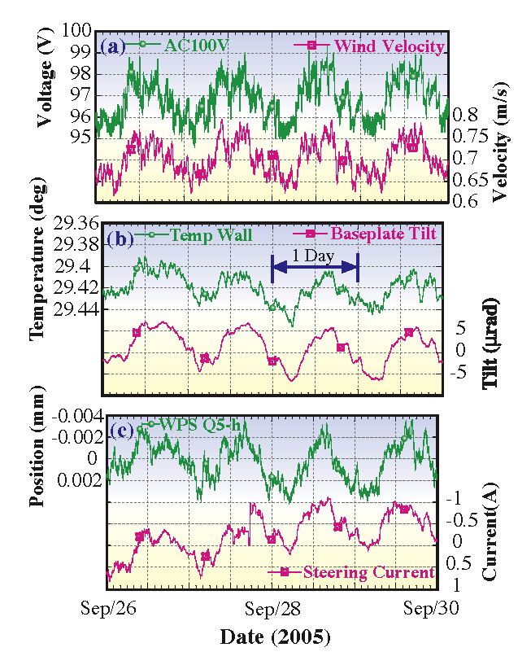
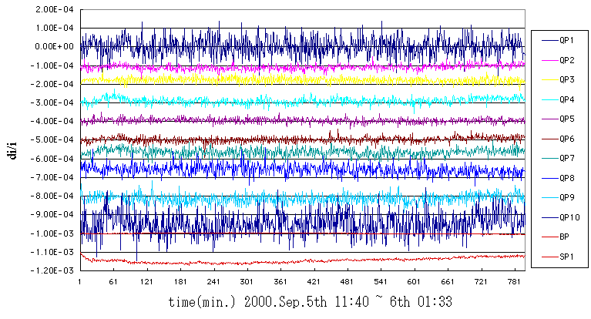
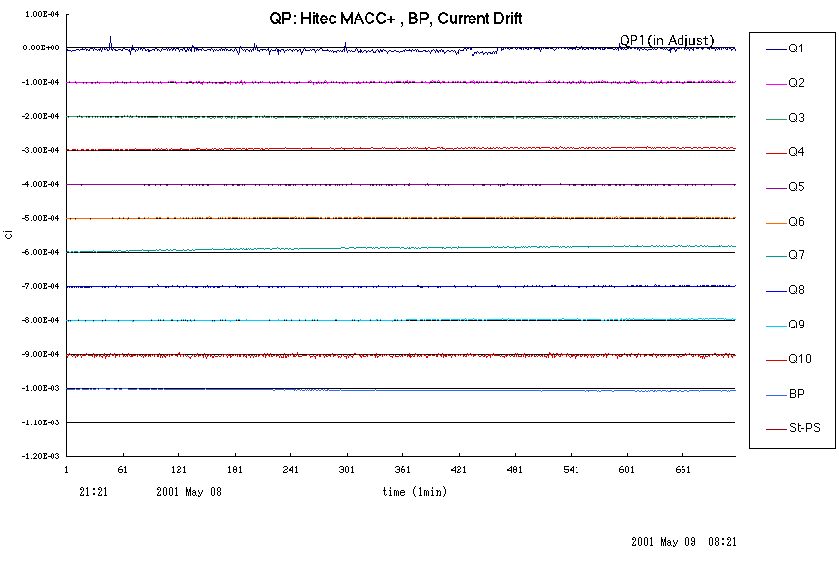
Sources of vibration at Spring-8 and improvement
Fast
Slow
1、Klystron PS ripple at 2KHz
3、Temperature fluctuation of cooling water
+/- 1ºC +/- 0.3ºC @1998 (+/-0.1ºC @present)
4、Wall plug electric power
5、Earth tide; Atmospheric temperature; Atmospheric pressure; Earthquake.
2、Quad PS ripple 50ppm → 3ppm

Slide 17
Feedback system improvement at Spring 8
Improvement on BPM and Steering PS
 | New Circuits | Old Circuits
Resolution | 0.1 μm | 0.3 μm
Measurement Cycle in user operation | 7 s (1 s @present) | 30 s
H, V: ~ 4,5 μm r.m.s
PS
16bit DAC
VME
Sum
Mag
16bit DAC
Att
1/32
 | Max. Kick Angle | Min. Step
H | 31 μrad | 1 nrad
V | 16 μrad | 0.5 nrad
H, V: ~ 1μm r.m.s

Slide 18
Chih-Hsien Huang’s (TPS) Talk
Relationship of ground motion to the beam motion.
Hunting 29Hz, 40Hz, 60Hz, 3Hz noises.
FOFB system performance at TPS

Slide 19
Relationship of ground motion to the beam motion
0.1~ 1 Hz ground vibration, the integrated RMS is in the order of μm. The motion is almost coherent in all ring.
0.1~ 0.5 Hz horizontal vibration Creates dispersive orbit, which may related to Lower alpha of the lattice.
For the frequency between 1 to 4 Hz, the integrated rms ground motion is < 100 nm in vertical. The components motion excited by the ground is almost in phase within one cell.
The location variation of the crane disturbs the beam orbit.
Thickness of the floor slab is 160 cm in the tunnel and 80 cm in the experiment hall, respectively. The increase of the thickness of floor slab can reduce the ground motion induced by mechanical vibration, especially higher than 4 Hz.

Slide 20
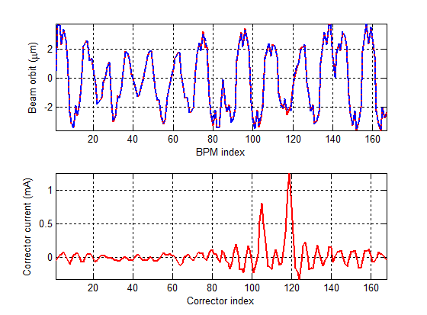
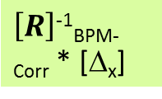
Hunting 29Hz, 40Hz, 60Hz, 3Hz noises
  Dry pump: Induction motor induced vibration ~ 29 Hz
    Turn off dry pumps => solved!
  Vacuum chamber vibration due to cooling water: ~ 40 Hz
    Lower the flow rate reduce the amplitude.
  Cooling fan, SRF transmitter: ~ 60 Hz
  Booster PS : ~ 3 Hz
3 Hz beam motion.
Corrector vs. BPM Response Matrix R
To hunting the noise: Match the frequeny
$\left[R\right]$⁻¹_{BPM-Corr} * [Δ_{x}]
Inverse Response matrix to location the noise

Slide 21
FOFB system performance at TPS
After removing error sources and before applying FOFB, the integrated RMS displacement from 1-100 Hz was around 2 μm in both horizontal and vertical directions for the ID BPM.
When the FOFB was turned on, the integrated RMS became smaller than 0.5 μm from 1 to 100 Hz.

Slide 22
Brian Norsk Jensen’s (MAX lab) Talk
A effective a one-man band to stable the beam at MAX IV
Many passive works to reduce the vibration.

Slide 23
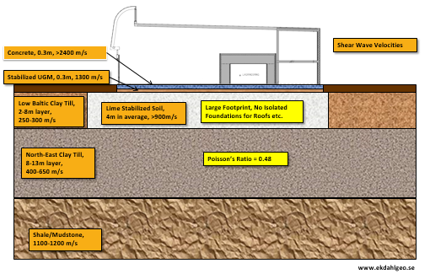
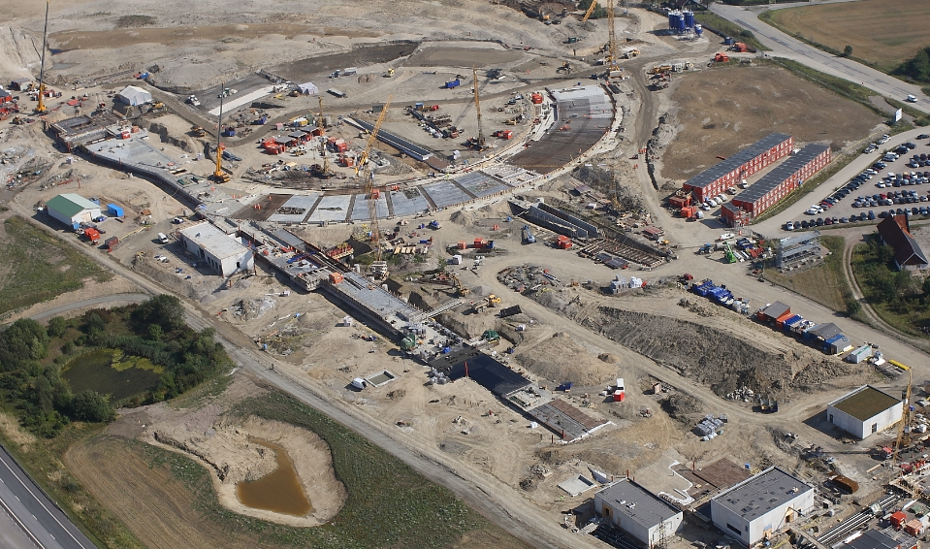
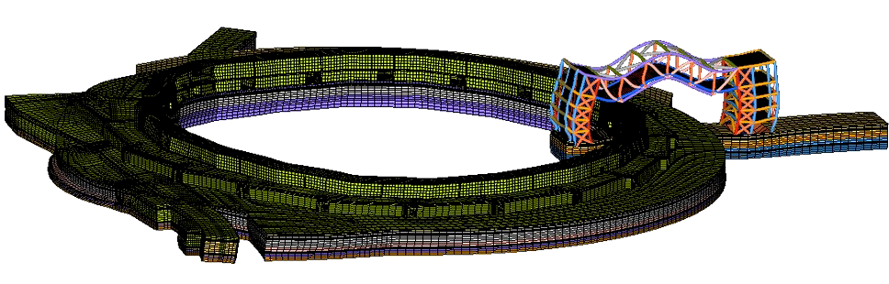
Civil Engineering
Notes:
Most tools are for measuring vibrations and mechanical stability

Slide 24
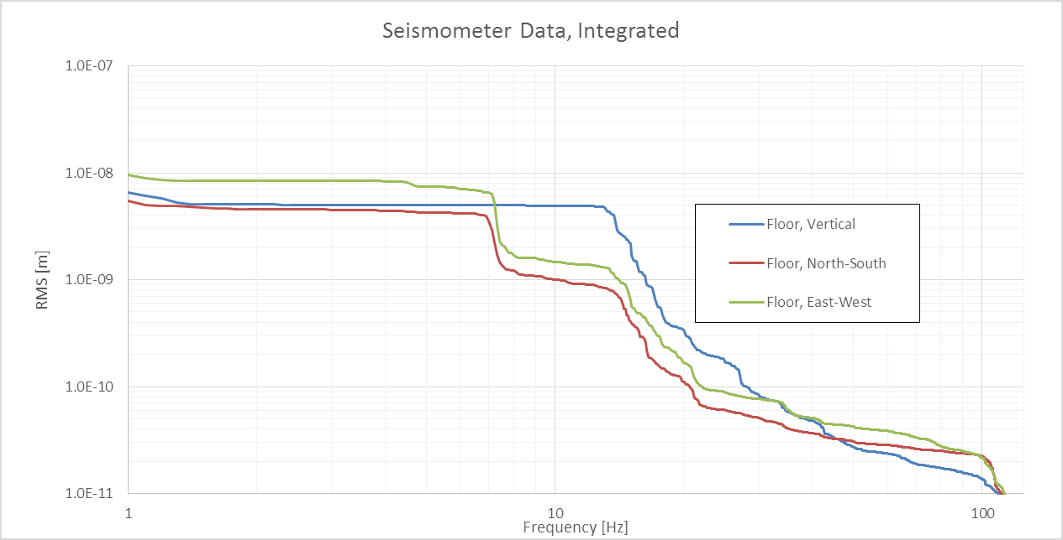
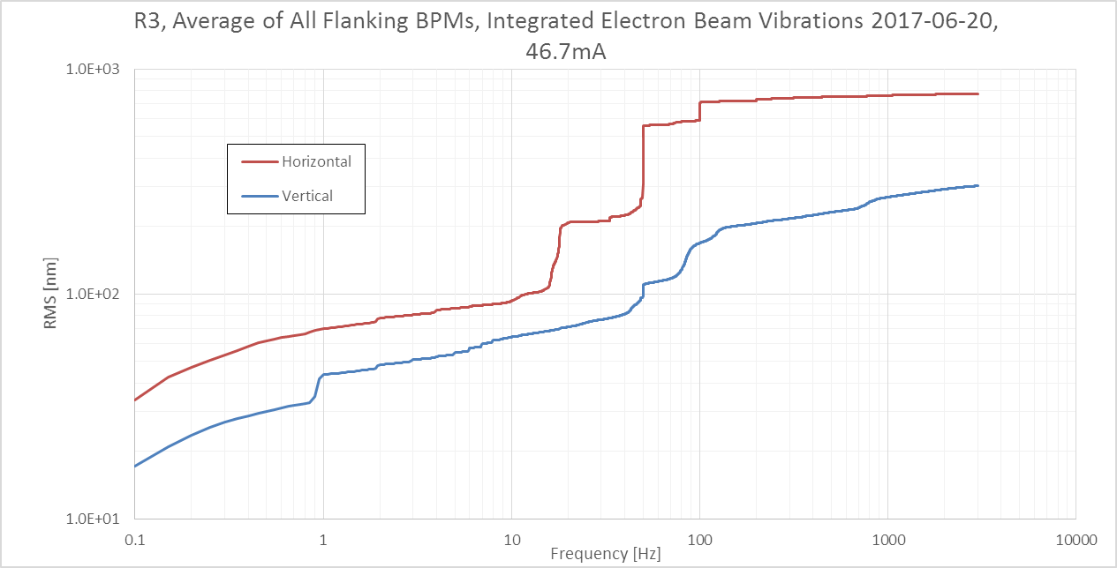
Ground vibration & Beam
MAX IV
Electron Beam, Integrated Values, NO FOFB
Already stratify 3GLS
However MAX IV is 4GLS
They needs 200~300 nm stability

Slide 25
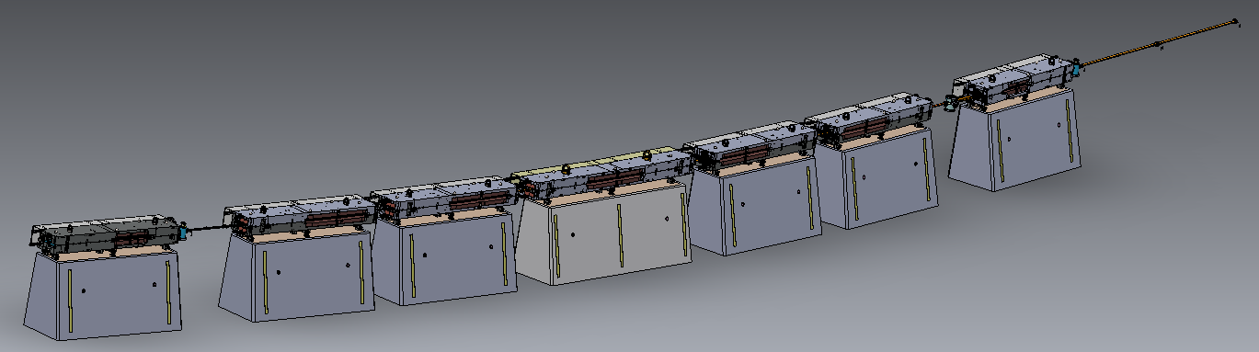
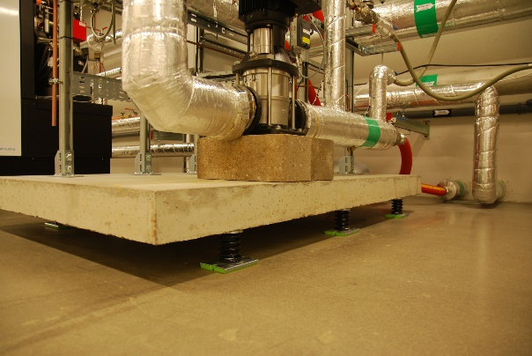
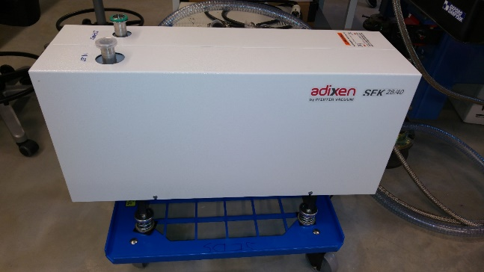
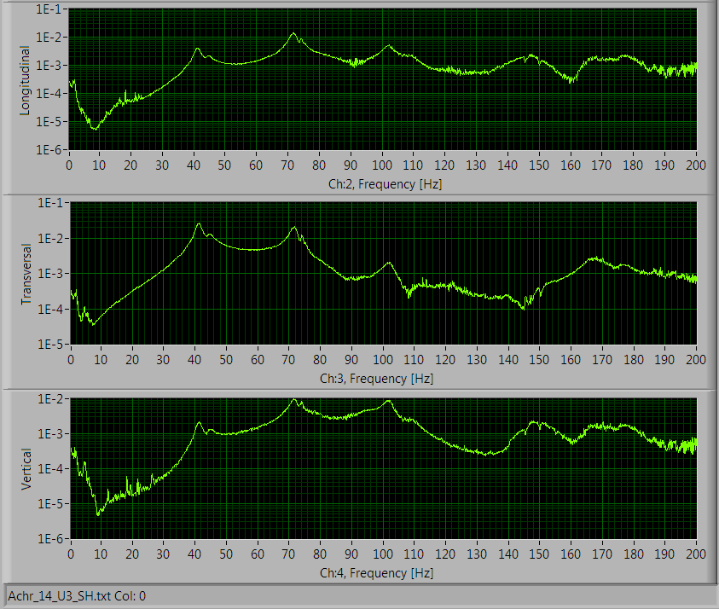
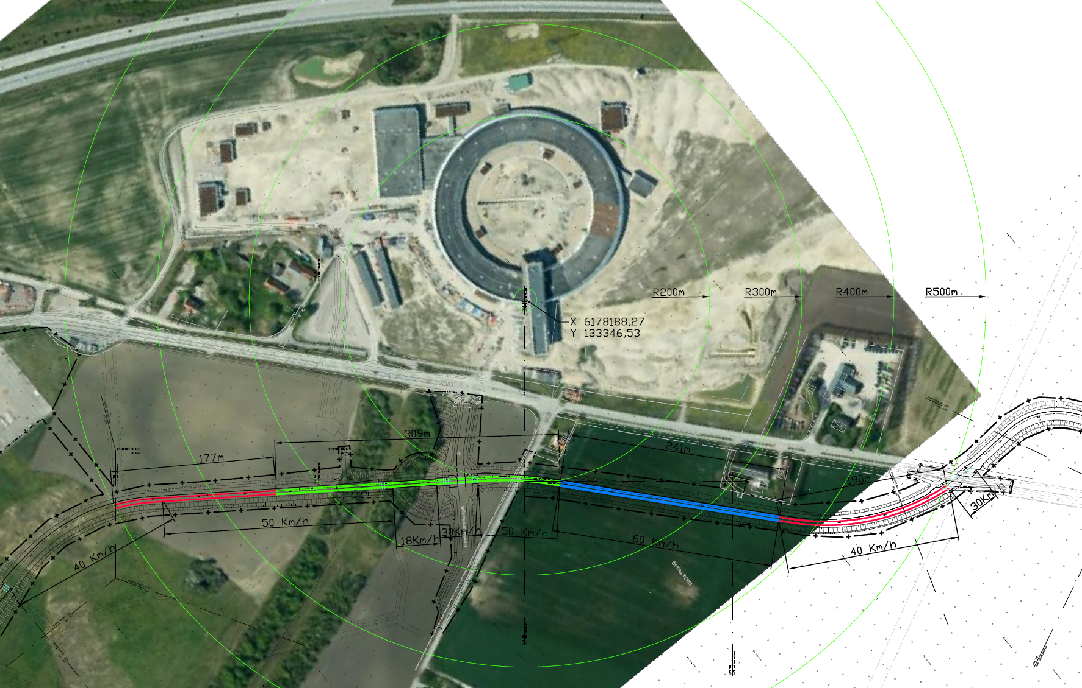
passive works to reduce the vibration
Increase eigen freuqency
Isolation

Slide 26
Summary
The geological conditions and the environment is important for LS stability.
Passive method is more reliable than feedback. Pile, Slab, Gird, Damping link(pad), isolation.
It common issues that we will face : PS ripple, water flow, temperature, ground vibration, we needs to hunt the source and to eliminate them.
FOFB is essential for high performance of orbit stability.

