Slide 1



Welcome to IHEP
Workshop on Ambient Ground Motion and Vibration Suppression for Low Emittance Storage Ring
IHEP, Dec. 11 – 13

Slide 2
Progress of the High Energy Photon Source Project
Qing Qin
Institute of High Energy Physics, CAS
Dec. 11, 2017

Slide 3
Outlines
Introduction
Accelerator physics issues
Key technologies to HEPS
Project progress
Summary

Slide 4
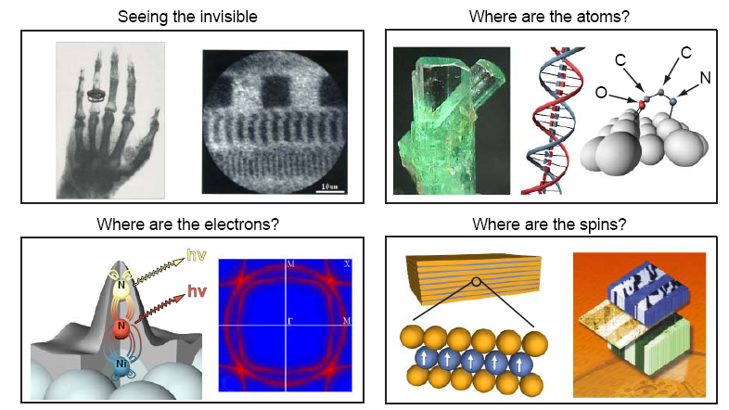
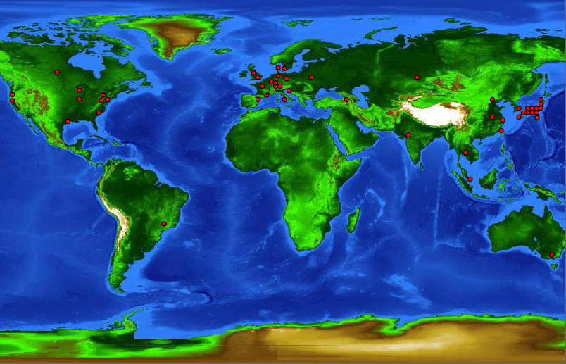
1. Introduction
Photon source – A powerful tool to probe the nature, required with widely tunable frequency range from infrared to hard X-ray

Slide 5
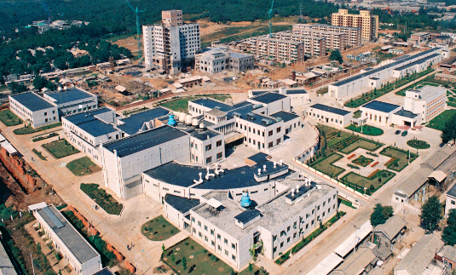
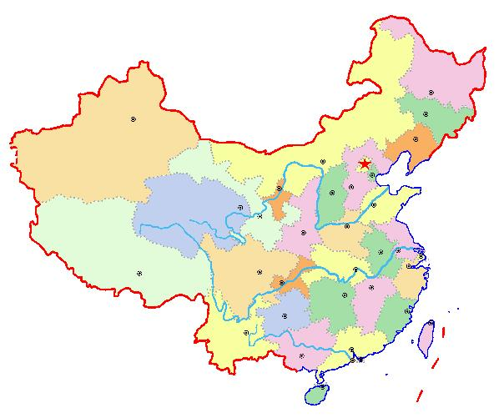
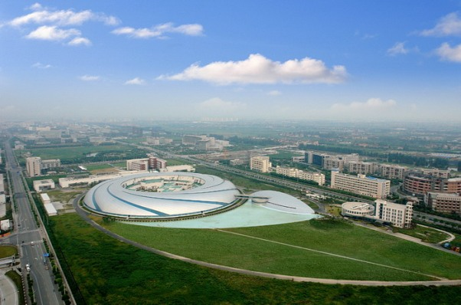
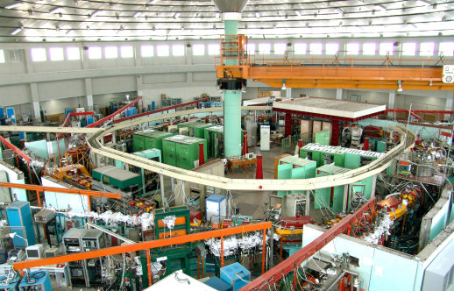
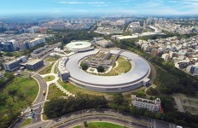
Storage ring-based synchrotron radiation light source
Developed in China from 1980s, BEPC/BSRF, HLS, SSRF, and TLS/TPS
Beijing Synchrotron Radiation Facility
BSRF
1GLS
Shanghai Synchrotron Radiation Facility
SSRF
3GLS
Hefei Light source
Taiwan Photon Source
HLS
2GLS
TPS
3GLS

Slide 6
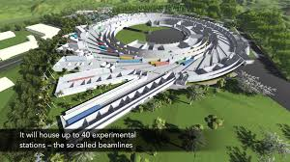
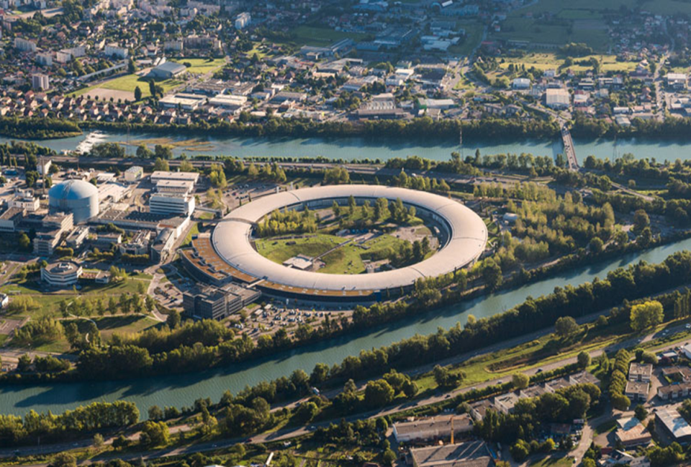
Trends of light source
MAX IV, Sweden, 528 m, 3 GeV, 0.33 nm
Sirius, Brazil, 518 m, 3 GeV, 0.27 nm
ESRF-EBS, France, 844 m, 6 GeV, 0.13 nm
Lower emittances (  ∼0.1 nmrad)
Higher brilliances (↗2~3 orders)
More advanced beam lines and end-stations (Better resolutions, higher speeds, etc.)
SR-based research centers

Slide 7
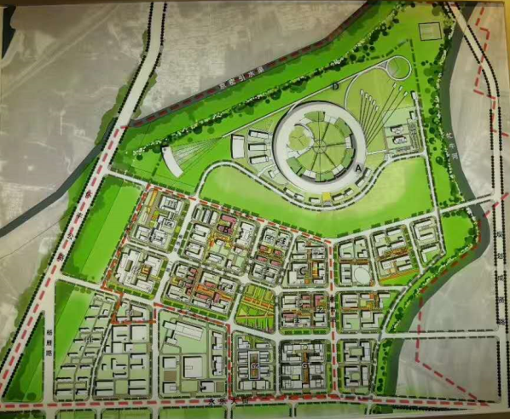
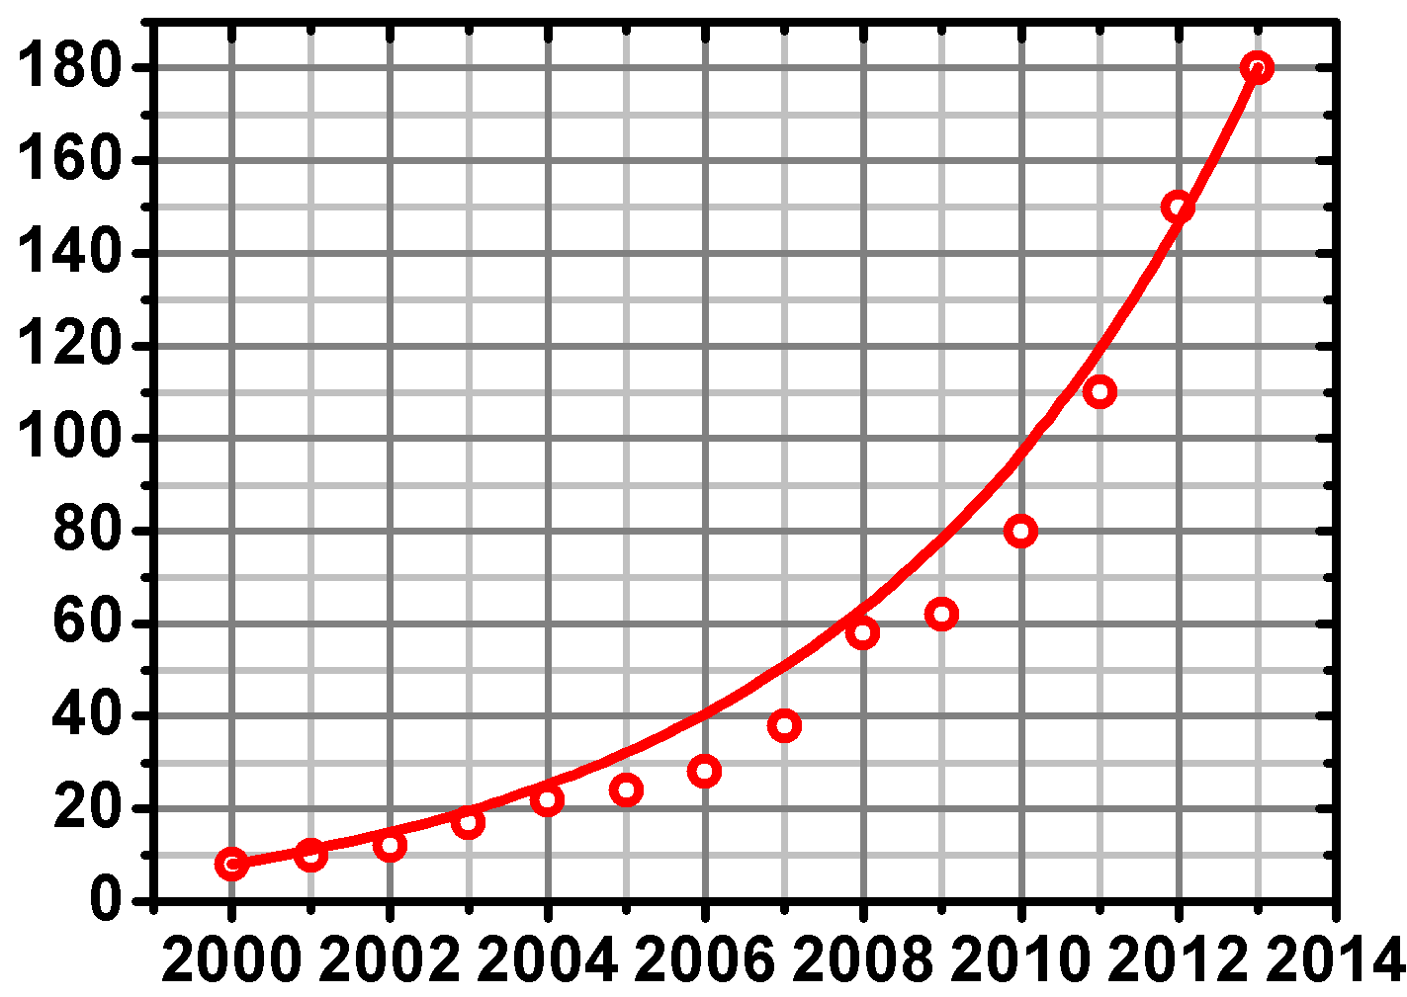
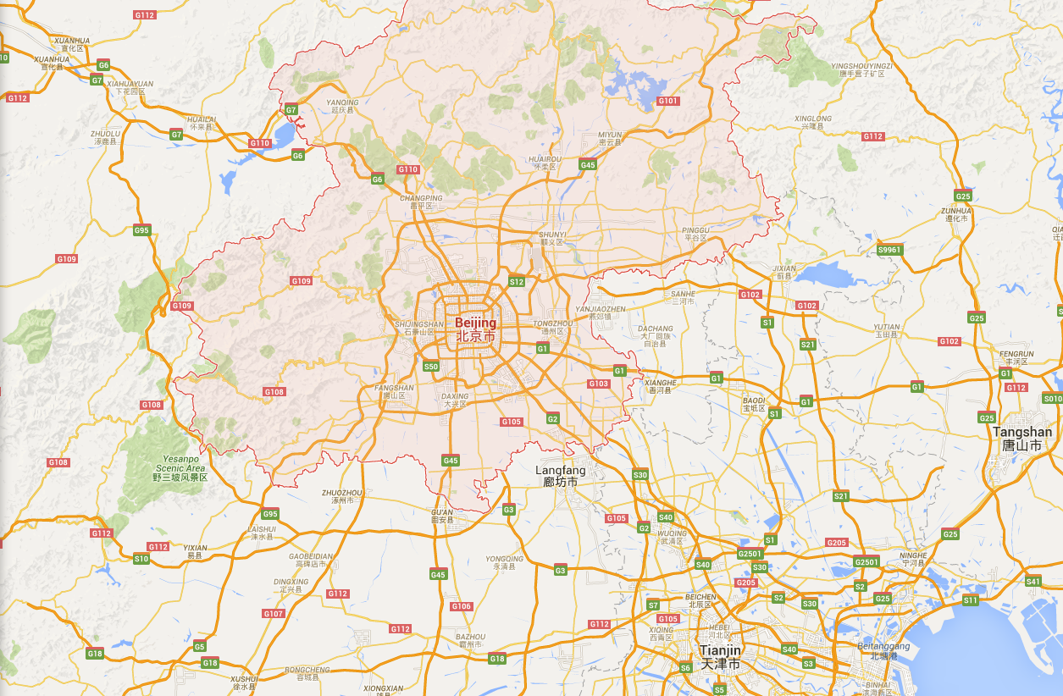

New light source in China — High energy, high brightness
Users increased as the development of Chinese sciences and economy
A new photon science research center at the north China
IHEP
SSRF
e.g. Increase of structure biology users in China
About 80 km from IHEP

Slide 8
Two steps
R&D of HEPS project
  One of the 16 large scientific facilities in the list of National Development and Reform Commission in the 12th 5-year plan.
  Scheduled from 2011 to 2015, but delayed.
  Officially started from Feb. 2016, and will be completed on Oct. 2018.
  Total budget: 321.6 M RMB (~48 M USD)
HEPS project
  Passed the review of the proposals for the large scientific facility, and shortlisted the 13th 5-year plan of the National Development and Reform Commission of China
  Expected to start the construction in late 2018, completed at 2024. The whole project finished in mid-2025 after commissioning.
  Total budget: 4.5-5 B RMB (~0.7 B USD)

Slide 9
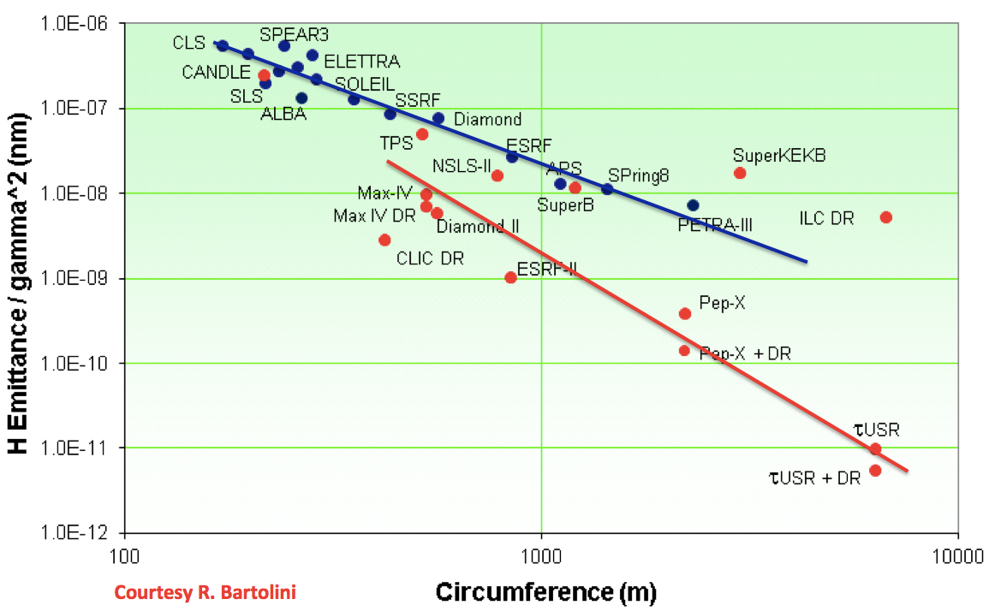
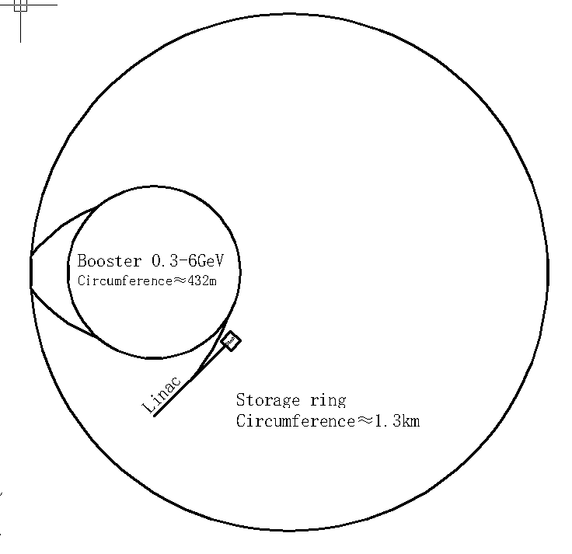
Design goal of the HEPS (high energy photon source)
Main parameters | Unit | Value
Beam energy | GeV | 6
Circumference | m | ~1360
Emittance | pm.rad | < 100
Beam current | mA | 200
Injection |  | Top-up
Brightness | Phs/s/mm² /mrad²/0.1%BW | >10²²
HEPS

Slide 10
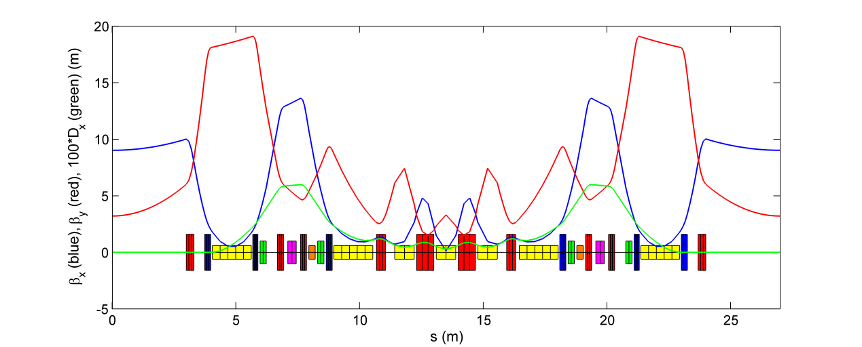
2. Accelerator physics issues
Linear lattice design
  find an optimized qusi-DLSR design for the HEPS storage ring.
    compromised between Chinese technology level and innovations (e.g., way to get the lowest emittance)
    compromise between user requirements and accelerator performance
  give a detailed parameter list and tolerance budget table for hardware systems.
Hybrid 7-BA lattice, adopts aggressively strong focusing which results in a compact layout as well as an ultra-low emittance. This allows practical and cost effective storage ring design, even when the natural emittance is reduced down to approaching the diffraction limit of hard X-rays

Slide 11
Parameter | Value | Unit
Beam energy | 6 | GeV
Beam current | 200 | mA
Circumference | 1360.4 | m
Partition number J_{x} /J_{y}/J_{z} | 1.51/1.0/1.49
Horizontal natural emittance | 58.4 | pm∙rad
Transverse tune (x/y) | 107.37/82.43
Natural chromaticity (x/y) | -214/-133
Corrected chromaticity (x/y) | +5/+5
No. of cell / long straight section | 48/48
Length of LSS | 6.15 | m
Beta function @ mid-LSS (x/y) | 8.9/4.1 | m
Damping time (x/y/z) | 18.3/27.8/18.7 | ms
U₀ per turn (w/o ID) | 1.959 | MeV
U₀ per turn (w/10 IDs) | 2.5 | MeV
Natural energy spread | 8.20×10⁻⁴
Momentum compaction factor | 3.43×10⁻⁵
RF frequency | 166.6/499.8 | MHz
RF voltage (swap-out injection) | 2.65/0.575 | MV
Harmonic number | 756
Bunch length with 3rd harm. cavity | 31.6 | mm
48 identical hybrid 7BAs.
Each 7BA cell is about 27 m.
48 dispersion-free 6-m straight sections, with beta functions of 9/3.2 m.
4 outer dipoles with long. gradients; 3 inner dipoles with defocusing gradients.
Neighboring 3 inner dipoles, high-gradient quadrupoles (~ 80 T/m).
6 sextupoles and 2 octupoles in one 7BA.

Slide 12
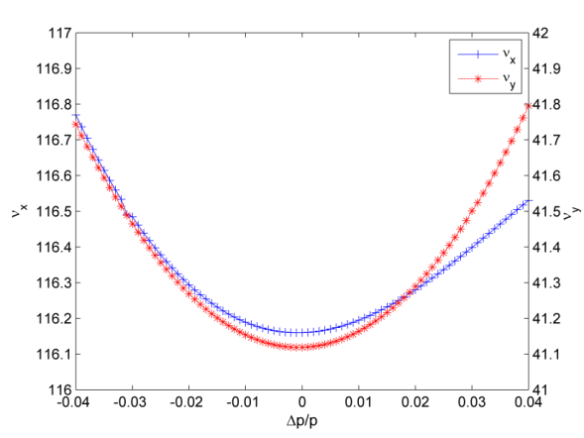
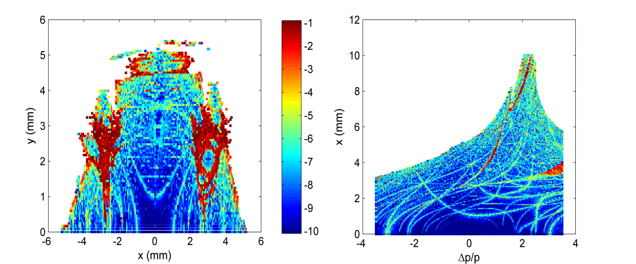
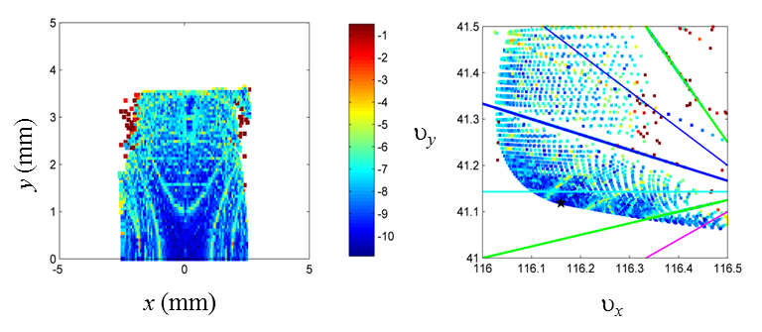
Dynamic aperture study
Nonlinear optimization w/ 4 families of multipoles (grid-scan)
  Effective on-momentum DA: ~2.5 mm in x and 3.5 mm in y;
  effective MA: ~3%.
  Effective DA/MA is required not only the motion remains stable after tracking over a few thousand turns (traditional definition of the DA or MA), but the tune footprint is bounded by the integer and half integer resonances nearest to the nominal tunes of the storage ring.
υ_{x}
υ_{y}
y (mm)
x (mm)
δ
x (mm)

Slide 13
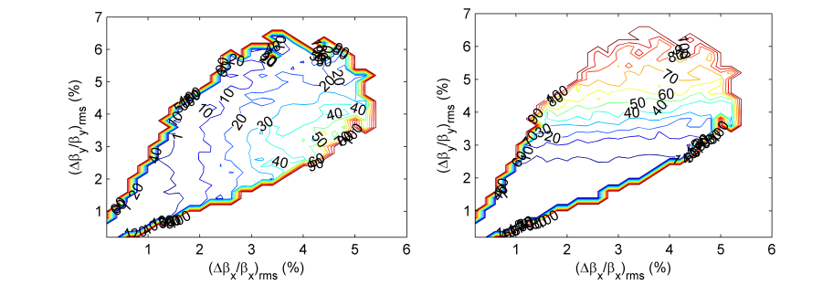
Nonlinearity study
Integer resonances
  always fatal to dynamics and can never be crossed
MA reduction probability (%) for the HEPS (Left: caused by horizontal half- integer resonances, Right: caused by vertical half integer resonances. Y. Jiao, Z. Duan, NIM-A, 841, 2017
Half-integer resonances
  Experimental (G. Wang et al., IPAC16) and numerical (M. Borland et al., IPAC15) studies show that the half-integer resonances can be safely crossed even w/ errors.
  For HEPS, keeping the probability of MA reduction due to crossing of half-integer resonances below 1%, the rms beta beating should be smaller than 1.5% in x and 2.5% in y plane, respectively.
  Within the effective DA or MA, not only the motion remains stable after tracking over a few thousand turns, but also the tune footprint is bounded by the integer and half integer resonances nearest to the nominal tunes.
  One can avoid too optimistic estimation of the nonlinear performance of the actual machine, when having only the bare lattice in hand.

Slide 14
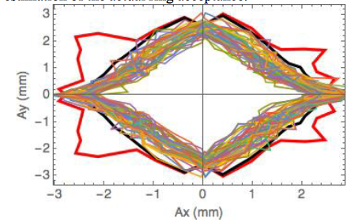
‘Effective’DA&MA: limited by IRs and HIRs
This can provide a quick and reasonable measure of the realistic acceptance of a DLSR while with only the bare lattice in hand！
DA defined in a conventional sense
‘Effective’ DA
This will facilitate the optimization of a DLSR design with MOGA to find multi rather than single “optimal” solutions.
ated error modeling and lattice calibration can then select one most robust design from these solutions.
In this way, we find an efficient approach to separate the optimization and evaluation of the lattice processes.
Y. Jiao, Z. Duan and G. Xu, IPAC 2017, WEPAB055, 2706-2708.
Y. Jiao and Z. Duan, arXiv:1606.07191.
Submitted to NIM-A.

Slide 15
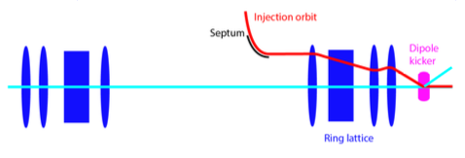
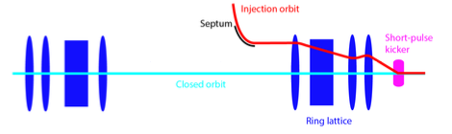
Injection design – On-axis injection schemes
schematic plot of the kicker pulse shape
On-axis transverse injection (swap-out)
Major challenge:
A full charge injector to replace stored bunches in storage ring,
in particular, HEPS timing mode requires a bunch charge of ~15 nC, generation and acceleration of such high charge bunches is nontrivial.
injected bunch
swap-out
bunch spacing = 6ns for HEPS
On-axis longitudinal injection (accumulation)
Major challenge:
Generation of a RF acceptance region to keep both injected and stored bunch with a large enough temporal separation, so as to accommodate the kicker pulse.
injected bunch
longitudinal injection

Slide 16
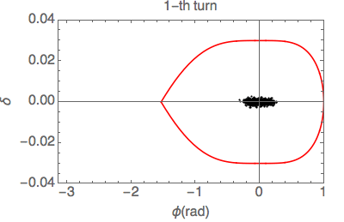
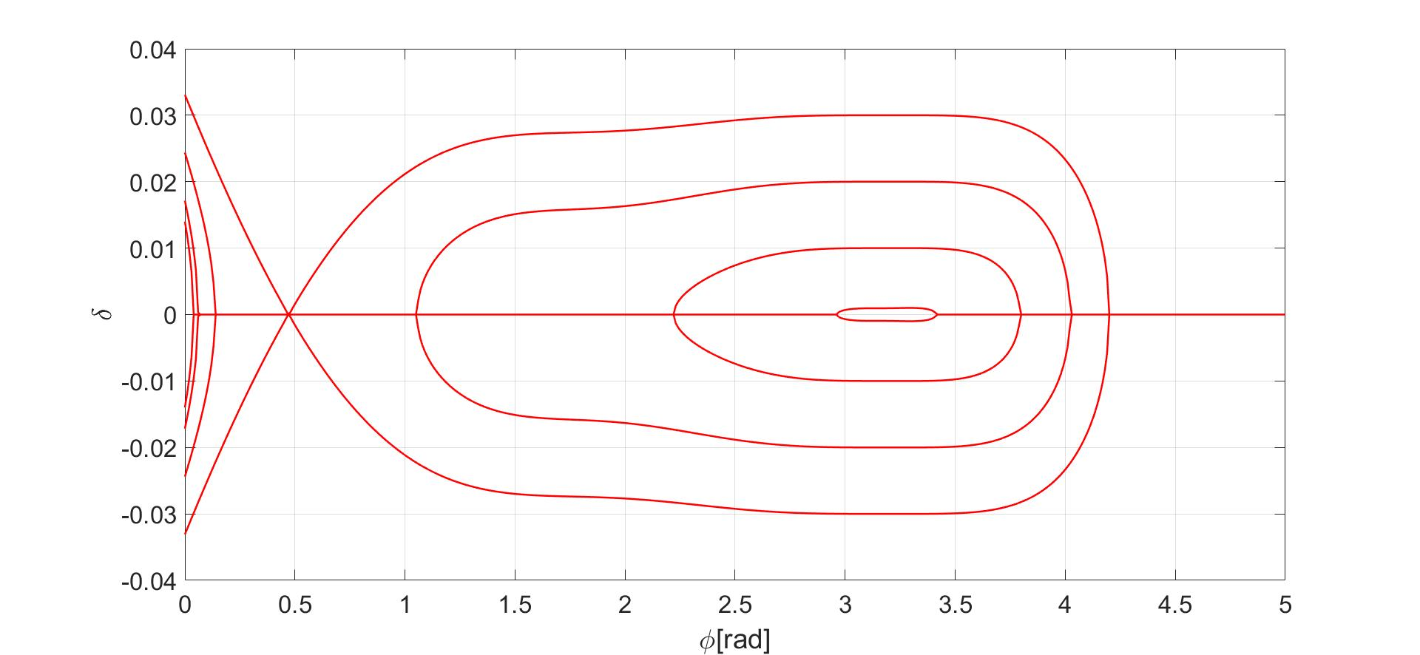
On-axis longitudinal injection schemes for HEPS
166 MHz + 500 MHz active RF system
Manipulation of RF voltages and phases in an injection period of ~ 200 ms
operation mode
injection mode
circulating bunch
injected bunch
166 MHz + 333 MHz (2nd harmonic) + 500 MHz (3rd harmonic) RF systems
A substantial increase in RF acceptance compared to what is achievable with a double RF system.
Challenge: requires a large enough (~ 2mm) dynamic aperture at large synchrotron amplitude( ~ 3%)
Challenges:
Operational issues with frequent RF ramping.
Substantial brightness drop (~20%) due to the short bunches at the injection mode.

Slide 17
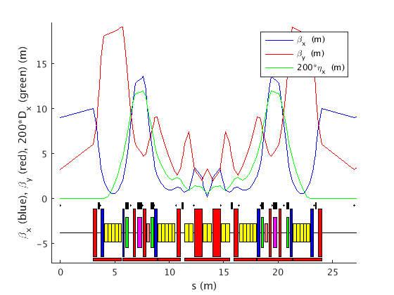
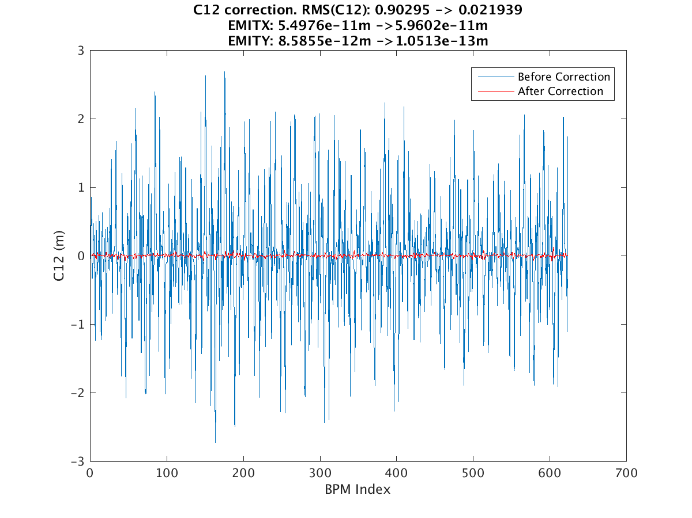
Error tolerance study
Lattice model – 7-BA, 7 girders, 12 hori. and 10 vert. correctors, 4 skew quads, and 13 BPMs
Error assign
  Multipole field components (1e-3) of magnets
  Alignment error (30μm on the same girder, 50μm on different girder) and rotation (100mrad)
  BPM resolution (0.5μm)
Alignment error is dominant
Dispersion in vertical and coupling should be controlled by correcting with skew quads
  From a max. 30 pm∙rad increase reduced to 1 pm∙rad increase.

Slide 18
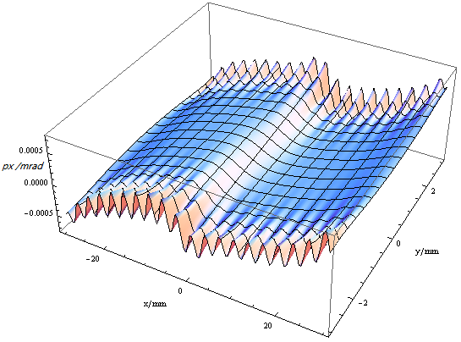
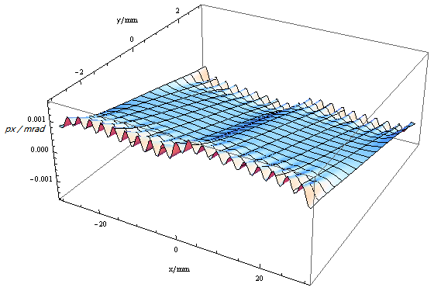
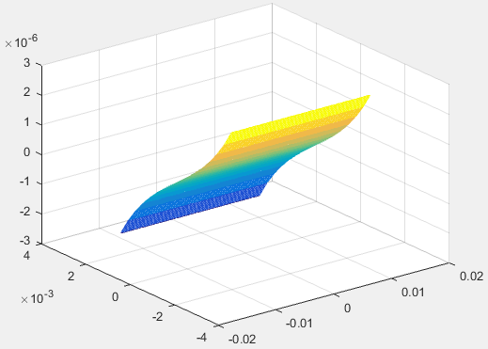
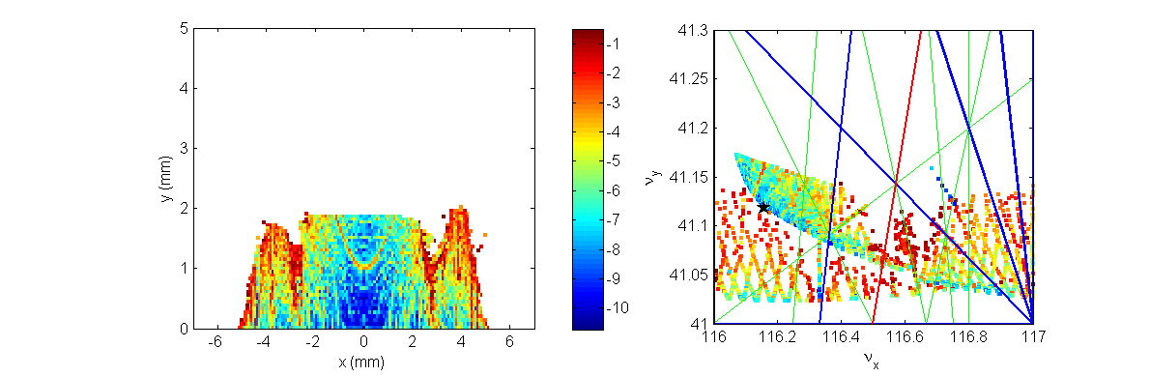
ID effect
Setup kick maps with Hamiltonian-Jacobin methods for 14 undulators to be installed in the first stage of HEPS.
Induced tune shift on the order of 0.003.
Obvious DA reduction, but not affects on-axis injection.
Elliptically polarizing undulator
Planar undulator

Slide 19
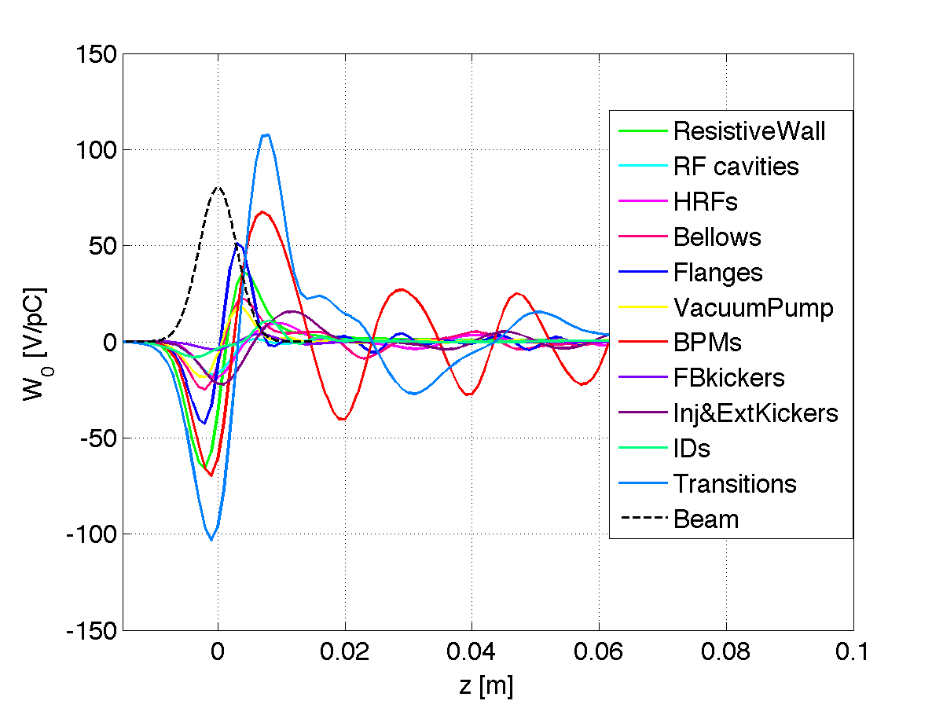
Collective effects – Impedance model
Impedance model is setup for instability studies
Geometrical contributions
Elements | Number | Elements | Number
RF cavities | 4 | LFB kicker | 1
Harmonic RFs | 2 | TFB kicker | 1
Flanges | 1000 | Inj. kickers | 10
Bellows | 400 | Ext. kickers | 4
Vacuum pumps | 288 | IDs | 15
BPMs | 768 | Transitions | 360
The longitudinal impedance is dominated by large number elements, e.g., flanges, BPMs.
The transverse impedance is dominated by the resistive wall impedance due to the small aperture of beam pipe.
More impedance contributors will be included in the further studies.
Longitudinal wake potential (σ_{z} =3mm)

Slide 20
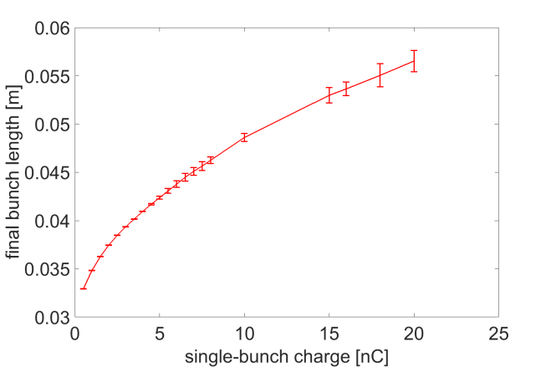
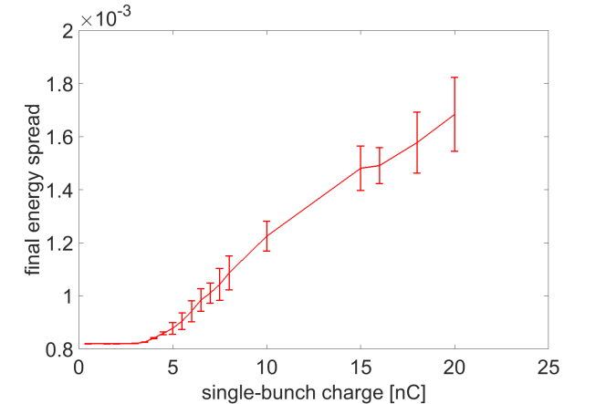
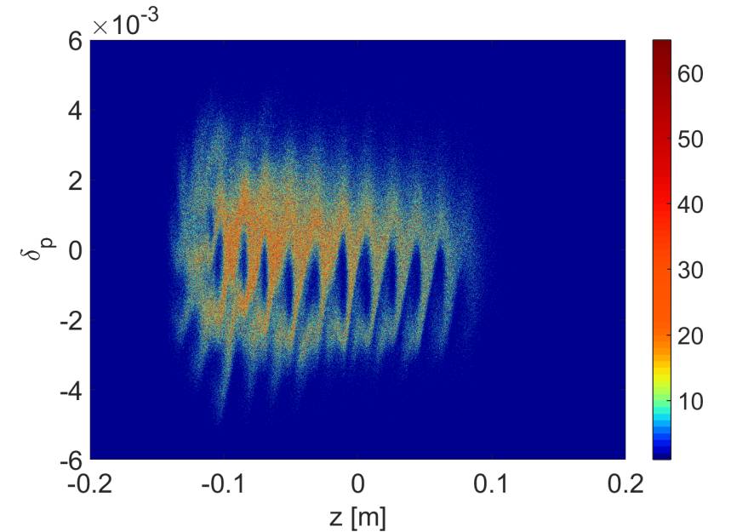
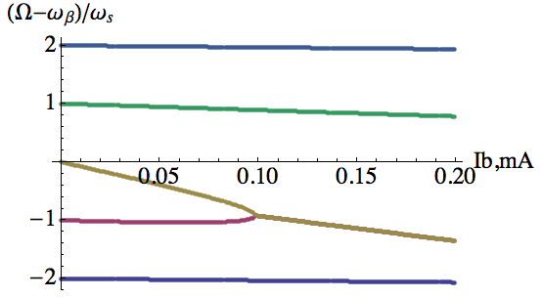
Collective effects – single bunch instability
Microwave instability
  The Keil-Schnell criterion gives threshold bunch current of 0.2 mA.
  Simulation studies shows that the threshold intensity is around 0.8 mA (3.5 nC) with harmonic cavity. Above threshold, turbulent distributions are observed.
TMCI
  For Gaussian bunch, the instability is evaluated
  with Eigen Mode analysis.
  The threshold bunch intensity is ~0.1 mA with ξ = 0.
  A positive chromaticity is required.
bunch charge=15nC

Slide 21
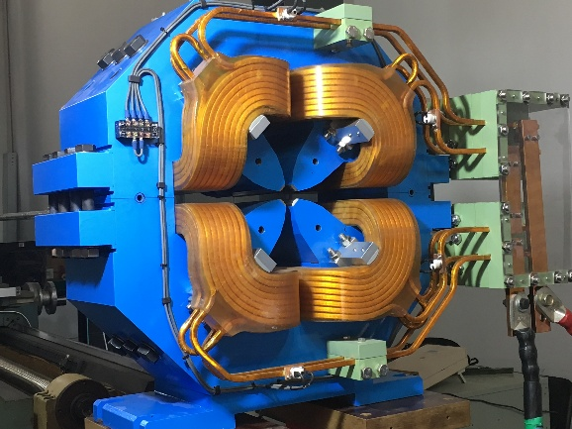
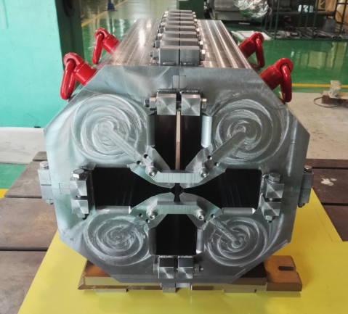
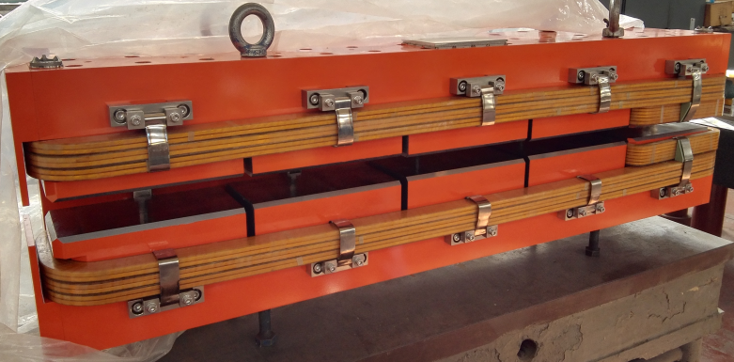
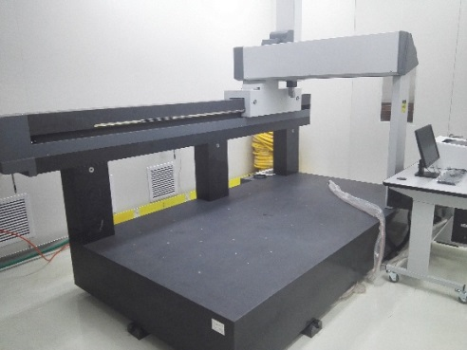
3. Key technologies to HEPS – supported by HEPS-TF
Magnets
  High-gradient quadrupole
  Gradient: 88T/m
  Longitudinal gradient dipole
  Combined function magnets: dipole+quad

Slide 22
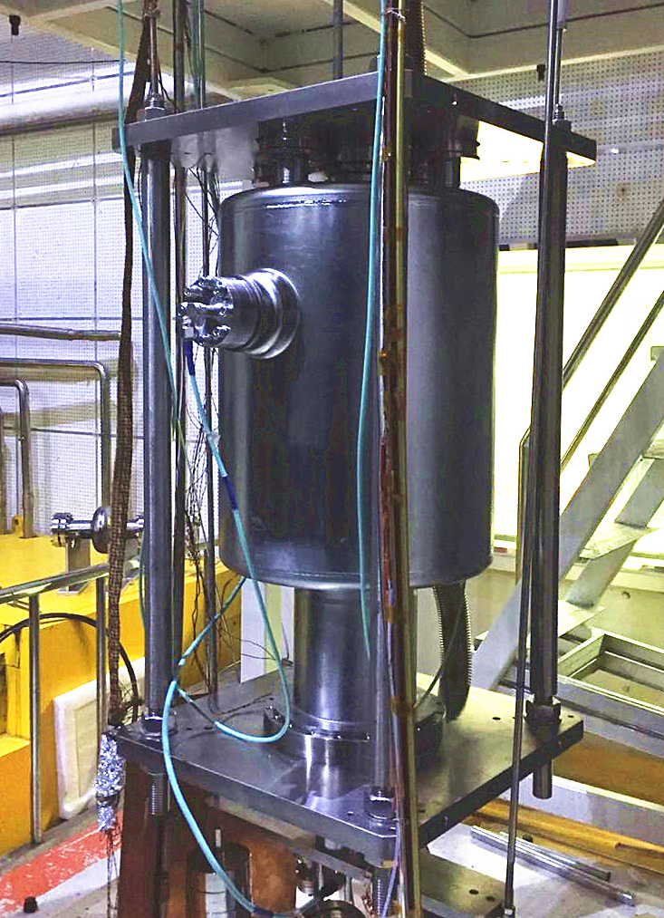
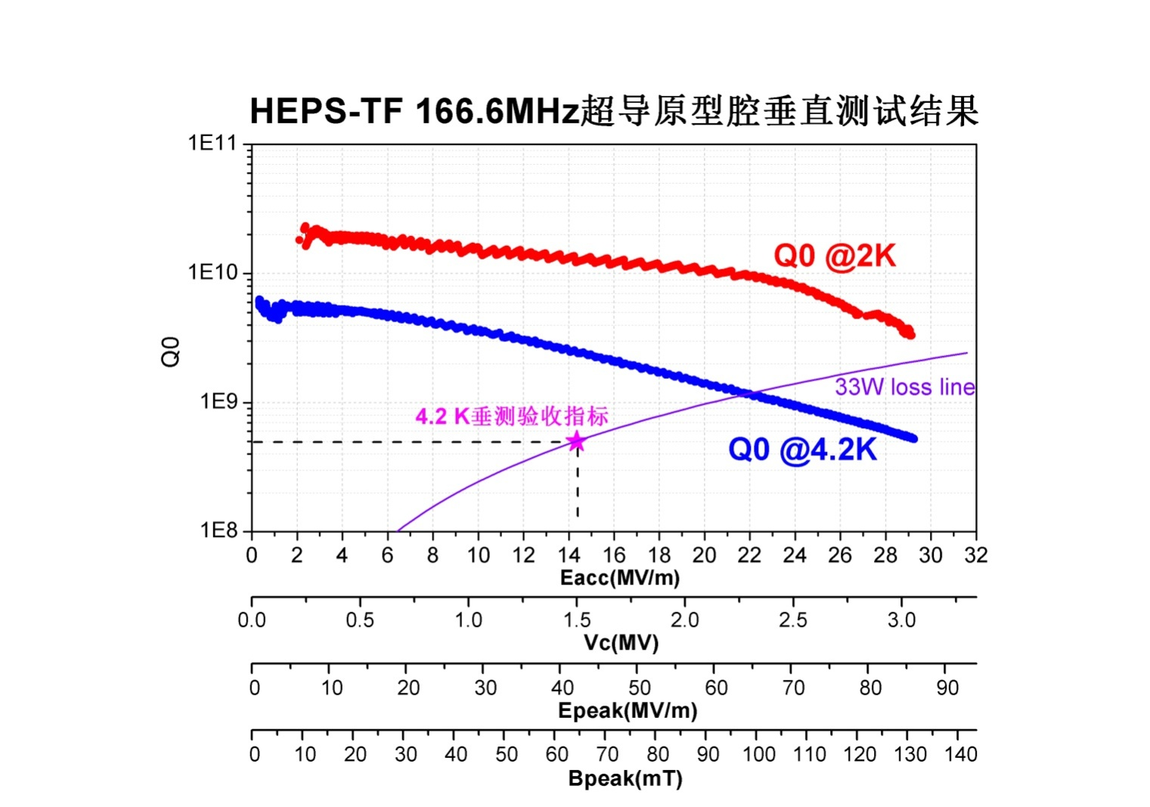
166.6 MHz SRF cavity – for longitudinal injection
  Tested in March 15, 2017
  85 MV/m, 130 mT, 2.3 nΩ

Slide 23
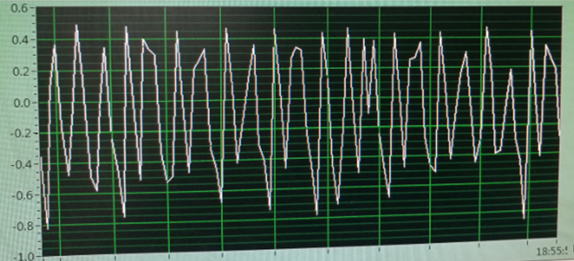
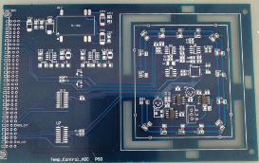
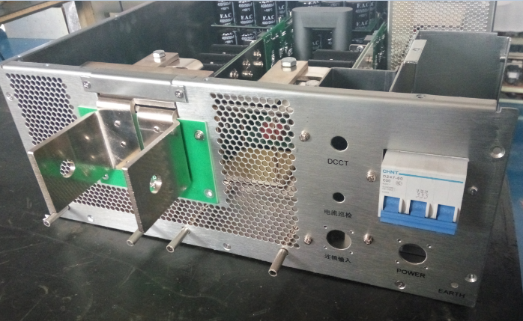
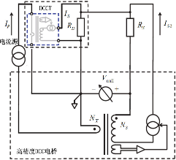
High accurate power supplies
Prototype of dynamic PS (acc. =0.1%)
DPSCM-II high acc. ADC plate
10ppm high accuracy PS

Slide 24
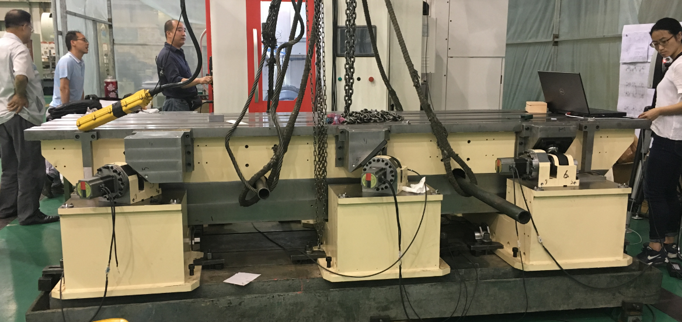
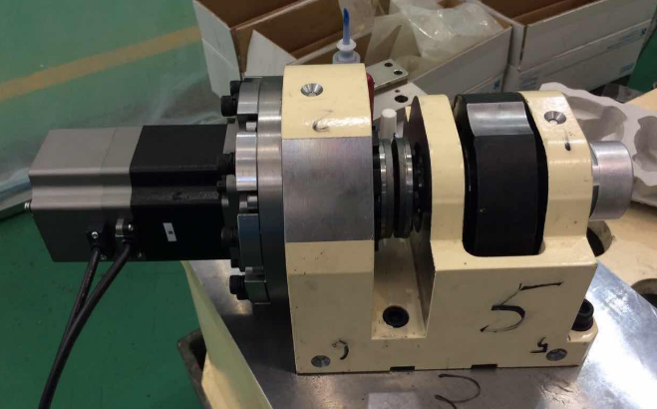
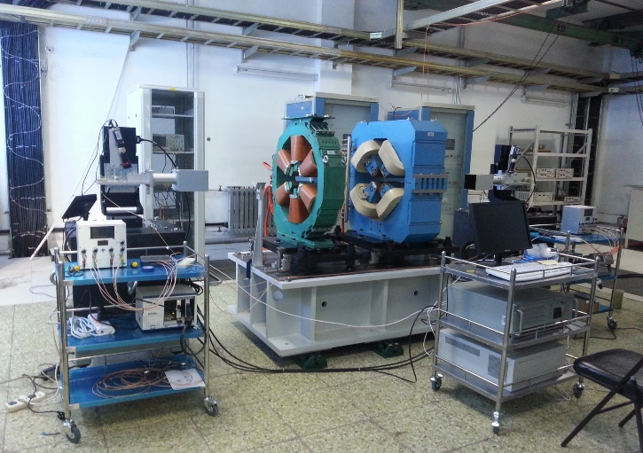
Mechanics & alignment
  Auto-control high precision tunable girder
Oscillating-line alignment tech.
支架I型总装配体
凸轮机构

Slide 25
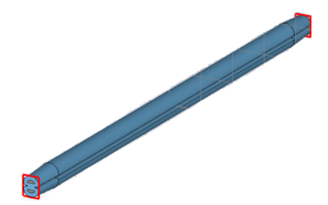
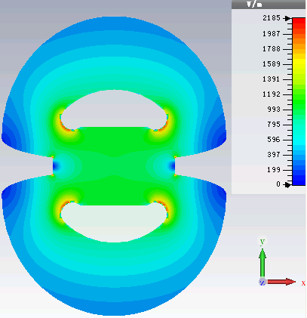







Injection kicker & power supply
  Physics and structure design for the strip-line kicker, on-line test
  DSRD rapid pulse PS – Test of single-level circuit & structure design for 6-level iterated circuit

Slide 26





Vacuum technique
  NEG coating device,
  still in progress
  Photon absorber

Slide 27








High-resolution X-ray monochromator
Checked by zygo :
Characterization of precision of the goniometers
Spherically bent Si(111)/(110)/(100) analyzers (R=1m)
Controller of goniometers
two kinds of techniques:
Gluing
Goniometers and laser interferometer
Anode-bonding
4-inch Si crystal
Online test:

Slide 28


High Heat Load Monochromator
Project timeline:
  Fabricate: finished in April, 2017.
  Offline test: April, 2017-June, 2017.
  Online test: Oct. 2017-Nov. 2017.
Performance test:
  Mono: mechanical, vacuum, basic operations, performance of stability, thermal leakage and heat extraction power.
  Cryogenic cooling system: pressure stability and basic operations.
  Control system: safety protection, PID flow rate control and basic operations.
Inside of the chamber
Cryo cooler
Mono
Laser interferometer
Scene of the offline test

Slide 29



Micro- & nano- focusing optics
High Energy Compound Refractive Lenses
Online testing @SSRF
8.5μm
10.6 gain
Knife edge scan
BL13W1 (50keV X-ray)
400µm
CCD imaging, Focal length: 3m

Slide 30


Nano-positioning and scanning system
Characterization of the Z-stage
Sub-nano steps 0.7 nm with a load of 1 kg
the device under measurement
Resolution：0.7 nm
Travel range： 1 mm
Load capacity： 1 kg

Slide 31



High repetition time-resolved experimental system
Storage ring –hybrid fill pattern
SR pulse width 100ps
Laser repetition up to 611kHz
Timing jitter < 0.6ps
Dedicated mode 250mA,
Top-up, 1.243MHz
4mA camshaft single bunch
Colliding mode: 500-700mA, Top-off, 1.263MHz
~100bunch, 5-7mA/bunch
Single bunch
Single bunch
XRD and XAS experiment

Slide 32






Rapid-loading DAC system
XRD system for fast dDAC experiments in SSRF
Lead shielding
Beam
stop
Pilatus3-6M
X-ray
SSRF-18U
dDAC
X-ray

Slide 33
4. Project progress (HEPS)
Milestones of HEPS
  01/2016, CDR study & writing
  02/2017, CD0 completed & submitted to CAS
  03/2017, internal review of CD0, modify CD0 report
  05/2017, CD0 submitted to National Development & Reform Commission
  06/2017, CD1 study and report writing started
  26/06/2017, national review of CD0
  12/2017, CD0 approved & CD1 report will be submitted
  02/2017, national review of CD1
  06/2018, national review of CD2
  11/2018, project construction starts, and will completed in 6.5 years

Slide 34








Design of the injector to HEPS
Linac design
  Electron gun, buncher, accelerating tube, etc.
Beam dynamics simulation & AP design
Design of accelerating structure & MW element
Physics design of various kind of magnets
Design of other systems of linac
  Bunch distribution at the linac exit
  Phase & position distribution of central bunch

Slide 35






Design of booster
  Single bunch current limit
  Effect on orbit error at low energy to injection
  Effect of magnetic errors to tunes
  Chromaticity variation due to ripple
  Mom. Acceptance @low energy
Lattice design & nonlinear tracking study
Magnetic errors effects to injection and beam store
Simulation on impedance, modification of AP parameters to get required bunch charge
Fit to the swap-out & long. on-axis injection
  Dynamic aperture study

Slide 36





Design on injection and extraction
  Pulse distribution at BTS line
Lattice design of injection and extraction sections
Simulation on injection
Physics design of key elements
Fit the requirements of swap-out & long. on-axis injection
  Slotted kicker

Slide 37






Design on key hardware of booster
7 kinds of magnet support
Injector 2D layout in general
Linac mechanics design
air loading & pressure analysis
vacuum chamber design & temp. deform calculation
Design on RF system integration
HOM calculation
Design of various magnets

Slide 38
Beamlines for the phase-I of HEPS
1 | High energy X-ray diffraction | High energy, low emmitance
2 | CDI and XPCS
3 | NRS and IXS
4 | Nano-probe
5 | Time-resolved techniques
6 | Hard X-ray imaging
7 | High-pressure
8 | Protein crystallography | Large users communities
9 | XAFS
10 | In situ surface diffraction and scattering
11 | High throughtput SAXS
12 | Ultrahigh resolution Electronic-Structure Spectroscopy | Application in industry, medicine, etc.
13 | Medium energy X-ray micro-spectroscopy
14 | Structure and spectrum imaging

Slide 39


The site for HEPS
BASIC: An area of 233 acres, including:
HEPS
SECUF (Synergized Extreme Condition User Facility)
Simulation Facility for the Earth
Series research platforms in energy, environment, biology, materials, etc.
Huairou District, Beijing area (near the venue of the USR workshop in Oct 2012, Hairou), ~100 km northeast of IHEP
Ground motion at the area were measured
UCAS
HEPS
High-Tech Zone , Huairou, Beijing

Slide 40


Site, construction & buildings

Slide 41

Platform for Advanced Photon Sciences (PAPS)
Supported by Beijing Municipality (~0.5 B RMB), 05/17 – 05/20
Research in accelerator and X-ray optic techniques
Testing infrastructure (magnets, RF, pre-alignment, vacuum, ID) of HEPS

Slide 42
5. Summary
A high energy photon source is requested by users, aiming at the lowest emittance and highest brightness in the exiting synchrotron light sources.
The R&D of the HEPS project is being carried on, and will be finished by the end of Oct 2018.
The HEPS is scheduled to start the construction by the end of 2018, and will be completed in mid of 2025.
The AP design and key technologies development for the HEPS are now under way.
Ground motion and vibration reduction is critical to HEPS

Slide 43
Thanks for your attentions!

