Slide 2
MAX IV Stability Task Force Update
Workshop on Ambient Ground Motion and Vibration Suppression for Low Emittance Storage Ring
Brian Norsk Jensen, MAX IV Laboratory Beijing 11 December 2017

Slide 3
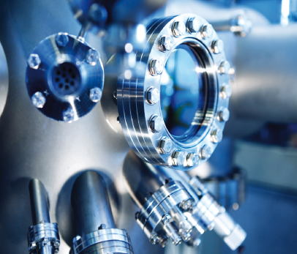
Outline
Why work on stability?
The Stability Philosophy at MAX IV
Tolerances and Goals
Examples from Construction work for MAX IV
What has been done inside the Lab?
Some Ongoing Stuff
Some things I think we should do
Notes:
I am an Engineer, so I have to deal with Problems IRL.
IRL solutions

Slide 4
Mission:
Stable Beams
Notes:
Stable and Reliable Beams for the Users
Dependent on the time you spend on thinking about this it seems first
obvious,
then simple
Concrete solutions
Then, rather unspecific
Increasingly more complex
…

Slide 5
Why Work on Stability?
Our users need Stable Measurements
  Flux
  Pointing Stability
  Quality of Light (polarization, coherence, free of frequency content,…)
  Availability
The MAX IV Stability Task Force Is Responsible for All Stability!
  Accelerators and Beamlines
  Procurement Participation
  Vibrations
  Mechanical
  Thermal
  Logging
  Collecting Input
  Problem Solving
  Characterization: Seismometers, Accelerometers, Vibrometer, Shaker, …
Only One Person Specifically Allocated to this Work
  I Get and Need Help from Many Colleagues
    Mechanical, Accelerator Physicists, IT, Control Room and Beamline Staff, …
  I have Great Help from People at the LTH, Dept. of Construction Sciences!!!
Notes:
The term “Stable Measurements” sounds simple but it is rather ambiguous.

Slide 6
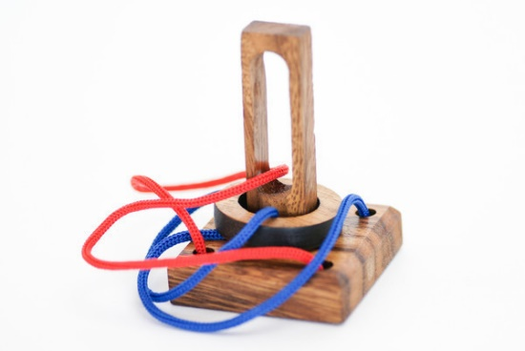
Strategy and Approach
Challenges are not always overcome by Fancy or Traditional Solutions
ZOOM Out!
Cross Disciplines, Interconnectedness of Things!
  Mechanical and Thermal Stability, Magnetic Design, Alignability and Tolerances
  Everything has to Work Well!
  Risk of Sub Optimization
Not only One single FIX
  Work on all Fronts
  Thorough Analysis before Assuming Solutions
Shifting the Problem
  Reducing Sensitivity
Responsibility Policy setting Specific
Tolerance Goals
  Responsibility taken by MAX IV
  Civil Engineering, Reducing Cost
  Collaborative work
  Co-Creation
  On the Same Side
Notes:
Overall Philosophy
Keep things as simple and passive as possible
Integrated design, taking care of challenges in several technical areas at the same time
Alignment
Stability
Accelerator Design
Installation

Slide 7
General Approach
Passive Systems As Far as it Goes!
  Mechanical
  Thermal
Isolate sources
  Vibrations
  Thermal
Active systems Only if You Really Need It!
  Tunnel Temperatures: “Active Passivity”
  SOFB, BbB, FOFB - use with Care
  Mechanical Systems
Notes:
I am a generalist, so Look at the whole picture
Many things are obvious, when you think about it, but not so easy to comply with
This can be organizational inhibits or limitations
It can also be lack of generalists with “holistic” interests
We should work on all fronts!
Risk of sub-optimization if you are too narrow in your approach

Slide 8
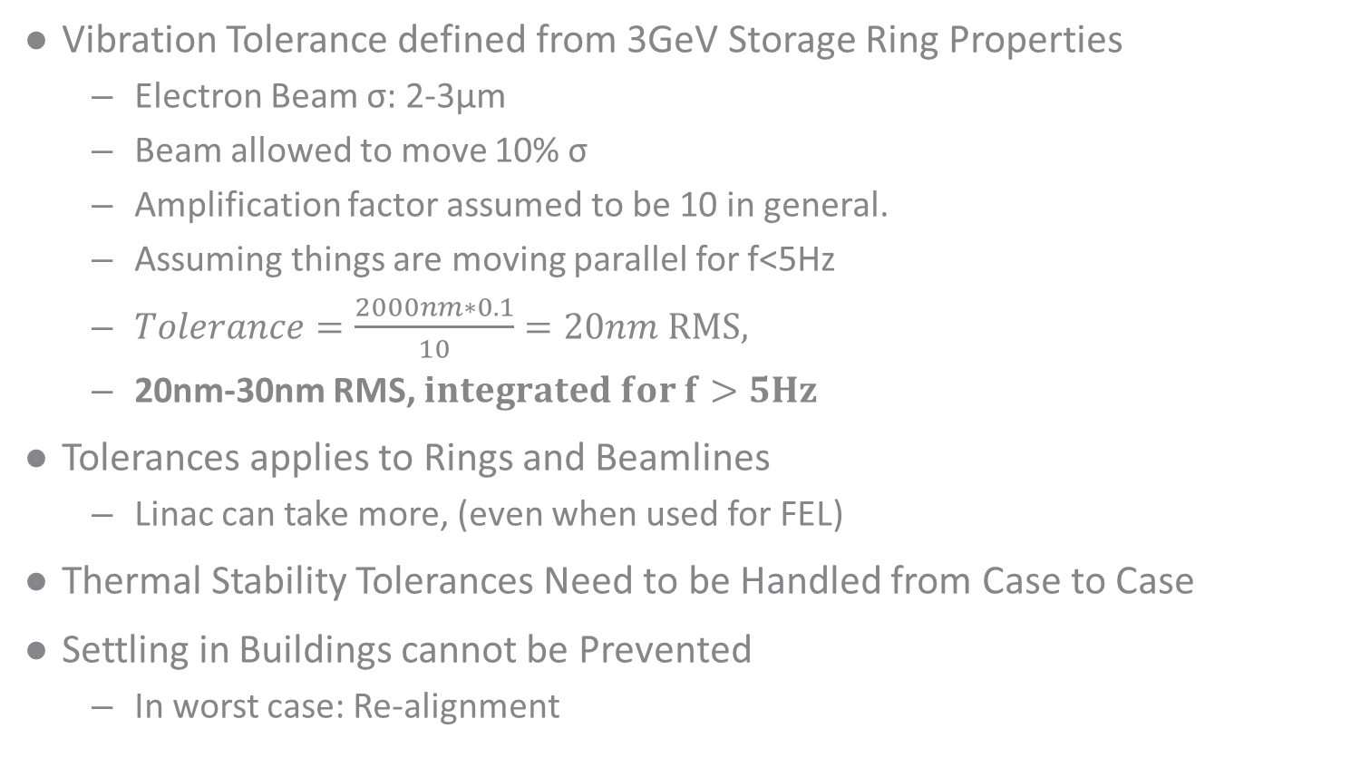
Speaking Tolerances
Vibration Tolerance defined from 3GeV Storage Ring Properties
  Electron Beam σ: 2-3µm
  Beam allowed to move 10% σ
  Amplification factor assumed to be 10 in general.
  Assuming things are moving parallel for f<5Hz
  $Tolerance=\frac{2000nm∗0.1}{10}=20nm RMS,$
  20nm-30nm RMS, $integrated for f>5Hz$
Tolerances applies to Rings and Beamlines
  Linac can take more, (even when used for FEL)
Thermal Stability Tolerances Need to be Handled from Case to Case
Settling in Buildings cannot be Prevented
  In worst case: Re-alignment
Notes:
In the Project These Numbers are treated as GOALS!
We decided early on to use the collaborative project method

Slide 9

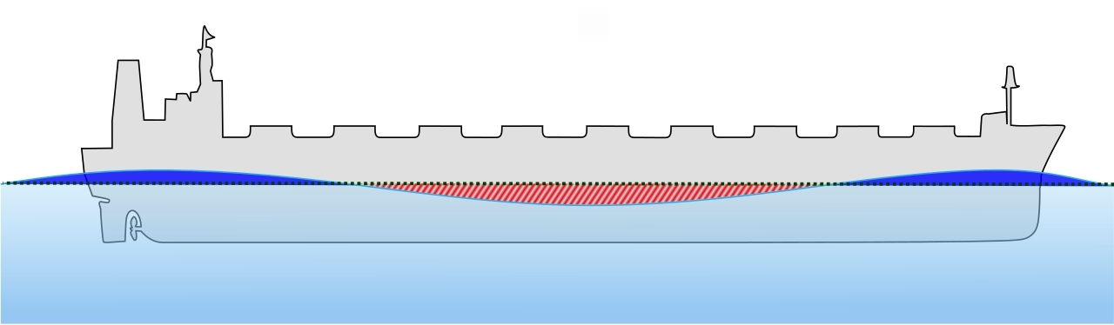
Correlated Motions
MAX IV is subjected to a Circular Vibration with ca 3 580 000m amplitude and a period of 24 Hours
We are mainly concerned about Relative Displacements
Sensitivity to Vibrations can be Reduced by increasing Correlation
The MAX IV Floor is the “Backbone” of our Machines and Beamlines
Stable Supports Ensure Correlated Motions (in Phase)
Stable Supports
Stable Supports
Illustrations:
http://upload.wikimedia.org/wikipedia/commons/1/17/Ship_wave_bending.svg
http://commons.wikimedia.org/wiki/File:Rotating_earth_axial_tiles_to_orbit.gif

Slide 10
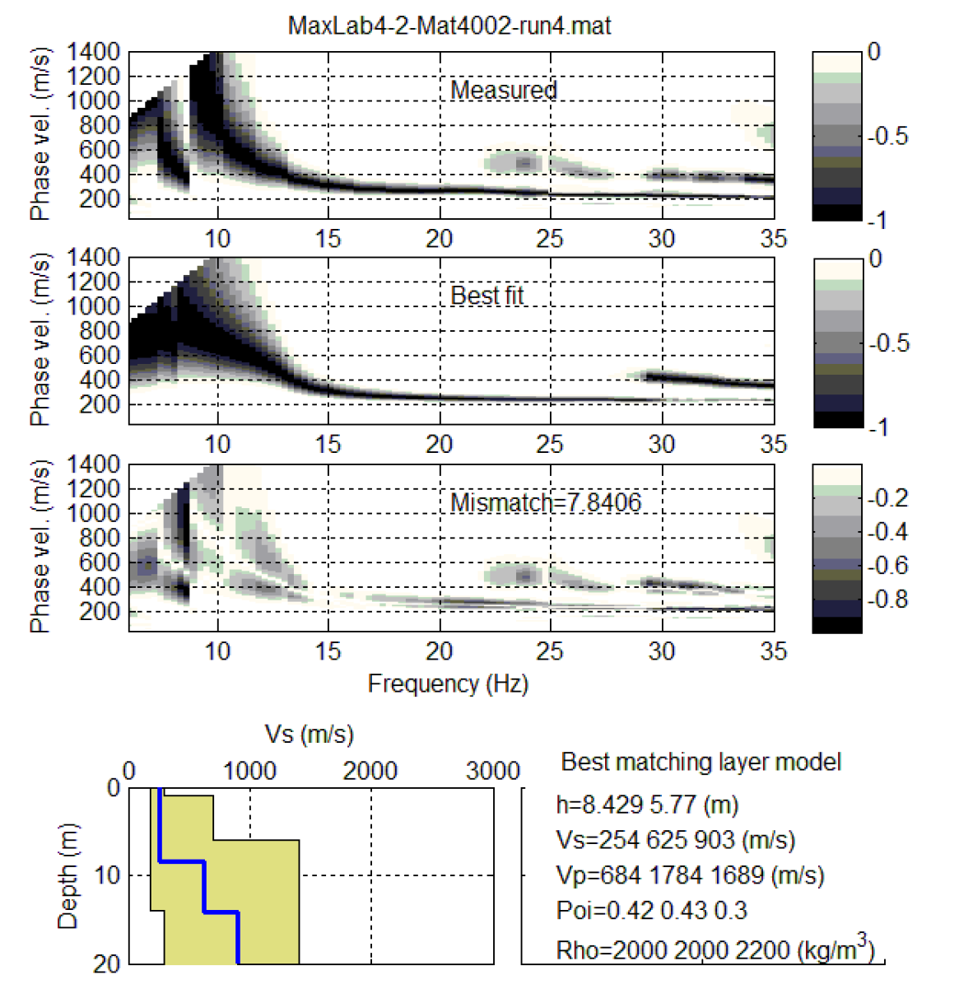
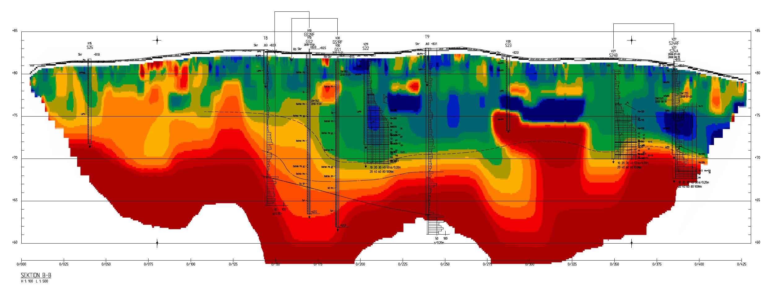
Geotechnical investigations
Geology Characterization
Resistivity
Seismic investigations
Mockup
  Testing Production Process
  Evaluation of performance
Analysis: Mats Svensson, TYRÉNS
Analysis: Nils Rydén, PEAB

Slide 11
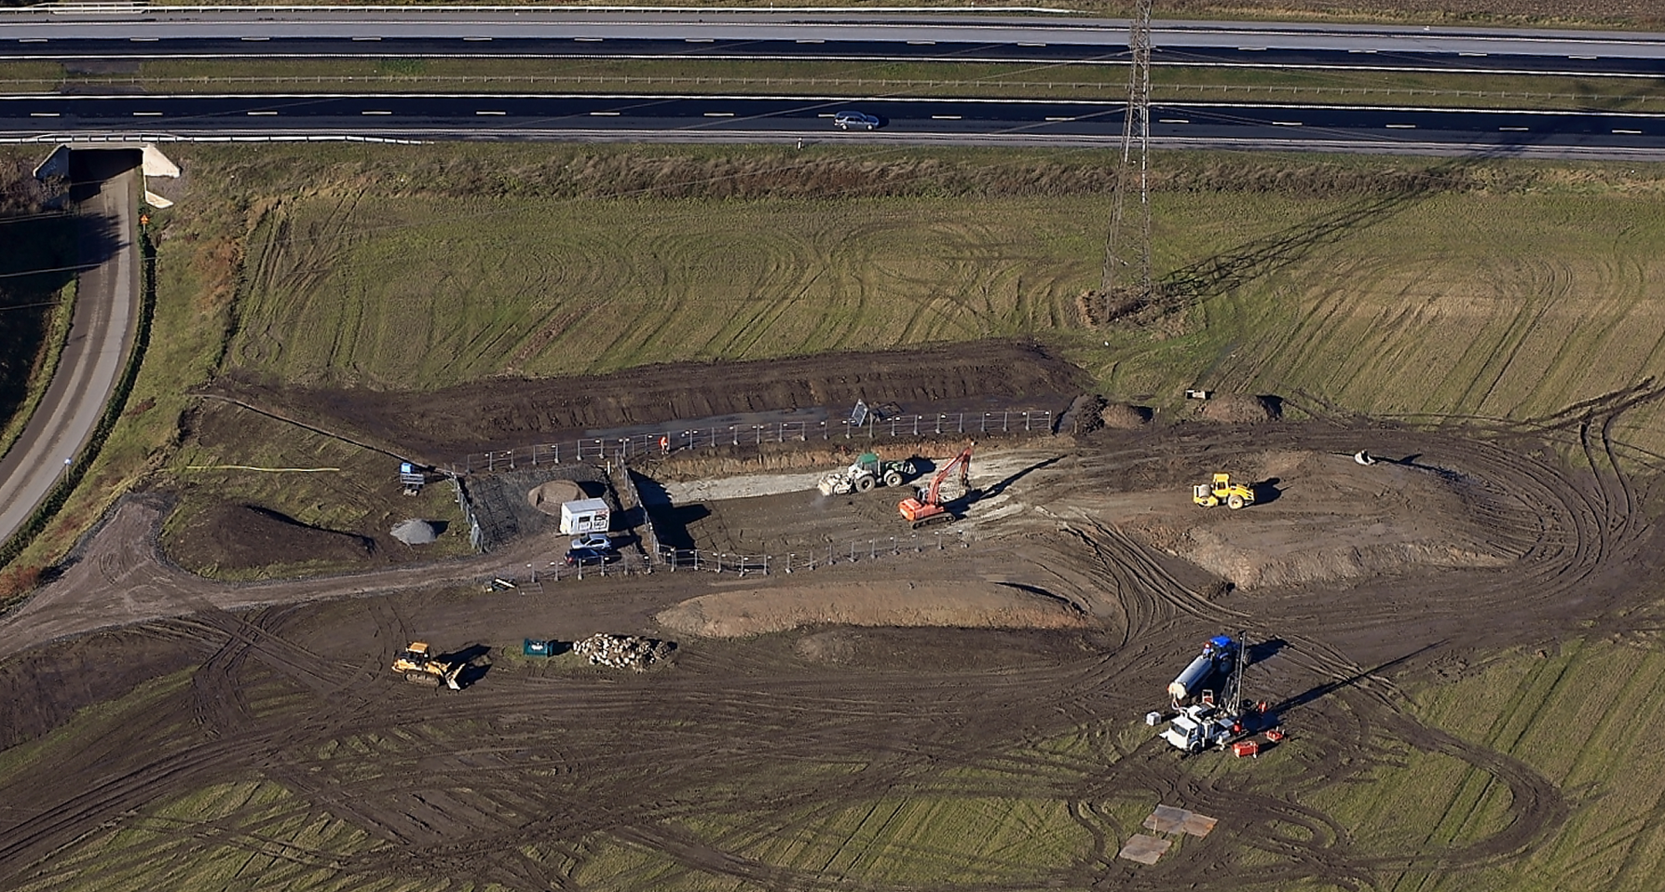
Mockup
Photos: Perry Nordeng
Notes:
In the picture we see:
Production of the MOCKUP
Before this picture was taken, the geologists had been investigating the soil layers visible in the pit
Part of the Geotechnical Survey, DRILLING TESTS

Slide 12
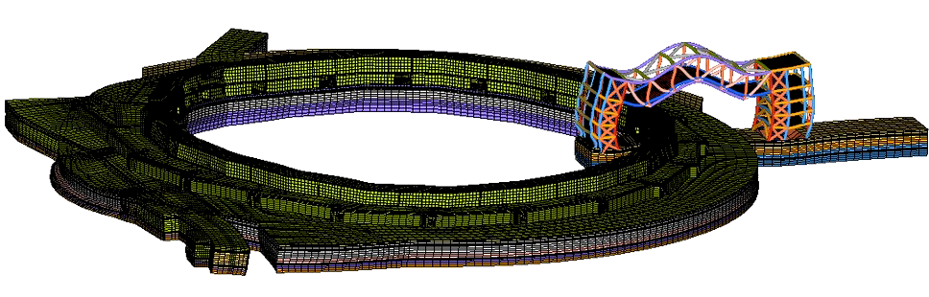
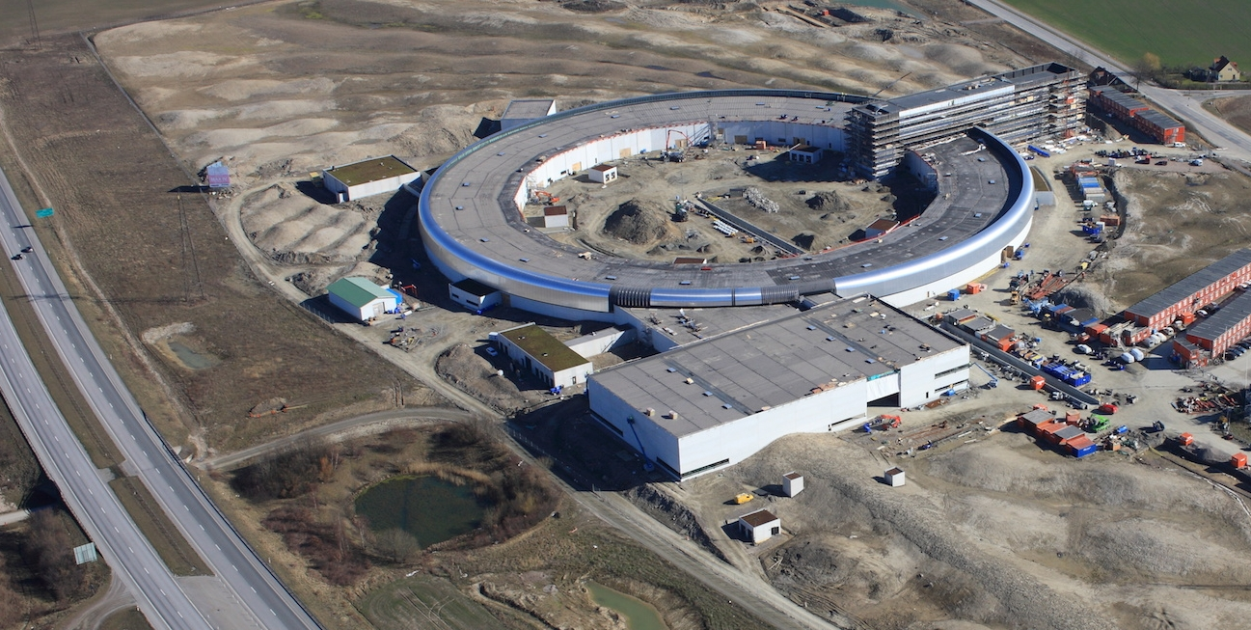
Civil Engineering, Analysis
Calculations:
Peter Davidsson,
CreoDynamics.com

Slide 13
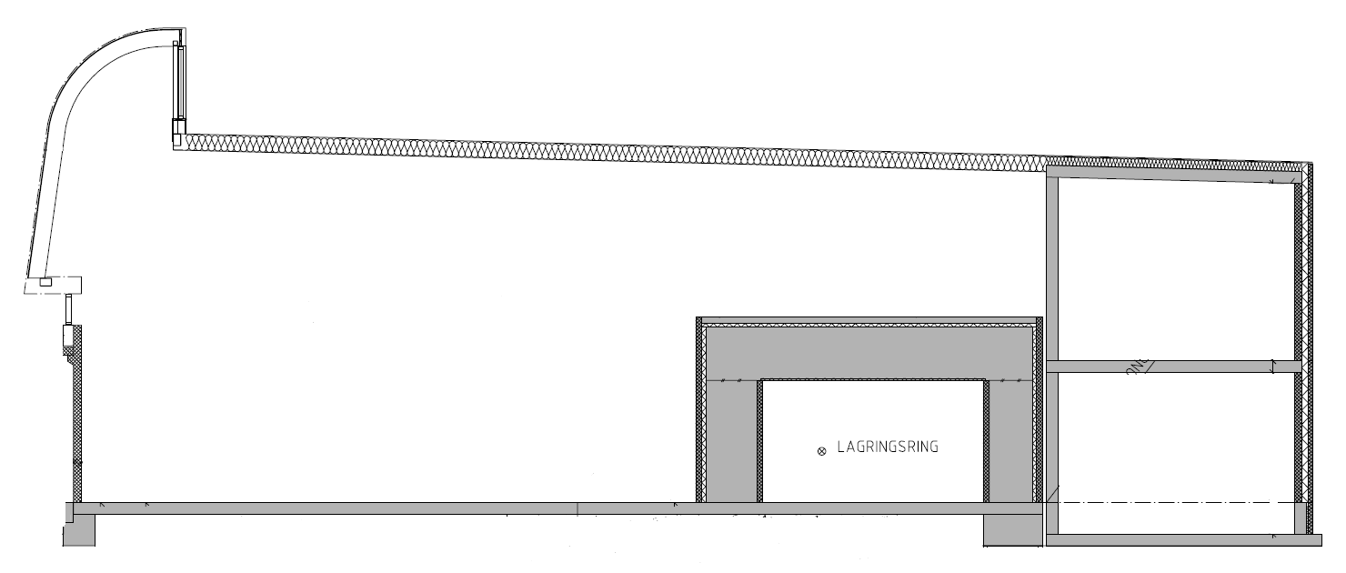






Civil Engineering
Shear Wave Velocities
Concrete, 0.3m, >2400 m/s
Stabilized UGM, 0.3m, 1300 m/s
Low Baltic Clay Till, 2-8m layer,
250-300 m/s
Lime Stabilized Soil,
4m in average, >900m/s
Large Footprint, No Isolated Foundations for Roofs etc.
North-East Clay Till, 8-13m layer,
400-650 m/s
Poisson’s Ratio = 0.48
Shale/Mudstone,
1100-1200 m/s
www.ekdahlgeo.se
Notes:
Most tools are for measuring vibrations and mechanical stability

Slide 14
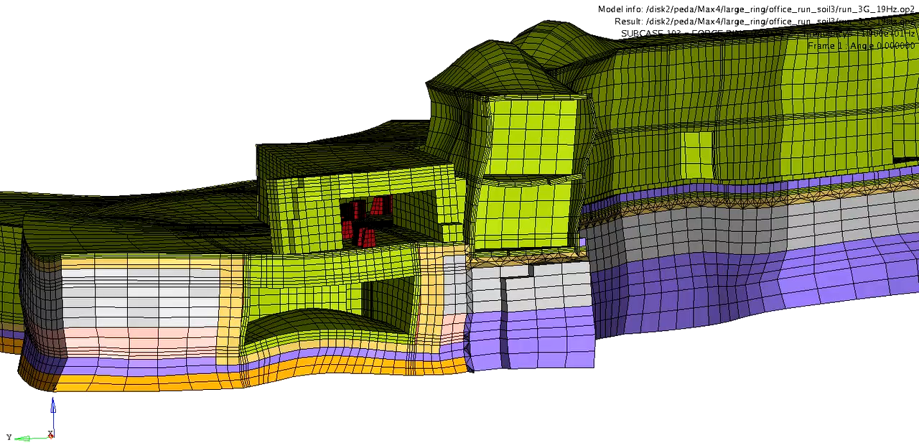
Calculations:
Peter Davidsson,
CreoDynamics.com
Notes:
Just to Make You Nevous…
Zoomed in on the section where the electrons are transferred from the Linac to the 3GeV Ring
Stiffer Stabilized
how building is constructed
Roof only rather weakly connected with joints

Slide 15
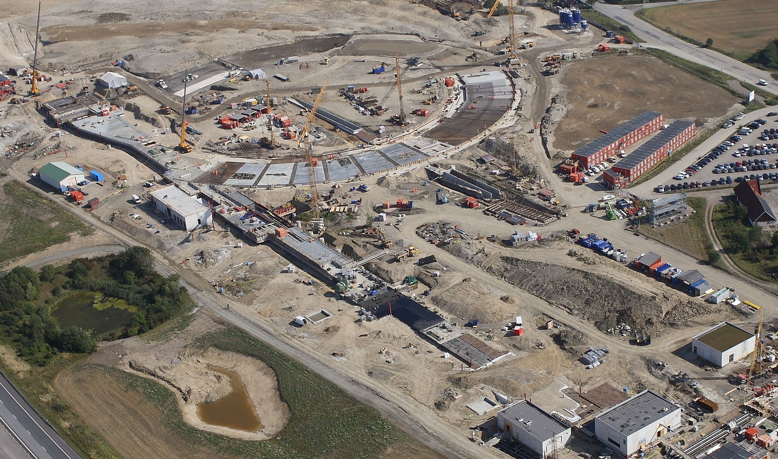
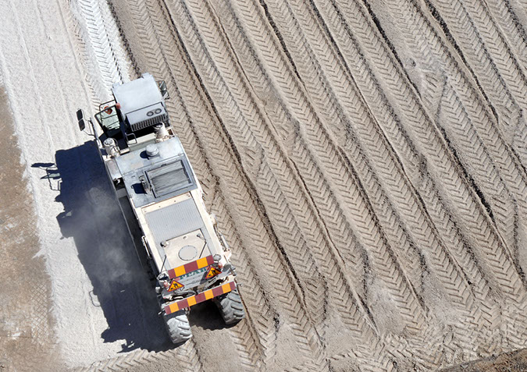
Construction Work and Stabilization
September 2012, Photos: Perry Nordeng
Notes:
This is how it looked during construction.
For logistics the floor construction was performed in different phases.
Reducing handling of soil.

Slide 16
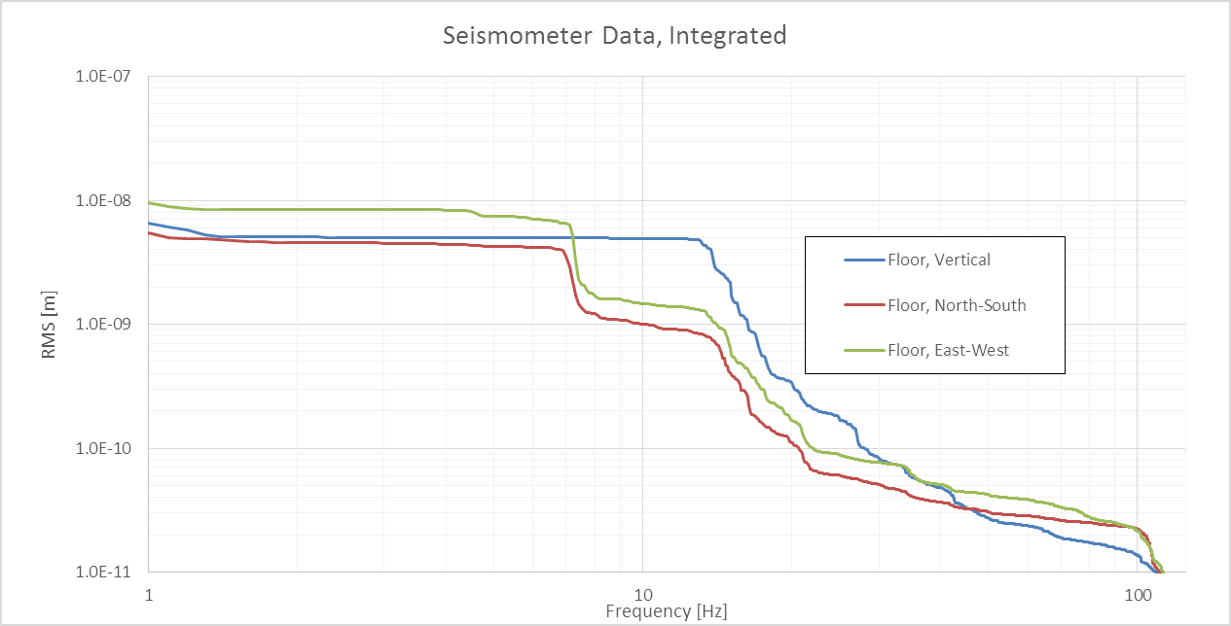
Floor Vibrations, SAM House, Closest to E22

Slide 17
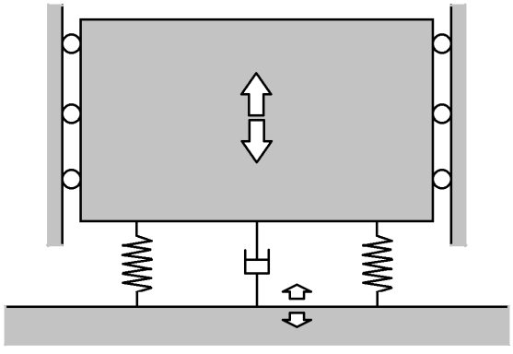


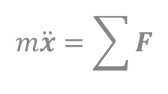

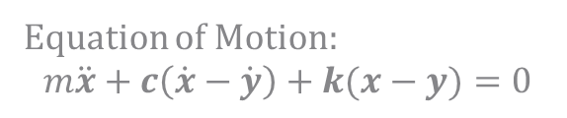
Designing Stable Supports
$$m\ddot{x}=\sum{F}$$
(Vibrations of the Mass)
x = X$\sin\left(ωt+θ\right)$
$$m\ddot{x}+c\dot{x}+kx=0$$
Stable Supports
(Floor Vibrations)
Equation of Motion:
$$m\ddot{x}+c\left(\dot{x}−\dot{y}\right)+k(x−y)=0$$
y = Y $\sin\left(ωt\right)$
55Hz

Slide 18
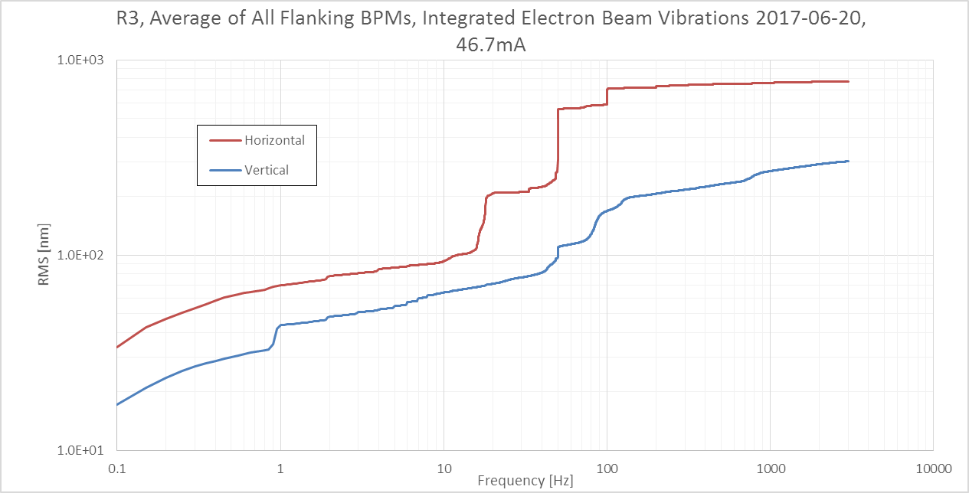
Electron Beam, Integrated Values, NO FOFB
The Tolerance Vertically is 200-300nm RMS (From the DDR)
RMS Values! Not Peak to Peak
A “typical “ example, although not based on many different days yet
No Beamline is “sticking out” from the average

Slide 19
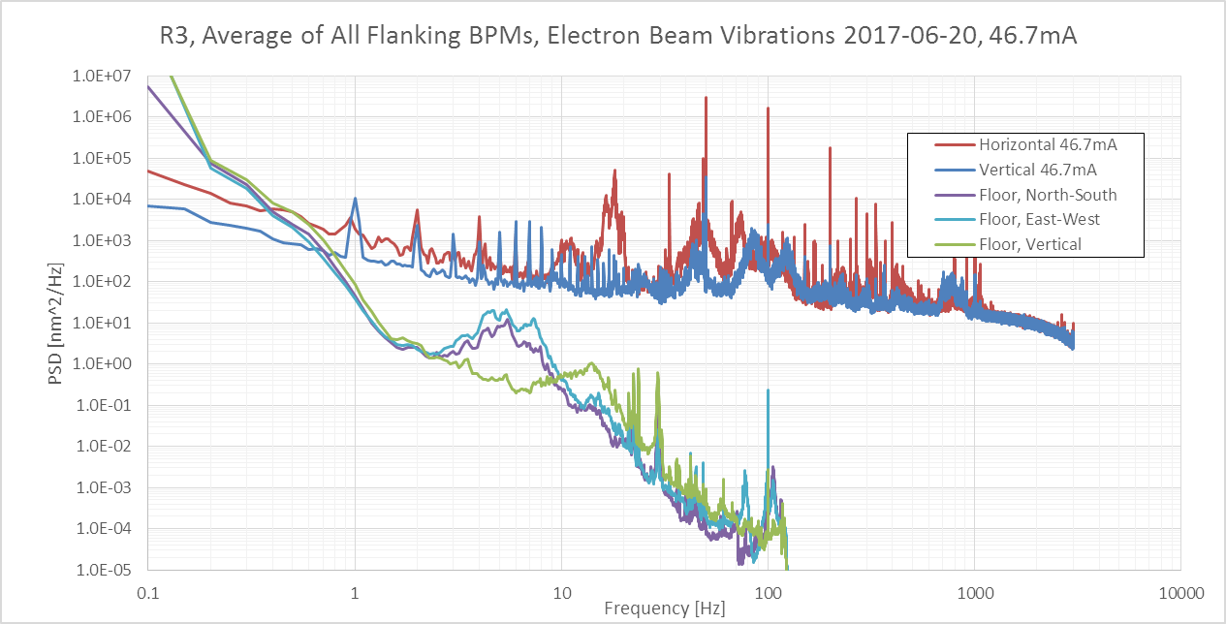
PSD of the Same Data, Together With Seismic Data
Seismometer placed in a Lab Floor Closest to the Highway

Slide 20
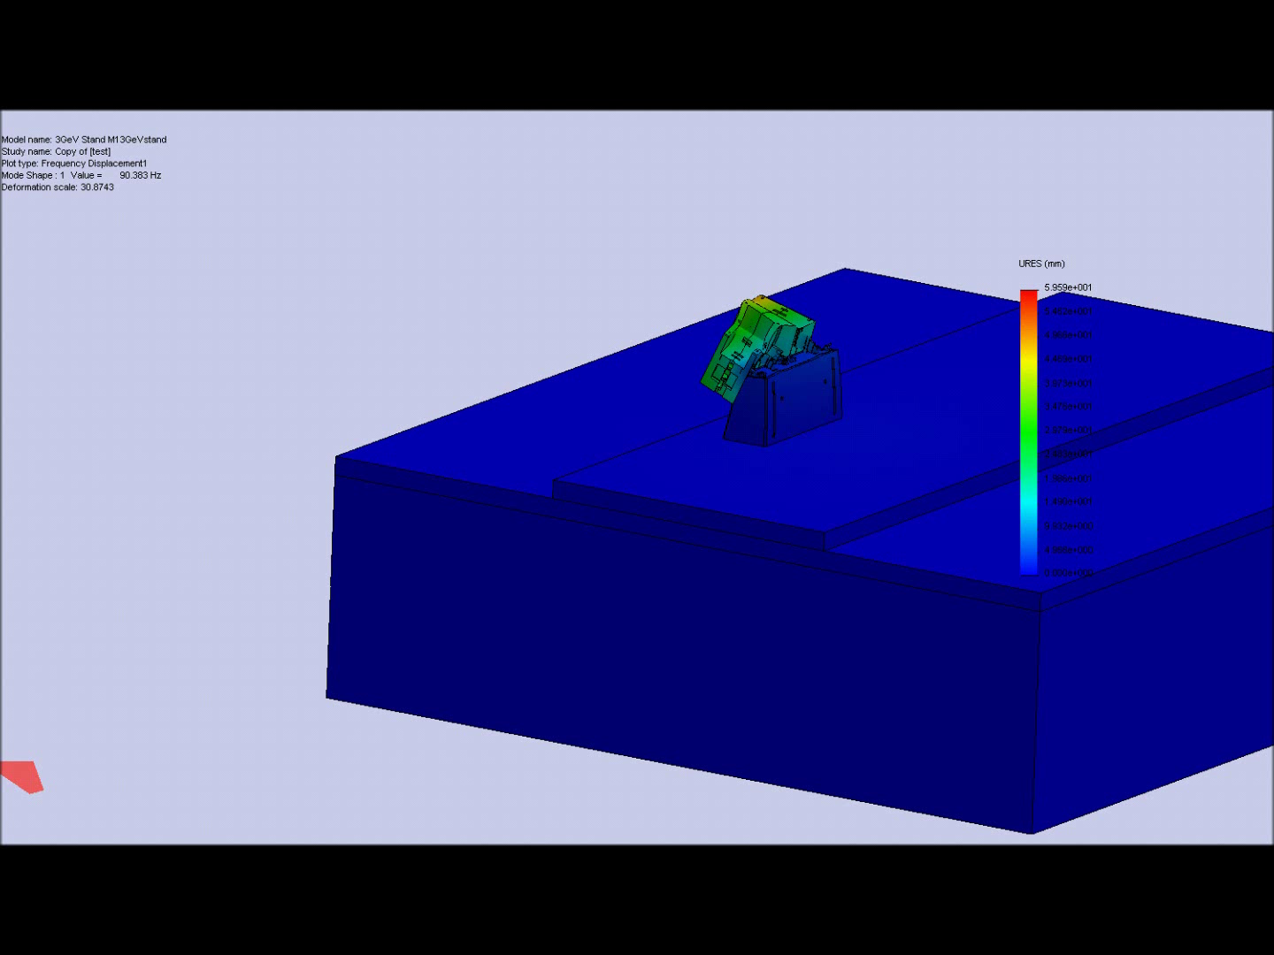
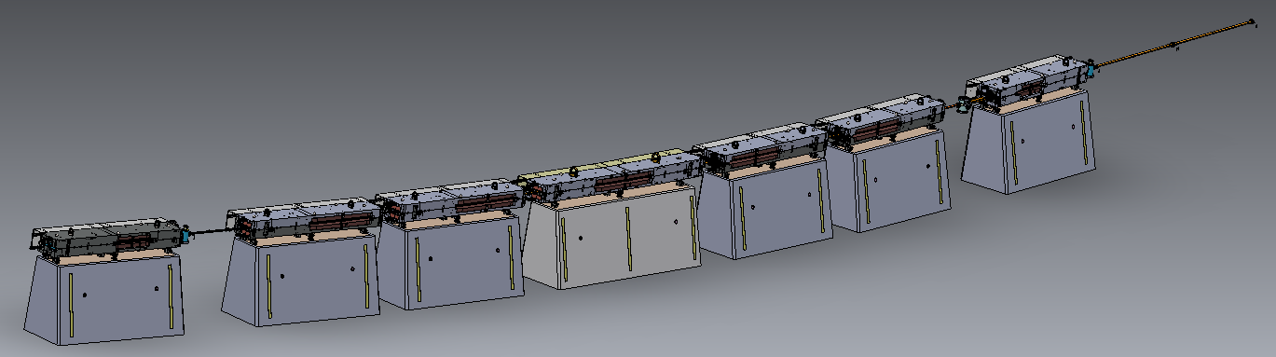
Examples Stable Supports
Calculations: Karl Åhnberg

Slide 21
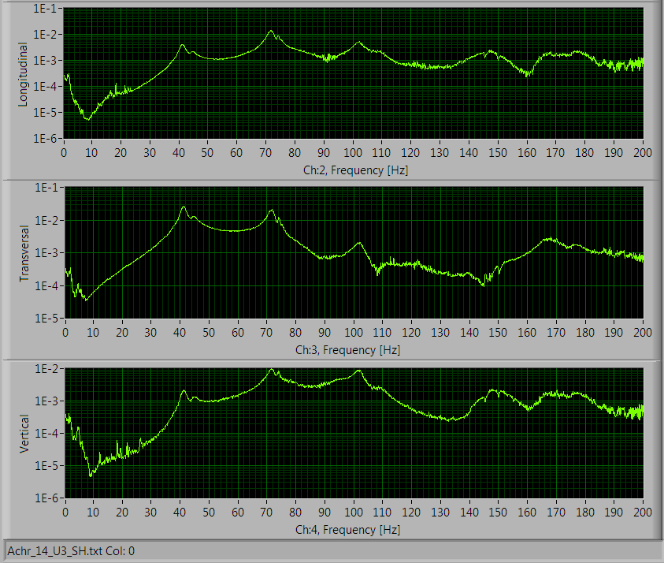
Eigen Frequency of Ring Components

Slide 22
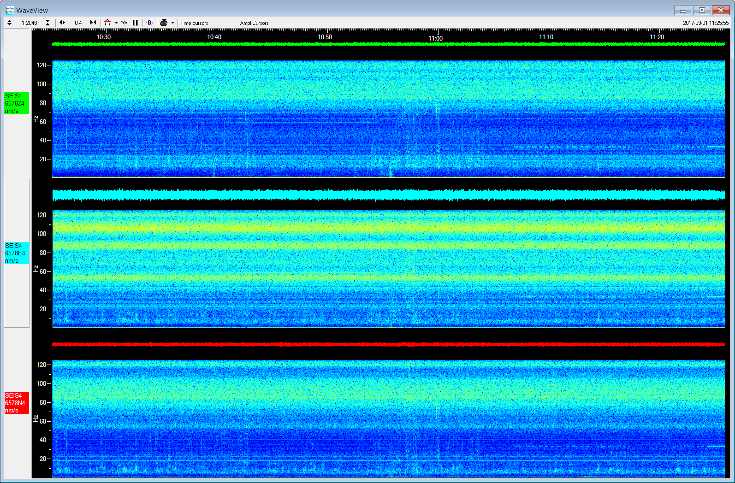
Seismometer on Achr18 M1

Slide 23
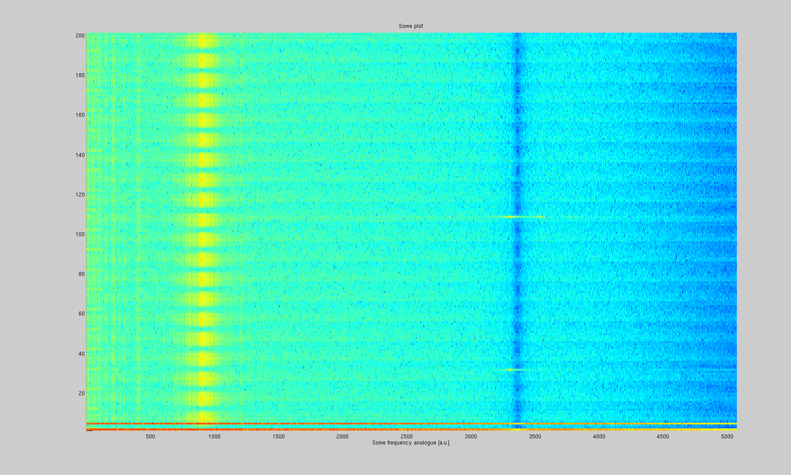
Electron Beam Stability, New Logging Tool
Electron Beam Position Monitor Number
FA Archiver: Guenther Rehm, Diamond LS
Frequency [Hz]
Matlab Acrobat: Magnus Sjöström, MAX IV
Notes:
Fast Acquisition Archiver
Steaming new picture
Thanks to Jerzy Jamroz and the rest of IT to set this up

Slide 24
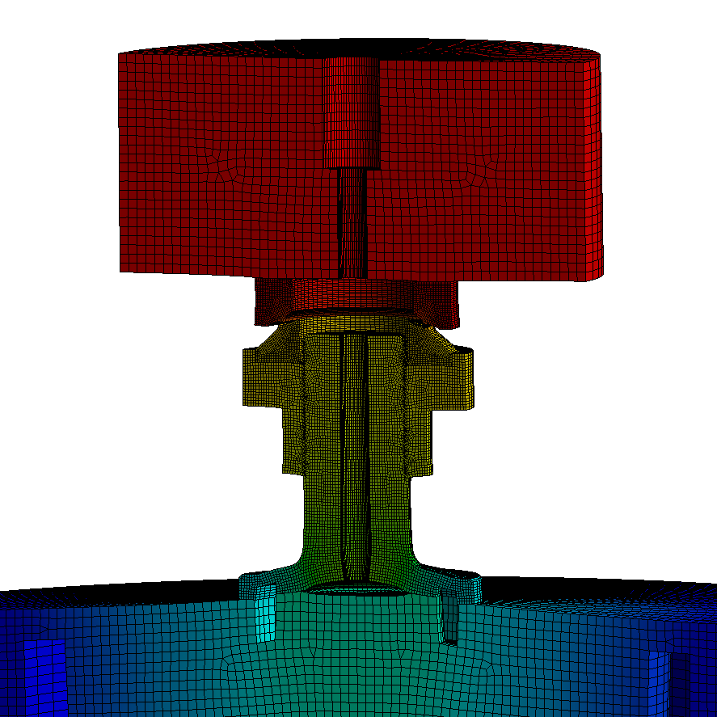
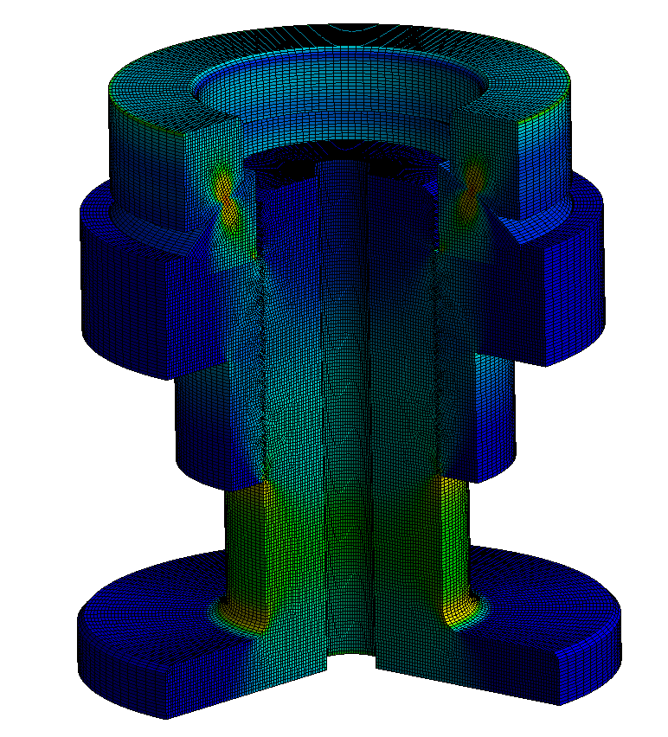
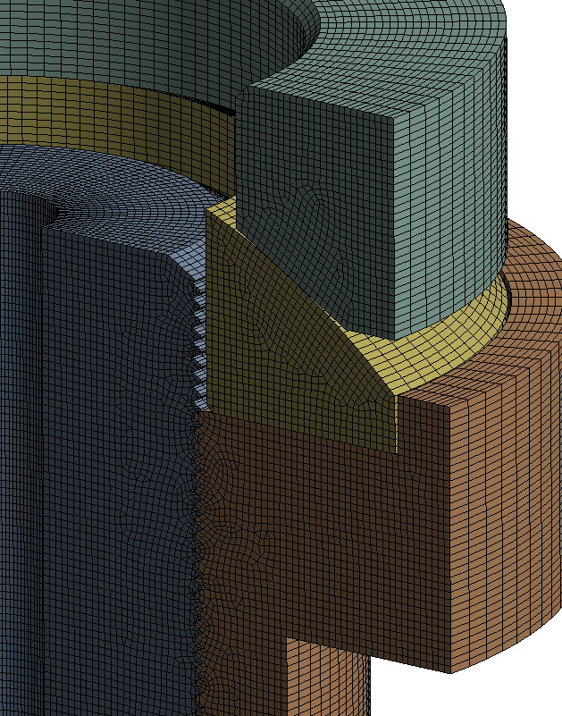
Example: Study of Adjustment Feet
With the help of:
Behrouz Afzali-Far
Linus Roslund
Keyu Zhou

Slide 25
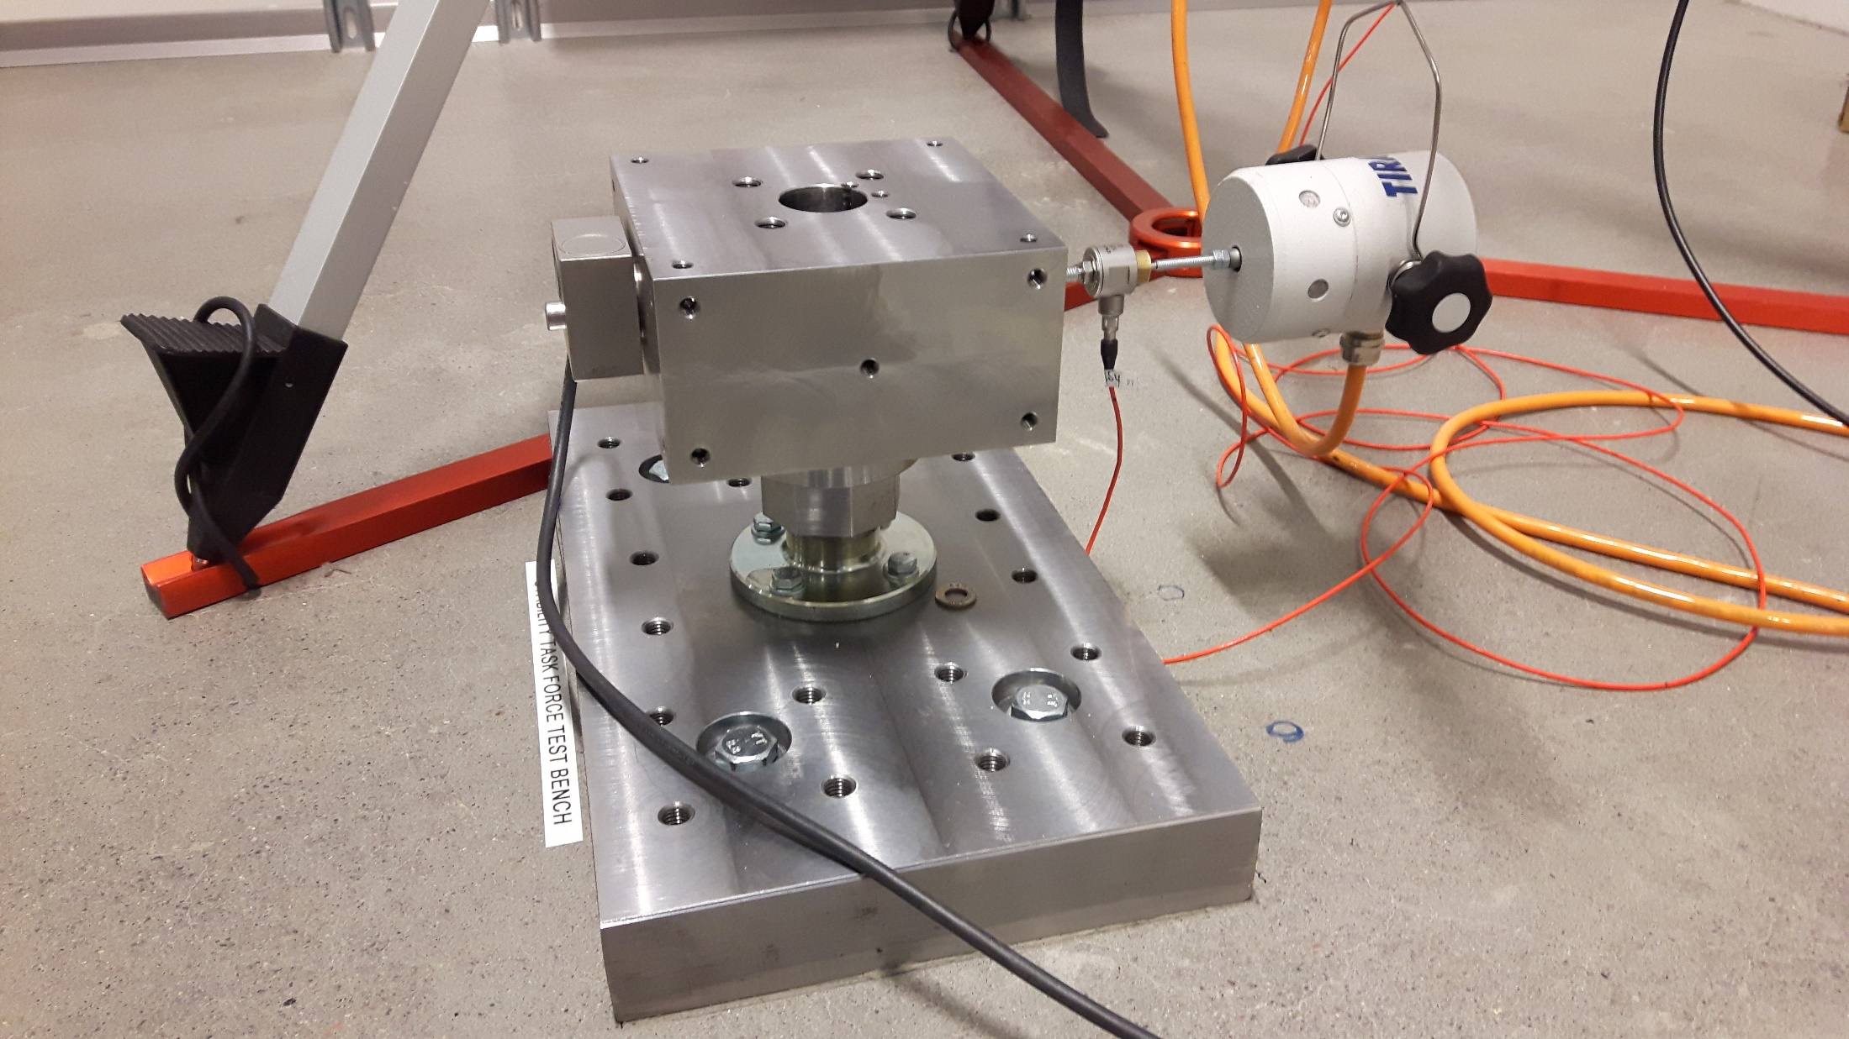
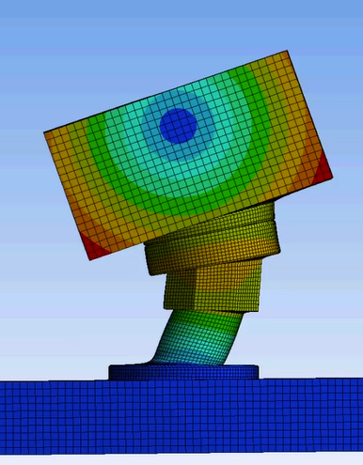
STF Test Bench
Behrouz Afzali-Far, Linus Roslund, Keyu Zhou, Lasse Håkansson and the Workshop!
Thanks for Inspiration, Collaboration and Good Discussions! :
Curt Preissner and Jeffrey Collins at the APS, Argonne in Chicago

Slide 26
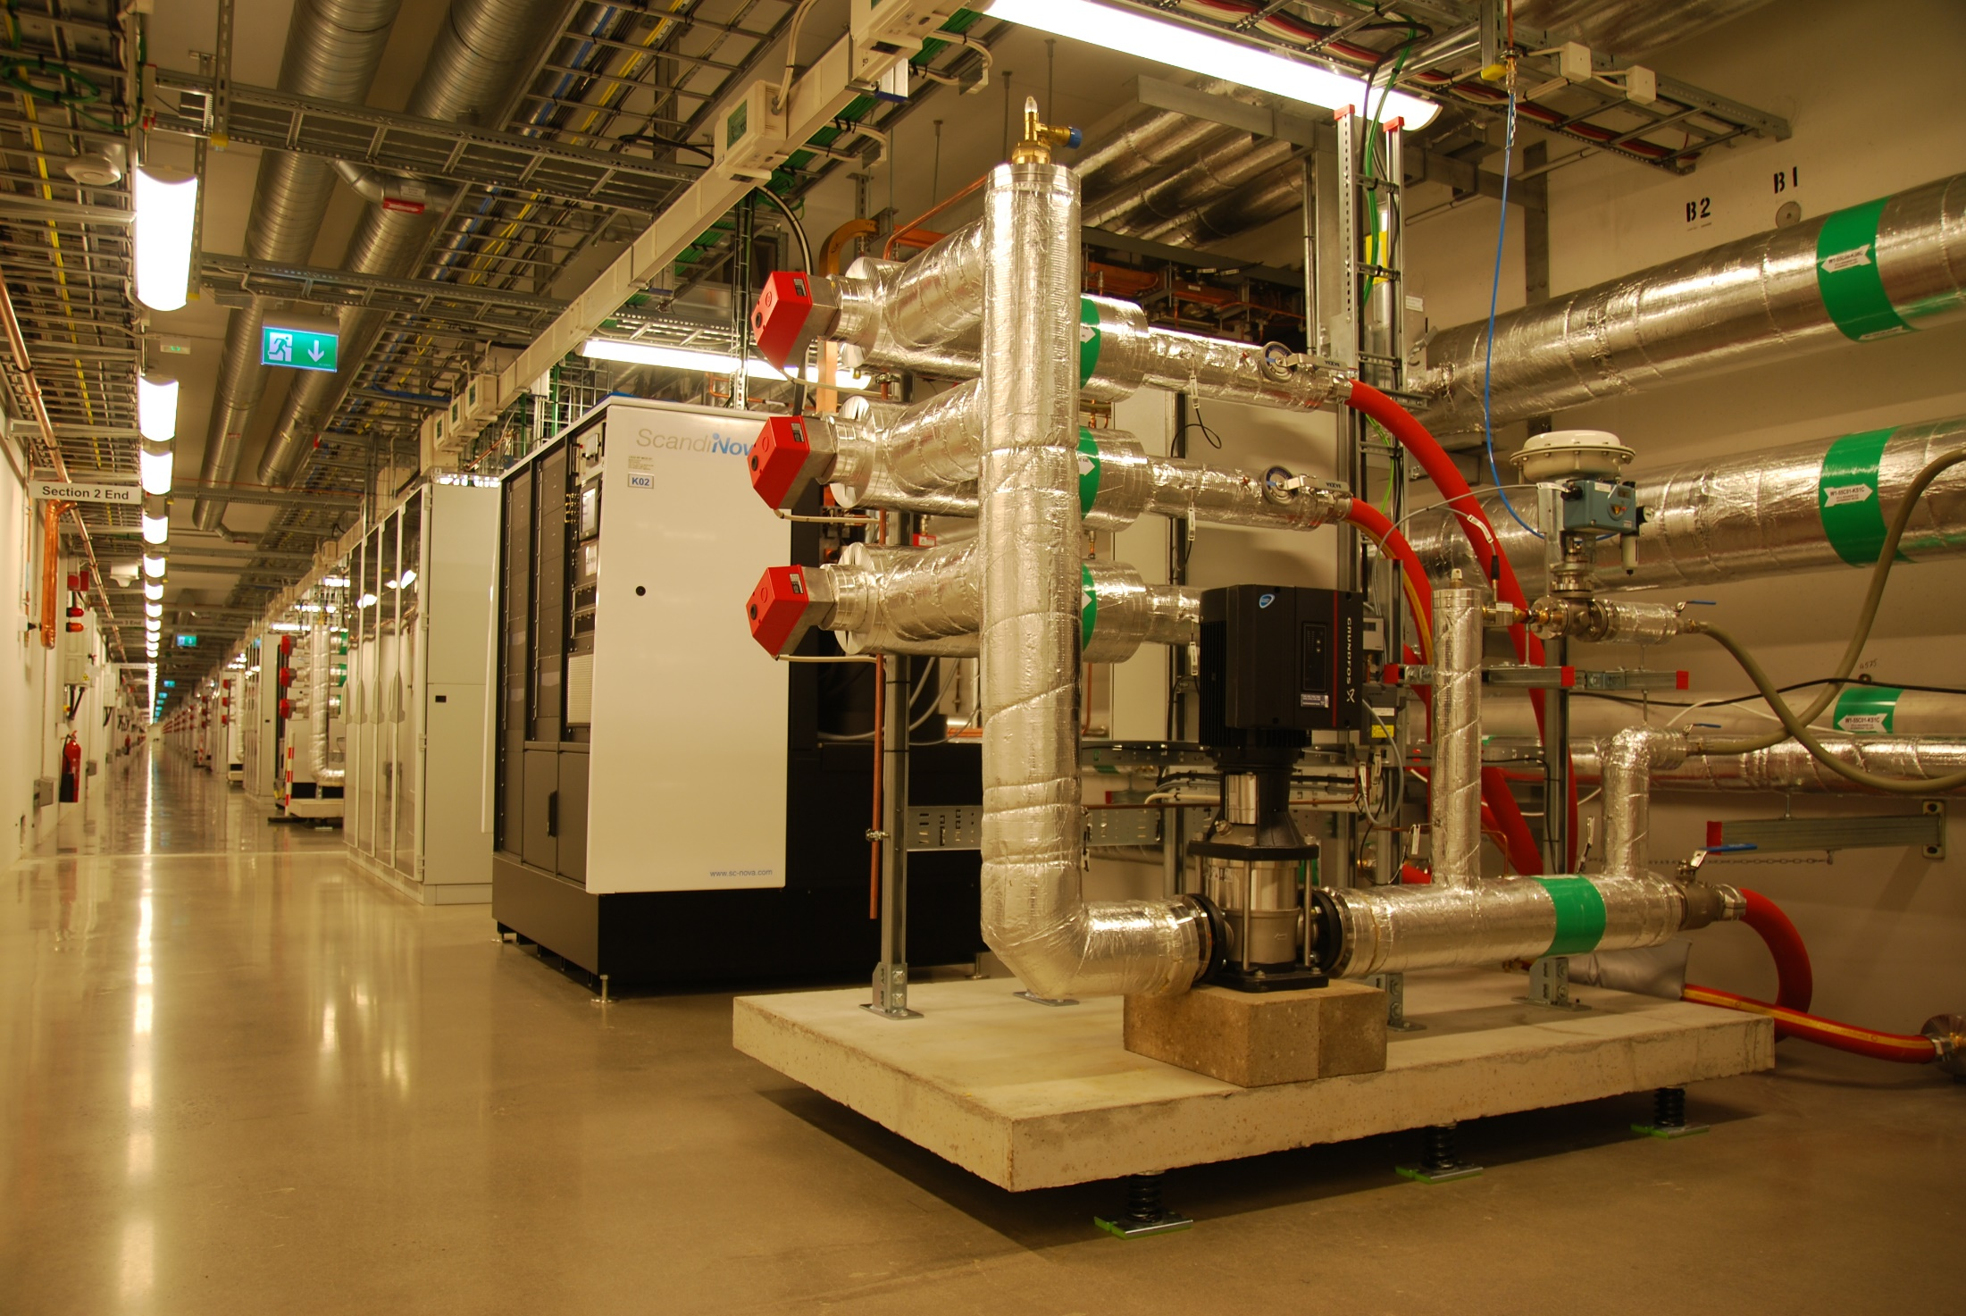
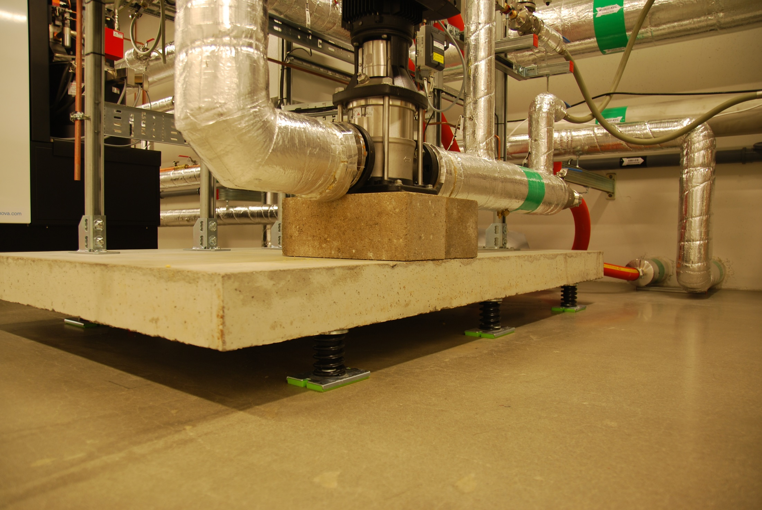
Vibration Isolation

Slide 27
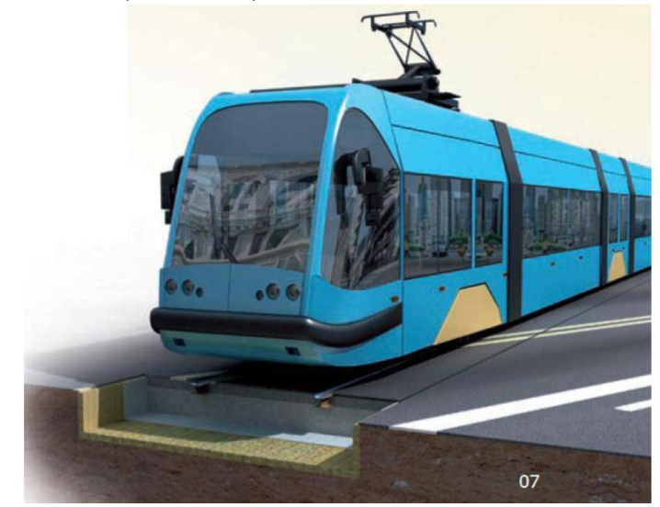
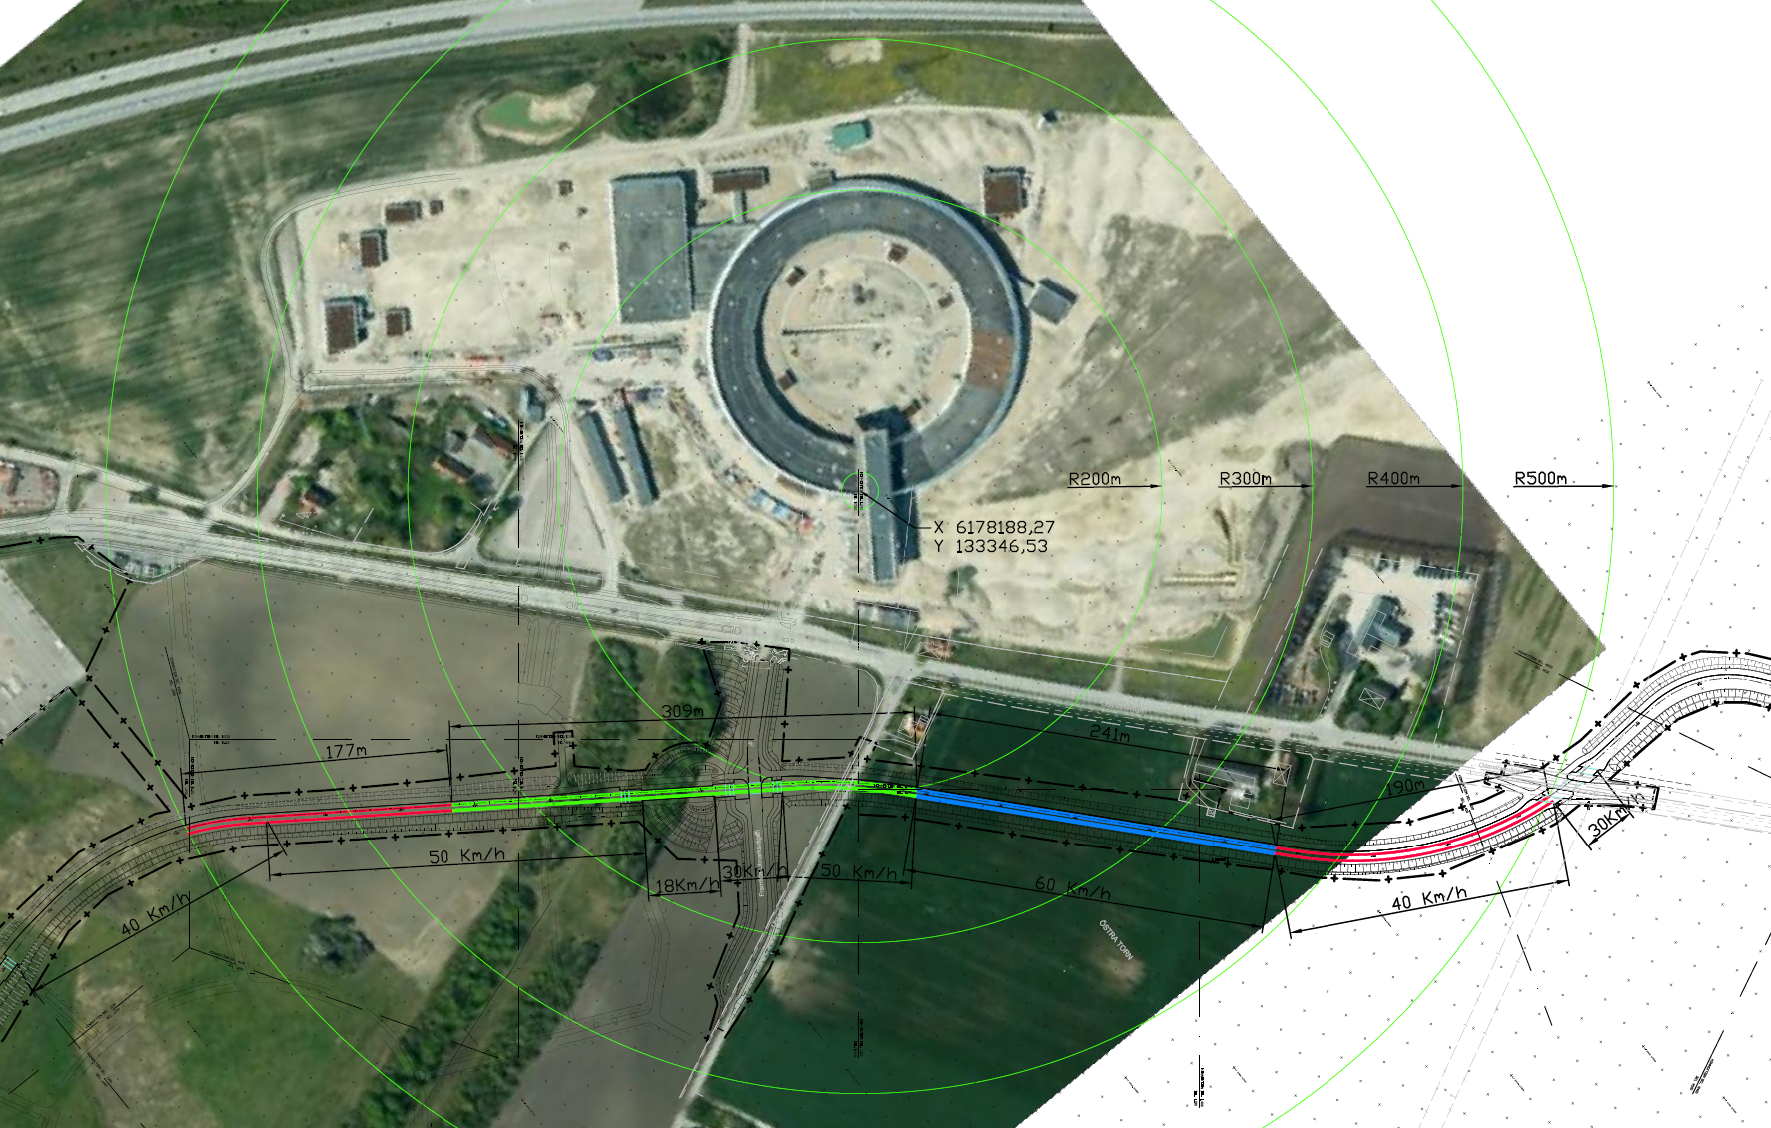
Tram Line Isolation
Thanks! to Jens Malmborg and Kent Persson, Dept. Construction Sciences, LTH
Notes:
Good Collaboration with the Municipality of Lund
Good Help from Jens and Kent from Faculty of Engineering at the University

Slide 28
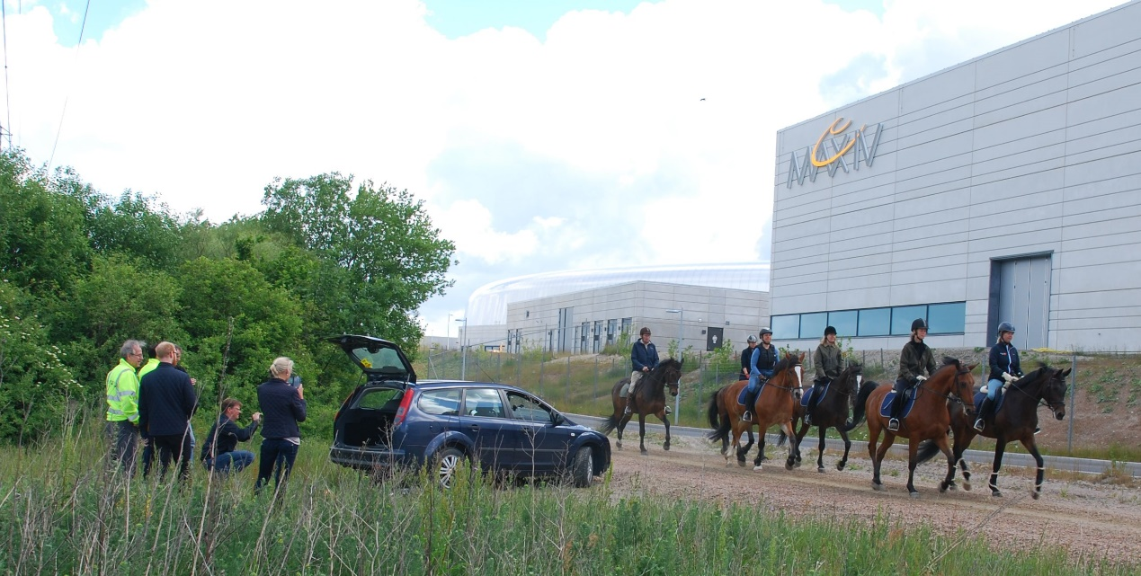
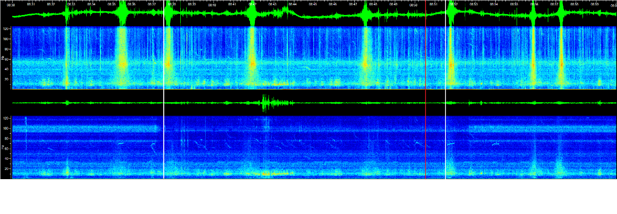
More Considerations regarding Stability Work
Stability Work is Never Ending – New Sources, Requirements and Issues Emerge
Gaining and Maintaining Experience takes Time
Measurements are relatively fast – It is the Analysis which takes time
Fourier is Your Friend - Spectra are like Fingerprints

Slide 29
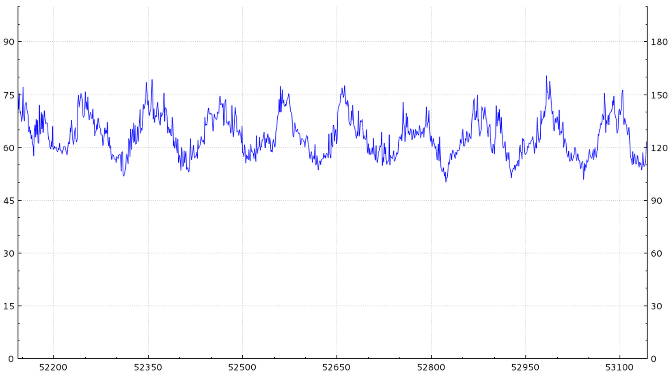
Thermal Stability
STF Have Still Not Done much in this Area
  First Attempt for some Type of Logging Equipment
Air
Water
Structures
Electronics…
1.5GeV Ring Electron Beam Life Time [h]
Time [s]
Robert Lindvall, MAX IV RF Group
Notes:
Important for both Accelerators and Beamlines
Example of air temperature in Electronics Racks
Influencing the readout of the Electron Beam Life Time in the 1.5GeV Ring

Slide 30
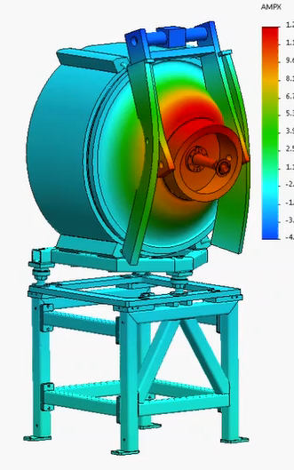
Things to Come and to Continue
More Logging
  Treatment of FA Archiver Data, for Accelerators
  Logging and Treatment of XBPM Signals
  Temperature
  Beamline Performance Data!
Web Page:
https://www.maxiv.lu.se/accelerators-beamlines/stability-task-force/
  Ongoing, Not much Content Yet…
  Ambition to have “Live” Stability Data
New Projects
  Fast Orbit Feed Back, Testing and Power Supplies
  Active Mechanical Damping
  Temperature Controlled Zones
  …
Calculations by Karl Åhnberg
Notes:
Some sources we cannot avoid (water cooling)
Some Places we cannot reach good Eigenfrequencies
RF Cavity Oscillations,
VERITAS Spectrometer
Magnet
Monochromators

Slide 31
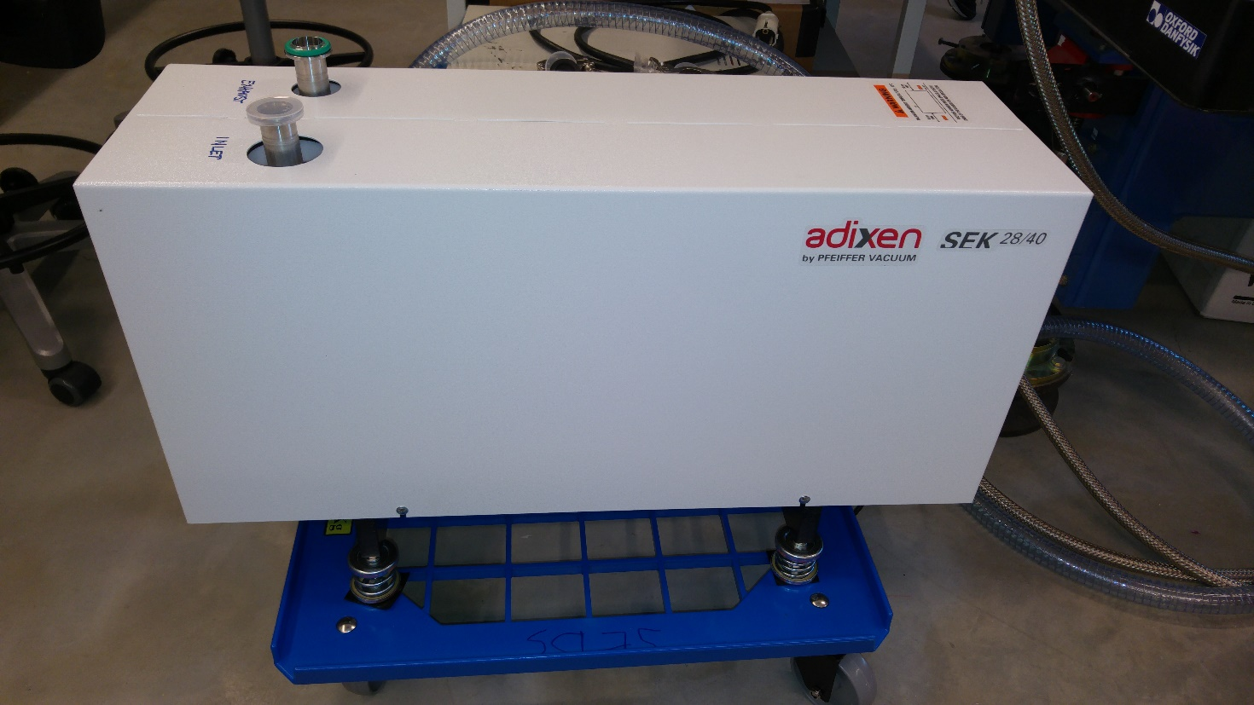
Lessons Learned
Proper Analysis before Assuming Solutions
FEA Predictions are uncertain
Be Consequential
Logging is Essential!
Follow the Guidelines!
  Isolate Your Sources
  Stabilize Your Components
  (Under-grouting!)
STF can Only Help you If People Get in Contact !!!
Photo: Dörthe Haase
Notes:
This type of Problem solving is not always easy or even Funny or rewarding
Problems are generally not going away by themselves

Slide 32
Conclusions
MAX IV Takes Responsibility for Functionality of Components Under the Condition that we have Full Influence
  (If things don’t work It is Still Our Problem, even if we could Sue our Vendors)
Vibration Tolerance Goal, defined by the 3GeV Ring Tolerances
  20-30nm RMS, f>5Hz
  Same tolerance Goal for Beamline Floors
Managing Vibrations is Mainly about Reducing Sensitivity
Stability Tolerance Goal For Facility Components
  55Hz lowest Eigenfrequency, Based on Frequency analysis of External Sources
  Ensures no Resonance
Passive Systems are Inherently Stable!

Slide 33
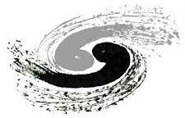

Thanks!

Slide 34
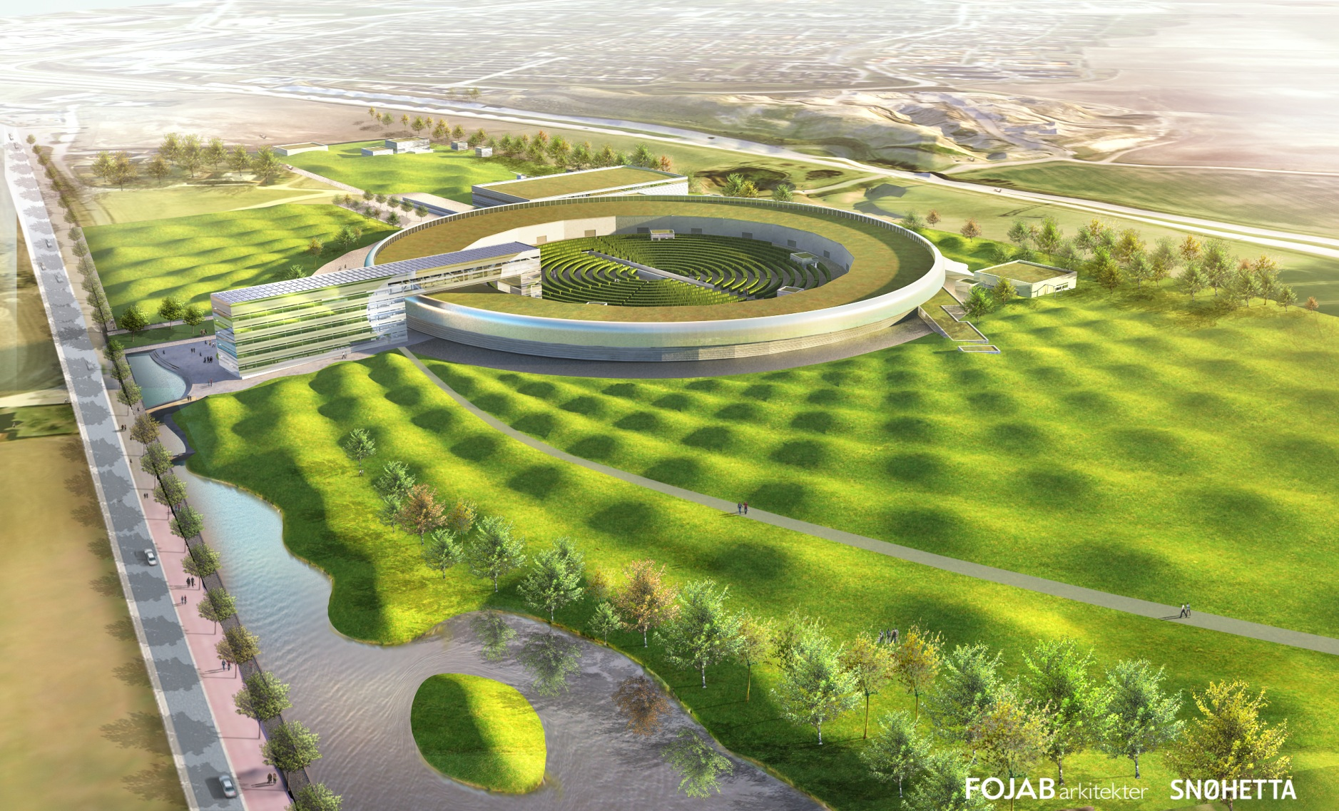
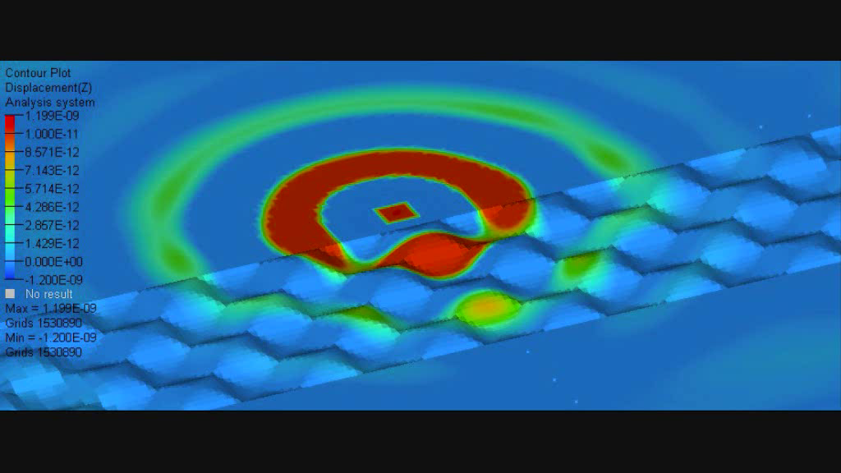
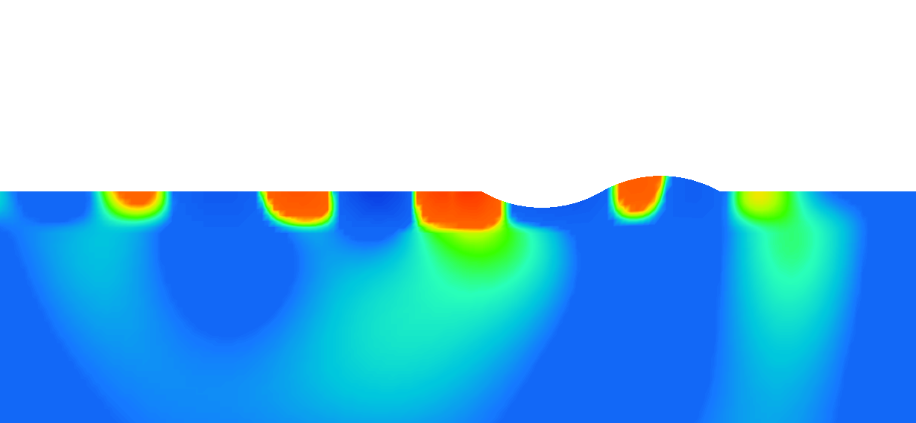
The (true) Story behind the Bumps
Calculations: Per Jørstad and Peter Persson, LTH

Slide 35
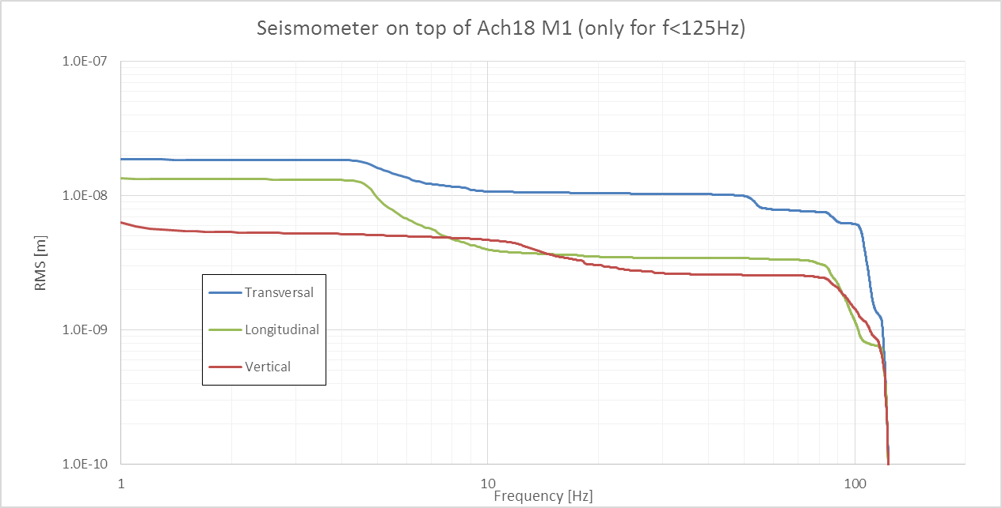
Achromat 18 M1, Integrated Values

Slide 36
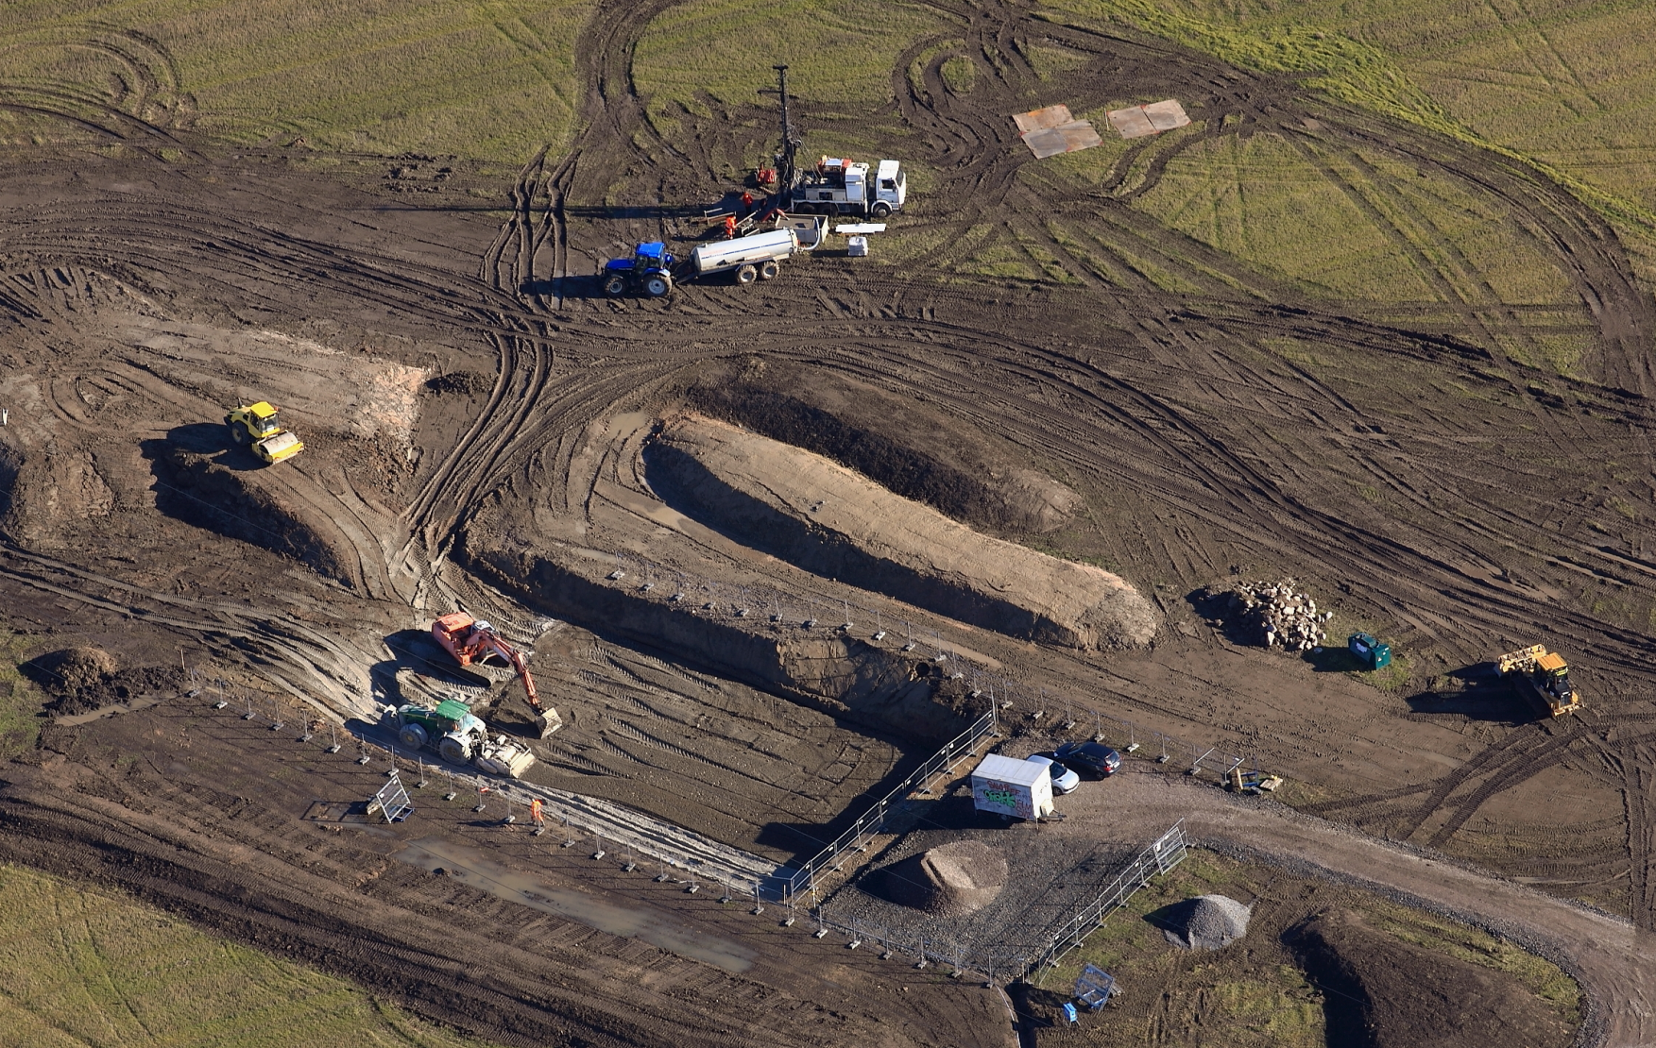

Slide 37
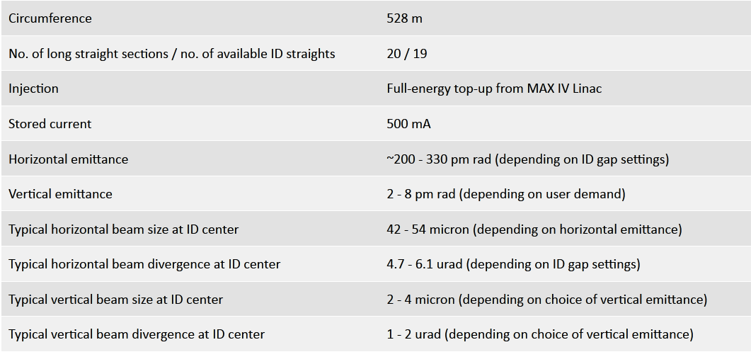
R3 Machine Data

