Slide 1
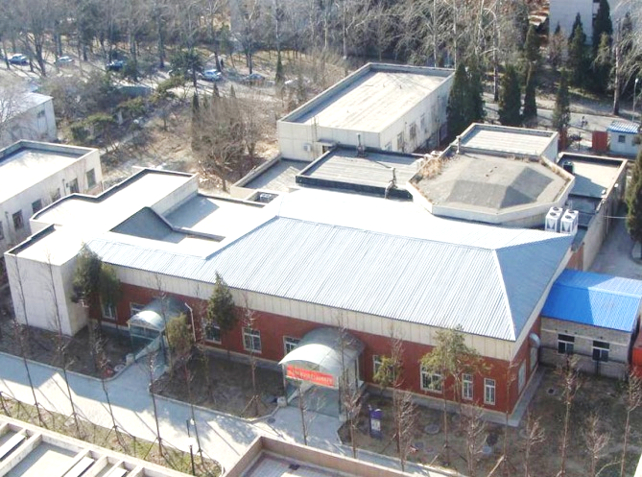
清华大学先进辐射源及应用实验室
Advanced Radiation Source and Application Laboratory, Tsinghua University

Slide 2
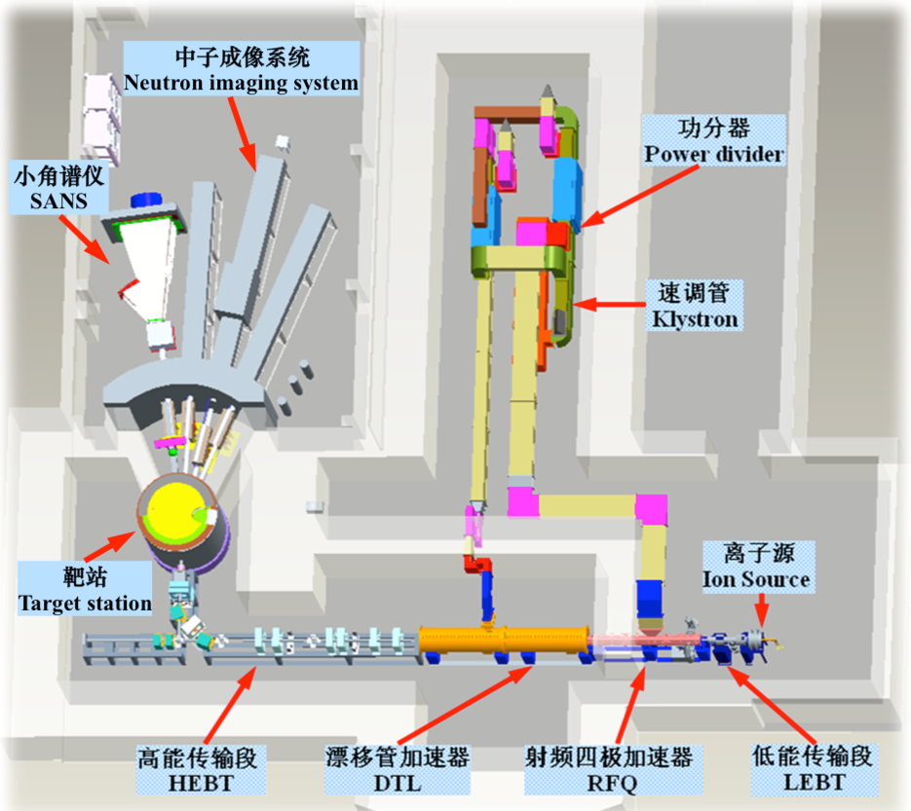
Compact Pulsed Hadron Source
CPHS Introduction
Compact Pulsed Hadron Source (CPHS) at Tsinghua University mainly consists of the 13MeV/16kW high current pulsed proton linear accelerator, target station, and experimental beam lines including proton irradiation station, neutron imaging station and neutron scattering spectrometer. Since the successful delivery of the first 3 MeV proton beam and the realization of the first neutron generation in 2013, the 3 MeV proton beam and the corresponding thermal neutron beam has been provided to the users with the total experimental time of 2000 hrs. In 2018 the Alvarez-type DTL will be installed downstream the RFQ accelerator to upgrade the beam energy to the designed value of 13 MeV.
CPHS layout

Slide 3
Key Design Parameters of CPHS
Protons |  | Neutrons
Beam power on target | 16 kW | Target for ~6 cm x 6cm proton beam
Output energy |  | Material | Be ~1.2 mm thick
DTL | 13 MeV | Coolant | Chilled water
RFQ | 3 MeV | Moderator
Ion source | 50 KeV | Material | Solid CH4 ~20 K
Average beam current | 1.25 mA | n-emitting surface | 10 cm x 10 cm
Pulse repetition rate | 50 Hz | Reflector | Water
Pulse length | 0.5 ms | Pulse length | ~1 ms
Peak beam current | 50 mA | Neutron yield (est.) | ~5 x 10¹³ /s
Protons per pulse | 1.56 x 10¹⁴
RF frequency | 325 MHz

Slide 4
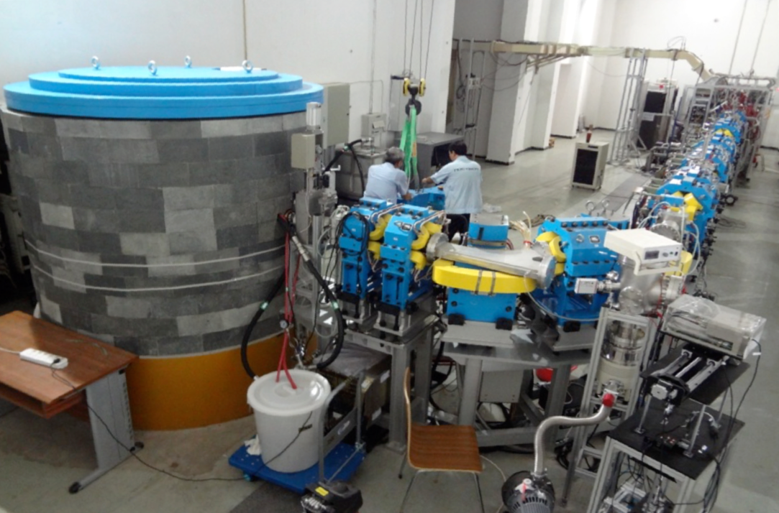
CPHS facility

Slide 5
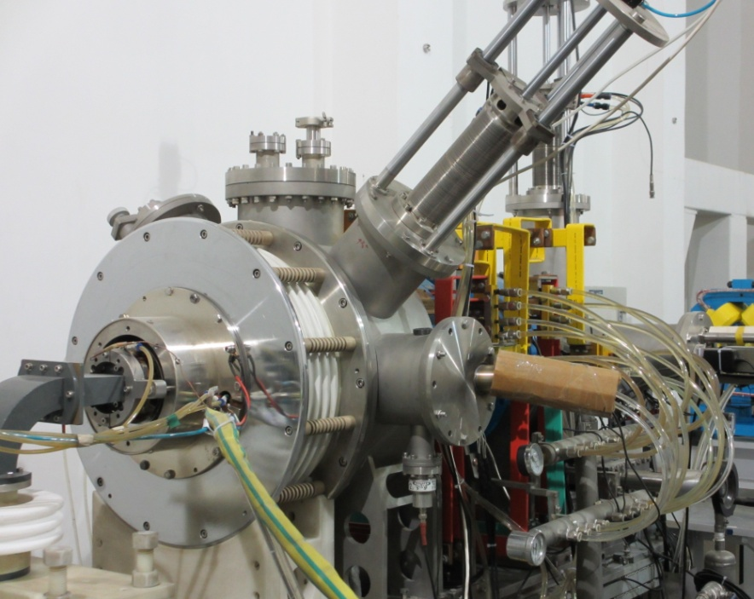
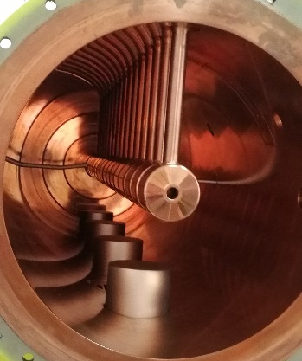
CPHS Linac
ECR proton source
RFQ accelerator
Four vane
Ramped intervane voltage
DTL accelerator
Alvarez-type
SmCo Permanent Magnet Quadrupole
RF system
RFQ and DTL powered by one klystron
ECR proton source
Klystron
RFQ
RFQ
DTL
DTL

Slide 6
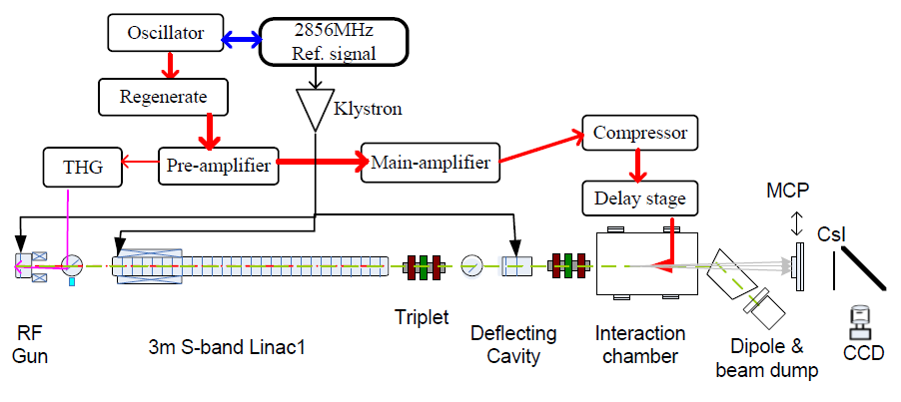
Tsinghua Thomson scattering X-ray source(TTX)
X-ray beam parameters:
X-ray energy: 20-50keV
Bandwidth: ~2%
Polarization: linear, elliptical, and circular polarization
Focus spot size: 10μm or less
Photon yield: ~2.0×10⁷ photons/pulse
Repetition frequency: 10Hz
Pulse length: 0.1-10ps

Slide 7
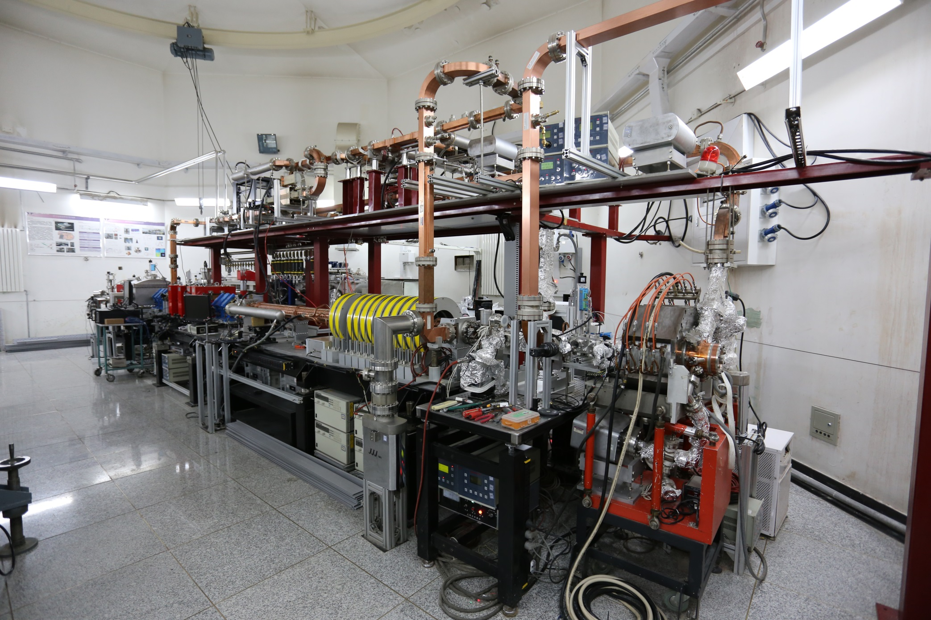
TTX beamline

Slide 8
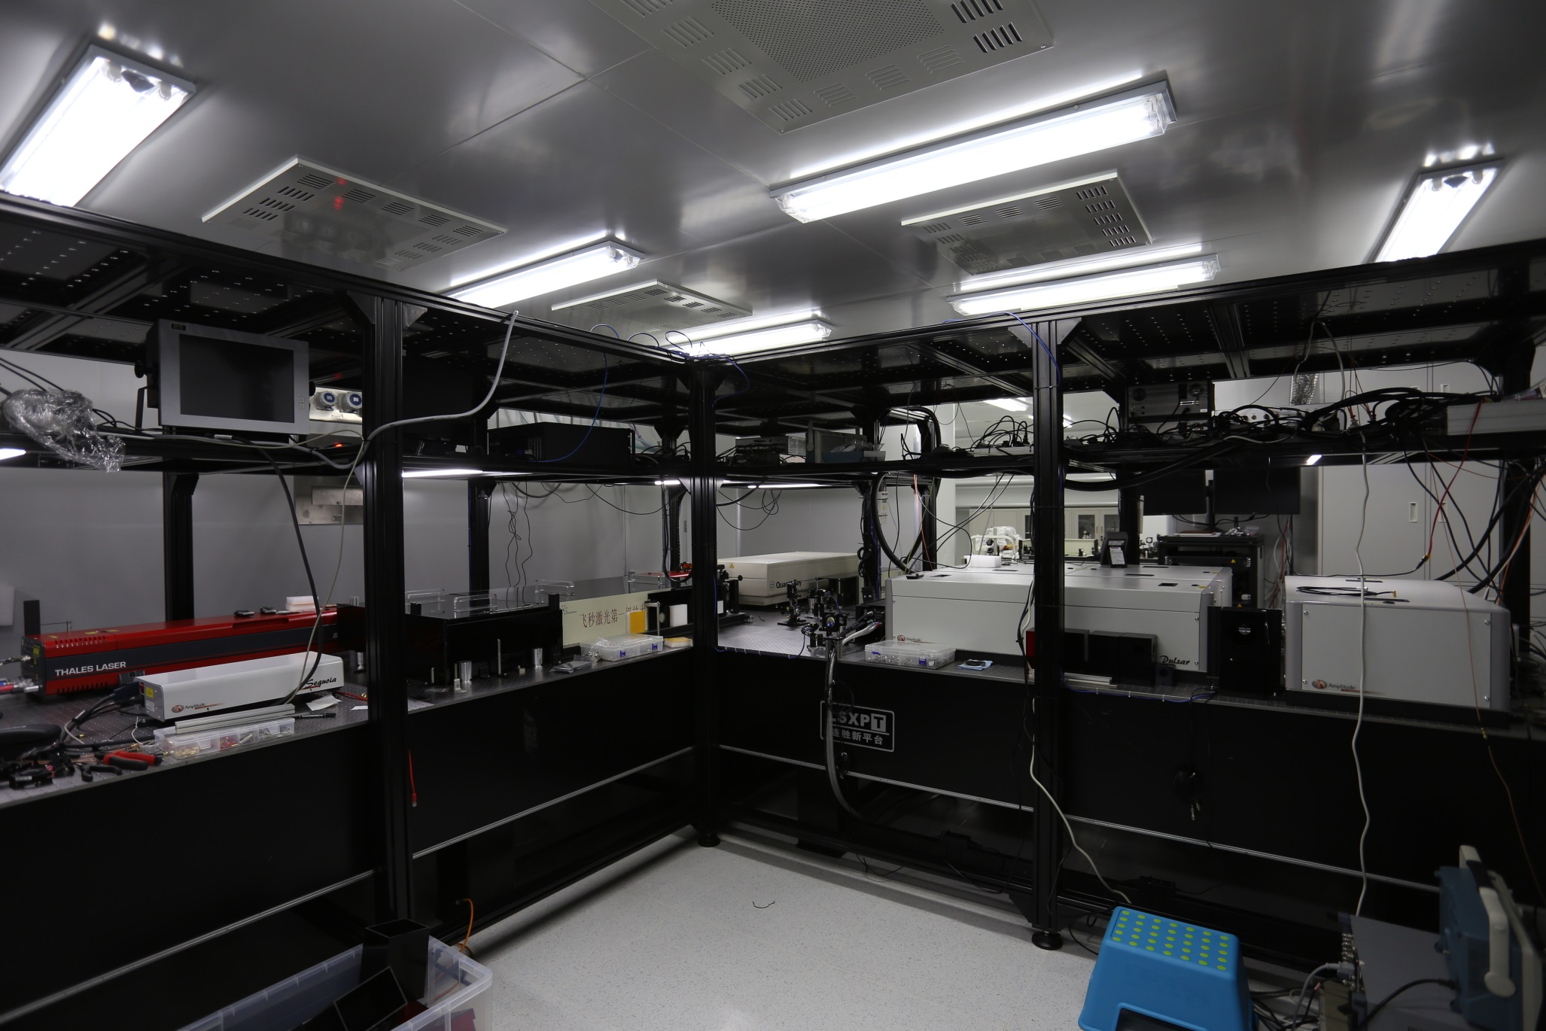
TTX laser system

