Slide 1

R&D progress for PMT signal processing in PandaX
Qibin Zheng(郑其斌), Xiangxiang Ren (任祥祥), Yong Yang(杨勇)
SJTU & USST
Notes:
代表PandaX电子学小组，给大家汇报一下我们正在进行的一项工作，PandaX实验-PMT脉冲信号的处理。

Slide 2
Outline
Introduction
New design of a Base board for dual-dynode readout of PMT Pulses
New design of a ADC with 500MS/s for PandaX experiment
Next work plan
Notes:
报告的提纲，首先概述项目的背景，
然后是介绍了新设计的双打拿级读出的base板
第三是为PandaX实验设计的500MS/s的ADC模块
最后是总结与下一步计划

Slide 3
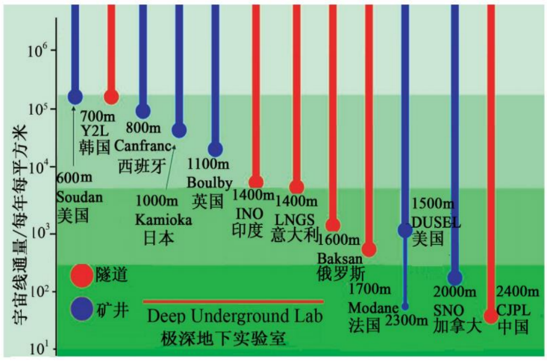
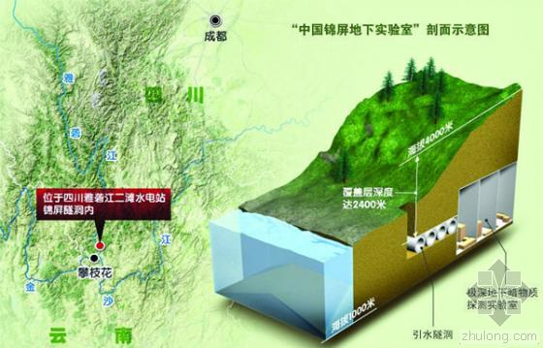
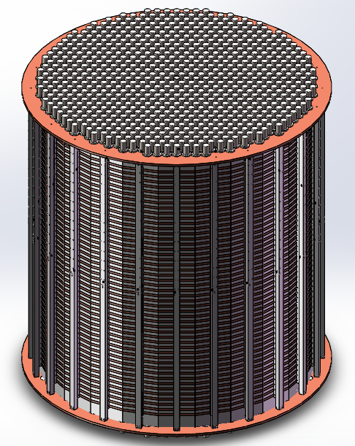
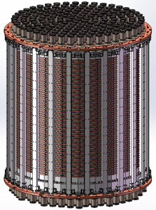
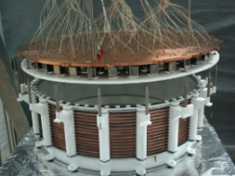
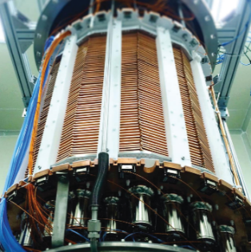
Particle and Astrophysical Xenon Experiments
PandaX-Ⅰ
PandaX-Ⅱ
PandaX-4T
PandaX-xT

Slide 4
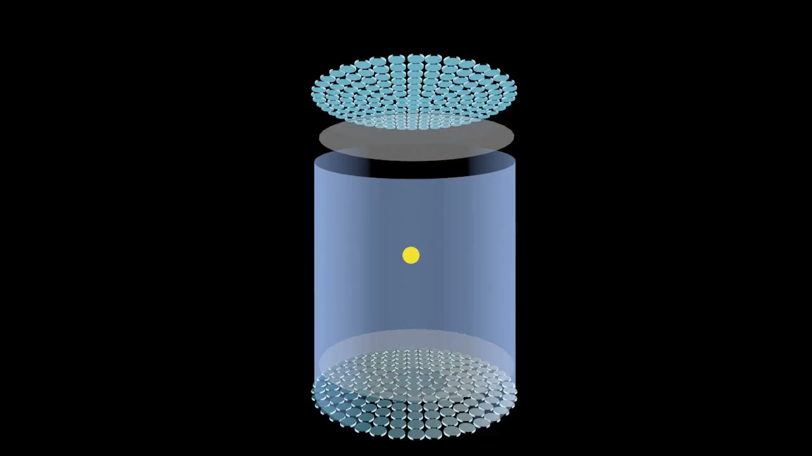
S1 and S2
Notes:
如视频所示，“两相氙型”暗物质直接探测实验PandaX的粒子探测过程。
以暗物质探测为例介绍一下PMT信号的产生过程
外来的暗物质粒子偶然和靶标物质氙碰撞释放能量；这些沉淀的能量首先产生“闪烁光信号”S1，以及电子离子对（部分电子离子对再结合产生进一步的S1）。
未结合的电子在TPC电场的作用下漂移到气液交界面进入气氙产生“电致发光信号”S2。S1、S2信号通过TPC端盖处的光电倍增管PMT收集。
我们这个报告主要关注的点是，S1、S2信号的测量。

Slide 5
Current PMT signal processing system
PMT single-anode readout
V1725: 250MS/s , 14-bit, 90MB/s readout speed
Meet the requirement in PandaX-4T DM
experiment

Slide 6
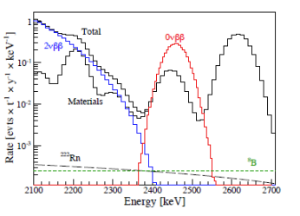
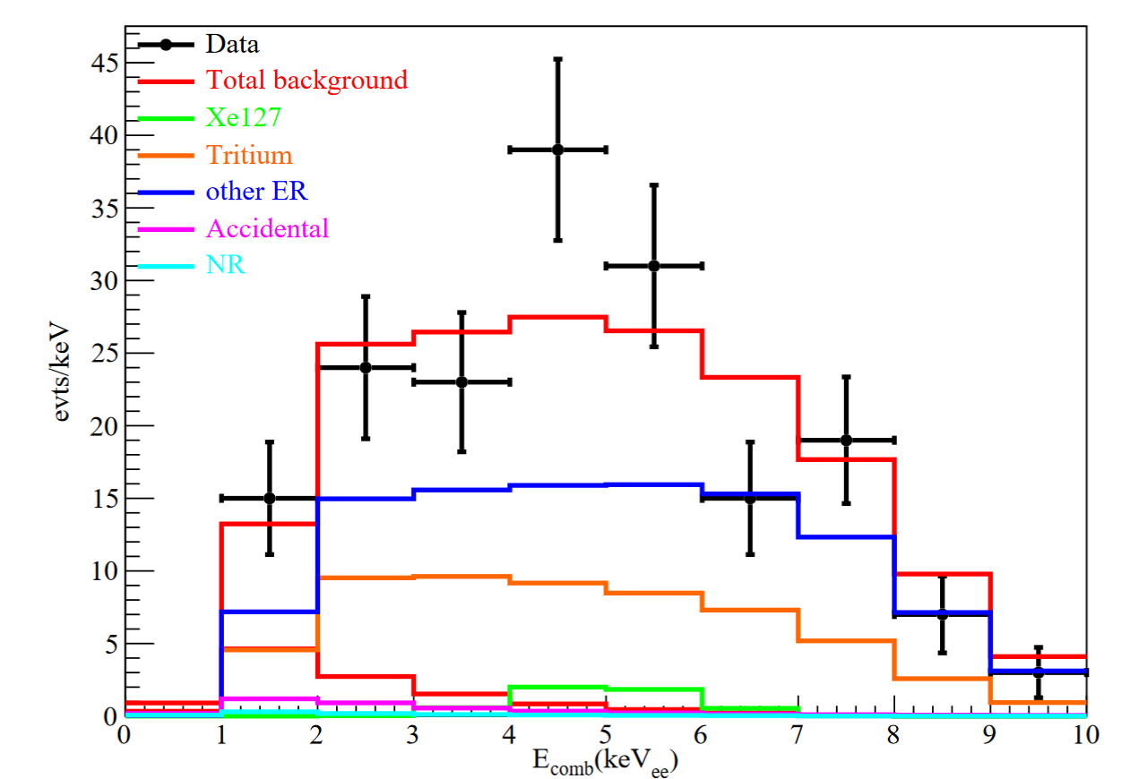
Future DM& 0νββ in one detector
Energy range: 1keV-10 keV (DM signal ) to
2.5 MeV (0νββ signal)
Spans more than 3 orders of magnitude
At least 18-bit ADC to achieve 1% precision
DM search energy window
Xe-136 0νββ

Slide 7
Design of a dual-dynode base for PMT
Current design (for DM experiment)
New design : dual-dynode read-out
For both DM and 0υββ experiments

Slide 8
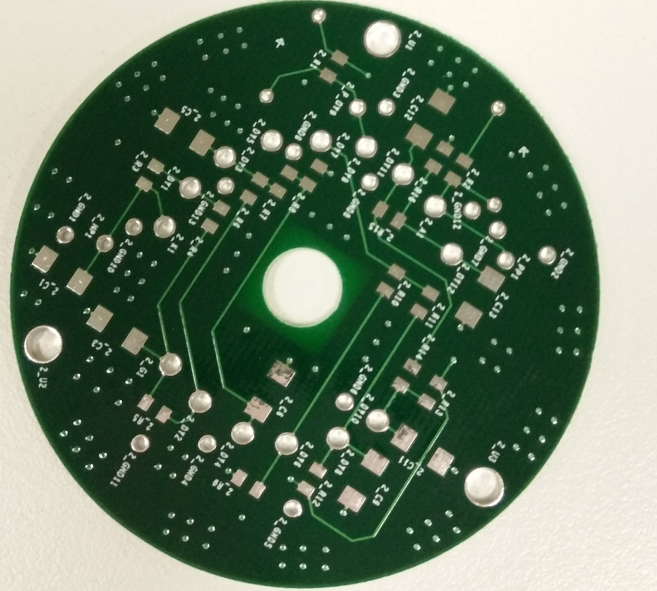
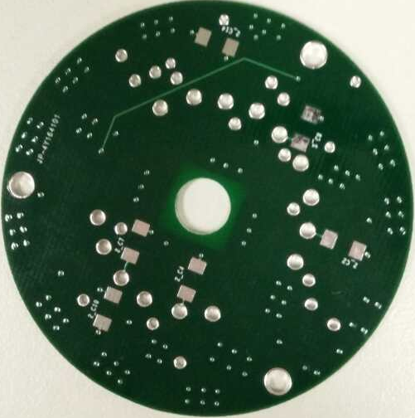
Base board

Slide 9
Design of ADC
Not much flexibility of using CAEN V1725 digitizers.
  For example, can not remove noise / sparking waveform
 | V1725B | Our Digitizer
Sampling rate | 250 MS/s | 500 MS/s
Resolution | 14-bit | 14-bit
Dynamic range | 2Vpp, or 0.5Vpp | 1.44-2.16 Vpp
Input bandwidth | DC-125 MHz | 0.06 – 400MHz
RAM | 164MB | 4GB
Readout bandwidth | 1Gb/s | 10Gb/s

Slide 10
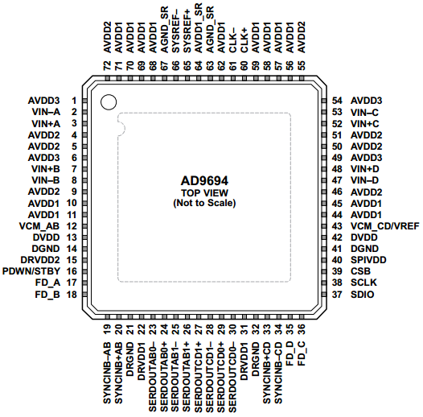
Key components of the design
ADT3-6T+: 0.06 – 400M
AD9694:
  1.44 V p-p to 2.16 V p-p (1.80 V p-p nominal)
  500MS/s
  14bit
  4-channel
  JESD204B
Readout 10Gb/s
Xilinx K7-325T FPGA

Slide 11
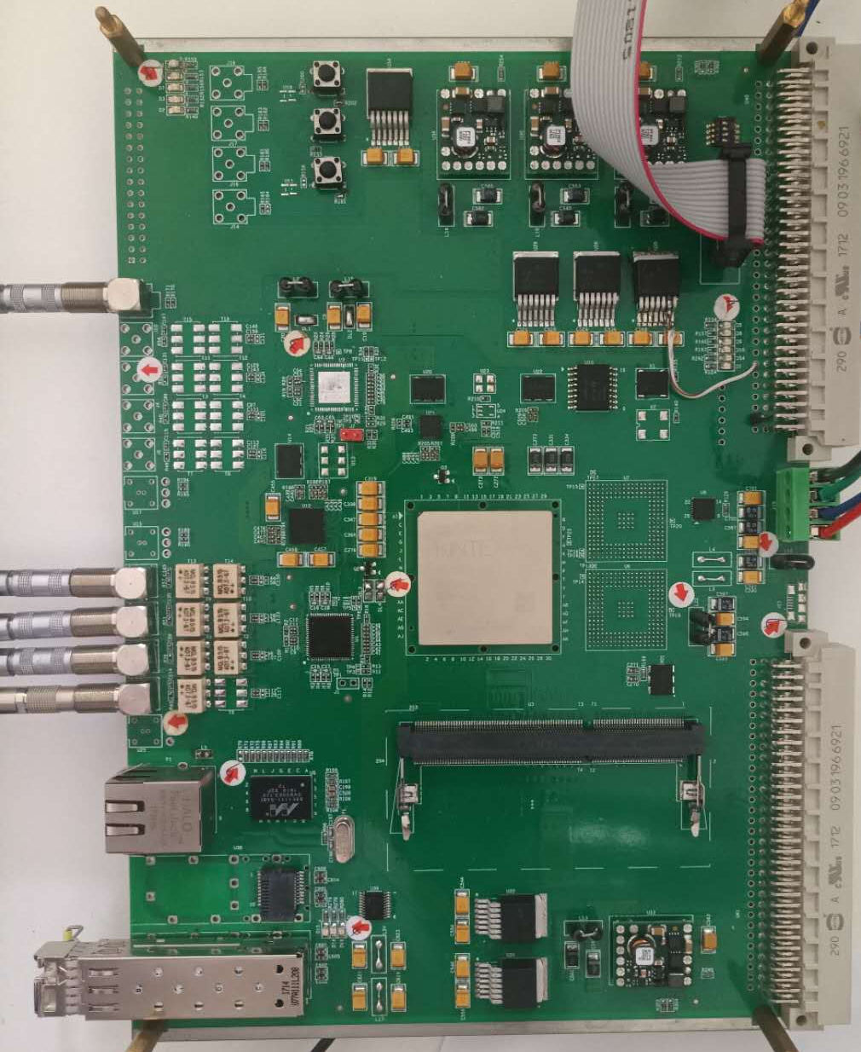
The schematics and the board
  JESD204B

Slide 12
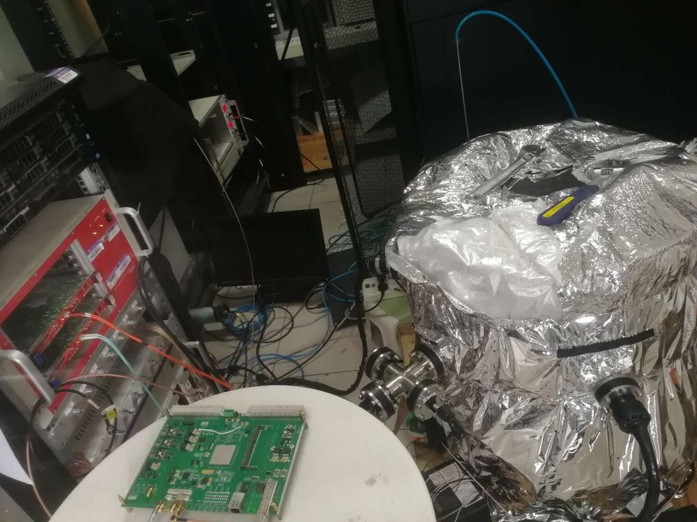
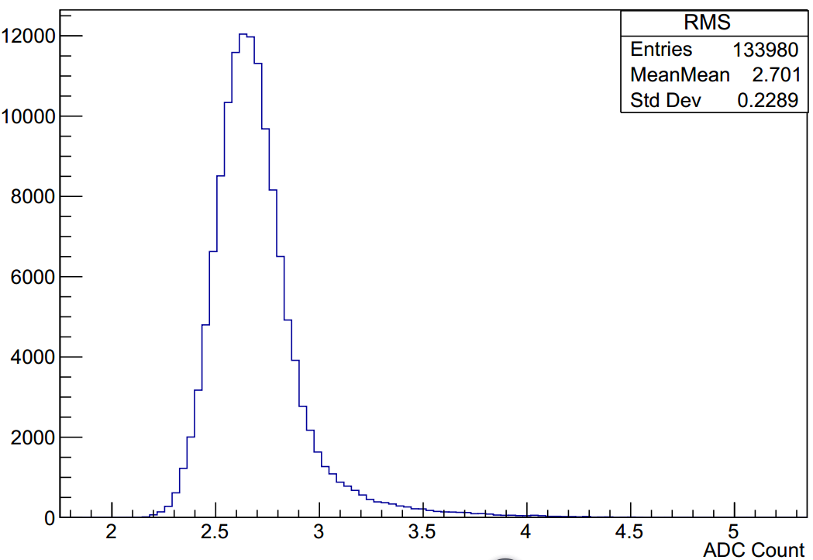
Test with LED source
PMT + low-intensity LED

Slide 13
Single PE spectrum
our digitizer (500MS/s, 1.8Vpp, 14-bit)
V1725B (250MS/s, 2Vpp, 14-bit)
our digitizer Fit (34.62%)
V1725B Fit (36.80%)

Slide 14
Work in progress
Further test
Noise suppression
Zero suppression algorithm
Trigger logic

Slide 15
感谢各位老师、同学！
请多多指正！

Slide 16
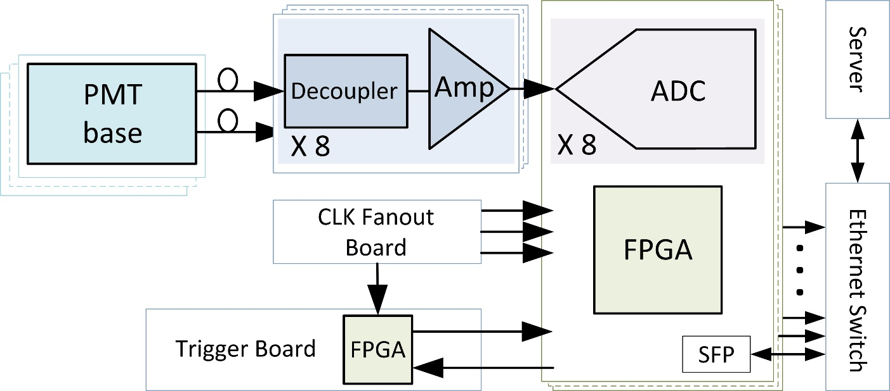
Block diagram
Self-designed
Base: two dynodes readout
ADC card：500MSPs、14bit、8channels、10Gb/s

