Slide 1
ATLAS Phase-I upgrade NSW Front-End Electronics
Feng Li, Peng Miao, Xinxin Wang, Zhilei Zhang, Shengquan Liu, Shuang Zhou, Liang Han & Ge Jin
State Key Laboratory of Particle Detection and Electronics
Depart of Modern Physics, University of Science & Technology of China
CHEP2018

Slide 2
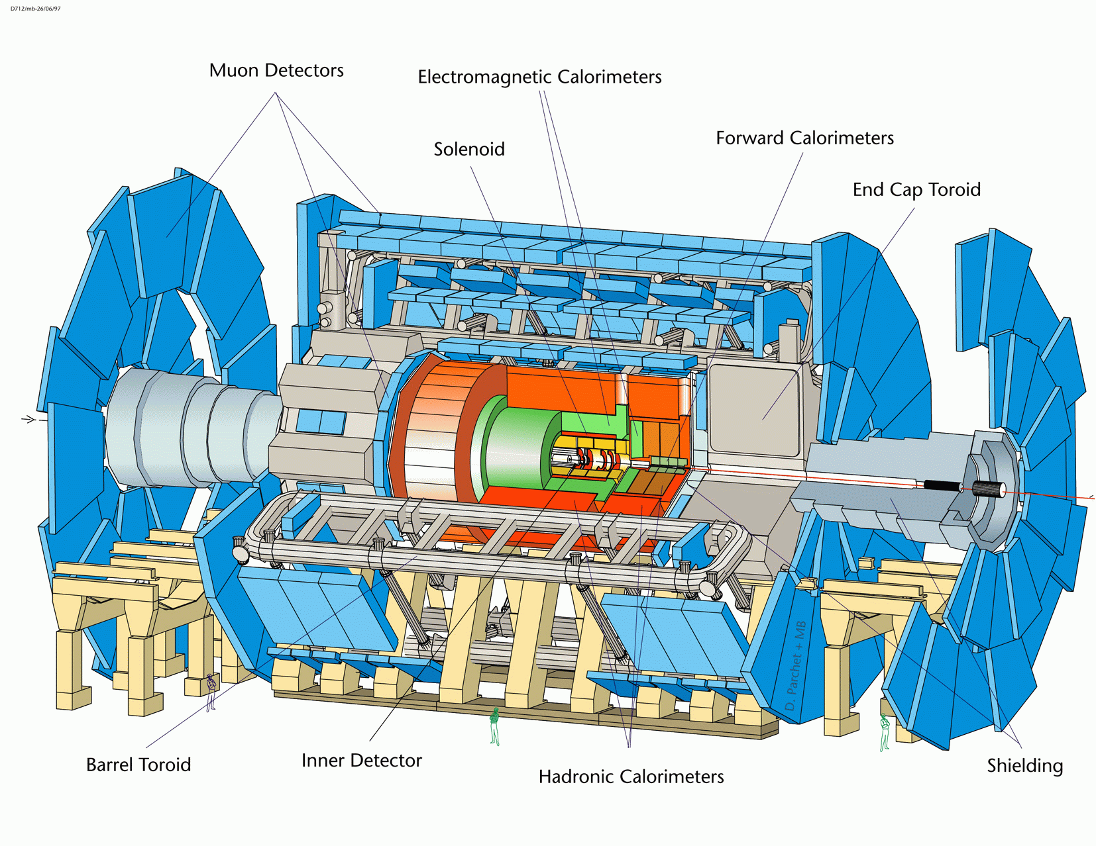
Introduction
LHC will be upgraded to 14TeV proton-proton collision
ATLAS: Current SW has fake event up to 98%
Build a completely New Small Wheel (NSW)
SW (Small Wheel)

Slide 3
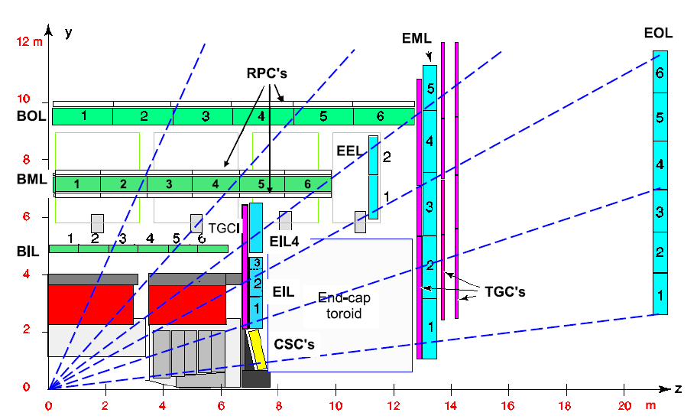

Slide 4
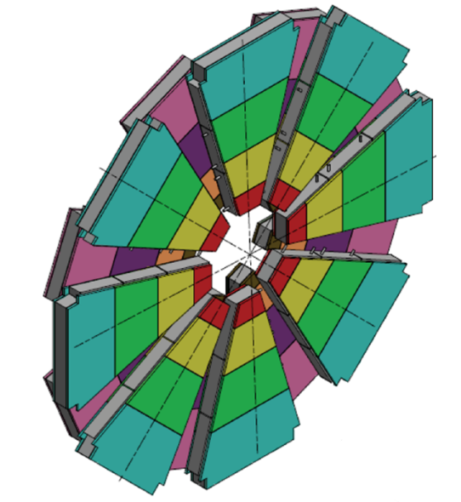
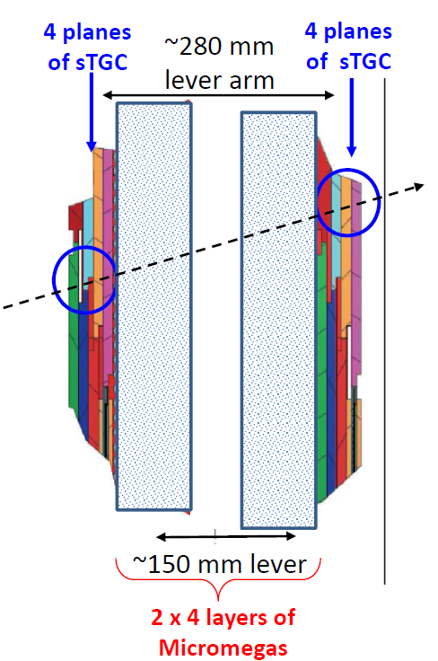
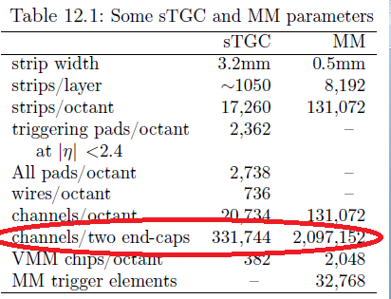
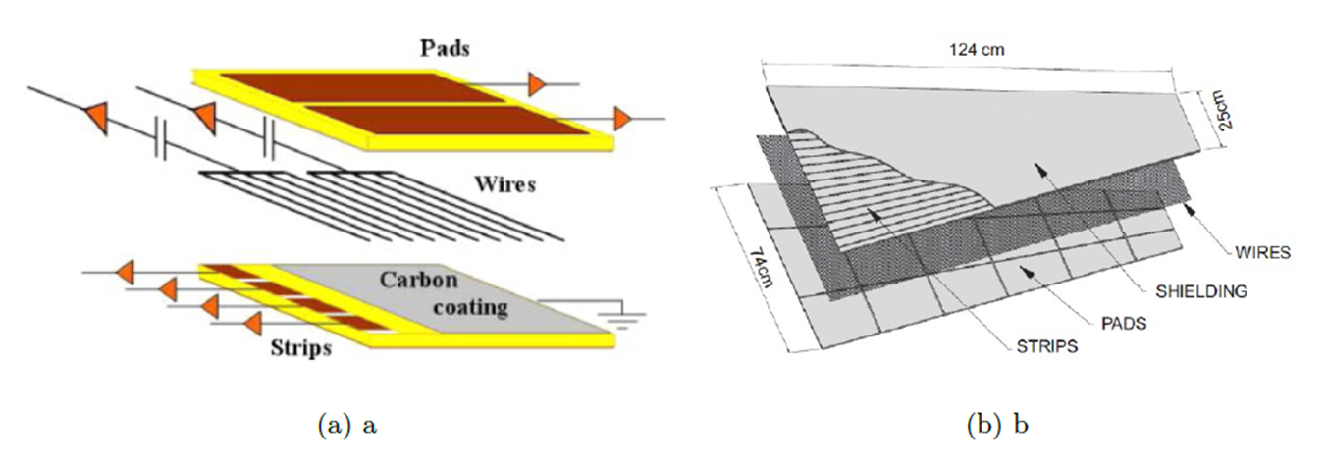
NSW Detector
sTGC: online trigger detector
MicroMegas : offline tracking detector
768 sTGC modules
sFEB to handle 512 Strip signals
pFEB to handle pad/Wire signals for each moudle

Slide 5
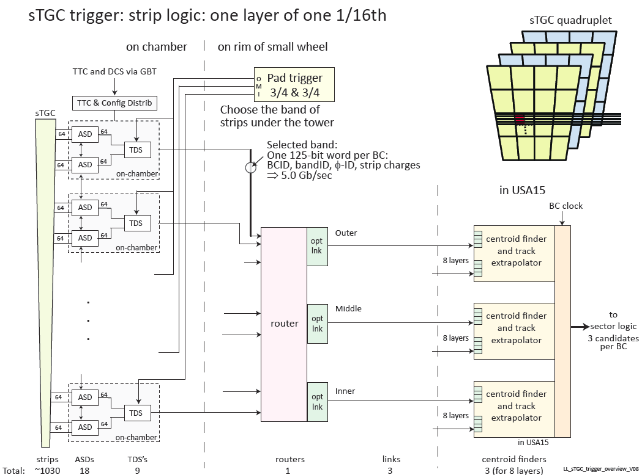
1/16 sTGC trigger diagram
768 sTGC module：
  768 Pad/Wire Front end boards(192 channels) in size 16.5*6cm
  768 StripFront end Boards(512 channels) in size 27*6cm
More than 330,000 channels

Slide 6
pFEB/sFEB specification
Read strip and pad/wire signals to VMM on sFEB and pFEB;
6B trigger of 2×VMM sent to TDS; 10B data of each VMM to ROC
pTDS → Pad Trigger, decision sent to sTDS; sTDS → Router
Configurations and 40MHz clock L1DDC → ROC/SCA
Components: VMM, TDS, SCA, ROC; FEAST; miniSAS; GFZ
FEB design: strict PCB size limitation; short traces for analog and high speed data transmission; analogue/digital signals and grounds well separated; etc.
Notes:
strict board size limitation, sufficient VMM protection, chips/miniSAS deploy for high speed data transmission

Slide 7
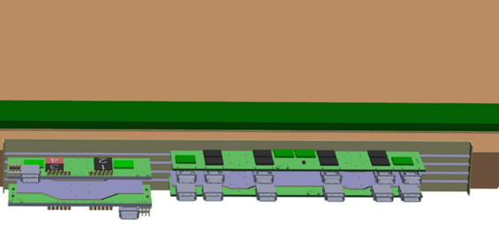
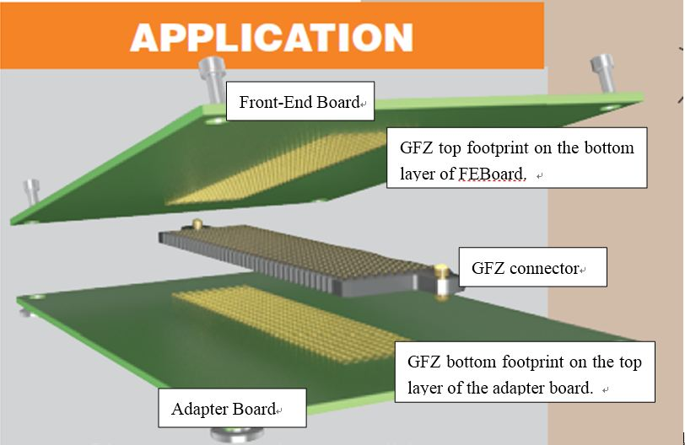
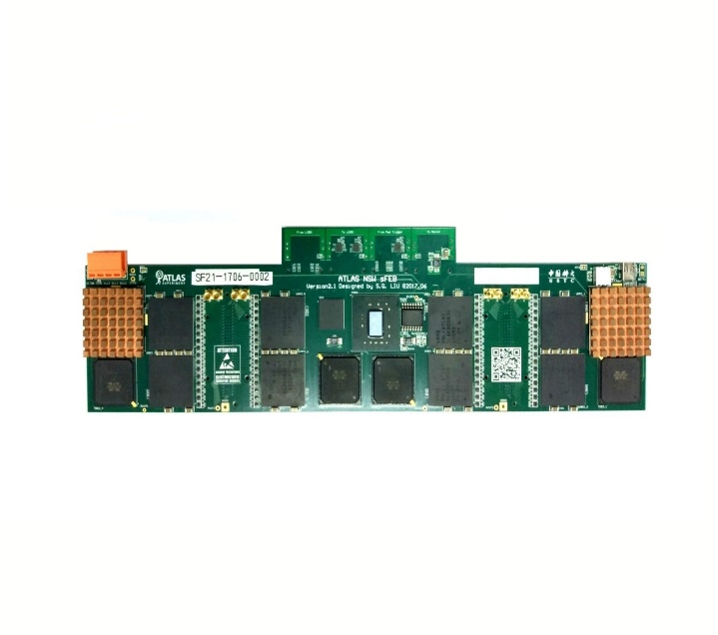
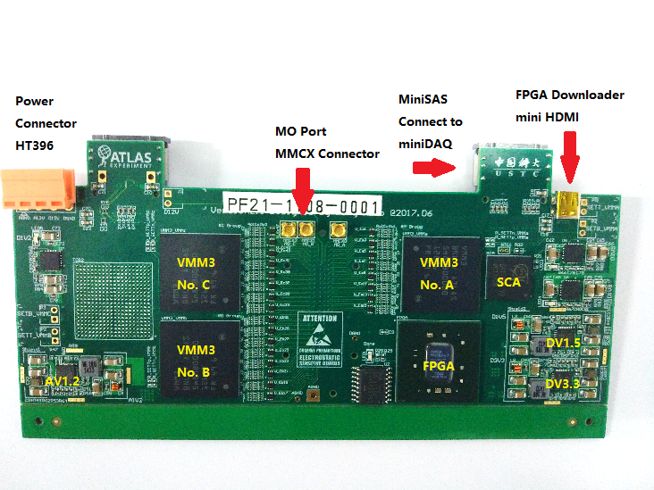
Chamber/FEB connection

Slide 8
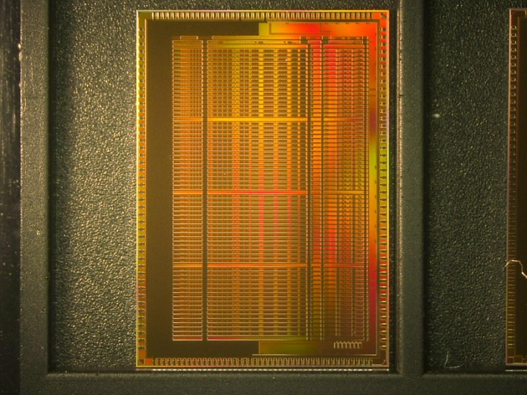
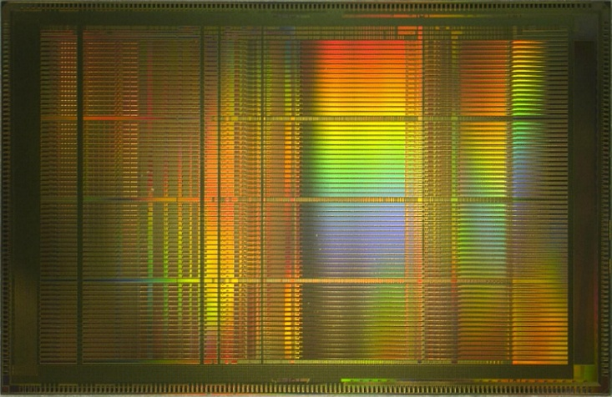
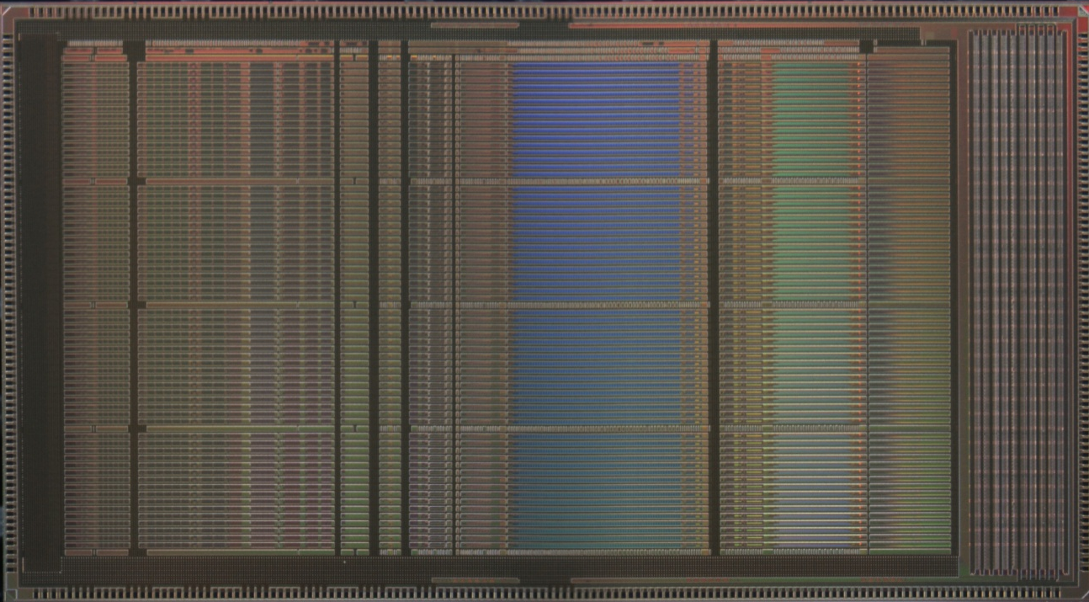
Path Towards VMM
VMM1
2011-12
50 mm²
500k FETs
(8k/ch.)
VMM2
2013-14
115 mm²
5M FETs
(80k/ch.)
VMM3
2015-16
130 mm²
10M FETs
(160k/ch.)
production
mixed-signal
2-phase readout
peak and timing
neighboring
sub-hysteresis
few timing outputs
mixed signal
continuous fully-digital readout
current-output peak detector
increased range of gains
three ADCs per channel
FIFOs, serialized data with DDR
serialized ART with DDR
additional timing modes
64 timing outputs
ITAR
additional functions and fixes
mixed signal + digital
continuous simultaneous readout
SEU-tolerant logic
deeply revised front-end for TGC
(2nF, 50pC, fast recovery, ...)
L0 handling digital core
SLVS and new config. interface
new reset control and fast reset
timing at threshold
timing ramp optimization
pulser range extension
ART synchronization
32-channel skip
additional functions and fixes
Designed at BNL
  G. De Geronimo

Slide 9
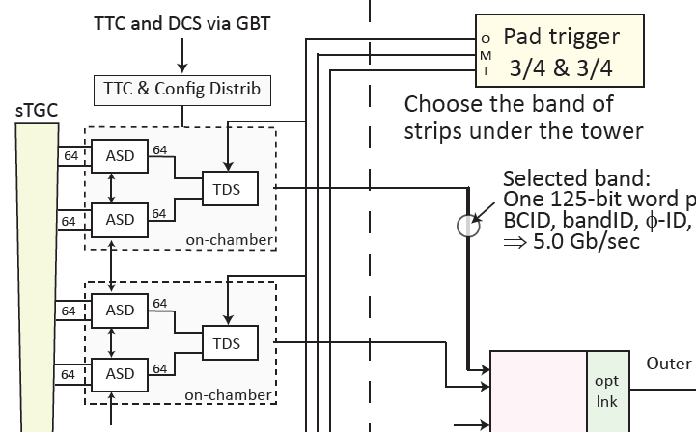
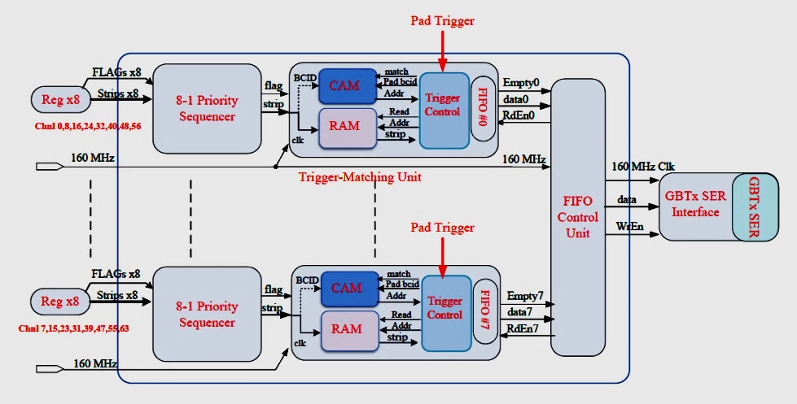
Trig Data Serializer: TDS
radiation hard IBM 130nm ASIC
Pad/Strip trig data preprocessing
Output: 128b@25ns, 5.1Gbps
Designed at UM
Notes:
引进美国BNL实验室研发的IBM130nm多通道、抗辐照专用ASIC TDS(Trigger Data Serializer)芯片，
研制单板128-512多通道抗辐照FE读出电路设计、生产与测试，并设计相关的6Gpbs高速光纤数据传输芯片

Slide 10
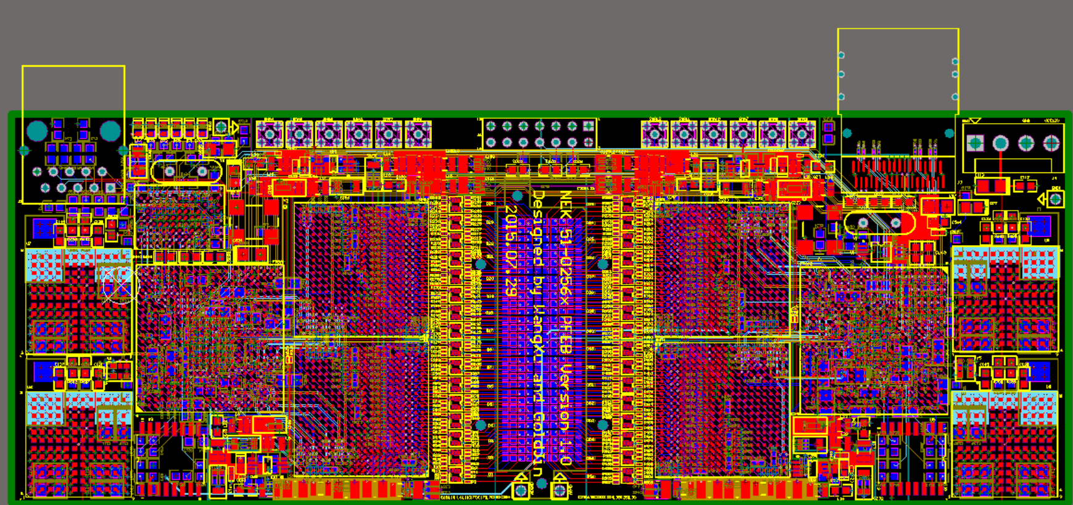
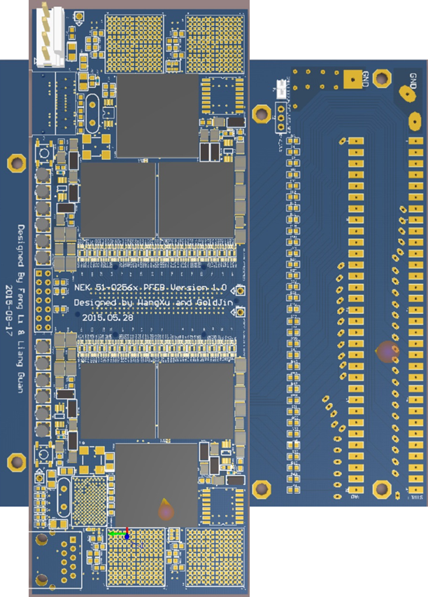
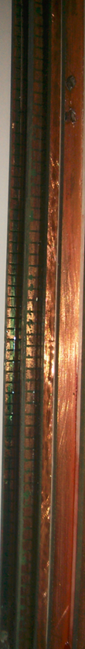
pFEB v1.0 based on VMM2
2015
sTGC strip side
pFEB
GFZ adaptor
Integration test with mini-sTGC at UM

Slide 11
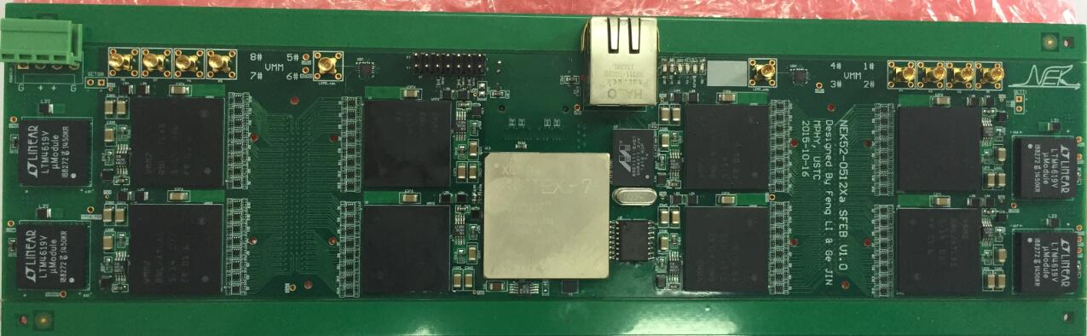
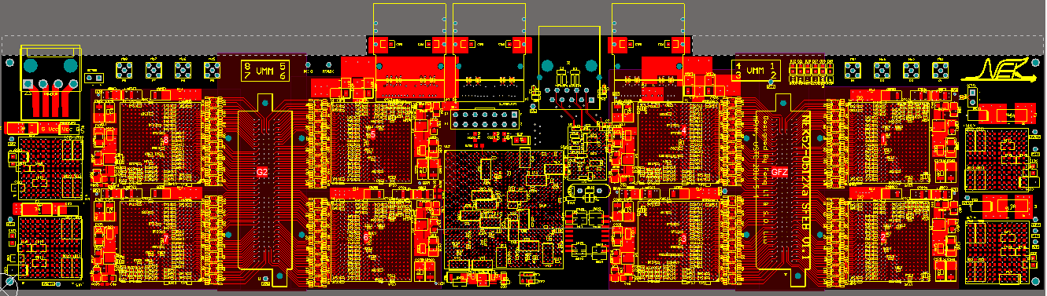
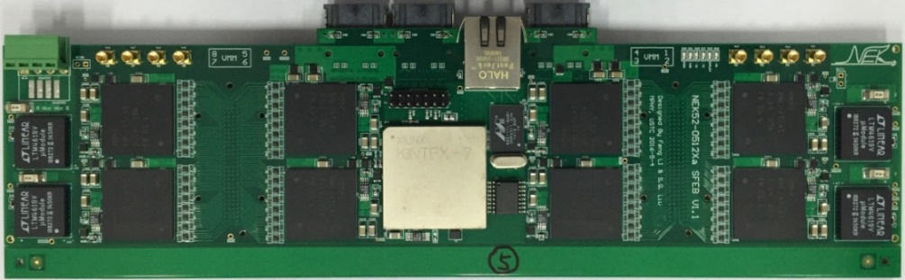
sFEB v1.0/1.1 based on VMM2
2015
VMM configuration and raw data read out
MiniSAS connectors added on sFEB v1.1 for data communication

Slide 12
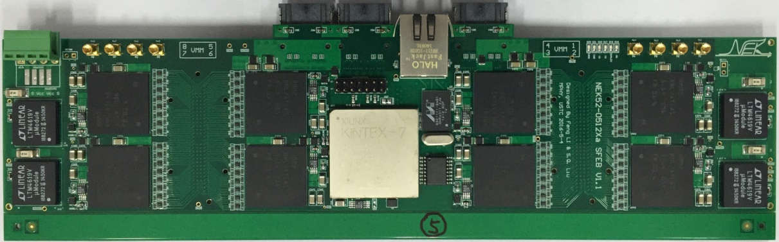
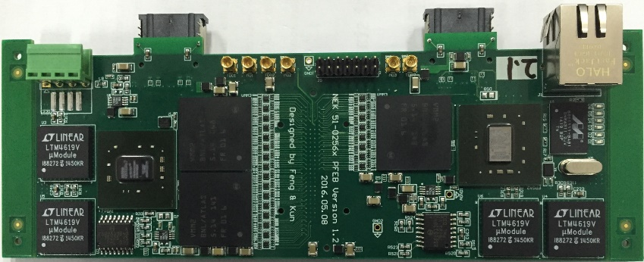
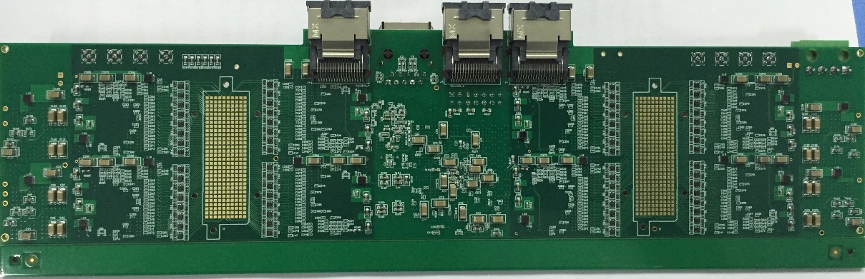
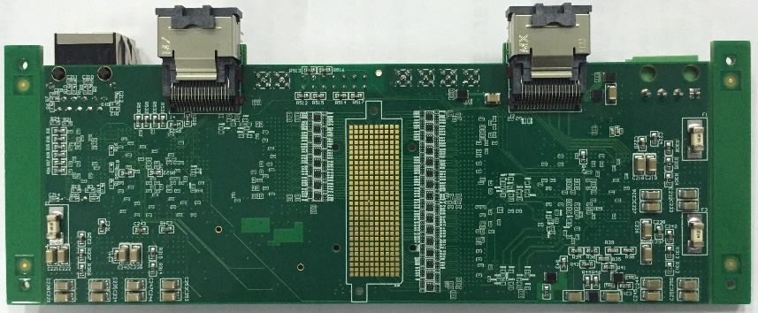
sFEB v1.1 and pFEB v1.2
2016
SFEB v1.1
pFEB v1.2
NSW upgrade Committee visited USTC for site review in June 2016.
Notes:
The first VMM2 never works no matter how we change the configuration bits.

Slide 13
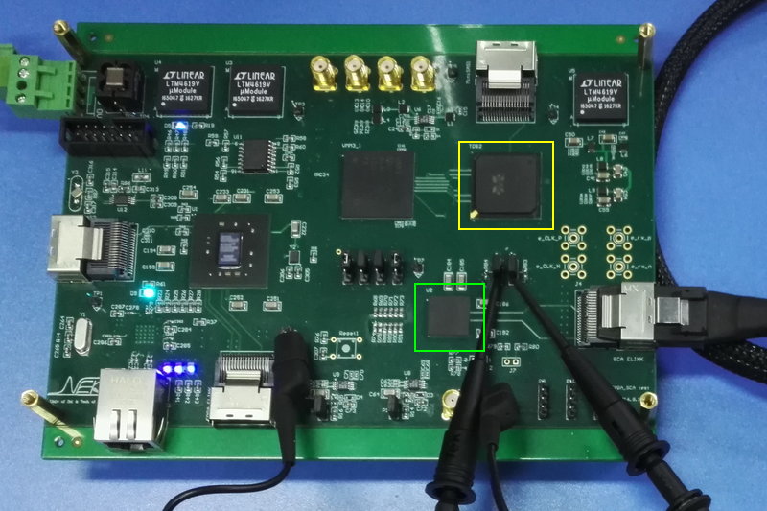
SCA Board
2016
TDS
SCA
Notes:
The first VMM2 never works no matter how we change the configuration bits.

Slide 14
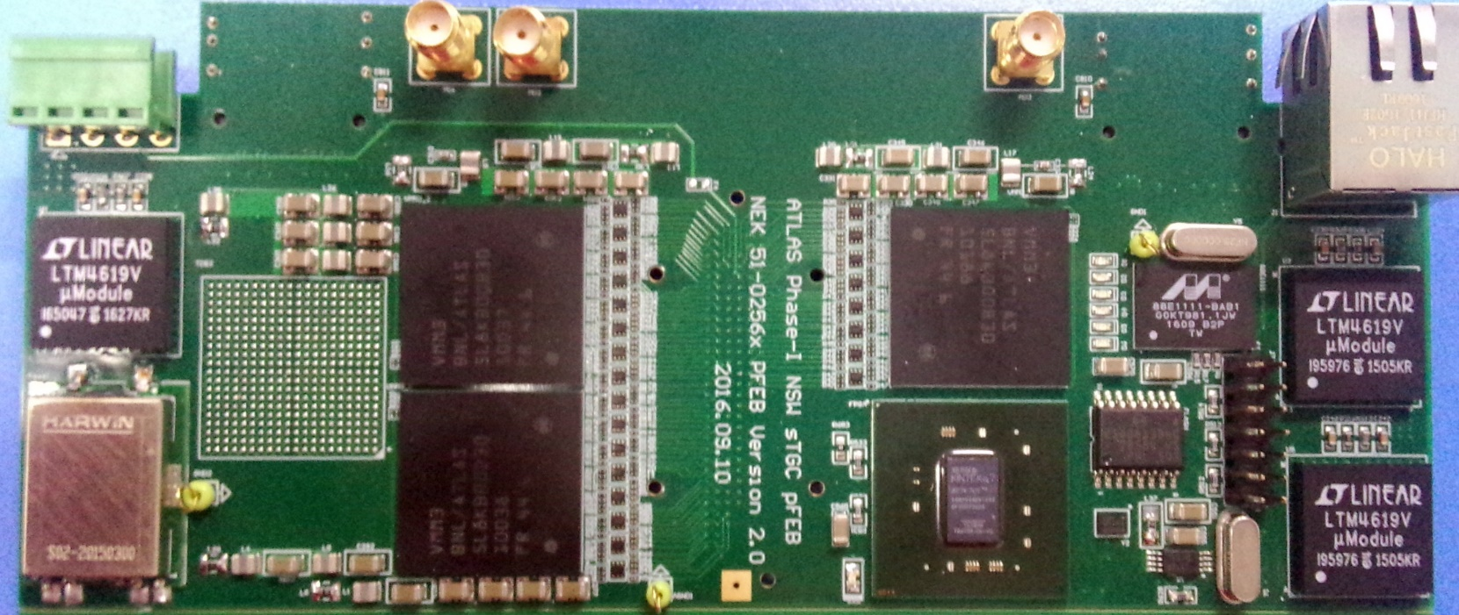
pFEB 2.0 board based on VMM3
2016
pFEB 2.0
One FEAST module is used as analog power supply

Slide 15
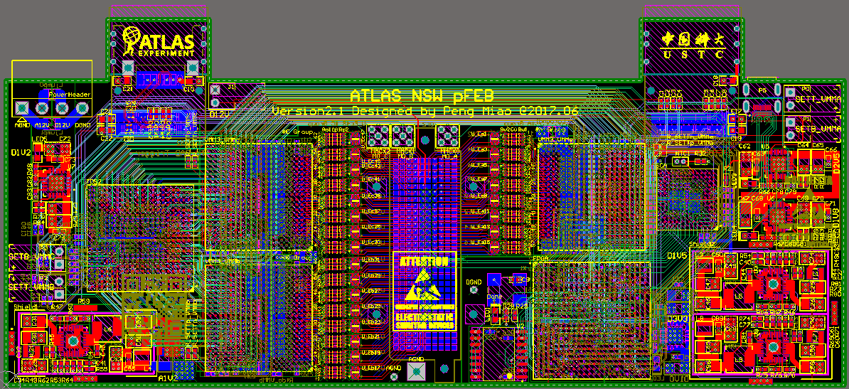
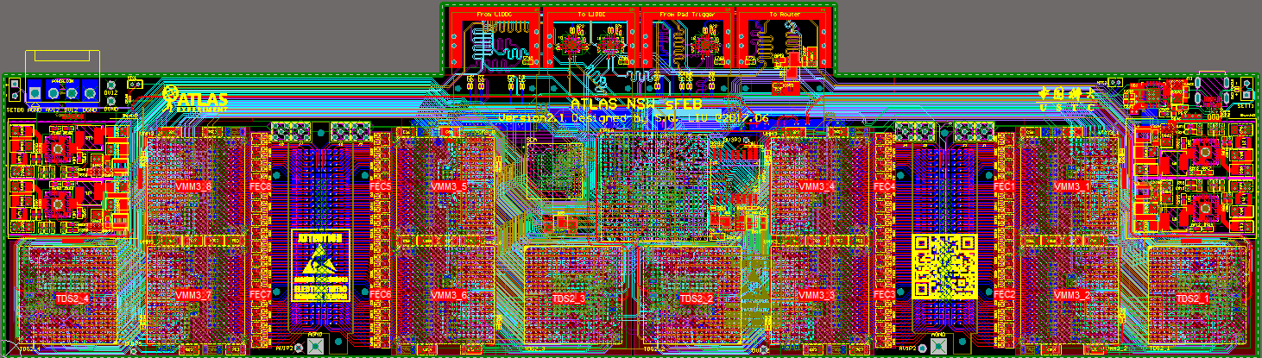
2017
pFEB/sFEB v2.1
Based on VMM3
pFEB: 16.5 × 6cm, 12 layers, 192 Channels;
sFEB: 27 × 6cm, 14 layers, 512 channels;
Used at WZ/CERN/McGill /SDU for chamber test
VMM
VMM
SCA
TDS
GFZ connector
VMM
FPGA
2(D) × FEAST
1(A) FEAST
4 × miniSAS
2(A) × FEAST
SCA
2(D) × FEAST
VMM
VMM
FPGA
VMM
VMM
GFZ connector
GFZ connector
TDS
VMM
VMM
TDS
TDS
VMM
VMM
TDS
Notes:
More crowd between GFZ and VMM to leave rooms for pi-network

Slide 16
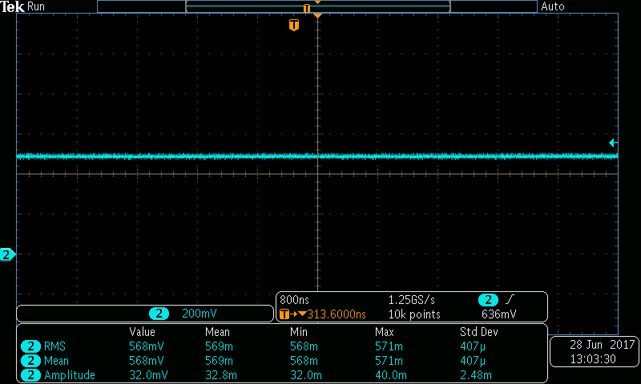
Electronics tests of pFEB v2.1
Noise of pad signal on pFEB:
Gain (mV/fC) | RMS (mV) | Amplitude (mV)
0.5 | 0.41 | 2.5
1 | 0.50 | 3.0
3 | 0.44 | 4.9
4.5 | 0.50 | 5.3
The typical intrinsic noise of pFEB is < 0.5mV for all gains

Slide 17
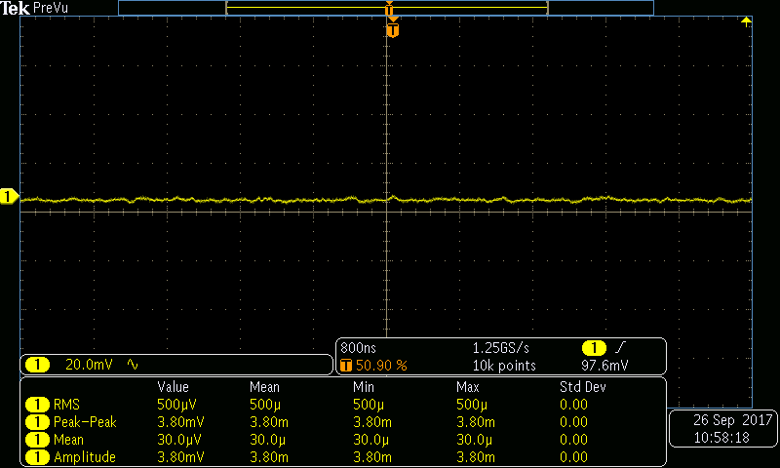
Electronics tests of sFEB v2.1
Noise of strip signal on sFEB:
Gain (mV/fC) | RMS (mV) | Amplitude (mV)
0.5 | 0.42 | 3.2
1 | 0.50 | 3.8
3 | 0.52 | 4.0
4.5 | 0.54 | 4.2
PT=50ns, Gain = 1mV/fC
The typical intrinsic noise of sFEB is ~ 0.5mV for all gains
Notes:
Amplitude peak-to-peak

Slide 18
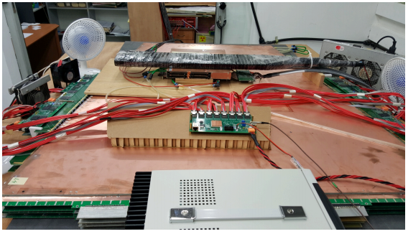
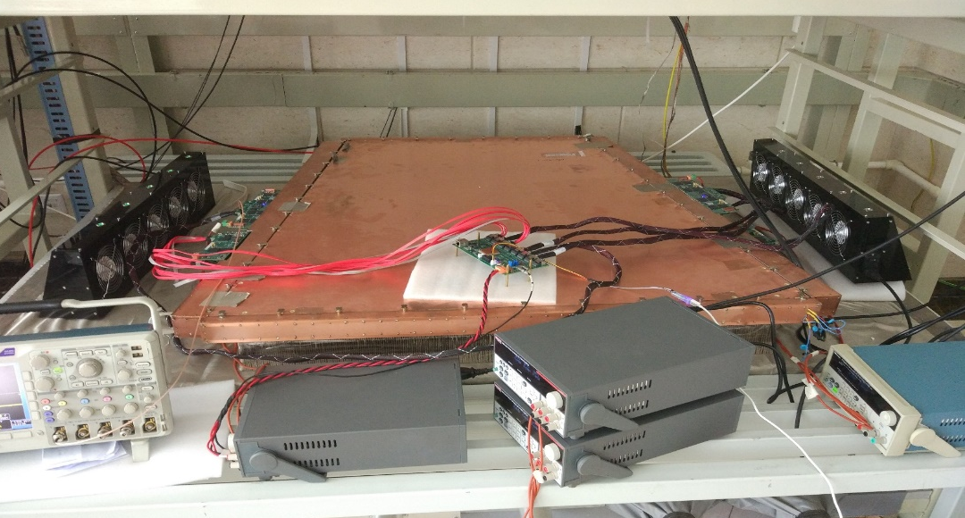
FEB v2.1 sTGC test @ SDU & WZ
QS2 @ WZ
QS2 @ SDU
sFEB
Configure & DAQ Board
sFEB
Cooling Fan
Cooling Fan
pFEB
pFEB
Linear Power Supplies
Full size QS2 with soldered adapter board and sFEB/pFEB
External trigger by scintillator cosmic coincidence
Configure and readout via a simple DAQ board
Good detector grounding and efficient chip cooling are vital

Slide 19
FEB v2.1 sTGC test @ SDU & WZ
pFEB noise on sTGC @ WZ:
Intrinsic noise of pFEB w/o sTGC is reported as 700-800e of ENC
When connected to a particular sTGC pad of ~ 2nF and powered up to 3.2kV, the level of noise is ~ 5200e ENC

Slide 20
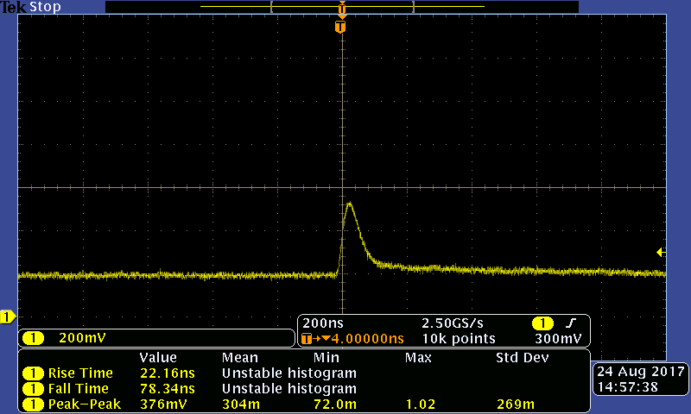
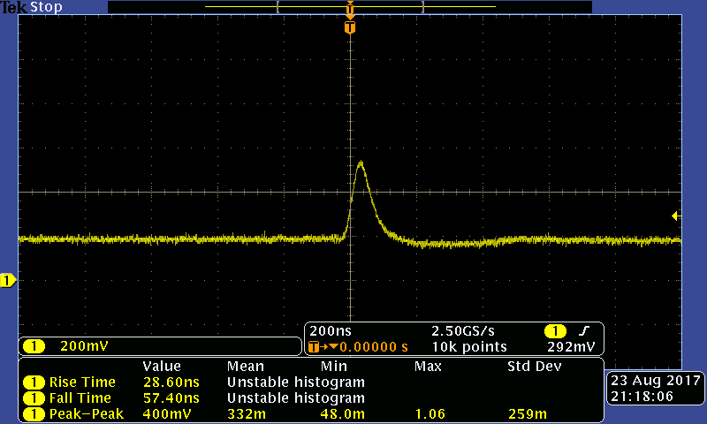
FEB v2.1 sTGC test @ SDU & WZ
Cosmic signals:
Signal of pFEB @ SDU
(PT=25ns, Gain = 3mV/fC)
Signal of sFEB @ SDU
(PT=25ns, Gain = 0.5mV/fC)
QS2 @ WZ
Clean and good analog signals of both sFEB and pFEB can be observed.

Slide 21
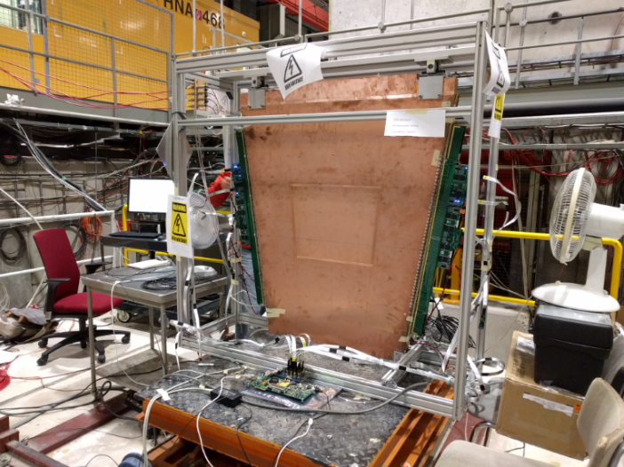
Beam Test at CERN, October 5,2017
Full setup with pFEB and sFEB installed
(reduced TTC, L1DATA to 80 Mbps; changed the firmware to support VMM daisy chain cfg.)

Slide 22
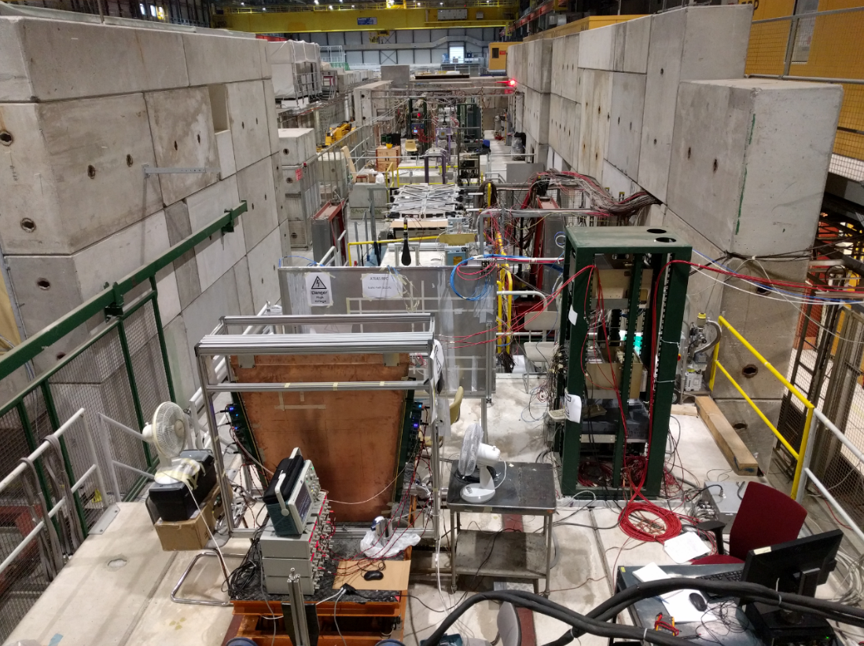
5th Oct.: Full setup (view from top)

Slide 23
NSW committee placed an order for 38 p/sFEB v2.1 for chamber production sites and CERN wedge test.
Cost estimation for FEB
  pFEB v2.1: 1945 CHF/board
  sFEB v2.1: 2505 CHF/board
Overall cost: 169,100 CHF
Can cover the cost of FEAST/SCA ASICs and MiniSAS/POWER connectors we shall pay.
All the p/sFEB boards were delivered to the sites.

Slide 24
FEB versions
Version | Descriptions | Tests
v1.2 (2016.06) | VMM2; FPGA to configure/read VMM2 via Ethernet | Site review; TGC test @ SDU
v2.0 (2017.01) | VMM3 + TDS + 1FEAST; FPGA to configure/read VMM3; Separate SCA test board | VS2017.03
v2.1 (2017.06) | VMM3 + TDS + FEAST + SCA; ROC-like FPGA; miniSAS, no ethernet | VS2017.07; SDU & WZ &McGill;
v2.2 (2017.12) | All-chip prototype,VMM3 | VS2018.01
v2.3(2018.06) | All-chip prototype, VMM3/3a footprint compatible, power design modified | VS2018.06 with VMM3a

Slide 25
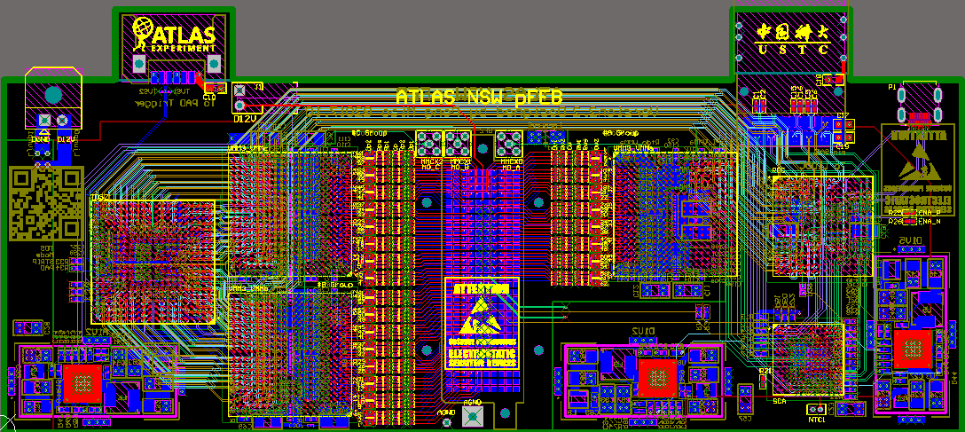
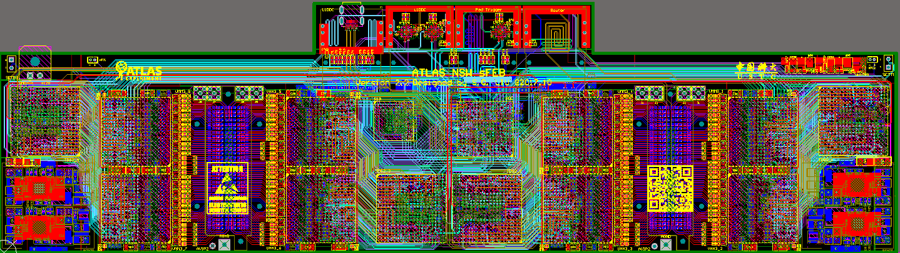
p/sFEB v2.2
FEAST: POWER ASIC
VMM3: Front-end ASIC
TDS2: Trigger Data Serializer
GBT-SCA: Giga Bit Transceiver-Slow Control Adapter ASIC
ROC: Read Out Controller for raw data
Layout completed on November 2017. Production and soldering completed early 2018. Joined the 5th VS test in Jan 2018.

Slide 26
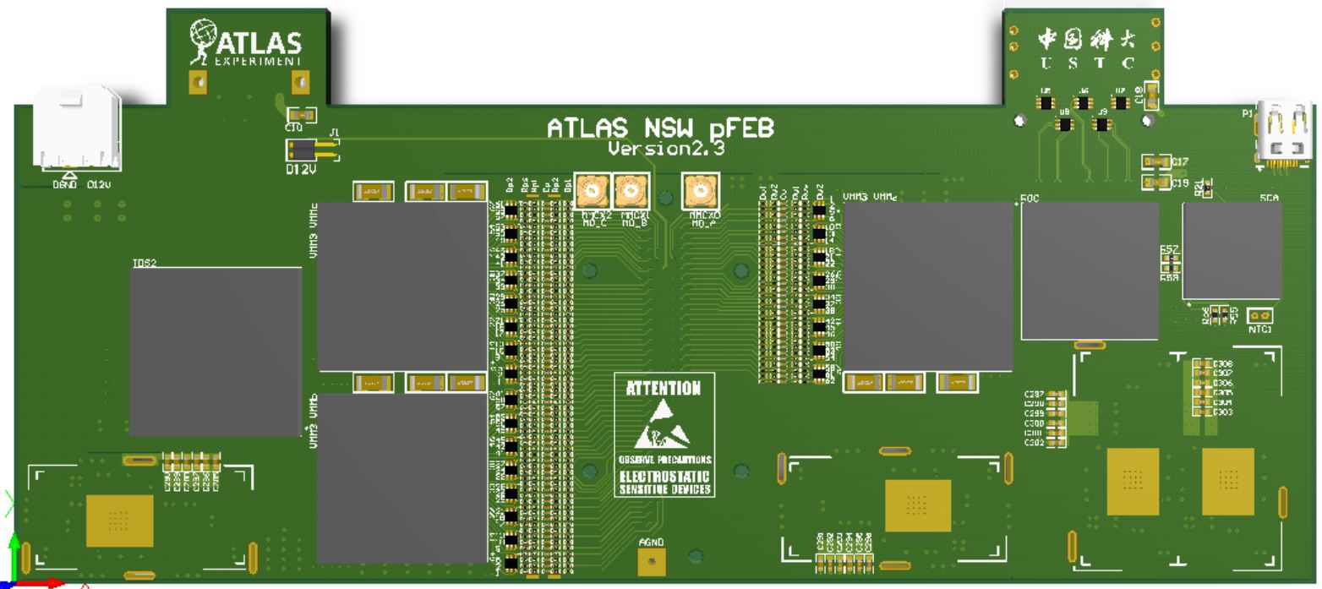
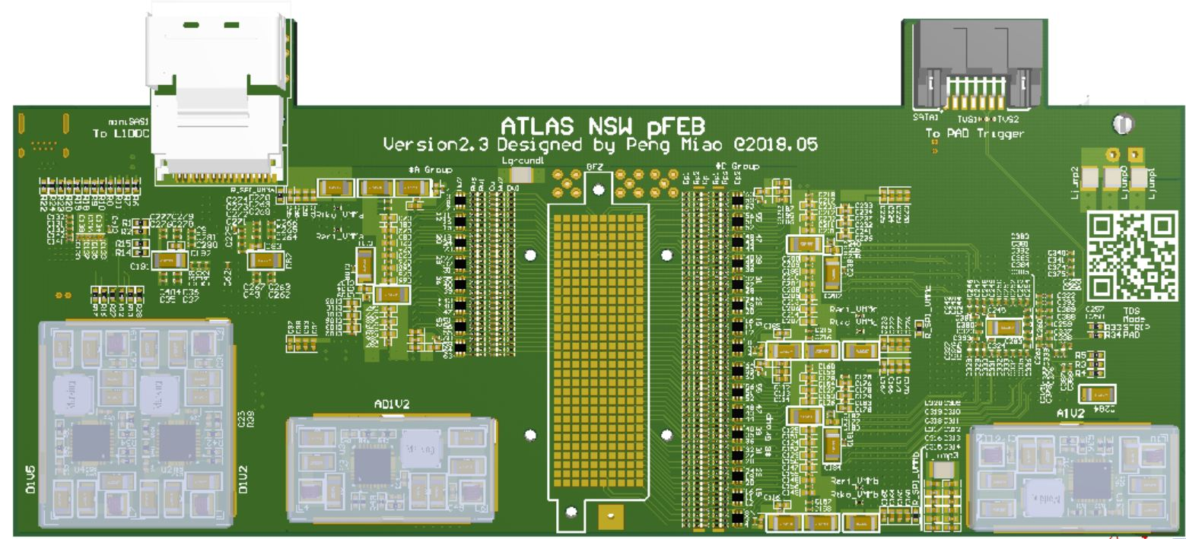
p/sFEB v2.3
pFEB V2.3 3D View

Slide 27
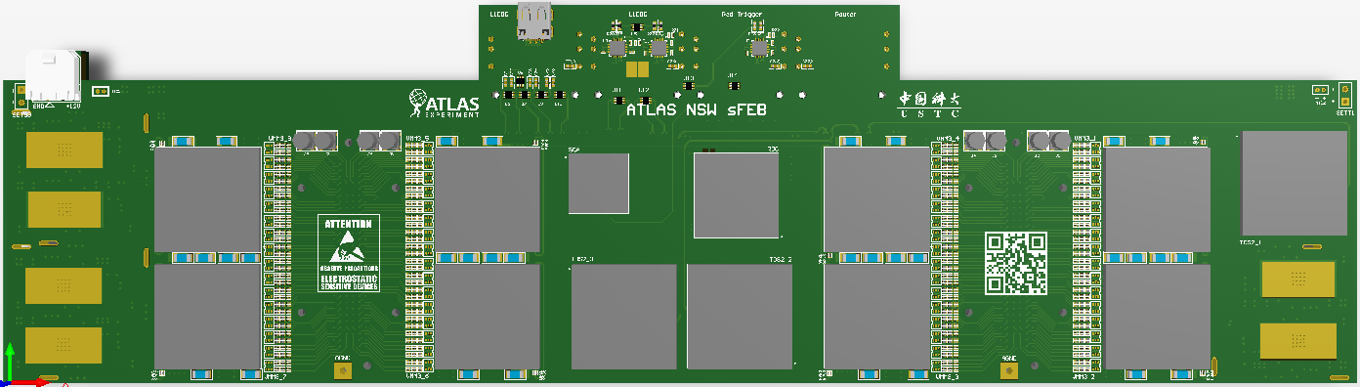
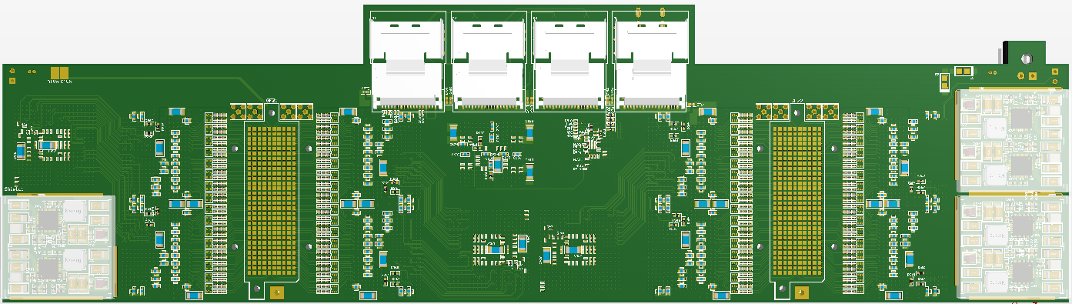
p/sFEB v2.3
sFEB V2.3 Type-B 3D Top View

Slide 28
Summary
p/sFEB v2.1:
All ASICs on FEB can be configured by the full chain.
The pFEB/sFEB noise level has been measured w/o and w/ full size sTGC detector. The intrinsic electronic noise RMS is ~ 0.5mV, and is less than 2.5mV when connected with powered sTGC.
Clean analog signals of cosmic have been seen, and digital readout of VMM3 have been tested at chamber sites.
No dead channel observed at chamber sites.
NEXT:
Latest p/sFEB v2.3 will join the 6th VS in June 25-July 6, 2018.
Final production run will start in October 2018.
Test and commissioning in 2018/2019.

Slide 29
Thanks！

