Slide 1
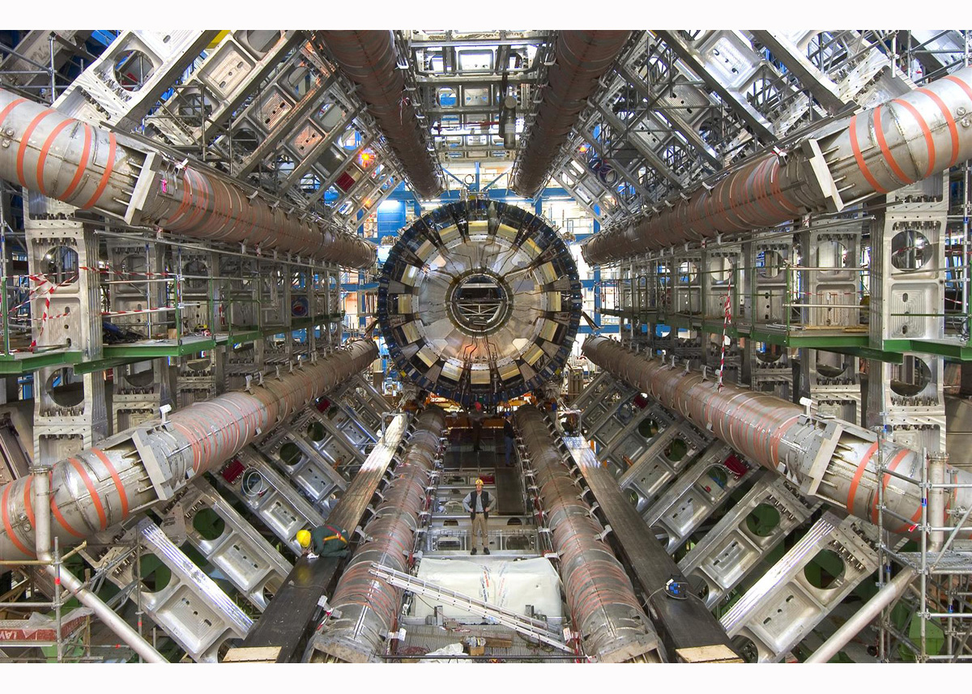
Search for Heavy Resonances decaying into W/ZH in leptons+jets final states with the ATLAS Detector
Jun Guo
Shanghai Jiao Tong University
Shanghai, China, 06/22/2018

Slide 2
Introduction
Search for a heavy resonance decaying to a SM Higgs boson and vector boson via three final states:
0-lepton (ννbb), 1-lepton (lνbb), 2-lepton (llbb)
Two Interpretations:
Heavy CP-odd A-boson, gluon fusion and bbA production mode (AZh model, 220 GeV -2 TeV): ll or νν from Z and bb from Higgs
Heavy Vector Triplet resonance (HVT model, 0.5 - 5 TeV): ll, lν, or νν from W or Z and bb from Higgs
Event Signature:
SM vector boson reconstructed from $E_{T}^{miss}$or di-lepton (Z boson), lepton+ $E_{T}^{miss}$ (W boson)
SM Higgs boson is reconstructed from two b-tagged jets (resolved regime) or one large-R jet with b-tagged track jets (merged regime)
JHEP03(2018)174
ATL-COM-PHYS-2016-479

Slide 3
Data and MC Samples
Data 2015 (3.21 fb⁻¹ ) + 2016 (33.3 fb⁻¹ )
MC signal:
AZh: gluon fusion A MadGraph5 + Pythia8, bbA MadGraph5_aMCNLO + Pythia8
HVT: MadGraph 5 + Pythia 8
MC backgrounds:

Slide 4
Analysis Strategy
Several strategies of resolved and merged events combination were studied
PriorityResolvedSR - maximizes the signal acceptance and sensitivity

Slide 5
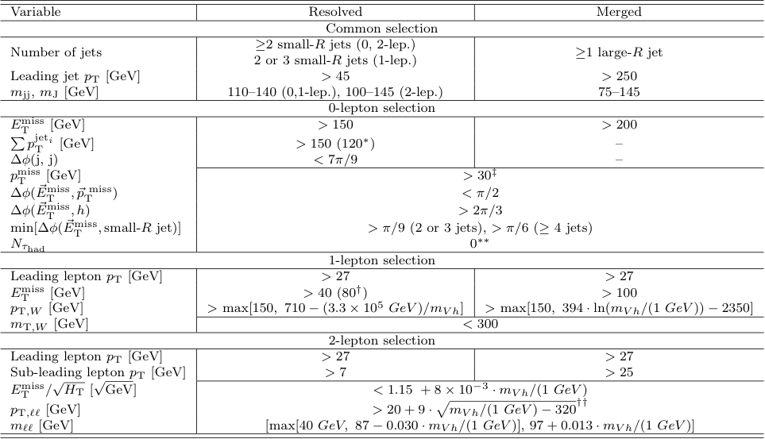
Event Categorization and Selection
Number of charged "Loose" leptons: 0, 1, 2 leptons
Number of b-tagged jets:
1, 2, 3+ b-tags for calo-jets AntiKt 0.4 for resolved regime
1, 2 b-tags for track-jets AntiKt 0.2 for merged regime
track-jets not associated to the leading large-R jet for merged regime

Slide 6
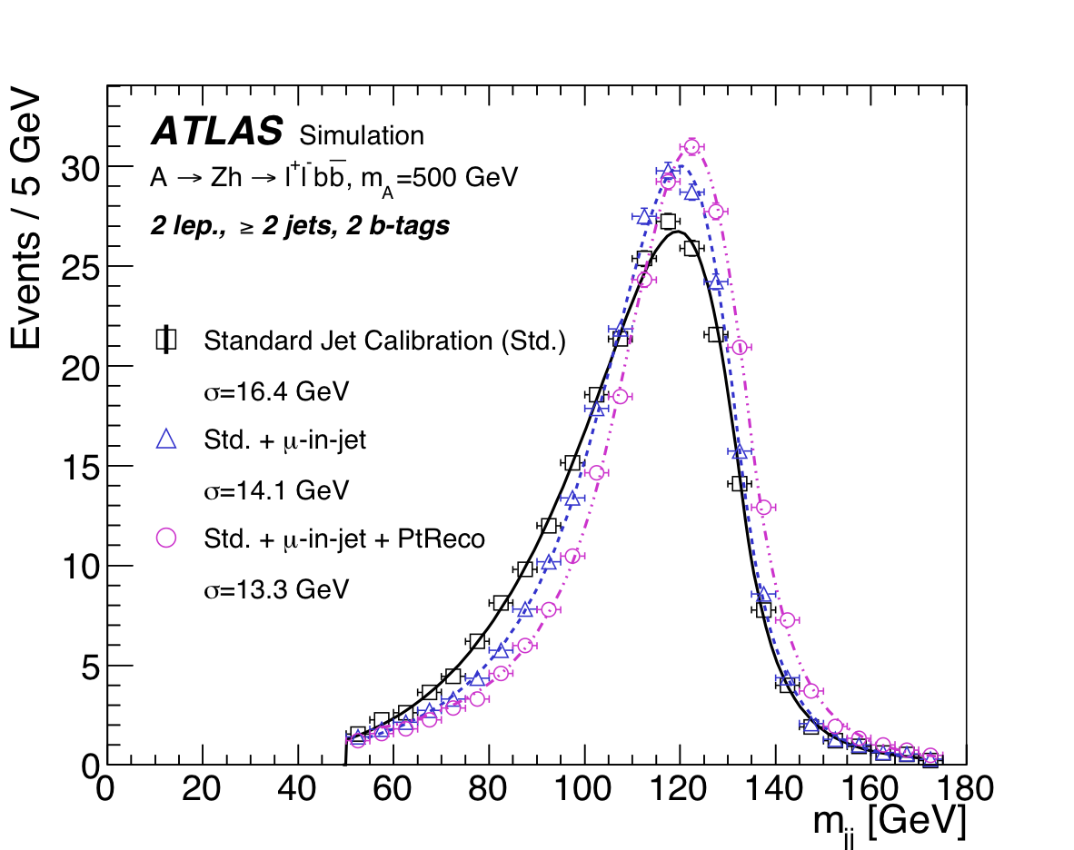
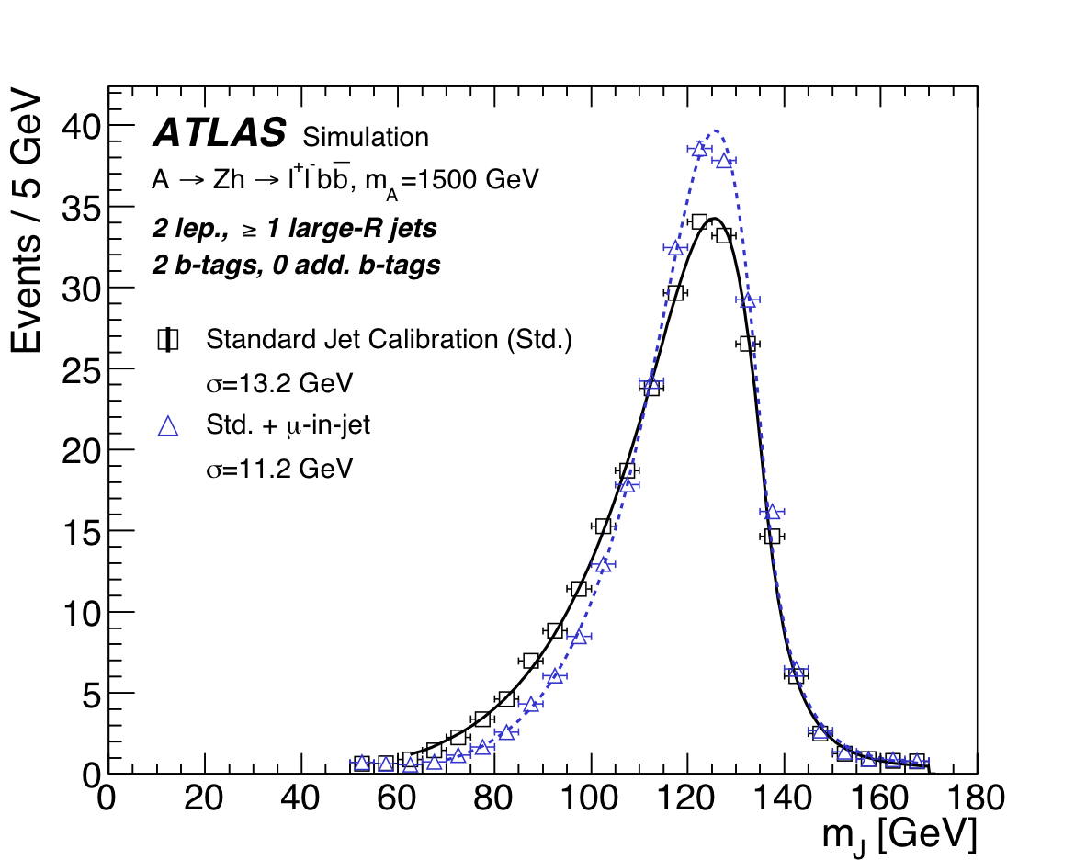
Higgs Reconstruction
Dedicated energy correction applied to b-tagged small- and large-R jets to account for semileptonic decays of b-hadrons
For small-R jets, an additional pT-dependent correction, PtReco, is applied to the jet four-momentum to account for biases in the response of b-jets
Dijet mass resolution is improved by 18%(20%) for the resolved (merged) case

Slide 7
Background
low-m_{h} regions are dominated by W/Z+jets; high m_{h} regions are dominated by tt in 0 and 1-lepton channels and by Z+heavy flavor in 2-lepton channel
Dominant background:
0-lepton: Z+jets, ttbar
1-lepton: ttbar, single top, W+jets
2-lepton: Z+jets, ttbar
Multijet: negligible in 0- and 2-lepton channels; in 1-lepton channel, remains significant only resolved 1 b-tag category. It is estimated from data; others are all from MC and normalized to data.

Slide 8
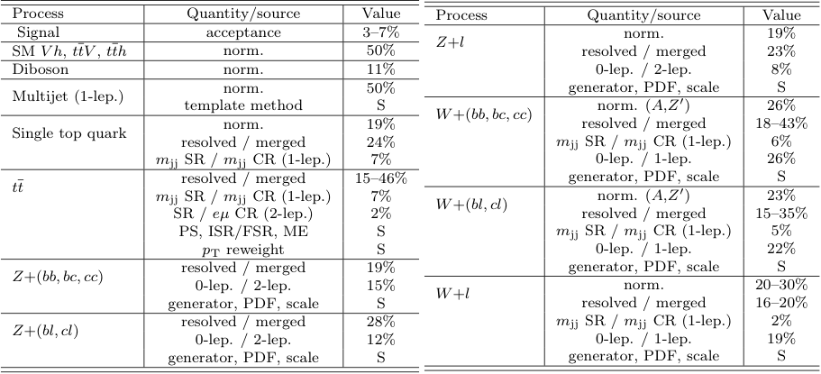
Systematics
Two types of systematic uncertainties:
Experimental: trigger, selection, the reconstruction, identification, energy/momentum, mass, and resolution for the leptons, jets and missing transverse momentum, ……
Modelling: shape and normalisation uncertainties of the different MC samples
Largest systematics comes from Jet related parameters, JES, JER, etc.

Slide 9
Results
m_{T,Vh} and m_{Vh} templates are fit to data to test for the presence of a massive resonance
A total of five different fits are performed according to the signal interpretation: Z’, W’, HVT, A in gluon-gluon fusion, and A in b-quark associated production.

Slide 10
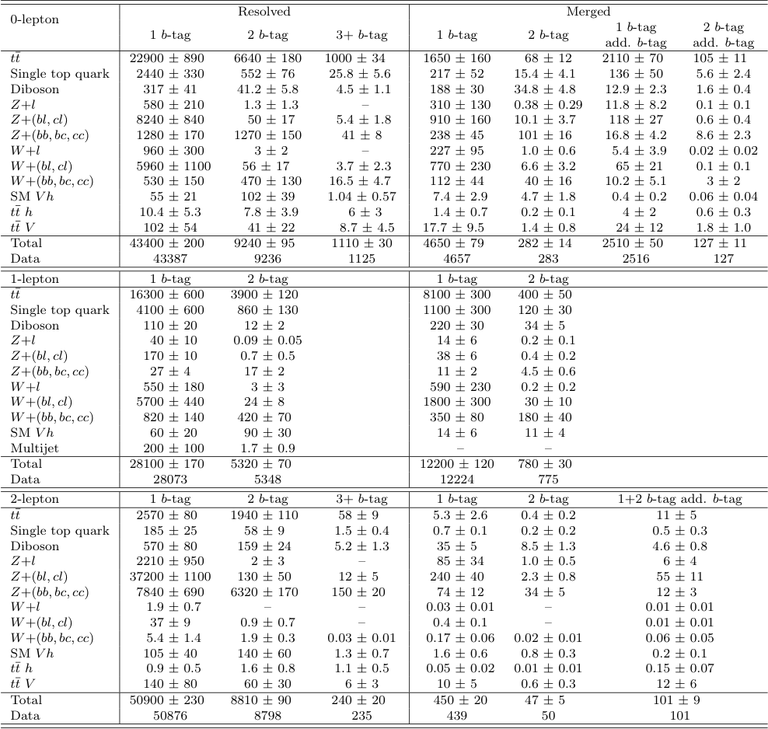
Results
No excess was found

Slide 11
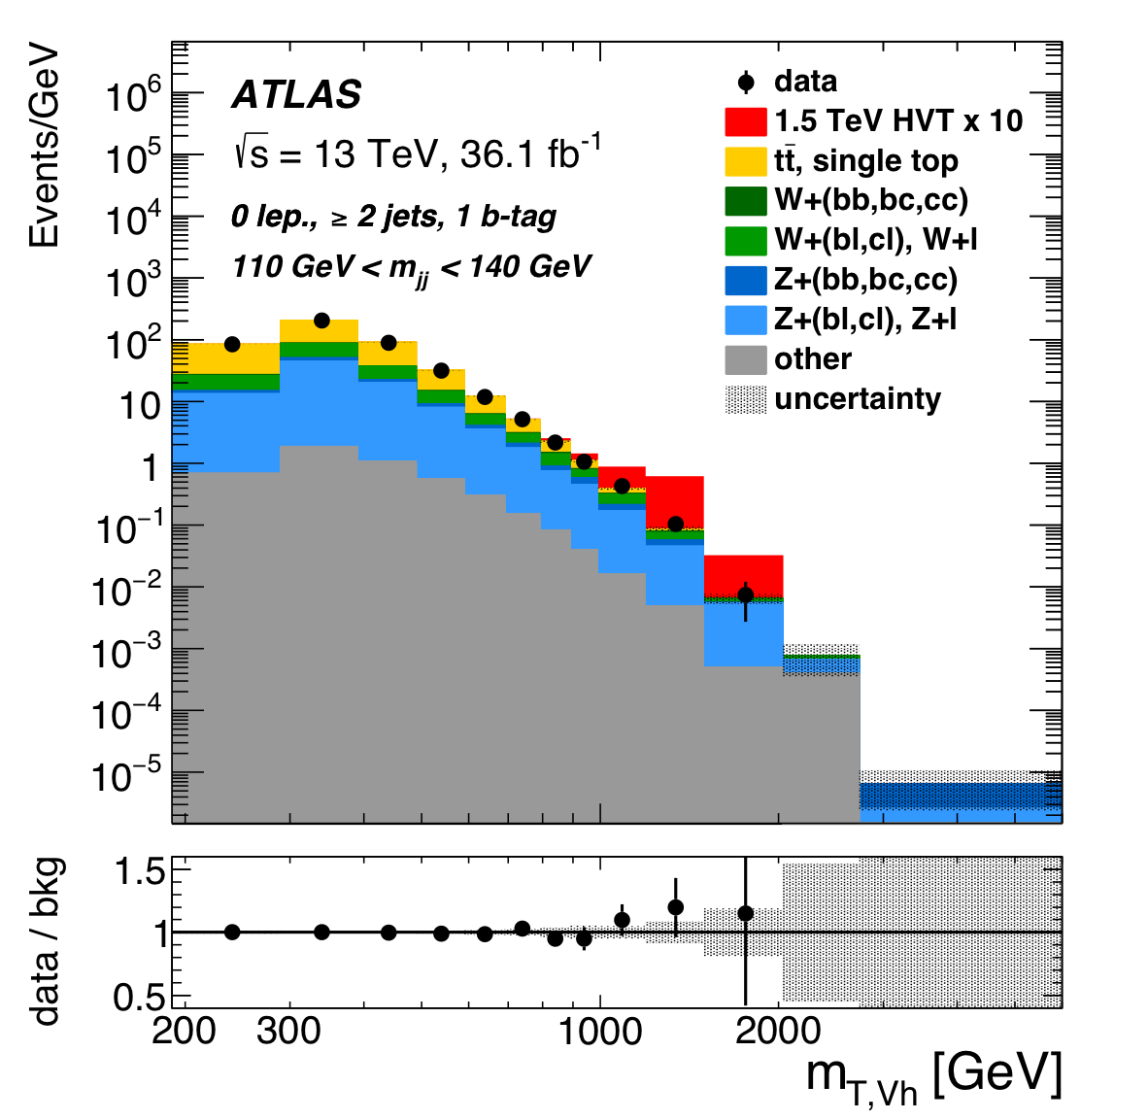
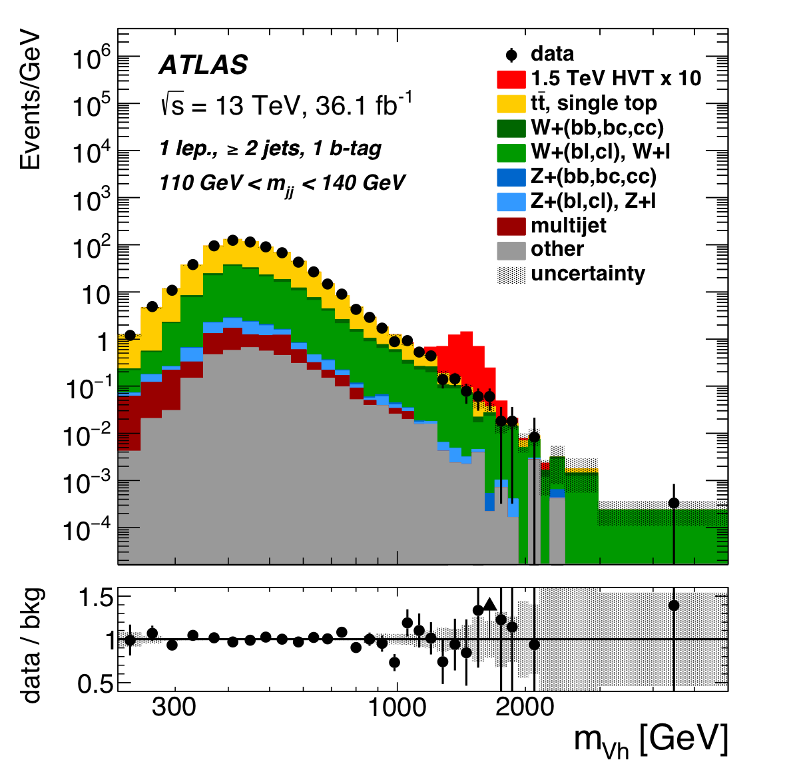
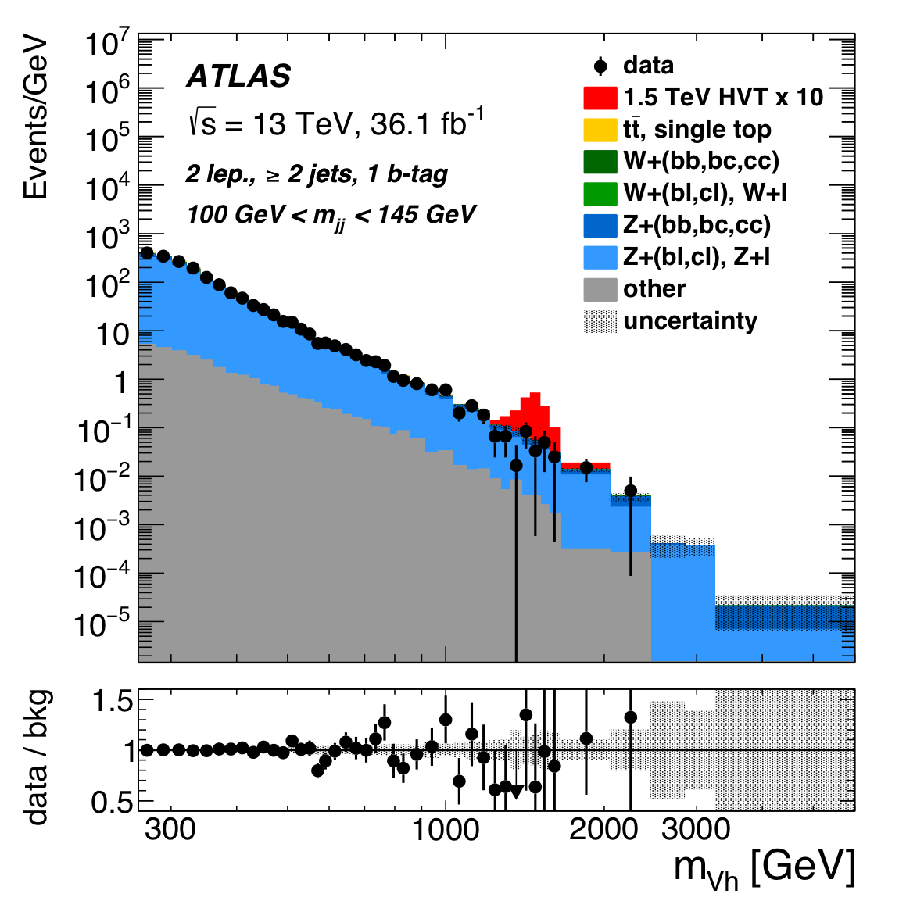
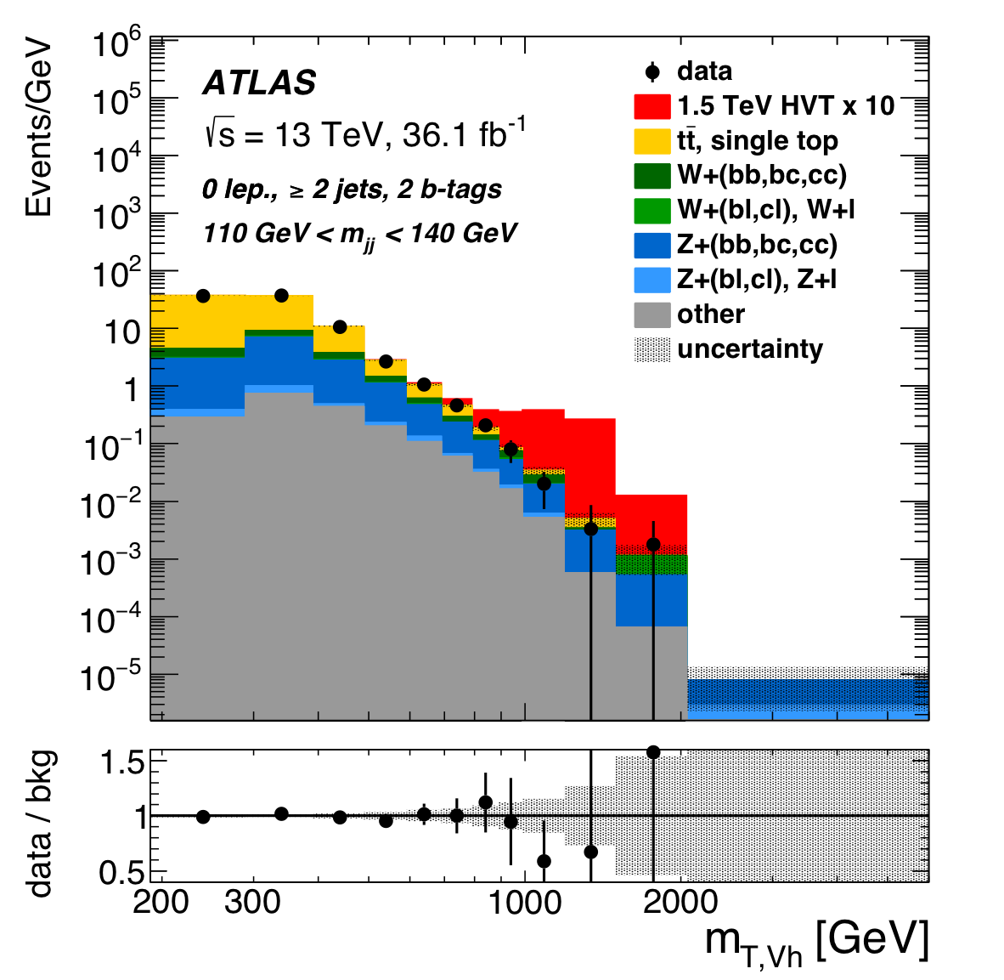
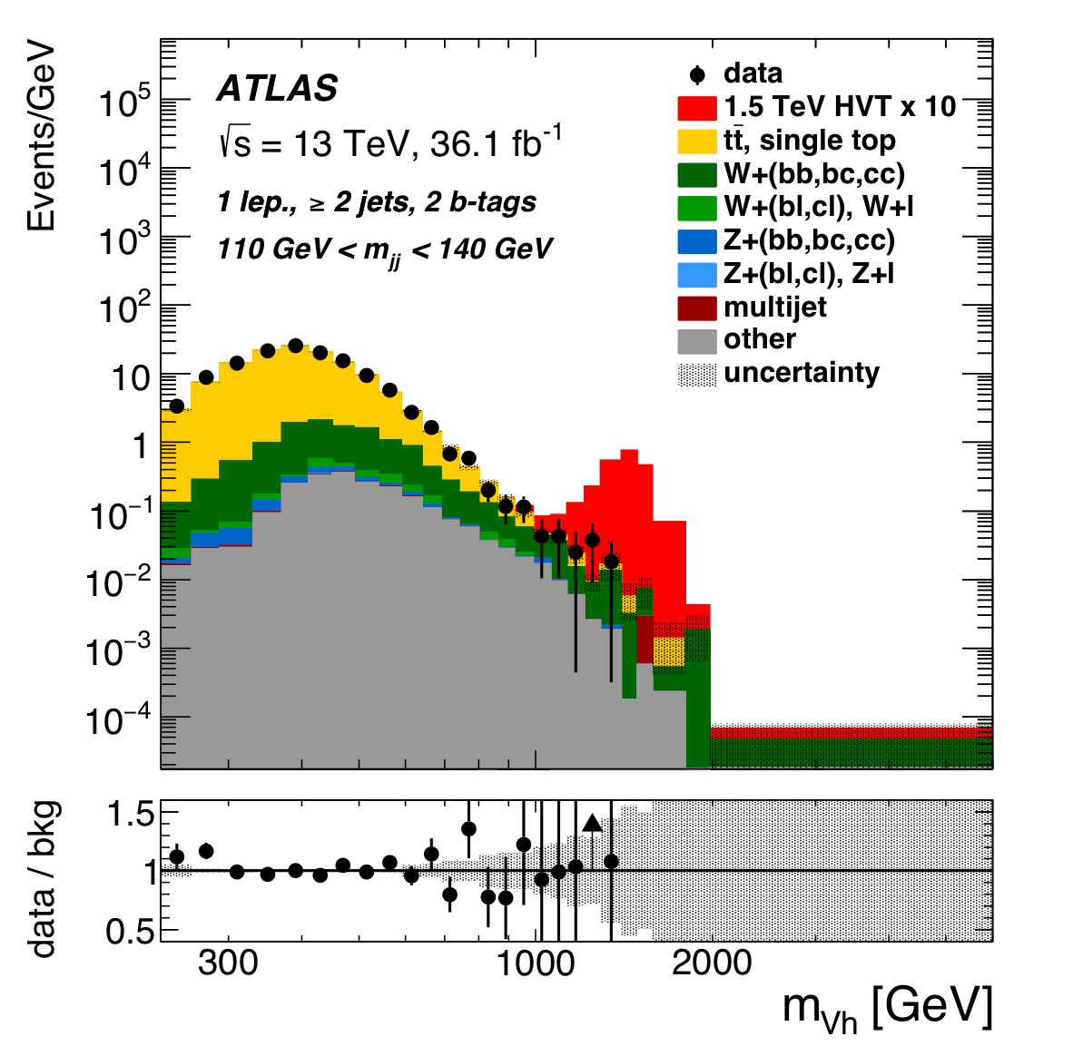
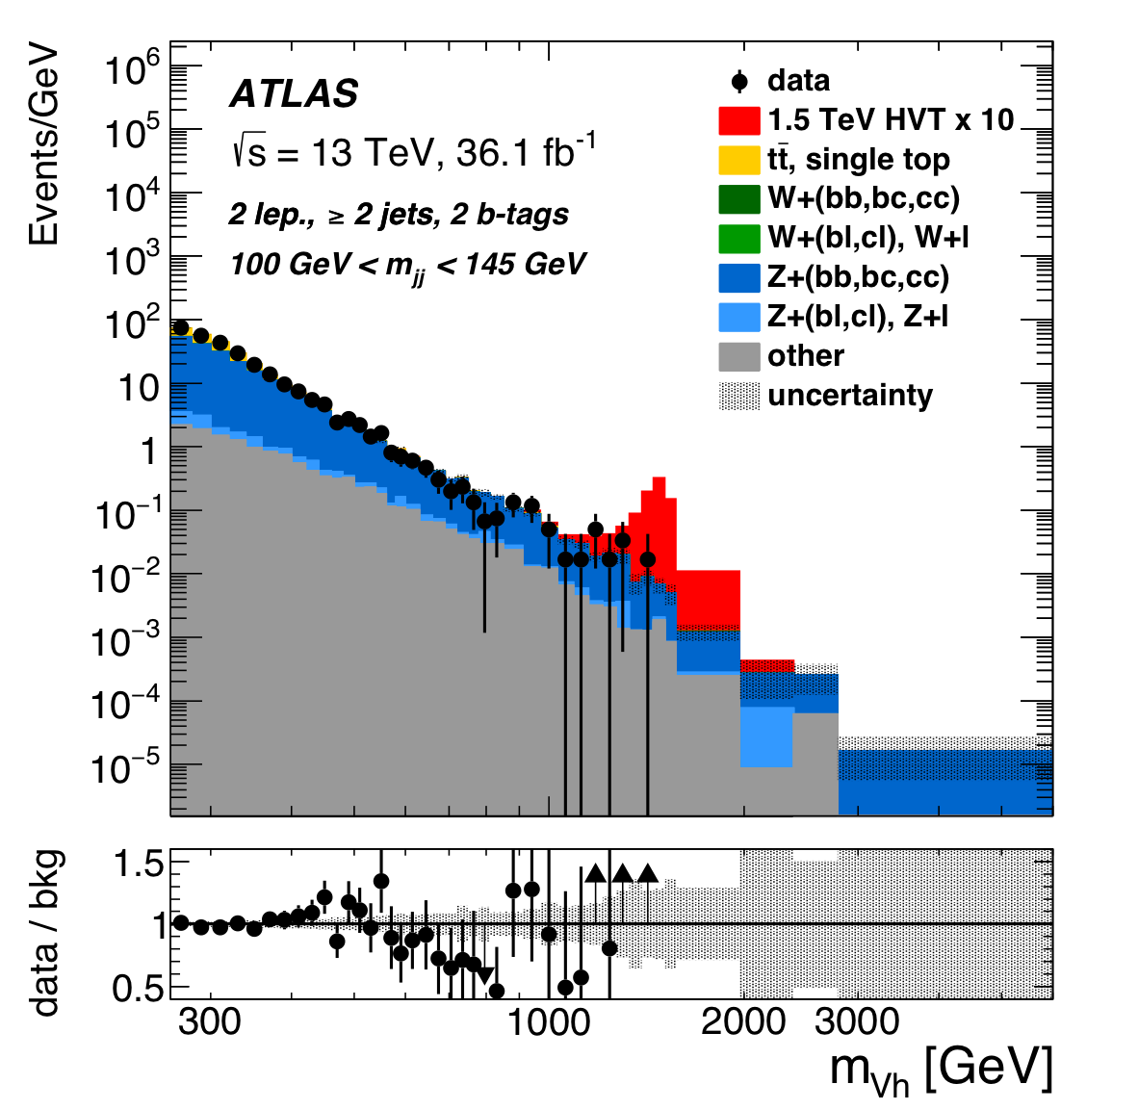
Results
HVT: Resolved

Slide 12
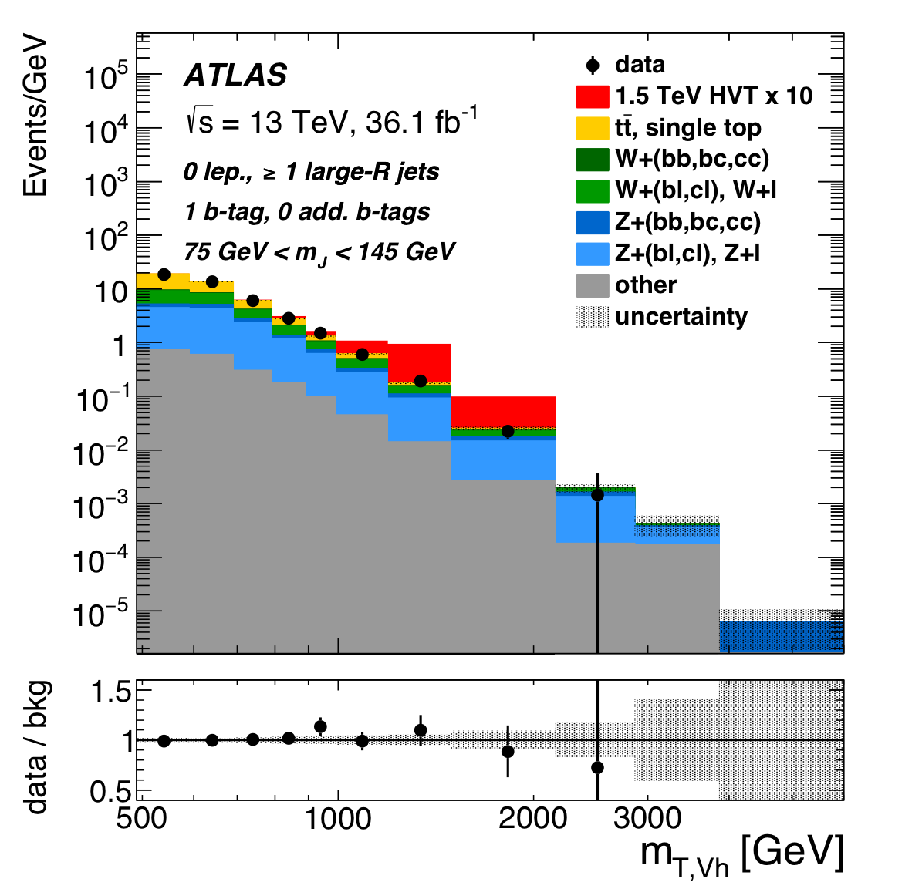
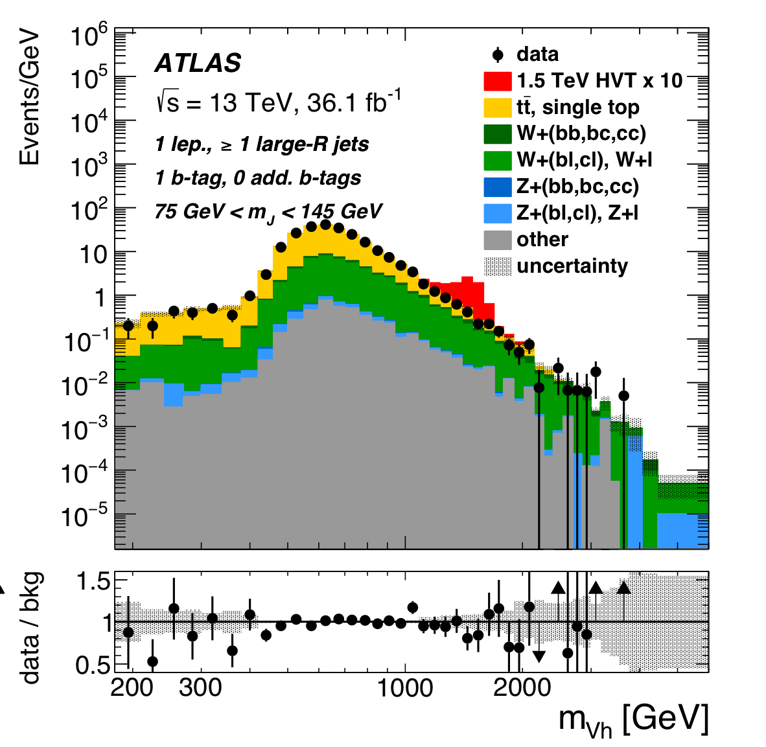
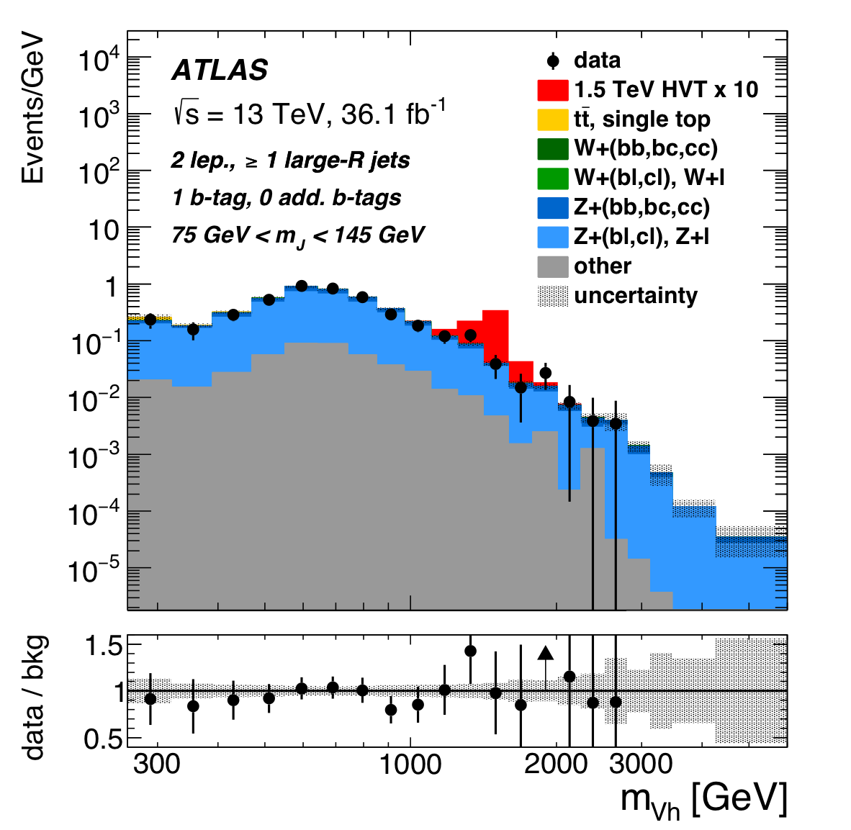
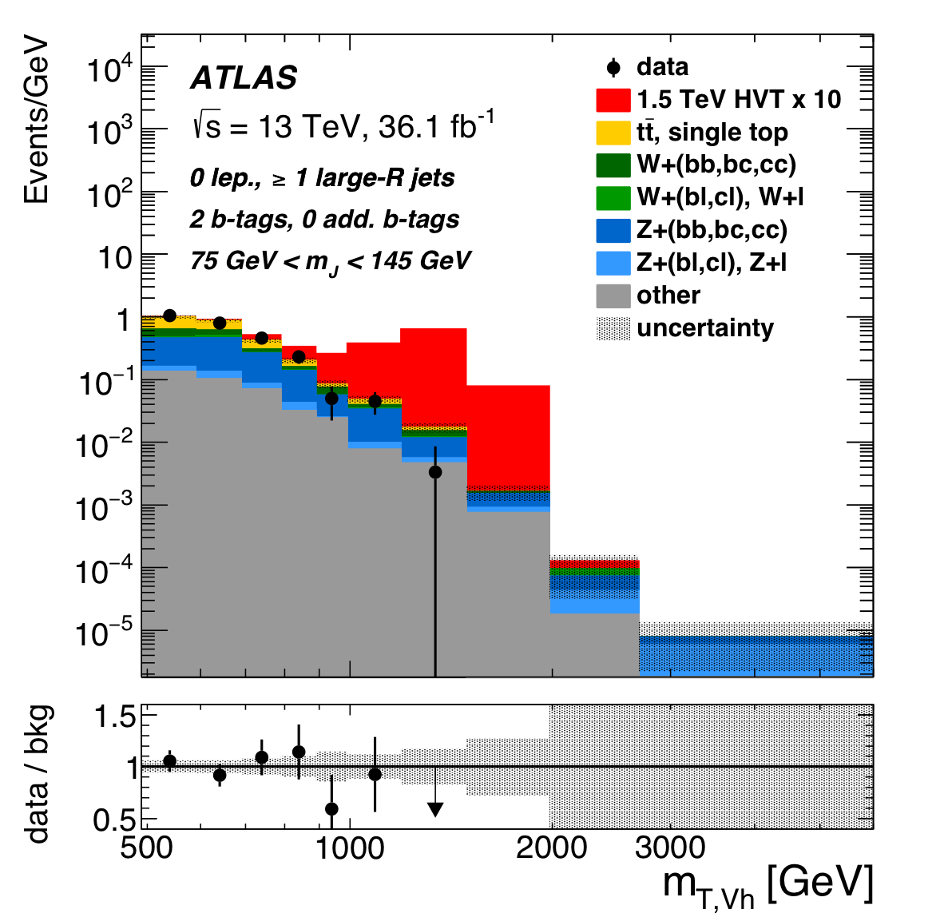
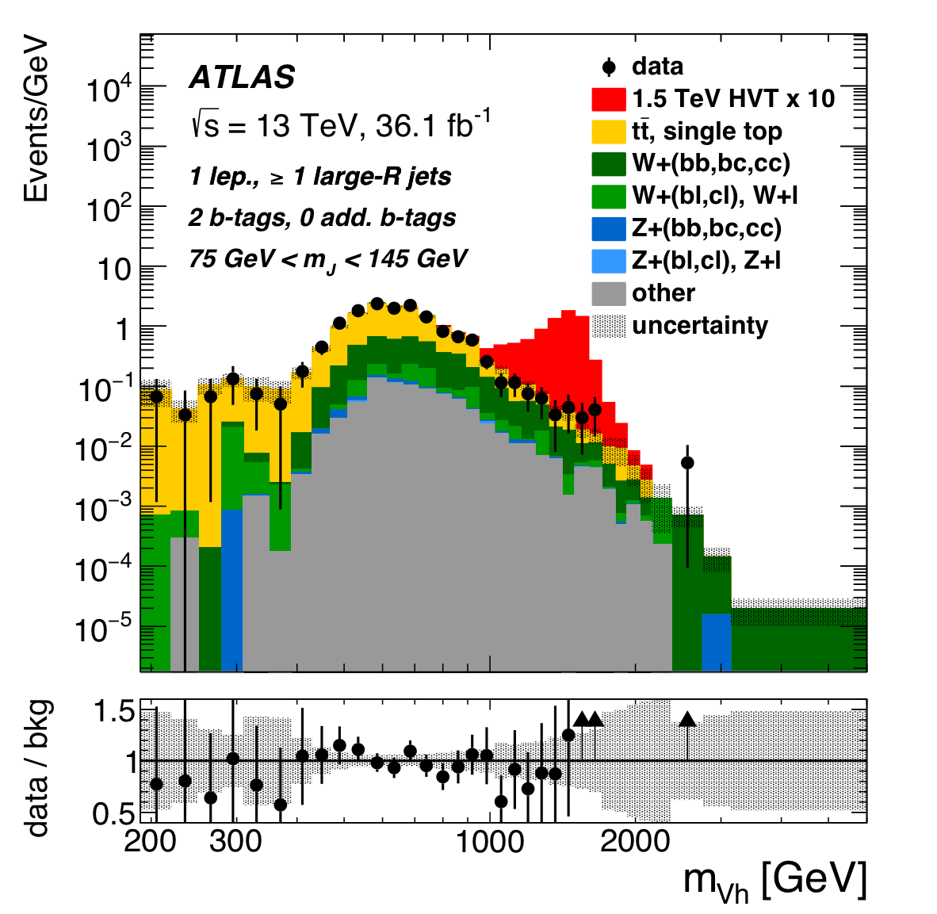
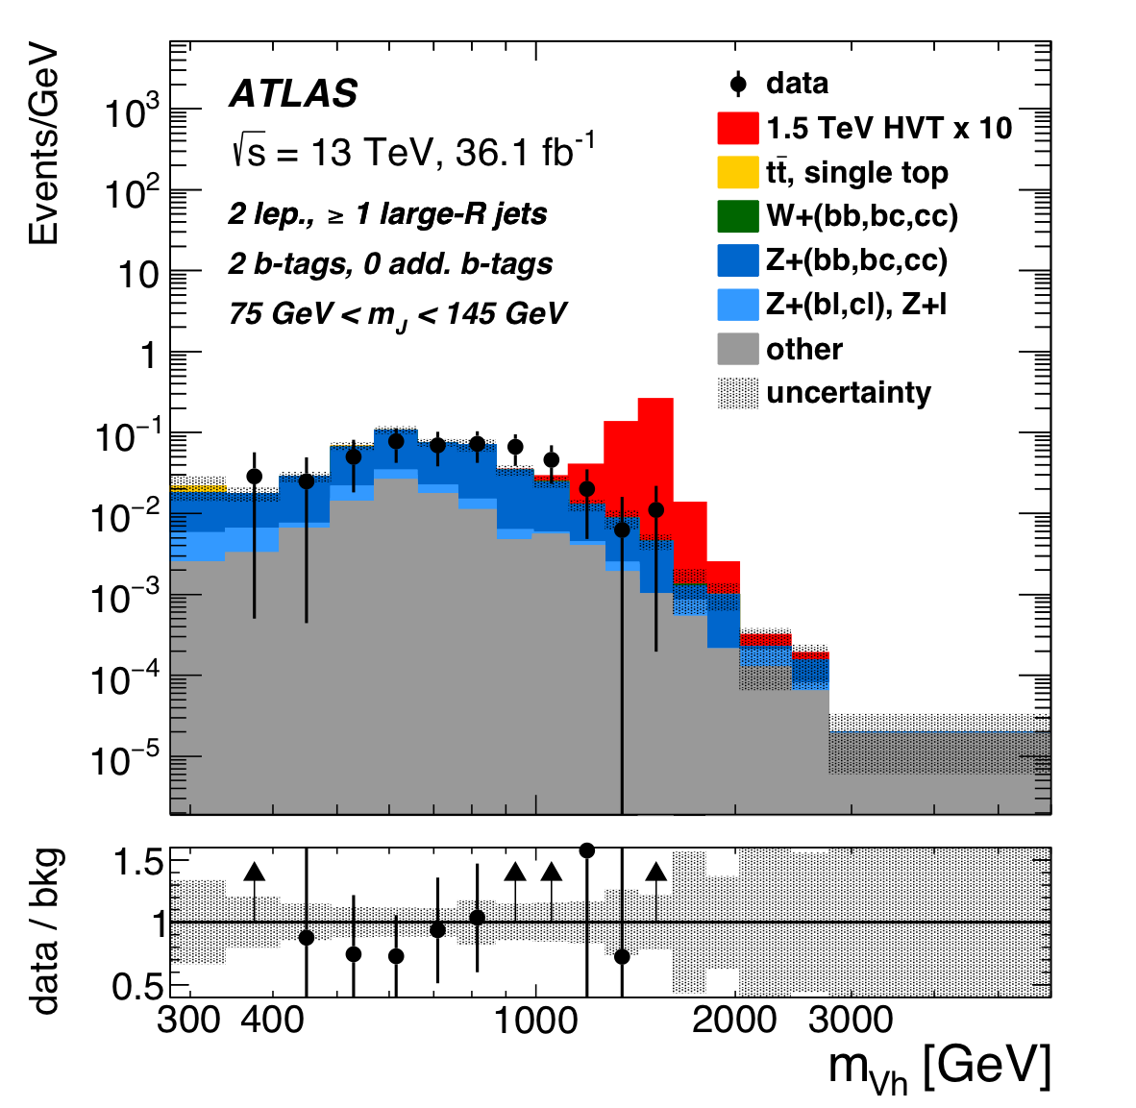
Results
HVT: Merged

Slide 13
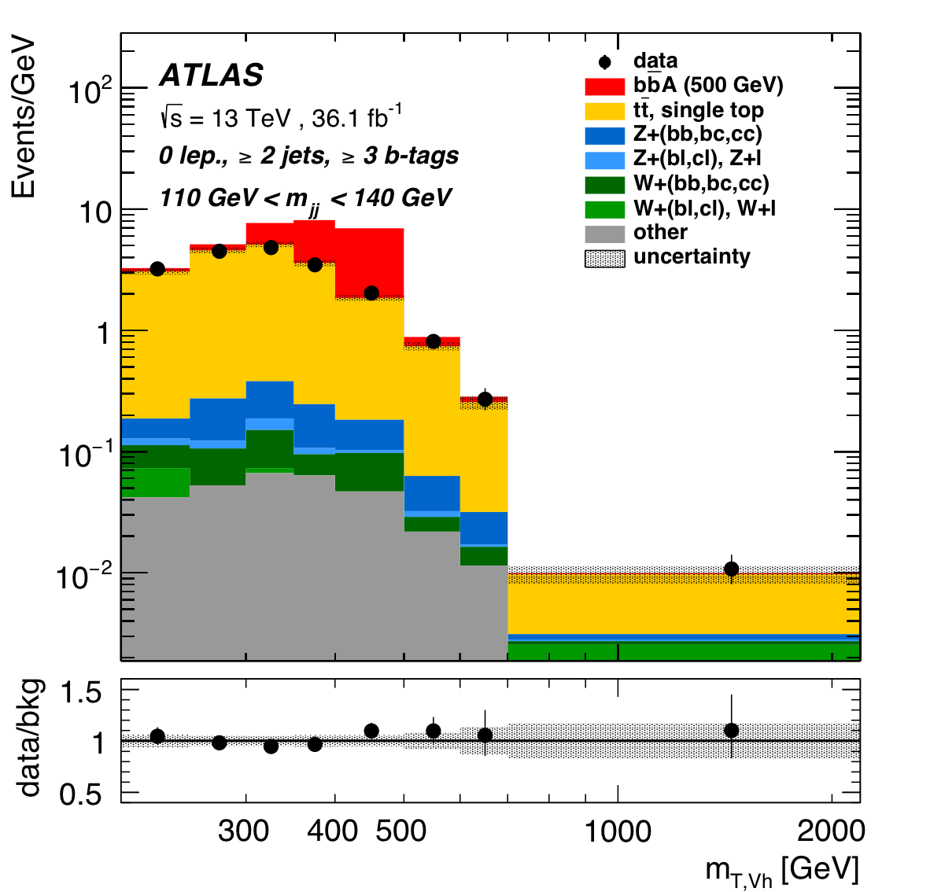
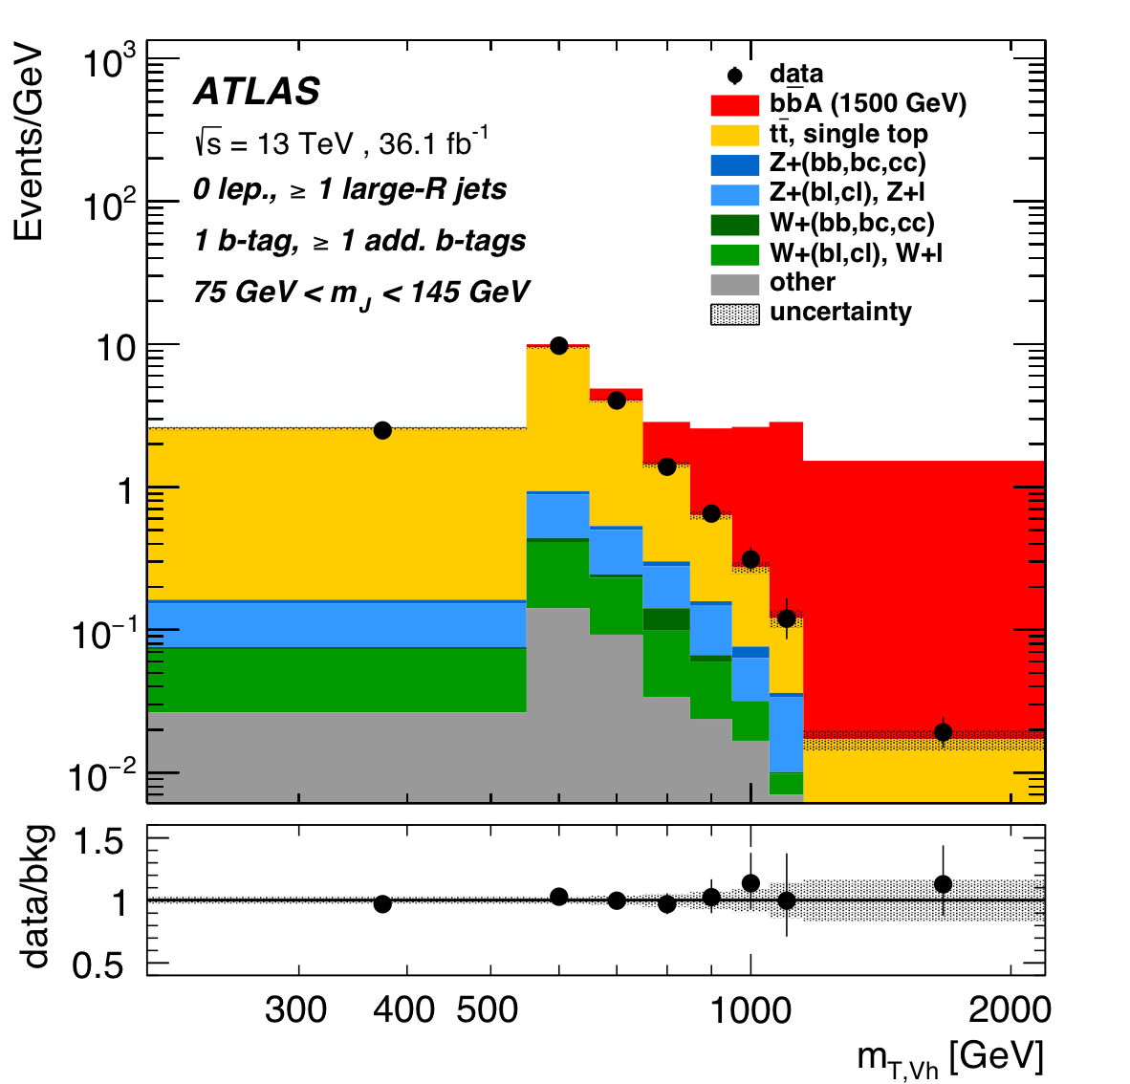
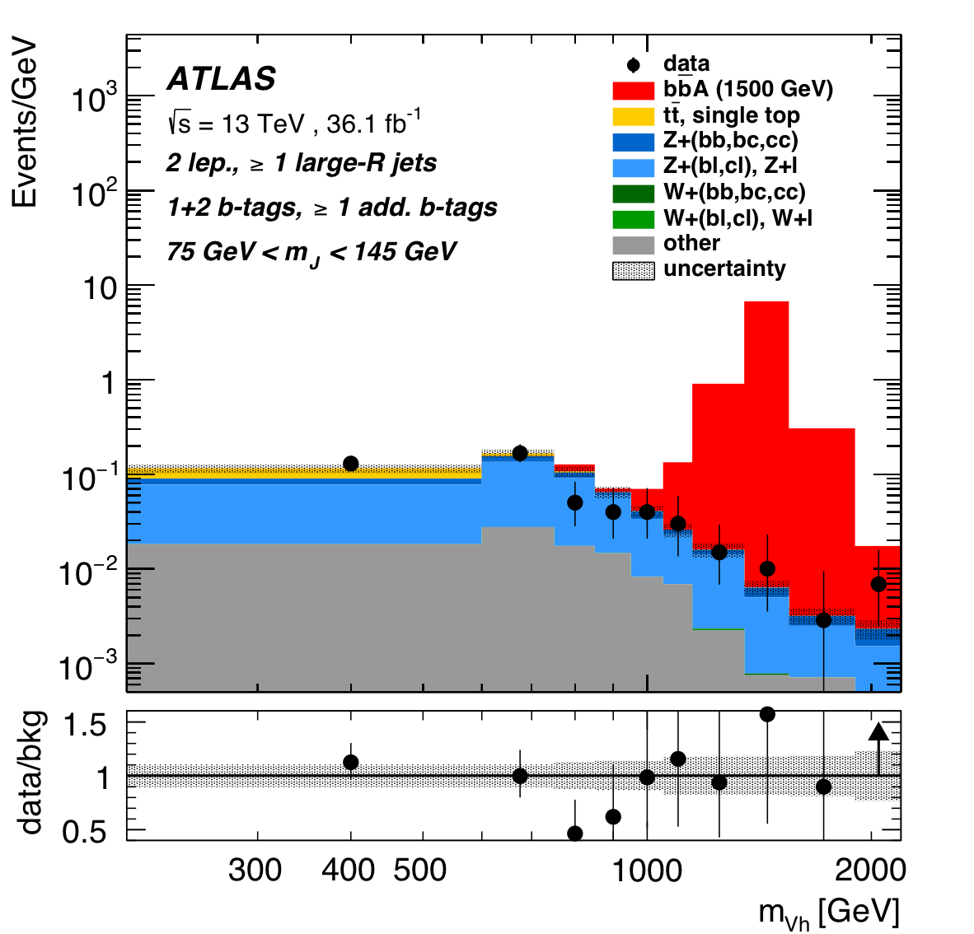
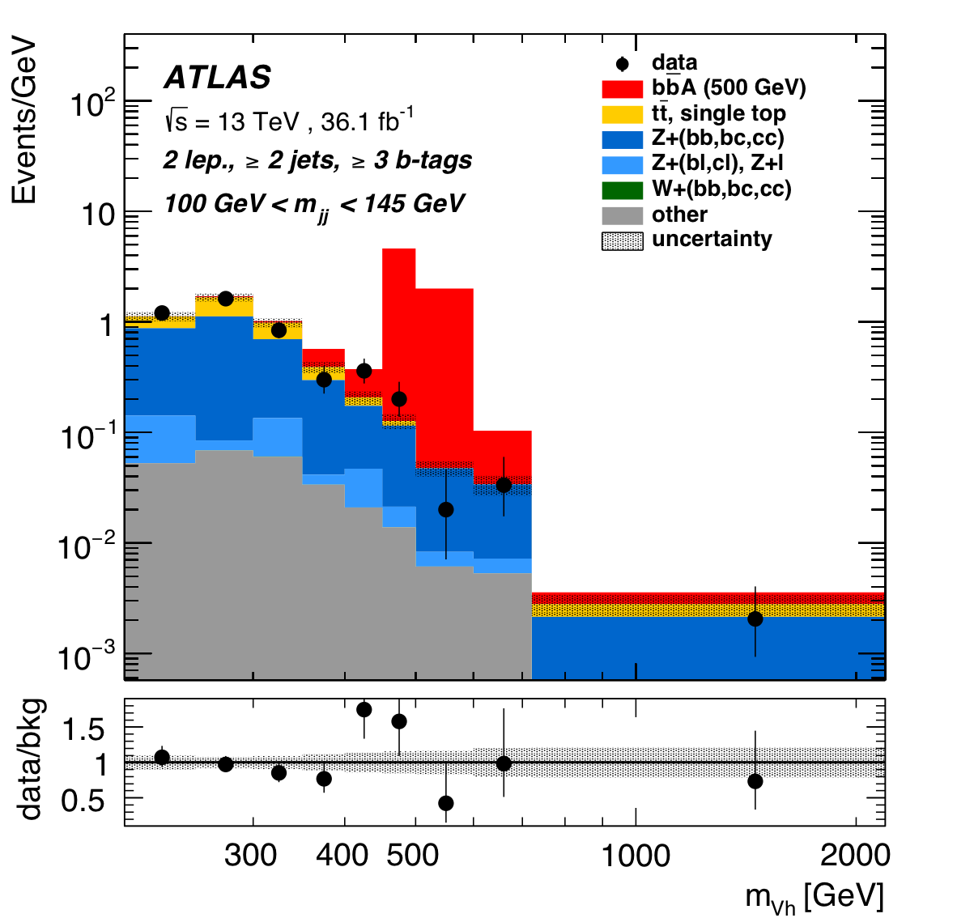
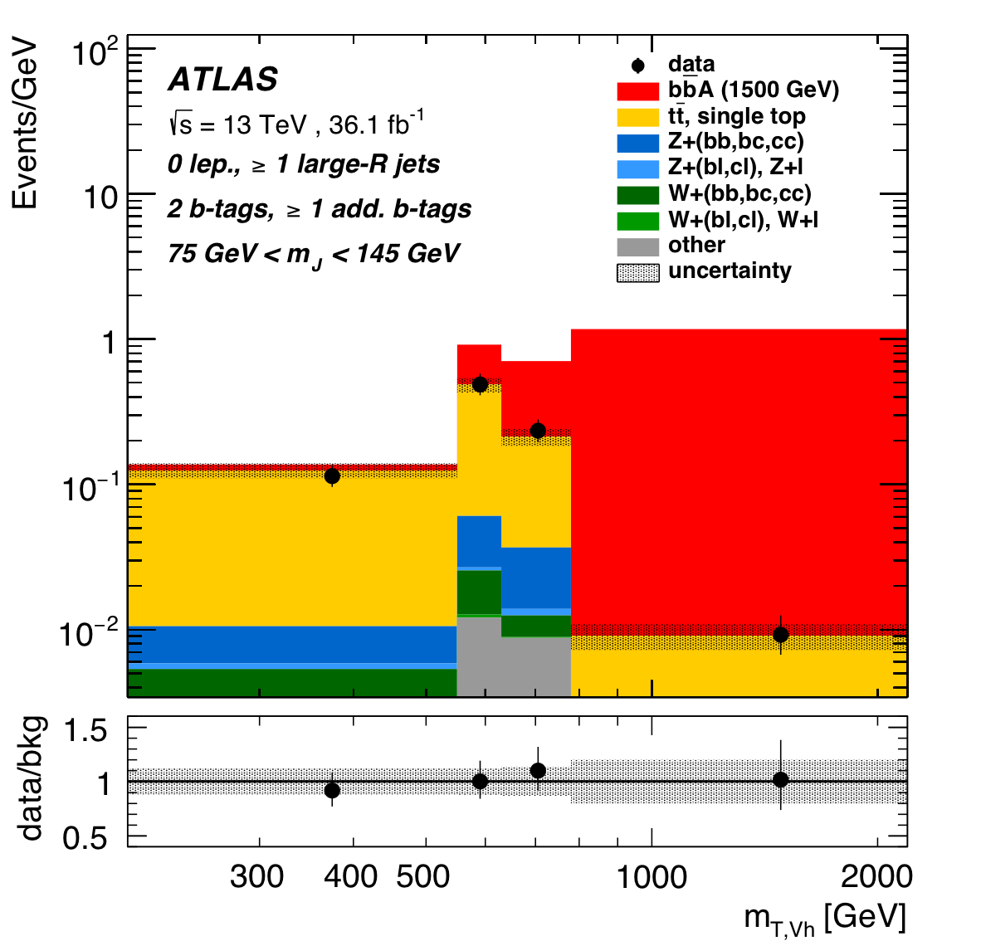
Results
bbA: Resolved and merged

Slide 14
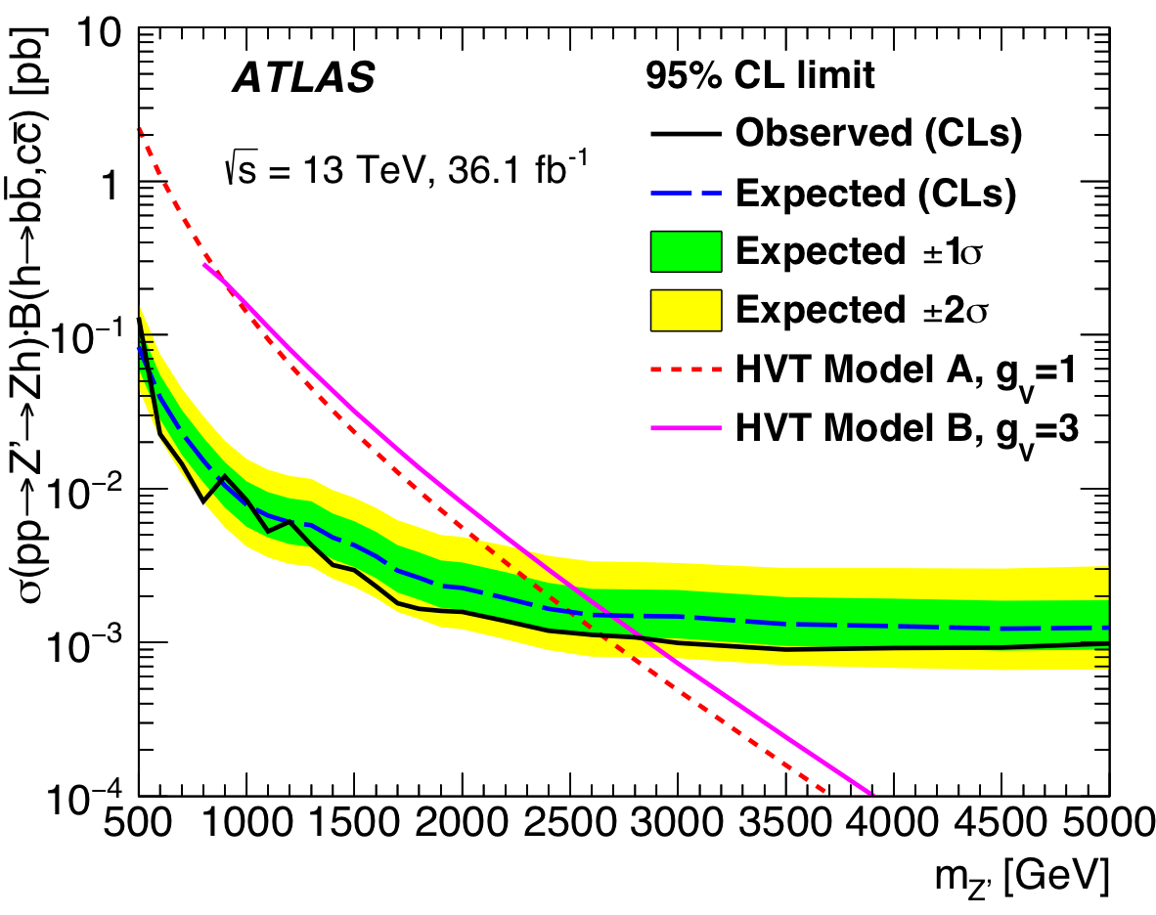
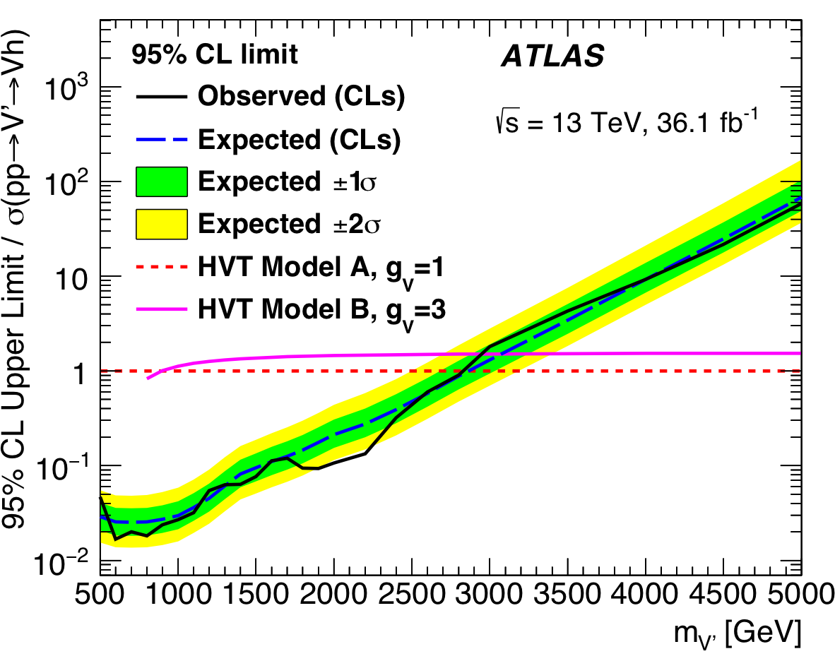
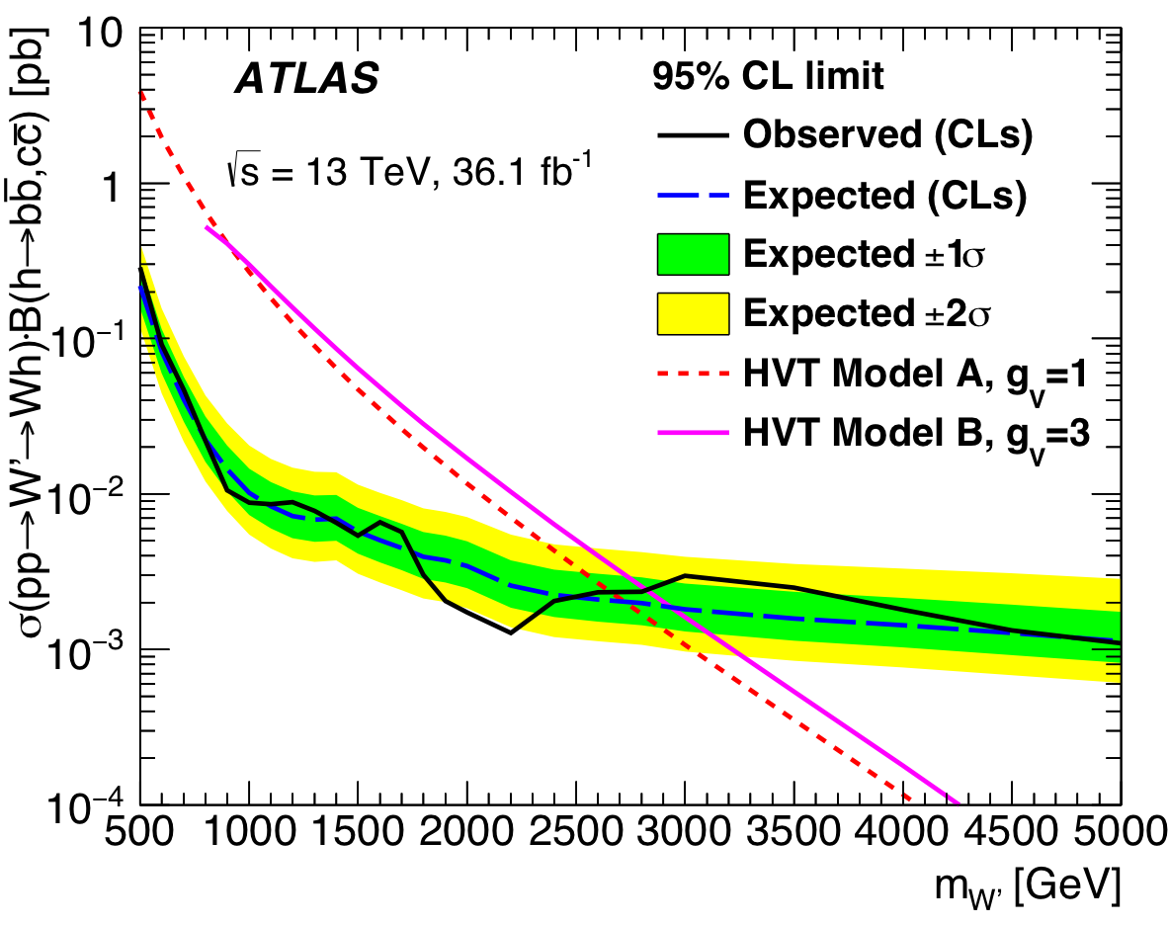
Limit Setting
m_{Z’}>2.65(2.83) TeV for g_{V}=1(3)
m_{V’}>2.80(2.93) TeV for g_{V}=1(3)
m_{W’}>2.67(2.82) TeV for g_{V}=1(3)

Slide 15
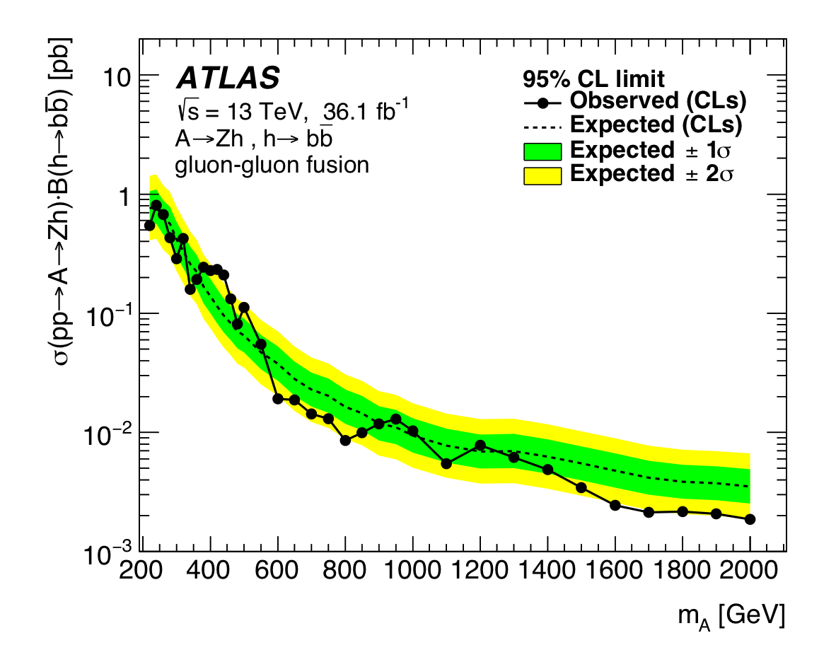
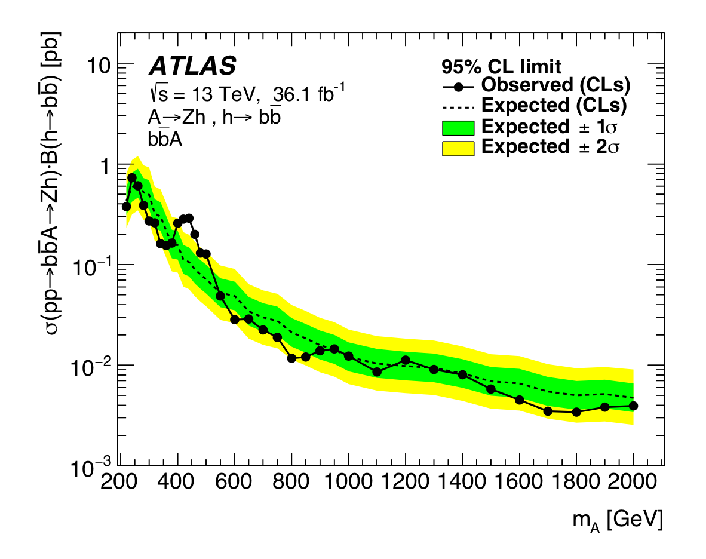
Limit Setting
Upper limits are placed separately for pure gluon-gluon fusion
production and pure b-quark associated production

Slide 16
Conclusion
A search for heavy resonance with leptons+jets final states is performed using 36.1 fb-1 of 13TeV pp collision data collected with the ATLAS detector at the LHC.
No significant excess of events is observed above the SM predictions in all three channels. Limit setting was performed. The W’ and Z’ bosons with masses m_{W’} < 2.67TeV (2.82TeV) and m_{Z’} < 2.65TeV (2.83TeV) are excluded for the benchmark HVT Model A (Model B), while for the combined HVT search masses up to 2.80TeV (2.93TeV) are excluded.
More information can be found in the paper
JHEP03(2018)174
ATL-COM-PHYS-2016-479 (internal note)

Slide 17
backup

Slide 18
Systematics
CP systematics are implemented in all three channels
Modeling systematics:
m_{Vh} shape systematics :
tt: compare nominal MC to MC with different ME, different PS, low/high radiation
V+jets: currently using shape uncertainties derived by comparing Sherpa 2.1 vs MadGraph+Pythia8
shape systematics ZPtV, ZMbb, WPtV and WMbb (derived for Resolved only):
data/MC comparison in control regions enriched in Z+jets
Sherpa 2.2.0 vs MadGraph+Pythia8 comparison for W+jets
m_{Vh} shape uncertainties are derived for resolved only regions for SimpleMerge500 strategy (applied in AZh resolved regime at low pTV)
m_{Vh} shape uncertainties are derived for merged only regions for MergedOnly strategy (applied in HVT merged regime at high pTV)

Slide 19
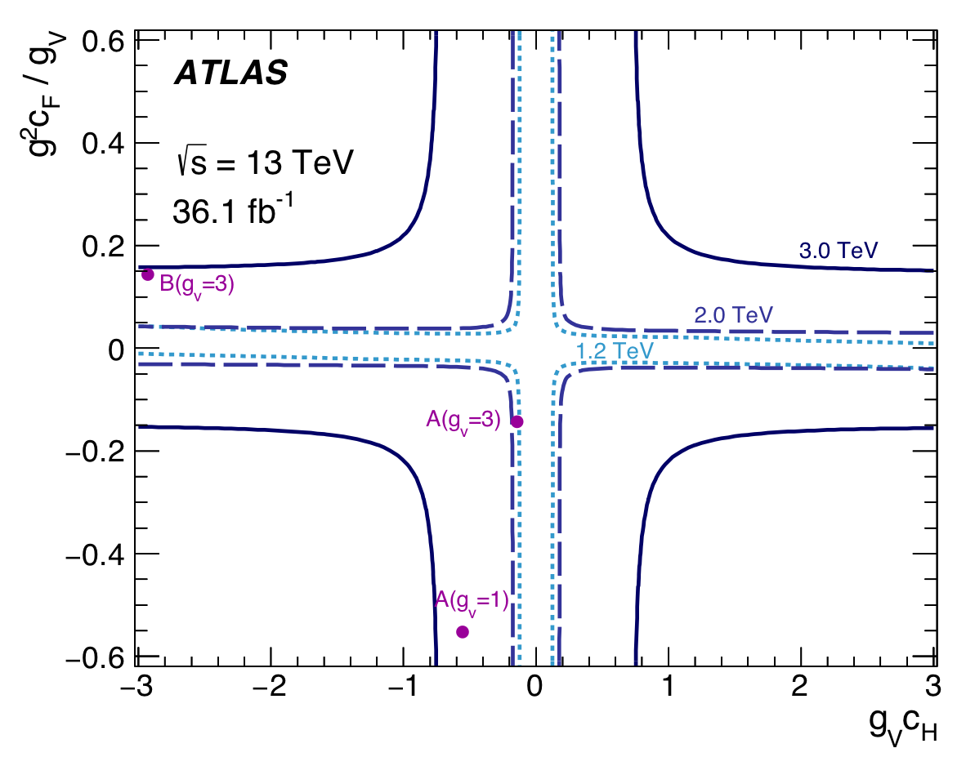
Limit Setting
m_{Z’}>2.65(2.83) TeV for g_{V}=1(3)
m_{V’}>2.80(2.93) TeV for g_{V}=1(3)
m_{W’}>2.67(2.82) TeV for g_{V}=1(3)

Slide 20
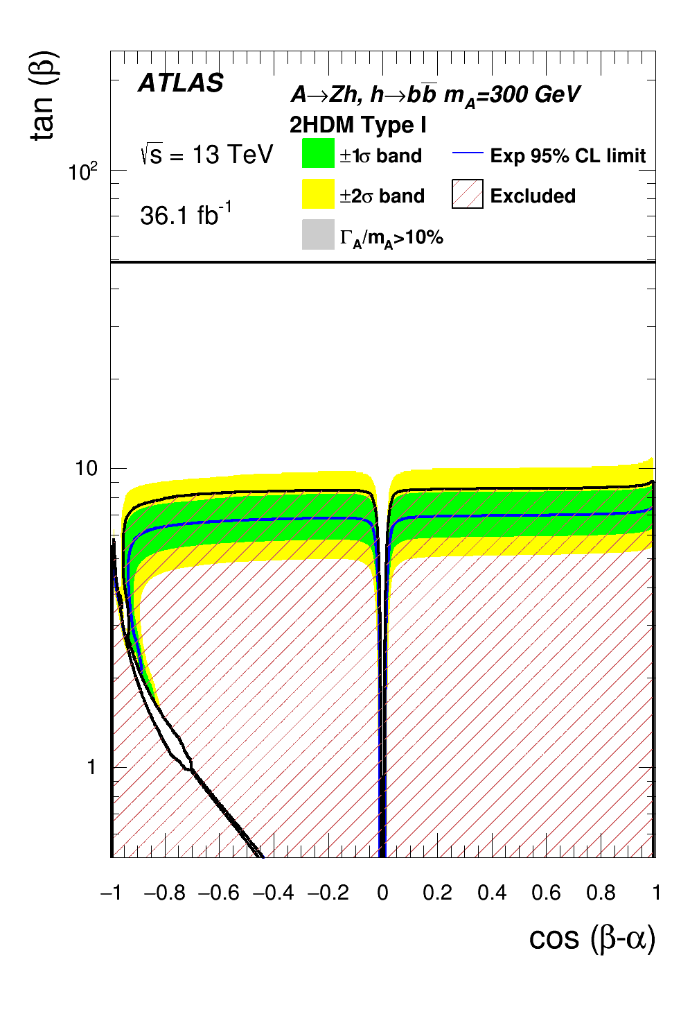
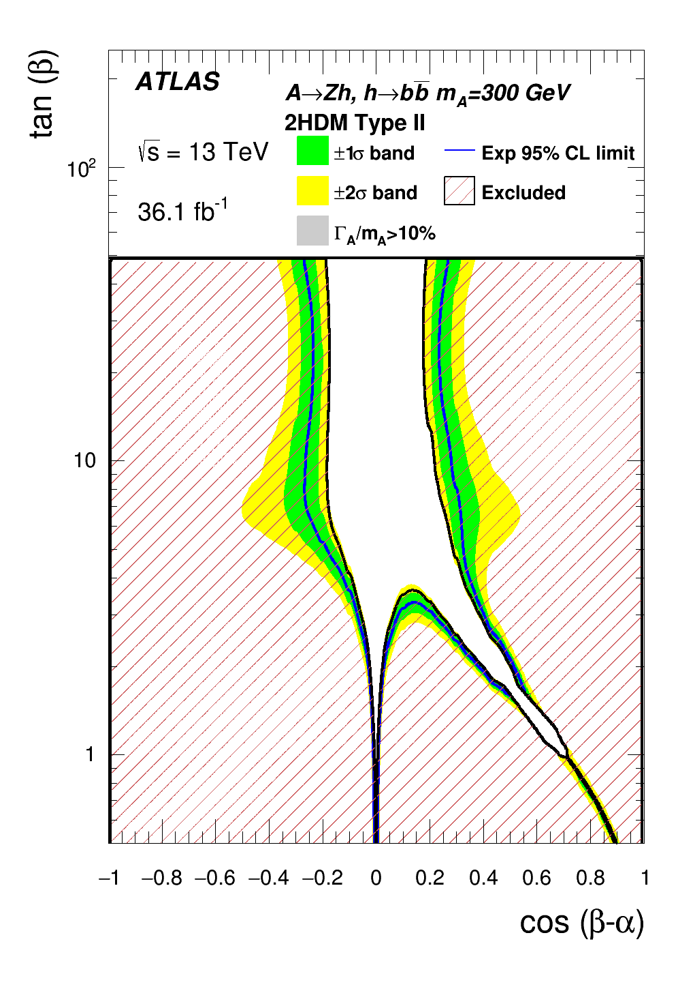
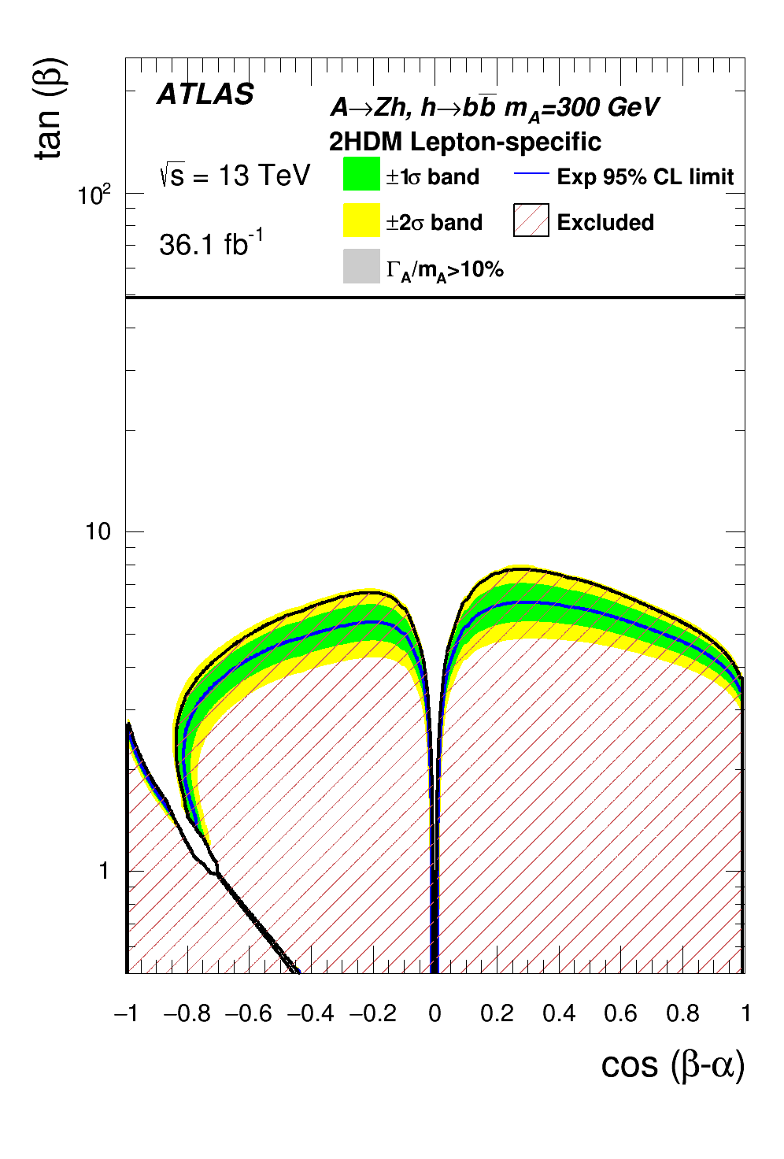
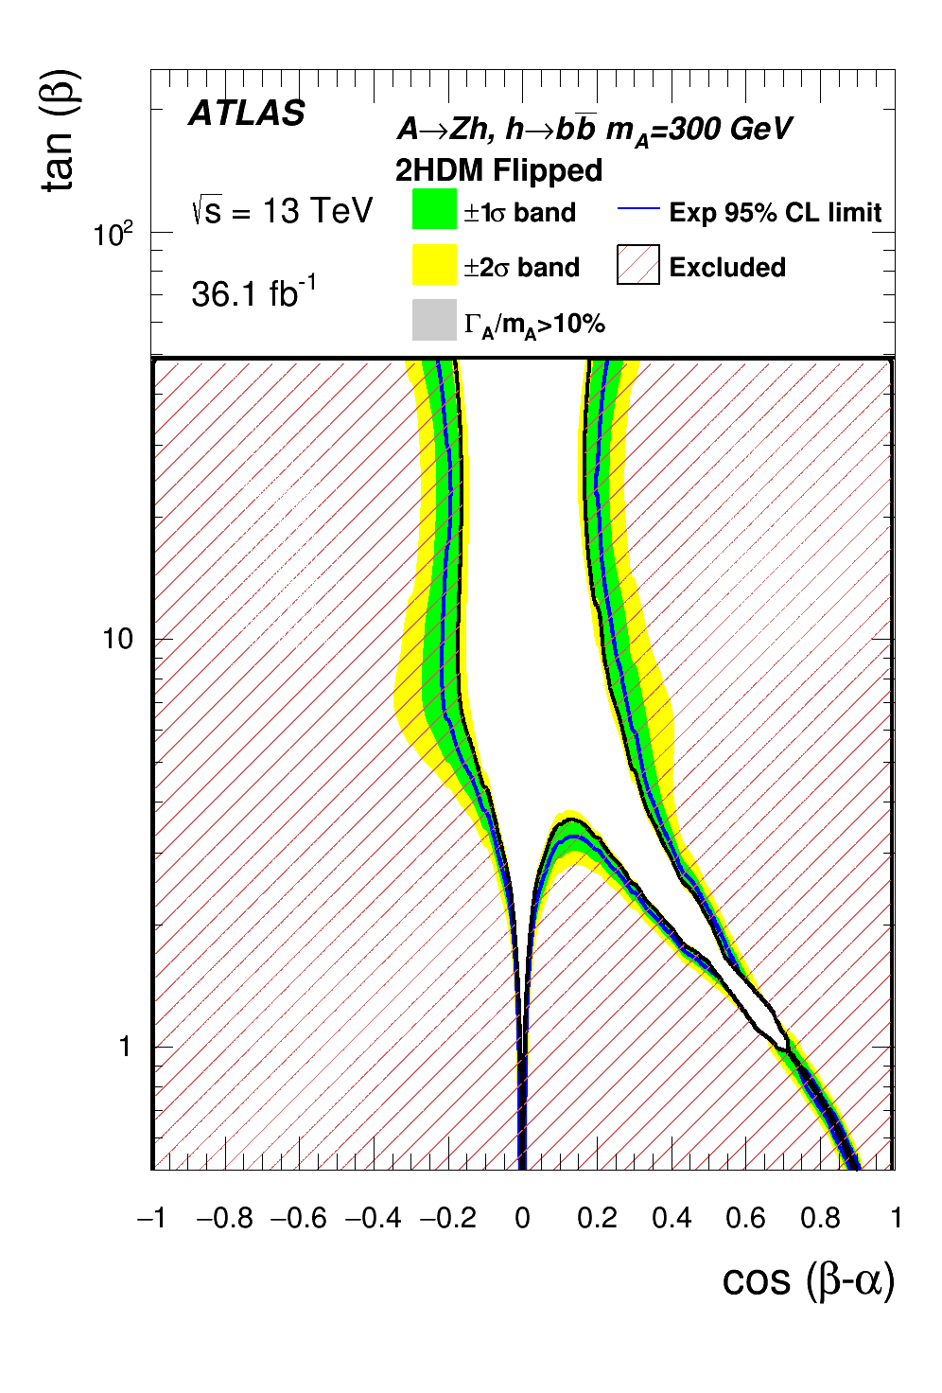
Limit Setting

Slide 21
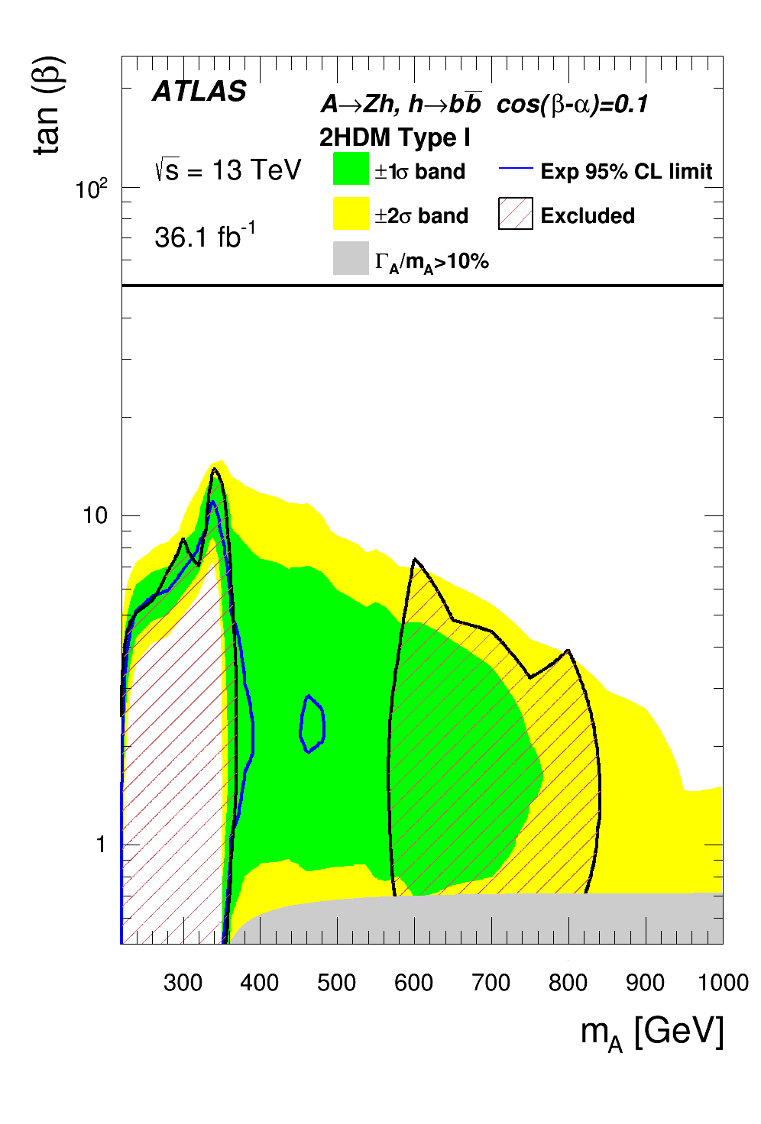
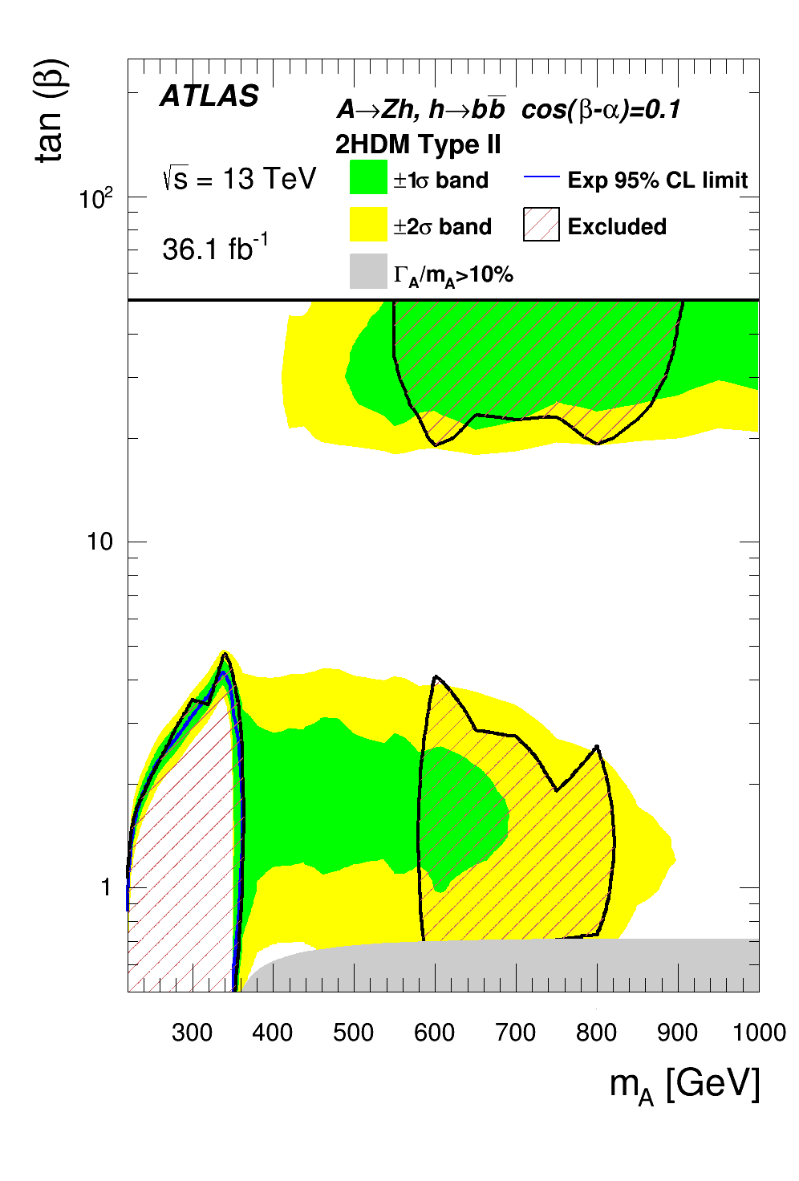
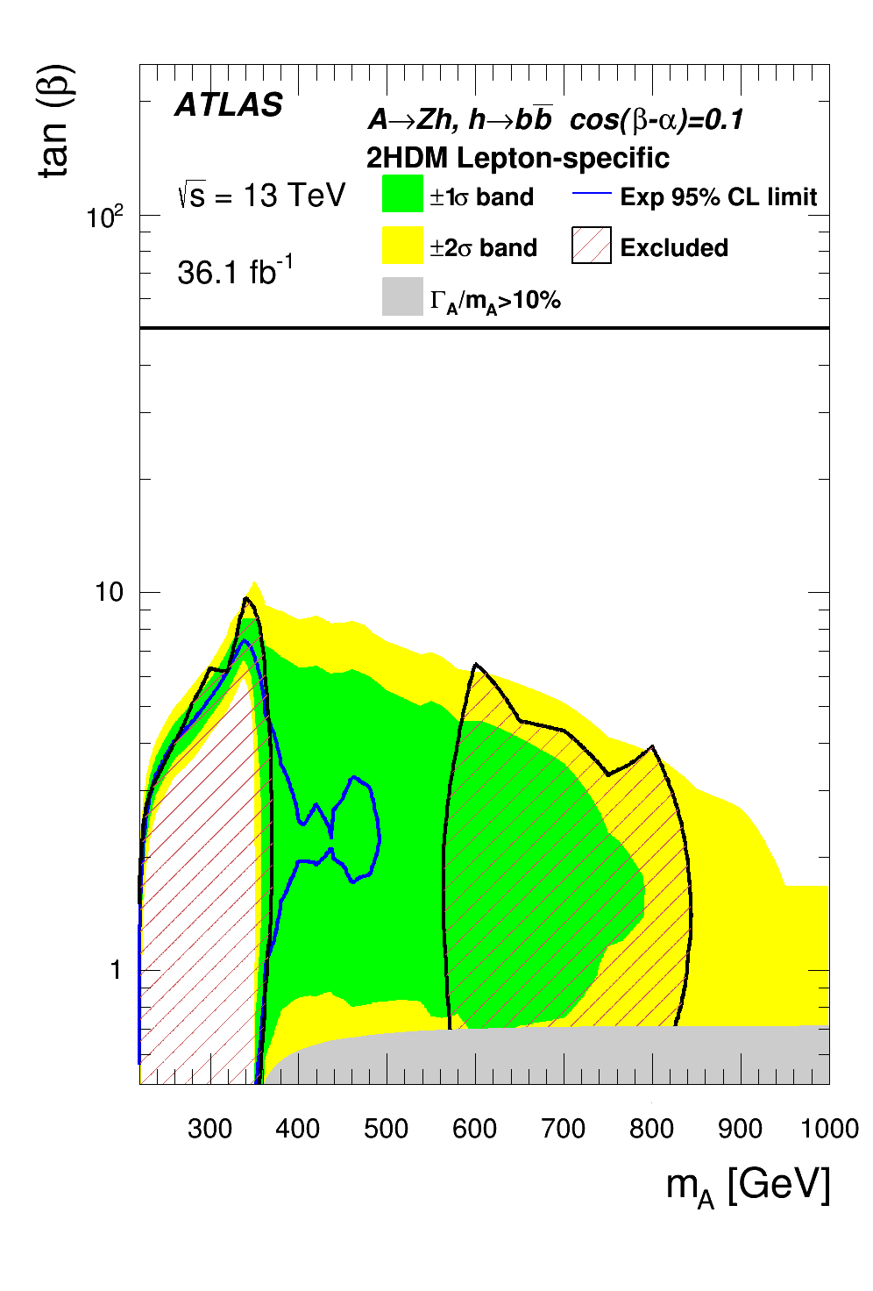
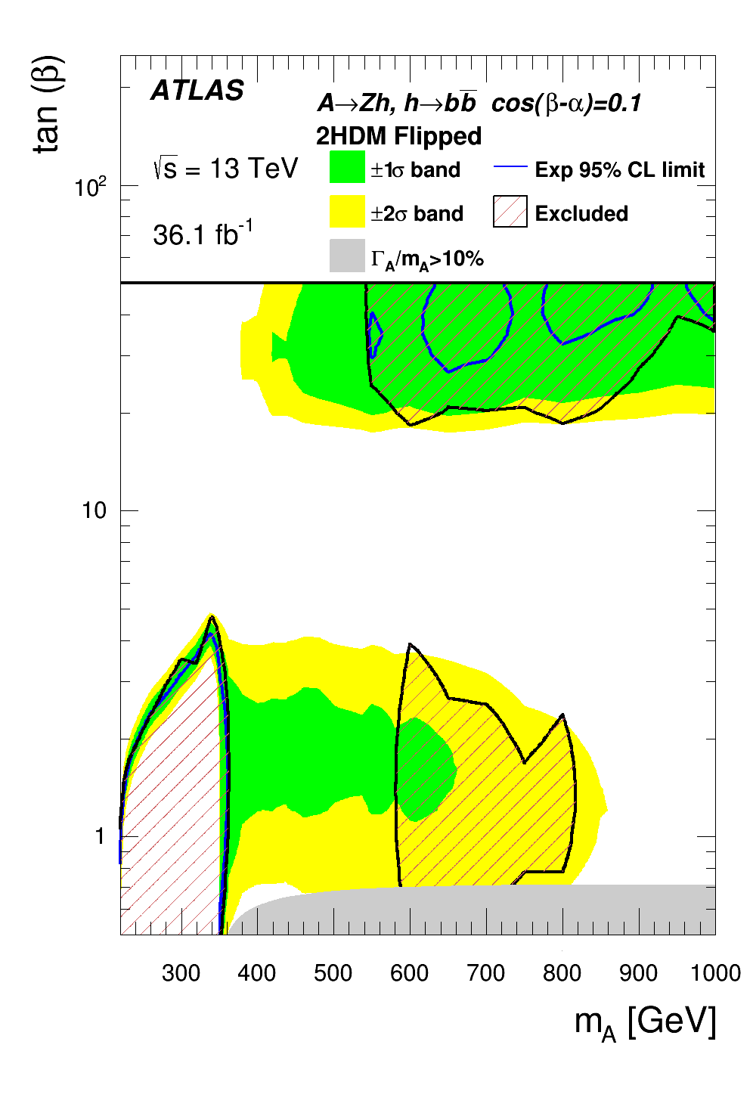
Limit Setting

