Slide 1
Axion Like Particle and the CMB Asymmetry
Qiaoli Yang
Jinan University, Guangzhou
06-2018
Shanghai

Slide 2
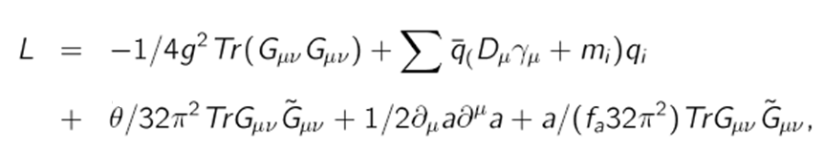

To solve the strong CP problem, one introduces the symmetry which is spontaneously broken
QCD Axions
relaxes to zero during QCD phase transition.

Slide 3
Axion like particles
interested background fields in string theory:
the metric
the two-form gauge antisymmetric field
dilaton
...

Slide 4
Axion like particles
alps arises due to compactification of the antisymmetric tensor fields
the x are non-compact coordinate, y are compact coordinates.

Slide 5
Axion like particles
the zero mode acquires a potential due to non-perturbative effects on the compactifying cycle.
The effective Lagrangian in four dimension:

Slide 6
ALPs
So if the string theory is true, alps exist inevitably.
Question is: what is the mass?

Slide 7
A GUT Scale ALP?
Q. Yang, Y. Liu, H.Di, PRD 96 (2017) 083516
H.Di, Q. Yang, arXiv:1712.09917
topological defect is a very common phenomenon.

Slide 8
Why we have not seen any fundamental field defects?
Axion strings, Axion Domain Walls
Inflated away..
But can we see their remnant?

Slide 10
The hemispherical power asymmetry：
Scale dependent:
A\sim0.072 for l<600

Slide 11
Inflation
Cosmological scale correlation length:
Structures should be Inflated away.
Structures formed after inflation:
Correlation length should be much smaller then the horizon

Slide 12
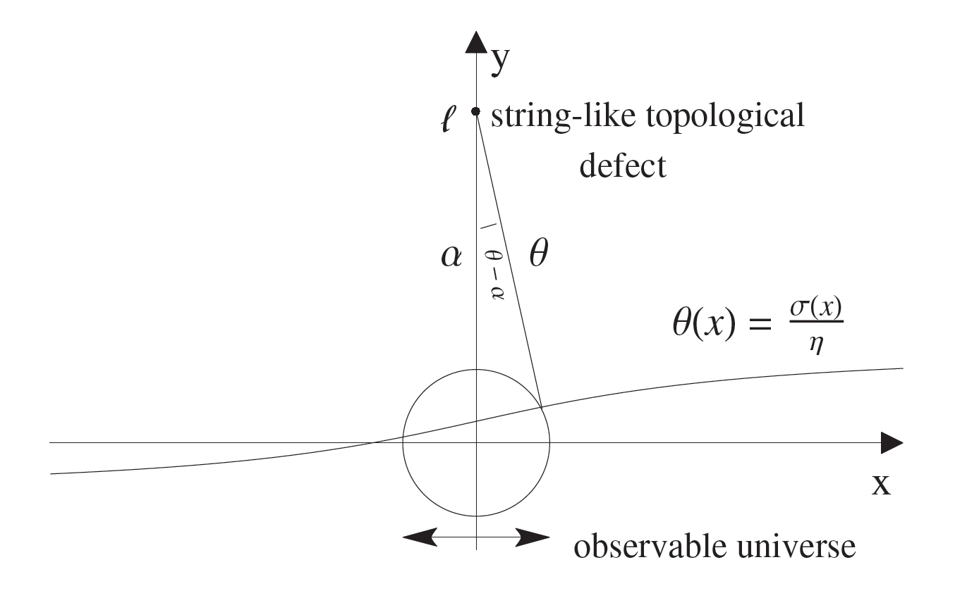

Slide 13
for small k modes, protected by topology.
for large k modes, frozen by causality

Slide 14
Initial fluctuation:

Slide 15
Amplitude fluctuation due to the quantum effects
When the field perturbation is small:

Slide 16
The power asymmetry is:
So the asymmetry is scale dependent:

Slide 17
Asymmetry due to the Grishchuk-Zeldovich effect:
Quadrupole is the leading term:

Slide 18
non-Gaussian term:

Slide 19
Power asymmetry

Slide 20
Conclusions:
Axion like particles exist in many BSM theories, and is well motivated.
Inflation can dilute typical cosmic structures formed by particles but remnant of topological defects can survive.
The dipole CMB anomaly may suggest an ALP with GUT Scale F_a.

