Slide 1

Studies on full jet evolution in medium and nuclear modification of jet splitting function
中国物理学会高能物理分会第十届全国会员代表大会暨学术年会
畅宁波
信阳师范学院（&华中师范大学）
合作者: 曹杉杉、秦广友、Yasuki Tachibana
文章: PRC.94,024902(2016), PRC95,044909(2017),PLB.781,423(2018）
Notes:
Hi, Thanks the organizer/committee giving me this opportunity to report/present our work. My name is Ningbo Chang, come from Xinyang Normal University of China . This work is done in collaboration with Shanshan Cao and Guang-You Qin， the paper has just been published in PLB.

Slide 2
Outline
Motivation
Full jet evolution in medium
Nuclear modification of jet splitting function
Summary and Outlook
Full jet energy loss
Nuclear modification of jet shape
Medium response
Jet energy dependence for the nuclear modification of groomed jet splitting function ?
Coherent or incoherent subjet energy loss ?
Notes:
This is the outline of my talk. Firstly I will talk about our motivation and the framework to study the groomed jet splitting function in heavy-ions collisions,. Our work focus on these two problems….., which will be discussed in following. Finally is the summary and outlook.

Slide 3
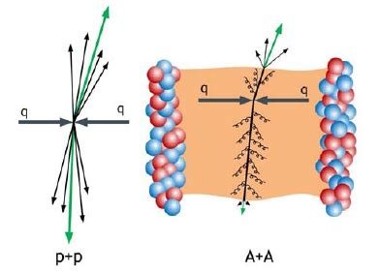
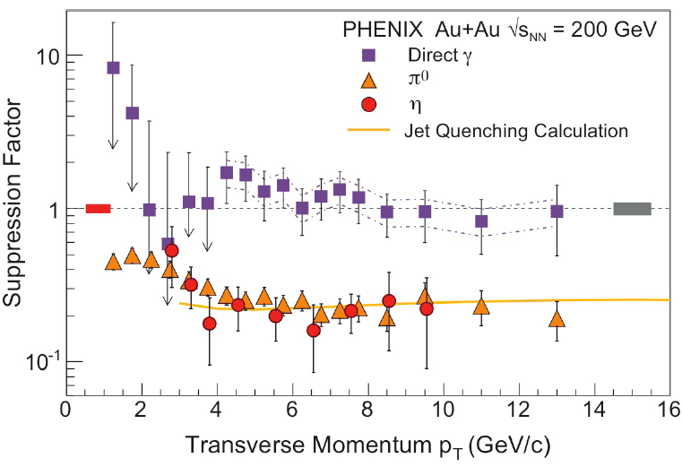
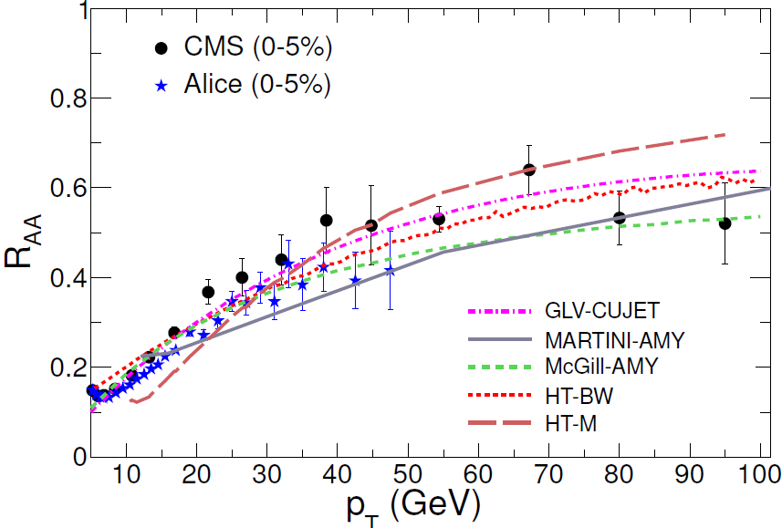
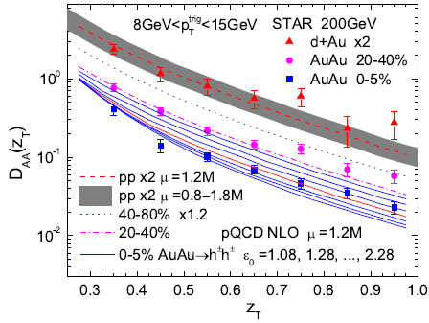
Motivation
PHENIX, Phys.Rev.Lett. 91 (2003) 072301
Karen M. Burke et al., RPC.90,014909
HanZhong Zhang et al.,arXiv:0804.2370
Hadron observables

Slide 4
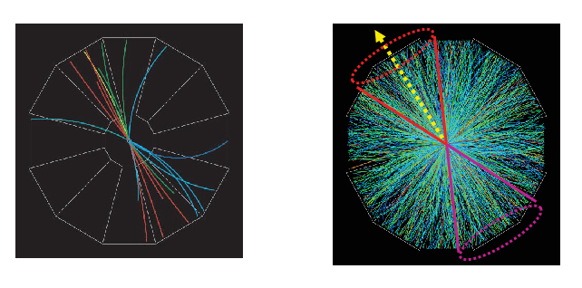
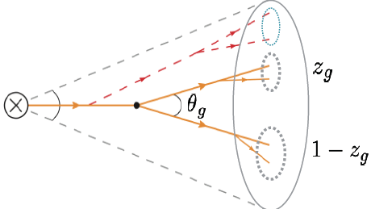
Motivation
Full Jet observables

Slide 5
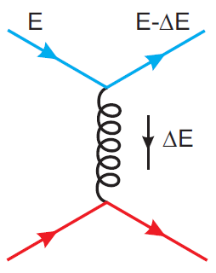
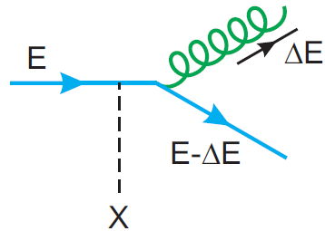
Full jet evolution in medium
Elastic scattering
Energy loss of the leading parton due to medium induced radiation may be not the energy loss of the full jet.
Collisional energy loss may be more important for full jets than single hadrons
Jet structure and its modification provides many observables, can reveal more detailed information
Inelastic scattering
Notes:
This is our motivation to study the evolution of the partonic jet shower in QGP. When the jet shower propagate through the medium, all partons in the shower will suffer multiple elastic or inelastic scattering, in which the elastic scatterings render/result in collisional , and the transverse momentum broadening, and the inelastic scatterings results in radiative energy loss/(medium induced radiation).[
We want to begin to study full jet instead of single hadron, because firstly the medium induced radiation from the leading parton is the main reason of its energy and the suppression of single hadron spectra, especially for light quark and gluon , may not the main reason for full jets……
~~~~~~~~~~~~~~~~~~~`
And all partons will branch/split to release/decrease their virtuality.] (Among them, the medium induced radiation is regarded as the main reason of its energy loss of the leading parton, is also the main reason for the suppression of the high pt hadron spectra.) In the (former)/earlier study on jet quenching using high-pt hadrons, people mainly concern the energy loss of the leading parton, and currently most people believe/recognize that the inelastic scattering contribute the most of the energy loss, especially for light quark and gluon. But for full jets, the story/picture may be different, because the radiated parton can be still in the jet cone, so the energy loss for the leading parton is not the energy loss of the jet with finite cone size. And due to there are many partons in a jet and every one of them can experience elastic scattering with the medium and then lose energy, the energy loss due to collisional energy loss and kt-broadening may be important.
What’s more , using/for full jet we can measure the momentum distribution in the jet, its modification in AA/heavy-ion collisions can tell us more informations about the jet-medium interaction than single hadron.

Slide 6
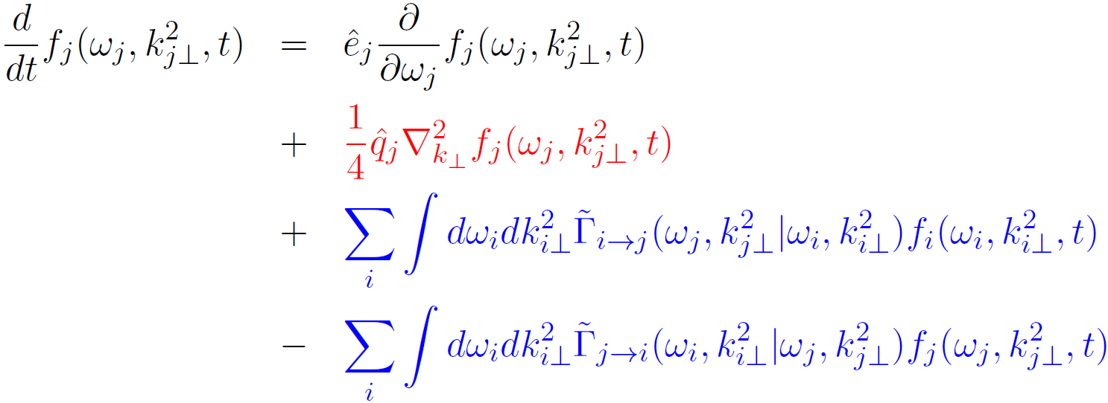
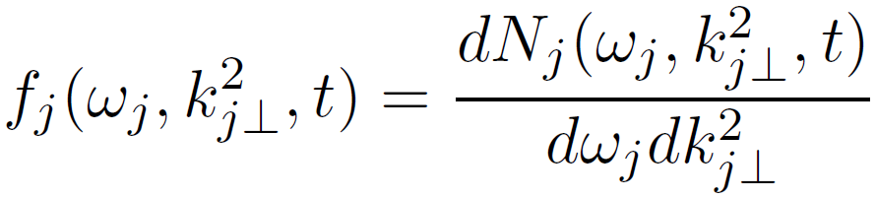
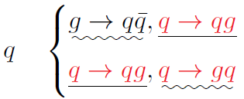



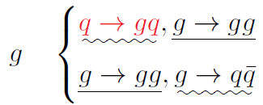
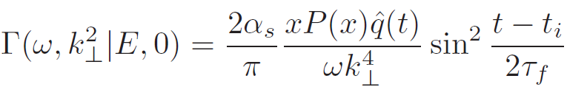
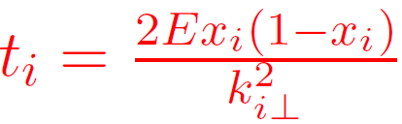
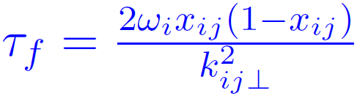
Framework: Boltzmann transport equation
Collisional energy loss
K_{T} broadening
gain
Radiation
loss
Notes:
In our work, we study/(foucs on) (three dimensional momentum)/(energy and transverse momentum) distribution of shower partons in the full jet, with which we can keep track of both the energies and transverse momenta of all partons in the full jet, so we can(so it is easy to ) study the modification of the full jet energy and internal structure directly/straightfowardly.(This plot is the quark distribution in quark jets, we can see that there’s a peak near the jet energy and a bump at low energy.) This the general boltzmann transport equation we formulate to calculate the evolution of the full jet, in which the first (drag term) and the second (diffusion) term account for the collisional energy loss and transverse momentum broadening caused by the elastic scatterings between the jet parton and the medium parton. The last two terms are the source term which represent medium induced radiation due to the inelastic scattering with the medium. There are gain term and loss term for parton j, because other parton with energy larger than its energy can split to produce the parton j, and parton j can split further into partons with less energy. In the equation, there are two transport coefficients: ehat and qhat which control the rate of longitudinal momentum loss and exchange of squared transverse-momentum. They are related by this equation/relation with the assumption that the medium is close to local thermal equilibrium and the fluctuation-dissipation theorm (is valid) can be applied. In the radiation terms, here the tilde gamma represent the radiation/splitting rates. We use results the from higher-twist formalism to calculate/account for the radiation rate. For quark and gluon in the jet, their splitting pattern/kernel is different, and they can convert into each other in the splitting porcess, so we need to solve the two evolution equations for quarks and gluons in a coupled way.
In calculation, we use the radiation rate from higher-twist fromula. Here is the definition of the rate gamma. The tilde gamma in the evolution equation is different with gamma. Because the gamma is defined when the parent leading parton don’t have transverse momentum, while in the full jet evolution, every parton may have transverse momentum with respect to/relative to the jet direction/axis. So we need to convert the gamma into tilde one according the shown gemotry. The daughter parton’s transverse momentum depend on the angle of parent parton with jet and the angle between the parent parton(I and j). this is the exact relation/formula, but there’s a simple relation when phi_ij is averaged out and both theta_i and theta_ij are small quantities. The averaged angle of j is the square root of the quadratic sum of theta_i and theta_ij.
Only parton with energy more than 2GeV be branched/radiated, considering the jet-medium radiation and absorption balance.
In the radiation rate, t_i is the time of parton is produced/created in the jet, at time step t, only produced parton can split. The formation time of j from I, i.e, tau_f can also be calculated from this formula.

Slide 7
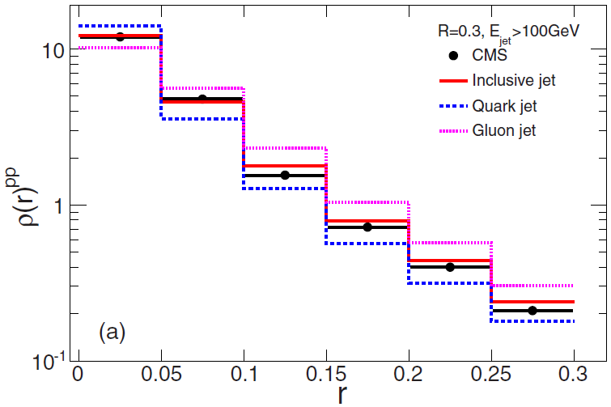

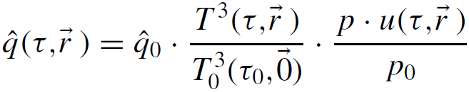
Initial condition from PYTHIA
Framework: input and hydro
Hydrodynamic simulation using VISH2+1
Notes:
To solve the coupled transport equations, we need to provide the initial condition which is the shower parton’s three dimensional momentum distribution in pp collisions. We generate it using PYTHIA and tune the parameter to make sure that the jet shape (close to)/(can describe) that of CMS data.
We also need to know the information of the evolved background medium, which is given by the simulation of …
We also need to know how the background medium evolve, which is simulated by the viscous hydrodynamics model of VISH2+1, from Ohio state uniuersity group. The value of qhat will be obtained/given by the local temperature and the flow velocity, with a parameter qhat_0 leave to be fixed./need bo be fixed.

Slide 8
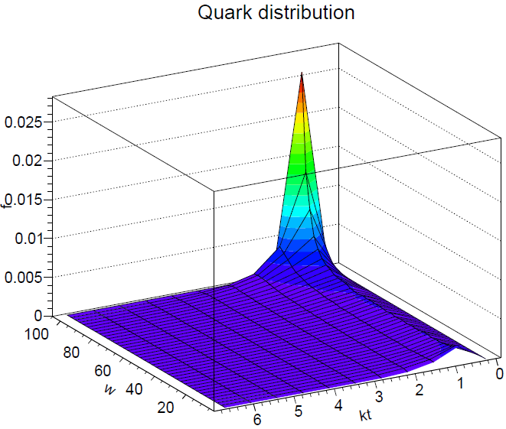
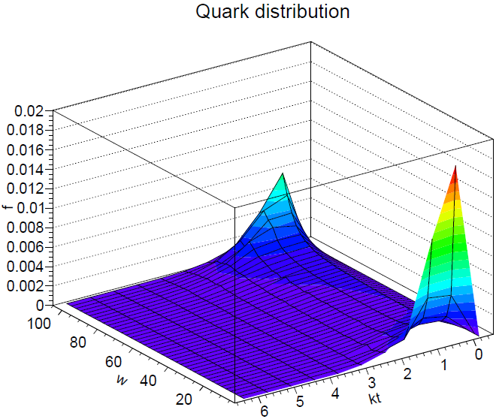
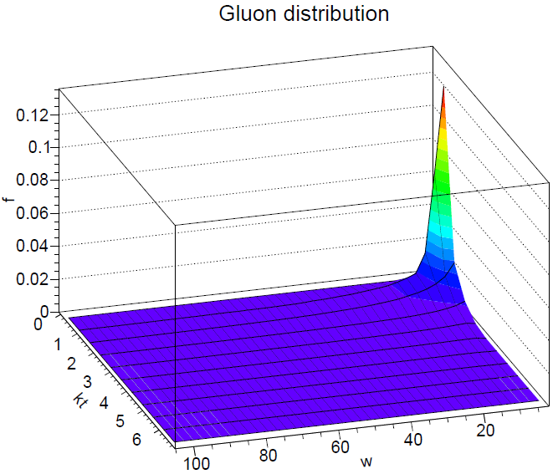
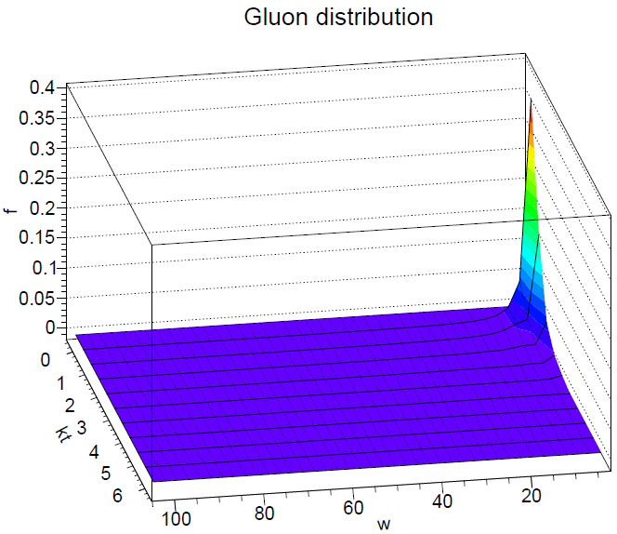
quark jet
Notes:
This slide show an example of the evolution of the quark and gluon distribution in the quark jets. For quark, the initial peak at high energy is suppressed and the low energy bump become a peak( is enhanced). For gluon in the quark jets, the peak at small/low energy is enhanced.

Slide 9
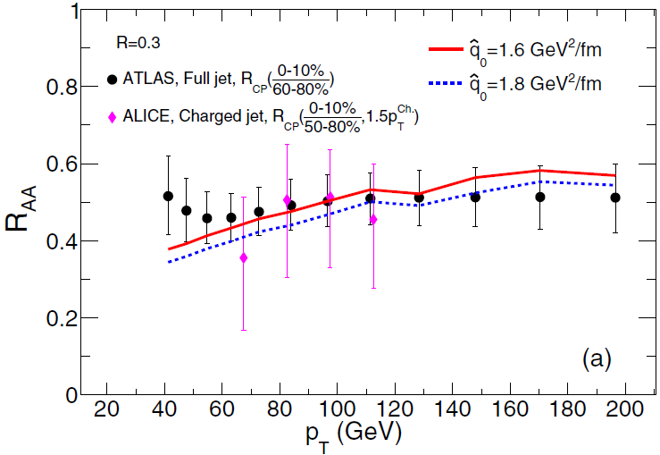
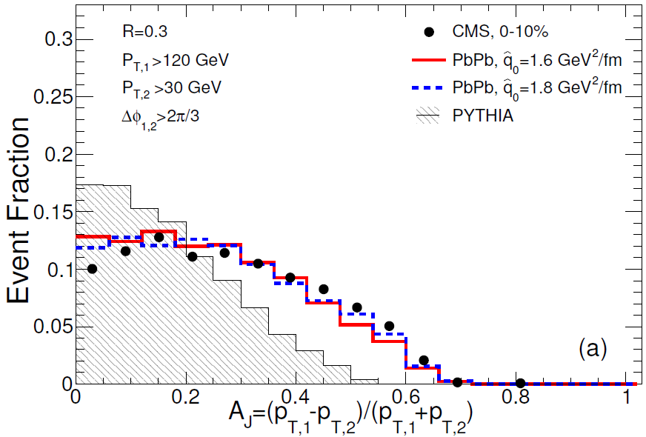
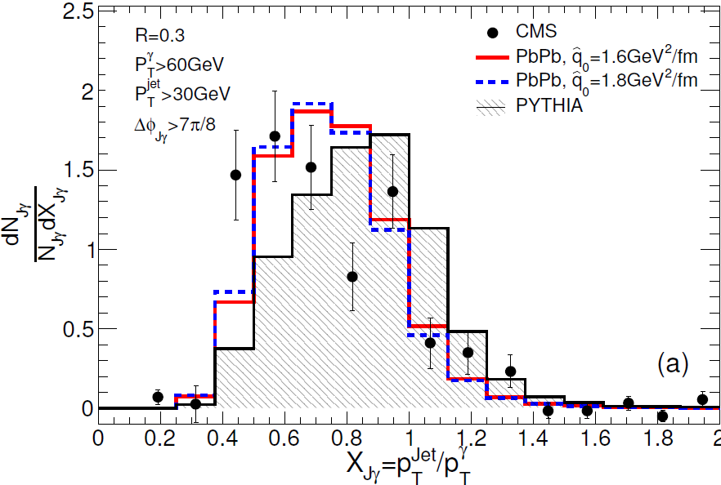
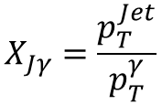

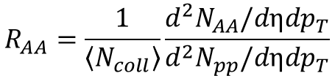
Observables related with full jets energy loss:
$$R_{AA}=\frac{1}{\left\langle N_{coll}\right\rangle }\frac{d^{2}N_{AA}/dηdp_{T}}{d^{2}N_{pp}/dηdp_{T}}$$
$$X_{Jγ}=\frac{p_{T}^{Jet}}{p_{T}^{γ}}$$
$A_{J}=\frac{p_{T,1}−p_{T,2}}{p_{T,1}+p_{T,2}}$
Notes:
After we solve the evolution of jet shower in the QGP medium, we can know/obtain/get/construct the modifications of many observables with respect to that in pp collisions(without medium modification). This slide show the observables about/(which concern) the full jet energy loss. At first we calculate is the inclusive jet Raa, which can be used to fix the value of qhat_0. Using the fixed qhat_0, we can describe the data of modificaion of di-jet asymmetry and momentum fraction distribution in gamma-jet events. Note that in calculation we need to impose a Gaussian effect on the jet energy both in pp and pb-pb collisions to take into account uncertainties in hadronization and experimental measurements, the principle is that after smearing the results in pp collisions close/can fit the experimental data in pp collisions.
~~~~~~~~~~~~~~~~~~~~~~~~~~~~~~~~~~~~~~~~~~~~~~~~~~~~~~~~~~~~~~~~~~~~~~~~~~~~~~~~~~~~~~~~~~~~~~
Now I SHOW the numerical results compared with experimental data. This is the jet raa with cone size 0.3. Raa is calculated using this formula, where the spectra in pp collisions are obtained from PYTHIA, n_coll is calculated by Glauber model. After evolution of the parton distribution we can know the final energy the jet, so obtain the final spectra in AA/Lead-lead collisions. You can notice that, our results have more dependence/sensitivity on the jet pt while ATLAS data is very flat. There is large uncertainty at small pt for ALICE. I think the result depend on the lower cut in re-construct jet both in theory and in experiment. Because our results are Raa and experimental data is Rcp, there’s also some differecy.

Slide 10
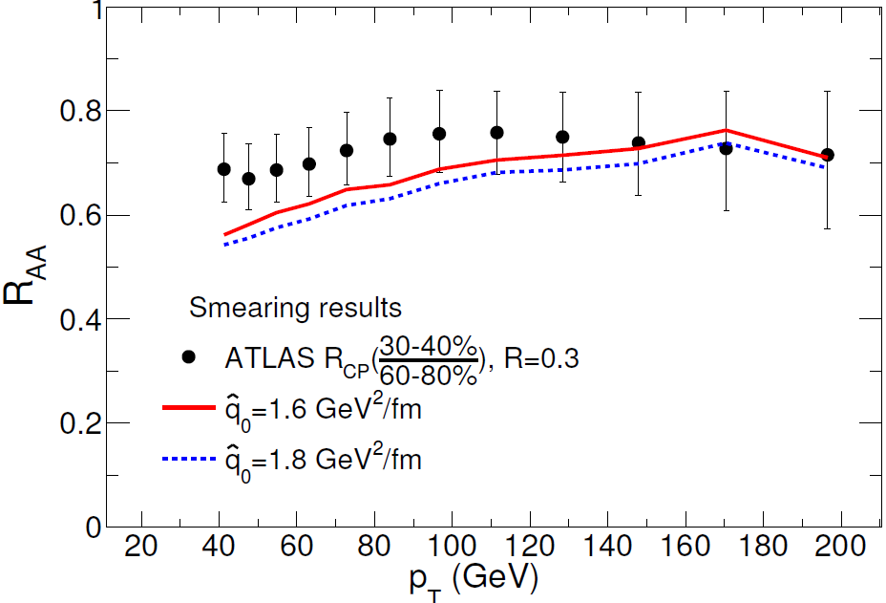
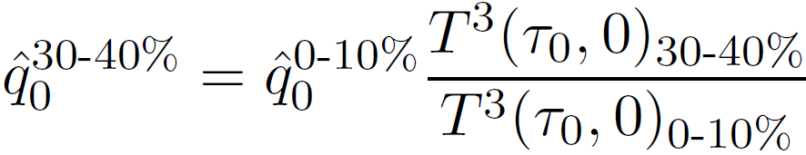
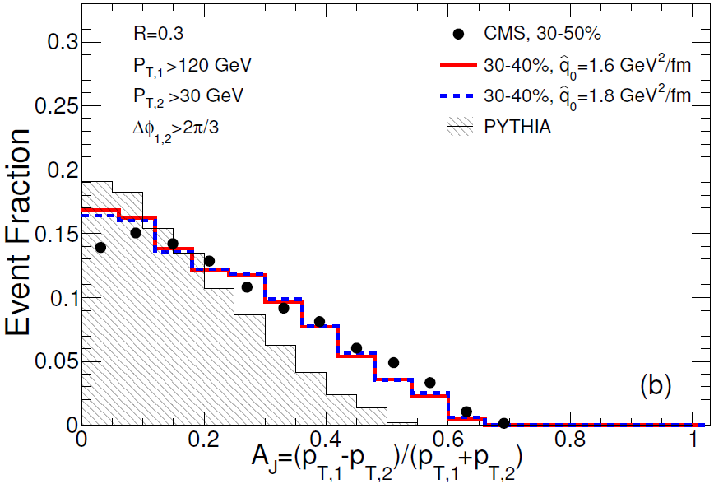
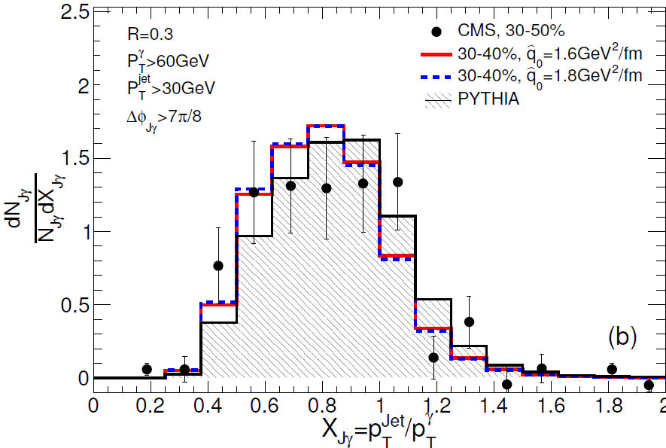
Centrality dependence
Notes:
This is the results on different centrality/mid-centrality. For inclusive jet, Note that real RAA should be a little smaller than Rcp if there is also little suppression on peripheral centrality. Consider this our results is consistent with the experimental data. Note that here the qhat is the value for center centrality. When calculating in other centrality, the value of qhat0 is shift according the cube of the ratio of initial highest temperature. We need not to adjust parameter from center centrality to peripheral centrality. We can describe Raa at different centrility, means we have right length dependence for energy loss. We can also describe the modification of momentum asymmetry in di-jet and gamma-jet at other centrality with the fixed qhat.

Slide 11
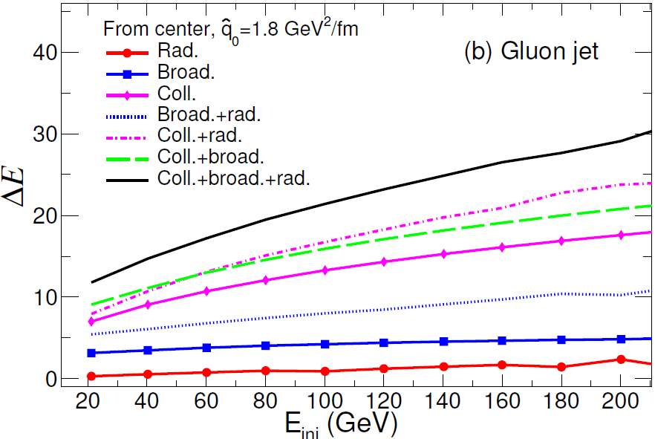
Jet Energy Loss from different mechanisms
R=0.3
Collisional energy loss contributes the most,
medium induced radiation contributes least
but can enhance other mechanism.
Notes:
After we can describe a set of observables on full jet energy loss./(after we have confidence the our model can describe observables on jet energy loss). We now can begin to see/study/search the main reason which is responsible to the full jet energy loss.
Here this plot show the effects of to energy loss (induced by)/of different mechanism and their combination. The upper one for quark jet and the lower one for gluon jets. We can see that, firstly gluon jet lose more energy than quark jets, and for both kinds of jets collisional energy dominate the energy loss . Inversely medium induced radiation render/results in/contribute lest energy loss. That because the radiated parton can still exist/be included in the jet cone. Though medium induced radiation results in little energy loss directly, it can enhance the energy loss of other mechanisms because it increase the parton number in the jet. This can be seen by the combination of rad. and other mechanism.
Collisional energy loss and energy loss from transverse momentum broadening are both proportional to the number of constituent partons in the jet, which can be learn from the fact the combined with medium induced radiation can enhance their energy loss.

Slide 12
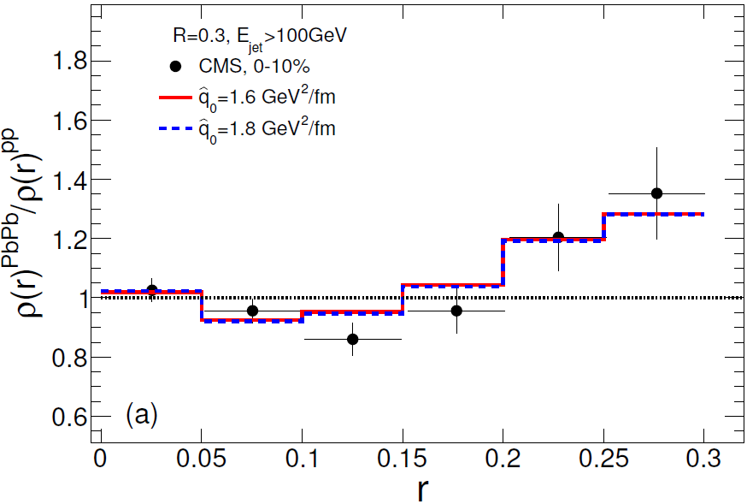
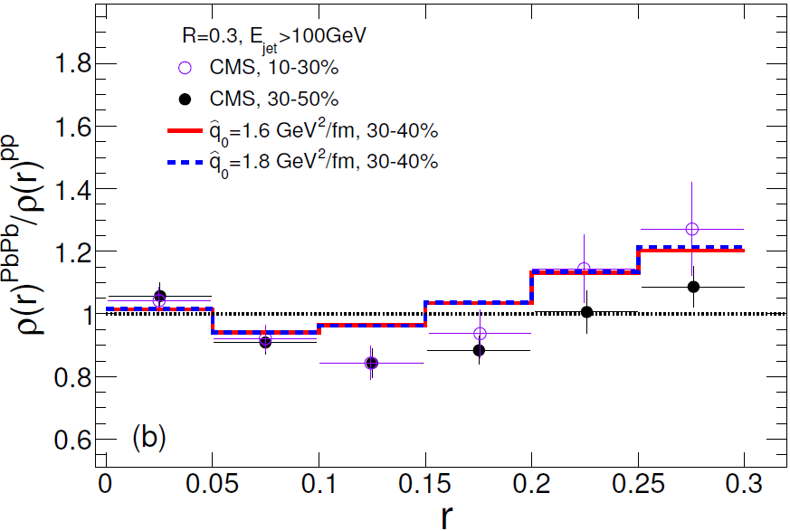
Nuclear modification of Jet shape
Jet shape function is normalized and deep-falling.
Jet shape is modified little at small r , suppressed at middle r and enhanced at large r
Notes:
All above results concern the energy loss of the jet./after our model can describe the measurements about jet energy loss. Now let’s see whether our model/theory can describe the modification of the jet internal structure. I show the results on jet shape. Though we can not describe the data exactly , but it does show same shape/partten as the data. AT center/small r, the jet shape is enhanced a little. Then suppressed/deplete at middle r and enhanced at large r. Considering the power-law decrease/deep-falling of tho(r) and tho(r) is normalized , the suppression at one bin must be compensated at other bins. it’s difficult to describe the modification of tho(r) exactly.

Slide 13
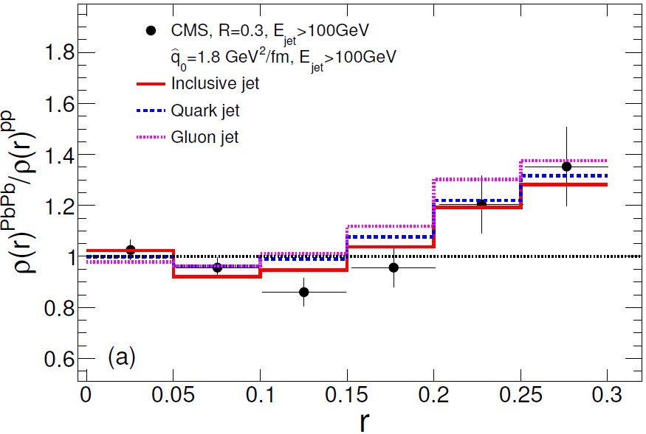
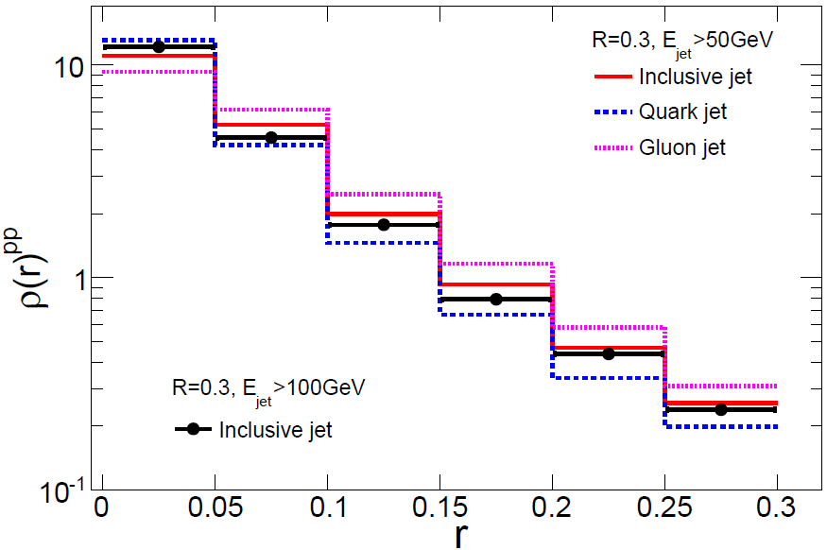
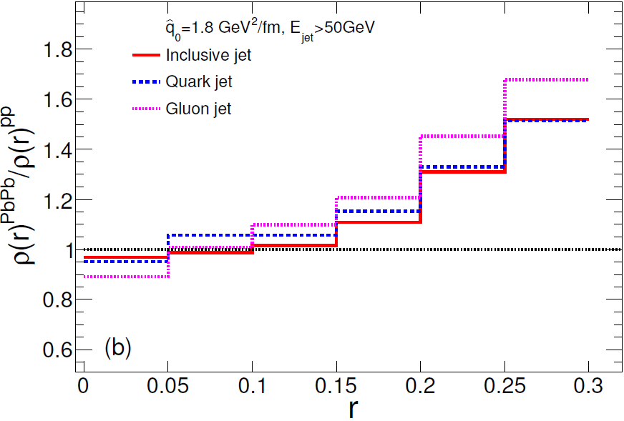
Energy dependence
Inner core of broader jet is easier to be modified!
Notes:
This slide show the energy and flavor dependence of the modification of the jet shape, from the upper panel, here the black line represent the jet shape of jets with energy greater than 100GEV. While the others are that of jets with energy larger than 50GeV. We can see that small energy jet broader than high energy jet, and gluon jet is broader than quark jet. Due to the difference in initial condition, we can expect/imagine their modification is different. As we can see from lower panel, there are indeed difference between quark jet and gluon jet. But the dependence on flavor is moderate and the dependence on jet energy is more obvious/dramatical, as shown in the right bottom panel, the shape of the modification for jet with lower energy cut 50GeV have total different with shape with that of lower cut 100GeV. It increase monotonously with r.

Slide 14
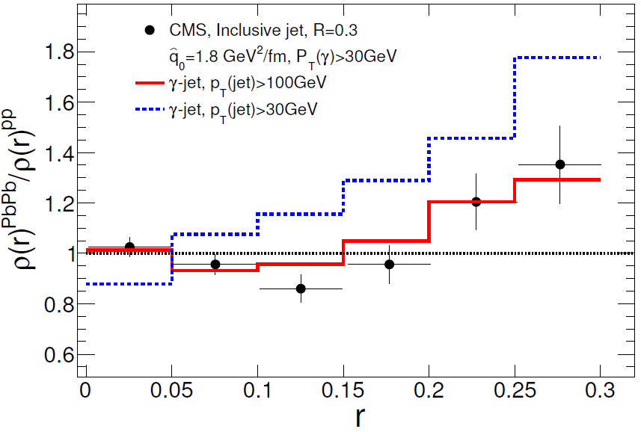
Jet shape: gamma-jet
Same energy dependence for gamma-jet
Notes:
This is our prediction of modification of jet shape in the events of gamma-jet, where the jet are dominated by quark jet, we see same dependence/sensitivity on jet energy. Only from the modification of jet shape function, we can distinguish inclusive jets and gamma-jets.

Slide 15
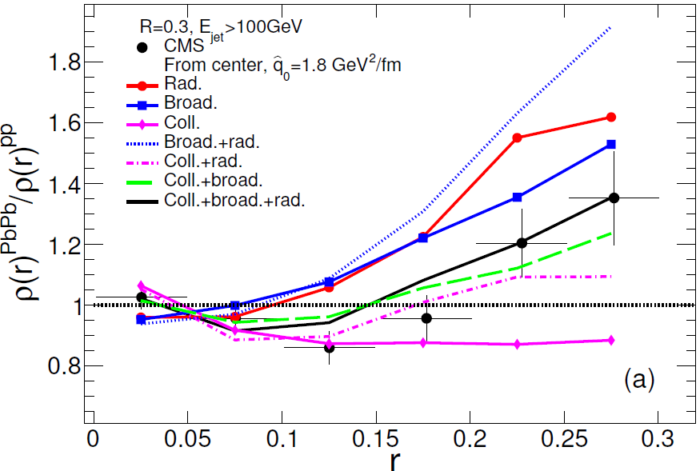
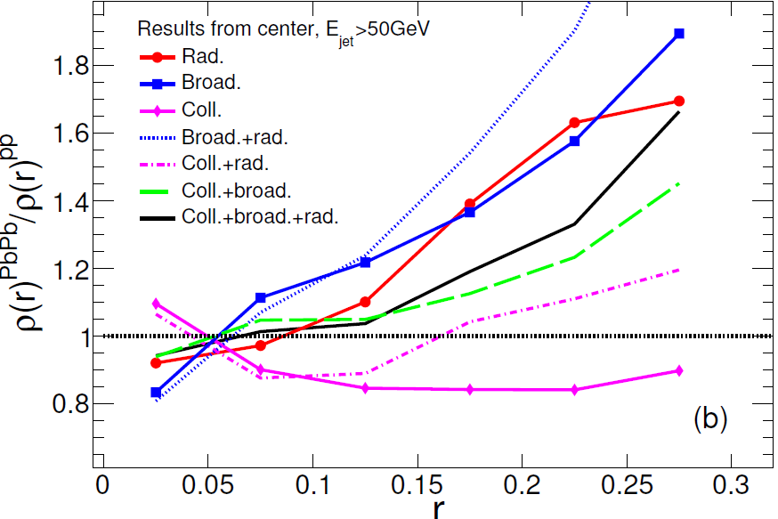
Effects of different mechanisms on nuclear modification of Jet shape
Rad. and Broad. transport energy from center to periphery,
Coll. lead inner core lose less fraction of energy than outer part.
For lower energy jet, the inner core can be affected more easily.
Notes:
Whether the jet shape at small r is suppressed or enhanced, depending on the competition of coll. and the other two mechanism.
This slide show the analysis using lower energy jet. For lower energy jet, elastic scattering become more important, the inner cone is easier to be modified, and the broadening effect enhance, the total result is that the ratio of jet shape increase monotonically.
It shows that to explain the experimental data , we must consider different mechanism together.

Slide 16

Medium response
$$∆e=e|_{w/jet}−e|_{w/ojet}$$

Slide 17
Effect of medium response
Lost energy is transported to medium at large r,
Medium response dominates jet shape at large r.

Slide 18
Nuclear modification of jet splitting function

Slide 19

Why study groomed jet splitting function?
In jet quenching studies, medium-modified splitting functions are key quantities.
They enter into many phenomenological studies (I_{AA}, R_{AA}, jet shape, jet fragmentation function.….) in various ways, e.g.,
DGLAP evolution for parton fragmentation function:
Transport model (scattering rate):
These phenomenological jet quenching studies can only indirectly probe splitting functions.
We would like to have a direct probe of splitting functions.
Notes:
We want to study groomed jet splitting function because that the medium induced splitting functions are key quantities in jet quenching studies. They enter many phenomenological studies in various ways like in DGLAP evolution equations and in transport models （to calculate…）. But these phenomenological studies can only probe splitting functions indirectly. We would like to have a direct probe of splitting functions.

Slide 20
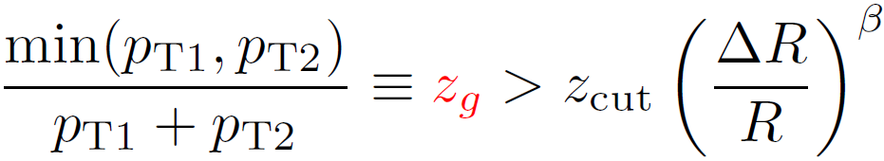


Softdrop jet grooming algorithm
Anti-kT jet is re-clustered with Cambridge/Aachen (CA)
Then decluster the angular-ordered CA tree, Drop soft branches
CMS: $z_{cut}=0.1, β$=0, $∆R≥0.1$
STAR: $z_{cut}=0.1, β$=0
Butterworth, Davison, Rubin and Salam,Phys.Rev.Lett. 100 (2008) 242001
Larkoski, Marzani, Soyez and Thaler, JHEP1405(2014)146,PRD91,111501(2015)
Chien and Vitev, Phys.Rev.let,119,112301(2017); Li and Vitev, arXiv:1801.00008.
Mehtar-Tani and Tywoniuk, JHEP 1704, 125 (2017)
Kunnawalkam Elayavalli and Zapp, JHEP 1707, 141 (2017)
Tripathee, Xue, Larkoski, Marzani and Thaler, Phys. Rev.D96, 074003 (2017)
Chang, Cao and Qin, Phys.Lett,B781,423(2018)
Milhano, Wiedemann and Zapp, Phys. Lett. B779, 409 (2018)
Lapidus and Oliver, arXiv:1711.00897. Chien and Kunnawalkam Elayavalli, arXiv:1803.03589
Notes:
Now using softdrop jet grooming algorithm, the jet splitting function which represents the parton splitting function to a great extent, can be detected directly. In this algorithm, we find two subjets in an anti-kt satisfying this relation. Here zg is the defined momentum sharing fraction, and its distribution is called jet splitting function. CMS and STAR have done the the measurements with beta=0 and z_cut=0.1. There have been much studies about the groomed jet substructure, especially after the data published after CMS and STAR.

Slide 21
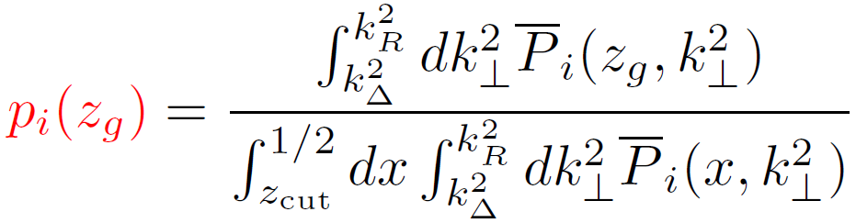
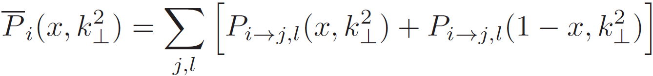
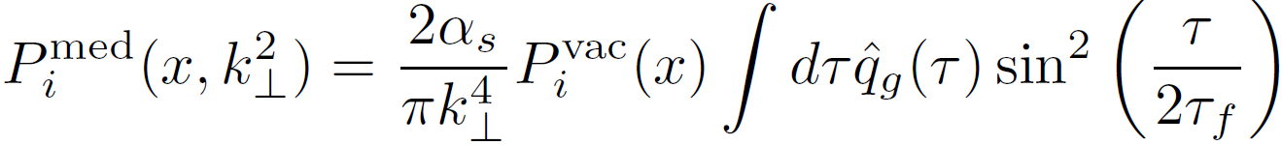
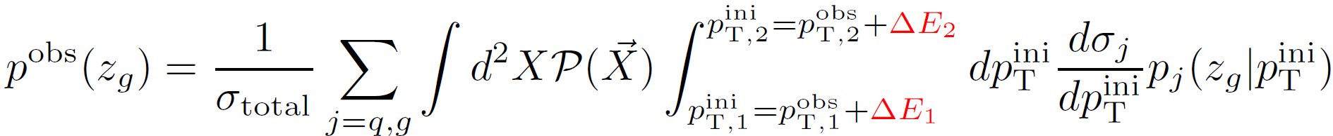
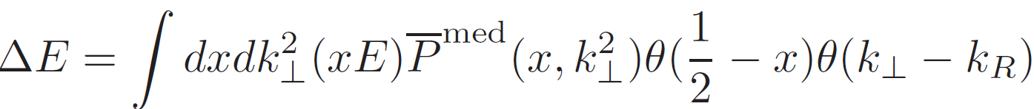
Framework
Calculate p(z_{g}) based on paron splitting function
Larkoski, Marzani, Thaler, Phys. Rev. D91,111501 (2015);
Y.-T. Chien and I. Vitev, Phys.Rev.let,119,112301
Paron splitting function is modified by medium
X.N. Wang and X.F. Guo,Nucl.Phys.A696,788(2001)
A. Majumder, Phys.Rev.D85,014023(2012)
Convolute with cross section and consider energy loss
Notes:
Here is framework we calculate the jet splitting function based on parton splitting functions. The jet splitting function is nothing else but the normalized distribution of the allowed splitting fraction by the Softdrop condition. Jet splitting function doesn’t identify the flavor of subjet, so the parton splitting function need to be symmetrized, and zg can’t be greater than 0.5. In heavy-ion, the parton splitting function includes the contribution from vacuum part and the medium induced part, and in our calculation the medium induced part is taken from the higher-twist formalism, which depends on the integration over the jet path.
Finally, if we want to compare theoretical results with the experimental data in a range of pT, we need to convolute the jet splitting function at fixed jet pT with the cross section and sum the contribution from different flavors. And we need to consider the energy loss of the jet. In this work, we only consider the energy loss due to radiation out of the jet cone, and at first step we consider the two subjets lose energy coherently(, which means energy loss reduce the total energy of their summation, but don’t change the momentum sharing fraction.) The scenario/effect of incoherent energy loss will be discussed in second part.

Slide 22
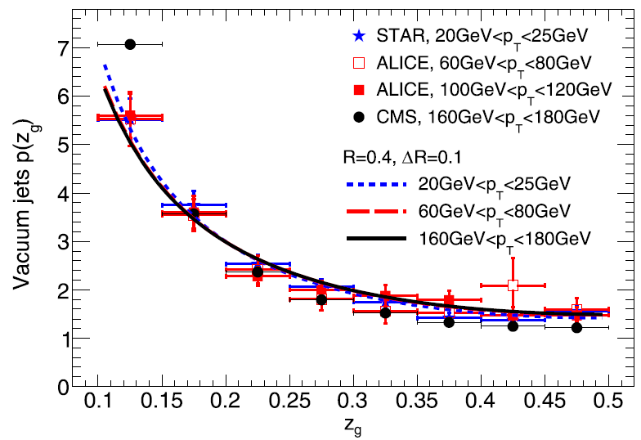
Jet splitting function in vacuum
Vacuum jet splitting function has little p_{T} dependence.
Notes:
With the framework, we firstly calculate the jets splitting function in vacuum in different pT range, and compare them with the experimental data from CMS, STAR and Alice. You can see that the jets splitting function in vacuum has weak pT dependence and our results can describe data well. This is/provides the baseline we calculate the nuclear modification of jets splitting function.

Slide 23
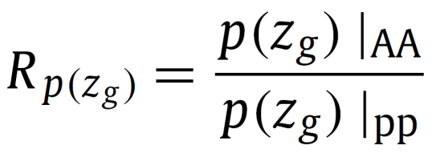
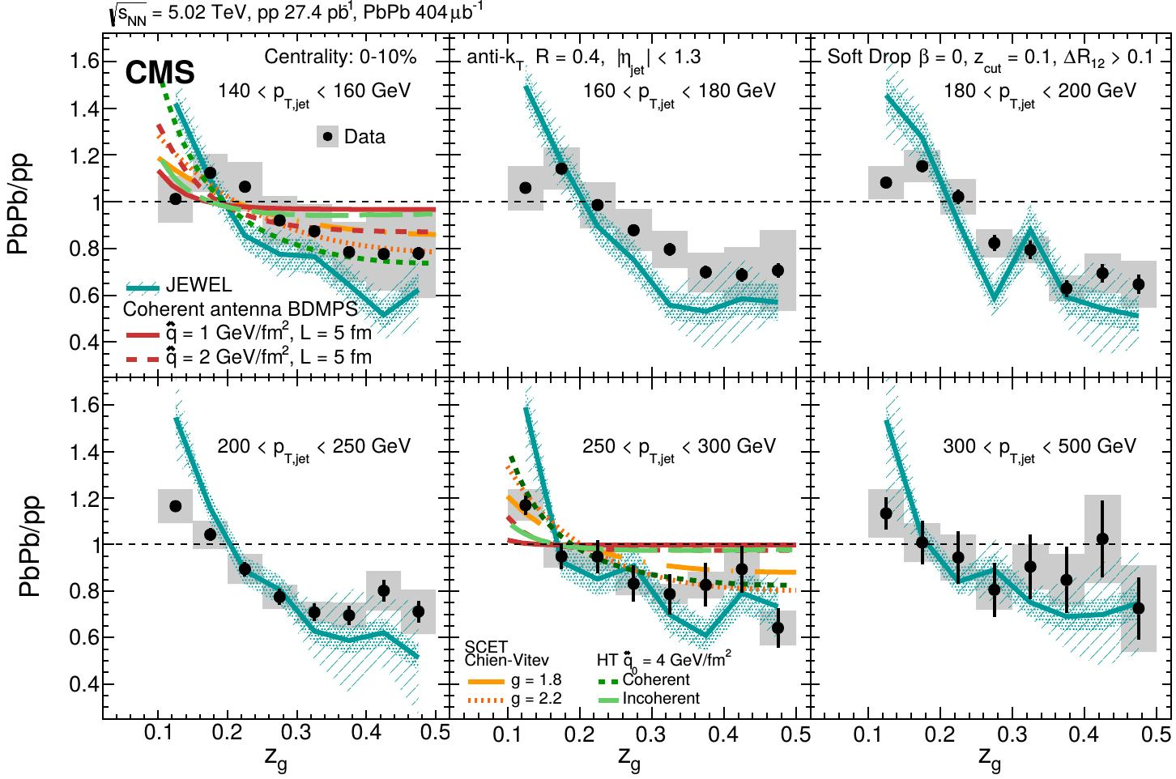
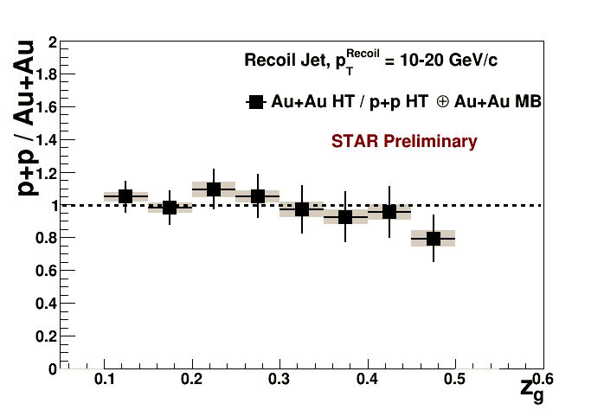
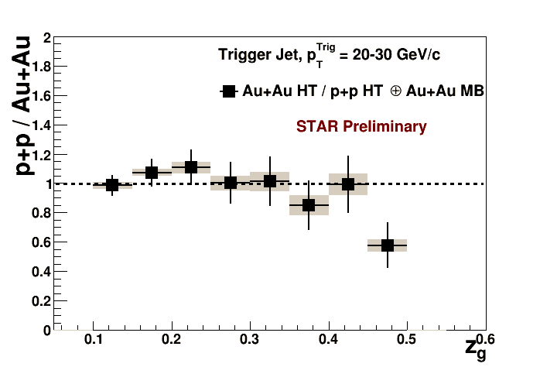
p_{T} dependence of the nuclear modification
CMS, PRL.120,142302
lower jet p_{T} ,
stronger modification
Kolja Kauder for STAR
Nucl.Phys.A967,516
small jet p_{T} ,
little modification
Notes:
Now let’s talk about the pT dependence of the nuclear modification of the zg distribution. Firstly, let’s see the data observed by CMS and STAR. They measure the zg distribution both in AA and pp collisions, and calculate the nuclear modification of zg distribution. Their results seem conflict with each other. From the measurement by CMS, we can see that the nuclear modification becomes stronger as the jet energy decreases. Follow this energy dependence we expect there should be stronger modification at RHIC energy, but actually there’s STAR observe very little modification . (Though there are different setup in two measurements, the main difference is that there is DeltaR cut in CMS but no such cut in STAR. But you can see from our theoretical results that, even with same setup there will be the conflict about the pT dependence. )

Slide 24


Comparison with CMS and STAR data
larger jet p_{T}
less modification
Non-monotonic jet p_{T} dependence!
larger jet p_{T}
larger modification
Notes:
Then let’s see the Let’s see the pT dependence of the nuclear modification, we can see that the nuclear modification becomes stronger with jet pT. Combined with the results at the LHC, the modification must depend on pT non-monotonically.
To show the non-monotonic behavior clearily, in next slide I will show the modification at endpoints as function of pT (pointing these points) continuously. I will show how the endpoints of the modification(these and those point) varying with pt.

Slide 25
Non-monotonic jet energy dependence
R_{AA} for p(z_{g}) at endpoints z_{g}=0.1 and z_{g}=0.5
Notes:
Solid lines represent the curve of (nuclear modification factor for) zg=0.1,which is always upper than 1, and dashed lines represent the curve for zg=0.5 which is always below than 1. We can see clearly the non-monotonic behavior, the modification increases with pT at first, then decreases after the maximum modification (at intermediate pT). Then Let’s see the origin to generate this non-monotonic behavior.

Slide 26



Origin of Non-monotonic jet energy dependence
Weight
x behavior
p_{T} decreases,
more p^{med}(x) vs. p^{vac}(x).
Explain p_{T} dep. of CMS
p_{T} decreases,
p^{med}(x) closer to p^{vac}(x).
Explain p_{T} dep. of STAR
Notes:
The origin is encoded in the calculation of the parton splitting function, it’s the competing of two factors about the medium induced splitting functions, the weight and x behavior. The weight means the fraction of the medium induced splitting process to the total. We can see from this plot that (the ratio decreases with increasing jet pT, because higher-twist contribution should be suppressed at larger energy. ) As pT decreases the contribution from medium induced splitting becomes more and more important making modification stronger, this is consistent with the observation by CMS collaboration, But why the modification can’t become stronger further at small jet energy?
This is related to the x behavior of the medium induced splitting. We can prove that at large energy limit the x behavior is one over x cube, and it becomes to one over x at small jet energy limit, note that the vacuum one is always roughly 1/x. So when jet energy decreases, the splitting function of the medium induced part becomes closer to the vacuum ones, making the modification decreases as jet energy decreases, this explain pt dependence indicated by the STAR data. The two competitive/competing factor lead to the non-monotonic behavior.

Slide 27




Coherent vs. incoherent energy loss of subjet?
By Casalderrey-Solana, Mehtar-Tani, Salgado and Tywoniuk, Phys. Lett. B 725 (2013) 357
Transverse separation:
Transverse wavelength:
Medium resolution scale:
Coherent: ${ r}_{⊥}<λ_{⊥}$ , $Λ_{med}$
Casalderrey-Solana and Iancu, JHEP 1108, 015 (2011)
Mehtar-Tani, Salgado and Tywoniuk, Phys. Lett. B707, 156 (2012)
Casalderrey-Solana, Mehtar-Tani, Salgado and Tywoniuk, Phys. Lett. B 725 (2013) 357
Mehtar-Tani and Tywoniuk, JHEP 1704, 125 (2017) ….
Notes:
All former results are obtained under the assumption that the two subjet lose energy coherently. There have been several studies about the color configuration between subjet. Whether they lose energy coherently or incoherently, depend on whether they can be resolved by the medium, which depends on the relation of transverse separation of two subjet, with the transverse wavelength of the subjet and the medium transverse resolution scale.

Slide 28



Effect of the incoherent energy loss (IEL)
Larger energy,
less energy loss fraction.
IEL reduces z_{g}:
$z_{1}≡z_{g}^{ini}$ , $z_{2}={1−z}_{1}$
IEL: $\frac{z_{1}^{′}}{z_{1}}<\frac{z_{2}^{′}}{z_{2}}$
$z_{g}^{fin}=\frac{z_{1}^{′}}{z_{1}^{′}+z_{2}^{′}}$ $≤z_{g}^{ini}$
How p(z_{g}) is modified depends on the slope of p(z_{g})
and details of z_{g} shift.
Notes:
We (are interested)/want to study the effect of incoherent energy loss, because in most theories “parton/jet with Larger energy, lose less fraction of energy ”, with this we can prove that if subjets lose energy incoherently, zg value is shifted to smaller value, and the naïve expectation is that the zg distribution at small zg will be enhanced. If zg distribution begin with zg euqals 0, it must be true. But the actual zg distribution starting from zg-cut/0.1 the final zg distribution need to be re-normalized in the range from 0.1 to 0.5. After the re-normalization, how the zg distribution is transformed/modified depends on the shape of p(z_{g}) and details of z_{g} shift.
.

Slide 29


Effect of the incoherent energy loss (IEL)
flattens p(z_{g})
steepens p(z_{g})
α≈1
α>1
Flattening factor dominates, larger α, larger modification.
Flattening factor dominates
Notes:
But in most cases, the zg-shift factor dominates the modification of zg distribution. The lower two figures show the ratio of the zg distribution after the incoherent energy loss with that before it. In the left figure, the initial p(zg) is the vacuum one, with the power alpha roughly euqals 1. In the right figure, the initial p(zg) is the medium modified one, with power alpha greater than 1. We can see that in both plots p(zg) are flatten so the distribution at large zg is enhanced, and because the factor delta zg over zg is multiplied by alpha, larger alpha leads to larger enhancement.
The effect of Jacobian factor partially counteracts/offsets the effect of zg-shift, making the modification more complicated.

Slide 30
Effect of the incoherent energy loss (IEL)
With IEL, the non-monotonic jet p_{T} dependence disappears, and the CMS data can’t be described.
Notes:
Last slide show the ratio of the final zg distribution with that before incoherent energy loss. To compare with the experimental data, we should calculate the ratio of final zg distribution with the vacuum one/(zg distribution). We can see that, in this case the nuclear modification still steepen the zg distribution, but the non-monotonic behavior disappears, (the modification becomes stronger with decreasing jet energy,) and CMS data can’t be described.

Slide 31

Coherent vs. incoherent energy loss
Only CEL can describe current experimental data.
Notes:
Finally, in this slide we compare the results of three scenarios . The black and red lines represent the results had been shown with coherent and incoherent energy loss respectively, and the dashed blue line is the result assuming incoherent energy loss but no medium induced splitting process. It seems that current experimental data prefer/favor the coherent energy loss.

Slide 32
Summary and outlook
Coupled differential transport equations for full jet evolution in QGP medium can describe the nuclear modification of the full jet energy and jet structure at LHC simultaneously.
The special effects of different jet-medium interaction mechanisms are analyzed, showing us:
Medium response can recover part of lost energy, is important for jet shape at large r.
Coll. contributes most to full jet energy loss
Coll. narrows jet shape, rad. and broad. broadens jet shape
Different mechanisms must be considered together
Inner core of lower energy jet becomes easier to be modified
Notes:
that medium induced radiation and kt broading is important to the modification of jet shape, but contribute less to the jet energy loss. Collisional energy loss is important for both of modification of jet energy and jet structure.
This is our outlook, among them the ‘medium response ’ in once on our list, but this work has been done in collaboration with Yasuki. We have seen the results in last talk.

Slide 33
Summary and outlook
We study the nuclear modification of groomed jet splitting function using higher-twist jet energy loss formula.
Nuclear modification of jet splitting function depend on jet p_{T} non-monotonically.
Within current kinematics, CMS and STAR data favor coherent energy loss picture.
Further measurements with wider p_{T} range at RHIC and the LHC, and with varying angular separation and jet cone size can test our finding about jet splitting function.
We need systematic studies to obtain full understanding on jet-medium interaction.
Thanks for your attention!
Notes:
To conclude, we study the nuclear modification of groomed jet splitting function and the color configuration of the subjet. We find the nuclear modification of groomed jet splitting function depends on jet pT non-monotonically, and current experimental data prefer the picture subjets lose energy coherently. Further measurement at RHIC or LHC covering wider pT range, and with various jet cone size and angular separation can test our finding/result.

Slide 34
Backup

Slide 35

Jet Energy Loss from diff. mechanisms
R=0.3
Collisional energy loss contribute the most,
medium induced radiation contribute least
but can enhance other mechanism.
Notes:
After we can describe a set of observables on full jet energy loss./(after we have confidence the our model can describe observables on jet energy loss). We now can begin to see/study/search the main reason which is responsible to the full jet energy loss.
Here this plot show the effects of to energy loss (induced by)/of different mechanism and their combination. The upper one for quark jet and the lower one for gluon jets. We can see that, firstly gluon jet lose more energy than quark jets, and for both kinds of jets collisional energy dominate the energy loss . Inversely medium induced radiation render/results in/contribute lest energy loss. That because the radiated parton can still exist/be included in the jet cone. Though medium induced radiation results in little energy loss directly, it can enhance the energy loss of other mechanisms because it increase the parton number in the jet. This can be seen by the combination of rad. and other mechanism.
Collisional energy loss and energy loss from transverse momentum broadening are both proportional to the number of constituent partons in the jet, which can be learn from the fact the combined with medium induced radiation can enhance their energy loss.

Slide 36

Sensitivity to the value of qhat
Every mechanism has sensitivity to qhat,
but the sensitivity become modest when all of them exist
Notes:
finally, we study the sensitivity of the modification on the value of qhat, this plot shows that when only one mechanism exsit, the modification of jet shape do have dependence on the value of qhat, but when all of the three mechanisms take effect, the modification of jet shape have very little sensitivity on the value of qhat. But on the way to describe the ratio/RAA of the jet shape more precisely/exactly, we can learm more informations on the interplay between different mechanisms and their relative magnitudes. We can’t expect one observable can tell us everything.

Slide 37
Effect of medium response

Slide 38


Comparison with CMS data of mid-central collision

Slide 39
Comparison with STAR data
There are non-monotonic jet energy dependence both in experimental data and in theory!
Notes:
Note that in the calculation at RHIC energy, we don’t adjust the value of qhat, just use the value of one half of that at LHC. The STAR measurement don’t set DeltaR-cut, so we do the calculation the results with different DeltaR. The result with small DeltaR can fit the STAR data, and even with same DeltaR=0.1 as that at the LHC the result can fit data in error bars. And from the results at higher pT bins, we can see that the nuclear modification becomes stronger as jet pT. Combined with the results at the LHC, there must be non-monotonic hehavior.

Slide 40



Slide 41



Effect of the incoherent energy loss (IEL)
z_{g} shift
Jacobian
increases with z_{g}
decreases with z_{g}
flattens p(z_{g})
steepens p(z_{g})
Notes:
If we assume the initial zg distribution is one over zg to the alpha power, after some derivation the final zg distribution is …. Here the black part is the modification due to zg-shift, the red part is the Jacobian.
(if without enough time: “it’s easily to prove that the zg-shift part flatten the zg distribution, and The jacobian steenpens the zg distribution”)
The zg-shift part depends on value of delta-zg over zg, and the Jacobian part depend on the differential of delta-zg over zg (as the function of initial zg). From the lower plot of zg shift we can get the plot of delta-zg. we can see the delta zg over zg is larger at small initial zg than that at large initial zg. This renders the zg-shift factor increases with zg, and will flatten the zg distribution. From the plot of delta-zg, we can also see that the differential of delta-zg over zg is positive at small initial zg and negative at large initial zg, this renders the Jacobian factor decreases with zg, which will steepen the zg distribution.

Slide 42


Effect of the incoherent energy loss (IEL)
$\frac{∆z_{g}}{z_{g}}$ large at small $z_{g}$,
small at large $z_{g}$.
$\frac{d∆z_{g}}{{dz}_{g}}$ plus at small $z_{g}$,
minus at large $z_{g}$.
increases with z_{g}
decreases with z_{g}
flattens p(z_{g})
steepens p(z_{g})
Notes:
If we assume the initial zg distribution is one over zg to the alpha power, after some derivation the final zg distribution is …. Here the black part is the modification due to zg-shift, the red part is the Jacobian.
(if without enough time: “it’s easily to prove that the zg-shift part flatten the zg distribution, and The jacobian steenpens the zg distribution”)
The zg-shift part depends on value of delta-zg over zg, and the Jacobian part depend on the differential of delta-zg over zg (as the function of initial zg). From the lower plot of zg shift we can get the plot of delta-zg. we can see the delta zg over zg is larger at small initial zg than that at large initial zg. This renders the zg-shift factor increases with zg, and will flatten the zg distribution. From the plot of delta-zg, we can also see that the differential of delta-zg over zg is positive at small initial zg and negative at large initial zg, this renders the Jacobian factor decreases with zg, which will steepen the zg distribution.

