Slide 1

High Intensity Electron Positron Accelerator (HIEPA) Super Tau Charm Facility（STCF）in China
彭海平
penghp@ustc.edu.cn
核探测与核电子学国家重点实验室
中国科学技术大学
(代表STCF指导委员会)
高能加速器物理战略研讨会2018, 6月21日, 上海

Slide 2
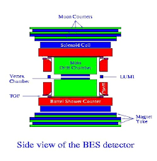
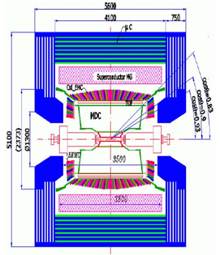
30 Years of τ-c facility in China
BEPCI (1988−2005)
Single Ring
10³¹cm⁻²s⁻¹ ⇒ 10³³cm⁻²s⁻¹
BEPCII (2006−now)
Double Ring
BESI/II
BESIII
Notes:
经历

Slide 3
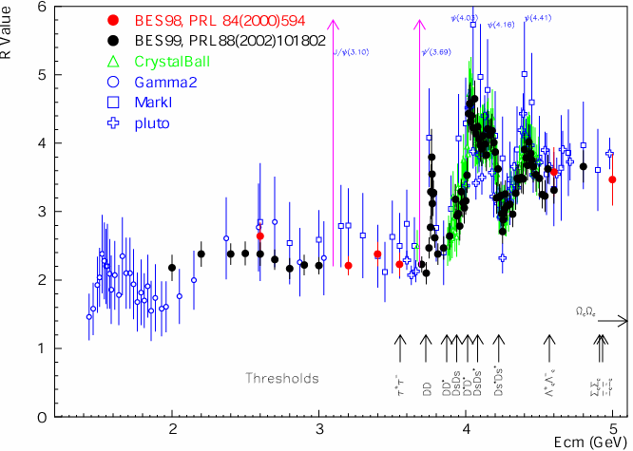
Broad Physics at τ-c Energy Region
Unique features ：Rich of resonance, Threshold characteristics, …..
Abundant physics
R=s(e⁺e⁻→hadron)/
s(e⁺e⁻→m⁺m⁻)
Hadron form factors
Y(2175) resonance
Mutltiquark states with s quark, Zs
MLLA/LPHD and QCD sum rule predictions
Light hadron spectroscopy
Gluonic and exotic states
Process of LFV and CPV
Rare and forbidden decays
Physics with τ lepton
XYZ particles
Physics with D mesons
f_{D} and f_{Ds}
D₀-D₀ mixing
Charm baryons
与其他高精度平台（如B、φ工厂）是互补，不可替代的
Notes:
Abundant physics topic are expected in the tau-charm energy region.
For example, in 2-3GeV, it is ideal region to study the hadron form factors,
Study the properties of Y(2175) and search for the mulitquaks states with s quark,
It also can be used to test QC sum rule predictions.
In the charmonium energy region, which can collect very very last data samples, and
It can be used to study the light hadron spectroscopy And gluonic and exotis states.
It also can be used to search for the LFV process, CPV process and rare and forbidden decays preocss.
Of course tau physics can be one of landmark in this region.
Above the 4GeV region, It is ideal place to study XYZ particle, Physics with D meason
And D-D0 mixing charm bayrons.
Of course, the R scane in the whole energy region will definenalyy improve the presision
Of delta Alpha QDQ, charm quark mass extraction. Estpcaiilly in the range from 5-7 GeV,
There are very rare experiment data to day.
The data can also be use for the hadron from factor study.

Slide 4
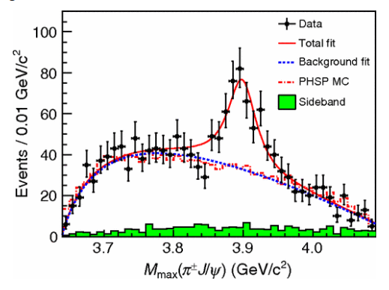
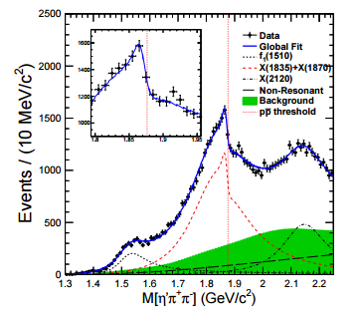
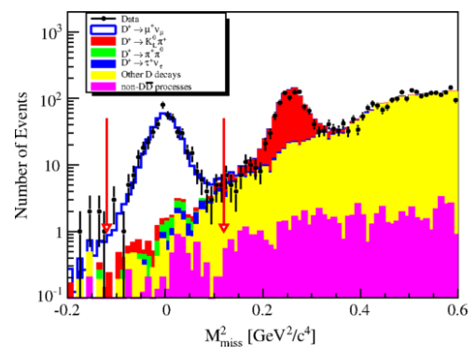
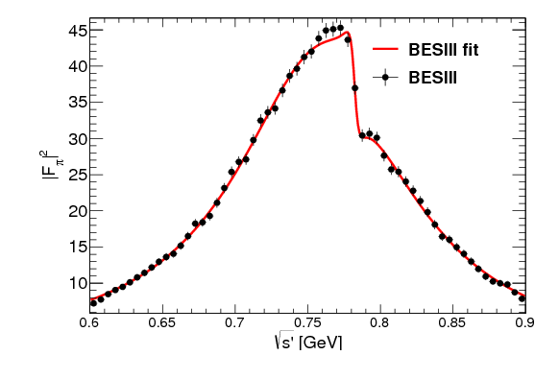
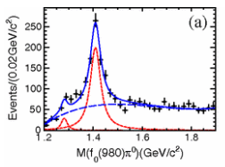
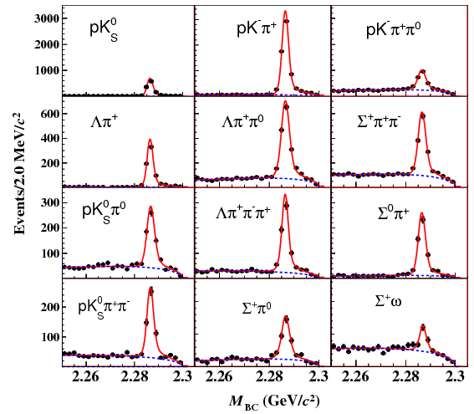
Fruitful BESIII Results
Z_{c}(3900)
Abrupt structure
Most precise measurement for D leptonic decay
X(1835)
Large Isospin Violation
η(1405)→f₀(980)π⁰
First Λc at BESIII
Precise measurement
Precise Measurement on Cross section
e ⁺e⁻→π⁺π⁻

Slide 5
Publication of BESIII
≈200 publications, 1/5 PRL
Excellent in both number and quality
http://bes3.ihep.ac.cn/pub/physics.htm

Slide 6
τ-c facility in China
BEPCII/BESIII have run 9 years, successful and excellent production
Limited by length of storage ring, no space and potential for the upgrade
Physics study limited by the luminosity, CME ……
Charmonium-like physics
Charmed baryon physics
Charmed meson and tau physics
………..
Challenged by Belle II
BEPCII/BESIII will end her mission in 5-10 years
A STCF far beyond BEPCII, is nature extension and a viable option for a post-BEPCII HEP project in China
Notes:
BEPCII/BESIII will end her mission around 2020,
Led by the high energy Physics association of China, we are exploring possible
Future collider proejct post BEPCII and BESIII
High intensity Electron Positron accelerator (HIEPA) is one of the options.
HIEPA facility can be serviced as a collider machine,
Which provide peak lumin…..
The energy range from 2-7Gev, polarization available on one beam
And the symmertic machine with low currents and crabbed saist solution for the interation….
It also can

Slide 7
STCF in China
Super Tau-Charm Facility (STCF)
Peak luminosity 0.5-1×10³⁵ cm⁻²s⁻¹ at 4 GeV
Energy range E_{cm} = 2−7GeV
Polarization available on beam (Phase II)
Basic Features of machine :
Symmetric machine with dual-ring, 600-1000meter
Large Piwinski angle collision + crabbed waist solution for the IR
Siberia snake for polarization
Notes:
BEPCII/BESIII will end her mission around 2020,
Led by the high energy Physics association of China, we are exploring possible
Future collider proejct post BEPCII and BESIII
High intensity Electron Positron accelerator (HIEPA) is one of the options.
HIEPA facility can be serviced as a collider machine,
Which provide peak lumin…..
The energy range from 2-7Gev, polarization available on one beam
And the symmertic machine with low currents and crabbed saist solution for the interation….
It also can

Slide 8
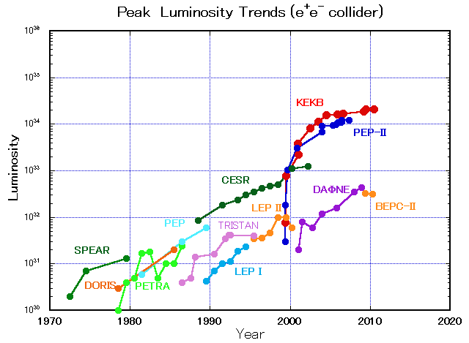
STCF in Perspective
SKEKB
STCF
BEPC-II
BEPC
2028
A luminosity 1×10³⁵ cm⁻²s⁻¹ at 4 GeV at 2028 is reasonable !!

Slide 9
Layout of Machine
Interaction Region : Large Piwinski Angle Collision
+ Crabbed Waist
Detector
Snakes
Crab Sextupole
Injector
Wigglers
Linac
0.5-3.5
GeV
Injector:
No booster, 0.5GeV→1~3.5GeV
e+, a convertor, a linac and a damping ring, 0.5GeV
e-, a polarized e- source, accelerated to 0.5GeV
Key Technology ：
Luminosity ：Large Piwinski Angle Collision + Crabbed Waist
Polarization：Siberlan Snake
e+0.5GeV
e- 0.5GeV

Slide 10
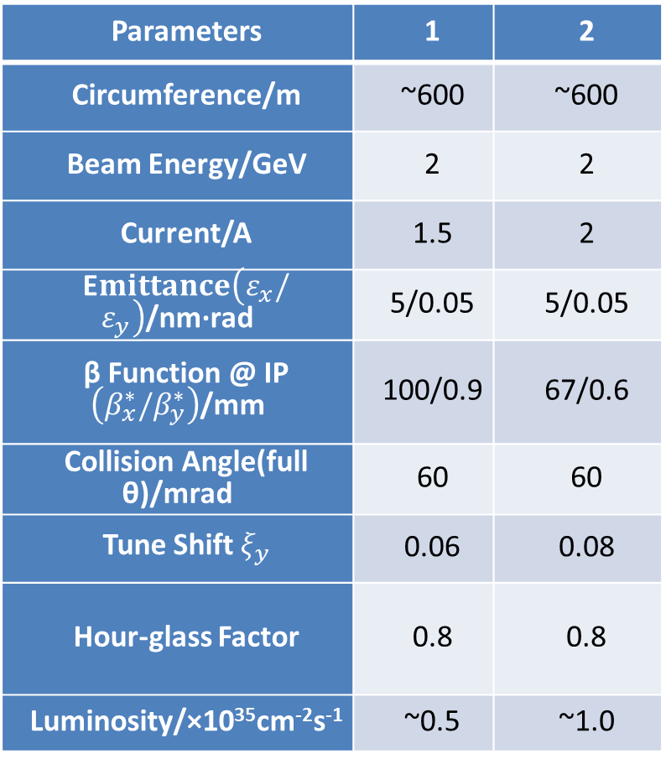
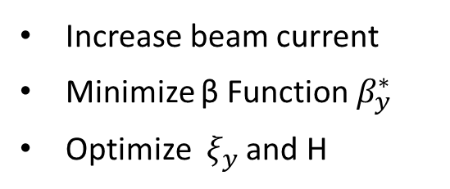
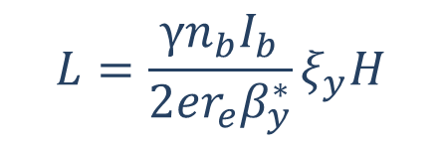
Parameters of Machine
Parameters | 1 | 2
Circumference/m | ~600 | ~600
Beam Energy/GeV | 2 | 2
Current/A | 1.5 | 2
E$mittance\left(ε_{x}/ε_{y}\right)$/nm·rad | 5/0.05 | 5/0.05
β Function @ IP $\left({β_{x}^{∗}/β}_{y}^{∗}\right)$/mm | 100/0.9 | 67/0.6
Collision Angle(full θ)/mrad | 60 | 60
Tune Shift $ξ_{y}$ | 0.06 | 0.08
Hour-glass Factor | 0.8 | 0.8
Luminosity/×10³⁵cm⁻²s⁻¹ | ~0.5 | ~1.0
Luminosity :
$$L=\frac{γn_{b}I_{b}}{2er_{e}β_{y}^{∗}}ξ_{y}H$$
Increase beam current
Minimize β Function $β_{y}^{∗}$
Optimize $ξ_{y}$ and H
Strategy :
(Phase 0) Pilot: 0.5×10³⁵
(Phase I) Nominal: 1.0×10³⁵
(Phase II) Polarized beam
…..

Slide 11
General Consideration of Detector
Much larger radiation tolerance, especially at IP and forward regions
The detector and electronics should withstand the expected does
Efficient event triggering, exclusive state reconstruction and tagging
High efficiency and resolutions for charged and neutral particles
Low noise and High rate capability
The Systematic uncertainty control
Detector acceptance : geometrical acceptance or detector response
Mis-Measurement : mis-tracking, fake photon, particle mis-id, noise
Luminosity measurement
Reasonable cost

Slide 12
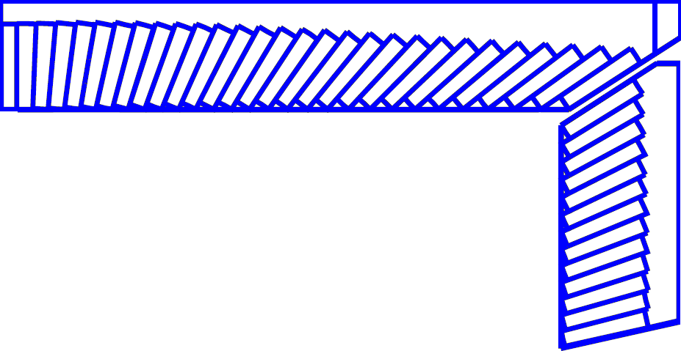
Detector Layout
245 cm
MUD
μ/π suppression power >10/30
York/Muon
185 cm
EMC
Energy range: 0.02-2.5 GeV
At 1 GeV σ_{E} (%)
Barrel(Cs(I): 2
Endcap (Cs): 4
Superconducting magnet
(0.7-1 T)
York/Muon
135 cm
EMC
105 cm
PID
π/K (and K/p) 3-4σ separation up to 2GeV/c
PID-barrel
85 cm
20°
PID-endcap
MDC (Low mass )
σ_{xy}=130 mm
dE/dx<7%, σ_{p}/p =0.5% at 1 GeV
MDC
15 cm
PXD/SSD
PXD
Material budget ~0.15%X₀/layer
σ_{xy}=50 mm
10 cm
3~6 cm
IP
120 cm
140 cm
190 cm
240 cm
300 cm
Notes:
We also have very preliminary conception design for the Detector, a very BESIII like symetry
Detectors is proposed.

Slide 13
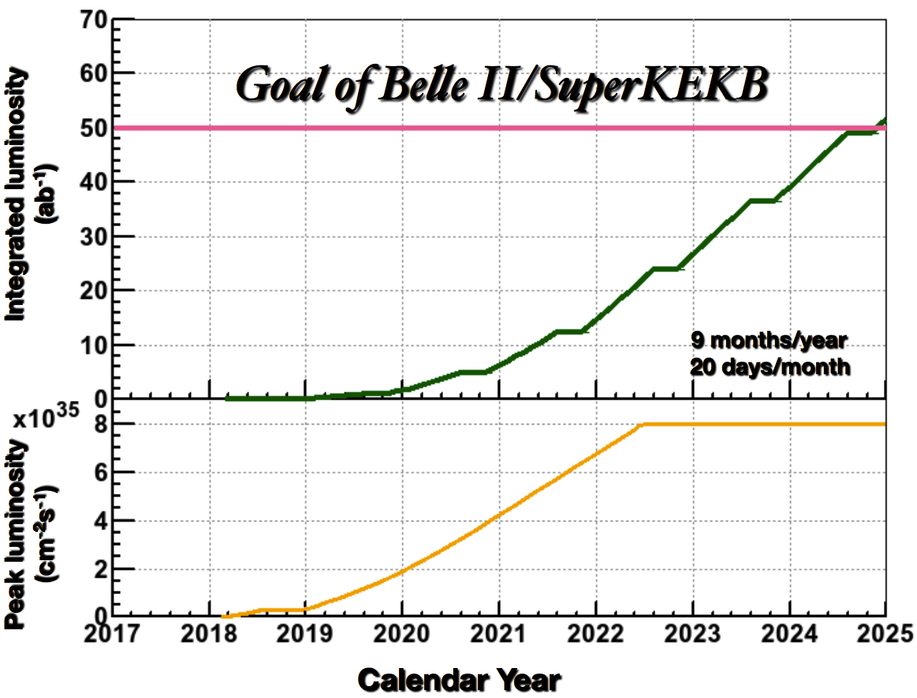
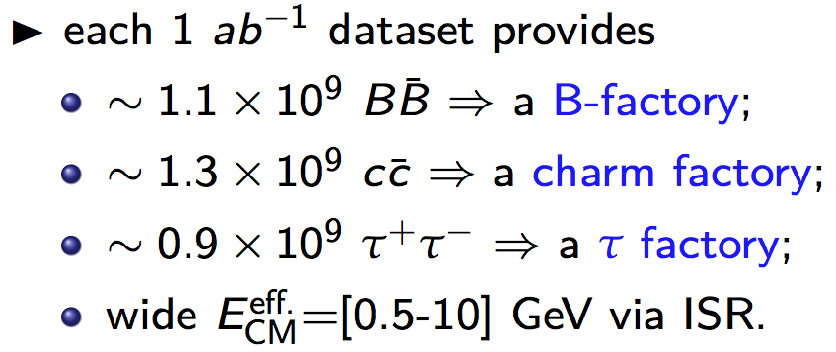
Integral Luminosity of STCF
No Synchrotron radiation mode, assume running time 9 months/year
Assume data taking efficiency 85%
10³⁵cm⁻²s⁻¹ × 86400s × 270days × 85% ∼ 2.0ab⁻¹ /year
10 years data taking, total 20 ab⁻¹ conservatively
Excellent opportunities for the τ-charm physics
BELLEII
Native question : Compete between STCF and BELLE II ?
Notes:
With assumed 10^35 luminrocity, it is estimated to get the 1.4ab-1 data per year
Taking into account really running days and data taking efficiency.
It is expected to collected 10^9 D meson pair and Tau lepton pairs.
These data is about 1/3 of BELLE-II data/per year which is expected to run with luminosity at 10^36

Slide 14
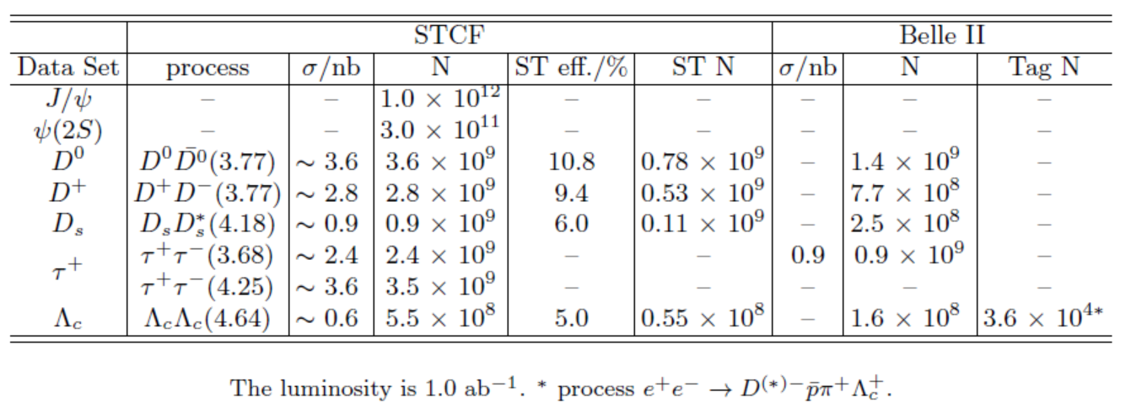
Data samples
Data samples with 1 ab⁻¹ integral luminosity
STCF have more yields /per luminosity
STCF is expected to have higher detection efficiency
Belle II can have larger integral luminosity
Detail simulations are ongoing to study the potential for the physics research

Slide 15
Highlight Physics @ STCF
Rich of physics program, unique for physics with c quark and τ leptons,
important playground for study of QCD, exotic hadrons and search for new physics.
Charmonium-like (luminosity and CME)
Charmed meson (Luminosity)
Charmed baryon (CME)
Tau CP (polarized beam)
New physics (luminosity)
……..

Slide 16
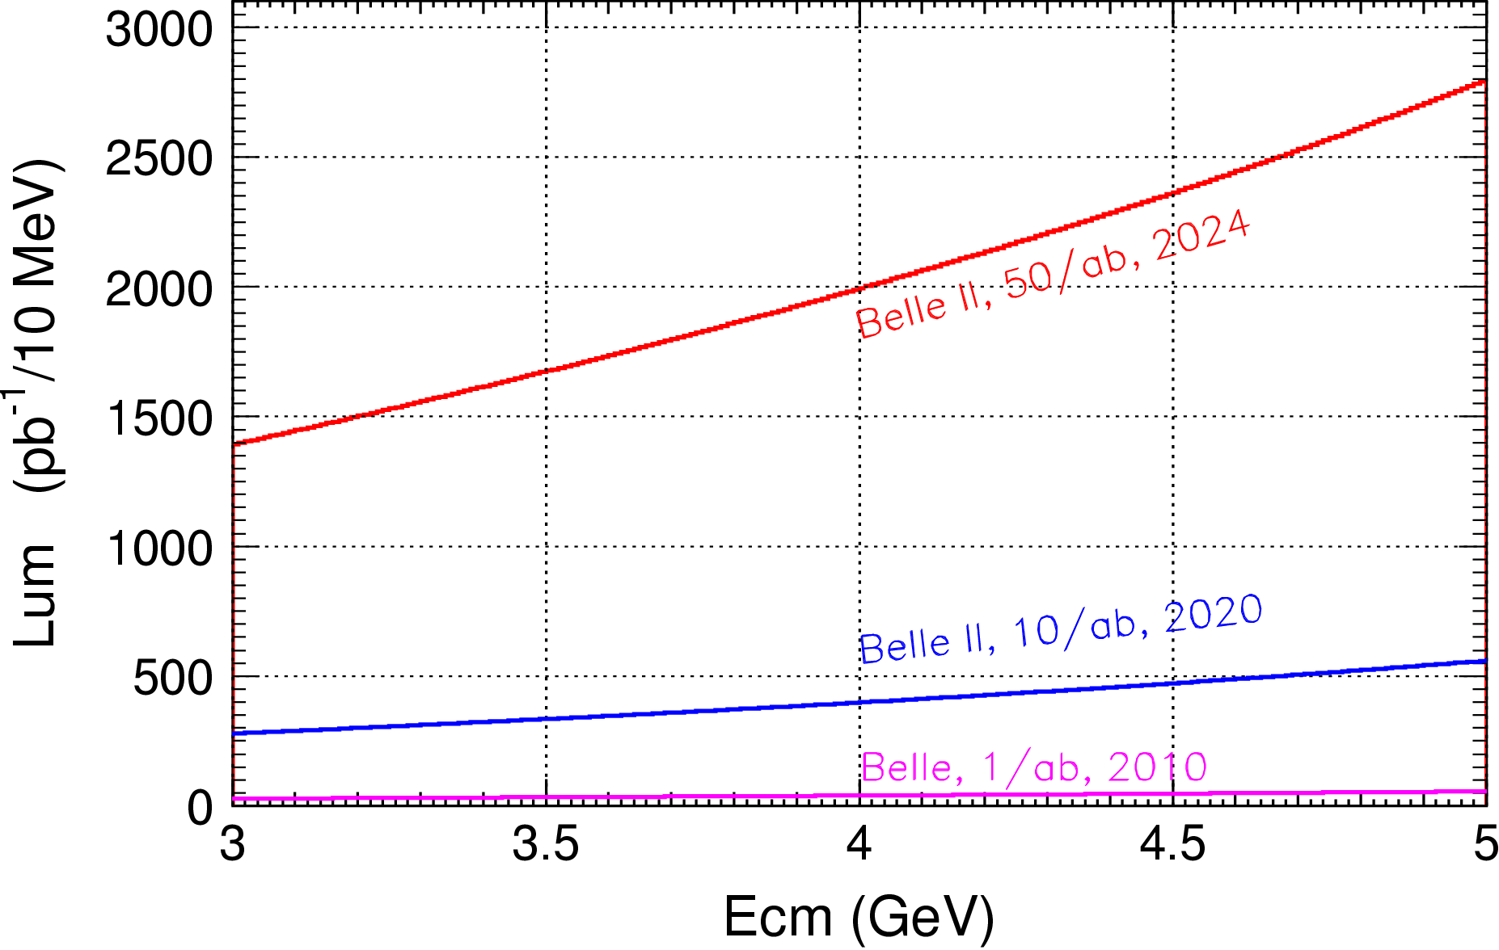

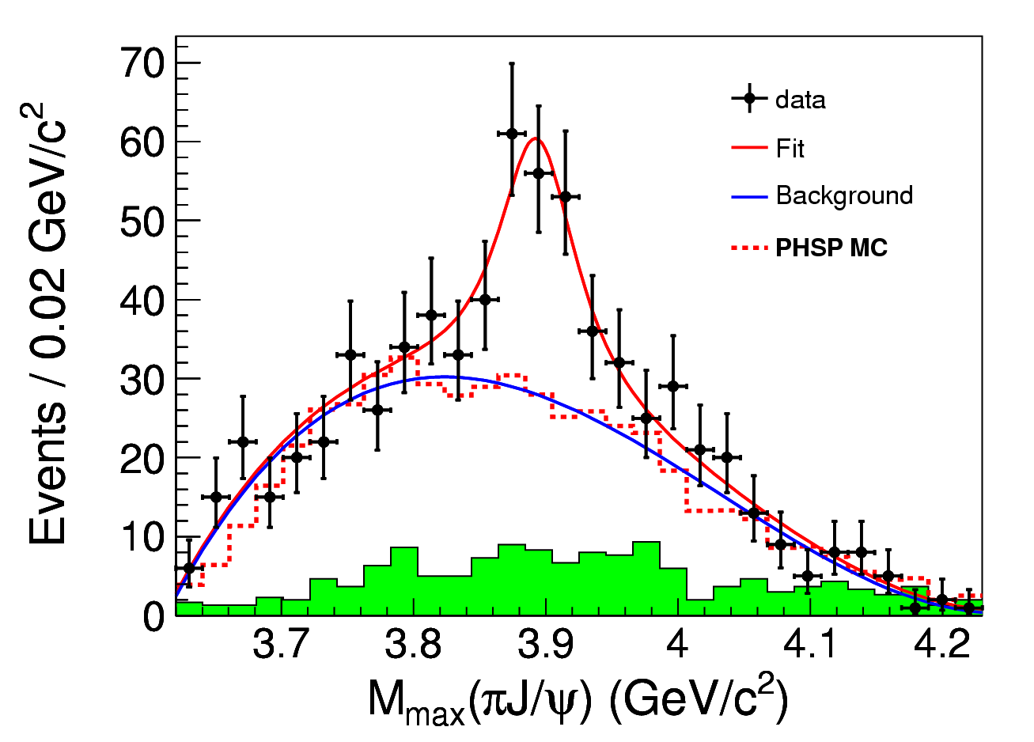
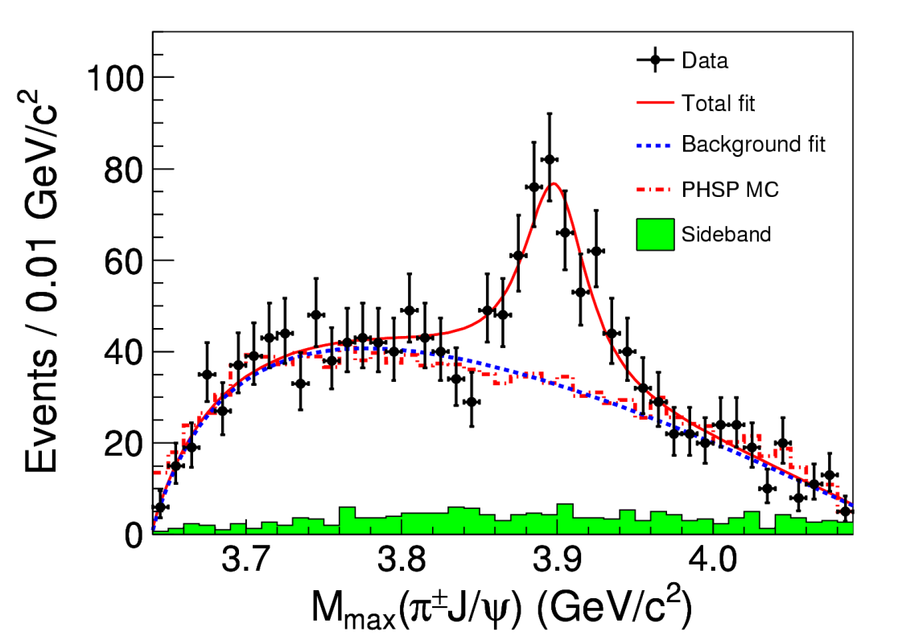

Charmonium-Like Physics
Fruitful results in past decade, a new territory to study exotic hadrons
τ-C Factory : e⁺e⁻→Y/ψ→Z_{c}+ X
B Factor : ISR, B decay
Belle with ISR: PRL110, 252002
967 fb⁻¹ in 10 years running time
@ 4.26 GeV for π⁺π⁻J/ψ
ε_{BESIII} = 46%, ε_{Belle} = 10%
>5.2σ
BESIII at 4.260 GeV: PRL110, 252001
0.525 fb⁻¹ in one month running time
B factory : Total integrate effective luminosity between 4-5 GeV is 0.23ab⁻¹ for 50 ab⁻¹ data
τ-C factory : scan in region 4-5 GeV, 10 MeV/step, every point have 20 fb⁻¹/year, 10 time of Belle II for 50 ab⁻¹ data
τ-C factory have much higher efficiency than B Factory
>8σ

Slide 17
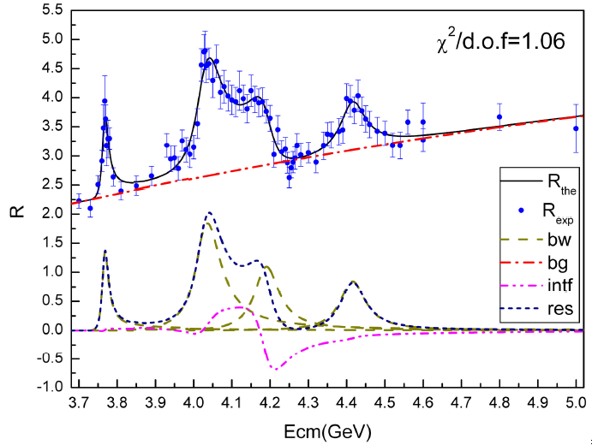
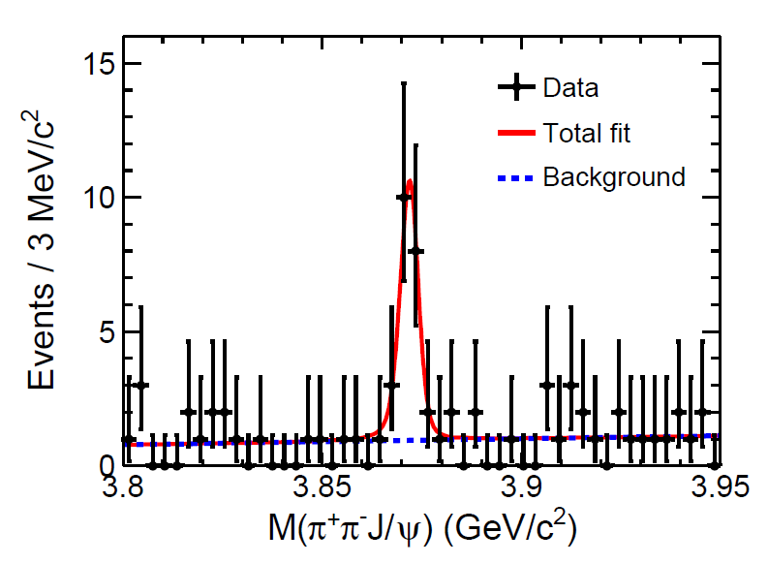
Charmonium-Like @ τ-c Factory
ψ/Y/Hybrid(ccg) (1⁻⁻) produced in the e⁺e⁻ collision
To determine the resonance parameters for the excited ψ or Y state
Precisely measure the x-sec of inclusive/exclusive final states at different Ecms
Charge parity c=+1 states produced via radiative transition from vector ψ/Y
The decay rate ψ(nS/nD)→γX(3872), X(3940)…
Search for χ_{cJ}(2P)、χ_{cJ}(3P)、η_{c}(3S)、 η_{c}(4S)、 …
  B(ψ(3S)→γχ’_{cJ}) = (7, 3, 1) x 10⁻⁴ for J=2,1,0
  [Rev. Mod. Phys. 80, 1161 (2008) ]
Search for new states from hadronic transition
To search for Zc, Zcs, hc(2P) ….
PLB 660, 315 (2008)
PRL 112, 092001 (2014)
σ(Y(4260) →γX(3872))∼6pb

Slide 18
Search for 1⁻⁻ Hybrid H_{ccg}→γη_{c} & γχ_{c0}
1^{–-} Hybrid may produce directly in e⁺e⁻ collision, and radiative decay to spin-zero charmonium states [in Hybrid, cc in spin-singlet, LQCD by Dudek′09]
Assume σ(e⁺e⁻→H_{ccg}) ∼ O(10−100) pb [???]
B(H_{ccg}→γη_{c})∼2×B(η_{c2}→γχ_{c0}) ∼ 4×10⁻⁴
Scan between 4-5 GeV for 1 year (2ab⁻¹), search for exotic structure in process e⁺e⁻→γη_{c} and γχ_{c0}
Assume εB ∼ 10% for γη_{c} and γχ_{c0} decay to γ+hadrons
With 100 energy points between 4-5 GeV
N^{obs}(γη_{c})=O(8-80) events/point/year at peak
N^{obs}(γχ_{c0})=O(4-40) events/point/year at peak
Notes:
A selected interesting topic is to search 1-- Hybrid state, since the spin is 1—
And it is expected to produced directly from the ee collistion and detecter
By its e1 trnasition to etc and chi_c0.
So we can try to scan the data for this exotic structure.
If

Slide 19
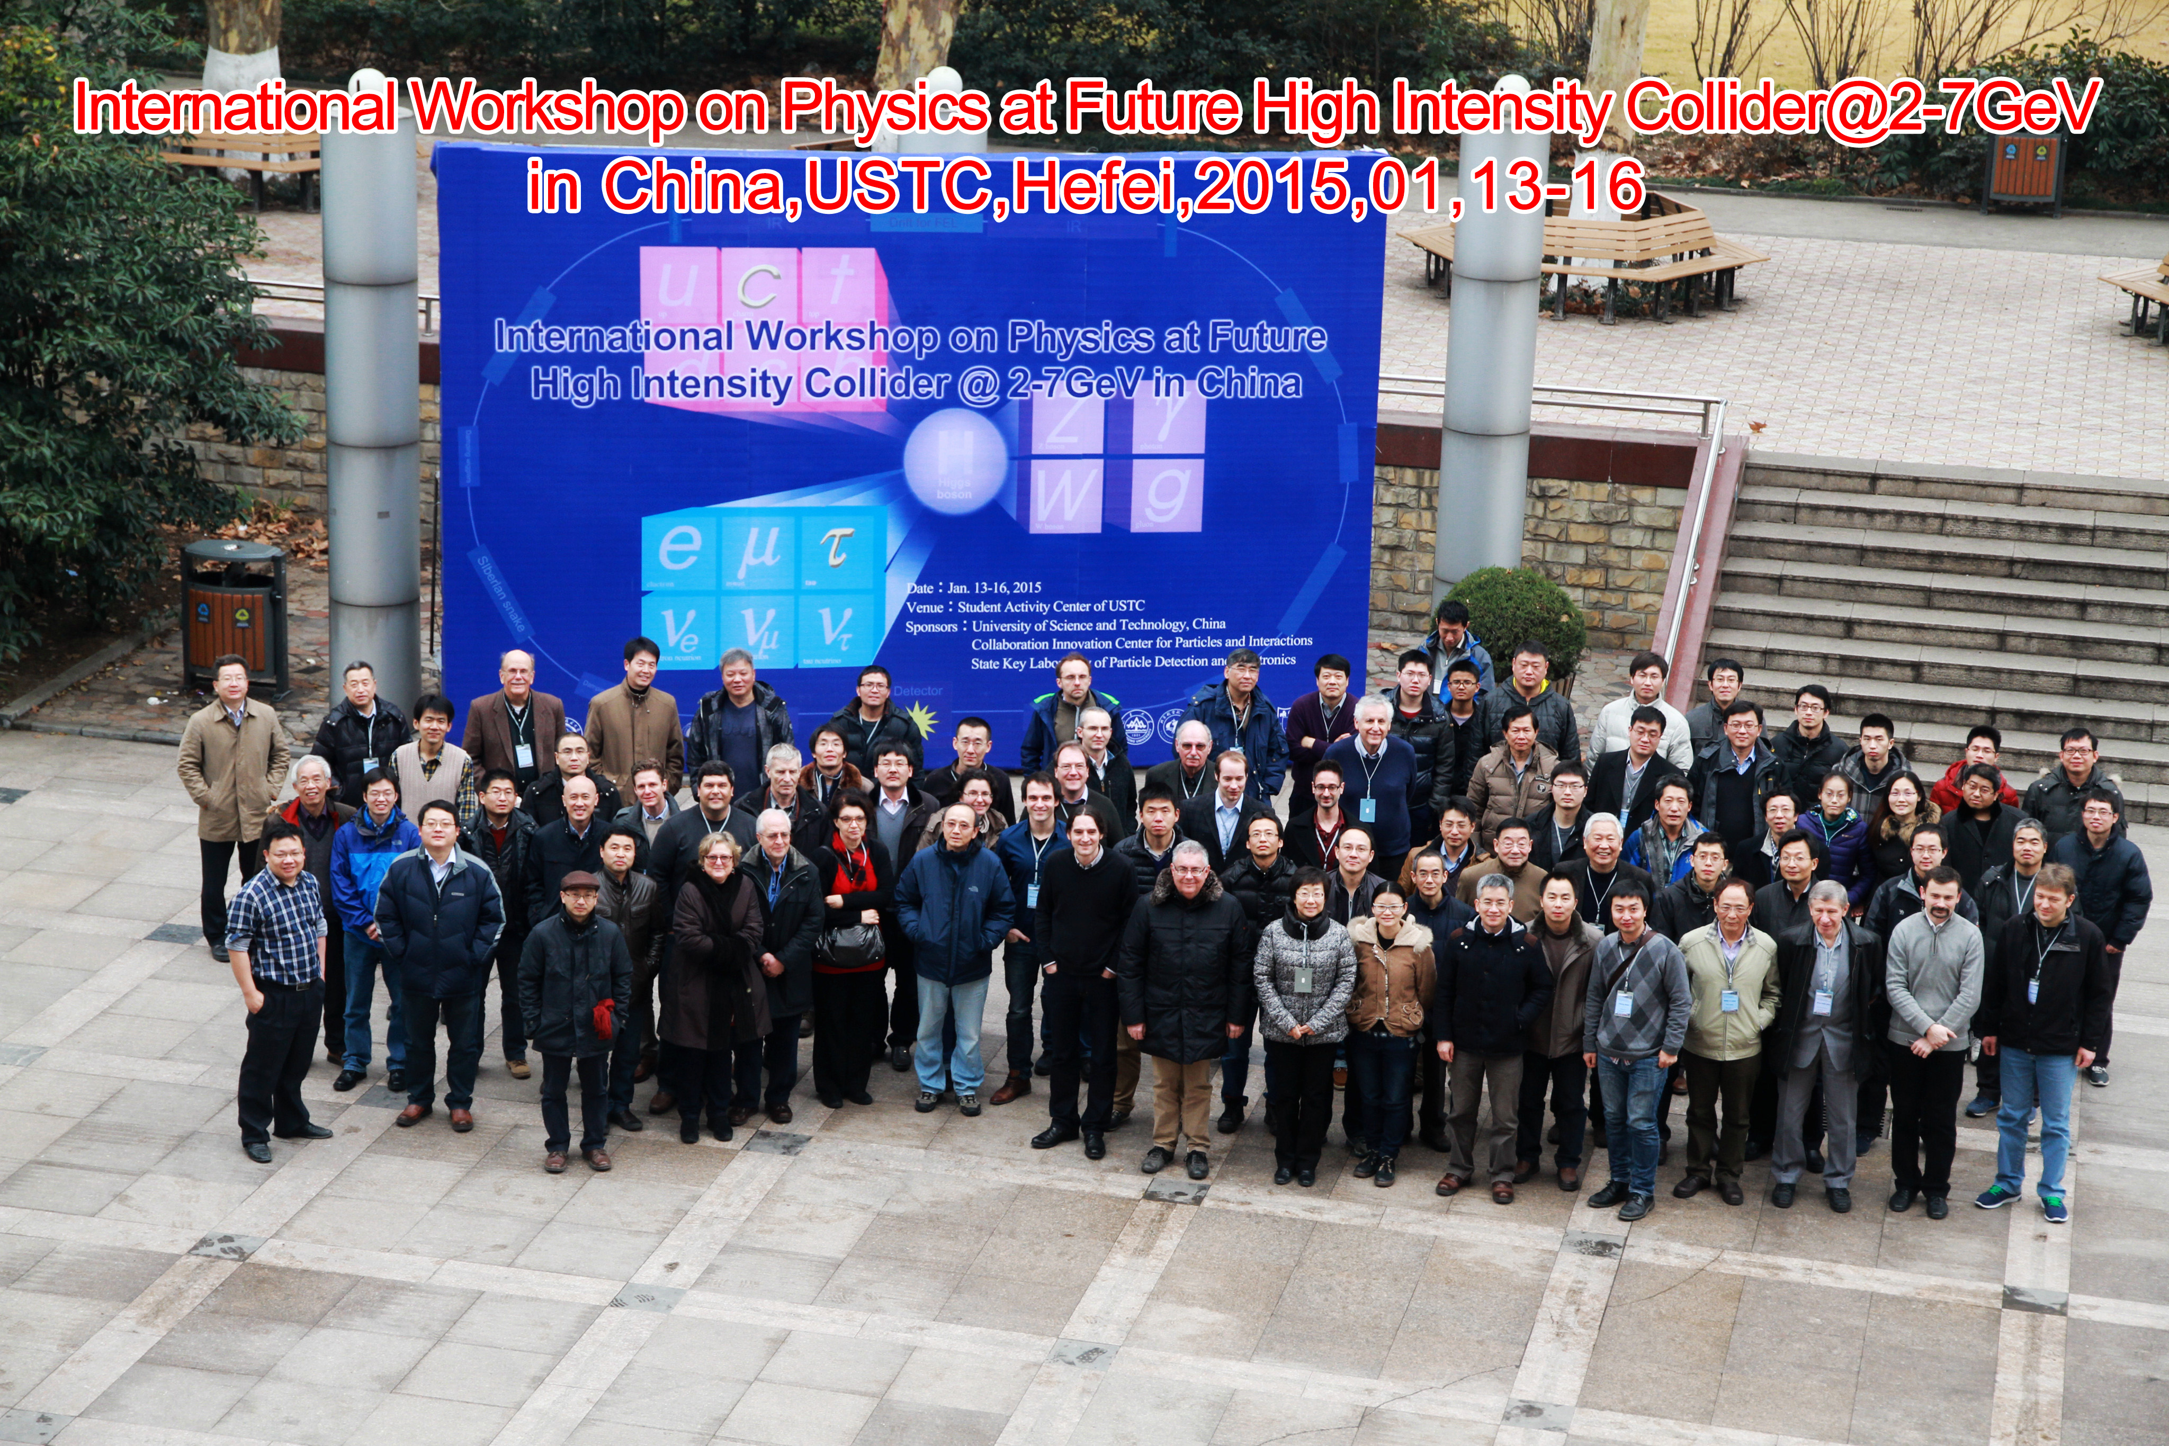
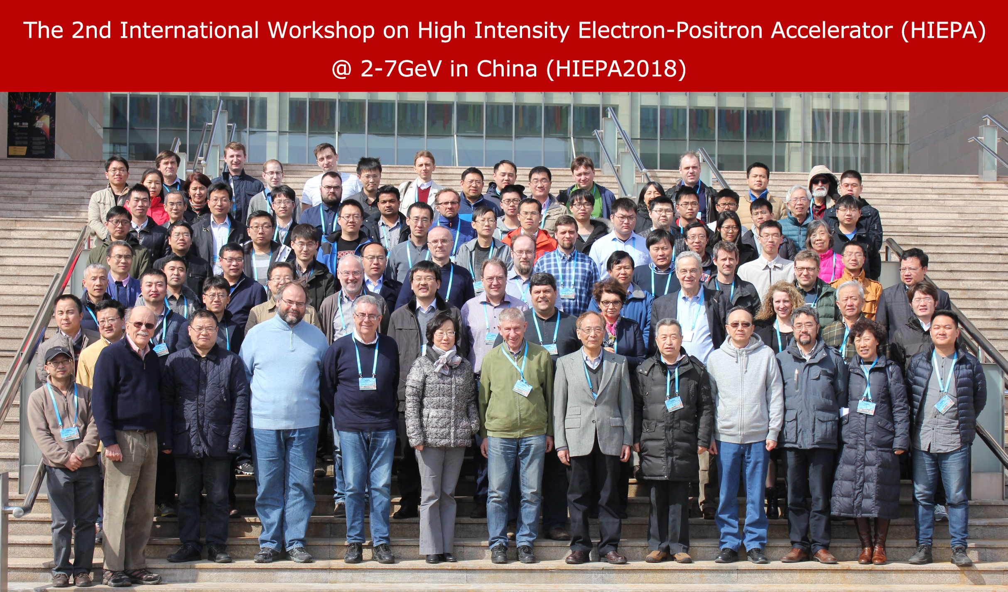
Science & Technology Review
Two international workshop : Hefei (2015), Beijing(2018)
More than 100 participants, more than 50% of them are from oversea
Presented project status, overview the physics potential and discuss the design and key technology of accelerator and detection

Slide 20

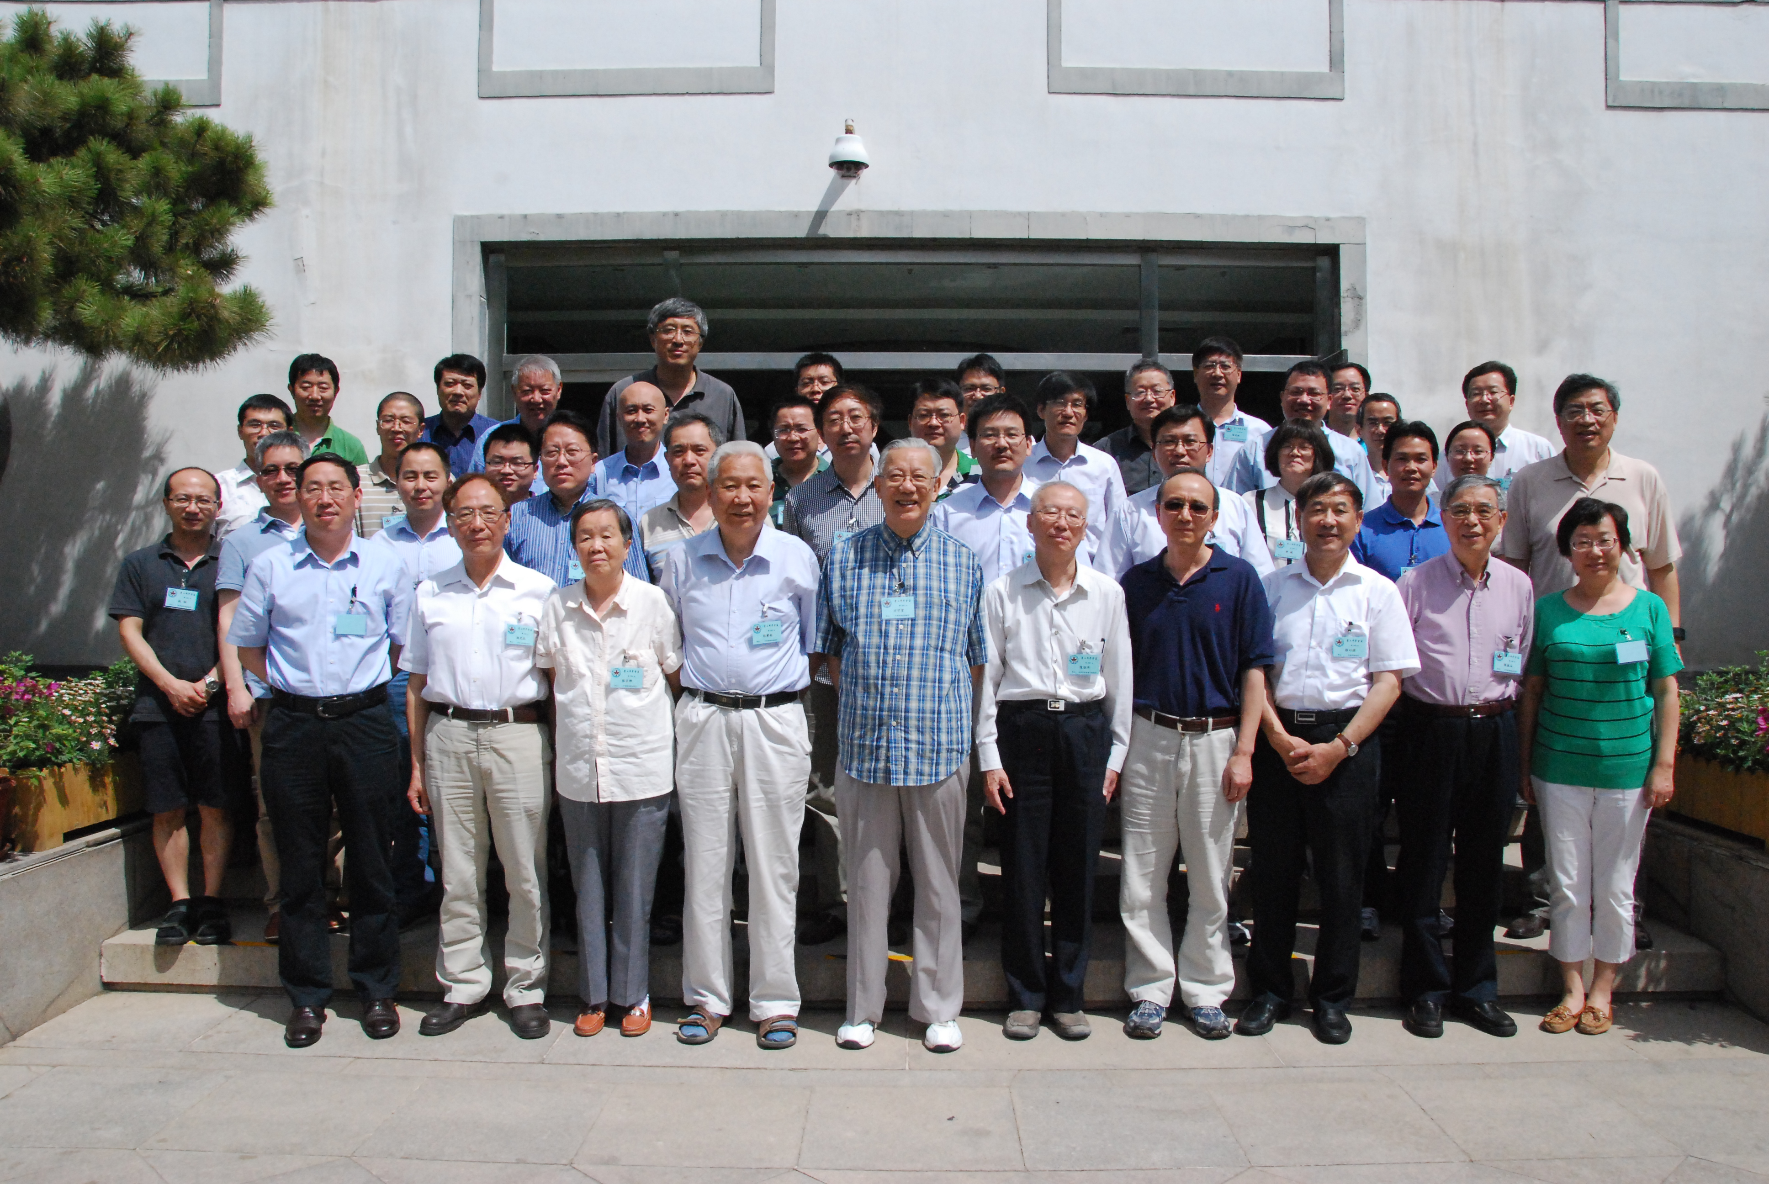
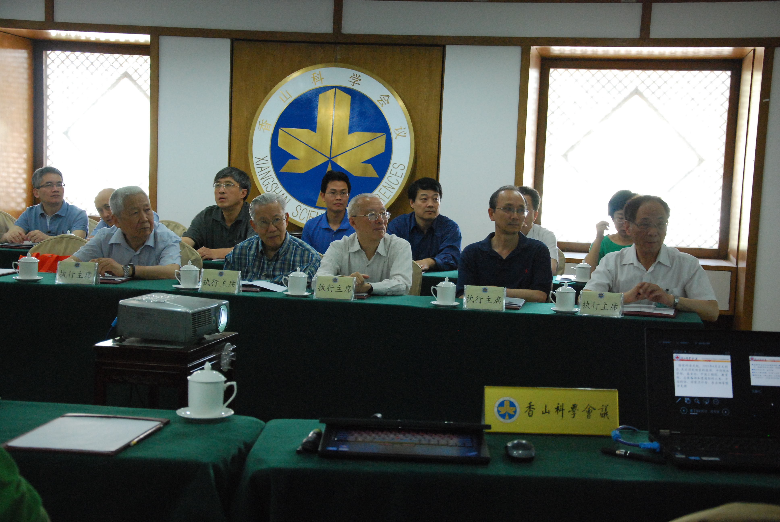
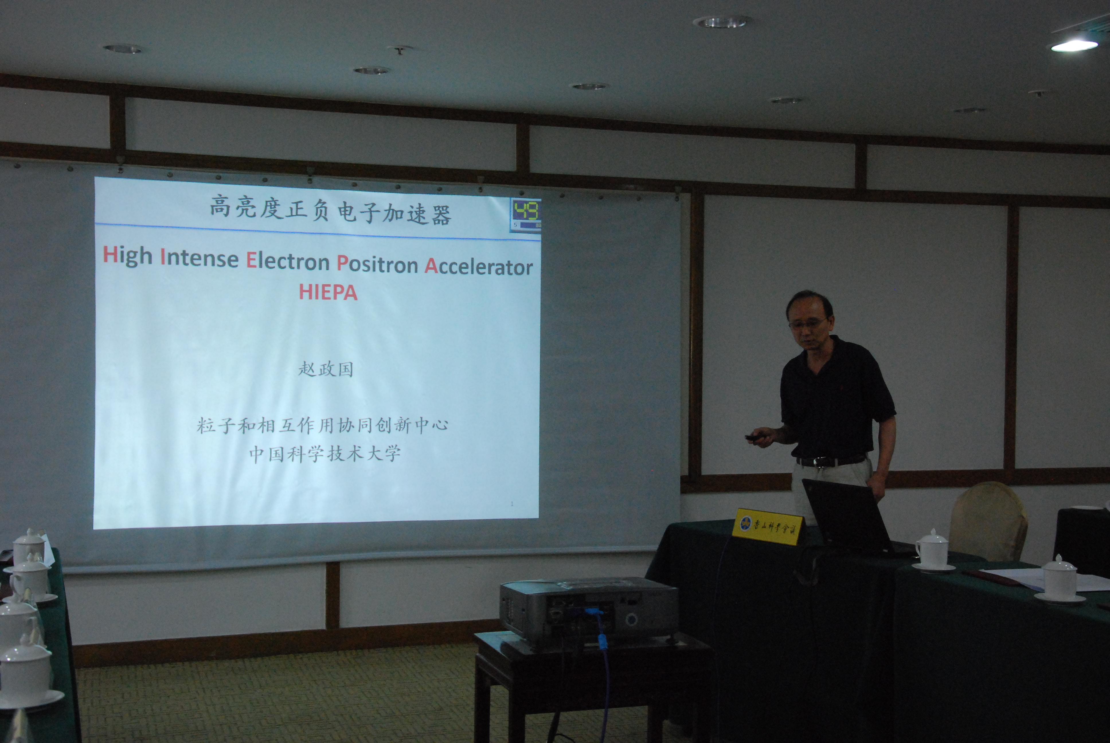
Science & Technology Review
Fragrance Hill science Conference, June, 2015, ∼40 scientists and officials joint

Slide 21
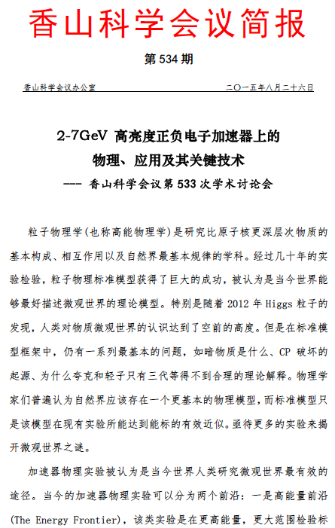
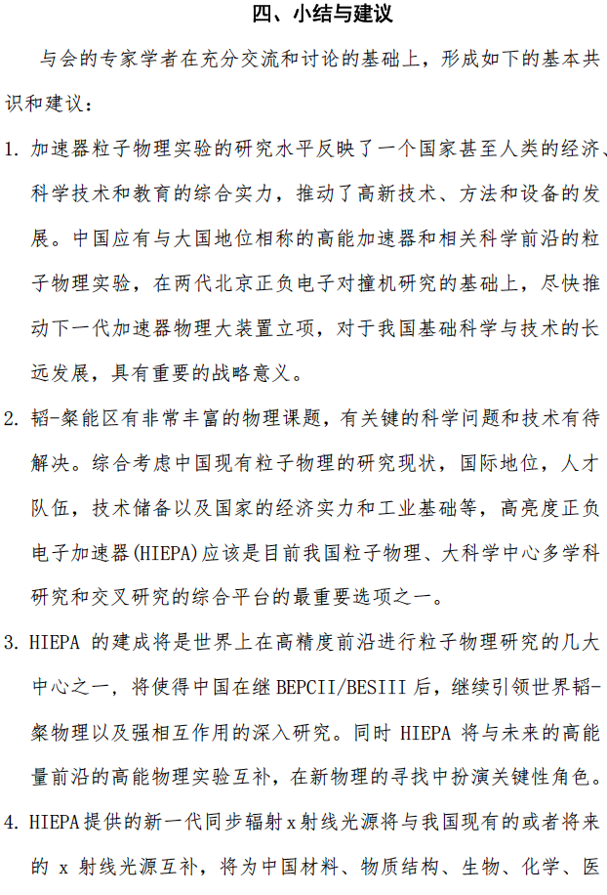
21

Slide 22
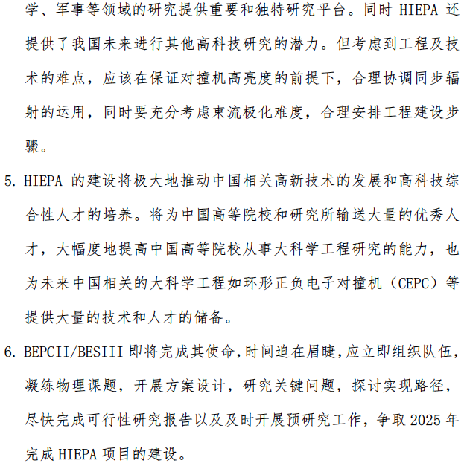

Slide 23
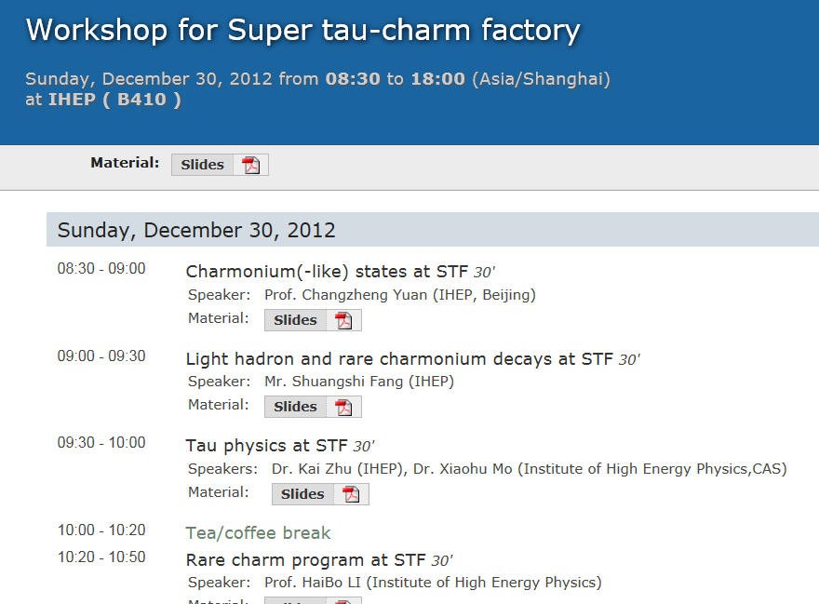
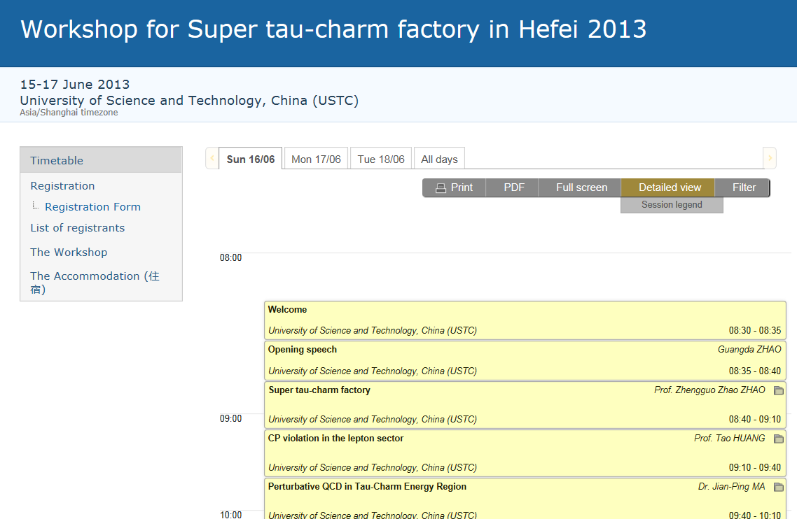
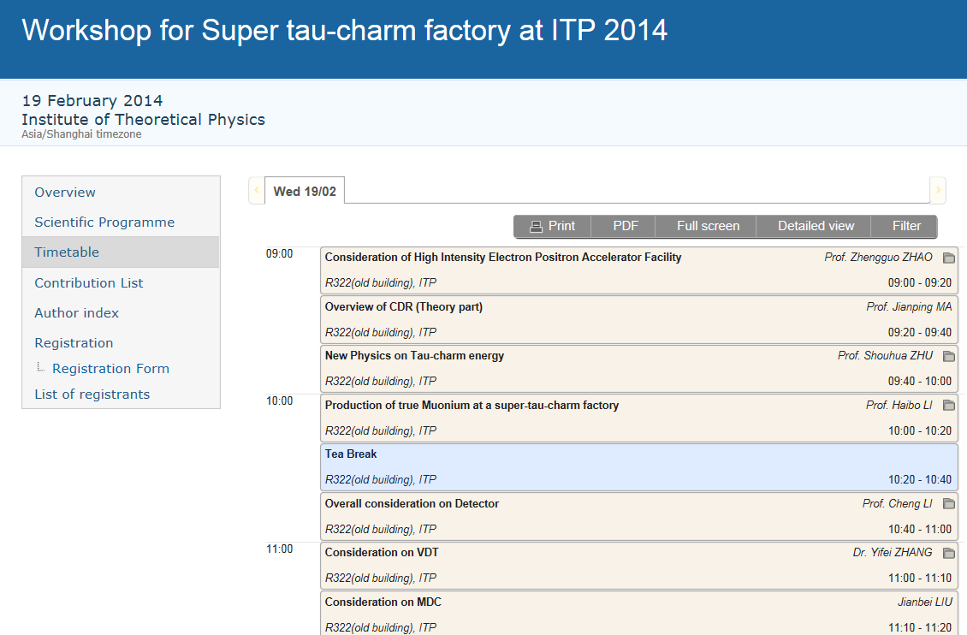
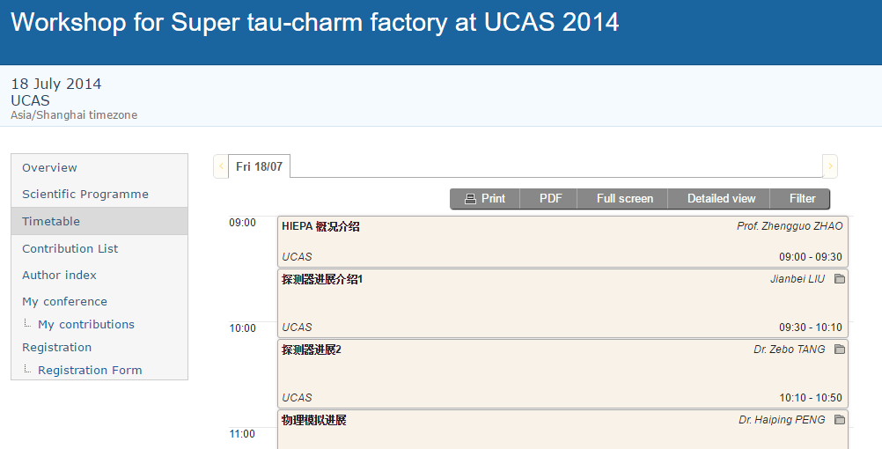
Science & Technology Review
Several Domestic Workshops (2011, 12, 13, 14)
Notes:
build a small working group,
Have domestic workshops every year,
Have a international workshop at Jan. 2015.

Slide 24
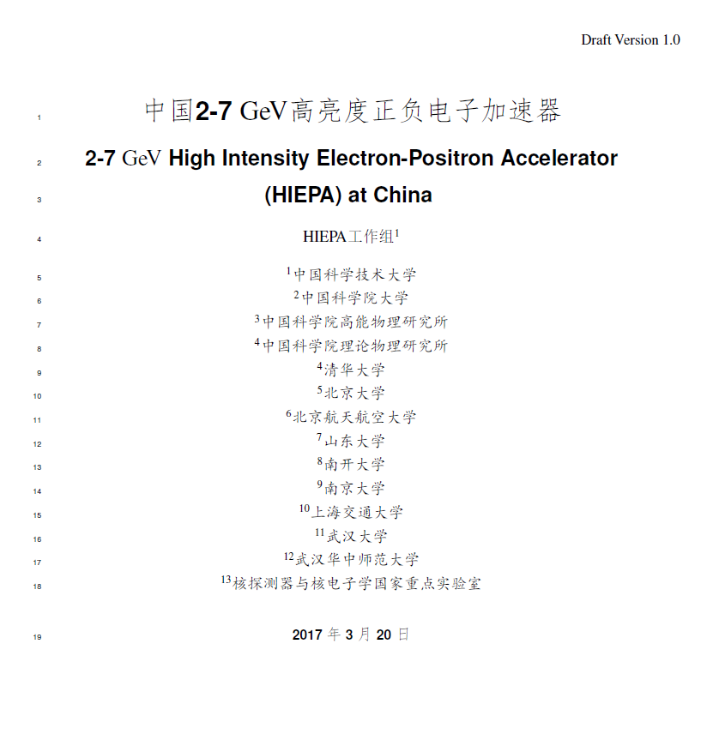
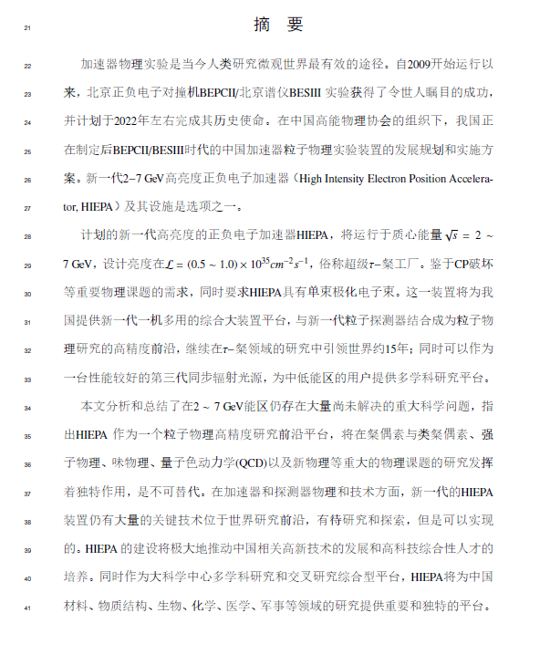
Pre-Conceptual Design Report

Slide 25
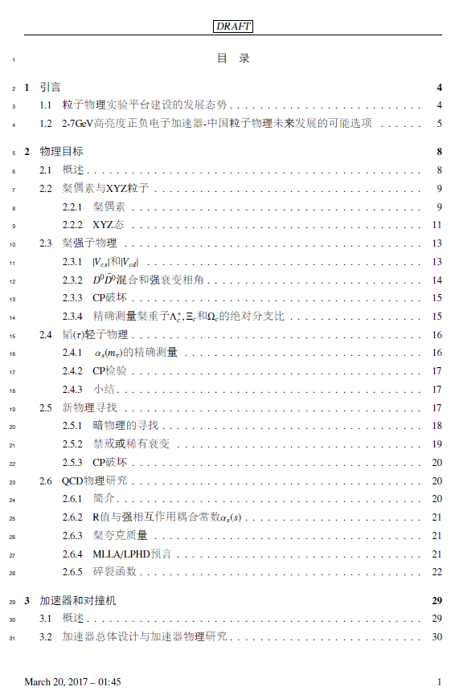
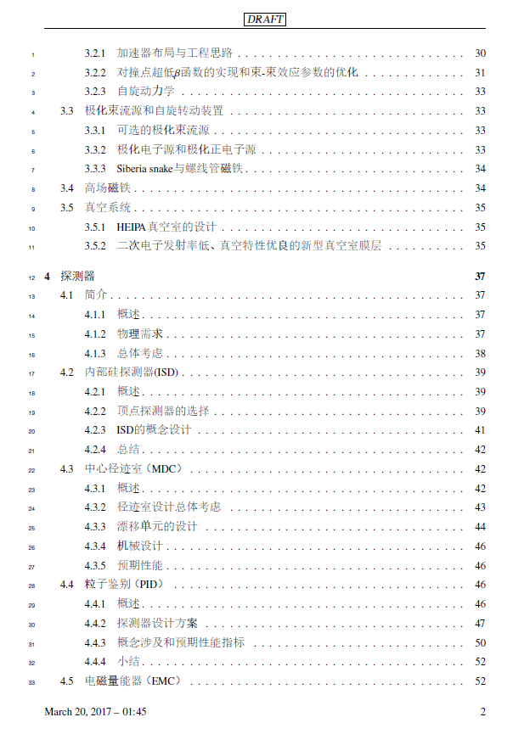
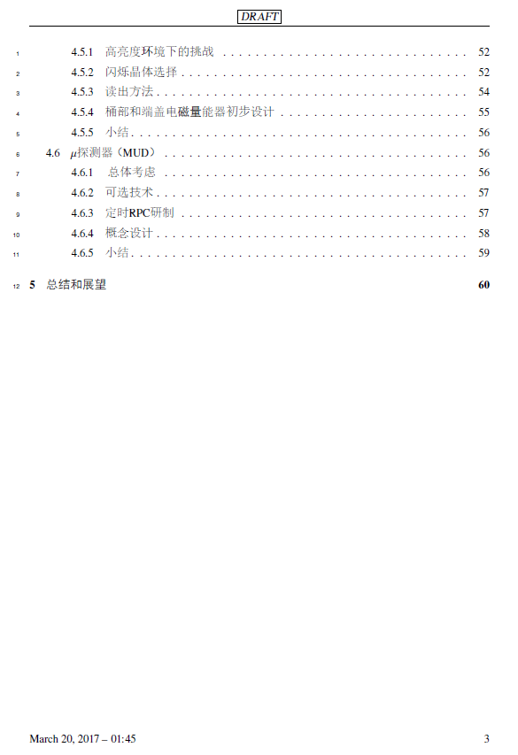
Pre-Conceptual Design Report

Slide 26
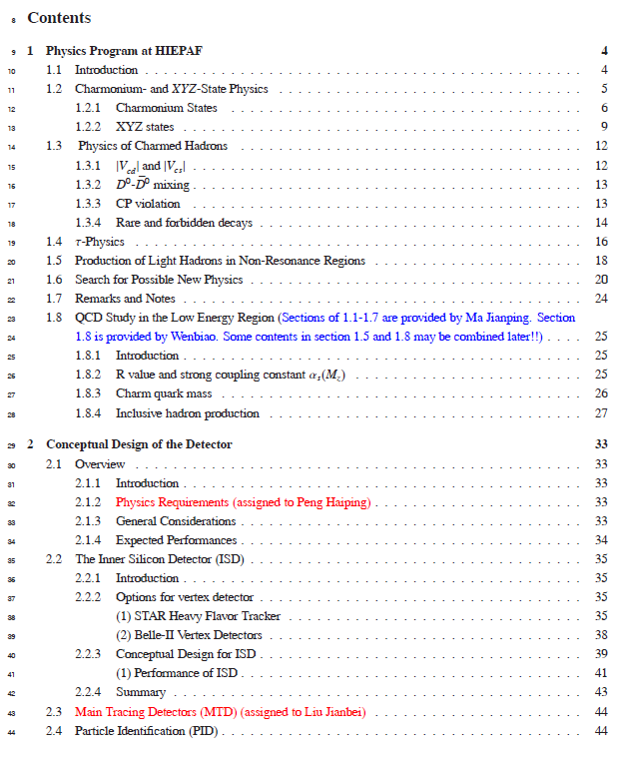
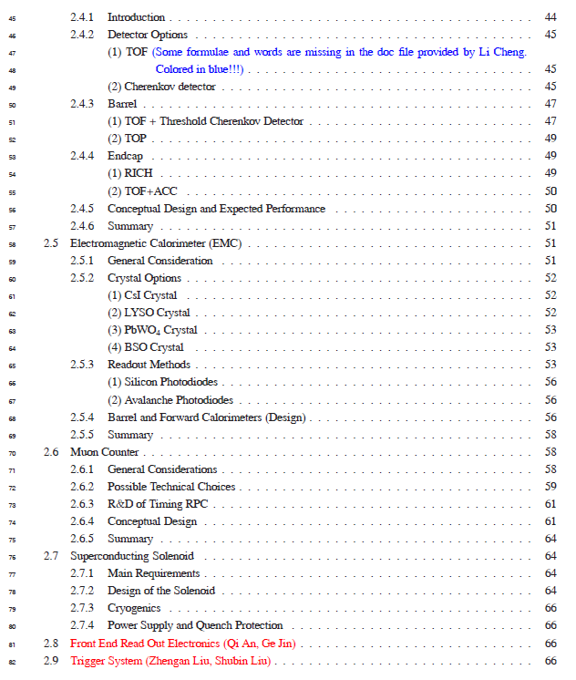
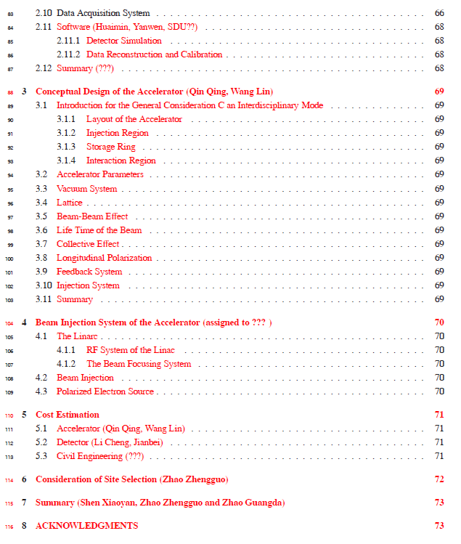
Pre-Conceptual Design Report

Slide 27

Local Government Support
Beijing
BEPCII
HEPS
Lanzhou
HIRFL
Hefei
HLS2, HALS
HIEPA
Shanghai
SLS
Tibet
Cosmic observatory
Sichuan
CJPL
LHASSO
Guangdong
Daya Bay Reactor ν JUNO
CNSS
HIAF→EiC
27

Slide 28
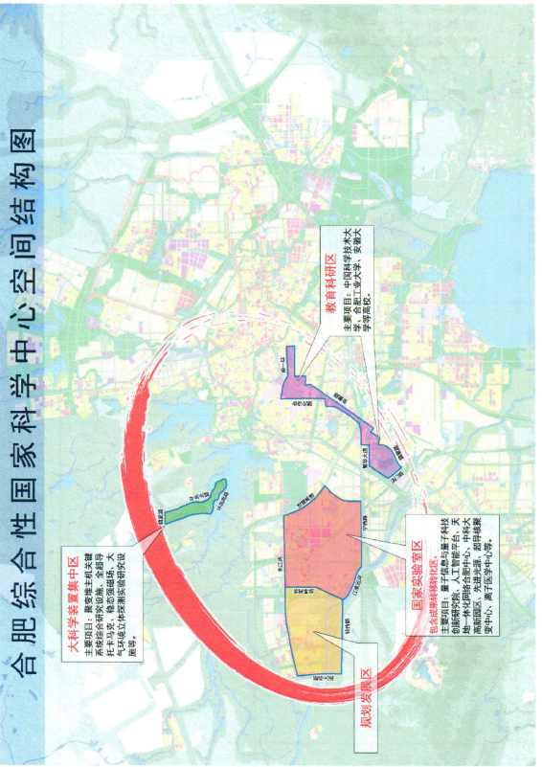
Local Government Support
Pay a lot of attention on accelerator facilities
Hefei Advanced light source is under design
STCF is listed in future plan
Report to Hefei High-tec Development Zone
Report to Anhui Development Planning Commission

Slide 29

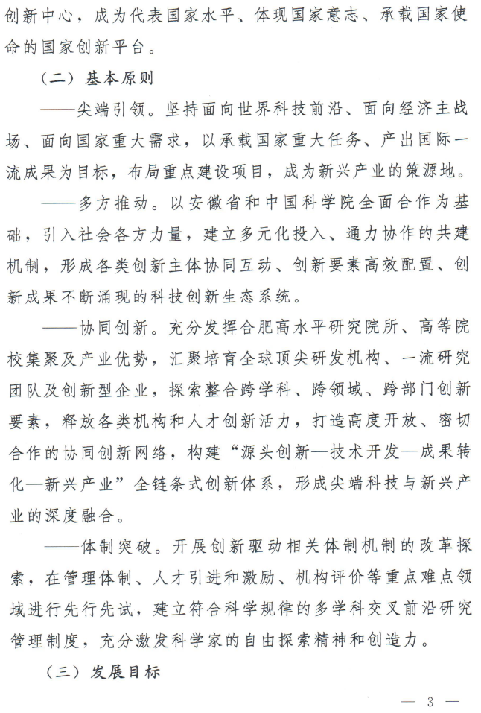

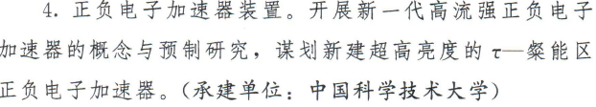

Slide 30
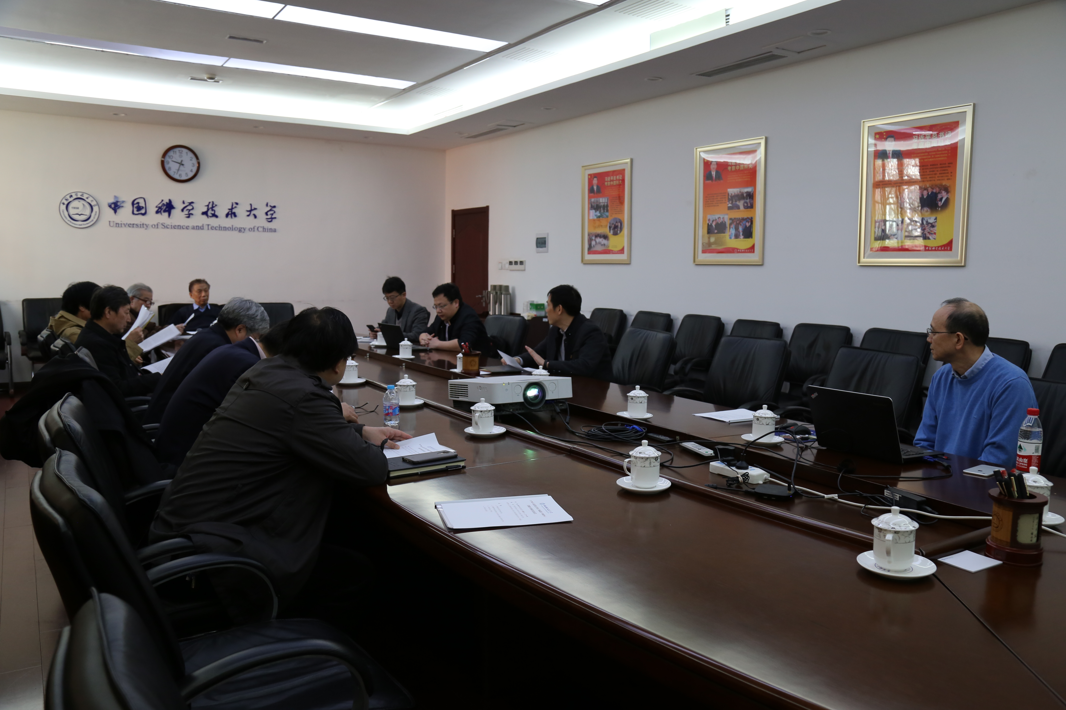
Support from USTC
Report to CAS Condition and Finance Bureau
Report to USTC scientific committee and USTC presidents
Jan. 2018, Report to USTC new president -- Prof. Bao
USTC president agreed
Scientific committee endorsed supporting R&D

Slide 31
Support from USTC
学校：
科大“双一流”重点支持项目，1000万启动经费支持
由学校发展改革部牵头组织与科学院、安徽省等相关部门联系
院系、重点实验室…:
物理学院 : 物理研究与人才培养，恢复加速器专业
核探测器与核电子学国际重点实验室：探测器与电子学研发、建造
合肥同步辐射国家实验室：对撞机的设计与建设
兄弟单位：
科学院合肥分院的研究所：机械设计与加工
国科大、山大等：物理、探测器、加速器
兰州近物所、北京高能所等：物理、探测器、加速器

Slide 32
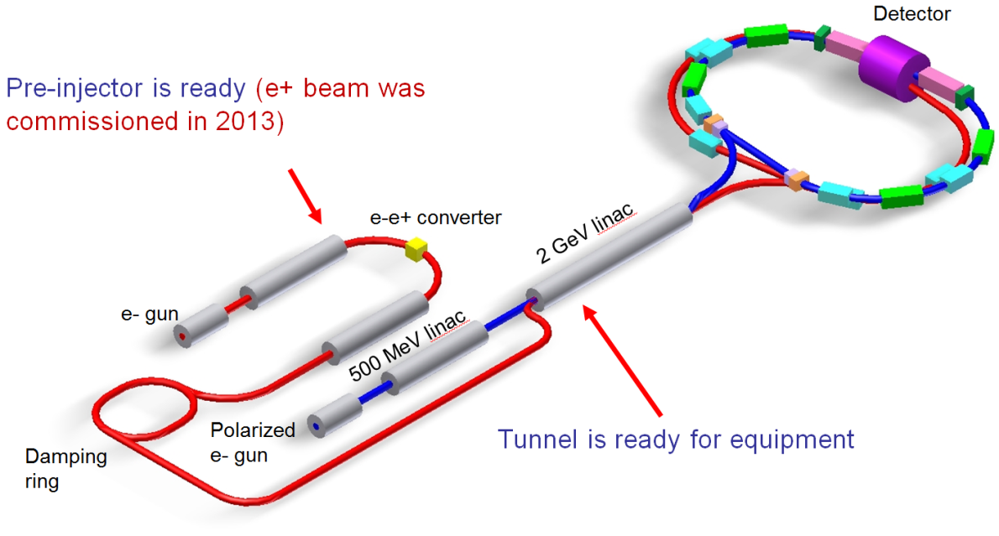
International Collaboration
SCT at Novosibirsk, RUSSIA
Budker Institute of Nuclear Physics
Long history…..
Pre-Agreement of Joint effort on R&D, details are under negotiation
Joint workshop between China, Russia, and Europe
2018 UCAS (March), Novosibirsk (May), Orsay (December)
2019 …..

Slide 33
Institutions shown Interest
University of Science and Technology of China
Institute of High Energy Physics, CAS
Institute of Theoretical Physics, CAS
Tsinghua University
University of Chinese Academy of Sciences
Shangdong University
Shanghai Jiaotong University
Peking University
Zhejiang University
Nanjing University
Nankai University
Wuhan University
Central China Normal University Lanzhou University
Nanhua University
Beijing University of Aeronautics and Astronautics
…….
Institute for Basic Science, Daejeon, Korea
Dubna, Russia
Budker Institute and Novosibirsk University, Russia
T. Shevchenko National University of Kyiv, Kyiv, Ukraine
University Ljubljana and Jozef Stefan Institute Ljubljana, Slovenia
Jozef Stefan Institute Ljubljana, Slovenia
Stanford University, USA
Wayne State University, USA
Carnegie Mellon University, USA
GSI Darmstadt and Goethe University Frankfurt,
Germany
Goethe University Frankfurt, Germany
GSI Darmstadt, Germany
Johannes Gutenberg University Mainz, Germany
Helmholtz Institute Mainz, Germany
LAL (IN2P3/CNRS and Paris-Sud University),
Orsay, France
Sezione di Ferrara, Italy
L'Istituto di Fisica Nucleare di Torino, Italy
L'Istituto di Fisica Nucleare di Firenze, Italy
Scuola Normale Superiore, Pisa, Italy
University of Silesia, Katowice, Poland
Laboratori Nazionali di Frascati, Italy
INFN, Padova, Italy
University of Pavia, Pavia, Italy
University of Parma, Italy

Slide 34
科学意义与作用
重大的国际影响力：使我国继续在陶粲物理和强相互作用的研究中引领世界。
重要的战略意义：提升我国粒子物理学科和基础科学研究实力、发展和储备核心高新技术、培养高科技综合性人才。
成为世界高能物理的研究中心之一，吸引优秀国际人才。
国内高校粒子物理实验研究的重要平台？

Slide 35
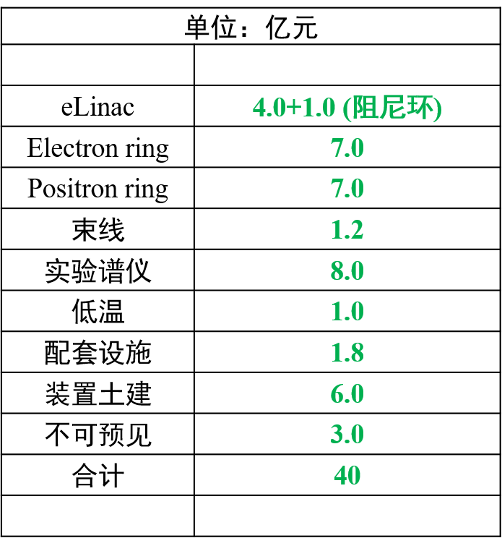
时间表和经费初步估算
 | 2018 | 2019 | 2020 | 2021 | 2022 | 2023 | 2024 | 2025 | 2026 | 2027 | 2028 | 2029 | 2030- 2040 | 2041- 2042
Form International Collaboration
Conception Design Report (CDR)
Technical Design Report (TDR)
Construction
Commissioning
Upgrade
A unique precision frontier in the world for 30 years!
R&D 经费 ： ∼2 亿

Slide 36
Organization for STCF
Institutional Board
Steering Committee
International Advisory Committee (IAC)
Project coordinator
Theory & MC Simulation
Accelerator
Detector/
software
Light Hadron
Charmonium
XYZ
Charm decay
Charm Spectroscopy
Tau
R&QCQ
New Physics
…
Design
RF
IP
Linac
Vacuum
Beam diagnose
…
Tracking
PID
ECAL
Muon
SC
Trigger
DAQ
Software
Computing & Network
…

Slide 37
Summary
Super τ-c Factory (STCF): nature extension and a viable option for a post-BEPCII HEP project
Symmetric, double ring with circumference around 600∼1000 m
e⁺e⁻ collision with E_{cm} = 2 – 7 GeV, L = 1 × 10³⁵ cm⁻²s⁻¹ , polarization beam
STCF is one of the crucial precision frontier
rich of physics program
unique for physics with c quark and τ leptons.
A critical project for China HEP, realistically, practically, reasonably.
A lot of activities recently :
Endorsed by USTC for R&D, initialized funding for R&D
More communication to CAS and Local government
Physics, accelerator, and detector groups are formed, progress are ongoing
An international collaboration is under preparing
……..

Slide 38

Welcome to join the effort

Slide 39
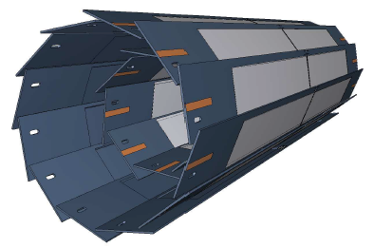
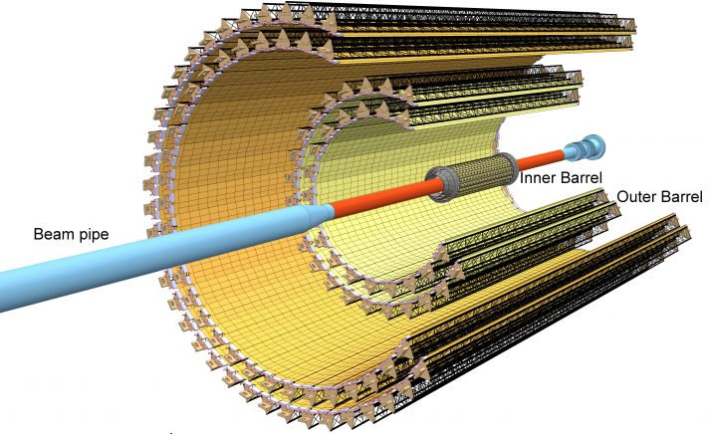



Detector requirements & Baseline
Vertexing :
Not very critical
But to combine with a central tracker to improve the tracking efficiency for low momentum track and resolution
Special design to cope with the large radiation close to IP
Technologies options :
A Low mass silicon detectors : DEPFET, MAPS …
MPGD : Cylindrical GEM/MicroMegas/Urwell
Central tracking :
large acceptance, low mass, high efficiency and high resolution
A low mass drift chamber with smaller cell size and lighter working gas

Slide 40



Detector requirements & Baseline
  PID system :
  π/K separation up to 2GeV, compact (<20cm) and low mass (<0.5X₀)
  Cherenkov-based technology is favorable for high momentum, and dE/dx for the low momentum tracks
  Technology options : RICH, DIRC-Like
  Baseline Design : Proximity RICH, similar to ALICE HMPID, but with CsI-coated MPGD readout
  Alternative Design : Aerogel + Position Sensitive Photon Detector, similar to BELLE-II ARICH
ALICE HMPID
iTOP for BELLE2
FTOF for superB

Slide 41


Detector requirements & Baseline
e/γ measurement :
  High efficiency for low energy γ
  Good energy, position and time resolution
  Fast response and Radiation hardened
  Technology option : Crystal + novel photon detector (e.g. SiPM)
  Crystal : pure CsI for barrel, LYSO for Endcap
  Readout : Larger Area PD, APD and SiPM

Slide 42


Detector requirements & Baseline
μ detection
  Low momentum threshold (p~0.4GeV)
  high μ efficiency and μ/π suppression power>10 (30）
  Technology option ：
  2-3 inner layers with MRPC for precise timing
  ~8 outer layers with RPC (Barrel : streamer, Endcap : avalanche)
Magnet
  Desirable to be adjustable from 0.5-1.0 T
Long-Strip MRPC Module at STAR
Active area: 87 x 52 cm²
Read out strip: 87 cm x 3.8 cm
Gas gaps: 0.25 mm x 5
MTD at STAR
Performance:
Efficiency: > 98%
Time resolution: < 80 ps
Spatial resolution: 0.6 cm

Slide 43
Charmonium-Like Physics
Fruitful results in past decade, a new territory to study exotic hadrons
τ-C Factory : e⁺e⁻→Y/ψ→Z_{c}+ X
B Factor : ISR, B decay
Belle with ISR: PRL110, 252002
967 fb⁻¹ in 10 years running time
@ 4.26 GeV for π⁺π⁻J/ψ
ε_{BESIII} = 46%, ε_{Belle} = 10%
>5.2σ
BESIII at 4.260 GeV: PRL110, 252001
0.525 fb⁻¹ in one month running time
B factory : Total integrate effective luminosity between 4-5 GeV is 0.23ab⁻¹ for 50 ab⁻¹ data
τ-C factory : scan in region 4-5 GeV, 10 MeV/step, every point have 20 fb⁻¹/year, 10 time of Belle II for 50 ab⁻¹ data
τ-C factory have much higher efficiency than B Factory
>8σ

Slide 44
Charmonium-Like @ τ-c Factory
ψ/Y/Hybrid(ccg) (1⁻⁻) produced in the e⁺e⁻ collision
To determine the resonance parameters for the excited ψ or Y state
Precisely measure the x-sec of inclusive/exclusive final states at different Ecms
Charge parity c=+1 states produced via radiative transition from vector ψ/Y
The decay rate ψ(nS/nD)→γX(3872), X(3940)…
Search for χ_{cJ}(2P)、χ_{cJ}(3P)、η_{c}(3S)、 η_{c}(4S)、 …
  B(ψ(3S)→γχ’_{cJ}) = (7, 3, 1) x 10⁻⁴ for J=2,1,0
  [Rev. Mod. Phys. 80, 1161 (2008) ]
Search for new states from hadronic transition
To search for Zc, Zcs, hc(2P) ….
PLB 660, 315 (2008)
PRL 112, 092001 (2014)
σ(Y(4260) →γX(3872))∼6pb

Slide 45
Search for 1⁻⁻ Hybrid H_{ccg}→γη_{c} & γχ_{c0}
1^{–-} Hybrid may produce directly in e⁺e⁻ collision, and radiative decay to spin-zero charmonium states [in Hybrid, cc in spin-singlet, LQCD by Dudek′09]
Assume σ(e⁺e⁻→H_{ccg}) ∼ O(10−100) pb [???]
B(H_{ccg}→γη_{c})∼2×B(η_{c2}→γχ_{c0}) ∼ 4×10⁻⁴
Scan between 4-5 GeV for 1 year (2ab⁻¹), search for exotic structure in process e⁺e⁻→γη_{c} and γχ_{c0}
Assume εB ∼ 10% for γη_{c} and γχ_{c0} decay to γ+hadrons
With 100 energy points between 4-5 GeV
N^{obs}(γη_{c})=O(8-80) events/point/year at peak
N^{obs}(γχ_{c0})=O(4-40) events/point/year at peak
Notes:
A selected interesting topic is to search 1-- Hybrid state, since the spin is 1—
And it is expected to produced directly from the ee collistion and detecter
By its e1 trnasition to etc and chi_c0.
So we can try to scan the data for this exotic structure.
If

Slide 46



CP Violation in τ Decay
CP violation is observed in B, D and K sectors to date，but not observed in lepton sector yet.
The discovery of CPV in the tau sector would be a clean signature of NP
One of the most promising CPV channels is τ⁻→K_{S}π⁻ν
SM CP asymmetry from K_{S}-K_{L} mixing is expected to be : [Bigi & Sanda, PLB 625, 2005, Grossman &Nir JHEP 1204 (2012) 002]
BaBar measurement [PRD 85, 031102]
Belle measurement [PRL 107, 131801]
Charge Higgs, new Scalar,
W_{L}-W_{R} Mixings, LeptonQuarks?
A_{cp} = (1.8±2.1± 1.4) ×10^{-3 @} W ∼ [0.89-1.11] GeV
Notes:
Now, we move to the CPV in tau decay.
To day, CP violation is observed in B,D and Ksystem
But no ovserved in the lepton sector,
The discovery of CPV in tau decay is a clean signture of NP.
The most promising CPV channels is tau-Ks pi v,
The SM predicted the CVP at 10-3 level duo to the Ks-Kl mixing,
But Belle and Babar did not observed any evindence for it CPV

Slide 47



τ CPV in Angle Distribution
Measurement on the angular CPV asymmetry is desirable
Use T-odd rotationally invariant products in >=2 hadrons, such as τ⁻→π⁻π⁰ν_{τ} /k⁻π⁰ν_{τ} , τ⁻→π⁻π⁺π⁻ν_{τ} /K⁻π⁺π⁻ν_{τ} :
Polarized of τ and beam are necessary
Figure of Merits
tau-charm
Y. S. TSAI, PRD 51 (1995) 3172
B factory
BESIII @ 4.25 (10³³cm⁻²s⁻¹) FOM=1
STCF @ 4.25 (10³⁵cm⁻²s⁻¹) FOM=100
SuperKEKB @ (8x10³⁵cm⁻²s⁻¹ ) FOM=52
Notes:
So we need a new measurement on the angular CPV asymmerty.
Like use T-od ratationally invariant products.
The kind of analysis can be performed in the tau decay into final state with more than 2 hadron.
But the polarized beam is necessary.
As we know, the polarization of electron beam can be transver to the produce
Tau,
In tau-charm region, all the produce tau is expected to the 100% poralaztion
While in the super factor, the proporazation is expected to be about 50% with
Tau cos\thet is 0.
A important variable “Figure Of Merits” proposed by the Y.S TSAI which take
into accouting luminorcist, polarization and total cross section,
to quantitative evaluate the feature of different experiment on CPV study
And HIEPA is found to be with the best quilaty.
Evaluate the characters of

Slide 48






Nucleon Electromagnetic Form Factors (NEFFs)
Spatial distributions of electric charge and current inside the nucleon
, Λ Λ
Space-like:
FF real
Time-like:
FF complex
Complete picture of nucleon structure requires space-like and time-like FF
JLab
Space-Like FF
1% Precision
JLab
Notes:
Now we move to the Nuclearon Electromagnetic Form factor topic.
The nucleon (proton and neutron) electromagnetic form factors describe the spatial distributions of electric charge and current inside the nucleon and thus are intimately related to its internal structure; these form factors are among the most basic observables of the nucleon.
There two kind of FF measurement, Space-like FF, which can be measured in the scatter process, while the Time like FF, can be measure in the annihilate in the ee and ppbar process.
An complete picture of the nucleon structrure requires both space-like and time-like FF measurement.

Slide 49



Proton FF (√s=2.23GeV) @ τ-c Factory
1 day
2 days
HIEPA reach 1
HIEPA reach 2
Notes:
So, for the Ratio of GE and Gm, the uncertainty of BESIII test run is about 24%,
While is expected 10% in BESIII final results,
while in HIEPA, the uncertiant is expected to be 1.5% or 1% with 1 or 2 days date
taking respectively.

Slide 51


Slide 52


To achieve high polarization
Siberia Snakes
  Mini-rotator
    Very large trace bending angle, increases emittance
    Spin resonance
  How many snakes? $τ_{damp}∝E^{−7}N_{snake}^{2}$
  For Energy of 3.5 GeV in future, 7 snakes
Courtesy of Prof. Dong Wang, SINAP
Courtesy of Dr. Anashin, Dr. Aulchenko, et al., BINP Tau Charm Report
Notes:
A.W. Chao, Problems in obtaining polarized e+ and e- beams and perspectives for PEP, High-Energy Physics with Polarized Beams and Polarized Targets Volume 38 of the series EXS 38: Experientia Supplementum, p. 15-26, 1981
V. V. Anashin, V.M. Aulchenko, et al., A project of super c-τ factory in Novosibirsk, 2011
https://ctd.inp.nsk.su/c-tau/Project/CDR_en_ScTau.pdf

Slide 53




Inner tracker Technologies
DEPFET
MAPS (ALPIDE)
Pixel size: 29*27μm, high resistivity epitaxial, deep PWELL, reverse bias, global shutter (<10 μs), triggered or continuous readout, resolution < 5um, material budget <0.3%X_{o}
Cylindrical GEM
Cylindrical MicroMegas

Slide 54





A new MPGD : uRWELL
Very compact, spark protected, simple to assemble, flexible in shapes (rather easy to make a cylindrical detector)
A possible solution to HIEPA inner tracking. R&D underway at USTC.

Slide 55
Outer tracker : A Drift Chamber
BESIII drift chamber can serve as a good starting point
  R_{in} has to be enlarged to avoid the very high rate region at HIEPA
  Smaller cell size for inner layers to accommodate a higher count rate
  No Au coating on Al wires and thinner W wires to reduce material
  A lighter working gas to reduce material
  Sharing field wire layers at the axial-stereo boundaries to reduce material

Slide 56

A Drift Chamber for STCF
Rin = 15 cm, Rout = 85 cm, L = 2.4 m
B = 1 T
He/C₂H₆ (60/40)
Cell size =1.0cm(inner),1.6cm(outer)
Sense wire: 20 um W
Field wire: 110 um Al
# of layers = 44
Layer configuration: 8A-6U-6V-6A-6U-6V-6A
Carbon fiber for both inner and outer walls
Expected spatial resolution: <130μm
Expected dE/dx resolution: <7%

Slide 57



Combination of inner/outer trackers
Notes:
A fast simulation of two option with MDC plus the star hevery flavor tracker or BELLEII pixel deter
Show the similar perfromce for the two options, and the results can be invprove sinificant at
High mass region with the inner deter, but not big change in the low mementum region.
And the tracker efficiency can be improved with the inner detector.

Slide 58
PID Detector
Key Features of PID System
Enable π/K (and K/p) 3-4σ separation up to 2GeV/c
Suitable for high luminosity run – fast detector
Radiation hard, especially in the endcap region
Compact – reduce costs of the outer detectors
Modest material budget - <0.5X₀
Low Momentum PID
Specific energy loss (dE/dx) in MDC can be used for low momentum PID
Better dE/dx resolution for longer track length
BESIII MDC (~6%, track length ~0.7m)
clean π/K/p ID for p<0.8/1.1 GeV/c
High Momentum PID
TOF can not identify π/K to p=2GeV/c
Cherenkov detector is necessary
Two catalogs
  Threshold Cherenkov – simple to build
  Imaging Cherenkov: RICH (large momentum range)/ DIRC / TOP (most compact)

Slide 59



PID Detector
Baseline Design
PID by RICH at 0.8<p<2GeV/c, no TOF
Proximity RICH, similar to ALICE HMPID design, but with PHENIX HBD (CsI coated GEM) readout
n~1.3 (liquid C₆F₁₄), UV detection
Already proven
Immune to B field → same structure at both the endcap and the barrel
Alternative Design
No TOF, PID by RICH only
Similar to BELLE-II ARICH design, Aerogel + Position Sensitive Photon Detector
n~1.13 (Below threshold for proton at p<2GeV/c)
Already proven at the BELLE-II endcap, how about the barrel part?
Need R&D
ALICE HMPID
PHENIX HBD

Slide 60

A RICH Design for HIEPA
Proximity focusing RICH, similar to ALICE HMPID design, but with CsI-coated MPGD readout
  avoid photon feedback
  less ion backflow to CsI
  Fast response, high rate capacity
  Radiation hard
Proximity gap ~10cm
Radiator: liquid C₆F₁₄, n~1.3, UV detection
MPGD

Slide 61


Performance Simulation
MPGD
The π/K separation requirement can be met with a RICH detector.
Sensor size: 5mm*5mm

Slide 62



MPGD Photon Detector R&D
A double-mesh Mircromegas detector is being developed at USTC
  High gain and very low ion backflow
  Very suitable for single photon detection (with a proper photon-electron converter)
  A promising photon detector option for RICH
IBF ~ 0.05%
Gain ~ 3⤫10⁶

Slide 63

DIRC-like TOF for Endcaps
DIRC-like forward TOF detector (FTOF: quartz + MCP-PMT ) was developed at LAL for the SuperB factory project.
Also an endcap PID option for HIEPA.
  Flight length ~ 1.4 m for endcaps. ~30ps time resolution is required for pi/K separation to reach 2GeV.
~ 80ps per PE

Slide 64



Electromagnetic Calorimeter
EMC Requirements
Good energy resolution
Good position/angular resolution
Good timing resolution if possible
Challenging
Radiation damage
  Decrease light yield
  A function of run time
High photon background rate
  Produce pile-up
  Degrade energy and angular resolution
Babar, NIM A479 (2002) 1
Behavior of the light emitted by a crystal
due the radiative Bhabha photons
0.75 krad
1.2 krad

Slide 65

Crystal Options
R&D on BSO
Different options for barrel and endcaps

Slide 66

SiPM Technology
SiPM: a novel and rapidly-developing photo-sensor technology
  High gain, low equivalent noise, B-field resistant, good time resolution
R&D at USTC

Slide 67

Aspects Other Than Energy
A timing ECAL !
Time resolution of pure CsI (10000 PE, PMT response not considered)
~ 130ps
Difference in TOF of n and 𝛄
The position resolution of ECAL has a significant impact on object/event reconstruction involving 𝛄 .
Energy resolution is not everything, position resolution is also important.
Precise ECAL timing is very useful in suppressing 𝛄 background

Slide 68




Muon Detector

Slide 69

Charmonium (like) Spectroscopy
Key Science question : Is there any exotic hadron exist
Z(3900)
Z(4020)
Z(4050)
Z(4200)
Z(4250)
Z(4430)
States below charm threshold are all well observed
Y(3940)
Y(4008)
Y(4260)
Y(4360)
Y(4660)
X(3872)
X(3940)
X(4160)
X(4350)
Many missing states above charm threshold
Many new observations in the last decade
Nature unclear
Charmonium?
Hybrid?
Tetraquark?
Molecule?
Non-resonance?
A better understanding on charmonium spectrum may help to understand their natures
Godfrey & Isgur, PRD 32, 189 (1985)
?
Notes:
This plots show the expected charmonium spectronscopy prodicted by QM,
To date, in experiment, states below charm trheshold are all observed well,
But above the charm threshold, there are still some missing states have not be observed yet
Also, in the last decay, a lot of new XYZ states are observed, which is not a obviously conventional charmonium states.
The nature is these new observetion is unclear.
A better understaing on charmonium spectron may help to understand their natures.

Slide 70
Summary of τ Physics
With 1ab⁻¹ near tau threshold:
LFV: 10⁻⁹
Lepton universality: 10⁻⁴
CP violation in decay: 10⁻⁴
CPT tests: 10⁻⁴
Tau mass
Vus: (0.1-0.5)%
A super-tau-charm and a BELLEII will be complementary machines for tau physics

Slide 71



Nucleons FF
提高中子形状因子的测量精度在实验和理论方面都具有重要意义！
意大利曾计划对DAΦNE/FINUDA做重大专门改进来测量核子形状因子

Slide 72
Search for η_{c2}(1¹D₂) and χ_{c1}(2³P₁)
Simple estimations
L _{peak} = 10³⁵cm⁻¹s⁻¹, 1 year running = 10⁶pb⁻¹ = 1ab⁻¹
A BESIII-Like detector
Detail MC studies are ongoing
η_{c2}(1¹D₂)
σ(e⁺e⁻→π⁺π⁻h_{c}(2P)) ∼ 20 pb @ Ecm=??GeV
B(h_{c}(2P) →γη_{c2}) ∼ 3×10⁻⁴ [E1 trans., Barnes′ 05]
B(η_{c2}→γh_{c}) ∼ (44−54)% [E1 trans., Fan′ 09]
B(h_{c}→γη_{c}) ∼ 54% [E1 trans., BESIII′10]
εB(η_{c}→hadrons) ∼ 1.5% at BESIII
N^{obs}=2×10⁻⁵×L (L is int. lumi. in pb⁻¹)
N^{obs}=20 events /year,
Bkg is low for narrow h_{c} and η_{c}
χ_{c1}(2³P₁)
σ(e⁺e⁻→ψ(nS)/ψ(mD)) ∼ (3-7) nb @ for n>1, m>2
B(ψ →γχ′_{c1}) ∼ 3×10⁻⁴ [E1 trans., Barnes′ 05]
B(χ′_{c1}→γψ′) ∼ 1 ×10⁻³ [E1 trans., Barnes′ 05]
B(χ′_{c1}→γJ/ψ) ∼ 1 ×10⁻⁴ [E1 trans., Barnes′ 05]
εB ∼ (1−5)% at BESIII
N^{obs} = (1−10)×10⁻⁵×L (L is int. lumi. in pb⁻¹)
N^{obs} = (10−100) events /year,
Bkg is low for narrow ψ′ and J/ ψ
Notes:
In Following, I introduce some very simple estimation for the searching for these missing states.
First Example is to search for the D wave singlet,
This D wave siglet states is expected produce and decay by the E1 transition of
P wave singlet,
If we asumment the production cross section of excited P wave singlet is 20pb
And the our experience from BESIII on the efficiency to tage etac hadron decay
mode is 1.5%,
We expected we can got the 20events/per years
The background is very low due to the narraow width of hc and etac
Another example is to search for the exicited stand of chi_cj,
Which is expected to produce by the E1 transition from the psip particle,
We expected we can get the 10-100 events per year.
The same, the background is very low due to the narraw with psip and psi.

Slide 73


cLFV Decay τ→μγ @ B Factory
From A. Bondar, Charm2010
Current limit : ~ 4×10⁻⁸ (5×10⁸ τ-pairs)
BABAR : 516fb⁻¹ [PRL, 104, 021802]
BELLE : 545fb⁻¹
At (4S) :
ISR background e+e-→τ⁺τ⁻γ
Upper Limit ∝ 1/√L
Expected limit : 3x10⁻⁹@75ab⁻¹ (7×10¹⁰ τ-pairs)
Belle-II Factory with L=10³⁶cm⁻²s⁻¹
10¹⁰ tau pairs per year (x-sec=1nb)
HIEPAF with L=10³⁵cm⁻²s⁻¹
10⁸ tau pairs per year at threshold (x-sec=0.1nb)
3.5×10⁹ tau pairs/year at 4.25GeV (x-sec = 3.5nb)
Super-B 75 ab⁻¹
7×10¹⁰ τ-pairs
What can HIEPA have with 3x10⁹ ττ pairs / year?
Notes:
Tua->gamma mu have been detail studying for many years in B facotry.
This plot show the update limint as function of luminosity for the different experiment.
The current update limit is about 4x10-8 from both BABAR and BELLE,
It is clear see that the upper limit is proportional to 1/sqrt(L)
The strudy from Supper B show the expected UL is 3x10-9 with 75ab-1 data.
At HIEPA, we expected to collected 3x109 tau pair per year
It is interesting to know what the expected UL can be acieved in hiepa.

Slide 74







Proton FF : Time-Like
Assume G_{M}=G_{E}
Only 2 measurements,
but results are contradict
10-24% precision from B factory
QCD predict
BES3 0.4fb⁻¹, ∼10% Precision
δ|R_{EM}|/|R_{EM}| ∼ 9% - 35%
δ|G_{M}|/|G_{M}| ∼ 3% - 9%
first time extraction without any assumption.
δ|G_{E}|/|G_{E}| ∼ 9% - 35%
Notes:
However, for the time like proton FF, to day, the experiment statistics are still limit,
It always assume the Gm=Ge in most of experiment, only two results from babar and PSI
To extract the ratio of Ge to Gm, but the results are contradict, and the uncertainty of
Ratio from the B factory is 10-24%.
In BESIII, the uncertainty of the ratio is expected to be round 10% with 0.4pb-1 data,
And it can be first time to extract the Gm and Ge without assumption.

Slide 75

Features of the τ-c Energy Region
Why Physics on τ-c energy region
τ⁺τ⁻
D_{s}D_{s}
Λ_{c}Λ_{c}
Rich of resonances, charmonium and charmed mesons.
Threshold characteristics (pairs of τ, D, D_{s}, charmed baryons…).
Transition between smooth and resonances, perturbative and non-perturbative QCD.
Mass location of the exotic hadrons, gluonic matter and hybrid.
Notes:
Now the naïve question is why we propose the machine on tau-charm energy region.
As we know, the tau-charm energy region have some advanced features.
The region have very rich of resonances, such as charmonium and charmed mesons.
It have threshold characteristics, which can provide a clean enviroment for physics
Also, It is well know that the region is serviced as a transition between soomth and resonances, pertubative and monpertubvative QCD
Also, mass of the extotic hadron, gluonic and hybird are expected in this region

Slide 76



Status of BEPCII/BESIII
RF
SR
RF
Compton back-scattering for high precision beam energy measurement
Large Crossing Angle
BESIII
IP
Beam energy : 1.0-2.3 GeV
Energy spread : 5.16 ×10⁻⁴
Optimum ene. : 1.89 GeV
Luminosity : 1×10³³ cm⁻²s⁻¹
No. of bunches : 93
Bunch length : 1.5 cm
Total current : 0.91 A
SR mode : 0.25A@2.5GeV
Unique machine running on tau-charm region in the world
Achieved 1.0×10³³cm⁻²s⁻¹ on April
Notes:
Let us begin from the BEPCII/BESIII,
As you know, BEPCII/BESIII is the only accelerator running in china to day.
It also is the unique machine running on tau-charm region in the world.
The design luminorcity of BEPCII is 10^33, and now we reach 70% our design goal

Slide 77




cLFV Decay τ→ℓγ
No evidence of new physics been found at high energy frontier.
important and complementary to search for new physics in the precision frontier.
μ/τ anomalous decays
μ → e
conversion
Anomalous
magnetic moment
In τ-charm factory, τ→μγ decay is a golden mode to search for NP
W. Altmannshofer et al. arXiv : 0909.1333
Notes:
Now we move the new physics,
As we know, the discovery of Higgs complete the list of the partilce in SM.
But there some still a lots questions can not be explain the the SM framework.
To date, there are not any evidence of new physics at high energy frontiers,
So it is important and complementart to directly search for new physics in the presision frontier.
This table is DNA for the new physics search in flavor physics,
and charge letpon Falvor violavation decay is found to be a promising process to find the new physics
And discribmate the different models and contraint theirs parameters.

Slide 78

STCF .VS. BF : τ→μγ ｂａｃｋｇｒｏｕｎｄ
Background e⁺e⁻→τ⁺τ⁻γ
Dominant BKG @ B Factory
Dominant source at Υ(4S) : e⁺e⁻ → τ⁺τ⁻γ
Does not contribute below √s ≈ 4m_{τ}/√3 ≈ 4.1 GeV.
Dominant BKG @ STCF
τ decays : [arXiv:1206.1909]
direct (τ⁺→π⁺π⁰ν_{τ}) and combinatorial
QED processes :
e⁺e⁻ → μ⁺μ⁻γγ, e⁺e⁻ → e⁺e⁻ μ⁺μ⁻γ
Continuum hadron production e⁺e⁻ → qq
ψ(2S) and D-meson decays
Polarized beam may further suppress background and increase the sensitivity for the new physics significantly
Notes:
The advance of this analysis in the Tau-charm region is that background e+e→gammga tautau is not contribute any more which is the dominant background in the B factory.
In tau-charm region, the background is expected to be tau directroly decay like tau->pi,
QED process, continuum hadron production, psi(2p) and D men

Slide 79
Expected τ→μγ Br upper limit
E(GeV) | σ(nb) | L(ab⁻¹) | N_{ττ}(10¹⁰)
3.686 | 5.0 | 1.5 | 0.75
3.77 | 2.9 | 3.5 | 1.03
4.17 | 3.6 | 2.0 | 0.71
Total |  | 7.0 | 2.49
Results from Vladimir Druzhinin,
(BINP, Novosibirsk) at
Workshop on Tau Charm at High Luminosity
26-31 May, 2013, La Biodola, Italy
Fast simulation for NP sensitivity and detector optimization is ongoing
 | σ_{E}/E=1.5% | σ_{E}/E=2.5%
Signal (Br=10⁻⁹) | 17 | 15
Muon background | 7 | 11
Pion background | 83 | 271
Expected 90% CL upper limit for Br | 1.1×10⁻⁹ | 3.0×10⁻⁹
Expected 90% CL upper limit for Br with pion suppression by a factor of 30 | 3.3×10⁻¹⁰ | 5.1×10⁻¹⁰
Supper-B Expected limit : 3x10⁻⁹@75ab⁻¹ (7×10¹⁰ τ-pairs)
Notes:
The study from Vlaimir show with 7ab-1 data, super tau-charm can get
The comparable or better upple limit than that of Supper-B expections.
We are prosssing the correspond fast simulation for NP sensitivity and to
Optimization the detector perfromance.

