Slide 1
Probing bino-wino coannihilation DM at the LHC
武 雷
南京师范大学
arXiv:1804.0523（PRD）v:1804.05238

Slide 2
Outline
MSSM neutralino DM
Bino-wino coannihilation and DM direct detections
Soft lepton pair as a probe of B-W at the LHC
Conclusions

Slide 3
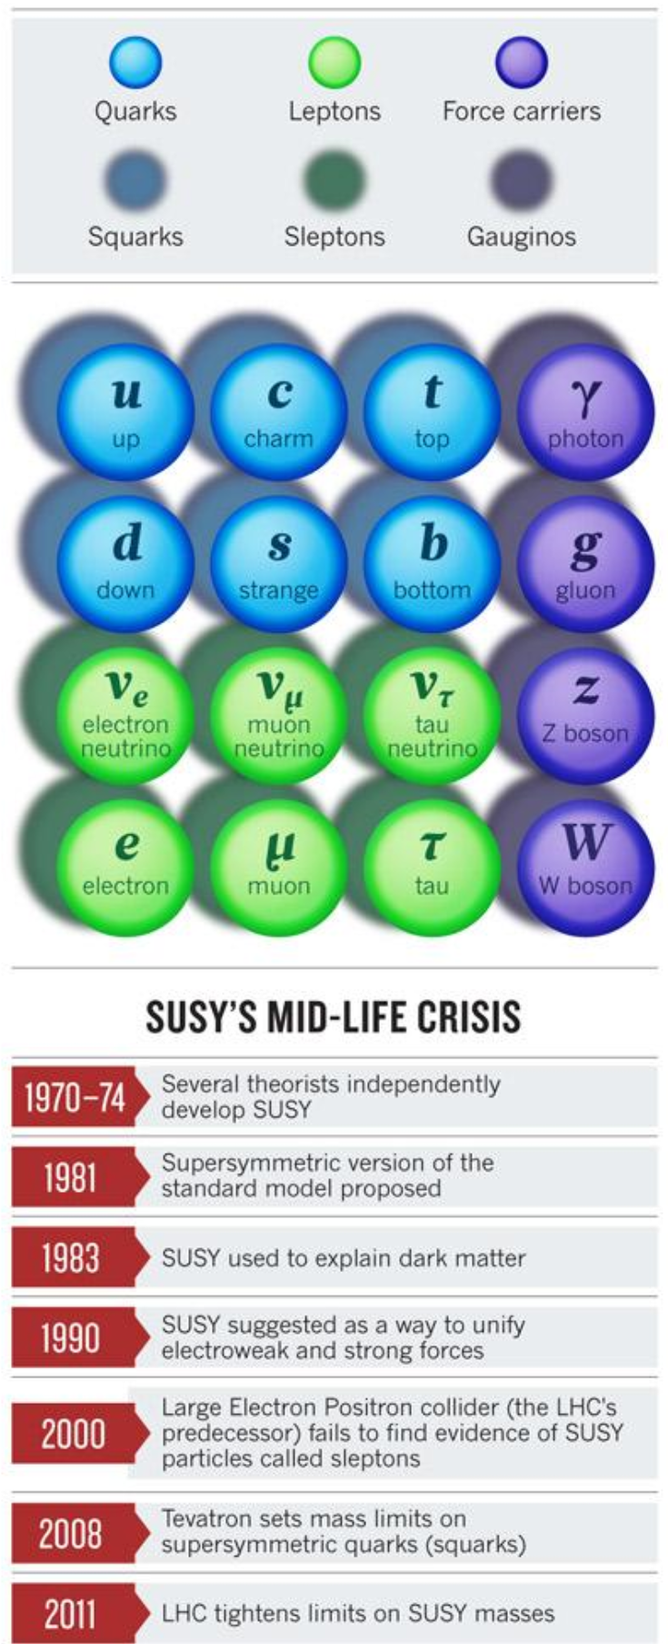
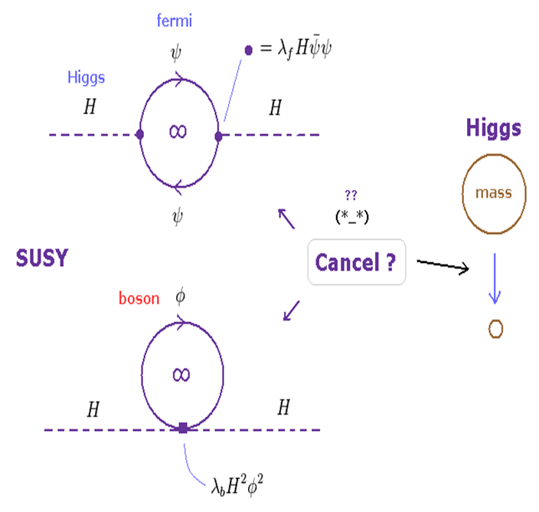
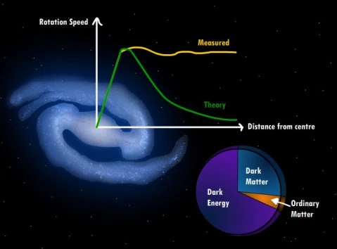
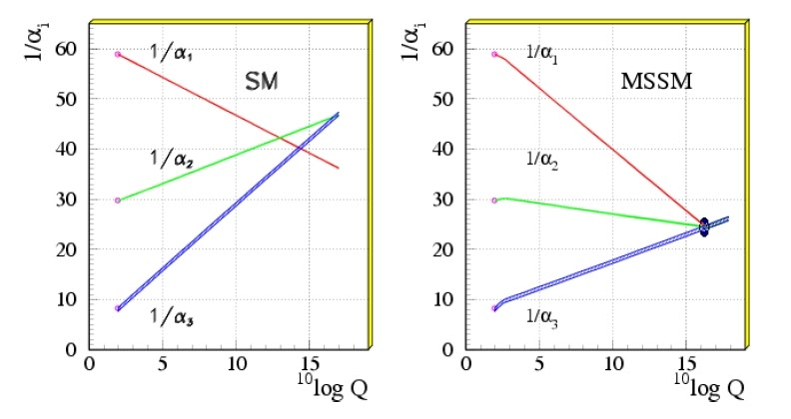
1. MSSM neutralino DM
Why Supersymmetry:
Naturalness
Dark Matter
Unification

Slide 5
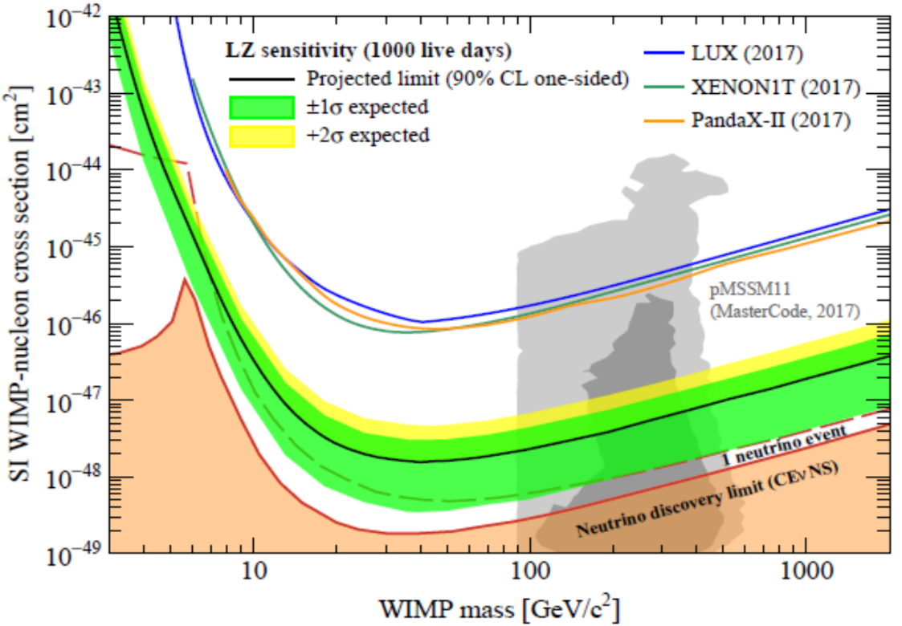
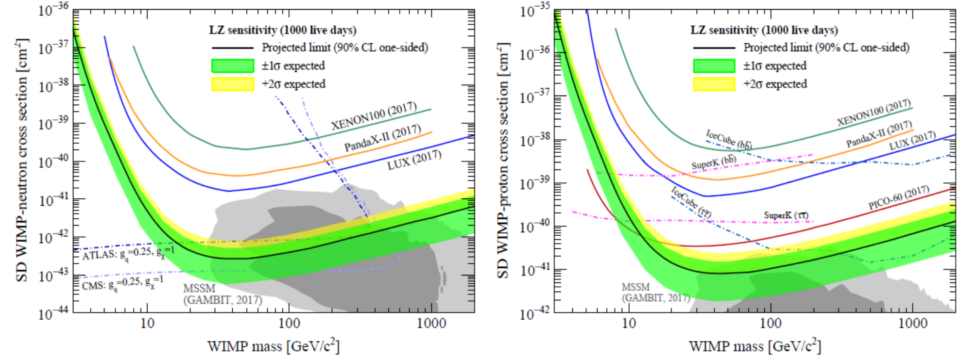

Slide 6
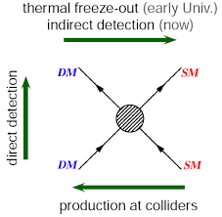
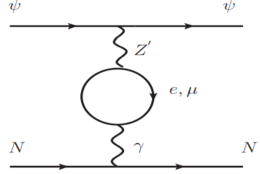
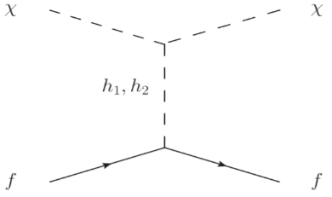
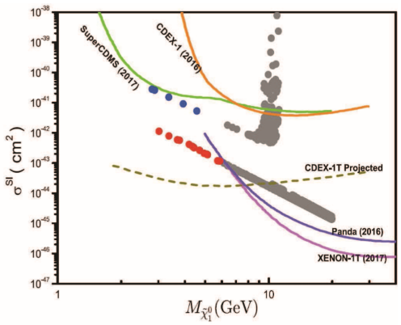
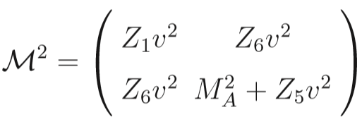
Weakening the correlation between Direct Detection and other DM processes
1. DM may interact with the nucleons at loop levels,
2. DM may annihilate with a light species that is nearby in mass,
3. DM may have a suppressed scattering cross section due to cancelation effect,
4. DM may be light enough, below the sensitivity of current DD experiment.
or
arXiv:1804.05238
Duan, Wang, Wu, Yang, Zhao

Slide 7
In the R-parity conserving MSSM, the lightest neutralino can play the role of DM,
This mass matrix can be diagonalized by a unitary 4 × 4 matrices N,
Bino-like
Wino-like
Higgsino-like
Mixed

Slide 8
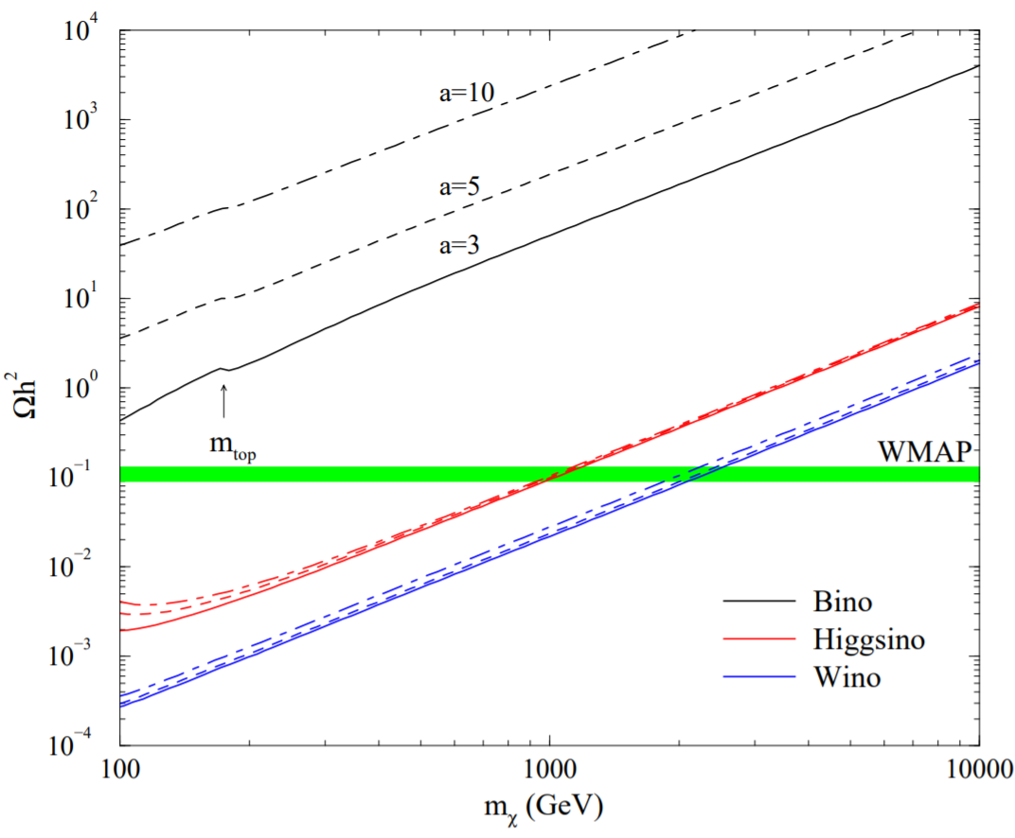
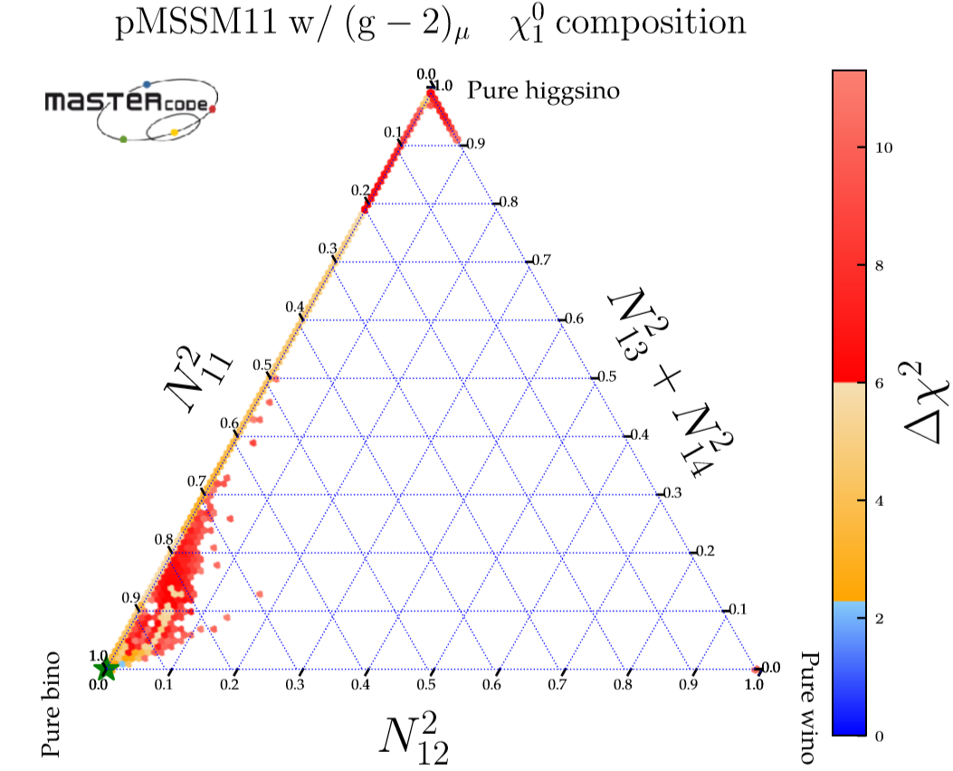
For Bino-like LSP, the observed relic density is usually achieved by:
Co-annihilating with stop/stau/wino…
Resonant annihilation via Z, h, A, H
Mixed with Higgsinos(+Wino)

Slide 9
2. B-W coannihilation and DD
B-W coannihilation can appear in e.g. Split SUSY, SUSY GUT models with NUGM, pMSSM11 w g-2.
We scan over the relevant parameter space for the B-W coannihilation:
and impose the constraints:

Slide 10
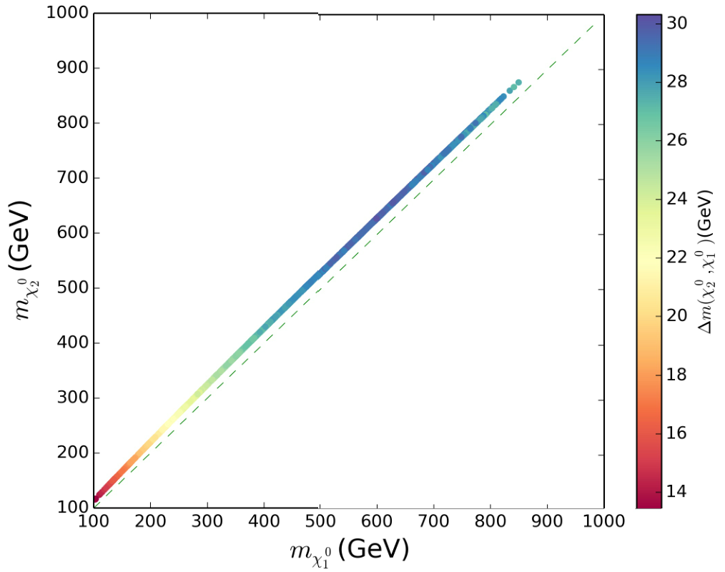

Slide 11
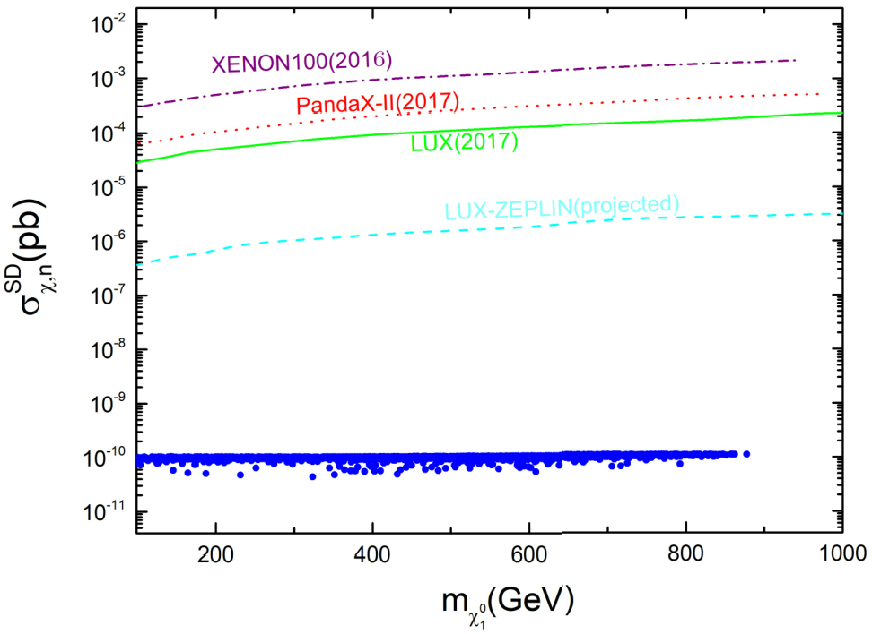

Slide 12
3. Soft lepton pair as a probe of B-W at the LHC

Slide 13
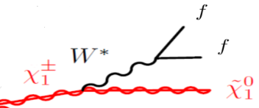
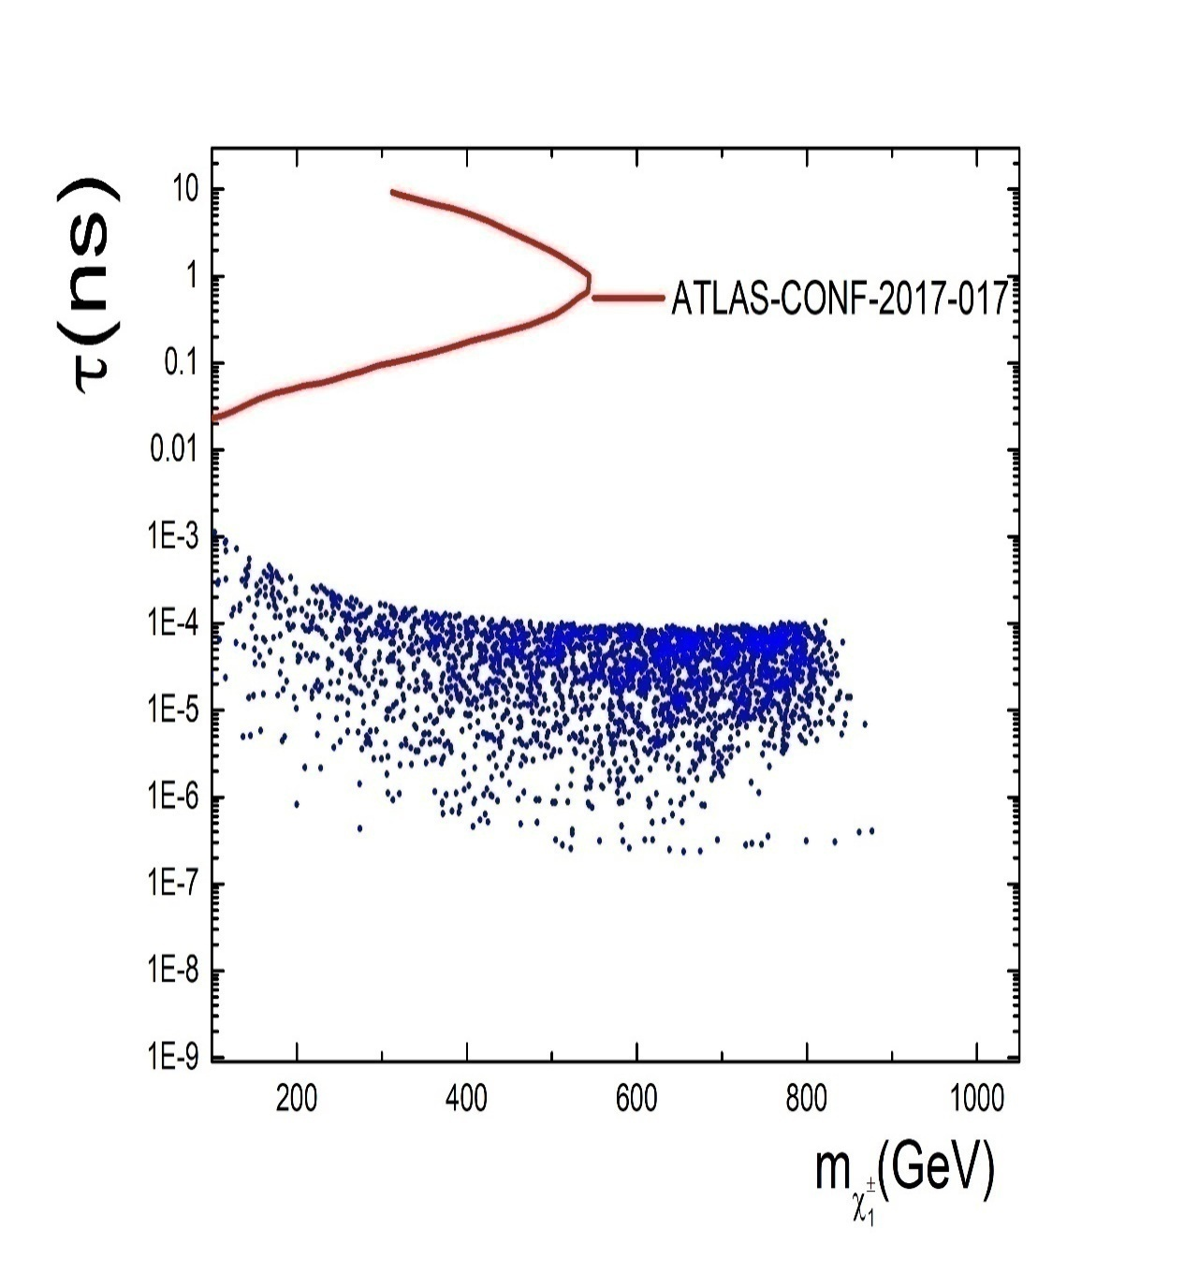
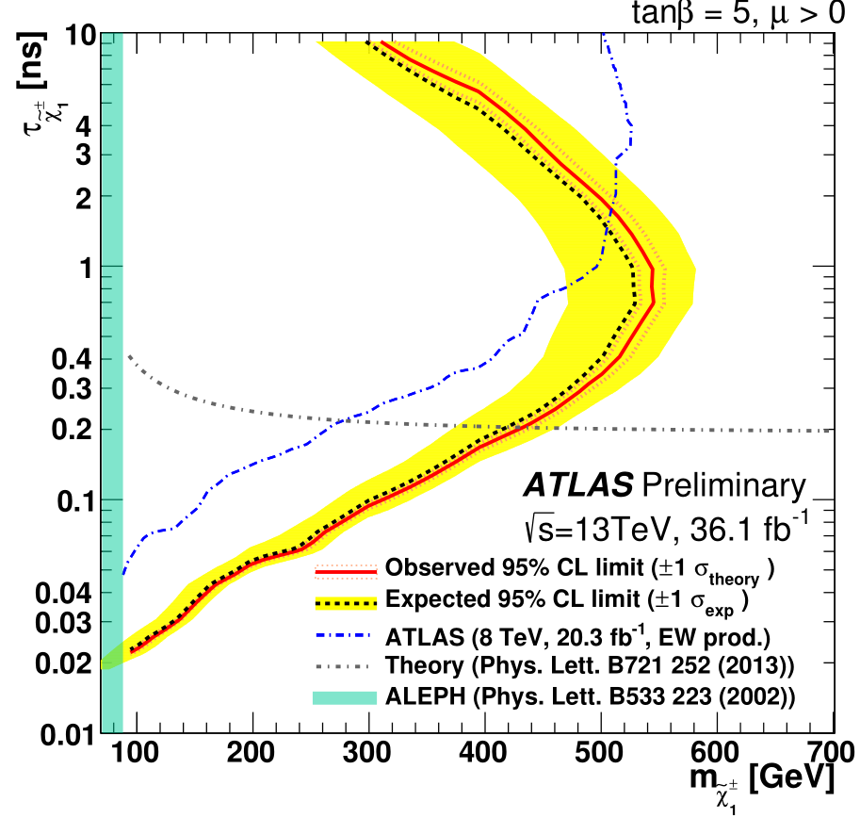
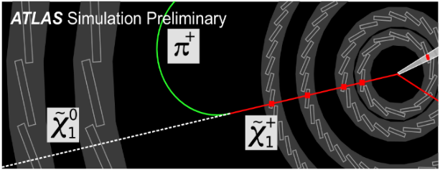

Slide 14
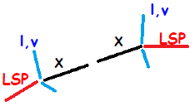
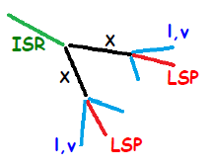
For small-splitting region, visible particles are soft and LSPs are back-to-back causing small MET.
ISR jet can boost the electrowinos X, making MET become larger as LSPs align.

Slide 15
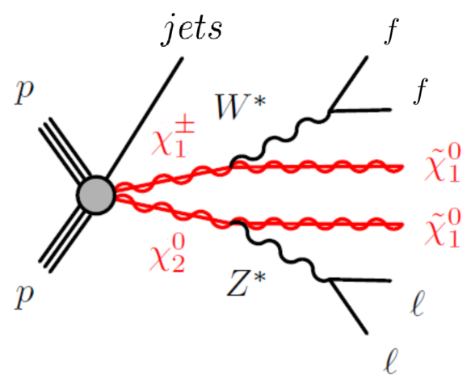
There is no upper limit on the number of jets in our analysis. Instead jet veto, a cut on can also remove background events efficiently but do not hurt the signal too much.
A soft lepton pair in the final states can help to suppress Dell-Yan and V+jets backgrounds.

Slide 17
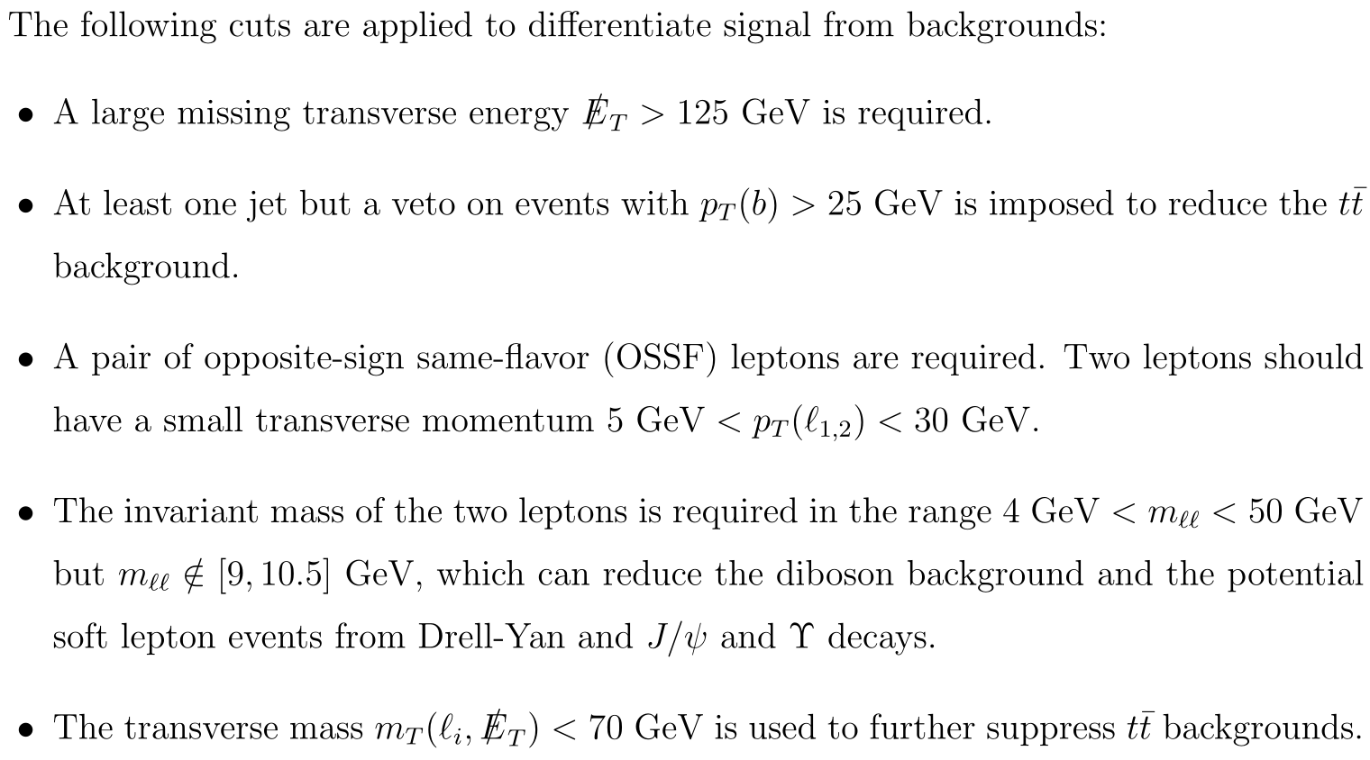

Slide 18
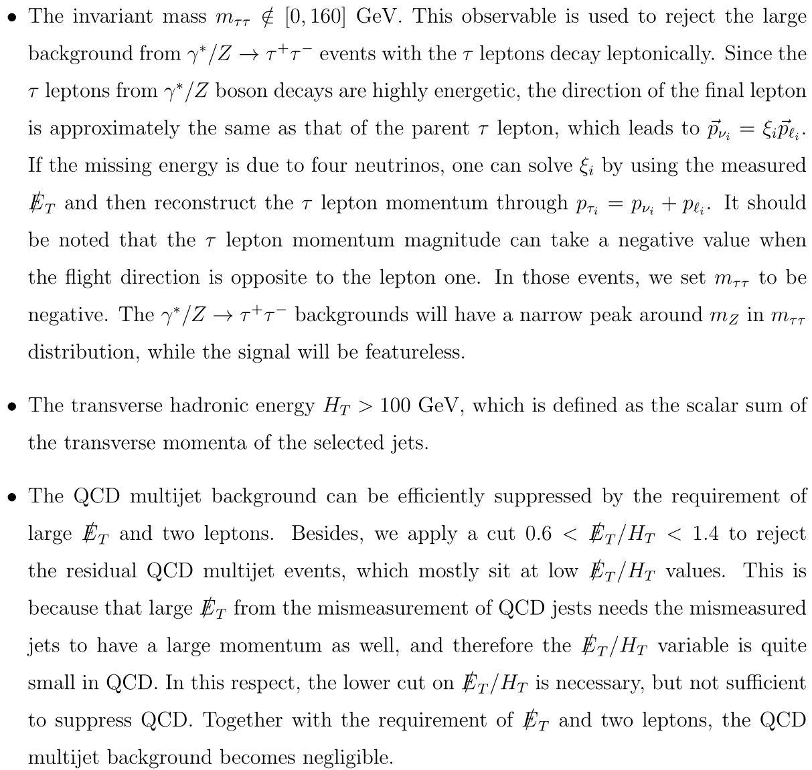

Slide 20
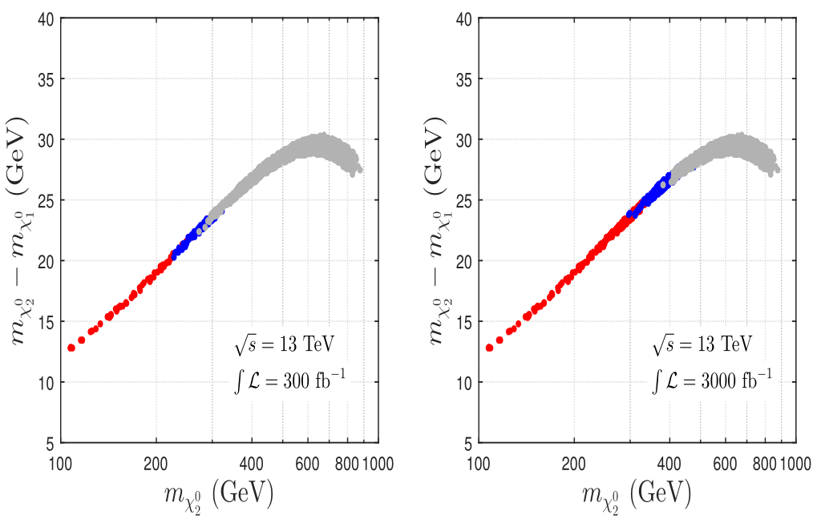

Slide 21
4. Conclusions
Neutralino DM is still alive, but under siege from direct detection
B-W coannihilation can satisfy the DM relic density and escape direct detection bounds.
Digging out neutralino DM under neutrino floor needs the help of colliders.

Slide 22
Thanks！
Welcome to NNU！

Slide 23
Backup

Slide 25
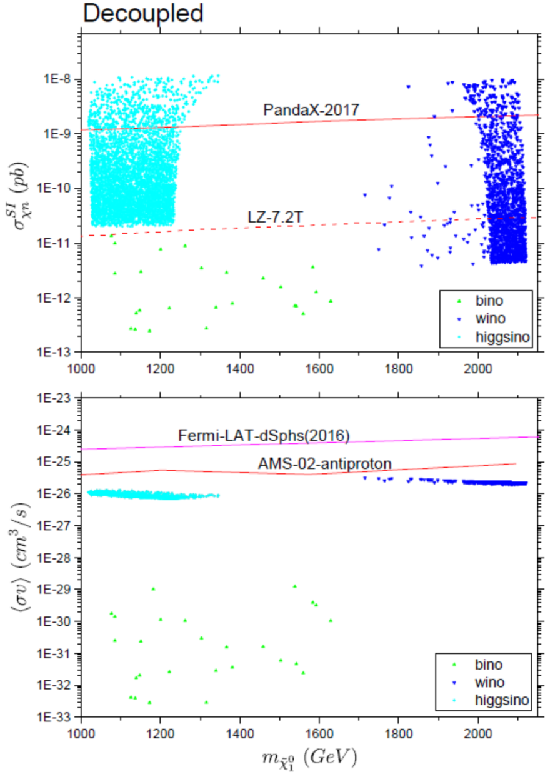
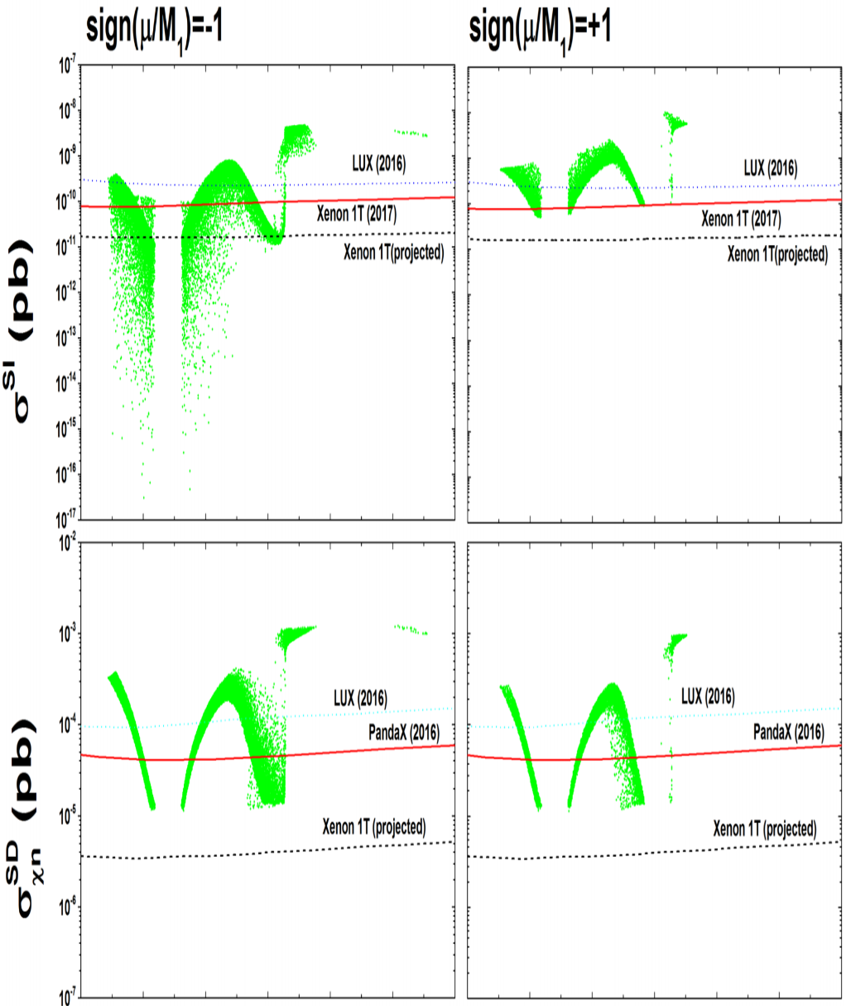
arXiv:1805.06206
Abdughani, Ren, Zhao
arXiv:1705.09164
Abdughani, Wu, Yang
Wino, Higgsino DM and Bino DM mixed with Higgsino (well-tempered) has been tightly constrained by direct detections and will be largely, even completed covered.

