Slide 1
Constraining Dark Matter Models with a
Light Mediator at PandaX Experiment
杨勇，上海交通大学
On behalf of PandaX-II Collaboration
2018/6/22
Results based on arxiv:1802.06912 (accepted by PRL)

Slide 2
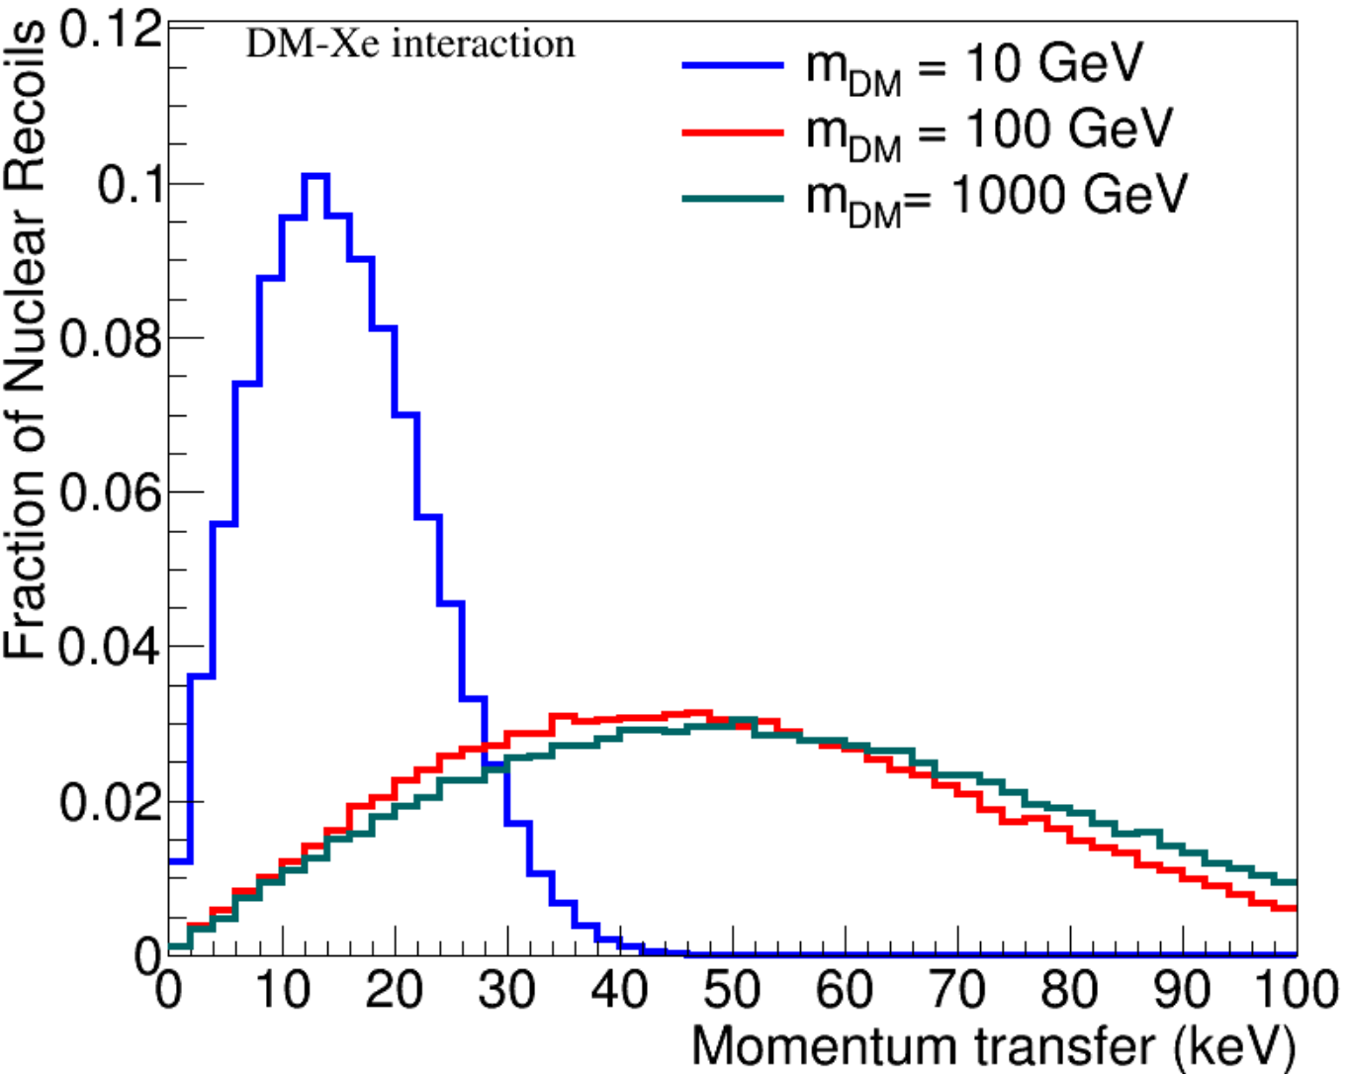
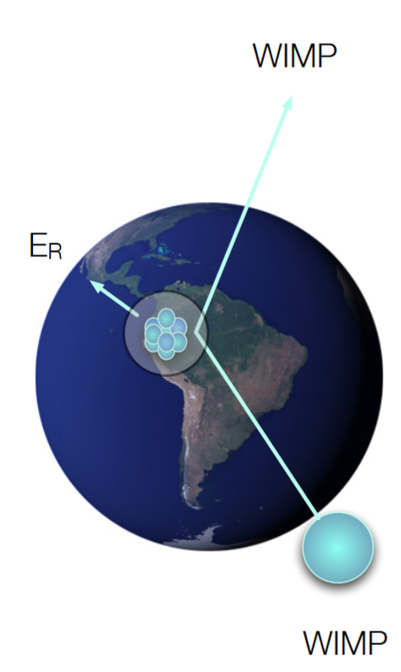
WIMP detection
DM
m_{φ} = 100 GeV
φ
nucleon
momentum transfer <q>: 10-50 keV for 10-100 GeV DM

Slide 3
Assumption in WIMP search
DM
$$\frac{1}{m_{φ}^{2}+q^{2}}\underset{→}{m_{φ}≫q}\frac{1}{m_{φ}^{2}}$$
DM
φ
nucleon
nucleon
Contact interaction
For mediator mass >> q, contact-interaction assumption is valid, no q-dependent.
Foundation of “main results” (SI/SD) from direct DM experiments.

Slide 4
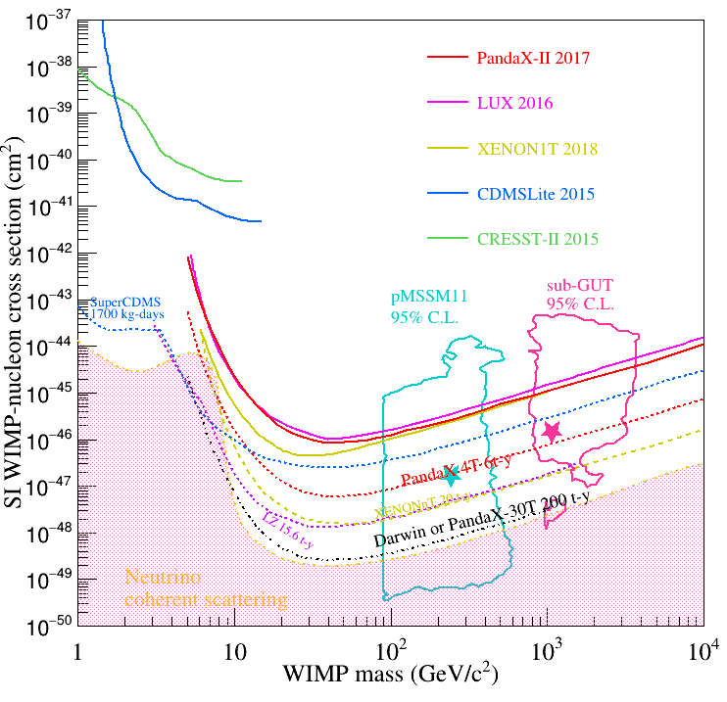
Roadmap of WIMP detection
3 orders of magnitude
to reach neutrino floor

Slide 5
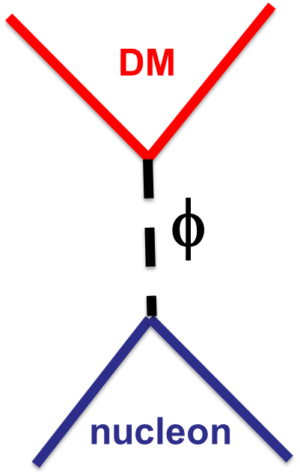
What if mediator is very light?
$$m_{φ}<q$$
Very light: means mediator mass is compared to or smaller than momentum transfer
How much our sensitivity is affected?

Slide 6
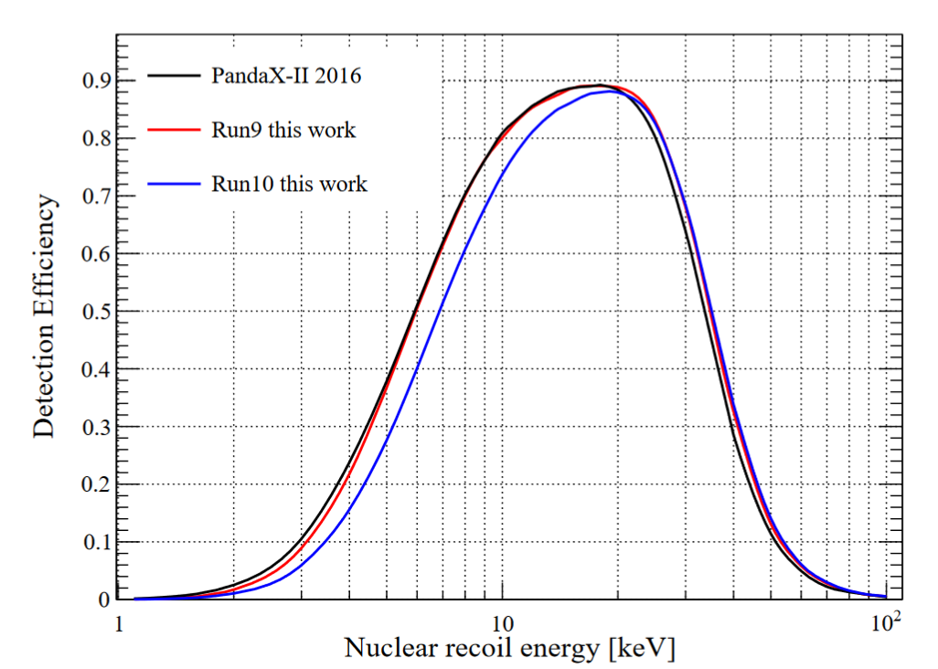
Recoil energy spectrum
Energy spectrum with a lighter mediator is more peaked
towards to low energies where efficiency is small.
This can change drastically PandaX’s sensitivity

Slide 7
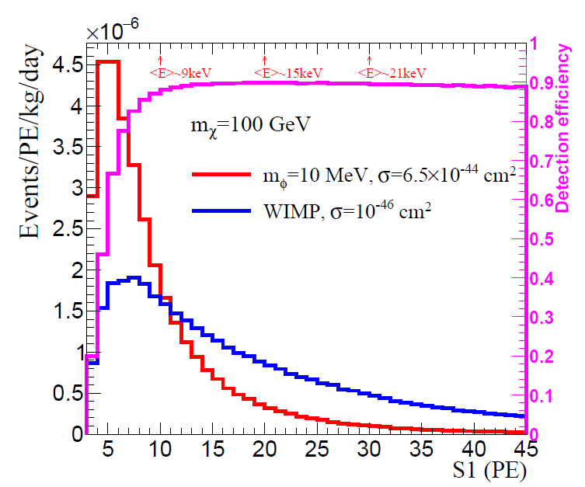
Simulated DM signals
Simulated distributions in PandaX-II after applying event-selections
Populated events near detector threshold for light mediator
This analysis uses identical selections as previous WIMP
analysis [PRL119, 181302 (2017)], so data and background
distributions are reusable.

Slide 8
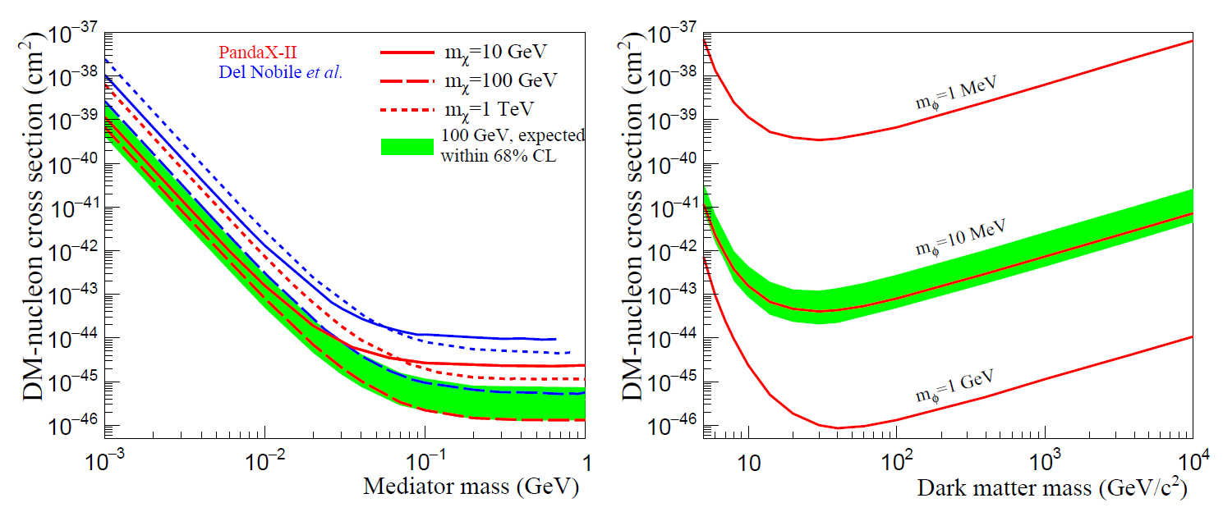
Limits on DM-nucleon cross sections
Agree with SI WIMP results
Our limits
For light-mediator DM models

Slide 9
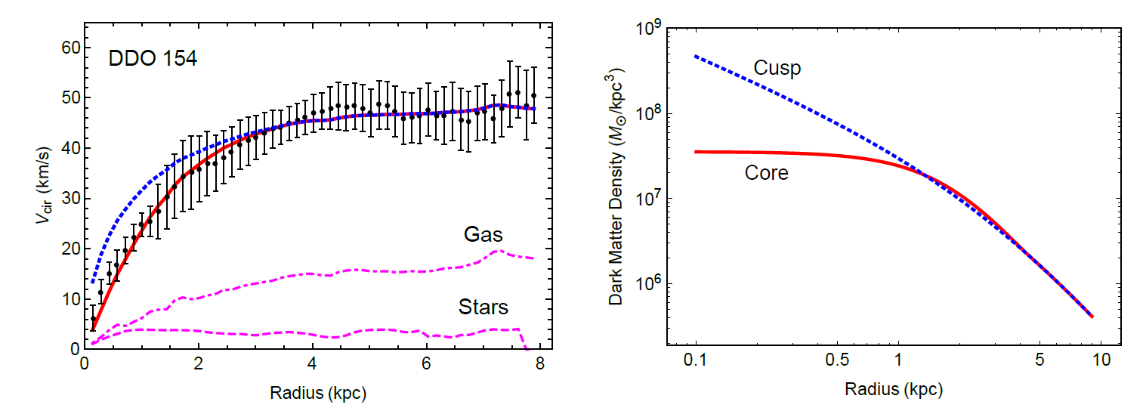
Self-interacting dark matter
Phys. Rept.
Phys.Rept. 730 (2018) 1-57
CDM
SIDM
Collisionless CDM-only simulations predict “cuspy” DM
density profiles, while observation prefer “core”.
Others: Missing satellites problem, Rotation curve diversity problem, Too-big-to-Fail problem.
SIDM is leading candidate to solve these issues.

Slide 10
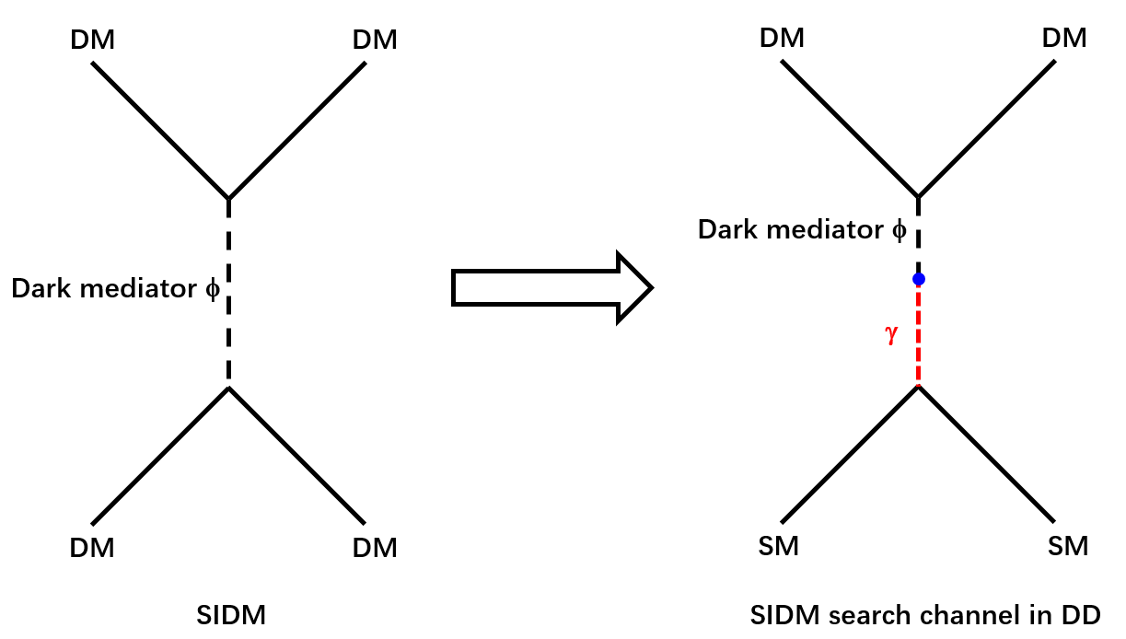
Self-interacting DM
We reinterpret our limits for a few SIDM models with a light mediator mixing with SM particles.
Two new parameters: mixing parameter ε and fine structure constant in the dark sector α_{χ}

Slide 11
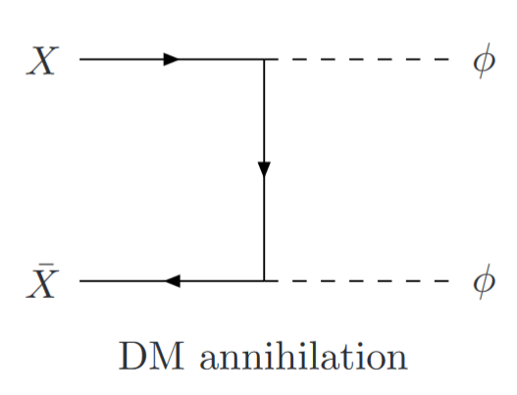
Fixing α_{χ}
For symmetric SIDM models, where DM and anti-DM are equally populated in early Universe, α_{χ} can be fixed by the observed DM relic density.
Symmetric
SIDM
, γ/Z mixing
, H mixing
Asymmetric
SIDM
α_{χ} = 0.01 (~SM fine-structure constant)

Slide 12
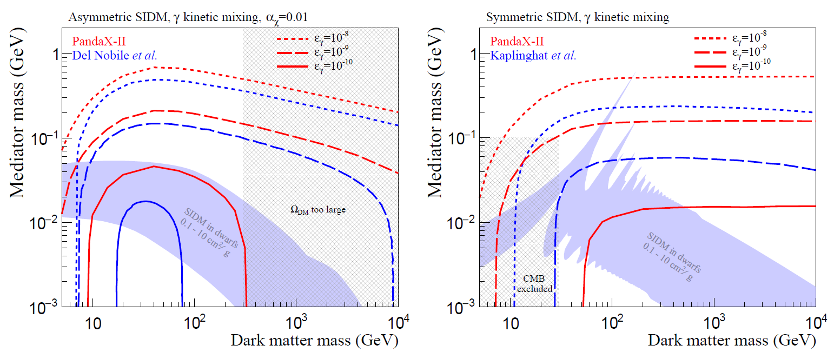
SIDM: γ mixing
In the region of interest by astrophysical observation, PandaX-II is sensitive to mixing parameter down to 10⁻¹⁰
However, we can not put direct limits on mediator mass because mixing parameter is not constrained

Slide 13
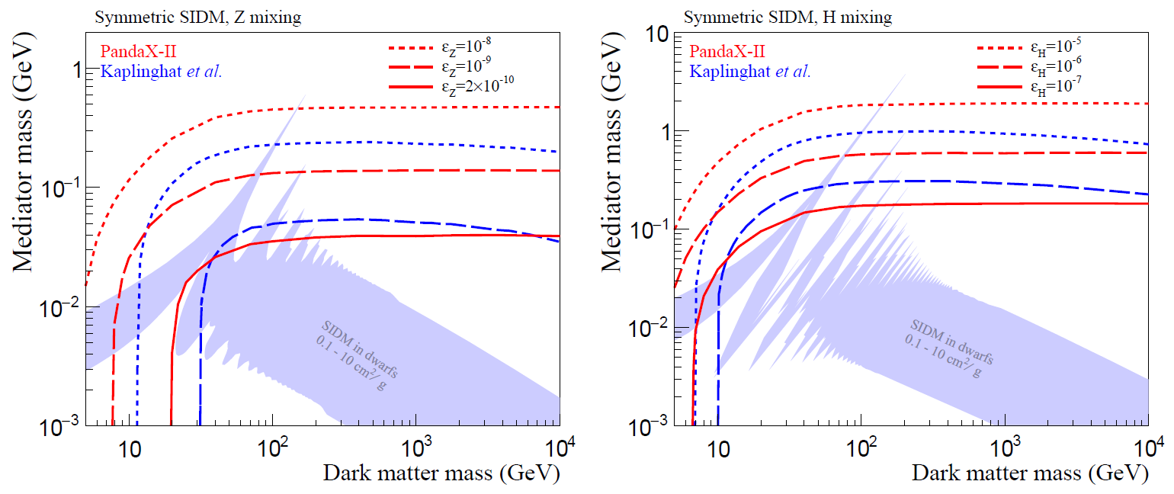
Z and H mixing
PandaX-II data are sensitive to as small as 2x10⁻¹⁰ mixing
parameter for Z mixing and 10⁻⁷ for H mixing

Slide 14
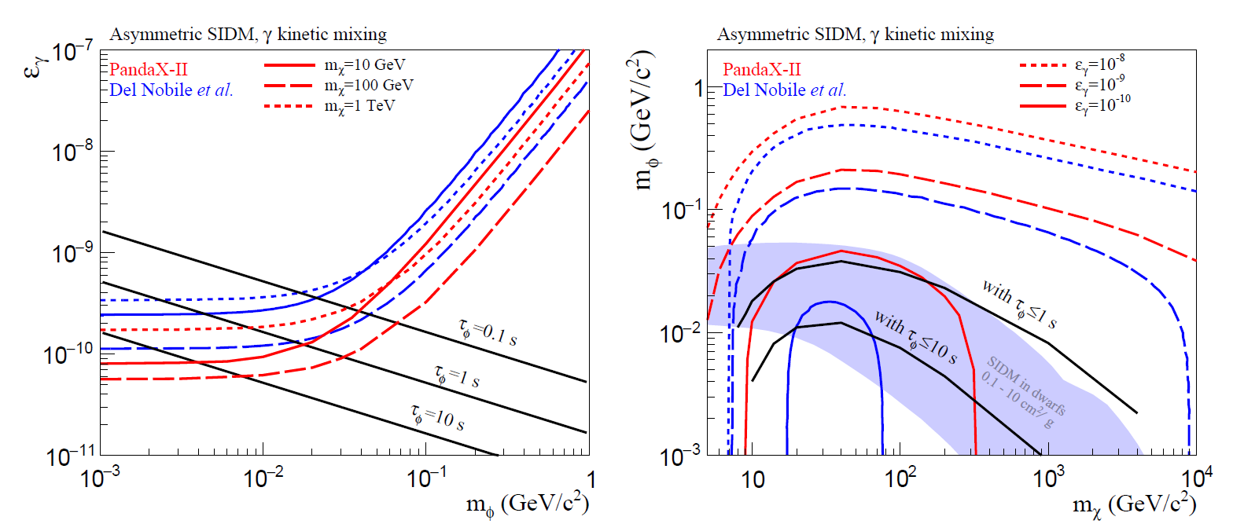
Mediator lifetime
1802.06912v1, Not in accepted PRL version
Decay products shall not alter light element abundance, which is well predicted by Big-Bang Nucleosynthesis (BBN)
Take few τ_{φ} reference limits from BBN consideration.
Notes:
Big-Bang nucleosynthesis (BBN) offers the deepest reliable probe of the early
Universe, being based on well-understood Standard Model physics [1]. Predictions of the
abundances of the light elements, D, 3He, 4He, and 7Li, synthesized at the end of the ‘first
three minutes,’ are in good overall agreement with the primordial abundances inferred
from observational data, thus validating the standard hot Big-Bang cosmology (see [2–5]
for reviews). This is particularly impressive given that these abundances span nine orders
of magnitude – from 4He/H ∼ 0.08 down to 7Li/H ∼ 10−10 (ratios by number).

Slide 15
Summary
DM-nucleon cross section limits are presented for the interaction through a light-mediator
Can be worsen by several orders of magnitude than the standard WIMP limits.
Direct detections can not put constraints on mediator mass in SIDM models
Potential constraints if mediator lifetime limits are imposed (from BBN consideration)

