Slide 1
Decay Properties of Molecular States
Dian-Yong Chen
Southeast University
PRD93,014003;D93,094011;D96,054017;EPJC77,398;A52,310
2018.6.22

Slide 2
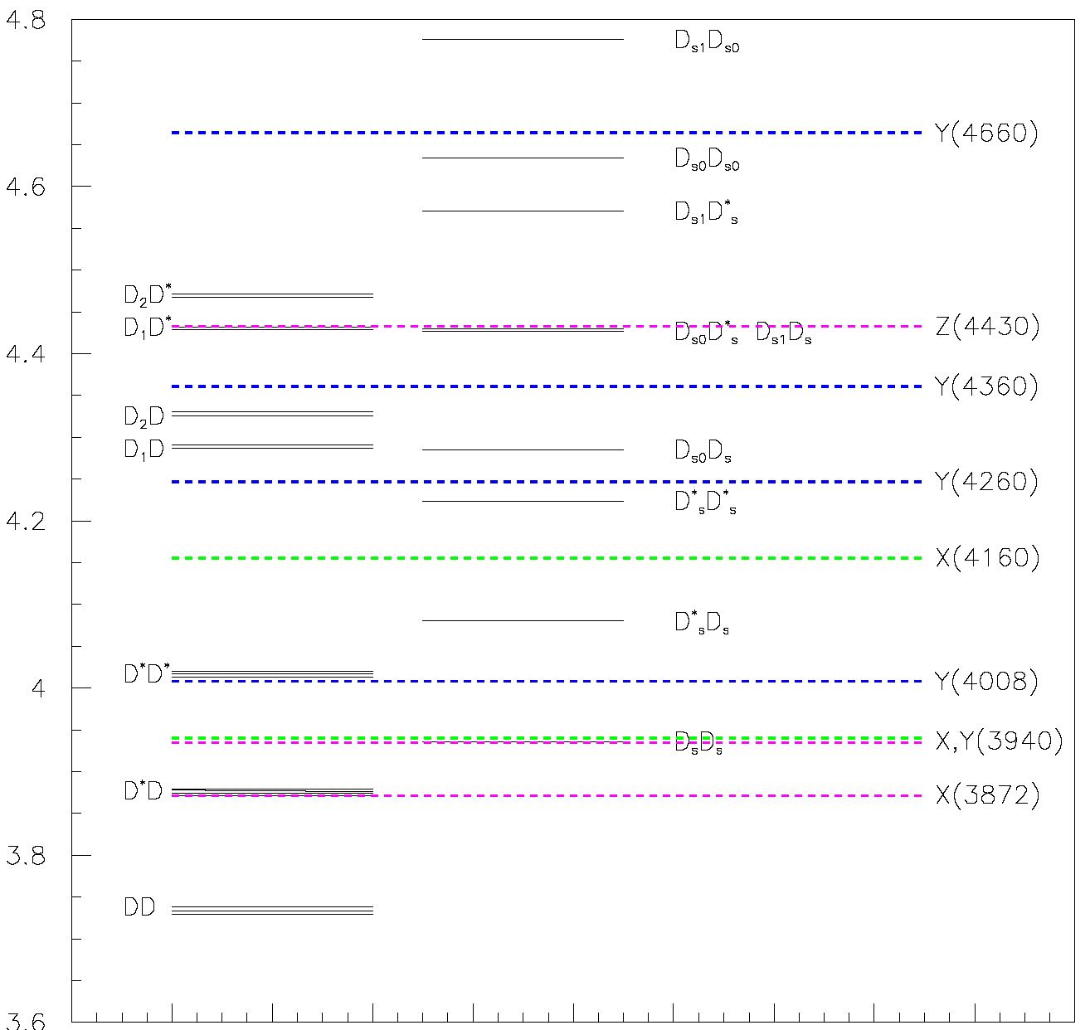
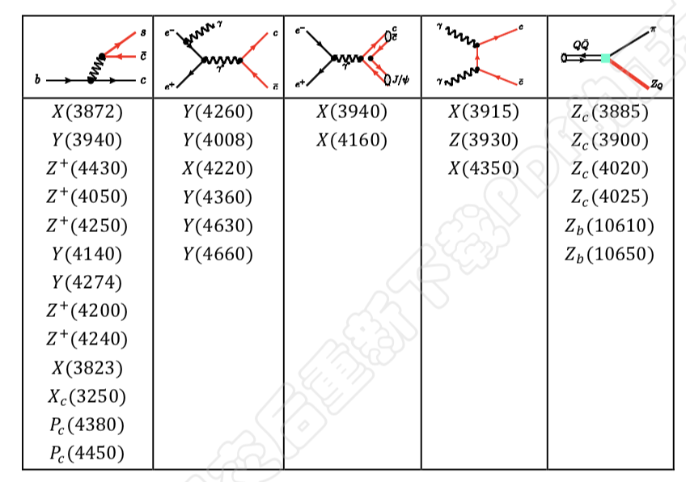
New hadron states
some of the states are near thresholds,
Candidates of deuteron-like molecular states.

Slide 3
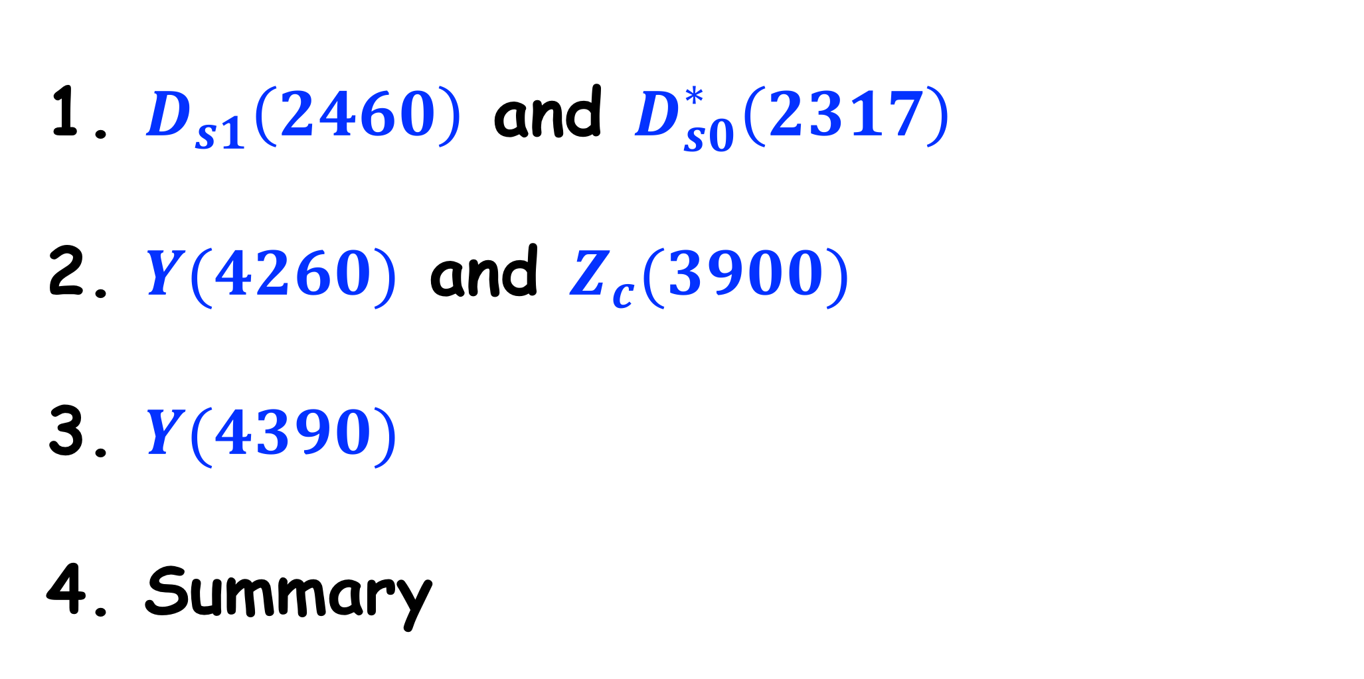
Outline
$D_{s1}\left(2460\right)$ and $D_{s0}^{∗}\left(2317\right)$
$Y(4260)$ and $Z_{c}(3900)$
$Y(4390)$
Summary

Slide 4
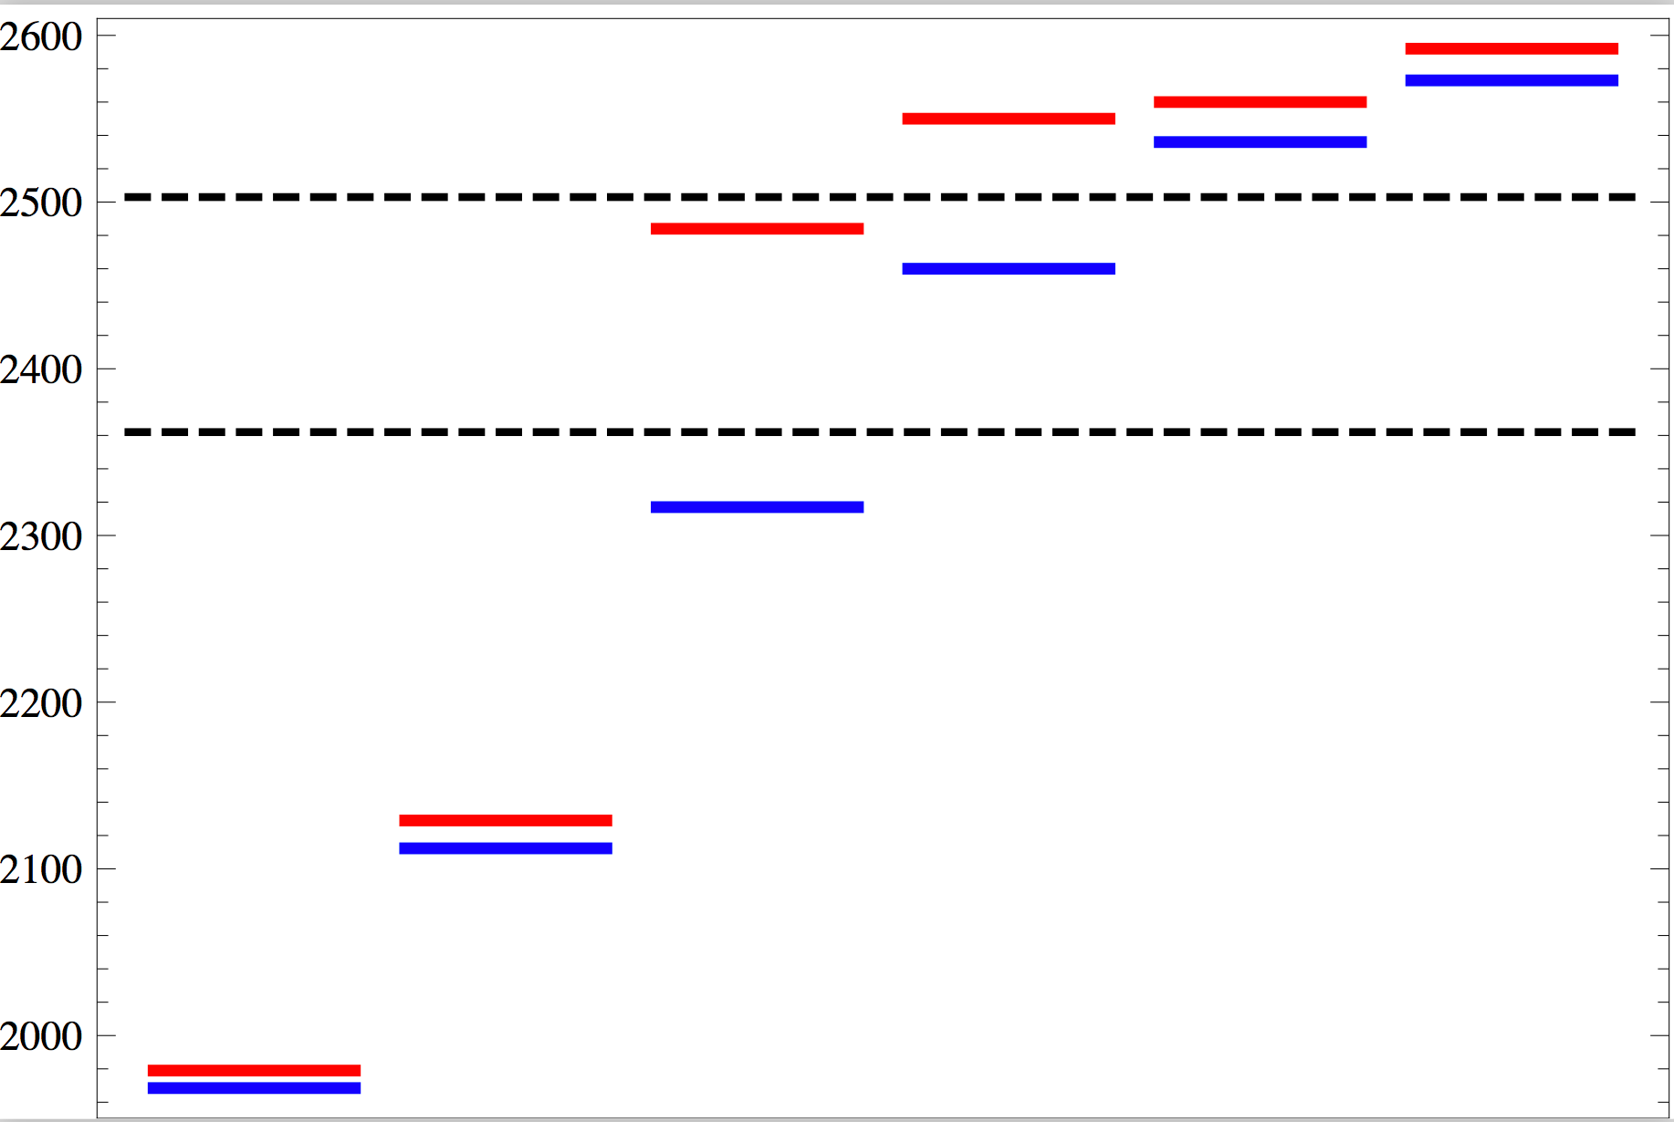
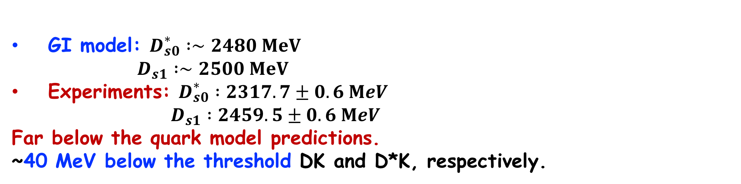
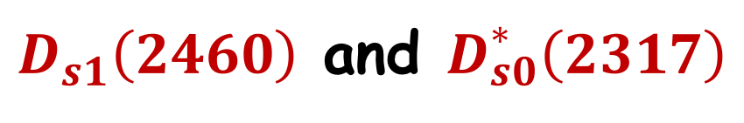








$D_{s1}\left(2460\right)$ and $D_{s0}^{∗}\left(2317\right)$
Quark Model VS Experiments
Charmed-strange VS charmed
$$D^{∗}K$$
$$DK$$
Experiments
GI Model
$$D_{s}$$
$$D_{s}^{∗}$$
$$D_{s0}^{∗}$$
$$D_{s1}$$
$$D_{s1}^{′}$$
$$D_{s2}$$
GI model: $D_{s0}^{∗} :∼2480 MeV$
$D_{s1} :∼2500 MeV$
Experiments: $D_{s0}^{∗} :2317.7±0.6 MeV$
$D_{s1} :2459.5±0.6 MeV$
Far below the quark model predictions.
~40 MeV below the threshold DK and D*K, respectively.
Comparison of Charmed and charmed-strange meson: SU(3) symmetry and breaking

Slide 5


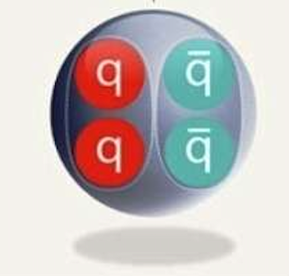
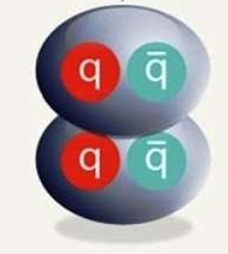
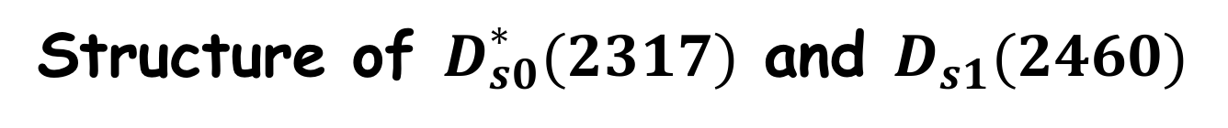
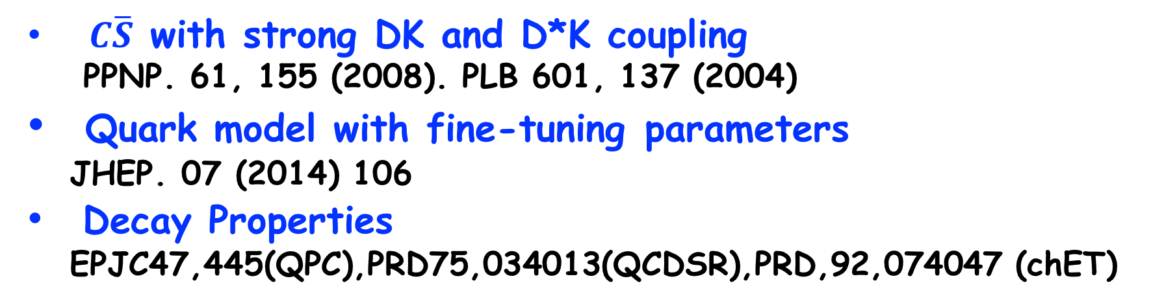
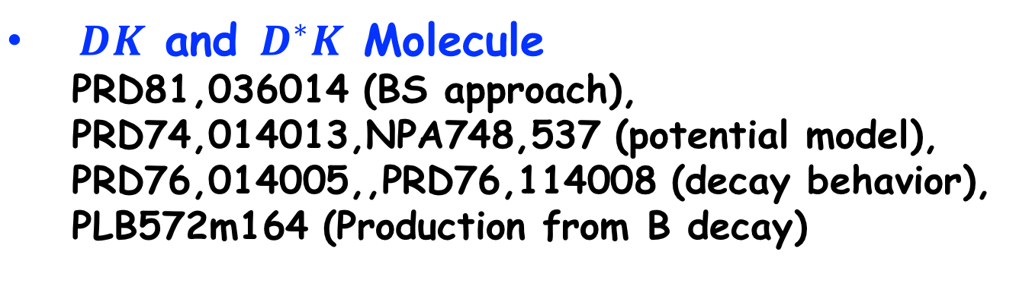
Structure of $D_{s0}^{∗}(2317)$ and $D_{s1}(2460)$
$C\overline{S}$ with strong DK and D*K coupling
PPNP. 61, 155 (2008). PLB 601, 137 (2004)
Quark model with fine-tuning parameters
JHEP. 07 (2014) 106
Decay Properties
EPJC47,445(QPC),PRD75,034013(QCDSR),PRD,92,074047 (chET)
Diquark-antidiquark tetraquark states
Mass: NPA778,22, PLB624 (2005) 217,
PRD68 (2003) 011501
Decay: PLB634,35
$DK$ and $D^{∗}K$ Molecule
PRD81,036014 (BS approach),
PRD74,014013,NPA748,537 (potential model),
PRD76,014005,,PRD76,114008 (decay behavior),
PLB572m164 (Production from B decay)

Slide 6
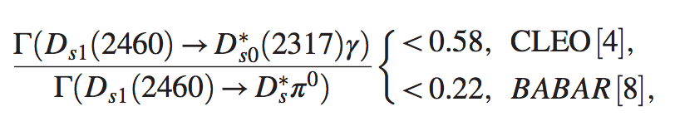
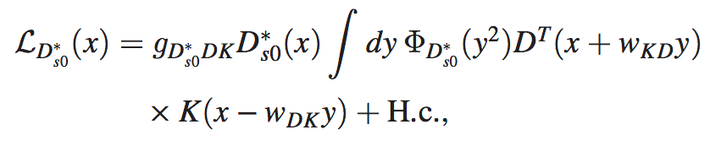
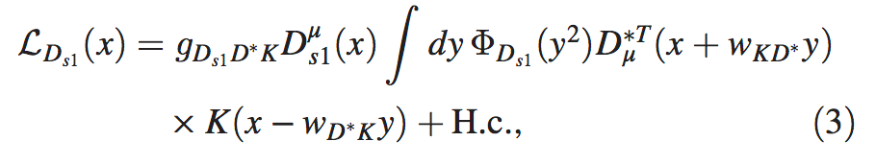
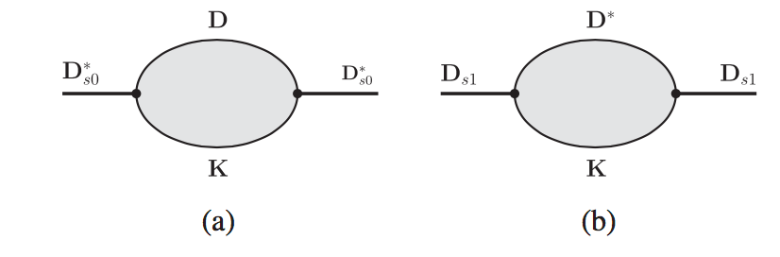
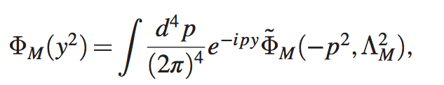
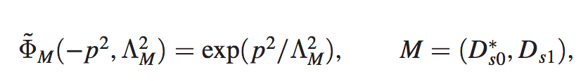
$D_{s1}\left(2460\right)→D_{s0}^{∗}\left(2317\right)γ/π^{0}$
Molecular structure

Slide 7
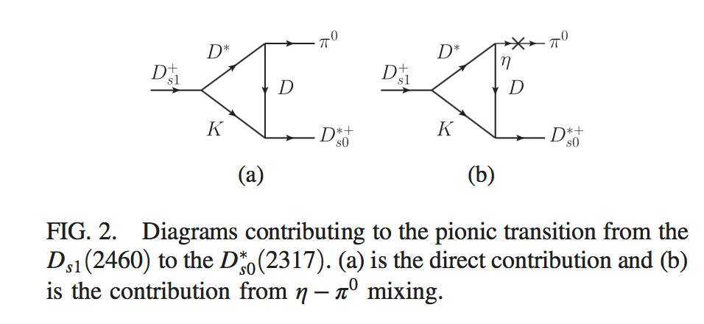
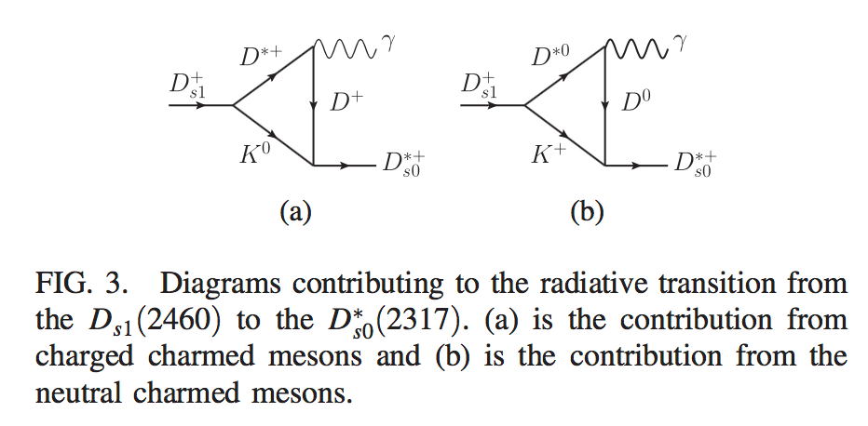
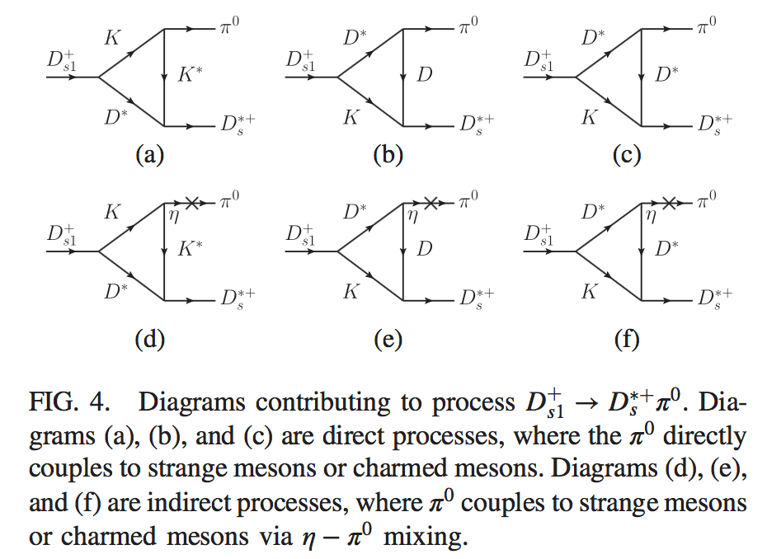



$$D_{s1}\left(2460\right)→D_{s0}^{∗}\left(2317\right)π^{0}$$
$$D_{s1}\left(2460\right)→D_{s0}^{∗}\left(2317\right)γ$$
$$D_{s1}\left(2460\right)→D_{s}^{∗}π^{0}$$

Slide 8
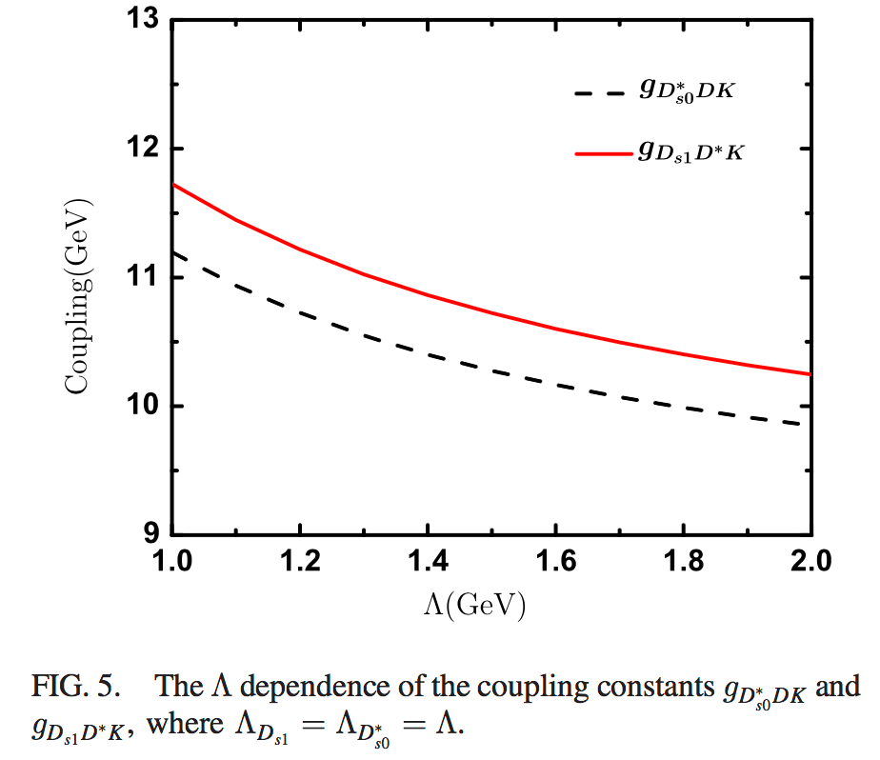
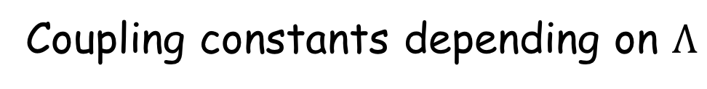
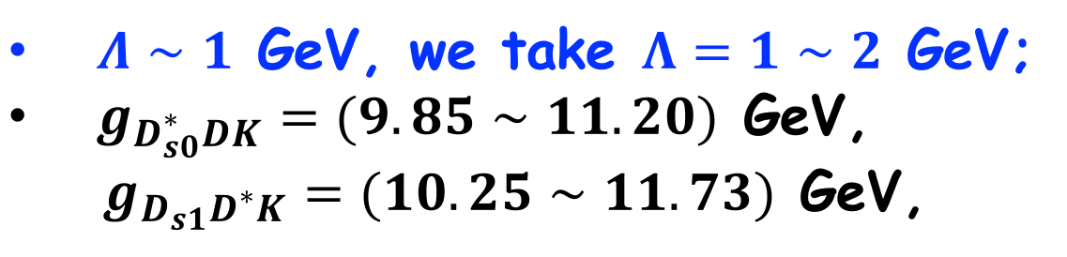
Coupling constants depending on $Λ$
$Λ∼1$ GeV, we take $Λ=1∼2$ GeV;
$g_{D_{s0}^{∗}DK}=(9.85∼11.20)$ GeV,
$g_{D_{s1}D^{∗}K}=(10.25∼11.73)$ GeV,

Slide 9
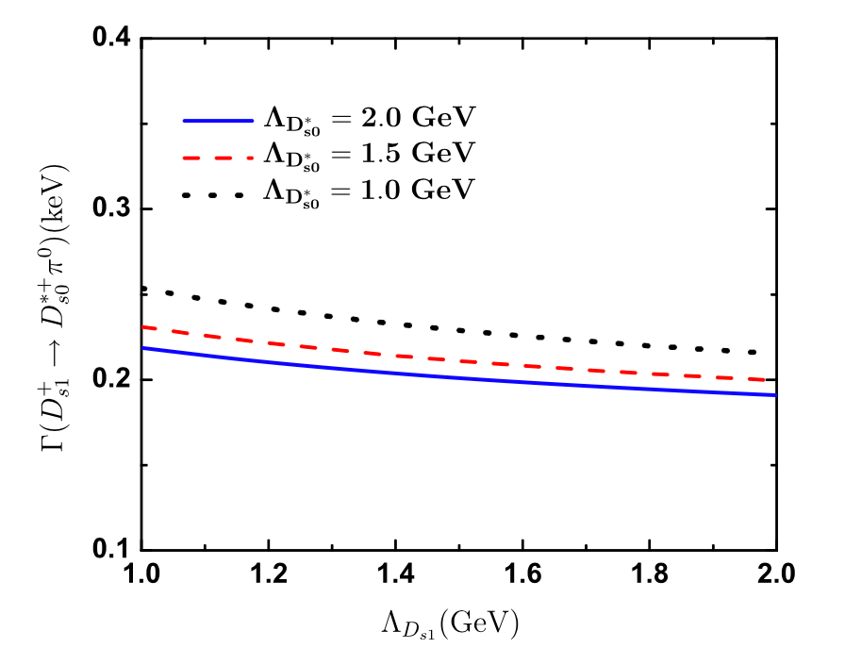
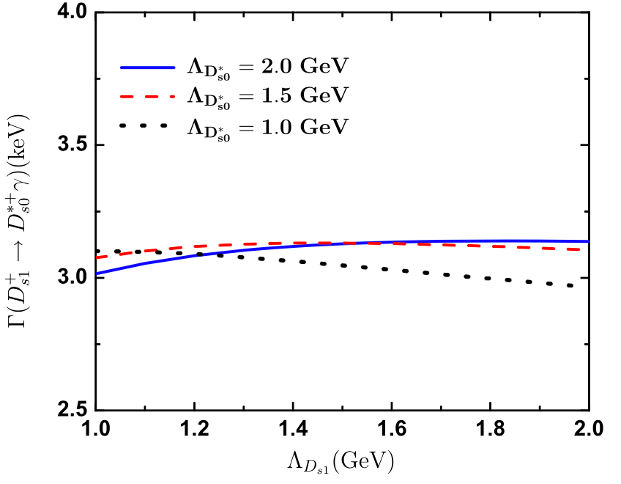
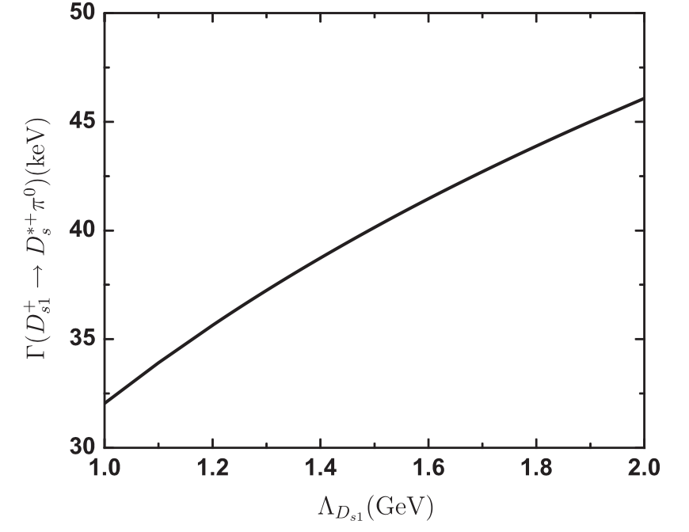





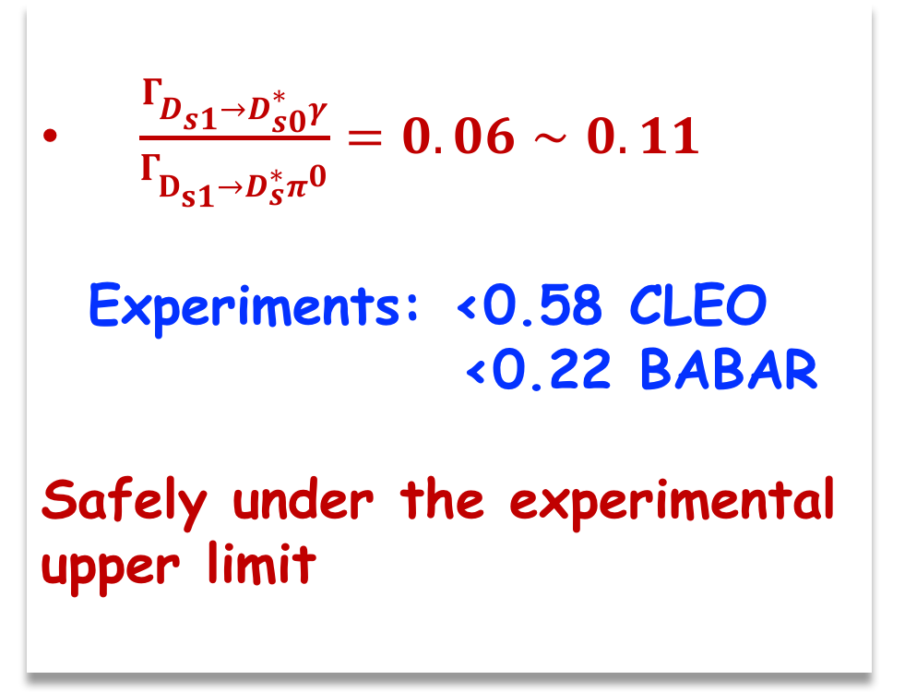

$$D_{s1}→D_{s0}^{∗}π^{0}$$
$$D_{s1}→D_{s0}^{∗}γ$$
$\frac{Γ_{D_{s1}→D_{s0}^{∗}γ}}{Γ_{D_{s1}→D_{s}^{∗}π^{0}}}=0.06∼0.11$
Experiments: <0.58 CLEO
<0.22 BABAR
Safely under the experimental upper limit
$Γ_{D_{s1}→D_{s0}^{∗}π^{0}}=0.19∼0.22keV$
$Γ_{D_{s1}→D_{s0}^{∗}γ}=3.0∼3.1 keV$
Weakly dependent on the model parameters
$$D_{s1}→D_{s}^{∗}π^{0}$$
$Γ_{D_{s1}→D_{s}^{∗}π^{0}}=31∼45keV$

Slide 10

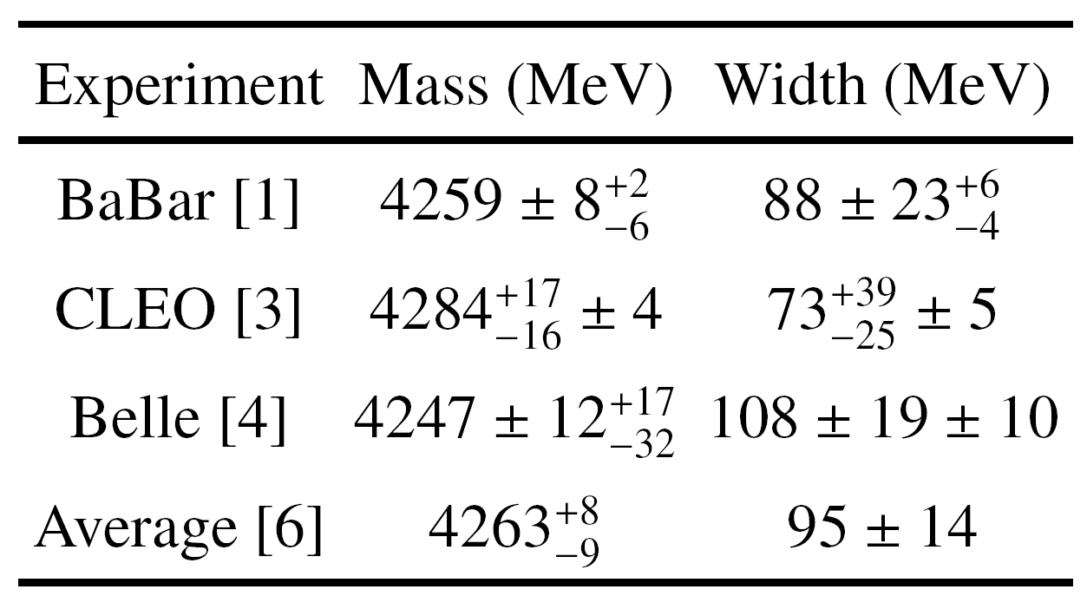
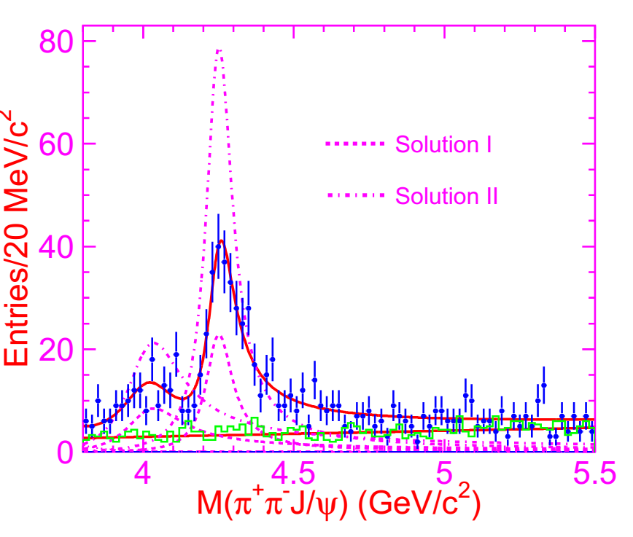

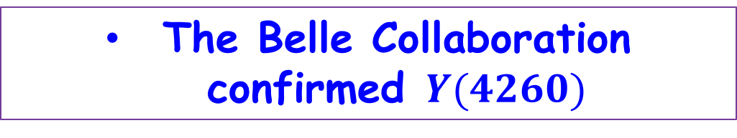
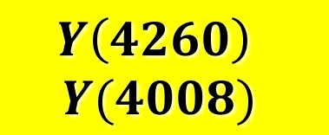
Y(4260) and Zc(3900)
PRL95, 142001 (2005)
$$Y\left(4260\right)$$
$$Y(4008)$$
PDG2016 4251±9 120±12.
PRL99,182004(2007)
The Belle Collaboration confirmed $Y(4260)$

Slide 11
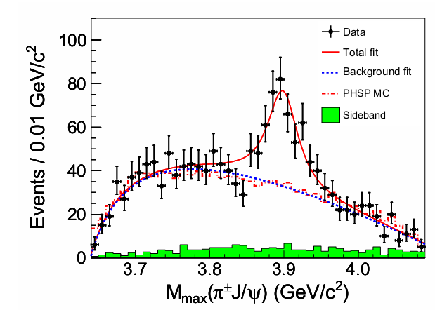
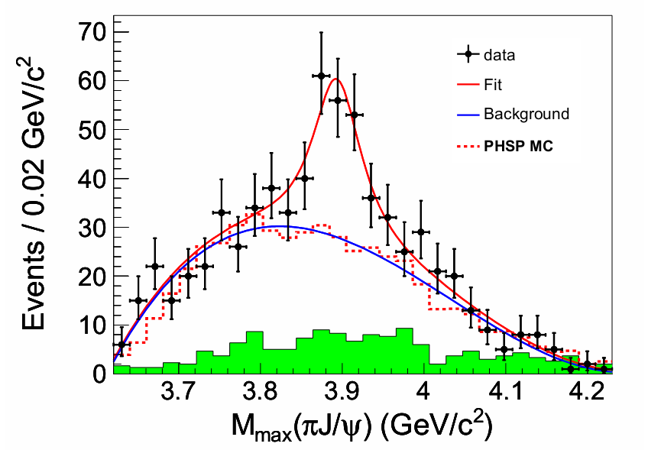
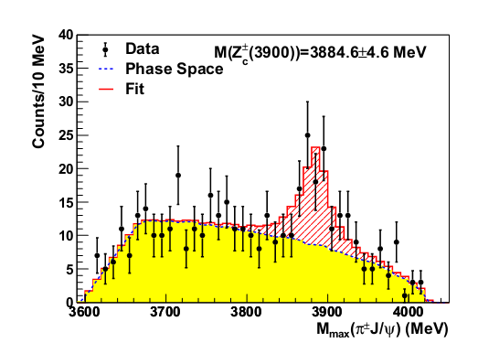
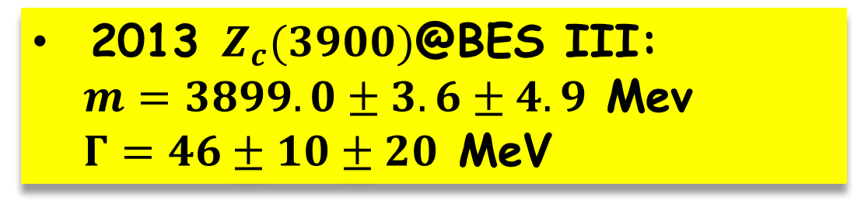
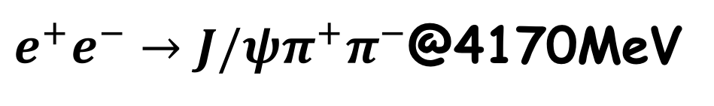
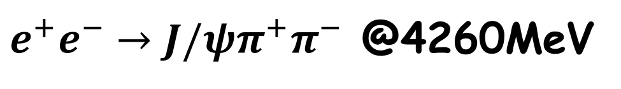
Experimental status: $Z_{c}(3900)$
2013 $Z_{c}(3900)$@BES III:
$m=3899.0±3.6±4.9$ Mev
$Γ=46±10±20$MeV
$e^{+}e^{−}→J/ψπ^{+}π^{−}$ @4260MeV
PRL110, 252001 (2013)
Belle II reported the same resonance in the same time?
CLEO also release their analysises @4170 GeV
$e^{+}e^{−}→J/ψπ^{+}π^{−}$@4170MeV
PRL110, 252002 (2013)
PLB 727 (2013) 366

Slide 12
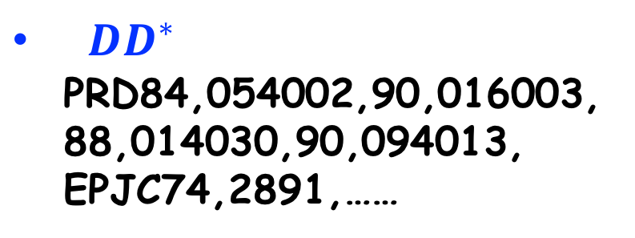
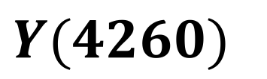
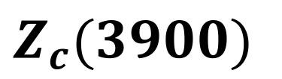
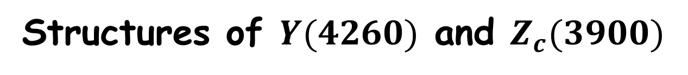
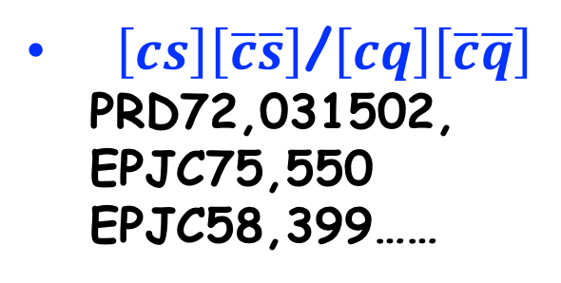


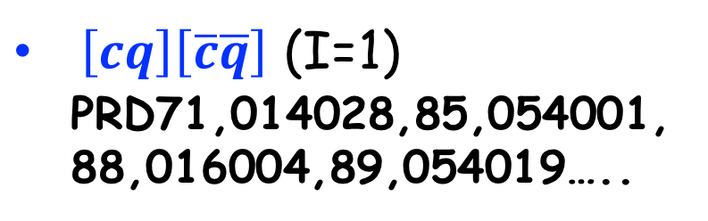
Structures of $Y(4260)$ and $Z_{c}(3900)$
$Y(4260)$
$$Z_{c}(3900)$$
2D,3D,4S $c\overline{c}$ PRD72,031503,
PRD79,094004,……
$\left[cs\right]\left[\overline{c}\overline{s}\right]$/$\left[cq\right]\left[\overline{c}\overline{q}\right]$
PRD72,031502,
EPJC75,550
EPJC58,399……
$\left[cq\right]\left[\overline{c}\overline{q}\right]$ (I=1)
PRD71,014028,85,054001,
88,016004,89,054019…..
$D_{1}D$/$D_{0}D^{∗}/χ_{c0}V$
PRD72,054023,79, 014001
PLB634,399,639,263,
PRL111,132003……
$DD^{∗}$
PRD84,054002,90,016003,
88,014030,90,094013,
EPJC74,2891,……

Slide 13
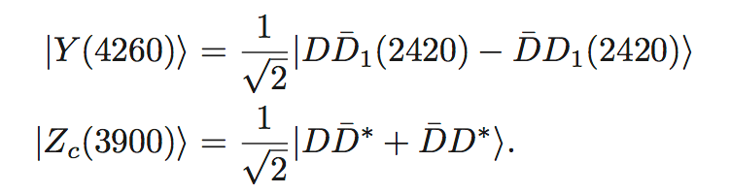
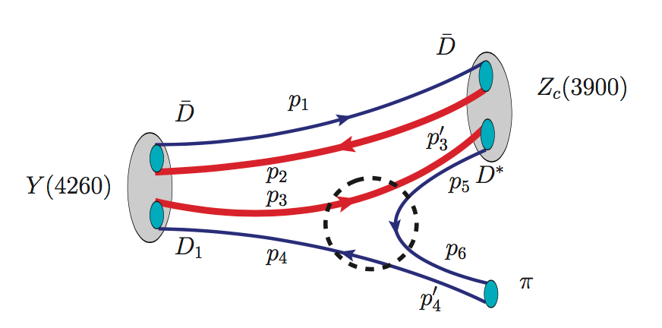
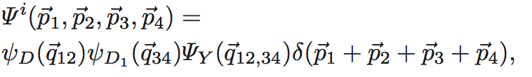
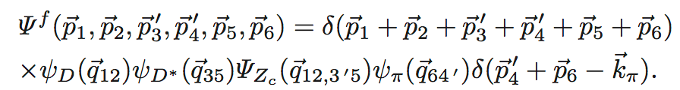
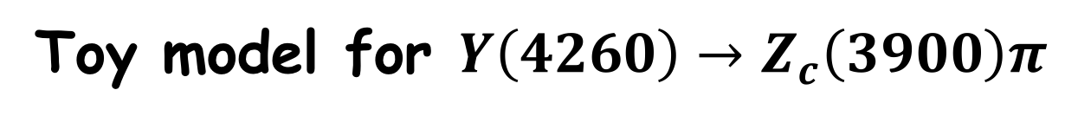
Toy model for $Y\left(4260\right)→Z_{c}\left(3900\right)π$
flavor function
Decay process
spectator
Subprocess
Wave function (final)
Wave function (initial)

Slide 14




Transition amplitude
subprocess
Wavefunction of molecule

Slide 15





subprocess
wavefunction
Simple Harmonic Oscillator Wavefunction (S-wave ground state)
Effective Radius (related to binding energy)
$R_{Y}=0.6∼0.8$fm,
$R_{Z}=1.4∼2.0$fm (5~10 MeV),

Slide 16







$$\frac{Γ\left(Y→Z_{c}π→ππψ\right)}{Γ(Y→ππψ)}∼\left(21.5±3.3\right)\%$$
$Γ\left(Y→Z_{c} π→ππψ\right)>100$ keV
$Γ\left(Y→ππψ\right)>508$ keV
$$\frac{Γ\left(Z_{c}→DD^{∗}\right)}{Γ(Z_{c}→πψ)}∼6.2±1.1±2.7$$
$$B\left(Z_{c}→πJψ\right)=\left(5.2∼13.2\right)\%$$
Experiments: $Γ\left(Y→πZ_{c}\right)>0.4$ MeV
Dong et al., effective Lagrangian approach:
$Γ\left(Y→πZ_{c}\right)=3.15±0.45$ MeV

Slide 17





Radiative Decay of Zc in molecular scenario
Molecular Structure
Mass Operator
$$Z_{c}^{0}→J/ψπ^{0}$$
Taking$Z_{c}^{0}→J/ψπ^{0}$ mode as a scale, we can fix the model parameter by comparing the theoretical results with the corresponding experimental measurements.

Slide 18






Radiative Decay of Zc
$$Z_{c}^{0}→η_{c}γ$$
$$Z_{c}^{0}→χ_{c0}γ/χ_{c1}γ$$
Triangle diagrams themselves of $Z_{c}^{0}→χ_{c0}γ$ are gauge invariant.
Contact diagram of $Z_{c}^{0}→χ_{c0}γ$ comes from higher partial wave coupling of $Z_{c}D^{∗}D$ and $χ_{c1}D^{∗}D$,
strong suppressed! Include by hand
Contact diagram is included to ensure the gauge invariance of the total amplitude

Slide 19




Coupling constant
$$Z_{c}^{0}→π^{0}Jψ$$
$$\frac{Γ\left(Z_{c}→DD^{∗}\right)}{Γ(Z_{c}→πψ)}∼6.2±1.1±2.7$$
$$B\left(Z_{c}→πJψ\right)=\left(5.2∼13.2\right)\%$$
$${Γ_{Z}}_{c}≃Γ_{DD^{∗}}+Γ_{πψ}=\left(28.1±2.6\right) MeV$$
$$Γ\left(Z_{c}→πJψ\right)=\left(1.3∼4.1\right) MeV$$
Theoretical estimation can overlap with the experimental measurement!!

Slide 20






$$Z_{c}^{0}→η_{c}\left(1S\right)γ/η_{c}\left(2S\right)γ$$
$$Z_{c}^{0}→χ_{c0}γ/χ_{c1}γ$$

Slide 21




Experimental potential:
Present estimation
$$\frac{Γ\left(Z_{c}^{0}→η_{c}(2S)γ\right)}{Γ\left(Z_{c}^{0}→π^{0}Jψ\right)}=\left(0.5∼1.5\right)\%$$
$$\frac{Γ\left(Z_{c}^{0}→χ_{c0}γ\right)}{Γ\left(Z_{c}^{0}→π^{0}Jψ\right)}=\left(1.5∼3.0\right)\%$$
Bes III measurement
$σ\left(e^{+}e^{−}→π^{0}Z_{c}^{0}→π^{0}π^{0}Jψ\right)=(9.9±2.1)$pb. @4230 MeV
$σ\left(e^{+}e^{−}→π^{0}Z_{c}^{0}→π^{0}π^{0}Jψ\right)=(4.0±1.2)$pb. @4260 MeV
$σ\left(e^{+}e^{−}→π^{0}Z_{c}^{0}→π^{0}γη_{c}(2S)\right)∼0.18$pb @4.230 MeV
$σ\left(e^{+}e^{−}→π^{0}Z_{c}^{0}→π^{0}γχ_{c0}\right)∼0.36$pb @4.230 MeV
$σ\left(e^{+}e^{−}→π^{0}Z_{c}^{0}→π^{0}γχ_{c0}\right)∼0.18$pb @4.260 MeV
only $γπ^{0}$ identified, without the reconstruction of $χ_{c0}/η_{c}(2S)$
$γπ^{0}$ recoil mass within the $χ_{c0}/η_{c}(2S)$ mass region,
$Z_{c}^{0}$ signals in the $π^{0}$ recoil mass distribution

Slide 22


Y(4390)
PRL118, 092002 (2017)
Y(4390)
$m=\left(4391.5_{−6.8}^{+6.3}±1.0\right) MeV,$
$Γ=\left(139.5 _{−20.6}^{+16.2}±0.6\right)MeV$
Only observed in $e^{+}e^{−}→π^{+}π^{−}h_{c}$process
$m_{Y\left(4390\right)}−m_{Y\left(4260\right)}≃m_{D^{∗}}−m_{D}$
Y(4260): $D_{1}D$ molecular;
Y(4390): $D_{1}D^{∗}$ molecular?

Slide 23




Possibility of Y(4390) as D*D1 molecule
Pion exchange
Pion exchange induced potential
Bethe-Salpter equation:

Slide 24

Y(4390)
Mass of D*D1 molecular: 4384 MeV;
Well consistent with Y(4390);
Y(4390) could be a good candidate of D*D1 molecular

Slide 25


Hidden charm decays of Y(4390)
Production process
Predicted process
$Z_{c}^{′}→π J/ψ$ ✘,
$Z_{c}^{′}→πh_{c}$ ✔
plays principle role in understanding of the production process

Slide 26



Partial width： order of 1 MeV
Branching ratio: order of 1%
Large enough to be observed.
Prediction:
 | Prediction | Experiments
$$\frac{Γ\left(ηJ/ψ\right)}{Γ\left(π^{+}π^{−}h_{c}\right)}$$ | $$0.52∼2.29$$ | $$0.11∼0.55$$
$$\frac{Γ\left(η^{′}J/ψ\right)}{Γ\left(ηJ/ψ\right)}$$ | $$0.18∼0.28$$ | -----
$$\frac{Γ\left({ηh}_{c}\right)}{Γ\left(π^{+}π^{−}h_{c}\right)}$$ | $$0.45∼2.63$$ | $$≤0.71$$
$$\frac{Γ\left({ηh}_{c}\right)}{Γ\left(ηJ/ψ\right)}$$ | $$0.80∼0.88$$ | $$≤4.15$$

Slide 27

Summary
1. $D_{s1}\left(2460\right)π$ and $D_{s0}^{∗}\left(2317\right)$
$Γ{(D}_{s1 } →D_{s0}^{∗}γ)$ and $Γ{(D}_{s1 } →D_{s0}^{∗}π)$ Weakly depend on the model parameter;
The ratio $Γ{(D}_{s1 } →D_{s0}^{∗}γ)$ and $Γ{(D}_{s1 } →D^{∗}π)$ is consistent with experiments;
2. $Y\left(4260\right)$ and $Z_{c}\left(3900\right)$
the toy model estimation is consistent with experiments and other methods;
Predicted the widths of $Z_{c}^{0}→γη_{c}, γη_{c}\left(2S\right), γχ_{c0}, γχ_{c1}$;
3. $Y\left(4390\right)$
Potential model: supports Y(4390) as a molecule state;
Production process could be understood in a molecule scenario;
Predicted the width of $ηJ/ψ, η^{′}J/ψ, ηh_{c}$.

Slide 28
Thank you
for your attention!

