Slide 1
Overview of PandaX-4T Experiment
Ning Zhou (周宁)
Shanghai Jiao Tong University
On behalf of PandaX Collaboration
中国物理学会高能物理分会，上海，2018-06-22

Slide 2
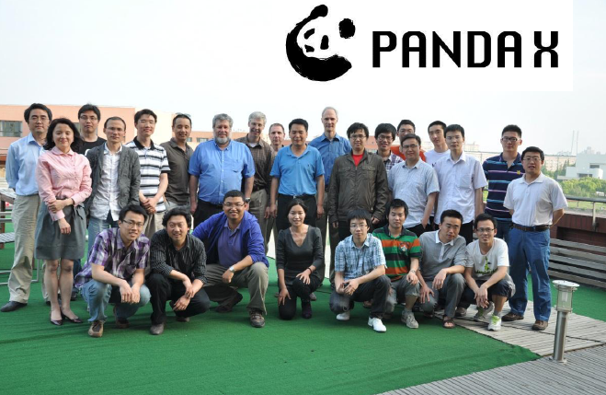
Outline
PandaX-4T upgrade plan
Background simulation
Expected sensitivity
Summary

Slide 3
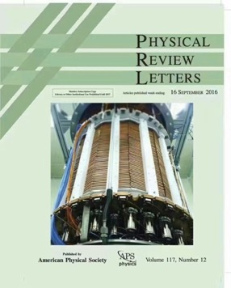
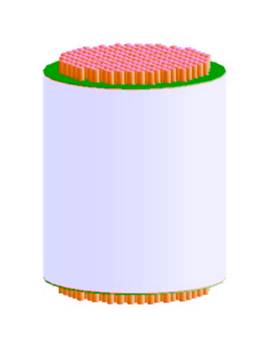
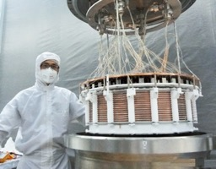
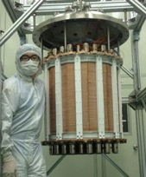
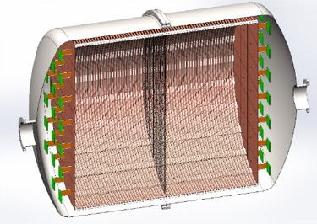
PandaX Experiment
Particle and Astrophysical Xenon Experiments
  Formed in 2009, ~50 people
PandaX-II experiment results with 54-ton-day
  World-leading signal constraints
Future: PandaX-xT multi-ton DM experiments
Phase I:
120 kg DM
2009-2014
PandaX-III:
200 kg to 1 ton ¹³⁶Xe 0vDBD
Future
Phase II:
580 kg DM
2014-2018
PandaX-xT: multi-ton DM
Future

Slide 4
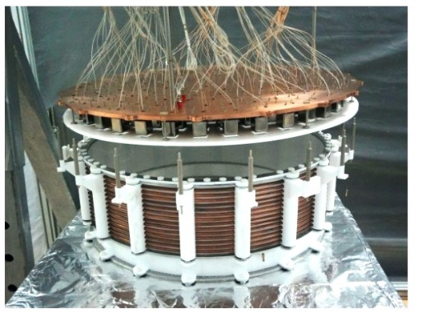
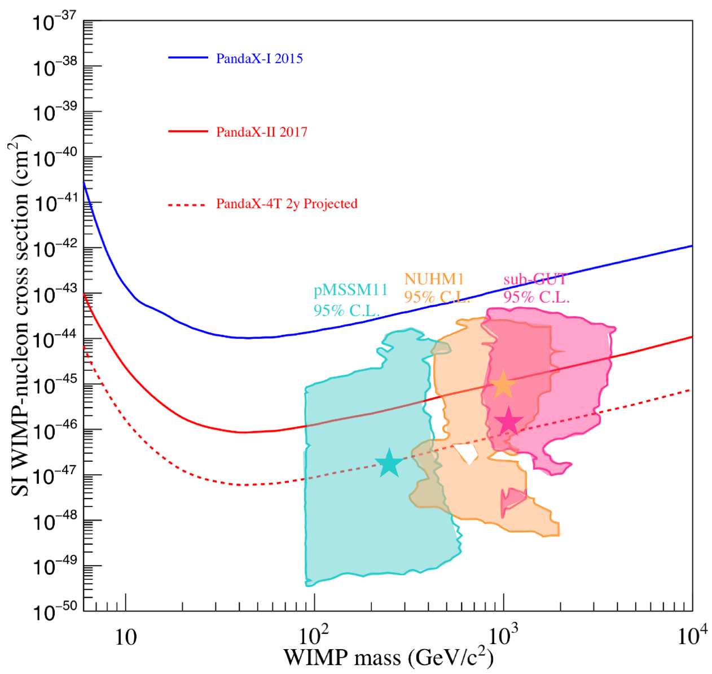
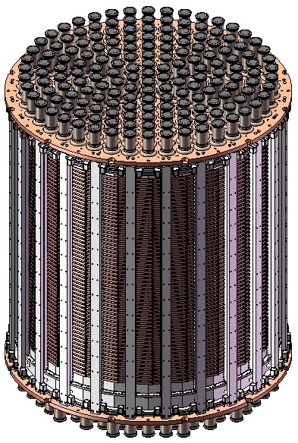
PandaX-4T Upgrade Plan
Improve the sensitivity by 1-2 magnitude
4-ton liquid xenon sensitive volume
PandaX-I 120kg detector
PandaX-II 580kg detector
Goal of 4-ton detector

Slide 5
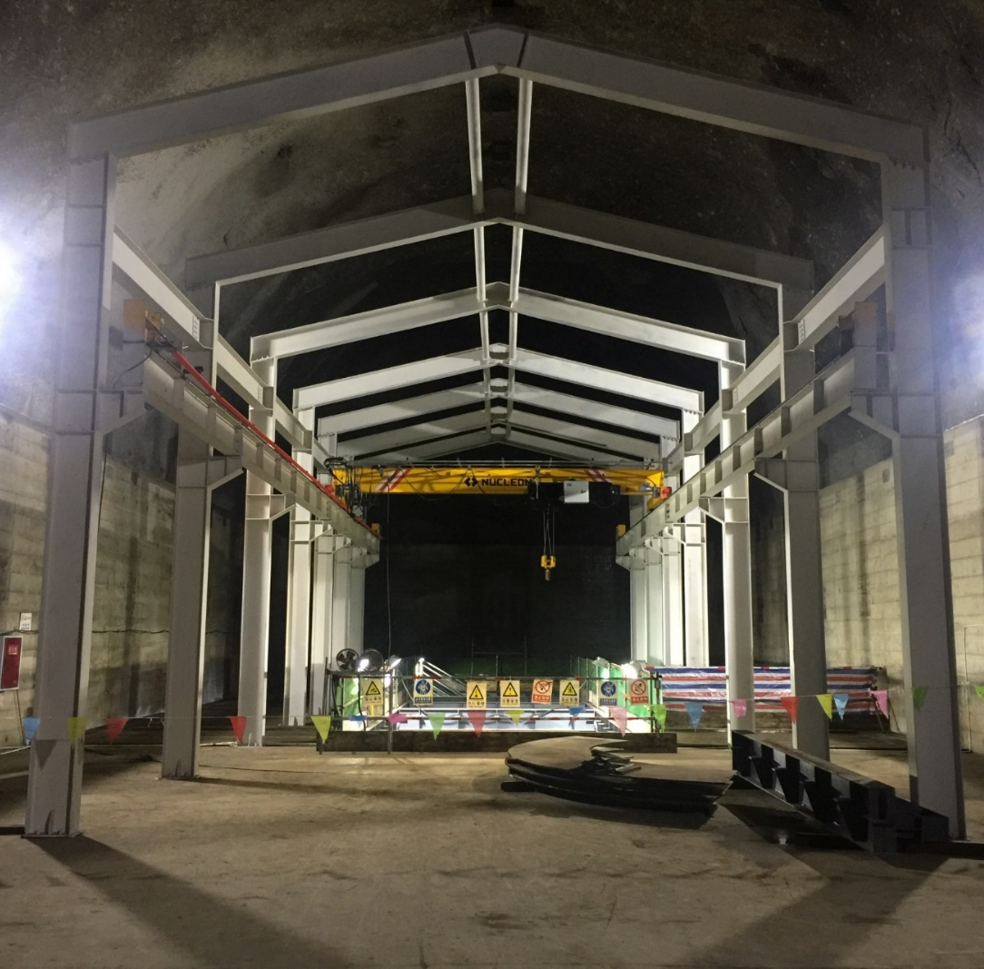
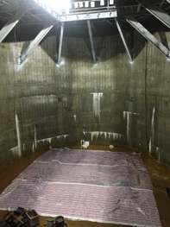
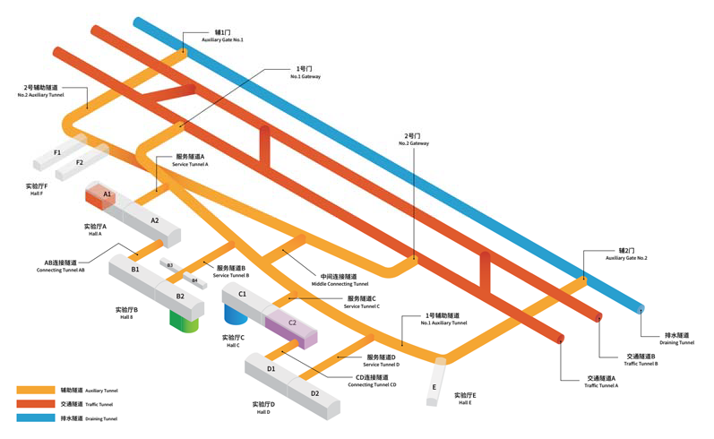
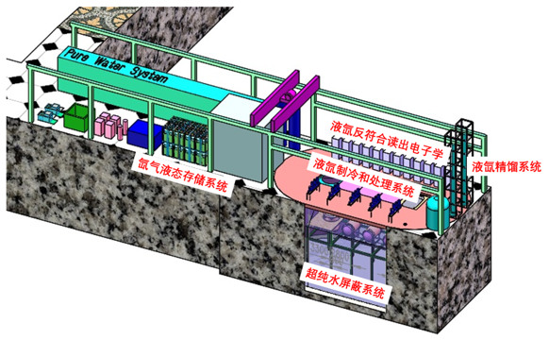
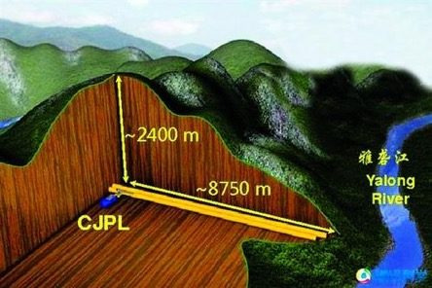
Experiment Hall B2 at CJPL-II
Water Shielding
  5000Ton pure water
  U/Th <10⁻¹⁴ g/g
Rn ctrl.
  <1mBq/m³ in water;
  ~10Bq/m³ in the cave
Fresh air
Experiment Hall
Water Tank
PandaX

Slide 6
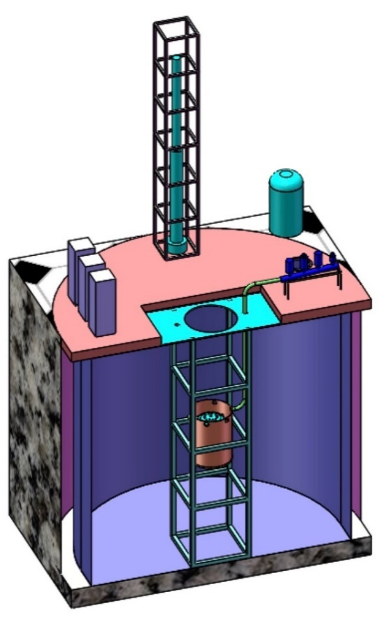
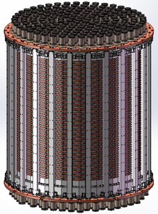
PandaX-4T Structure
Large scale TPC
Background control
Xenon storage and handling
PMTs
Electronics
Cryogenics
TPC
TDAQ
Cryostat vessels

Slide 7
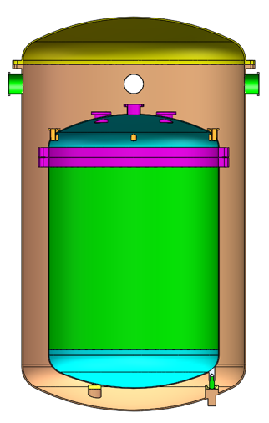
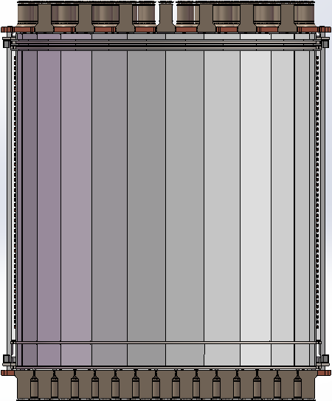
Large Scale TPC
Drift region: Φ ~1.2m，H ~1.2m
  Xenon in sensitive region～4 ton
Design goal:
  High signal collection efficiency
  Uniform E field in a large volume
  Veto facility
Top PMT array, 3”
Top Cu plate
Teflon supporter
Electrodes and shaping rings
Bottom Cu plate
Bottom PMT array 3”
Veto System

Slide 8
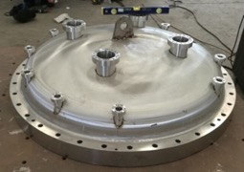
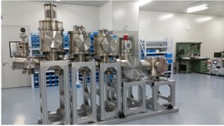
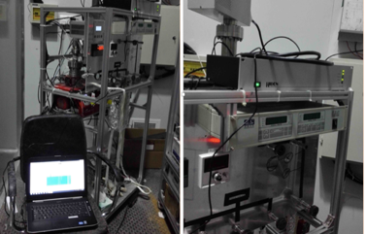
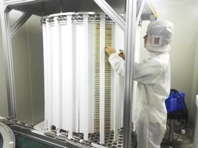
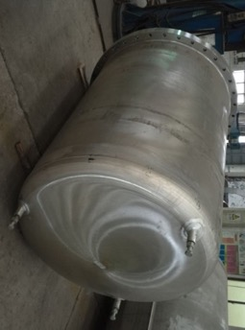
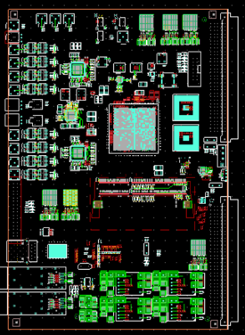
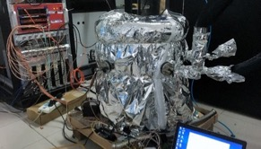
Current Status and Schedule
R&D work-in-progress
2019-2020: assembly and commissioning
See Zhou Huang’s poster

Slide 9
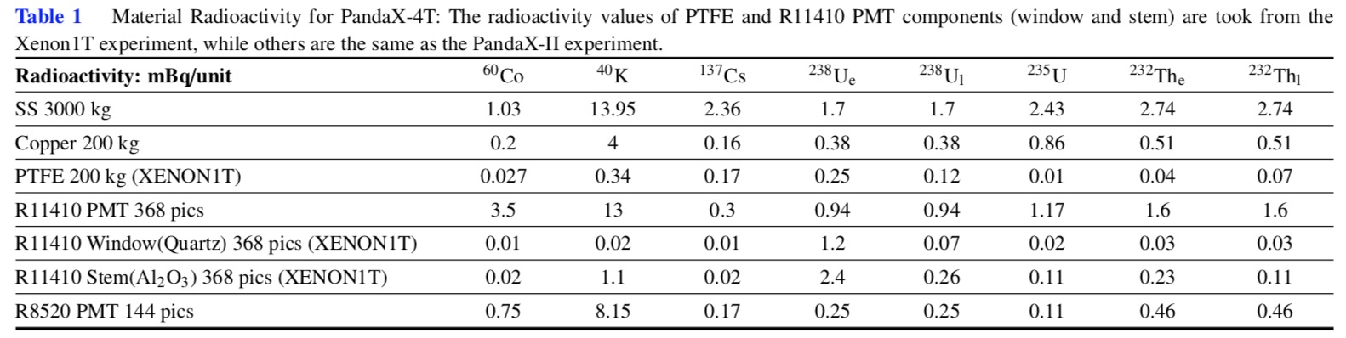
Background Simulation
Simulate the ER and NR backgrounds
  Detector materials: inner/outer vessels, flanges, copper plates, electrodes, PTFE materials, PMTs etc
  Radioactivity in xenon: ⁸⁵Kr, ²²²Rn, ¹³⁶Xe
  Neutrino: electron scattering and coherent nucleus scattering
See Linhui Gu’s poster

Slide 10
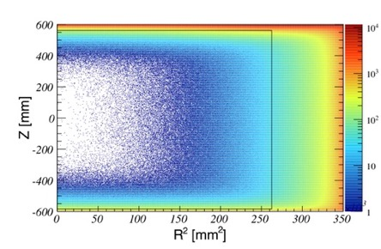
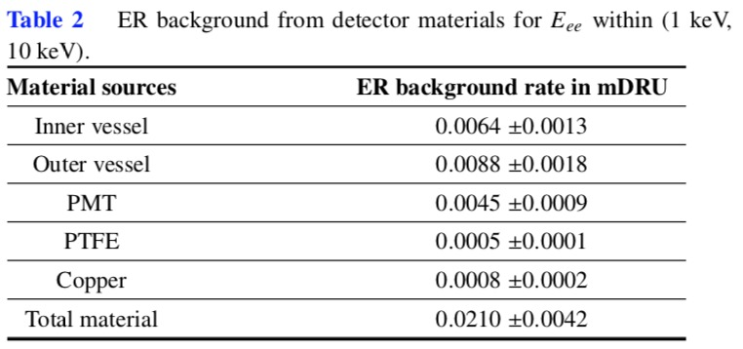
ER Background from Materials
Dominant ER background sources are from inner/outer vessels and PMTs
ER from materials
mDRU = 1 event / ton / day / keV

Slide 11
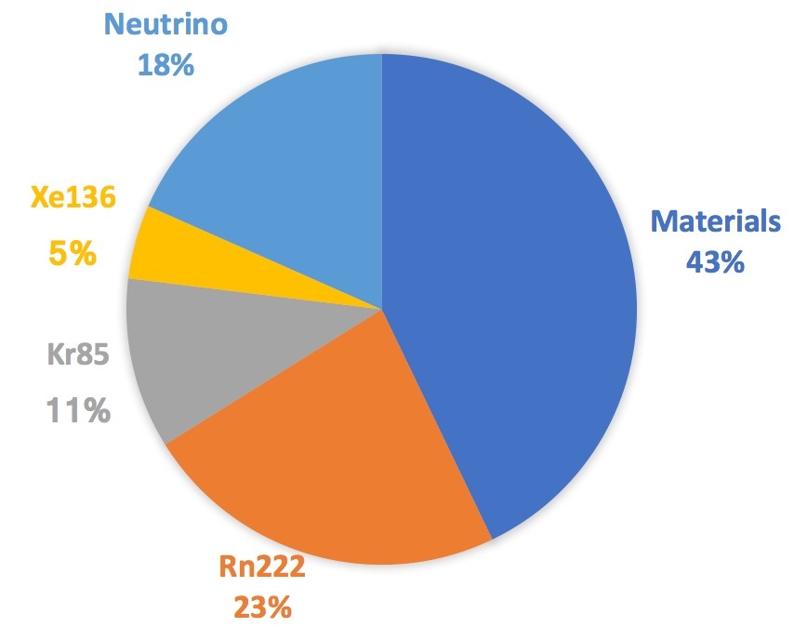
Total ER Background
⁸⁵Kr and ²²²Rn need to be tightly controlled
  The goal is to control ^{nat}Kr ~ 0.1 ppt, ²²²Rn ~1 μBq/kg
ER

Slide 12
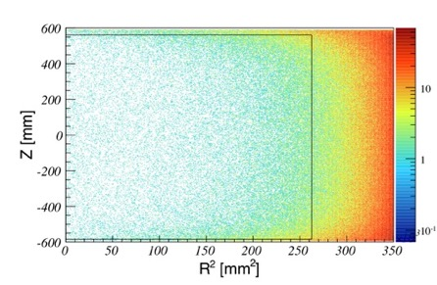
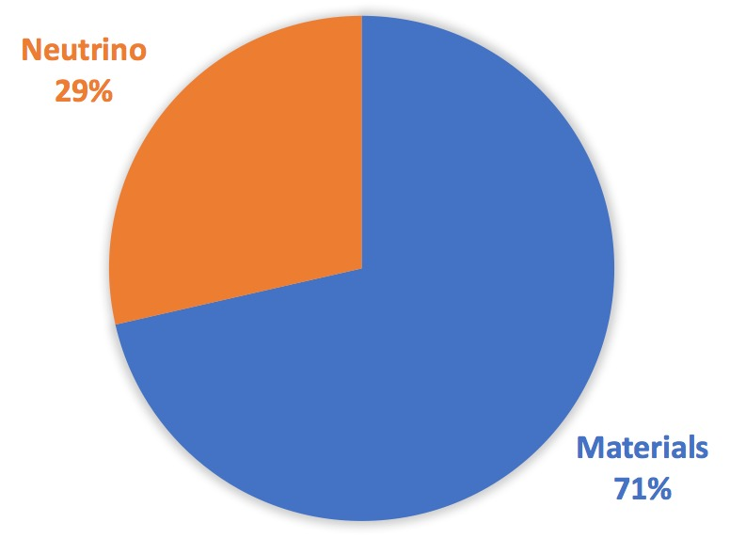
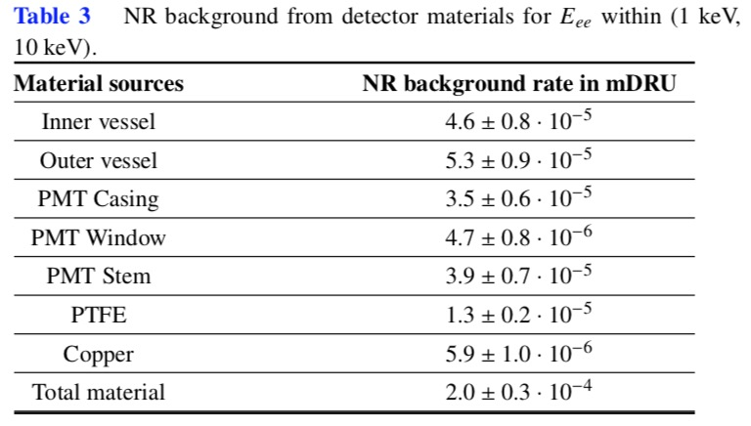
NR Background
Simulate S.F. and (α,n) processes
Take into account of the associated gamma production
Neutrino CNNS
NR from materials
See Q.H. Wang’s talk
NR

Slide 13
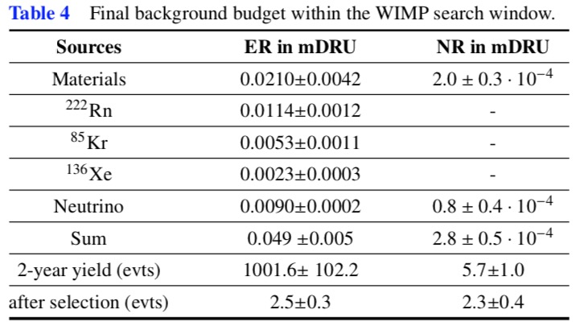
Background Simulation
Total ER background: 0.05 mDRU
Total NR background: 1 event / ton / year
With 2-year exposure:
  2.5 ER events and 2.3 NR events
Notes:
可以实现

Slide 14
Expected Sensitivity
arXiv:1806.02229
With two-year exposure, x10 improvement on sensitivity could be achieved.
Spin-independent DM-nucleon sensitivity may reach below 10⁻⁴⁷cm²
Spin-dependent DM-neutron 10⁻⁴² cm²
SI
SD
neutron only
SD
proton only

Slide 15
Summary and Outlook
PandaX experiment with 580kg Xenon has reached the world frontier of dark matter direct detection.
PandaX-4T could be a multi-purpose detector for rare signal searches like dark matter, neutrino, etc
Detector R&D is ongoing; assembly/commissioning is expected during 2019-2020
From detailed MC simulations, background level of PandaX-4T is estimated.
The sensitivity to SI DM could reach ~10⁻⁴⁷cm² with two-year exposure.

Slide 16
Detector Principle
Double phase Xenon Time Projection Chamber
  Mature technique
  Sensitive to massive DM candidate
  Self-shielding property
  Signal/background discrimination
  …
Dark matter detection in Xenon detector
  Incoming DM collides with Xenon atom
  Two signatures
    S1：scintillation light in LXe upon scattering
    S2：scintillation light in GXe due to ionization electron
  Reconstruct the collision energy and 3-D position

Slide 17
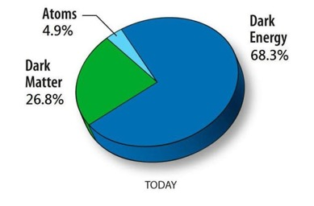
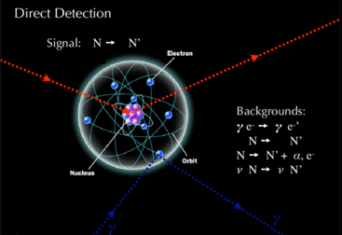
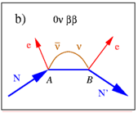
Motivation
LXe Detector for measuring rare physics events
Dark Matter Direction Detection
  Xenon detectors leading sensitivity for massive DM
  Cross-check with indirect detection and collider search
Neutrino detection
  Neutrino-nucleus coherent scattering
  Solar pp, ⁸B, DSNB
Neutrinoless double beta decay
  ¹³⁶Xe → ¹³⁶Ba + 2e⁻
  Majorana neutrino? Anti-matter? Neutrino mass?
Notes:
氙是很好的探测稀有物理事件的靶物质，对自旋无关和自旋相关的暗物质和物质相互作用都有很好的灵敏度，同时也能够探测低能太阳中微子。氙中的136Xe可以开展无中微子双贝塔衰变探测。

Slide 18
Interesting Signatures from Indirect Search
AMS-02
DAMPE
Notes:
近期，空间暗物质间接探测出现了一些反常的超出，有可能是暗物质粒子湮灭产生的信号。我们希望利用液氙进行暗物质直接探测对这些疑似信号进行独立检验。

Slide 19
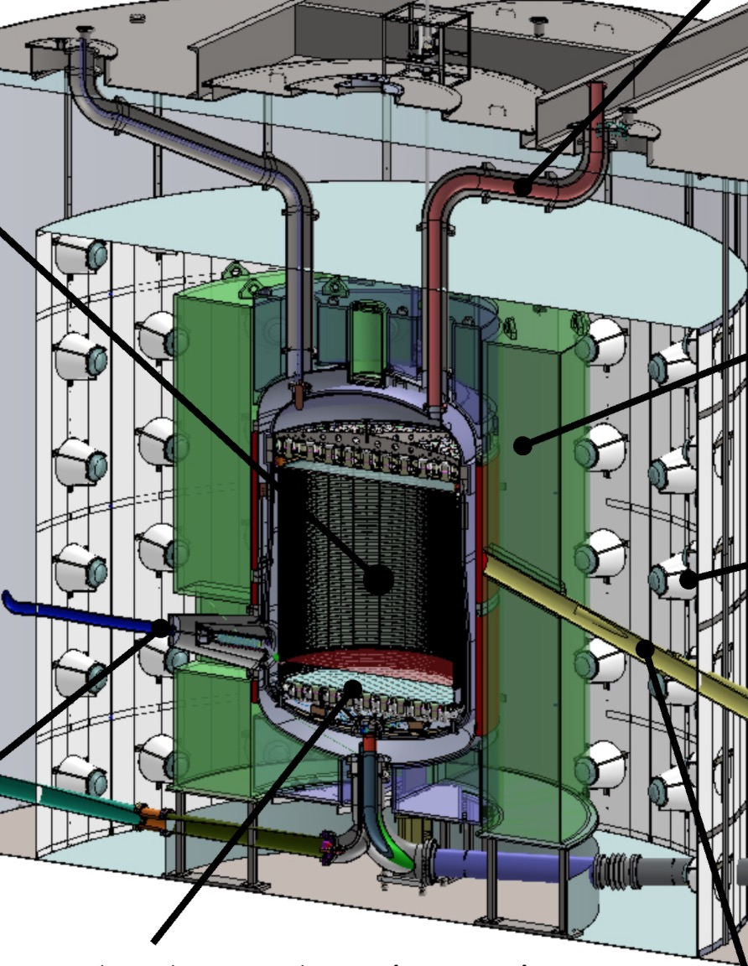
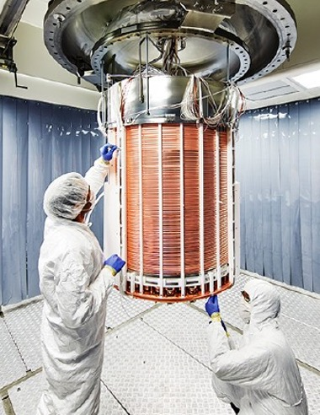
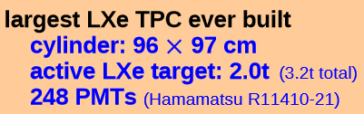
Multi-ton Xenon Detectors in the World
XENON1T
LZ, 7-ton, in preparation, Sanford Lab
Notes:
与此同时，世界上也在开展数吨级液氙暗物质探测实验，XENON1T的灵敏区有2吨的液氙，未来的LZ 7吨级的实验也在准备中，但是进展有了两年的延迟。

