Slide 1



A preliminary reconstruction of the carbon in cosmic rays with DAMPE experiment
Libo Wu
(on behalf of the DAMPE collaboration)
State Key Laboratory of Particle Detection and Electronics
University of Science and Technology of China

Slide 2
Outline
Motivation
DAMPE Experiment
Carbon Analysis
  Charge Reconstruction
  Energy Reconstruction
  Results
Summary

Slide 3
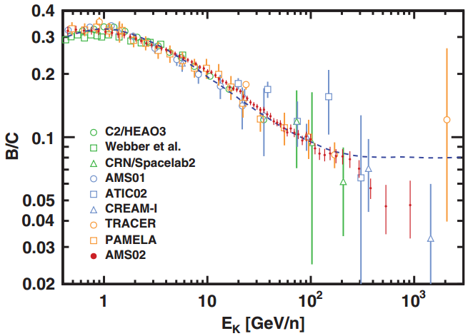
Motivation
PRL 117, 231102 (2016)
Cosmic rays from other galactic sources
Unknown acceleration mechanisms
Different propagation effects

Slide 4



DAMPE Experiment
The collaboration of DArk Matter Particle Explorer (DAMPE)
Scientific Goals:
Origins and propagations of CRs
Dark Matter Indirect Detection
Gamma-ray Astronomy
CHINA
  Purple Mountain Observatory
  University of Science and Technology of China
  Institute of High Energy Physics National Space Science Center
  Institute of Modern Physics
ITALY
  INFN Perugia and University of Perugia
  INFN Bari and University of Bari
  INFN Lecce and University of Salento
SWITZERLAND
  University of Geneva
Orbit Information:
Orbit: sun-synchronous
Altitude: 500 km
Period: 94 minutes
Launched Date: Dec. 17th, 2015

Slide 5
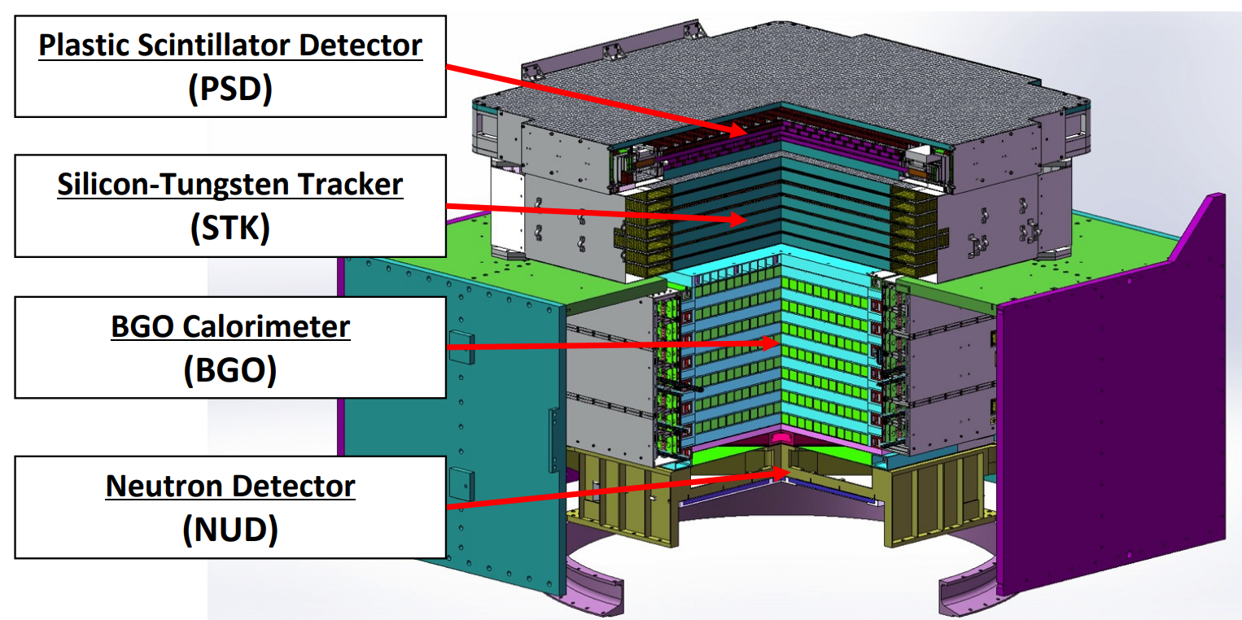
DAMPE Detector
Charge measurement (dE/dx in PSD, STK and BGO)
Pair production and precise tracking (STK and BGO)
Precise energy measurement (BGO)
Electron/hadron identification (BGO and NUD)

Slide 6
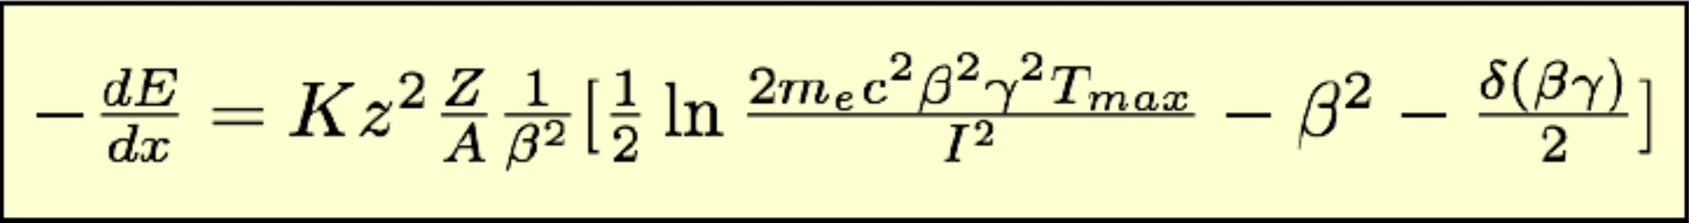
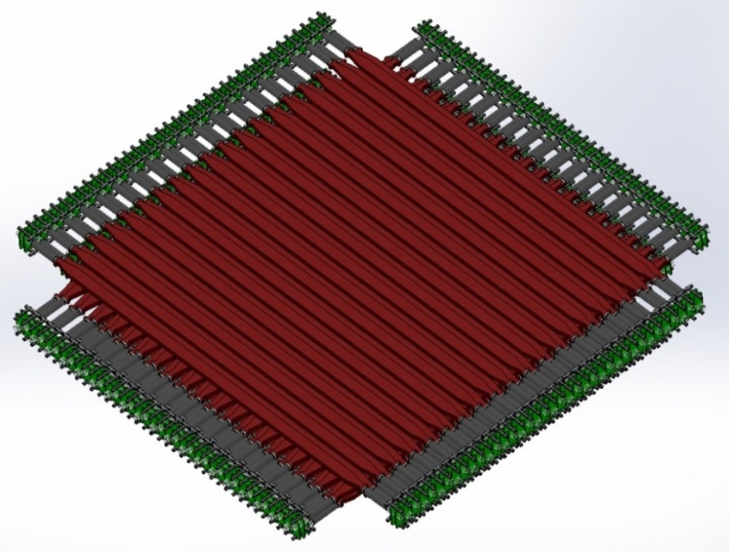
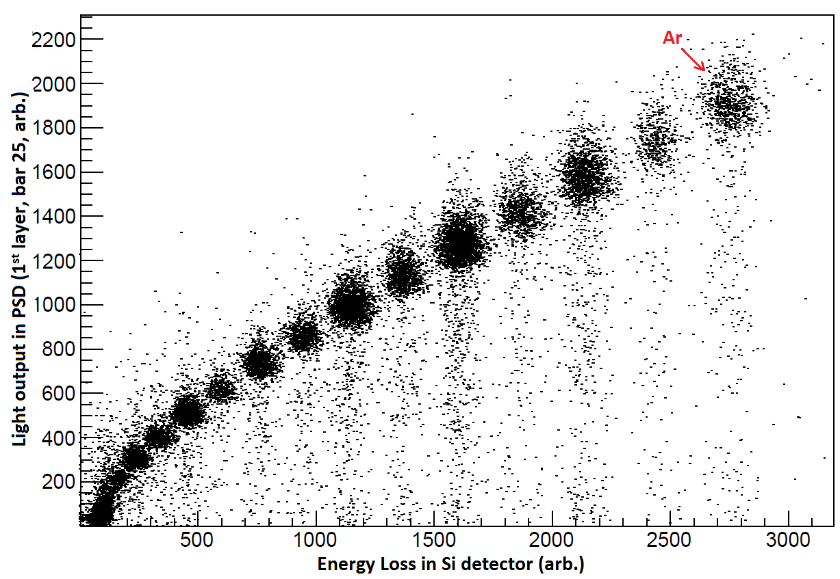
Carbon Analysis
Charge Reconstruction
Ar

Slide 7
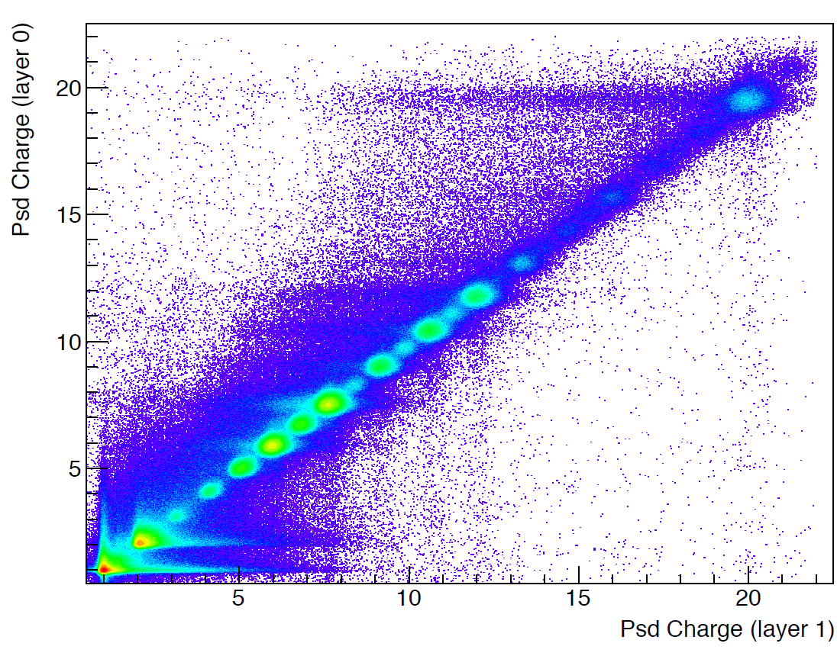
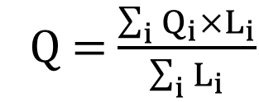
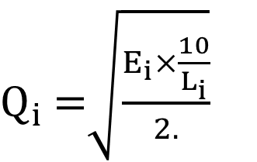
Carbon Analysis
Charge Reconstruction Method
PSD_0
Data
PSD_1
$Q_{i}$ =$\sqrt{\frac{E_{i}×\frac{10}{L_{i}}}{2.}}$
Q = $\frac{\sum_{i}{Q_{i}×L_{i}}}{\sum_{i}{L_{i}}}$

Slide 8
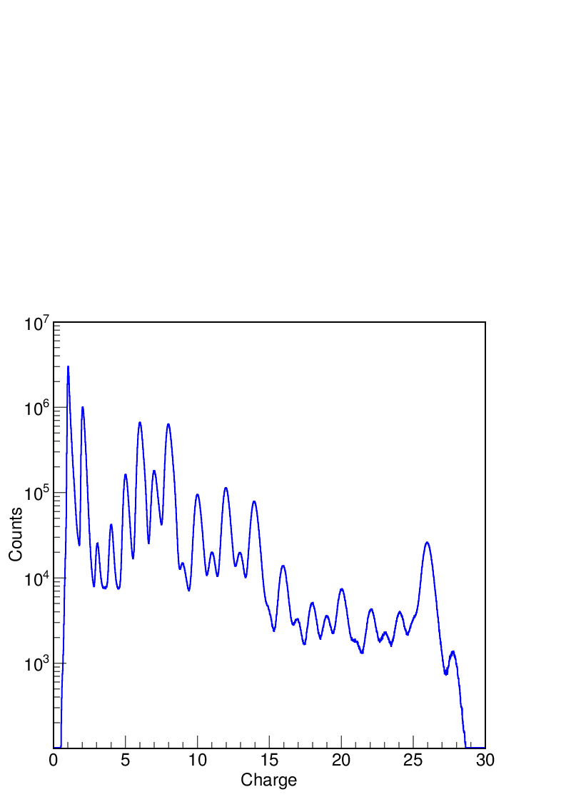
Carbon Analysis
Results
H
He
C
O
B
N
Ne
Mg
Si
Be
Li
Na
Al
Fe
F
S
P
Ca
Mn
Ar
Ti
Cr
Cl
K
V
Sc
Ni

Slide 9
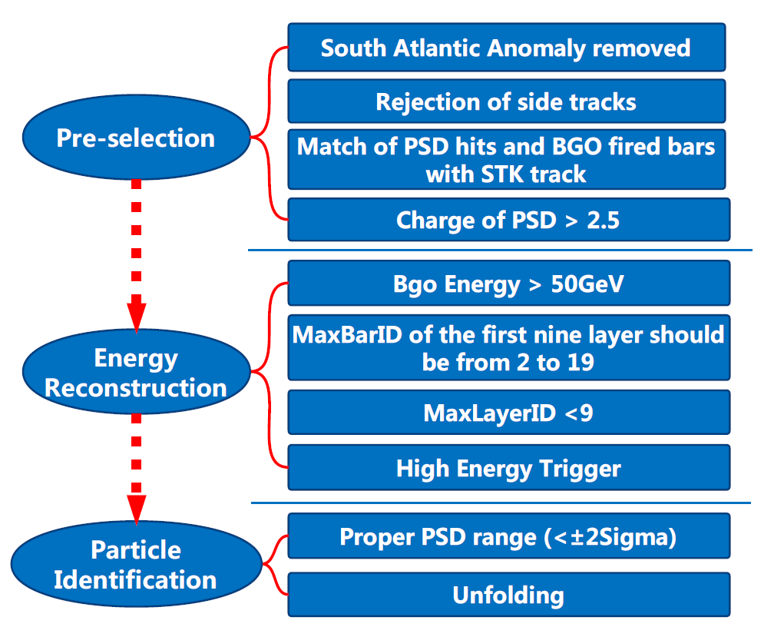
Carbon Analysis
Energy Reconstruction

Slide 10
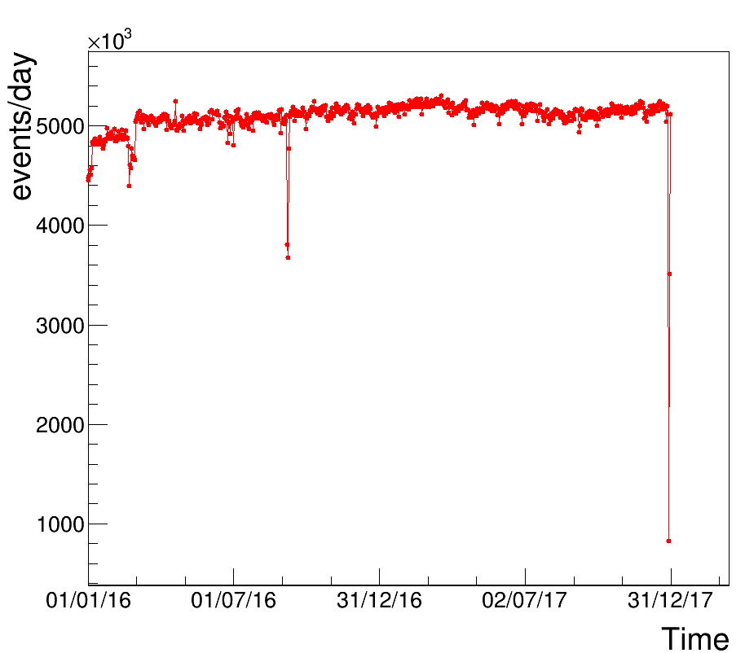
Carbon Analysis
Data Sample
Stable data acquisition very soon after the satellite launch (December 17, 2015)
Here a data sample collected in about 2 year is analyzed looking for events induced by Carbon nuclei

Slide 11
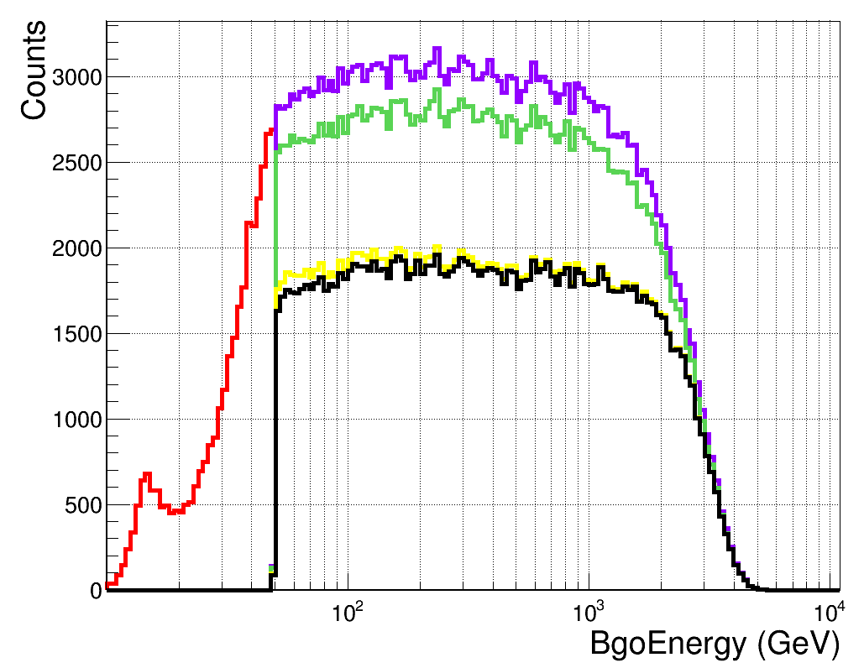

Carbon Analysis
Efficiency
MC
Color | Logic | Entries | Eff(%)
 | PreSelection | 285063 | 0.85
 | Energy>50GeV | 251321 | 0.75
 | MaxBarIDCut | 230515 | 0.69
 | MaxLayerIDCut | 164608 | 0.49
 | High Energy | 161033 | 0.48

Slide 12
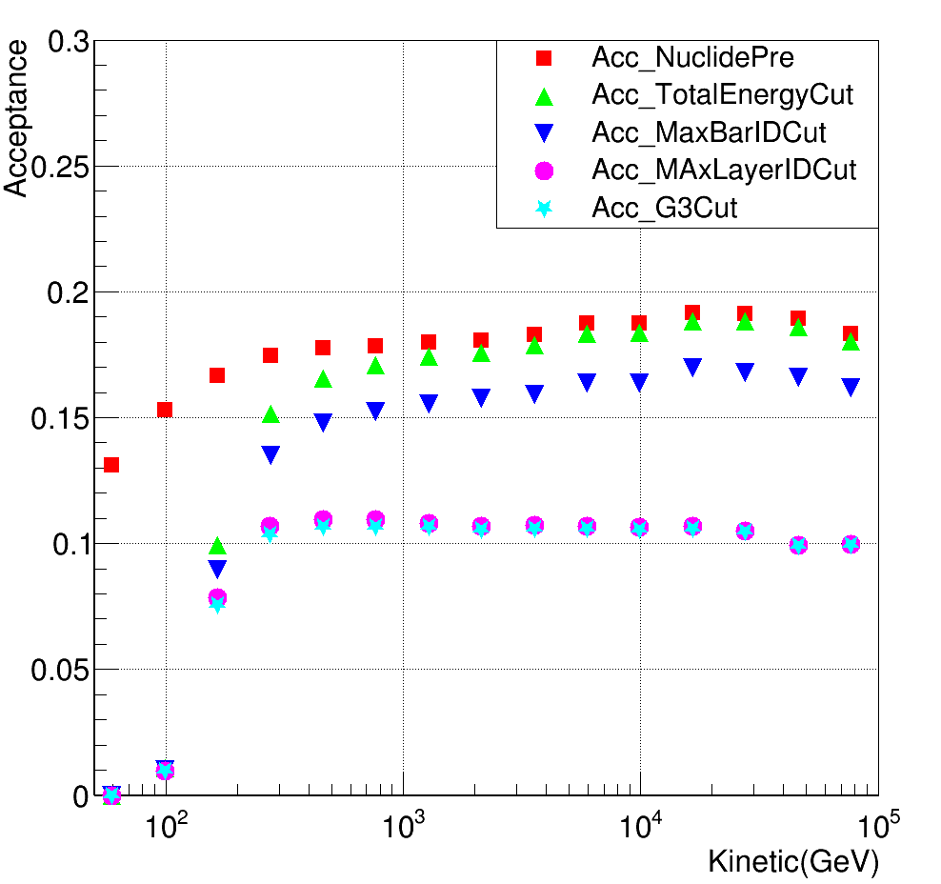
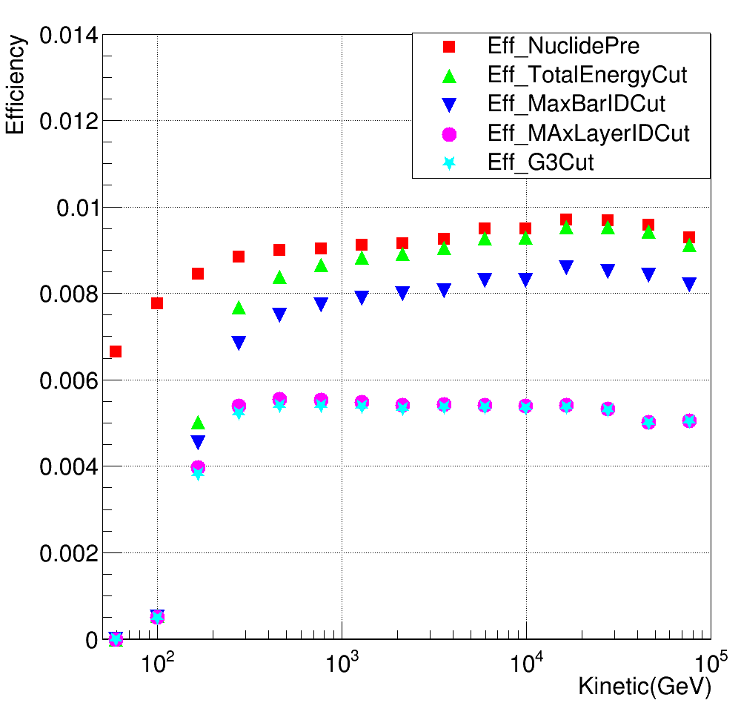

Carbon Analysis
Acceptance && Efficiency
$${(m}^{2}Sr)$$
MC
MC

Slide 13
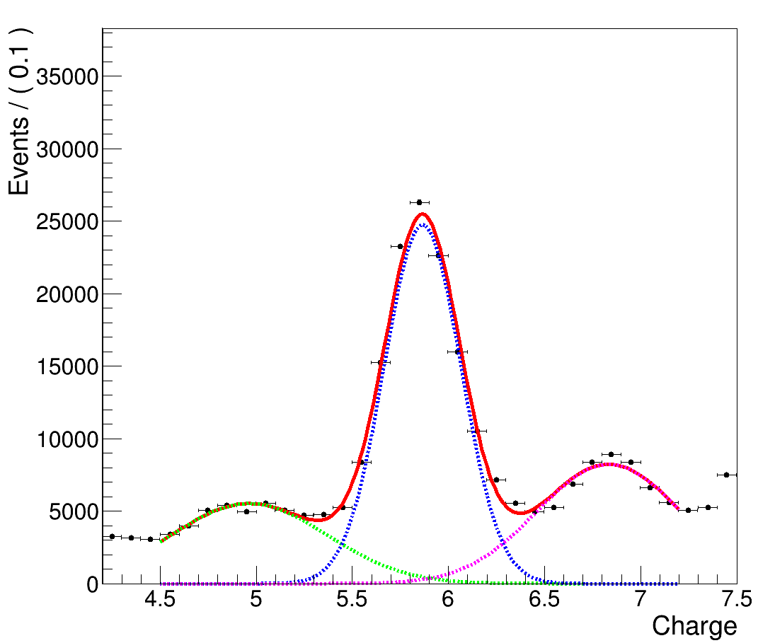
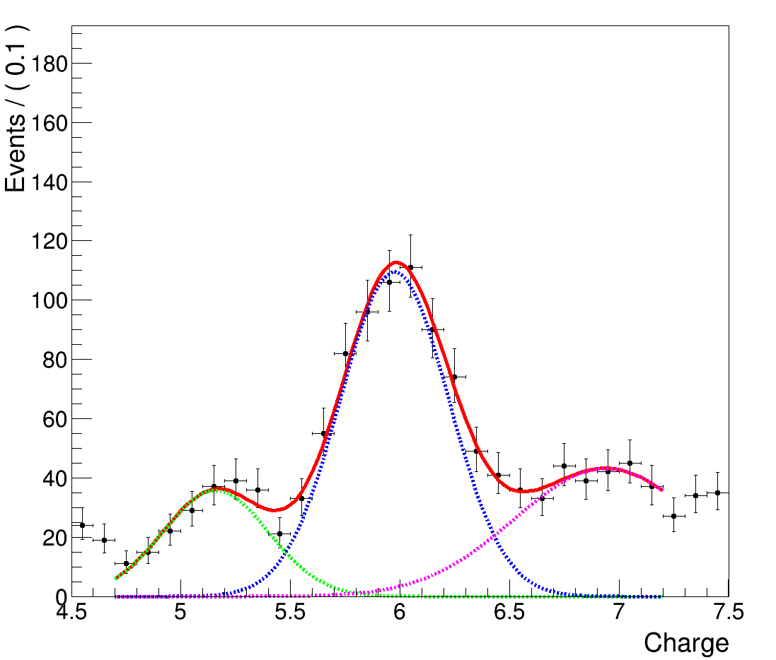

Carbon Analysis
PSD Charge Cut
129GeV - 215GeV
2782GeV - 4641GeV
C
Mean=5.86
Sigma=0.20
Mean=5.98
Sigma=0.24
C
N
B
N
B
$$Charge \sim (Mean ±2×Sigma)$$

Slide 14
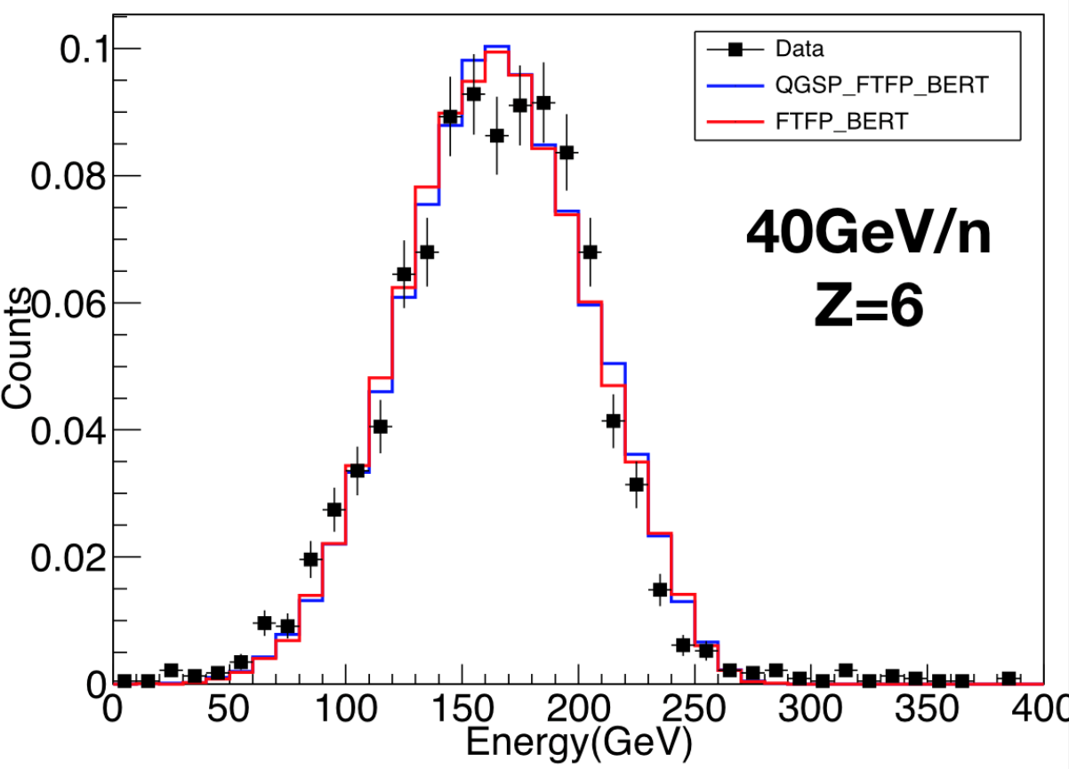
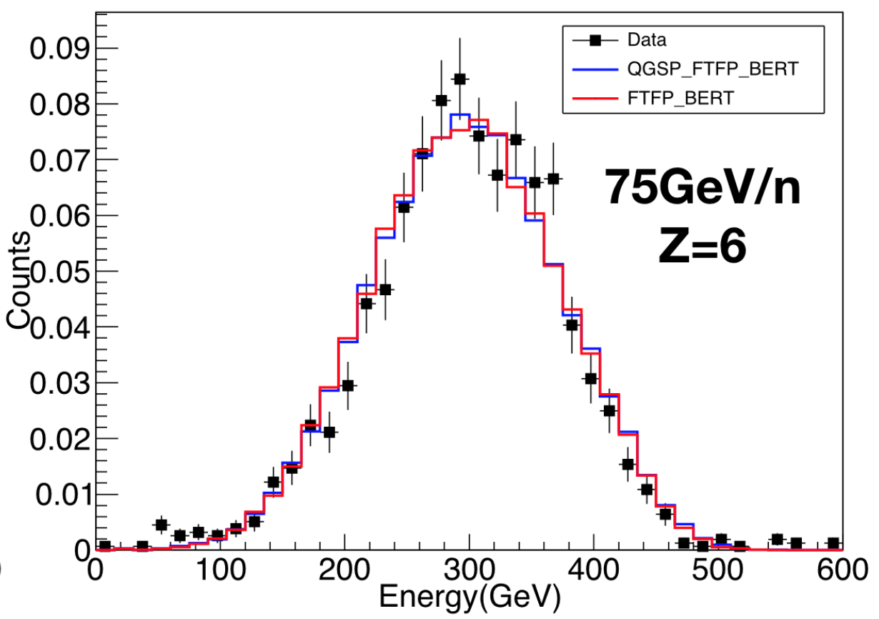
Carbon Analysis
Energy response to carbon for BT-data
Energy resolution is batter than 30% at these two energy points

Slide 15
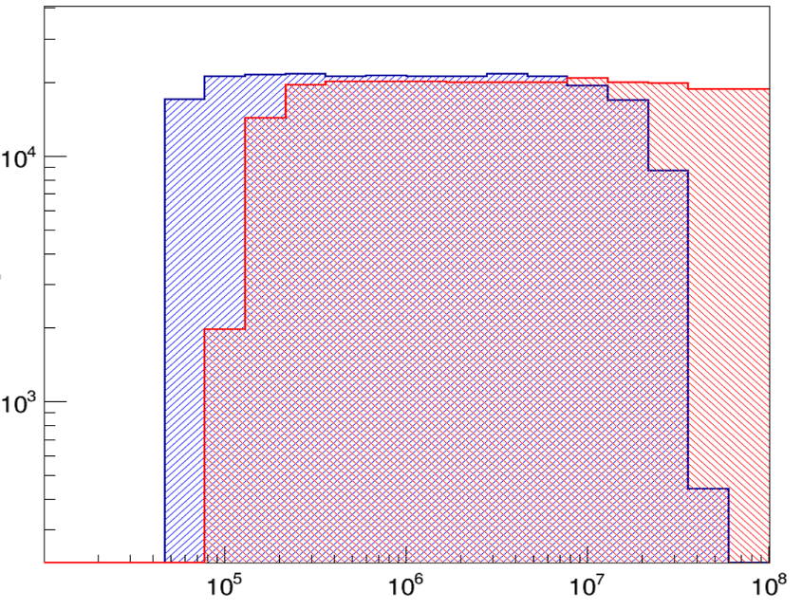
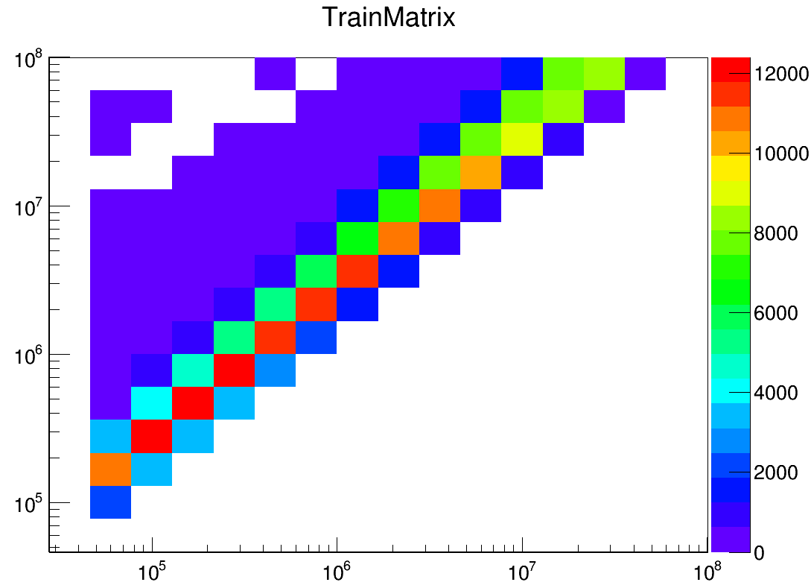
Carbon Analysis
Bayes Unfolding
Energy Spectrum (MC)
MC
Counts
Primary Energy(MeV)
Bgo energy
Primary energy
MC
Energy(MeV)
Bgo Energy(MeV)

Slide 16
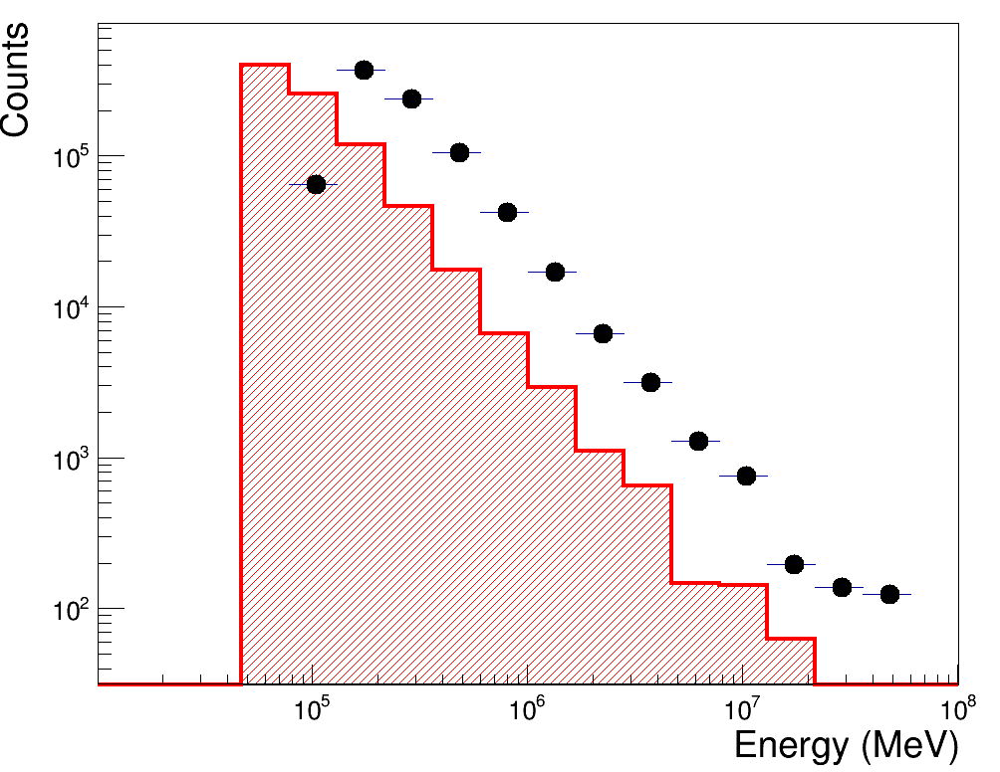
Carbon Analysis
Results
Carbon Energy Spectrum (Data)
Bgo energy
Unfolding
Data

Slide 17
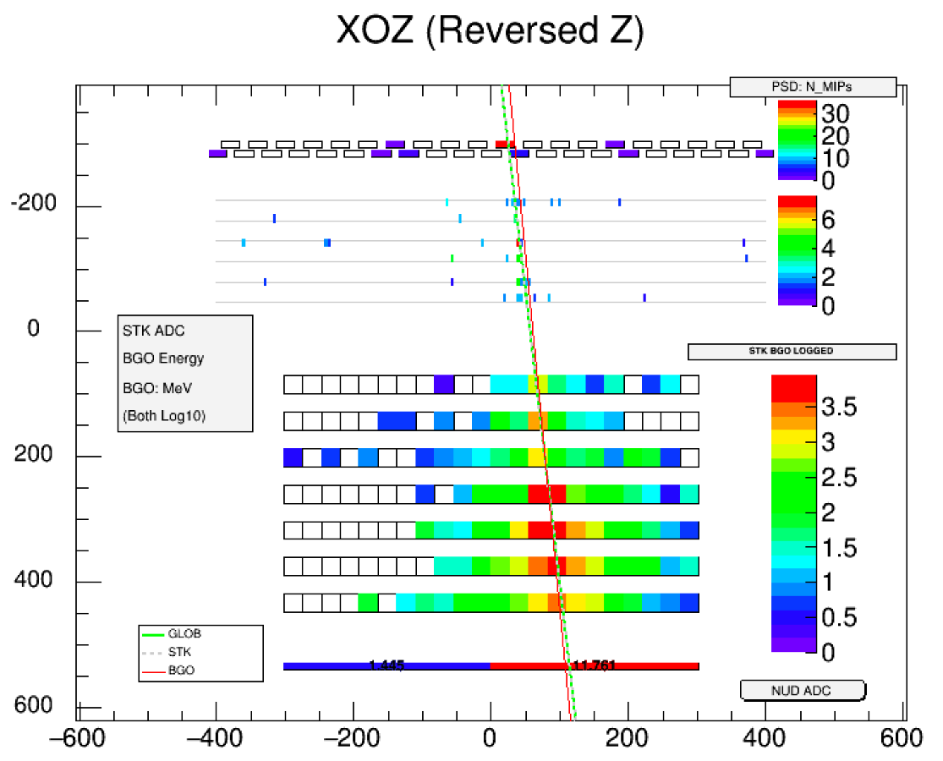
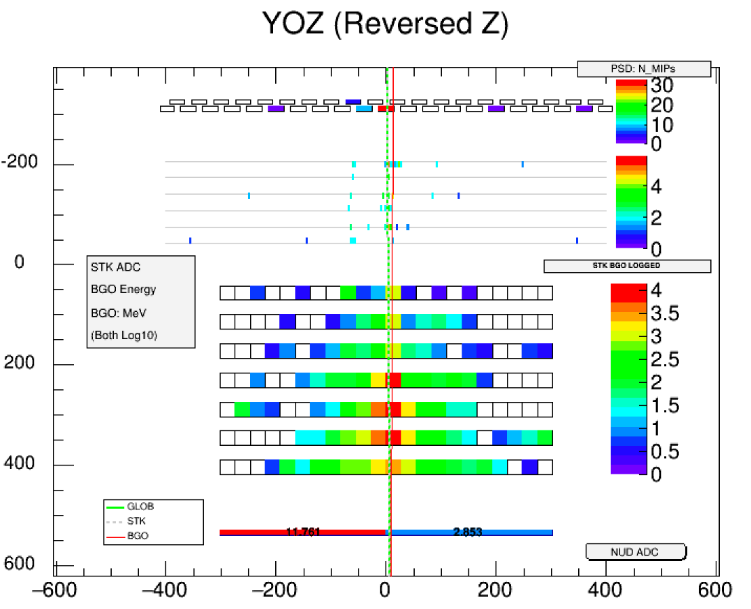
Carbon Analysis
Carbon Candidates
BGO Energy: 118.64 GeV
Max PSD Bar Energy: 71.19 MeV

Slide 18
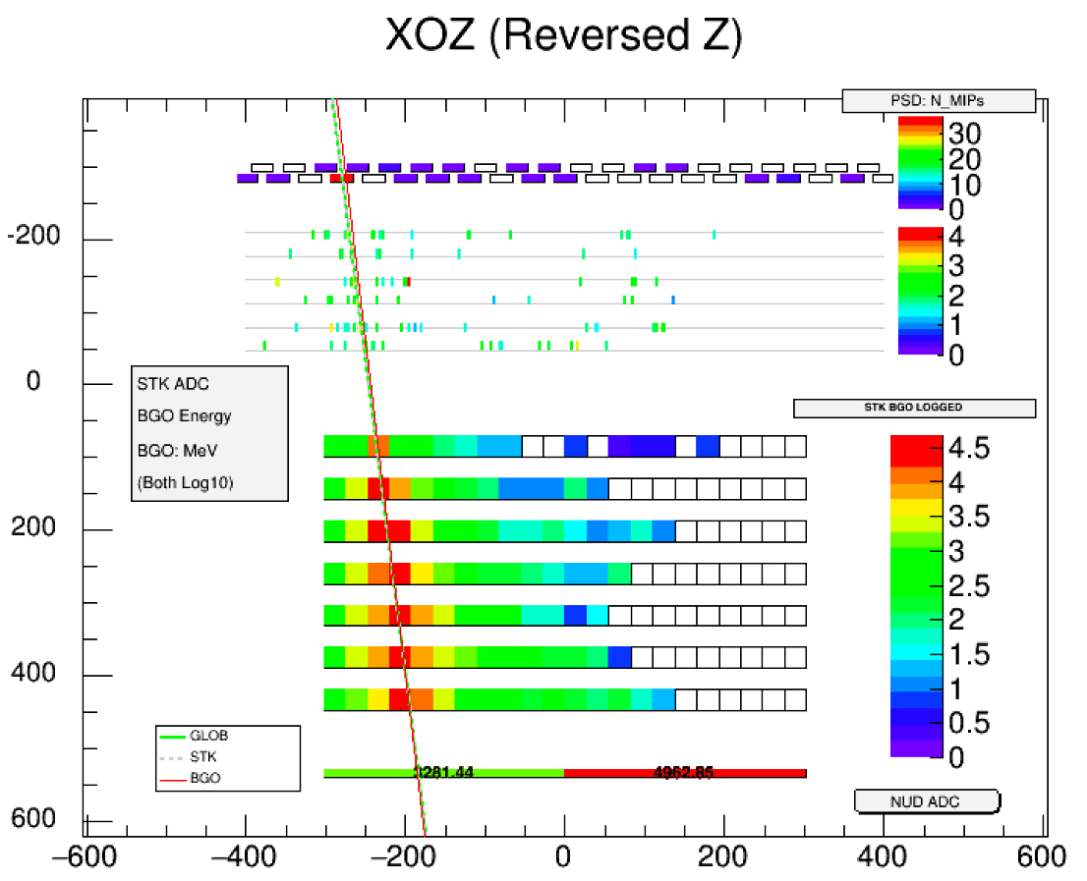
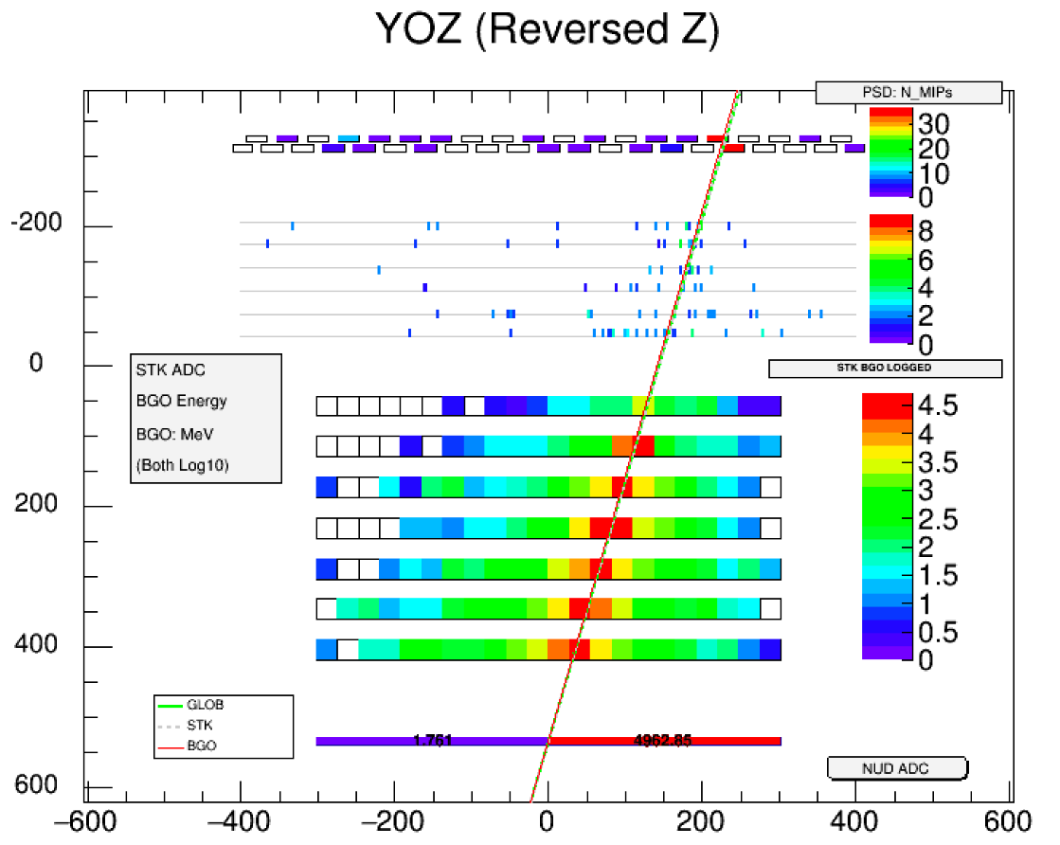
Carbon Analysis
Carbon Candidates
BGO Energy: 704.72 GeV
Max PSD Bar Energy: 72.83 MeV

Slide 19
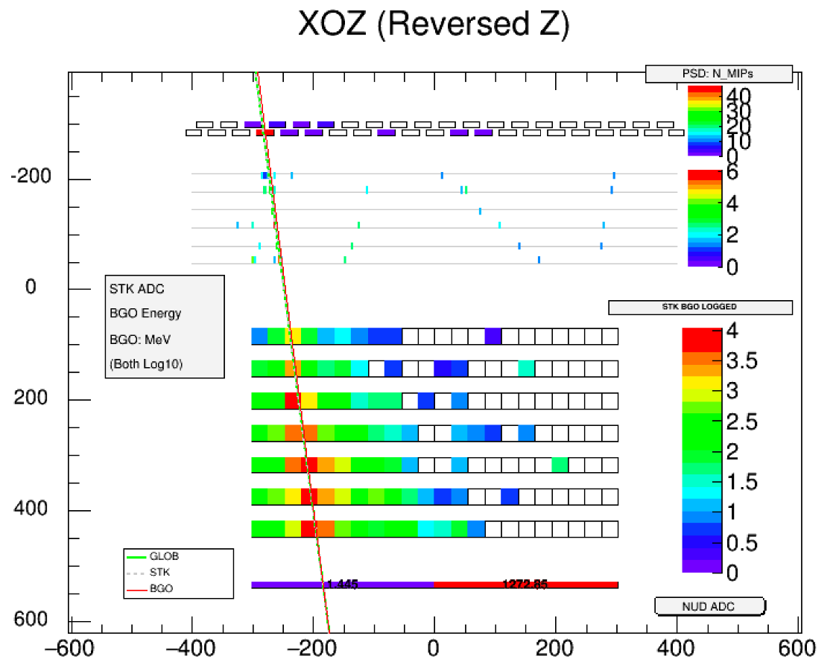
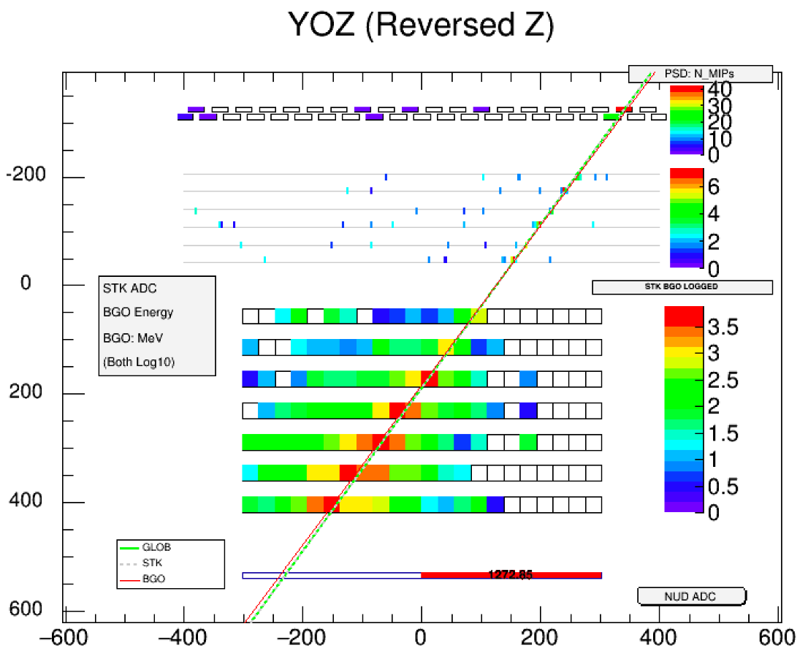
Carbon Analysis
Carbon Candidates
BGO Energy: 1.19 TeV
Max PSD Bar Energy: 92.32 MeV

Slide 20
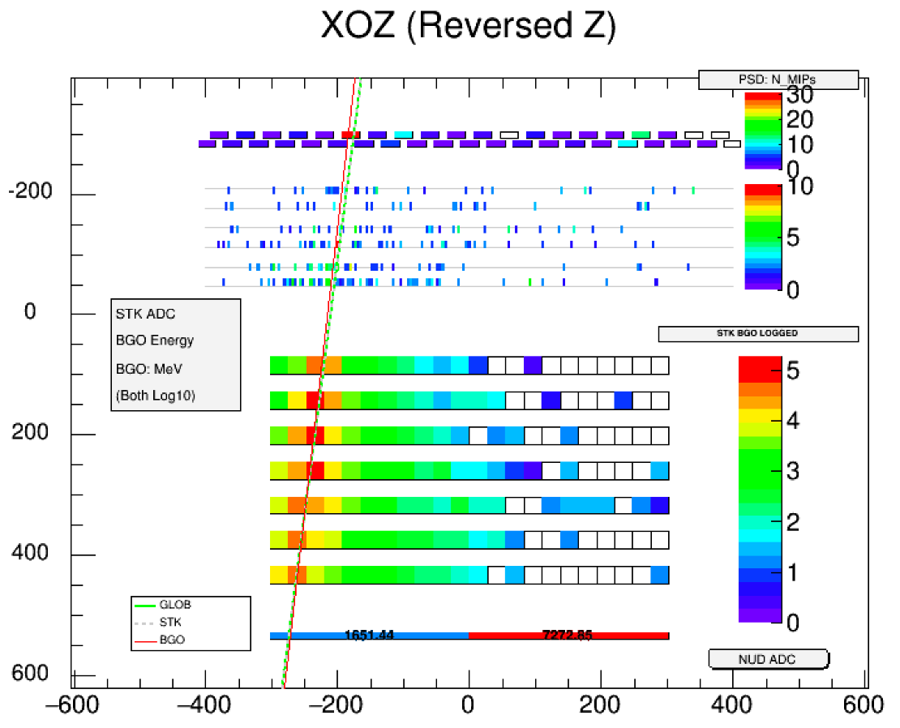
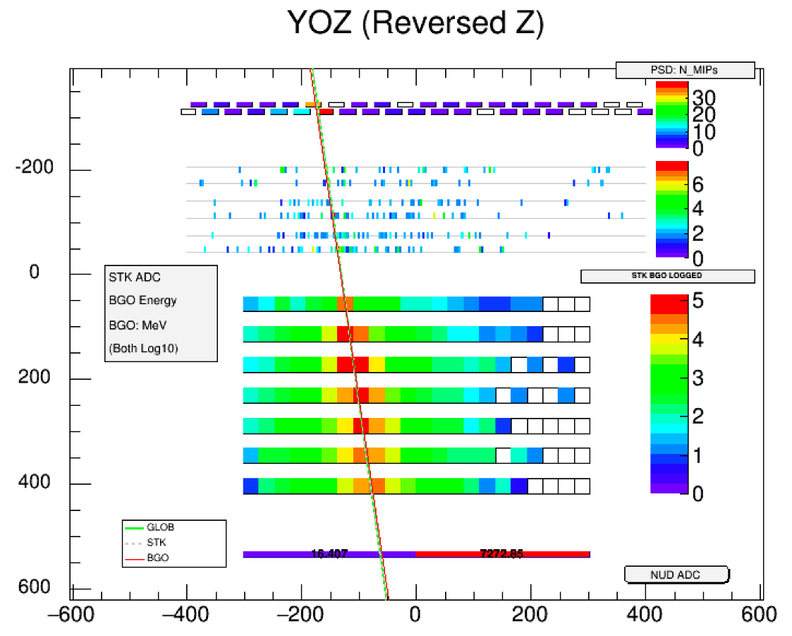
Carbon Analysis
Carbon Candidates
BGO Energy: 1.57 TeV
Max PSD Bar Energy: 60.61 MeV

Slide 21
Summary
DAMPE detector has been in operation for 2.5 years since launch on Dec. 17th 2015.
A charge reconstruction method and a carbon selection criteria is developed
Each logic acceptance and efficiency is obtained by MC.
In the future
  some charge corrections will be done with MC
  Calculate the contamination of B&N
Thank you

Slide 22
Backup

Slide 23
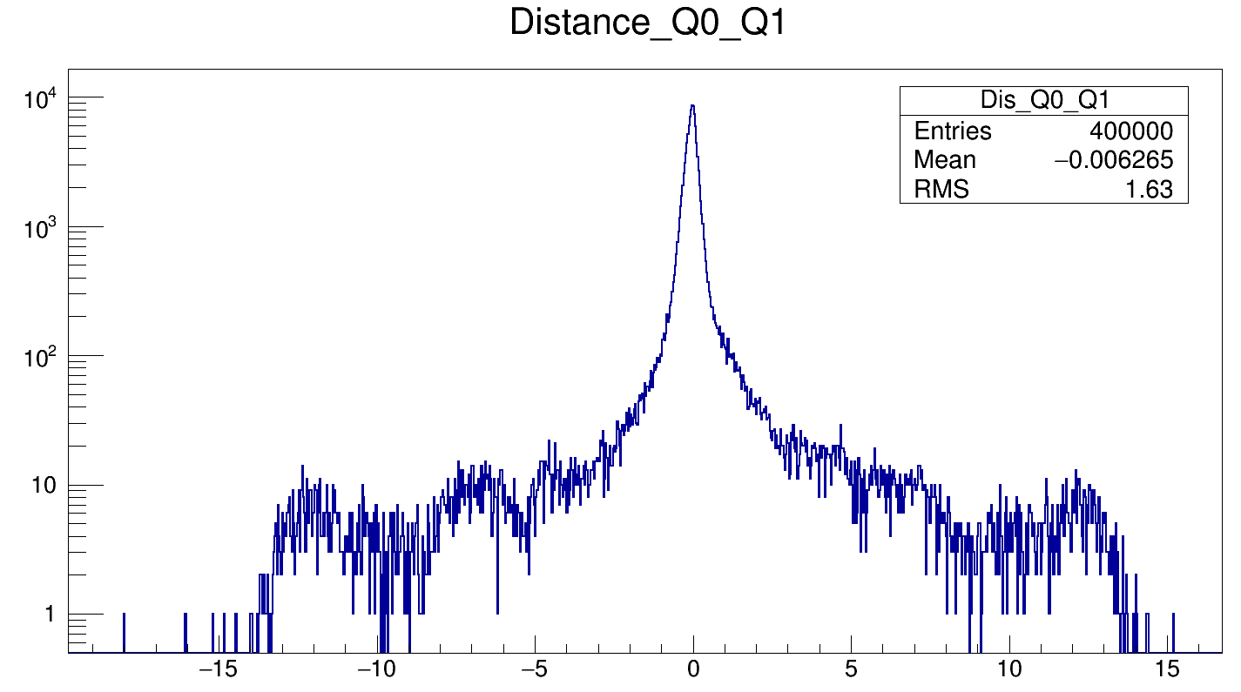
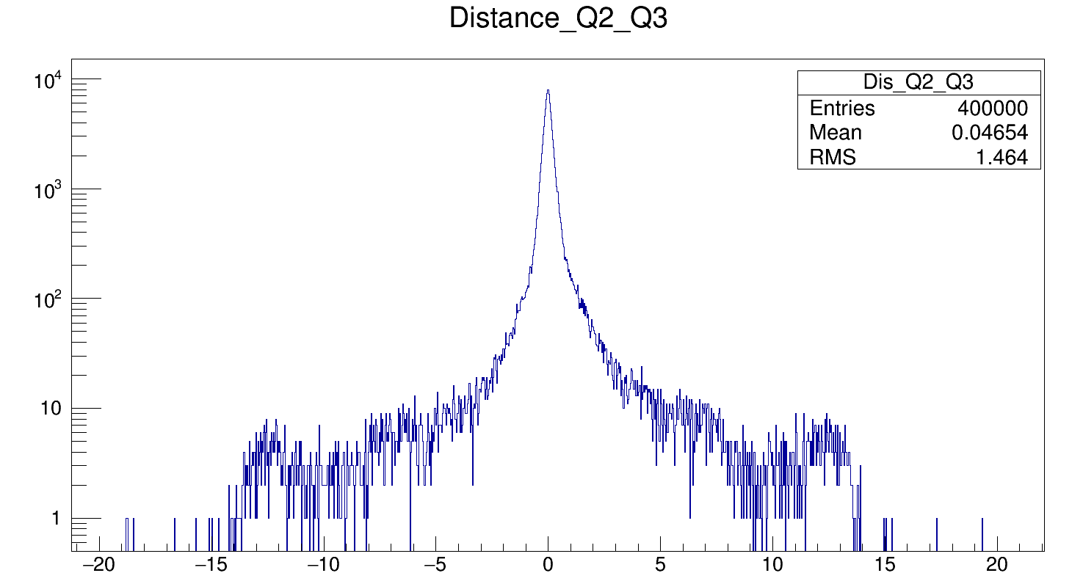
Backup
Counts
distance
Counts
distance

Slide 24
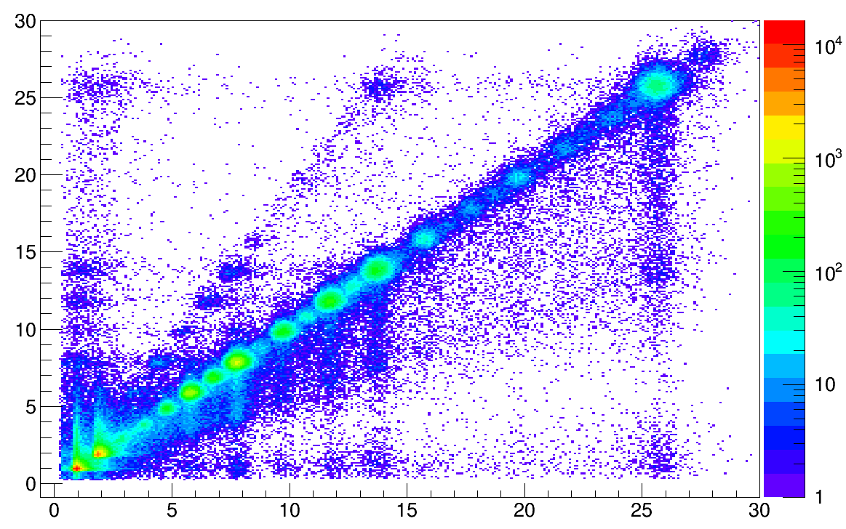
Backup
Method2_QCor0_QCor1
L0Problem
L1_Charge
L1Problem
L0_Charge

Slide 25
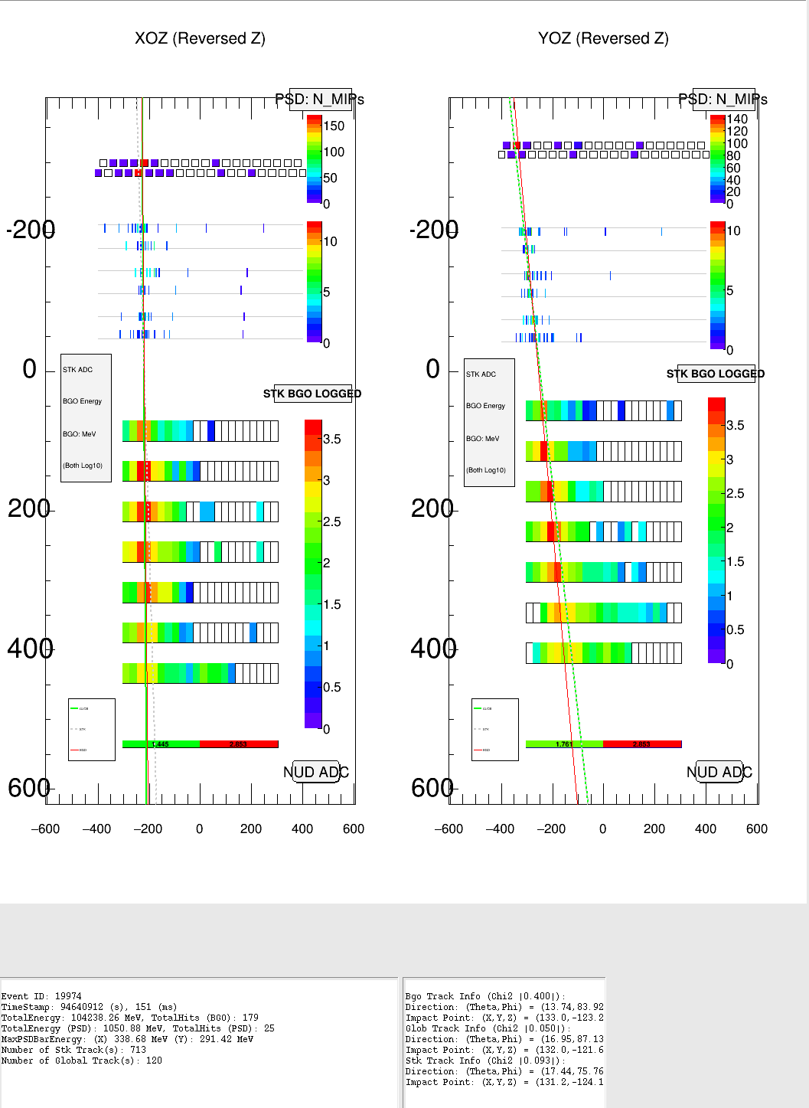
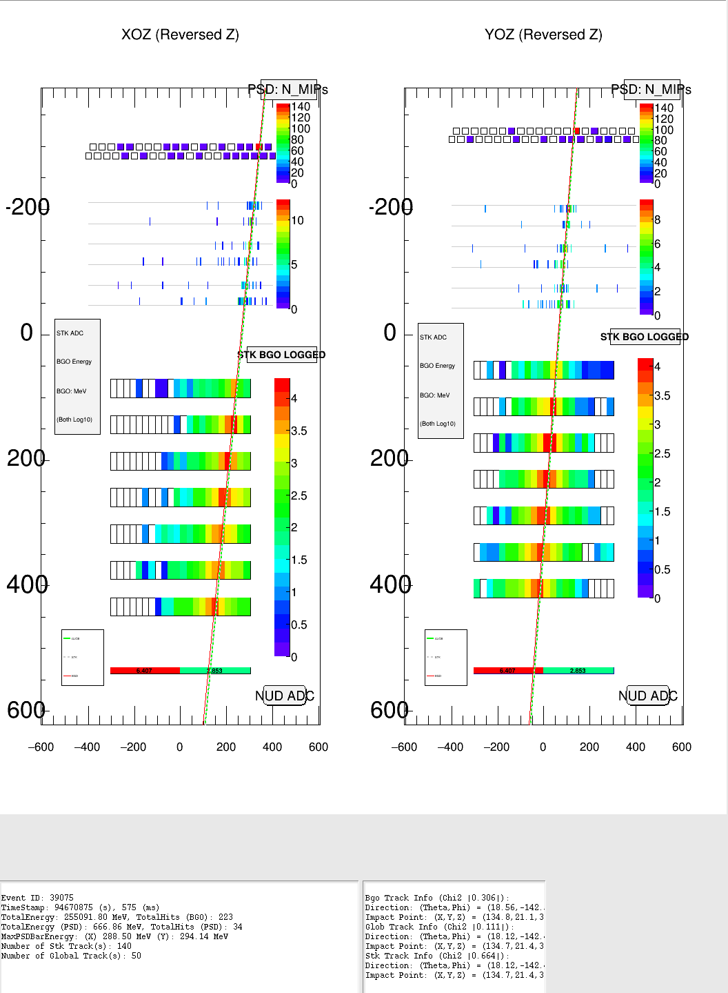
Backup

Slide 26
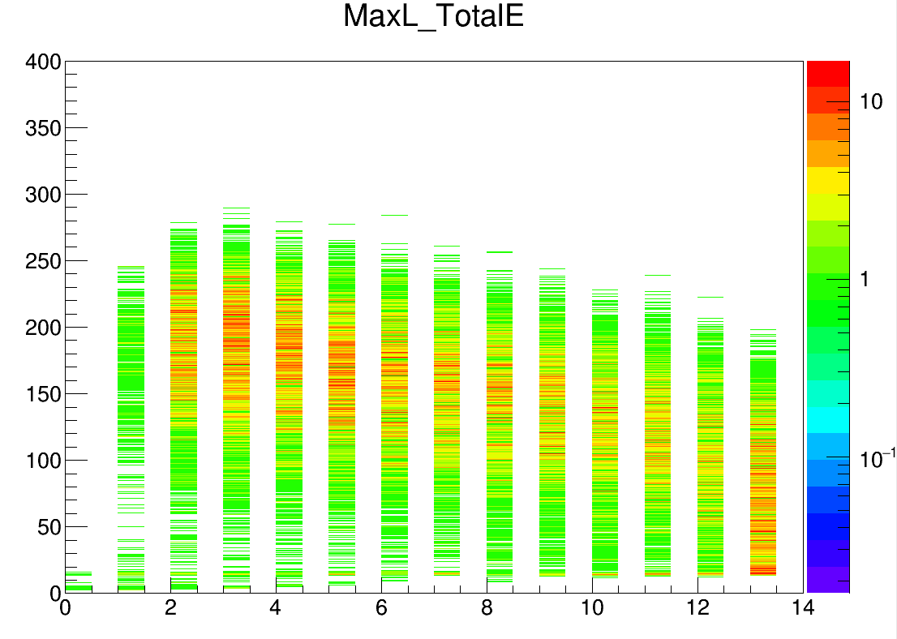
Total Energy (GeV)
Max LayerID
Max LayerID < 9

Slide 27
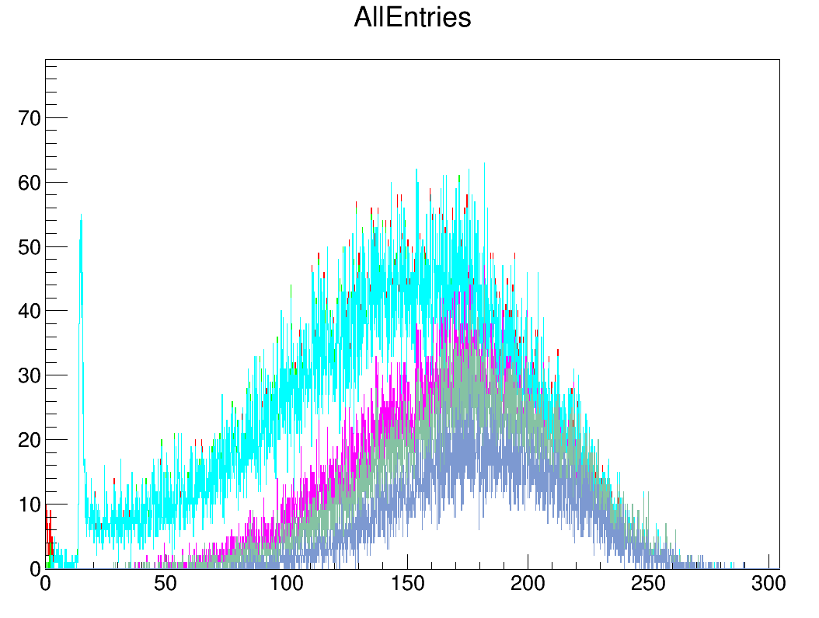
Backup
Count
All Entries
GlobalTrackCut
G3Cut
LayerEnergyCut
MaxLayerIDCut
MaxBarEnergyCut
LayerEnergy (GeV)

Slide 28
Backup

