Slide 1
PMT Test for PandaX-4T Experiment
Jumin YUAN* (袁鞠敏), Anqing WANG (王安庆)
Shandong University
On behalf of PandaX-4T Collaboration
06/22/2018

Slide 2
Outline
PMT system of PandaX-4T
Experimental setup for PMT batch testing
Testing Procedure
Preliminary test results
Summary and outlook

Slide 3
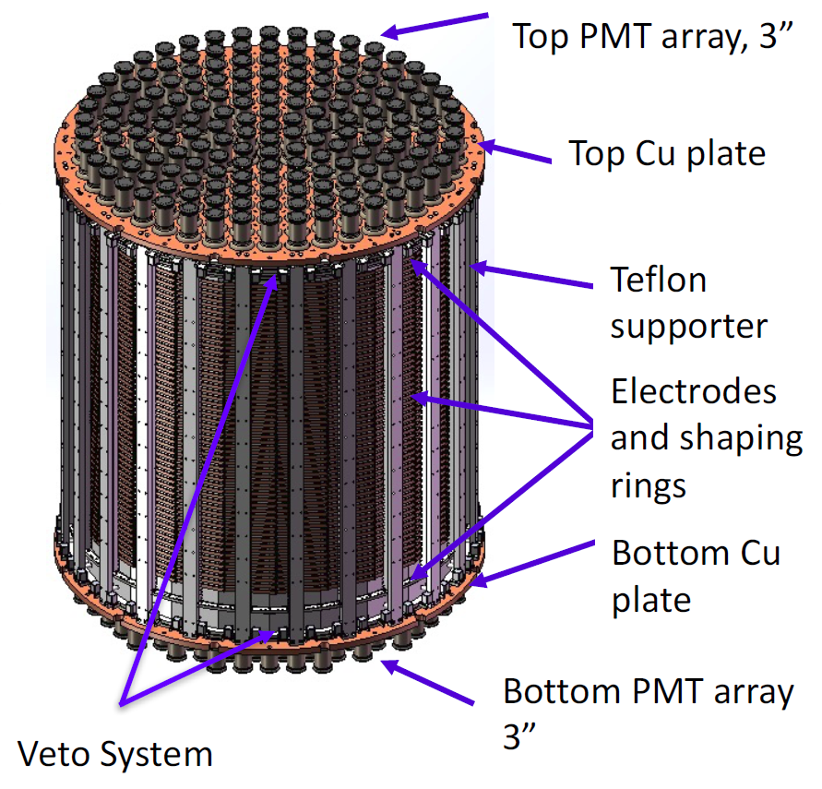
I. PMT system of PandaX-4T
PandaX-4T TPC
PMT system:
Top PMT array: 169 3-inch R11410-23
Bottom PMT array: 199 3-inch R11410-23
Veto system: ~140 1-inch R8520
Key requirements:
Low radioactivity
Low dark current rate
High Quantum Efficiency (QE) at 178 nm
Low temperature
Top PMT array, 3”
Bottom PMT array, 3”
Veto System
All PMTs are custom-made by Hamamatsu!

Slide 4
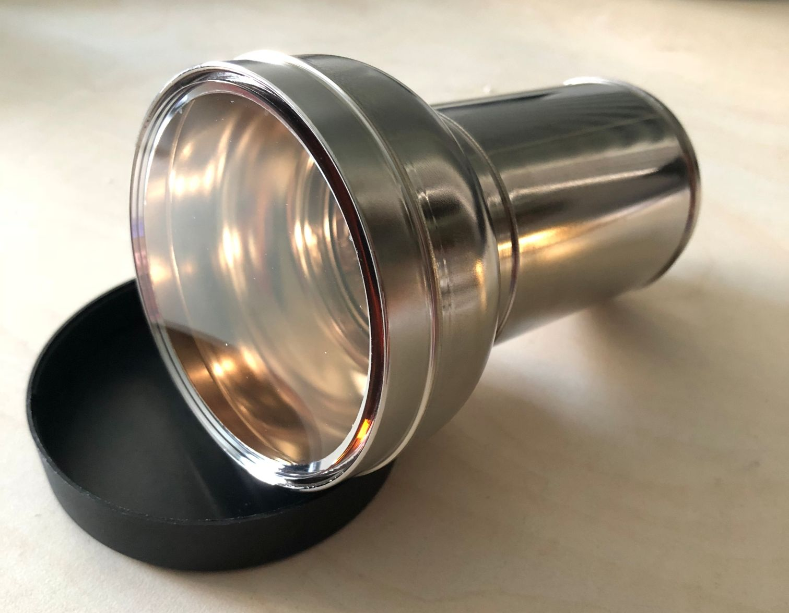
I. PMT system of PandaX-4T
PMT Acceptance Criteria:
Low Radioactivity : ²³⁸U + ²³²Th < 15 mBq/pc, ⁴⁰K<30 mBq/pc, ⁶⁰Co <7.5 mBq/pc, ¹³⁷ Cs <50mBq/pc.
Quantum Efficiency: typical 30% (>26%) at 178 nm.
Dark Current Rate (DR):
room temperature: typical 4 kHz, max 10 kHz, ¼ PE threshold.
low temperature (-100 ºC ) : typical 50 Hz, max 200 Hz, ¼ PE threshold.
Afterpulse Probability (APP): < 5% between 400 ns to 5 µs.
Temperature rate: lower than -100 ℃ (-115 ℃).
Single Photoelectron gain (SPE gain): ~5×10⁶ @1500V.

Slide 5
I. PMT system of PandaX-4T
PMT Acceptance Criteria:
Low Radioactivity : ²³⁸U + ²³²Th < 15 mBq/pc, ⁴⁰K<30 mBq/pc, ⁶⁰Co <7.5 mBq/pc, ¹³⁷ Cs <50mBq/pc.
Quantum Efficiency: typical 30% (>26%) at 178 nm.
Dark Current Rate (DR):
room temperature: typical 4 kHz, max 10 kHz, ¼ PE threshold.
low temperature (-100 ºC ) : typical 50 Hz, max 200 Hz, ¼ PE threshold.
Afterpulse Probability (APP): < 5% between 400 ns to 5 µs.
Temperature rate: lower than -100 ℃ (-115 ℃).
Single Photoelectron gain (SPE gain): ~5×10⁶ @1500V.

Slide 6
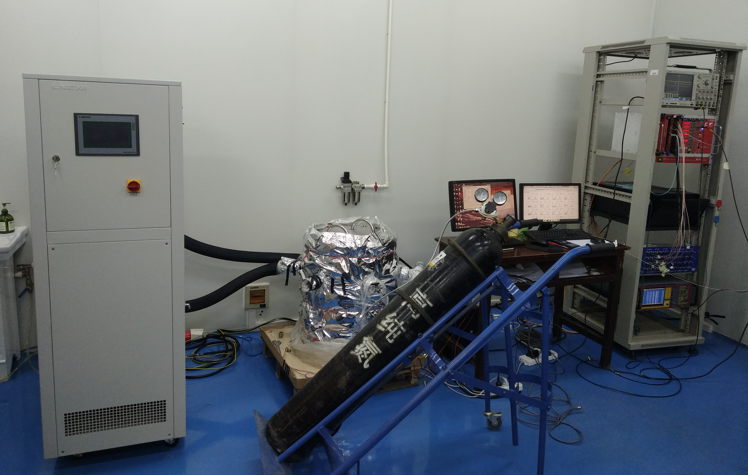
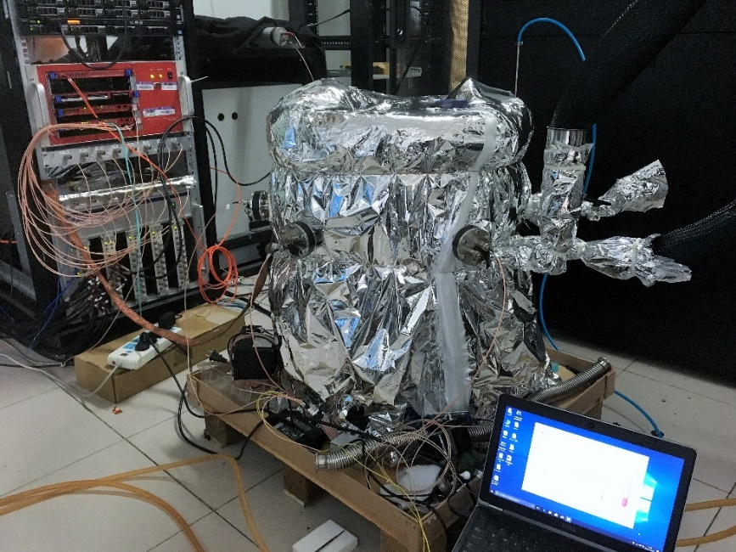
II. Experimental setup
Low temperature chamber
DAQ
PMT array
Low temperature chamber
Electronics and data acquisition (DAQ)
@SDU
Refrigerator
Two similar testing systems for cross check (SDU & SJTU )
@SJTU

Slide 7
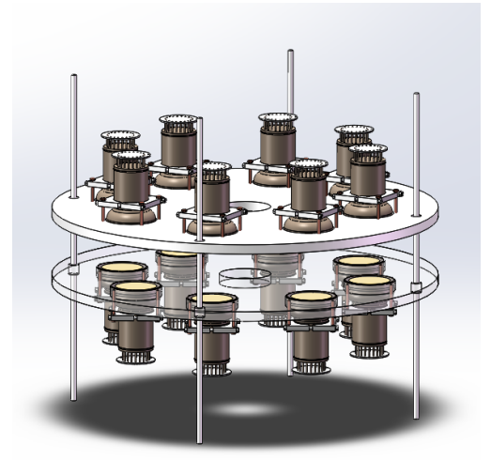
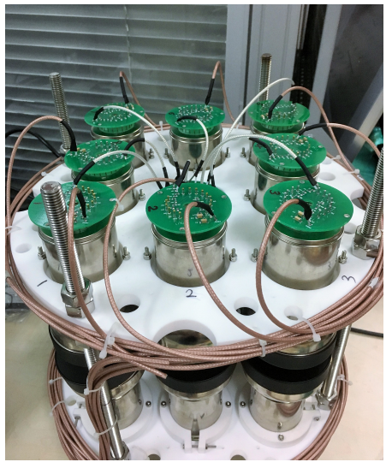
a. PMT array
PMT mounting：
16 PMTs per batch test.
Face-to-face mounted on the top and bottom PTFE array.
The gap between two opposite PMTs is around 3 cm
HV Divider (PMT Base)：
Split HV supply: -800 V and +700V (typical)
18 pairs of cables for 16 PMTs: 16 positive HV + 2 negative HV.
Signals are decoupled from the +HV by the decoupler outside the chamber.

Slide 8
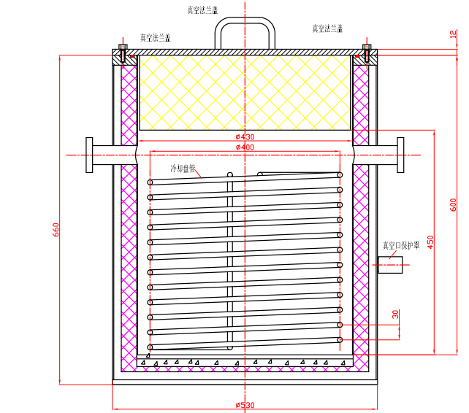
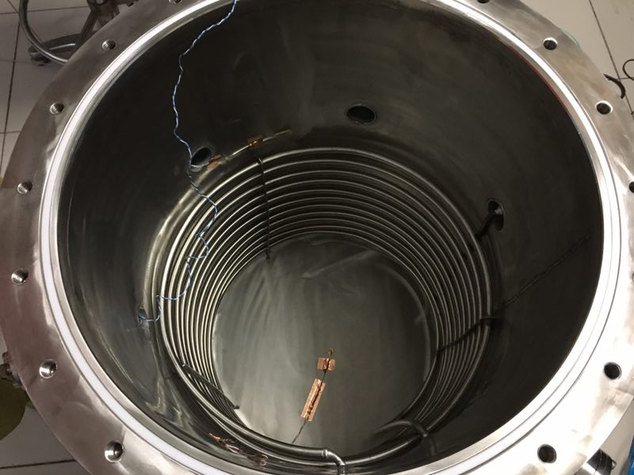
b. Low temperature chamber
真空法兰盖
真空法兰盖
Chamber: filled with dry nitrogen gas, pressure is 1.5 barg
Refrigerator (LT-A025WN): refrigerant (ethanol) pass through the coil tube inside the chamber
Φ430
Φ400
660
600
450
Φ530
Temperature monitor: 3 PT100 sensors on top, middle and bottom.
Temperature field: -50 ℃ (top) and -80 ℃ (bottom), limited by the power

Slide 9
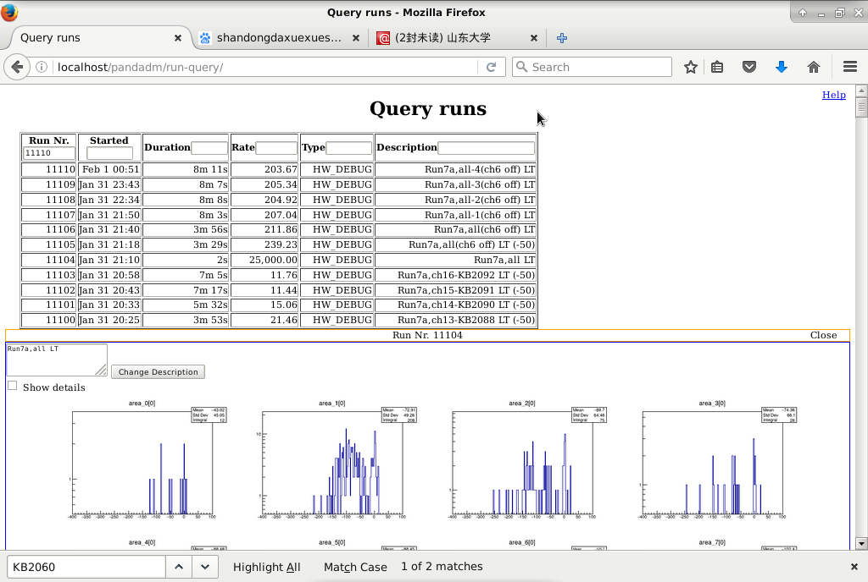
c. Electronics & DAQ
Digitizer: CAEN V1725B, 16 channels, 14 bit ADC and 250 MHz sampling
Trigger mode: self_trigger (DR) and external_trigger (LED)
Noise suppression:
Trigger threshold: ¼ PE
Quality cuts (waveform): rms<5 ADC, overshoot<15 ADC
Data quality online monitor
Automatic data analysis scripts: DR, APP and SPE gain
MySQL database to record data files

Slide 10
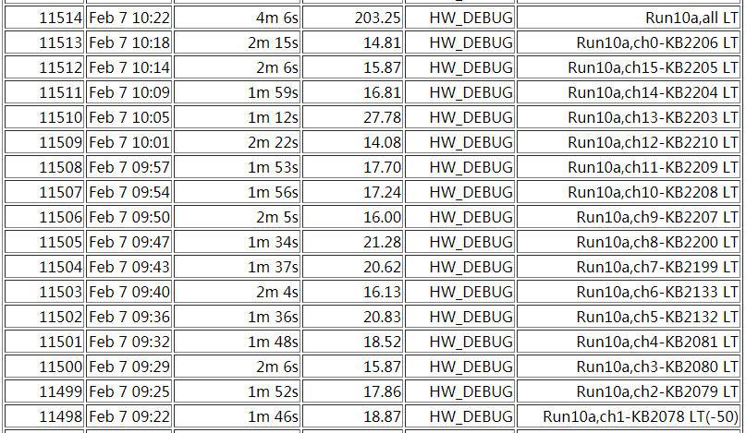
IV. Testing procedure
Run10a running history (LT)
PMT mounting
Fill nitrogen gas into the chamber : 1.5 barg
Test DR, APP, SPE gain in RT
Cool down the chamber: take 4.5 h from 25℃ to -50℃ (top)
Test DR, APP, SPE gain in LT
24 h return back 25℃
One whole run need 3 days

Slide 11
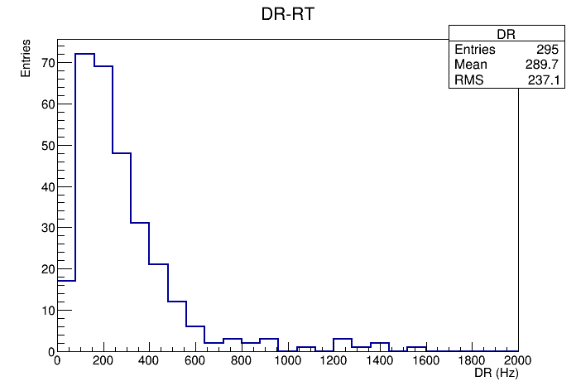
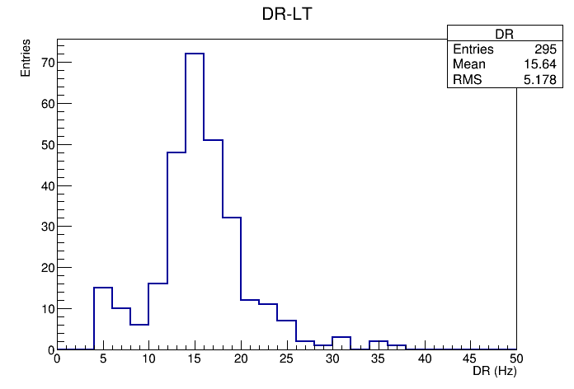
V. Test results
a. Dark rate
Trigger mode: self_trigger
Trigger threshold:
30 ADC (~3.66mv) in amplitude
Charge cut: ¼ mean value of SPE
Quality cuts:
rms<5 ADC, overshoot<15 ADC
DR = Event number/ live time
Room temperature
Average DR: 290 Hz
preliminary
Low temperature
Average DR: 15.6 Hz

Slide 12
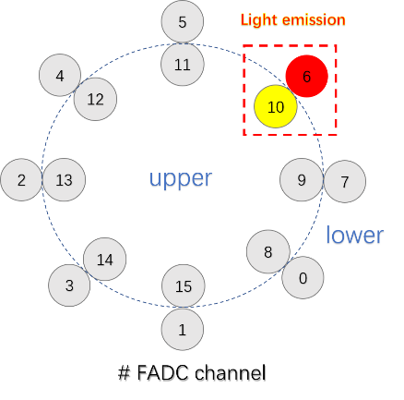
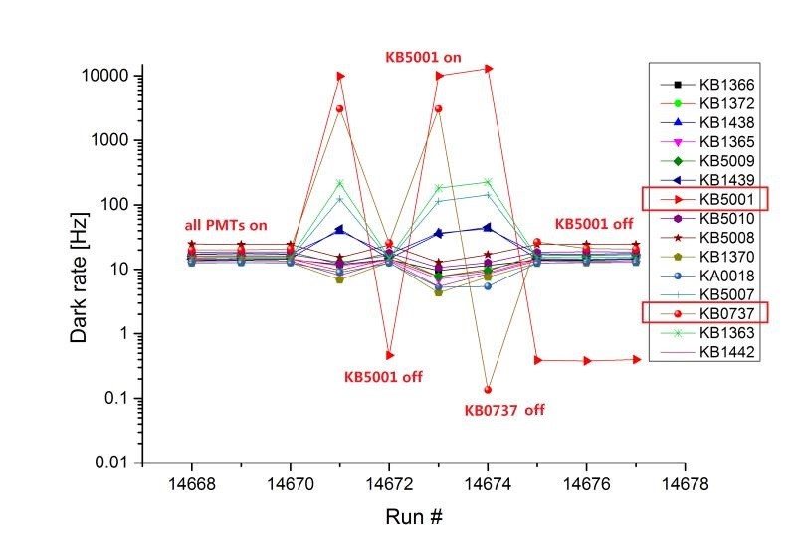
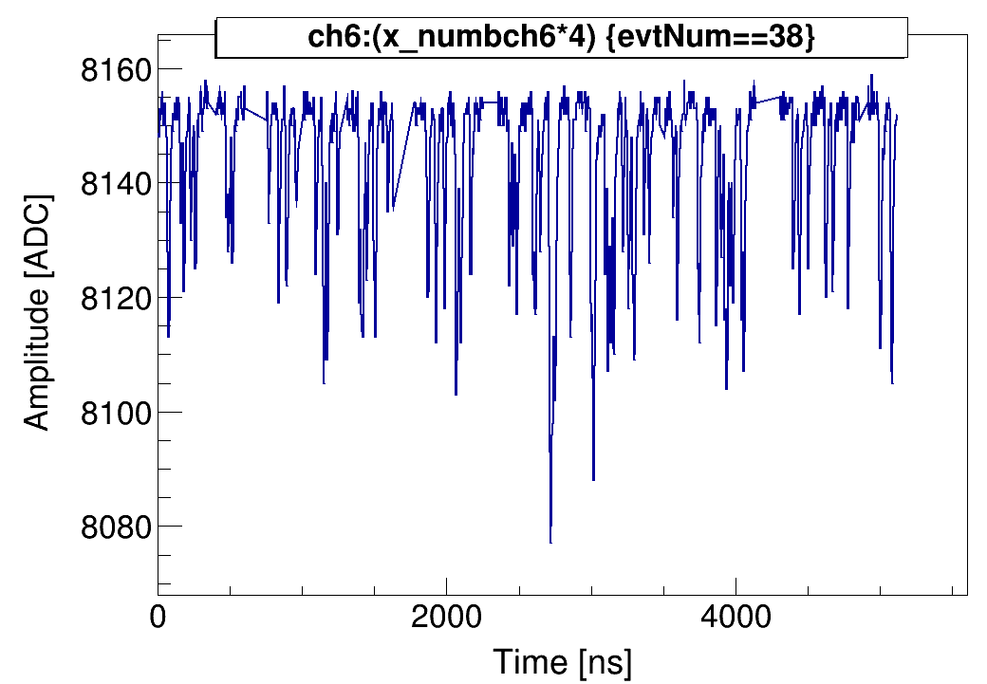
b. Light emission
Some PMT dark rate suddenly increased at low temperature for few hours.
The dark rate of few opposite PMTs correlated increased, but the rest PMTs still quiet.
Total 13/300 PMTs (5%) were found with light emission problem so far, much lower than Xenon1T’s R11410-20 PMTs (53/248, >20%) .
All PMTs with light emission will be returned to Hamamatsu.

Slide 13
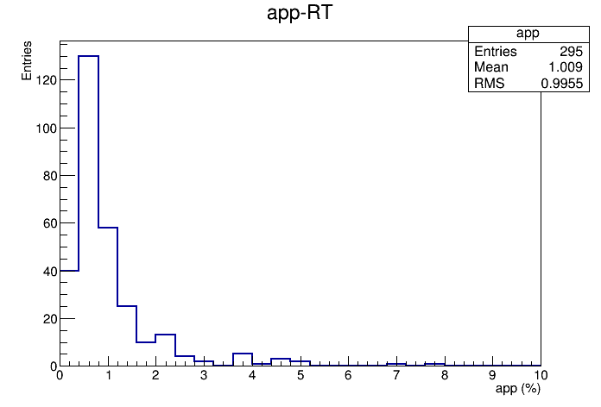
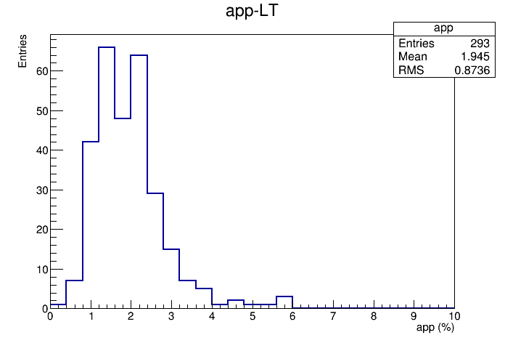
c. Afterpulse probability (APP)
Trigger mode: external trigger with LED.
After pulse (AP) : the pulses following the main pulse (in trigger window) by the delayed time between 400 ns and 5 µs
APP = AP events / main pulse events
Room temperature
Average APP: 1%
Below
acceptance
preliminary
Typical timing profile for Afterpulses
low temperature
Average APP: 1.9%
Below
acceptance

Slide 14
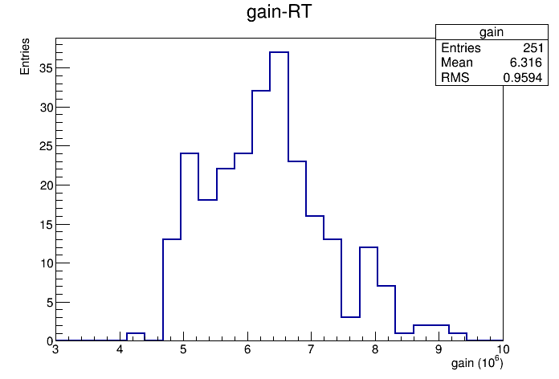
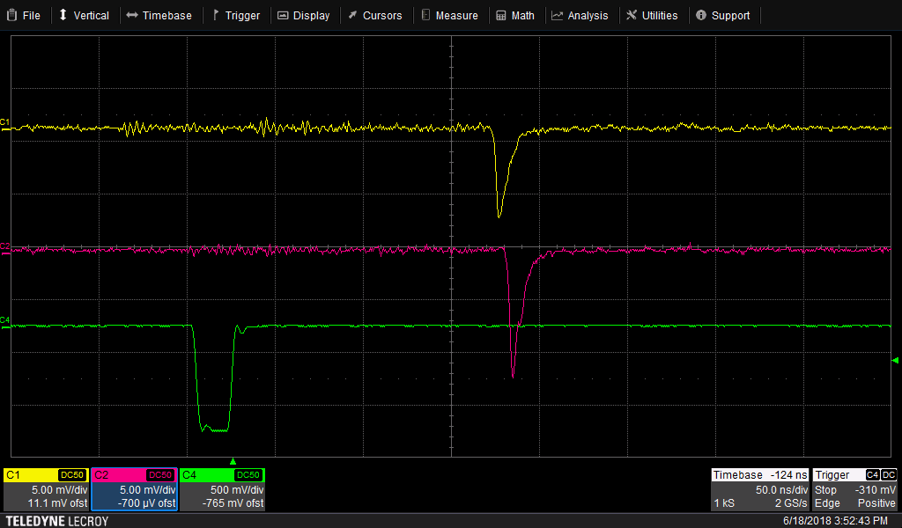
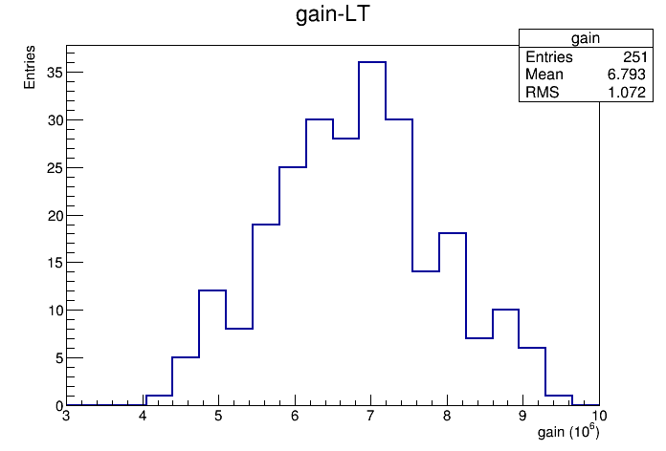
d. Single PE gain
Trigger mode: external trigger with LED (light fed in the chamber via optical fiber from the outside). Single photon occupancy ~10%
Charge integration in the trigger window.
Average gain@1500V: 6.3x10⁶@RT, 6.8x10⁶ @LT
PMT2
PMT1
LED driver
preliminary

Slide 15
Summary and Outlook
Completed the preliminary tests of 300 R11410-23 PMTs by the joint efforts from SDU and SJTU.
Most PMTs performed well in the tests (low dark rate, low APP, good SPE gain & resolution, etc.).
5% PMTs were identified with the problem of light emission and will be returned to Hamamatsu.
More tests are undergoing to further check the questionable PMTs which were found in the preliminary tests.
PMT radioactivity screening, additional acceptance tests for newly purchased PMTs (~100 pieces).
To be continued…

Slide 16
Thanks for your attention !

