Slide 1
Associated production of Higgs boson with μ⁺μ ⁻ at CEPC
桑 文 龙
西南大学 重庆
In collaboration with Wen Chen, Feng Feng, Yu Jia
第十届高能物理年会
上海 松江富悦大酒店
2018.06.19-2018.06.24

Slide 2
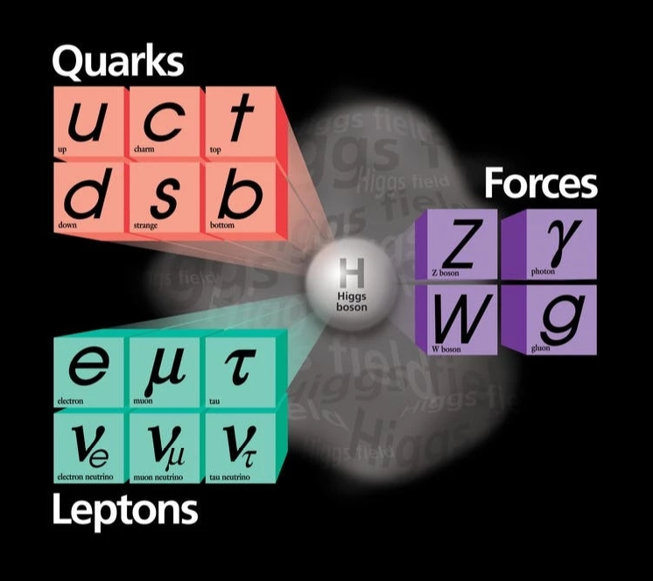
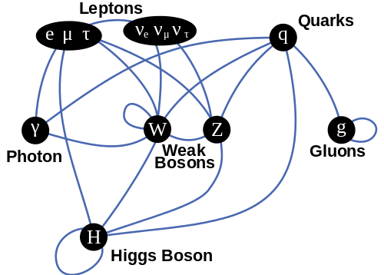
Higgs Bosons
Summary of interactions between particles described by the Standard Model
Elementary particles in the Standard Model
Spontaneous symmetry breaking

Slide 3
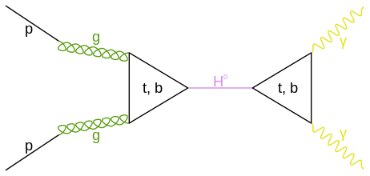
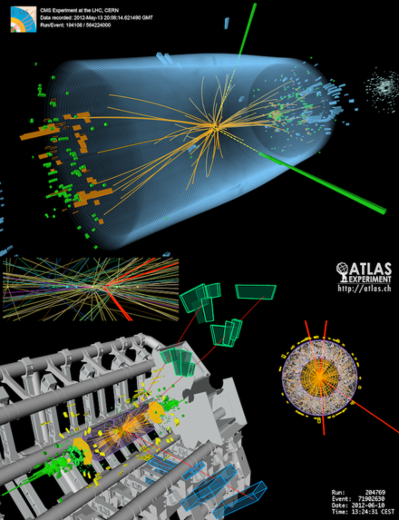
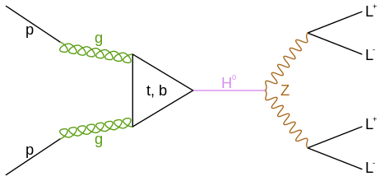
Higgs Bosons
On 4 July 2012, Higgs boson has been independently found by both CMS and ATLAS detectors at LHC.
Feynman diagrams observed by ATLAS and CMS at the LHC

Slide 4
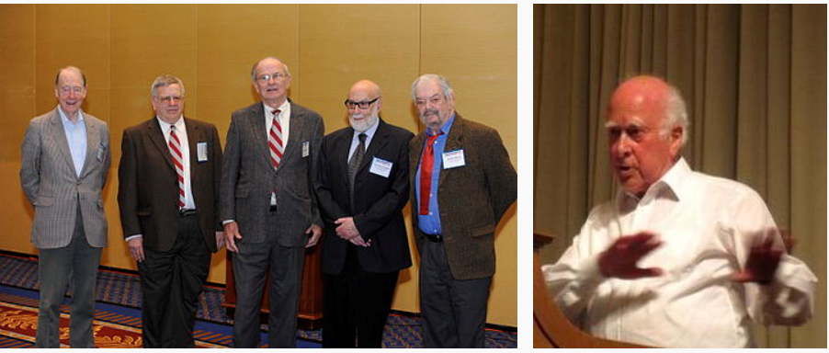
Higgs Bosons
The six authors of the 1964 PRL papers, who received the 2010 J. J. Sakurai Prize for their work. From left to right: Kibble, Guralnik, Hagen, Englert, Brout. Right: Higgs

Slide 5
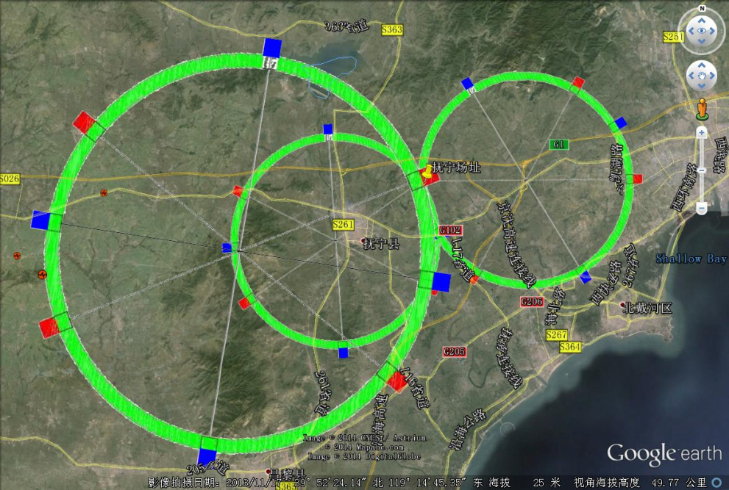
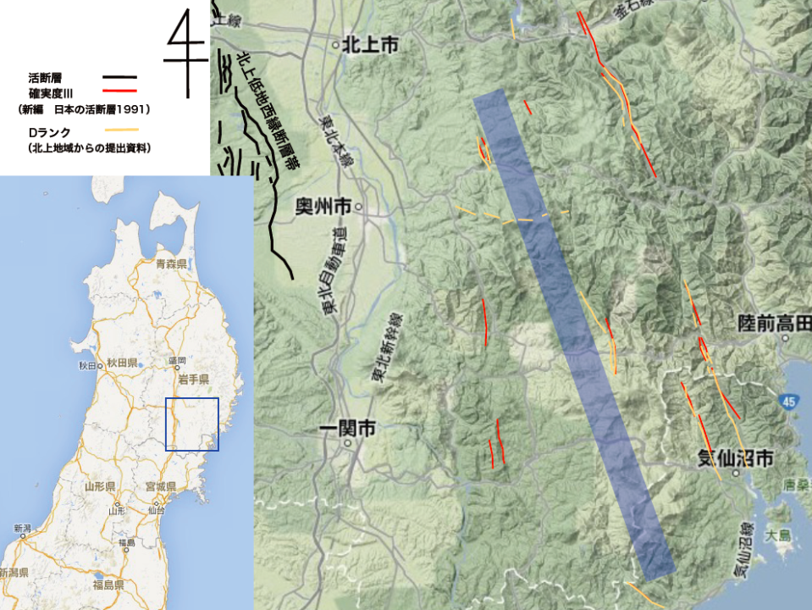
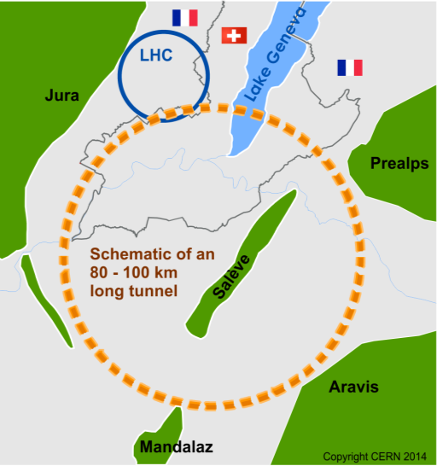
Higgs factories at plan
CEPC@240GeV(China)
秦皇岛 vs 雄安？
ILC@500,350,250 GeV(Japan)
Kitakami Candidate Site
FCC-ee@90-400GeV

Slide 6
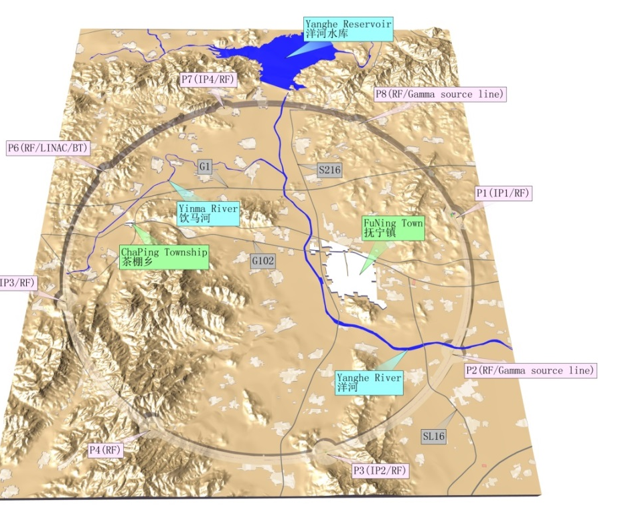
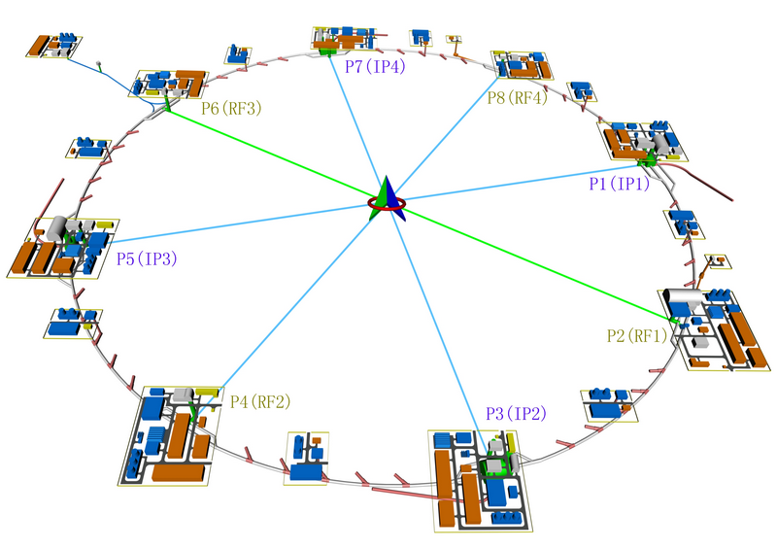
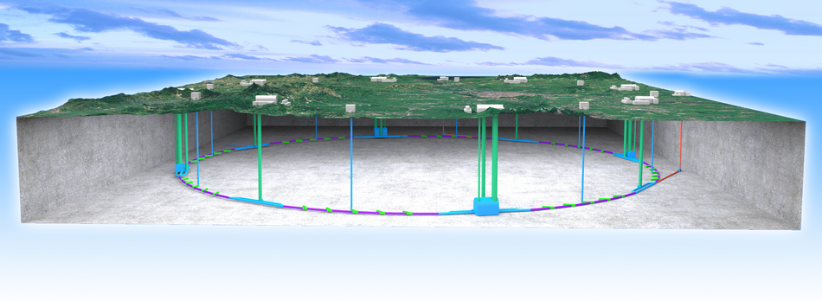
CEPC-SppC QingHuangDao site.
e⁺e⁻ collider(CEPC)
Higgs produced above the e⁺e⁻ → ZH threshold. Collide e⁺e⁻ at E_{cm}~240GeV，σ~ 200 fb Need 250 fb⁻¹/y/IP —> 1M Higgs particles in 10 years
pp collider(SppC)
E_{cm}=70 TeV or higher
Precise measurements of Electroweak Symmetry-Breaking parameters at Z-pole and WW threshold
etc. + searches for rare decays

Slide 7
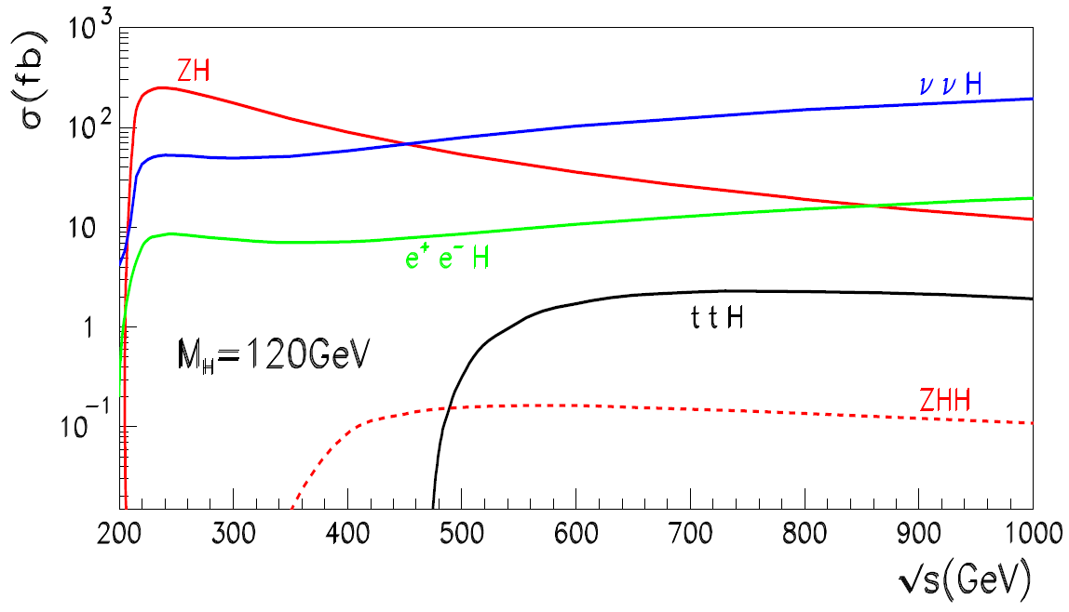
Dominant Higgs production e⁺ e⁻ → HZ

Slide 8
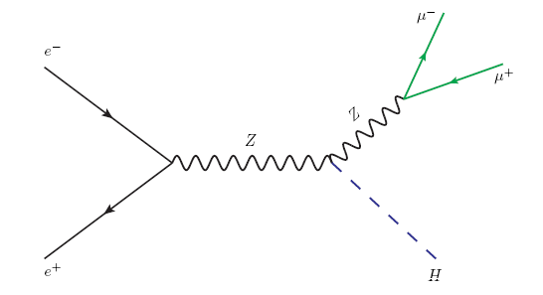
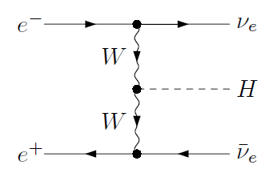
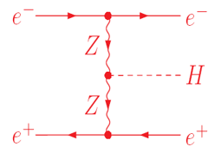
e⁺ e⁻ → H μ⁺μ ⁻
J. D. Bjorken, Conf. Proc. C7608021, 1 (1976).
D. R. T. Jones and S. T. Petcov, Phys. Lett. 84B,
440 (1979).
G. Belanger, et al., Phys. Lett. B559,
252(2003).
F. Boudjema, et al., Phys. Lett. B600,
65 (2004).
EM corrections are also included!

Slide 9
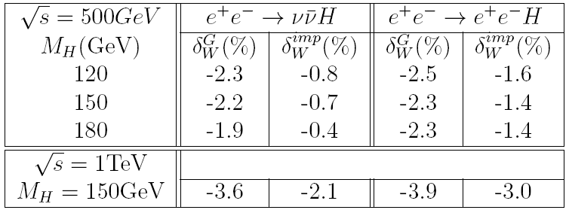
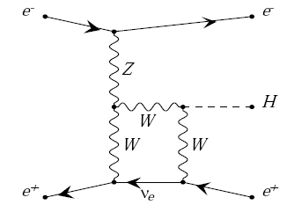
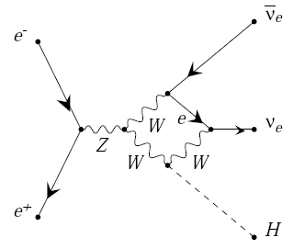
Sizable corrections in e⁺e⁻→Hνν(e⁺e⁻)
F. Boudjema, et al., Phys. Lett. B600, 65 (2004).

Slide 10
Sizable corrections in e⁺ e⁻ → HZ
We expect the corrections to e⁺ e⁻ → H μ⁺μ – are also considerable, larger than CEPC experimental precision.
We completely compute the EM & EM-QCD corrections to e⁺ e⁻ → H μ⁺μ.

Slide 11
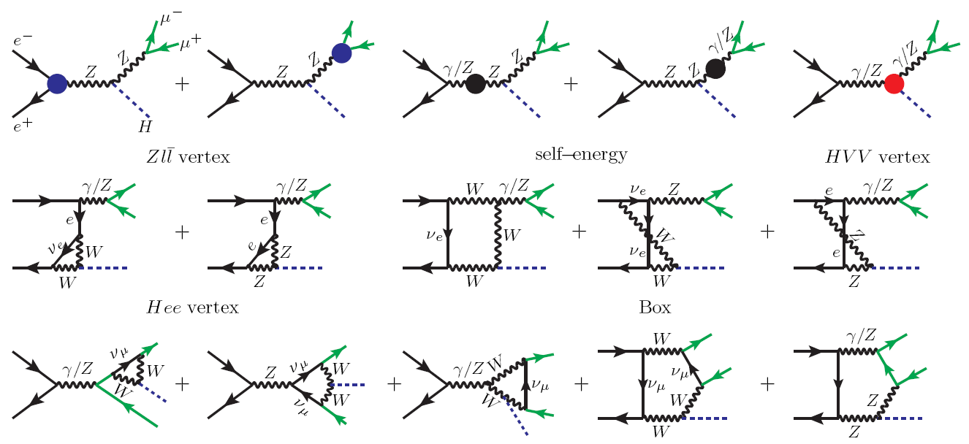
e⁺ e⁻ → H μ⁺μ ⁻

Slide 12
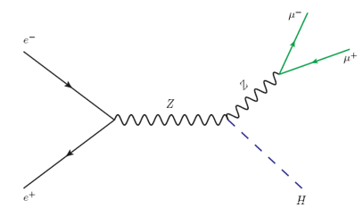
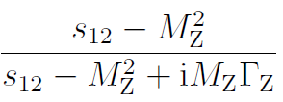
Treatment of the Z-boson width
fixed Z-boson width or running width?
gauge invariance?
double-counting?

Slide 13
Treatment of the Z-boson width
naive fixed-width scheme
potentially violates gauge invariance
虚部避免了double counting
质量抵消项

Slide 14
Treatment of the Z-boson width
A. Denner, S. Dittmaier, M. Roth, and M. M. Weber, Nucl. Phys. B660, 289 (2003)
both gauge invariance
factorization scheme

Slide 15
Detailed Techniques and results
Renormalization
To get a UV finite result, one should do the renormalization for the amplitude.
We renormalized the UV divergences with on-mass-shell scheme.
A. Sirlin, Phys.Rev.D22,971(1980).
A. Denner, Fortsch. Phys.41,307(1993).
We calculated various electroweak counter terms according to the renormalization conditions, such as

Slide 16
We apply three variants of On-Shell renormalization schemes:
α(0) scheme
α(MZ) scheme
G_{μ} scheme

Slide 17
Input Parameters
^{Particle Data Group}
Chin. Phys. C 40, no. 10, 100001 (2016)

Slide 18
Our predictions in α(0) scheme
NLO enhances the LO prediction by about 6%
NNLO mixed EW-QCD correction is sizable, about 1.5% of the
LO prediction!

Slide 19
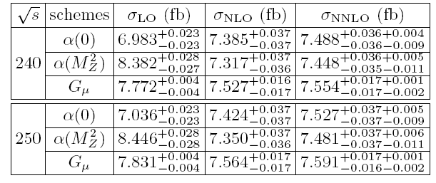
Our predictions for cross section in three different schemes (including uncertainty)
Sources of uncertainty
Observe strong scheme dependence!
The NNLO predictions now range from 7.44 to 7.55 fb!
Need go to 2-loop EW corrections to reduce Scheme dependence!

Slide 20
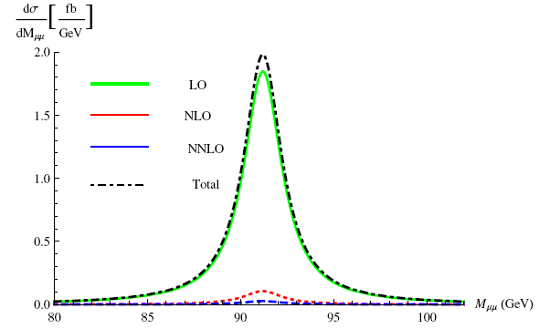
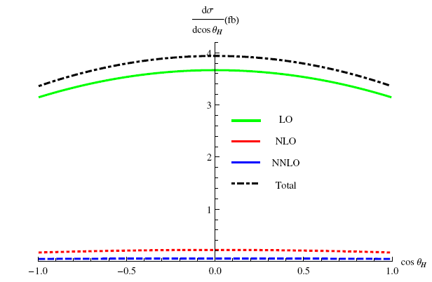
Distributions for e⁺ e⁻ → H μ⁺μ ⁻
Differential cross section of Higgs scattering angle.
Differential cross section of muon pair invariant mass.

Slide 21
Summary
1. The associated production of Higgs with μ⁺μ –at CEPC is investigated. We observed considerable EW and mixed EM-strong corrections.
2. Z boson width is carefully treated.
3. Distribution of Higgs scattering angle and muon pair invariant mass are obtained.
4. Strong α-scheme dependence observed, also sizable uncertainty arising from input parameters.

Slide 22
Thanks for your attention!

