Slide 1
Following the density perturbations through a bounce with AdS/CFT Correspondence
Lei Ming
Nanjing University
Collaborator: Taifan Zheng Supervisor: Edna Cheung
arxiv.org/abs/1701.04287v1, conditional accepted by European Physical Journal C

Slide 2
AdS/CFT bounce
Why bounce, especially CSTB ?
solving the Big Bang Singularity, Horizon as well as Flatness problems, and CSTB can producing a scale invariant spectrum during contraction phase, and realize bounce without violation of the null energy condition
Why AdS/CFT ?
bounce point: gravitational interactions may be strongly coupled
AdS/CFT: bulk/boundary correspondence is a strong/weak duality
CSTB: type IIB string theory

Slide 3
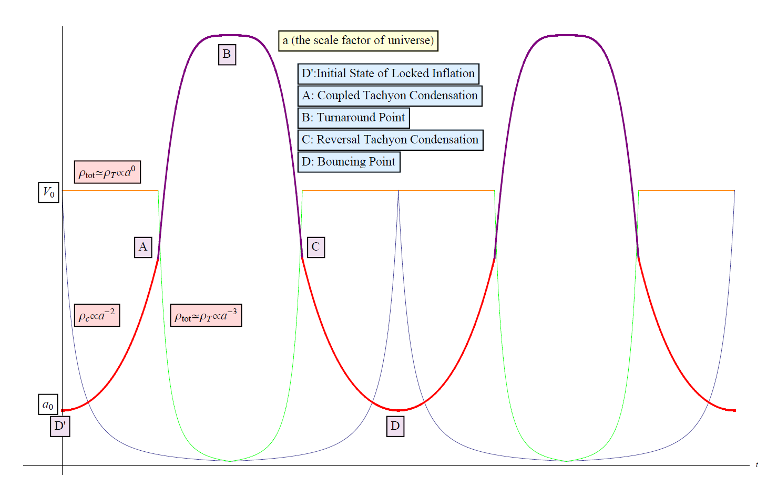
CSTB: Coupled Scalar Tachyon Bounce model
constructed from a Rolling Tachyon and its coupling to the Scalar (Higgs) fields in a system of D-branes and anti-D-branes
Bound to bounce: A coupled scalar tachyon model for a smoothly bouncing or cyclic universe. Phys. Dark Univ. 3, 18 (2014) doi:10.1016/j.dark.2014.02.001

Slide 4
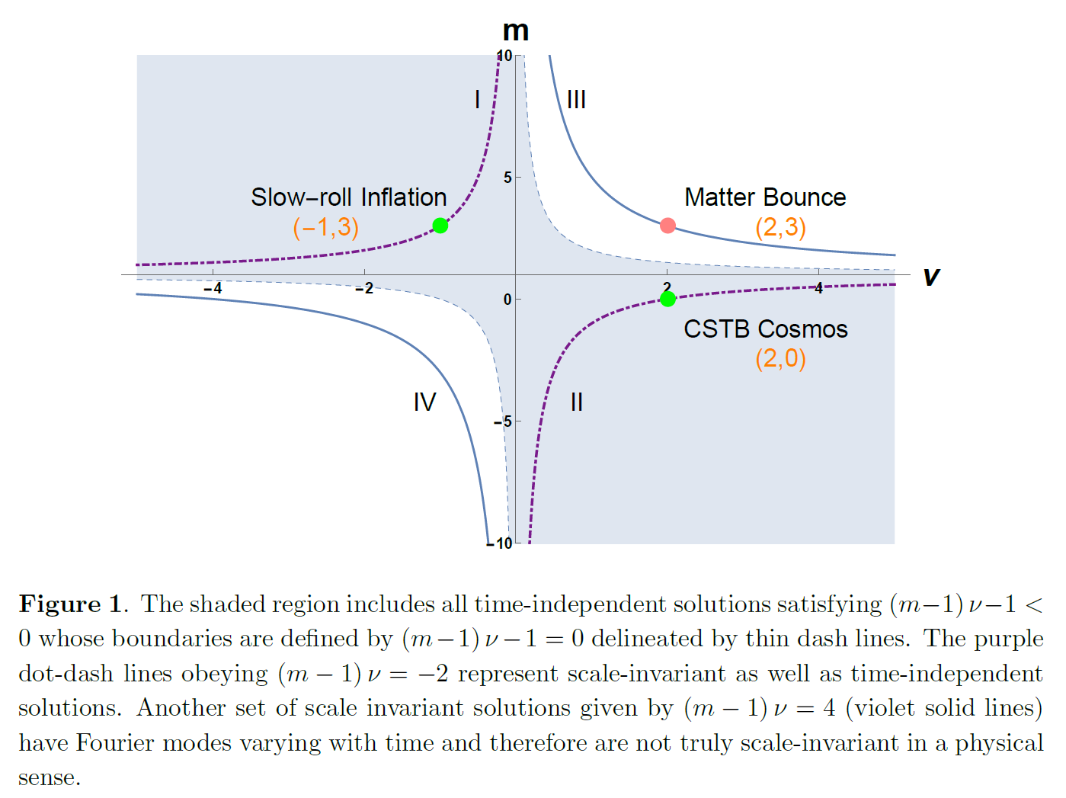
CSTB model
a method to analyse early universe models -- inflation or its alternative -- by the time independence $η^{W(υ,m)}$ and scale invariance $k^{L(ν,m)}$ of perturbation modes $χ_{k}$:
The scale invariant power spectrum of the primordial curvature perturbations from the coupled scalar tachyon bounce cosmos, JCAP 1407,008 (2014) doi:10.1088/1475-7516/2014/07/008

Slide 5
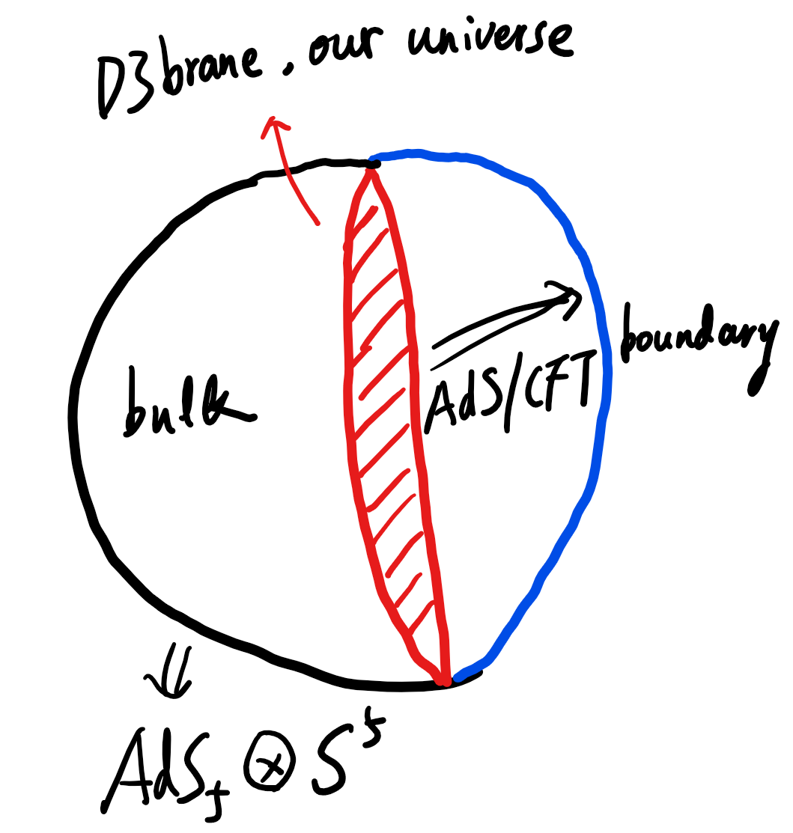
AdS/CFT correspondence

Slide 6
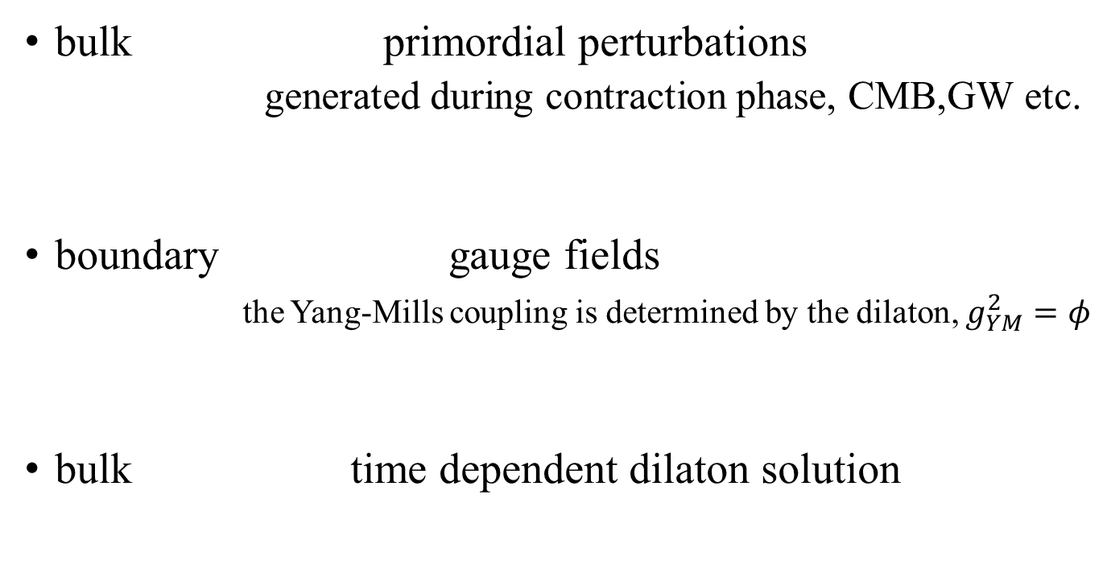
AdS/CFT correspondence
bulk primordial perturbations
generated during contraction phase, CMB,GW etc.
boundary gauge fields
the Yang-Mills coupling is determined by the dilaton, $g_{YM}^{2}=φ$
bulk time dependent dilaton solution

Slide 7
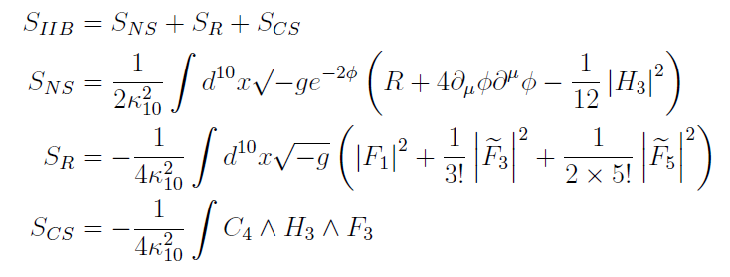
Embedded into a AdS₅⊗S⁵ :
low energy effective action of Type IIB string :

Slide 8
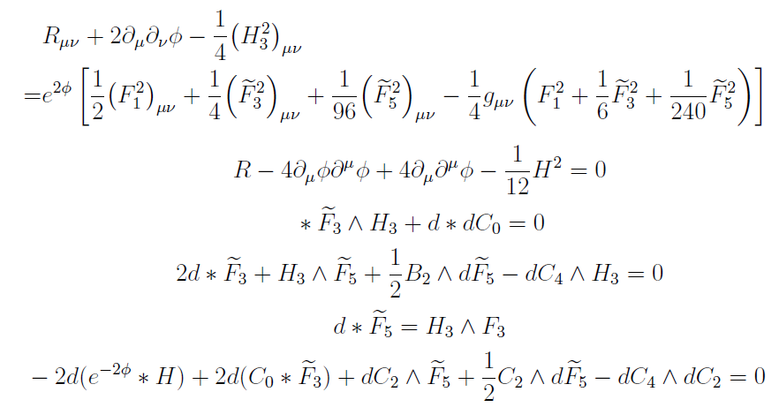
equations of motion :
time dependent dilaton solution φ :

Slide 9
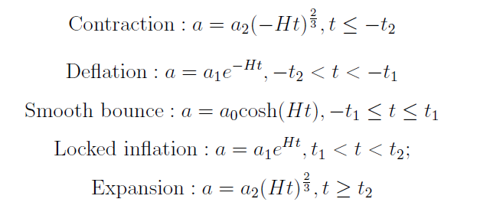
After rescaling and Fourier transformation:
modes of the gauge field
where
phases of universe evolution in the CSTB model:

Slide 10
Solutions and matching
contraction:
deflation:
smooth bounce:
locked inflation:
expansion:

Slide 11
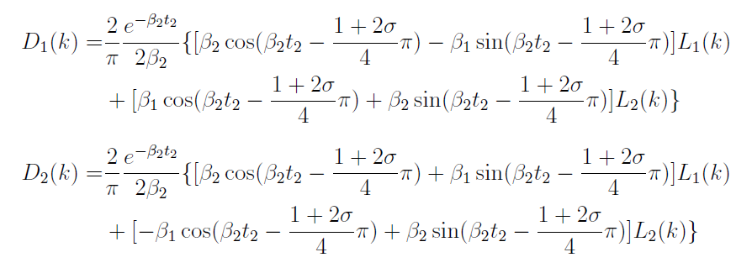

Solutions and matching
matching at -t₂:
matching at –t₁:
matching at t₁ and t₂ …...
relations from $L_{1,2}\left(k\right)$ to $R_{1,2}(k)$

Slide 12
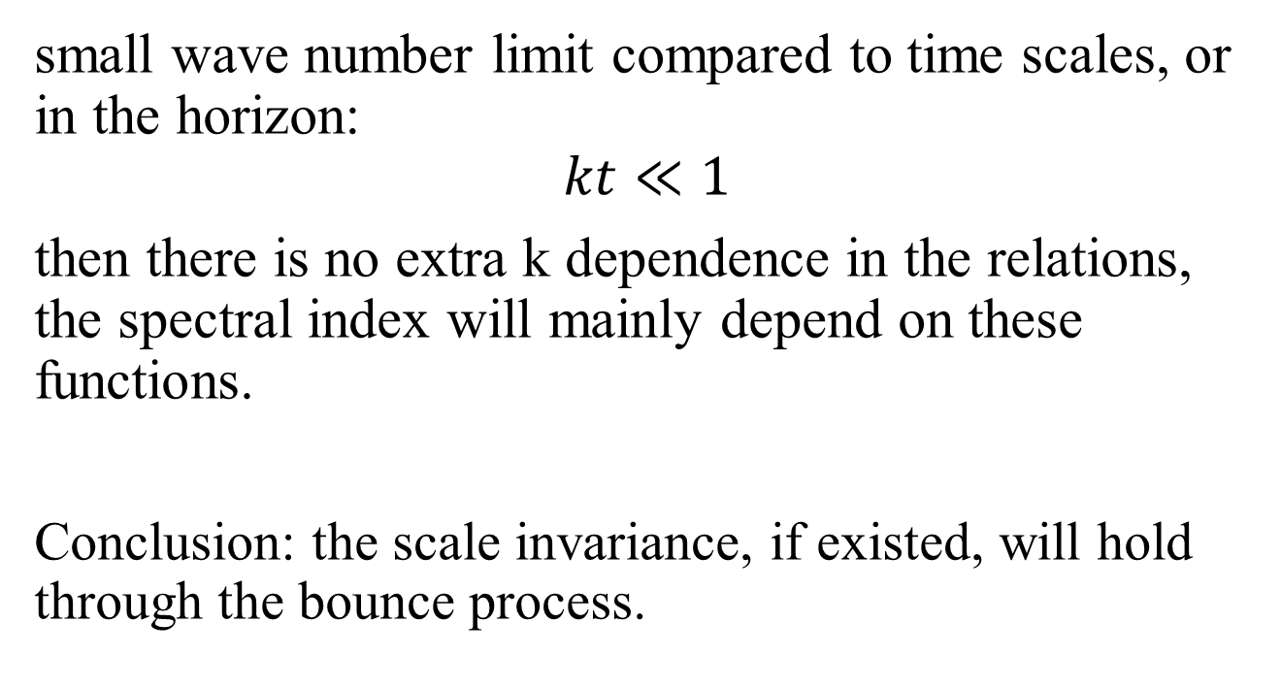
small wave number limit compared to time scales, or in the horizon:
$$kt≪1$$
then there is no extra k dependence in the relations, the spectral index will mainly depend on these functions.
Conclusion: the scale invariance, if existed, will hold through the bounce process.

Slide 13
Summary and outlook
using the AdS/CFT correspondence to study whether the spectral index of the primordial perturbations is altered by the bounce dynamics, especially in the Coupled-Scalar-Tachyon Bounce Universe model
some more details about compactification and the D-brane and anti-D-brane annihilation process

Slide 14
Thank you!

