Slide 1
中国物理学会高能物理分会第十届全国会员代表大会暨学术年会
Heavy hadron production in proton-proton collisions at LHCb
许泽华@LHCb
清华大学高能物理中心

Slide 2
Outline
Introduction
Recent results in heavy flavor production at LHCb
$Υ$ production in $pp$ collisions at $\sqrt{s}=13 TeV$
$B^{+}$ production cross-section in $pp$ collisions at $\sqrt{s}=7 TeV$ and $\sqrt{s}=13 TeV$
$D_{s}^{+}$ production asymmetry at $\sqrt{s}=7 TeV$ and $\sqrt{s}=8 TeV$
Summary and outlook

Slide 3
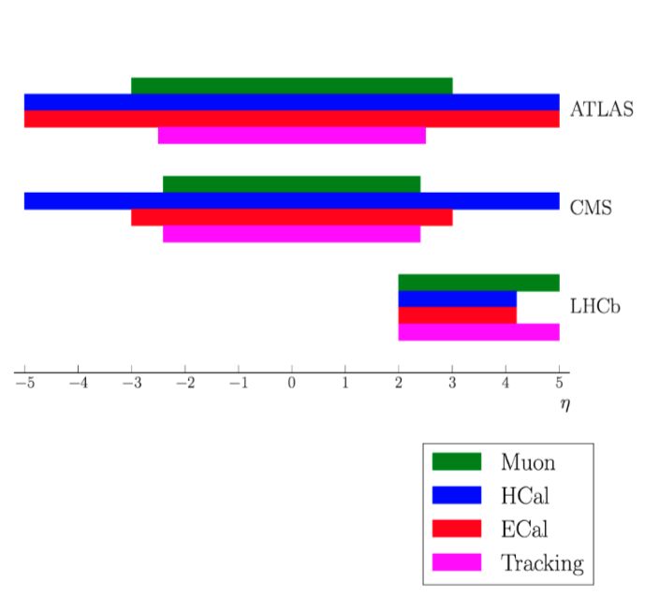
Introduction
Probe of QCD, both perturbative and non-perturbative aspects
Study of heavy-flavor production can help improving our understanding of OCD
Rely on data to fix non-perturbative parameters
Why LHCb?
LHCb geometrical acceptance allows to perform unique measurements in the forward region
Fully equipped in forward with tracking, hadron ID, muon ID, ECAL/HCAL
Complementary to other LHC experiments

Slide 4
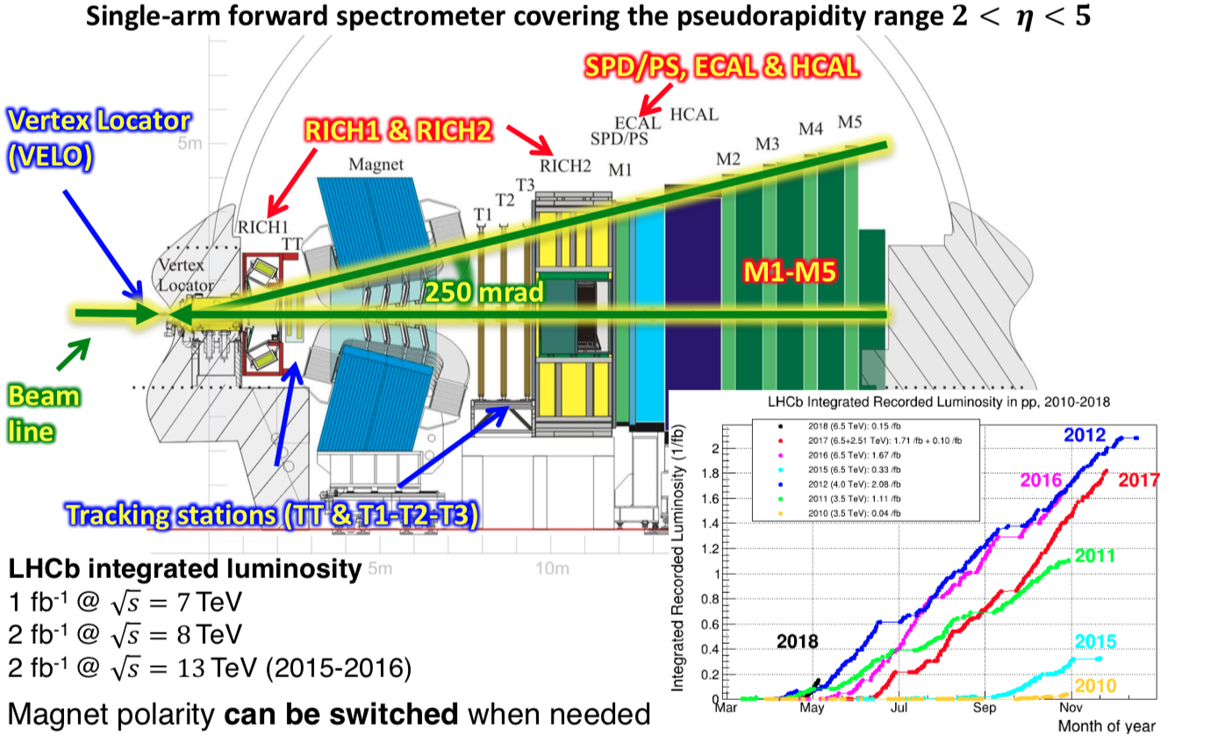
J.Instrum.3(2008) S08005
Int. J. Mod. Phys. A 30, 1530022 (2015)
The LHCb detector

Slide 5
$Υ$ production in $pp$ collisions at $\sqrt{s}=13 TeV$

Slide 6
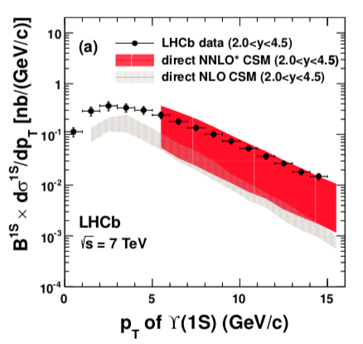
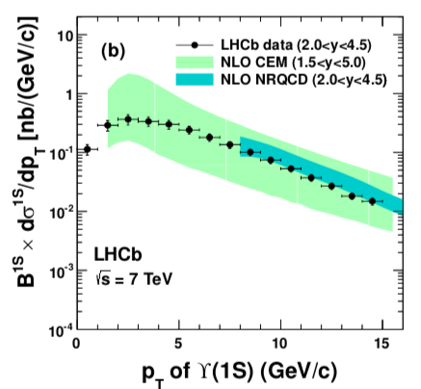
Motivations
arXiv:1804.09214
Study of heavy quarkonium production in high-energy collisions provides information on QCD
Several models proposed to describe underlying dynamics.
Color singlet model (CSM)
Non-relative QCD (NRQCD)
Color Evaporation Model (CEM)
Calculate ratio with respect to 7 and 8 TeV results $→$ cancel majority of systematic uncertainties

Slide 7
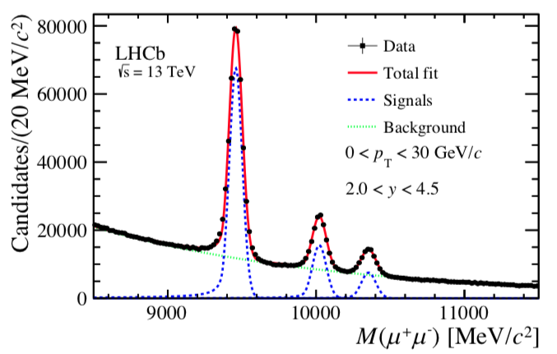
Analysis strategy
arXiv:1804.09214
Measure differential production cross-section as function of $p_{T}$ and $y$ multiplied by the $Υ\left(nS\right)→μ^{+}μ^{−}$ branching fraction
Data sample
277 $pb^{−1}$ @$\sqrt{s}=13 TeV$
Calculate:

Slide 8
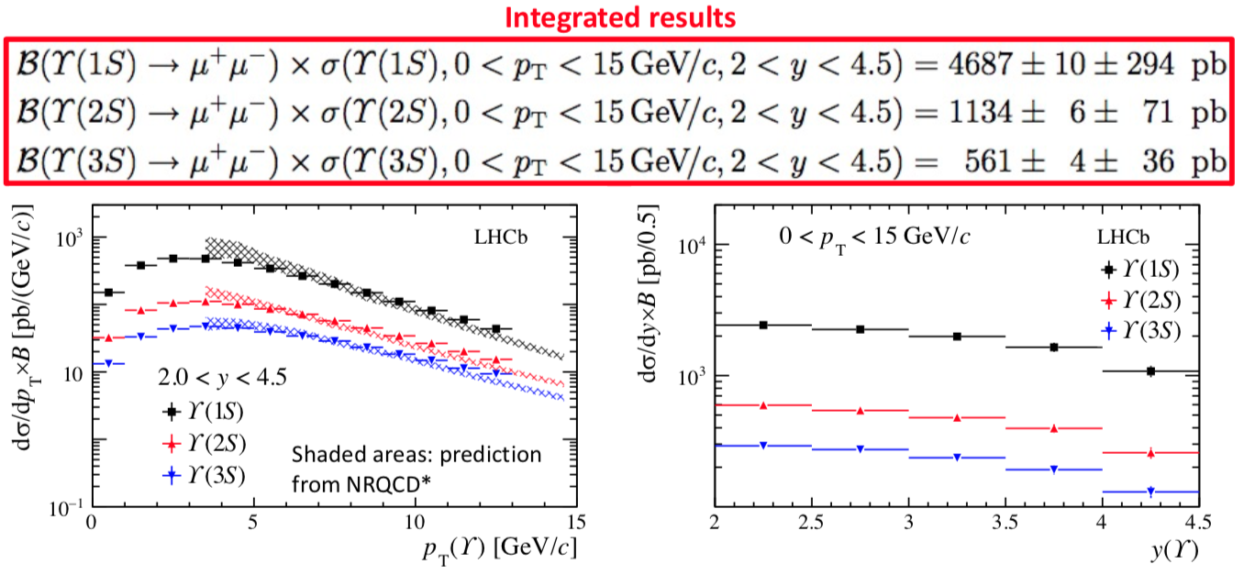
Results
arXiv:1804.09214
Measurements are dominated by systematic uncertainty
Main contribution due to trigger efficiency and luminosity determination
The prediction from NRQCD provides a reasonable description of data at high $p_{T}$

Slide 9
Ratios
arXiv:1804.09214
13/8 TeV ratio increasing as a function of $p_{T}$ and $y$
iS to 1S ratio increasing as a function of $p_{T}$ and flat as function of $y$

Slide 10
$B^{+}$ production cross-section in $pp$ collisions at $\sqrt{s}=7 TeV$ and $\sqrt{s}=13 TeV$

Slide 11
Motivations
JHEP 12 (2017) 026
Precise measurement of production cross-section of $B^{+}$ mesons provides important test of QCD calculations
Complementary phase-space with respect to ATLAS and CMS allow to test theory at low $p_{T}/$high $y$
Possibility to measure ratios at different center-of-mass energies to largely cancel theory and experimental uncertainties

Slide 12
Analysis strategy
JHEP 12 (2017) 026

Slide 13
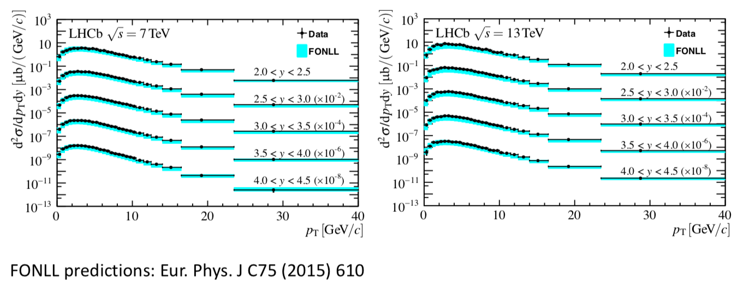
Results
JHEP 12 (2017) 026
The results are in good agreement with FONLL predictions

Slide 14
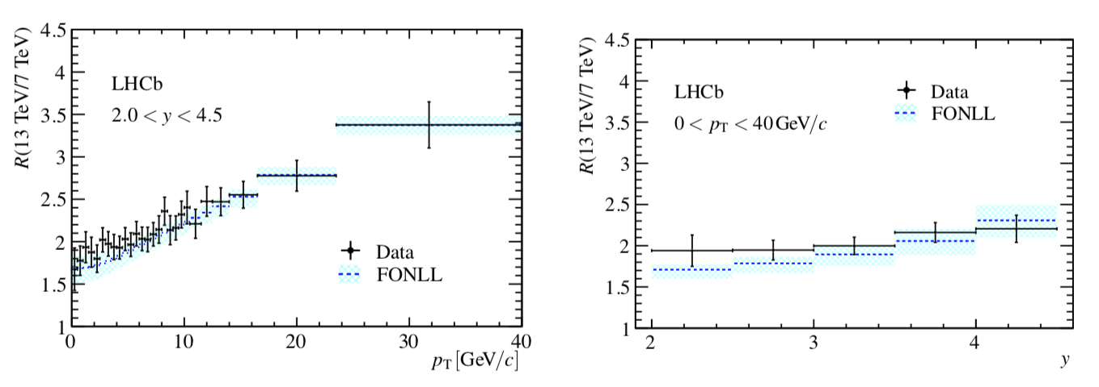
13/7 TeV Ratios
JHEP 12 (2017) 026
Also the ratio at the two different center-of-mass energies (13 and 7 TeV) is compatible with FONLL predictions
FONLL predictions from Eur.Phys.J C75 (2015) 610

Slide 15
$D_{s}^{+}$ production asymmetry at $\sqrt{s}=7 TeV$ and $\sqrt{s}=8 TeV$

Slide 16
Motivations
arXiv:1805.09418
b and c-hadrons are not expected to be produced at the same rate with respect to $\overline{b}$ and $\overline{c}$-hadrons in pp collisions
u and d quarks from the remnants of the colliding protons can combine with $\overline{b}$ and $\overline{c}$ quarks to form a meson, whereas the opposite can’t happen
This has to be compensated by an opposite asymmetry in the other species

Slide 17
Motivations
arXiv:1805.09418
Production asymmetry measurements are a key ingredient to perform CP violation measurement
One needs to disentangle the physical CP asymmetry from other spurious effects
Production asymmetries are defined as:
$$A_{p}\left(D_{s}^{+}\right)=\frac{σ\left(D_{s}^{+}\right)−σ(D_{s}^{−})}{σ\left(D_{s}^{+}\right)+σ(D_{s}^{−})}$$
where $σ$ is the inclusive prompt production cross-section

Slide 18
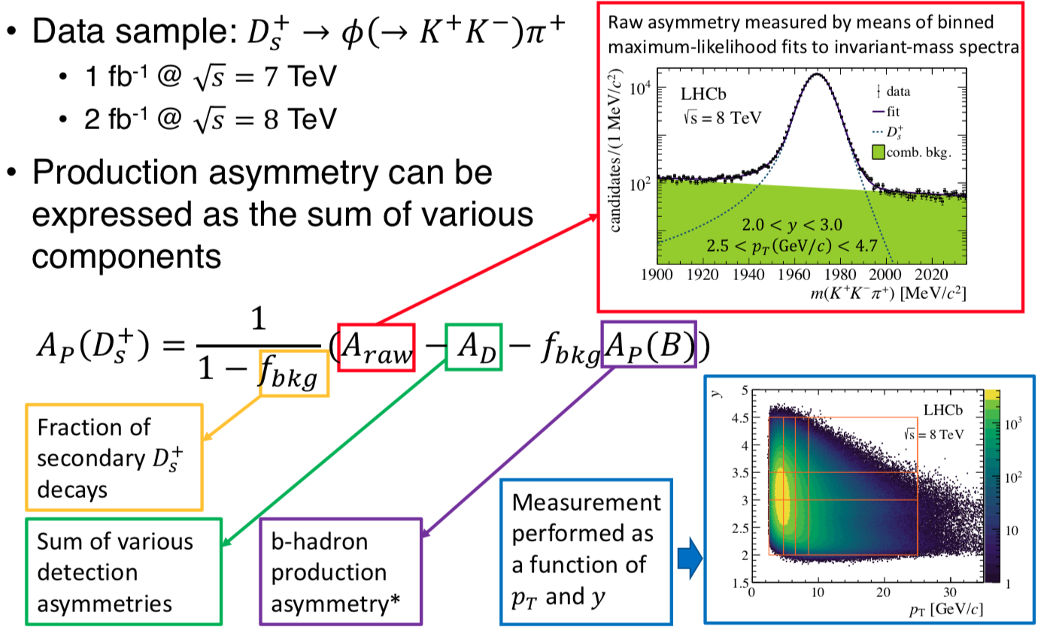
Analysis
arXiv:1805.09418

Slide 19
Results
arXiv:1805.09418
Integrating in the range of $2.5<p_{T}\left(GeV/c\right)<25$ and $2.0<y<4.5$ the $D_{s}^{+}$ production asymmetry is found to be
$A_{p\left(D_{s}^{+}\right)}=\left(−0.52±0.13\left(stat\right)±0.10(syst)\right)\%$
Evidence for nonzero asymmetry at $3.3σ$ level
No dependence on kinematics observed

Slide 20
Comparison with Pythia 8.1
arXiv:1805.09418
The Pythia event generator includes models accounting for mechanisms that cause production asymmetries
Pythia simulation shows a strong dependence on both $p_{T}$ and $y$, that is not observed in data
Results obtained in this analysis can be used to tune production models for various event generators

Slide 21
Summary and outlook
Several results presented today, exploiting both Run1 and Run2 data samples collected by LHCb
LHCb is testing theoretical model predictions in a unique kinematic region
Interplay with theory community very important
Many more measurements are coming, using Run2 and 5 TeV data sets
Run2 samples allow to perform analyses in final states that were limited by statistics in Run 1
More analysis with data collected in Run2 in the pipe
Stay tuned for more results

Slide 22
Thanks for your attention!

Slide 23
Backup

Slide 24
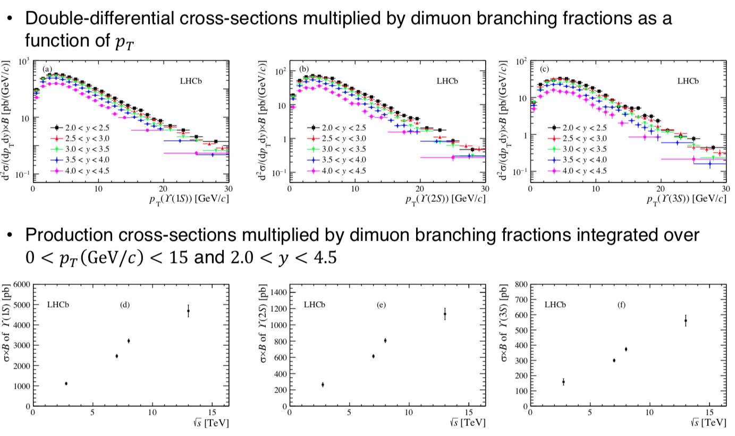
$Υ(nS)$ production

Slide 25
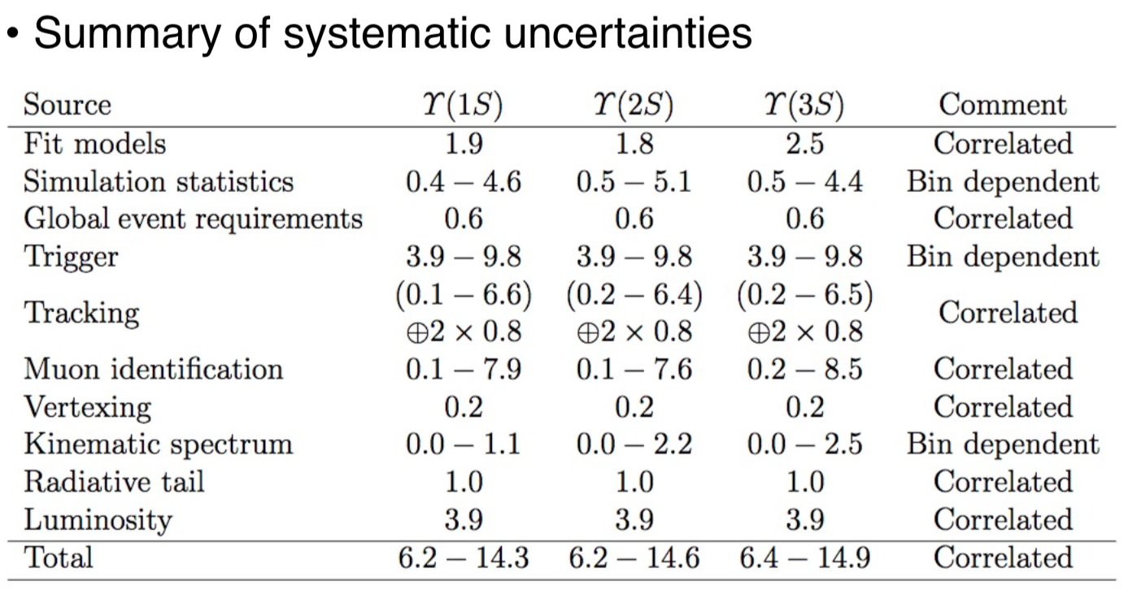
$Υ(nS)$ production

Slide 26
$B^{+}$production

Slide 27
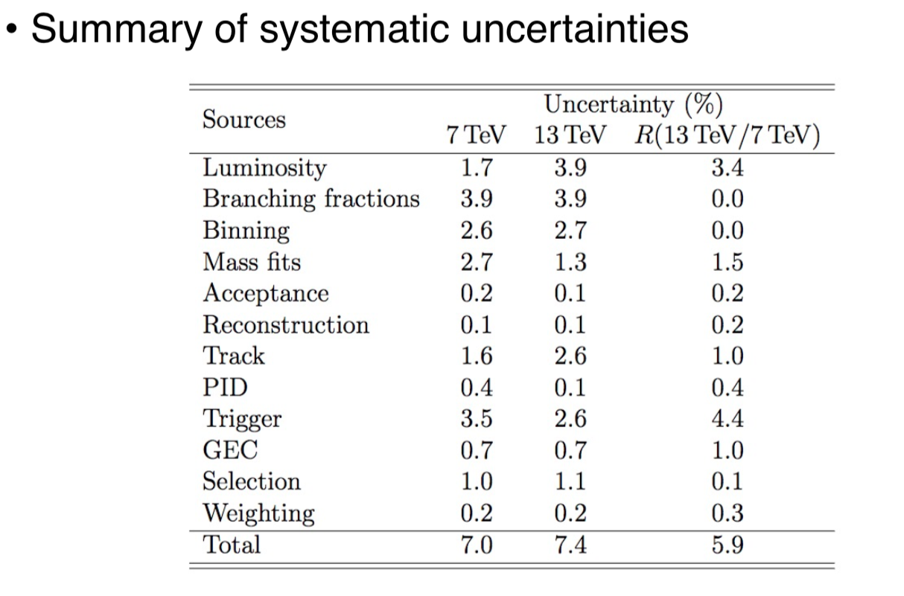
$B^{+}$production cross-section

Slide 28
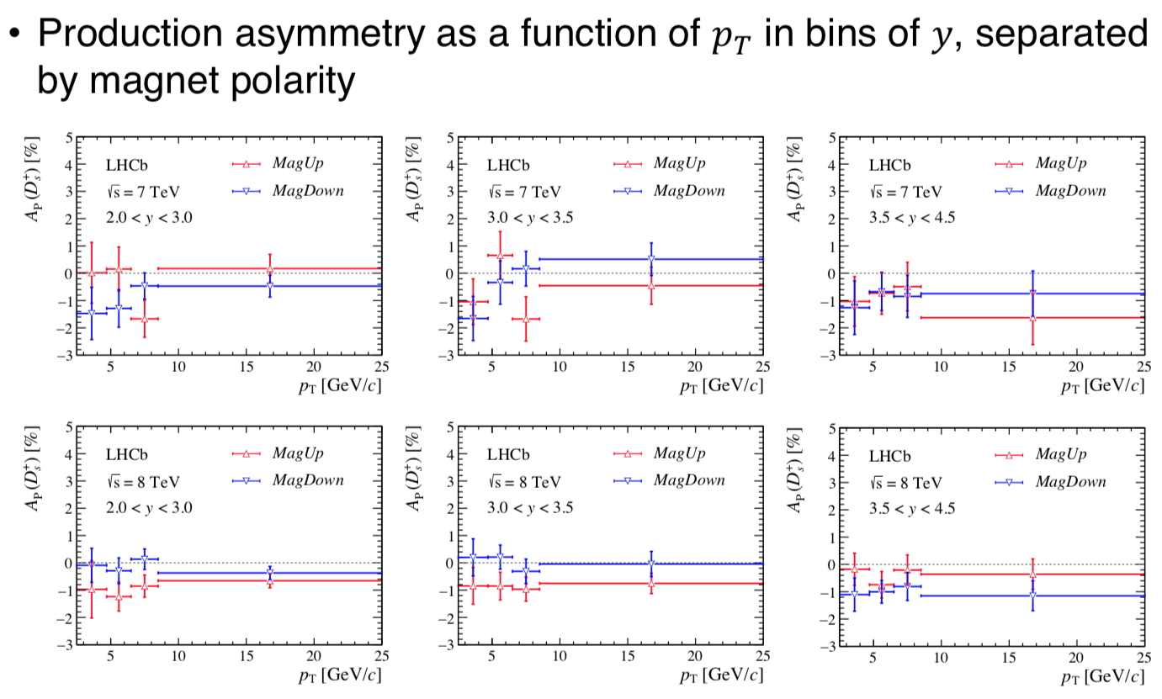
$D^{+}$production asymmetry

Slide 29
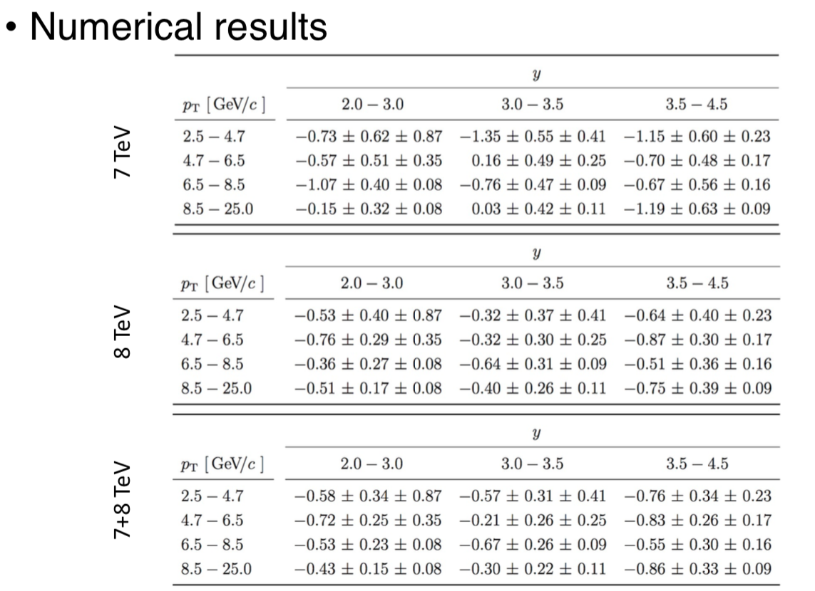
$D^{+}$production asymmetry

