Slide 1



CMOS strip sensor for the ATLAS phase-II tracker upgrade
Yubo Han_{IHEP} , Hongbo Zhu_{IHEP}
In close collaboration with SLAC and UCSC
Dionisio Doering, Herve Grabas, Pietro Caragiulo, Larry Ruckman, Camillo Tamma, Vitaliy Fadeyev, Su Dong

Slide 2
Outline
Motivation
Introduction to CHESS ( CMOS HV/HR Evaluation for Strip Sensors )
CHESS2 design and performance characterization
-> Charge Injection
-> response to LED/laser
-> updates
Summary and Next

Slide 3
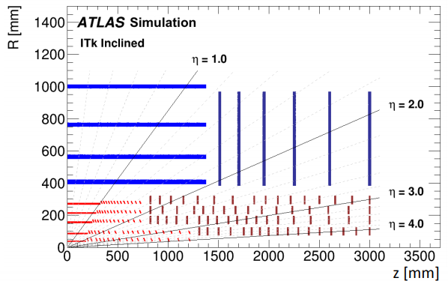
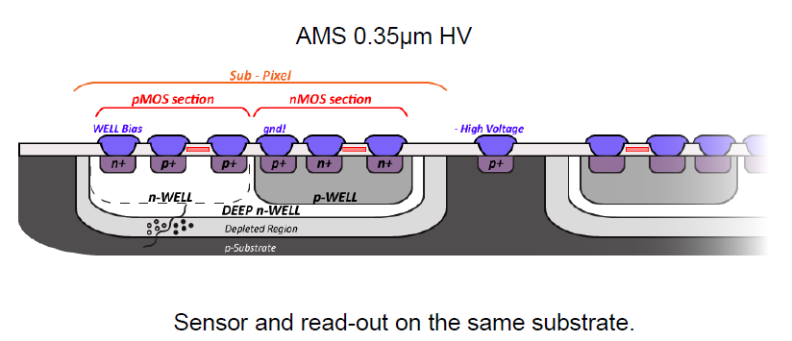
Motivation
Discover of Higgs -> HL LHC
Improve the precision of the measurement of Higgs properties and enhance the sensitivity to search for new physics
HL-LHC (high luminosity LHC) 2026
10 times of the original LHC design luminosity
Planned to run for 10 years
Challenges for tracker: higher particle density, harsh radiation environment, less material, thus electronics, cooling ……
New tracking system needed for HL-LHC to maintain the tracking performance
An all-silicon design is chosen comprising Pixels layers and Strip layers. (figure top right : ITK cross section)
MAPS (Monolithic Active Pixel Sensor) as a potential candidate

Slide 4
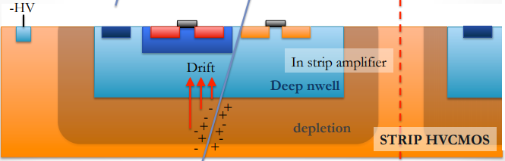
CMOS strip sensor
Working Principle of conventional MAPS (e.g. MIMOSA28 for STAR PXL):
electron-hole pair produced when there is a particle going through the epitaxial layer; charge collected by the electrode via diffusion
Advantages:
Combine both silicon sensors and readout processing circuitry on one single chip
Small feature size : moderate radiation hardness, high granularity, less cost and material budget (could be thinned down to 50μm)
Draw back: small signal ->
in-pixel amplifier (built-in amplifier) needed.
HR/HV CMOS could bring larger depletion
depths thus obtain the sufficient signal and
fast collection time(e-h pair collected via drifting).
CHESS (CMOS HV/HR Evaluation for Strip Sensors )

Slide 5
Brief Introduction to CHESS1
CHESS1 (implemented in AMS H35 process)
The first demonstrators for HR/HV-CMOS for strip sensor
Evaluate the basic device properties of HV-CMOS and HR-CMOS technologies.
Contain several different types of test structures
->Multiple active and passive HVCMOS pixels matrices
(capacitance/resistance measurement)
->large array to allow for charge deposition measurement.(2x2mm in size)
->small passive array near the edge to support edge-TCT test
->component array to study radiation defects in transistors/diodes.
Layout of CHESS1

Slide 6
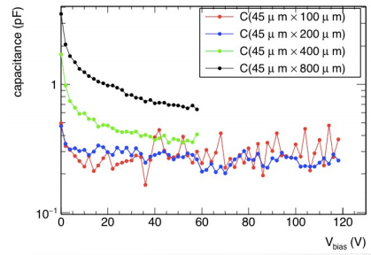
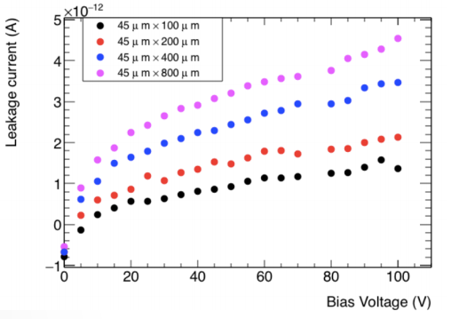
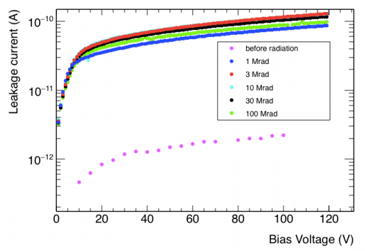
CHESS1 results
IV curve
CV curve
0.15nA/strip at 100V before IR
45X800μm pixels capacitance: 400fF at 100V
6.4nA/strip at 100V after IR
Working with bias voltage around 60V

Slide 7
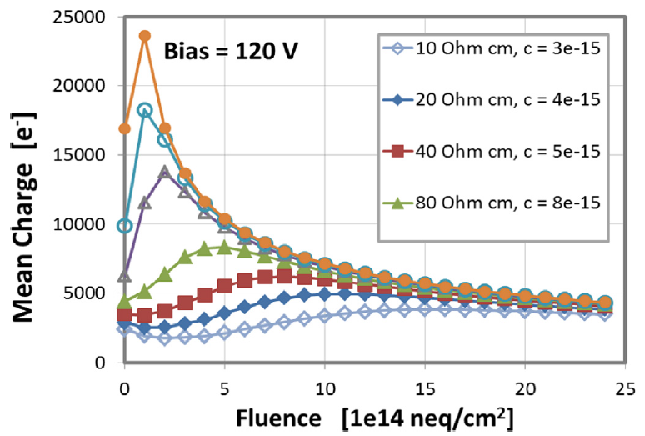
CHESS1 results
Charge collection study
Edge-TCT tests on the pixels near to the edge .(Laser wavelength 1064nm, spot size ~5μm)
Empirical calculations of collected charge as a function of fluence for different initial bulk resistivities.
Main conclusion:
continued to perform after being radiated
preferences for CHESS2 (size of collecting n-well, resistance…)
CHESS2 — the second demonstrators for HR/HV-CMOS for strip sensor.

Slide 8
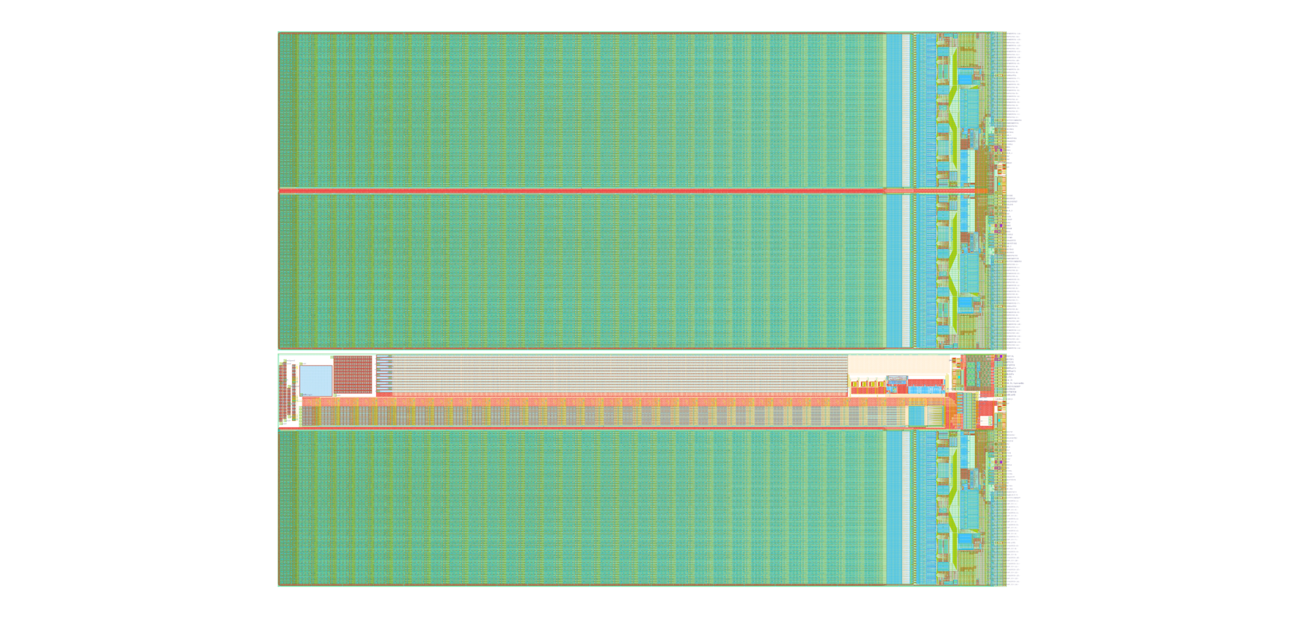
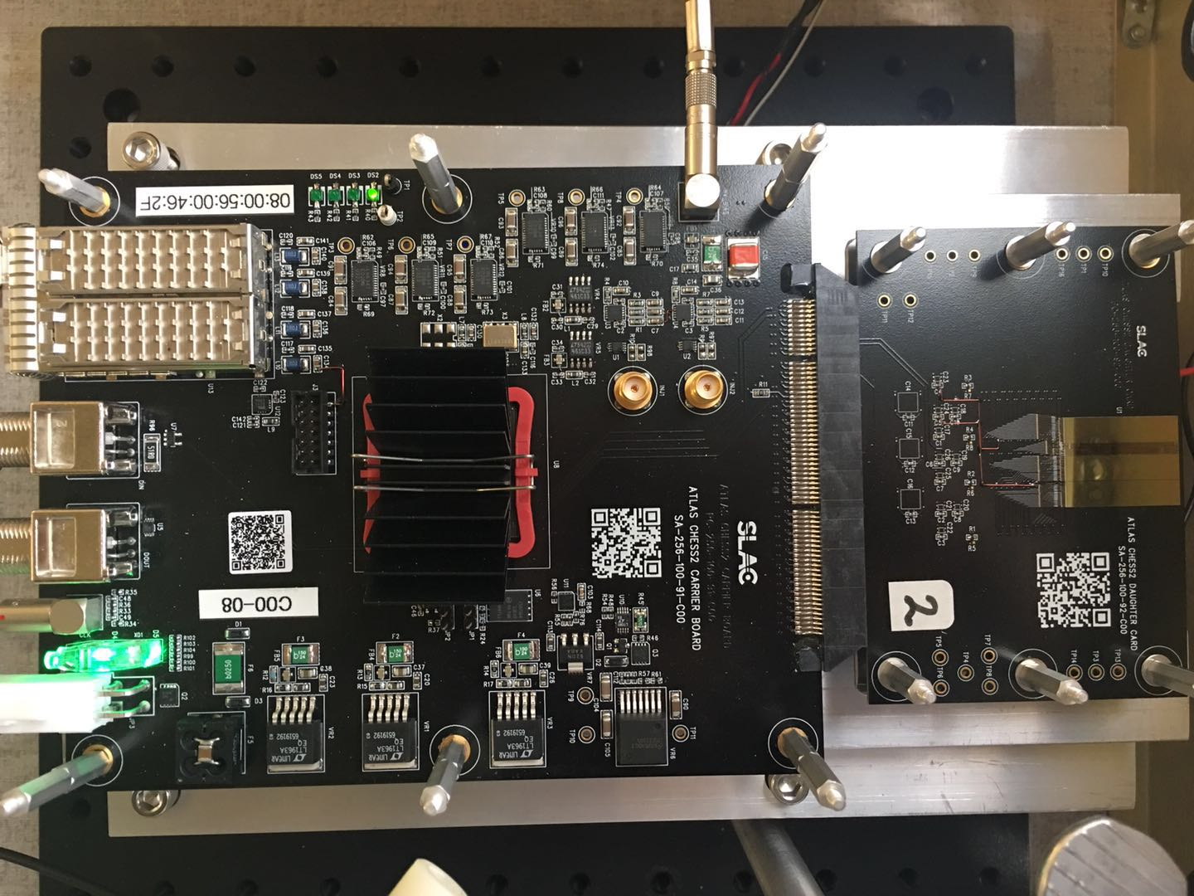
Brief Introduction
5.1mm x 20.1mm
CHESS-2
2nd generation of CMOS HV/HR Evaluation for Strip Sensors
Verify the feasibility of using HV/HR-CMOS MAPS as alternative sensors for the ATLAS Phase-II strip tracker upgrade
3 array of 128*32 short strips (n-in-p)with full digital encoding and readout chain
Varies substrate resistivity chips for testing. (20-2000Ohm/cm).
Bias voltage
Ethlink
LEMO Trigger
Charge Injection
LV power supply
Layout of CHESS2 chip Size:2.4cm x 2cm

Slide 9
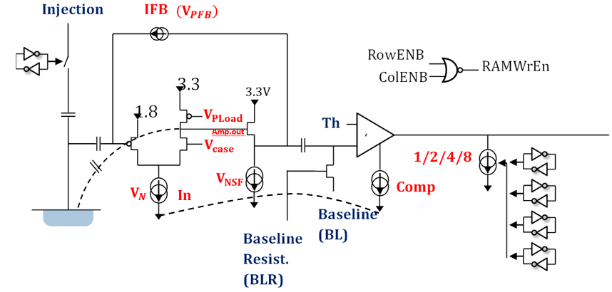
In-Pixel electronics
Charge Injection circuit (connect in parallel with the sensor)
Charge sensitive amplifier
Threshold trimming
Digital part
the configuration of all the registers and memories of CHESS2 is done through SACI interface.
Filter, Comparator
(Threshold common to all the pixels)

Slide 10
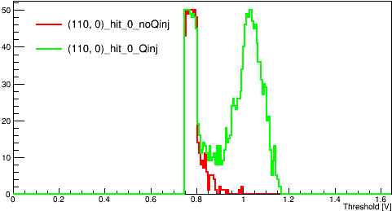
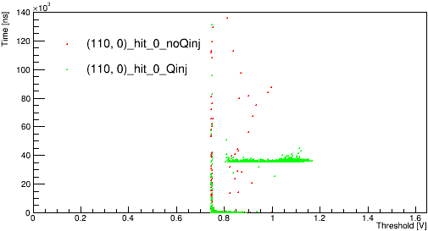
Charge Injection
Counts
the performance of the in-pixel ASIC
-> use Charge Injection circuit
Compare the results: with/without Charge Injection
E.g. (one typical result)
BL=0.75V
Threshold sweeping
Threshold vs Time, projection on Threshold/Time.
Threshold sweeping with varies BL to find proper working parameter
counts vs Threshold
Time vs threshold
E.g.
Green:
Signal: triggered by square pulse with 35μs delay
Red:
Noise
Problem to be understand:
Valley structure
35μs

Slide 11
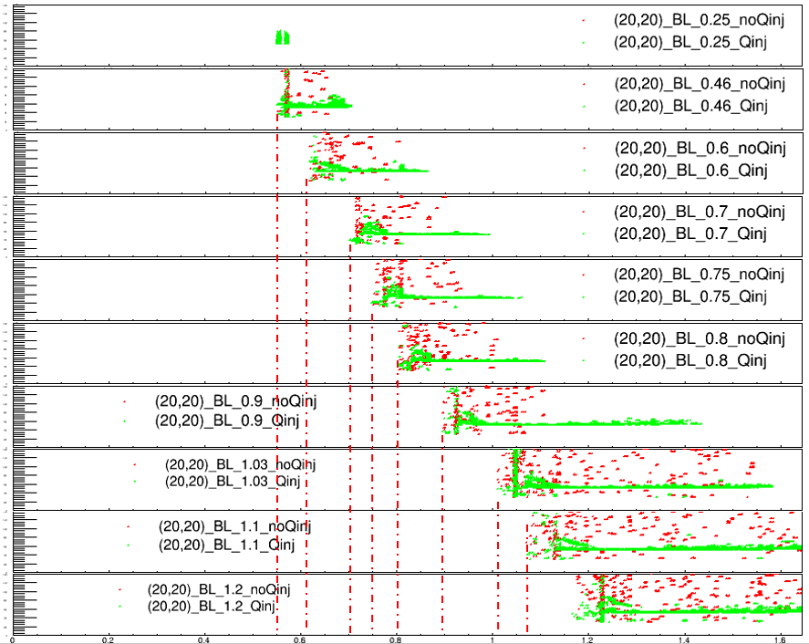
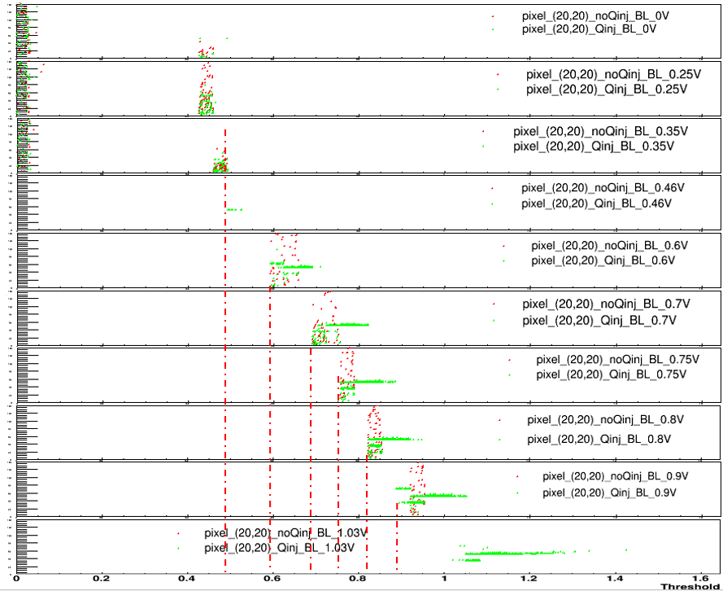
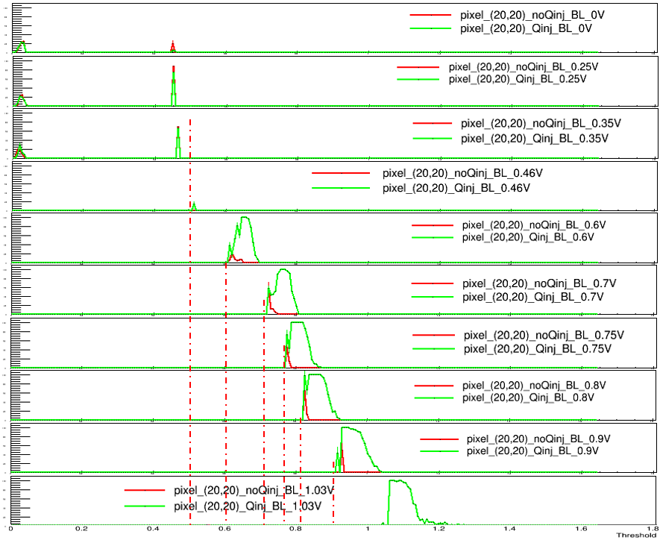
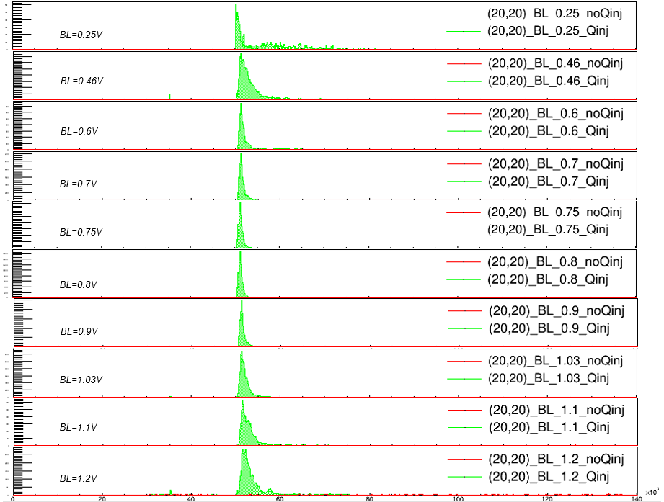
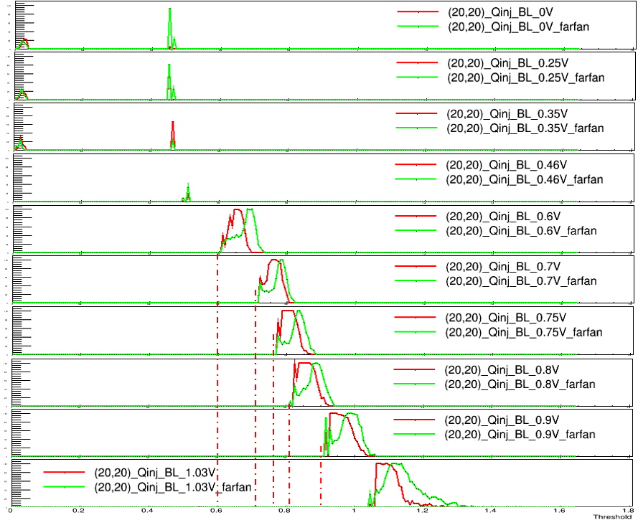
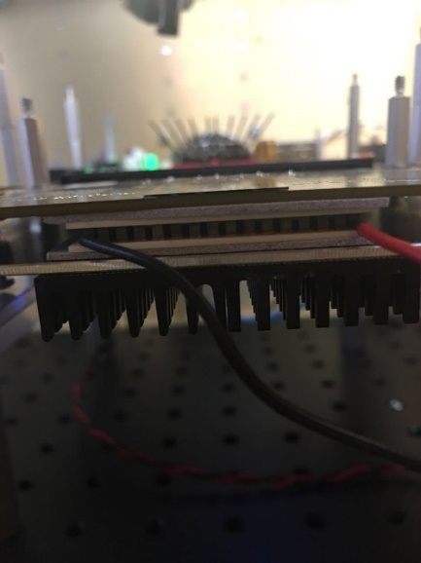
Test with Charge Injection
High resistivity chip: 2000 Ohm/cm #19
Default conf
Matrix2
Time[ns]/efficiency
Tests: threshold scan with fixed BL.
varies BL :
  0 V
  0.25V ...
Observation:
Working for the first time
Sensitive to the temperature
BL and Threshold are controllable and have good linearity in range [0.6-0.9V].(repeatable result)
Correct Qinj time reported
Using external signal
Threshold [v]

Slide 12
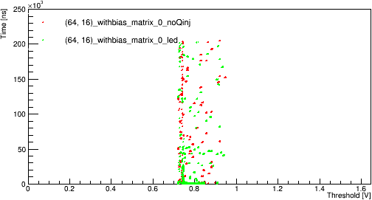
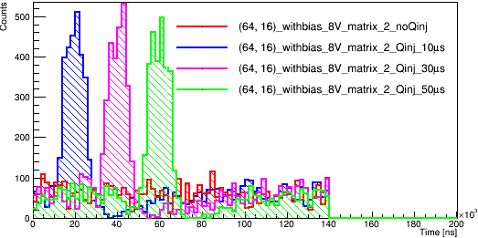
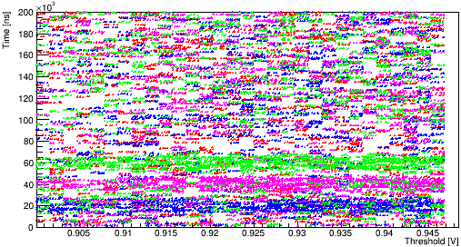
Test with LED
High resistivity chip: 2000 Ohm/cm #19
Default conf
Matrix0
Threshold vs time
Time vs counts
Using a regular LED
LED fixed ~1cm above the chip.
LED: triggered by the Qinj pulse.
noLED vs LED
Compare results with different delay time: 10μs, 30μs, 50μs
-> interval time: 20μs
reason for the delayed signal: time needed for LED to be active
Conclusion:
First time using and observing external signal source
Almost Correct time information reported
using more intensive external source: Laser(red and IR laser)
Preparations : Biasing the sensor, Mechanical setup upgrade

Slide 13
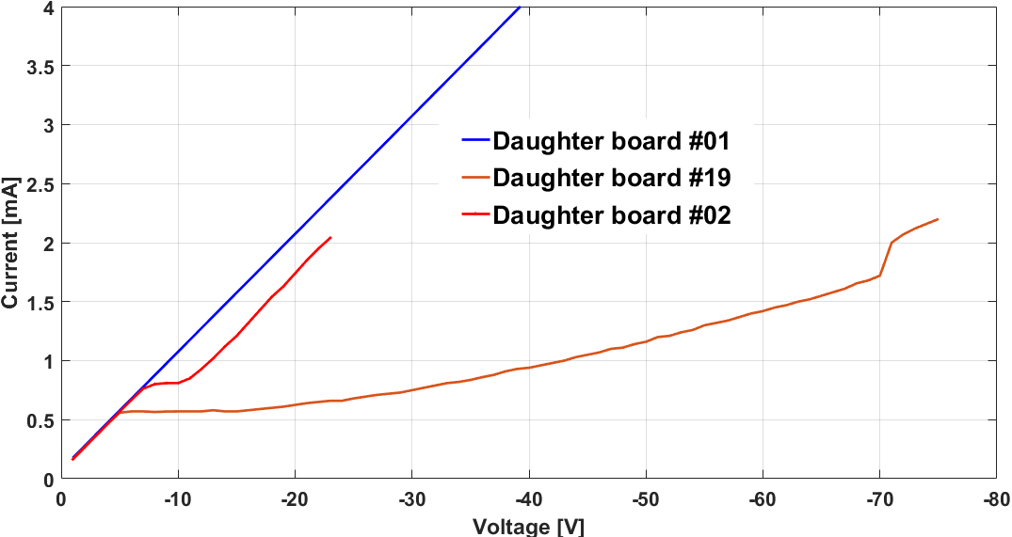
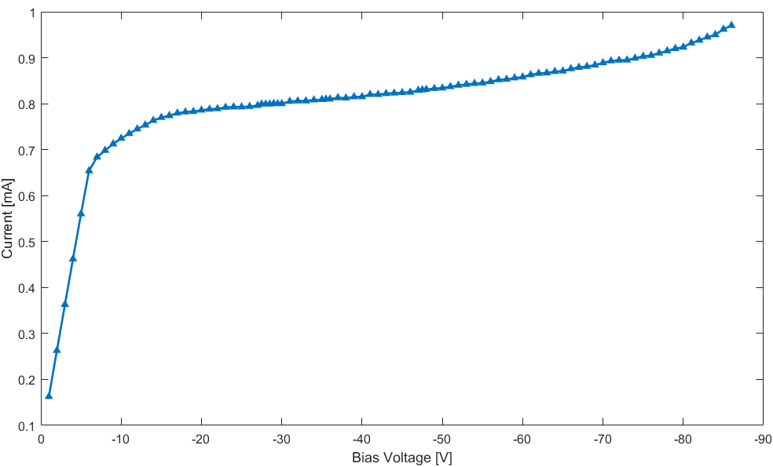
Bias the sensor
IV-Curve of 3 boards:
Std Resistance board: 20Ohm/cm #01, #02
High Resistance board: 2000Ohm/cm #19
#19:
->stop linearly increasing at -5V and keep ~0.57mA till -15V.
->gradually increased to 2mA (the upper limit)
#02: have a flat region at voltage -8V~-9V
#01: keep increasing
Reload a new chip on daughter board #01
Resistance 200Ohm/cm
Wire bonded at UCSC
#01: “healthy ” shape but still have large leakage current
Could be biased with voltage: ~-50V
IV Curve of new Board #01

Slide 14
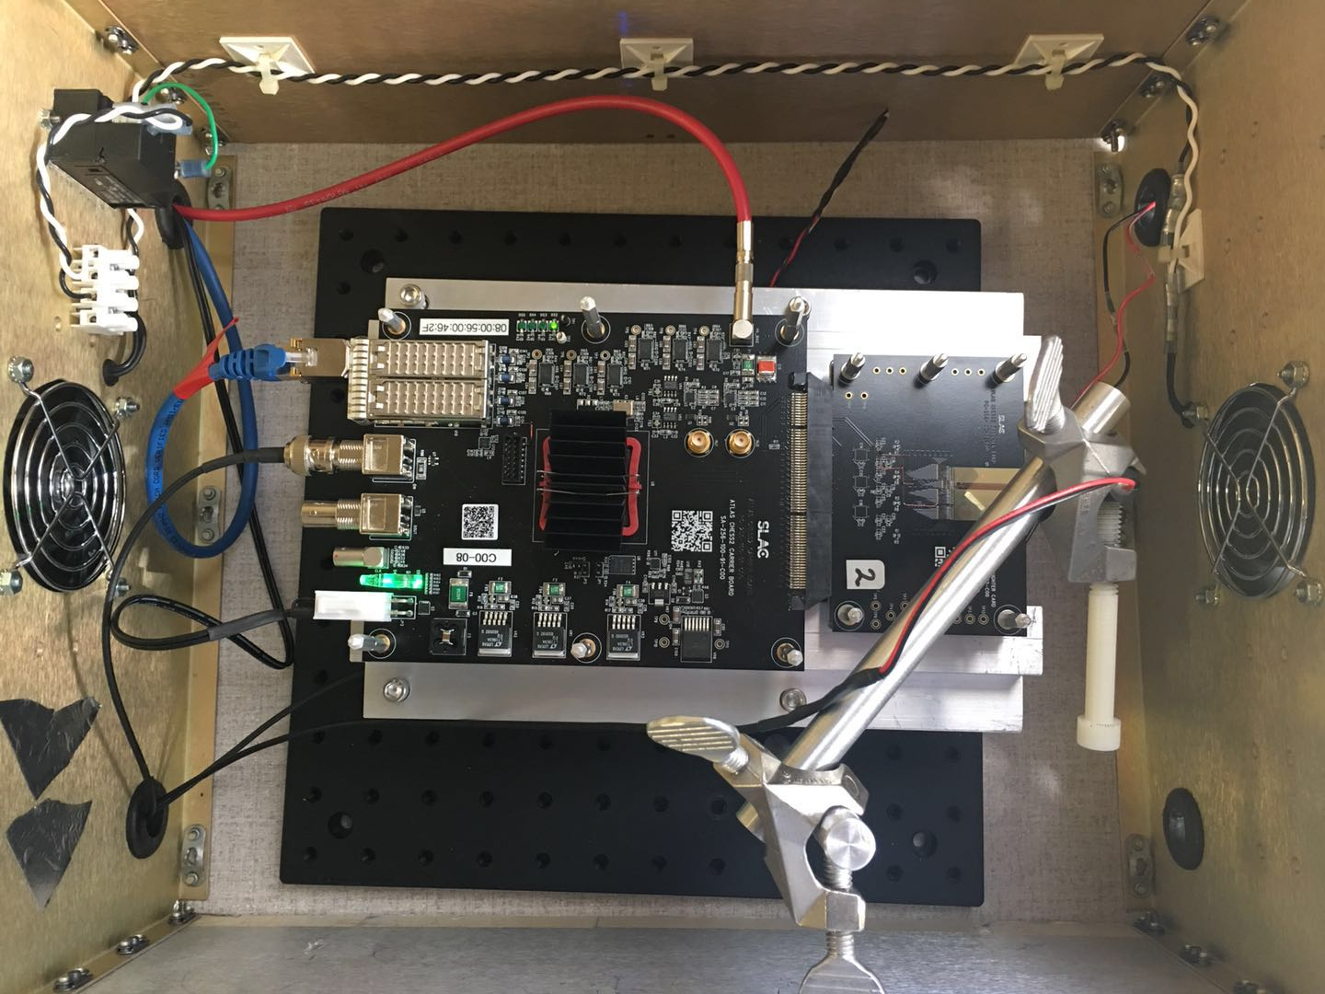
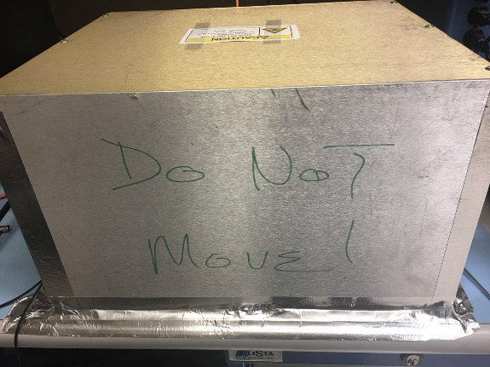
Test with Laser: Mechanical upgrade
Mechanical setup upgraded:
Mechanical setup:
Dark box: with a laser label providing dark environment.
Fan on two sides.
Metal structure base to raise and fix the board near to inlet of the fan.
Metal arm holding the laser.
Working …

Slide 15
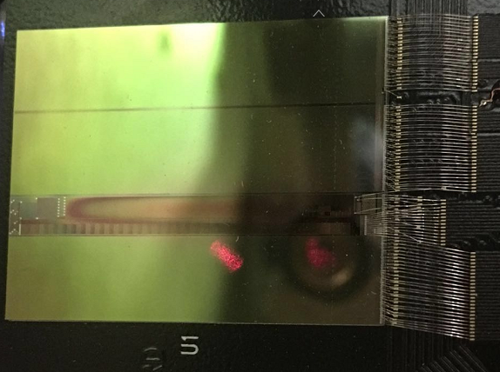
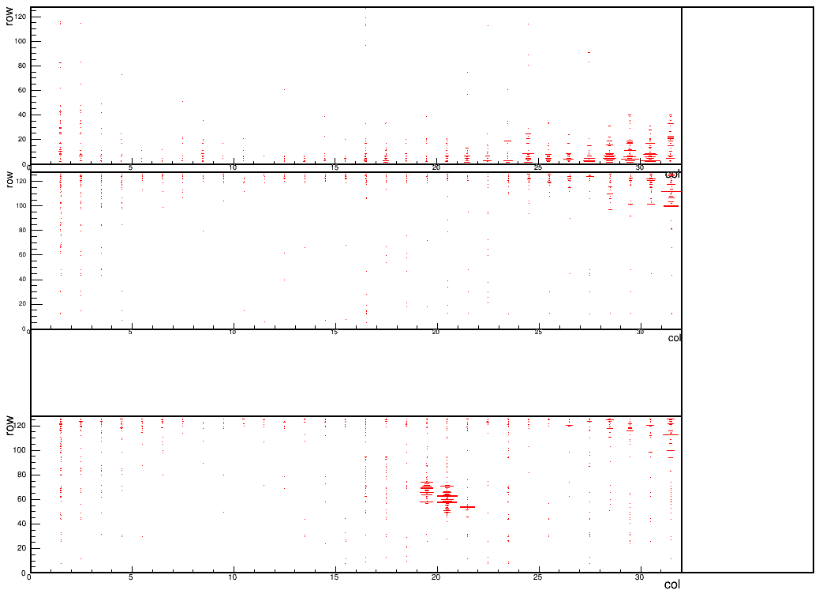
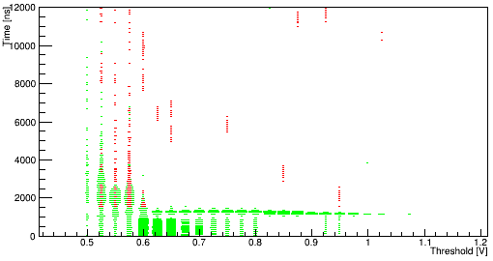
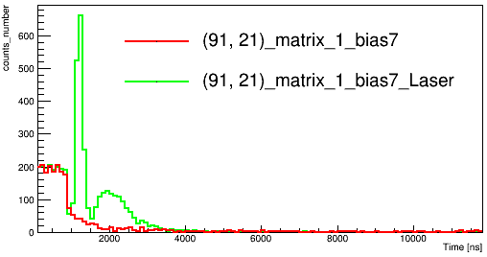
Response to Laser
High resistivity chip: 2000 Ohm/cm #19
Default conf
Just to show how the laser looks like.
Testing parameters:
BL=0.6, Threshold=0.7V
Observation:
Hitmap: the laser’s location and shape
Threshold sweeping: signal & slow hits at lower Threshold
Conclusion:
Successfully see the Laser(shape and location)
other phenomenon to be understand
Result from one of the targeted pixels:
Speed up the test by changing to stream readout.

Slide 16
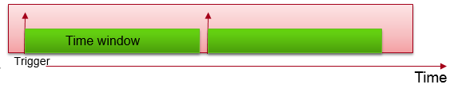
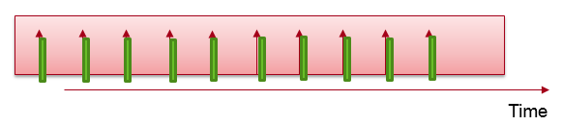
Reading register vs Stream readout
To speed up the tests-> move to stream readout.
Previous way to read the data: Directly reading from the register
Correctly configure the board -> Give the board a Trig signal-> Start waiting and checking the DataValid Flag in certain time window(200μs)
[if True: read and return the information directly from the register. Could give the information of 24hits(90 bytes) at most] -> Next Trigger
Stream readout : read a frame of data at with given runrate.
Correctly configure the board -> Give the board a Trig signal -> always latching the data and will send the adjustable(up to 256 bytes) size of data (certain time window like 6.5μs for 256 bytes) -> Next Trigger
Upgrades and improvements:
Firmware and software have been upgraded for the stream readout
Setting the proper run parameters (delay [time alignment], threshold, the frame size ) is very import in stream readout
Real-time results display/Online monitors have been developed for both two ways
At least 100 times faster

Slide 17
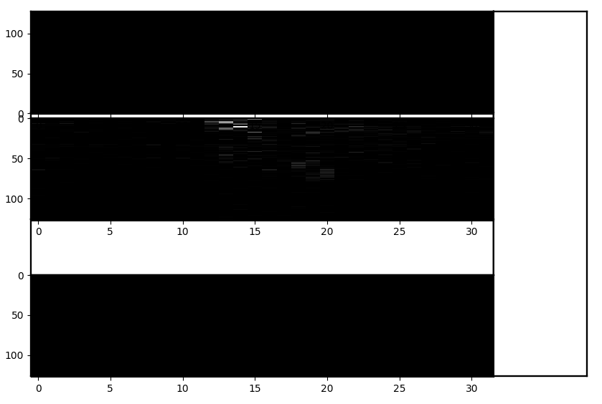
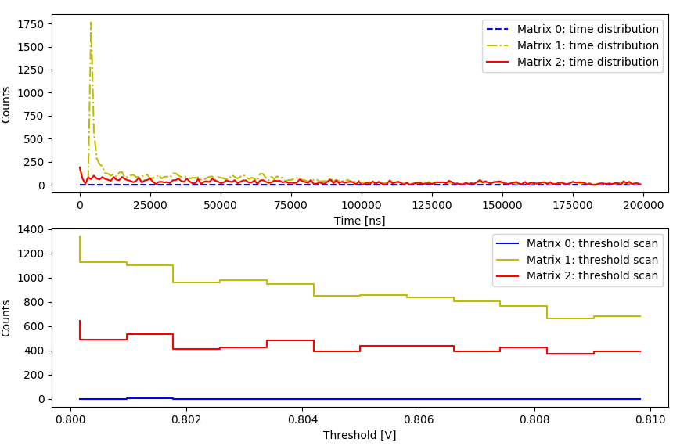
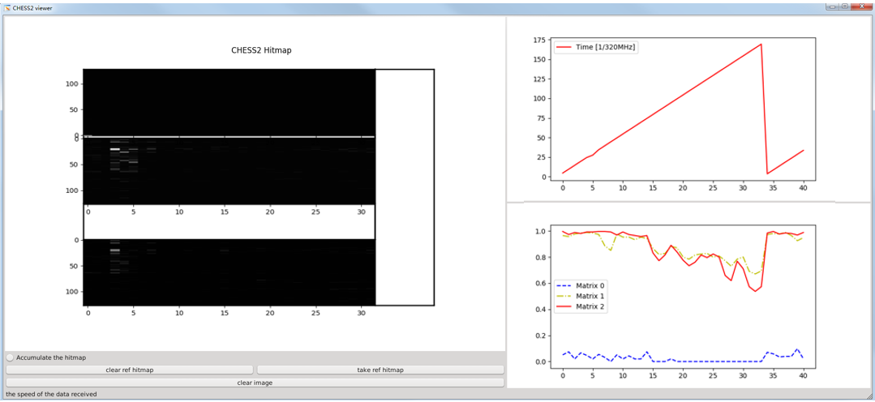
Real time monitoring
For register reading: real time updating figures
Hitmap, time distribution, efficiency vs threshold
For stream readout: an Online viewer (GUI)
Online viewer: a real time data decoding and display GUI
Hitmap, timestamp, efficiency display
Several functions
Shortcomings: could run stable at lower runrate like 5Hz
GUI needs to be optimized for running with higher frequency and more statistic

Slide 18
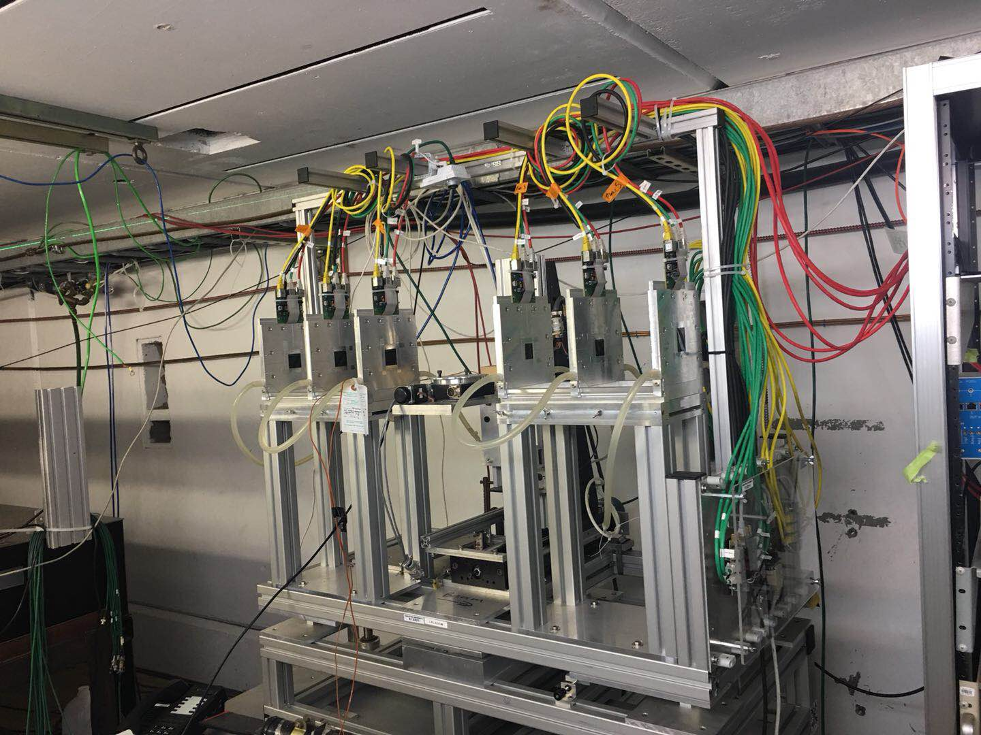
Summary and Next
Main conclusion:
Signal could be observed using Qinj, LED, LASER
Repeatable and stable results could be get with cooling module added
The 200Ohm/cm could be biased but have large leakage current
Large noise observed
The chip is working
Questions :
Why large leakage current?
Optimal working parameters (Threshold, time window)
……
Next:
Test with Cadmium source (20keV X ray)
Test using SLAC electron beam
SLAC caladium telescope

Slide 19
Thanks for your attention!

Slide 20
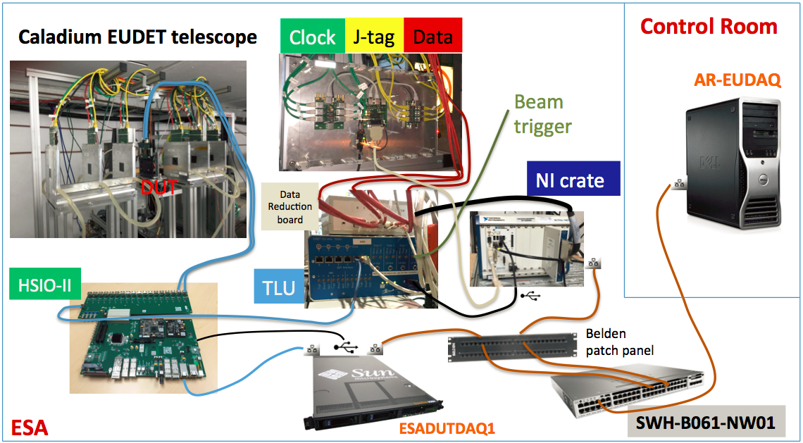
Backup

Slide 21
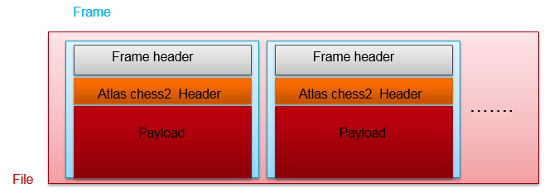
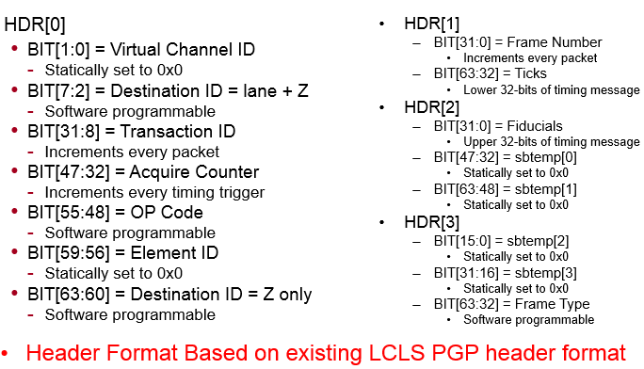
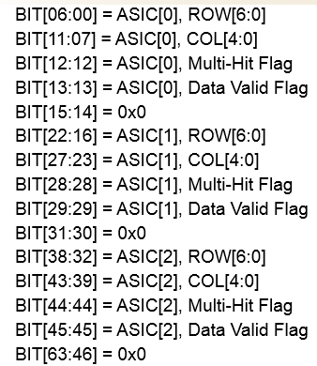
Backup
Structure of the data:
Fixed size of Frame Header: 64 bits
ATLAS Chess2 Header: 32*8 bits
Payload size: variable and accessible(first 32 bits of the Frame Header)

Slide 22
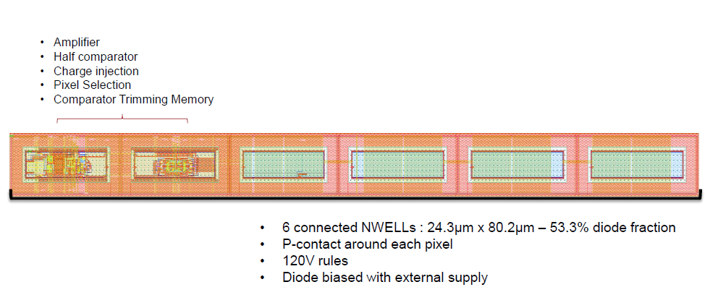
Backup

