Slide 1
The new silicon microstrips tracker for the Phase-II ATLAS detector
Zhijun Liang (梁志均)
IHEP, CAS (中国科学院高能物理研究所)
On behalf of the IHEP/THU ATLAS ITk Group

Slide 2
Outline
Overview of ATLAS inner tracker phase 2 upgrade project
Status of IHEP/THU ATLAS ITk Group
  Highlight of Recent progress
  Module production status and plan

Slide 3
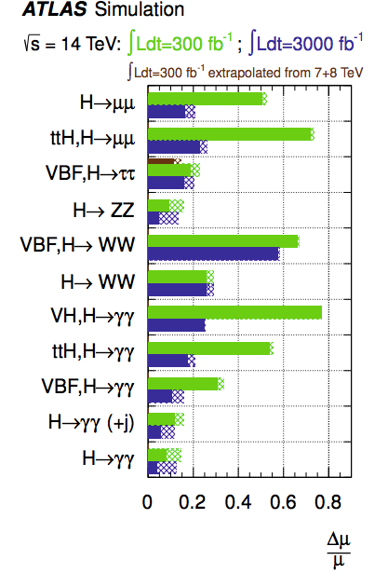
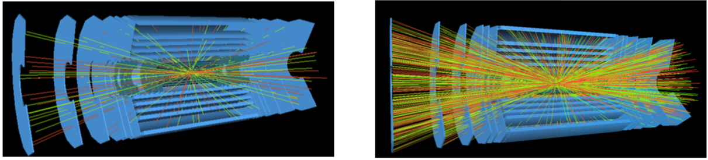
Introduction to LHC phase II upgrade
High Luminosity-LHC (HL-LHC) is foreseen to be completed in 2026
  will substantially improved Higgs measurement precision (eg: H->μμ)
  Aim to increase the integrated luminosity to about ten times the LHC design.
  Instant luminosity ∼ 5 − 7.5 × 10³⁴ cm⁻²s⁻¹ , deliver 3000 fb⁻¹
  Expect to have 200 collision per bunch crossing
Current LHC
High luminosity LHC

Slide 4
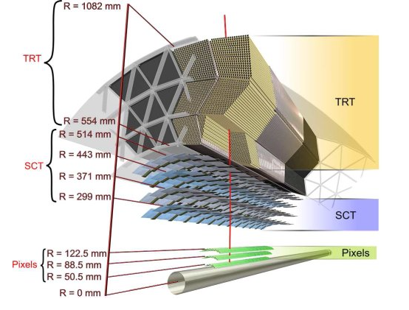
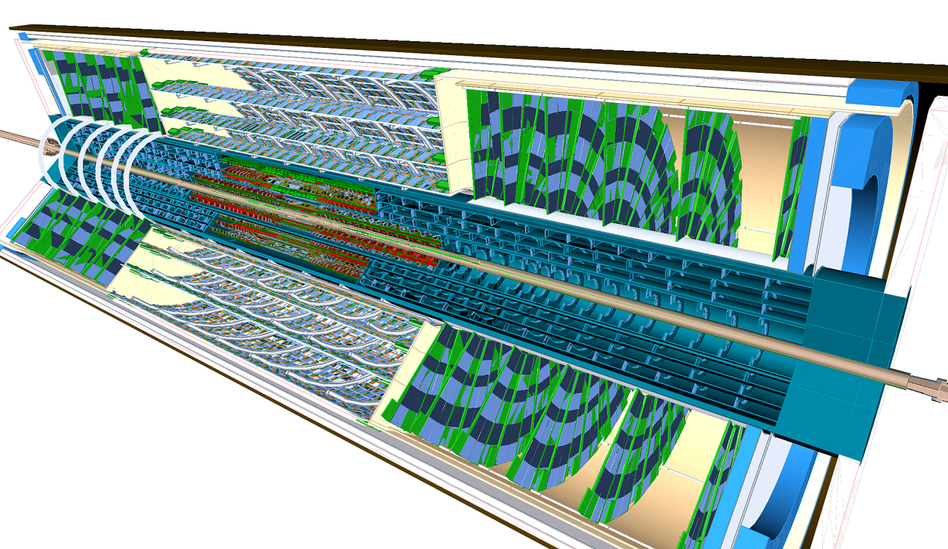
ATLAS Inner TracKer ( ITK) upgrade
Require a new full-silicon tracker for upgrade (more area/channels)
Current tracker
New ITK tracker
IHEP will contribute 1000 modules (10 m² silicon)
In the ITK strip tracker upgrade
Strip detector comparisons | Current Inner strip tracker (SCT) | Future ITK strip tracker
Radial distance | 300-560mm | 400-1000mm
Channels | ~8 millions | ~100 millions
Modules | 4 thousands | ~20 thousands (165m² silicon)

Slide 5
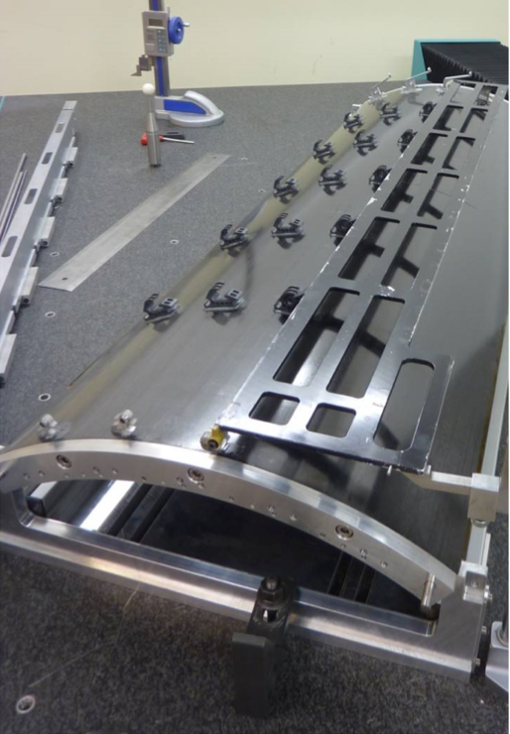
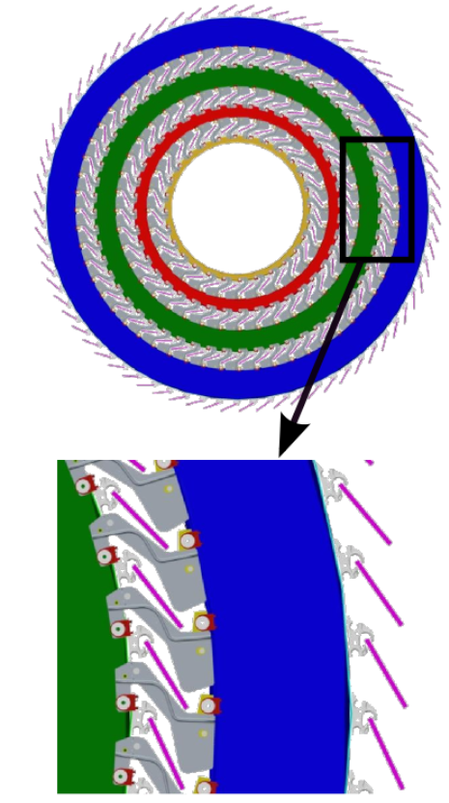
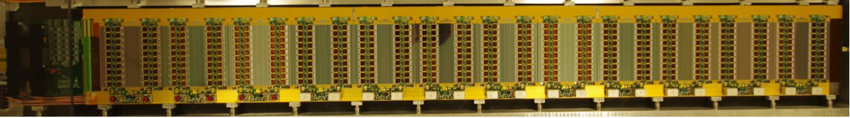
Structure of the silicon strip tracker
Global structure: 4 layers of silicon strip tracker in Barrel
Local structure (Stave)： 28 barrel modules on each stave
Barrel Global structure
Local strcture: Stave
= 28 modules
+ electronic (bus tape)
+ thermal (cooling pipe)
+mechanics (carbon fibre )
Stave prototype

Slide 6
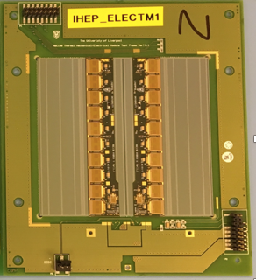
Module: the basic detector unit
  10 readout ASIC (ABC130) wire-bonded on one hybrid
  Two Hybrids are glued on short strip sensor, and wire bonded to sensor to readout 2560 channels each
One Module prototype by IHEP
Readout ASICs
Wire bond
Silicon Sensor
Hybrid

Slide 7

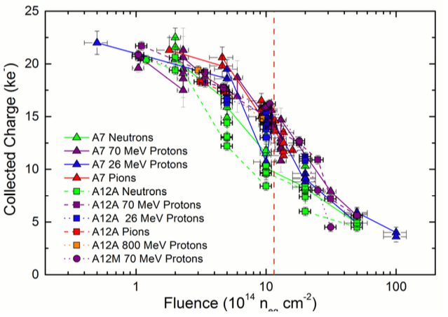
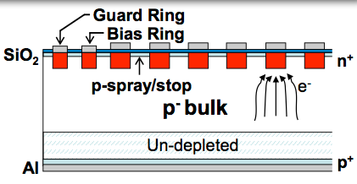
Radiation hard strip Sensor
  N+-on-p strip sensor (9.7 cm² X 9.7 cm² )
  Collect electrons (fast carriers, reduce charge trapping)
  >22k （10k） electrons for MIP before (after) irradiation
  Market survey for two company (Infineon and hamamatsu)
    Infineon gave up the project recently
    final sensor is likely to order from hamamatsu.
    Final round of prototyping this year, IHEP contribute to testing and qualifying sensors.

Slide 8
Overview of ATLAS inner tracker phase 2 upgrade project
Status of IHEP/THU ATLAS ITk Group
  Highlight of Recent progress
  Module production status and plan

Slide 9

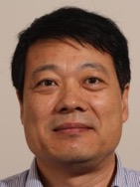


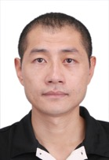



The IHEP/THU ATLAS ITk team
8 Staff Members (7 IHEP + 1 THU)
Xinchou Lou
Joao da Costa
Hongbo Zhu
Weiguo Lu
Xin Shi
Zhijun Liang
Yiming Li
Xin Chen

Slide 10
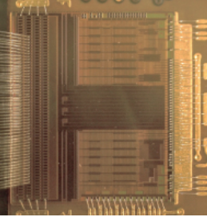
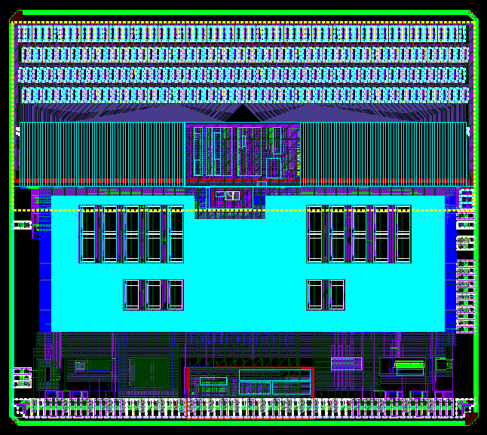

Frontend ASIC: ABCStar chip
IHEP/THU contributed to ASIC digital design
ABCStart readout chip
  Standard binary readout architecture
  Radiation hard design
  IBM/GF 130nm technology
IHEP/THU Contribute to design and verification
IHEP/THU Contribute to verification

Slide 11
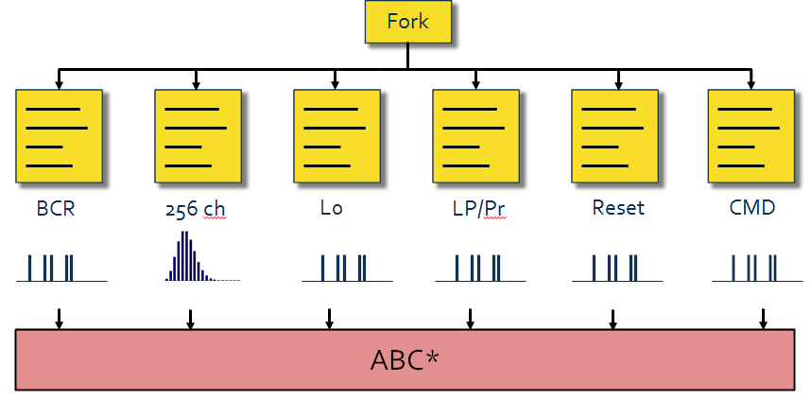
Frontend ASIC: Functional Verification
IHEP/THU contributed to digital design and verification
A top verification setup based on (UVM) Universal Verification Methodology was built for ABCStar
  Functional coverage with customized random stimulus
  SystemVerilog assertions for validating key design features
UVM setup
From Weiguo Lu

Slide 12
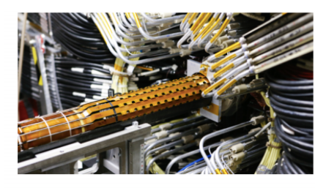
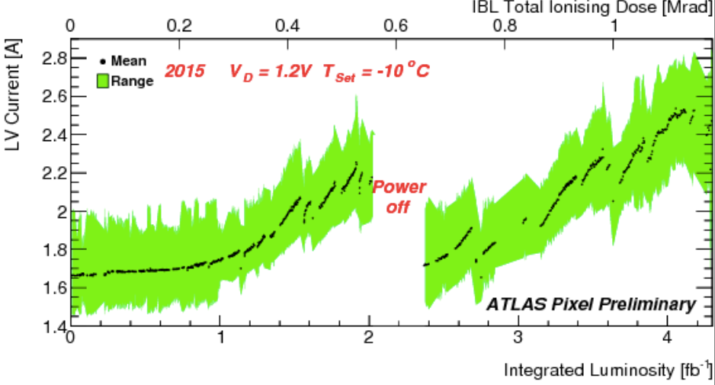
Progress: ASIC radiation hardness
Lesson from ATLAS Insertable B layer pixel （IBL) operation
  Digital current in FEI4 ASIC (IBM/GF 130nm CMOS) increase significantly

Slide 13
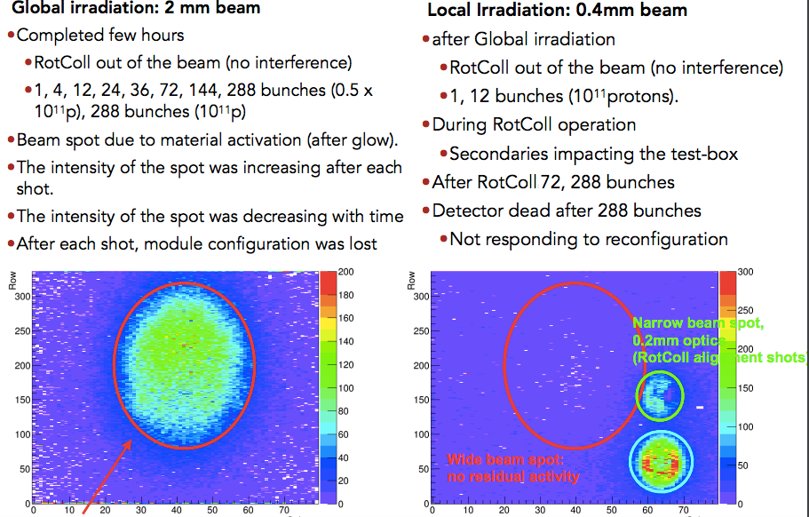
ITK project irradiation
IHEP/THU group coordinated the ITK irradiation at SPS (CERN）
  C. Bertella presented this study in HSTD2017 conference

Slide 14
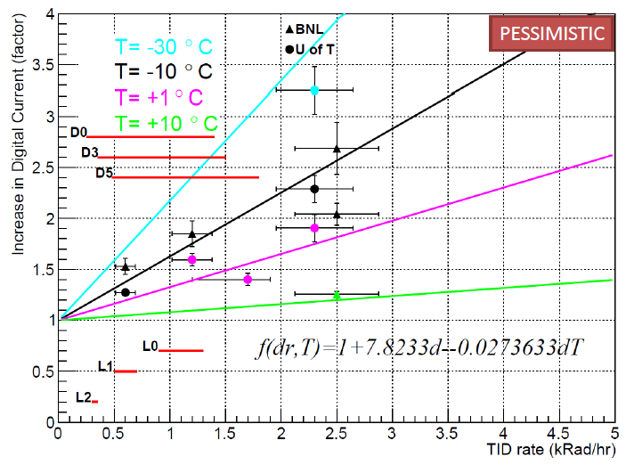
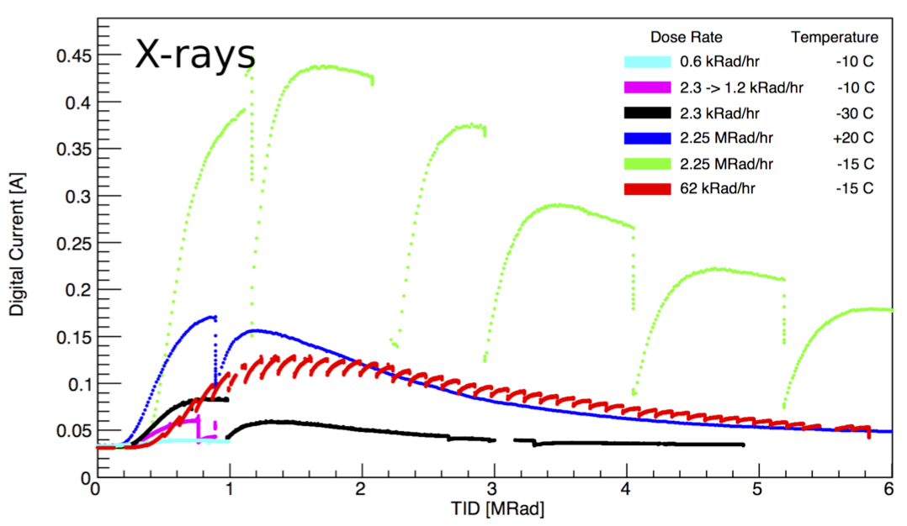
TID current bump in ASIC
ABC130 chip Digital current increase after irradiation
Low rate, low temperature irradiations of ABC130 have been done
Expected the digital current increase by 100% after irradiation.
Bump at 1Mrad

Slide 15
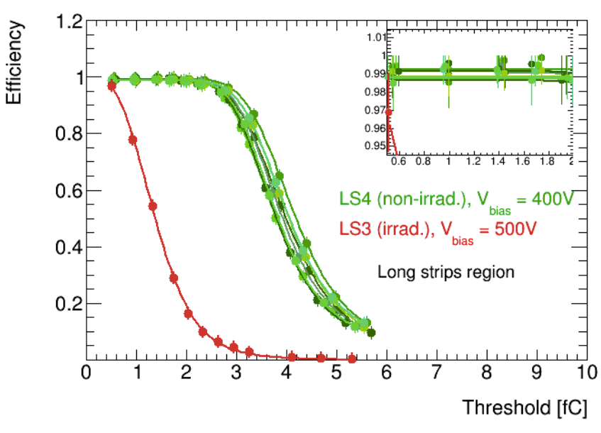
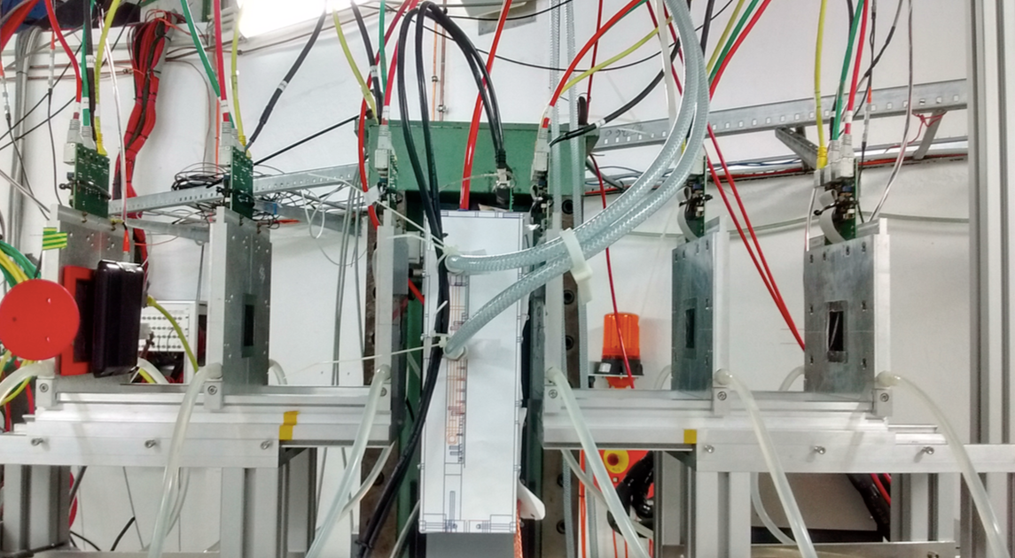
Module testbeam at DESY
We contribute to module testbeam at DESY
  Xiaocong Ai, Liejian Chen and Yi Liu
  EUDAQ telescope DAQ support , data analysis, data taking shifts
ATLAS R0 module and SS module test at E-lab in DESY May 2017
  S/N>20, detection efficiency > 99% after irradiation

Slide 16
Overview of ATLAS inner tracker phase 2 upgrade project
Status of IHEP/THU ATLAS ITk Group
  Highlight of Recent progress
  Module production status and plan

Slide 17
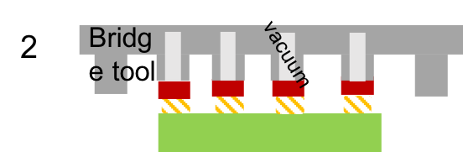
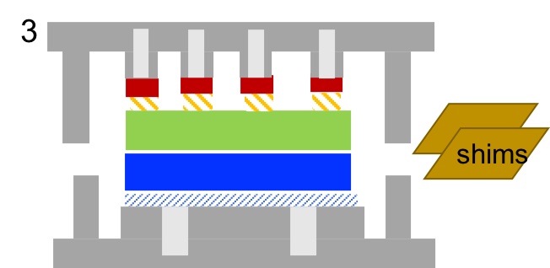
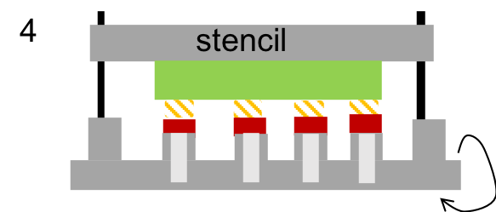
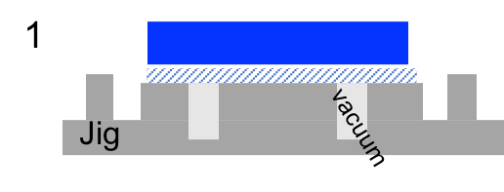
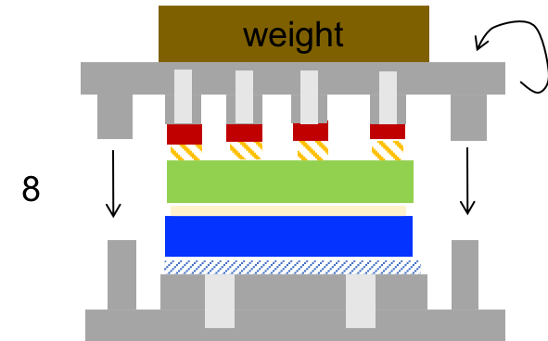
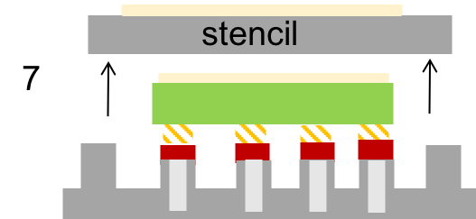
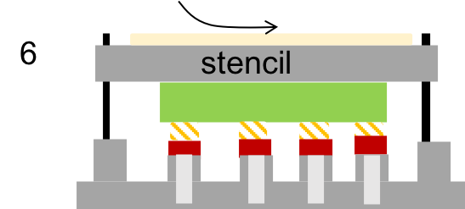
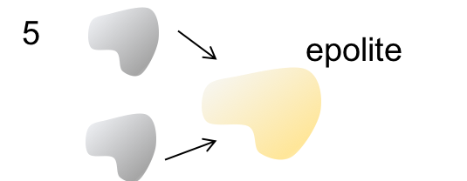
Module production workflow
sensor
hybrid
sensors, ASICs, hybrid PCB,...
receiving components
Assembled modules
packaging and shipping
ASIC to sensor gluing,
ASIC to sensor bonding,
electrical tests
hybrid assembly
hybrid to sensor gluing, sensor bonding, electrical tests
module assembly

Slide 18
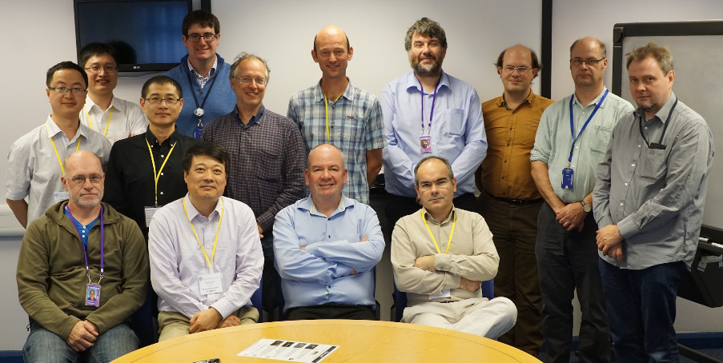
Collaboration with RAL in module R & D
RAL in UK is the leading institution on ATLAS ITk upgrade.
MoU to be signed with RAL (500 modules at RAL , 500 modules at IHEP)
Staff rotation plan to maintain 2 FTE’s at RAL for the coming years.
Invited RAL collaborators to China.
  Giulio Villani visited IHEP in Dec 2017
  Craig Sawyer visited IHEP in Jan 2018
IHEP Team visited RAL on September 19, 2016

Slide 19
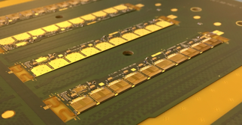
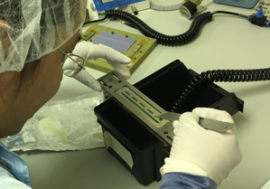
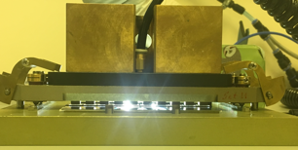
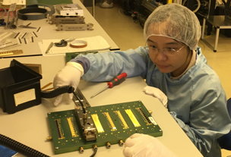
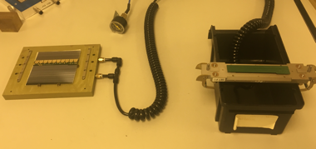
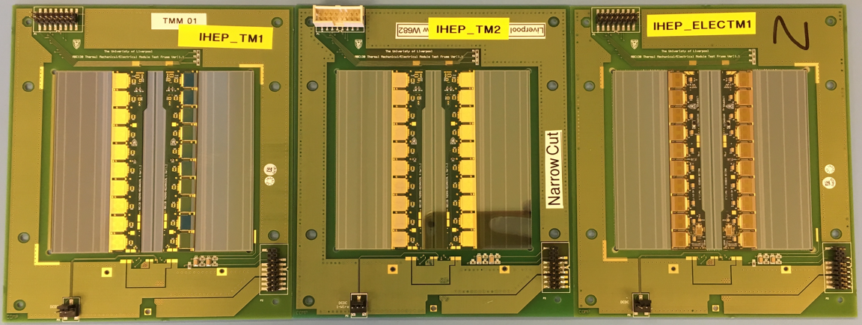
Module production at RAL
Glued three modules (two thermal mechanical and one electrical)
Passed electrical test after wire bonding.

Slide 20
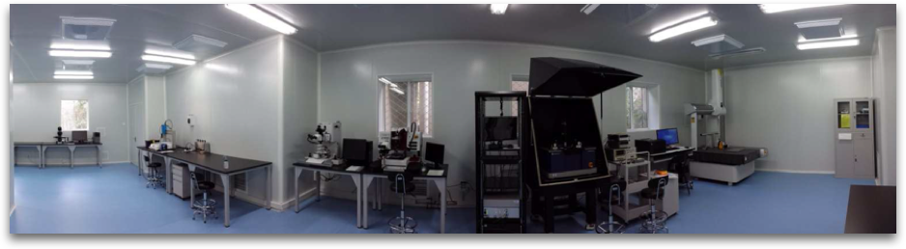
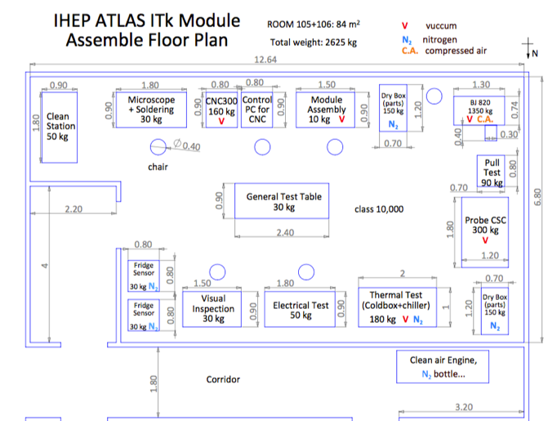
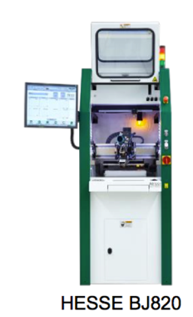
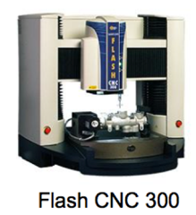
IHEP Lab for module production
An existing class 1000 Cleanroom with 150m²
An new class 10000 cleanroom with 80m² is on the way
OGP Flash CNC 300
Smart scope
Visual inspections
Hesse BondJet820
Fast auto wire bonder
OGP Flash CNC 300 smart scope
Hesse BondJet820 received

Slide 21
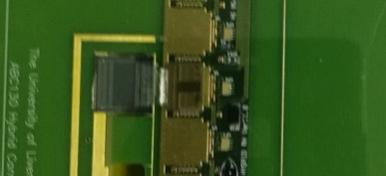
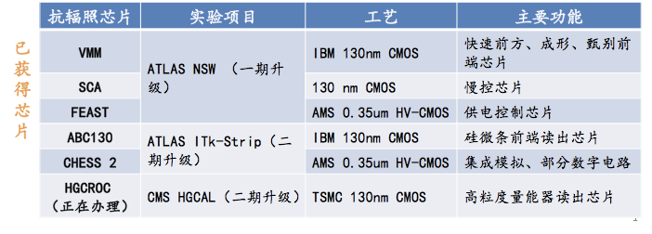
Local production: Radiation-hard ASICs Import issue
Rad-hard ASICs under export control → obstacle
Main driving factors:
  China’s deeper involvements in operation, upgrade and analyses
Discussion with ATLAS and CERN
  obtained export license from US DoC
  Overall package (valid for ATLAS/CMS projects), valid for seven years
  Obtained SECO for ABC130 (Swiss export license)
ABC130
Received the first ABC130 (strip readout ASIC) which allows setting up the local module test system
Milestone of the project

Slide 22

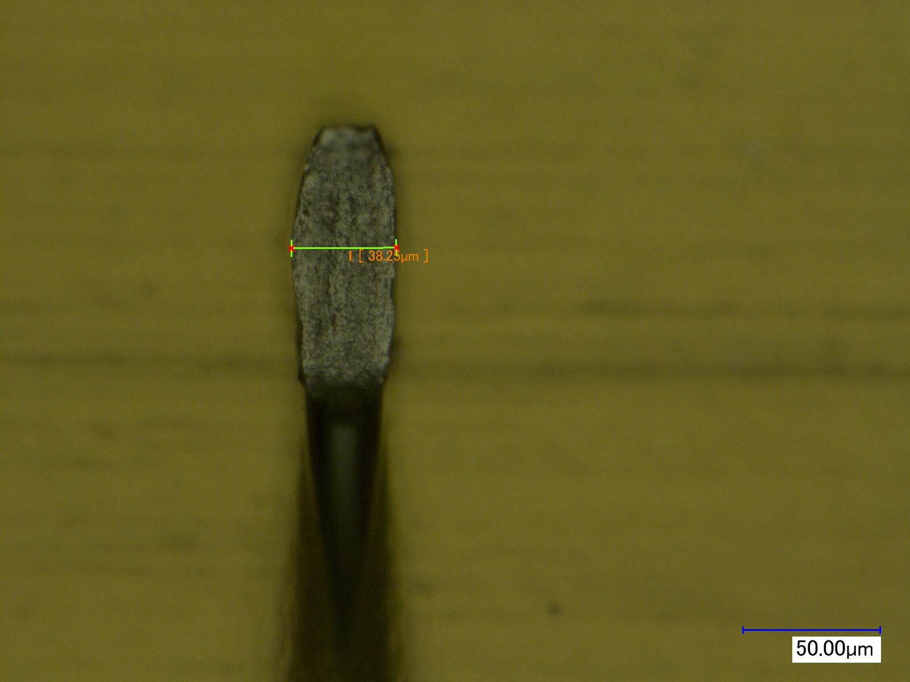
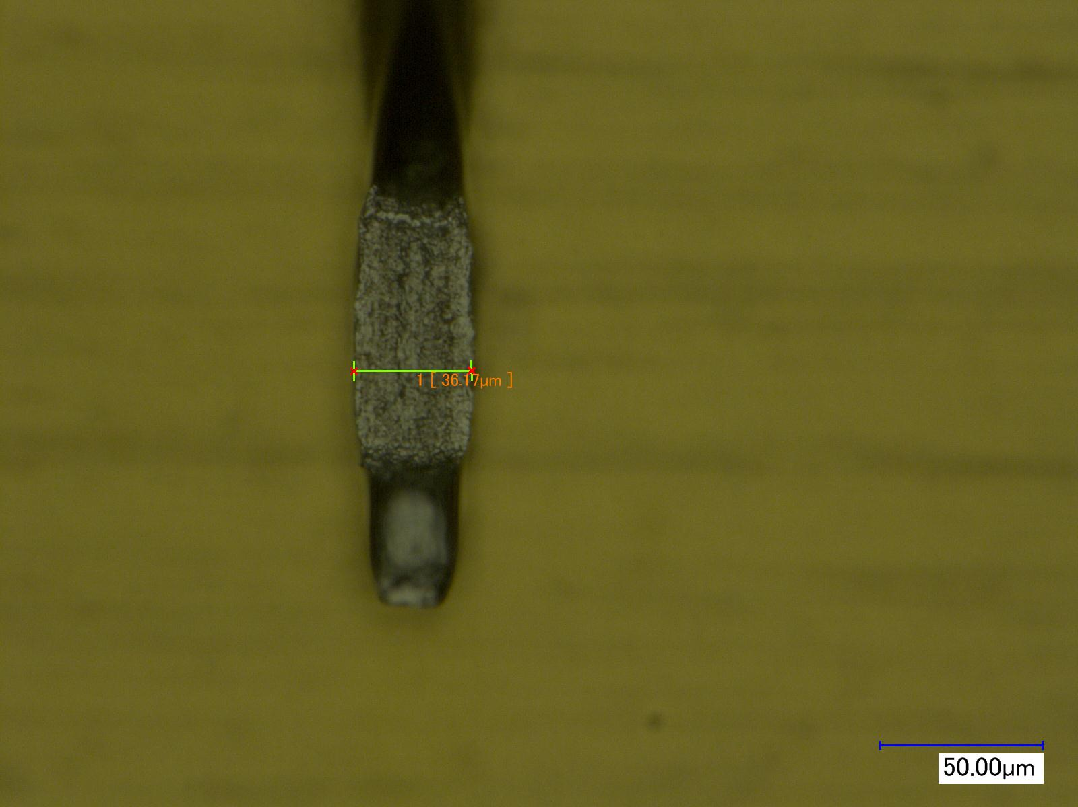
Wire bonding study for module production
Wire bonding is one of key issue for module production
  key parameter study: deformation, ultrasonic and force
How to evaluate the quality ?
  pull test： important step in QA/QC
effects by Bond Force & Ultrasonic
1st Bond
2nd Bond
pull force
Bond Force=25cN
Ultrasonic=25%
Deformation=35%

Slide 23
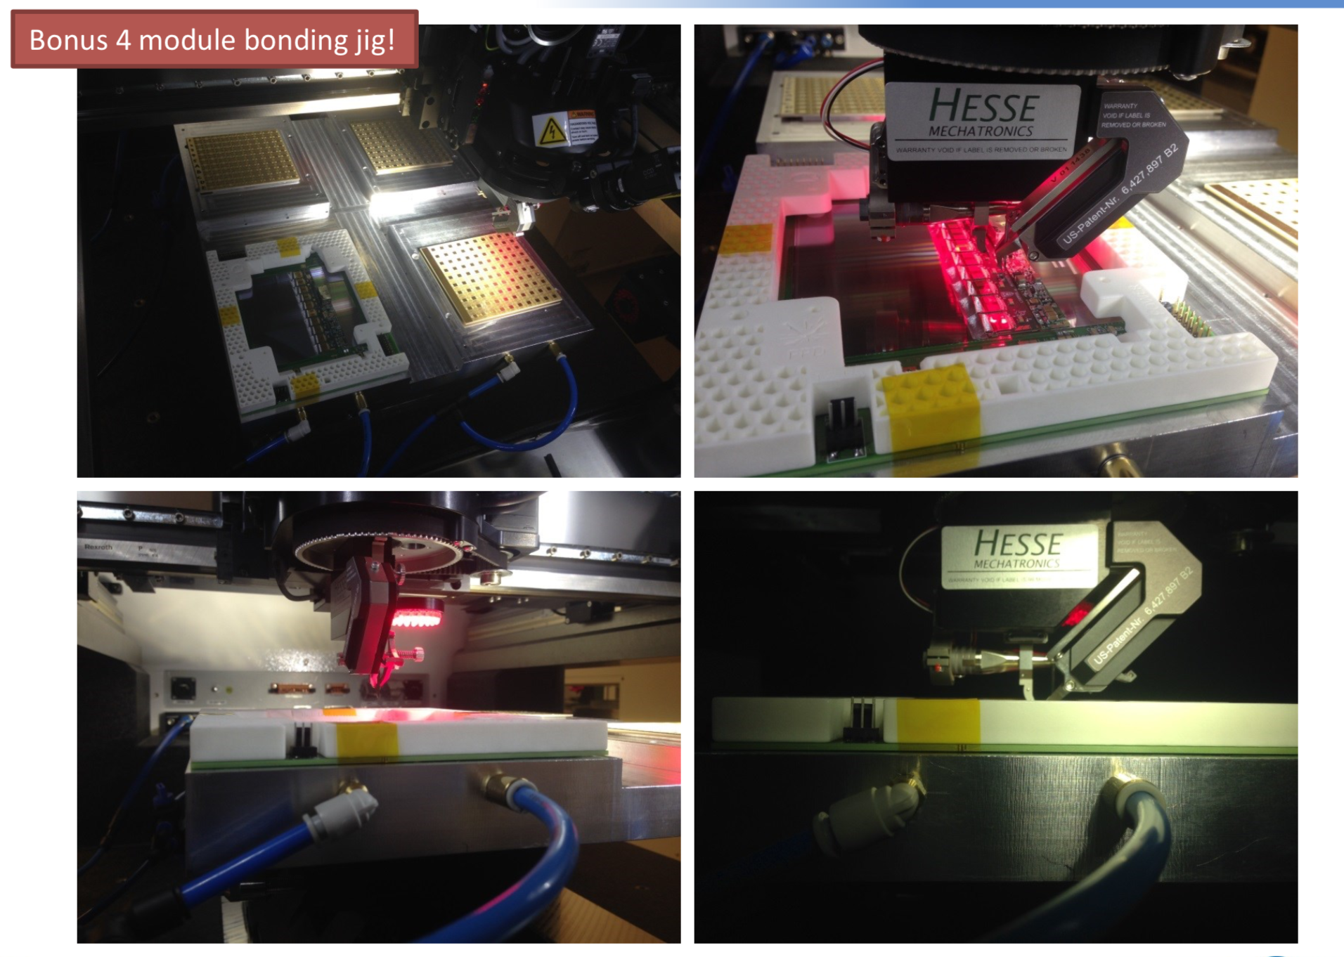
New Module production tool by IHEP: 2X2 jig
IHEP developed new tool to improve the module production efficiency
  One module each time -> 4 module each time (by Yuzhen)
Notes:
each

Slide 24
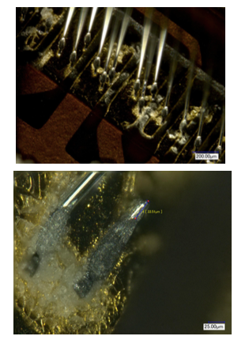
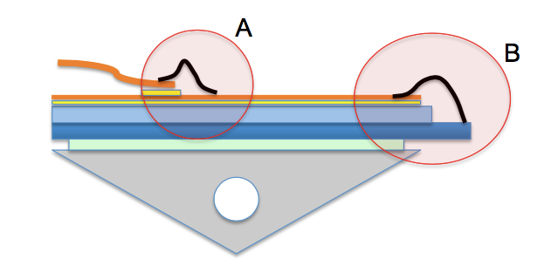
Issue in production: wire bond corrosion
Lesson from IBL pixel detector:
  Al wire Bond Corrosion due to humidity
  White remnants which are likely Al(OH)3
  Humidity control became most important step in quality control
    Humidity at <5%
  White remnants which are likely Al(OH)3

Slide 25
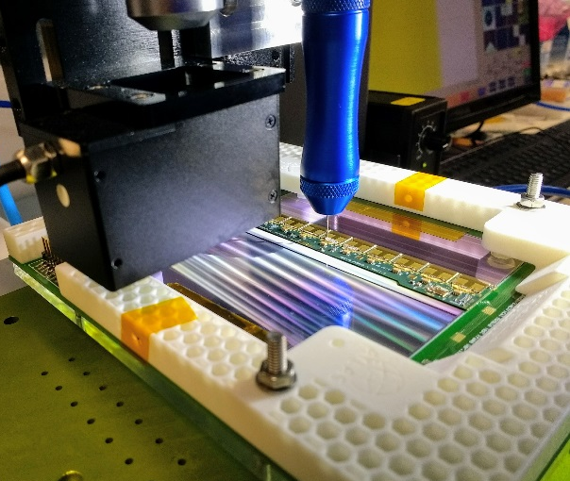
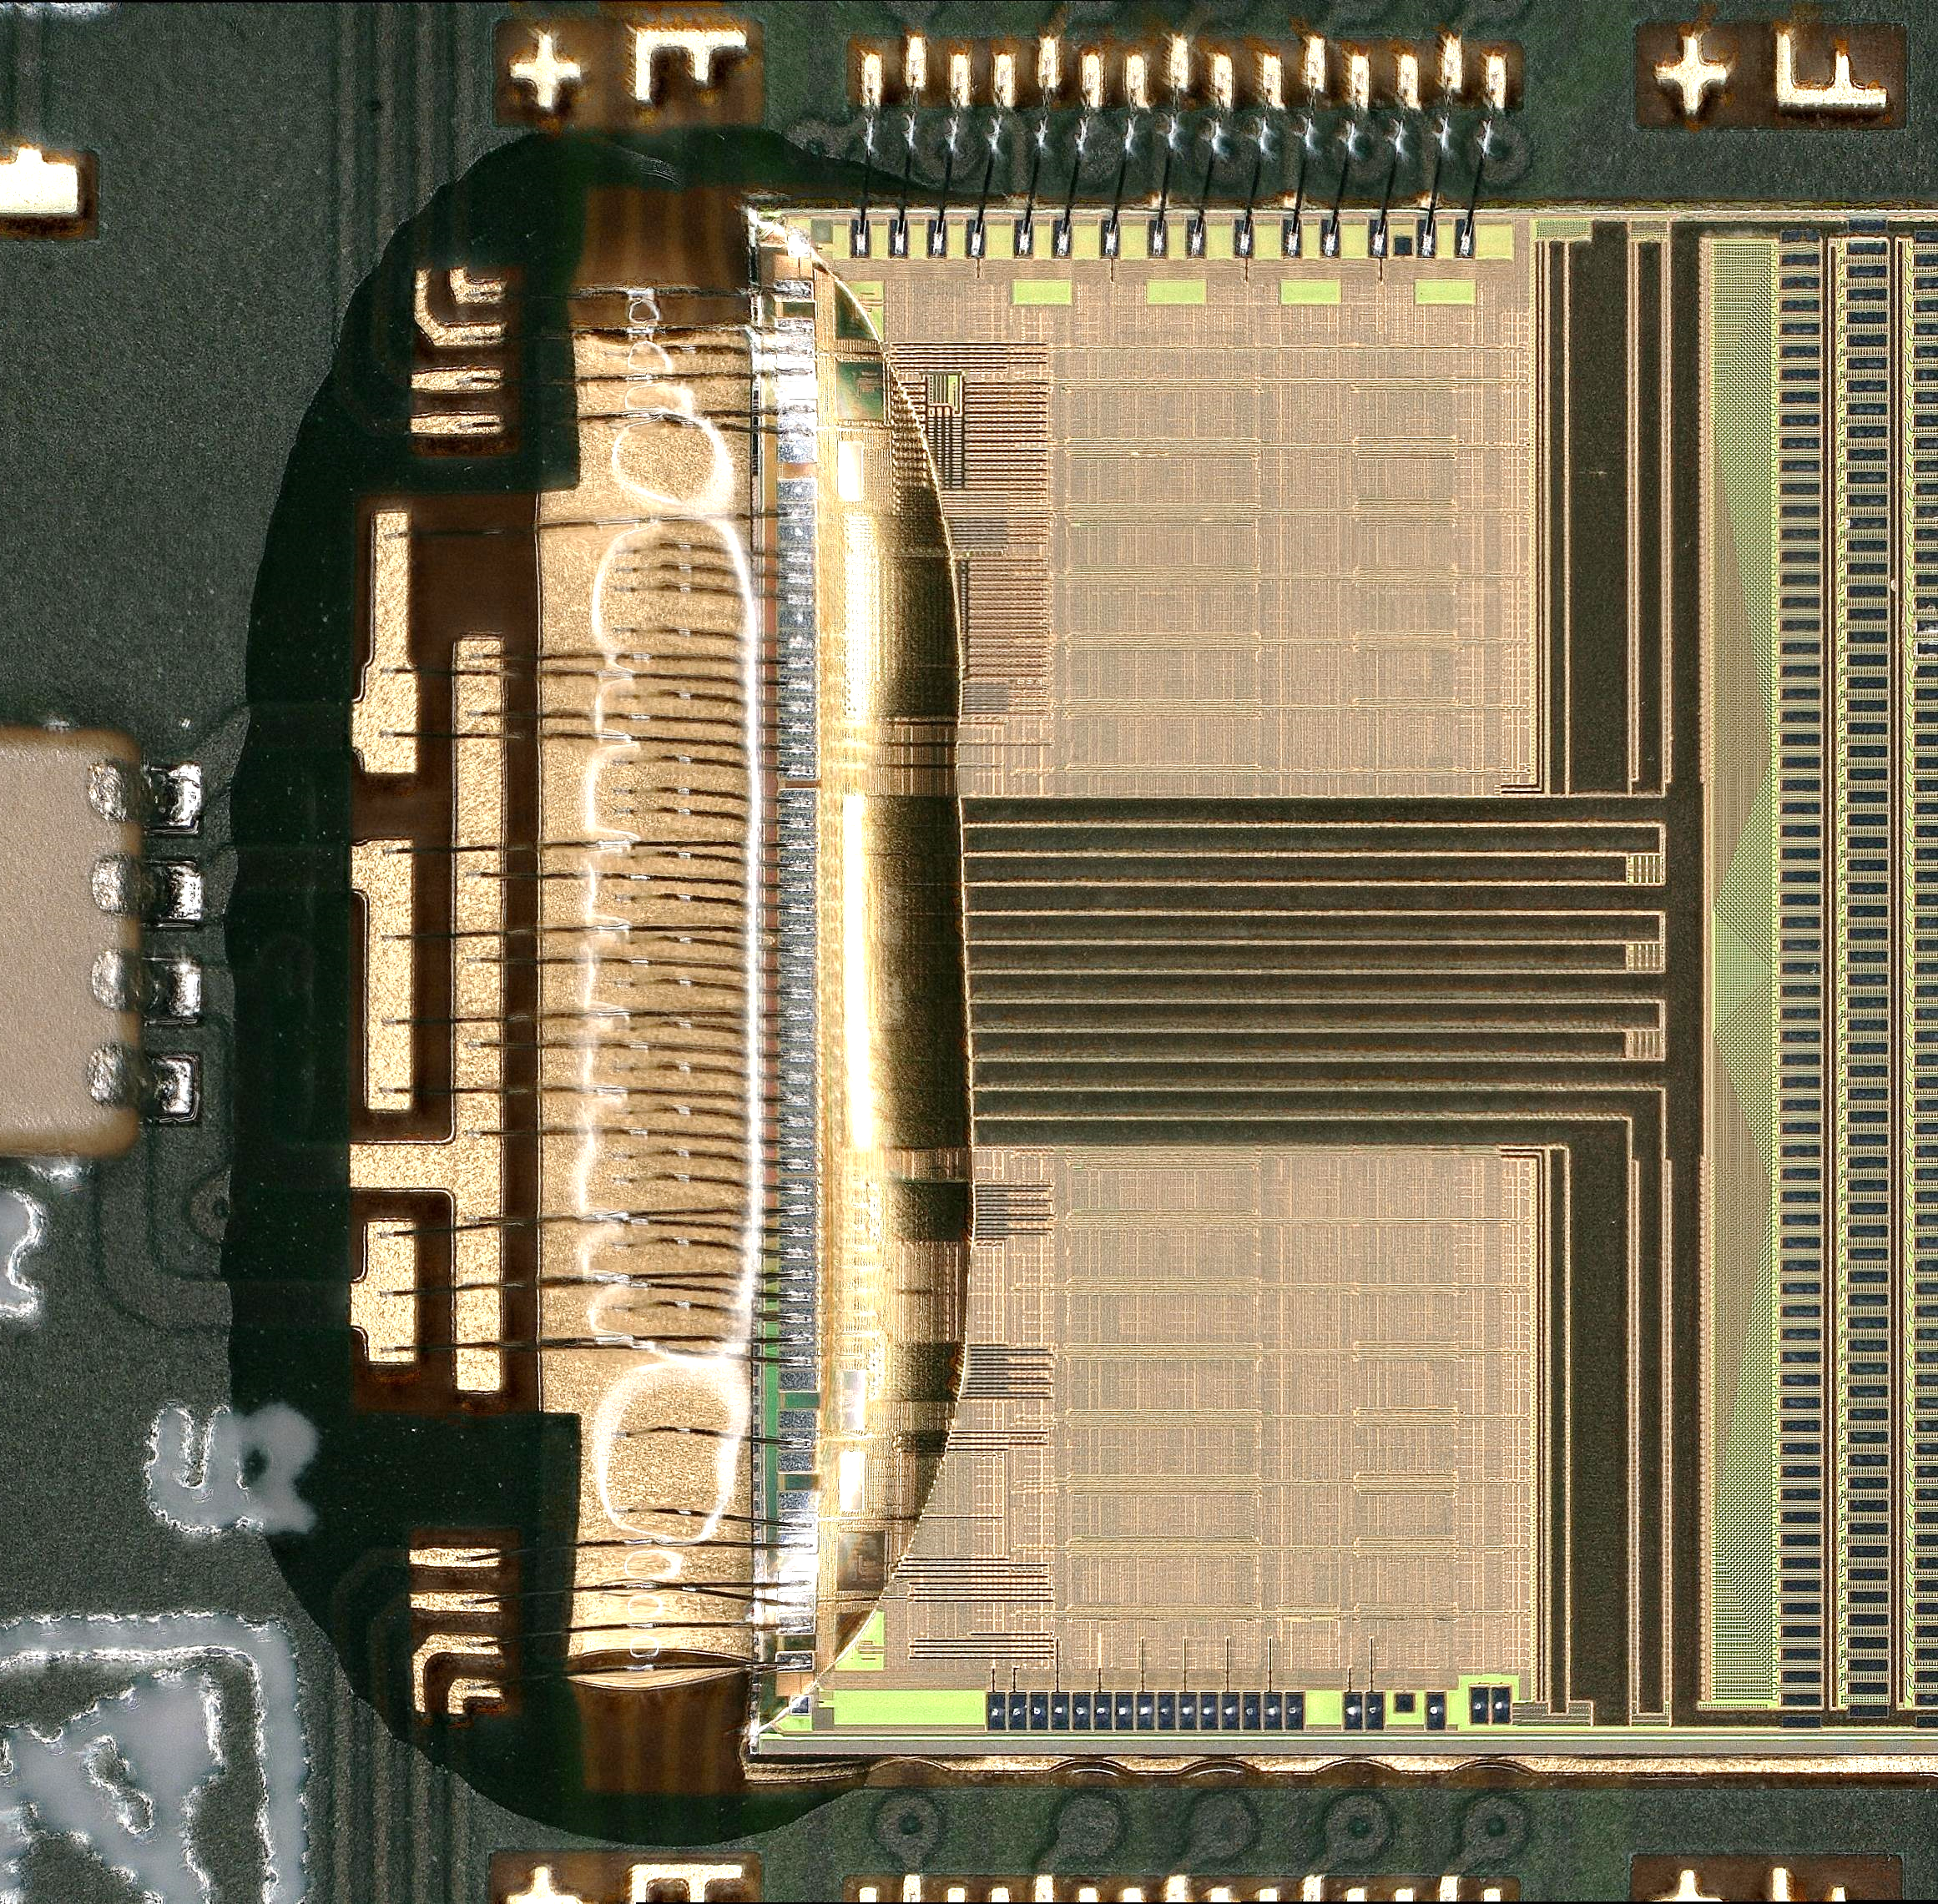
Issue in production: wire bond protection (encapsulation)
Another way to protect wire bond: encapsulation
IHEP/THU group with Oxford contribute to this R & D.
  Fully encapsulate ASIC back-end wires (ASIC to hybrid)
  More tests on going check the performance before and after
Glue dispenser to perform
The encapsulation R & D
Photo of wire bond
encapsulation

Slide 26
Summary
The HL-LHC upgrade requires ATLAS ITk upgrade to meet the challenge
IHEP/THU ATLAS ITk team is making steady progress on barrel module assembly and tests
More experience will be brought back to China

Slide 27


QA/QC for module production
Quality Control and Quality Assurance are essential in mass production towards a reliable and performant ITk detector
With the experience of module assembly, IHEP naturally involved in the definition of QC/QA procedures in (pre-)production of modules
  QC for all parts: reception, quality of component attachment, electrical confirmation, shipping …
  QA for samples: irradiation tests, mechanical stability, destructive thermal testing, …
QA tests
QC steps

Slide 28

Long Strip Module
We made an electric hybrid at RAL

Slide 29

Local structure: Stave
  Designed to minimize material, large scale assembly
  Carbon fibre sandwich panel, low mass.
  Titanium cooling tube and Bus tapes for power and data
  28 barrel modules on each stave (14 per side), 18 endcap modules on each petal ( 9 per side)

Slide 30
Research grant for ATLAS ITK
IHEP team got the research grant supported by Ministry of Science and Technology of China (MOST): 13 million Yuan
This grant covers the following R & D for ATLAS upgrade:
Front-end electronic readout ASIC design for ATLAS strip detector
Silicon strip detector module prototyping and production
CMOS-based silicon strip detector performance study

Slide 31


Star chips for ITk Strip
Readout ASICs (ABC)
Hybrid Control ASIC (HC)
Silicon Sensor
Hybrid
LV/HV power board
Challenge for ITk Strip upgrade
  Higher luminosity , finer granularity, larger scale, harsher radiation…
Chipset on module
  ABC--ATLAS Binary Chip
  HCC--Hybrid Control Chip
Star architecture on hybrid
  Increased trigger rate->1MHz L0
  shorter latency
  From serial transfer to star connection

Slide 32

Timeline of ATLAS strip detector upgrade
End of 2016 , technical design report（TDR）
2018-2019 pre-production
2020-2023 production

Slide 33
芯片禁运问题
目前硅微条探测器模块芯片，包括读出芯片ABC、控制芯片HCC、电流监控芯片AMAC、DC-DC芯片FESAT以及高压转换芯片因为抗辐照原因，均对中国禁运。
积极申请禁运豁免：ATLAS和CMS合作组内多个国家面临相同问题，CERN专门聘用律师统一协调针对技术（GF/IBM CMOS工艺）申请禁运豁免（出口许可）。高能所为ATLAS合作组代表单位，高能所Joao Costa教授被任命为ATLAS方联络人。
国际合作：在禁运问题完全解决之前，积极利用国际合作，借用国外合作单位先进设施开展预研工作。充分锻炼人才队伍，为后期回到国内开展建造任务奠定扎实基础。

Slide 34


本地实验室建设
努力申请芯片禁运豁免、开展国际合作的同时，加快本地实验室基础设施建设，为后期回国批量生产做好准备。
依托核探测与核电子学国家重点实验室，建有150 m²千级洁净间，配有探针台、绑定机等基本设备。
购置高速线绑定机（Hesse BJ820，已购置），非接触式显微镜（OGP Flash CNC 300，清华购置），恒温恒湿箱等关键设备。
Recent progress in IHEP/THU ATLAS ITk Group
Flash CNC 300
BJ 820

