Slide 1
TCAD Simulation work based on a 0.18µm technology for a Beam Telescope
李龙 刘剑 张亮 董家宁 王萌
Shandong University
longli@mail.sdu.edu.cn
Shanghai , Jun. 22th ,2018

Slide 2
Outlines
Requirement of the sensor for beam telescope
Simulation for large size pixel design
Simulation for small size pixel design
Optimization of small size pixel design
Summary

Slide 3
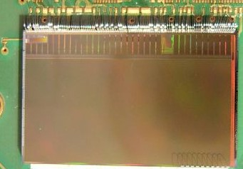
Background and requirement of sensor
MIMOSA 26 AMS350 epi-layer technology
18.4 μm*18.4 μm pixel pitch
Binary resolution 5.31 μm .
3.24 μm with 5 GeV beam.
Overview of EUDET type beam telescope
A beam telescope project has been applied by SDU pixel group. In order to achieve the required resolution, the geometry of the sensor such as the pixel size, the gap width between Pwell and Nwell have been simulated.
and this talk is mainly about the charge collection and the capacitance of the pixel diode related to the geometry.

Slide 4
About TCAD
Technology Computer Aided Design(TCAD) is a branch of electronic design automation（EDA） that models semiconductor fabrication and semiconductor device operation.
The simulation tool we use is Sentaurus which belongs to SYNOPSYS Inc.
Tools used for the simulation in TCAD Sentaurus
Physical models used in Sentaurus Device
Generation and Recombination models
Mobility models
Traps and fixed charge models
Models for the carriers generating and recombing
Models to describe the carriers mobility
Models for charge collection depend on traps and fixed charge.
Etc.

Slide 5
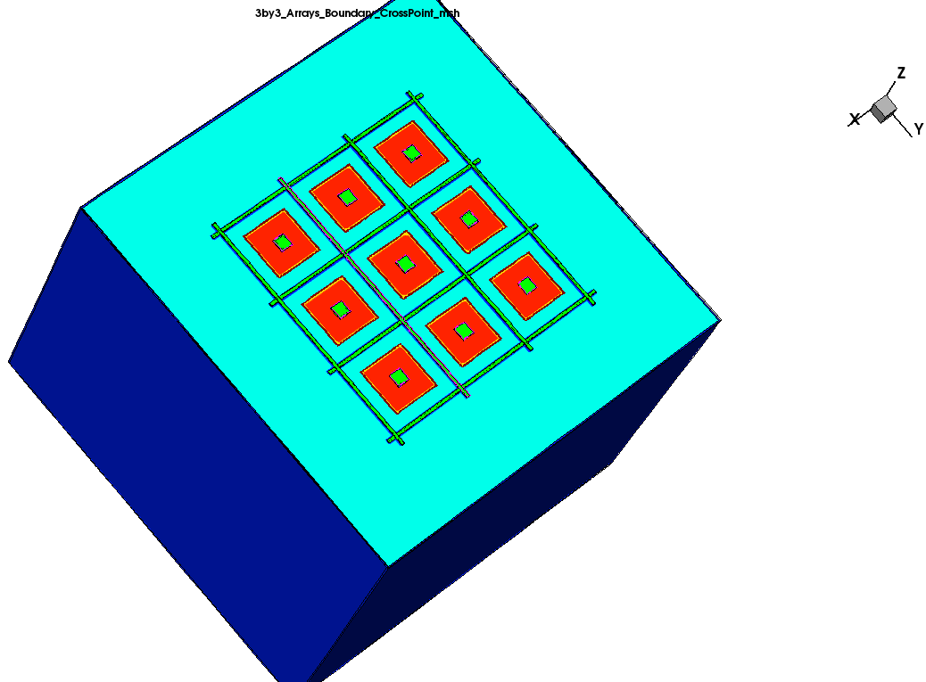
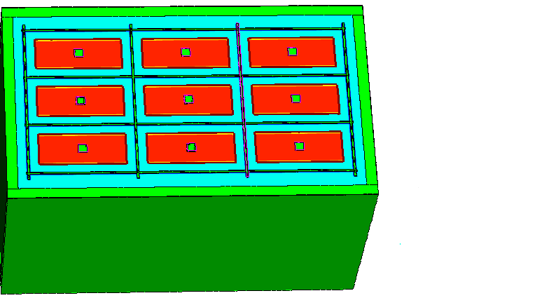
Large size pixel design research
In order to test the feasibility of the 0.18μm technology we used for our beam telescope, the large pixel size simulation research was carried out. In the large size pixel design, 3 kinds of pixel pitch have been chosen: 50 μm *50 μm, 50 μm *100 μm and 30 μm *100 μm as the figures show.
Feature: 200 μm low resistance substrate, no epi-layer.
3*3_Arrays_50 μm *50 μm _Pixel pitch
3*3_Arrays_50 μm *100 μm _Pixel pitch
3*3_Arrays_30 μm *100 μm _Pixel pitch

Slide 6
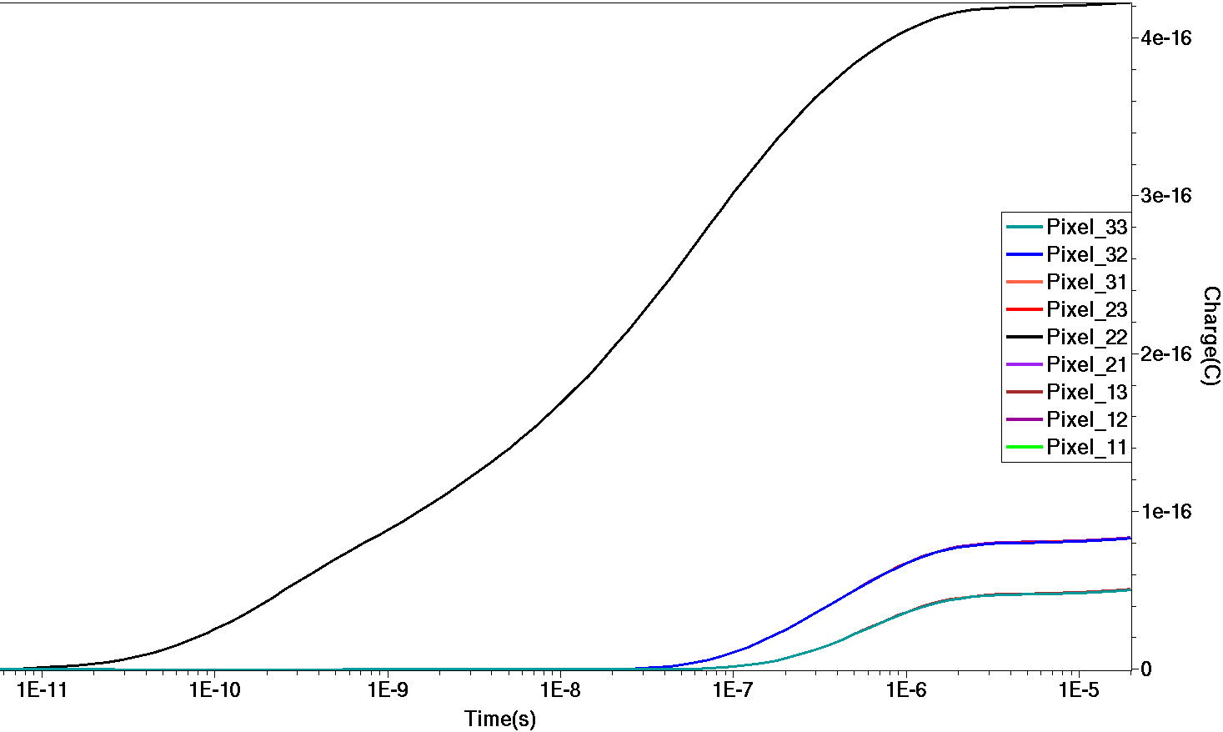
Charge Collection simulation
Pixel_11
Pixel_33
Pixel_22
~3μs
All the pixels have been numbered according to their positions and the collected charge has been given in the above figures. It is reasonable that the “Pixel_22” collects the main charge since it is the seed pixel, and the pixels which share the same distance from the seed pixel collect the same charge. And almost all the charge has been collected within 3μs.

Slide 7
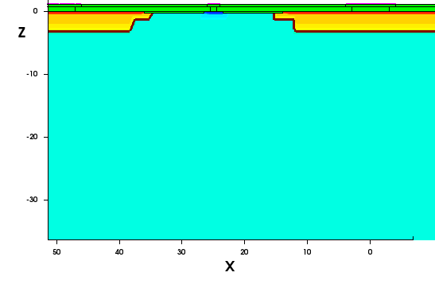
Charge collection of the large size pixel design
There are two modes of the charge collection: No radiation and with the radiation flux. The results are:
3*3_Arrays_50 μm *50 μm _Pixel pitch with the bias voltage -2.5V
Gap width(µm) | 8 |  | 4 |  | 2
Radiation flux | Y | N | Y | N | Y | N
Pixel No. | Charge($e^{−}$)
11 | 1.6 | 319 | 1.9 | 312 | 2.0 | 312
12 | 4.4 | 519 | 5.5 | 519 | 6.0 | 519
13 | 1.6 | 319 | 1.9 | 312 | 2.0 | 312
21 | 4.4 | 519 | 5.5 | 519 | 6.0 | 519
22 | 1062 | 2625 | 1125 | 2688 | 1125 | 2688
23 | 4.4 | 519 | 5.5 | 519 | 6.0 | 519
31 | 1.6 | 319 | 1.9 | 312 | 2.0 | 312
32 | 4.4 | 519 | 5.5 | 519 | 6.0 | 519
33 | 1.6 | 319 | 1.9 | 312 | 2.0 | 312
Total | 1086 | 5977 | 1132 | 6012 | 1157 | 6012
The radiation flux is 1.63e13 neq/cm2 .
8, 4, 2 is the gap between the pwell and nwell.
Gap width between Pwell and Nwell

Slide 8
Charge collection result of 50 μm *100 μm pitch
3*3_Arrays_50*100_Pixel pitch with the bias voltage -2.5V
Gap width(µm) | 8 |  | 4 |  | 2
Radiation flux | Y | N | Y | N | Y | N
Pixel No. | Charge(C)
11 | 1.6 | 188 | 1.8 | 219 | 1.9 | 231
12 | 4.4 | 688 | 6.9 | 750 | 6.9 | 750
13 | 1.6 | 188 | 1.8 | 219 | 1.9 | 231
21 | 4.4 | 688 | 6.9 | 750 | 6.9 | 750
22 | 1125 | 3125 | 1062 | 3187 | 1062 | 3187
23 | 4.4 | 688 | 6.9 | 750 | 6.9 | 750
31 | 1.6 | 188 | 1.8 | 219 | 1.9 | 231
32 | 4.4 | 688 | 6.9 | 750 | 6.9 | 750
33 | 1.6 | 188 | 1.8 | 219 | 1.9 | 231
Total | 1149 | 6629 | 1097 | 7063 | 1097 | 7111

Slide 9
Charge collection result of 30 μm *100 μm pitch
3*3_Arrays_30*100_Pixel pitch with bias voltage -2.5V
Gap width(µm) | 8 |  | 4 |  | 2
Radiation flux | Y | N | Y | N | Y | N
Pixel No. | Charge($e^{−}$)
11 | 1.0 | 175 | 1.3 | 194 | 1.4 | 212
12 | 17.5 | 812 | 22 | 875 | 22 | 937
13 | 1.0 | 175 | 1.3 | 194 | 1.4 | 212
21 | 17.5 | 812 | 22 | 875 | 22 | 937
22 | 875 | 2250 | 937 | 2375 | 937 | 2437
23 | 17.5 | 812 | 22 | 875 | 22 | 937
31 | 1.0 | 175 | 1.3 | 194 | 1.4 | 212
32 | 17.5 | 812 | 22 | 875 | 22 | 937
33 | 1.0 | 175 | 1.3 | 194 | 1.4 | 212
total | 949 | 6198 | 1030 | 6651 | 1030 | 7033

Slide 10
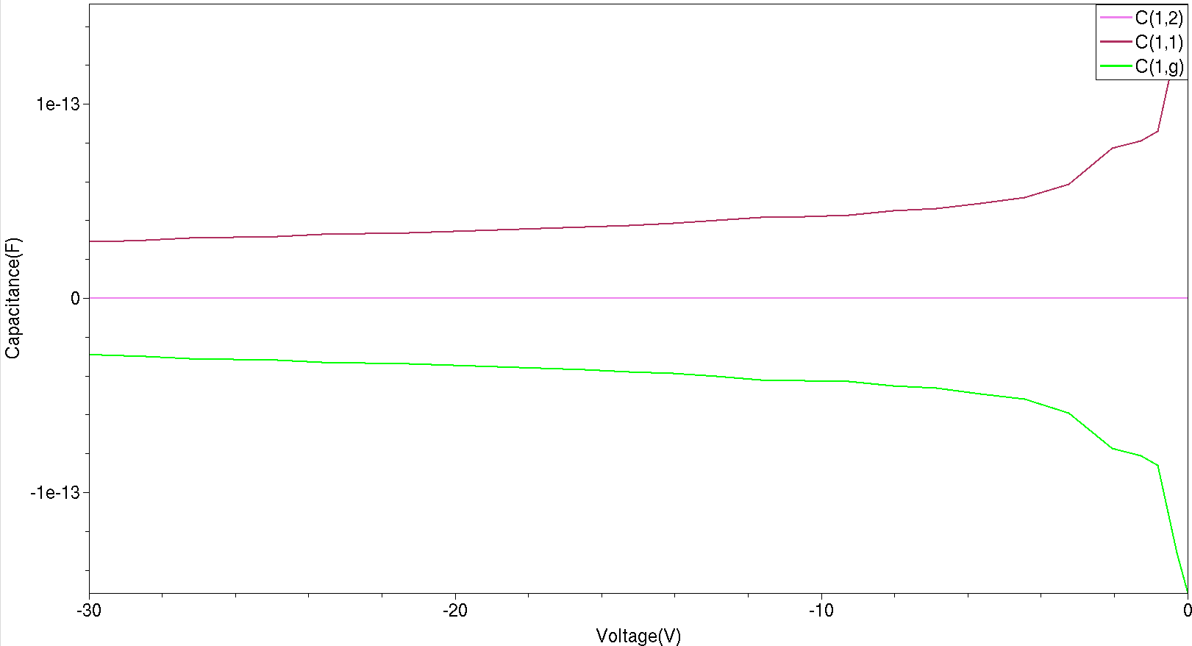
AC coupled simulation
AC coupled is the method aims to determine the$C_{det}$of the device.
AC coupled result of 50 μm *50 μm pixel pitch
g
2
1

Slide 11
AC coupled result
Capacitance between different nodes Bias voltage -30V
Type | 50μm *50μm | 50μm *100μm | 30μm *100μm
 | Capacitance(F)
C(i, g) | 2.89$e^{−14}$ | 6.71$e^{−14}$ | 3.40$e^{−14}$
C(i , j ≠i) | ~0 | ~0 | ~0
C( i , i ) | 2.89$e^{−14}$ | 6.71$e^{−14}$ | 3.40$e^{−14}$
Obviously, the capacitance between pixels is almost 0 , the capacitance between NWell and “GuardRing” is equal to the capacitance from NWell to the ground.

Slide 12
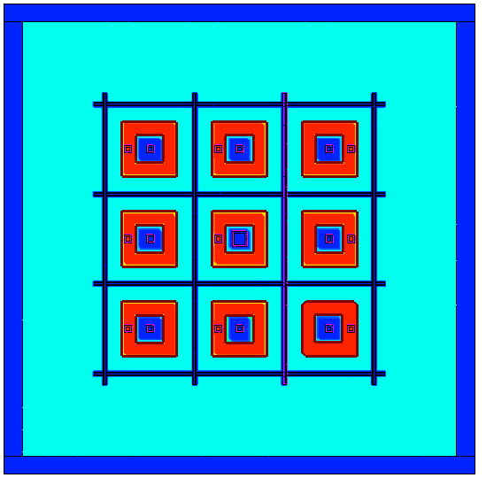
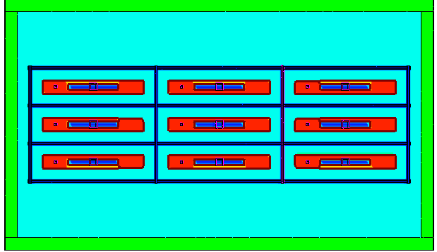
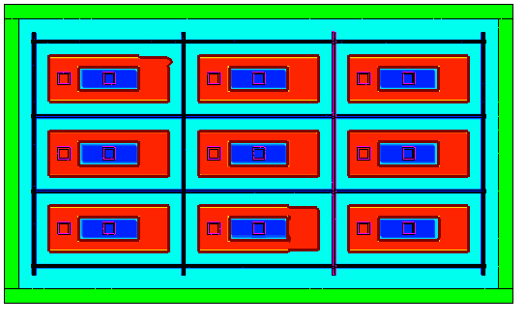
P in N design AC coupled result
In order to put the circuit in the pixel , the capacitance calculation for the P well in N well simulation is necessary.
3*3_Arrays_30 μm *100 μm Pixel pitch_ P in N design
Obviously, the total capacitance
C($n_{i}$, $n_{i}$ ) =C( $p_{i}$ , $n_{i}$)+C($n_{i}$ , g ),
which matches the expectation.
3*3_Arrays_50 μm *50 μm *Pixel pitch_P in N design
3*3_Arrays_50 μm *100 μm Pixel pitch_P in N design
Capacitance of P in N design Bias Voltage -30V
Type | 50μm *50μm | 50μm *100μm | 30μm *100μm
 | Capacitance(F)
C($n_{i}$, g) | 2.82$e^{−14}$ | 6.64$e^{−14}$ | 3.48$e^{−14}$
C($p_{i}$,g ) | ~0 | ~0 | ~0
C($p_{i}$,$n_{i}$ ) | 7.81$e^{−14}$ | 1.62$e^{−13}$ | 6.10$e^{−14}$
C($n_{i}$ , $n_{i}$ ) | 1.06$e^{−13}$ | 2.26$e^{−13}$ | 9.62$e^{−14}$

Slide 13
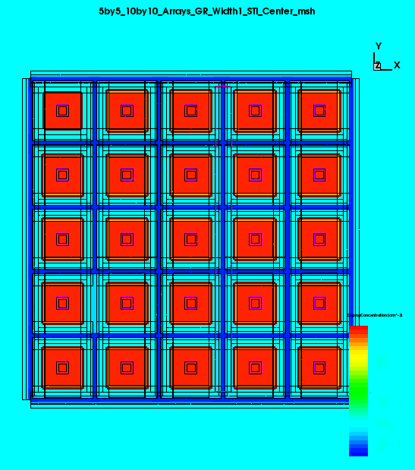
Small size pixel design research
Since the capacitance of the large size pixel designs are out of our requirement(<10fF), and the spatial resolution requirement of a beam telescope needs to be considered. We need less capacitance and smaller binary resolution design which push us to pursue a new design.
16 μm *16 μm pitch is a promising design considering the binary resolution, power consumption and the circuit inside the sensor.
5*5 arrays 16 μm *16 μm pitch geometry

Slide 14
5*5Arrays with 16 μm *16 μm Pixel Pitch
The collected charge is less than the large pixel design, since the active pixel area is smaller(90µm*90µm)compared to
50 μm *50 μm Pitch(150µm*150µm),
50 μm *100 μm Pitch(150µm*300µm),
30 μm *100 μm Pitch(100µm*300µm).
Comparison of Charge collection for all designs Bias voltage: -2.5V
type | 3*3_Arrays_50μm *50μm Pitch | 3*3_Arrays_50μm *100μm Pitch | 3*3_Arrays_30μm *100μm Pitch | 5*5_Arrays_16μm *16μm Pitch
Total Charge Collection($e^{−}$) | 5975 | 6625 | 6200 | 2920

Slide 15
AC coupled result for 16 μm *16 μm Pitch
Comparison of the capacitance for all designs Bias Voltage -30V
Type | 50μm *50μm Pitch | 50μm *100μm Pitch | 30μm *100μm Pitch | 16μm *16μm Pitch
Capacitance(F) | 1.06$e^{−13}$ | 2.26$e^{−13}$ | 9.62$e^{−14}$ | 3.51$e^{−15}$
Obviously, the charge collection can be ensured with the equal active pixel area for the 16 μm *16 μm Pitch,but the capacitance between the pixel diode and the ground is much smaller , which counts much for noise in the output of the sensor.

Slide 16
Optimization based on 16 μm *16 μm pitch
The width of the P+ well has been narrowed from 4 µm to 1 µm.Pwell from 6 µm to 2 µm.
More designs have been carried out based on 16 μm *16 μm pitch in order to optimize the performance of the sensor. Narrowing the width of the P+ well in the “GuardRing” region could be an effective one.

Slide 17
Optimization based on 16 μm *16 μm pitch
AC coupled result for different designs based on 16 μm *16 μm pitch
Capacitance of different pixel size based on 16 μm *16 pixel μm pith.
Comparison of the performance for different designs based on 16*16pitch Bias Voltage -2.5V
Pixel size | 3µm*3µm (GRW:2µm) | 6µm*6µm (GRW:2µm) | 10µm*10µm (GRW:2µm) | 3µm*3µm (GRW:6µm)
Charge collection($e^{−}$) | 2929 | 3302 | 3575 | 2920
Capacitance(F) | 3.25$e^{−15}$ | 6.83$e^{−15}$ | 1.34$e^{−14}$ | 3.51$e^{−15}$

Slide 18
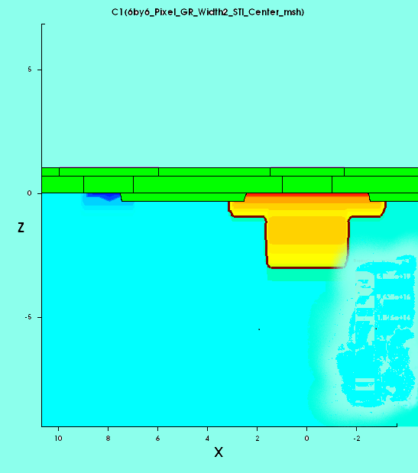
Detailed optimization based on 16 μm *16 μm pitch
The 6µm* 6µm design has been chosen considering the charge collection, the capacitance and the design rule of the semiconductor technology. The detailed optimization has also been carried out based on this design due to the circuit inside the Pwell , which should be considered later on .
The DNW has been narrowed from 5µm to 3µm to reduce the capacitance.
The different situations have been simulated with the Pwell width ranging from 2µm to 6µm , considering the circuit inside later on.

Slide 19
Charge collection of the optimization
Pixel_11
~1μs
Pixel_33
Pixel_55
Charge collection of 5*5 arrays 16 μm *16 μm pixel pitch GR_Pwell_width 6μm Bias Voltage -2.5V
The charge collection characteristic is similar to the 3*3 arrays 50 μm *50 μm pixel pitch design, but the charge collection time is about 1 μs.

Slide 20
Detailed optimization result
Comparison of the optimization design based on the 6µm*6µm size Bias voltage -2.5V
Type | GR_Pwell_Width2 (DNW width 5µm) | GR_Pwell_Width2 | GR_Pwell_Width4 | GR_Pwell_Width6
Charge Collection($e^{−}$) | 3302 | 3181 | 3187 | 3158
Capacitance(F) | 6.83$e^{−15}$ | 5.60$e^{−15}$ | 5.57$e^{−15}$ | 5.59$e^{−15}$
Obviously , the capacitance of the detailed optimization design decreases a lot by 18%, compared to the original one , and fortunately the charge collection does not change a lot . The “GR_Width6”design should be the best one since there is more space for the circuit inside.

Slide 21
Summary
The charge collection efficiency can reach 16.2%~ 19.9% for different design based on 16μm *16μm pixel pitch, since the MIPs is 80${ e}^{−}$-h/μm.
The capacitance of the 16*16 pixel pitch design can reach 5.6fF after a series of optimization. And the 6 μm*6 μm pixel size with 6 μm GR_Pwell_Widthdesign would be the best choice among all the designs.
More detailed optimization need to be carried out in order to achieve better performance.

Slide 22
Thanks !

