Slide 1
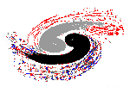



Institute of High Energy Physics
Triangle singularity and threshold phenomena
– a long story about the pseudoscalar glueball
Qiang Zhao
Institute of High Energy Physics, CAS
and Theoretical Physics Center for Science Facilities (TPCSF), CAS
zhaoq@ihep.ac.cn
The International Workshop on Partial Wave Analyses and Advanced Tools for Hadron Physics, July 16-20, 2018, Beijing

Slide 2
Outline
Exotic hadrons and observable effects produced by leading kinematic singularities, “triangle singularity”
Controversial issues in the study of pseudoscalar glueball
Reconsile the the dynamical model calculations with LQCD simulations
Observables sensitive to the underlying dynamics
Brief summary

Slide 3
Exotic hadrons and observable effects produced by leading kinematic singularities, “triangle singularity”

Slide 4
Hadrons beyond the conventional QM and…
Exotic hadrons
convential hadron
Hybrid
Glueball
Tetraquark
(q‾q)
(qqq)
Pentaquark
Hadronic molecule
Proton
u
π
d
u
d
Neutron
Evidence for QCD exotic states is a missing piece of knowledge about the Nature of strong QCD.
d
u
Deuteron: p-n molecule

Slide 5
Exotics of Type-I:
J^{PC} are not allowed by Q‾Q configurations
States in natural spin-parity: if P=(−1)^{L+1} =(−1)^{J} , then S=1 and hence CP=(−1)^{(L+S)+(L+1)} =+1.
Mesons with natural spin-parity but CP= −1 will be forbidden:
0⁺⁻, 1⁻⁺, 2⁺⁻, 3⁻⁺, …
L
+
Natural: 0⁺⁺, 1⁻⁻, 2⁺⁺, 3⁻⁻, …
Unnatural: ( 0⁻⁻), 1⁺⁺, 2⁻⁻,3⁺⁺, …
−
S=1
L
+
Unnatural: 0⁻⁺, 1⁺⁻, 2⁻⁺, 3⁺⁻, …
−
S=0

Slide 6

Exotics of Type-II:
J^{PC} are the same as Q‾Q configurations
‾qq SU(3) flavor nonet: ‾3⊗3 =1⊕8
S
J^{PC} = 0⁻⁺
K⁰ (‾sd)
K⁺ (‾su)
+1
I₃
–1
+1
π– (‾ud)
π⁰, η, η′
π⁺(‾du)
−1
K⁻(‾us)
‾K⁰ (‾ds)

Slide 7
Light hadrons:‾qq SU(3) flavor nonet: ‾3⊗3 =1⊕8
f₀(1500) ?
a₁(1420)?
η(1405) ?
Additional states beyond the QM flavor symm. pattern imply “exotic” signals!

Slide 8
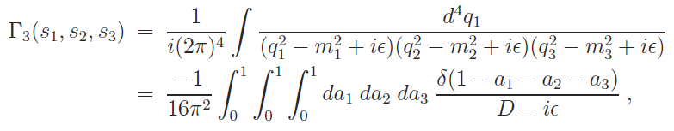
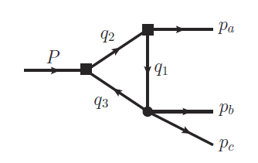



Exotics of Type-III:
Peak structures caused by kinematic effects, in particular, by triangle singularity.
The TS occurs when all the three internal particles can approach their on-shell condition simultaneously:
for all j=1,2,3.
L. D. Landau, Nucl. Phys. 13, 181 (1959);
J.J. Wu, X.-H. Liu, Q. Zhao, B.-S. Zou, Phys. Rev. Lett. 108, 081003 (2012);
Q. Wang, C. Hanhart, Q. Zhao, Phys. Rev. Lett. 111, 132003 (2013); Phys. Lett. B 725, 106 (2013)
X.-H. Liu, M. Oka and Q. Zhao, PLB753, 297(2016);
F.-K. Guo, C. Hanhart, U.-G. Meissner, Q. Wang, Q. Zhao, B.-S. Zou, arXiv:1705.00141[hep-ph], Rev. Mod. Phys. 90, 015004 (2018)

Slide 9
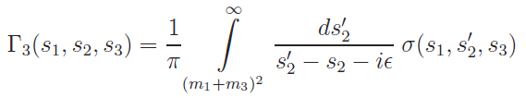

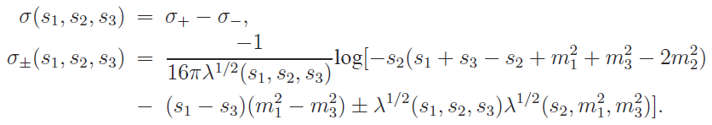
Single dispersion relation in s₂:
The spectral function σ(s₁, s₂, s₃) can be obtained by means of the Cutkosky’s rules (absorptive part of the loop amplitude) or the formula
which reads

Slide 10


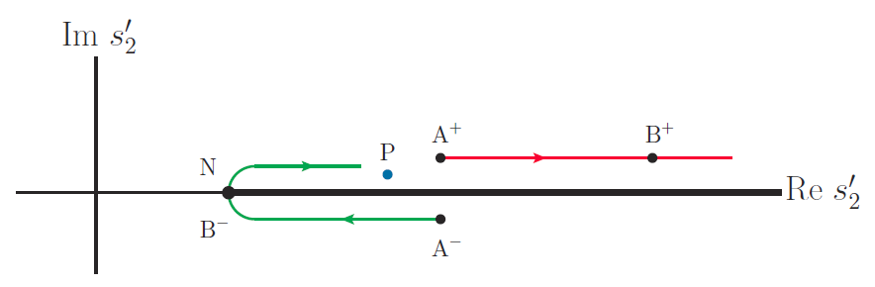
How the logarithmic branch points s±₂ move as s₁ increases from the threshold of (m₂ + m₃)², with s₃ and m_{i} fixed?
Trajectories of s±₂ in the complex s′₂-plane with
s₁ increasing from s_{1N} → ∞:
A⁺ :(s₁=s_{1N}, s₂⁺=s_{2C} +iε) → B⁺ :(s₁=s_{1C}, s₂⁺=s_{2N}+m₃ λ(s₃,m₁²,m₂²)/(m₁m₂)+iε)
A⁻ :(s₁=s_{1N}, s₂⁻=s_{2C} −iε) → B⁻ :(s₁=s_{1C}, s₂⁻=s_{2N})
s₂
P :

Slide 11
A brief reminder:
Exotics of Type-I:
J^{PC} are not allowed by Q‾Q configurations, e.g. 0⁻⁻,1⁻⁺ …
Direct observation
Exotics of Type-II:
J^{PC} are the same as Q‾Q configurations
Outnumbering of conventional QM states?
Peculiar properties?
Exotics of Type-III:
Leading kinematic singularity can cause measurable effects, e.g. the triangle singularity.
What’s the impact?
How to distinguish a genuine state from kinematic effects?
F.-K. Guo, C. Hanhart, U.-G. Meissner, Q. Wang, Q. Zhao, B.-S. Zou, Rev. Mod. Phys. 90, 015004 (2018)

Slide 12
2. Controversial issues in the study of pseudoscalar glueball

Slide 13
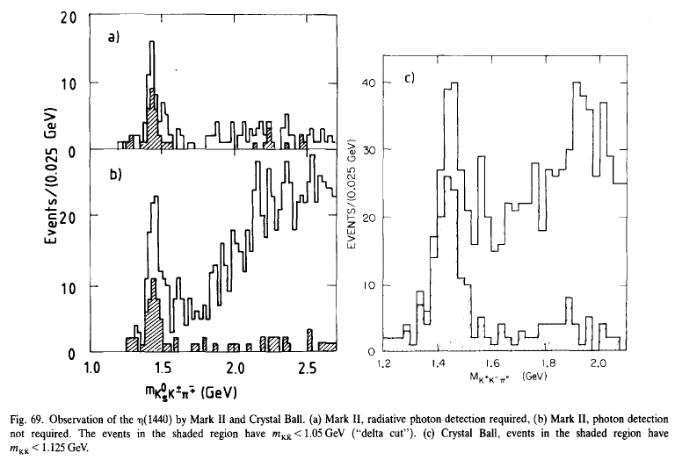
The arising of the E-ι puzzle:
E meson was first observed in 1965 in p‾p → (K‾Kπ) π⁺π⁻.
Observation of ι(1440) at Mark II (left, 1980) and Crystal Ball (right, 1982)
ι(1440)

Slide 14
Confirmation of η(1440) at Mark III in 1987

Slide 15

Distorted lineshape?
(c)
Mark III
(a)
(b)
A single Breit-Wigner fit
Two interfering B-W fit
Coupled channel B-W fit
η(1405)
η(1475)
Also “confirmed” by Obelix collaboration

Slide 16
Type-II exotics?
The abundance of 0⁻⁺ (I=0) states implies an exotic candidate
S
The first radial excitation of J^{P(C)}=0⁻⁽⁺⁾ states also make a‾qq SU(3) flavor nonet:
‾3⊗3 =1⊕8
K⁰
K⁺ (1460)
+1
1st radial excitation
I₃
Three η states have been listed by Particle Data Group around 1.2 ~ 1.5 GeV:
η(1295), η(1405), and η(1475)
–1
+1
π–
π⁰, η(1295), η(1475)
π⁺(1300)
−1
K⁻(1460)
‾K⁰(1460)

Slide 17
Regge trajectory for the η/η′ mass spectrum
1st radial excitation
How to understand the presence of η(1405) ?
η(1405)
J.S. Yu, Z.F. Sun, X. Liu, and Q. Z., PRD83, 114007 (2011)

Slide 18
The abundance of 0⁻⁺ (I=0) states implies a glueball candidate?
Positive:
Flux tube model favors M_{G}≅ 1.4 GeV [1]
Dynamical model based on U_{A}(1) anomaly gives a similar mass [2].
Caveat:
LQCD favors M_{G}≅ 2.4 – 2.6 GeV [3,4]
How to understand the HUGE difference between the dynamical calculations and LQCD results?
What can we learn from modern high-precision data? E.g. BESIII, Belle, LHCb…
[1] Faddeev, Niemi, and Wiedner, PRD70, 114033 (2004)
[2] H. Y. Cheng, H. n. Li, and K. F. Liu, Phys. Rev. D 79, 014024 (2009)
[3] Morningstar and Peardon, PRD60, 034509 (1999); Y. Chen et al., PRD73, 014516(2006)
[4] Richards, Irving, Gregory, and McNeile (UKQCD), PRD82, 034501 (2010)

Slide 20
Apparent inconsistency between the analyses for η(1405) and η(1475)
No data from BESIII quoted!!!

Slide 21
BESIII measurements of η(…) states in J/ψ and ψ′ decays
Only a single state is observed in the J/ψ and ψ′ decays!
γ
c
J/ψ, ψ′
q
‾q
‾c
η(…),
I=0
BES-III
BES-II

Slide 22
Invariant mass spectra measured at BES-III
J/ψ → γπππ
J/ψ → γπππ

Slide 23
The present status of the η(1405) and η(1475) paradox:
No evidence for η(1405) and η(1475) to be present in the same decay channel!
The peak positions for the η(1405/1475) are slightly different in different channels, why?
How to understand different masses and lineshapes for η(1405) and η(1475) in different channels?

Slide 24
2. The presence of the “triangle singularity”
γ
π
Isospin-violating decay
of J/ψ → γ η(1405) → γπππ
J/ψ
π
η(1405/1475)
f0(980)
π
BES-III Collaboration, Phys. Rev. Lett. 108, 182001 (2012)

Slide 25
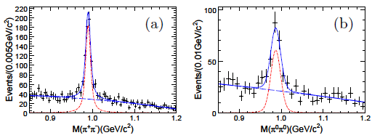
K⁺ K⁻
K⁰‾K⁰
f₀(980) is extremely narrow: Γ ≅ 10 MeV !
PDG: Γ ≅ 40~100 MeV.
Anomalously large isospin violation!
≅

Slide 26
“a₀(980)-f₀(980) mixing”gives only ~1% isospin violation effects！
π
K⁰ (K⁺)
π
η(1405)
g(a₀K⁺K⁻) g(f₀K⁺K⁻)
= −g(a₀K⁰‾K⁰) g(f₀K⁰‾K⁰)
M(K⁰)−M(K±) = m_{d}−m_{u}
a₀(980)
f₀(980)
π
I=1
‾K⁰ (K⁻)
I=0
“Triangle singularity”
Internal‾KK*(K) approach the on-shell condition simultaneously!
f₀(980)
K*
π
K⁺ K⁻
K⁰‾K⁰
η(1405/1475)
K
π
‾K
f₀(980)
π
A novel isospin breaking mechanism!
J.J. Wu, X.H. Liu, Q.Z. and B.S. Zou, PRL(2012);
X.G. Wu, J.-J. Wu, Q. Z., and B.-S. Zou, PRD87, 014023 (2013)

Slide 27
Interferences from the TS mechanism
η(1405/1475) → K‾Kπ
η(1405/1475) → ηππ
The “Triangle Singularity” mechanism can shift the peak positions exclusive channels.
Different lineshapes in difference channels, i.e. K‾Kπ, ηππ, and 3π.
No obvious need for two independent states, η(1405) and η(1475)!

Slide 28
3. Reconsile the the dynamical model calculations with LQCD simulations

Slide 29
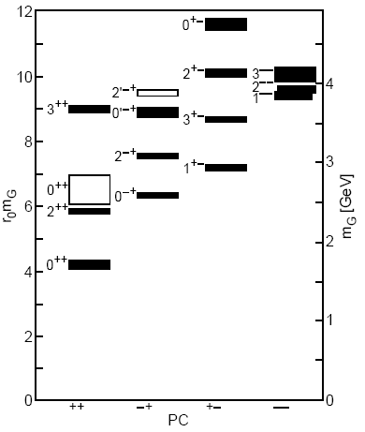
Stable PG masses from LQCD simulations
quenched LQCD
unquenched LQCD
Morningstar and Peardon, PRD60, 034509 (1999); Y. Chen et al., PRD73, 014516(2006)
Richards, Irving, Gregory, and McNeile (UKQCD), PRD82, 034501 (2010)

Slide 30
N_{f} = 2 LQCD study on anisotropic lattices
W. Sun et al. [CLQCD], arXiv:1702.08174[hep-lat]

Slide 31
Can mixing bring down the PG mass in a dynamical calc.?
η(1295) and η(1475) are the 1st radial excitation between the flavor singlet and octet with I=0.
η(1405) is a pseudoscalar glueball candidate which favors to mix with the ground states η(547) and η′(958).
Caution: Lattice QCD gives the pseudoscalar glueball mass of ~2.4 GeV.
G. Li, Q. Zhao, C.H. Chang, JPG35, 055002 (2008); hep-ph/0701020
C. Thomas, JHEP 0710:026, 2007
R. Escribano, EPJC65, 467 (2010)
H.Y. Cheng, H.n. Li and K.F. Liu, PRD79, 014024 (2009)
… …

Slide 32
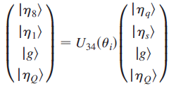
One can even include η_{c} (‾cc) in the mixing scheme.
M_{G} ≅ 2.4 GeV
Mη_{c} = 2.98 GeV
Constraints on the η and η′, but not strongly on a glueball candidate!
Y.-D. Tsai, H.-n. Li and Q.Z., PRD85, 034002 (2011)
Re-investigated in Qin, QZ, and Zhong, PRD 97, 096002 (2018)

Slide 33
Assuming that the decay constants in the flavor basis follow the same mixing pattern of the particle states, we have
T. Feldmann, P. Kroll, and B. Stech, PRD 58, 114006 (1998); PLB 449, 339 (1999)
where
The axial vector anomaly is given by the U_{A}(1) Ward identity:

Slide 34
The axial vector anomaly can then relate the pseudoscalar meson masses to the flavor singlet pseudoscalar densities and the topological charge density:
where
And
--- (A)
Meanwhile, the axial vector anomaly gives:
--- (B)

Slide 35
The equivalence of Eqs. (A) and (B) gives:
with

Slide 36
This allows a relation for the physical glueball mass and the topological charge density in association with the other constrained parameters:

Slide 37
With the LQCD results for the topological charge density, we can fit the parameters:
where we have applied the condition:
Note:
If
~
~
~ 1.4 GeV !
Inapprox. made in
H.-Y. Cheng, H.-n. Li and K.-F. Liu, PRD79, 014024 (2009)
Y.-D. Tsai, H.-n. Li and Q.Z., PRD85, 034002 (2011)

Slide 38
With the LQCD results for the topological charge density, we can fit the parameters:
where we have applied the condition:

Slide 39
The topological susceptibility can be extracted for the pseudoscalar mesons:
LQCD results:
Low mass pseudoscalar glueball is unlikely to be favored!

Slide 40
4. Observables sensitive to the underlying dynamics

Slide 41
Radiative decay patterns are out of intuition
Immediate crucial questions:
If η(1440) is assigned as the (s‾s) partner of η(1295), can we understand that η(1440) → φ (s‾s) γ is much smaller than η(1440) → ρ⁰ (n‾n) γ?
Why J/ψ → γη(1440) is so much stronger than J/ψ → γη(1295)?
Particle Data Group 2012:
BR(J/ψ → γη(1295))/BR(J/ψ → γη(1440)) ≤ 0.1

Slide 42
Answer to question (i):

Slide 43

γ
Answer to question (ii):
Magnetic dipole transition operator:
η(1440)
V(φ,ρ,ω)
The flavor and spin wavefunction for the pseudoscalar:
The flavor and spin wavefunction for the vector:

Slide 44
The M1 transition amplitudes for η(1440) → γ V:
with
So far, there is no obvious difficulty for having only one η(1440) to cope with the existing observables!

Slide 46
5. Brief summary
We have to alter our present view about the pseudoscalar spectrum dramatically even for the 1st radial excitation! (A brief status review: Qin, QZ, and Zhong, PRD 97, 096002 (2018))
The η(1405) puzzle is originated from the triangle singularity mechanism. Only one state is needed!
The dynamical calculations of the PG mass are consistent with the LQCD expectations if an inappropriate approx. is corrected.
Where to look for the pseudoscalar glueball candidate?
Isoscalar pseudoscalars with higher masses above 2 GeV, e.g. X(2120), X(2370) …
Joint analysis of PWA including TS is going on.

Slide 47
Institute of High Energy Physics
Thanks for your attention!

Slide 48
Triangle loop amplitudes:
Absorptive amplitudes
Dispersive amplitudes

