Slide 1
课题3：CMS端盖μ子探测器升级
CMS-MRPC探测器
王义
清华大学工程物理系

Slide 2
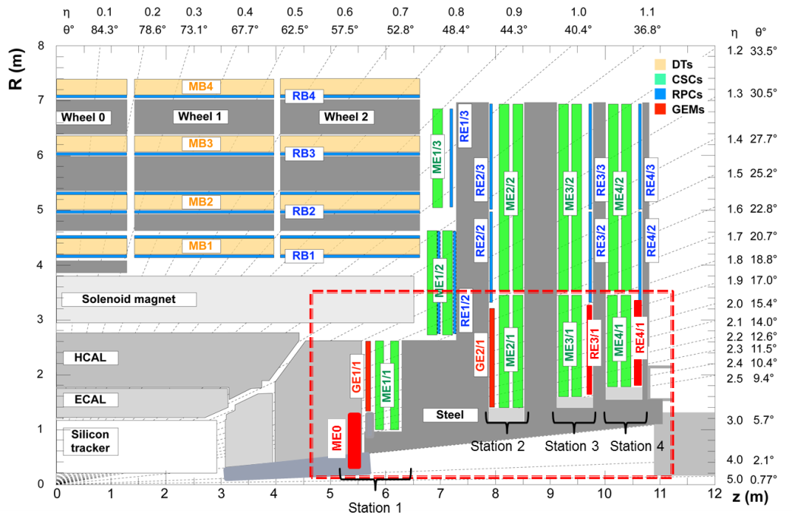
CMS端盖缪子探测器升级内容
In CMS PhaseII upgrade, station 3 and 4 of Muon system is intended to be constructed with RPC.
Requirement:
Rate >2kHz/cm²
Trapezoidal, space limit
Time resolution <100ps
Efficiency >95%
端盖μ探测器升级
清华大学, 玻璃MRPC
RE3/1+RE4/1

Slide 3
主要研究内容
根据物理条件要求及现场空间的限制，拟研制梯形MRPC。探测器长度达1米，上底宽度45cm，下底宽度55cm。由于我们研制的低电阻玻璃尺寸的限制，整个探测器由6个小梯形MRPC拼接而成，而整个探测器采用统一的PCB读出感应信号。每个MRPC包含5个气隙，气隙宽度为250微米，采用条形读出，读出条平均宽度为10mm。这种结构的优点是能够保证高的时间分辨，同时也能保证探测器的厚度在限定的范围内。
需要解决玻璃拼接，阻抗匹配，信号串扰及传输，探测器宇宙射线及粒子束流测试等关键技术问题。
同时还要研究高亮度实验中的气体污染问题，以保证探测器的长期稳定工作。
完成CMS前端缪子探测器ME3/1和ME4/1两个区的部分升级。

Slide 4
450 mm
1020 mm
540 mm
大面积拼接型MRPC
性能指标为：
计数率： >10kHz/cm²，
时间分辨：<100ps，
空间分辨：<2mm，
效率： >95%。

Slide 5
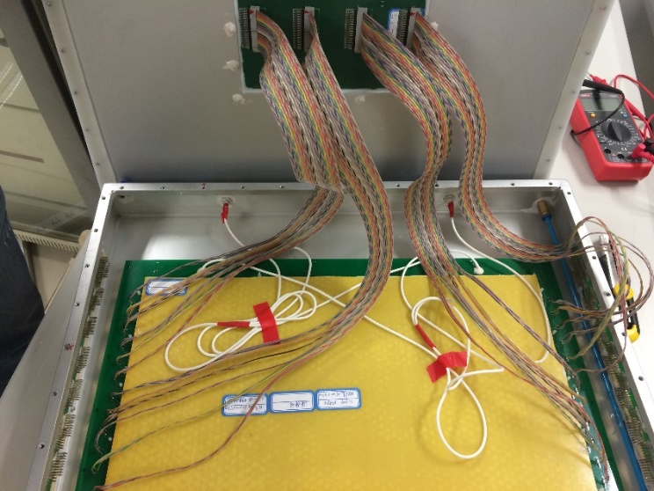
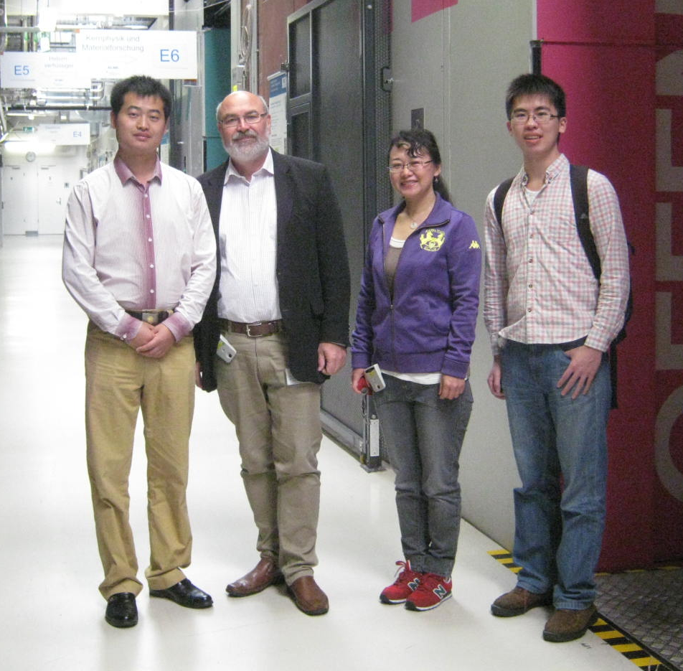
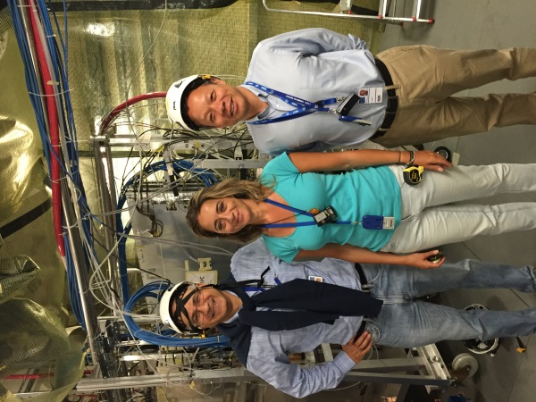
研究进展
20cm
27cm
25 cm
拼接型高计数率MRPC

Slide 6
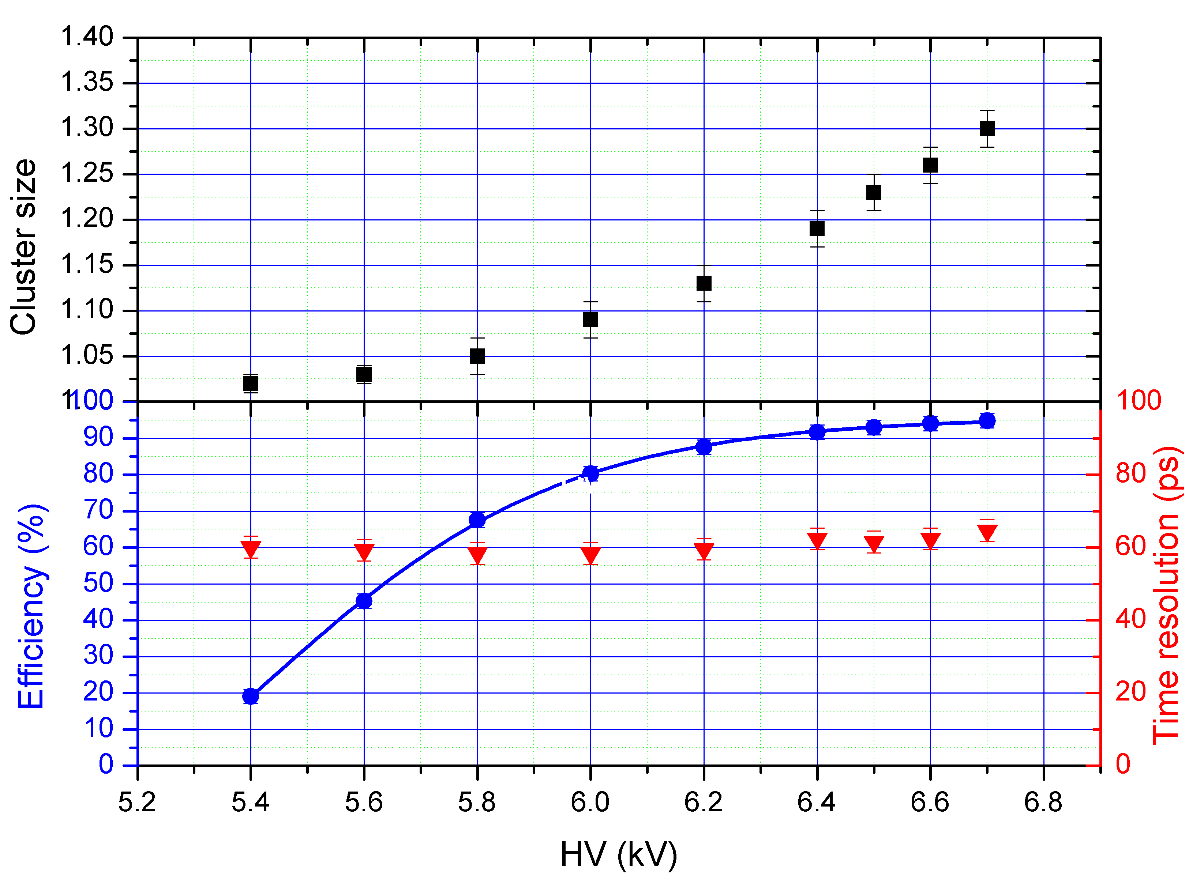
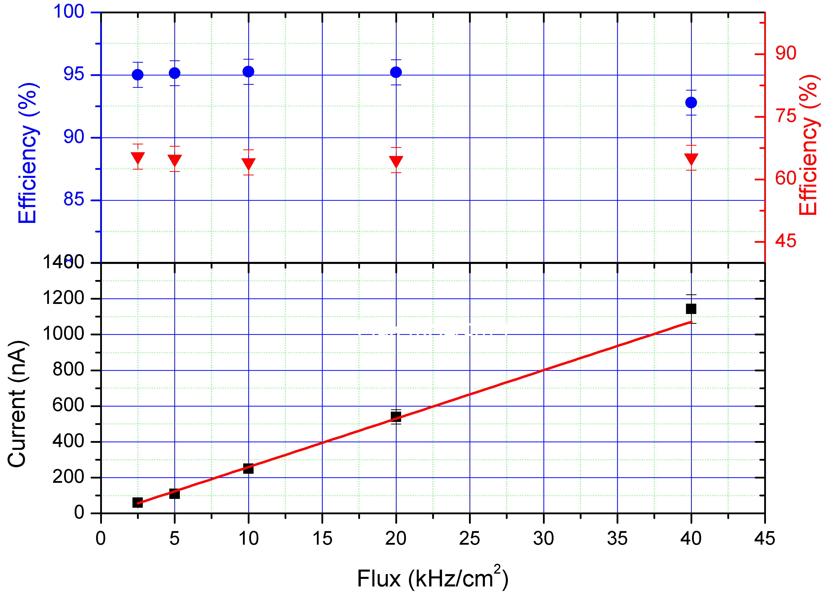
小面积拼接型MRPC的性能
Cluster size<1.3
Efficiency -> 95%
Time resolution ~60ps
计数率>40kHz/cm²

Slide 7
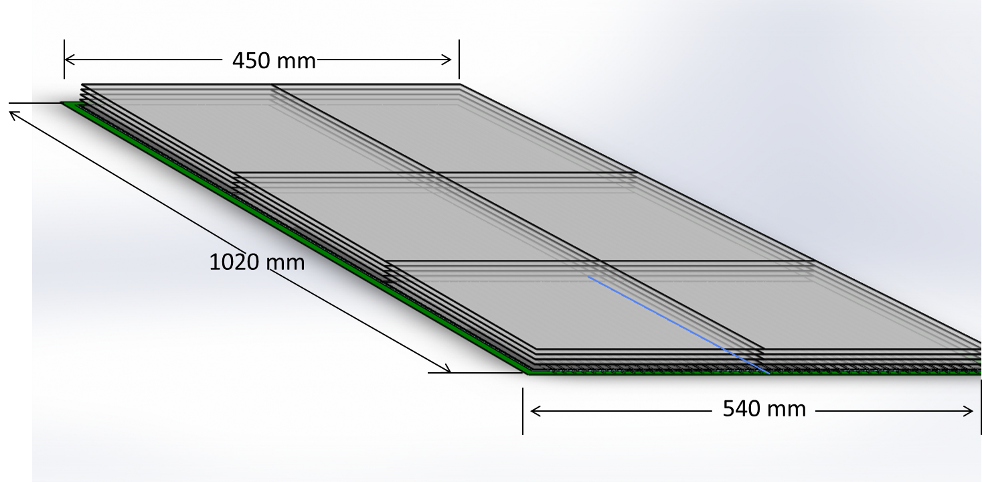
全尺寸拼接型MRPC的研发
Real size mosaic MRPC.
Mosaic interface
212 mm
330 mm
330 mm
330 mm
256 mm
Gas gap number: 5
Gas gap width: 250 μm
Glass thickness: 0.7 mm
Glass bulk resistivity: ~ 10¹⁰ Ωcm
Mosaic interface: glass directly mosaic together
Strip number: 44
Strip shape: trapezoidal (6 mm/8 mm)
Strip interval: 3 mm
Strip length: 1 m

Slide 8
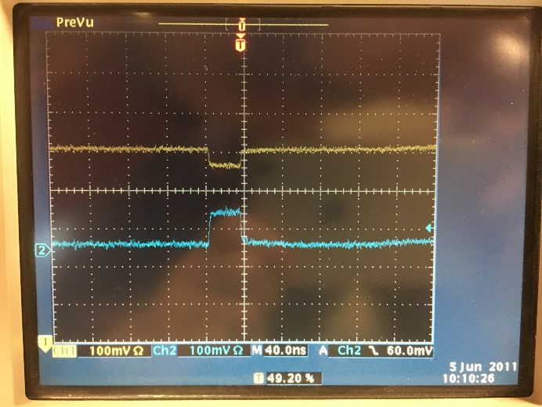
在CERN 904实验室的宇宙射线测试
Cosmic ray test at CERN in Feb, 2017:
Scan000086: 5000 trigger events. Gas: 90% C₂H₂F₄ + 5% i-C₄H₁₀ + 5% SF₆.
NINOs signal
Dark current
Cluster size
Efficiency

Slide 9
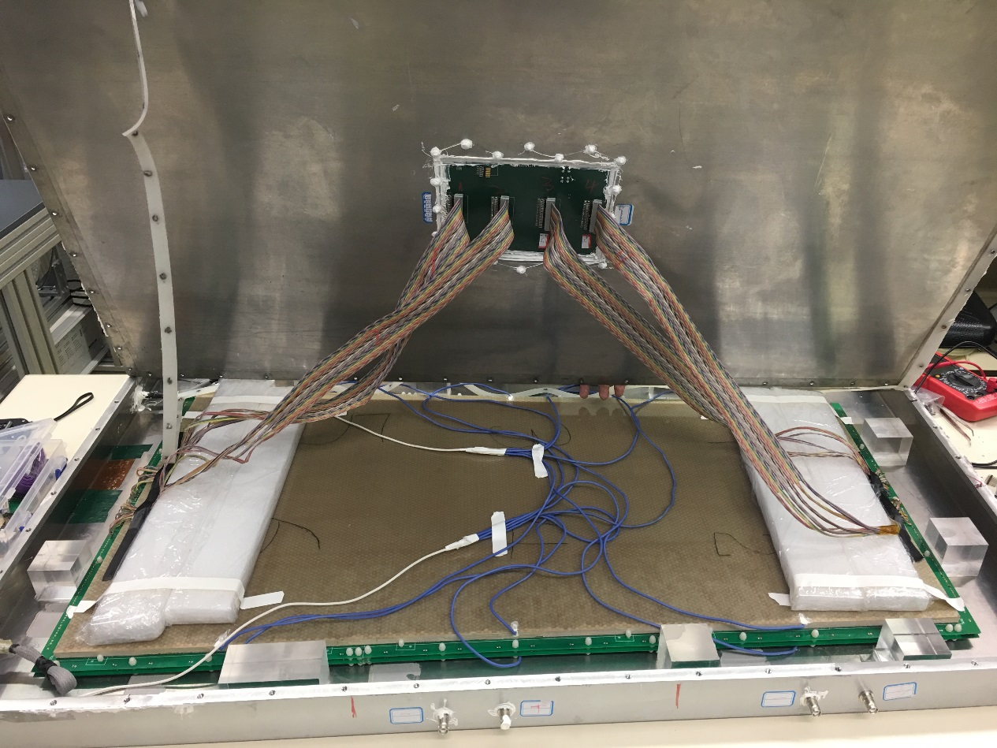
在德国HZDR的束流测试
Maxime and xiaolong brought the Mosaic MRPC to HZDR by car on March 24th.
Gas box was again opened to switch the Jupiter HV connector to SHV connector.
Gas was flushed with a component: 90% C₂H₂F₄ + 5% i-C₄H₁₀ + 5% SF₆.

Slide 10
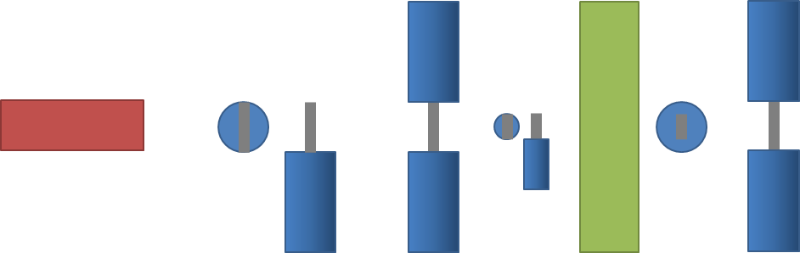
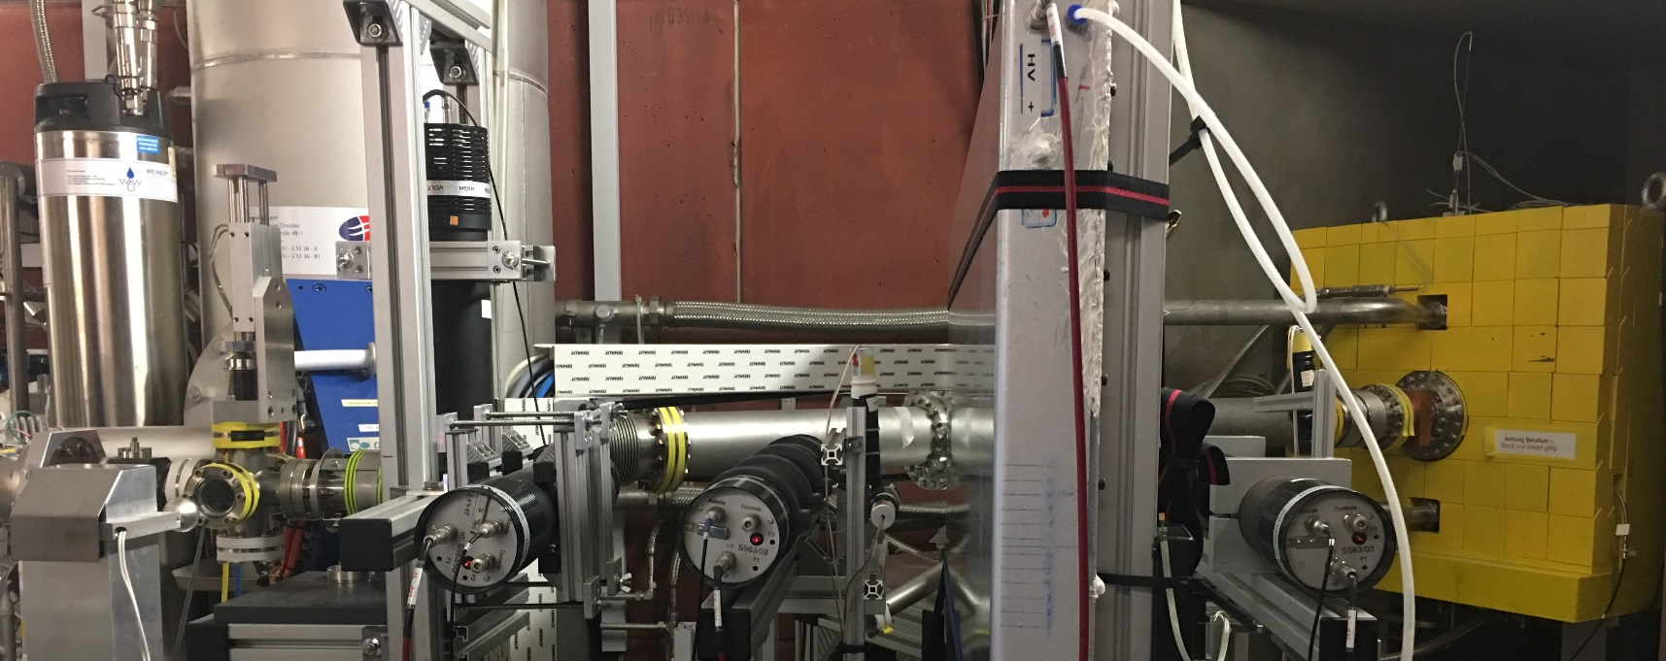
束流测试设备布置
Setup.
Coincidence triggering
S1
MRPC
S3
Coincidence triggering
S24
S14
S6
e- beam
S13
Rate measurement
S25
S2
Position selection
S4

Slide 11
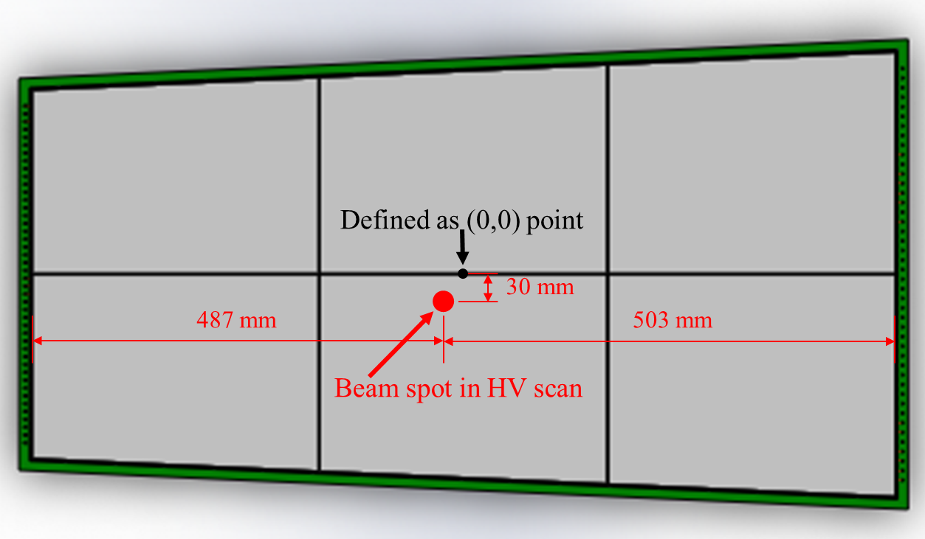
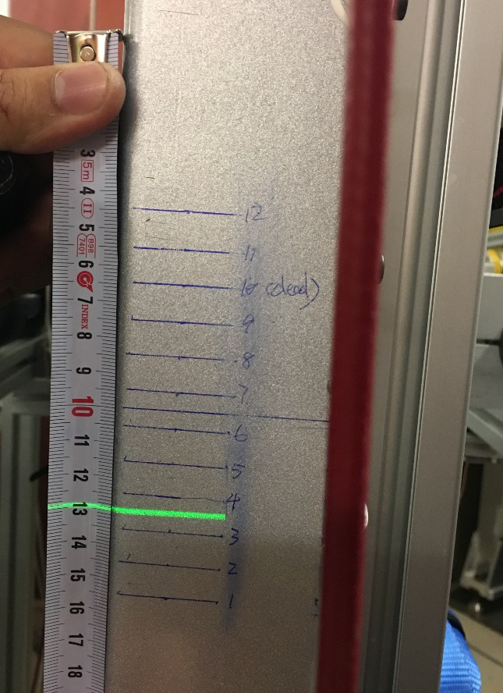
高压扫描
Run005 ~ Run021: HV: ±5400 V ~ ±6700 V; Rate: 11 kHz/cm².
Beam spot position: Horizontal – center; Vertical: between 3rd and 4th strip.
Define the horizontal center on the mosaic interface as zero point, beam spot at (-8, -30).
PMT Trigger (S1&S2&S3&S4) dimension: 20 × 20 mm².
Beam spot dimension: 100 mm in diameter.

Slide 12
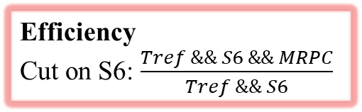
工作电流和探测效率
Rate: 11 kHz/cm².
Rate: 11 kHz/cm².
Efficiency
Cut on S6: $\frac{Tref \&\& S6 \&\& MRPC}{Tref \&\& S6}$
Rate: 11 kHz/cm².

Slide 13
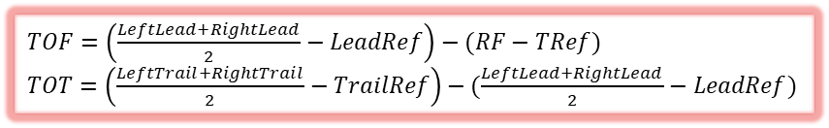
时间分辨
Run005 ~ Run009
Run017 ~ Run021
$TOF=\left(\frac{LeftLead+RightLead}{2}−LeadRef\right)−(RF−TRef)$
$TOT=\left(\frac{LeftTrail+RightTrail}{2}−TrailRef\right)−(\frac{LeftLead+RightLead}{2}−LeadRef)$

Slide 14
计数率扫描
HV scan at different rate of 0.35 kHz/cm², 2.3 kHz/cm² and 11 kHz/cm² before the MRPC was damaged.
探测效率
时间分辨

Slide 15
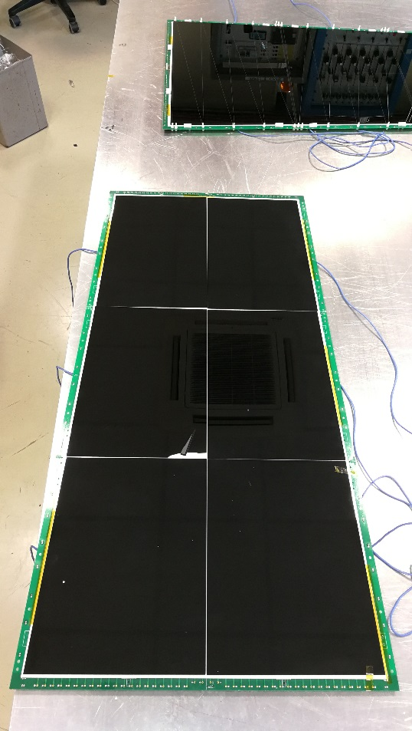
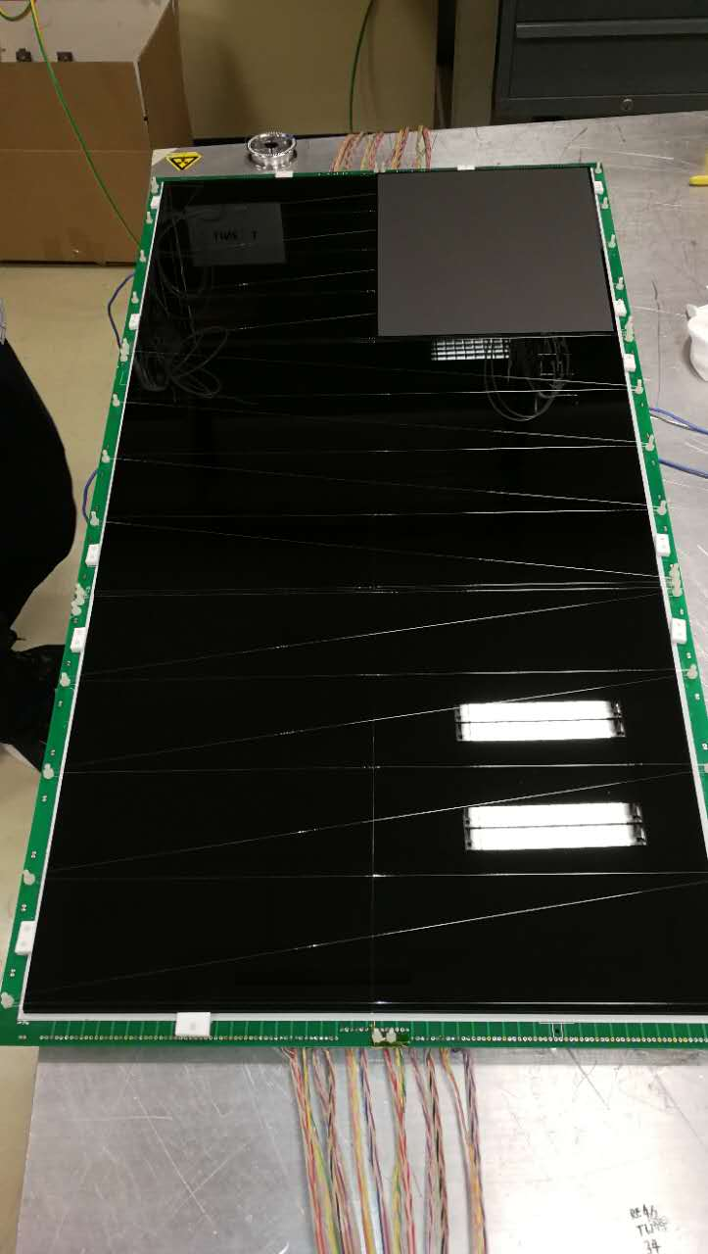
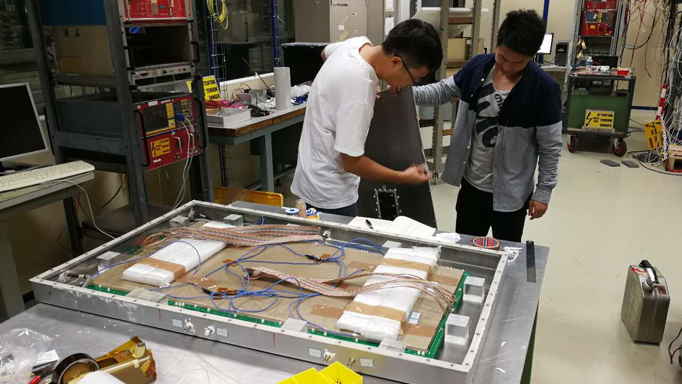
探测器修复后进行GIF⁺⁺实验
Chamber has been repaired at CERN in Sep, 2017
Gas was flushed with CMS gas: 95.2% C₂H₂F₄ + 4.5% i-C₄H₁₀ + 0.3% SF₆.
Dark current was 0.02 μA at ±5000 V
Before repair
After repair

Slide 16
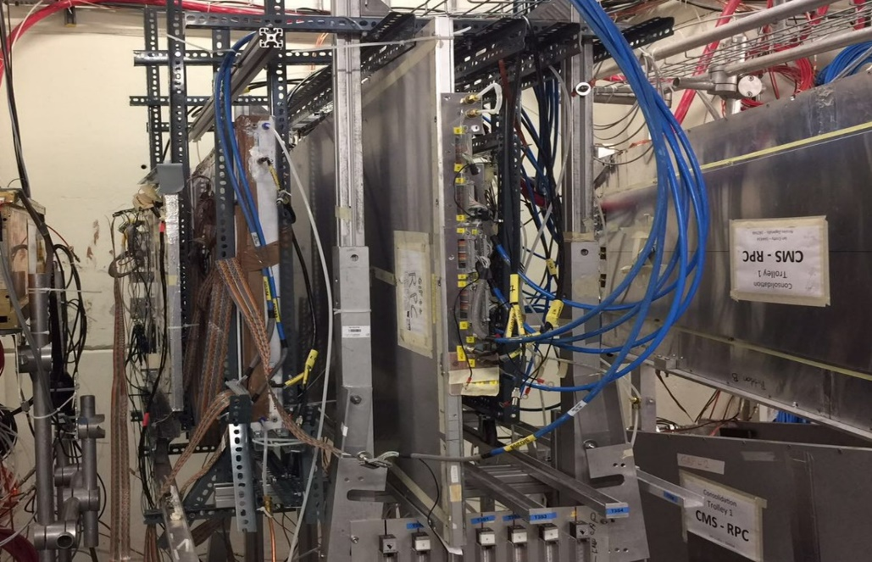
GIF⁺⁺实验布置
MRPC Chamber
GT1 and GT2
Source
beam
External + Internal trigger
External trigger
Internal trigger
External trigger

Slide 17
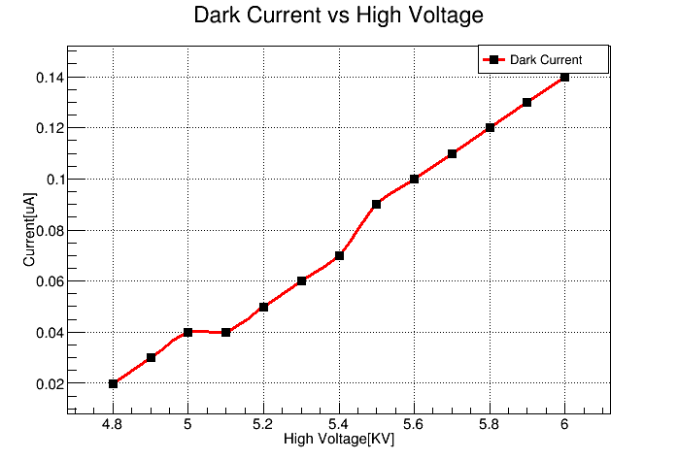
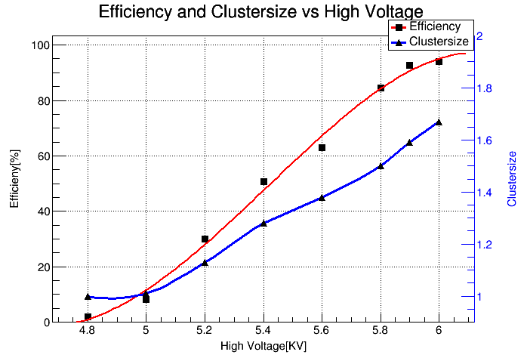
Cs源关闭时的高压扫描

Slide 18
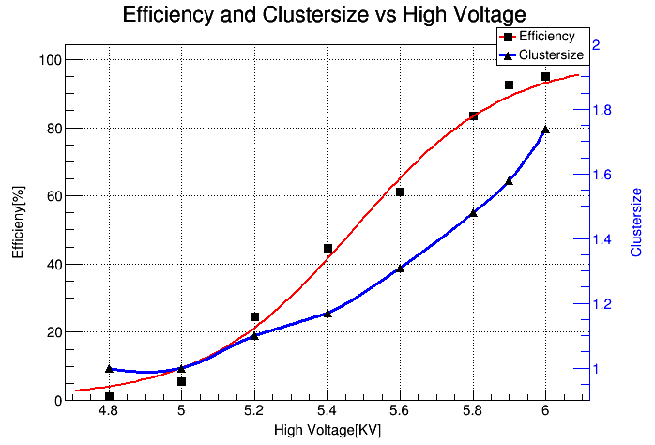
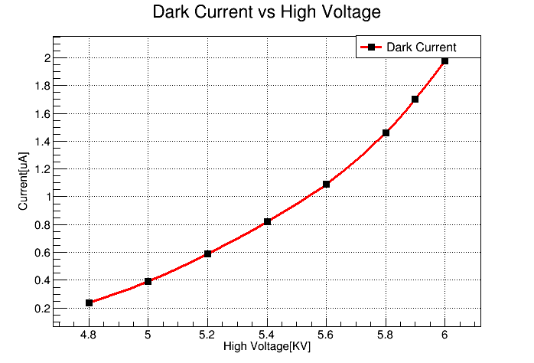
1KHz/cm² 本底时的高压扫描
Rate:1 kHz/cm²
Rate:1 kHz/cm²

Slide 19
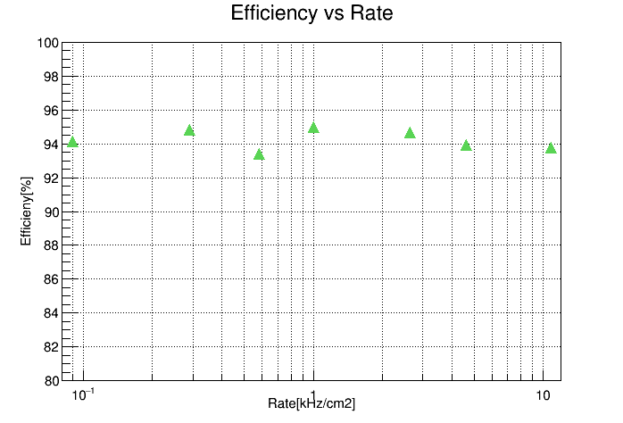
不同本底计数率时的探测效率
Rate[kHz/cm²] | Efficiency[%]
0 | 94.12
0.29 | 94.81
0.58 | 93.41
1.007 | 95
2.64 | 94.68
4.64 | 93.93
10.83 | 93.75
There is no efficiency loss along with high rate. Efficiency always reaches about 95% at ± 6000V.

Slide 20
文章和专利
Wang Fuyue, Wang Yi. Performance study of new style mosaic MRPC. Chinese Physics C, 2016, 40(11) , 116006 . DOI：10.1088/1674-1137/40/11/116006.
Wang Fuyue, Han Dong and Wang Yi. Performance study of a Mosaic high rate MRPC. 2016 JINST 11 C09016
Lyu Pengfei, Wang Yi. et al. Gas related effects on multi-gap RPC performance in high luminosity experiments. 2016 JINST 11 C11041
Lyu Pengfei, Wang Yi. Development and performance of self-sealed MRPC. JINST，12，C03055
一种新型的阻性板室探测器, 发明专利号：ZL201410190976.X
快时间响应射线探测器，实用新型，ZL 201520890740.7

Slide 21
经费使用情况
材料费： 24万元
测试加工费： 1.3万
差旅费： 3.9万
国际合作交流费：21万
文献出版： 1.1万
劳务费： 6.1万
专家咨询费： 0.76万
合计： 58万元

Slide 22
后续工作
继续分析实验数据
开展探测器性能模拟，包括工作气体性能，计数率性能等
阻抗研究，对探测器进行优化设计
研究寻找探测器的新型环保工作气体，如以HFO替代Freon等
。。。

Slide 23
谢谢各位专家的指导与支持！

