Slide 1
CEPC Software Management Tool
Xianghu Zhao
Nov 20, 2017

Slide 2
cepcenv
This tool is developed for simplifying the management of cepc offline software
For both administrator and user
Features include
CEPC software installation
Version selection and switch
Environment variable management
Package management

Slide 3
Install cepcenv
cepcenv is located on github
https://github.com/cepc/cepcenv
Written in python
Support different shells
Setup environment variables
sh, bash, zsh already supported
csh, tcsh will be included
Install with single command
\curl -sSL https://github.com/cepc/cepcenv/raw/master/tool/install.sh | sh -s [CEPCENV_DIR]
This will create a setup.sh file for later use

Slide 4
Install cepcsoft with cepcenv
cepcenv ls-remote
Show available release versions
cepcenv install <version>
Could specify installation destination by “-r”
The package dependencies are pre-configured and will be automatically resolved
Parallel downloading and compiling to speed up the installation process

Slide 5
User Configuration
Create user configuration file
cepcenv config -e > ~/.cepcenv.conf
User should change the release_root to where all release versions are installed

Slide 6
Use Installed Release Version
cepcenv ls
List all locally installed versions
cepcenv use <version>
Could change current version if one already used
cepcenv use <version> --default
With --default option this version will be set as default version. This version will be automatically selected while doing cepcenv initialization
cepcenv clean
Wipe all the environment of the current release
cepcenv exit
Exit cepcenv entirely

Slide 7
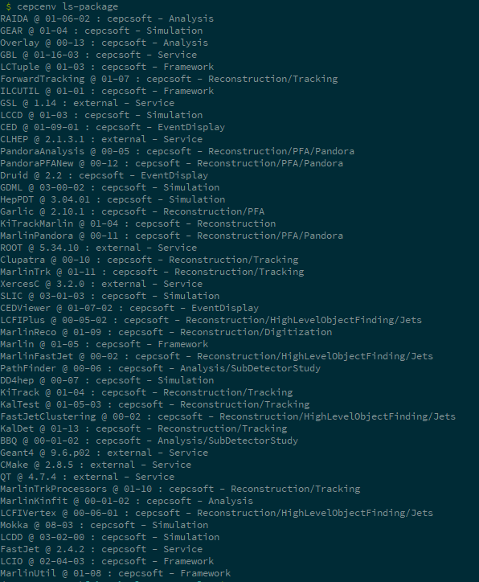
List All Packages of Current Release Version
cepcenv ls-package
Name
Version
Category
Directory

Slide 8
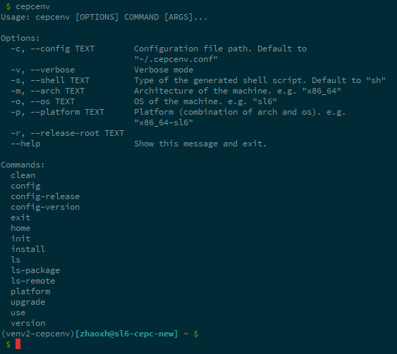
Other cepcenv Commands

Slide 9
Release a Version
All release definitions are kept in a separate project
https://github.com/cepc/cepc-release
Definitions include information of all packages
Package version
Install method and arguments
Dependencies
Attributes for setup environment variables

Slide 10
Plans
Simplify package development process for physics user
Without writing CMake files
Only need c++ source and header files
Configure package dependency easily
Include packages currently developing
Standardize the future release procedure

Slide 11
Thanks!

