Slide 1
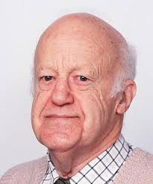
Dalitz Plots I
A powerful method for visualizing the
dynamics in three-body particle systems
Richard Dalitz 1925-2006
Stephen Lars Olsen
Graphics from Brian Lindquist (SLAC)

Slide 2
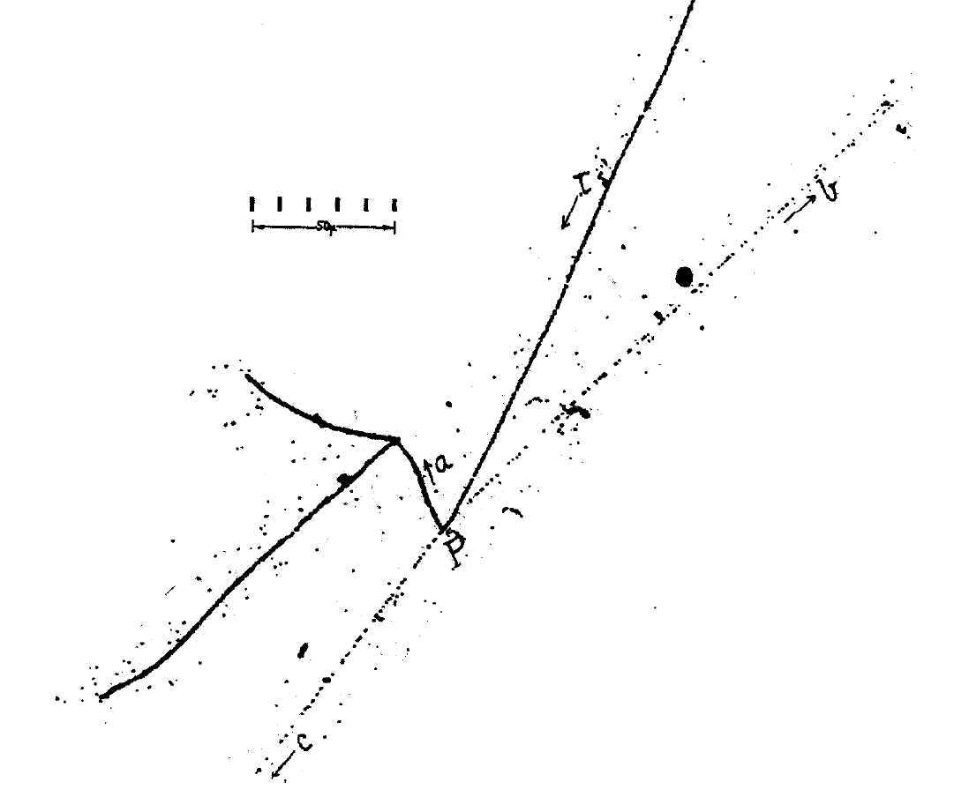
invented to study τ⁺→π⁺π⁺π⁻ decays
photographic emulsion
τ⁺
π⁺
π⁻
π⁺
τ⁺ → π⁺π⁺π⁻
m_{τ} = 970 m_{e} (495 MeV)
R.Brown et al., Nature 163, 47,82 (1949)
today, this is called a K⁺→π⁺π⁺π− decay

Slide 3
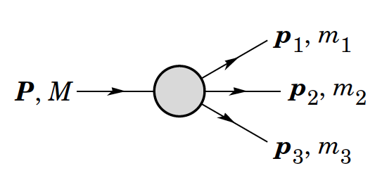
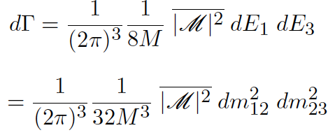
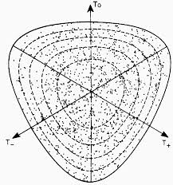
Fermi’s Golden Rule for 3-body decays
dΓ
dE₁dE₂

Slide 4
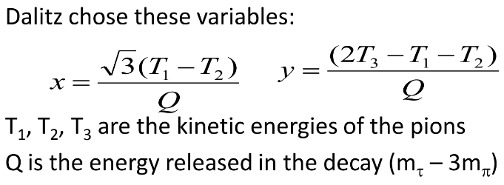
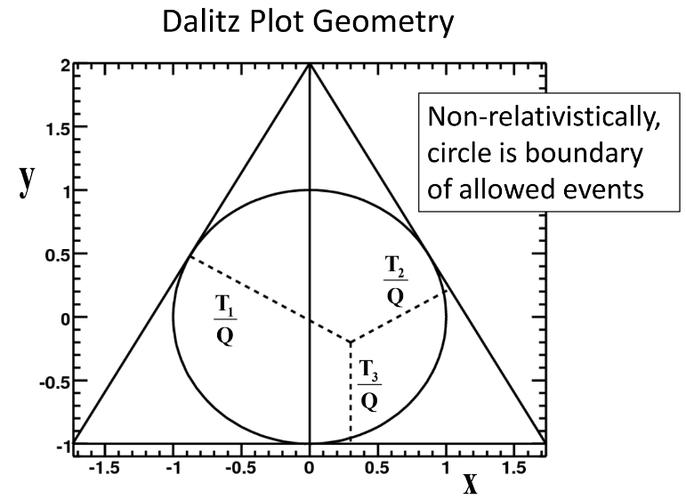
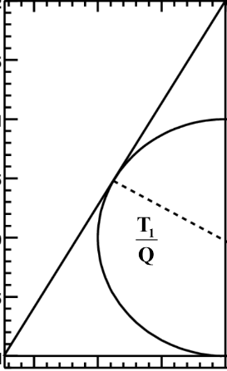
in the case of τ⁺→π⁺π⁺π⁻ use T₃=T_{π−} , the
plot is L-R symmetric & can be folded

Slide 5
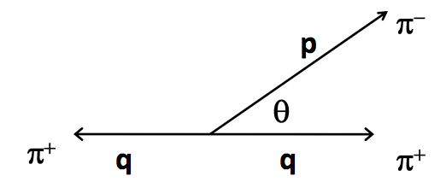
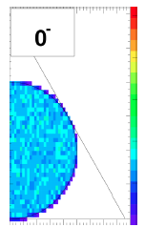
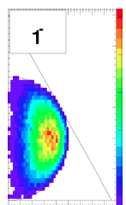
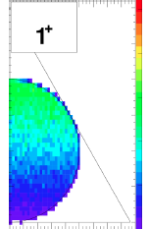
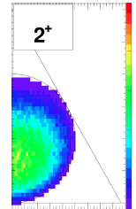
Expectations for different τ-meson J^{P} values

Slide 6
data in 1954
Dalitz: data favors
J-even, P=odd (-1)
J^{P}(τ⁺)=0⁻ ?

Slide 7
J^{P}(τ⁺)=0⁻ conflicts θ⁺→π⁺π⁰ decays

Slide 8
1956: Weak interactions violate parity
a discovery that can be attributed to the 1st application of Dalitz Plots
^
In part, at least,

Slide 9
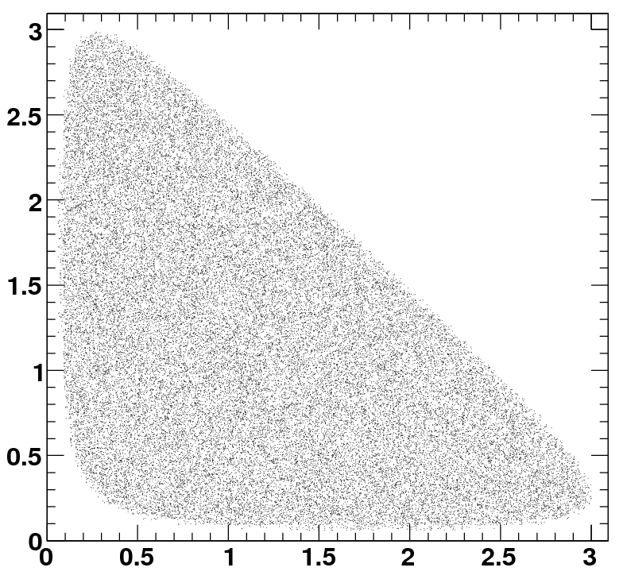
Dalitz Plots: old- vs modern-style
old-style
old-style
modern-style
here symmetries are more obvious

Slide 10
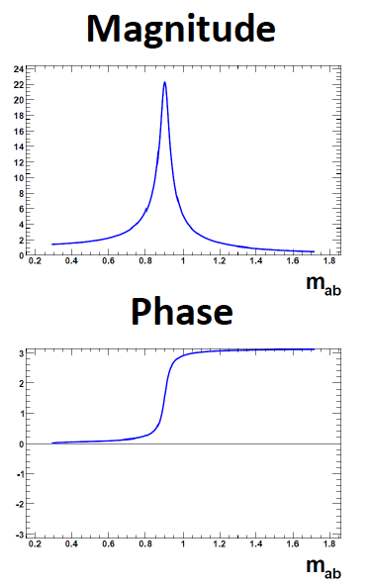
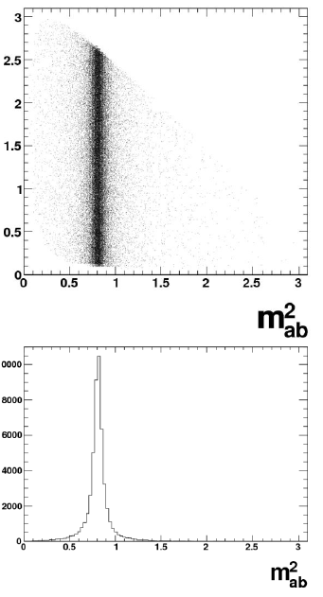
A resonance on a Daltiz
p₂
p₃
X
p₁

Slide 11
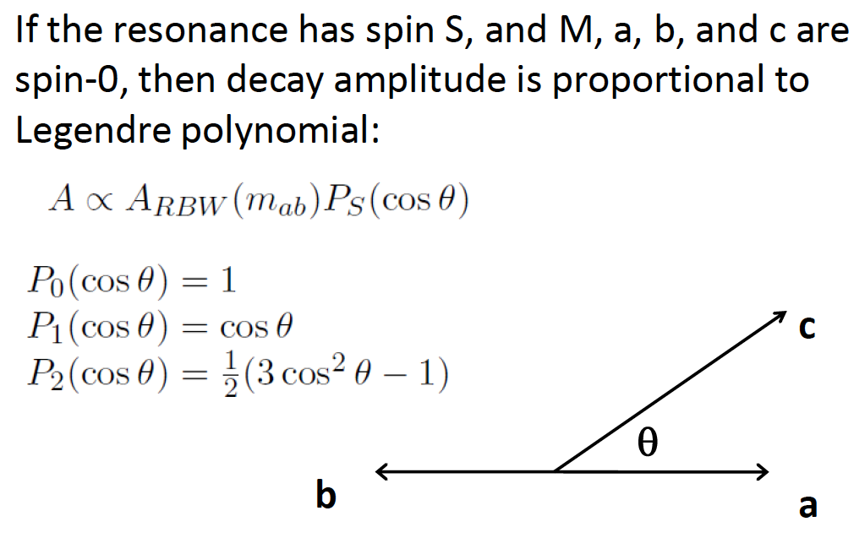
parent with spin
1, 2
3
1
2
3

Slide 12
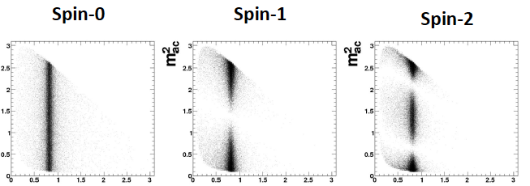
Resonance spin

Slide 13
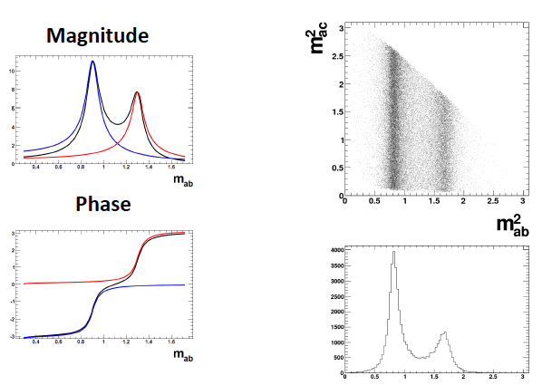
Constructive interference
very abrupt

Slide 14
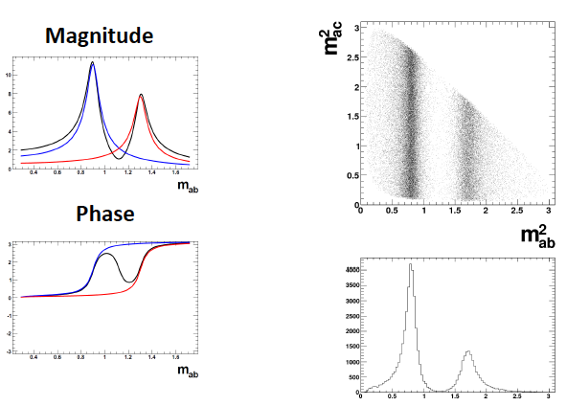
Destructive interference

Slide 15
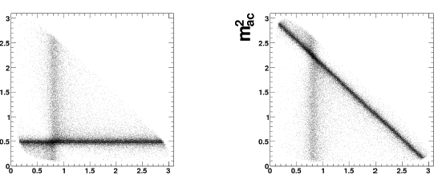
crossing resonances

Slide 16
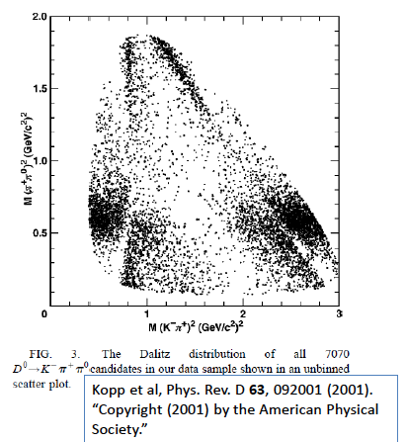

Slide 17
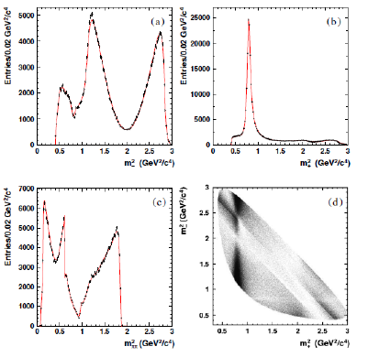
Invariant mass histograms don’t give a clue about the physics

Slide 18
Dalitz plot tells all!
reflections
K*(892)
σ
ρ
f₂(980)
Phys.Rev. D73, 112009 (2006)

Slide 19
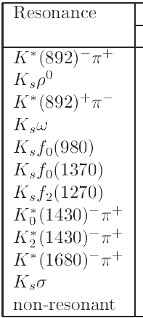
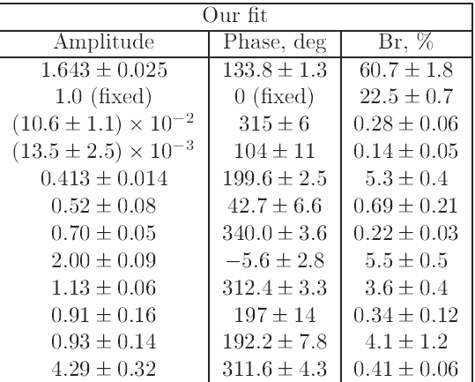
Details

Slide 20
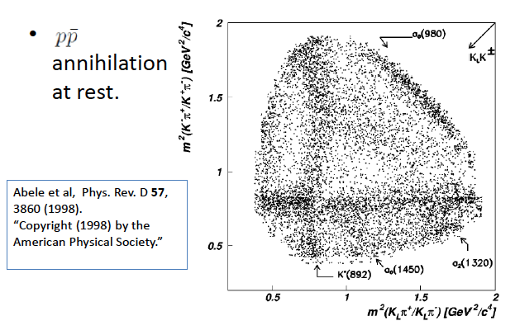

Slide 21
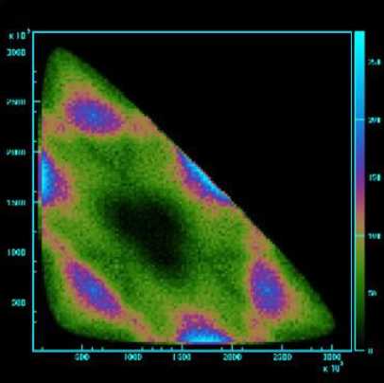
Dalitz plot symmetries
only Ispin=1 allowed

Slide 22
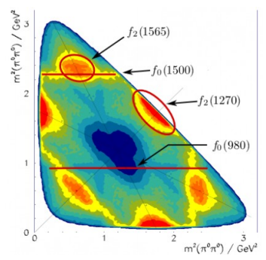
Interpretation
J^{P}=0⁻

