Slide 1
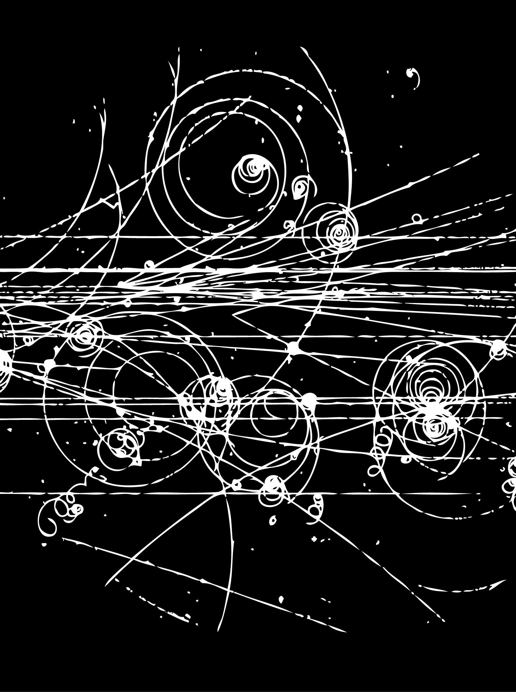
Hadron Spectroscopy
Lecture 1
Stephen Lars Olsen
Institute for Basic Science (KOREA)
University of the Chinese Academy of Science
Weihai August 16-19, 2018

Slide 2
Why study hadron spectroscopy?

Slide 3
The QCD “dilemma”
Theory works here
We live here

Slide 4
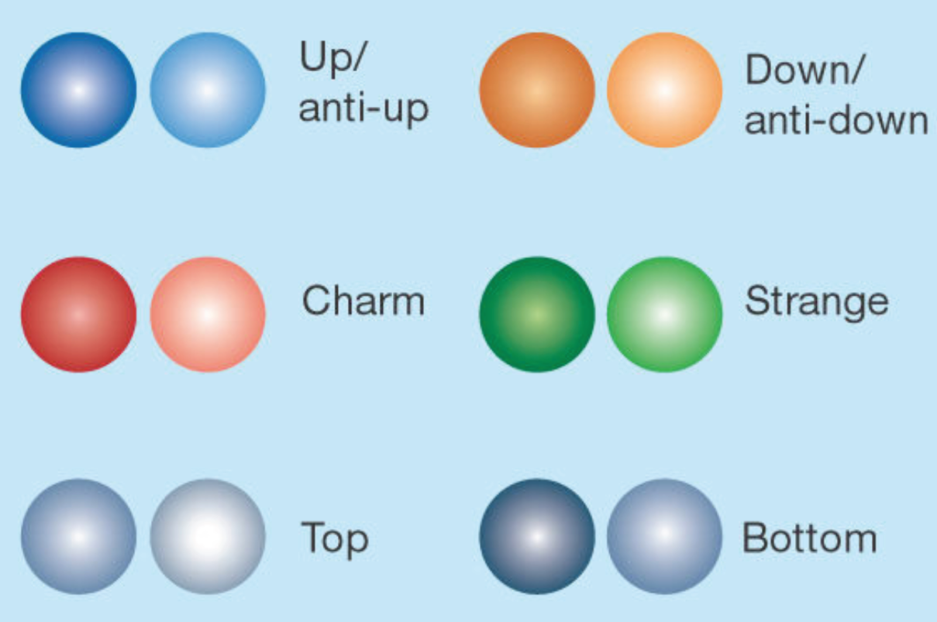
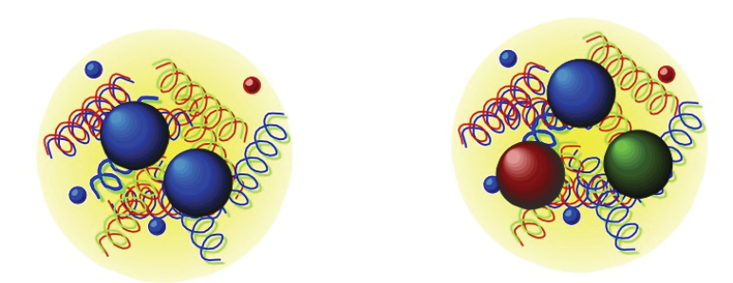

“psychological” problem
-- theory is divorced from reality --
strongly interacting particles
of the Standard Model
strongly interacting particles
in Nature
quarks
mesons
no useful 1st-principle
relation connects these
baryons
gluons

Slide 5
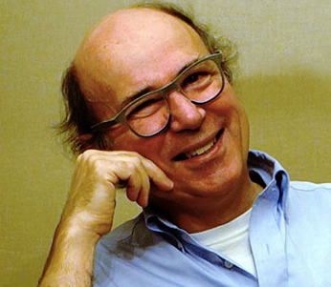
Frank Wilczek (on long-distance QCD)
https://www.edge.org/conversation/frank_wilczek-power-over-nature
We have something called a standard model, but its foundations are kind of scandalous. We have not known how to define an important part of it mathematically rigorously,…

Slide 6
Q: When facing a dilemma, what does an experimenter do?
A: More experiments!
Q: Why?
A: Distinguish good models from bad.
Look for new patterns and/or trends.

Slide 7
Outline
Main Lecture
  -- introduction, units, symmetries, commonly used jargon, etc
  -- properties of the common hadrons
  meson and baryon octets and baryon decuplet
  SU(3) flavor-symmetry
  discovery of the Ω⁻ and the φ(1020)
  OZI rule and the need for something new
Special topic
  Dalitz plots
  ω→π⁺π⁻π⁰ Dalitz plot
  D→Kρ⁰→Kπ⁺π⁻ Dalitz plot
  D→K*⁻π⁺→Kπ⁺π⁻

Slide 8
Units, notation, important quantum numbers, etc.

Slide 9
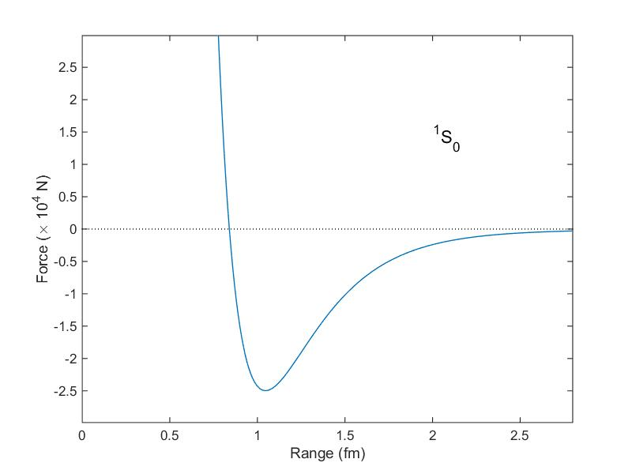
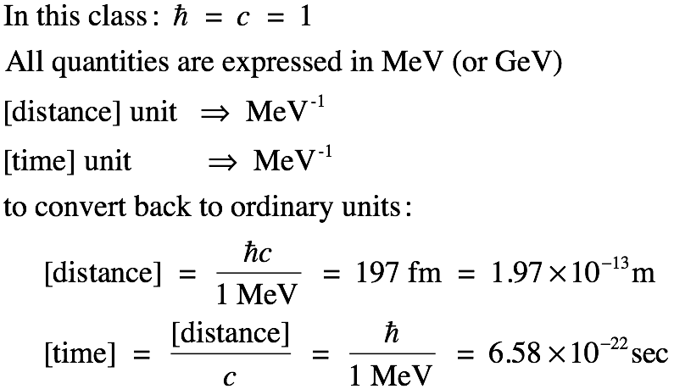
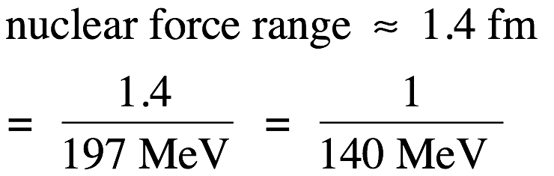
Units
nucleon-nucleon force
Example:
≈ 1/7 m_{proton}
≈m_{π}

Slide 10
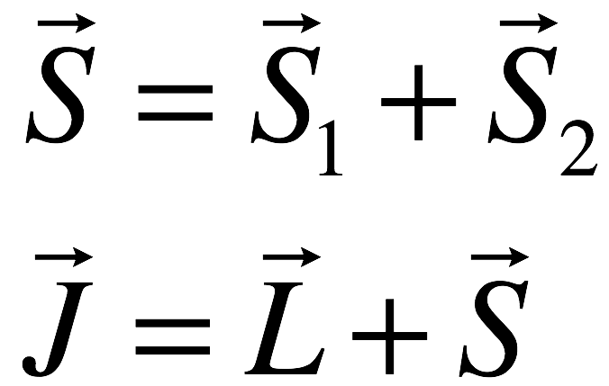
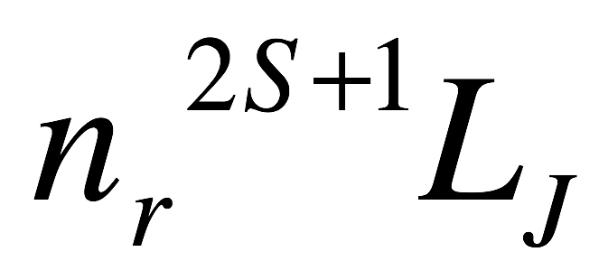
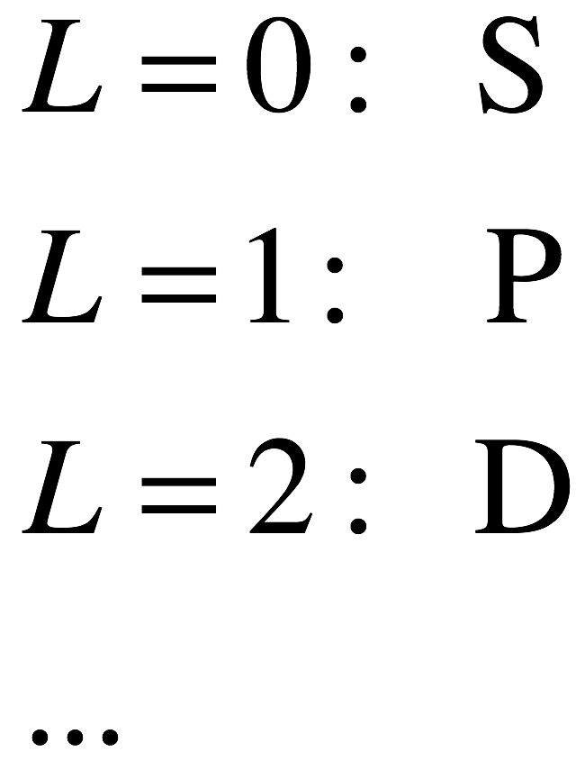
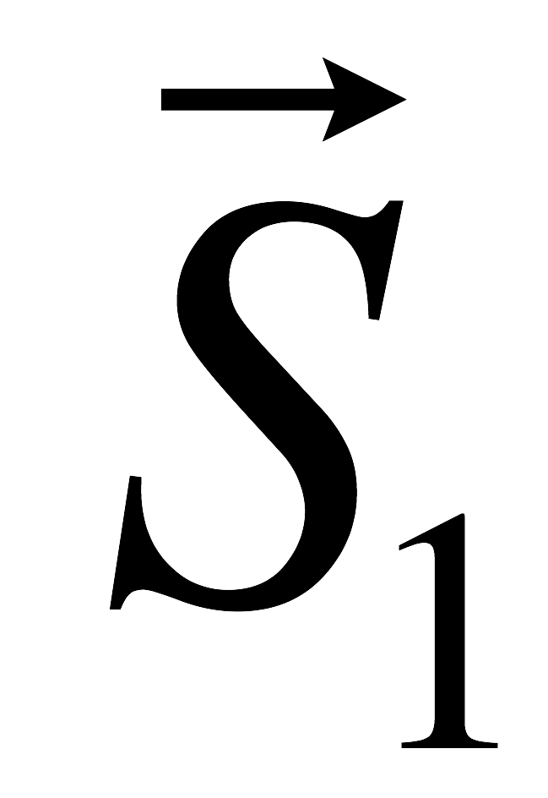
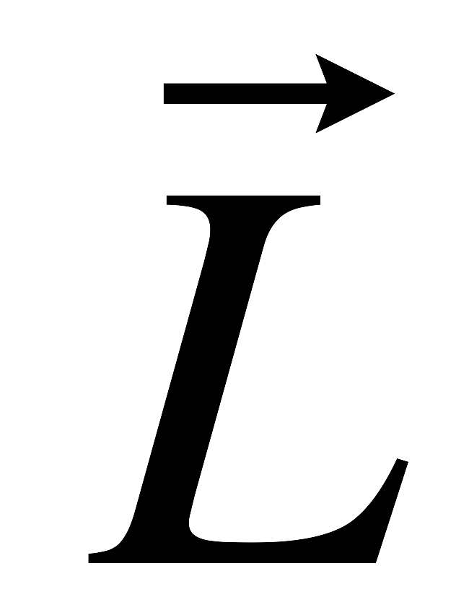
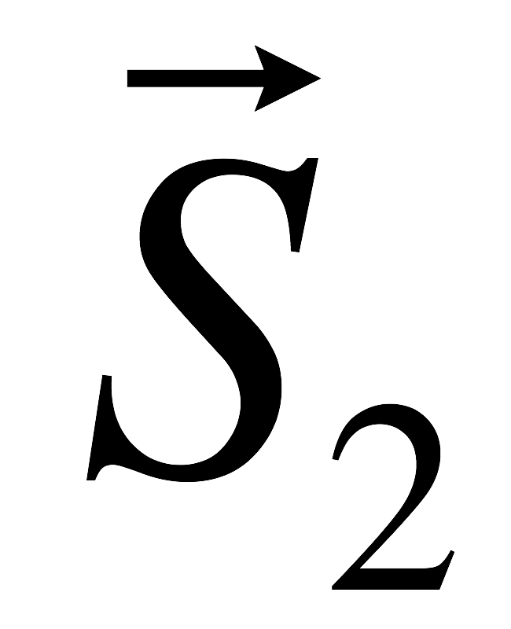
Spectroscopic Notation
J^{PC} quantum numbers
c
A
B
S=1 ➔ triplet of state
S=0 ➔ singlet
radial q.n.

Slide 11
Important Quantum numbers

Slide 12
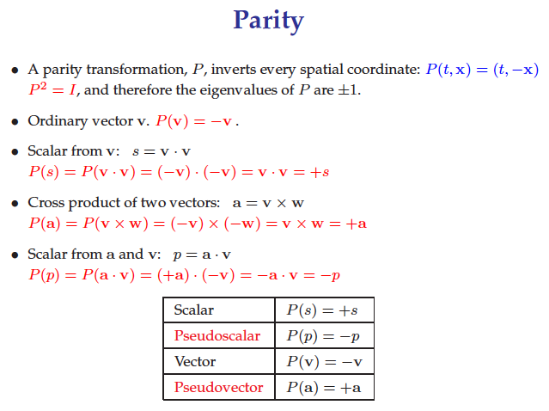
called an “axial” vector
Slide copied from Diego Bettoni

Slide 13
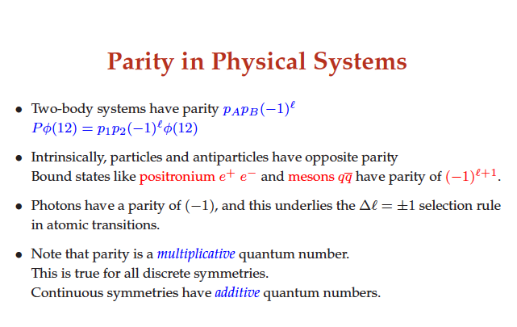
fermions and antifermions
Slide copied from Diego Bettoni

Slide 14
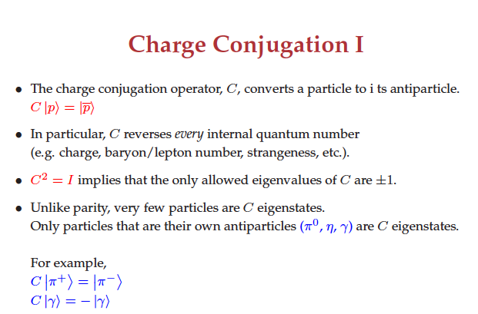
Slide copied from Diego Bettoni

Slide 15
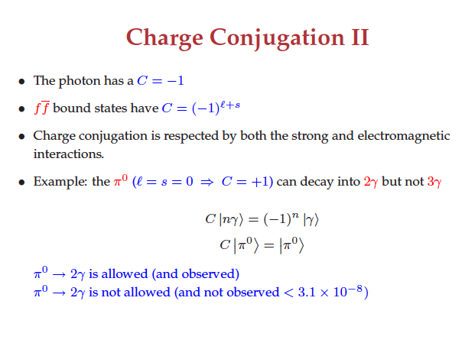
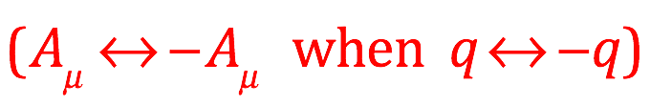
Slide copied from Diego Bettoni

Slide 16
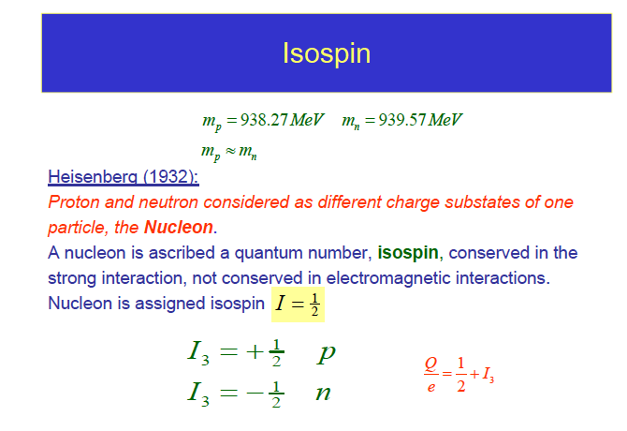
Slide copied from Diego Bettoni

Slide 17
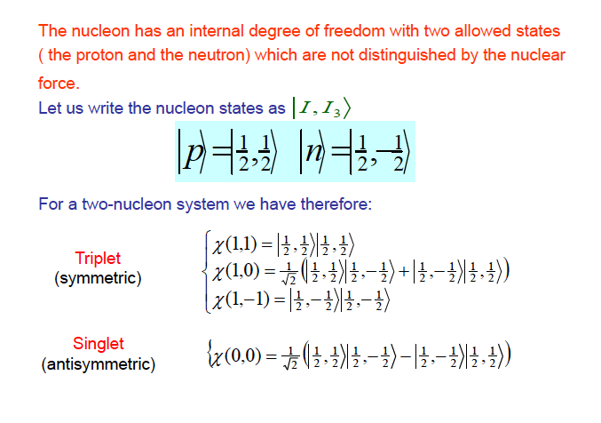
Slide copied from Diego Bettoni

Slide 18
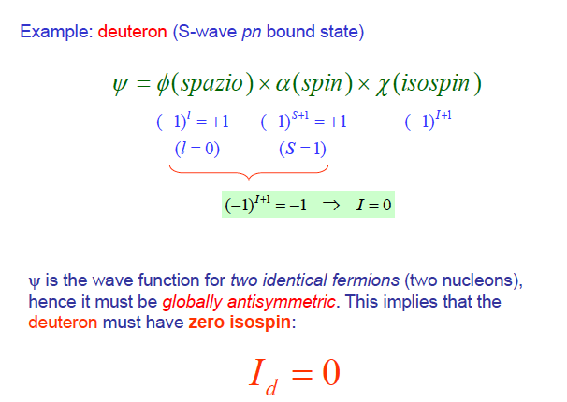
Slide copied from Diego Bettoni

Slide 19
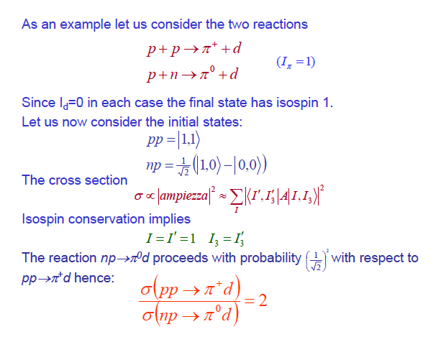
Slide copied from Diego Bettoni

Slide 20
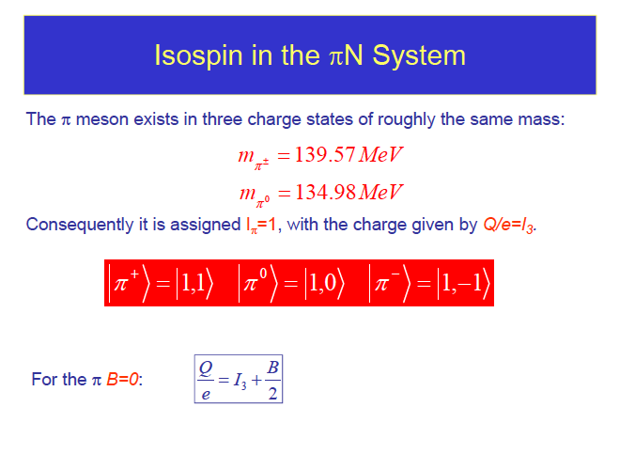
Slide copied from Diego Bettoni

Slide 21
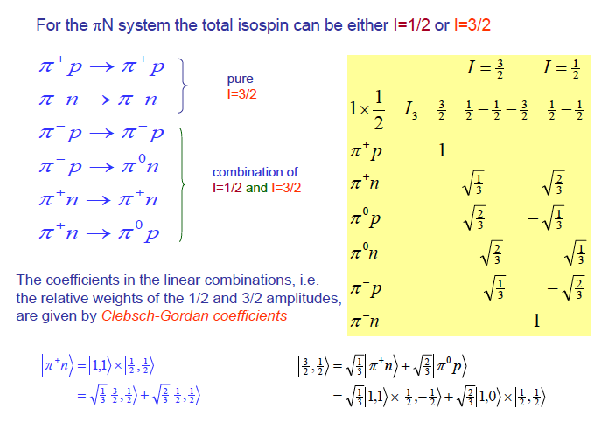
Slide copied from Diego Bettoni

Slide 22
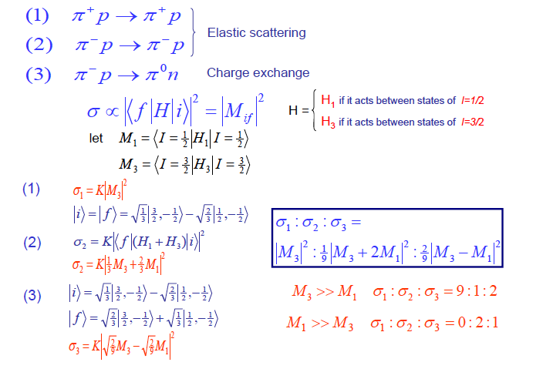
(2)
(3)
Slide copied from Diego Bettoni

Slide 23
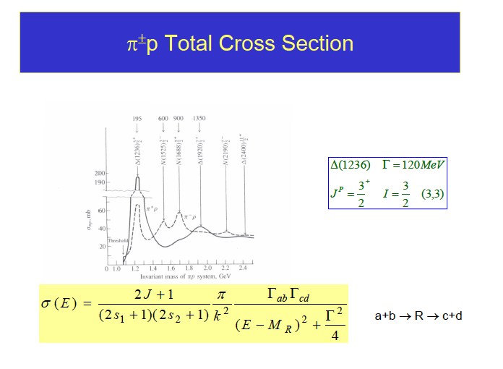
Slide copied from Diego Bettoni

Slide 24
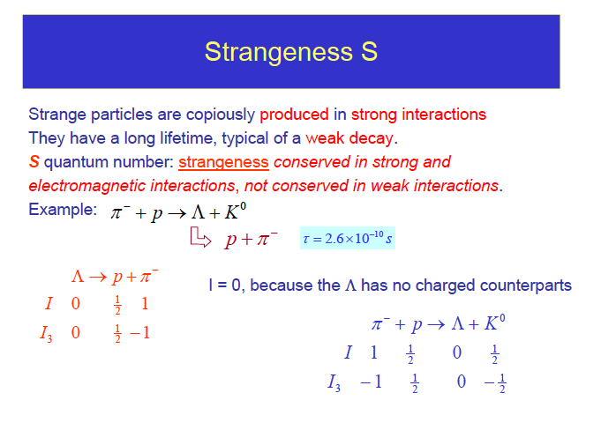
Slide copied from Diego Bettoni

Slide 25
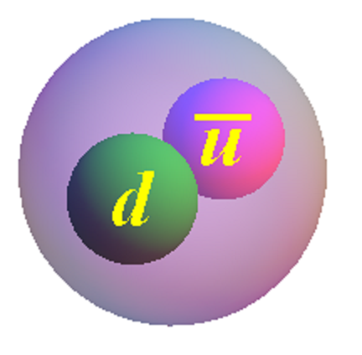
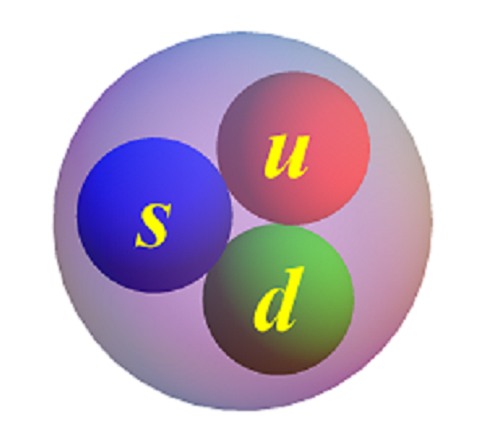
“strange” quark has “strangeness” S=-1
_
_
s
_
K⁰
S=+1
_
_
Λ⁰
_
_
d
S=-1
K⁰
s
Λ⁰

Slide 26
too many S’s ?
In hadron spectroscopy, we use ”S” for many things:
the strangeness of the K⁰ or Λ⁰ is S=+1
S= spin of a system of fermions
orbital angular momentum L=0 is called an S-wave
_

Slide 27
too many S’s ?
In hadron spectroscopy, we use ”S” for many things:
the strangeness of the K⁰ or Λ⁰ is S=+1
S= spin of a system of fermions
orbital angular momentum L=0 is called an S-wave
Sorry!
_

Slide 28
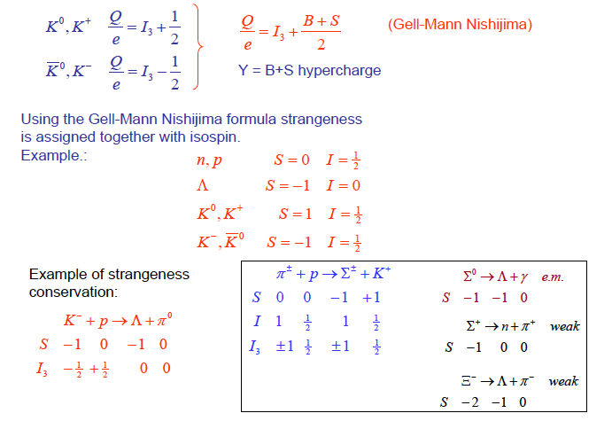
Slide copied from Diego Bettoni

Slide 29
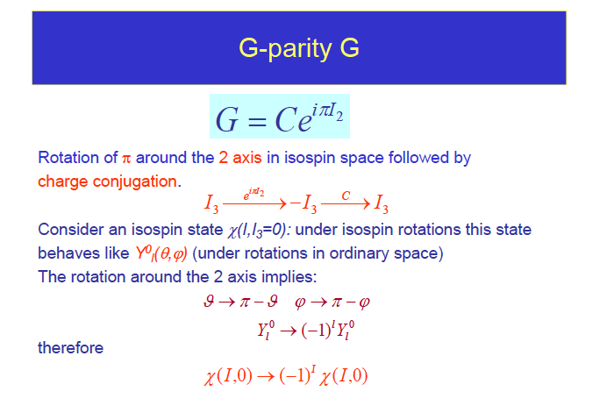
Slide copied from Diego Bettoni

Slide 30
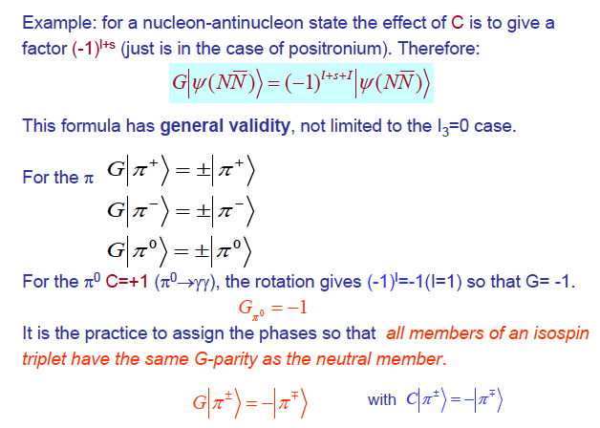
Slide copied from Diego Bettoni

Slide 31
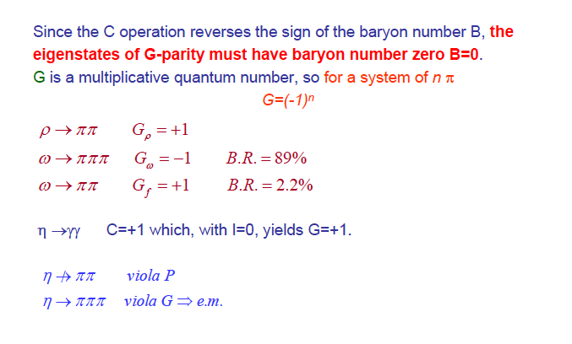
Slide copied from Diego Bettoni

Slide 32
important page in the PDG booklet

Slide 33
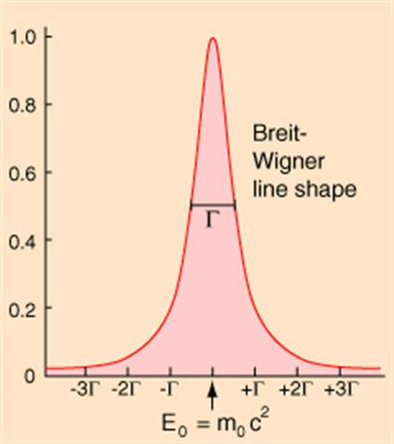
comment on widths, lifetimes, branching factions, partial widths
branching fraction
Γ=total
width
partial width
τ=lifetime
these are what theories calculate

Slide 34
example:
total widths
partial widths
although Bf(K_{S}→πeν)<<Bf(K_{L}→πeν), the partial widths are equal

Slide 35
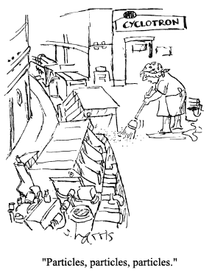
properties of π- and K-mesons

Slide 36
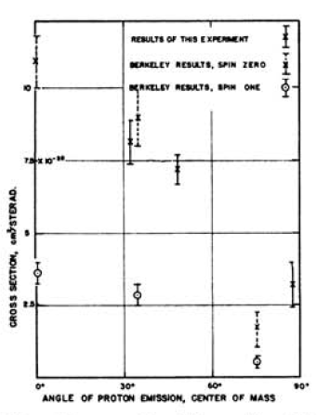
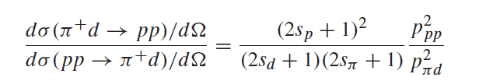

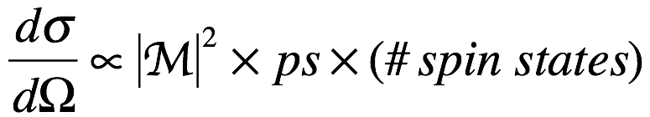
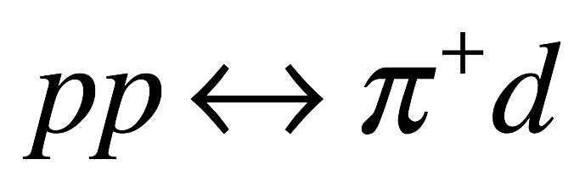

Spin of the π⁺
p
π
M
s_{π} =0
p
d
expt
same both ways
s_{π} = 1
=4/3 for s_{π} = 0
=4/9 for s_{π} = 1

Slide 37


Parity of the π⁻
stopped
capture occurs
in an S-wave
J=S_{d}=1
only Pauli-allowed’
J=1 nn state is ³P₁

Slide 38
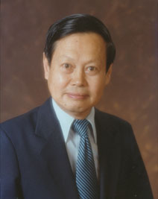

Spin of π⁰ ➔ Yang’s theorem
C.N. Yang: Spin=1 particle cannot
decay to 2 photons
Gell-Mann
C.N.Yang
Phys. Rev. 77, 242 (1950)
Homework: prove this

Slide 39



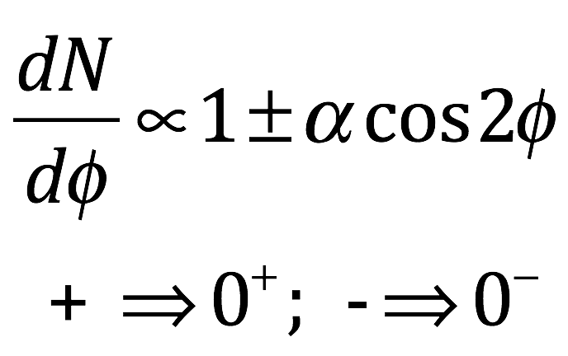
Parity of π⁰ ⬅use double “Dalitz” decays
π⁰ decay modes
from PDG
“Dalitz” decays
2x“Dalitz” decays
Phys. Rev. 98, 1355 (1955)
e⁺
e⁺
e⁻
e⁻
φ

Slide 40
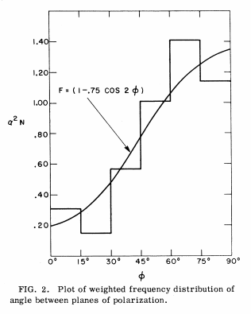
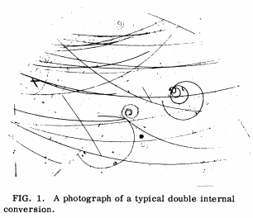
Phys. Rev. Lett. 3, 525 (1959)
for this expt’s acceptance: α_{theory} = 0.48
“typical” event
P_{π0} = -1

Slide 41
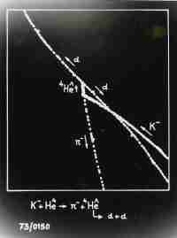
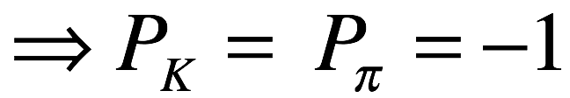
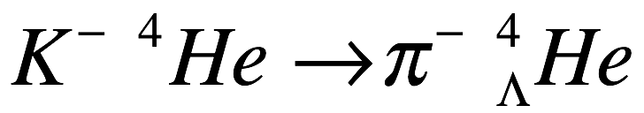

Parity of the K⁻
strong interaction
He bubble chamber
stopped
⁴He nucleus
with n→Λ
capture occurs
in an S-wave
J=0
π: J^{PC}=0⁻⁺
K: J^{PC}=0⁻⁺
“pseudoscalar mesons”

Slide 42
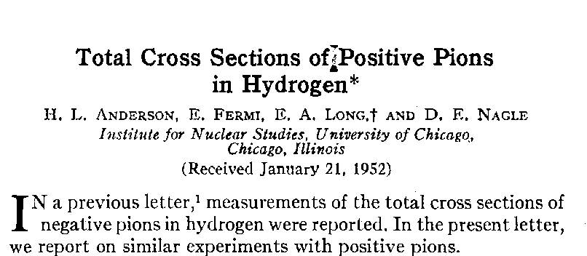
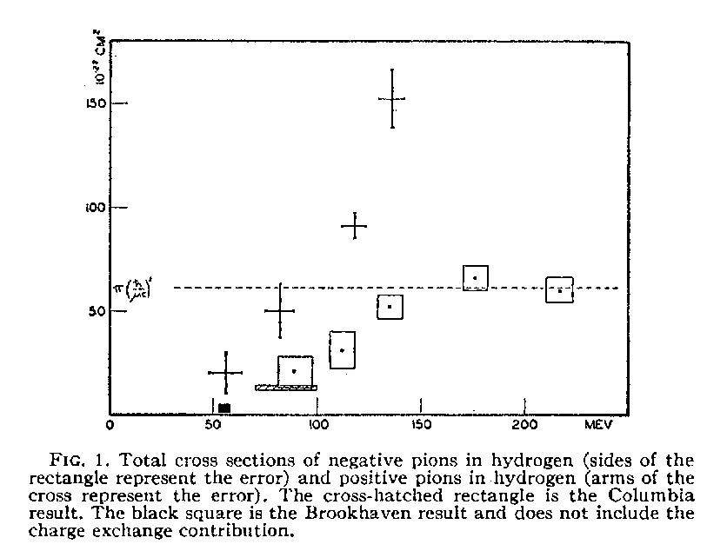
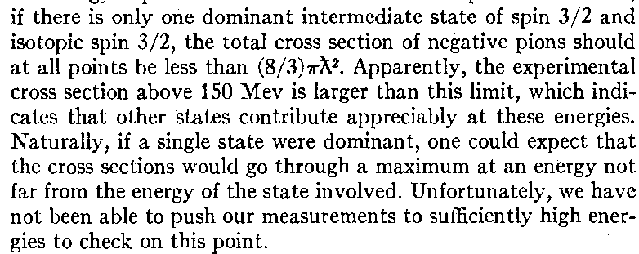

Resonances
The Fermi π-Nucleon resonance: Δ(1236)
π⁺p
σ_{tot}
π⁻p
Based on these data, Fermi
predicted a J=3/2; I=3/2
resonance with mass just
above 1200 MeV

Slide 43
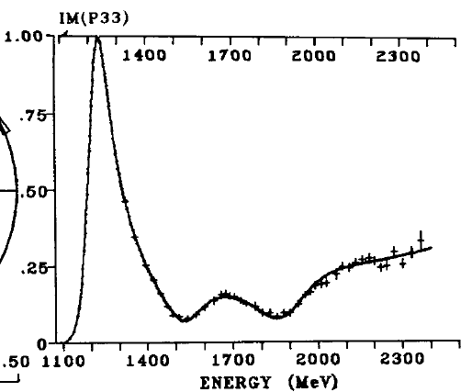
The Δ(1232) resonance

Slide 44




Breit Wigner line shape
Please note: This is the simplest version of many different expressions used to
describe resonance line shapes. These general features are common to all forms.

Slide 45






Phase structure of A_{BW}
M=M₀
Im
3M₀/2
M₀/2
≈90⁰
Re
Im
≈180⁰
Re
Im
≈0⁰
Re
M=0
M₀
Argand plot
-- A_{BW} moves CCW in a circle
-- rapid “phase motion” where
|A_{BW}| is maximum
Γ
M

Slide 46




return to the Fermi resonance: Δ(1232)
“Argand plot”

Slide 47
Other Resonances
-- The glory days of Bubble Chambers --

Slide 48


Bubble chambers
Pressurize the liquid to ~10 Atm
to keep it from boiling
Pass particle beam through liquid
Rapidly depressurize the liquid
--it starts to boil around the
track-induced ions.
Allow bubbles to grow for ~3 msec
Flash lamps; take photographs
Recompress before general boiling
occurs.
Repeat
Cryogenic liquid
above its normal
boiling point
1959 Nobel physics prize
Donald Glaser
1926-2013

Slide 49

80-inch bubble chamber at Brookhaven

Slide 50

80-inch bubble chamber optics

Slide 51


Bubble chamber event

Slide 52

Lots and lots of pictures
-- most of them uninteresting --
Scanner

Slide 53

First large-scale applications of digital computers.
On many University campuses, the most powerful computers were in the HEP lab.

Slide 54


K⁻p→ K⁰ Ξ⁰ π⁺ π⁻ event
“cascade-zero”

Slide 55









Why are Ξ baryons called “cascades?”
Ξ ⬅ Greek letter”Xi” “cascade” ⬅English word for multi-tier waterfall
Cascade Waterfall

Slide 56







Invariant mass
daughter particles
(the ones we measure)
resonance or particle
we want to study
b
A
A
very short lifetime
c
Einstein rest-mass vs energy relation
“invariant mass” of particles a and b
energy-momentum conservation

Slide 57

S=-1 resonances
Phys.Rev.Lett. 5, 115 (1960)
|
“Dalitz plot”
“reflection” from Y*⁻
π⁻
Y*⁻ →π⁻Λ
“signal”
Y*⁻
|
K⁻p
Λ
π⁺
“reflection”
“bachelor” π

Slide 58


Y*(1385) → Λπ

Slide 59


S=-2 resonance: Ξ*(1530)→Ξ π

Slide 60




Meson resonance: K*(892)→Kπ
Phys.Rev.Lett. 6, 120 (1961)
“Dalitz plot”
M(Kπ) MeV
KE_{p} (Mev)
KE_{π} (Mev)
|

Slide 61

comment on Dalitz plots
p_{K}
p_{π}
E_{cm}
equivalent kinematic variables
p_{p}
Richard Dalitz 1925-2006
HW: check this relations
old fashioned:
modern:
x→-x
y→-y

Slide 62



Meson resonance: ρ(770)→ππ
Phys.Rev.Lett. 6, 124 (1961)
must be I=1
M( ππ) MeV

Slide 63



Meson resonance: ω(782)→π⁺π⁻π⁰
Phys.Rev.Lett. 7, 126 (1961)
|
M( πππ) GeV

Slide 64
Quantum numbers of the ρ & ω

Slide 65





ρ meson quantum numbers
Known: ρ⁰→π⁺π⁻ and Ispin=1
Ispin=1
J^{PC}=1⁻ ⁻

Slide 66



ω meson quantum numbers
Known: ω⁰→π⁺π⁻ π⁰ and Ispin=1
0’s in the Dalitz plot: C. Zemach
Phys.Rev. 113. B1201 (1964)
event density is
0 at boundary
(π parity)³
J^{PC}=1⁻ ⁻

Slide 67
What about K*(892) quantum numbers?
-- examine the Dalitz plot --
KE_{p} (Mev)
not uniform
more events
more events
M² (Kp)
KE (π)
few (≈0) events

Slide 68

What about K*(892) quantum numbers?
-- examine the Dalitz plot --
most events @ cosθ_{K}≈ ±1
≈ 0 events at cosθ_{K}≈0
KE_{p} (Mev)
cosθ_{K}≈-1
cosθ_{K}≈+1
K
K
θ_{K}
θ_{K}
p
p
π
π
M² (Kp)
KE (π)

Slide 69


What about K*(892) quantum numbers?
-- examine the Dalitz plot --
KE_{p} (Mev)
cosθ_{K}≈-1
cosθ_{K}≈+1
K
K
θ_{K}
θ_{K}
p
p
π
π
M² (Kp)
KE (π)

Slide 70






Discovery of the η meson (1961)
Phys.Rev.Lett. 7, 131 (1961)
Deuterium –filled
80” bubble chamber
p
p
π⁺
π⁻
d
π⁰
p
π⁺
π⁰ is not detected.
presence inferred
by kinematics
|
|

Slide 71


η is also seen in η→γγ decay mode
Phys.Rev.Lett. 9, 127 (1962)
-- η→γγ seen
η→γγ
⬅Charge Parity=+1
-- by Yang’s theorem,
spin 1 is not allowed
⬅ Spin=0
-- η→ππ not seen
⬅ Parity=-1
-- η→πππ violates
G-parity
⬅Elec-Mag process
J^{PC}=0⁻⁺
θγγ

Slide 72




Elementary particle “Zoo” in 1963
←”wallet cards”
“stable” hadrons
meson resonances
baryon resonances
Ξ
Σ
Λ
Ν
K
Ξ*
π
K*
μ
ω
e
Y*
“flavors”
ρ
Two “classes” of hadrons
K₂*
“non-strange:” n, p, π, ρ, …
Δ
“strange:” Λ, Σ, K, K*, …

Slide 73


Meson and Baryon Octets
strangeness
baryon number
Y = “hypercharge” = S+B; I₃= 3rd I-spin component
Y
J^{P}=½⁺ baryon octet
J^{P}=0⁻ meson octet
Y
I₃
I₃

Slide 74

resonances
J^{P}=1⁻ vector meson octet
J^{P}=3/2⁺ baryon “decuplet"
K*⁰
K*⁺
ρ⁻
ω
ρ⁰
ρ⁺
φ
_
K*⁻
K*⁰
?
missing in 1961

Slide 75



Slide 76




1961: Gell-Mann, Nishijima & Nee’man: The Eightfold Way

Slide 77













Octets (and decuplets) are representations
of the SU(3) Lie group:
SU(2) group:
Angular Momentum in QM
SU(3) group:
Generalization of SU(2)
Pauli Matrices
Gell-Mann Matrices
Representations:
…
Representations:
Spin=1/2
…
Spin=1
octets
decuplets

Slide 78

SU(3) prediction for the Ω⁻ mass
Each unit of Strangeness increases M by 150 MeV
Gell-Mann Okubo mass formula
J^{P}=3/2⁺
M=1232 MeV
Δ≈ 153 MeV
M=1385 MeV
Δ ≈ 148 MeV
M=1533 MeV
?
M≈1533 + 150 MeV = 1683 MeV
Q=-1 S=-3

Slide 79

1965: Ω⁻ discovery
1965: the Ω⁻ was discovered at
the Brookhaven Lab in NY. USA
with S=-3 & M = 1672 MeV, near
the Gell-Mann/Okubo prediction

Slide 80


Ω⁻ seen at CERN too
Κ_{S}→π⁺π⁻
Κ⁻
Ω⁻
Λ→pπ⁻
Κ⁻
Κ⁺

Slide 81
another important discovery occurred at about the same time

Slide 82


Discovery of the φ(1020)
-- more important than the Ω⁻ ? --
Phys.Rev.Lett. 10, 134 (1963)
⬅well above 3π threshold
⬅narrower than ω(782)

Slide 83



no φ→π⁺π⁻; φ→π⁺π⁻π⁰ <φ→K⁺K⁻
1020 MeV
1020 MeV
For J=1⁻ and I=0, φ→π⁺π⁻ is forbidden
φ→π⁺π⁻π⁰ is allowed and has lots of phase- space. Why is it suppressed relative to
φ→K⁺K⁻, which has tiny phase-space?

Slide 84

what’s the difference between the ω(782) and the φ(1020)?
remember: partial width, ,
is what theorists calculate
same quantum
numbers
ω is 10×larger
φ has more phase space

Slide 85


“totalitarian” principle
极权主义
Gell-Mann
What isn’t forbidden,
is mandatory
Ω⁻
Why is φ→K⁺K⁻ enhanced
& φ→π⁺π⁻π⁰ suppressed?

Slide 86
Summary (lecture 1)
Experiments showed that the spin and parity of the π-, K- and η- mesons are all J^{P}=0⁻.
A matching set of meson resonances with J^{P}=1⁻., the ρ-, K*- and
ω-mesons, were found in bubble chamber experiments.
A set of spin=3/2 baryon resonances, the Δ(1232), Y*(1385) (now called the Σ(1385)) and Ξ(1530) were also discovered.
Mesons come in octets; baryons come in octets and decuplets.
Gell-Mann and Nee’man identified the octets and decuplets as representations of the SU(3) symmetry group.
The Okubo - Gell-Mann model for SU(3) breaking predicted an Ω⁻ mass of ≈1863 MeV. Brookhaven found it with m _{Ω−} =1872 MeV.
The φ(1020) meson was found at Brookhaven. For some unknown reason, its decay width to K⁺K⁻ was enhanced & to π⁺π⁻π⁰ was suppressed

Slide 87
some discussion items/questions
Prove Yang’s theorem.
Why would the decay η(547)→ππ violate parity conservation?
Although the η(547) mass is well above 3m_{π}, the partial decay width
Γ(η→3π) is only ≈1 keV, which means it is not an allowed strong Interaction
process. Why is η→3π not an allowed strong Interaction process?
Why doesn’t the ρ(770)⁰ decay to π⁰π⁰?
Why doesn’t the ω(782)⁰ decay to π⁰π⁰π⁰?

