Slide 1
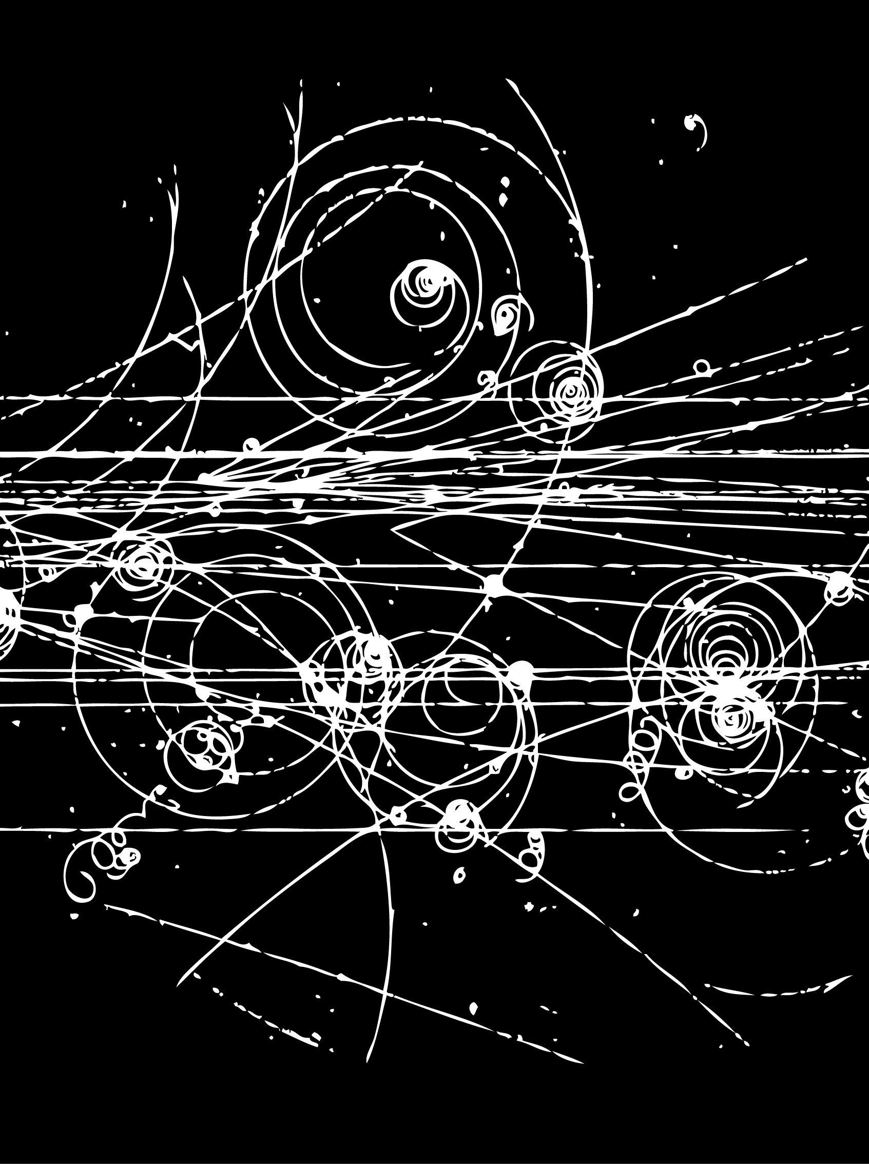
Hadron Spectroscopy
Lecture 4
Stephen Lars Olsen
Institute for Basic Science (KOREA)
University of the Chinese Academy of Science
Weihai August 16-19, 2018

Slide 2
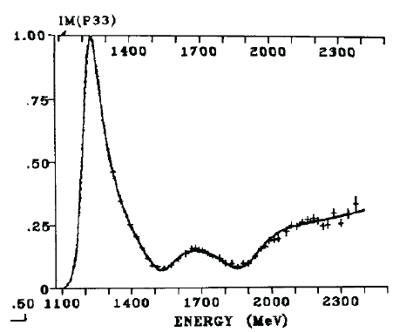
1st lecture: particle zoo → quarks
1947
16 years
1964
many, many particles
octets & decuplets
K∗(890)
π,K,Λ,Σ,…
φ(1020)
quarks!
Δ(1236)
ρ(770)
SU(3)
Ξ(1315)
etc…
Σ∗(1315)

Slide 3
2nd lecture: hadrons & the quark model
1964
- 10 years -
1974
K₂*(1430)
some problems but for
many states the quark
model works well
f₁(1285)/η(1440

Slide 4
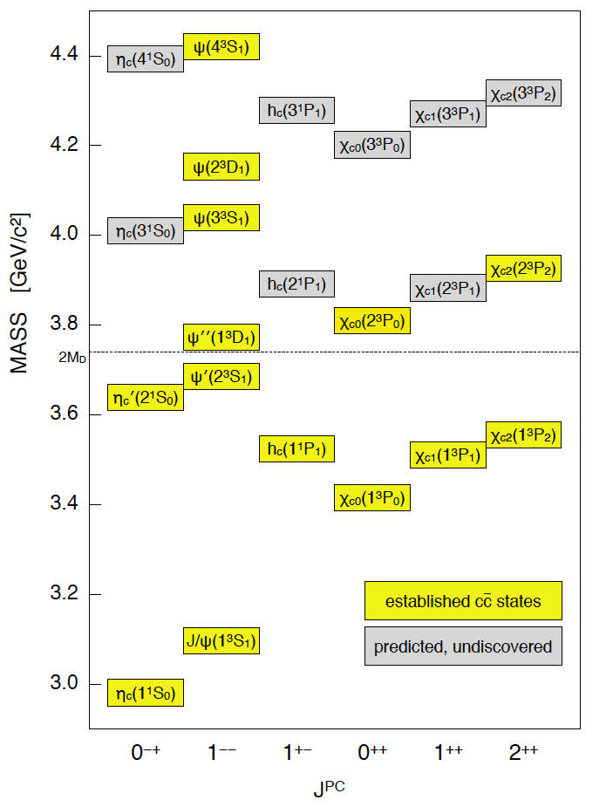
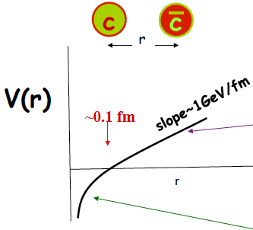
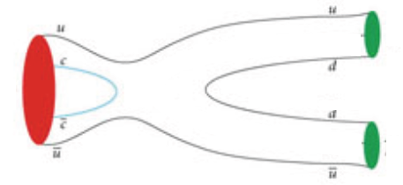
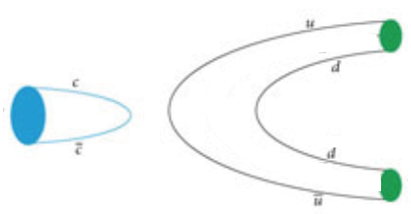
3rd lecture: charmonium
1975
2000+
Cornell model potential
-- spectum predicted
forty-plus years of work
potential model works well
all M<2m_{D} states
found at predicted masses
OZI-rule applies
no exceptions
η₂(21¹D₂)
ψ₂(2³D₂)
ψ₃(2³D₃)
η₂(1¹D₂)
ψ₂(1³D₂)
ψ₃(1³D₃)
OZI-allowed
C
D
ψ’’
_
D
C
2⁻ ⁺ 2⁻ ⁻ 3⁻ ⁻
OZI-suppressed
ρ
J/ψ
π
Notes:
es

Slide 5
3rd lecture: charmonium
1975
2000+
Cornell model potential
-- spectum predicted
forty-plus years of work
potential model works well
all M<2m_{D} states
found at predicted masses
OZI-rule applies
no exceptions
η₂(21¹D₂)
ψ₂(2³D₂)
ψ₃(2³D₃)
η₂(1¹D₂)
ψ₂(1³D₂)
ψ₃(1³D₃)
No Surprises
OZI-allowed
C
D
ψ’’
_
D
C
2⁻ ⁺ 2⁻ ⁻ 3⁻ ⁻
OZI-suppressed
ρ
J/ψ
π
Notes:
es

Slide 6

Lesson from 20th century charmonium
ψ’’’
χ_{c0}
’
ψ’’
η_{c}
χ_{c2}
’
ψ’
h_{c}
ψ’
η_{c}
χ_{c1}
J/ψ
χ_{c0}
Jigsaw Puzzle (拼图游戏)
If it’s the correct piece, it “snaps” into place
If you have to push hard, it‘s the wrong piece

Slide 7

Lesson from 20th century experiments
ψ’’’
χ_{c0}
’
ψ’’
η_{c}
χ_{c2}
’
ψ’
h_{c}
ψ’
η_{c}
χ_{c1}
J/ψ
Jigsaw
χ_{c0}
Jigsaw Puzzle (拼图游戏)
If it’s the correct piece, it “snaps” into place
If you have to push hard, it‘s the wrong piece

Slide 8
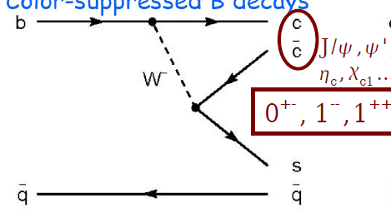
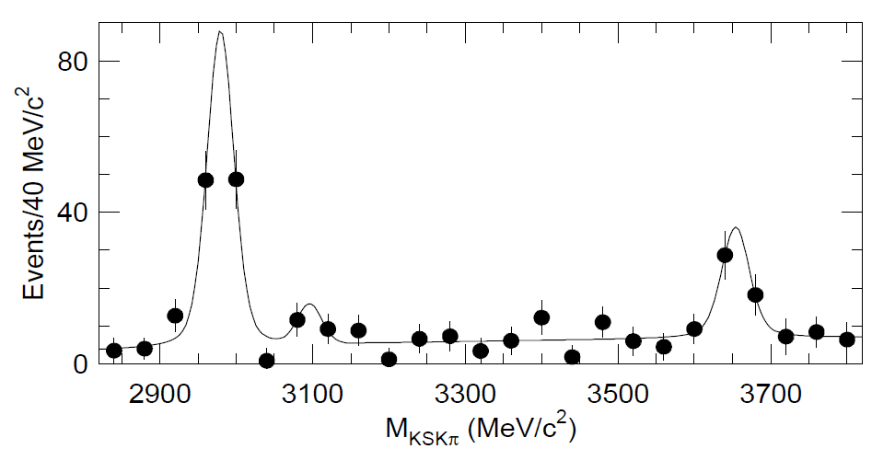
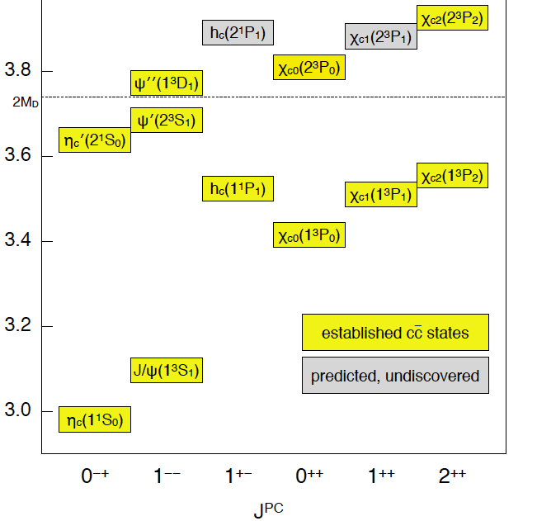
example: 1st observation of the η_{c}’
c
c
_
‘
→η_{c}(η_{c})→K_{S}K⁺π⁻
B meson
Belle PRL 89, 102001 (2002)
M_{ηc’}=3654±10 MeV
Γ<55 MeV
s
q
η_{c}
_
→K
η_{c}’
M(K_{S}K⁺π⁻)

Slide 9
1st observation of the η_{c}’
c
c
_
‘
→η_{c}(η_{c})→K_{S}K⁺π⁻
B meson
Belle PRL 89, 102001 (2002)
M_{ηc’}=3654±10 MeV
Γ<55 MeV
s
q
η_{c}
_
→K
η_{c}’
M(K_{S}K⁺π⁻)
X(3650) as the η_{c}’ scorecard
 | predicted | measured | comment
mass (MeV) | 3640 | 3654±10 | OK
width (MeV) | ≤30 | <55 | OK
decay mode | K_{S}Kπ | K_{S}Kπ | OK

Slide 10
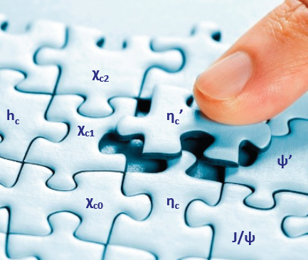
Bingo!

Slide 11
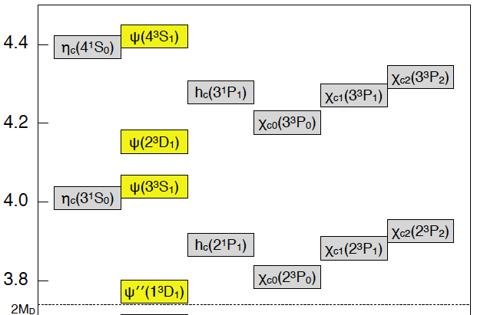

20TH century expectations for
21st century charmonium physics
discover these
D-wave states
Notes:
hese

Slide 12
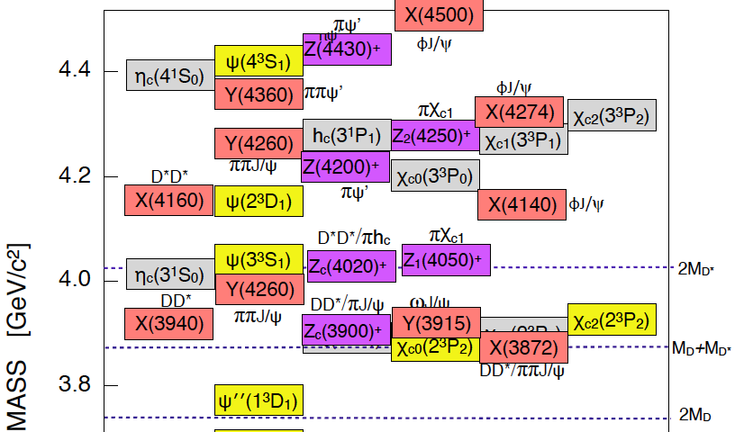
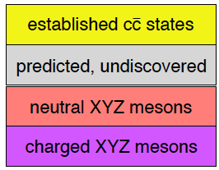
21st century: reality strikes
>15 charmonium-like states found with M>2m_{D}
that do not match expectations for any of the
as yet unassigned charmonium levels

Slide 13
21st century: reality strikes
many surprises
>15 charmonium-like states found with M>2m_{D}
that do not match expectations for any of the
as yet unassigned charmonium levels

Slide 14
A new spectroscopy?
_
2003: X(3872) right at D⁰D*⁰ threshold, molecule ?
_
2005: X(3915 ) far from any DD threshold, cannot be
a molecule. A diquark-diantiquark?
_
2005: Y(4260 ) far from any DD threshold, quite
complex. Not a good molecule or
diquark-diantiquark candidate.
A cc-gluon hybrid?
_

Slide 15
A new spectroscopy?
_
2003: X(3872) right at D⁰D*⁰ threshold, molecule ?
no unifying theme!
_
2005: X(3915 ) far from any DD threshold, cannot be
a molecule. A diquark-diantiquark?
_
2005: Y(4260 ) far from any DD threshold, quite
complex. Not a good molecule or
diquark-diantiquark candidate.
A cc-gluon hybrid?
_

Slide 16
Today’s lecture

Slide 17
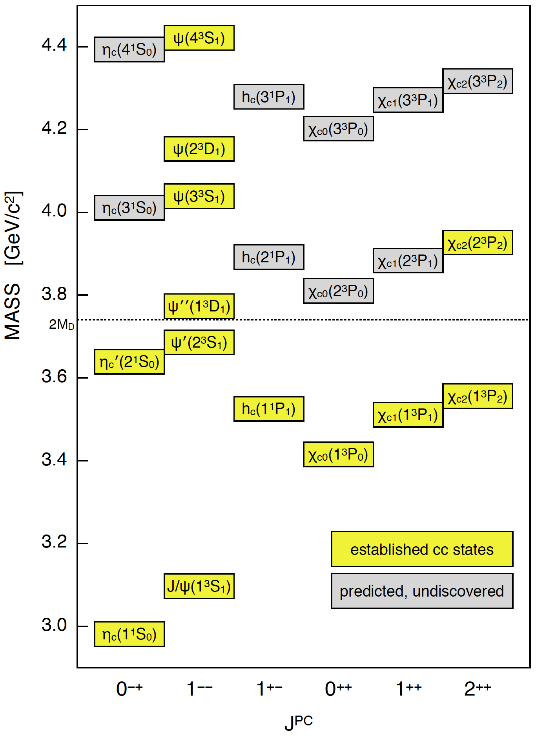
Discovery of the X(3872)
X(3872)
π⁺π⁻

Slide 18
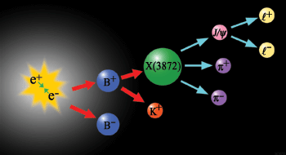
Select B→Kψ’; ψ’→π⁺π⁻J/ψ
Belle
ψ’
B⁰
K⁰
B⁰
_
flavor =?

Slide 19
mysterious satellite peak of the ψ’
神秘
卫星高峰
c
c
→π⁺π⁻J/ψ
_
Belle PRL 91, 262001 (2003)
B meson
s
q
_
→K
M(π⁺π⁻J/ψ)−Μ(J/ψ)

Slide 20
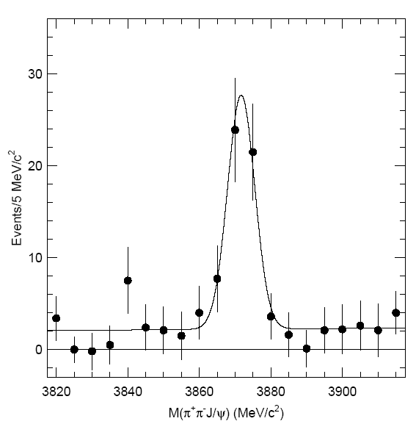

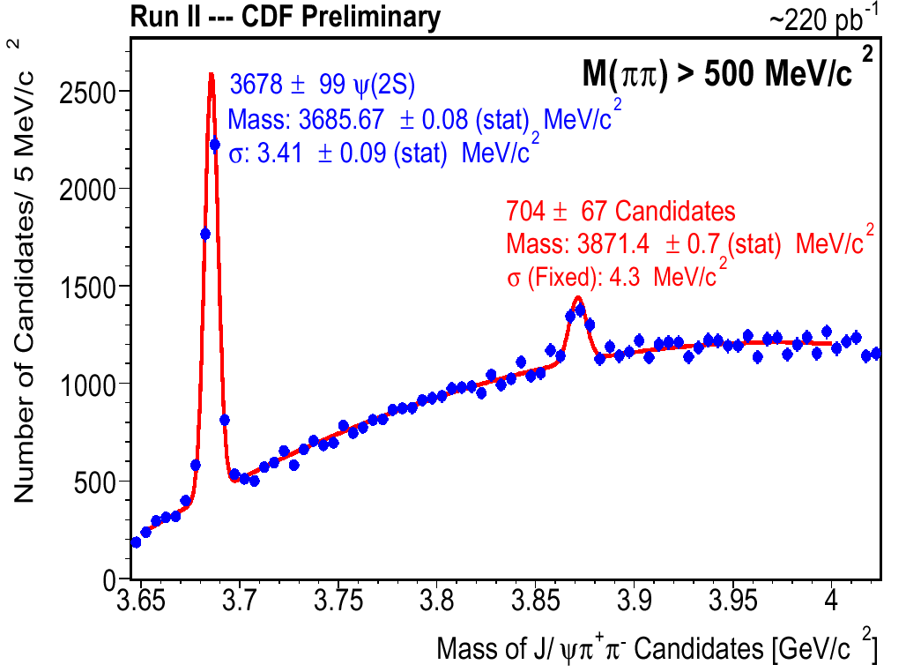
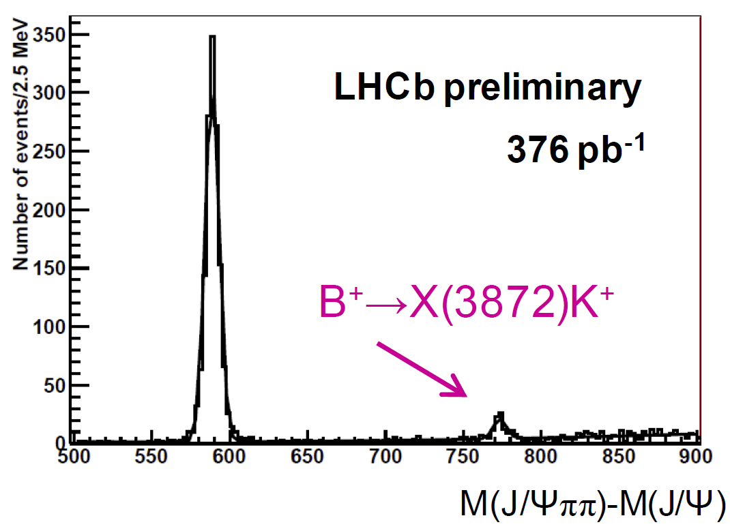
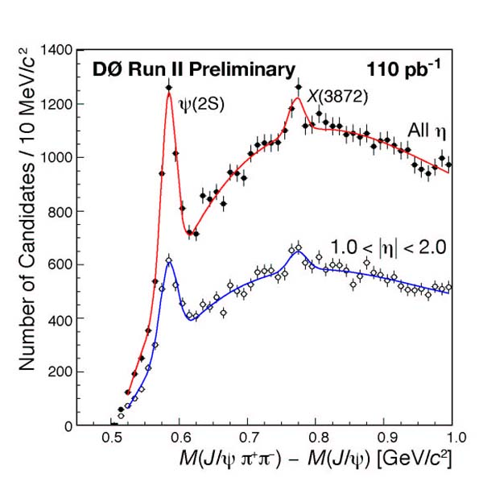
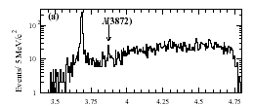
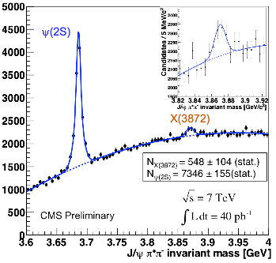

X(3872) seen in many experiments
CDF
X(3872)
BaBar
D0
X(3872)
CMS
X(3872)

Slide 21
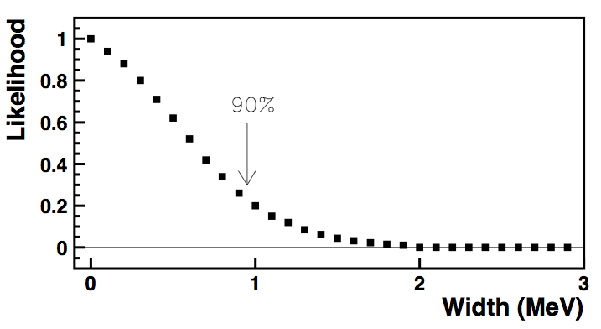
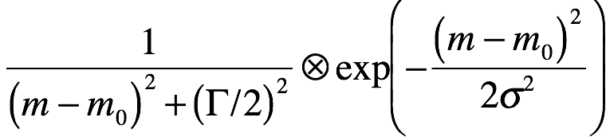
X(3872) width is narrow
Γ_{tot}<1.2 MeV
B→π⁺π⁻J/ψ
For comparison: Γ_{χc1(1P)} = 0.84±0.04 MeV
173 events
Belle PRD 84 052004
Γ_{D*}+
M(π⁺π⁻J/ψ)
Γ_{tot}=1.2 MeV
Gaussian resolution
function
Breit-Wigner
function
σ≈2.5 MeV

Slide 22
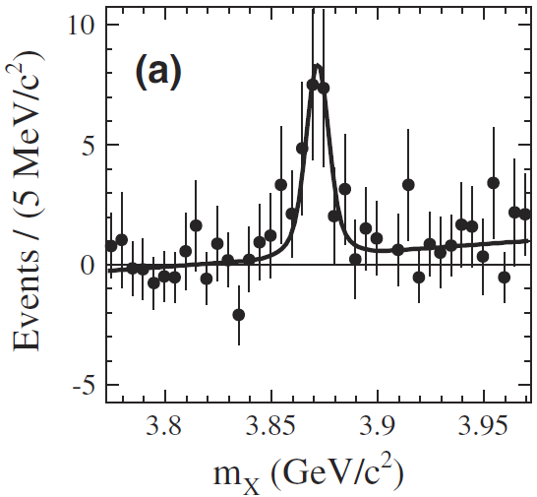
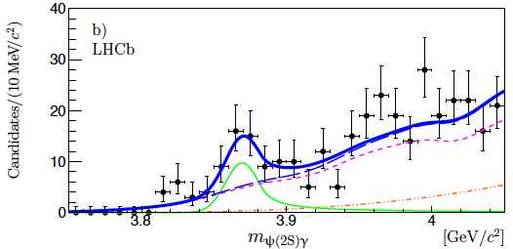
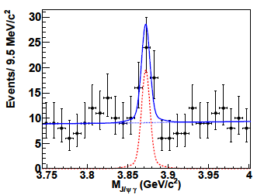
X(3872)→ γ J/ψ & γ ψ’ also established
B→K γ J/ψ
B→K γ ψ’
BaBar PRL 102 132001
LHCb 2014
LHCb NP B886 665 (1404.027)
BaBar 2009
PRL 102, 132001
M(γ ψ’)
Belle 2010
Belle PRL 107 091803
X(3872)→ γ J/ψ
C_{γ}=-1 × C_{J/ψ}=-1 ➔ C_{X3872}=+1
M(γ J/ψ )

Slide 23
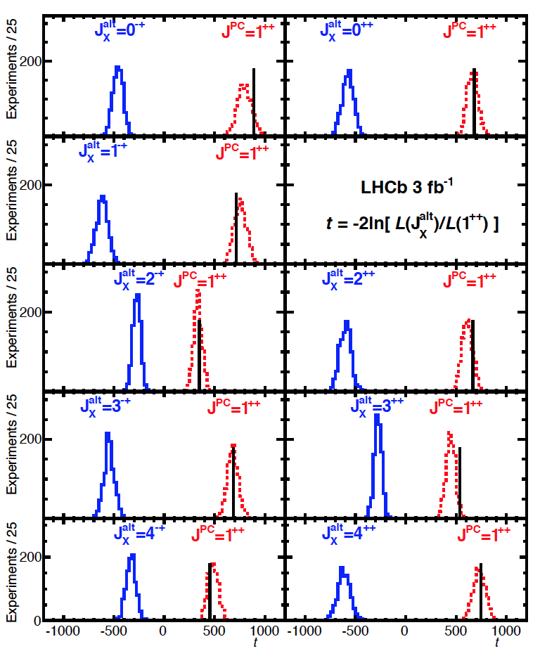
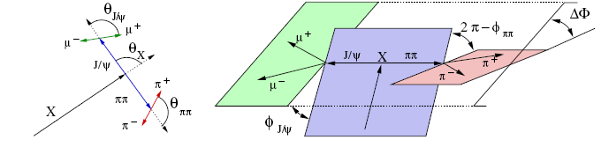
spin of X(3872) established as J=1
Parity established as P=+1
Angular correlation analysis by LHCb:
LHCb PRD 92 011102
J^{PC} = 1⁺⁺
D-wave<4%

Slide 24
the χ_{c1} 1⁺⁺ cc state?
Charmonium assignment for the X(3872)?
_
_{c1}?
‘
χ’
X(3872)

Slide 25
Is the X(3872) the χ_{c1} 1⁺⁺ cc state?
‘
_
Mass is too low
  3872 vs ≥3890 MeV
≥3890 MeV is set by:
Mχ_{c2}=3927 MeV
X(3872)
55 MeV
‘
the n_{r}³P₂-n_{r}³P₁ mass splitting
decreases with increasing n_{r}
41 MeV

Slide 26
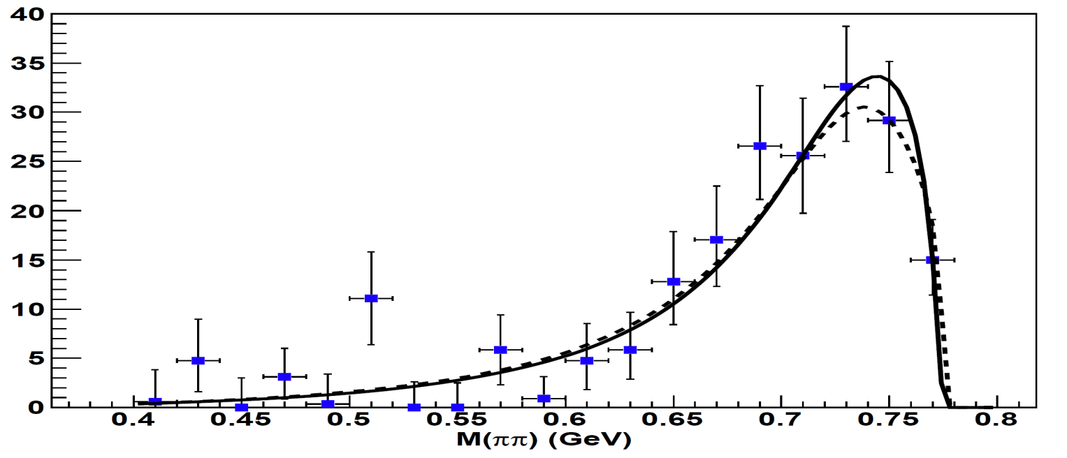
π⁺π⁻ system in X₃₈₇₂→π⁺π⁻ J/ψ comes from ρ→π⁺π⁻ established
m_{ρ}=775 MeV is at kinematic limit
Belle
CDF
Belle PRD 84 052004
CDF PRL 96 102002
τρυνχατεδ
ρ→π⁺π⁻ lineshape
截
m_{ρ} = 775 MeV
Γ_{ρ}= 149 MeV
J^{PC}=1⁻ ⁻
Isospin= 1
M(π⁺π⁻)
M(π⁺π⁻ )
X₃₈₇₂→ ρ⁰J/ψ→π⁺π⁻ J/ψ

Slide 27
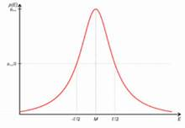
π⁺π⁻ system in X₃₈₇₂→π⁺π⁻ J/ψ comes from ρ→π⁺π⁻ established
m_{ρ}=775 MeV is at kinematic limit
“usual” ρ meson
Belle
CDF
Belle PRD 84 052004
CDF PRL 96 102002
τρυνχατεδ
ρ→π⁺π⁻ lineshape
截
|
775 MeV
M(π⁺π⁻)
M(π⁺π⁻)
M(π⁺π⁻ )
X₃₈₇₂→ ρ⁰J/ψ→π⁺π⁻ J/ψ

Slide 28

π⁺π⁻ system in X₃₈₇₂→π⁺π⁻ J/ψ comes from ρ→π⁺π⁻ established
m_{ρ}=775 MeV is at kinematic limit
切去了右面
truncated ρ meson
Belle
CDF
Belle PRD 84 052004
CDF PRL 96 102002
τρυνχατεδ
ρ→π⁺π⁻ lineshape
m_{ππ}>M_{X3872}-m_{J/ψ}
截
|
775 MeV
M(π⁺π⁻)
M(π⁺π⁻)
M(π⁺π⁻ )
X₃₈₇₂→ ρ⁰J/ψ→π⁺π⁻ J/ψ

Slide 29
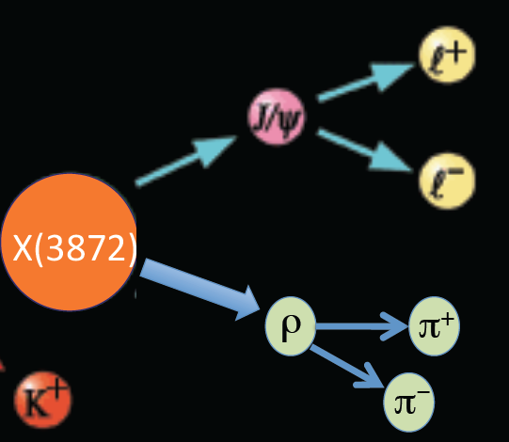
χ_{c1}→ρJ/ψ violates Isospin
‘
Ispin=0
Ispin=0
χ_{c1}
‘
Ispin=1
≠
Initial Isospin=0 final Isospin =1

Slide 30
Is the X(3872) the χ_{c1} 1⁺⁺ cc state?
‘
_
Mass is too low
  3872 vs ≥3890 MeV
X(3872)→ρ J/ψ decay
violates Isospin, and
should be small
X(3872)
ρ meson

Slide 31
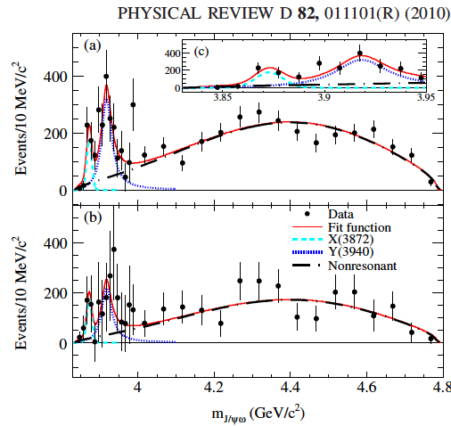
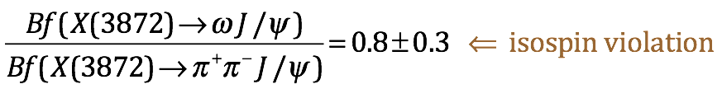
X(3872)→ωJ/ψ seen
BaBar:
X(3872)
X(3872)
X(3915)
truncated ω meson
m_{ππ}>M_{X3872}-m_{J/ψ}
|
M(π⁺π⁻π⁰)
785 MeV
only the tail of the ω is
accessible in X₃₈₇₂→ωJ/ψ

Slide 32
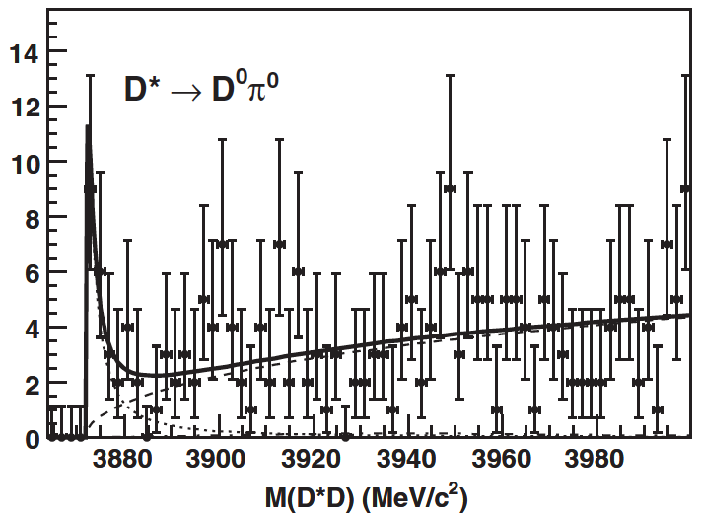
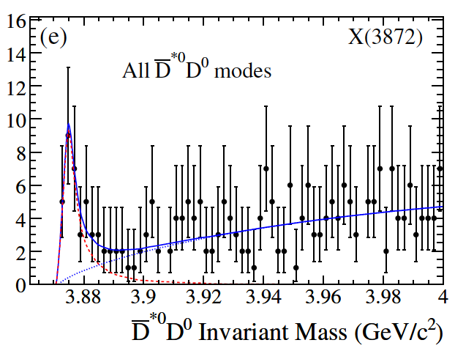
Strong decays to D⁰D*⁰
_
B⁺→K⁺D⁰D*⁰
Belle
_
BaBar
Belle PRD 81 031103
Babar PRD 77 111101
Bf(X(3872)→D⁰D*⁰) = (10±3)xBf(X(3872)→π⁺π⁻J/ψ)
_
S-wave
_

Slide 33

X(3872) decay channels
γJ/ψ
γψ’
π⁺π−J/ψ
ωJ/ψ
γJ/ψ >0.8%
γψ’ >3.6%
π⁺π−J/ψ >3.1%
ωJ/ψ >2.3%
D⁰D*⁰ >38%
total seen >48%
strong DD*
coupling
_
D⁰D*⁰
_
_

Slide 34
Is the X(3872) the χ_{c1} 1⁺⁺ cc state?
‘
_
Mass is too low
  3872 vs ≥3890 MeV
X(3872)→ρ J/ψ decay
violates Isospin, and
should be small
X(3872)
Width is too narrow
Γ(X3872)<1.2 MeV;
Γ(χ_{c1}) should be wider
than~2×Γ(χ_{c1})=1.7 MeV
‘
Notes:
×

Slide 35
Is the X(3872) the χ_{c1} 1⁺⁺ cc state?
‘
_
Mass is too low
  3872 vs ≥3900 MeV
X(3872)→ρ J/ψ decay
violates Isospin, and
should be small
X(3872)
Width is too narrow
Γ(X3872)<1.2 MeV;
Γ(χ_{c1}) should be much
wider than Γ(χ_{c1})=0.84 MeV
X(3872) as the χ_{c1} scorecard
‘
 | predicted | measured | comment
mass (MeV) | ≥3900 | 3872 | NG
width (MeV) | >1.7 | <1.2 | NG
decay mode | ρJ/ψ | ρJ/ψ | NG

Slide 36
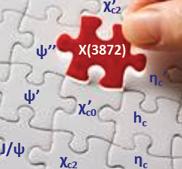
not a good fit
-- wrong mass
-- wrong width
-- wrong decay modes

Slide 37
Is the X(3872) the χ_{c1} 1⁺⁺ cc state?
‘
_
‘
Mass is too low
  3872 vs ≥3900 MeV
The X(3782) is probably not the χ_{c1}
X(3872)→ρ J/ψ decay
violates Isospin, and
should be small
X(3872)
Width is too narrow
Γ(X3872)<1.2 MeV;
Γ(χ_{c1}) should be much
wider than Γ(χ_{c1})=0.84 MeV
‘
 | predicted | measured | comment
mass (MeV) | ≥3900 | 3872 | NG
width (MeV) | >1.7 | <1.2 | NG
decay mode | ρJ/ψ | ρJ/ψ | NG

Slide 38
if not the χ_{c1}, what?
‘

Slide 39
M(X₃₈₇₂)≈m_{D}0 + m_{D*}0
curious fact:
M_{X(3872)} =3871.69 ±0.17 MeV
m_{D}0+m_{D*}0=3871.80 ±0.16 MeV
(m_{D}0+m_{D*}0)-M_{X} =0.11 ±0.23 MeV
m_{D}0+m_{D*}0
X(3872)

Slide 40
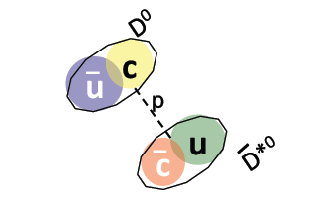
a deuteron-like molecule?
氘核
deuteron
(²H nucleus)
X(3872)?
¹
p
π
π
n
m_{d}≈m_{n}+m_{p}
m_{X3872}≈m_{D}0+m_{D*}0

Slide 41



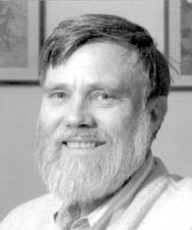
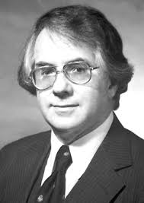
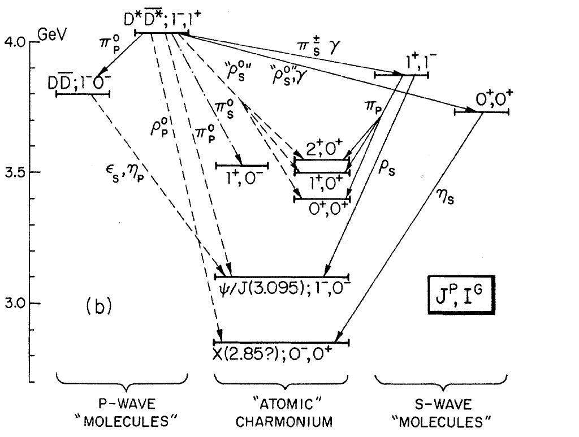
An old idea
_
Okun Voloshin
JETP Lett. 23, 333 (1974)
the ψ(4030 (the ψ(3S)?) has
very strong decays to D*D*,
even though the phase space
for this mode is very small
DeRujula Georgi Glashow
PRL 38, 317 (1977)
ψ(4030)
2m_{D*}
m_{D}+m_{D*}
2m_{D}
χ_{c0,1,2}
h_{c}
J/ψ
η_{c}

Slide 42
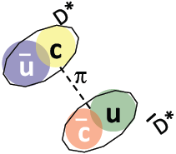
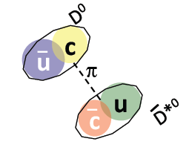
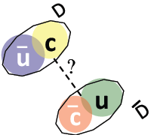
An old idea
Okun Voloshin
JETP Lett. 23, 333 (1974)
DeRujula Georgi Glashow
PRL 38, 317 (1977)
P-wave
ψ(4040)
S-wave
2m_{D*}
X(3872)?
S-wave
m_{D}+m_{D*}
X?
2m_{D}
ρ
η
J/ψ
η_{c}

Slide 43

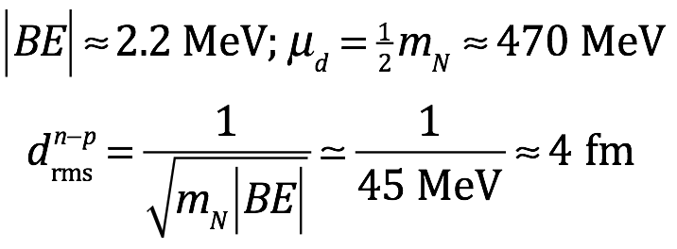
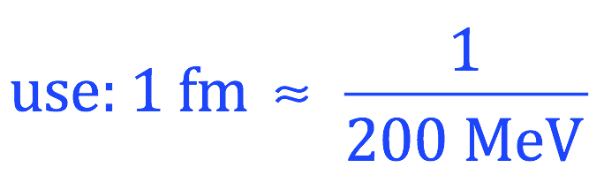
X(3872) as a deuteron-like DD* molecule
_
QM:
size =
binding
energy
reduced
mass
deuteron
p
D*⁰
≈4 fm
n

Slide 44
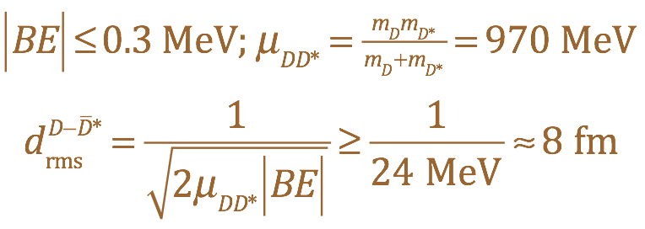
X(3872) as a deuteron-like DD* molecule
_
QM:
size =
X(3872)
binding
energy
|BE|=|m_{D}+m_{D*}-m_{X3872}|<0.2 MeV
reduced
mass
D*⁰
_
deuteron
p
D*⁰
>8 fm
≈4 fm
n
D⁰

Slide 45
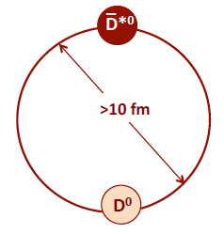
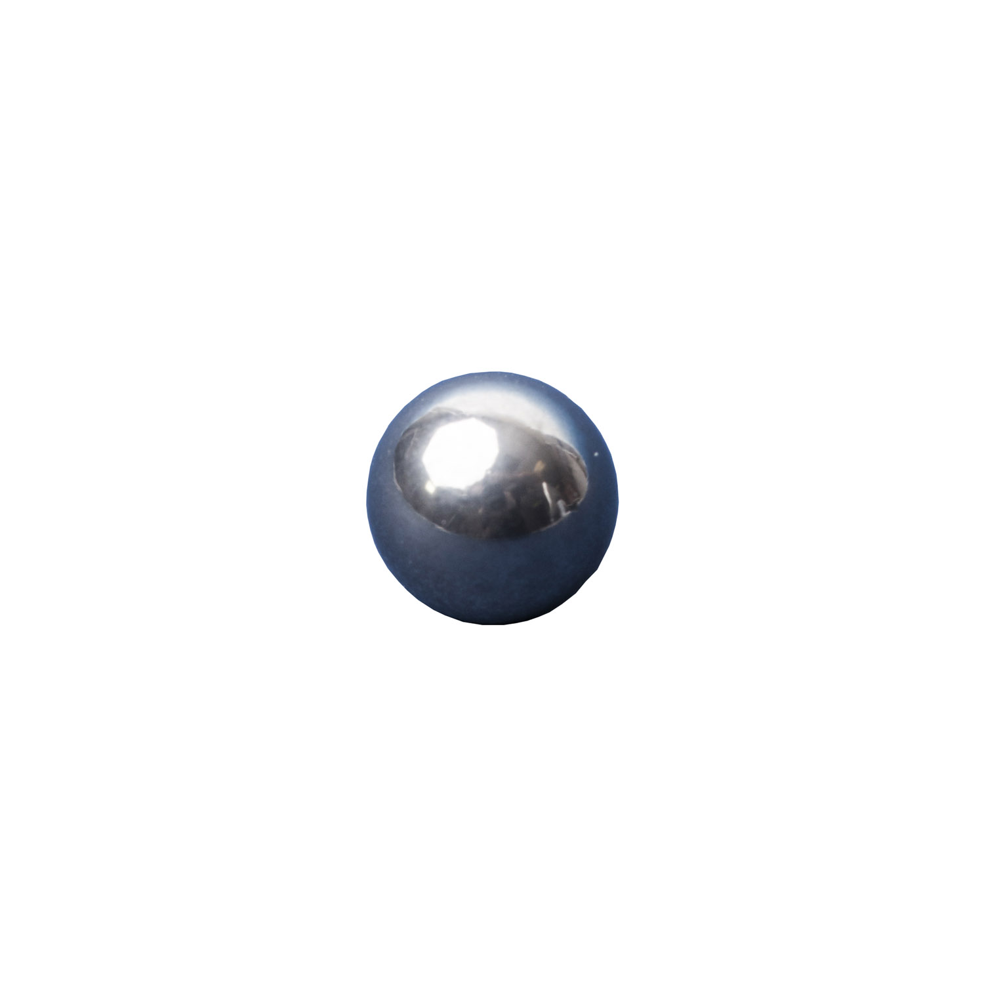
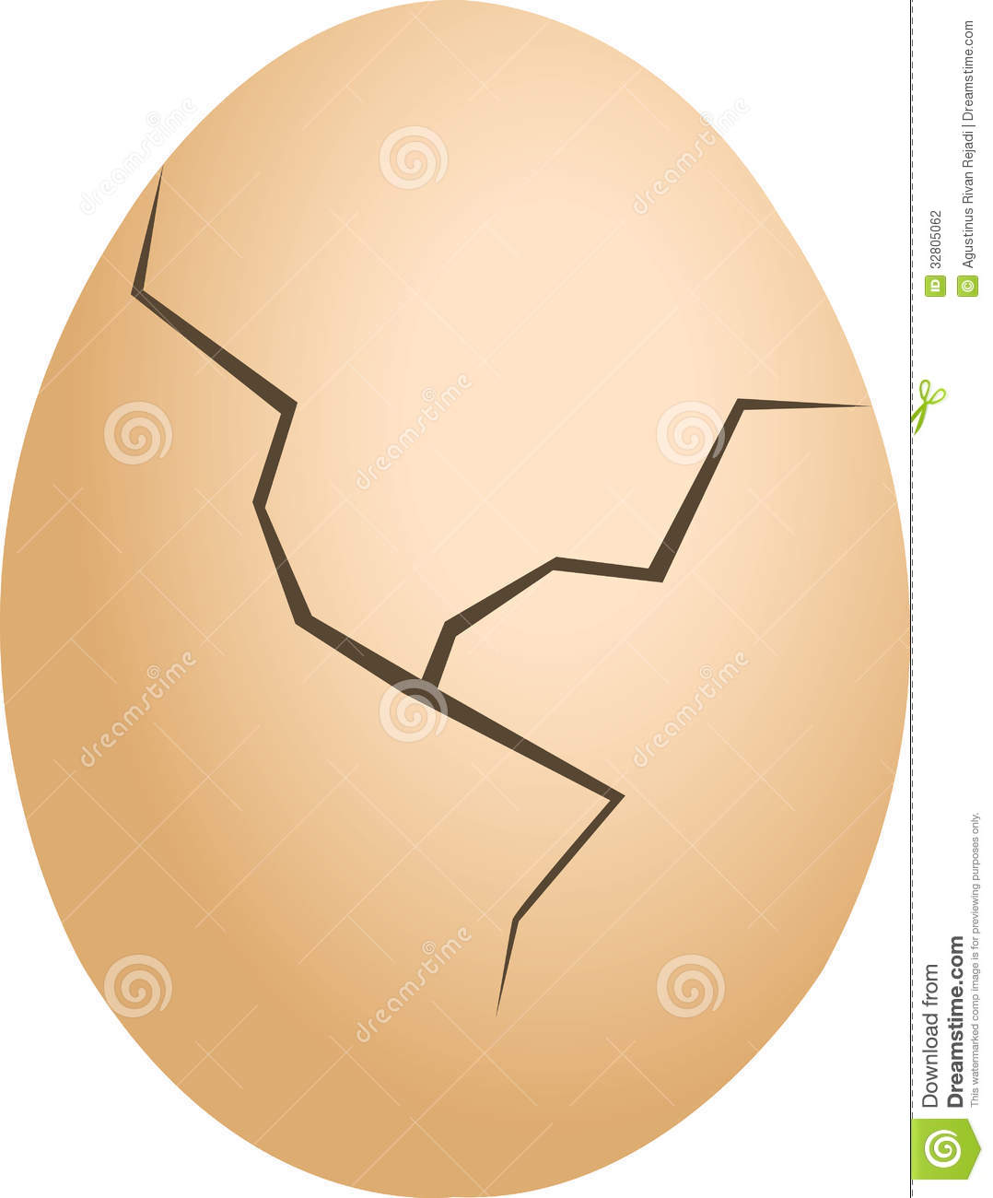
DD* molecule vs cc meson
_
_
--- very different --
_
DD* molecule
-- very large
-- very fragile
cc meson
-- very compact
-- very durable
_
紧凑
耐用
脆弱
>8 fm
c
‘
_
χ_{c1}
c
<1 fm
like a steel ball
like an egg

Slide 46
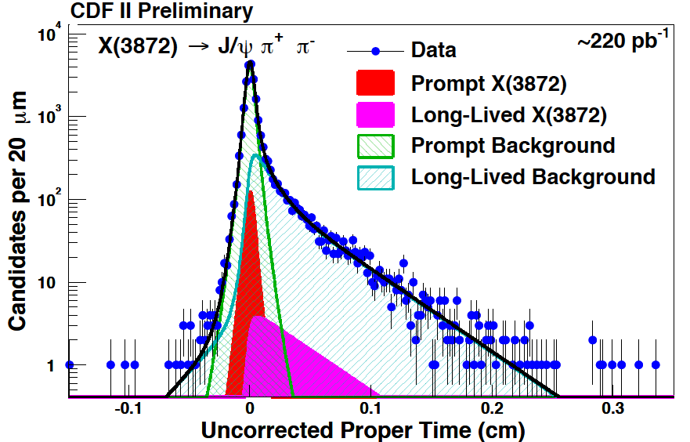
pp → X(3872) + … at high energy
_
J/ψ
π⁺
J/ψ
π ⁻
π⁺
X3872
ct
π ⁻
B
p
X3872
p
p
p
_
_
pp→X(3872)+…
pp→B+…; B→X(3872)+…
_
_
1.95 TeV pp collisions
unpublished
_
84% pp → X(3872) +… (direct)
“prompt” production
16% pp → B-meson + …
→X(3872) + …
_
prompt 84%
_
|
long-lived (16%)
ct

Slide 47



at LHC: X₃₈₇₂ produced like ψ’; not like ³He
7 TeV
pp →ψ’+ …
pp → X₃₈₇₂ + …
pp → ³He + …
2 TeV
X₃₈₇₂
p
p
ALICE PL B754 360 (2016)
PRC 93 029917 (2016)
ATLAS JHEP01 717 (2017)
p_{T} = transverse momentum
See Esposito et al., PRD 92 034028 (2015)

Slide 48







is X(3872) a deuteron-like molecule?
-- production --
how does a molecule survive in
high energy, high p_{T} pp collisions?
how do the c and c quarks get close
enough to form a J/ψ meson?
“eggs”
“steel balls”
-- decay--
_
J/ψ
>8 fm
≈0.5 fm
Bf (X₃₈₇₂ → J/ψ + …) >10%

Slide 49
is X(3872) a deuteron-like molecule?
-- production --
how does a molecule survive in
high energy, high p_{T} pp collisions?
how do the c and c quarks get close
enough to form a J/ψ meson?
“eggs”
“steel balls”
The X(3782) is not like a “pure” molecule
-- decay--
_
J/ψ
>8 fm
≈0.5 fm
Bf (X₃₈₇₂ → J/ψ + …) >10%

Slide 50
if not a molecule, what?

Slide 51
Colored diquarks in QCD

Slide 52

1st, a quick review quark-antiquarks
_
_
_
us
ds
s
d
_
u
_
dd
_
_
_
uu
ud
du
u
d
_
ss
s
_
_
sd
su
_
Q=electric-charge (=I_{z}+Y/2)
9 states:
SU(3) singlet
+ SU(3) octet

Slide 53



QCD diquarks?
instead of combining q & q,
combine q & q
_
d
u
d
u
d
u
d
u
d
u
=
d
u
s
s
s
s
s
s
_
q
q’
q
q
short distance q-q binding force = ½ that for q-q
_

Slide 54

QCD diquarks?
u
d
±
d
u
d
u
d
u
d
d
u
u
d
u
d
u
d
u
=
d
u
=
s
s
d
s
±
s
d
u
s
±
s
u
s
s
s
s
s
s

Slide 55
good diquarks bad diquarks
anti-color anti-triplet
anti-color sextet
antisymm. in color
antisymm in flavor
must be Spin =0
antisymm. in color
symmetric in flavor
must be Spin =1
-
d
d
u
d
+
d
u
u
u
u
d
d
u
6
_
3
d
s
+
s
d
u
s
+
s
u
-
-
d
s
s
d
u
s
s
u
s
s
q
q’
q’
q
a “good” diquark is bound
with ~ ½ the qq binding
a “bad” diquark force is also
attractive, but not as strong
_

Slide 56
in color space: diquark ≈ antiquark
(& diantiquark ≈ quark)
yellow diquark
q
yellow diquark
q
q
q
q
q
_
q
blue quark
u
_
blue diantiquark
strong diquark-quark attraction
-- baryonic states--
strong diquark-diantiquark attraction
-- 4-quark meson states--

Slide 57
multiquark states from diquarks & diantiquarks
red-blue diquark
green-red diquark
blue-green diquark
d
u
d
u
d
u
_
⊗
_
⊗
_
3
3
3
d
s
u
s
d
s
u
s
d
s
u
s
magenta
anti-triplet
yellow
anti-triplet
cyan
anti-triplet
(anti-green)
(anti-blue)
(anti-red)
d
u
Pentaquark
d
u
H-dibaryon
c
u
tetraquark
meson
_
u
u
s
_
_
s
d
s
d
d
c
magenta-cyan-yellow
color singlet 5-q state
magenta-cyan-yellow
color singlet 6-q state
green-magenta
color singlet 4-q state
(anti-green)

Slide 58
X(3872) as a diquark – diantiquark?
Maiani et al.
PRD 71, 014028 (2005)
C
Spin=1 diquark
u
I
gluons
spin forces are ∞1/m_{Q},
➔ “bad” diquarks that
contain a c-quark are
not so bad
C
_
u
Spin=0 diantiquark
_
expect partner states (e.g.,
a nearby state with u→d) that
have yet be seen.

Slide 59
look for related tetraquarks
charged partners of the X(3872)?
nearby neutral X(3872) partners?
u
d
u
d
u
d
_
_
C
C
d
d
S=1 diquark
S=1 diquark
gluons
gluons
C
C
_
_
d
u
_
_
S=0 diantiquark
S=0 diantiquark

Slide 60


charged partners of the X(3872)?
no sign of X(3872)⁺ in B→Kπ⁺π⁰J/ψ
m_{D+}+m_{D*0}
m_{D+}+m_{D*0}
B⁰→Kπ⁺π⁰J/ψ
B⁺→K⁰π⁺π⁰J/ψ
M(π⁺π⁰J/ψ) (GeV)
M(π⁺π⁰J/ψ) (GeV)
BaBar PRD 71, 031501
Belle PRD 84, 052004(R)

Slide 61

QM mixture of DD* & a cc?
_
_
most of the time looks
like a D⁰D*⁰ molecule
Specific model by
Takizawa & Takeuchi, PTEP 9, 093D01
D*⁰
_
_
~90%
~5%
c
~5%
D*⁻
c
…
_
>8fm
_
…
c
≈1.5 fm
c
D⁺
produced in pp via
this component
“core”
state
D⁰

Slide 62
X(3872) questions to be answered:
exactly how close is M_{X(3872)} to m_{D0} + m_{D*0}?
what is Γ_{X(3872)}? (now there is only a limit Γ_{X(3872)}<1.2 MeV)
are there other states near m_{D+} + m_{D*-} ? … or 2m_{D*} ?
Bf(B→KX(3872)) = ?

Slide 63
Search for other states

Slide 64
The X(3915)
X(3915)
ω

Slide 65
B→KX; X→ωJ/ψ→π⁺π⁻π⁰J/ψ
Ξ
ω
π⁺
π⁰
π⁻
E_{B}=E_{cm}/2

Slide 66

Why ω J/ψ ?
K*⁰
K*⁺
>> π⁺π⁻ → π⁺π⁻π⁰ is the simplest
next step experimentally
>> ω meson is the Isospin = 0 “brother”
of the ρ meson
ρ
ρ⁰
ω
ρ⁺
E_{B}=E_{cm}/2
ρ⁰
_
K*⁻
K*⁰

Slide 67

Study of B→KωJ/ψ decays
π⁺
π⁰
ω
π⁻
c
c
_
compute π⁺π⁻π⁰
invariant mass
J/ψ
B meson
m_{ω}
|
ω →π⁺π⁻π⁰
s
q
_
→K
m_{ω} = 783 MeV
Γ_{ω}=8.5 MeV
J^{PC}=1⁻ ⁻
Isospin= 0

Slide 68

M(ω J/ψ)
unexpected peak near ω J/ψ mass threshold
X₃₉₁₅ →ωJ/ψ
M=3940 ± 11 MeV
Γ= 92 ± 24 MeV
X(3915)
S.-K. Choi et al (Belle)
PRL94, 182002 (2005)

Slide 69


X(3915)→ωJ/ψ also seen by BaBar
BaBar PRL 101, 082001
B±→K±ωϑ/ψ
B⁰→K_{S}ωJ/ψ
ratio
Μ(ωJ/ψ)
Some discrepancy in M & Γ; general features agree

Slide 70



Also seen in γγ→ωJ/ψ
ω
X
J/ψ
γγ → ωJ/ψ
M=3915 ± 5 MeV
Γ= 17 ± 11 MeV
Belle
2010
M(ωJ/ψ)
γγ → ωJ/ψ
BaBar
2012
M=3919± 3 MeV
Γ= 13 ± 7 MeV
M(ωJ/ψ)

Slide 71


BaBar measurements determine J^{PC}=0⁺⁺
θ_{l}*
n
Beam axis
θ_{l}*
θ_{ln}
0⁺
2⁺
BaBar PRD 86, 072002 (2012)
arXiv:1207.2651

Slide 72
properties of the X(3915)
PDG 2017:
M(X₃₉₁₅) = 3918 ± 2 MeV ← well established
Γ(X₃₉₁₅) = 20 ± 5 MeV ← well established
J^{PC} = 0⁺⁺ ← needs confirmation

Slide 73
X(3915) = χ_{c0} charmonium state?
‘
M=3918 ± 2 MeV
X(3915)
‘
‘
χ_{c0} = 2³P₀ cc state?
_

Slide 74
X(3915) = χ_{c0} charmonium state?
‘
If X(3915) = χ_{c0}:
‘
- mass is too high:
M(χ_{c2})-M(χ_{c0}) ≈ 9 MeV
≈1/15th the n=1 splitting:
M(χ_{c2})-M(χ_{c0})=141 MeV
width is too narrow,
Γ(X₃₉₁₅) = 20 ± 5 MeV
theory: Γ(χ_{c0})>40 MeV
‘
‘
M=3918 ± 2 MeV
M=3927 ± 3 MeV
X(3915)
ΔM=9 MeV
‘
‘
χ_{c0} = 2³P₀ cc state?
_
‘
ΔM=141 MeV

Slide 75

χ_{c0}→DD should be large
‘
_
“fall-apart” mode, no
OZI suppression
c
D
q
χ_{c0}’
c
q (=u or d)
c
q
D
c

Slide 76
no sign of X(3915) → DD ?
_
B→KD⁰D⁰
_
B→Kψ(3770)
→D⁰D⁰
68+15 events
|
_
J. Brodzicka et al. (Belle) PRD 100, 092001
3915 MeV
B→KΞ(3915)?
→D⁰D⁰
<10 events
|
_
Γ(X₃₉₁₅)→DD) <1 MeV
_
charmonium theory: Γ(χ_{c0}→DD) > 30 MeV
‘
_

Slide 77
X(3915) = χ_{c0} charmonium state?
‘
If X(3915) = χ_{c0}:
‘
- mass is too high:
M(χ_{c2})-M(χ_{c0}) ≈ 9 MeV
≈1/15th the n=1 splitting:
M(χ_{c2})-M(χ_{c0})=141 MeV
width is too narrow,
Γ(X₃₉₁₅) = 20 ± 5 MeV
theory: Γ(χ_{c0})>40 MeV
‘
‘
M=3918 ± 2 MeV
M=3927 ± 3 MeV
X(3915)
ΔM=9 MeV
‘
‘
χ_{c0} = 2³P₀ cc state?
_
‘
X(3915)→DD not seen
Γ(Y(3940)→DD) < 1 MeV
theory: Γ(χ_{c0}→DD) ≈ 30 MeV
_
_
‘
_

Slide 78

χ_{c0}→ωJ/ψ should be tiny
‘
“OZI” suppressed
ω
q
no connecting quark lines
q
c
‘
c
χ_{c0}
J/ψ
c
c

Slide 79
X(3915) = χ_{c0} charmonium state?
‘
If X(3915) = χ_{c0}:
‘
- mass is too high:
M(χ_{c2})-M(χ_{c0}) ≈ 9 MeV
≈1/15th the n=1 splitting:
M(χ_{c2})-M(χ_{c0})=141 MeV
width is too narrow,
Γ(X₃₉₁₅) = 20 ± 5 MeV
theory: Γ(χ_{c0})>40 MeV
‘
‘
M=3918 ± 2 MeV
M=3927 ± 3 MeV
X(3915)
ΔM=9 MeV
‘
‘
χ_{c0} = 2³P₀ cc state?
_
‘
X(3915)→DD not seen
Γ(Y(3940)→DD) < 1 MeV
theory: Γ(χ_{c0}→DD) ≈ 30 MeV
_
_
ω
‘
_
- X(3915)→ωJ/ψ is too strong
χ_{c0}→ωJ/ψ is OZI-suppressed
& should be tiny, &n not a
discovery mode.

Slide 80
X(3915) = χ_{c0} charmonium state?
‘
If X(3915) = χ_{c0}:
‘
- mass is too high:
M(χ_{c2})-M(χ_{c0}) ≈ 9 MeV
≈1/15th the n=1 splitting:
M(χ_{c2})-M(χ_{c0})=141 MeV
width is too narrow,
Γ(X₃₉₁₅) = 20 ± 5 MeV
theory: Γ(χ_{c0})>40 MeV
‘
‘
M=3918 ± 2 MeV
M=3927 ± 3 MeV
X(3915)
ΔM=9 MeV
‘
‘
χ_{c0} = 2³P₀ cc state?
_
‘
X(3915)→DD not seen
Γ(Y(3940)→DD) < 1 MeV
theory: Γ(χ_{c0}→DD) ≈ 30 MeV
_
_
‘
‘
X(3915) as the χ_{c0} scorecard
_
 | prediction | expt | comment
Mass (MeV) | <3900 | 3918 ±2 | NG
Width (MeV) | >40 | 20 ±5 | NG
Γ(X→DD) (MeV) | >30 | <1 | NG
Γ(X→ωJ/ψ) | tiny | large | NG
- X(3915)→ωJ/ψ is too strong
χ_{c0}→ωJ/ψ is OZI-suppressed
& should be tiny, & not a
discovery mode.
‘
_

Slide 81
not a good fit
-- wrong mass
-- wrong width
-- Bf(X₃₉₁₅→DD too small
-- Bf(X₃₉₁₅→ωJ/ψ) too large
X(3915)

Slide 82





2017 news: Belle finds the “real” χ_{c0}
‘
K. Chilikin et al. (Belle) PRD 95, 092003c(2017)
M=3862 MeV
Γ=200 MeV
J^{PC}=0⁺⁺ favored
D
D
_

Slide 83
2017 news: Belle finds the “real” χ_{c0}
‘
K. Chilikin et al. (Belle) PRD 95, 092003c(2017)
X*(3860)
M=3862 MeV
Γ=200 MeV
J^{PC}=0⁺⁺ favored
D
D
_
‘
X*(3860) as the χ_{c0} scorecard
 | prediction | expt | comment
Mass (MeV) | <3900 | 3862 | OK
Width (MeV) | >40 | 200 | OK
Γ(X→DD) (MeV) | >30 | ~200 | OK
Γ(X→ωJ/ψ) | tiny | not seen | OK
_

Slide 84
Bingo!
X*(3860)

Slide 85
If X(3915) ≠ χ_{c0}, what is it?
’
X(3915)→ωJ/ψ violates OZI-rule unless it’s a 4-quark state
Mass is near 2m_{Ds} threshold: M(X(3915)) = 2m_{Ds} -18 MeV
X(3915)→DD decays are suppressed: Γ(X(3915)→DD) < 1 MeV
_
_

Slide 86

Possibilities
_
[cs][cs] tetraquark?
D_{s}-D_{s} molecule?
_
cc-gluon hybrid?
_
_
Li & Voloshin, PRD 91, 114014
Lebed & Polosa, PRD 93, 094024
C
C
C
C
s
s
_
D_{S}
_
gluons
?,…
L=0
g
C
C
_
_
s
s
_
D_{s}
_

Slide 87
X(3915) as a D_{s}-D_{s} molecule?
_
Li & Voloshin, PRD 91, 114014
C
s
what binds it?
D_{S}
_
?,…
C
_
s
D_{s}
_
“BE”=2m_{Ds} – M_{X3915}=18 MeV

Slide 88
no pion exchange between 0⁻ and 0⁻
i → j + π
j=0⁻
π=0⁻
initial state
P=-1; J=0
0⁻
i=0⁻
to conserve P, j & π
should be in a P-wave
& not conserve J
0⁻
π
0⁻
0⁻
0⁻ 0⁻ 0⁻ vertices must be 0

Slide 89
π-exchange: DD*=OK; DD or D_{s}D_{s}=NG
_
_
_
D
0⁻
1⁻
0⁻
D (or D_{s})
D (or D_{s})
D*
0⁻
_
_
1⁻
D
NG
_
π
π
NG
D
D (or D_{s})
D (or D_{s})
0⁻
_
_
0⁻
D*
_
0⁻
1⁻
0⁻
no plausible nuclear-physics-type
force can bind D_{s}D_{s} into a “molecule”
_

Slide 90
X(3915) as a [cs][cs] tetraquark?
_
_
Lebed & Polosa, PRD 93, 094024
C
s
how does it decay?
gluons
L=0
C
s
_
_

Slide 91

how does a J^{PC}=0⁺⁺, M=3915 MeV cscs tetraquark decay?
_
_
OZI allowed decay processes
C
c
c
c
ϑ/ψ
s
“good diquark”
s
gluons
c
s
L=0
s
ω
s
C
s
_
“good diantiquark”
ω has a small (≈3%) ss content
_
_
c
c
η_{χ}
s
c
c
s
η
s
s
η has a large (≈40%) ss content
_

Slide 92


X(3915)→η_{c}η
Vinokurova et al (Belle) JHEP06,132
plus erratum

Slide 93
X(3915) as a cc-gluon hybrid?
_
C
C
_
too light for 0⁺⁺ cc-hybrid
_
g

Slide 94

3915 MeV is too light for a 0⁺⁺ hybrid
-- Lattice QCD calculation --
lightest
0⁺⁺ hybrid
M (MeV)
- 4500
~500 MeV
- 4000
X(3915)
- 3500
m_{π}≈400 MeV
- 3000
Liu, et al (Had Spec Collab) JHEP07,126

Slide 95
What is the X(3915)?
It is not a good candidate for the χ_{c0} charmonium state
Belle recently found a much better χ_{c0} candidate
If it is a D_{s}D_{s} molecule:
B.E. ≈ 18 MeV ← need a binding mechanism to produce this
standard nuclear-physics-type forces do not work
If it is a cc-gluon hybrid:
current (m_{π}≈400 MeV) LQCD mass calculation off by ≈500 MeV!
If it is a [cs][cs] QCD tetraquark:
the X(3915)→ηη_{c} decay mode should be strong ⬅but it is not seen
‘
‘
_
_
_
_

Slide 96
What is the X(3915)?
It is not a good candidate for the χ_{c0} charmonium state
Belle recently found a much better χ_{c0} candidate
If it is a D_{s}D_{s} molecule:
B.E. ≈ 18 MeV ← need a binding mechanism to produce this
standard nuclear-physics-type forces do not work
If it is a cc-gluon hybrid:
current (m_{π}≈400 MeV) LQCD mass calculation off by ≈500 MeV!
If it is a [cs][cs] QCD tetraquark:
the X(3915)→ηη_{c} decay mode should be strong ⬅but it is not seen
‘
‘
_
The X(3915) is an intriguing puzzle
_
_
_

Slide 97
The Y(4260)
Y(4260)
π⁺π⁻

Slide 98

The Y(4260)
--discovered at Babar--
BaBar detector

Slide 99
found by BaBar in e⁺e⁻ → γ_{ISR}π⁺π⁻J/ψ
α
σ(e⁺e⁻ → hadrons)
E_{cm} (GeV)

Slide 100

found by BaBar in e⁺e⁻ → γ_{ISR}π⁺π⁻J/ψ
α
σ(e⁺e⁻ → hadrons)
BaBar PRD86, 051102
E_{cm} (GeV)
σ(e⁺e⁻ → π⁺π⁻J/ψ)
Y(4260)
M(π⁺π⁻J/ψ) (GeV)

Slide 101

found by BaBar in e⁺e⁻ → γ_{ISR}π⁺π⁻J/ψ
α
σ(e⁺e⁻ → hadrons)
BaBar PRD86, 051102
E_{cm} (GeV)
σ(e⁺e⁻ → π⁺π⁻J/ψ)
Y(4260)
M(π⁺π⁻J/ψ) (GeV)
Xinchou Lou
Shuwei Ye

Slide 102
What is the Y(4260)?
Y(4260)
prod. mode ensures J^{PC} = 1⁻ ⁻
all the J^{PC} = 1⁻ ⁻ charmonium
states below M=4500 MeV
have already been assigned

Slide 103

Y(4260) → π⁺π⁻J/ψ confirmed by Belle
e⁺e⁻ →γ_{ISR}π⁺π⁻J/ψ
Belle PRL99, 182004

Slide 104


Y(4260) → π⁺π⁻J/ψ confirmed by Belle
e⁺e⁻ →γ_{ISR}π⁺π⁻J/ψ
Belle PRL99, 182004
PDG-2016:
no sign of Y(4260) → D^{(*)}D^{(*)}
_
4250 MeV
Y(4260) peak in σ (π⁺π⁻J/ψ)
occurs at a dip in σ(D^{(*)}D^{(*)})
_
M(π⁺π⁻J/ψ) (GeV)
e⁺e⁻ →hadrons
Γ(π⁺π⁻J/ψ) is large, but
should be OZI suppressed if cc
_
BESII PRL88, 101802
E_{cm} (GeV)

Slide 105


other resonances in e⁺e⁻ → γ_{ISR}π⁺π⁻ψ’
BaBar: another one in π⁺π⁻ψ’ (not the Y(4260))
Belle: confirms the Y(4360) & finds another @ 4660
Y(4260)
PRL 98 212001
PRL 99 142002
PDG-2016:
PDG-2016:

Slide 106
Is there a b-quark version of Y(4260)?
e⁺e⁻ → hadrons
e⁺e⁻ →π⁺π⁻J/ψ
e⁺e⁻→π⁺π⁻ J/ψ
E_{cm} (GeV)

Slide 107

Is there a b-quark version of Y(4260)?
e⁺e⁻→hadrons
B*B*
e⁺e⁻→π⁺π⁻ϒ(1S)
e⁺e⁻ → hadrons
BB
BB*
e⁺e⁻ →π⁺π⁻J/ψ
e⁺e⁻→π⁺π⁻ J/ψ
E_{cm} (GeV)

Slide 108
Is there a b-quark version of Y(4260)?
?
π⁺π⁻ϒ(1S)
e⁺e⁻→hadrons
B*B*
e⁺e⁻→π⁺π⁻ϒ(1S)
e⁺e⁻ → hadrons
BB
BB*
e⁺e⁻ →π⁺π⁻J/ψ
e⁺e⁻→π⁺π⁻ J/ψ
E_{cm} (GeV)

Slide 109


Yes
_
e⁺e⁻→B⁽*⁾B⁽*⁾+…
e⁺e⁻→π⁺π⁻ϒ(nS)
Βφ[ϒ(5S)→π⁺π⁻ϒ(1S)] is ≈100× larger
than expectations for bb
& 70×Βφ[ϒ(4S)→π⁺π⁻ϒ(1S)]
_

Slide 110




“ϒ(5S)” →π⁻Z_{b1,2}
⁺
Belle PRL 108, 122001 (2012)
121.4 fb⁻¹
→π⁺ϒ (1,2,3S)
π⁺
10,660 MeV
10,610 MeV
→ϒ(3S)
→ϒ(2S)
→ϒ(1S)
M(ϒ(nS)π⁺)_{max}

Slide 111


Observation of h_{b}(1P,2P) at Belle
e⁺e⁻ → ϒ (5S) → h_{b}(nP) π⁺π–
reconstructed, use M_{miss}(π⁺π⁻)
=√(p_{e+e-} – p_{π+π-})²
ϒ(11020)
11.00
ϒ(10860)
PRL108,032001(2012)
10.75
π⁺π⁻
raw distribution
ϒ(4S)
2M(B)
h_{b}(2P)
10.50
η_{b}(3S)
ϒ(3S)
residuals
h_{b}(1P)
h_{b}(2P)
χ_{b}(2P)
10.25
η_{b}(2S)
ϒ(2S)
10.00
h_{b}(1P)
χ_{b}(1P)
δM_{HF}(1P)
9.75
Belle arxiv:1205.6351
δM_{HF}(1P) = +0.8 ± 1.1 MeV
δM_{HF}(2P) = +0.5 ± 1.2 MeV
consistent with zero,
as expected
ϒ(1S)
9.50
η_{b}(1S)
-
--
-
J^{PC} = 0 ⁺
1
1 ⁺
(0,1,2)⁺⁺
Large h_{b}(1,2P) production rates

Slide 112

look at M(πh_{b}(1P)) and M(πh_{b}(2P))
two peaks
data
data
PHSP
PHSP
M(πh_{b}(1P))
M(πh_{b}(2P))

Slide 113






_
Resonant structure of ϒ(5S)→(bb)π⁺π–
ϒ(5S) → h_{b}(1P)π⁺π⁻
ϒ(5S) → h_{b}(2P) π⁺π⁻
Two peaks are observed
in all modes!
no non-res.
contribution
phsp
Belle: PRL108, 232001 (2012)
phsp
Z_{b}(10610) and Z_{b}(10650)
should be multiquark states
M[ h_{b}(1P)π]_{max}
M[ h_{b}(2P) π ] _{max}
Dalitz plot analysis
ϒ(5S) →ϒ(1S) π⁺π⁻
ϒ(5S) →ϒ(2S)π⁺π⁻
ϒ(5S) → ϒ(3S) π⁺π⁻
note different scales

Slide 114

Summary of Z_{b} parameters
Average over 5 channels
M₁ = 10607.2±2.0 MeV
Γ₁ = 18.4±2.4 MeV
M₂ = 10652.2±1.5 MeV
Γ₂ = 11.5 ± 2.2 MeV
M₁ – (M_{B}+M_{B*}) = + 2.6 ± 2.1 MeV
M₂ – 2M_{B*} = + 1.8 ± 1.7 MeV
Z_{b}(10610) yield ~ Z_{b}(10650) yield in every channel
Relative phases: 0º for ϒππ and 180º for h_{b}π π
Notes:
114

Slide 115



ϒ(5S)→B*B^{(*)}π: Signal Region
Z_{b}(10610)
BB*π
B*B*π
Z_{b}(10650)
Z_{b}(10610) +
Z_{b}(10650)
Z_{b}(10650)
alone
PhSp
Z_{b}(10610)+
PhSp
PhSp
Z_{b}(10610) +
Z_{b}(10650) +
PhSp
Z_{b}(10650)+
PhSp
points – right sign Bπ combinations (data);
lines – fit to data with various models (times PHSP, convolved with resolution
function = Gaussian with σ=6MeV).
hatched histogram – background component
B*B*π signal is well fit to just Z_{b}(10650) signal alone
BB*π data fits (almost) equally well to a sum of Z_{b}(10610) and Z_{b}(10650) or
to a sum of Z_{b}(10610) and non-resonant.

Slide 116

ϒ(5S)→B*B^{(*)}π: Results
Branching fractions of ϒ(10680) decays (including neutral modes):
BBπ < 0.60% (90%CL)
BB*π = 4.25 ± 0.44 ± 0.69%
B*B*π = 2.12 ± 0.29 ± 0.36%
Assuming Z_{b} decays are saturated by the already observed ϒ(nS)π, h_{b}(mP)π and B(*)B* channels, one can calculate complete table of relative branching fractions:
B(*)B* channels dominate Z_{b} decays !

Slide 117

B-B* & B*-B* molecules??
_
_
Z_{b}(106010)±
B
Z_{b}(106050)±
B*
b
b
b
_
_
b
_
_
B*
B*
_
_
B-B* “molecule”
B*-B* “molecule”
M_{Zb(106010)} –(M_{B}+M_{B*}) = + 3.6 ± 1.8 MeV
M_{Zb(106010)} –2M_{B*} = + 3.1 ± 1.8 MeV
Slightly unbound threshold resonances??
Amplitude analyses: both states have J^{P} = 1⁺

Slide 118

Z_{b1} & Z_{b2}, “smoking guns” for non-qq mesons
_
u
b
decays to ϒ(nS) & h_{b}(nP) ➔ must contain bb pair
electrically charged ➔ must contain ud pair
_
d
b
_

Slide 119
Are there c-quark versions of Z_{b}’s
Y(4260) discovered
Is there a b-quark equivalent?
???
Yes, & it decays to Z_{b} states
Are there c-quark versions of Z_{b}’s?

Slide 120

run BEPCII/BESIII as a Y(4260) factory
e⁺e⁻→ π⁺π⁻J/ψ
@E_{cm}=4260 MeV
Typical
J/ψ →μ⁺μ⁻
J/ψ
π⁺
e⁺
Y4260
e⁺
π⁻
Belle PRL99, 182004
e⁺e⁻ →γ_{SR}π⁺π⁻J/ψψ
BESIII: PRL 110, 252001 (2013)
σ(e⁺e⁻→π⁺π⁻J/ψ) = (62.9±1.9±3.7) pb

Slide 121

e⁺e⁻ → π⁺π⁻ J/ψ “Dalitz plot”
BESIII PRL 100, 252001

Slide 122


e⁺e⁻ → π⁺π⁻ J/ψ “Dalitz plot”
BESIII PRL 100, 252001

Slide 123



e⁺e⁻ → π⁺π⁻ J/ψ “Dalitz plot”
BESIII PRL 100, 252001
π⁺
Z_{c} →πJ/ψ
“signal”
Z_{c}
Y₄₂₆₀
J/ψ
π⁻
“reflection”

Slide 124



e⁺e⁻ → π⁺π⁻ J/ψ “Dalitz plot”
BESIII PRL 100, 252001
π⁺
π⁺
f₀ →π⁺π⁻
Z_{c} →πJ/ψ
“signal”
f₀
Y₄₂₆₀
π⁻
Z_{c}
Y₄₂₆₀
J/ψ
J/ψ
π⁻
“reflection”

Slide 125



→ π⁺J/ψ
Y(4260)→π⁻Z_{c}(3900)⁺
I
Z_{c}
J/ψ
Y(4260)
π⁻
Significance
>8σ
BESIII: PRL 110, 252001
π ⁺
Mass = (3899.0±3.6±4.9) MeV
Width = (46±10±20) MeV
Fraction = (21.5±3.3±7.5)%

Slide 126

Z_{c}(3900) also seen by Belle
Mass = (3894.5 ± 6.6 ± 4.5) MeV
Width = (63 ± 24 ± 26) MeV
Fraction = (29.0 ± 8.9)% (stat. err. only)
Belle: PRL 110, 252002

Slide 127


Y(4260)→π⁻Z_{c}(3900)⁺
D⁰
_
→ DD*
D*⁺
_
Z_{c}
Y(4260)
Significance
>18σ
π⁻
BESIII PRL 112, 022001 (last month)
D⁰D*⁺
_
DD*
_
D⁺D*⁰
_
Mass = (3883.9 ±1.5 ±4.2) MeV
Width = (24.8 ±3.3 ±11.0) MeV
DD*/π⁺π⁻J/ψ = 6.2 ± 1.1 ± 2.7
_

Slide 128









J^{P} of the Z_{c}(3900)?
J^{PC}=??
initial state:
Z_{c}
θ_{π}
e+
1;±1
e-
final state:
π | Z_{c}
0⁻ | 0⁺ | forbidden by Parity | ---
0⁻ | 0⁻
0⁻ | 1⁺ |  | flat
0⁻ | 1⁻
π-
J^{PC}=0⁻
BESIII data
J^{P}=1⁻
The data clearly
establish J^{P}=1⁺
J^{P}=1⁺
J^{P}=0⁻

Slide 129
Are there others?

Slide 130
Study Y(4260)→π⁺π⁻ h_{c} decays
γη_{c}
16 channels
π⁺π⁻
γ
hadrons

Slide 131

detecting h_{c} charmonium states at BESIII

Slide 132

detecting h_{c} charmonium states at BESIII
CLEO 2005 (20 evts)
BESIII 2013 (1600 evts)
CLEOII
signal

Slide 133


Y(4260)→π⁺π⁻ h_{c} Dalitz plot
sharp peak, but at M(πh_{c}) = 4020 MeV, not near ~3900 MeV
M(π±h_{c})
BESIII PRL 111, 242001

Slide 134

Y(4260)→π⁺Z_{c}(4020)⁻
π⁻h_{c}
no significant signal for Z_{c}(3900)±→π±h_{c}
π⁺
Z_{c}(4020)
π⁻
BESIII PRL 111, 242001
M(π±h_{c})
γ
5.6 ± 2.8 MeV above D*⁰D*⁻ thresh.
= 4017.3 ±0.3 MeV
Mass = (4022.9 ±0.8 ±2.7) MeV
Width = (7.9 ±2.7 ±2.6) MeV
fraction = 0.18 ± 0.07
Fit results:
hadrons

Slide 135

Observation of Z_{c}(4020)→D*D*
_
only detect bachelor π⁺ and one D (or D)
_

Slide 136

Z_{c} states seen at BESIII
Z_{c}(3900)
Z_{c}(4020)
Y(4260)→π⁺π⁻J/ψ
Y(4260)→π⁺π⁻h_{c}
BESIII: PRL
110, 252001
Belle: PRL 110, 252002
M(π⁻J/ψ)
Both: J^{P}=1⁺
M(π⁻h_{c})
BESIII PRL 111, 242001
Z_{c}(4020) → D*D*
Z_{c}(3900) → DD*
_
_
D⁺D*⁰
_
BESIII PRL 112, 022001
BESIII PRL 112, 132001

Slide 137

Bottomonium-like vs Charmonium-like states
i

Slide 138
New last year (from BESIII): other Y(4260) decay modes

Slide 139












Radiative decays? Y(4260)→γ π⁺π⁻J/ψ?
3872 MeV
3872 MeV
4251 MeV
3871.9 MeV
assuming Bf(X₃₈₇₂→π⁺π⁻J/ψ)=5%:
←not small!!
some commonality between X(3872) & Y(4260)?

Slide 140


Y(4260)→ωχ_{c0}??
mass threshold
4250 MeV

Slide 141

Y(4260)→ηJ/ψ ?
4250 MeV
BESIII ηJ/ψ PRD91,112005

Slide 142

e⁺e⁻→π⁺π⁻h_{c}
1610.07044

Slide 143


The Y(4260) is not a single BW resonance!
1611.01317
1611.01317
2 BW res. fit preferred over 1 BW res. fit by >7σ

Slide 144



Y(4260): mass → lower & width → narrower
pre-2017
post-2017
PDG-2016:
-31 MeV
×⅓
Y(4220) decay modes:
- π⁺π⁻J/ψ
⬥ πZ_{c}(3900)
⬥ f₀(980) J/ψ
- π⁺π⁻h_{c}
- ωχ_{c0}
- ηJ/ψ
- γX(3872)
- πDD*
_

Slide 145
Y(4260): mass → lower & width → narrower
pre-2017
post-2017
what is the 2nd peak?
PDG-2016:
-31 MeV
×⅓
Y(4220) decay modes:
- π⁺π⁻J/ψ
⬥ πZ_{c}(3900)
⬥ f₀(980) J/ψ
- π⁺π⁻h_{c}
- ωχ_{c0}
- ηJ/ψ
- γX(3872)
- πDD*
_

Slide 146




Y(4260): mass → lower & width → narrower
pre-2017
post-2017
what is the 2nd peak?
Y(4360)??
PDG-2016:
-31 MeV
×⅓
Y(4220) decay modes:
- π⁺π⁻J/ψ
⬥ πZ_{c}(3900)
⬥ f₀(980) J/ψ
- π⁺π⁻h_{c}
- ωχ_{c0}
- ηJ/ψ
- γX(3872)
- πDD*
δM≈-1.8σ
spot on
Y(4320) decay modes:
- π⁺π⁻J/ψ
- π⁺π⁻ψ’
_

Slide 147
What is the Y(4260)?

Slide 148





some proposed models
DD₁(2420) molecule
_
-
QCD cc-gluon hybrid
QCD diquark-diantiquark
“tetra-quark”
“hadrocharmonium”

Slide 149

Models for the Y(4260) I
Molecule?
Ding PRD 79, 014001
Wang, Hanhart & Zhao PRL 111, 132002
Cleven, Wang, Guo, Hanhart, Meissner & Zhao PRD 90, 074039
D₁(2420) J^{P}=1⁺
M=2421.4 ± 0.6 MeV
Γ= 27.4 ± 2.5 MeV
~66 MeV
Decay: D₁(2420)→D*π
Y(4260) “B.E.” ≈ 66 MeV
pre-2017: BE≈35 MeV

Slide 150

Models for the Y(4260) II
cc-gluon hybrid?
1⁻ ⁻
M_{LQCD}=4285 ± 14 MeV
_
D
Zhu PLB 625, 212
Y₄₂₂₀
Close & Page PLB 628, 215
Kou & Pene PLB 631, 164
S-wave
J=1
P-wave
D₁(2420)
_
→
D*π
_
2012 LQCD calc: lowest 1⁻ ⁻ cc-gluon hybrid: M=4285 ± 14 MeV”
_
pre-2017: too high by ~35 MeV
post-2017: too high by ~65 MeV
very broad
hard to see
Had. Spectr. Collab. JHEP07, 126

Slide 151
Models for the Y(4260) III
QCD tetraquark?
Maiani et al.
PRD 89, 114010
L=1 excitation of the X(3872):
- naturally accounts for
large Y(4260)→γX(3872)
as an allowed E1 transition
X(3872):
ΔL=1
ΔM=350 MeV
Y(4220):
350 MeV is a typical mass
“penalty” for ΔL=1:
L=1 | L=0 | δM (MeV)
D₁(2420) | D*(2010) | 410
D_{s1}(2460) | D_{s}(2110) | 350
h_{c}(3525) | J/ψ | 430
C
C
q
q
S=1 diquark
S=1 diquark
gluons
gluons
L=1
L=0
C
C
_
_
q
q
S=0 diquark
_
_
S=0 diquark

Slide 152
Models for the Y(4260) IV
Hadrocharmonium?
Dubynskiy & Voloshin, PLB 666, 344
Li & Voloshin, Mod. Phys. Lett. A29, 1450060
color-singlet charmonium core
(for Y(4260) this a J/ψ + h_{c} mixture)
surrounding color-singlet cloud
of light quarks & gluons
C
_
C
charmonium core & light-quark gluon cloud are coupled
via Van-der-Waals–like color field forces
Y(4260) → J/ψ (or h_{c})+ light-hadrons decays should be dominant,
--- decays to other charmonium states are suppressed

Slide 153




Testing Y(4260) models against data
- DD₁(2420) molecule:
expect a strong Y(4260) affinity for DD₁(2420)-like final states
_
_
- cc-gluon hybrid:
expect a strong Y(4260) affinity for D*D₀(2400)-like final states
_
_
- QCD tetraquark models:
expect partner states, including charged partners (likewise for the X(3872))
Y⁺(I=1;I_{z}=+1)
±
Y⁻(I=1;I_{z}=-1)
+: Y⁰(I=1;I_{z}=0)
-: Y⁰(I=0;I_{z}=0)
- hadrocharmonium model:
expect Bf(Y(4260)→ππ J/ψ) >>
Bf(Y(4260)→ω χ_{c0})

Slide 154






Partner states?
±
Y⁻(I=1;I_{z}=-1)
+: Y⁰(I=1;I_{z}=0)
Y⁺(I=1;I_{z}=+1)
I=1, 1⁻ ⁻ states have not been seen
—need to look at π J/ψ or πψ’—
-: Y⁰(I=0;I_{z}=0)
Y(4260)?
Belle
Belle
(same for X(3872). BaBar & Belle searches
for B→K”X±”; “X±“→ ρ± J/ψ found nothing):
PRD 84, 052004

Slide 155






Bf(Y(4260)→ππJ/ψ) vs Bf(Y(4260)→ωχ_{c0})

Slide 156


What is the Y(4260)?
The Y(4260) mass is lower and width narrower than previously thought
“Y(4260)” → Y(4220)?
If it is a DD₁(2420) molecule:
B.E. ≈ 66 MeV ⬅too large??
“affinity” to DD₁(2420) should be high
If it is a cc-gluon hybrid:
its mass is ~65 MeV below current (m_{π}≈400 MeV) LQCD predictions ⬅ not so bad?
“affinity” to DD₀(2400) should be high
If it is a QCD diquark–diantiquark tetraquark:
it should have Isospin- & SU_{F}(3)-multiplet partner states ⬅ not seen
If it is hadrocharmonium:
decays to non-J/ψ(h_{c}) charmonium states should be suppressed
BESIII is well suited to further investigate this intriguing puzzle
_
_
_
_

Slide 157
Big job/opportunity for BESIII

Slide 158
Summary
The study of the spectrum of hadrons has taught us lots of physics
-- discovery of flavor
-- prediction of quarks
-- etc.
After 70 years of research, the hadron spectrum is still not well understood
There are many interesting puzzles, with new ones appearing every year
This is an experiment-driven subject: theory is way behind experiment
We need a major breakthrough or a new revolutionary idea
The BESIII experiment is well suited to make such a major breakthrough

Slide 159


