Slide 1
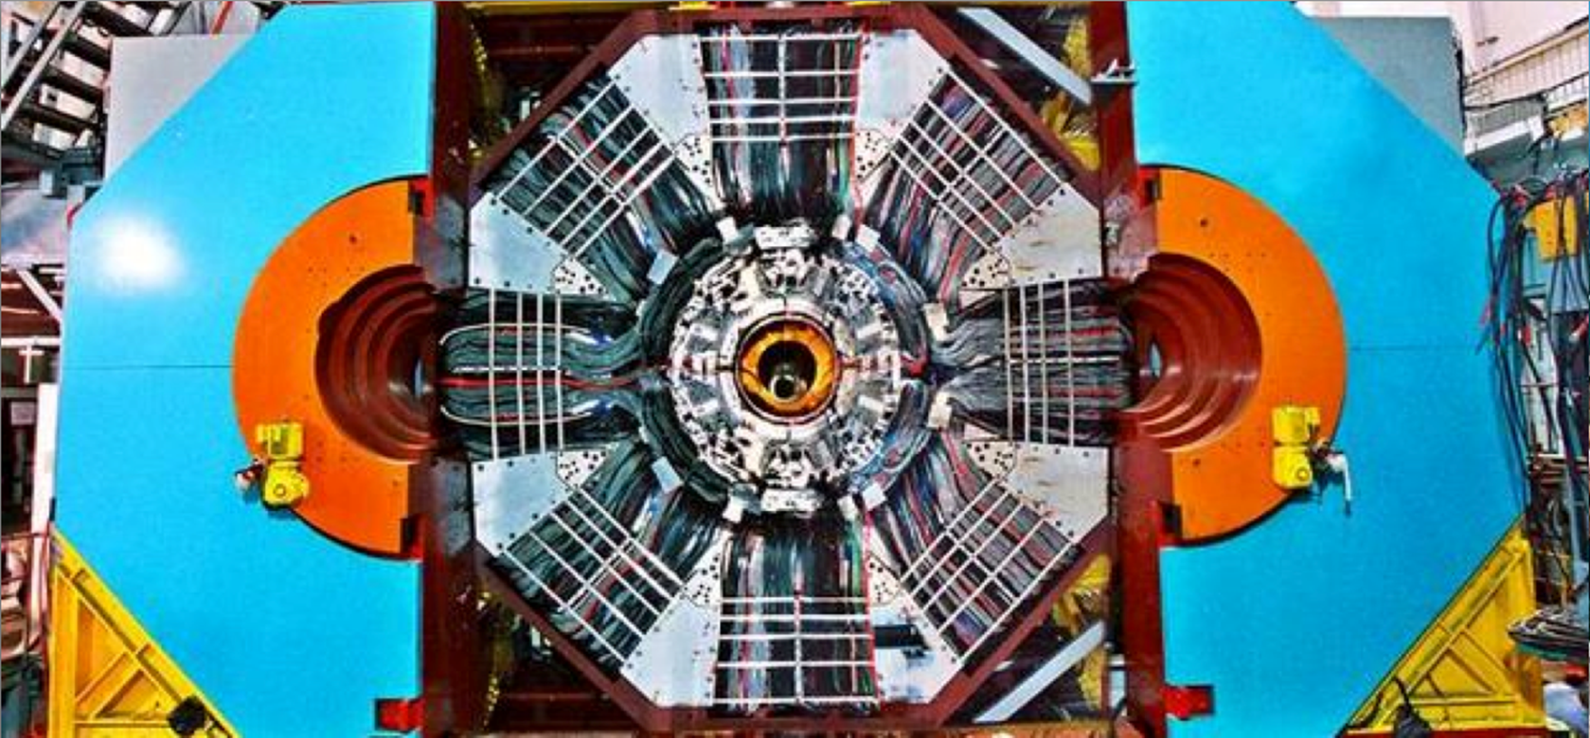
Recent results on hadron physics at BESIII
Xiao-Rui Lyu (吕晓睿)
University of Chinese Academy Sciences
(On behalf of the BESIII collaboration)
10th Workshop on Hadron physics in China and Opportunities Worldwide
July 26th-30th, 2018, Weihai, China

Slide 2
Outline
Introduction
Recent results on hadron physics
  Hadron spectroscopy and exotics
  Charmed hadron decays
  Charmed baryon form factor
Summary

Slide 3
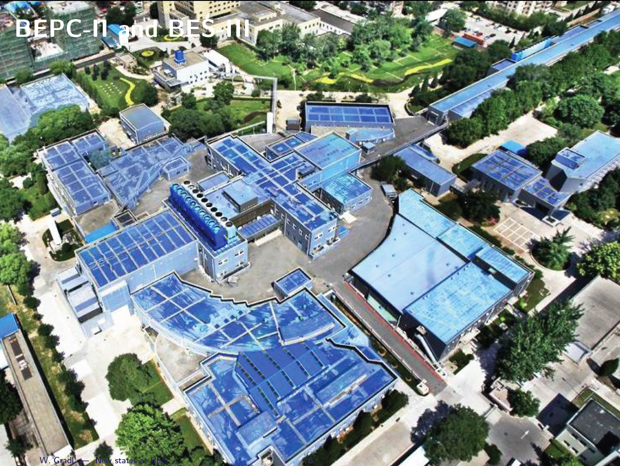
Beijing Electron Positron Collider (BEPC)
beam energy: 1.0 – 2.3 GeV
LINAC
e⁺
2004: started BEPCII upgrade,
BESIII construction
2008: test run
2009 - now: BESIII physics run
e⁻
BESIII detector
1989-2004 (BEPC):
L_{peak}=1.0x10³¹ /cm²s
2009-now (BEPCII):
L_{peak}= 1.0 x10³³/cm²(4/5/2016)

Slide 4
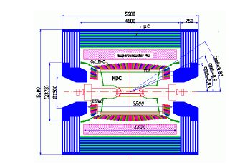
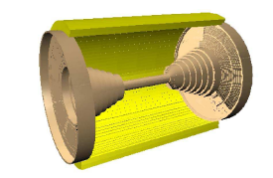
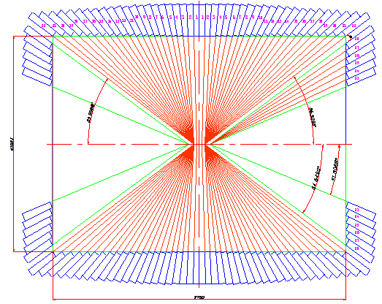
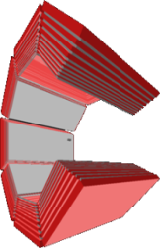







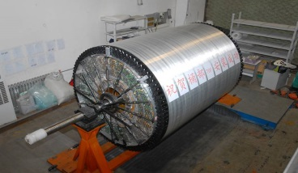
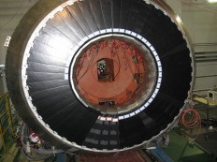
BESIII Detector
MDC
R inner: 63mm ;
R outer: 810mm
Length: 2582 mm
Layers: 43
CsI(Tl) EMC
Crystals: 28 cm(15 X₀)
Barrel: |cosθ|<0.83
Endcap:
0.85 < |cosθ| < 0.93
RPC MUC
BMUC: 9 layers – 72 modules
EMUC: 8 layers – 64 modules
TOF
BTOF: two layers
ETOF: 48 crys. for each

Slide 5
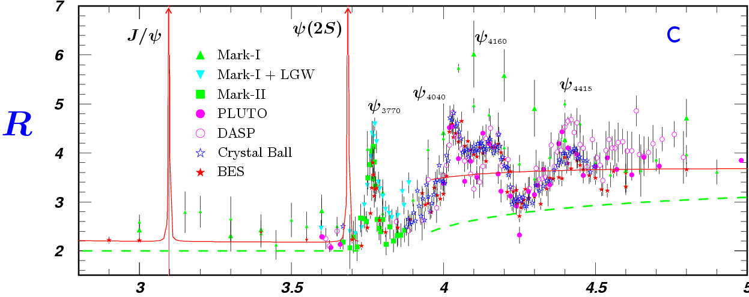
Features of the BEPC Energy Region
Rich of resonances: charmonia(-like) and charmed hadrons
Threshold characteristics (pairs of τ, D, D_{s}, Λ_{c} …)
Transition between smooth and resonances, perturbative and non-perturbative QCD
Energy location of the new hadrons: glueballs, hybrids, multi-quark states
PDG
The Y’s

Slide 6
Physics at tau-charm Energy Region

Slide 7
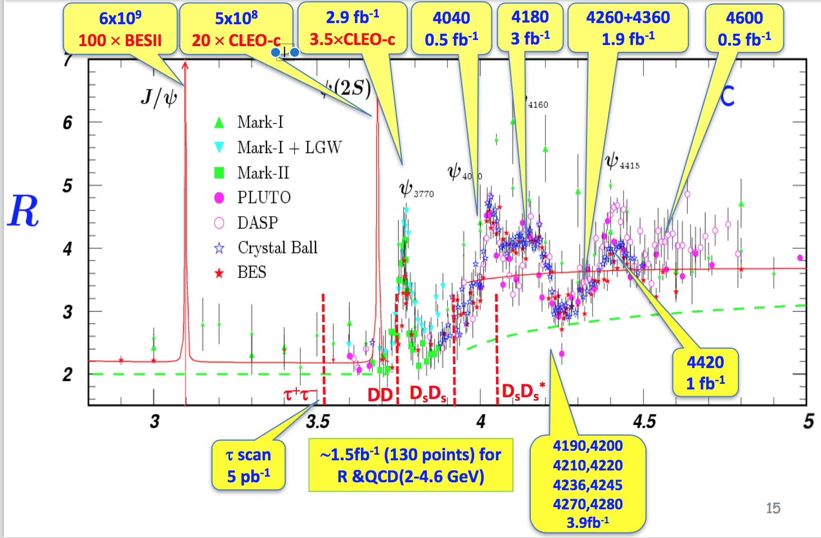
BESIII data samples

Slide 8
  Hadron spectroscopy and exotics

Slide 9




New forms of hadrons
Conventional hadrons consist of 2 or 3 quarks：
Naive Quark Model：
QCD predicts the new forms of hadrons:
  Multi-quark states ：Number of quarks >＝ 4
  Hybrids ： qqg，qqqg …
  Glueballs ： gg， ggg …
meson
baryon
g
g
g
g
None of the new forms of hadrons is settled !

Slide 10
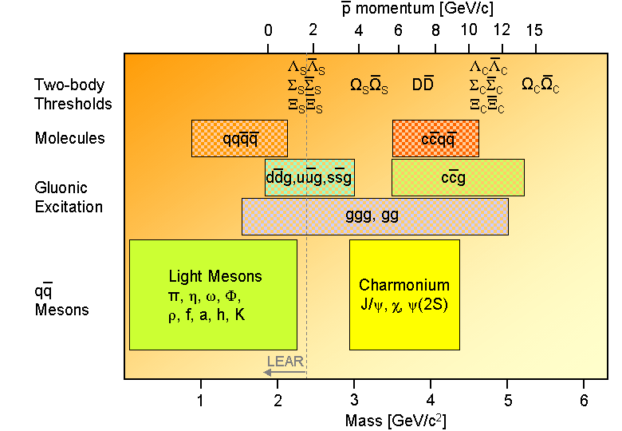
Hadron Landscape
Hadron-physics challenges:
  Understanding of established states:
  precision spectroscopy
  Nature of exotic states:
  search and spectroscopy of unexpected states
BESIII
At BESIII, two golden measures to study hadron spectroscopy, esp., to search for exotics
                Light hadrons: charmonium radiative decays (act as spin filter)
                Heavy hadrons: direct production, radiative and hadronic transitions

Slide 11
The Zc states

Slide 12
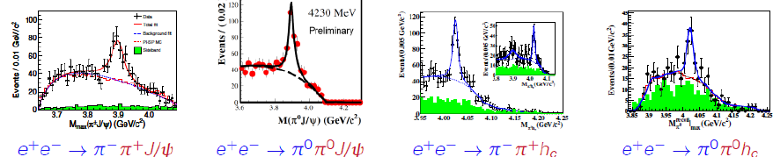
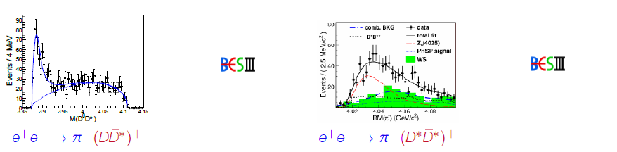
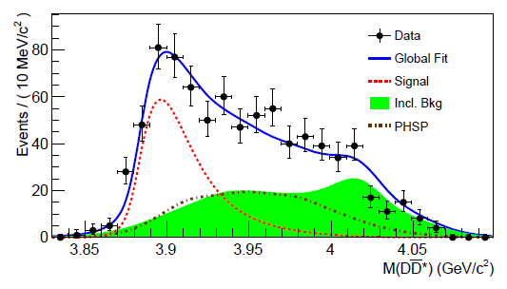
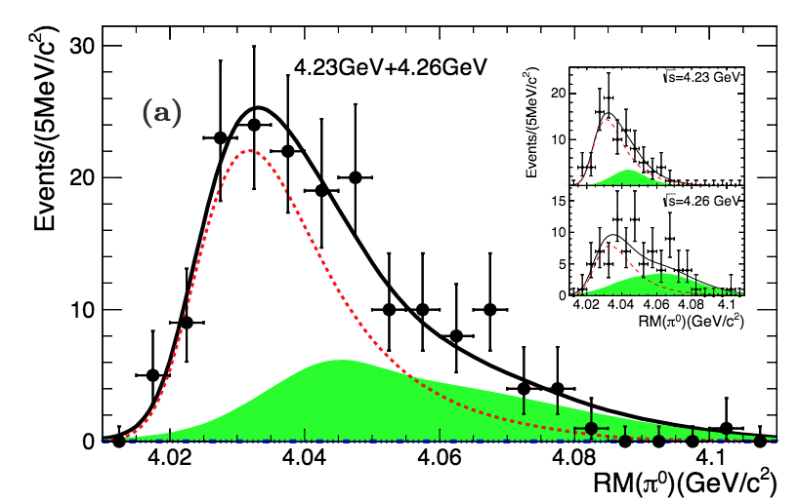


The Zc Family at BESIII
Zc(3900)⁺?
Zc(3900)⁰?
Zc(4020)⁺?
Zc(4020)⁰?
PRL 110, 252001 (2013)
PRL 115, 112003 (2015)
PRL 111, 242001(2013)
PRL113,212002 (2014)
Zc(3885)⁺?
Zc(3885)⁰?
Zc(4025)⁺?
Zc(4025)⁰?
ST: PRL 112, 022001(2014)
DT: PRD92, 092006 (2015)
PRL 115, 222002 (2015)
PRL 112, 132001 (2014)
PRL115, 182002 (2015)
$$e^{+}e^{−}→π^{0}{(D^{∗}{\overline{D}}^{})}^{0}$$
$$e^{+}e^{−}→π^{0}{(D^{∗}{\overline{D}}^{∗})}^{0}$$
Which is the nature of these states?
Different decay channels of the same observed states? Other decay modes?

Slide 13
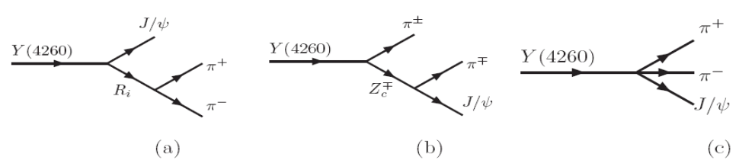
Amplitude analysis of e⁺e⁻ →π⁺π⁻J/𝜓
PRL 119.072001 (2017)

Slide 14
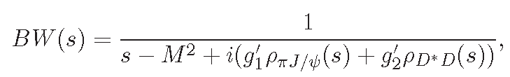
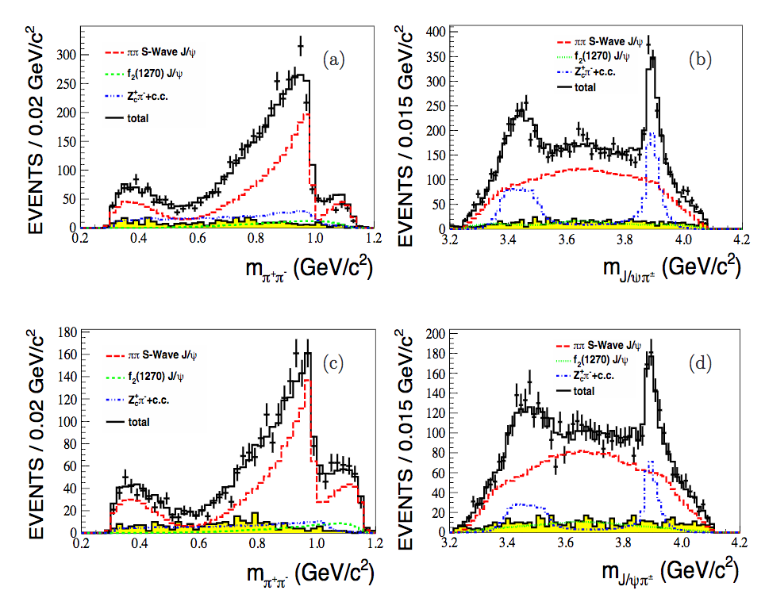
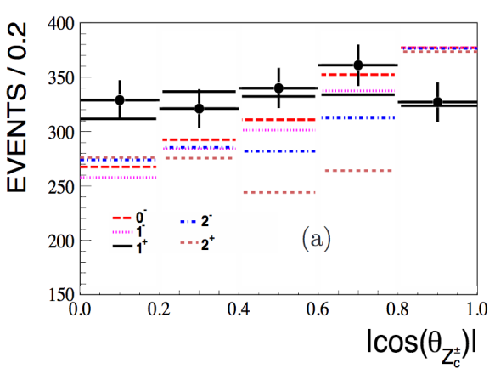
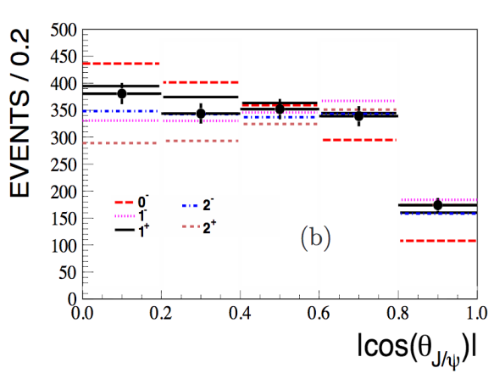
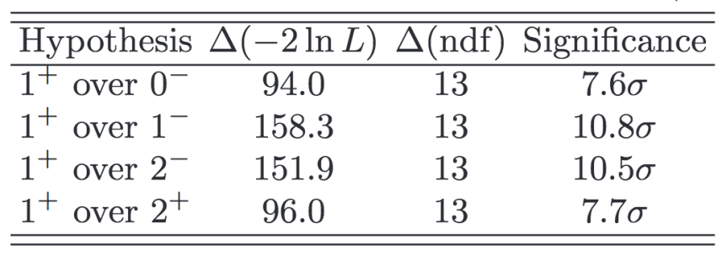
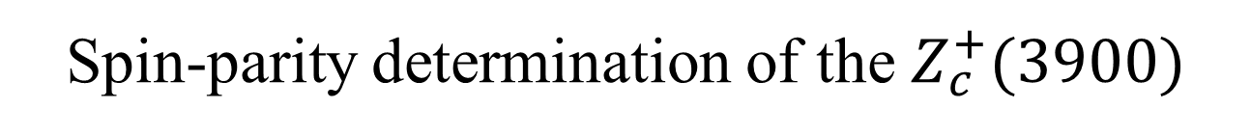
Spin-parity determination of the $Z_{c}^{+}(3900)$
PRL 119.072001 (2017)
Zc line shape parameterized with Flatte-like formula
4.23GeV
J^{P}=1⁺
4.26GeV
J^{P} is measured to be 1⁺ with significance larger than 7.6𝞼

Slide 15
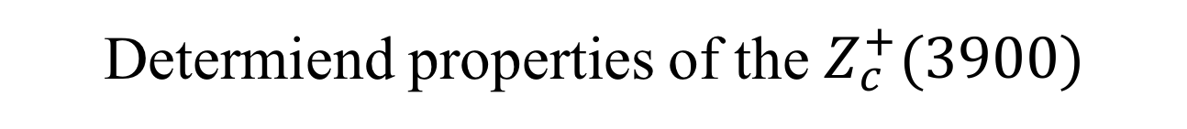
Determiend properties of the $Z_{c}^{+}(3900)$
PRL 119.072001 (2017)

Slide 16
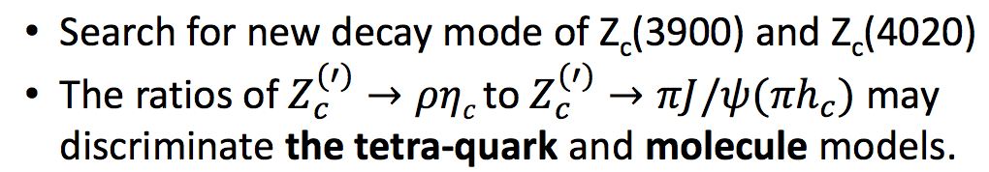
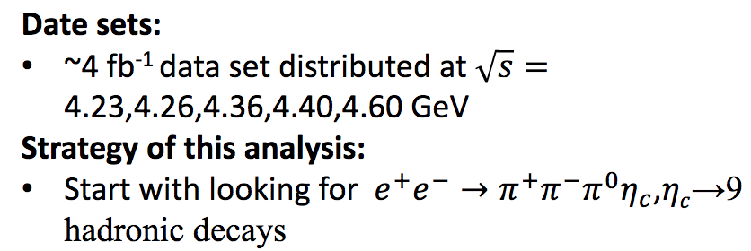
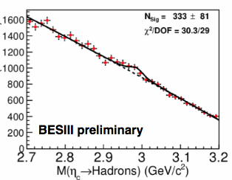
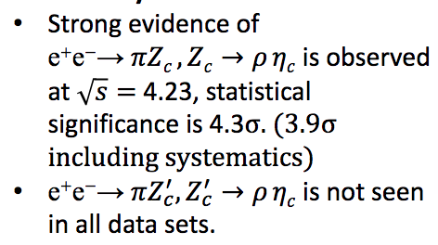
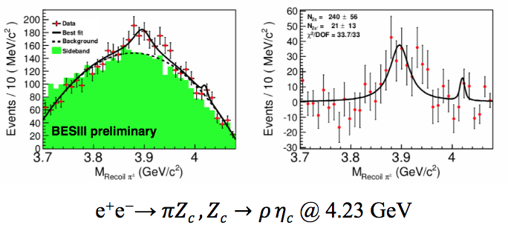

Search for $Z_{c}^{(′)}→ρη_{c}$
@ 4.23 GeV

Slide 17
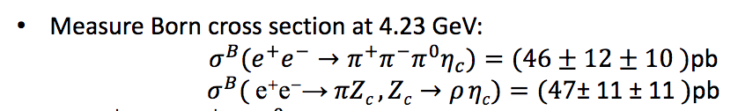
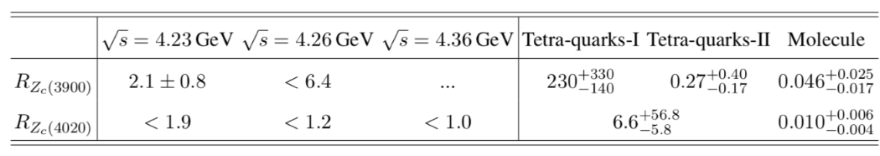
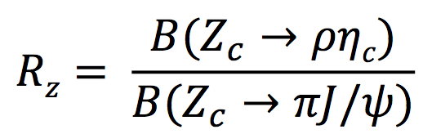
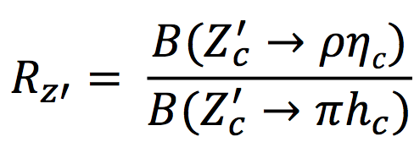
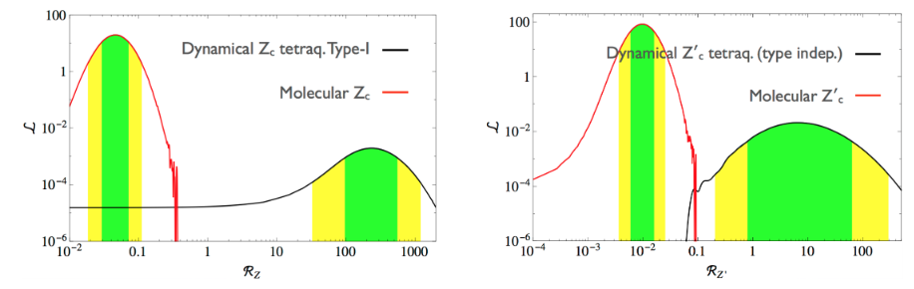

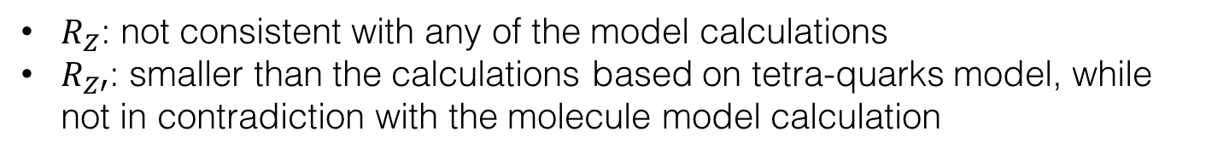
Evidence for $Z_{c}→ρη_{c}$
preliminary
results
PLB 746, 194 (2015)
preliminary
$R_{Z}$: not consistent with any of the model calculations
$R_{Z′}$: smaller than the calculations based on tetra-quarks model, while not in contradiction with the molecule model calculation

Slide 18
Y(4260)?
?
Zc(3900)
Zc(3885)
?
X(3872)
?
Multiquark
Hybrid
Hadrocharmonium
Molecule
Threshold effects
Cusps
…
States or/and interactions
Zc 4020)
Zc(4025)
What is the role of threshold
--Many new observations near thresholds: D*D,D*D*, D₁D, …
* Phase variations appear in many process: not unique for resonance
To have a complete picture, more findings are desired
Energy-dependence
Patterns in productions and decays
For XYZ, the picture is still unclear
Pole properties
World-wide experimental efforts
Models
LQCD
Notes:
Those discoveries of exotic hadron candidates have expanded our understanding of the strong interactions to a new region
However, what is the nature of those exotic? There’s still no answer
We should pay attention to an obvious fact that Many new observations are near thresholds.
To have a complete picture, more clues are needed from world-wide experimental research , development of models, and Lattice calculations.
I may add one thing is, recently, there’re several recent theoretical works propose to study the photon production of Pc and Zc. The new experiment at j-lab is coming. We might have some insights in a near future.

Slide 19
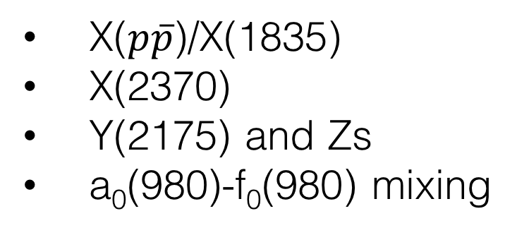
Light hadron spectroscopy
X($p\overline{p}$)/X(1835)
X(2370)
Y(2175) and Zs
a₀(980)-f₀(980) mixing

Slide 20
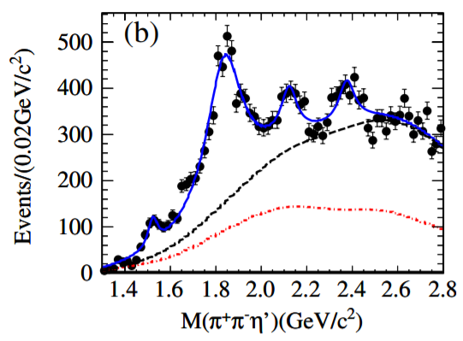
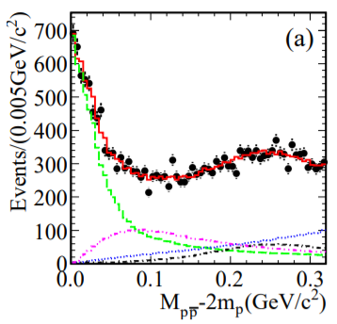

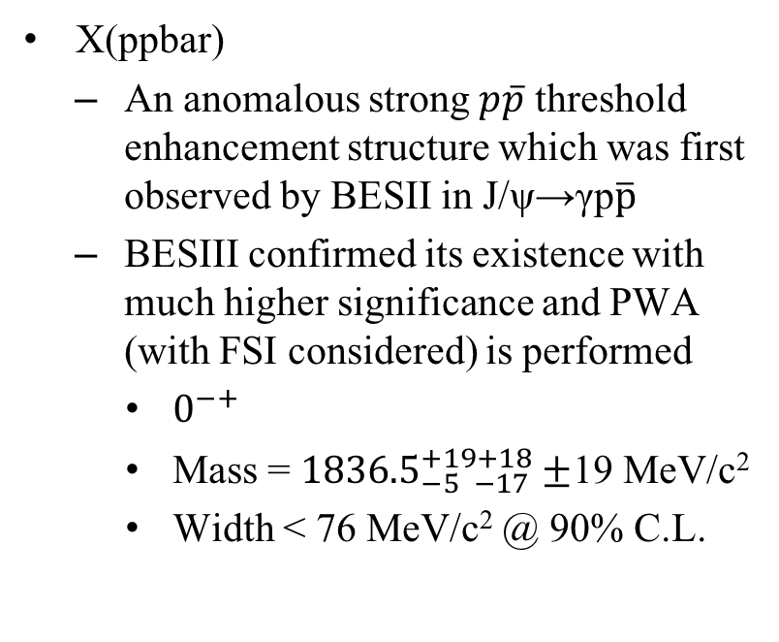
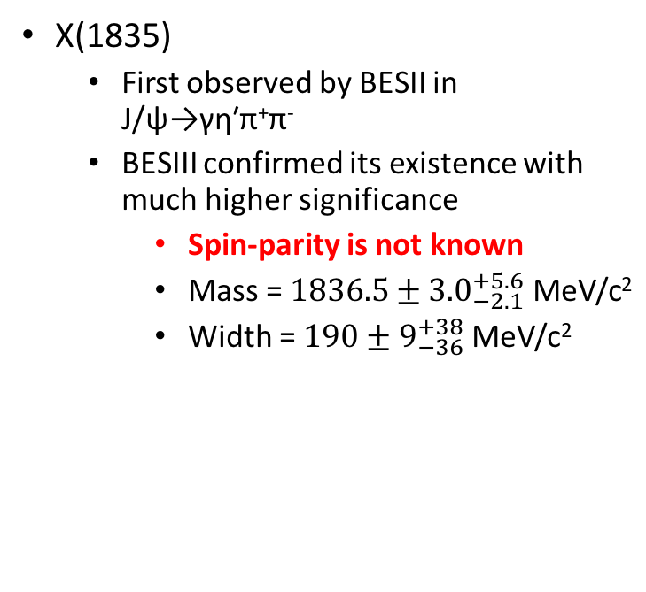

X($p\overline{p}$)/X(1835)
X(ppbar)
  An anomalous strong $p\overline{p}$ threshold enhancement structure which was first observed by BESII in J/ψ→γp$\overline{p}$
  BESIII confirmed its existence with much higher significance and PWA (with FSI considered) is performed
    $0^{−+}$
    Mass = ${1836.5}_{−5 −17}^{+19+18}±$19 MeV/c²
    Width < 76 MeV/c² @ 90% C.L.
X(1835)
  First observed by BESII in J/ψ→γη′π⁺π⁻
  BESIII confirmed its existence with much higher significance
    Spin-parity is not known
    Mass = ${1836.5±3.0}_{−2.1}^{+5.6}$ MeV/c²
    Width = ${190±9}_{−36}^{+38}$ MeV/c²
PRL106, 072002
X(1835)
X(2120)
X(2370)
PRL108, 112003
Are they the same state? A $p\overline{p}$ bound state?
What’s the spin-parity of X(1835)?
Why their widths are so different?

Slide 21
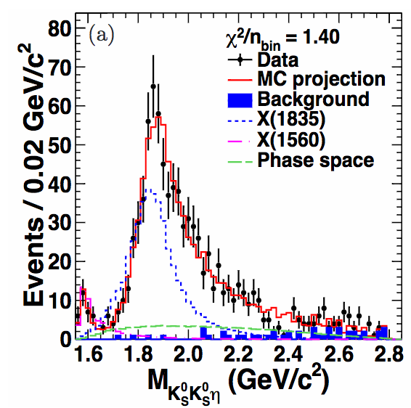
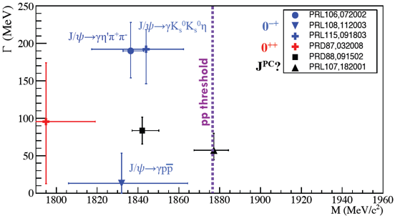
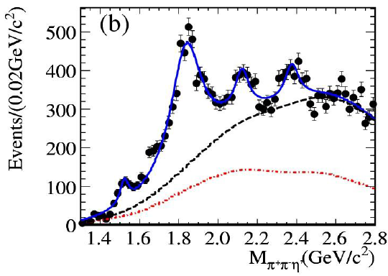
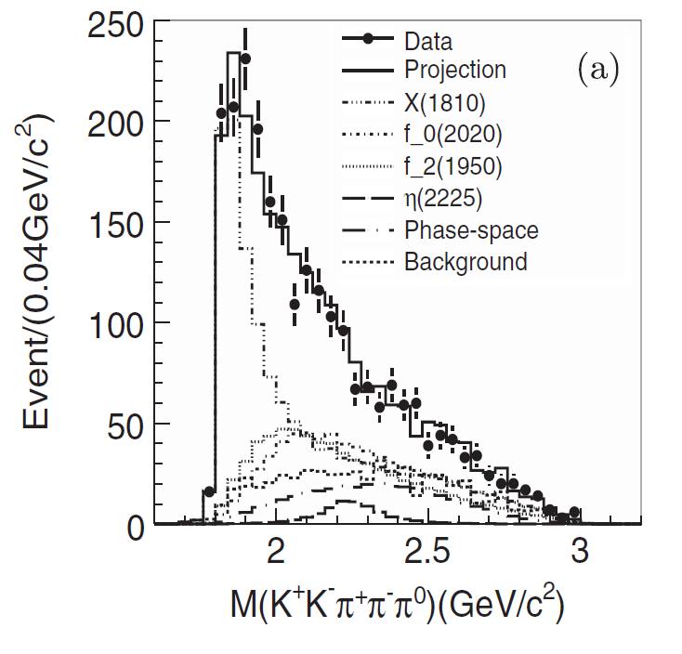
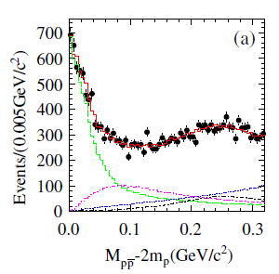
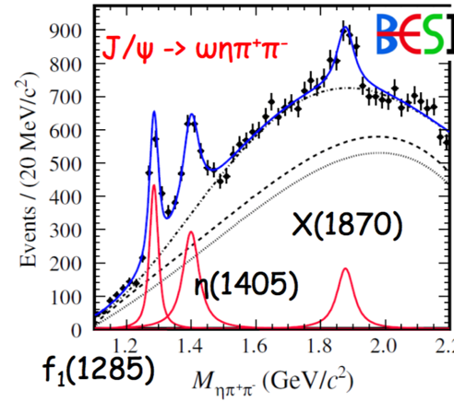

The X(18??) between 1.8~1.9 GeV
PWA of J/ψ→γKsKsη
1.31B
J/ψ→γη'π⁺π⁻
225M
PWA of J/ψ→γωφ
PWA of J/ψ→γ$p\overline{p}$
J/ψ→γ3(π⁺π⁻)
J/ψ→ωηπ⁺π⁻
225M
225M
225M
225M
Are they the same state? It is crucial to understand their connections.

Slide 22
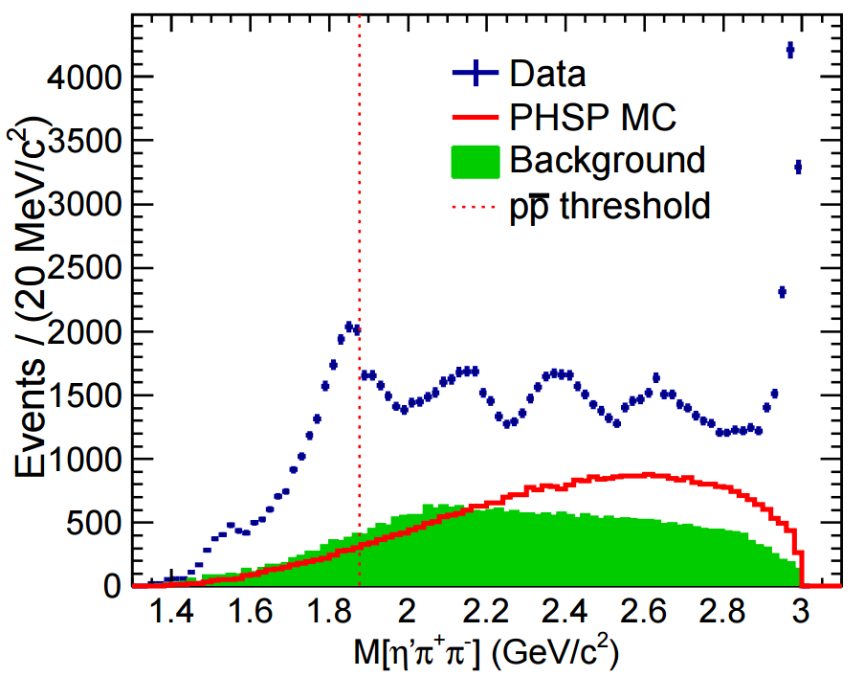
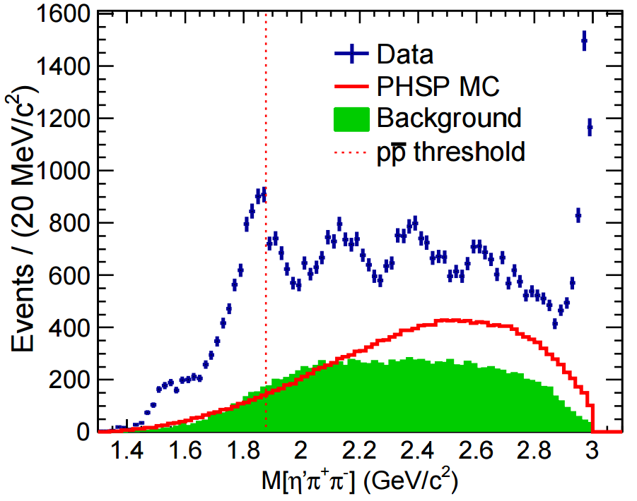
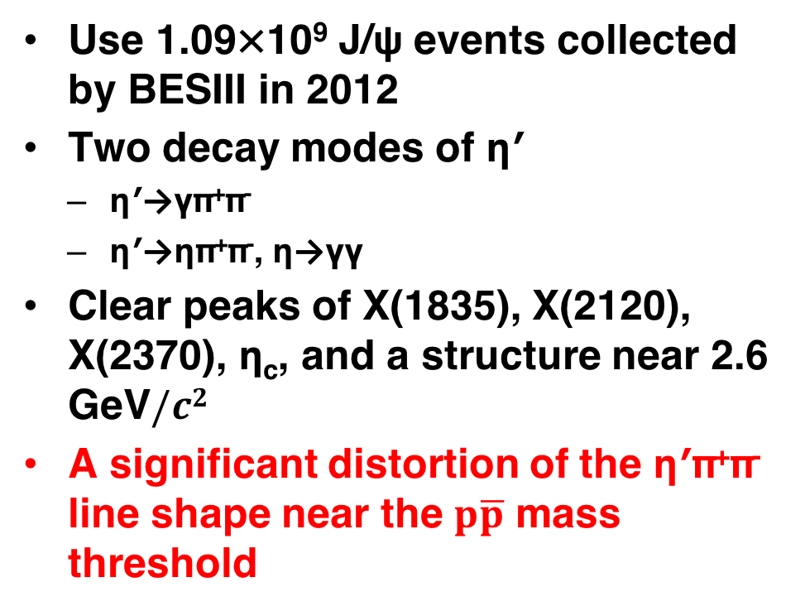
  New: connection is emerging
PRL 117, 042002 (2016)
Use 1.09×10⁹ J/ψ events collected by BESIII in 2012
Two decay modes of η′
  η′→γπ⁺π⁻
  η′→ηπ⁺π⁻, η→γγ
Clear peaks of X(1835), X(2120), X(2370), η_{c}, and a structure near 2.6 GeV$/c2$
A significant distortion of the η′π⁺π⁻ line shape near the $p\overline{p}$ mass threshold
  η′→γπ⁺π⁻
  η′→ηπ⁺π⁻

Slide 23
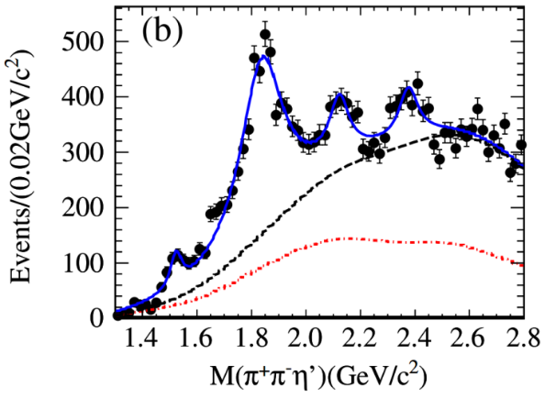
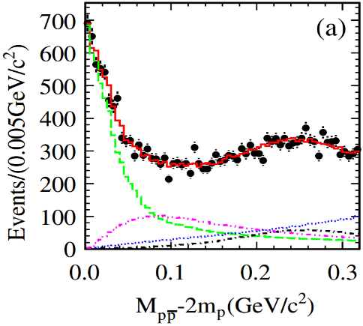










Anomalous line shape of η′π⁺π⁻ near $p\overline{p}$ mass threshold: connection between X(1835) and X($p\overline{p}$)
X($1835$) observed in J/ψ→γ$η^{′}π^{+}π^{−}$
X($p\overline{p}$) observed in J/ψ→γ$p\overline{p}$
Phys. Rev. Lett. 106, 072002 (2011)
PRL 108, 112003 (2012)
PRL 115, 091803 (2015)
X(1835) J^{PC}=0⁻⁻ ⁺
$$\text{M}= 1844±9_{−25}^{+16} MeV/c^{2}$$
$$Γ={192}_{−17−43}^{+20+62} MeV/c^{2}$$
X($p\overline{p}$) J^{PC}=0⁻⁻ ⁺
$$M={1832}_{−5 −17}^{+19 +18}±19 MeV/c2$$
$Γ=13±19 MeV/c2$ ($<76 MeV/c2$ @ 90% C.L.)
Connection is emerging
PRL 117, 042002 (2016)
The anomalous line shape can be modeled two models with equally good fit quality.
Suggest the existence of a state, either a broad state with strong couplings to $p\overline{p}$, or a narrow state just below the $p\overline{p}$ mass threshold
Support the existence of a $p\overline{p}$ molecule-like state or bound state

Slide 24




J/ψ→γγφ
First observation of X(1835)→γφ
  Sizeable $s\overline{s}$ components in X(1835): more complicated than a pure N$\overline{N}$state
First observation of η(1475)→γφ
  Measured Г(η(1475)→γρ)/Г(η(1475)→γφ) = (11.1±3.5) or (7.5±2.5)
  Theoretical prediction Г(η(1440)→γρ)/Г(η(1440)→γφ) ≈ 3.8
PRD97, 051101 (R) (2018)
PLB594, 47 (2004)
PRD87, 014023 (2013)
14.3σ
5.6σ
$$η(1405/1475)$$
X$(1835)$
Dots: data
Magenta: 1+cos²θ
Green: flat distribution
Blue: 1-cos²θ

Slide 25


Observation of X(2370) in J/ψ→γKKη′
X(2120) and X(2370) were first observed in J/ψ→γη′π⁺π⁻
  LQCD predicts the lowest lying 0⁻⁺ glueball has mass between 2.3-2.6 GeV/c²
  X(2120) and X(2370) are candidates?
Combined study of J/ψ→γK⁺K⁻η′/γK_{S}K_{S}η′
Spin-parity is not yet determined
  First observation of X(2370) in this process
  Mass/width are consistent with X(2370) in J/ψ→γη′π⁺π⁻
  B [X(2370)→KKη′]/B[X(2370)→η′π⁺π⁻] ~ 1/15
  A theoretical work predicts
  Г_{G->KKη′}/Г_{G}=0.011 and Г_{G→η′ππ}/Г_{G}=0.090 for M_{G}=2.37 GeV/c² (PRD 87, 054036)
  No clear signal of X(2120)

Slide 26





Y(2175) and the strangeonium-like Z_{S}
Y(2175) (denoted as $φ\left(2170\right)$ by PDG) was observed by BaBar, and confirmed by Belle, BESII and BESIII
  A candidate for a tetraquark state, a strangeonium hybrid state, or a conventional $s\overline{s}$ state
Unique place to search for the Z_{S}:
  Y(2175) is regarded as strangeonium-like state analogous to Y(4260)
  Mode: Z_{S}→π±ϕ ${\text{(}\text{Expected} \text{mass} M}_{Z_{S}}≈1.4$ GeV/c²)
PRD74, 091103(R) (2006)
PRD80, 031101(R) (2009)
PRD91,052017 (2015)
𝛾

Slide 27




Observation of e⁺e⁻→ηY(2175) at $\sqrt{s}>3.7$ GeV
arXiv:1709.04323, submitted to PRD
Perform the search for Y(2175) resonance in the process e⁺e⁻→ηϕf₀(980) at $\sqrt{s}$ between 3.7 and 4.6 GeV.
Combined significance for Y(2175) signal is observed to be larger than 10σ.
No significant Z_{S} signals in ϕπ± spectrum.

Slide 28




Search for the Z_{S} at 2.125 GeV
arXiv:1801.10384 (2018) submitted to PRL
Perform the search for Z_{S} via e⁺e⁻→ϕπ⁺π⁻ (ϕπ⁰π⁰) using 108 pb⁻¹ data collected at $\sqrt{s}=2.125$ GeV.
PWA is performed
No clear Z_{S} signal is observed in the ϕπ mass spectrums around 1.5 GeV/c².

Slide 29


a₀(980)-f₀(980) mixing
The lightest scalar nonet: σ, κ, a₀(980), f₀(980)
Theorists proposed a₀(980)-f₀(980) mixing mechanism ~40 years ago, to clarify the nature of these two states
BESIII reported evidence of a₀(980)-f₀(980) mixing using 225 million J/ψ events and 106 million ψ′ events
(suggested by Wu, Zhao, and Zou, PRD 75, 114012 (2007) )
No affirmative experimental result for
almost 40 years on the magnitude of the mixing
3.4σ
< 1.1% @ 90% C.L.
PRD83, 032003 (2011)
1.9σ
< 1.0% @ 90% C.L.

Slide 30





With 1.3 billion J/ψ and 450 million ψ′, a₀(980)-f₀(980) mixing is observed for the first time
7.4σ
5.5σ
statistical significance
Observed mixing between two light scalar mesons may help constrain their internal structure.
from PRD 75, 114012 (2007)

Slide 31





The charmed meson decays
$D_{(s)}$ purely leptonic decay (see Shuangshi's talk)
$D_{(s)}$ semi-leptonic decay
$D_{s}→p\overline{n}$
+scan data
$$D_{S}^{−∗}D_{S}^{+}$$
Particle data group 2015
$$D\overline{D}$$
$$Λ_{c}{\overline{Λ}}_{c}$$

Slide 32
Precision measurement of CKM elements
-- Test EW theory
CKM matrix elements are fundamental SM parameters that describe the mixing of quark fields due to weak interaction.
CKM matrix
BESIII + B factories + LQCD
Three generations of quark?
Unitary matrix?
BESIII + B factories + LHCb + LQCD
Expected precision < 2% at BESIII
Precision measurement of CKM matrix elements
A precise test of SM model
New physics beyond SM?

Slide 33

Double Tag (DT) techniques
100% of beam energy converted to D pair (Clean environment, kinematic constrains ν Recon. )
D_{(S)} generated in pair ⇒ absolute Branching fractions
Fully reconstruct about 15% of D_{(S)} decays
Double tag techniques: Hadronic tag on one side, on the other side for missing-mass studies
(Double tag efficiency is high.)

Slide 34




D_{(S)} Leptonic decays
Purely Leptonic:
Extract decay constant f_{D(s)} incorporates the strong interaction effects (wave function at the origin)
To validate Lattice QCD calculation of f_{B(s)} and provide constrain of CKM-unitarity
Semi-leptonic: form facotr (FF)
  Measure |V_{cx}| x FF
  Charm physics:
      CKM-unitarity ⇒ | V_{cx}|, extract FF, test LQCD
      Input LQCD FF to test CKM-unitarity

Slide 35



D⁰→K⁻μ⁺ν
  2.93 fb⁻¹ @E_{cm} = 3.773 GeV
consistent with SM within 2σ

Slide 36


BF for D_{s}→η⁽'⁾e⁺ν
  3.19 fb⁻¹ @E_{cm} = 4.178 GeV
Comparison of BFs
PDG 2017
PDG 2017
CLEO^{[1]}
CLEO^{[1]}
BESIII
@4.009GeV
BESIII
@4.009GeV
BESIII
preliminary
BESIII
preliminary
B[D_{s}⁺→ηe⁺ν](%)
B[D_{s}⁺→η'e⁺ν](%)
Preliminary Result:
B[D_{s}⁺→ηe⁺ν] = 2.31±0.06±0.06%
B[D_{s}⁺→η'e⁺ν] = 0.82±0.07±0.03%
[1]PRD80, 052007 (2009)

Slide 37



Form factors for D_{s}→η⁽'⁾e⁺ν
  3.19 fb⁻¹ @E_{cm} = 4.178 GeV
LQCD M_{π}=370MeV [1]
LQCD
M_{π}=370MeV [1]
LQCD M_{π}=470MeV [1]
LQCD
M_{π}=470MeV [1]
LCSR[2]
LCSR[2]
LCSR[3]
LCSR[3]
BESIII
Preliminary
BESIII
Preliminary
[1] PRD 91 014503
[2] JHEP 1511 138
[3] PRD 88 034023

Slide 38





Observations of D_{s}⁺→K^{(*)0}e⁺ν
B[D_{s}⁺→K⁰e⁺ν ]=(3.25 ± 0.38 ± 0.14)×10⁻³
B[D_{s}⁺→K*⁰e⁺ν ]=(2.38 ± 0.26 ± 0.12) ×10⁻³
(3.9 ± 0.9) ×10⁻³ [PDG2017]
(1.8 ± 0.4) × 10⁻³ [PDG2017]
BESIII preliminary
BESIII preliminary
BESIII preliminary

Slide 39


Observation of D_{s}⁺→p‾n
  3.19 fb⁻¹ @E_{cm} = 4.178 GeV
Only kinematic allowed baryonic decay of charmed meson, and help for understanding the dynamical enhancement of W-annihilation
  Short-distance expected:Br~10⁻⁶
  Long-distance enhance to: Br~10⁻³
First evidence was observed by CLEO-c: (1.30±0.36^{+0.12}_{−0.16})×10⁻³
PLB663, 326 (2008)
(PRL100, 181802(2008))
preliminary result
Confirm CLEO-c’s measurement with greatly improved accuracy
Consistent with the prediction of the enhanced BR due to long-distance effect via hadronic loop
BESIII preliminary

Slide 40


The $Λ_{c}^{+}$ decays
based on ~1 month data taking
  Hadronic decay
    $Λ_{c}^{+}→pK^{−}π^{+}$ + 11 CF hadronic modes :PRL 116, 052001 (2016)
    $Λ_{c}^{+}$→pK⁺K⁻, pπ⁺π⁻ :PRL 117, 232002 (2016)
    $Λ_{c}^{+}$→nKsπ⁺ :PRL 118, 12001 (2017)
    $Λ_{c}^{+}$→pη, pπ⁰ :PRD 95, 111102(R) (2017)
    $Λ_{c}^{+}$→ $Σ^{−}$π⁺π⁺π⁰ :PLB 772, 388 (2017)
    $Λ_{c}^{+}→Ξ^{0(∗)}K^{+}$ :PLB783, 200 (2018)
  Semi-leptonic decay
    $Λ_{c}^{+}$→$Λ$e⁺$ν_{e}$ : PRL115, 221805(2015)
    $Λ_{c}^{+}$→$Λ$μ⁺$ν_{μ}$ : PLB767, 42 (2017)
  Inclusive decay
  $Λ_{c}^{+}$→$Λ$X : arXiv: 1803.05706, accepted by PRL
  $Λ_{c}^{+}$→$e^{+}$+X : arXiv:1805.09060
  Production
  $Λ_{c}^{+}Λ_{c}^{−}$ cross section : PRL 120,132001(2018)

Slide 41


Λ_{c} threshold production at BESIII
In 2014, BESIII took data above Λ_{c} pair threshold and run machine at 4.6GeV with excellent performance.
Energy(GeV) | lum.(1/pb)
4.575 | 47.67
4.580 | 8.54
4.590 | 8.16
4.600 | 567.93
PRL101 (2008) 172001
BELLE
Measurement using the threshold pair-productions via e⁺e⁻ annihilations is unique: the most simple and straightforward
First time to systematically study charmed baryon at threshold!

Slide 42


Renaissance on the charmed heavy baryon
Before 2014, the c-ed baryons have been produced and studied at many experiments, notably fixed-target experiments (such as FOCUS and SELEX) and e+e- B-factories (ARGUS, CLEO, BABAR, and BELLE).
Large uncertainties in experiment; Retarded development in theory
Afterwards, more extensive measurements on charmed baryons are performed at the BESIII, BELLE and LHCb
                The absolute BF measurements at BESIII and BELLE
                The observation of the DCS mode $Λ_{c}^{+}→pK^{+}π^{−}$ at BELLE
                The observation of the cc-d baryon $Ξ_{cc}^{++}$ at LHCb
            These experimental progresses have revoked the activities in the theoretical efforts
PDG2014

Slide 43

The improvement after 2014
EPJC 77, 895 (2017)
PRL 116, 052001 (2016)
PRL113, 042002 (2014)
HFLAV2016
            Improved precisions significantly with factors of 4~10

Slide 44






W-exchange-only process $Λ_{c}^{+}→Ξ^{ (∗)0}K^{+}$
W-exchange diagram is non-factorable in theoretical calculation
This measurement helps in calibration of the W-exchange process in the charmed baryon sector
The previous measurements have poor precision
CLEO
PDG: (5.0±1.2)$×{10}^{−3}$
CLEO
PDG: (4.0±1.0)$×{10}^{−3}$
ARGUS

Slide 45








W-exchange-only process $Λ_{c}^{+}→Ξ^{0(∗)}K^{+}$
PLB783, 200 (2018)
Double tag and missing $Ξ^{0(∗)}$ to increase the detection efficiency
Low backgrounds because the anti-strangeness of $K^{+}$
$$K^{+}$$
First absolute measurement of the decay BF
Improved precision
No models can accommodate the both rates
10.3σ
$$60±12$$
6.4σ
$$68.2±9.9$$

Slide 46






The inclusive channel $Λ_{c}^{+}$→$Λ$+X
arXiv:1803.05706, accepted by PRL
Mediated by the c-s transition, essential input in the calculation of the $Λ_{c}^{+}$ life time
Current PDG: BF($Λ_{c}^{+}$→$Λ$+X)=(35±11)% with large uncertainty
The sum of known exclusive modes: $\left(24.5±2.1\right)\%$: need better understanding of the gap between exclusive and inclusive rates
ST modes of $Λ_{c}^{+}$→pΚ⁻π⁺ and p$K_{s}^{0}$, to measure the probability of finding a $Λ$ in the final states
Data-driven (𝑝−|𝑐𝑜𝑠𝜃|) 2D efficiency correction using several $Λ$ control samples
$ℬ\left(Λ_{C}^{+}→Λ+X\right)={(38.2}_{−2.2}^{+2.8}±0.8)\%$
  indicates ~1/3 BFs are unknown
$Acp{=(2.1}_{−6.6}^{+7.0}\text{±1.4}\text{)\%}$
  (No CPV is observed.)

Slide 47



The inclusive channel $Λ_{c}^{+}$→$e^{+}$+X

Slide 48




The cross-section of baryon pair
PRD97,032013(2018)

Slide 49





Study of e⁺e⁻→ $Λ_{c}^{+}Λ_{c}^{−}$ near threshold
Combined analysis of 10 ST hadronic modes
PRL 120, 132001 (2018)
$$pK^{−}π^{+}$$
4575 MeV
4580 MeV
4590 MeV
4600 MeV
Belle's leftmost bin is corrected due to spanning below threshold

Slide 50






Angular dependence analysis of e⁺e⁻→ $Λ_{c}^{+}Λ_{c}^{−}$ near threshold
PRL 120, 132001 (2018)
combined data
4575 MeV
4600 MeV
One of the most basic observables that intimately related to the internal structure of the nucleon.
One of the most challenging questions in contemporary physics is why and how quarks are confined into hadrons.
The electromagnetic form factors (EMFFs) have been a powerful tool in understanding the structure of nucleons.
First measurements of the EMFFs of the $Λ_{c}^{+}$

Slide 51
Summary
  Fruitful results with large varieties of physics outputs
  The hadron spectroscopy and exotics
    X states between 1.8~1.9 GeV/c²
    Glueball searches
    Efforts on studies on the strangeonium-(like) and charmonium-(like) states
  Charmed hadron decays
    Measurements of decay constants f_{D(s)+} and form factors
    Determinations of |V_{cs(d)}|: improved test on CKM matrix unitarity
    Important testes on non-perturbative QCD
    Significant improvement in charmed baryon sector
  Approved future BEPCII upgrade
      Top up mode :
      30% going-up of data taking efficiency
      Increase the beam energy:
      4.6 GeV → 4.7 GeV (~2018 summer) → 4.9 GeV (~2020)

Slide 52

Thank you!
谢谢！

Slide 53

Search for Z_{S} at 2.125 GeV
arXiv:1801.10384 (2018) submitted to PRL
90% C.L. upper limits on the cross-section for Z_{S} production are determined.
In addition, the cross-sections of e⁺e⁻→ϕπ⁺π⁻ and e⁺e⁻→ϕπ⁰π⁰ at 2.125 GeV/c² are measured to be (343.0±5.1±25.1) pb and (208.3±7.6±13.5) nb, respectively.
Different assumptions of mass, width and J^{P} of Z_{S}
The cross-section for e⁺e⁻→ϕπ⁺π⁻ slightly differs from previous measurements from BaBar ((510±50±21) pb at 2.1125 GeV) and Belle ((480±60±42) pb at 2.1125 GeV) measurements, but consistent within 3𝜎.
The cross-section for e⁺e⁻→ϕπ⁰π⁰ is consistent with BaBar measurement (195±50±14) pb within uncertainty.
BaBar Collaboration Phys. Rev. D 86, 012008 (2012)
BELLE Collaboration Phys. Rev. D 80, 031101 (2009)

Slide 54


The Zc Family at BESIII

Slide 55







Many charged Charmonium-like states
arXiv:1708.04012
in $e^{+}e^{−}→π^{−}Zc$
in $e^{+}e^{−}→π^{−}Zc$
$$π^{±}J/ψ$$
in ${B→KZc}^{}$

