Slide 1
Status and Prospects of JUNO
10th Workshop on Hadron physics in China and Opportunities Worldwide
Ran HAN
Beijing Institute of Spacecraft Environment Engineering
On behalf of the JUNO Collaboration
Shandong Univ, Weihai, 26-30 July 2018

Slide 2
Outline
JUNO Introduction and Main Physics Goal
JUNO Detector R&D and JUNO Near Detector
JUNO Other Physics Potentials
4. Milestones & Schedule
5. Summary

Slide 3
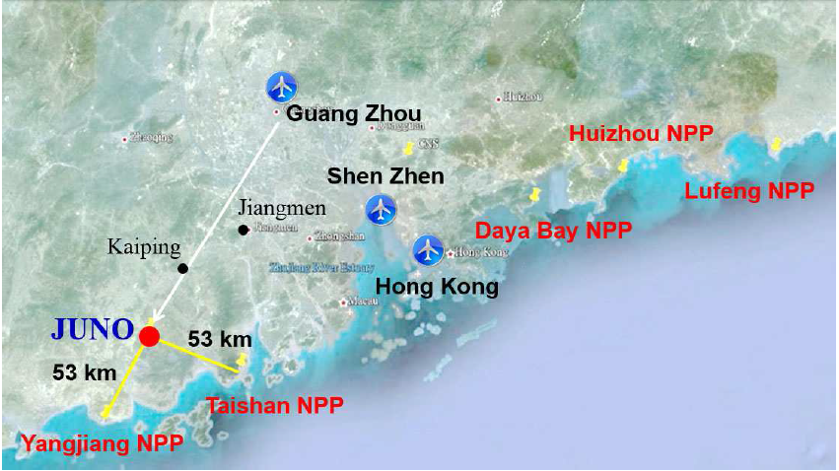
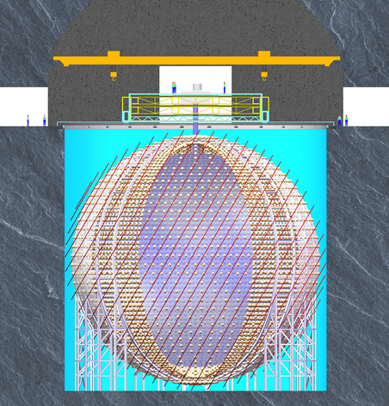
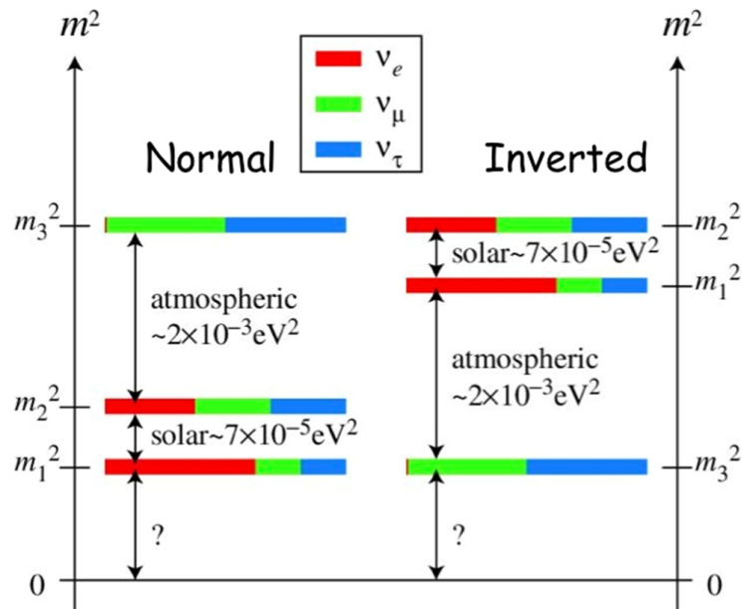
Jiangmen Underground Neutrino Observatory
Main goal: Mass Hierarchy (MH)
Acrylic sphere: ID35.4m
Stainless steel latticed shell: ID40.1m
~17000 20” PMT+
~25000 3’’ PMT
20kton，3%/sqrt(E)

Slide 4
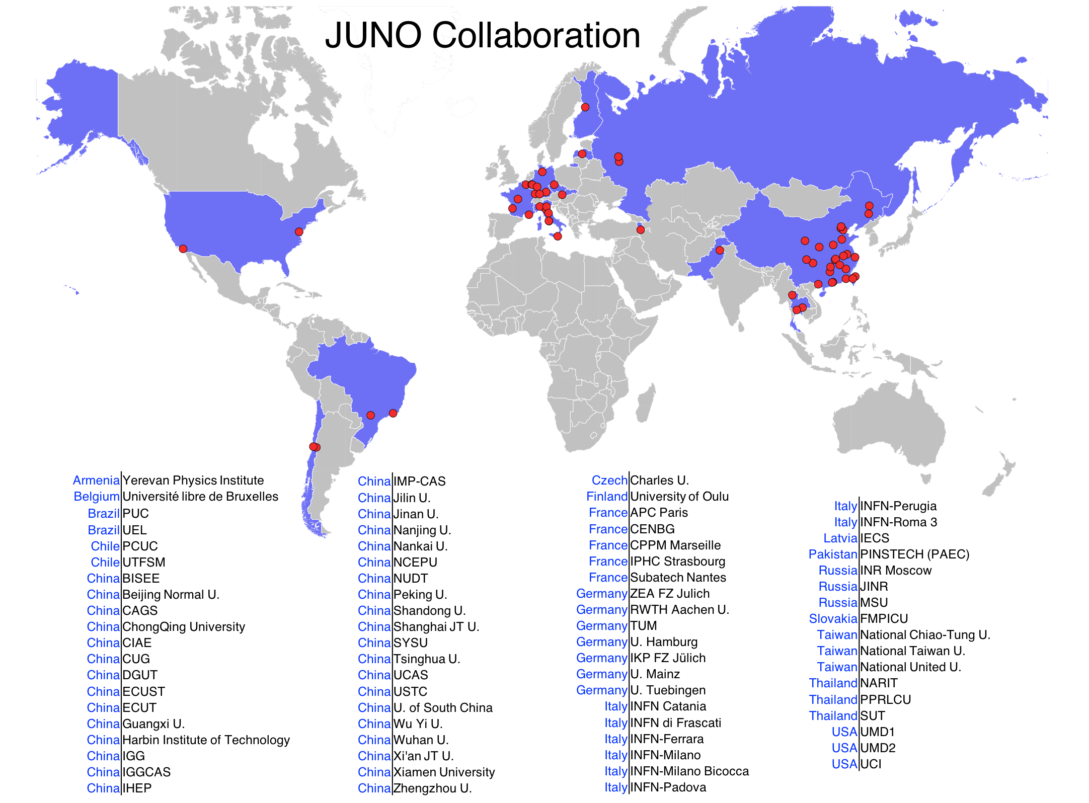
JUNO Collaboration
Country | Institute | Country | Institute | Country | Institute
Armenia | Yerevan Physics Institute | China | IMP-CAS | Germany | U. Mainz
Belgium | Universite libre de Bruxelles | China | SYSU | Germany | U. Tuebingen
Brazil | PUC | China | Tsinghua U. | Italy | INFN Catania
Brazil | UEL | China | UCAS | Italy | INFN di Frascati
Chile | PCUC | China | USTC | Italy | INFN-Ferrara
Chile | UTFSM | China | U. of South China | Italy | INFN-Milano
China | BISEE | China | Wu Yi U. | Italy | INFN-Milano Bicocca
China | Beijing Normal U. | China | Wuhan U. | Italy | INFN-Padova
China | CAGS | China | Xi'an JT U. | Italy | INFN-Perugia
China | ChongQing University | China | Xiamen University | Italy | INFN-Roma 3
China | CIAE | China | NUDT | Latvia | IECS
China | DGUT | China | CUG-Beijing | Pakistan | PINSTECH (PAEC)
China | ECUST | China | ECUT-Nanchang City | Russia | INR Moscow
China | Guangxi U. | Czech | Charles U. | Russia | JINR
China | Harbin Institute of Technology | Finland | University of Jyvaskyla | Russia | MSU
China | IHEP | France | APC Paris | Slovakia | FMPICU
China | Jilin U. | France | CENBG | Taiwan-China | National Chiao-Tung U.
China | Jinan U. | France | CPPM Marseille | Taiwan-China | National Taiwan U.
China | Nanjing U. | France | IPHC Strasbourg | Taiwan-China | National United U.
China | Nankai U. | France | LLR Palaiseau | Thailand | NARIT
China | NCEPU | France | Subatech Nantes | Thailand | PPRLCU
China | Pekin U. | Germany | FZJ-ZEA | Thailand | SUT
China | Shandong U. | Germany | RWTH Aachen U. | USA | UMD1
China | Shanghai JT U. | Germany | TUM | USA | UMD2
China | IGG-Beijing | Germany | U. Hamburg | USA | UC Irvine
China | IGG-Wuhan | Germany | FZJ-IKP
Collaboration established in July 2014
Now: 77 institutions, 598 collaborators

Slide 5
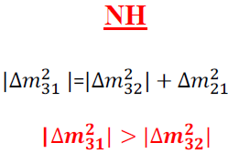
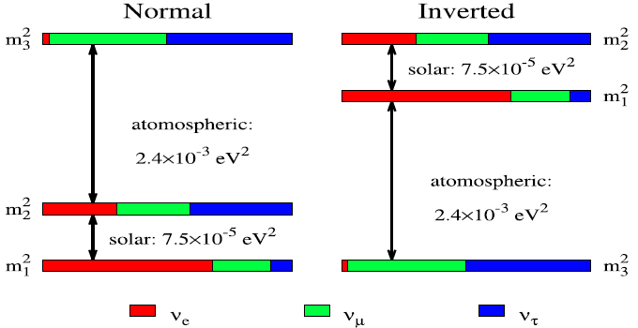
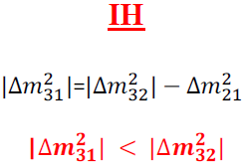
Mass Hierarchy
the discovery of non-zero θ₁₃ in neutrino experiments like Dayabay
the non–zero mixing angles have been measured with the precision from 4% to 10%.
the two independent mass-squared difference, have been measured with the precision better than 4%.
Two possible scenarios
Why measure MH?
• important discriminator for model building of the neutrino masses
helps to resolve δCP
define the goal of0νββ
key parameters of the neutrino astronomy and neutrino cosmology.
Vacuum oscillation: reactor neutrinos S. T. Petcov et al., PLB 533 (2002) 94

Slide 6
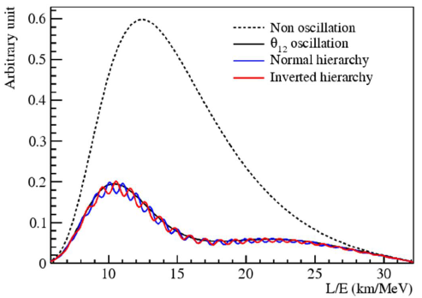
How to Measure
How the interference happens?
L/E spectrum contains the MH information:
J. Learned et. al. hep-ex/0612022 L. Zhan et. al. 0807.3203
Requirements for measuring MH:
Reactor baseline variation: < 0.5 km
JUNO site meets this requirement
Statistics: 100k events in 6 yrs
- 36 GW reactor power
- 20 kton detector (→ ~60 evts/day)
- Precision muon tracking to maximize exposure (minimize vetoed volume)
Energy resolution: ~ 3%/√E
- The crucial parameter
Energy scale uncertainty: < 1%
- Large uncertainties could lead to wrong answer
JUNO Collaboration, J. Phys. G 43, 030401 (2016)

Slide 7
Overall Detector Design
Central detector
- Acrylic sphere liquid scintillator
- PMTs in water buffer
- 75% PMT coverage
Water Cherenkov muon veto
- 2400 20” PMTs
- 35 ktons ultra-pure water
- Efficiency > 95%
- Radon control → less than 0.2 Bq/m³
Compensation coils
- Earth magnetic field <10%
- Necessary for 20” PMTs
Top tracker
- Precision muon tracking
- 3 plastic scintillator layers
- Covering half of the top area
JUNO Detectors
Yellow: CD
Blue:Veto
Calibration
Top Tracker
LS/Water Filling room
Earth Magnetic Field shielding coils
Pool’s height 44m
Water depth 43.5m
Central detector
Steel Structure + Acrylic sphere +
20kt Liquid Scin
Acrylic sphere: ID35.4m
Stainless steel latticed shell: ID40.1m
~18000 20” PMT+
~25000 3’’ PMT
Water Cherenkov
~2400 20’’ PMT
Water pool diameter: 43.5m

Slide 8
JUNO Liquid Scintillator
Requirement for 3%/√E
High light-yield: 10⁴ photons/MeV (pure organic solvent and high fluor content)
High transparency: Attenuation Length (A.L.) > 20m @ wavelength of 430nm
Purification pilot plant
Under operation at Daya Bay
Distillation, Al2O3 column purification, water extraction and gas stripping
> 23 m A.L. after filling (measured)
Optimizing LS recipe
Studying radio-purity
Notes:
One of most essential parts will of course be the liquid scintillator. To reach the aimed for energy resolution of 3% we need to generate and collect as much light as possible.
Thus we require a light-yield of about 10000 photons per MeV. This can be reach with pure organic solvent and high fluor content.
And we need an attenuation length of more than 20 m at a wavelength of 430nm.
This requires careful material selection and purification.
Therefore, we have a pilot plant under operation at the Daya Bay site using four different purification methods: Ablesen
With this an attenuation length of more than 23 m could be reached after filling one of the Daya Bay detectors.
We also use this facility to optimise the liquid scintillator recipe and study the radiopurity.

Slide 9
JUNO 20” PMTs
(Northern Night Vision Technology)
15000 MCP-PMTs from NNVT
5000 dynode PMTs from Hamamatsu
In production since 2016
Already >9000 delivered
More than 5000 tested
Characteristics | MCP-PMT | R12860
Detection Eff. (QE×CE*area) (%) | 27%, >24% | 27%, >24%
P/V of SPE | 3.5, >2.8 | 3,>2.5
TTS on the top point (ns) | ~12,<15 | 2.7,<3.5
Rise time/Fall time(ns) | R~5; F~12 | R~5,<7; F~9,<12
Anode Dark count(Hz) | 20k,<30k | 10k,<50k
After Pulse (%) | 1,<2 | 10,<15
Glass Radioactivity (ppb) | ²³⁸U:50 ²³²Th:50 ⁴⁰K:20 | ²³⁸U:400 ²³²Th:400 ⁴⁰K:40
JUNO PMT with implosion protection cover
Notes:
MCP: New Technology
Potential of even higher PDE using reflection on backside
New Technology + Large HQE PMTs → Mass production within a very short time → very impressive

Slide 10
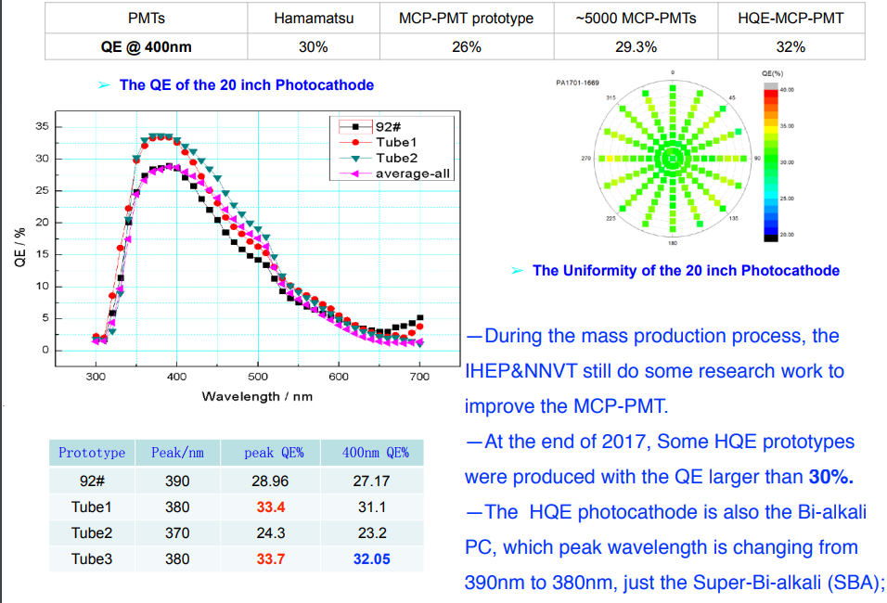
The improvement of the MCP-PMTs

Slide 11
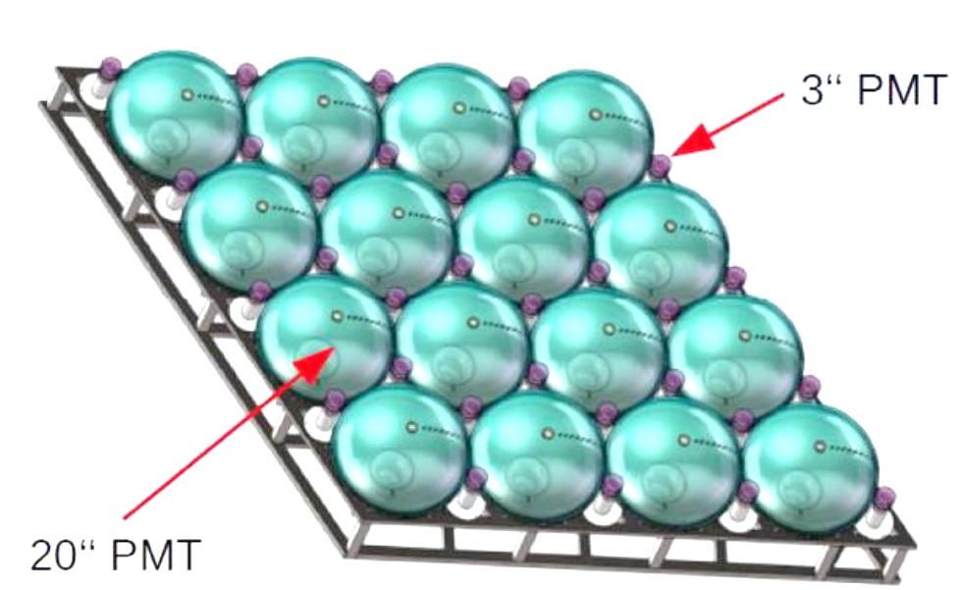
3” PMTs
Double calorimetry
Always photon counting
→ Better control of systematics
(Calibration of non-linear response of large PMTs)
Increased dynamic range
→ Helps with large signals
25000 PMTs contracted to HZC
4000 produced, 3000 tested at HZC
(e.g. muons, supernova signal)
200 boxes × 128 PMTs
JUNO custom design: XP72B22
QE 24% , P/V 3.0
SPE resolution 30%
TTS 2-5 ns
Prototype already built

Slide 12
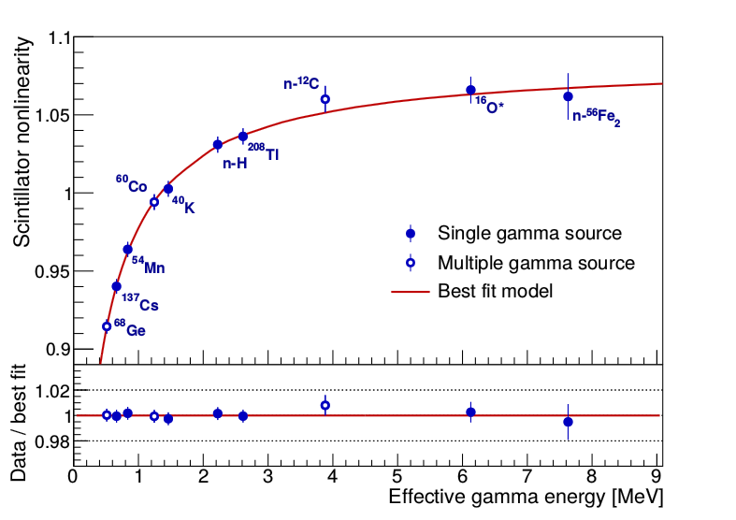
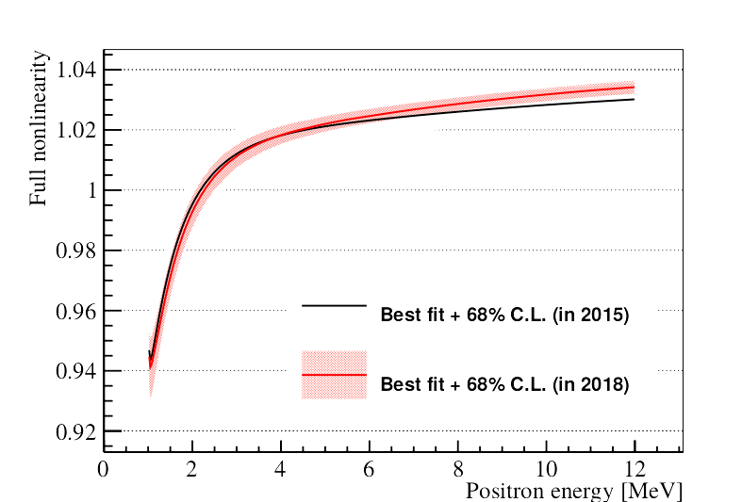
How to Control the Energy Scale Uncertainties
Answer: Meticulous calibration
(Different sources, over whole energy range, continuously, ...)
Other experiments already achieved 1% accuracy
(Daya Bay ~0.5%, Double Chooz 0.74%, Borexino <1% (at low energies), KamLAND 1.4%)
New results from ESCAPE workshop
Daya Bay collaboration,
at ESCAPE workshop
Daya Bay collaboration,
at ESCAPE workshop
For more information see: Daya Bay collaboration, Phys. Rev. D 95, 072006 (2017)
Notes:
Shaded grey area:
Uncertainties due to errors on parameters from fit
Stabel under:
Variation of model under removal of single calibration reference from data set.
Also used continous spectrum produced by 12B electron

Slide 13
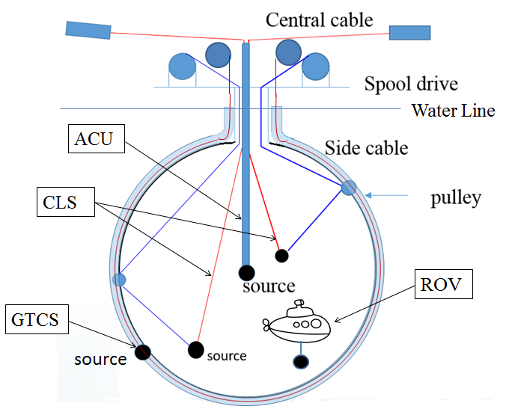
Calibration System
Automatic Calibration Unit (ACU)
Cable Loop System (CLS)
Remotely Operated under-liquid-scintillator Vehicles (ROV)
Guide Tube Calibration System(GTCS)
Complementary for covering entire energy range of reactor neutrinos and full-volume position coverage inside JUNO central detector

Slide 14
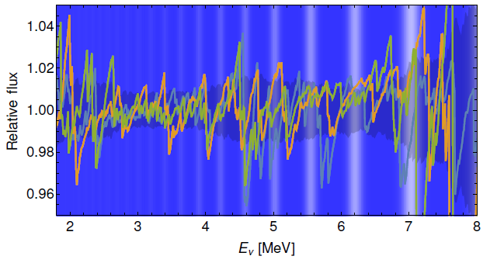
Reactor Spectrum Uncertainties
Reactor spectrum might show micro-structure
this micro-structure can have a similar size and frequency as the oscillations we are looking for
(see e.g. A.A.Sonzogni, et al. arXiv:1710.00092,
D. A. Dwyer &T. J. Langford, Phys. Rev. Lett. 114,012502 (2015))
JUNO need a reference antineutrino spectrum with similar energy resolution as JUNO as input
From reactor flux model? No bump & unknown uncertainty
From experiment measurement? Uncertainties from detector response and reference antineutrino spectrum Could be correlated.
Reference antineutrino spectrum
Detector response
JUNO spectrum
Oscillation pattern determine mass hierarchy
Notes:
Another important and very active topic is the uncertainty of the reactor spectrum. HORIZON workshop
It is expected to have a micro structure, due to the many thousand beta decay branches involved.
And this micro-structure can have a similar size and frequency as the oscillations we are looking for.
This can be seen in this plot, where the deviation of the micro structure from the average spectrum is shown and the neutrino oscillation frequency is indicated by the white and blue background.
The result is that our sensitivity will depend on the energy resolution that we know our reactor spectrum with.
And as you can see here on the right the optimal sensitivity requires a reactor spectrum with a similar energy resolution as JUNO.
That is why we have started R&D on a near detector.
A. A. Sonzogni, M. Nino, E. A. McCutchan arXiv:1710.00092
→ Fine Structure ->possible danger for JUNO
95 Y, 98,101 Nb and 102 Tc could explain 5MeV bump

Slide 15
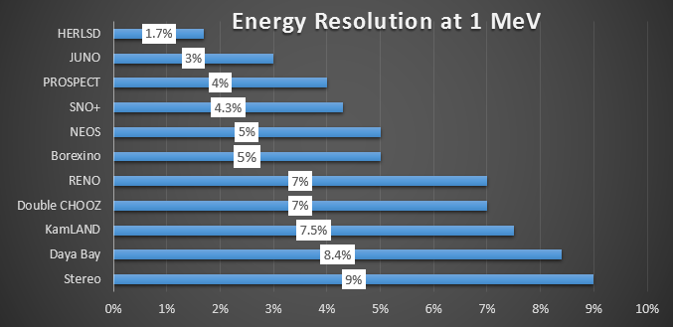
Solution: A JUNO Near Detector
Fiducial mass: 1 ton
Baseline: 33-35 m from the reactor
Thermal power: 4.6 GW(YangJiang NPP)
Statistics: ~3 million IBD reactions for 3 years. (~30 X JUNO)
10 m² SiPM of 50% PDE, operated at -50 degree, on a copper support aim to energy resolution of 1.7% at 1 MeV
Notes:
The current baseline is that it will have …
Currently we have two sensor types under consideration:
SiPM, which need to be cooled, but would give us an energy resolution of about 1.4%.

Slide 16
MH sensitivity for JUNO
Median sensitivity on MH after100k IBD (6 yr of running):
3𝞼 (ΔX²>10) with the spectral measurement
4𝞼 if including an external Δm²(µµ) measurement spread of reactor cores, uncertainties from reactor neutrino flux, the energy scale and non-linearity.
Advantages
JUNO looks at almost vacuum oscillations and, therefore, it doesn’t suffer from the uncertainty on Earth density profile and the ambiguity of CP-violating phase.
Y. F. Li et al., PRD.88.013008

Slide 17
Other Oscillation Probes
JUNO can measure antineutrino spectrum with excellent energy resolution
Precision measurement of the neutrino oscillation parameters to an accuracy of better than 1%,
JUNO Collaboration, J. Phys. G 43, 030401 (2016)
Esteban et. al, JHEP 1701 (2017) 087 and F. Capozzi et al., arXiv: 1703.04471[hep-ph]

Slide 18
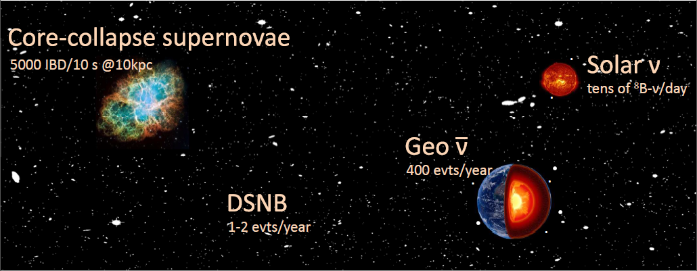
Observatory of Astrophysical Sources

Slide 19
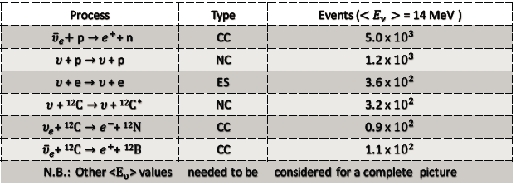
Supernova Neutrino Physics @ JUNO
For a SN at a distance of10kpc, JUNO will register about 5000 events from IBD, 2000 events from all-flavor elastic neutrino-proton scattering (>0.2 MeV).
SN neutrino events with high statistics, flavor information, good energy resolution, give us a great opportunity to understand the mechanism of supernova explosion and physical pictures of the neutrino oscillation.

Slide 20
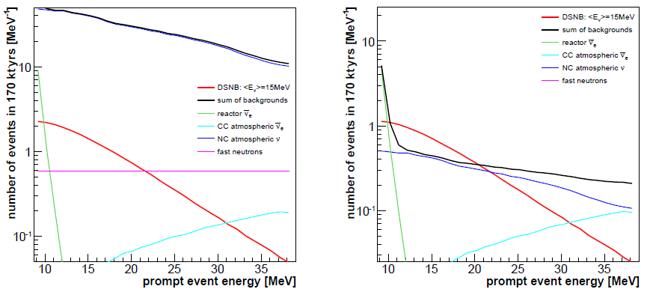
DSNB@JUNO
DSNB: the integrated neutrino flux from past Core collapse SN rate
Gives: cosmic star-formation rate，the average spectrum and rate of failed SN
Strong atmospheric neutrino background, pulse-shape discrimination techniques
3𝞼 expected for observation after 10 yr
non-detection improve current limits and exclude a significant range of DSNB parameter space.

Slide 21
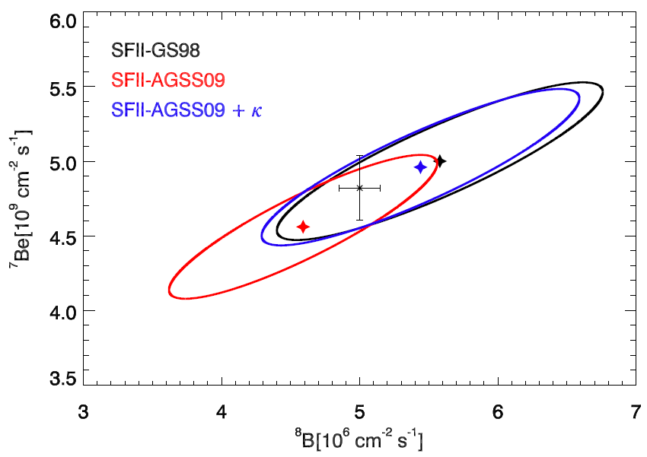
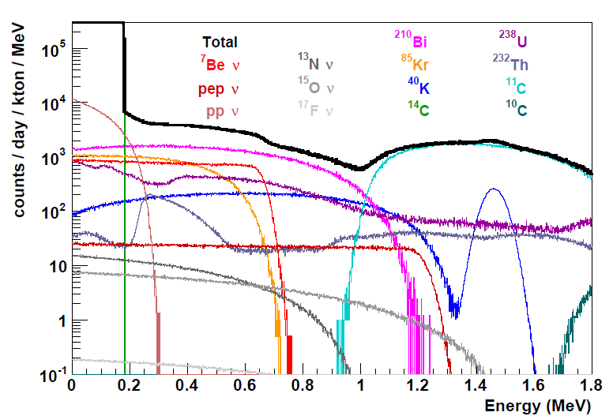
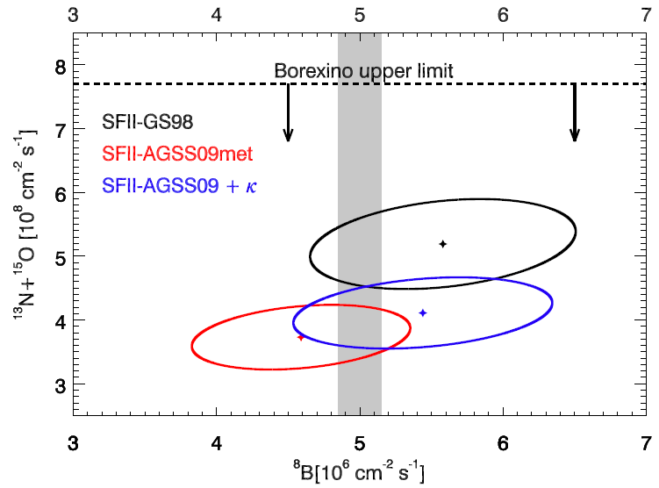
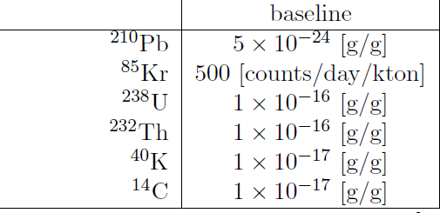
Solar neutrinos @ JUNO
νe elastic neutrino electron scattering
Study of part of the pp solar fusion chain
• ⁷Be neutrinos:
sub-MeV part of spectrum
• ⁸B neutrinos
Test of MSW oscillation pattern. Impact on Solar Models. Metallicity problem

Slide 22
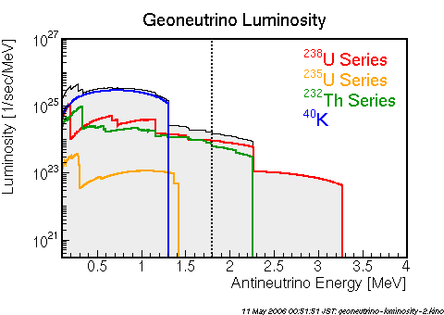
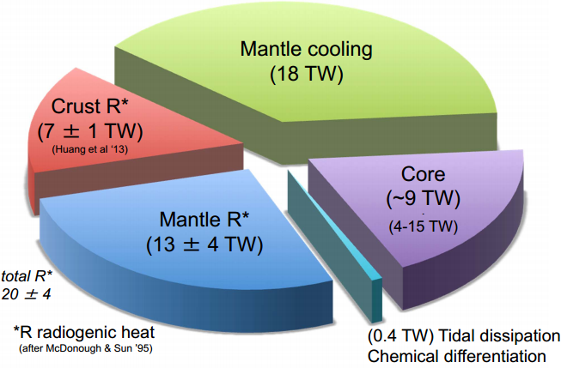
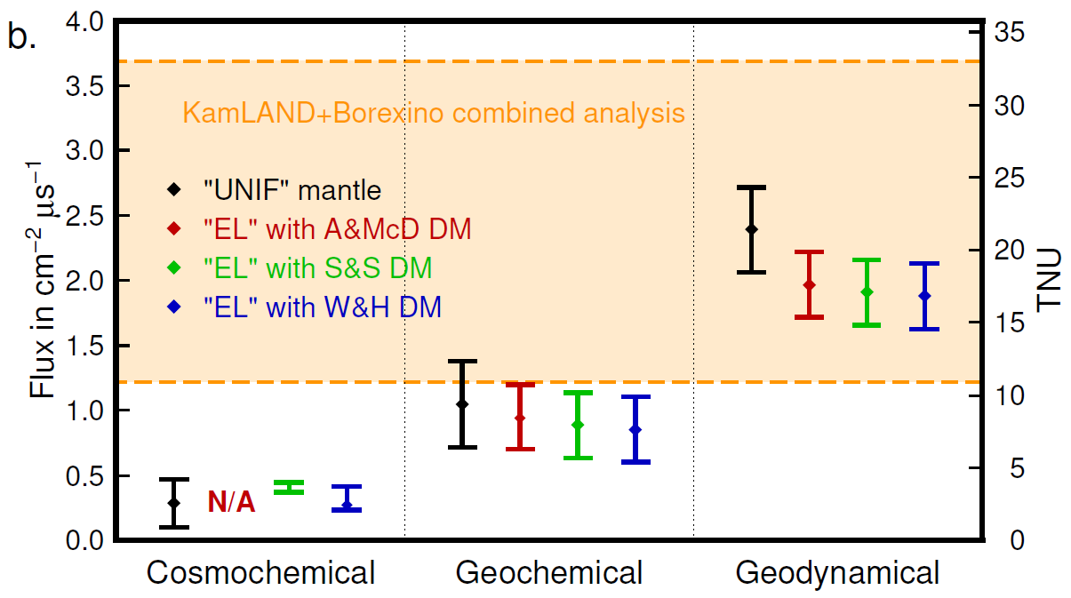
Geo-neutrino physics
the future… Geoneutrino studies

Slide 23
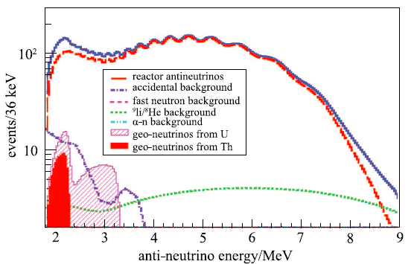
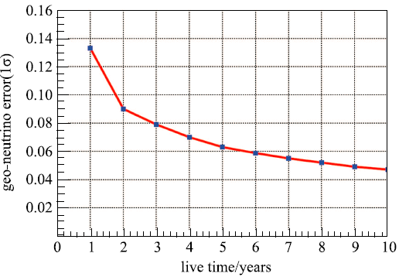
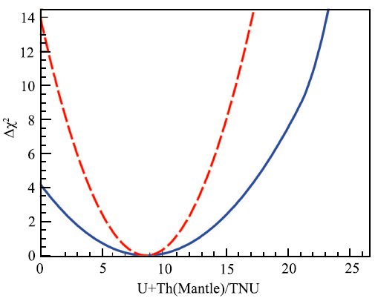
Geo-neutrino physics @ JUNO
R. Han et al. Chin.Phys.C(2016)
400events/year, much larger than before
With 10 years: total uncertainty reach 5%（2TNU
Comparison of the global reference model (18% crust) and a benchmark accuracy of the local model(8% crust)
3D local crust model is built.

Slide 24
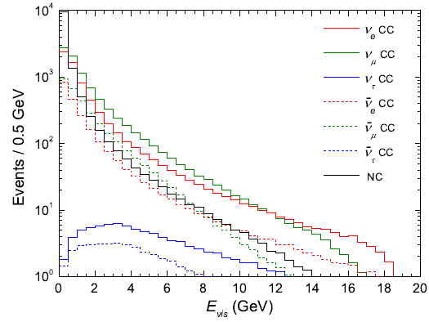
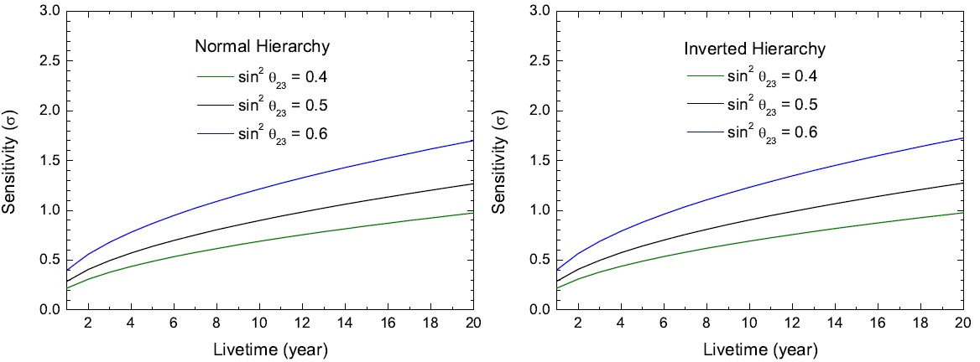
Atmospheric Neutrinos
Atmospheric neutrinos are a very important neutrino source to study the neutrino oscillation physics.
The JUNO central detector has a very low energy threshold and can measure atmospheric neutrinos with excellent energy resolution.

Slide 25
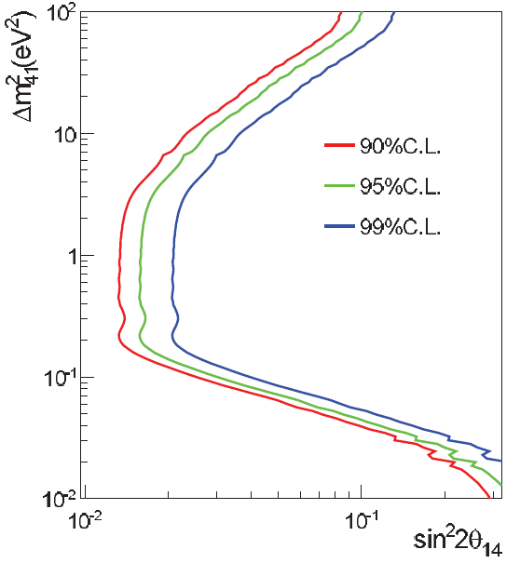
Sterile Neutrinos
Sterile neutrinos are gauge singlets of the Standard Model. They do not participate in standard weak interactions but couple to the active neutrinos through non-zero mixing between active and sterile flavors.
The diameter of the JUNO central detector will be around 35 meters, which is perfectly suitable for a short-baseline oscillation experiment with a radioactive neutrino source sensitive to eV-scale sterile neutrinos.
Sensitivity search at JUNO, assuming a 50 kCi ¹⁴⁴Ce source at the detector center, with 450 days of data-taking. show the 90, 95 and 99% confidence levels including the reactor antineutrino background.

Slide 26
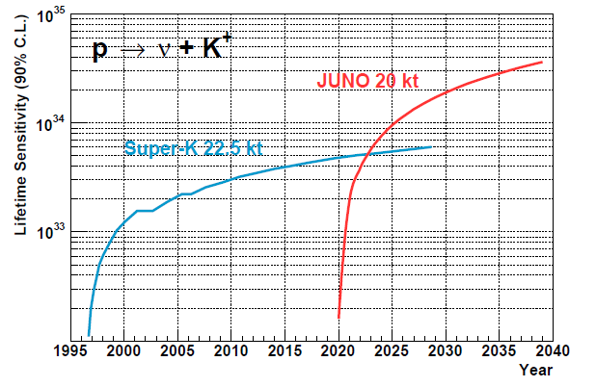
Exotic searches
Indirect dark matter search
Nucleon decay
Non-standard interaction
Test unitarity using absolute measurements
Other probes of new physics
Nucleon decay

Slide 27
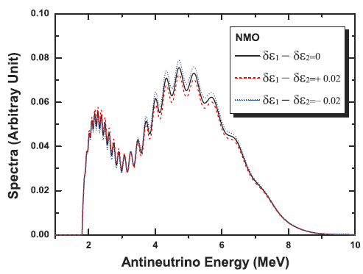
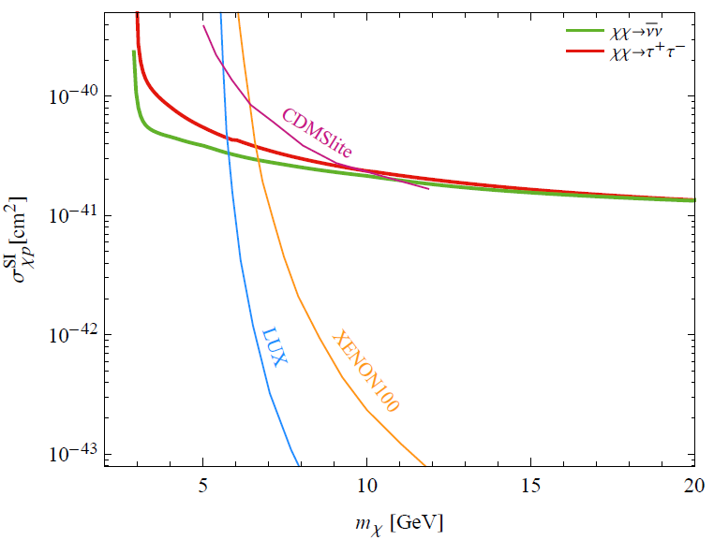
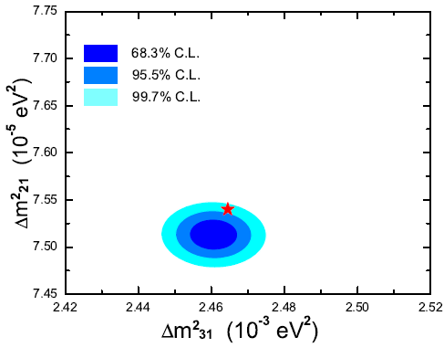
Neutrinos from Dark Matter
Others
Non-standard Interactions

Slide 28
Milestones & Schedule
2021:
Detector ready for Data taking!
2019-2020:
Electronics production starts
Civil work and lab preparation
Completed
Detector constructing
2018:
PMT potting
starts Delivery of surface buildings
Start production of acrylic sphere
2017:
Start PMT testing
TT arrived
2016:
Start PMT production
Start CD parts production
2015:
PMT production line setup
CD parts R&D
2014:
International collaboration established
Start civil construction

Slide 29
Summary
JUNO is a multipurpose underground precision neutrino detector, which is a very active R&D program.
JUNO will achieve design goals by High light-yield, transparency LS, Purification pilot plant, HQE PMTs, Meticulous calibration and JUNO Near Detector
JUNO will measure Mass hierarchy (3­‐4 σ in 2027) and 3 oscillation parameters to <1% level, with other rich physics potentials, such as supernova, geo-neutrino, solar neutrino, sterile neutrino.
JUNO detector R&D and fabrication are progressing smoothly, aiming at data-taking in 2021.
Thanks for your attention!

Slide 30
Back up slides

Slide 31
Oscillation Current Status
Resolved issues:
Three non-zero mixing angles
have been measured
Two independent mass-squared differences$\left|∆m_{31}^{2}\right|$(or$\left|∆m_{32}^{2}\right|$ ) and $∆m_{21}^{2}$ have been measured
Unresolved issues:
Mass hierarchy
CP-violating phase
Theta(23) octant
Constitutes the main focus of the future neutrino oscillation experiments.

Slide 32
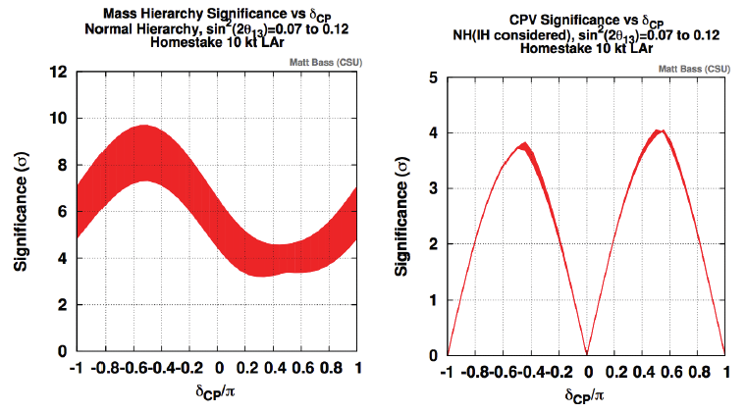
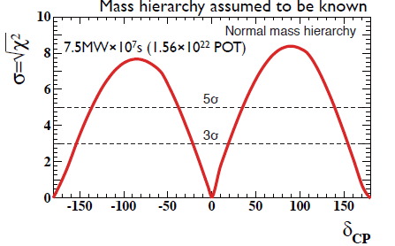
未来中微子振荡：CP破坏
DUNE/LBNF
美国加速器实验DUNE
日本加速器实验T2HK

Slide 33
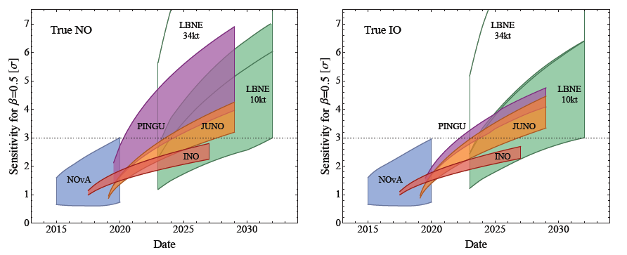
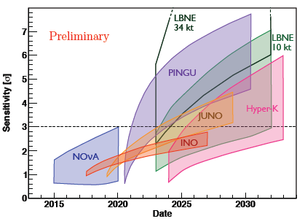
未来中微子振荡：质量顺序
PINGU LOI, arXiv:1401.2046
M. Blennow et al., arXiv:1311.1822(2013)
美国NOvA：将延长运行至2024年
美国DUNE：已批准，2024年探测器、2026年束流运行，1-3年5σ
印度INO：已批准，因环保问题未开工
日本Hyper-K：接近批准，2026年运行，5年3-5σ
南极PINGU：计划2025(?)运行，5年3σ
法国ORCA：部分批准，计划2022年运行，3年3σ

Slide 34
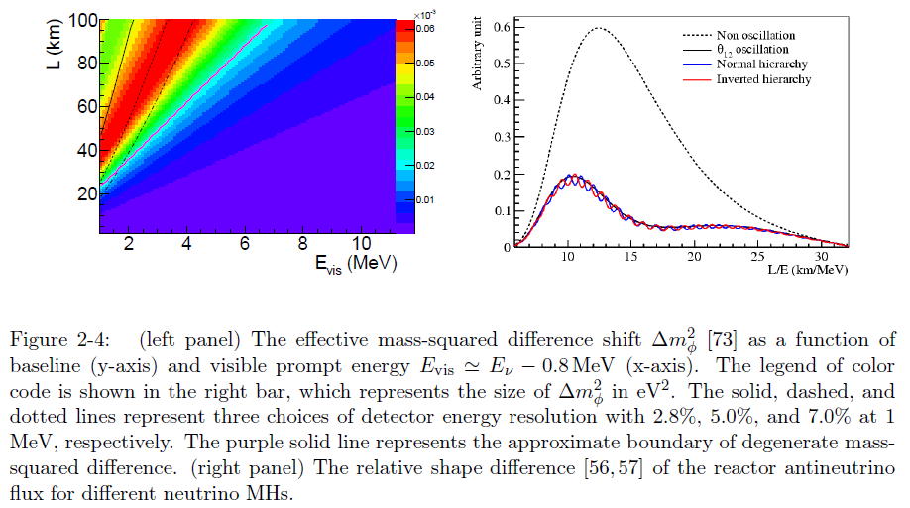
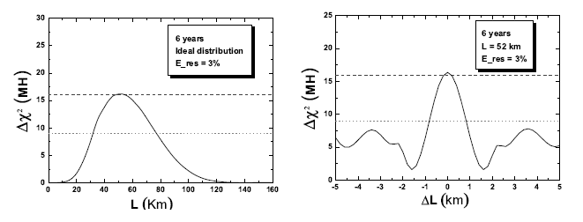

Slide 35
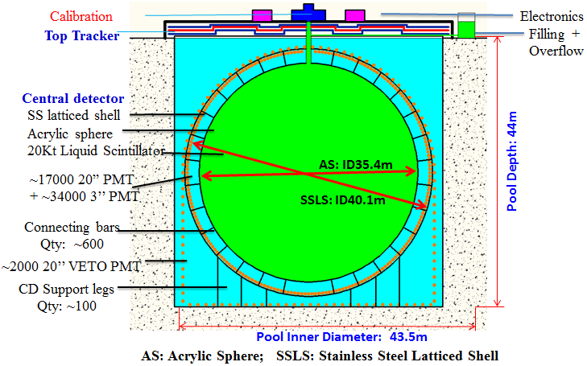
JUNO Detector R&D
Veto Detector
Water Cherenkov detector: track muons and shield ambient radioactivity
Top Trackers: independent muon tracking
Energy resolution: ~ 3%/√E
Energy Non-linearity : < 1%
Central Detector
~20kt @ Φ35.4m (Largest LS detector) filled with LS.
Equipped with ~18k high QE 20” PMTs
25k 3” PMTs for better timing and higher saturation energy
Calibration system
Multiple sources: e⁺, γ, n
Full volume positioning
Overburden of~700 m rock for cosmic-ray shielding
Notes:
JUNO Document 1468-v15

