Slide 1
HIAF-EicC Accelerator consideration
Jiancheng Yang
Accelerator Department
Institute of Modern Physics , Chinese Academy of Sciences

Slide 2
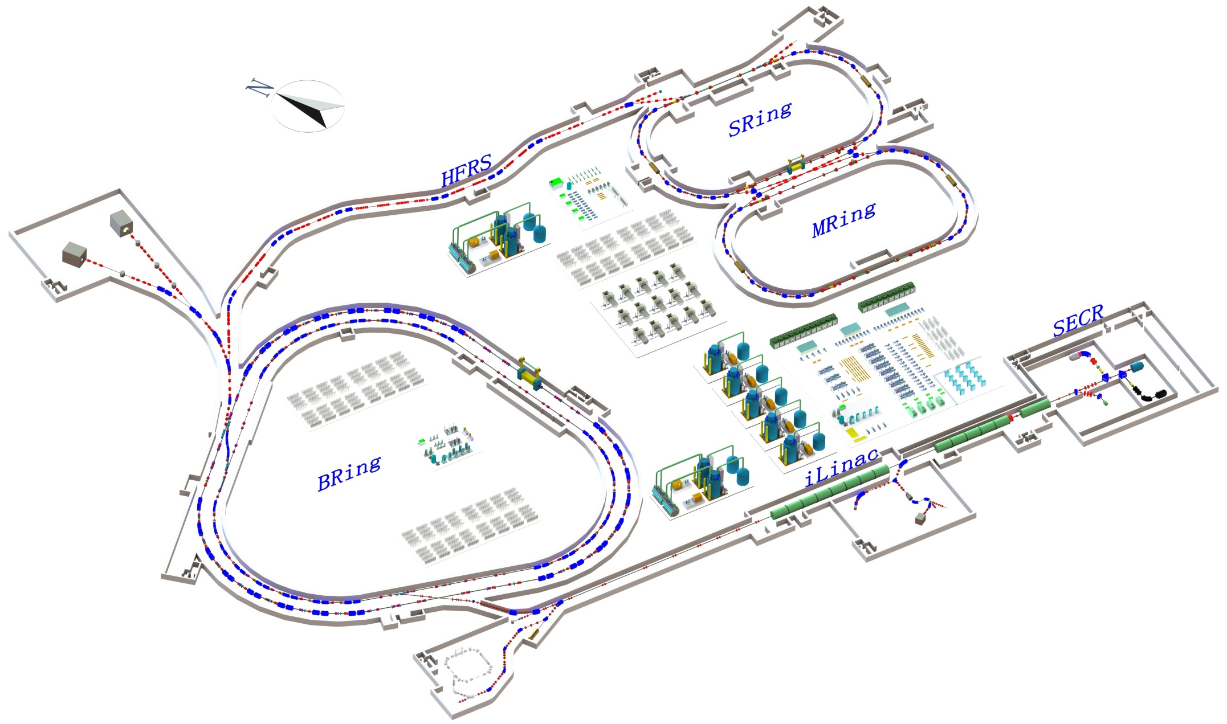
Main accelerator components
HIAF layout
SRing: Spectrometer ring
Circumference: 273m
Rigidity: 13-15 Tm
Electron/Stochastic cooling
Two TOF detectors
Four operation modes
Bring-S: Booster ring
Circumference: 600 m
Rigidity: 40 Tm
Beam stacking
Beam acceleration
L: 180m, Bρ: 25 Tm
MRing: Figure “8” ring
Circumference: 273m
Rigidity: 15 Tm
Ion-ion merging
BRing-N: Fast cycle ring
Circumference: 590 m
Rigidity: 34 Tm
Large acceptance (250/120)
Two planes painting injection
Fast ramping rate（5-10Hz, 20Hz）
iLinac: Superconducting linac
Length:100 m
Energy: 17 MeV/u(U³⁵⁺)
These tunnels will be built in a cut and cover method and will be filled with 5 m overlay of soil. This conforms to the requirements of radiation safety.

Slide 3
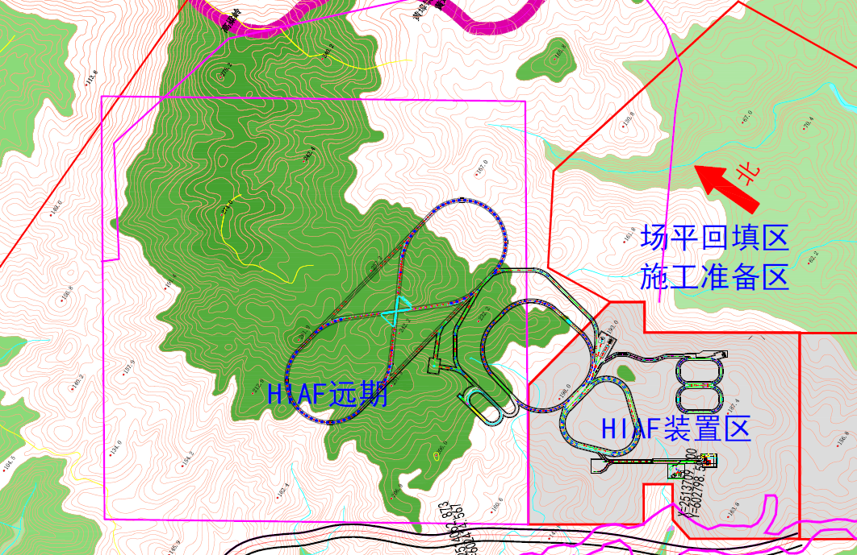
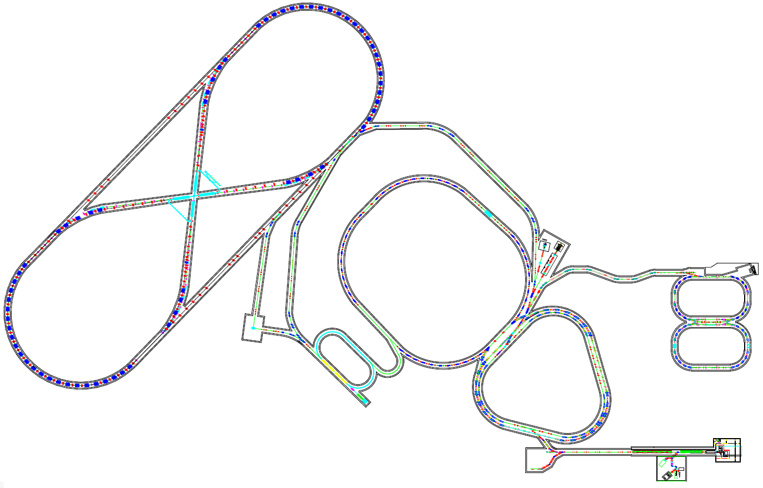
EIC-I：20GeV p + 3.5GeV e
$\sqrt{S}$=16.7GeV
EIC-II：60GeV p + 5GeV e
$\sqrt{S}$=34.6GeV
HERing
5-10 GeV
C: 1.5-2.0 km
EiC-II
eRing
HFRS
HPRing
60-100 GeV
C: 1.5-2.0 km
3.5 GeV
EiC-I
BRing
SRing
MRing
FRing
HIAF-I
Collider Ring (2 km):
Up: Polarized electron, 10 GeV
Down: Polarized proton, 60-100GeV
Electron injector:
SRF Linac-ring, 3.5-10GeV

Slide 4
HIAF-EicC
EIC-I：20GeV p + 3.5GeV e
$\sqrt{S}$=16.7GeV
EIC-II：60GeV p + 5GeV e
$\sqrt{S}$=34.6GeV
HERing
5-10 GeV
C: 1.5-2.0 km
EiC-II
eRing
HFRS
HPRing
60-100 GeV
C: 1.5-2.0 km
3.5 GeV
EiC-I
BRing
SRing
MRing
FRing
HIAF-I
Collider Ring (2 km):
Up: Polarized electron, 10 GeV
Down: Polarized proton, 60-100GeV
Electron injector:
SRF Linac-ring, 3.5-10GeV

Slide 5
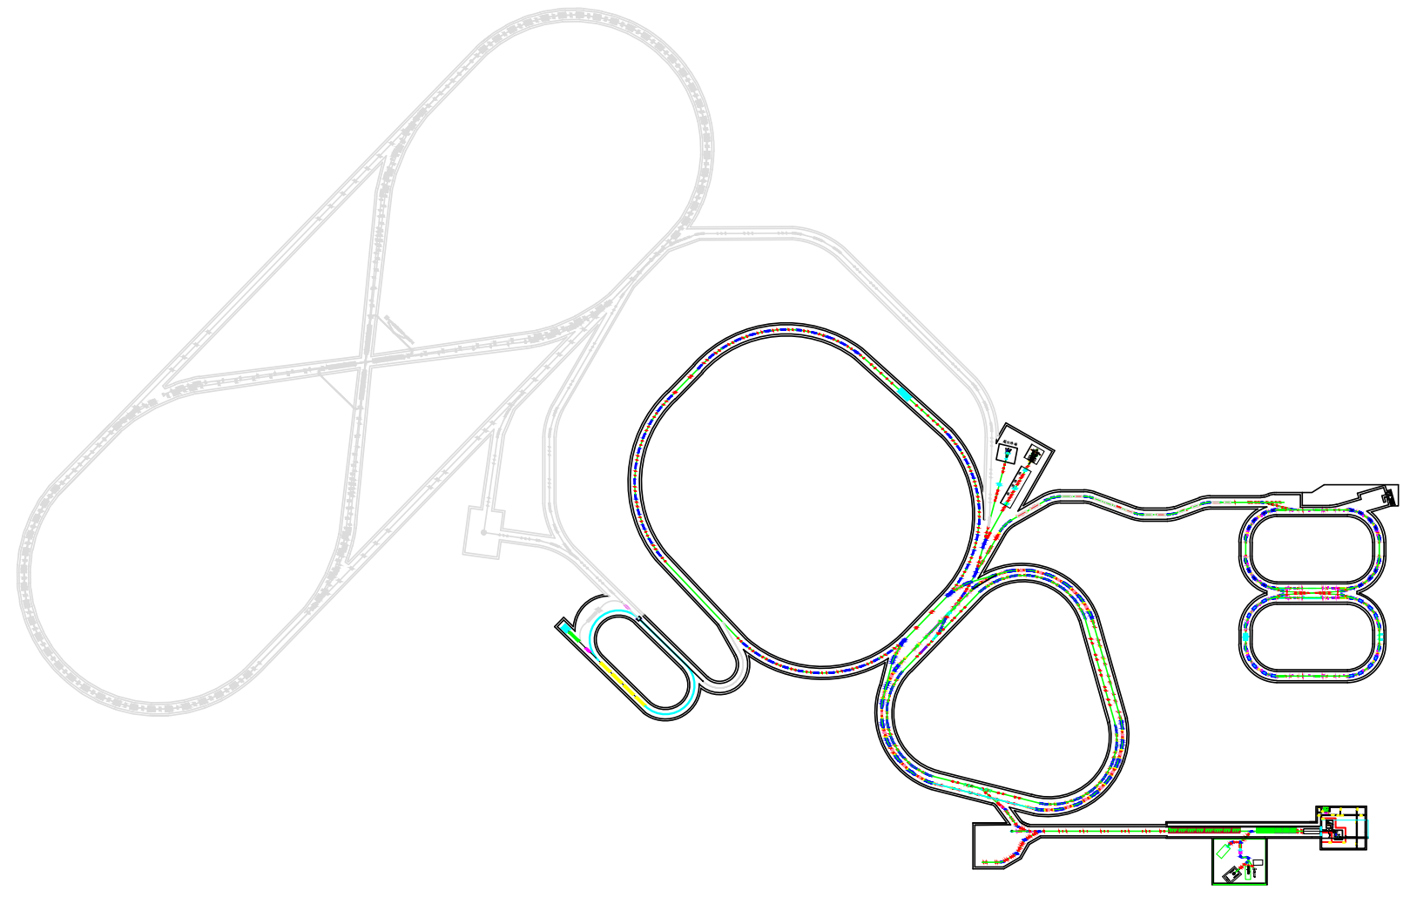
EicC-1 Layout
EIC-I New construction
polarization ion source
Siberia snake for FRing
BRing
Superconducting，4T
Sharing the tunnel with FRing
e injector
SRF Linac-ring
4~5 passes
eRing
3~4A SR
EicC-1
Electron ring
周长 800 m, 3.5-5 GeV
对撞点
探测器
电子注入器
SRF Linac-ring，3.5-10 GeV
Proton ring
周长 600 m, 25GeV

Slide 6
SRF Linac-ring
EIC-I:
3.5GeV
for future upgrading
60m
70m
Spreader
Recombiner
EIC-II:
10GeV
70MeV
e-gun
20m for future upgrading
5 cryomodules
700MeV
Particle | electron | Energy [GeV] | 3.5
Micro-pulse current [pC] | 66 | Macro-pulse current [nC] | 1
Micro-pulse width [ps] | <1 | Macro-pulse width [ns] | 10
Micro-pulse frequency [MHz] | 1497 | Macro-pulse frequency [Hz] | 10
Micro-pulse duty factor [10⁻⁴] | 15 | Macro-pulse duty factor | 0.1%
Transverse emittance[πmm·mrad] | 0.05/0.05 | Energy spread | ≤10⁻³

Slide 7
SRF Linac-ring
Structure of cryomodule
850cm
940cm
Cryomodules are separated by warm sections which contain quadrupoles, diagnostics and vacuum equipment.
Number of cryomodule | 5
Number of cavities per cryomodule | 8
Length of low temperature range [cm] | 850
Length of normal temperature range [cm] | 90
Length of per cryomodule [cm] | 940
Distance between cryomodules [cm] | 70
Length for acceleration [cm] | 560
Energy gain per pass [MeV] | 151

Slide 8
SRF Linac-ring
Structure of cavity
Number of cell | 7
Electric length [m] | 0.7
Frequency [MHz] | 1497
Operating temperature [K] | 2
Operating mode | π-mode
Design gradient [MeV/m] | 27
Design Q | 6×10⁹
HOM coupling | Coaxial
RF window | 1
2K RF heat load [W] | 160
Frequency tuner | coarse/fine
Energy gain per pass [MeV] | 18.9
Distance between cavities [cm] | 30
0.7m
Equipment between cavities:
Fundamental power coupler
HOM absorber
Connecting flanges
Pickup probe
Frequency tuners
Connection to helium tank

Slide 9
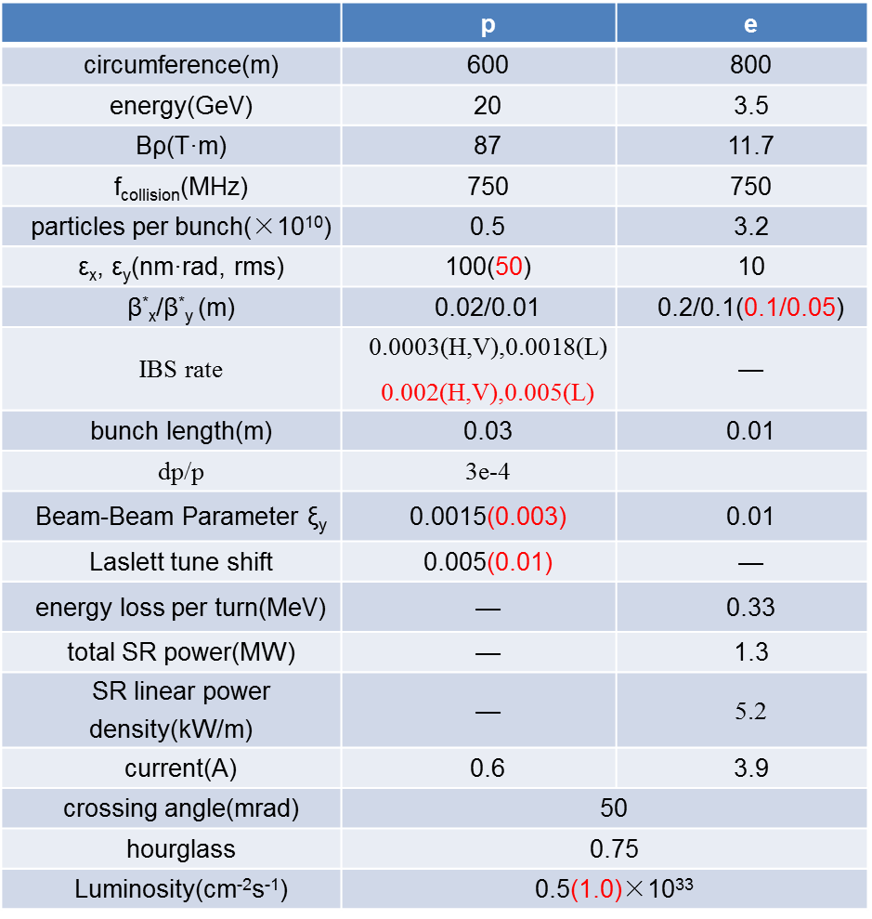
Luminosity estimation

Slide 10
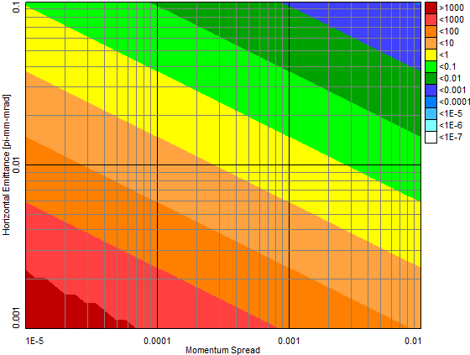
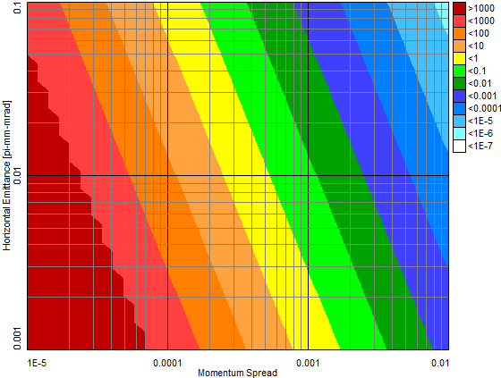
Cooling scheme
low luminosity
high luminosity
low luminosity
high luminosity
transverse
longitudinal
Fast cooling is necessary for both low luminosity mode (t_{cooling} < 1000 sec)
and high luminosity (t_{cooling} < 100 sec)
Challenging task!

Slide 11
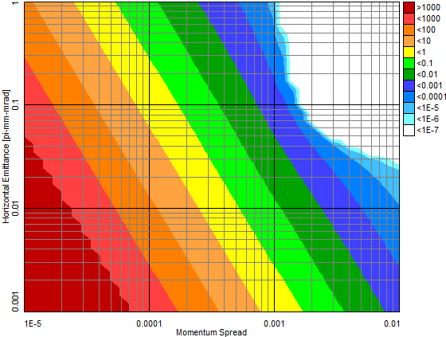
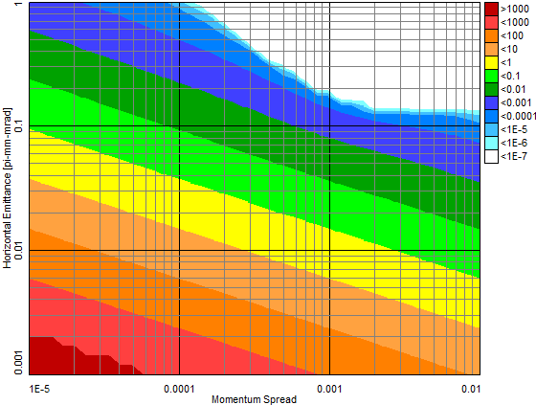
Cooling scheme
equilibrium point
电子束能量 | 10.89 MeV
电子束团长度 | 20 mm
电子束团动量分散 | 10⁻⁴
电子束团半径 | 2 mm
电子束团发射度 | 0.04 urad
电子束团峰值流强 | 4.7 A
电子束团密度 | 1.7×10¹⁴cm⁻³

Slide 12
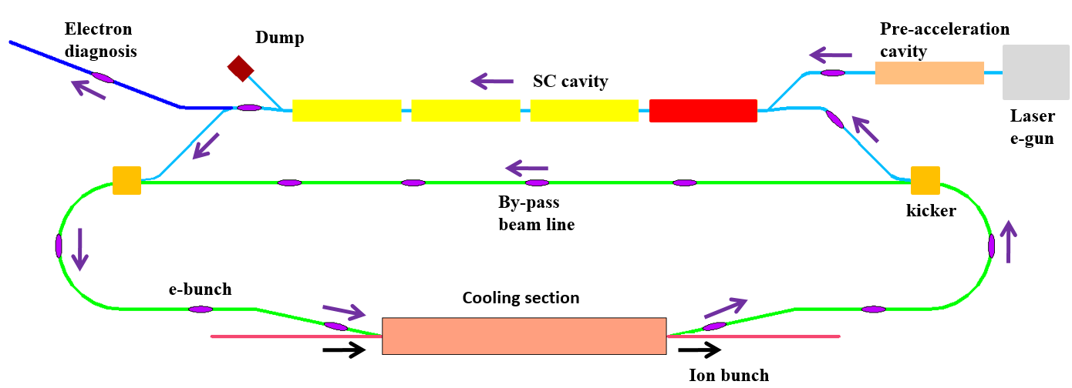
Cooling scheme
IMP – JLab are working together on the high energy electron cooling device

Slide 13
Thanks for your attention!

