Slide 1
Nuclear physics with shanghai electron and photon beams
Jinhui Chen
Gongtao Fan, Yugang Ma, Hongwei Wang
Nuclear Physics Department, Shanghai Institute of Applied Physics (SINAP), CAS

Slide 2
Contents
1. LCS Gamma Sources at SINAP
2. New Opportunity in HXFEL
3. Proposed LCGS Station
4. Nuclear Physics and Related Research
5. Summary

Slide 3
Part 1
LCS Gamma Sources at SINAP

Slide 4
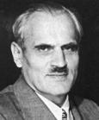
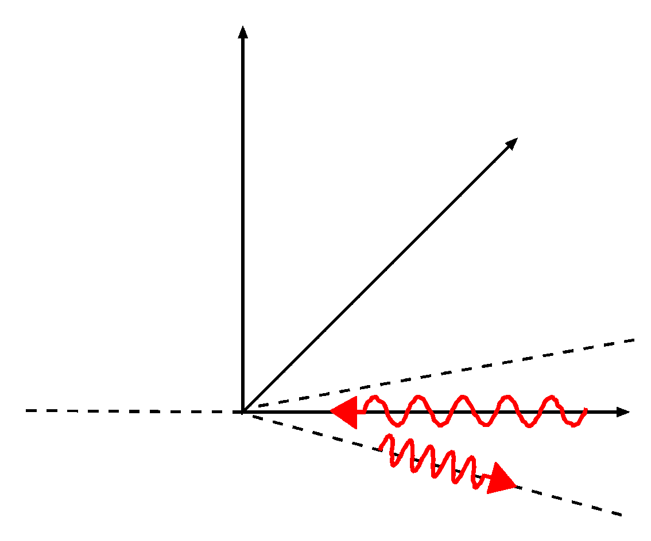
二、线站整体布局
1 LCS Gamma Sources at SINAP
1.1 Laser Compton Scattering Gamma Source
Laser-Compton scattering
Bang!
Scattered electrons
Incident
Photons E_{l}
A. H. Compton
（1892-1962）
Incident electrons E_{e}
θ
Scattered photons
E_{γ}
Notes:
4
.

Slide 5
二、线站整体布局
1 LCS Gamma Sources at SINAP
1.2 History of LCS Gamma Source
Project name | Ladon | Taladon | LEGS | LEGS-2 | Graal |  | ROKK-1M | LEPS |  | LEPS-2
Location | Frascati, Italy |  | Brookhaven, US |  | Grenoble, France |  | Novosibirsk,Russia | Harima, Japan
Storage ring | Adone | Adone | NSLS | NSLS | ESRF |  | VEPP-4M | SPring-8 |  | SPring-8
Scattering method | BCS | BCS | BCS | BCS | BCS |  | BCS | BCS |  | BCS
Energy defining method | Collimation | Internaltagging | Externaltagging | Externaltagging | Externaltagging |  | Collimation /Tagging | Internaltagging Tagging |  | Internaltagging Tagging
Electron energy (GeV) | 1.5 | 1.5 | 2.584 | 2.8 | 6.03 |  | 1.4- | 7.975 |  | 7.975
Electron current (A) | 0.1 | 0.1 | 0.3-0.35 | 0.3-0.35 | 0.2-0.5 |  | 0.1 | 0.1 |  | 0.1
Laser photon energy (eV) | 2.45 | 2.45 |  |  |  |  | 1.17-3.51
Laser Waveength(nm) |  |  | 333,351,364 | 302 | 514 | 333,351,364 |  | 355 | 266 | 355 | 266
Laser power(W) |  |  | 9 | 3 | 10 | 8 |  | 8 | 1 | 16 | 2
Gamma-ray energy (MeV) | 5-80 | 35-80 | 180-330 | 285-420 | 1100 | 1530 | 100-1600 | 1500-2400 | 1055-2900 | 1500-2400 | 1500-2900
Energy resolution (%) | 1.4-10 | 5 | 1.6 | 1.1 | 1.1 |  | 1-3 | 0.5 |  | 0.5
Energy spread (MeV) | 0.07-8 | 4-2 | 5 | 5 | 16
Gamma intensity (s⁻¹) | 10⁵ | 5*10⁵ | 4*10⁶ | 2*10⁶ | 2*10⁶ | 1-2*10⁶ | 2*10⁶ | 1-3*10⁶ | 1-3*10⁵ | >10⁷ | >10⁶
First year of operation | 1978-1993(closed) |  | 1987-2006(closed) |  | 1989-2008(closed) |  | 1993- | 1999- |  | 2013-
Project name |  |  |  | ETL-LCS |  |  |  |  |  |  |  | HIGS
Location | Harima, Japan |  |  | Japan |  |  |  |  |  | Japan |  | Durham, NC US
Storage ring | NewSUBARU |  |  | TERAS |  |  |  |  |  | UVAOR-II |  | Duke-SR
Scattering method | BCS |  |  | BCS |  |  |  |  |  | BCS | BCS | BCS
Energy defining method | Collimation |  |  | Collimation |  |  |  |  |  |  |  | Collimation
Electron energy (GeV) | 0.5-1.5 |  |  | 0.2-0.8 |  |  |  |  |  | 0.75 |  | 0.24-1.2
Electron current (A) | 0.3 |  |  | 0.4 |  |  |  |  |  | 0.35 |  | 0.01-0.1
Laser photon energy (eV) |  |  |  |  |  |  |  |  |  |  |  | 1.17-6.53
Laser Waveength(nm) | 1064 | 532 | 10540 | 1064 | 1053 | 532 | 527 | 551 | 263 |  | 800
Laser power(W) | 5 | 5 | 20 | 10 | 40 | 5 | 15 | 2 | 0.5 |  | 2
Gamma-ray energy (MeV) | 37.6 | 73 | 3.9 | 1.6-10 | 1.6-10 | 3-20 | 3-20 | 5-30 | 7-40 |  | 6.6 | 1-100(158)
Energy resolution (%) |  |  |  |  |  |  |  |  |  |  |  | 0.8-10
Energy spread (MeV) |  |  |  |  |  |  |  |  |  |  |  | 0.008-8.5
Gamma intensity (s⁻¹) | ~10⁶ | ~10⁶ | ~10⁶ | 10⁵ | 5*10⁵ | 5*10⁴ | 2*10⁵ | 10⁴ | 7*10³ |  | >10⁷ | 10⁶-3*10⁹
First year of operation | 2007- |  |  | 1985- |  |  |  |  |  | 2011- |  | 1996-
Typical LCS Gamma Source: storage ring + Traditional Laser
New LCS Gamma Source: LINAC + High power laser (ELI-NP);
LINAC/ storage ring + FEL (HIγs-II)
Notes:
5
.

Slide 6
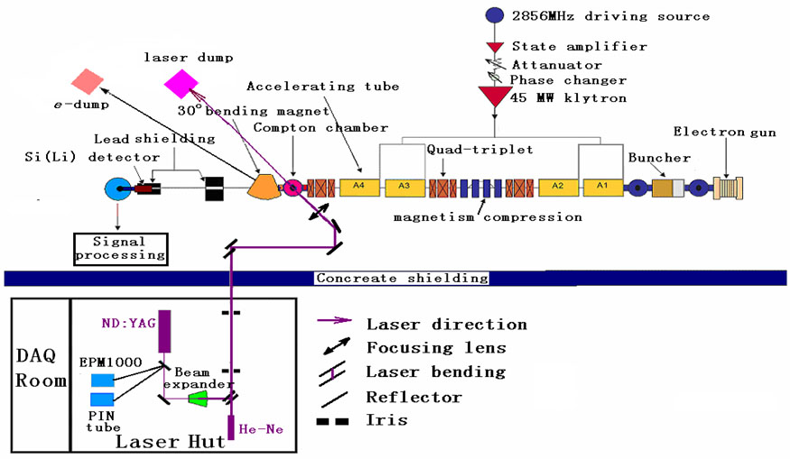
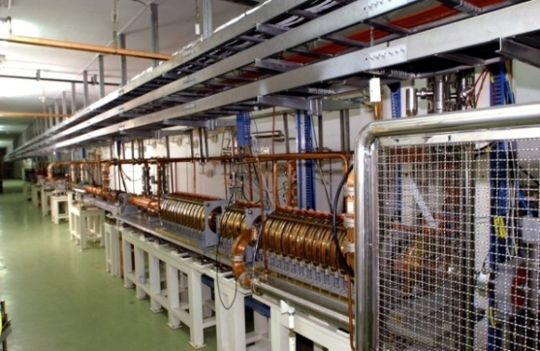
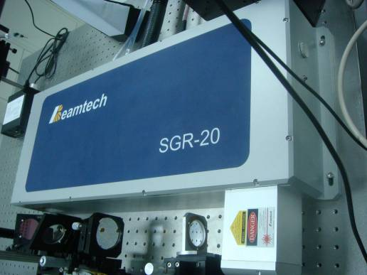
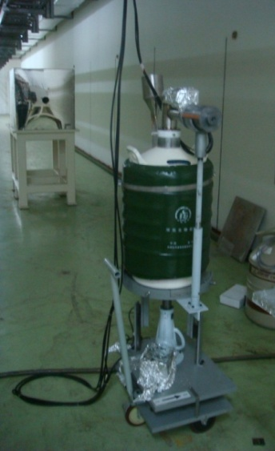
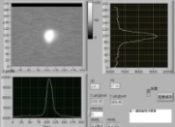
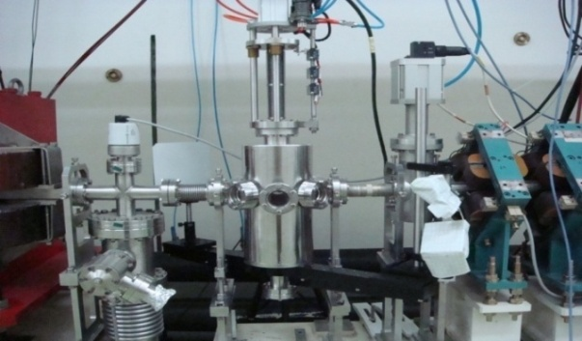
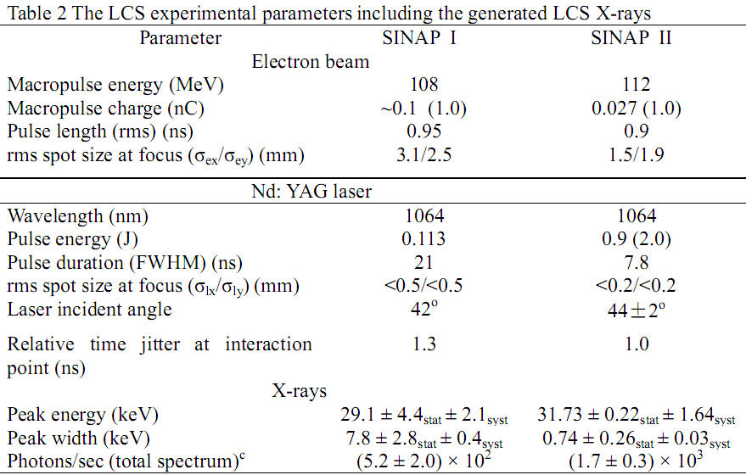
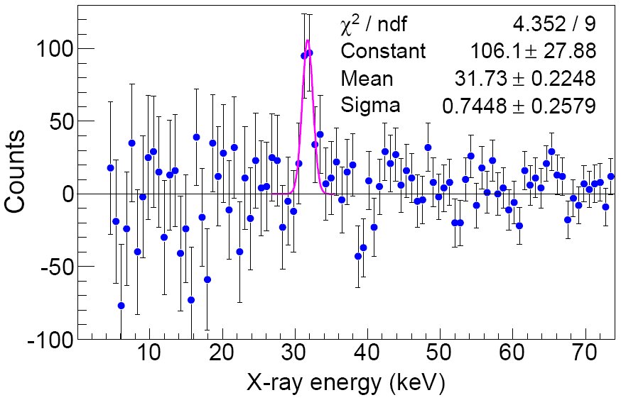
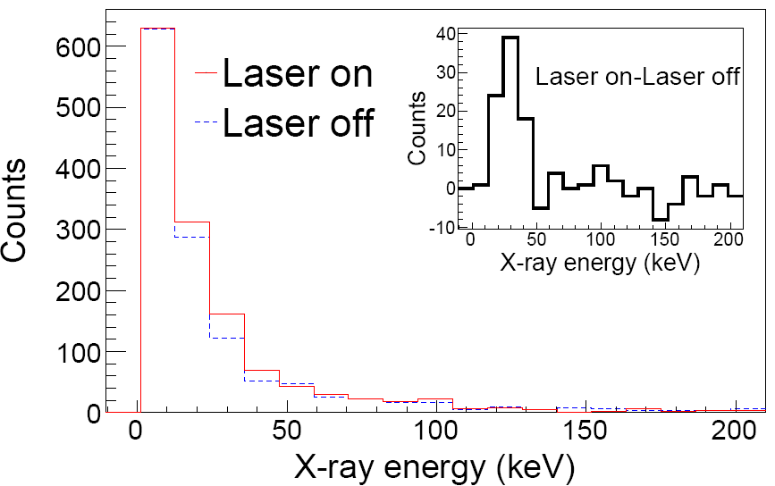
二、线站整体布局
1 LCS Gamma Sources at SINAP
1.3 LCS x-ray Source @ Jiading Campus (Prototype for SLEGS，2010)
[1] SINAP, Nucl. Inst. And Meth. A, Vol.624 (2010) 141；[2] SINAP, Rev. of Sci. Inst., Vol.81(2010)13304
Notes:
6
.

Slide 7
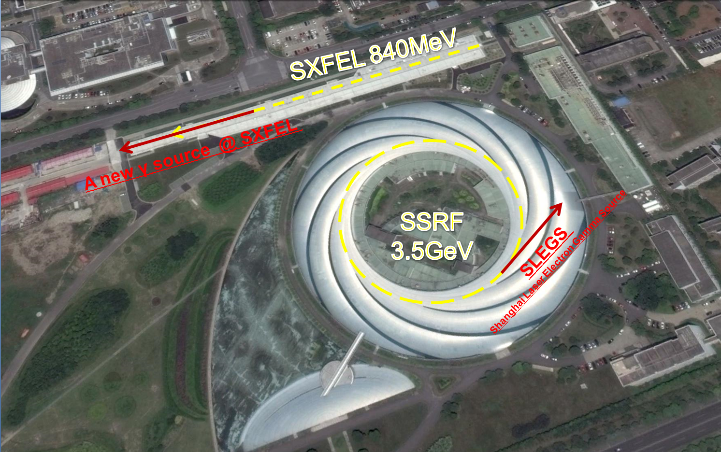
二、线站整体布局
1 Current LCS Gamma Sources at SINAP
SXFEL 840MeV
1.1 Two LCS Gamma Sources @ Zhangjiang Campus
Gamma Energy： 0.4MeV ~ 20MeV

Slide 8
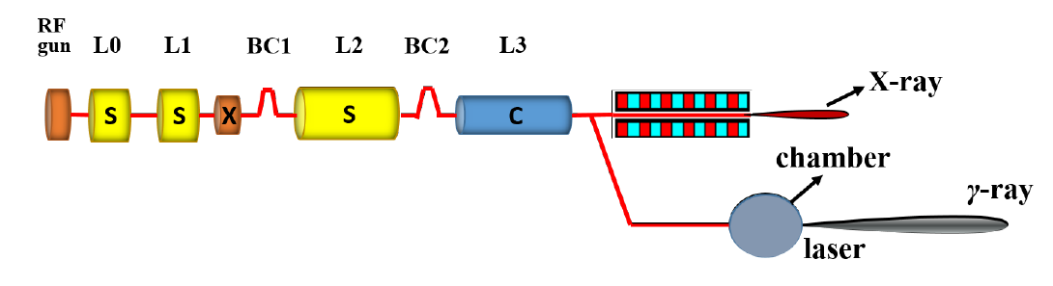
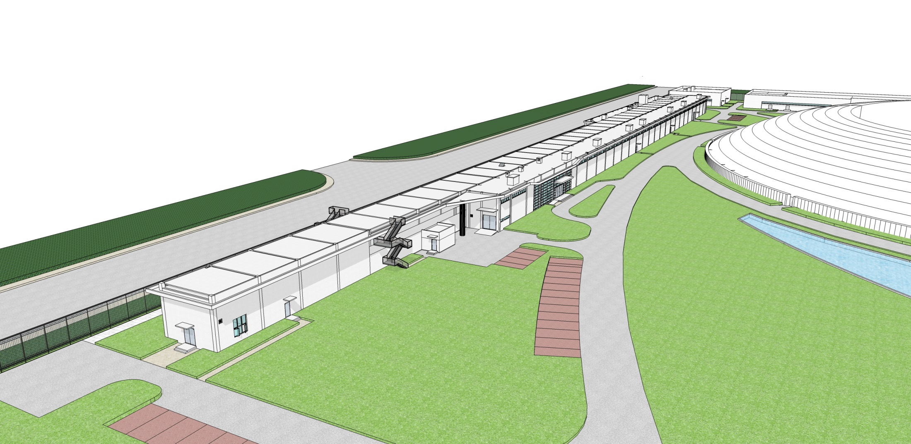
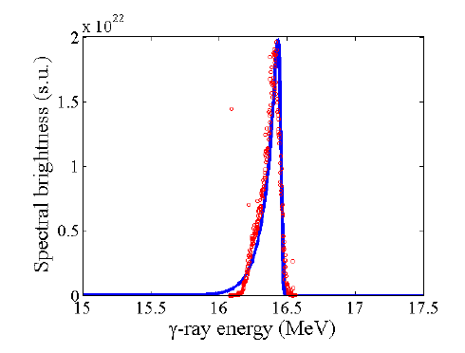
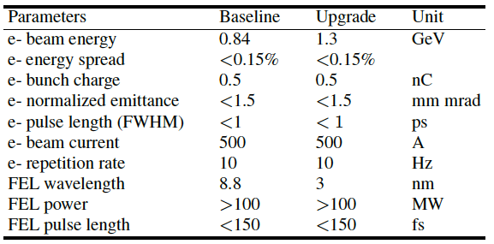
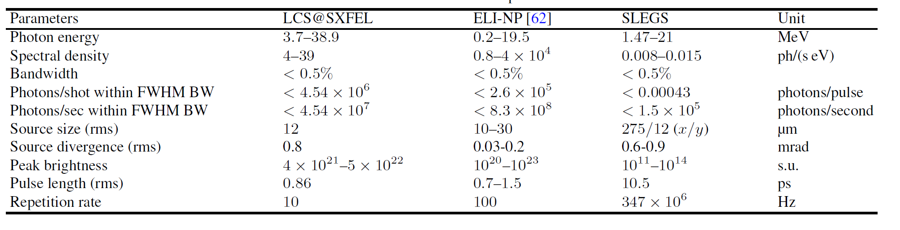
二、线站整体布局
1: LCS Gamma Sources at SxFEL@SINAP
1.2 A new proposal for LCS Gamma Source similar to ELI-NP @ SXFEL
Gamma Energy： 3.7MeV ~ 38.9MeV
Schematic layout of the gamma source at SXFEL
SSRF
SXFEL
Main parameters of the gamma source at SXFEL and ELI-NP
Wu H et al. Nuclear Science and Techniques, Vol.26 (2015) 050103

Slide 9
Part 2
New Opportunity in HXFEL

Slide 10
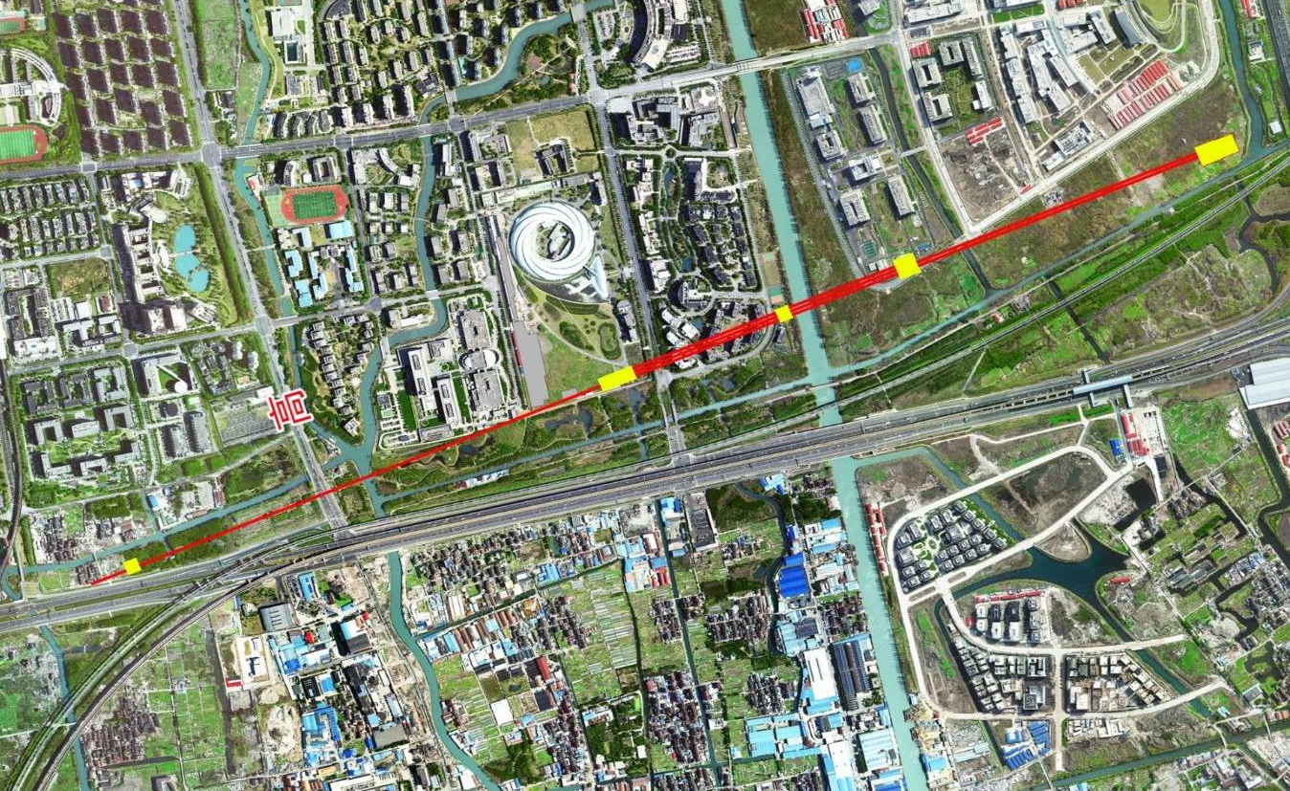
二、线站整体布局
2 New Opportunity in Hard X-ray FEL
Layout of the HXFEL: from SINAP to ShanghaiTech
Length ~ 3.2km， Located underground 38m
Beam line
Experiment hall
Undulator and beam line
Main experiment hall
Injector
Main accelerator
E
N
S
W

Slide 11
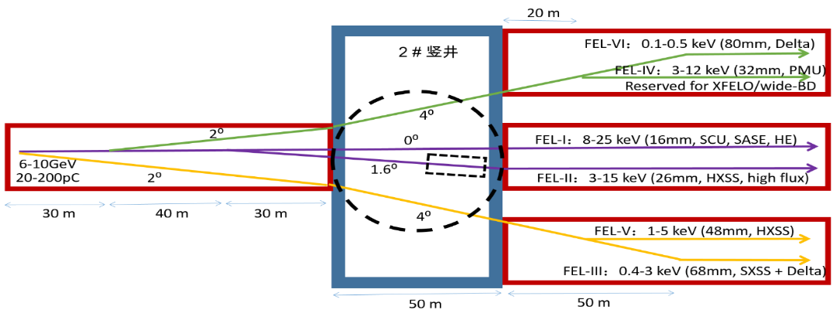
二、线站整体布局
2 New Opportunity in Hard X-ray FEL
Layout of the HXFEL
[1]Proposal of Shanghai Coherent Light Facility (SCLF- Hard X-ray FEL) ,2016.11

Slide 12
二、线站整体布局
2 New Opportunity in Hard X-ray FEL
Electron Parameters of HXFEL
Parameter | Values
Electron Energy (GeV) | 8
charge per pulse (pC) | 20-200
Norlimalize Perpendicularslice eiitance (mm·mrad) | ≤0.4
Peak current (A) | ≥3000
Slice energy spread (rms) | <0.01%
Pulse duration (ps) | 0.7
Frequency (MHz) | 1
Beam bunchs diameter (um) | 50
Energy dispersion | 0.01%
The last four parameters are used to Laser Compton Gamma source calculation based on the Monte Carlo Code developed by our group.
Compare with SACLA Japan
Beam energy (GeV) | 8
Peak current (kA) | 4.4
Slice emittance | 0.77
Slice energy spread | 7.1e-5
Total charge (nC) | 0.29
Bunch width (fs, FWHM) | 55
Beam side at ID exit (um, rms) | 35
Repetition rate (Hz) | 60 to 1
[1] Design Report of Shanghai Coherent Light Facility (SCLF- Hard X-ray FEL) ,2016.11.
[2] Nuclear Instruments and Methods in Physics Research A, Vol.726 (2013) 67.

Slide 13
Part 3
Proposed LCGS Station

Slide 14
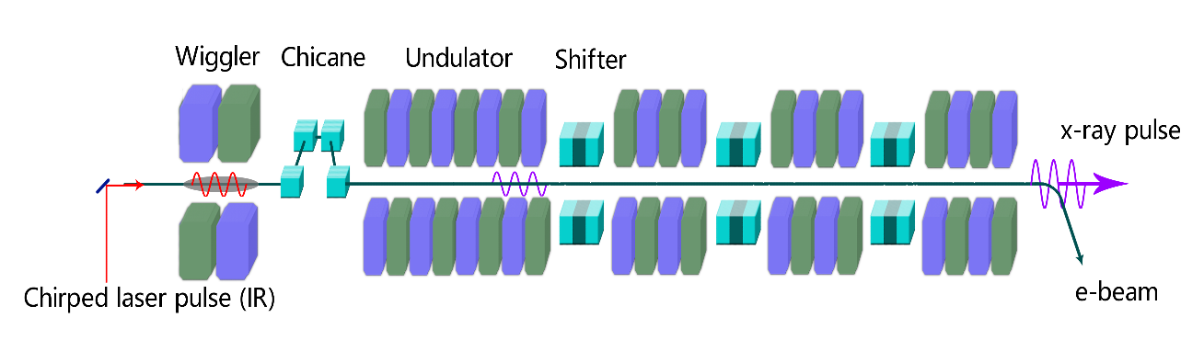
二、线站整体布局
3 Proposed LCGS @ HXFEL
Mode 1: External laser + Electron
External laser
Gamma ray
Laser wavelength um/nm | Type | Power /W | Duration fs/ps | Frequency /Hz | Single Pulse /J | Gamma Energy /MeV | Gamma flus photons/s/W
10.64um | CW | 1 |  |  |  | 112.7 | 3.95×10¹
1.64um | CW | 1 |  |  |  | 999.8 | 3.55×10²
800nm | Pulse |  | 50fs | 10Hz | 5J | 1277.4 | 3.6×10⁵
355nm | CW | 1 |  |  |  | 2397.8 | 1.09×10³
266nm | CW | 1 |  |  |  | 2908.0 | 4.19×10⁴
0.1keV@FEL | FEL |  | 0.7ps | 1MHz |  | 7398.6 | 2.18×10¹⁴
1.0keV@FEL | FEL |  | 0.7ps | 1MHz |  | 7937.8 | 4.13×10¹⁶

Slide 15
二、线站整体布局
3 Proposed LCGS @ HXFEL
Mode II: X-ray from HXFEL + Electron
Gamma ray
Bragg Mirror
Laser wavelength um/nm | Type | Power /W | Duration fs/ps | Frequency /Hz | Single Pulse /J | Gamma Energy /MeV | Gamma flus photons/s/W
10.64um | CW | 1 |  |  |  | 112.7 | 3.95×10¹
1.64um | CW | 1 |  |  |  | 999.8 | 3.55×10²
800nm | Pulse |  | 50fs | 10Hz | 5J | 1277.4 | 3.6×10⁵
355nm | CW | 1 |  |  |  | 2397.8 | 1.09×10³
266nm | CW | 1 |  |  |  | 2908.0 | 4.19×10⁴
0.1keV@FEL | FEL |  | 0.7ps | 1MHz |  | 7398.6 | 2.18×10¹⁴
1.0keV@FEL | FEL |  | 0.7ps | 1MHz |  | 7937.8 | 4.13×10¹⁶

Slide 16
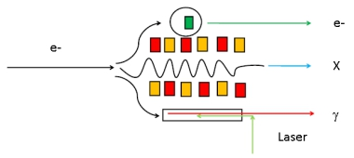
二、线站整体布局
3 Proposed LCGS @ HXFEL
What we can used in HXFEL station
HXFEL station can serve us the 8GeV electron and tunable max 25keV hard X-ray and 0.1-8 GeV tunable Gamma Source， based on these beams, we can develop electron scattering， hard X-ray physics and photonuclear reaction research and many applied physics studies.
Fig1-2 The beam station of HXFEL

Slide 17
Part 4
Nuclear Physics and Related Research

Slide 18
二、线站整体布局
4 Nuclear Physics and Related Research
1st: High energy electron scattering experiment
2nd: Hard X-Ray physics
（2.1）High energy density plasma physics
（2.2）non-linear, non-perturbative QED
（2.3）Hard X-Ray Photonics
（2.4）Nuclear Excitation by Electron Transition/Capture (NEET/NEEC)
3rd: Physics based Laser Compton Gamma Source
（3.1）Particle Physics
（3.2）Nuclear Physics
（3.3）Nuclear Astrophysics
（3.4）Nuclear Photonics
4th: New Gamma Source based on the Hard X-Ray

Slide 19
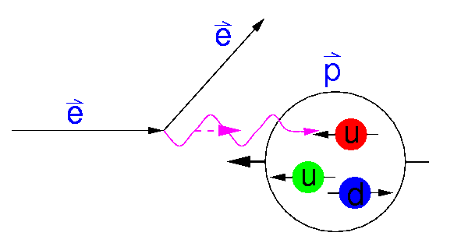
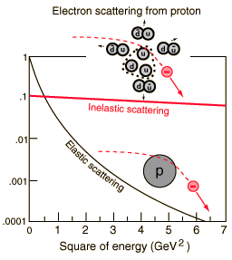
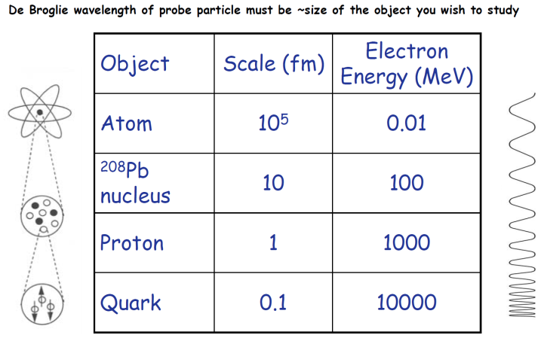
二、线站整体布局
4 Nuclear Physics and Related Research
1st: High energy electron scattering experiment
The electron is a probe which is uniquely well suited to reveal many aspects of nuclear structure.
The general theory of its interaction with the constituents of the nucleus via the electromagnetic field is well understood.
Fig 1.1-1 Electron scater process in Proton
Surface modes: Giant resonances
Nuclear constituents: protons and neutrons – momentum distributions
Sub-nucleonic degrees of freedom: effective field theories
Nucleon substructure: quarks, gluons and QCD.
[1]Ingo Sick,Elastic electron scattering from light nuclei,arXiv:nucl-ex/0208009v1 14 Aug 2002
[2] Kyle Foster,Electron Scattering: Form Factors and Nuclear Shapes,November 16, 2011
[3] H.K,Nuclear Instruments and Methods in Physics Research A 507 (2003) 582–586
[4] A. Ringwald，Pair production from vacuum at the focus of an X-ray free electron laser，Physics Letters B 510 (2001) 107–116
[5] Daniel Watts, University of Edinburgh UK Nuclear Physics summer school Chester, September 2005

Slide 20
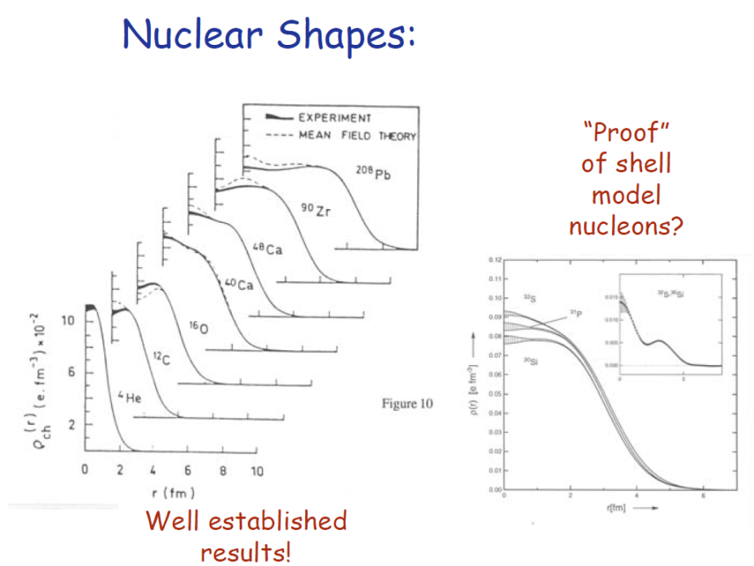
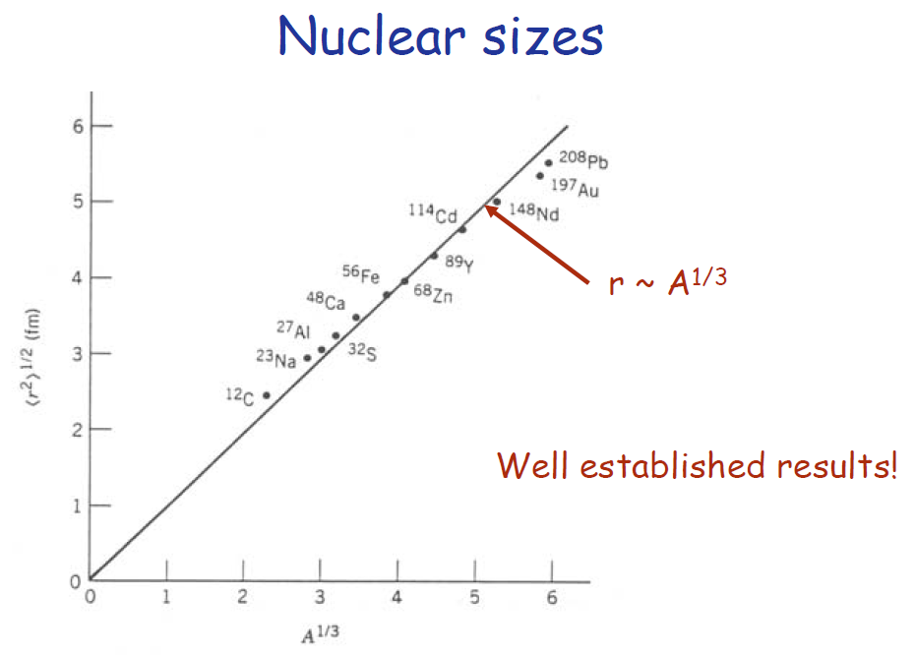
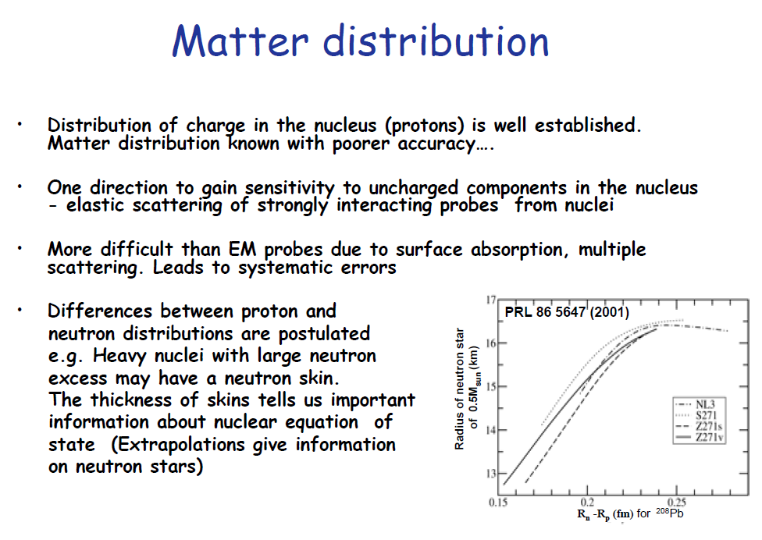
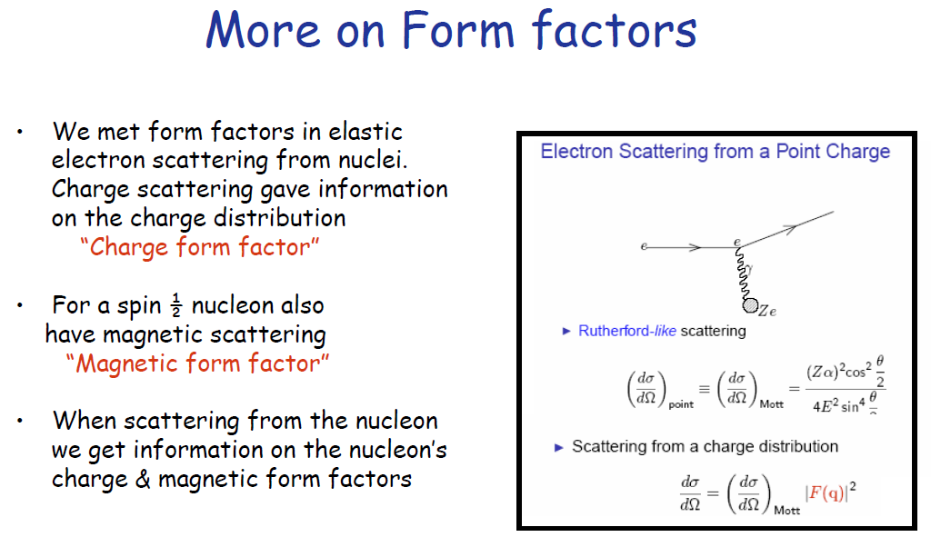
二、线站整体布局
4 Nuclear Physics and Related Research
1st High energy electron scattering experiment
[1] Daniel Watts, University of Edinburgh UK Nuclear Physics summer school Chester, September 2005

Slide 21
二、线站整体布局
4 Nuclear Physics and Related Research
2nd: Hard X-Ray Physics
2.1 High energy density plasma physics
New research opportunities in HED science will be investigated, including:
Warm dense matter and hot plasmas;
Ultra-intense field physics;
High pressure and material dynamics;
The dynamics of ultra-intense laser-matter interactions.
Recent advances will be presented on the use of coherent x-ray diffraction techniques in solid-density laser-plasma interaction physics.
These will assess the feasibility of temporal- and spatial-resolved measurements of the electron density, ionization state, magnetic field structure, and electron-electron correlation function in solid-density plasma;
The prospect for deriving the spatial- and temporal-resolved electron temperature and conductivity.
[1] Thomas E. Cowan, New Science Opportunities in High Energy Density Physics with High Power Lasers at the European XFEL

Slide 22
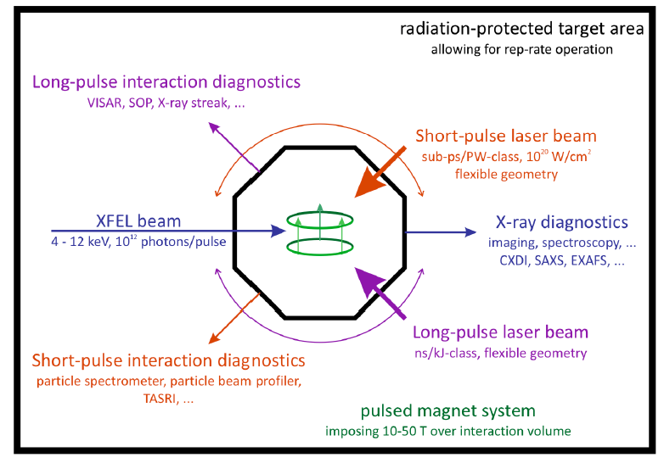
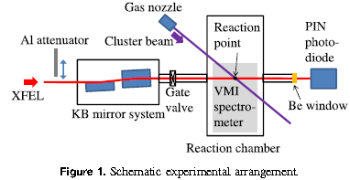
2.2 non-linear, non-perturbative QED
二、线站整体布局
4 Nuclear Physics and Related Research
2nd: Hard X-Ray Physics
Fig 2.2.1 Opportunity at Helmholtz International Beamline for Extreme Fields(HIBEF) at the European XFEL
Non-linear and non-perturbative QED
• Vacuum magnetic birefringence
• Non-linear Compton processes and pair creation from electron beam crossed with laser beam
Searches for very weakly interacting light particles
• Axions and axion-like particles
• MeV-GeV scale hidden or dark photon
[1] Andreas Ringwald(DESY),Physics of fundamental Symmetries and Interactions - PSI2013, Paul-Scherrer-Institut, Villigen, CH,8-12 September 2013

Slide 23
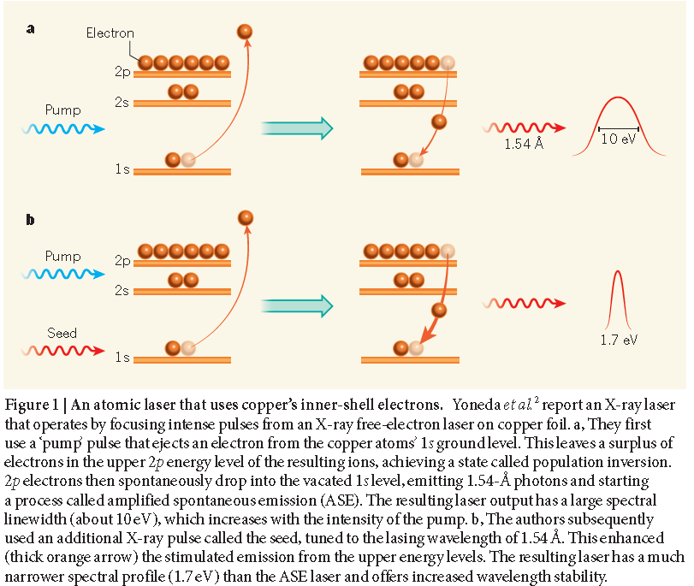
2.3 Hard X-Ray Photonics
4 Nuclear Physics and Related Research
二、线站整体布局
2nd: Hard X-Ray Physics
Recently, several nonlinear optical phenomena have been successfully observed in hard and soft x-ray wavelength lasers. Those include:
Lasing,
Two-photon absorption,
Second harmonic generation,
Saturable absorption,
Atomic branching ratio control
Self-guiding lasers
These phenomena are actually key component for photonics
An atomic laser operating at the shortest wavelength yet achieved has been createdby bombarding a copper foil with two X-ray pulses tuned to slightly different energies. The results may lead to ultrastable X-ray lasers.
Fig 2.3-1 An atomic laser in inner-shell electrons
[1] Linda Young，A stable narrow-band X-ray laser, Nature 524, 424-425(2015).

Slide 24
二、线站整体布局
4 Nuclear Physics and Related Research
2nd: Hard X-Ray Physics
2.4 Succeeded in observing the first NEET signal on ¹⁹⁷Au at Spring-8 beamline
BL09XU in 1999.
[1] S. Kishimoto et al.: Phys. Rev. Lett. 85 (2000) 1831.

Slide 25
二、线站整体布局
4 Nuclear Physics and Related Research
2nd: Hard X-Ray Physics
NEEC in ^{93m}Mo Nuclei@ European XFEL
[1] Jonas Gunst et al., Dominant Secondary Nuclear Photoexcitation with the X-Ray Free-Electron Laser. Phys. Rev. Lett. 112 (2014) 082501.

Slide 26
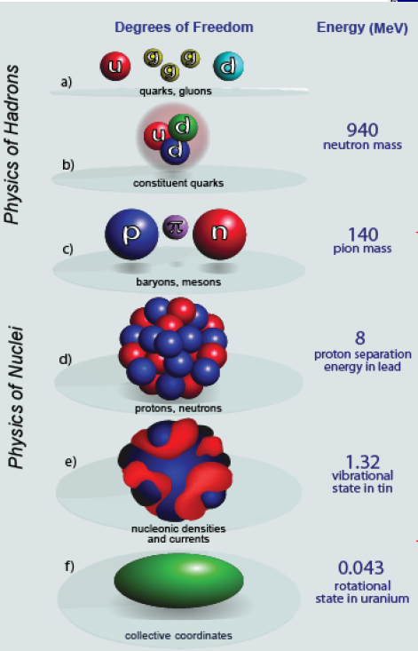
二、线站整体布局
4 Nuclear Physics and Related Research
3rd: Physics based Laser Compton Gamma Source
3.1 Particle Physics (several hundred MeV - GeV)
Fig 3.1-1 Pion production in particle Physics
Nucleon forces
Nucleon form factors, missing resonances, magnetic moments of nucleon resonances
Nucleon substructure: quarks, gluons and QCD.
QCD exotica

Slide 27
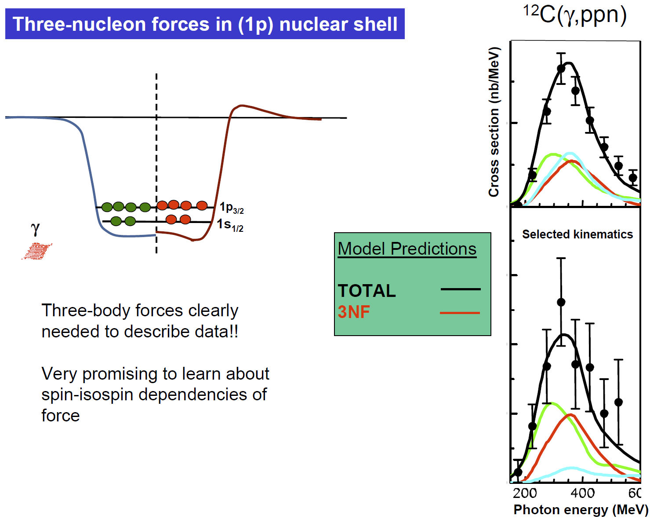
二、线站整体布局
4 Nuclear Physics and Related Research
3rd Physics based Laser Compton Gamma Source
3.1 Particle Physcis-Nucleon forces
[1] Daniel Watts, University of Edinburgh UK Nuclear Physics summer school Chester, September 2005

Slide 28
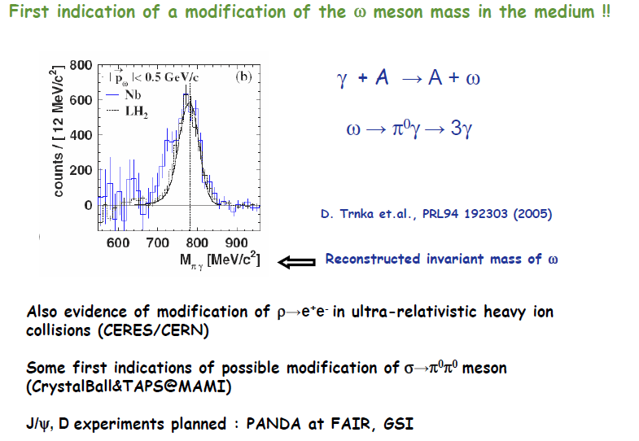
二、线站整体布局
4 Nuclear Physics and Related Research
3rd: Physics based Laser Compton Gamma Source
3.1 Particle Physcis-modification of particles by the nuclear medium
[1] Daniel Watts, University of Edinburgh UK Nuclear Physics summer school Chester, September 2005

Slide 29
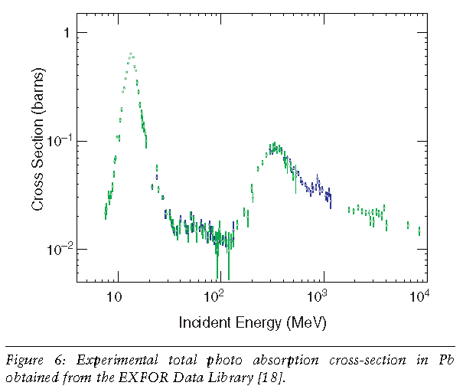
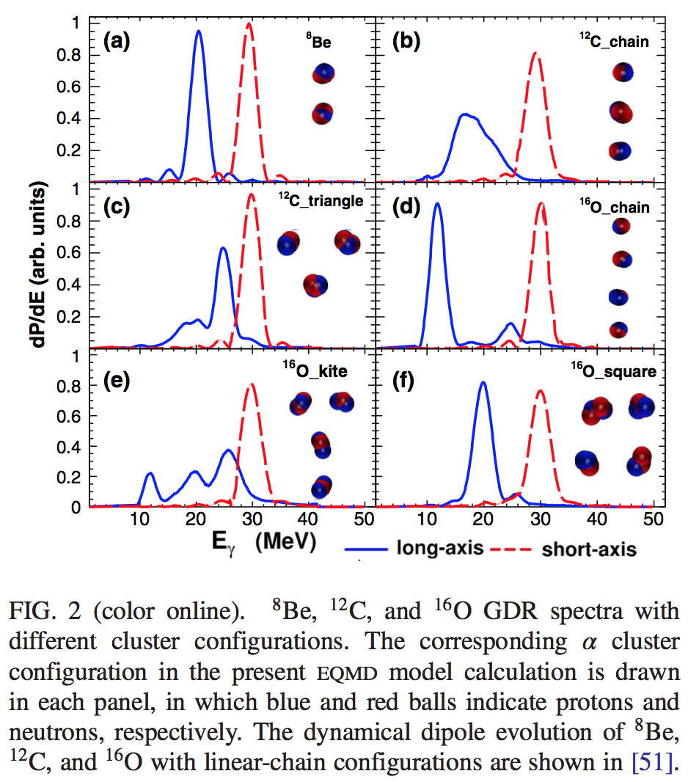
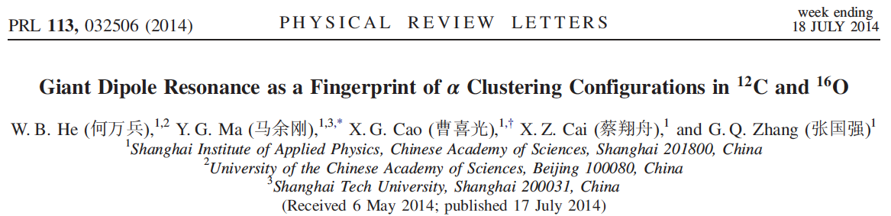
3.2 Nuclear Physics (under several hundred MeV)
二、线站整体布局
4 Nuclear Physics and Related Research
3rd: Physics based Laser Compton Gamma Source
Basic symmetry and properties of nuclei A ≤ 2;
Photodisintegration involving low-energy few-body (A≤ 4) nuclei
Photoreaction involving finite nuclei (mediate A, ~ 13~15)
Multi-body (large A,~ 206) nuclear systems research
PDR,GDR and nuclear cluster study

Slide 30
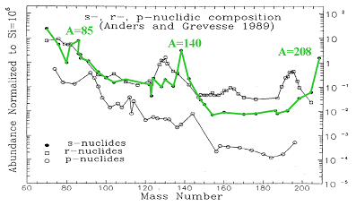
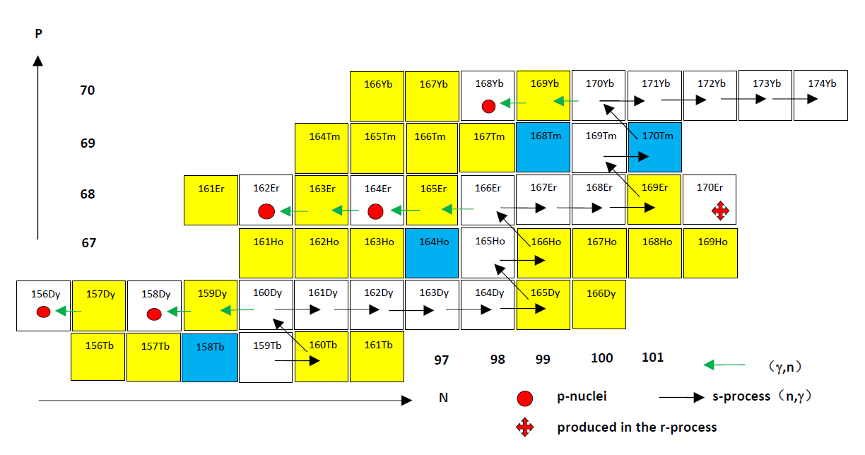
3.3 Nuclear Astrophysics
二、线站整体布局
4 Nuclear Physics and Related Research
3rd: Physics based Laser Compton Gamma Source
For example, p-nuclei and s-,r-,p-process...
The γ process scenario suffers from a strong underproduction of the most abundant p isotopes, ^{92,94}Mo and ^{96,98}Ru, due to lack of seed nuclei with A >90.
For these missing abundances, alternative processes and sites have been proposed, for example, νp process,rp process,ν process...
Using strong neutrino fluxes in the deepest ejected layers of a SNII (ν p process).
Rapid proton-captures in proton-rich, hot matter accreted on the surface of a neutron star (rp process).
A few p nuclides may also be produced by neutrino-induced reactions during the γ -process(ν process).
This ν process was additionally introduced because the γ process alone strongly underproduces the odd-odd isotopes ¹³⁸La and ^{180m}Ta.
While the reaction rate ^{A}X(γ,n)^{A-1}X can be determined by bremsstrahlung , the reaction ^{A+1}X(γ,n)^{A}X has to be measured via its inverse (n,γ) rate.
[1] Eur. Phys. J. A 27(2006)129-134

Slide 31
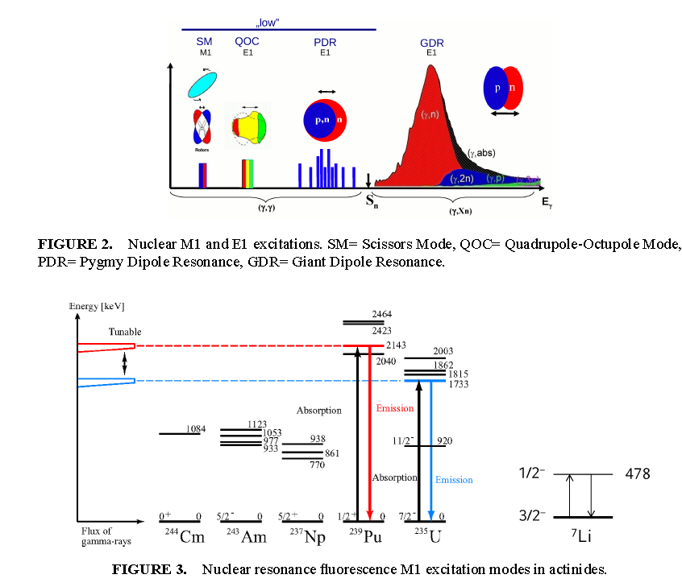
3.4 Nuclear Photonics
二、线站整体布局
4 Nuclear Physics and Related Research
3rd: Physics based Laser Compton Gamma Source
Nuclear structure
• Modes of excitation below the GDR
Impact on nucleosynthesis
• Gamow window for photon–induced reactions in explosive stellar events
Understanding exotic nuclei
• E1 strength will be shifted to lower energies
in neutron rich system
Potential NRF applications：
Detection of radioactive isotopes
Nondestructive assay of plutonium and minor actinide in spent fuel
Detecting clandestine material
Nuclear waste imaging and assay
[1] NIMA 621 (2010) 695-700; Applied Physics Express 2 (2009) 036502

Slide 32
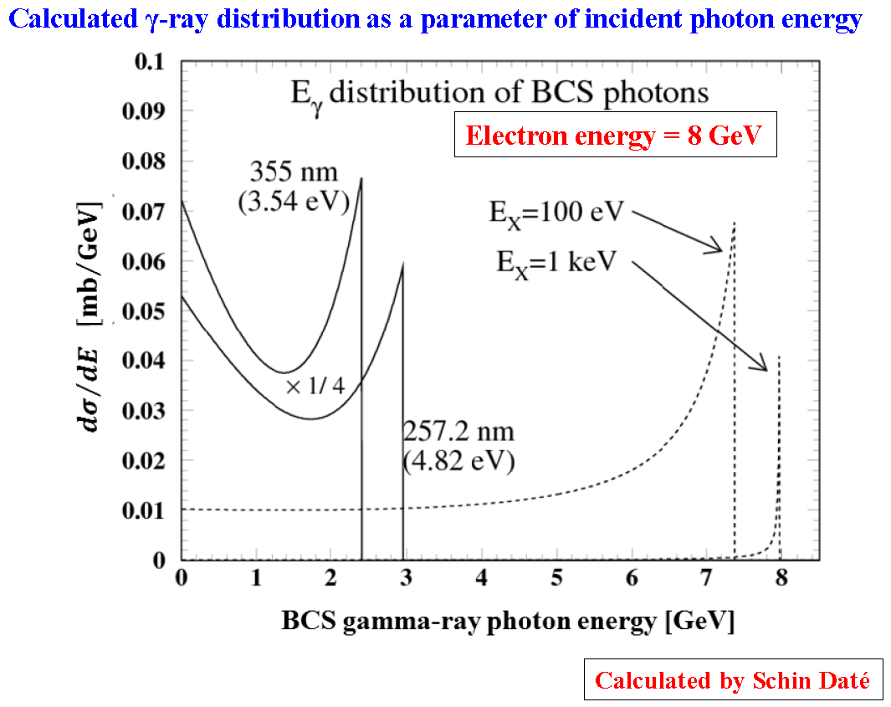
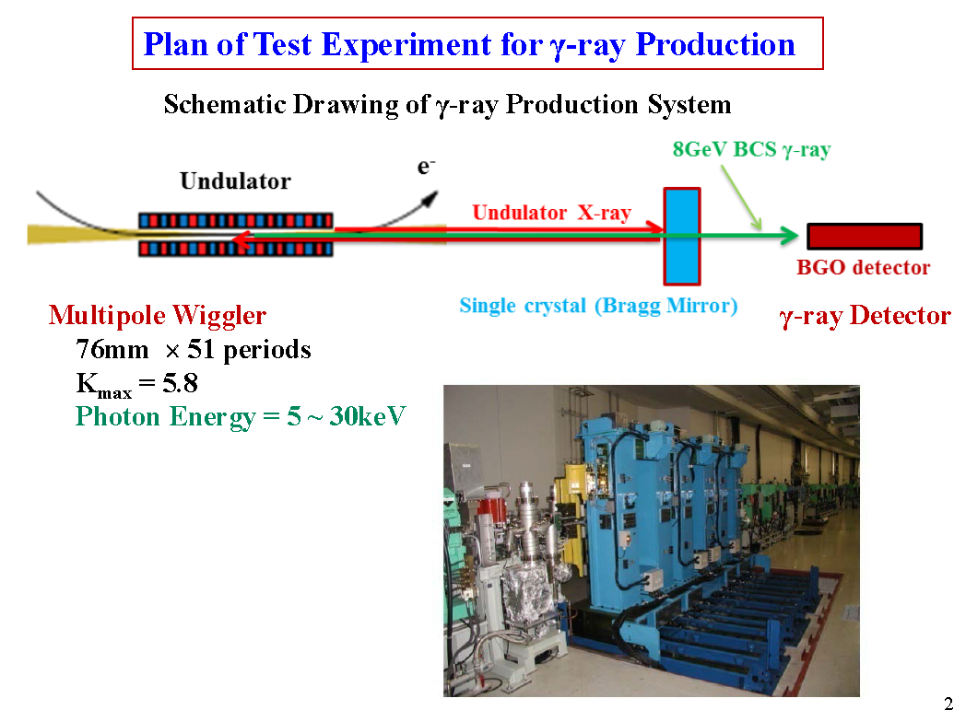
二、线站整体布局
4 Nuclear Physics and Related Research
4th: New Gamma Source based on the Hard X-Ray
Spring-8：
BCS using laser (infrared to ultra-violet) established with successful results, but extension of the maximum photon energy of γ-ray opens new fields of the photon production experiments of nuclear and particle physics
Proposed BCS using X-ray undulator radiation and Bragg reflection of single crystal to produce quasi-monochromatic GeV γ-ray.
[1] H. Ohkuma，Construction Experience of LEPS and LEPS2 and X-ray Compton Scattering at SPring-8,LCS@Saskatoon 2014.11, ppt report

Slide 33
二、线站整体布局
5 Summary
Compton sources, photon sources based on Compton scattering, have been developed in the world to realize high-flux/high-brightness X-ray/gamma-ray sources and exploit applications with energy-tunable and narrow-bandwidth photon beams from these sources.
Recent progress of electron accelerator and laser technologies will open a new era in Compton sources. An electron beam of small emittance and high-average current contributes to improving spectral brightness of Compton scattered photons. Flux of generating photons is also increased by a high-power laser together with apparatus such as laser enhancement cavity.
A new opportunity for a high energy, high flux and short pulse gamma source production, and new physics chance used High energy Electron and X-Ray based HXFEL facility!
Electron Facility @SINAP | Laser be used | Gamma Energy | Physics | LCS Status
SSRF，3.5GeV | CO₂, 10.64um，CW | 0.4-20MeV | Nuclear Physics and Astrophysics, Medicine Application... | In construction
SXFEL， 0.85-1.6GeV | 100TW， 800nm，~50fs | 3.7-38.9MeV | Nuclear Physics and Astrophysics,Position production, Application... | Plan
HXFEL， 8GeV | Optical laser & FEL X-Ray | 100-8000MeV | Particle Physics, Nuclear physics and Astrophysics... | Proposal

Slide 34
Thank you for your attention!

