Slide 1
The Design of the eRHIC
Electron Ion Collider
Ferdinand Willeke
Workshop on Hadron Physics
Weihai, China, July 26-31, 2018

Slide 2
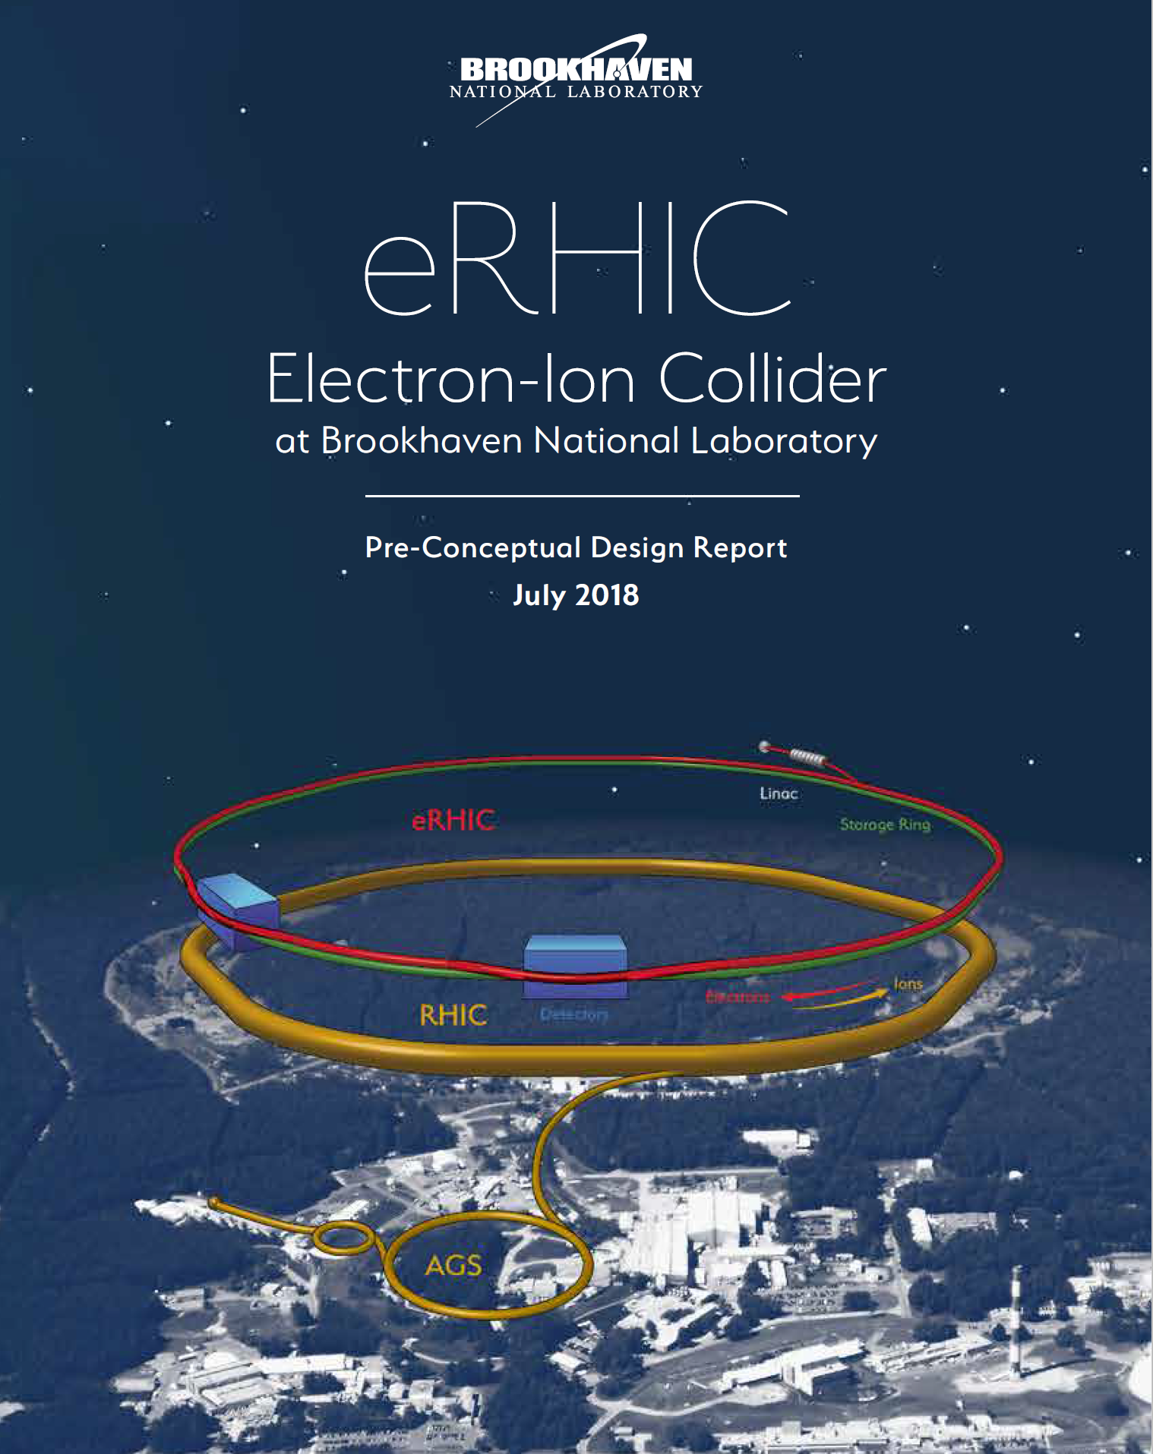
Outline
Requirements
Assumptions
Design concept
Luminosity and
Beam-Beam interaction
Beam Dynamics
Electron Storage Ring Design
Electron Injection
Infrastructure
Summary

Slide 3
EIC Physics Questions
Nuclear Physics Community compiled an EIC WHITE PAPER^{*)} (2014/5):
How are quarks, gluons & their spins distributed in space & momentum in nucleus?
How do nucleon properties emerge from quarks and gluons and their interactions?
How do color-charged quarks, gluons & colorless jets, interact with a nuclear medium
How do confined hadronic states emerge from quarks & gluons
how do the quark-gluon interactions create nuclear binding?
How does dense nuclear environment affect the quarks-gluons correlations & interactions?
Does gluon density in nuclei saturate @ high energy
➔ gluonic matter with universal properties?
*) A. Accardi et al, Eur. Phys. J. A529:268 (2016)

Slide 4
Requirements
eRHIC is designed to meet the following requirements:
Large Luminosity: L = (10³³-10³⁴) cm⁻²sec⁻¹
Large range of Center of Mass Energies E_{cm}= (29-140) GeV
Polarized beams with flexible spin patterns
Favorable condition for detector acceptance such as p_{T} =200 MeV
Large range of hadron species: protons ….Uranium
Collisions of electrons with protons and polarized light ions (h³He, hd,…)
➔
Meets or exceeds the requirements formulated in the
White Paper on EIC

Slide 5
Assumptions
Assumed Timeline (for planning purpose only)
-now Pre-conceptual design phase
- EIC will receive CD-0 End of 2018➔Conceptual design
- External Cost Review FY19
- Site Decision in FY19 ➔Complete conceptual design
- Directors Review CDR
- CD-1 in FY21 ➔preliminary engineering design
- CD-2 in FY22 ➔final design
- CD-3 in FY24 ➔Construction
- Commissioning in FY28
- CD4 in FY29 ➔ Project Complete
We expect to carry through with ring-ring approach but there will be a final consideration on alternate design approaches before CD-2
Will continue studying high current polarized -sources & ERL technology

Slide 6
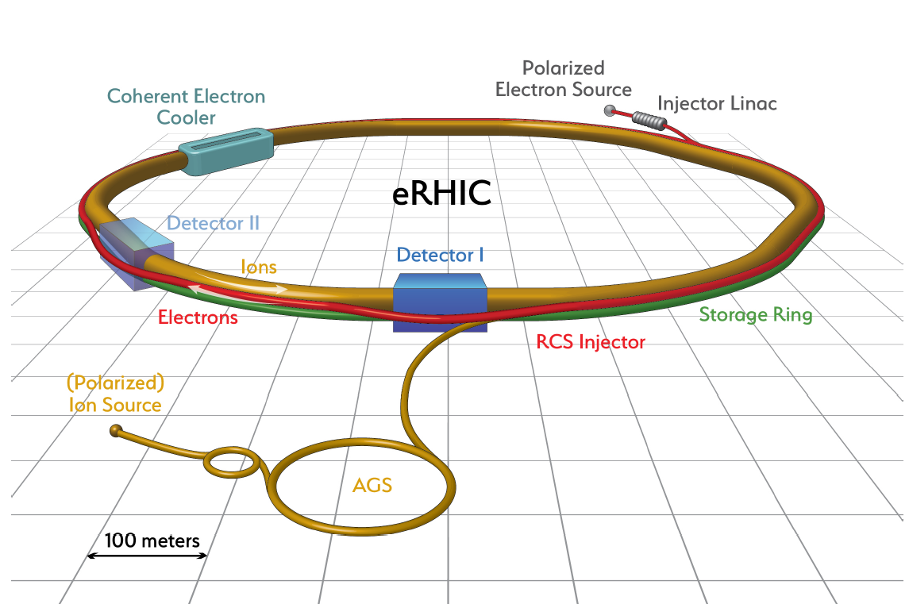
Design Concept
eRHIC is based on the RHIC complex:
Storage ring (Yellow Ring), injectors, ion sources, infrastructure, which need only
relatively few modifications and upgrades
Todays RHIC beam parameters are close to what is required for eRHIC (except number of bunches and 3 times higher beam current)
A (5-18) GeV electron storage ring & its injectors are added to the RHIC complex ➔ E_{cm} = (29-141) GeV
Design aims to meet the goals formulated in the EIC WHITE PAPER, in particular the high luminosity of L = 10³⁴cm⁻²s⁻¹.
Design is optimized under the assumption that each beam will have the parameters (in particular beam-beam tune shift) as has been demonstrated in collisions between equal species (HERA Concept).
The requirement to store electron beams with a variable spin pattern requires an on-energy, spin transparent injector.
The total power of synchrotron radiation of the electron beam is assumed to be limited to 10 MW. This is a design choice.

Slide 7
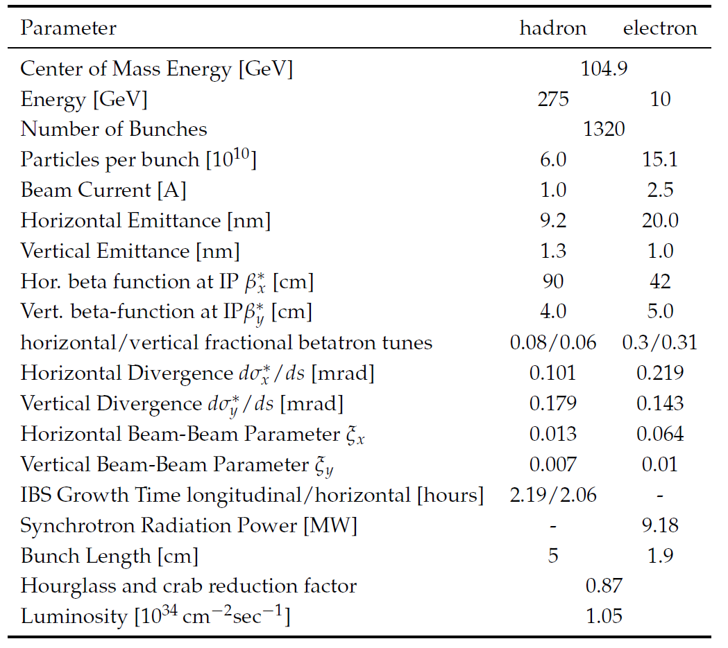
Maximum Luminosity Parameters
High beam currents
Many bunches
Large beam-beam tune-shift
Flat beams
Need strong hadron
cooling
Short hadron bunches
22 mrad crossing angle
with crab cavities
➔ Large Luminosity
0.10
No problem
Challenge
Difficult/R&D required

Slide 8
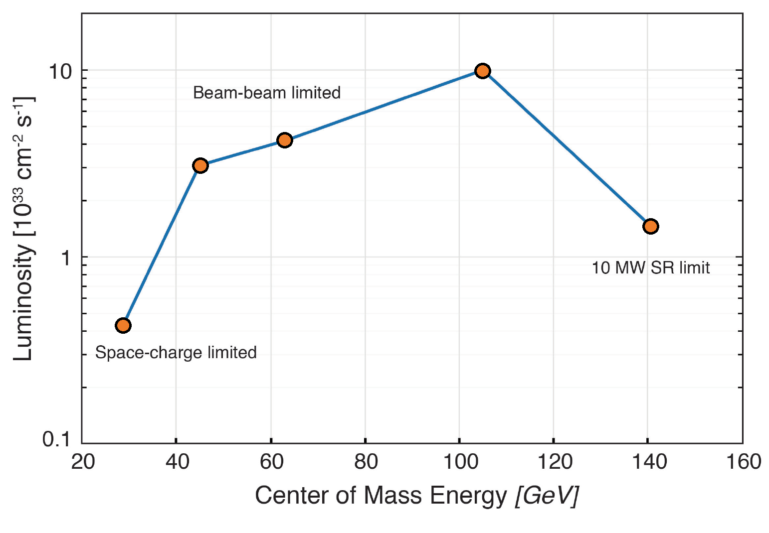
Luminosity versus Center of Mass Energy

Slide 9
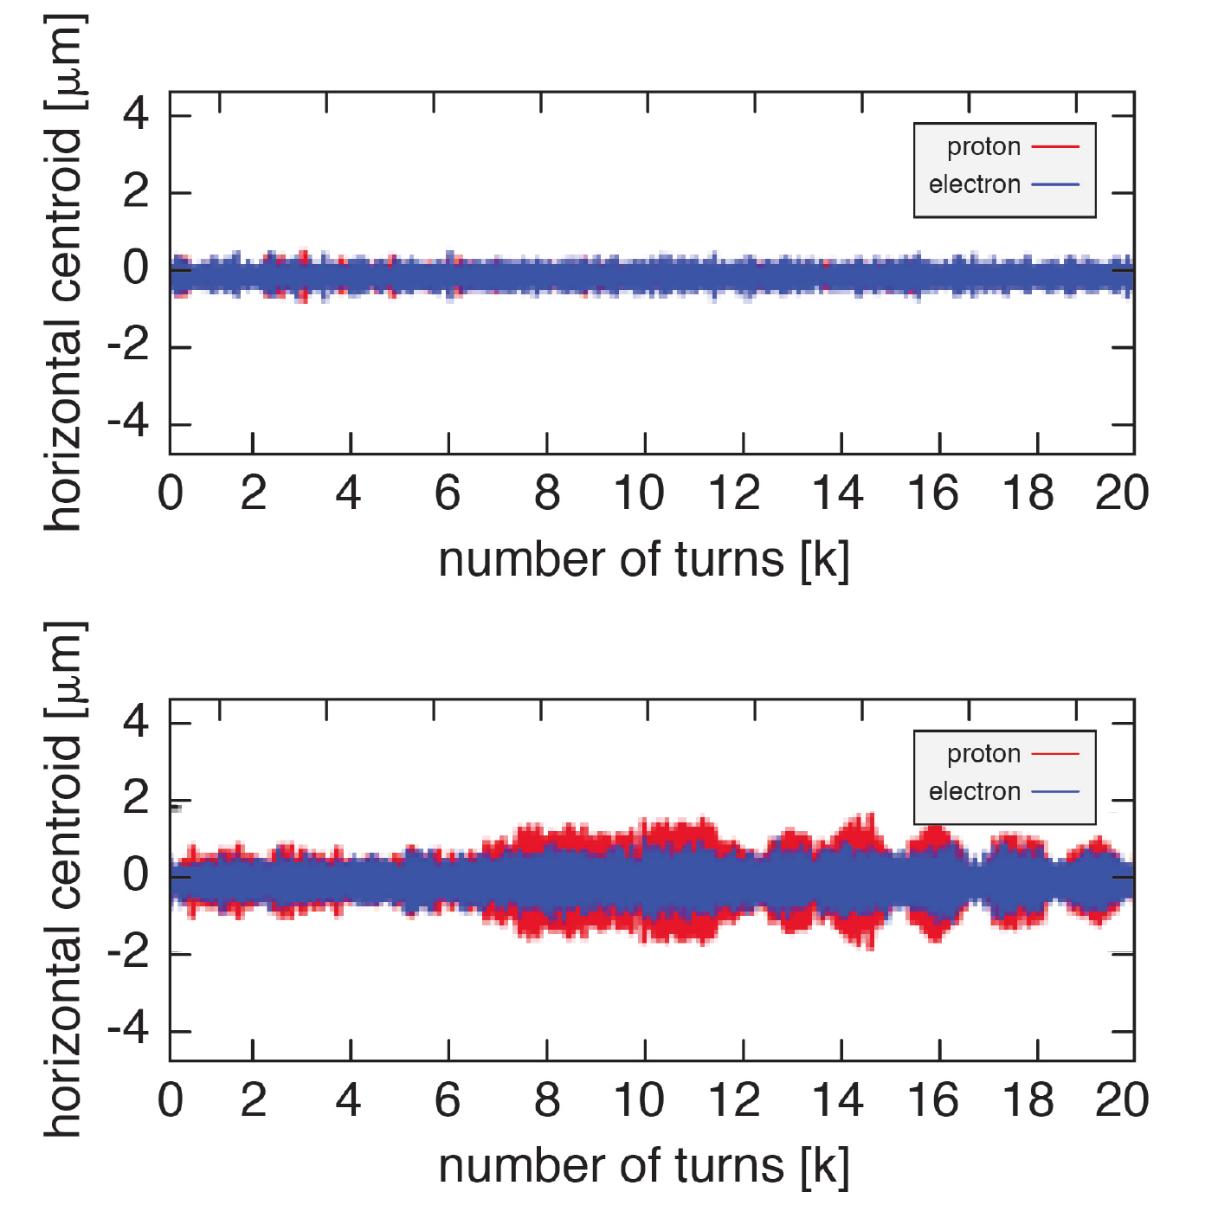

Beam-Beam Physics
ξ_{p} =0.012, ξ_{e} = 0.1
Operate electrons near integer Resonance
Q_{x,y} integer to benefit from pinch effect
Concerns addressed:
Slow emittance growth,
examined using long term weak-strong
Simulation
No evidence
Coherent beam-beam instability as observed in HERA occasionally
Examined by strong-strong simulations
using several codes
Threshold found for N_{p} = 2 x N_{p}-design
Radiation found not to have a strong impact

Slide 10
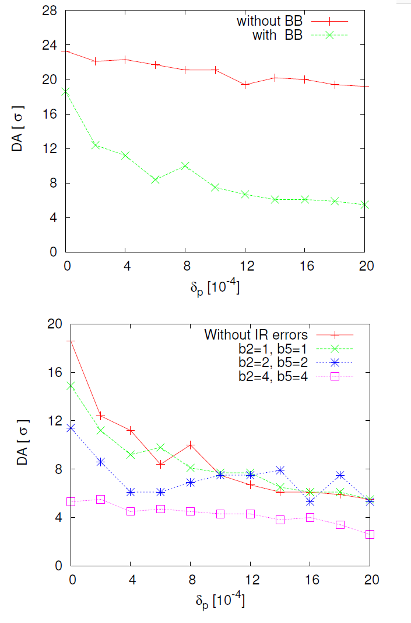
Dynamic Aperture Assessment
Requirements: Hadrons DA> 5 σ (RHIC experience)
Long terms tracking in eRHIC hadron ring
with beam-beam effect
with Multipole errors
Beam-beam has a strong impact on DA
Multipole errors in the IR should not
Exceed 2 units of 10⁻⁴ @ 25mm
High demand of IR magnet design
No attempts to improve DA by nonlinear corrections yet
No study of random errors yet

Slide 11
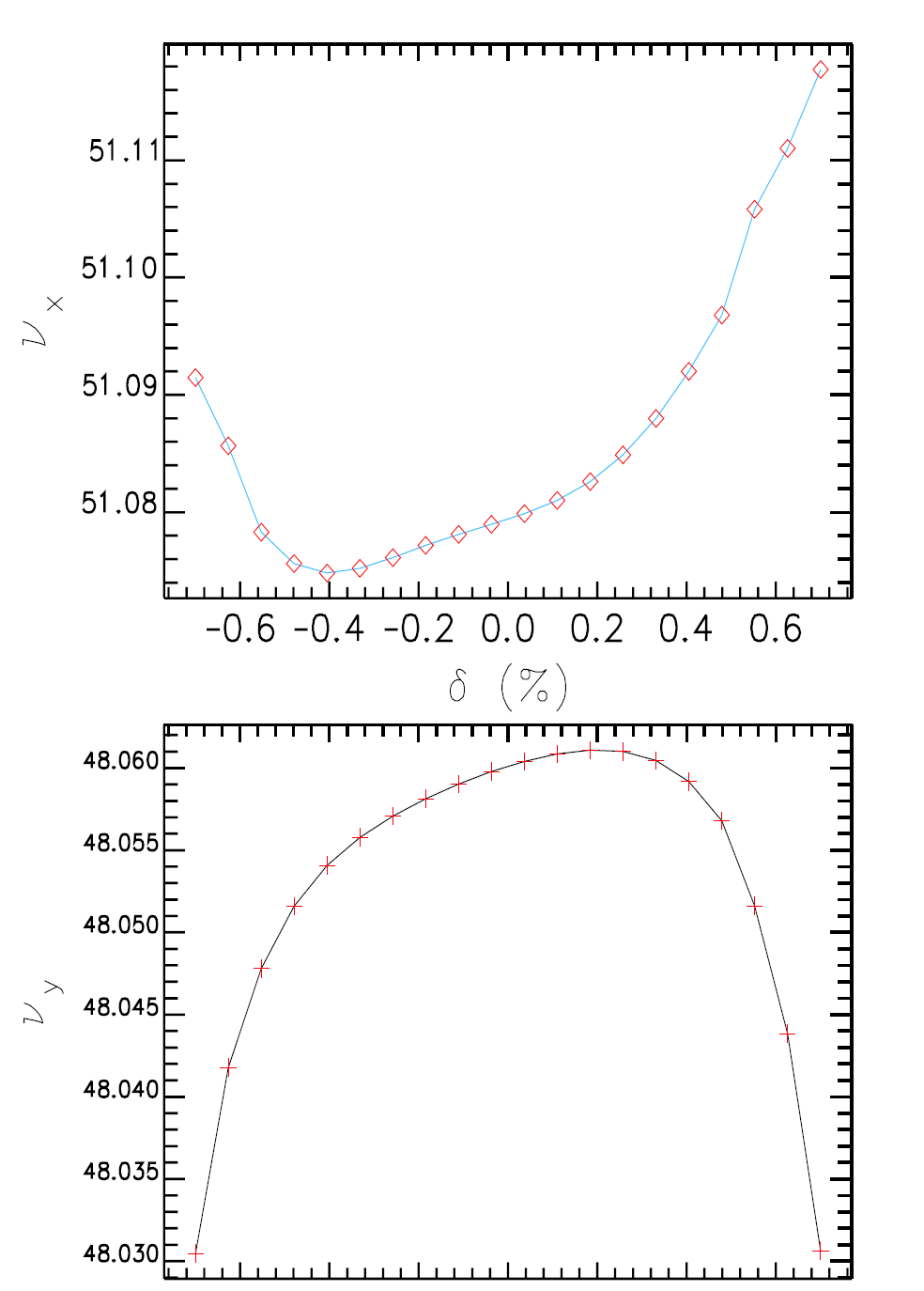
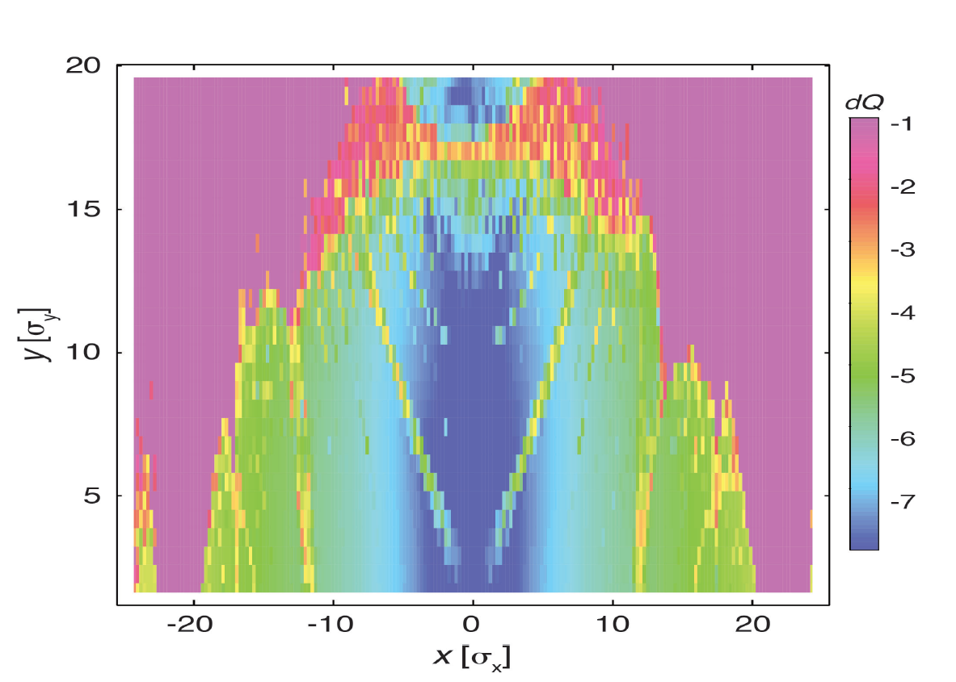
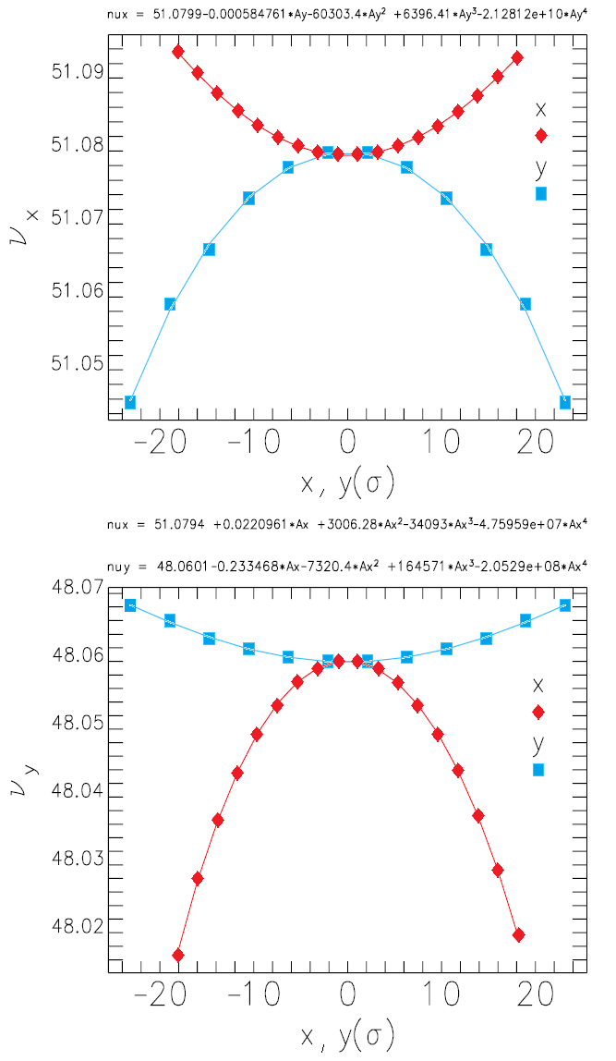

Electron Ring Dynamic Aperture
Requirement: > 10 σ in all three planes (liftetime)
Emittance 20 nm ➔ A > 2 π mrad mm
Main issue: 2nd order chromaticity ( local IR ξ_{x,y} = -30)
Sextupole scheme: A-B-E-A-B-A-B-C-A-B-C-A-B-E-A-B
Off-momentum DA still limited at 0.7% (12σ) by
2nd order vertical chromaticity
On-momentum DA ~ 20 σ, limited by tune shift with
amplitude $\frac{∂Q_{x,y}}{∂J_{y,x}}$
No results with beam-beam and imperfections yet
No optimization of non-chromatic sextupoles yet

Slide 12
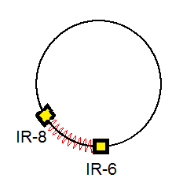
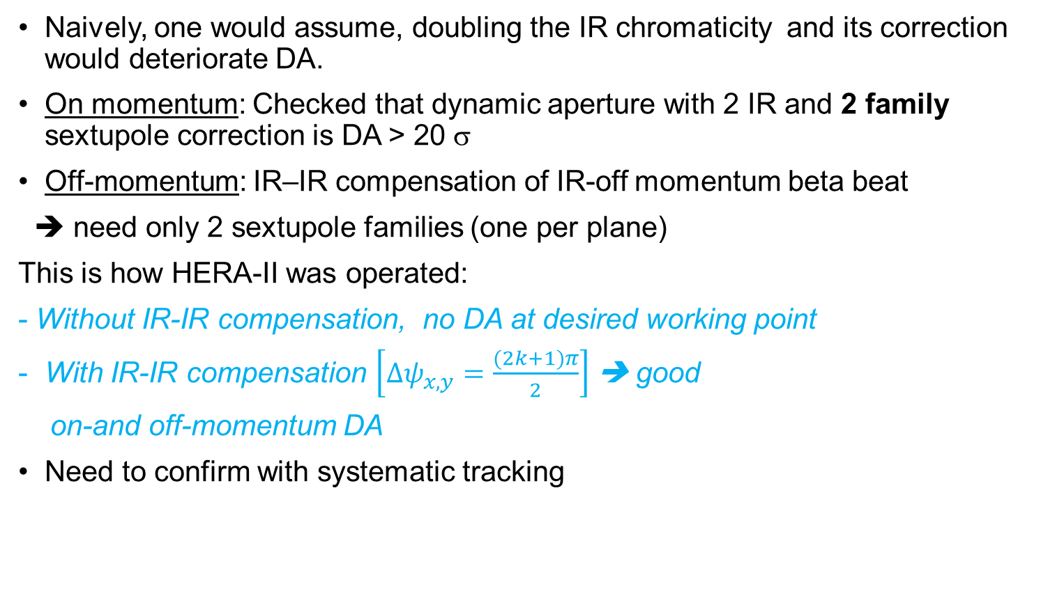
Dynamic Aperture with 2 IRs
Naively, one would assume, doubling the IR chromaticity and its correction would deteriorate DA.
On momentum: Checked that dynamic aperture with 2 IR and 2 family sextupole correction is DA > 20 σ
Off-momentum: IR–IR compensation of IR-off momentum beta beat
➔ need only 2 sextupole families (one per plane)
This is how HERA-II was operated:
- Without IR-IR compensation, no DA at desired working point
With IR-IR compensation $\left[∆ψ_{x,y}=\frac{(2k+1)π}{2}\right]$ ➔ good
on-and off-momentum DA
Need to confirm with systematic tracking

Slide 13
Collective Effects
Electrons:
Single bunch instabilities checked with standard code and appear to be stable.
Transverse coupled bunch modes appear to be stable.
Might need a longitudinal damper for coupled bunch instabilities.
We consider the possibility of removing the 3rd harmonic RF system ($$)
Fast ion instability is expected to be present and requires feedback to control.
Feedback noise might affect hadrons ➔ still needs to be studied and noise specs
need to be defined
Hadrons:
Electron cloud is most worrisome➔ Cu and amorphous C coating of stainless steel vacuum chamber needed (prepared and planned)
IBS: 2 hour emittance growth time horiz. and long. ➔ need strong hadron cooling
Coherent instabilities appear to absent at top energy
Might need a narrowband damper to control coupled bunch instabilities at injection.

Slide 14
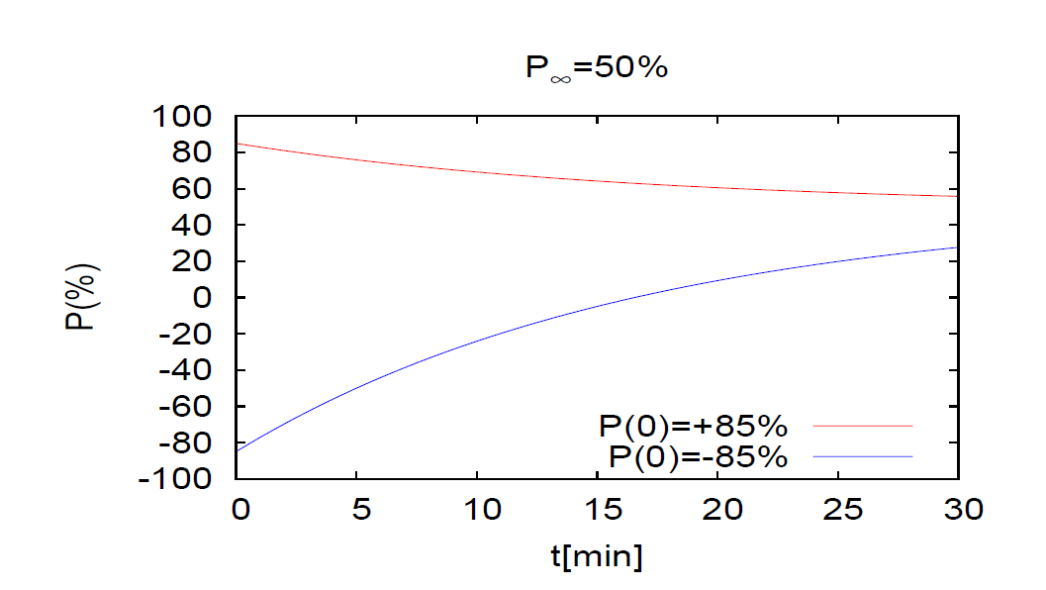
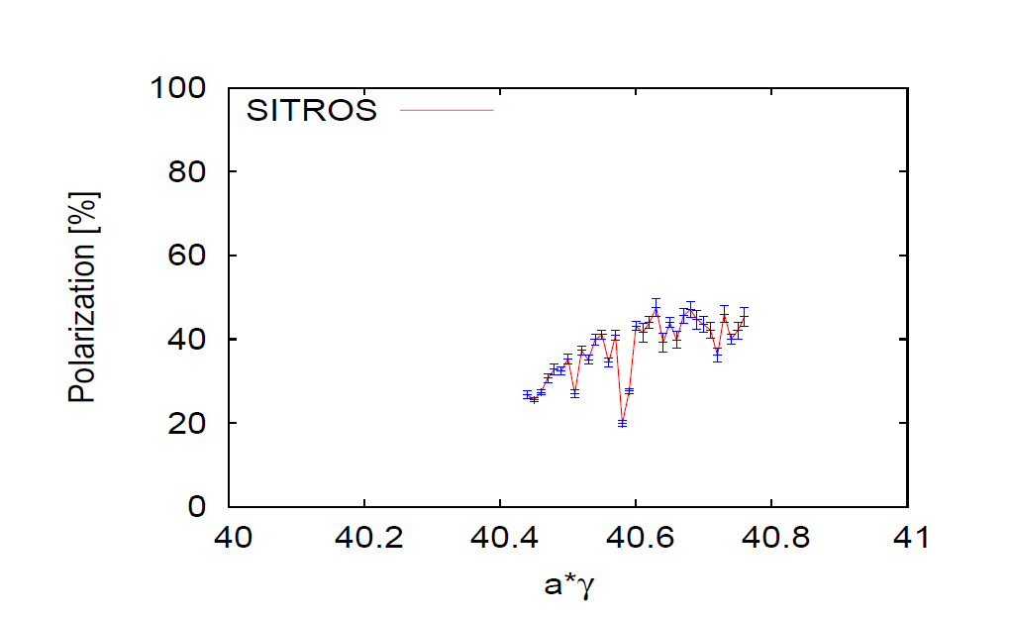
e Storage Ring Polarization
Need to store bunches with 85% initial polarization with spin parallel ↑ ↑ and spin antiparallel ↑↓ to guide field in the arc.
Need to replace bunches with parallel spin ↑ ↑ with a rate of up to 1/(5 minutes) because of Sokolov-Ternov Depolarization (defines the injection chain)
Equilibrium polarization P∞ = 50% in eRHIC sufficient
to maintain polarization with <P> = 63% (spin ↑↓➔ 80%)
Higher vertical tune better (bb feasibility to be checked))
Spin matching between rotators essential
(spin matching confirmed with alternative software, is ok)
Polarization with BB not yet done (HERA polarization suffered
only indirectly from BB: non-colliding bunches pushed to
unfavorable tunes by fixing the tunes for colliding ones (e⁻ - p)
Detector solenoid: influence not checked, (important for p↑)
Conclusion:
Polarization ok so far,
more improvements expected by harmonic bumps, BBA, etc
↑ 50% reachable
Polarization with realistic machine errors

Slide 15
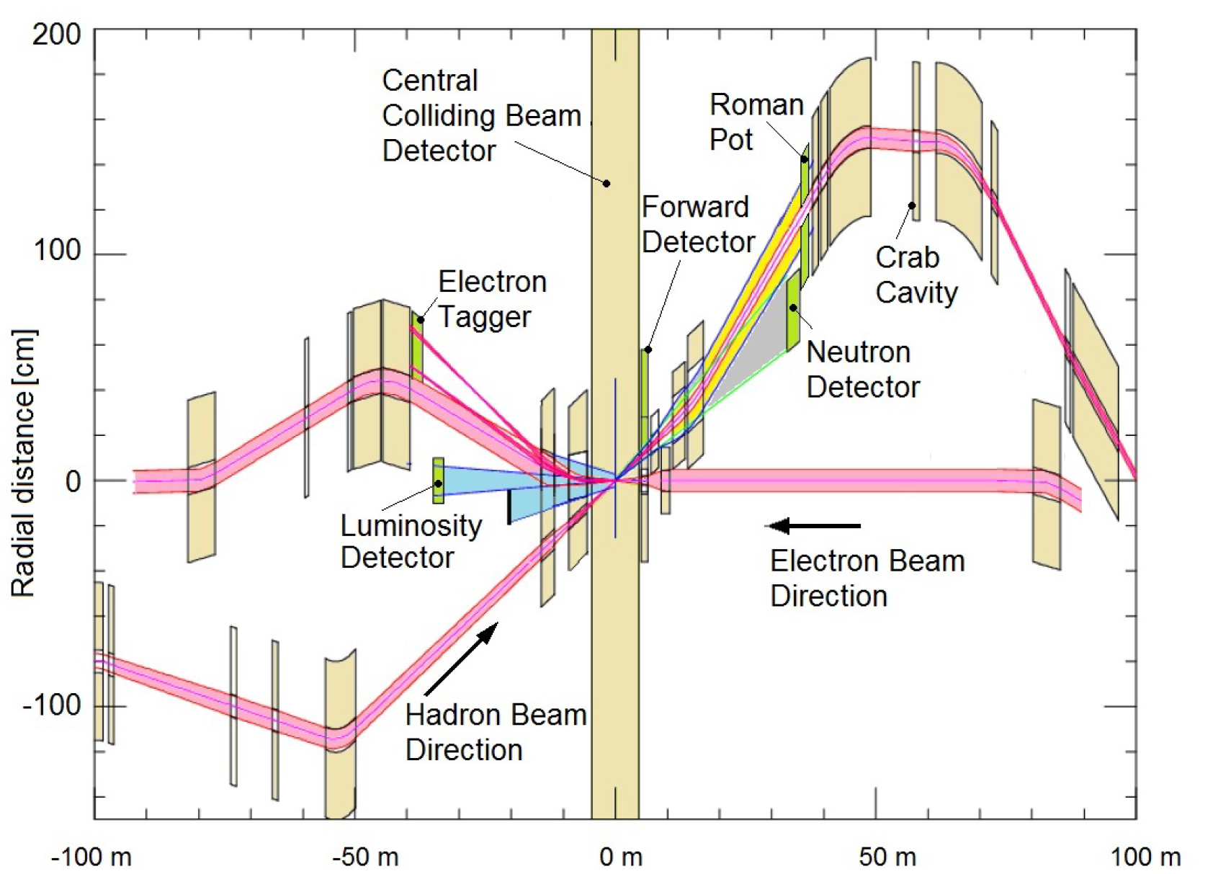
IR Layout
REAR
Forward
IR design requirements:
  Small β* for high luminosity
  Limited IR Chromaticity contributions
  Large final focus quadrupole aperture
  Large Detector acceptance
  ➔ Large quadrupole aperture, limited beam divergence
  Accommodate dipole spectrometer in the low-β optics
  No accelerator magnets +/-4.5 m
  22 mrad Crossing angle, crab crossing, crab cavities 90° from IP
  Avoid Synchrotron radiation,
  - no electron bends on the forward side
  - absorb SR far from IP
  - need mask against backscattered SR photons
  Accommodate spin rotators, spin matching
  Space for luminosity monitor, neutron detector, “roman pots”
Design meets all requirements ➔ very constrained systems, requires novel types of magnets in the IR

Slide 16
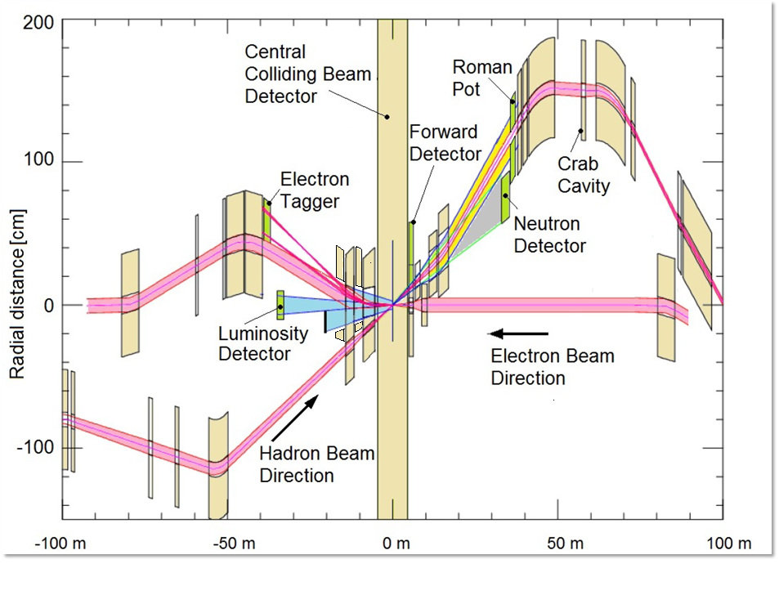
Nb3Sn

Slide 17
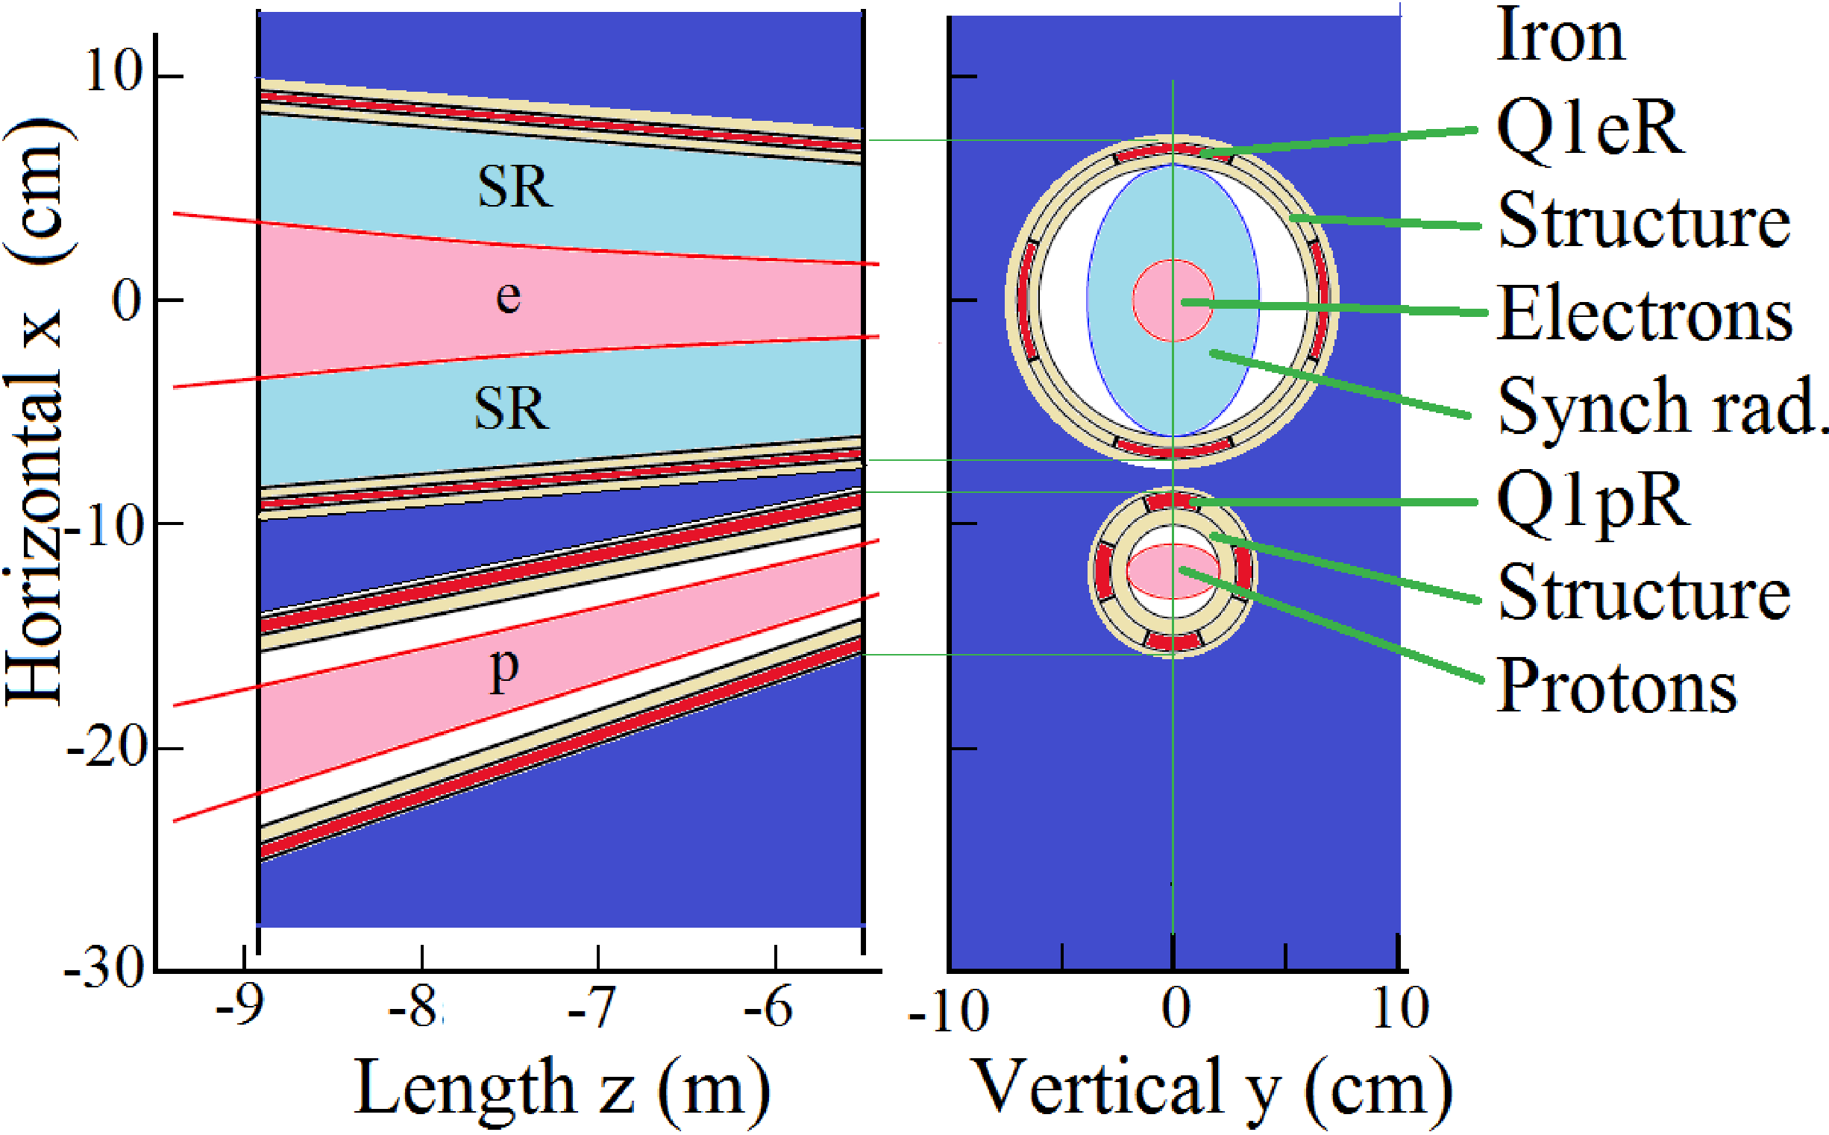
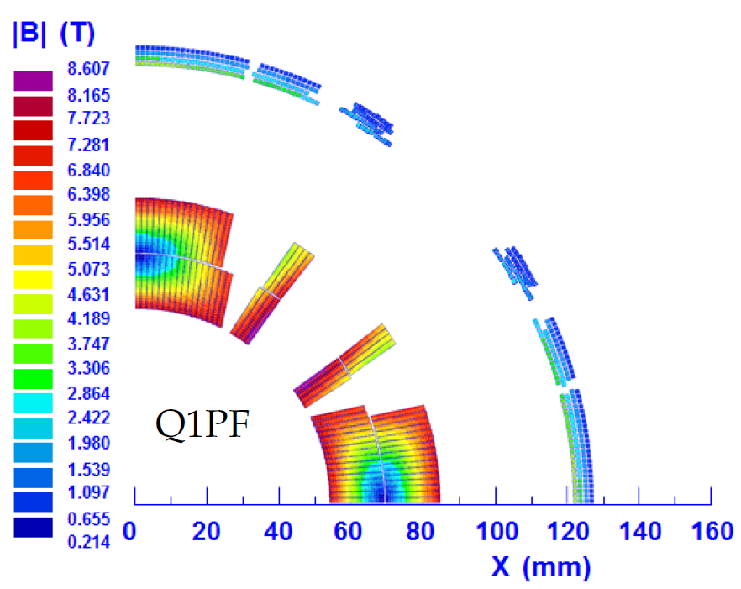
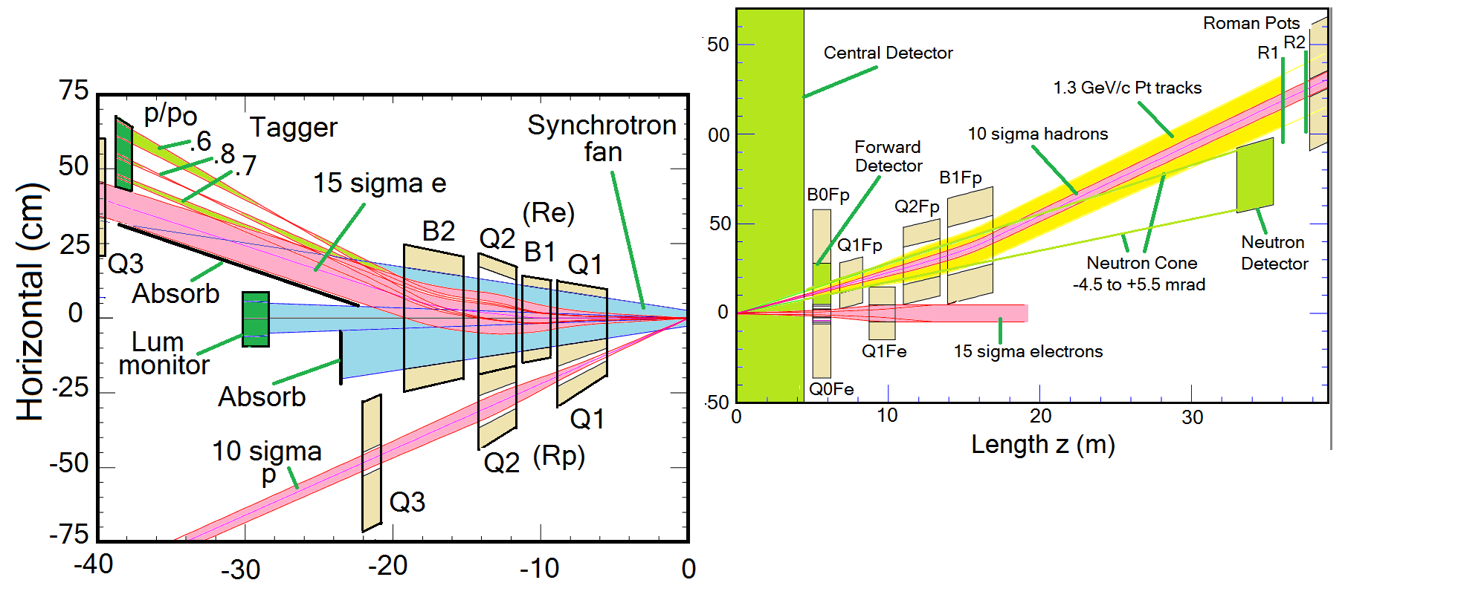
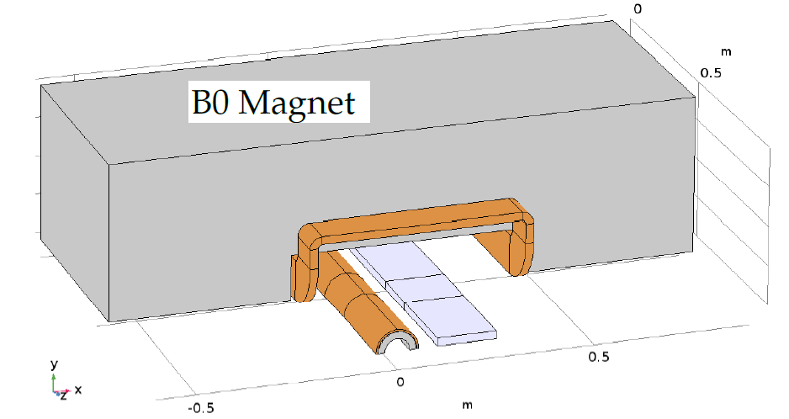

Slide 18
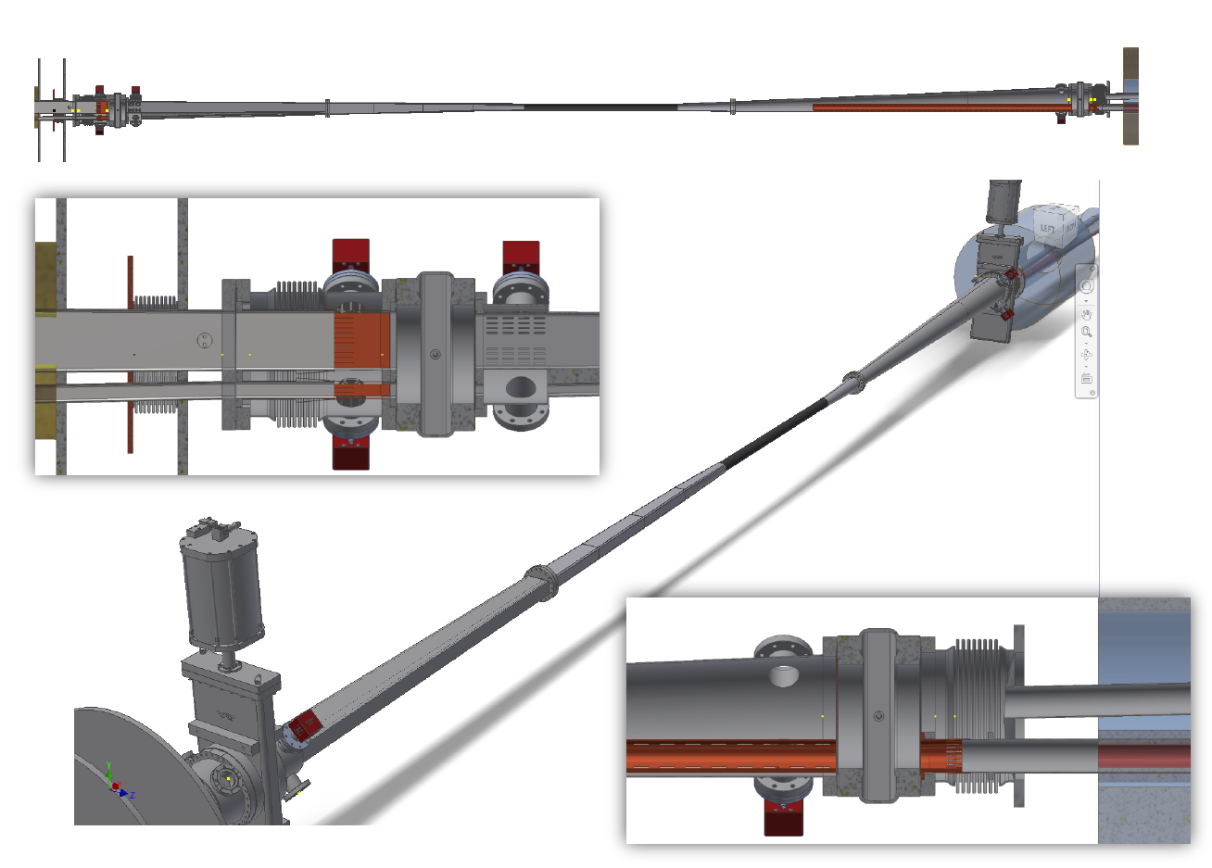
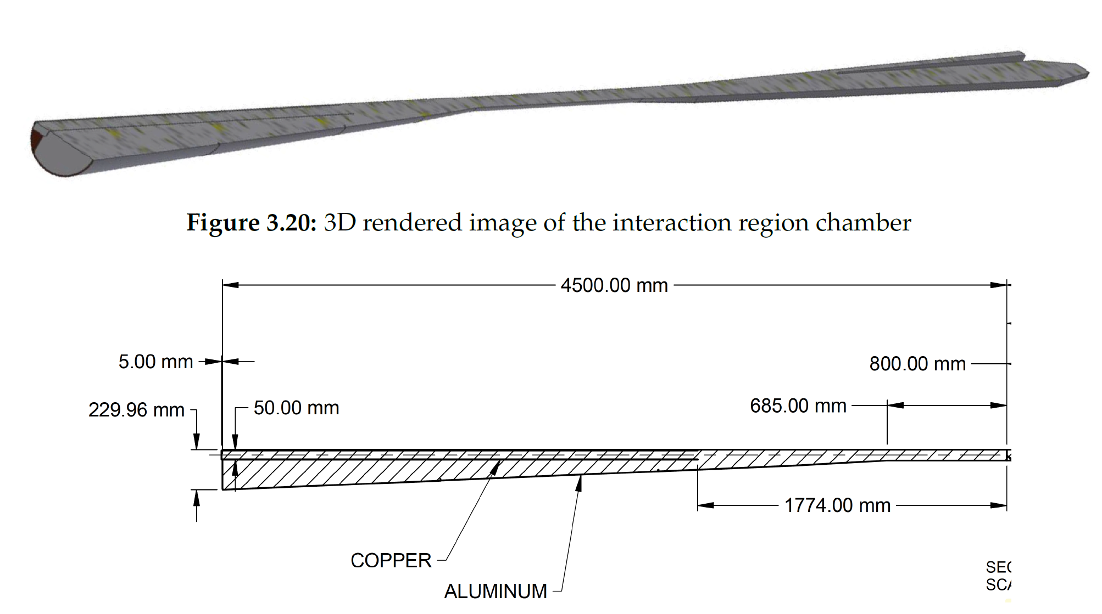
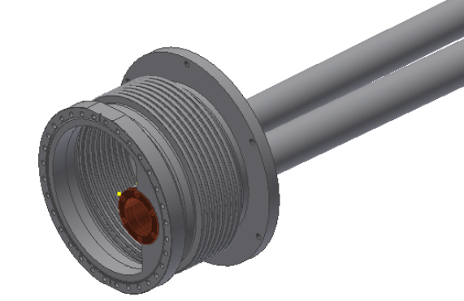
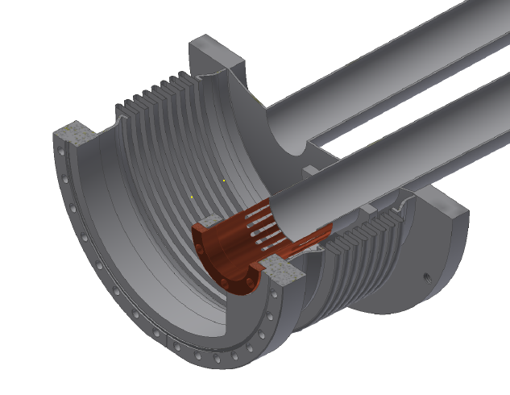
IR Vacuum Design
Design is still at an early stage
Lengths of warm-cold vacuum transitions taken into account in lattice design
Impedance assessment has started
22 kW power deposition
in the IR is a challenge for cooling ➔
Further optimization in progress;
- Cooling design not yet started

Slide 19
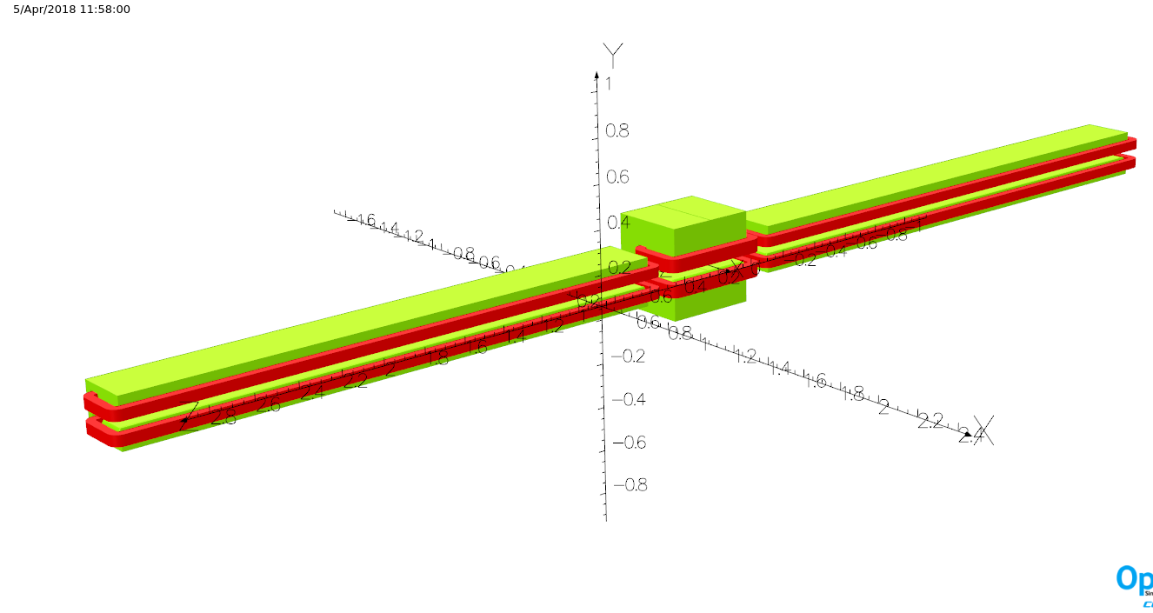
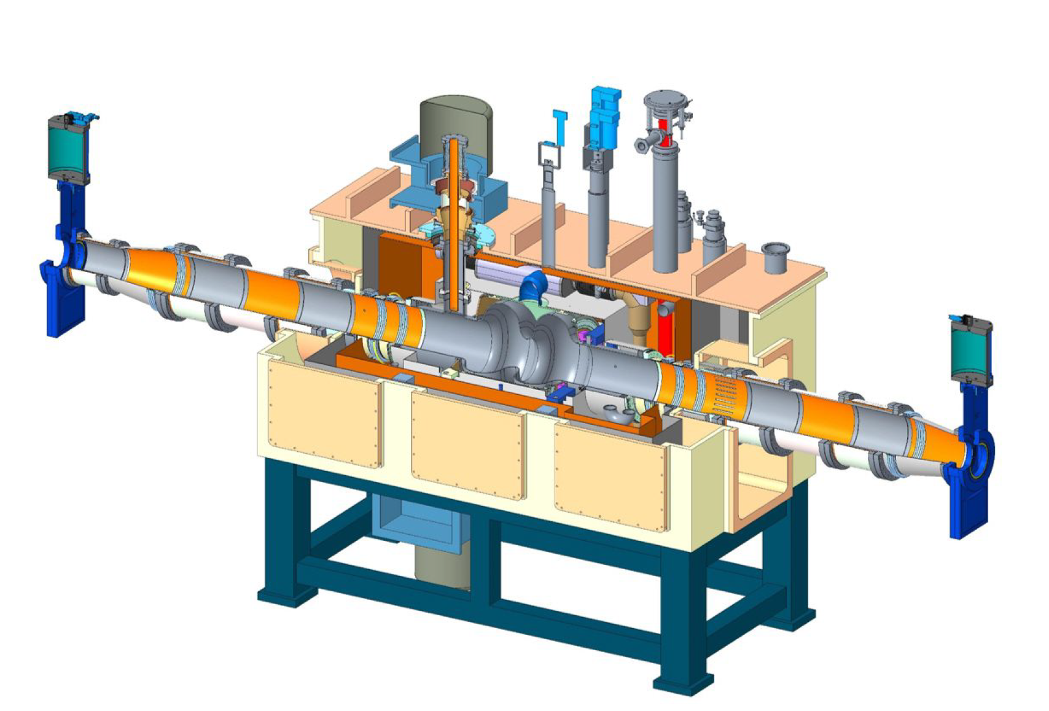
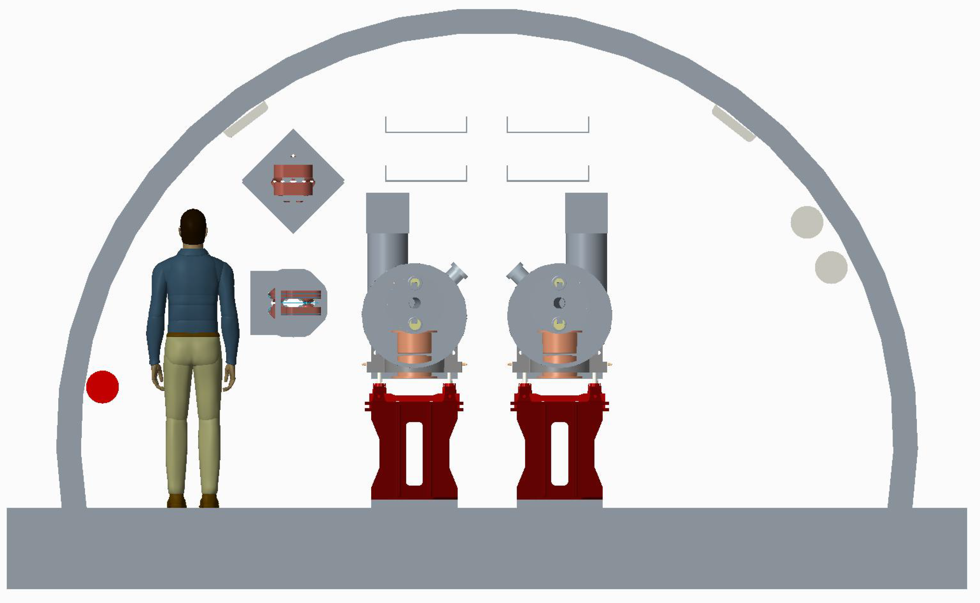
Storage Ring
Composed of six FODO arcs with 60º /cell for 5-10 GeV
90º /cell for 18 GeV
Super-bends for 5-10 GeV for emittance control
6 Straight sections with simple layout
Radiate some 10 MW for maximum luminosity parameters at 10GeV
➔ 11 superconducting 2-cell 563 MHz RF cavities
RCS
Storage
Ring

Slide 20
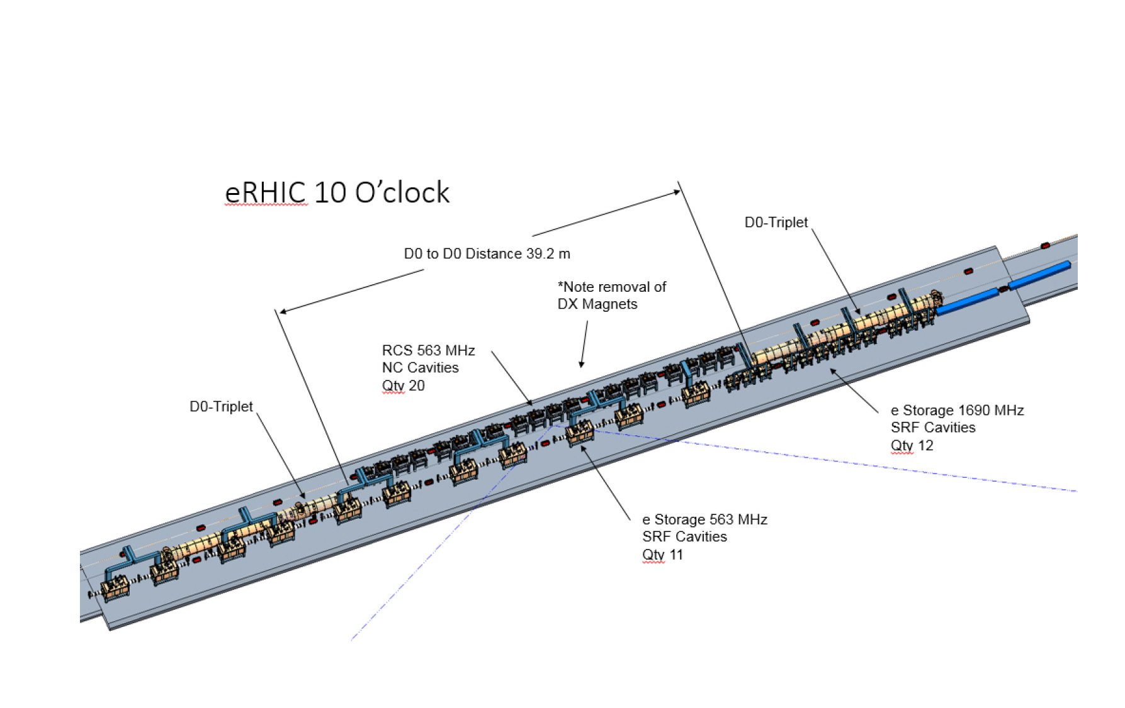
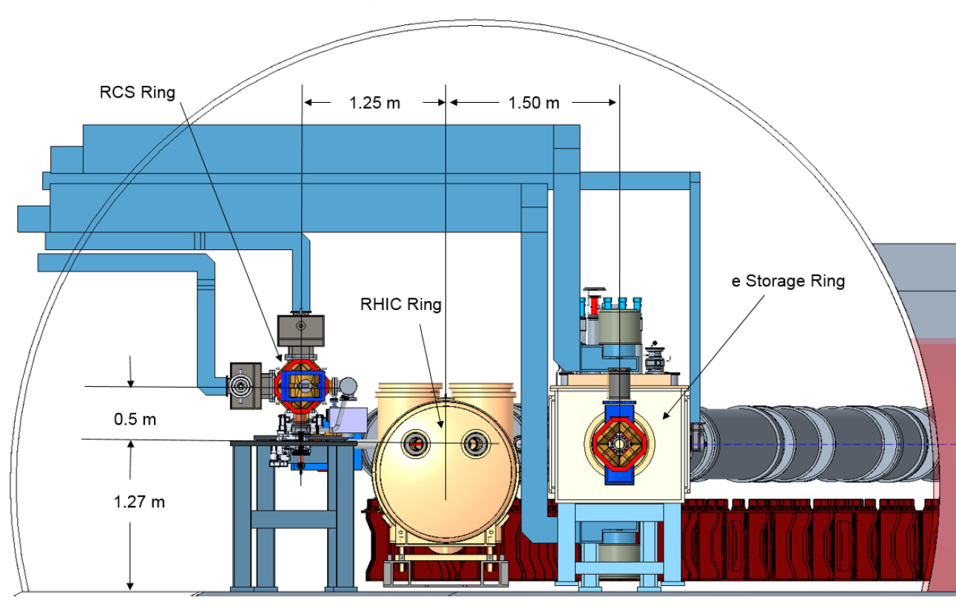

Slide 21
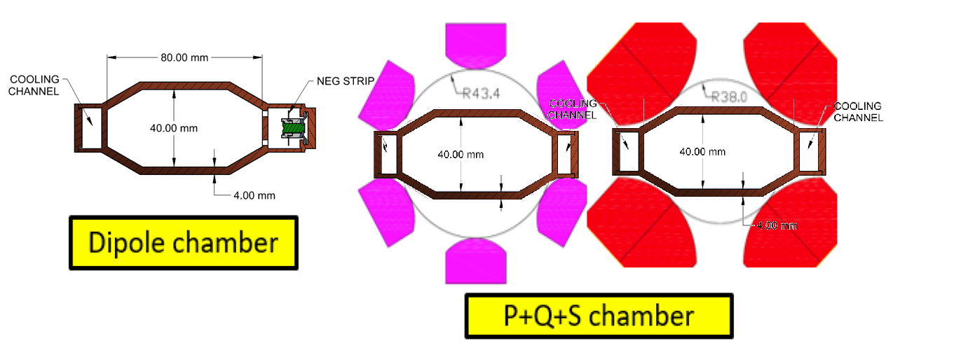
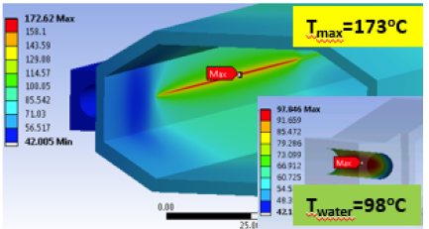
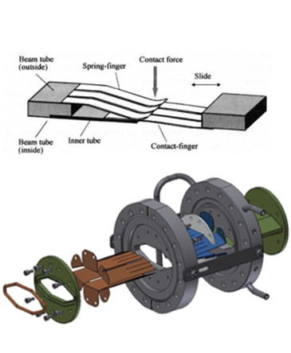
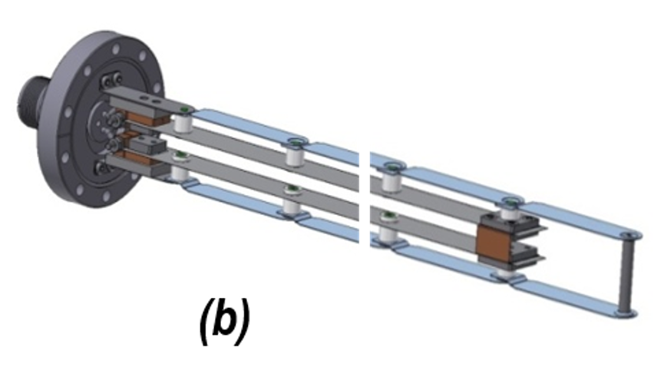
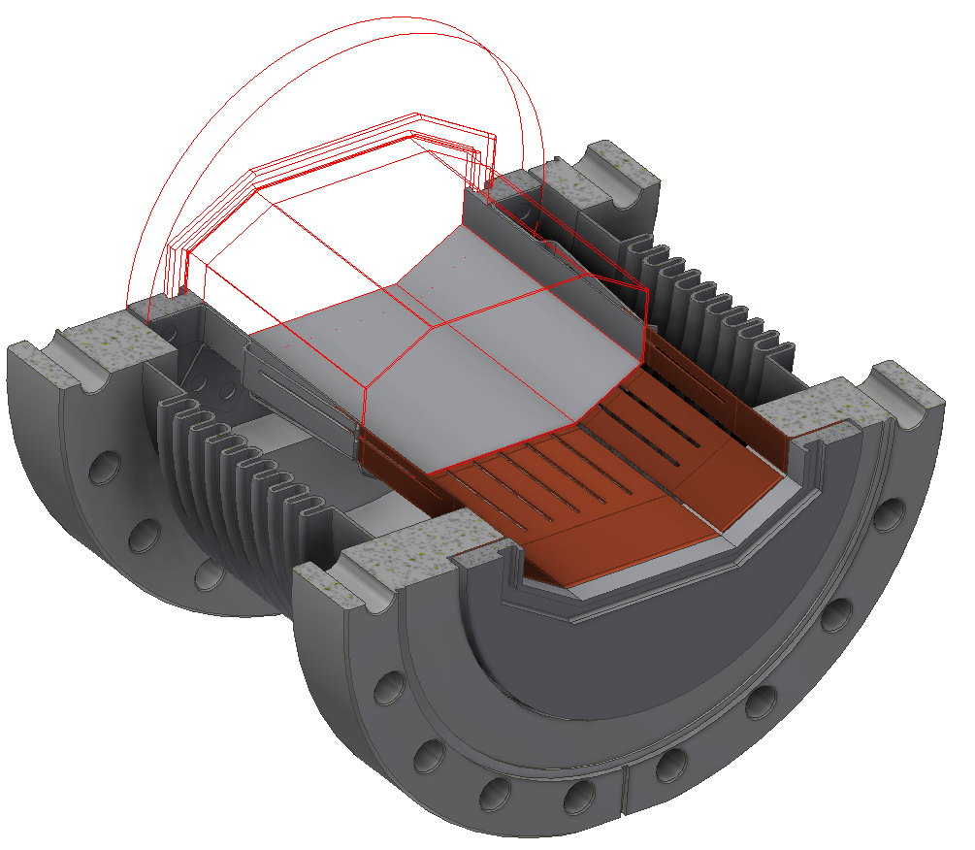
SR Vacuum System
Vacuum chamber from CuCrZr Alloy
Good thermal properties
Weldable
Brazabe
Easily available
Reasonable price
Thermal SR Power Load
ok
Maximum temperature 173°C
well below yield strength limit
Pumping based on
Integrated NEG Pumps
Silver plated sleeve
Copper fingers
RF Bellows:
Critical element of the vacuum system
Improved NSLS-II bellow with outside
CuCr fingers good candidate
Contact spring
RF spring groove

Slide 22
Electron Injector Synchrotron
(5-18) GeV spin polarized electrons are required for injection into the storage ring.
A comprehensive study resulted in the choice of a spin-transparent rapid cycling synchrotron in the RHIC tunnel
High lattice quasi-symmetry (achieved by straight sections designed as unity transformations) suppress systematic depolarizing resonance during the ramp
A 200 ms ramp is sufficiently fast to cross resonances without loss of polarization
Systemic tracking calculation result in stringent orbit control need, orbits should not deviate by more than 0.5 mm from ideal orbit. While this is a demanding requirement, it is believed but feasible using state of the art controls and correction tools.
Magnetic Stray-field from the injector experienced by the storage ring have been calculated as negligible
Electric interference is under study (the power circuit store the magnetic energy to reduce impact on the grid)
Bypass around the detectors are accomplished without distorting the quasi symmetry

Slide 23
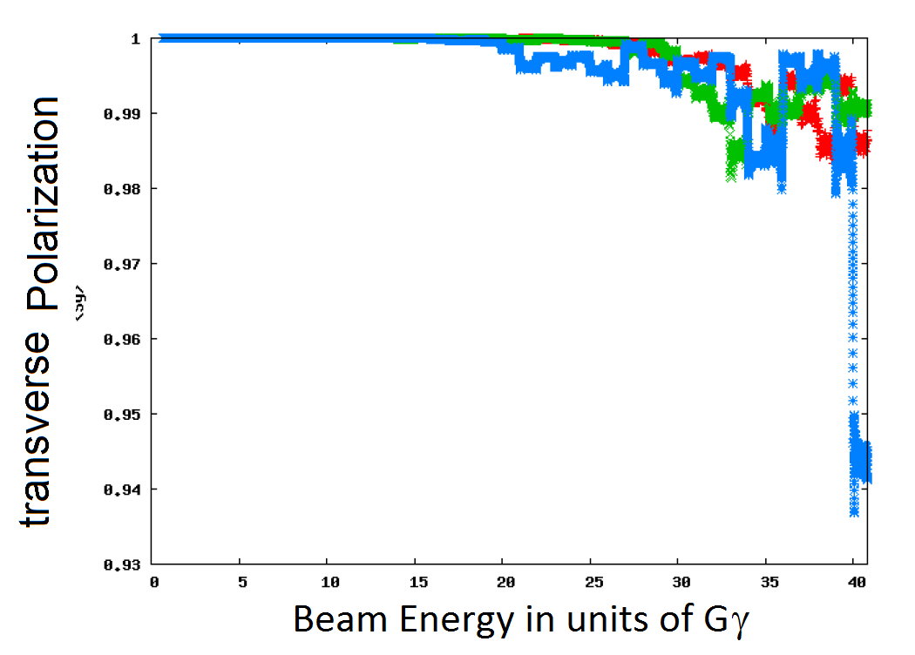
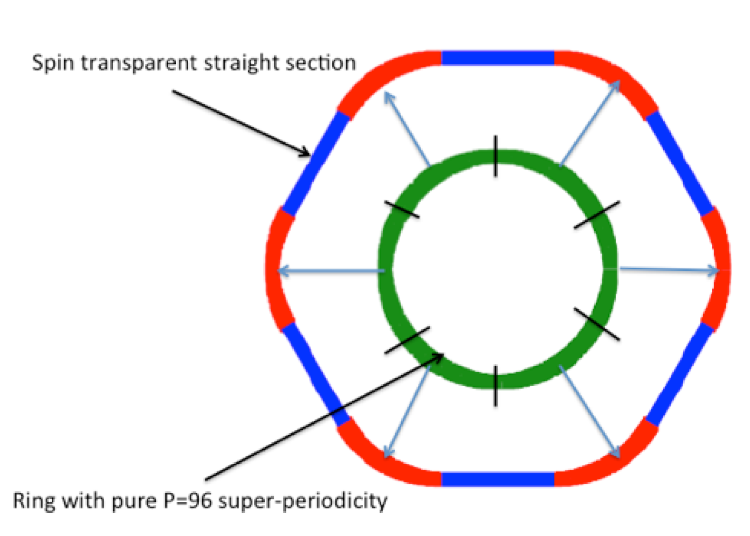
RCS Polarization
High Quasi-symmetry
➔ Good spin transparency properties
Blue asterix: 200 ms ramp time

Slide 24
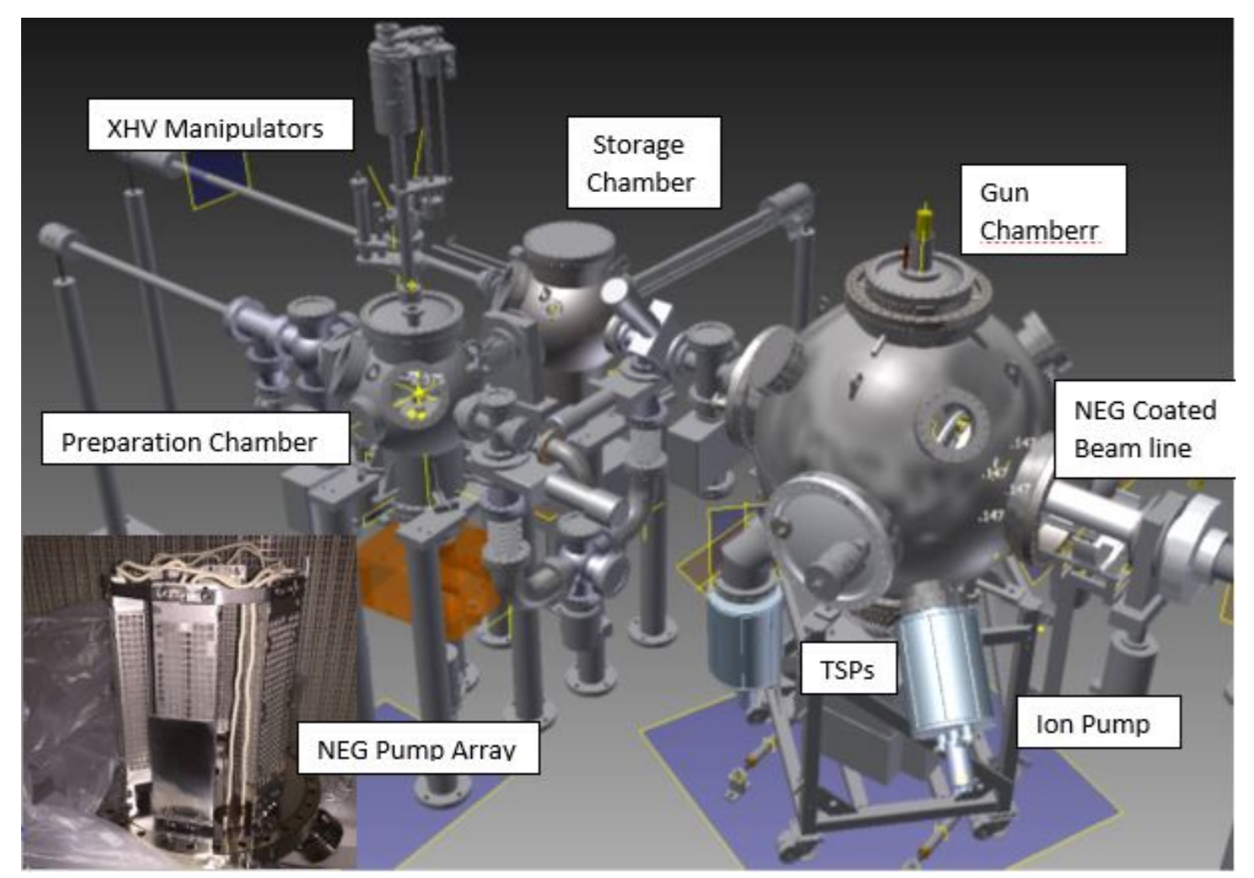
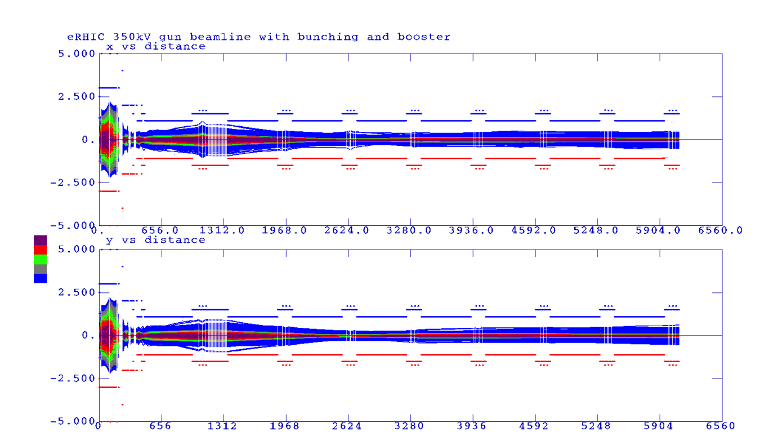
Polarized Electron Source
Need to provide 10 nC of polarized electrons/second
SLAC Gun with 16 nC 150 Hz operation is the existence proof
eRHIC polarized gun is based on the JLAB inverted gun
The gun, low energy beamline
Design and design verified by PIC beam dynamics simulations
400 MeV injector linac will be a SLAC type s-Band linac.
Beam transport simulated and found to be ok for eRHIC beams.
Wien filter, polarimeter design already in fairly large detail

Slide 25
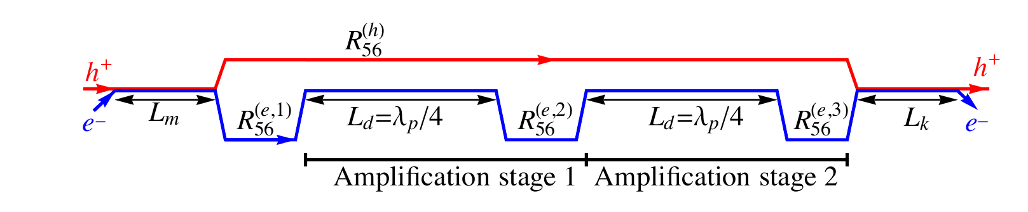
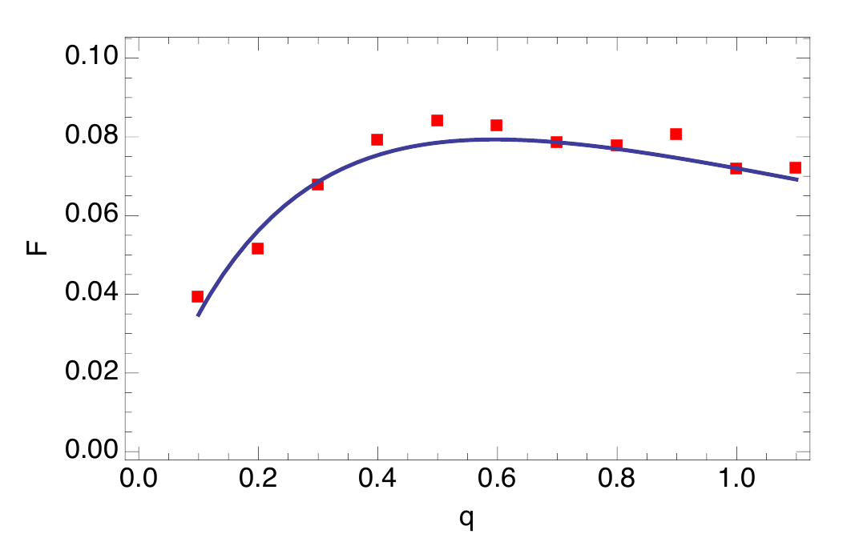
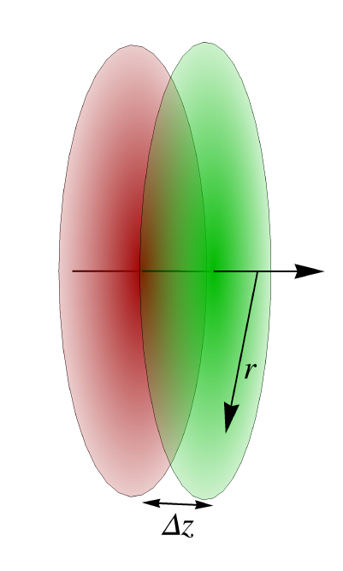
Strong Hadron Cooling
Several methods of strong hadron cooling have been studied.
Bunched Beam Electron Cooling with an electron storage ring
Coherent electron cooling with FEL amplifier or micro-bunching amplifier
➔ The most promising approach at this point is micro-bunched electron beam cooling with 2 plasma amplification stages.
Achievable cooling rates with 100 mA electron current and flat beams are in the order of
1 h which would be sufficient for eRHIC.
Analytical calculation of the
cooling rate agrees well with
simulations within the 1-D model.

Slide 26
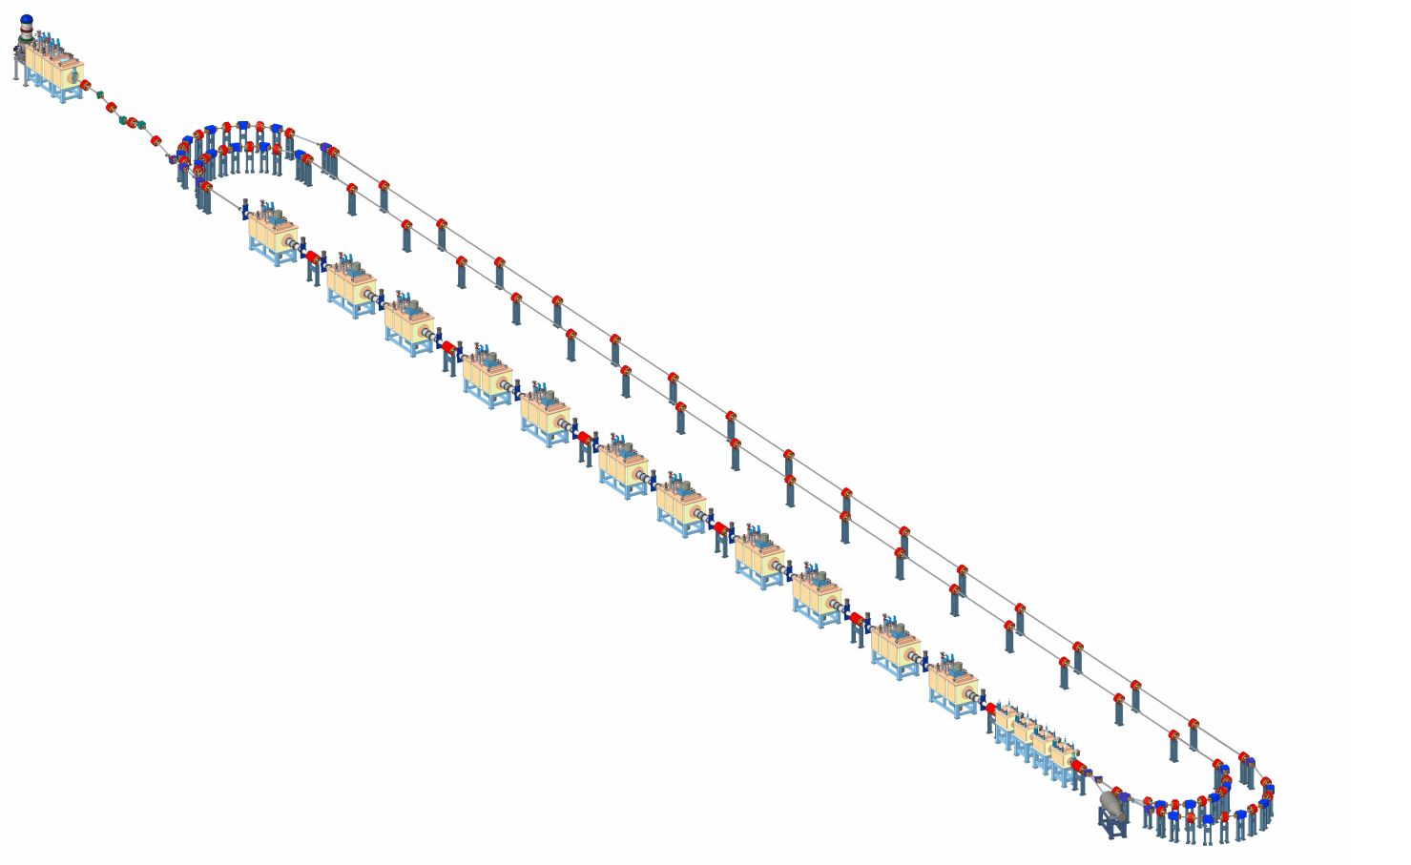
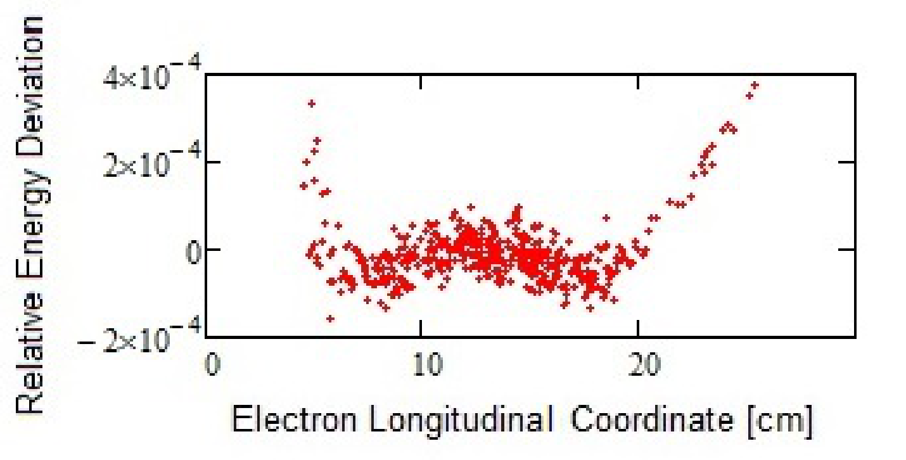
Hadron Cooling
A preliminary layout of the cooler facility, based on a 3-turn ERL with 567 MHz cavities

Slide 27
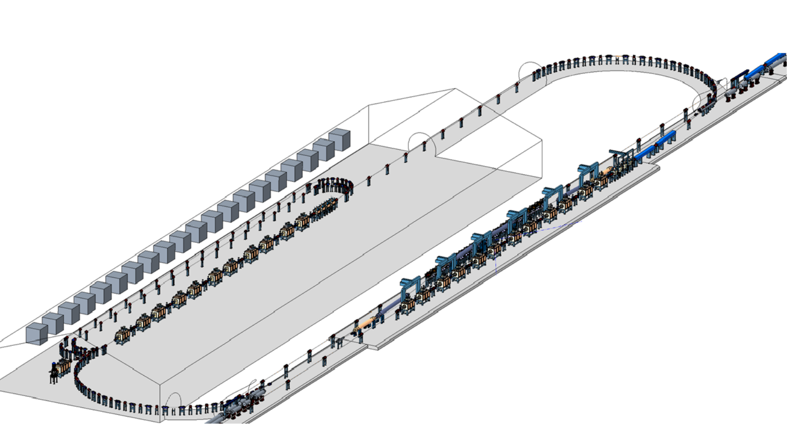
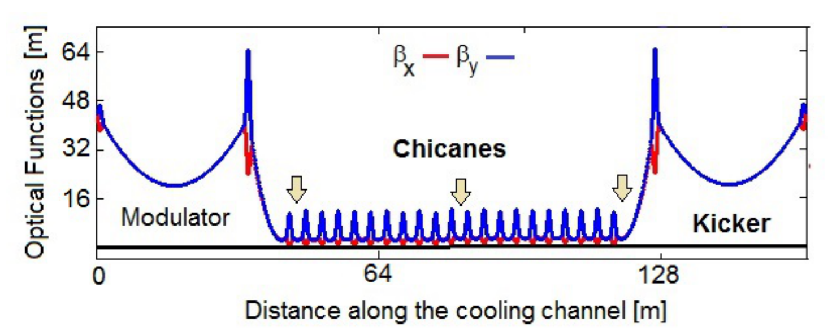
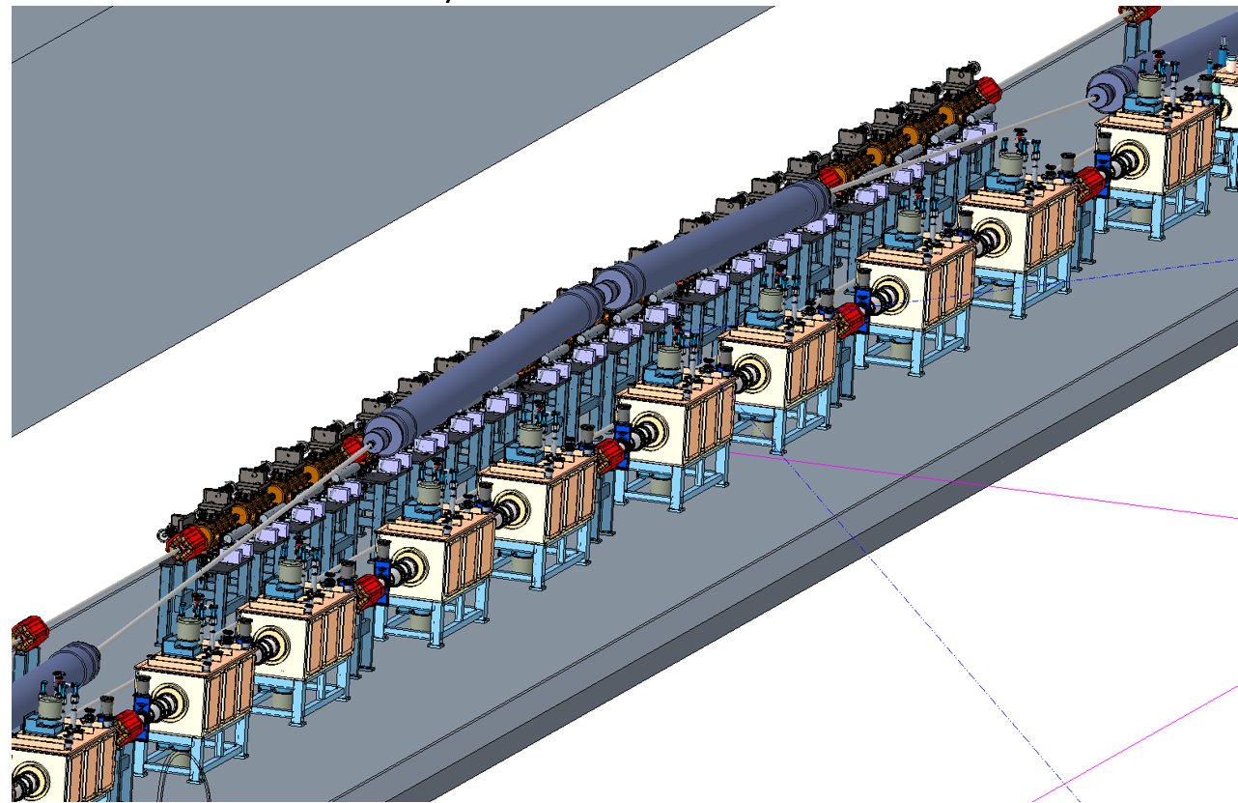
Strong Hadron Cooling
Challenges:
100 mA CW electron source is beyond state of the art
Hadron Chicane to compensate for electron delay in the micro-bunching chicanes is a considerable effort (need several blue ring s.c. RHIC magnets)
Unexplored:
Short bunches might boost the cooling rate, reduce the electron current and reduce number of amplifications.
To Do:
3-D model
Simulation including space charge and drifts
Optimization of parameters for short bunches

Slide 28
Infra-Structure
eRF,
Cold p RF
Cooling
Beam dump
6 snakes, polarimeter Feedback Diagnostics
e-Injection
p-instrumentation
eRHIC Layout
Detector
IR magnets
Crab Cav.
Spin rotators
h-warm RF,
h-injection
Detector
IR magnets
Cab cavities
Spin rotators

Slide 29
Summary
After the Design Validation Review. April 2017, we changed eRHIC design goals from the moderate solution with
L= 10³³cm⁻²s⁻¹ ➔ L= 10³⁴cm⁻²s⁻¹
However, this can only be achieved with strong hadron cooling, which is beyond state of the art, and is a topic of ongoing R&D.
The corresponding design risk is mitigated by R&D, exploring variants for hadron cooling and by a fall back position with a respectable luminosity of
L= 0.44·10³⁴cm⁻²s⁻¹
eRHIC design has progressed very well and a tremendous amount of design work organized in 430 design tasks was accomplished during the last 12 months.
While a large amount of work is still ahead to arrive at a Conceptual Design, we believe that the present state of the eRHIC design matches well the expectations of a Pre-Conceptual Design

Slide 30
Summary, continued
The Ring-Ring eRHIC is technically feasible and is consistent with the anticipated cost expectations for an EIC.
The eRHIC machine performance will satisfy the EIC scientific requirements.
Plans for the eRHIC facility include two detectors.
The staged implementation of the eRHIC facility is possible, if necessary.
There are viable alternatives for DOE ONP to meet the CD-0 Mission Need.

Slide 31
Backup

Slide 32
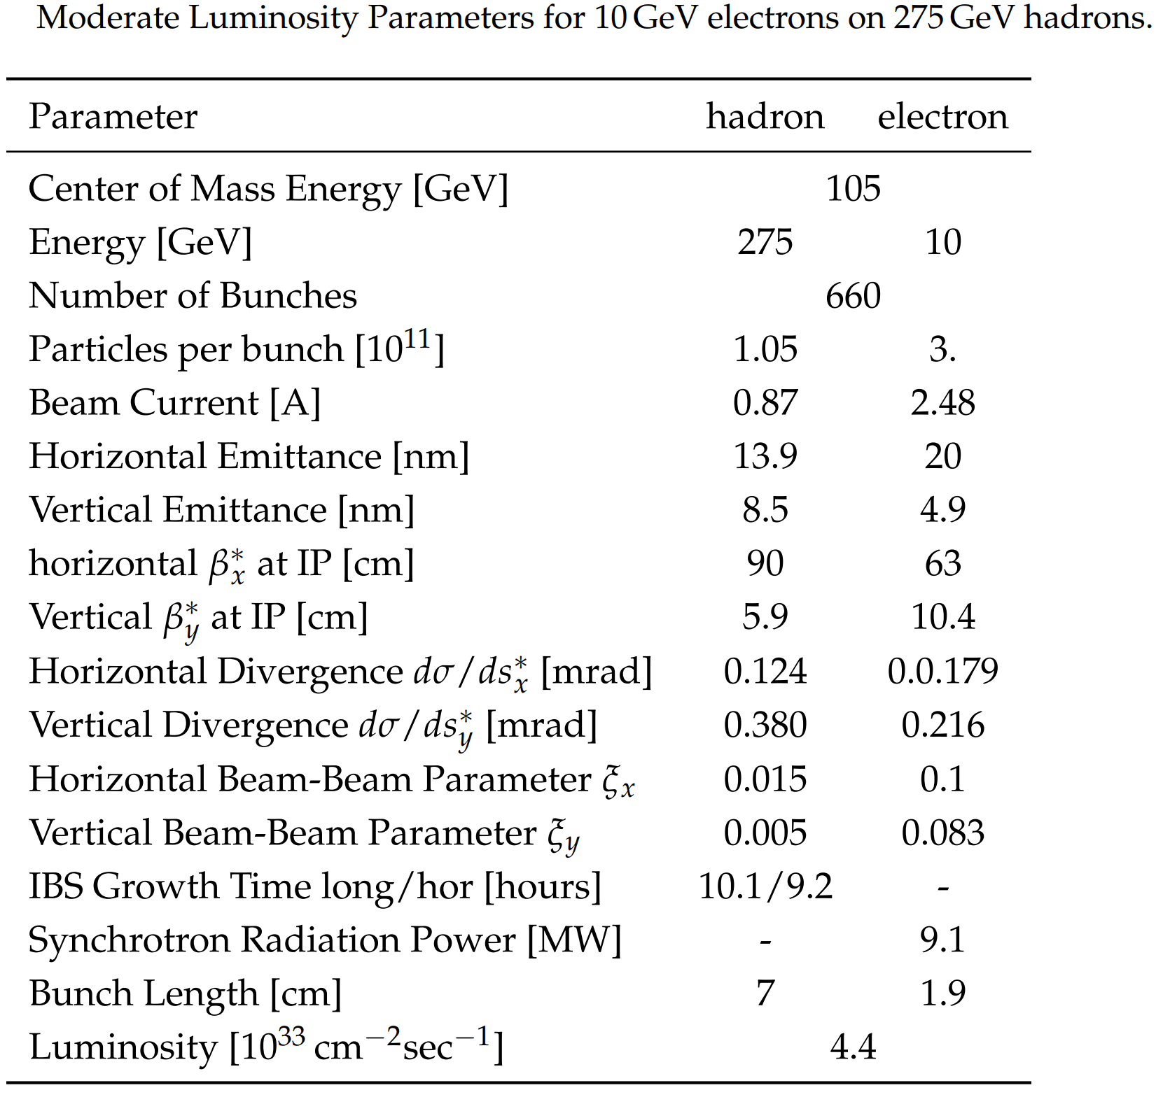
Mitigation of Strong Hadron Cooling Risk
Solution with L = 0.44·10³⁴cm⁻²s⁻¹ and hor., long IBS growth rates of 10,9 h

Slide 33
Some of the…
Areas Requiring Additional Effort
Dynamic aperture for all beam optics, all beam energies, comprehensive study of imperfections and beam-beam
Polarization: include a beam-beam & polarization study
Collective effects: Study fast ion instability of electrons and impact of feedback residuals on hadron beam stability
Continue electron cloud studies
Continue studies of strong hadron cooling
Continue IR impedance studies
Continue IR hadron background studies
Design synchrotron radiation mask against back scattering
Explore elimination of 3rd harmonic RF system for electrons ($$)
Explore hadron bunch rotation to eliminate 225 MHz RF system ($$)
…

