Slide 1

Progress of Super Tau-Charm Facility in China
Yangheng Zheng
zhengyh@ucas.edu.cn
(On behalf STCF Steering Committee)
Hadron2018, July 26-31, Weihai

Slide 2
Outline
BEPCII/BESIII ⇒ STCF : Why?
Conceptual Design status of STCF
  Accelerator/Collider
  Detector
Some highlight physics topics at STCF
Status of Science & Technology Review
Summary
High Intensity Electron Positron Accelerator (HIEPA)
= Super Tau Charm Facility (STCF) + SR Light Source

Slide 3
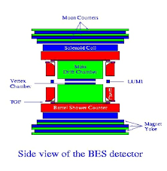
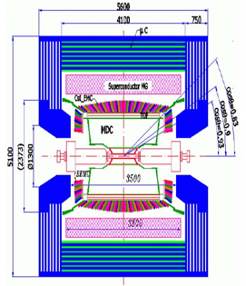
30 Years of τ-c facility in China
BEPCI (1988−2005)
Single Ring
10³¹cm⁻²s⁻¹ ⇒ 10³³cm⁻²s⁻¹
BEPCII (2006−now)
Double Ring
BESI/II
BESIII
BEPCII/BESIII are playing a leading role in tau-charm physics area and will end her mission in 5-7 years
Notes:
经历

Slide 4
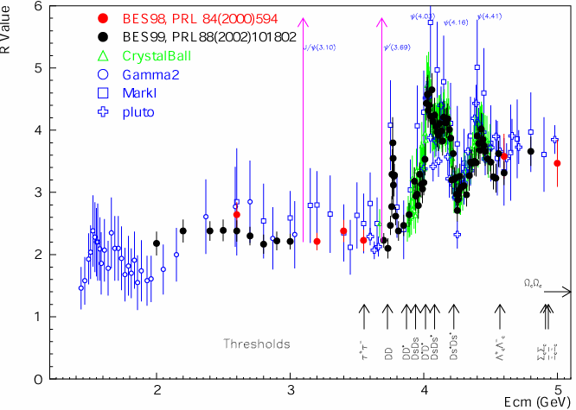
Broad Physics at τ-c Energy Region
Unique features ：Rich of resonance, Threshold characteristics, …..
Abundant physics
R=s(e⁺e⁻→hadron)/
s(e⁺e⁻→m⁺m⁻)
Hadron form factors
Y(2175) resonance
Mutltiquark states with s quark, Zs
MLLA/LPHD and QCD sum rule predictions
Light hadron spectroscopy
Gluonic and exotic states
Process of LFV and CPV
Rare and forbidden decays
Physics with τ lepton
XYZ particles
f_{D} and f_{Ds}
D₀-D₀ mixing
coherent D mesons decays
Charm baryons
LHCb, (Super)B factory, (Super)τ-c factory, φ factories are complementary.
Notes:
Abundant physics topic are expected in the tau-charm energy region.
For example, in 2-3GeV, it is ideal region to study the hadron form factors,
Study the properties of Y(2175) and search for the mulitquaks states with s quark,
It also can be used to test QC sum rule predictions.
In the charmonium energy region, which can collect very very last data samples, and
It can be used to study the light hadron spectroscopy And gluonic and exotis states.
It also can be used to search for the LFV process, CPV process and rare and forbidden decays preocss.
Of course tau physics can be one of landmark in this region.
Above the 4GeV region, It is ideal place to study XYZ particle, Physics with D meason
And D-D0 mixing charm bayrons.
Of course, the R scane in the whole energy region will definenalyy improve the presision
Of delta Alpha QDQ, charm quark mass extraction. Estpcaiilly in the range from 5-7 GeV,
There are very rare experiment data to day.
The data can also be use for the hadron from factor study.

Slide 5
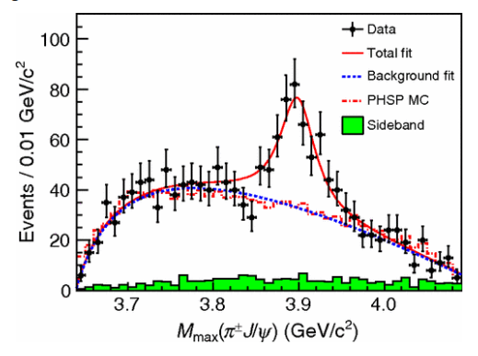
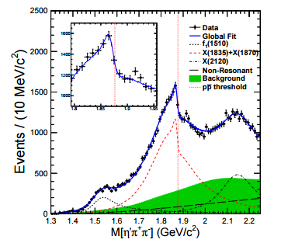
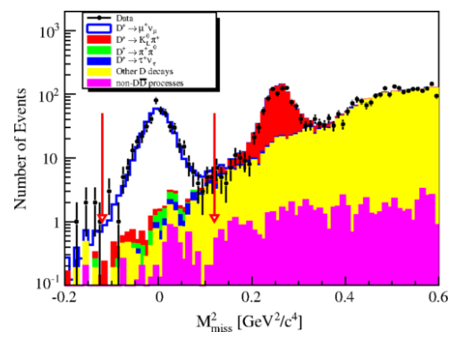
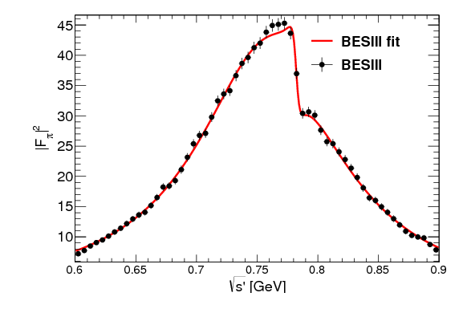
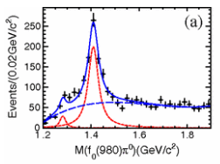
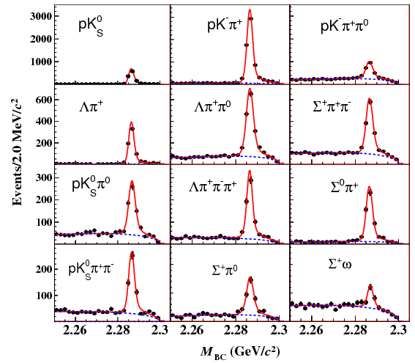
Some highlights from BESIII
Z_{c}(3900)
Abrupt structure
Most precise measurement for D leptonic decay
X(1835)
Large Isospin Violation
η(1405)→f₀(980)π⁰
First Λc at BESIII
Precise measurement
Precise Measurement on Cross section
e ⁺e⁻→π⁺π⁻
Please see Shuangshi’s talk for more highlights.

Slide 6
Publication of BESIII
≈200 publications, 1/5 PRL
Excellent in both number and quality
http://bes3.ihep.ac.cn/pub/physics.htm

Slide 7
Some limitations for BEPCII/BESIII
BEPCII/BESIII have run 9 years, successful and excellent production
Limited by length of storage ring, no space and potential for the upgrade
Physics study limited by the luminosity, CME ……
Charmonium-like physics
Charmed baryon physics
Charmed meson and tau physics
Challenged by Belle II
BEPCII/BESIII will end her mission in 5-7 years (up to 2025)
A Super τ-charm Facility is the nature extension and a viable option for a post-BEPCII HEP project in China
Notes:
BEPCII/BESIII will end her mission around 2020,
Led by the high energy Physics association of China, we are exploring possible
Future collider proejct post BEPCII and BESIII
High intensity Electron Positron accelerator (HIEPA) is one of the options.
HIEPA facility can be serviced as a collider machine,
Which provide peak lumin…..
The energy range from 2-7Gev, polarization available on one beam
And the symmertic machine with low currents and crabbed saist solution for the interation….
It also can

Slide 8
STCF in China
Peak luminosity 0.5-1×10³⁵ cm⁻²s⁻¹ at 4 GeV
Energy range E_{cm} = 2−7GeV
Polarization available on beam (Phase II)
Basic Features of machine :
Symmetric machine with dual-ring, 600-1000meter
Large Piwinski angle collision + crabbed waist solution for the Interaction Region
Siberia snake for polarization (Phase II option)
Notes:
BEPCII/BESIII will end her mission around 2020,
Led by the high energy Physics association of China, we are exploring possible
Future collider proejct post BEPCII and BESIII
High intensity Electron Positron accelerator (HIEPA) is one of the options.
HIEPA facility can be serviced as a collider machine,
Which provide peak lumin…..
The energy range from 2-7Gev, polarization available on one beam
And the symmertic machine with low currents and crabbed saist solution for the interation….
It also can

Slide 9
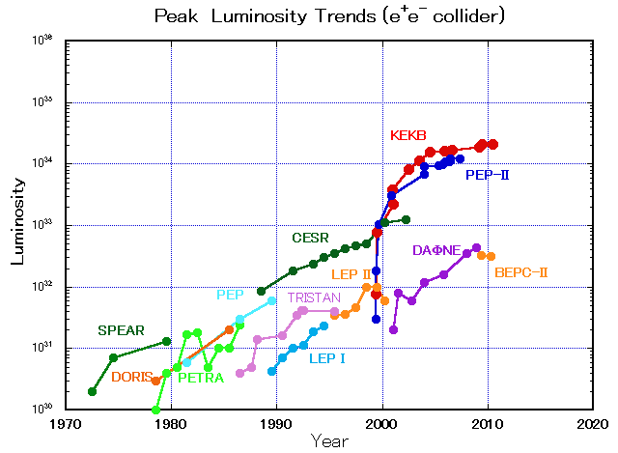
Perspective of STCF
SKEKB
STCF
BEPC-II
BEPC
2028
A luminosity 1×10³⁵ cm⁻²s⁻¹ at 4 GeV at 2028 is reasonable !!

Slide 10
Layout of Machine
Symmetric machine with dual-ring (600∼1000m)
IR : Large Piwinski Angle Collision + Crabbed Waist
Detector
Crab Sextupole
Injector
Wigglers
Snakes
Polarization (>80%)
Linac
0.5-3.5
GeV
Full energy linac, no boost
e+0.5GeV
e- 0.5GeV
Injector:
e+, a convertor, a linac and a damping ring, 0.5GeV
e-, a polarized e- source, accelerated to 0.5GeV

Slide 11
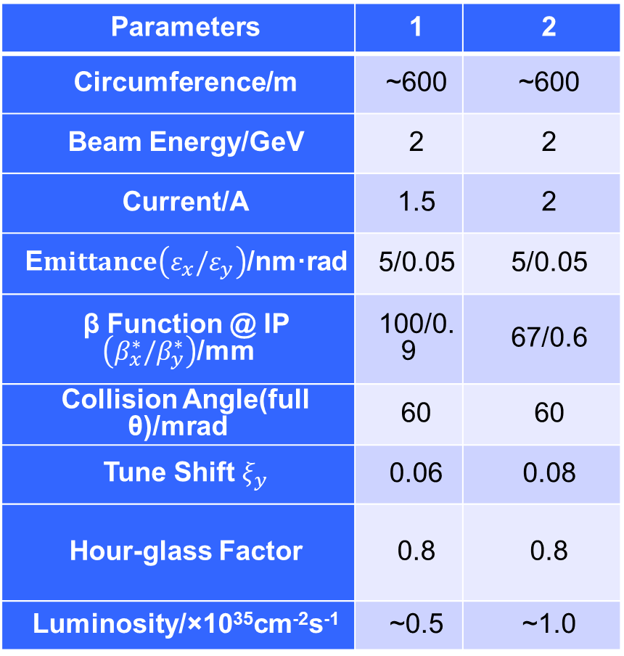
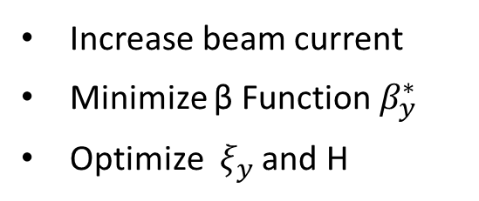
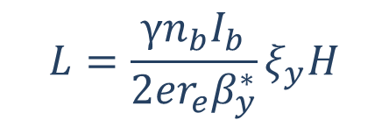
Parameters of the Machine
Parameters | 1 | 2
Circumference/m | ~600 | ~600
Beam Energy/GeV | 2 | 2
Current/A | 1.5 | 2
E$mittance\left(ε_{x}/ε_{y}\right)$/nm·rad | 5/0.05 | 5/0.05
β Function @ IP $\left({β_{x}^{∗}/β}_{y}^{∗}\right)$/mm | 100/0.9 | 67/0.6
Collision Angle(full θ)/mrad | 60 | 60
Tune Shift $ξ_{y}$ | 0.06 | 0.08
Hour-glass Factor | 0.8 | 0.8
Luminosity/×10³⁵cm⁻²s⁻¹ | ~0.5 | ~1.0
Luminosity :
$$L=\frac{γn_{b}I_{b}}{2er_{e}β_{y}^{∗}}ξ_{y}H$$
Increase beam current
Minimize β Function $β_{y}^{∗}$
Optimize $ξ_{y}$ and H
Strategy :
(Phase 0) Pilot: 0.5×10³⁵
(Phase I) Nominal: 1.0×10³⁵
(Phase II) Polarized beam
…..

Slide 12
General Consideration of Detector
Much larger radiation tolerance, especially at IP and forward regions
The detector and electronics should withstand the expected does
Efficient event triggering, exclusive state reconstruction and tagging
high efficiency and resolutions for charged and neutral particles
Fast response, low noise and high rate capability
The Systematic uncertainty control
Detector acceptance : geometrical acceptance or detector response
Mis-Measurement : mis-tracking, fake photon, particle mis-id, noise
Luminosity measurement
Reasonable cost

Slide 13
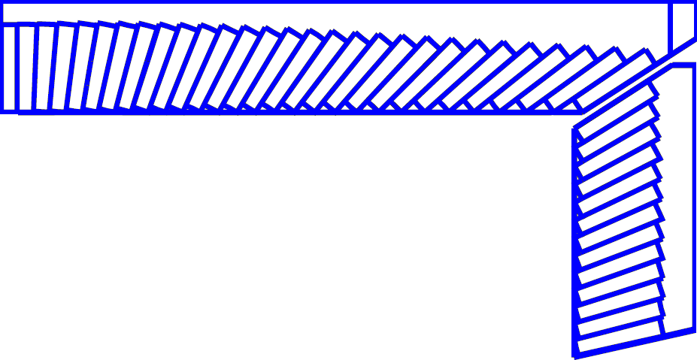
Detector Layout
245 cm
MUD
μ/π suppression power >10/30
York/Muon
185 cm
EMC
Energy range: 0.02-2.5 GeV
At 1 GeV σ_{E} (%)
EnBarrel(Cs(I): 2
dcap (Cs): 4
Superconducting magnet
(0.7-1 T)
York/Muon
135 cm
EMC
105 cm
PID
π/K (and K/p) 3-4σ separation up to 2GeV/c
PID-barrel
85 cm
20°
PID-endcap
MDC (Low mass )
σ_{xy}=130 mm
dE/dx<7%, σ_{p}/p =0.5% at 1 GeV
MDC
15 cm
PXD/SSD
PXD
Material budget ~0.15%X₀/layer
σ_{xy}=50 mm
10 cm
3~6 cm
IP
120 cm
140 cm
190 cm
240 cm
300 cm
Notes:
We also have very preliminary conception design for the Detector, a very BESIII like symetry
Detectors is proposed.

Slide 14
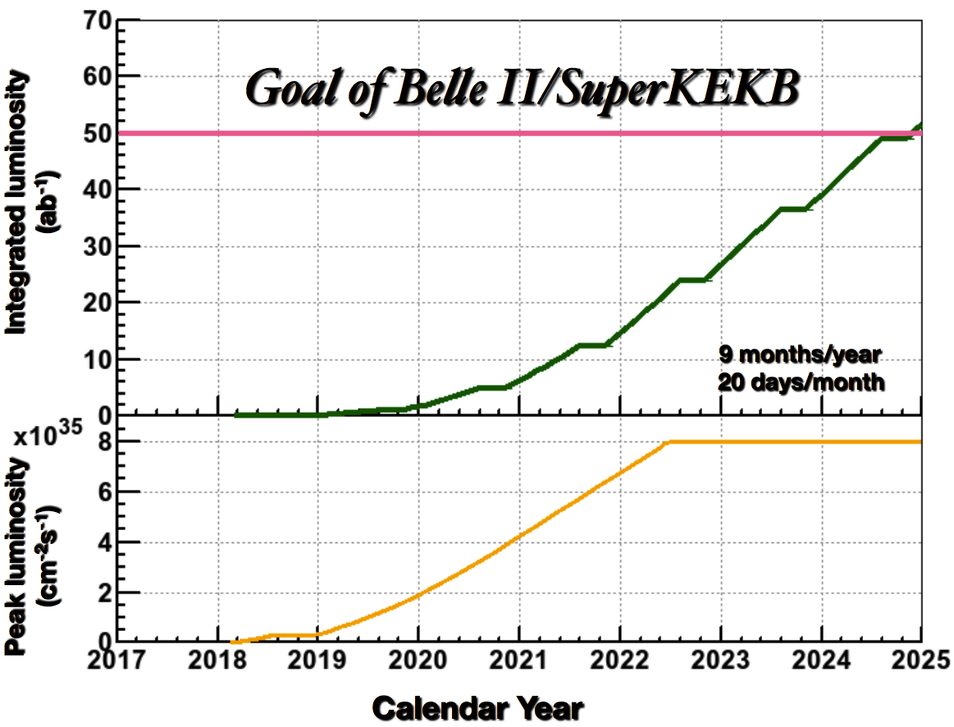
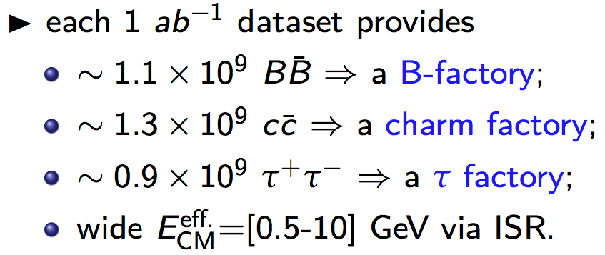
Integral Luminosity of STCF
No Synchrotron radiation mode, assume running time 9 months/year
Assume data taking efficiency 90%
10³⁵cm⁻²s⁻¹ × 86400s × 270days × 90% ∼ 2.0ab⁻¹ /year
10 years data taking, total 20 ab⁻¹ conservatively
Excellent opportunities for the τ-charm physics
BELLE-II
Native question : Compete between STCF and BELLE-II ?
Notes:
With assumed 10^35 luminrocity, it is estimated to get the 1.4ab-1 data per year
Taking into account really running days and data taking efficiency.
It is expected to collected 10^9 D meson pair and Tau lepton pairs.
These data is about 1/3 of BELLE-II data/per year which is expected to run with luminosity at 10^36

Slide 15
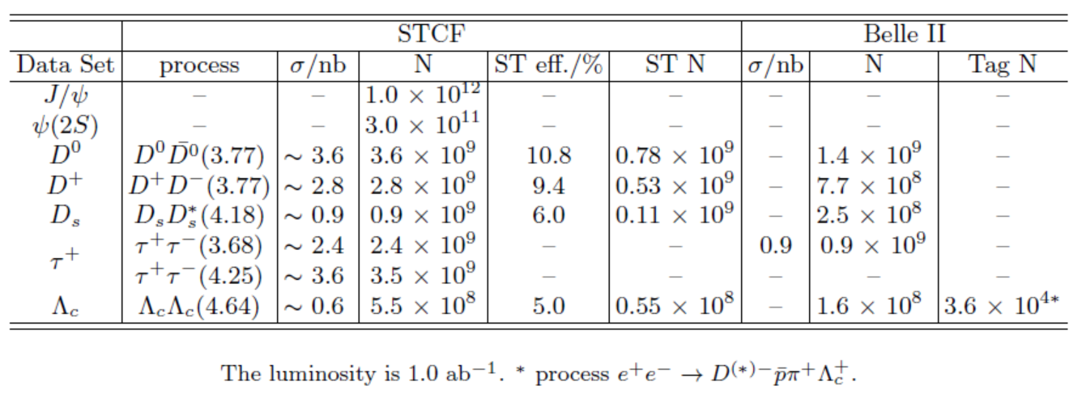
Data samples
Data samples with 1 ab⁻¹ integral luminosity
STCF have more yields /per luminosity
STCF is expected to have higher detection efficiency
Belle II can have larger integral luminosity
Detail simulations are ongoing to study the potential for the physics research.

Slide 16
Highlight Physics @ STCF
Rich of physics program, unique for physics with c quark and τ leptons,
important playground for study of QCD, exotic hadrons and search for new physics.
Charmonium-like (luminosity and CME)
Charmed meson (Luminosity)
Charmed baryon (CME)
Tau CP (polarized beam)
New physics (luminosity)
……..

Slide 17
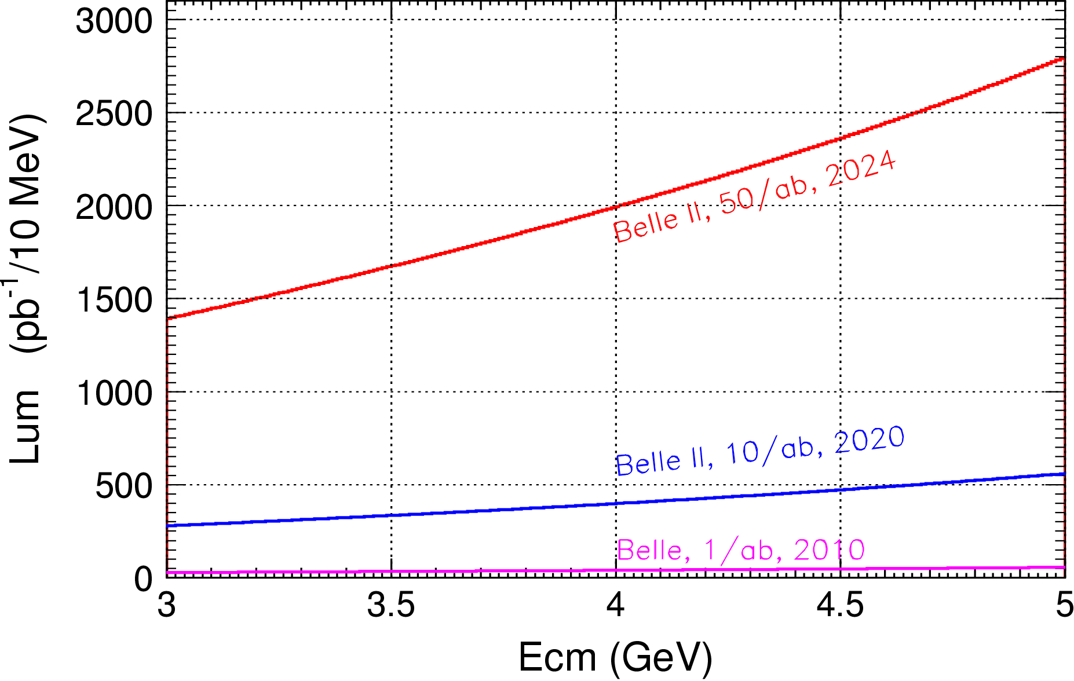

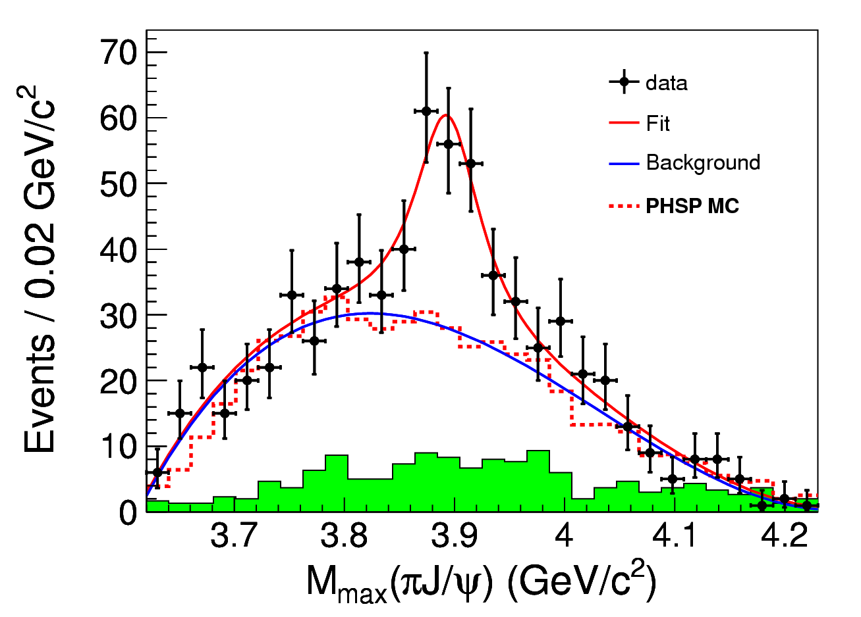
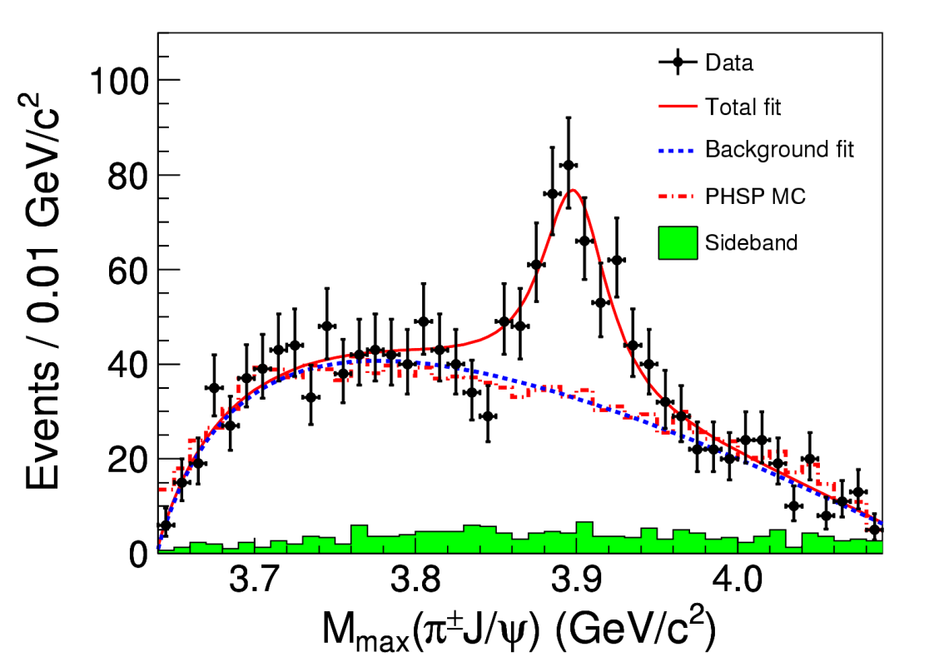

Charmonium-Like Physics
Fruitful results in past decade, a new territory to study exotic hadrons
τ-C Factory : e⁺e⁻→Y/ψ→Z_{c}+ X
B Factory : ISR, B decay
Belle with ISR: PRL110, 252002
967 fb⁻¹ in 10 years running time
@ 4.26 GeV for π⁺π⁻J/ψ
ε_{BESIII} = 46%, ε_{Belle} = 10%
>5.2σ
BESIII at 4.260 GeV: PRL110, 252001
0.525 fb⁻¹ in one month running time
B factory : Total integrate effective luminosity between 4-5 GeV is 0.23ab⁻¹ for 50 ab⁻¹ data
τ-C factory : scan in region 4-5 GeV, 10 MeV/step, every point have 20 fb⁻¹/year, 10 time of Belle II for 50 ab⁻¹ data
τ-C factory have much higher efficiency than B Factory
>8σ

Slide 18
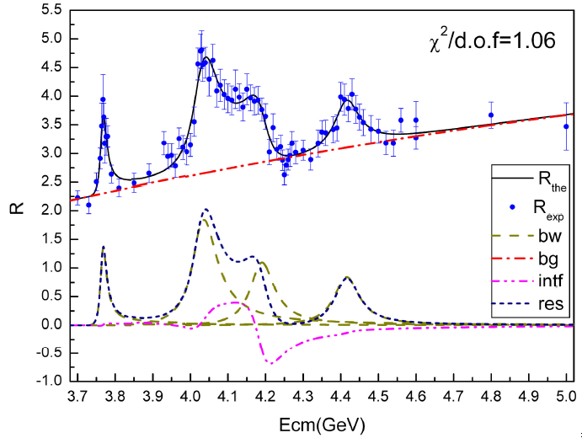
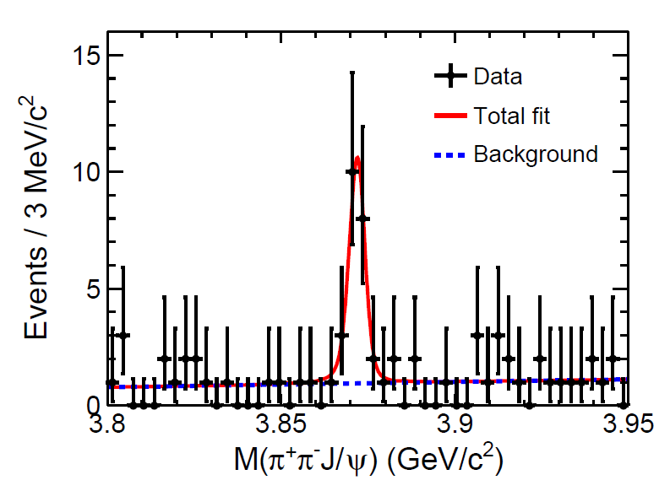
Charmonium-Like @ τ-c Factory
ψ/Y/Hybrid(ccg) (1⁻⁻) produced in the e⁺e⁻ collision
To determine the resonance parameters for the excited ψ or Y state
Precisely measure the x-sec of inclusive/exclusive final states at different Ecms
Charge parity c=+1 states produced via radiative transition from vector ψ/Y
The decay rate ψ(nS/nD)→γX(3872), X(3940)…
Search for χ_{cJ}(2P)、χ_{cJ}(3P)、η_{c}(3S)、 η_{c}(4S)、 …
  B(ψ(3S)→γχ’_{cJ}) = (7, 3, 1) x 10⁻⁴ for J=2,1,0
  [Rev. Mod. Phys. 80, 1161 (2008) ]
Search for new states from hadronic transition
To search for Zc, Zcs, hc(2P) ….
PLB 660, 315 (2008)
PRL 112, 092001 (2014)
σ(Y(4260) →γX(3872))∼6pb

Slide 19
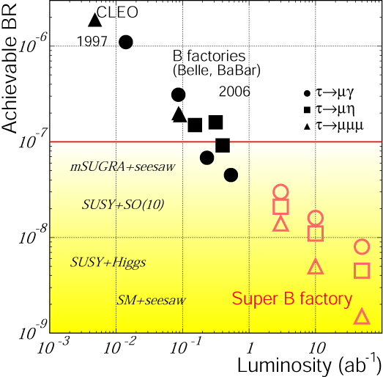
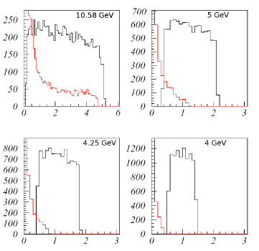
cLFV Decay τ→μγ @ B Factory
From A. Bondar, Charm2010
Current limit : ~ 4×10⁻⁸ (5×10⁸ τ-pairs)
BABAR : 516fb⁻¹ [PRL, 104, 021802]
BELLE : 545fb⁻¹
At (4S) :
ISR background e+e-→τ⁺τ⁻γ
Upper Limit ∝ 1/√L
Expected limit : 3x10⁻⁹@75ab⁻¹ (7×10¹⁰ τ-pairs)
Background e⁺e⁻→τ⁺τ⁻γ
Super-B 75 ab⁻¹
7×10¹⁰ τ-pairs
Does not contribute below √s ≈ 4m_{τ}/√3 ≈ 4.1 GeV.
Notes:
Tua->gamma mu have been detail studying for many years in B facotry.
This plot show the update limint as function of luminosity for the different experiment.
The current update limit is about 4x10-8 from both BABAR and BELLE,
It is clear see that the upper limit is proportional to 1/sqrt(L)
The strudy from Supper B show the expected UL is 3x10-9 with 75ab-1 data.
At HIEPA, we expected to collected 3x109 tau pair per year
It is interesting to know what the expected UL can be acieved in hiepa.

Slide 20
Expected τ→μγ Br upper limit
Dominant background
E(GeV) | σ(nb) | L(ab⁻¹) | N_{ττ}(10¹⁰)
3.686 | 5.0 | 1.5 | 0.75
3.77 | 2.9 | 3.5 | 1.03
4.17 | 3.6 | 2.0 | 0.71
Total |  | 7.0 | 2.49
τ decays, direct (τ⁺→π⁺π⁰ν_{τ}) and combinatorial
QED processes: e⁺e⁻ → μ⁺μ⁻γγ, e⁺e⁻ → e⁺e⁻ μ⁺μ⁻γ
Continuum hadron production e⁺e⁻ → qq
ψ(2S) and D-meson decays
 | σ_{E}/E=1.5% | σ_{E}/E=2.5%
Signal (Br=10⁻⁹) | 17 | 15
Muon background | 7 | 11
Pion background | 83 | 271
Expected 90% CL upper limit for Br | 1.1×10⁻⁹ | 3.0×10⁻⁹
Expected 90% CL upper limit for Br with pion suppression by a factor of 30 | 3.3×10⁻¹⁰ | 5.1×10⁻¹⁰
Supper-B Expected limit : 3x10⁻⁹@75ab⁻¹ (7×10¹⁰ τ-pairs)
Notes:
The study from Vlaimir show with 7ab-1 data, super tau-charm can get
The comparable or better upple limit than that of Supper-B expections.
We are prosssing the correspond fast simulation for NP sensitivity and to
Optimization the detector perfromance.

Slide 21
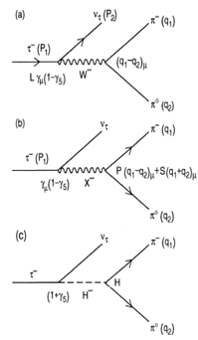


CP Violation in τ Decay
CP violation is observed in B, D and K sectors to date，but not observed in lepton sector yet.
The discovery of CPV in the tau sector would be a clean signature of NP
One of the most promising CPV channels is τ⁻→K_{S}π⁻ν
SM CP asymmetry from K_{S}-K_{L} mixing is expected to be : [Bigi & Sanda, PLB 625, 2005, Grossman &Nir JHEP 1204 (2012) 002]
BaBar measurement [PRD 85, 031102]
Belle measurement [PRL 107, 131801]
Charge Higgs, new Scalar,
W_{L}-W_{R} Mixings, LeptonQuarks?
A_{cp} = (1.8±2.1± 1.4) ×10^{-3 @} W ∼ [0.89-1.11] GeV
Notes:
Now, we move to the CPV in tau decay.
To day, CP violation is observed in B,D and Ksystem
But no ovserved in the lepton sector,
The discovery of CPV in tau decay is a clean signture of NP.
The most promising CPV channels is tau-Ks pi v,
The SM predicted the CVP at 10-3 level duo to the Ks-Kl mixing,
But Belle and Babar did not observed any evindence for it CPV

Slide 22

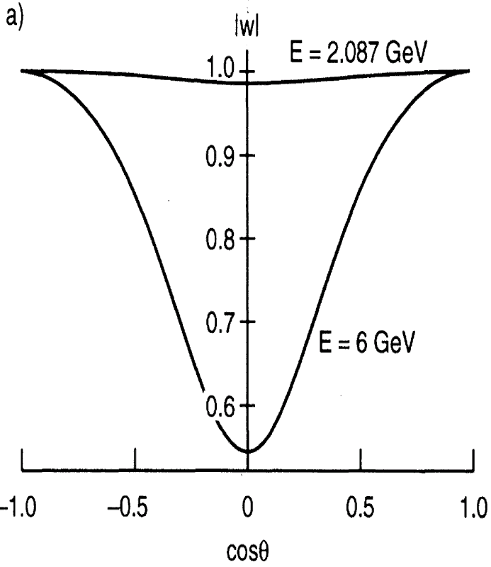

τ CPV in Angle Distribution
Measurement on the angular CPV asymmetry is desirable
Use T-odd rotationally invariant products in >=2 hadrons, such as τ⁻→π⁻π⁰ν_{τ} /k⁻π⁰ν_{τ} , τ⁻→π⁻π⁺π⁻ν_{τ} /K⁻π⁺π⁻ν_{τ} :
Polarized of τ and beam are necessary
Figure of Merits
tau-charm
Y. S. TSAI, PRD 51 (1995) 3172
B factory
BESIII @ 4.25 (10³³cm⁻²s⁻¹) FOM=1
STCF @ 4.25 (10³⁵cm⁻²s⁻¹) FOM=100
SuperKEKB @ (8x10³⁵cm⁻²s⁻¹ ) FOM=52
Notes:
So we need a new measurement on the angular CPV asymmerty.
Like use T-od ratationally invariant products.
The kind of analysis can be performed in the tau decay into final state with more than 2 hadron.
But the polarized beam is necessary.
As we know, the polarization of electron beam can be transver to the produce
Tau,
In tau-charm region, all the produce tau is expected to the 100% poralaztion
While in the super factor, the proporazation is expected to be about 50% with
Tau cos\thet is 0.
A important variable “Figure Of Merits” proposed by the Y.S TSAI which take
into accouting luminorcist, polarization and total cross section,
to quantitative evaluate the feature of different experiment on CPV study
And HIEPA is found to be with the best quilaty.
Evaluate the characters of

Slide 23
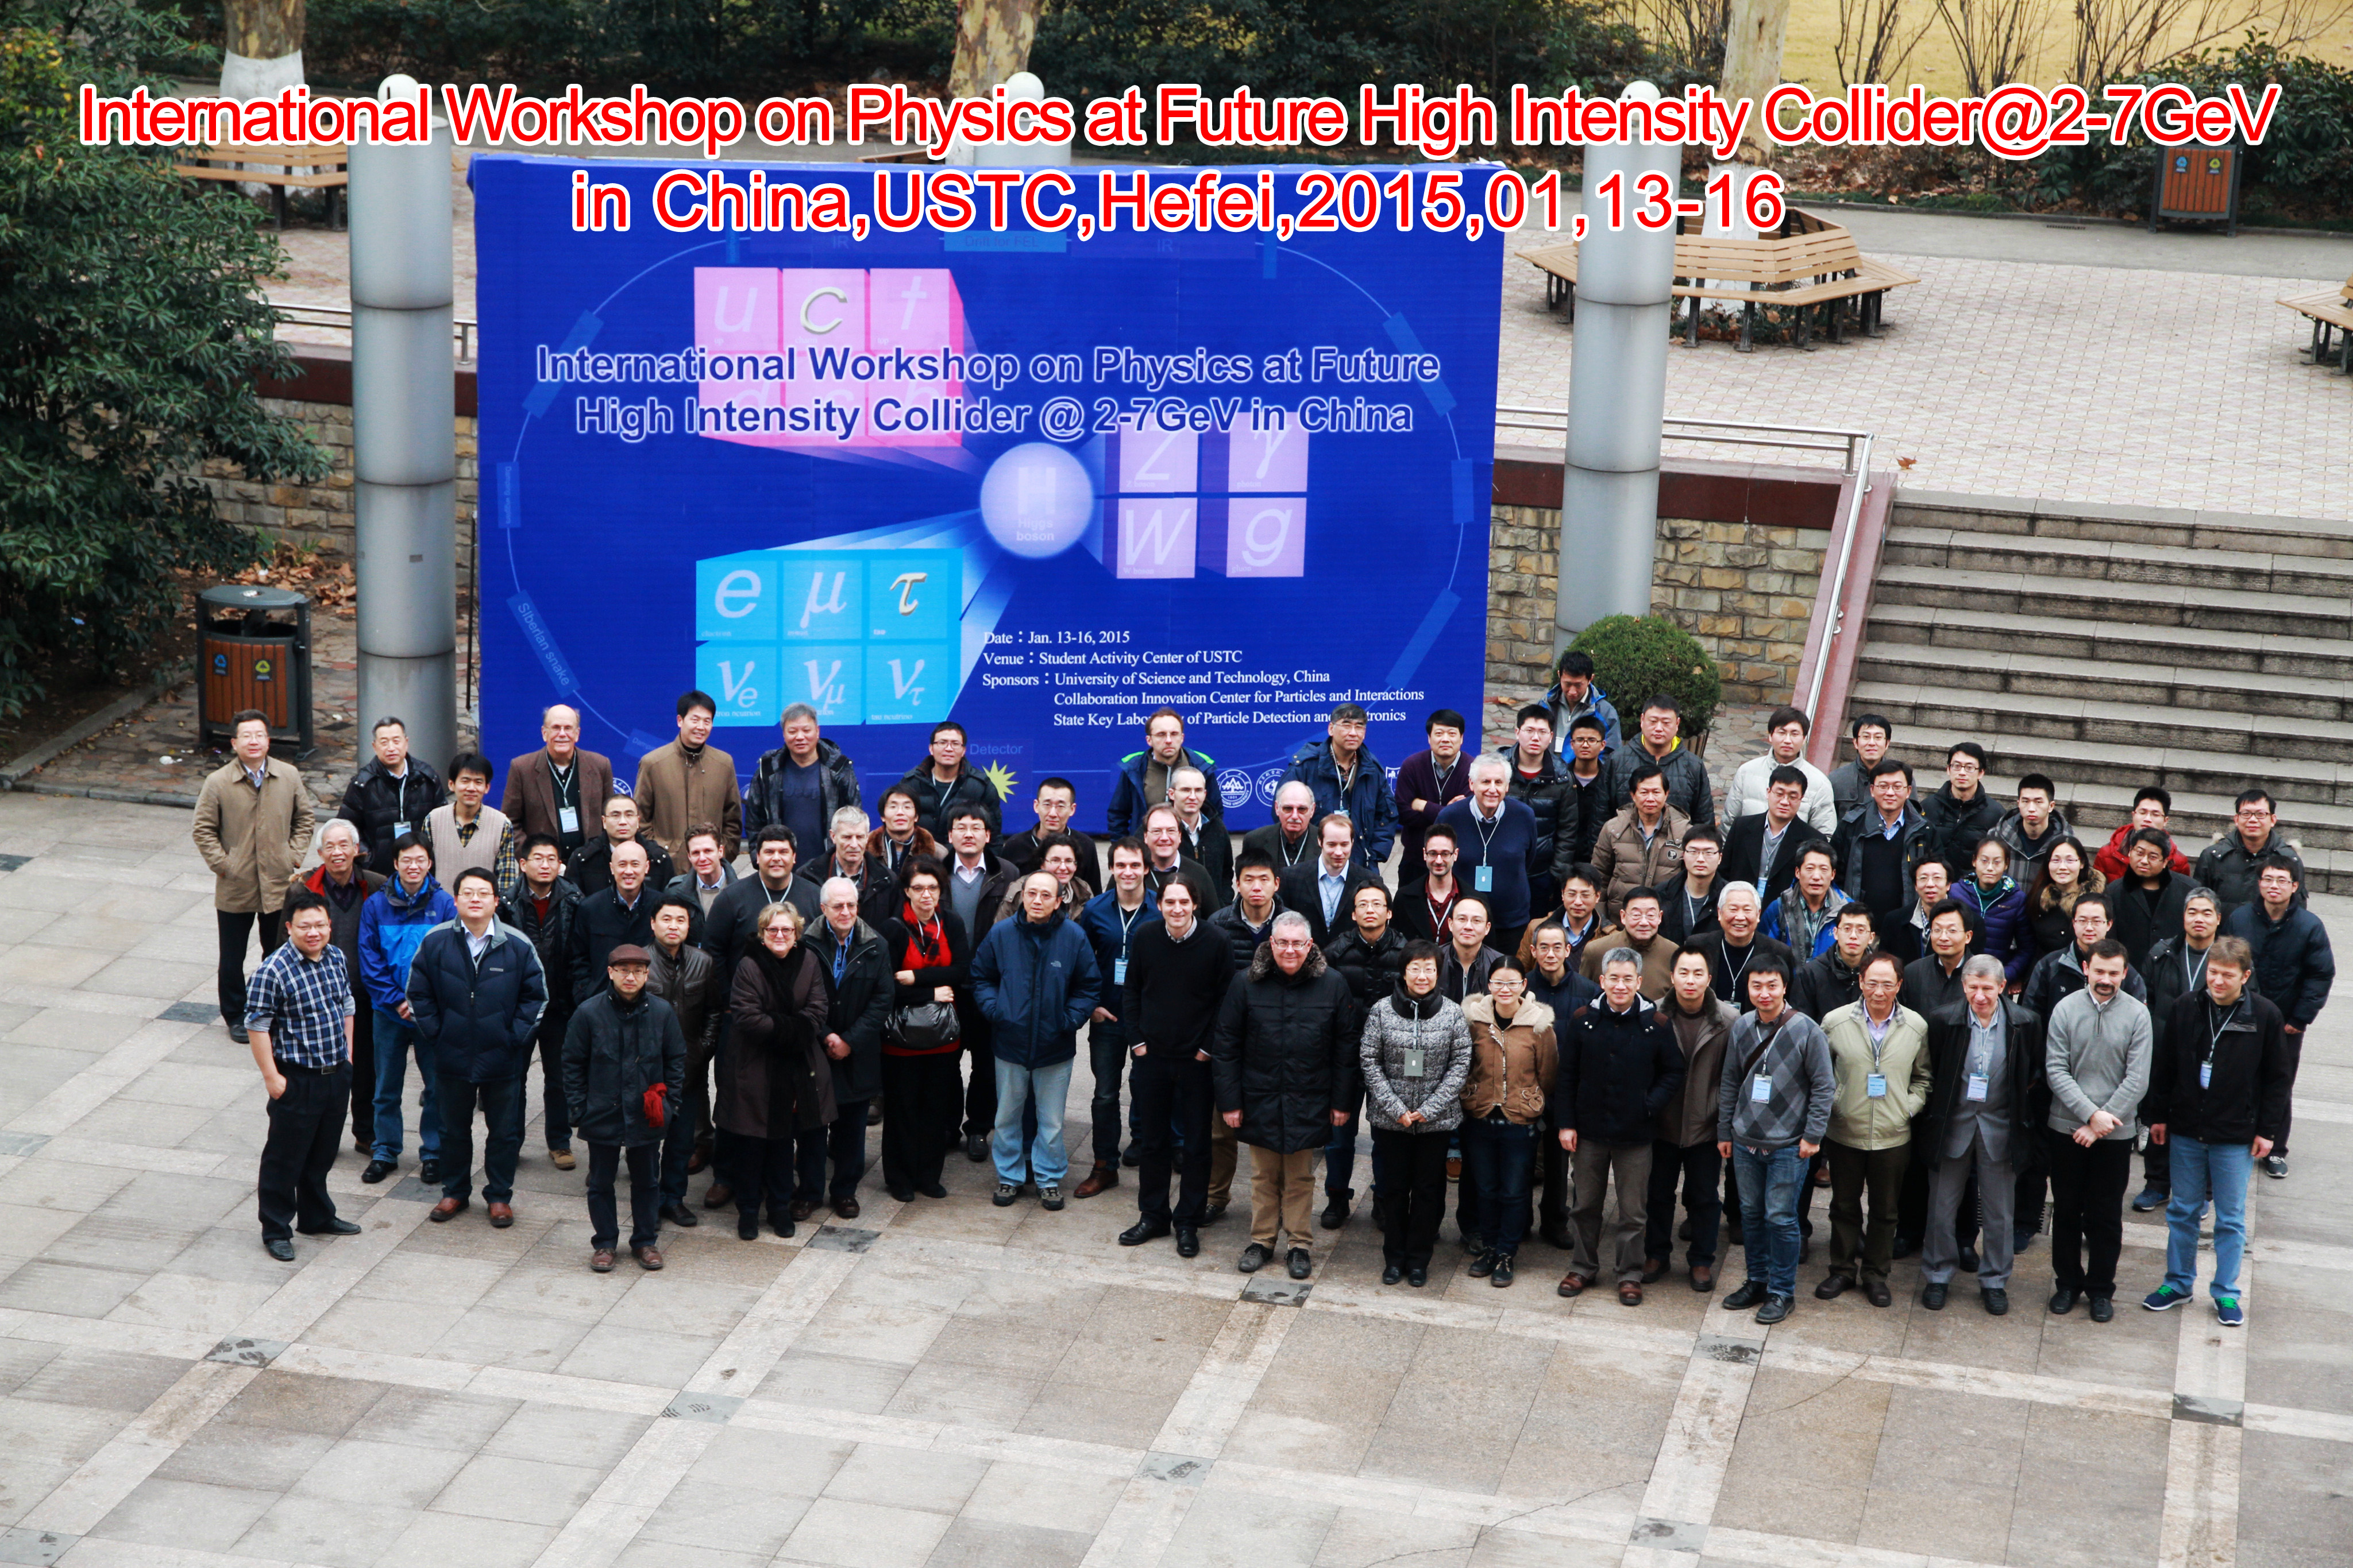
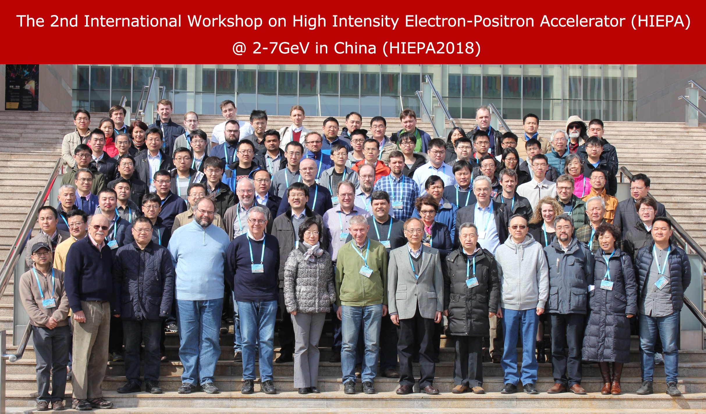
Science & Technology Review
Two international workshop : Hefei (2015), Beijing(2018)
More than 100 participants, more than 50% of them are from oversea
Presented project status, overview the physics potential and discuss the design and key technology of accelerator and detection

Slide 24

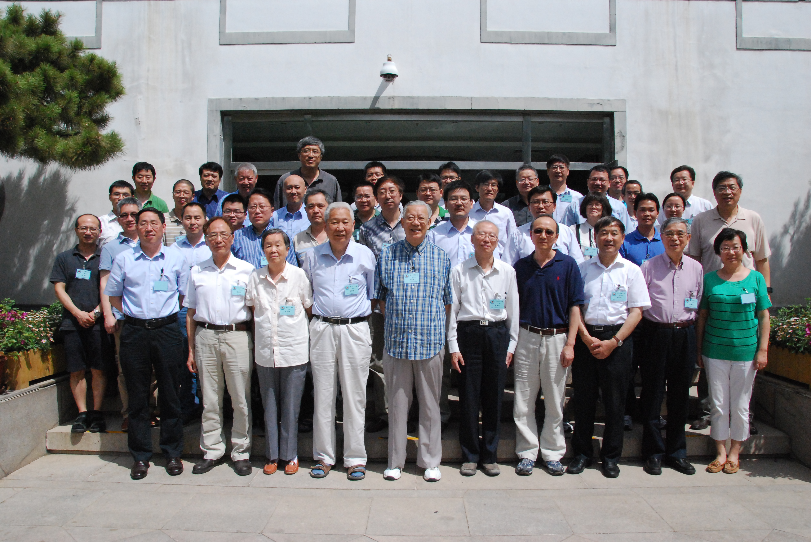
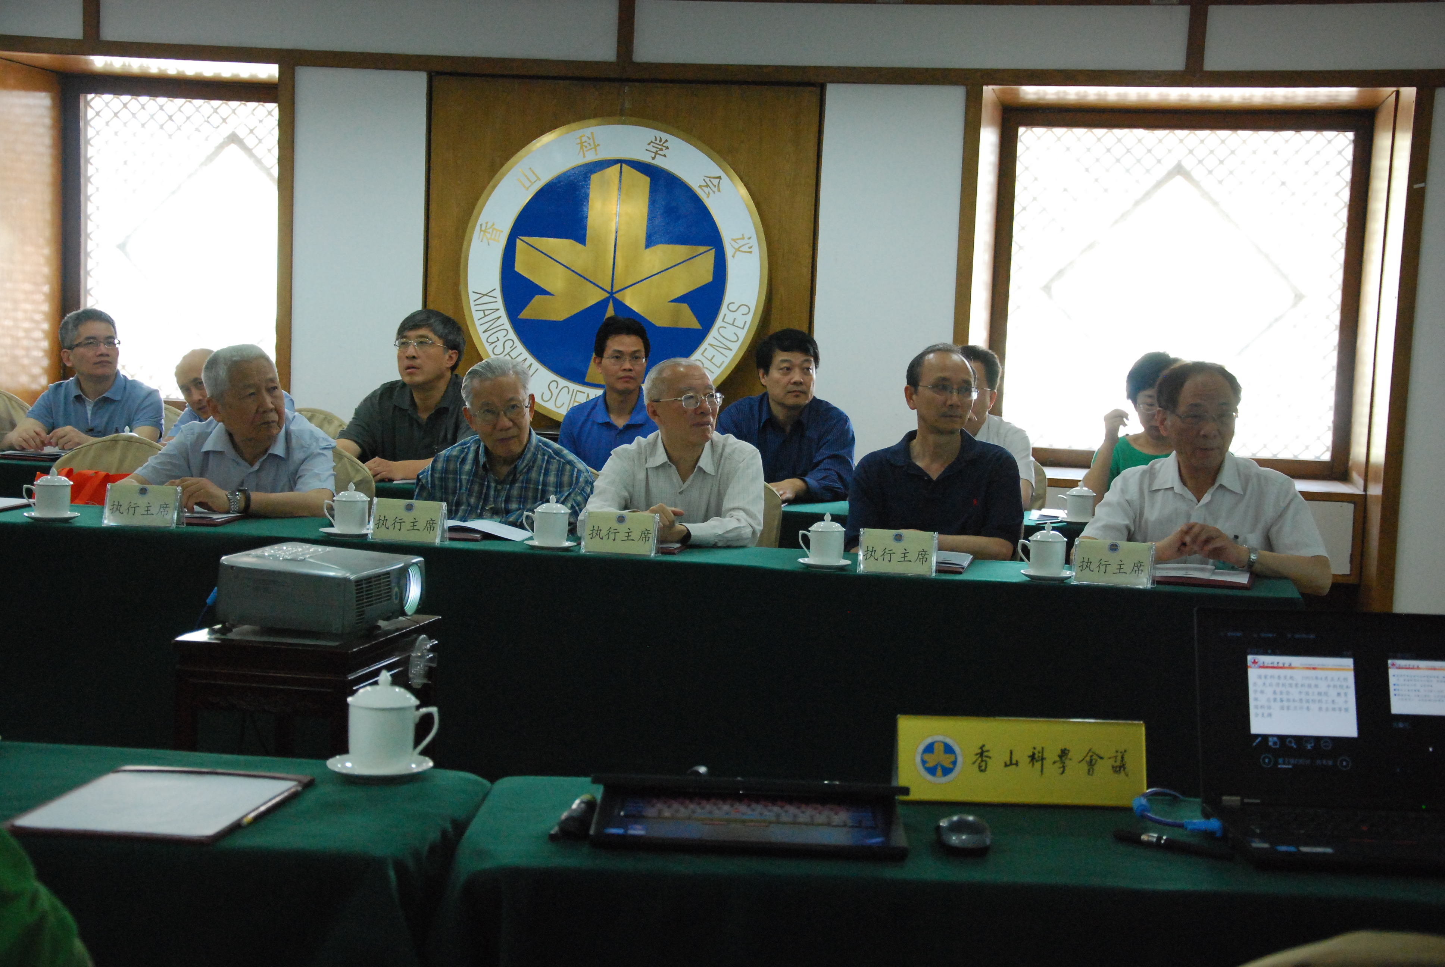
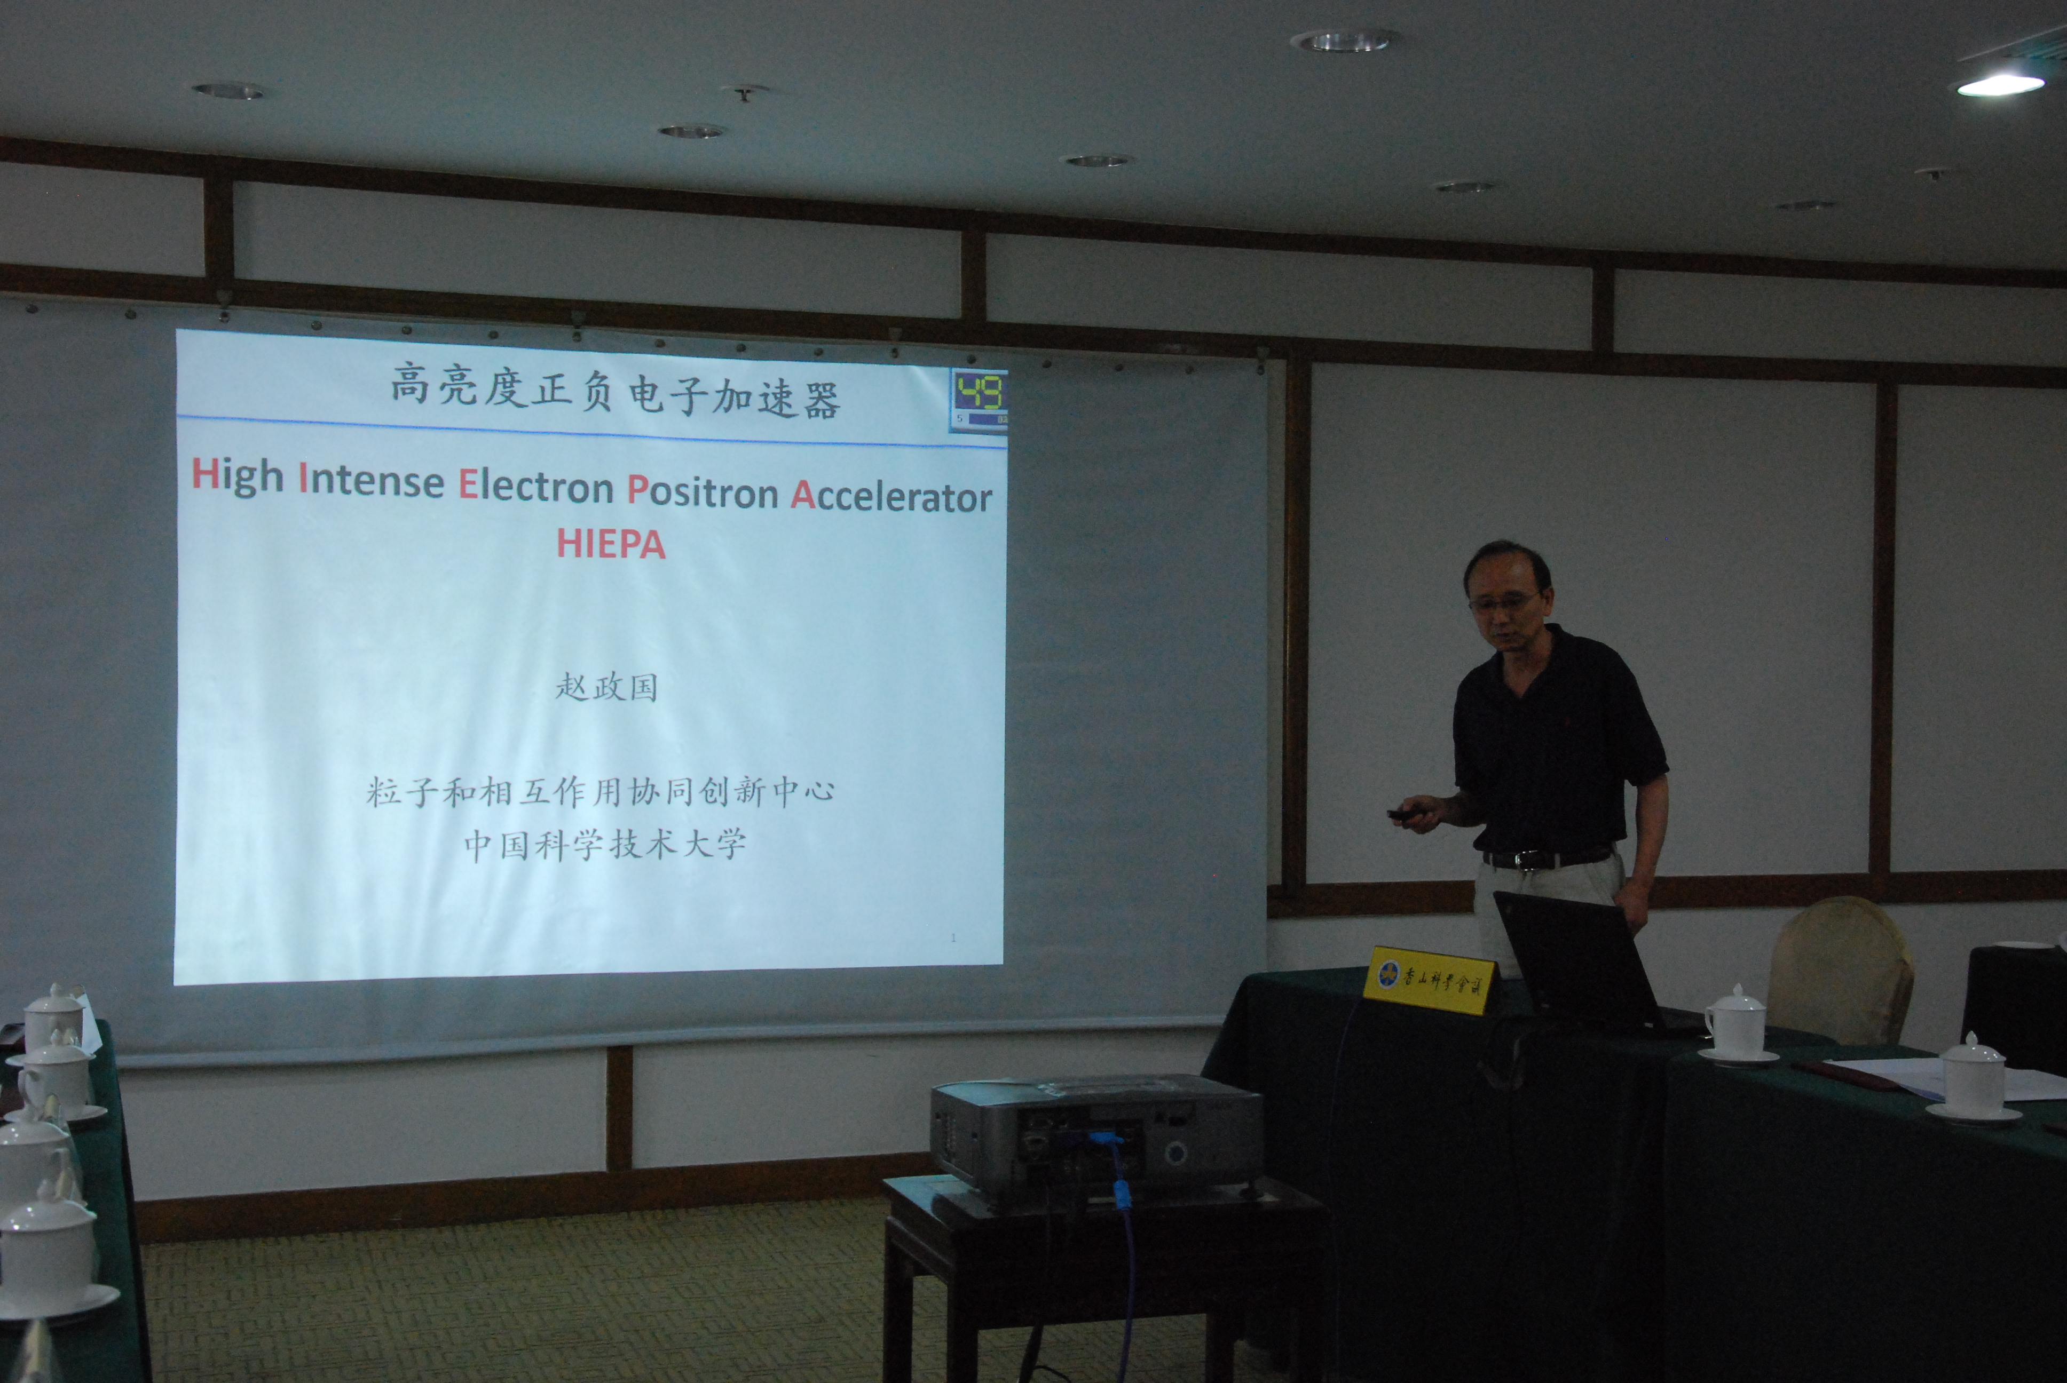
XIANGSHAN-Science Conference
XIANGSHAN science Conference, June, 2015, ∼40 scientists and officials joint,
Very important conference for Large Scale/Key Project in China

Slide 25
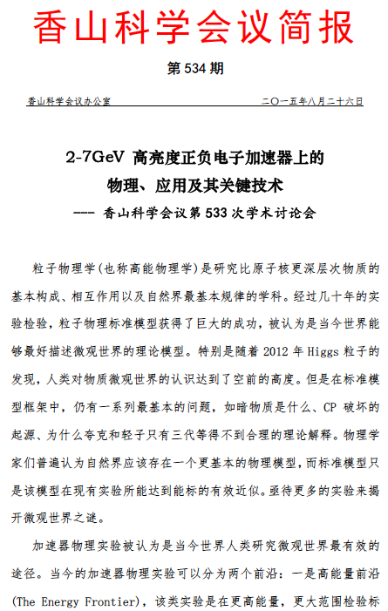
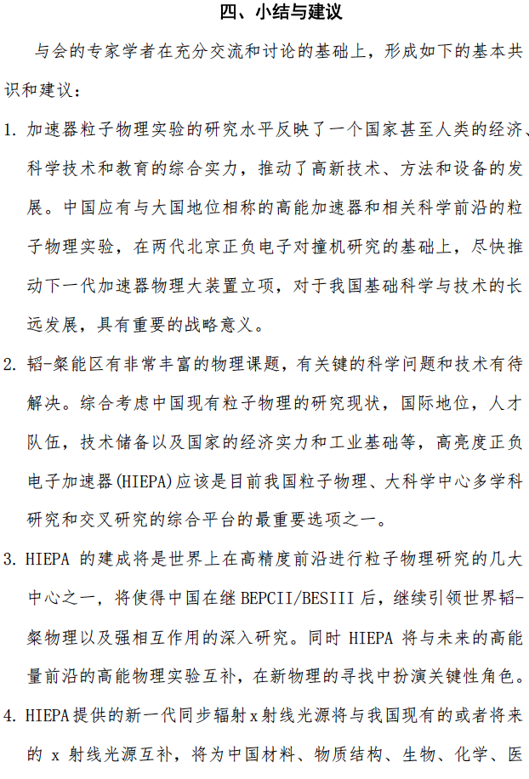
Brief report of XIANGSHAN science conference
The project is strategic significance for the long term development of China’s fundamental science and technology
Is one of the most important options for China’s particle physics filed, Integrated National science center, the platform of multi-disciplinary research
is one of the unique particle physics center on precision frontier in the world
25

Slide 26
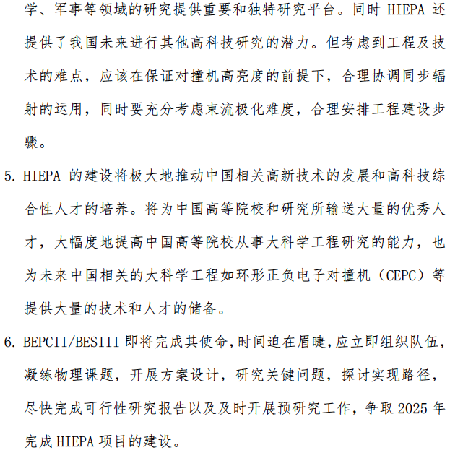
Greatly promoted the development of high and new technology and cultivating talents in China
Complete feasibility study and carry out the pre- R&D work as soon as possible
report have been delivered to the Ministry of Science and Technology, National natural Science Foundation, Academy of Science of China

Slide 27
Activities
CDR → TDR → project application → construction → commissioning
Webpage: http://wcm.ustc.edu.cn/pub/CICPI2011/futureplans/
Domestic Workshops (2011, 12, 13, 14, 16)
International Workshops (2015, 18)
Report to USTC Scientific Committee and USTC presidents
Report to Hefei High-tech Development Zone
Report to Anhui Development Planning Commission
Report to CAS Condition and Finance Bureau
Report to USTC new president (2018/01)
Form the Organization for the project

Slide 28
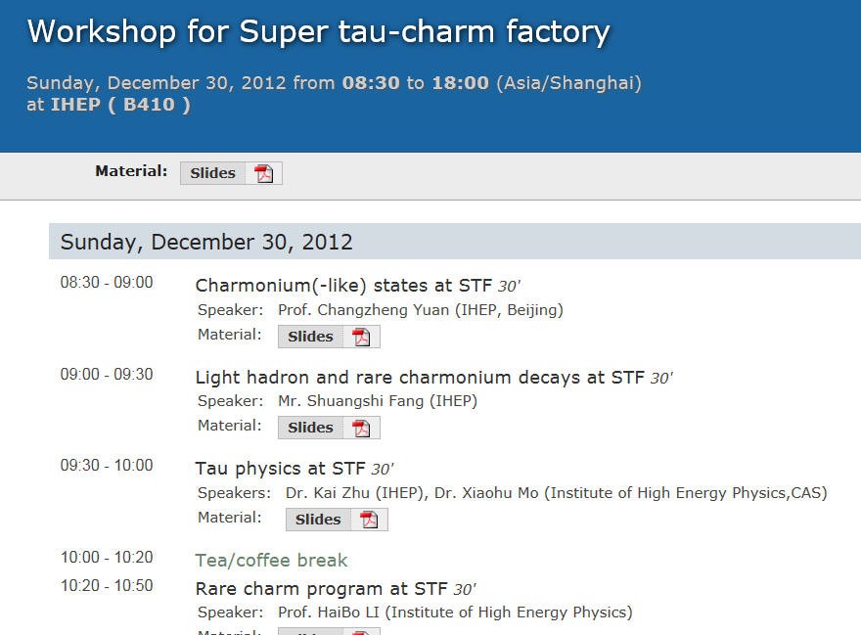
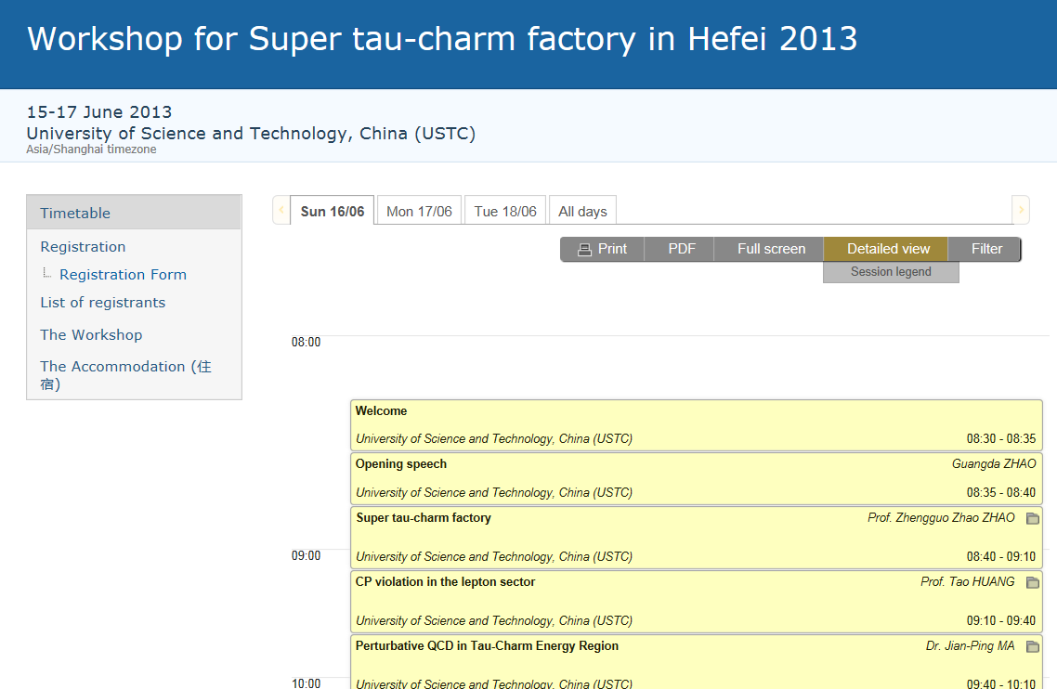
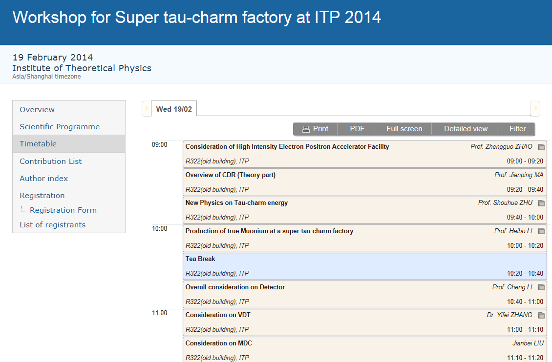
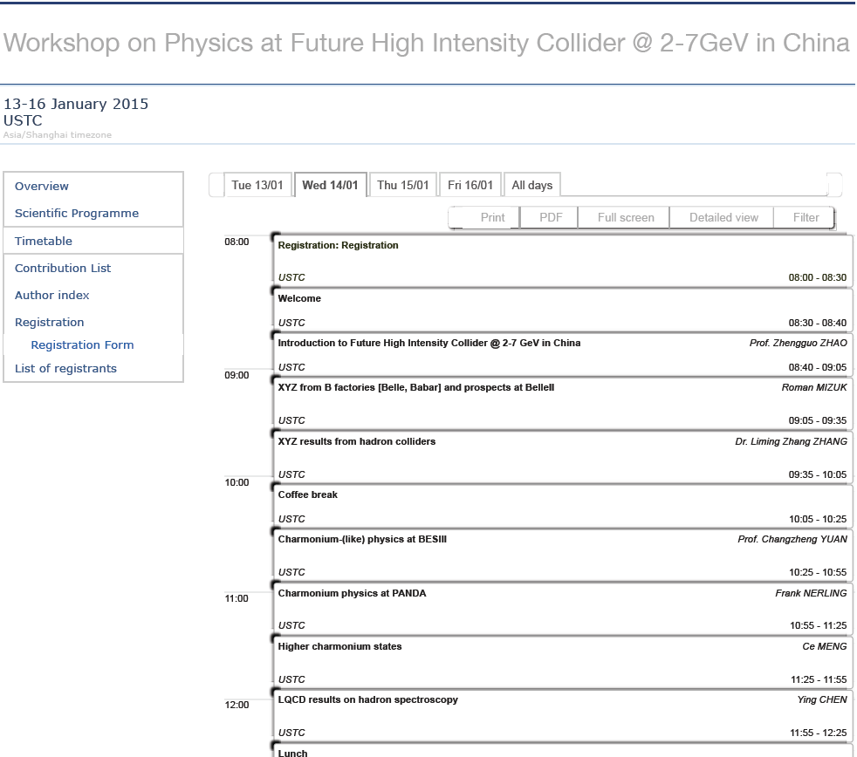
Activities
Notes:
build a small working group,
Have domestic workshops every year,
Have a international workshop at Jan. 2015.

Slide 29
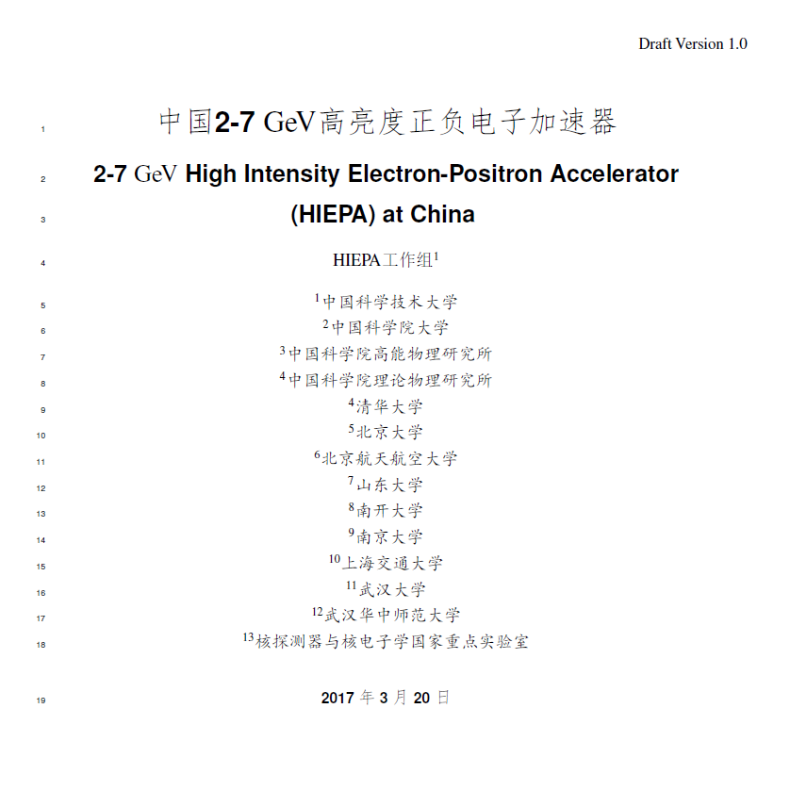
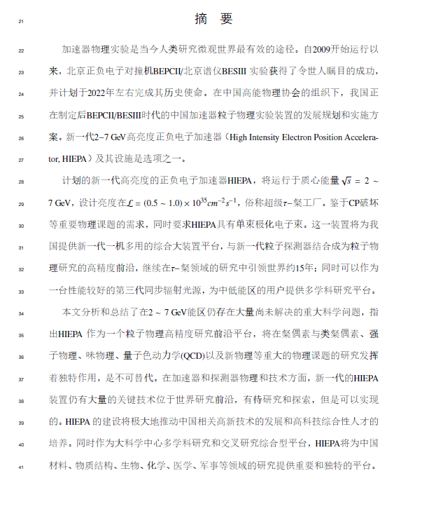
Pre-Conceptual Design Report

Slide 30
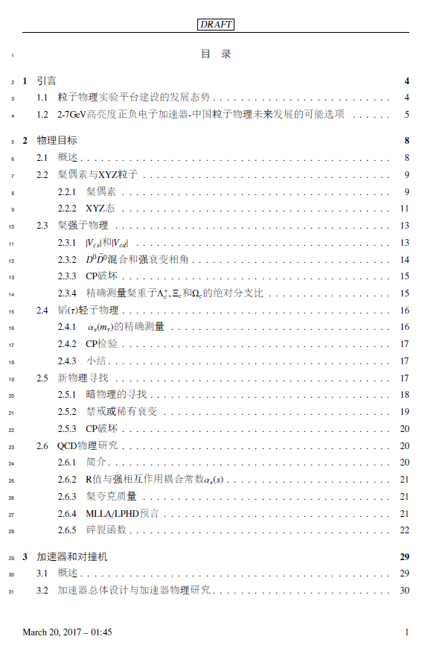
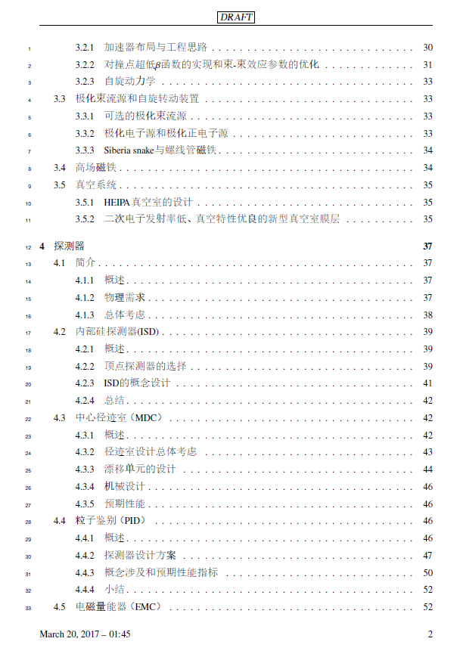
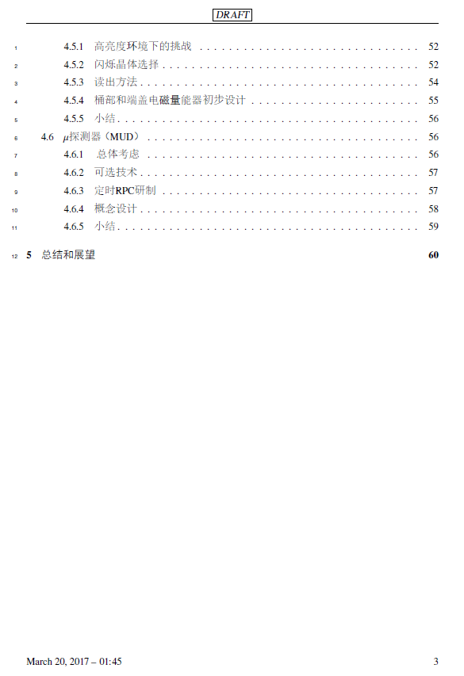
Pre-Conceptual Design Report

Slide 31
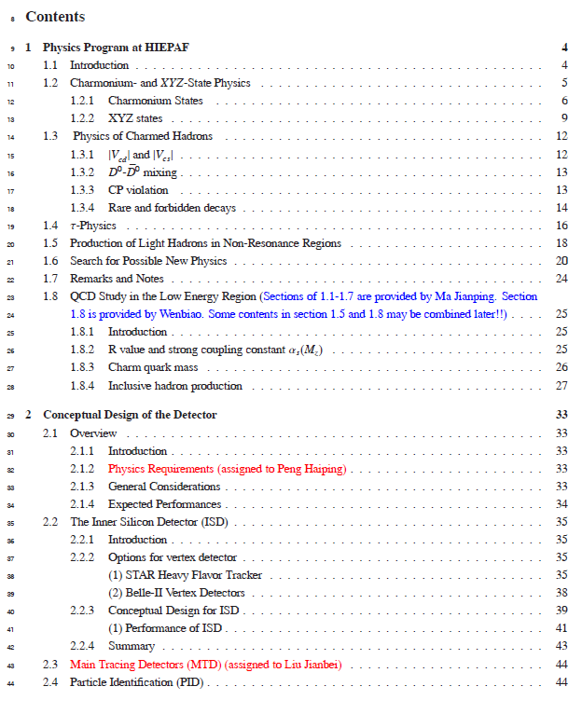
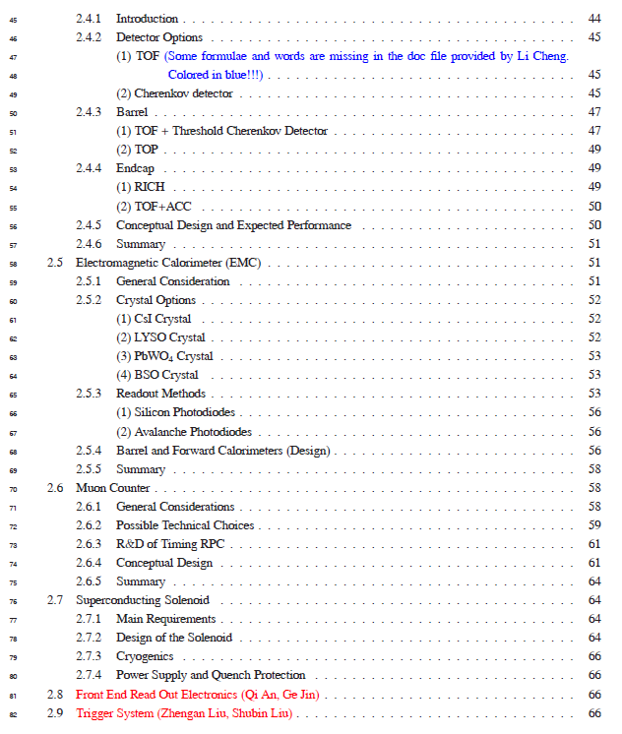
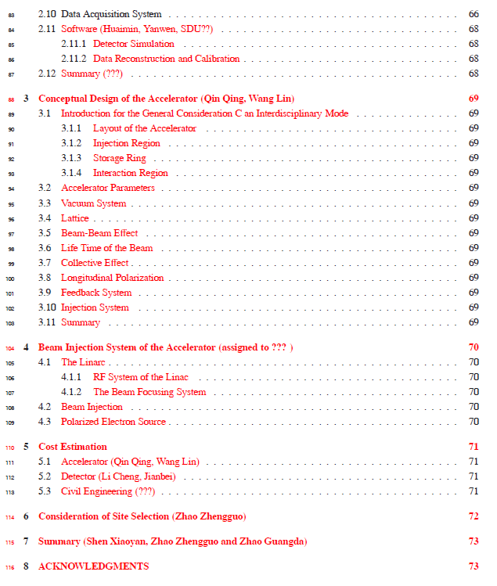
Pre-Conceptual Design Report

Slide 32
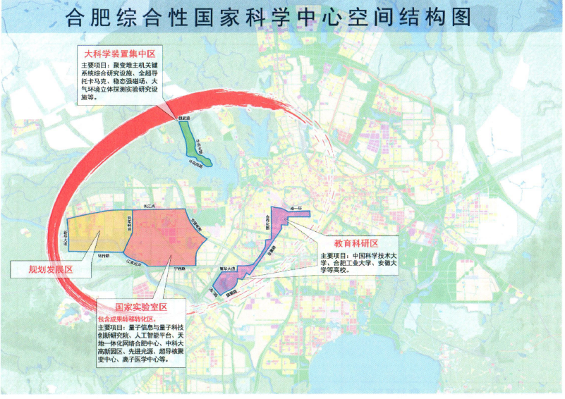
Candidate site : Hefei, Anhui province
One of three integrated national science centers, which will play important role in ‘Megascience’ of China in near future
Hefei Integrated National Science Center
University of Science and Technology of China (USTC)
National Synchrotron Radiation Lab and Hefei Light Source, operated by USTC
The only National Lab operated by University in China. (Totally Four officially approved National Labs in China)
Pay a lot of attention on accelerator facilities
Hefei Advanced light source is under design
STCF is listed in future plan

Slide 33
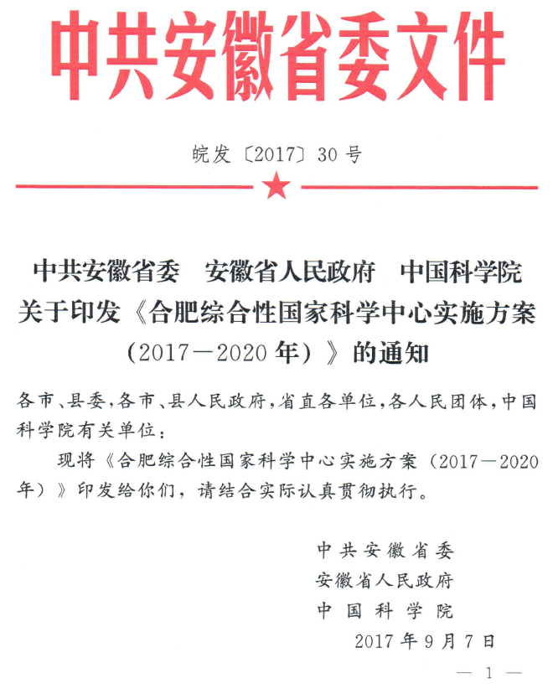
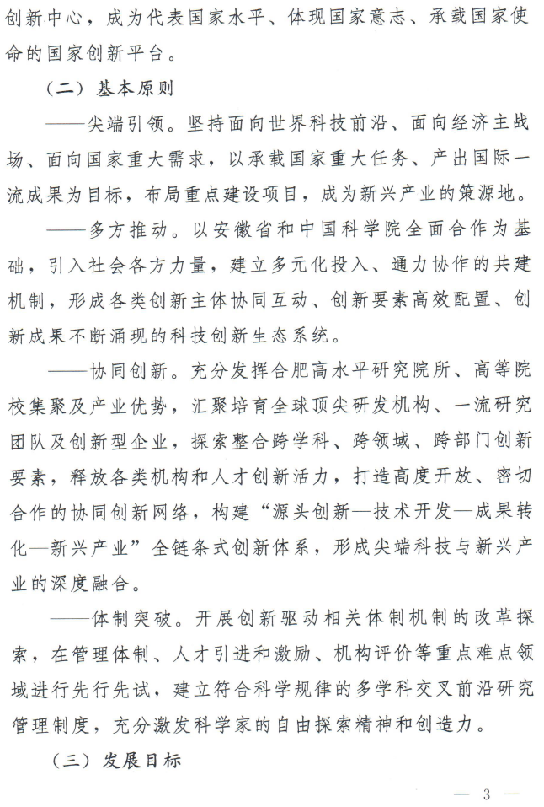

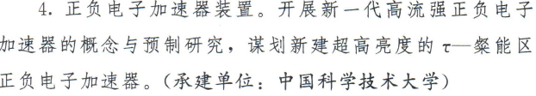
Listed in the future project of Anhui government
4. High Intensity Electron Positron Accelerator (HIEPA) R&D --- undertaken by USTC

Slide 34

USTC Scientific Committee Review
USTC president agreed, and scientific committee
endorsed supporting R&D → 10 M RMB for this year

Slide 35

International Collaboration
SCT at Novosibirsk, RUSSIA
Budker Institute of Nuclear Physics
Long history…..
Pre-Agreement of Joint effort on R&D, details are under negotiation
Joint workshop between China, Russia, and Europe
2018 UCAS (March), Novosibirsk (May), Orsay (December)
2019 …..

Slide 36
Institutions shown Interest
University of Science and Technology of China
Institute of High Energy Physics, CAS
Institute of Theoretical Physics, CAS
Tsinghua University
University of Chinese Academy of Sciences
Shangdong University
Shanghai Jiaotong University
Peking University
Zhejiang University
Nanjing University
Nankai University
Wuhan University
Central China Normal University Lanzhou University
Nanhua University
Beijing University of Aeronautics and Astronautics
…….
Institute for Basic Science, Daejeon, Korea
Dubna, Russia
Budker Institute and Novosibirsk University, Russia
T. Shevchenko National University of Kyiv, Kyiv, Ukraine
University Ljubljana and Jozef Stefan Institute Ljubljana, Slovenia
Jozef Stefan Institute Ljubljana, Slovenia
Stanford University, USA
Wayne State University, USA
Carnegie Mellon University, USA
GSI Darmstadt and Goethe University Frankfurt,
Germany
Goethe University Frankfurt, Germany
GSI Darmstadt, Germany
Johannes Gutenberg University Mainz, Germany
Helmholtz Institute Mainz, Germany
LAL (IN2P3/CNRS and Paris-Sud University),
Orsay, France
Sezione di Ferrara, Italy
L'Istituto di Fisica Nucleare di Torino, Italy
L'Istituto di Fisica Nucleare di Firenze, Italy
Scuola Normale Superiore, Pisa, Italy
University of Silesia, Katowice, Poland
Laboratori Nazionali di Frascati, Italy
INFN, Padova, Italy
University of Pavia, Pavia, Italy
University of Parma, Italy

Slide 37
Organization
Institutional Board
Steering Committee
Chair:Zhengguo Zhao
International Advisory Committee (IAC)
Project Director
Haiping Peng，Yangheng Zheng
Theory &MC simulation
Accelerator
Detector
Light Hadron
Charmonium, XYZ
Charm decay,
charm Spectroscopy
Tau
R&QCQ
New Physics
…….
Design
RF
IP
Vacuum
Beam diagnose
Linear….
Tracking
PID
ECAL
Muon
SC
Trigger, DAQ
Software
Computing & Network

Slide 38

Tentative Plan & Estimated Budget
 | 2018 | 2019 | 2020 | 2021 | 2022 | 2023 | 2024 | 2025 | 2026 | 2027 | 2028 | 2029 | 2030- 2040 | 2041- 2042
Form International Collaboration
Conception Design Report (CDR)
Technical Design Report (TDR)
Construction
Commissioning
Upgrade
A unique precision frontier in the world for 30 years!
R&D budget: 200M RMB
Total budget: 4B RMB

Slide 39
Summary
Super τ-c Facility (STCF): nature extension and a viable option for a post-BEPCII HEP project
Symmetric, double ring with circumference around 600∼1000 m
e⁺e⁻ collision with E_{cm} = 2 – 7 GeV, L = 1 × 10³⁵ cm⁻²s⁻¹, polarization beam
STCF is one of the crucial precision frontier experiment
rich of physics program
unique for physics with c quark and τ leptons.
A critical project for China HEP, realistically, practically, reasonably.
A lot of activities recently :
Endorsed by USTC for R&D, initial funding 10M RMB for this year
More communication to CAS and Local government
Physics, accelerator, and detector groups are formed, progress are ongoing
An international collaboration is under preparing

Slide 40
Welcome to join the effort
Thank you!

Slide 41
Backup Slides

Slide 42
Accelerator Physics
Lattice Design:
  Ring and Interaction Region Lattice: β↓↓ 𝜉_{𝑦}↑
Non-linearity
  Focus↑↑ ☞ Dynamic Aperture ↓ etc.
Collective Effect
  Current↑ Bunch Size↓↓ ☞ Beam Instability↑ ↑ ↑

Slide 43
Key Technologies
Polarization
  Spin Polarized Electron Source
  Polarization Rotation and Maintenance for Rings and Final Focus
RF
  Superconducting Cavities, Deflecting Cavities, Higher Harmonic Cavities, etc.
Magnets
  High Quality Magnets with high strength, Superconducting Magnets and Solenoids
Diagnostics and Control
  Low Emittance Measurement, Transverse and Longitudinal Feedback, etc.

Slide 44
Collaboration Needed
Accelerator Physics
  IR Design
  Polarization: Spin Rotation and Maintenance
  Collective Effects: Simulation and Bench Measurements
  Advanced Computational Accelerator Physics
Accelerator Technologies
  Superconducting Cavities and Magnets
  Polarized Beam Sources
  Ultrahigh Vacuum Chamber with Small Aperture, Optimized Impedance and Low SEE

