Slide 1
Hadrons:
What Lurks Within
Craig Roberts

Slide 2
Collaborators: 2015-Present
Students, Postdocs, Profs.
Daniele Binosi (ECT*)
Stan Brodsky (SLAC);
Volker Burkert (Jlab)
Lei Chang (Nankai U. ) ;
Xiao-Yun Chen (Jinling Inst. Tech., Nanjing)
Bruno El-Bennich (São Paulo);
Tanja Horn (Catholic U. America)
Yu-Xin Liu (PKU);
Joannis Papavassiliou (U.Valencia)
M. Ali Paracha (NUST, Islamabad)
Jia-Lun Ping (Nanjing Normal U.)
Si-xue QIN (Chongqing U.);
Jose Rodriguez Quintero (U. Huelva) ;
Sebastian Schmidt (IAS-FZJ & JARA);
Peter Tandy (KSU);
Shaolong Wan (USTC) ;
Qing-Wu Wang (SICHUAN U)
Pei-Lin Yin (NJUPT)
Hong-Shi Zong (Nanjing U)
Ya LU (Nanjing U.)
Zhao-Qian YAO (Nanjing U.)
Yin-Zhen XU (Nanjing U.)
Chen CHEN (UNESP - São Paulo, USTC & IIT);
Muyang CHEN (NKU, PKU)
Zhu-Fang CUI (Nanjing U.) ;
J. Javier COBOS-MARTINEZ (U Michoácan);
Minghui DING (ANL, Nankai U.) ;
Fei GAO (Valencia, Peking U.) ;
L. Xiomara GUTIÉRREZ-GUERRERO (MCTP)
Bo-Lin LI (Nanjing U.)
Cédric MEZRAG (INFN-Roma) ;
Khépani RAYA (U. Huelva, U Michoácan);
Eduardo ROJAS (Antioquia U.)
Jorge SEGOVIA (IFAE&BIST, Barcelona);
Chao SHI (ANL, Nanjing U.)
Shu-Sheng XU (Nanjing U.)
Adnan Bashir (U Michoácan);

Slide 3
Collaborators: 2015-Present
Students, Postdocs, Profs.
China based/trained 57%
Daniele Binosi (ECT*)
Stan Brodsky (SLAC);
Volker Burkert (Jlab)
Lei Chang (Nankai U. ) ;
Xiao-Yun Chen (Jinling Inst. Tech., Nanjing)
Bruno El-Bennich (São Paulo);
Tanja Horn (Catholic U. America)
Yu-Xin Liu (PKU);
Joannis Papavassiliou (U.Valencia)
M. Ali Paracha (NUST, Islamabad)
Jia-Lun Ping (Nanjing Normal U.)
Si-xue QIN (Chongqing U.);
Jose Rodriguez Quintero (U. Huelva) ;
Sebastian Schmidt (IAS-FZJ & JARA);
Peter Tandy (KSU);
Shaolong Wan (USTC) ;
Qing-Wu Wang (SICHUAN U)
Pei-Lin Yin (NJUPT)
Hong-Shi Zong (Nanjing U)
Ya LU (Nanjing U.)
Zhao-Qian YAO (Nanjing U.)
Yin-Zhen XU (Nanjing U.)
Chen CHEN (UNESP - São Paulo, USTC & IIT);
Muyang CHEN (NKU, PKU)
Zhu-Fang CUI (Nanjing U.) ;
J. Javier COBOS-MARTINEZ (U Michoácan);
Minghui DING (ANL, Nankai U.) ;
Fei GAO (Valencia, Peking U.) ;
L. Xiomara GUTIÉRREZ-GUERRERO (MCTP)
Bo-Lin LI (Nanjing U.)
Cédric MEZRAG (INFN-Roma) ;
Khépani RAYA (NKU, U. Huelva, U Michoácan);
Eduardo ROJAS (Antioquia U.)
Jorge SEGOVIA (IFAE&BIST, Barcelona);
Chao SHI (ANL, Nanjing U.)
Shu-Sheng XU (Nanjing U.)
Adnan Bashir (U Michoácan);

Slide 4
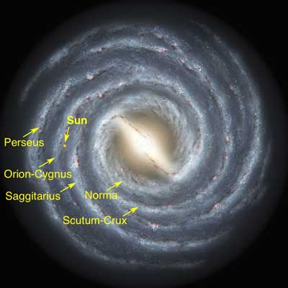
Emergent Phenomena in the Standard Model
Existence of the Universe as we know it depends critically on the following empirical facts:
Proton is massive, i.e. the mass-scale for strong interactions is vastly different to that of electromagnetism
Proton is absolutely stable, despite being a composite object constituted from three valence quarks
Pion is unnaturally light (not massless, but lepton-like mass), despite being a strongly interacting composite object built from a valence-quark and valence antiquark
Emergence: low-level rules producing high-level phenomena, with enormous apparent complexity

Slide 5
Strong Interactions in the Standard Model
Only apparent scale in chromodynamics is mass of the quark field
Quark mass is said to be generated by Higgs boson.
In connection with everyday matter, that mass is 1/250th of the natural (empirical) scale for strong interactions,
viz. more-than two orders-of-magnitude smaller
Plainly, the Higgs-generated mass is very far removed from the natural scale for strongly-interacting matter
Nuclear physics mass-scale – 1 GeV – is an emergent feature of the Standard Model
No amount of staring at L_{QCD} can reveal that scale
Contrast with quantum electrodynamics, e.g. spectrum of hydrogen levels measured in units of m_{e}, which appears in L_{QED}

Slide 6
Whence Mass?
Classical chromodynamics … non-Abelian local gauge theory
Remove the current mass … there’s no energy scale left
No dynamics in a scale-invariant theory; only kinematics … the theory looks the same at all length-scales … there can be no clumps of anything … hence bound-states are impossible.
Our Universe can’t exist
Higgs boson doesn’t solve this problem …
normal matter is constituted from light-quarks
the mass of protons and neutrons, the kernels of all visible matter, are 100-times larger than anything the Higgs can produce
Where did it all begin?
… becomes … Where did it all come from?

Slide 7
Trace Anomaly
Classically, in a scale invariant theory
the energy-momentum tensor must be traceless: T_{μμ} ≡ 0
Regularisation and renormalisation of (ultraviolet) divergences in Quantum Chromodynamics introduces a mass-scale
… dimensional transmutation: mass-dimensionless quantities become dependent on a mass-scale, ζ
α → α(ζ) in QCD’s (massless) Lagrangian density, L(m=0)
⇒ ∂_{μ}D_{μ} = δL/δσ = αβ(α) dL/dα = β(α) ¼G_{μν} G_{μν} = T_{ρρ} =: Θ₀
Quantisation of renormalisable four-dimensional theory forces nonzero value for trace of energy-momentum tensor
Trace anomaly
QCD β function
Notes:
Alpha -> alpha(zeta) seems to be enough to generate M(zeta), which is large for zeta small.

Slide 8
Whence?
Classical chromodynamics
non-Abelian local gauge theory
local gauge invariance
But no confinement without a mass-scale
Three quarks can still be colour-singlet
Colour rotations will keep them colour singlets
But they need have no proximity to one another
… proximity is meaningless in a scale-invariant theory
Whence mass … equivalent to whence a mass-scale … equivalent to whence a confinement scale
Understanding the origin of mass in QCD is quite likely inseparable from the task of understanding confinement.

Slide 9
Where is the mass?

Slide 10
Trace Anomaly
Knowing that a trace anomaly exists does not deliver a great deal
… Indicates only that a mass-scale must exist
Can one compute and/or understand the magnitude of that scale?
One can certainly measure the magnitude … consider proton:
In the chiral limit the entirety of the proton’s mass is produced by the trace anomaly, Θ₀
… In QCD, Θ₀ measures the strength of gluon self-interactions
… so, from one perspective, m_{p} is completely generated by glue.

Slide 11
On the other hand …

Slide 12
Trace Anomaly
In the chiral limit
⇒
Does this mean that the scale anomaly vanishes trivially in the pion state, i.e. gluons contribute nothing to the pion mass?
Difficult way to obtain “zero”!
Easier to imagine that “zero” owes to cancellations between different operator contributions to the expectation value of Θ₀.
Of course, such precise cancellation should not be an accident.
It could only arise naturally because of some symmetry and/or symmetry-breaking pattern.

Slide 13
Whence “1” and yet “0” ?
No statement of the question
“Whence the proton's mass?”
is complete without the additional clause
“Whence the absence of a pion mass?”
Natural visible-matter mass-scale must emerge simultaneously with apparent preservation of scale invariance in related systems
Expectation value of Θ₀ in pion is always zero, irrespective of the size of the natural mass-scale for strong interactions = m_{p}

Slide 14
Ideas: Old & New

Slide 15
Particle Data Group

Slide 16
Gluon Gap Equation
Pinch Technique: Theory and Applications
Daniele Binosi & Joannis Papavassiliou
Phys. Rept. 479 (2009) 1-152

Slide 17
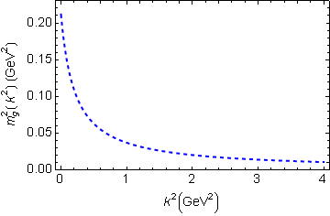
In QCD: Gluons become massive!
Bridging a gap between continuum-QCD and ab initio predictions of hadron observables, D. Binosi et al., arXiv:1412.4782 [nucl-th], Phys. Lett. B742 (2015) 183-188
Running gluon mass
Gluons are cannibals – a particle species whose members become massive by eating each other!
μ_{g} ≈ ½ m_{p}
Expression of trace anomaly:
Massless glue becomes massive
gluon mass-squared function
Power-law suppressed in ultraviolet, so invisible in perturbation theory
5%
Interaction model for the gap equation, S.-x.Qin et al., arXiv:1108.0603 [nucl-th], Phys. Rev. C 84 (2011) 042202(R) [5 pages]
Class A: Combining DSE, lQCD and pQCD analyses of QCD’s gauge sector

Slide 18
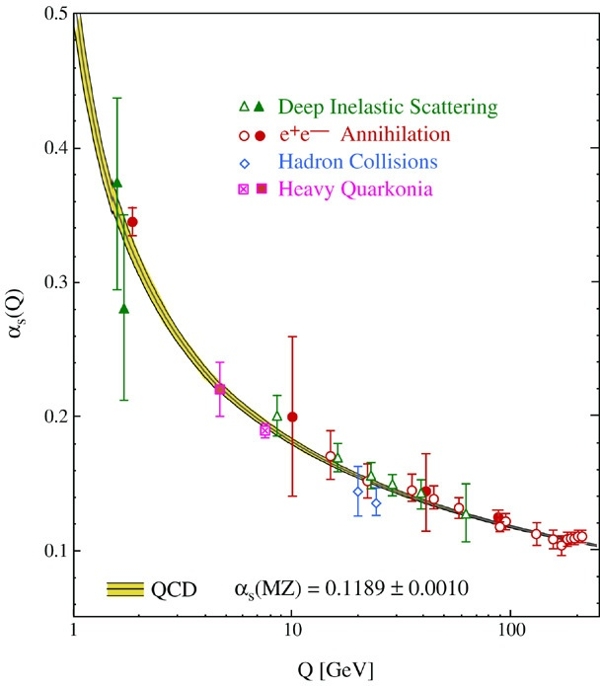
QCD’s Running Coupling
⇐
What’s happening
out here?!

Slide 19
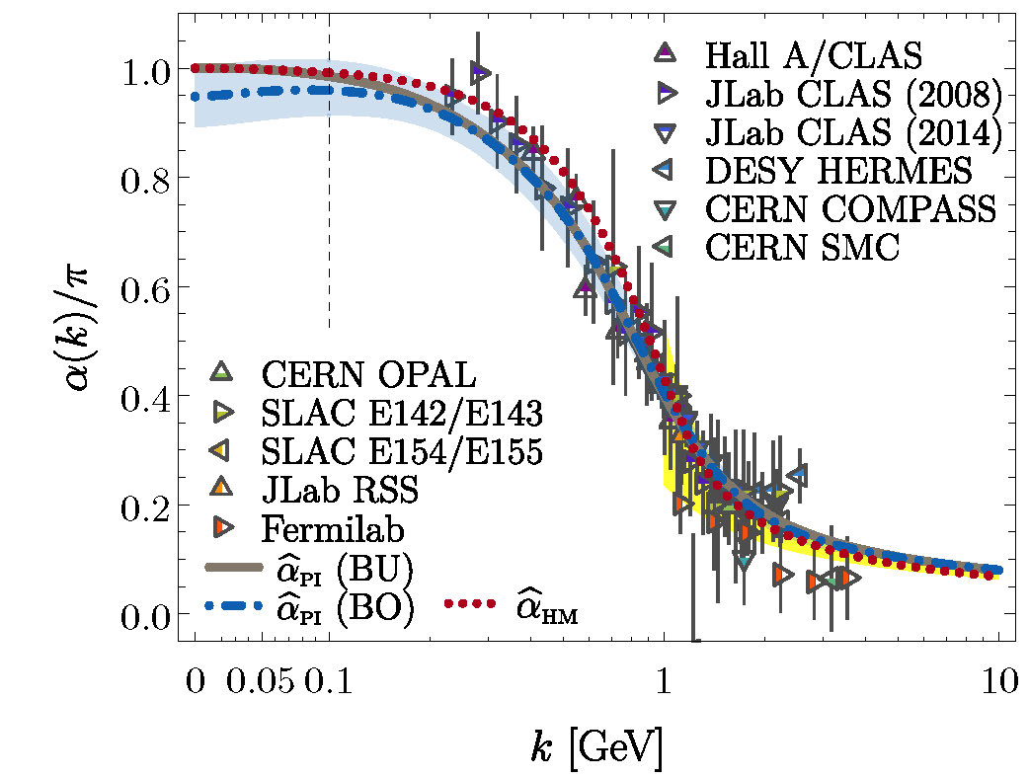
Process-independent effective-charge in QCD
Process independent strong running coupling
Binosi, Mezrag, Papavassiliou, Roberts, Rodriguez-Quintero
arXiv:1612.04835 [nucl-th], Phys. Rev. D 96 (2017) 054026/1-7
Modern continuum & lattice methods for analysing gauge sector enable
“Gell-Mann – Low”
running charge to be defined in QCD
Combined continuum and lattice analysis of QCD’s gauge sector yields a parameter-free prediction
N.B. Qualitative change in α̂_{PI}(k) at k ≈ ½ m_{p}

Slide 20
QCD Effective Charge
Process independent strong running coupling
Binosi, Mezrag, Papavassiliou, Roberts, Rodriguez-Quintero
arXiv:1612.04835 [nucl-th], Phys. Rev. D 96 (2017) 054026/1-7
The QCD Running Coupling,
A. Deur, S. J. Brodsky and G. F. de Teramond,
Prog. Part. Nucl. Phys. 90 (2016) 1-74
Near precise agreement between process-independent
α̂_{PI} and α_{g1}
& α̂_{PI} ≈ α_{HM}
Perturbative domain:
difference = (1/20) α_{M̅S̅}²
Parameter-free prediction:
Curve completely determined by results obtained for gluon & ghost two-point functions using continuum and lattice-regularised QCD.
Data = process dependent effective charge [Grunberg:1982fw]:
α_{g1}, defined via Bjorken Sum Rule

Slide 21
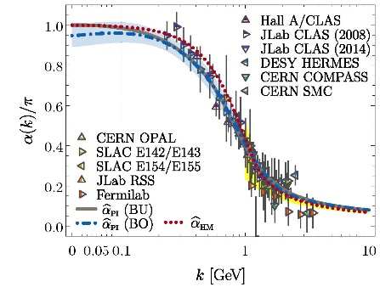
QCD Effective Charge
α̂_{PI} is a new type of effective charge
direct analogue of the Gell-Mann–Low effective coupling in QED, i.e. completely determined by the gauge-boson two-point function.
α̂_{PI} is
process-independent
appears in every one of QCD’s dynamical equations of motion
known to unify a vast array of observables
α̂_{PI} possesses an infrared-stable fixed-point
Nonperturbative analysis demonstrating absence of a Landau pole in QCD
QCD is IR finite, owing to dynamical generation of gluon mass-scale, which also serves to eliminate the Gribov ambiguity
Asymptotic freedom ⇒ QCD is well-defined at UV momenta
QCD is therefore unique amongst known 4D quantum field theories
Potentially, defined & internally consistent at all momenta

Slide 22
QCD Effective Charge
α̂_{PI} is a new type of effective charge
direct analogue of the Gell-Mann–Low effective coupling in QED, i.e. completely determined by the gauge-boson two-point function.
α̂_{PI} is
process-independent
appears in every one of QCD’s dynamical equations of motion
known to unify a vast array of observables
α̂_{PI} possesses an infrared-stable fixed-point
Nonperturbative analysis demonstrating absence of a Landau pole in QCD
QCD is IR finite, owing to dynamical generation of gluon mass-scale, which also serves to eliminate the Gribov ambiguity
Asymptotic freedom ⇒ QCD is well-defined at UV momenta
QCD is therefore unique amongst known 4D quantum field theories
Potentially, defined & internally consistent at all momenta
Conceivably, therefore,
QCD can serve as a basis
for theories that take physics
beyond the Standard Model

Slide 23
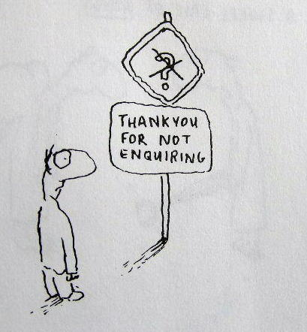
Enigma of Mass

Slide 24
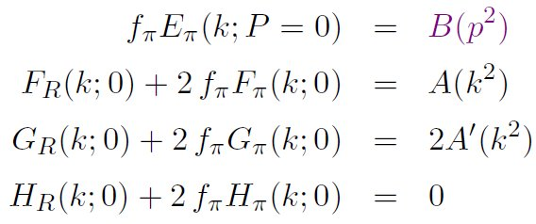
Pion’s Goldberger -Treiman relation
Maris, Roberts and Tandy
nucl-th/9707003, Phys.Lett. B420 (1998) 267-273
Pion’s Bethe-Salpeter amplitude
Solution of the Bethe-Salpeter equation
Dressed-quark propagator
Axial-vector Ward-Takahashi identity entails
B(k²)
Owing to DCSB
& Exact in
Chiral QCD
Miracle: two body problem solved, almost completely, once solution of one body problem is known

Slide 25
The most fundamental expression of Goldstone’s Theorem and DCSB
Rudimentary version of this relation is apparent in Nambu’s Nobel Prize work
Model independent
Gauge independent
Scheme independent
f_{π} E_{π}(p²) = B(p²)

Slide 26
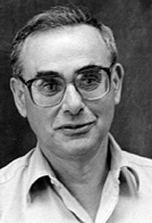
Enigma of mass
f_{π} E_{π}(p²) = B(p²)
This algebraic identity is why QCD’s pion is massless in the chiral limit
The quark level Goldberger-Treiman relation shows that DCSB has a very deep and far reaching impact on physics within the strong interaction sector of the Standard Model; viz.,
Goldstone's theorem is fundamentally an expression of equivalence between the one-body problem and the two-body problem in the pseudoscalar channel.
This emphasises that Goldstone's theorem has a pointwise expression in QCD
Hence, pion properties are an almost direct measure of
the dressed-quark mass function.
Thus, enigmatically, the properties of the massless pion
are the cleanest expression of the mechanism that is
responsible for almost all the visible mass in the universe.

Slide 27
Observing Mass

Slide 28
Pion’s valence-quark Distribution Amplitude
Imaging dynamical chiral symmetry breaking: pion wave function on the light front, Lei Chang, et al., arXiv:1301.0324 [nucl-th], Phys. Rev. Lett. 110 (2013) 132001 (2013) [5 pages].
Methods have been developed that enable direct computation of the pion’s light-front wave function
φ_{π}(x) = twist-two parton distribution amplitude = projection of the pion’s Poincaré-covariant wave-function onto the light-front
Results have been obtained with the DCSB-improved DSE kernel, which unifies matter & gauge sectors
ϕ_{π}(x) ∝ x^{α} (1-x)^{α}, with α≈0.5

Slide 29
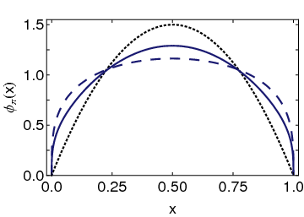
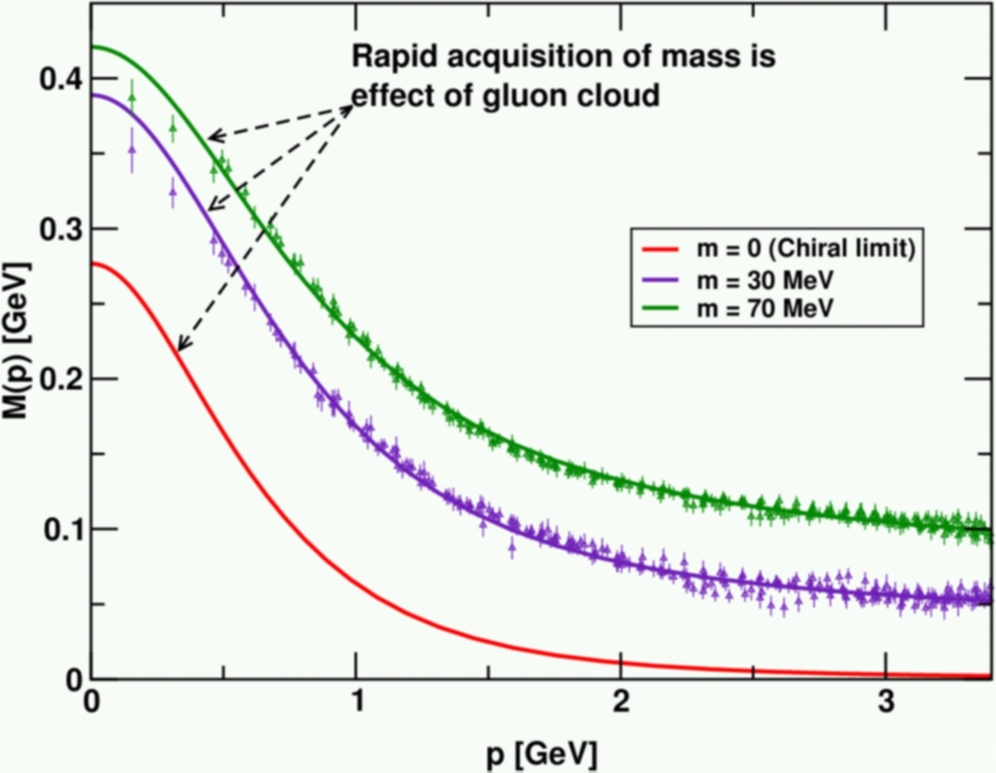
Pion’s valence-quark Distribution Amplitude
Imaging dynamical chiral symmetry breaking: pion wave function on the light front, Lei Chang, et al., arXiv:1301.0324 [nucl-th], Phys. Rev. Lett. 110 (2013) 132001 (2013) [5 pages].
Continuum prediction:
marked broadening of φ_{π}(x), which owes to DCSB
Conformal QCD
DB
RL
Real-world PDAs are squat and fat
A theory that produces M(p)=constant
also produces φ(x)=constant

Slide 30
Leading-twist PDAs of S-wave light-quark mesons
End of a long story (longer than 30 years war)
Continuum predictions that pion and kaon PDAs are broad, concave functions confirmed by simulations of lattice-regularised QCD
Pion Distribution Amplitude from Lattice QCD, Jian-Hui Zhang et al., Phys.Rev. D95 (2017) 094514; 1702.00008
Kaon Distribution Amplitude from Lattice QCD and the Flavor SU(3) Symmetry, Jiunn-Wei Chen et al., arXiv:1712.10025 [hep-ph]
Pion and kaon valence-quark parton quasidistributions, S.-S. Xu, L. Chang et al. Phys. Rev. D97 (2018) 094014; arXiv:1802.09552 [nucl-th]
Continuum analyses predict that these properties characterise the leading-twist PDAs of all S-wave light-quark mesons
Many empirically verifiable predictions

Slide 31
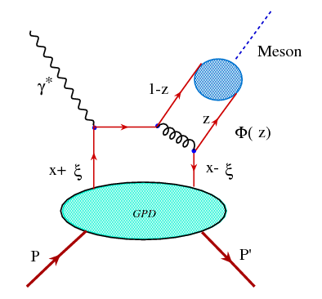
DVMP
Two nonperturbative quantities
GPD of target
ϕ_{M}, PDA of meson produced
Can’t extract GPD unless ϕ_{M} is known
Similar structure to elastic scattering formula
v̅ = 1-z … Extracted result for GPD is very sensitive to endpoint behaviour of meson PDA
Overlapping renormalisation/factorisation scales, must “communicate” under evolution because result should be scale-independent
D. Müller, et al.
Nuclear Physics
B 884 (2014) 438–546
We add that one usually assumes that the scheme (and framework) dependent meson DA is known, but even in the case of the pion DA rather different models were proposed [161–165,143,166,167] which, unfortunately, can be discriminated only partially by present experimental pion form factor [168–171] and pion-to-photon transition form factor [172–175] data and lattice results [176].

Slide 32
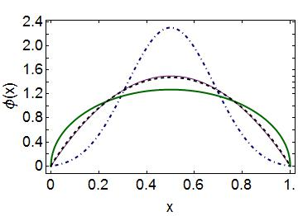
Emergent Mass vs. Higgs Mechanism
Parton distribution amplitudes of S-wave heavy-quarkonia Minghui Ding, Fei Gao, Lei Chang, Yu-Xin Liu and Craig D. Roberts arXiv:1511.04943 [nucl-th], Phys. Lett. B 753 (2016) pp. 330-335
When does Higgs mechanism begin to influence mass generation?
limit m_{quark}→ ∞
φ(x) → δ(x-½)
limit m_{quark} → 0
φ(x) ∼ (8/π) [x(1-x)]^{½}
Transition boundary lies just above m_{strange}
Comparison between distributions of light-quarks and those involving strange-quarks is good place to seek signals for strong-mass generation
conformal
c+c_{bar}: Higgs
(weak mass)
s+s_{bar}:
on the border
q+q_{bar}: Emergent
(strong mass)

Slide 33
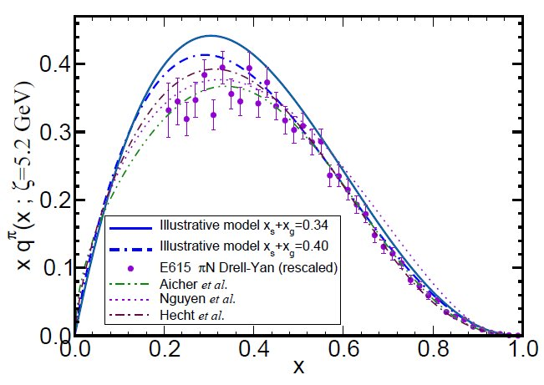
π & K Valence-quark Distribution Functions

Slide 34
π & K PDFs
Extant data on π & K PDFs (mesonic Drell-Yan) is old: 1980-1989
New data would be welcome:
persistent doubts about the Bjorken-x ≃1 behaviour of the pion’s valence-quark PDF
single modest-quality measurement of u^{K}(x)/u^{π}(x) cannot be considered definitive.
Approved experiment, using tagged DIS at JLab 12, should contribute to a resolution of pion question
Similar technique should also serve for the kaon.
Future:
new mesonic Drell-Yan measurements at modern facilities could yield valuable information on π and K PDFs (COMPASS),
as could two-jet experiments at the large hadron collider;
EIC would be capable of providing access to π and K PDFs through measurements of forward nucleon structure functions.
Gribov-Lipatov reciprocity (crossing symmetry) entails connection between PDFs and fragmentation functions on z ≃ 1 (z ≥ 0.75)
D_{H/q}(z) ≈ z q^{H}(z)
Reliable information on meson fragmentation functions is critical if the worldwide programme aimed at determining TMDs is to be successful

Slide 35
Valence-quark PDFs within mesons
Basic features of the pion valence-quark distribution function,
Lei Chang, Cédric Mezrag, et al.,
arXiv:1406:5450 [nucl-th], Phys. Lett. B 737 (2014) pp. 23–29
Valence-quark distribution functions in the kaon and pion,
Chen Chen, Lei Chang et al.
arXiv:1602.01502 [nucl-th], Phys. Rev. D 93 (2016) 074021/1-11
Compute PDFs from imaginary part of virtual-photon – pion forward Compton scattering amplitude:
γ π → γ π
Handbag diagram is insufficient. Doesn’t even preserve global symmetries. Exists a class of leading-twist corrections that remedies this defect ⇒
Similar expressions for u_{V}^{K}(x), s_{V}^{K}(x)
Projection onto light-front
Partial derivative wrt relative momentum
Measurable quantities
Directly related to
dynamically generated quark masses
& bound-state wave functions

Slide 36
Valence-quark PDFs within mesons
Basic features of the pion valence-quark distribution function,
Lei Chang, Cédric Mezrag, et al.,
arXiv:1406:5450 [nucl-th], Phys. Lett. B 737 (2014)pp. 23–29
Valence-quark distribution functions in the kaon and pion,
Chen Chen, Lei Chang et al.
arXiv:1602.01502 [nucl-th], Phys. Rev. D93 (2016) 074021/1-11
Valence-quark PDFs satisfy, independent of any and all structural details:
Formulae provide algebraic proof that (hadronic scale ζ ≈ 0.5 GeV)
q_{V}^{M}(x ≃ 1) ∝ (1-x)^{2n}
in any theory with (1/k²)^{n} vector-boson exchange interaction

Slide 37
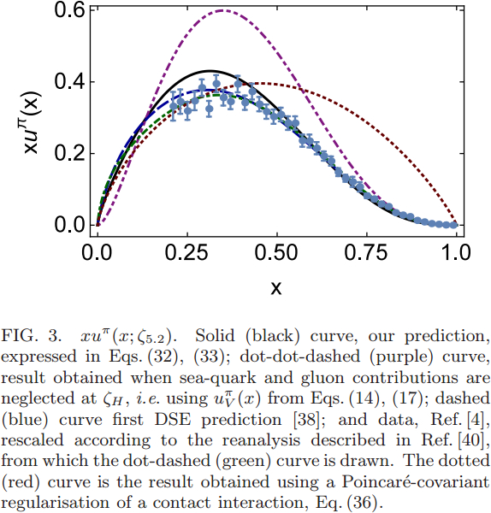
Pion PDF
DSE
2000 2016
Purple dot-dot-dash = prediction at ζ_{H}
Data = modern reappraisal of E615: NLO analysis plus soft-gluon resummation (ASV)
Solid black curve, prediction evolved to ζ=5.2GeV, the scale associated with the experiments
Blue dashed curve = first DSE prediction, in 2000 (ζ=5.2GeV)
Dotted red curve = result obtained with momentum-independent gluon exchange (contact interaction, ζ=5.2GeV)
CI: (1-x)^{1.0±0.1}
ζ=5.2GeV
QCD demands it
& phenomenology should respect that
DSE: (1-x)^{3.0±0.1}

Slide 38
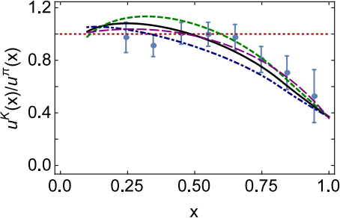
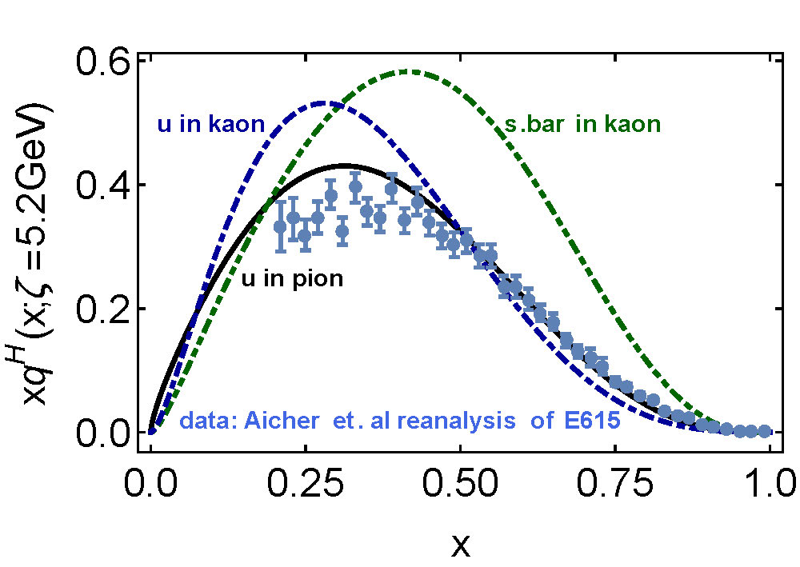
Kaon’s gluon content
0%
10%
〈x〉_{g}^{K}(ζ_{H}) = 0.05 ± 0.05
⇒ Valence quarks carry
95% of kaon’s
momentum at ζ_{H}
DGLAP-evolved to ζ₂
Valence-quarks carry ⅔ of kaon’s light-front momentum
Cf. Only ½ for the pion

Slide 39
π & K PDFs
Valence-quark distribution functions in the kaon and pion,
Chen Chen, Lei Chang et al.
arXiv:1602.01502 [nucl-th], Phys. Rev. D93 (2016) 074021/1-11
Marked differences between π & K gluon content
ζ_{H}:
Whilst $\frac{1}{3}$ of pion’s light-front momentum carried by glue
$Only \frac{1}{20}$ of the kaon’s light-front momentum lies with glue
ζ₂² = 4 GeV²
Glue carries $\frac{1}{2}$ of pion’s momentum and $\frac{1}{3}$ of kaon’s momentum
Evident in differences between large-x behaviour of valence-quark distributions in these two mesons
Signal of Nambu-Goldstone boson character of π
Nearly complete cancellation between
one-particle dressing and binding attraction
in this almost massless pseudoscalar system
2 Mass_{Q} + U_{g} ≈ 0

Slide 40
π & K PDFs
Valence-quark distribution functions in the kaon and pion,
Chen Chen, Lei Chang et al.
arXiv:1602.01502 [nucl-th], Phys. Rev. D93 (2016) 074021/1-11
The character of Nambu-Goldstone modes in the Standard Model is far more interesting than usually thought
Nambu-Goldstone modes are nonpointlike!
Intimately connected with origin of mass!
Possibly/Probably(?) inseparable from expression of confinement!
Difference between gluon content of π & K is measurable … using well-designed EIC
Write a definitive new chapter in future textbooks on the Standard Model

Slide 41
Structure of Baryons

Slide 42
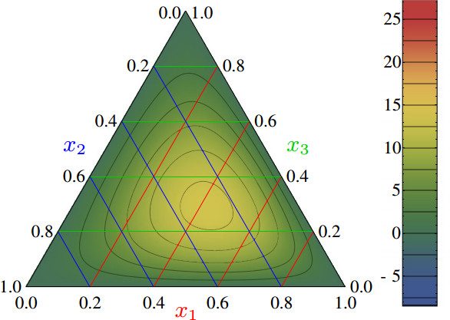
Nucleon PDAs & lQCD
Light-cone distribution amplitudes of the nucleon and negative parity nucleon resonances from lattice QCD
V. M. Braun et al., Phys. Rev. D 89 (2014) 094511
Light-cone distribution amplitudes of the baryon octet
G. S. Bali et al. JHEP 1602 (2016) 070
First lQCD results for n=0, 1 moments of proton’s leading twist PDA are available
Used to constrain strength (a₁₁) of leading-order term in a conformal expansion of proton’s PDA:
Φ(x₁,x₂,x₃)
= 120 x₁ x₂ x₃ [ 1 + a₁₁ P₁₁(x₁,x₂,x₃) + … ]
Shift in location of central peak
One u–quark in proton carries more momentum than the other
Other u-quark seems “paired”
with the d-quark, carrying
equal momentum
(0.5,0.25,0.25)
Notes:
The calculation is done using Nf = 2 + 1 flavors of dynamical (clover) fermions on lattices of different volumes and pion masses down to 222 MeV. Significant SU(3) flavor symmetry violation effects in the shape of the distribution amplitudes are observed.

Slide 43
PDAs of Nucleon & its 1st Radial Excitation
Parton distribution amplitudes: revealing diquarks in the proton
and Roper resonance, Cédric Mezrag, Jorge Segovia, Lei Chang and Craig D. Roberts arXiv:1711.09101 [nucl-th], Phys. Lett. B in press
Continuum methods used for mesons can be extended to compute pointwise behaviour of baryon PDAs
Just like QM & PDAs of meson radial excitations
conformal
nucleon
Roper’s quark core
Diquark clustering skews the distribution toward the dressed-quark bystander, which therefore carries more of the proton’s light-front momentum
Excitation’s PDA is not positive definite … there is a prominent locus of zeros in the lower-right corner of the barycentric plot

Slide 44
PDAs of Nucleon & its 1st Radial Excitation
Parton distribution amplitudes: revealing diquarks in the proton
and Roper resonance, Cédric Mezrag, Jorge Segovia, Lei Chang and Craig D. Roberts arXiv:1711.09101 [nucl-th], Phys. Lett. B in press
Methods used for mesons can be extended to compute pointwise behaviour of baryon PDAs
Just like QM & PDAs of meson radial excitations
conformal
nucleon
Roper’s quark core
Diquark clustering skews the distribution toward the dressed-quark bystander, which therefore carries more of the proton’s light-front momentum
Excitation’s PDA is not positive definite … there is a prominent locus of zeros in the lower-right corner of the barycentric plot

Slide 45
Diquark correlations in the nucleon
Agreement between continuum and lattice results
ONLY when nucleon contains scalar & axial-vector diquark correlations
Nucleon with only a scalar-diquark, omitting the axial-vector diquark, ruled-out by this confluence between continuum and lattice results
Parton distribution amplitudes: revealing diquarks in the proton
and Roper resonance, Cédric Mezrag, Jorge Segovia, Lei Chang and Craig D. Roberts arXiv:1711.09101 [nucl-th], Phys. Lett. B in press

Slide 46
Nucleon and Roper PDAs
No humps or bumps in leading-twist PDAs of ground-state S-wave baryons
The proton’s PDA is a broad, concave function
maximum shifted relative to peak in QCD’s conformal limit expression
Magnitude of shift signals presence of
both scalar & axial-vector diquark correlations in the nucleon
scalar generates around 60% of the proton’s normalisation.
The radial-excitation (Roper) is constituted similarly
Pointwise form of its PDA
Negative on a material domain
Is result of marked interferences between the contributions from both scalar and axial-vector diquarks
particularly, the locus of zeros, which
highlights its character as a radial excitation.
These features originate with the emergent phenomenon of dynamical chiral symmetry breaking in the Standard Model.

Slide 47
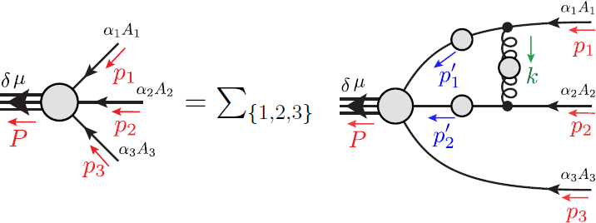
Baryons as a 3-valence-body problem

Slide 48
Heavy Baryons
Poincaré-covariant analysis of heavy-quark baryons
S.-X. Qin, C. D. Roberts & S. M. Schmidt,
arXiv:1801.09697 [nucl-th]
Poincaré-covariant analysis of heavy-quark baryons
S.-X. Qin, C. D. Roberts & S. M. Schmidt,
arXiv:1801.09697 [nucl-th], Phys.Rev. D 97 (2018) 114017/1-13
Unified study of an array of mesons and baryons constituted from light- and heavy-quarks
Symmetry-preserving rainbow-ladder truncation of all relevant bound-state equations:
Gap equations
Bethe-Salpeter equations
and Faddeev-equations
No diquark approximation to the quark-quark scattering kernel
Reverse engineering … searching for dynamical emergence of diquark correlations and their effects
Produced spectrum and decay constants of ground-state pseudoscalar- and vector-mesons:
q′ q̅ & and Q′ Q̅, with q′,q=u,d,s, Q′,Q = c,b
& masses of J^{P}=3/2⁺ qqq, QQQ ground state baryons and their first positive-parity excitations.
Only two people in the world can do this.
Neither of them is in the USA
Si-Xue Qin, was at Argonne
Now Professor at Chongqing U.

Slide 49
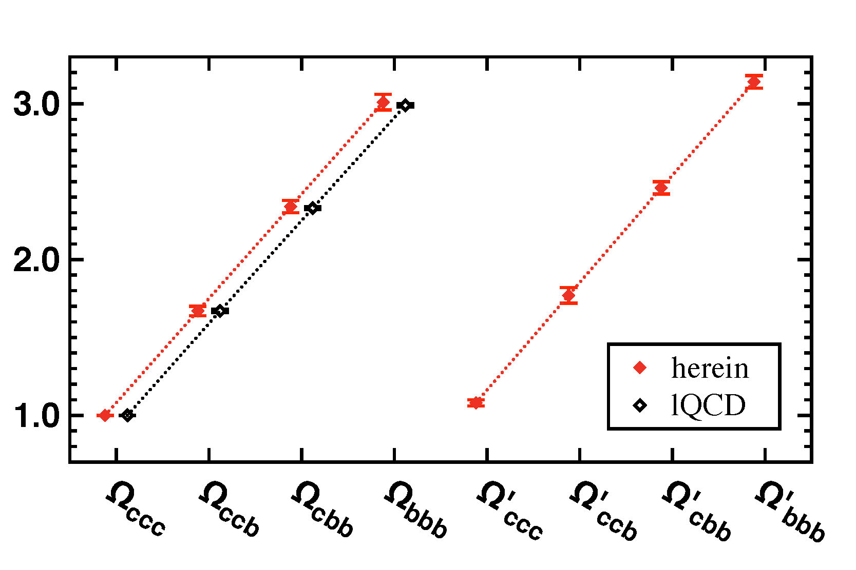
Triply Heavy Baryons
Poincaré-covariant analysis of heavy-quark baryons
S.-X. Qin, C. D. Roberts & S. M. Schmidt,
arXiv:1801.09697 [nucl-th], Phys.Rev. D 97 (2018) 114017
Ω_{ccc}= 4.76(7) GeV (RL DSE)
Ω_{ccc}= 4.80(2) GeV (lQCD)
Solved Faddeev equation in RL-truncation directly for n=0,1 ccc & bbb
Used equal spacing rule (Gell-Mann+Okubo) for other states
lQCD = Z. S. Brown, W. Detmold, S. Meinel and K. Orginos,
Phys. Rev. D 90, 094507 (2014).

Slide 50
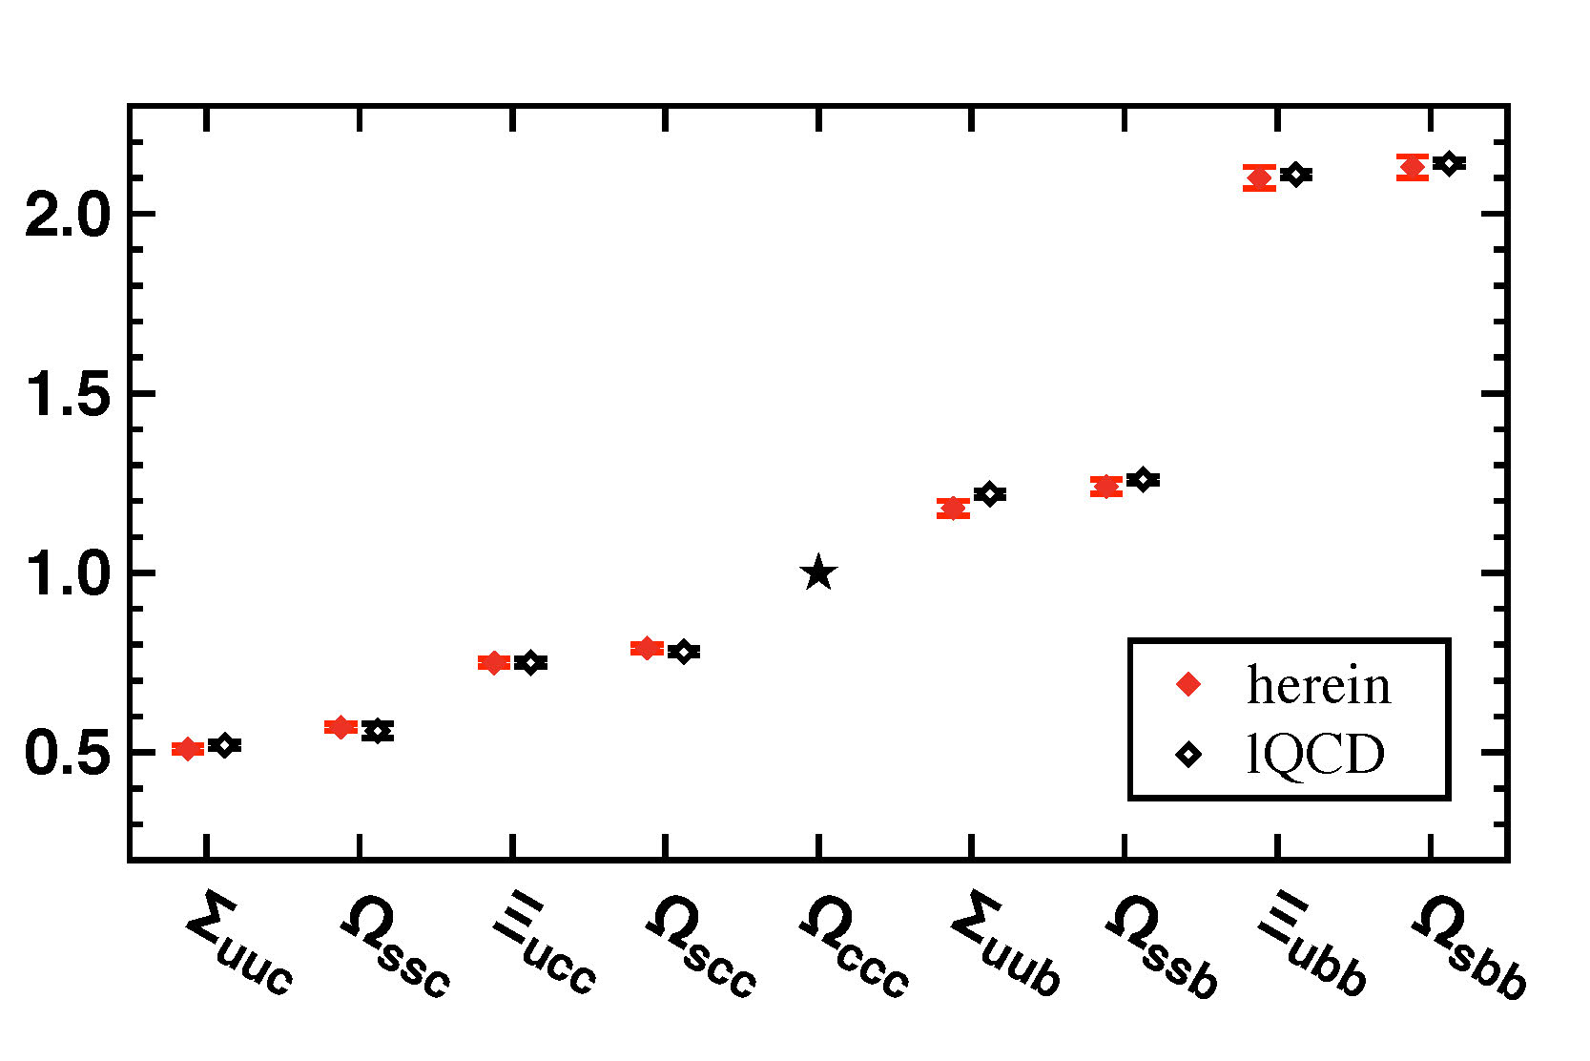
Heavy Baryons
Poincaré-covariant analysis of heavy-quark baryons
S.-X. Qin, C. D. Roberts & S. M. Schmidt,
arXiv:1801.09697 [nucl-th], Phys.Rev. D 97 (2018) 114017/1-13
Equal spacing rule provides sound estimates for
masses
decay constants
of all systems considered
ESR … underestimate direct calculations by not more than 3%
< typical RL error
Obvious in hindsight
… QCD’s interaction is flavour-independent
… need only survey DSE studies of these observables in kindred systems

Slide 51
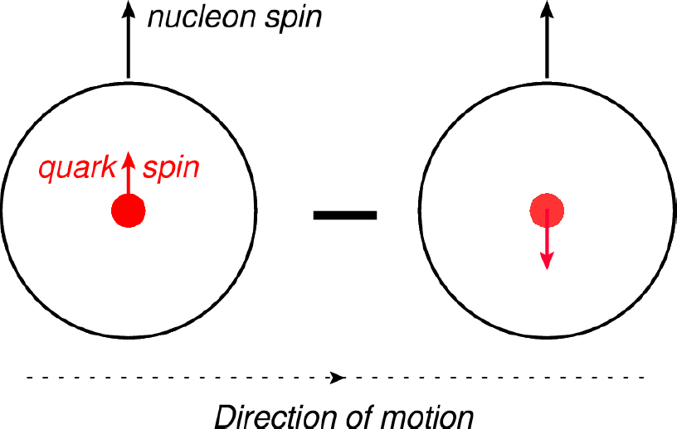
Proton’s Tensor Charge

Slide 52
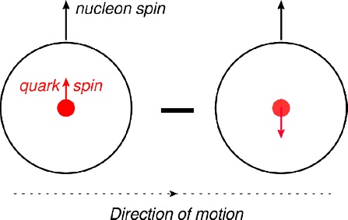
Tensor Charge and TMDs
New generation experiments aim to obtain data that can be used to determine the proton's transverse momentum dependent parton distribution functions (TMDs)
At leading-twist, three distinct TMDs are nonzero in the collinear limit, i.e. in the absence of parton transverse momentum within the target, k⊥ = 0:
unpolarized = f₁ ,
helicity = g_{1L} ,
transversity = h_{1T} .
Proton’s tensor charges:
measure any bias in quark transverse polarisation induced by a polarisation of the parent proton
Phenomenological extraction/inference from extant data on h_{1T}

Slide 53
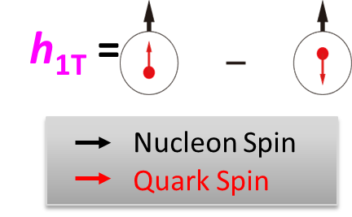
TMDs … Transversity … Tensor Charge
Direction of motion
Intrinsic, defining property of the nucleon
… just as significant as axial-charge
… in non-relativistic limit it is axial charge
No gluon transversity distribution
Value of tensor charge places constraints on some extensions of the Standard Model <PRD85 (2012) 054512>
Current knowledge of transversity:
SIDIS @HERMES, COMPASS, JLab
Future SIDIS at JLab (SoLID), EIC, …

Slide 54
Proton Tensor Charges
Theoretical predictions:
Compute directly from matrix element
Used widely for Lattice-QCD analyses:
[Bhattacharya:2015esa, Bhattacharya:2016zcn, Alexandrou:2017qyt, Bali:2014nma]
Continuum studies, too:
Quark model [He:1994gz, Yamanaka:2013zoa]
Diquark approximations to Faddeev equation [Hecht:2001ry, Pitschmann:2014jxa, Xu:2015kta]

Slide 55
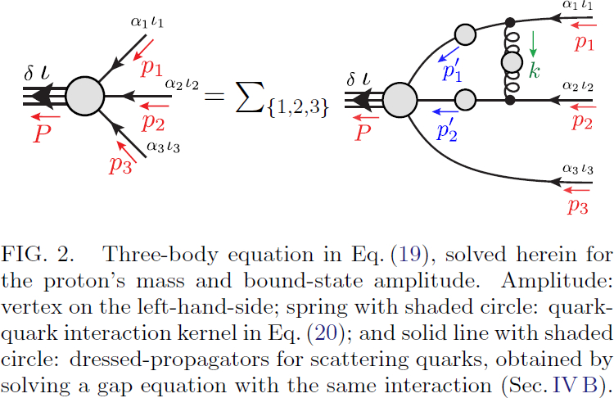
Proton Faddeev Amplitude
Proton tensor charges from a
Poincaré-covariant Faddeev Equation
Q.-W. Wang, S.-X. Qin, C. D. Roberts & S. M. Schmidt
Using precisely same interaction as for mesons, solved for the nucleon, using symmetry-preserving RL-truncation of all relevant equations:
Gap equations
Bethe-Salpeter equations
and Faddeev-equations
No diquark approximation to the quark-quark scattering kernel
Must solve for dressed-quark tensor charges, via tensor vertex.
Only Q=0 required
Renormalise at ζ₂ = 2 GeV
Natural size is now evident

Slide 56
Proton’s Tensor Charges
Proton tensor charges from a
Poincaré-covariant Faddeev Equation
Q.-W. Wang, S.-X. Qin, C. D. Roberts & S. M. Schmidt
Charges computed from the proton’s tensor current
Symmetry-preserving form, consistent with Faddeev amplitude
Two isospin channels in Faddeev equation
and in current
00 = kernel for isoscalar-scalar diquark
11 = isovector-axial-vector diquark
Signal that
δ_{T}d ≈ 0 in models that
suppress axial-vector diquarks

Slide 57
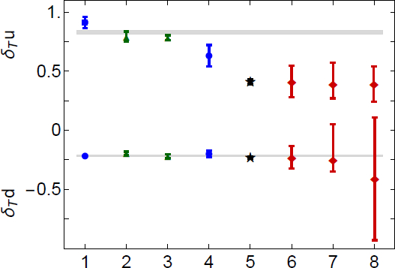
Proton’s Tensor Charges
Interaction kernel has one parameter, ω
Fixed by requiring a good description of π and ρ properties
Variation shows sensitivity to ± 10% changes in ω around the favoured value
δ_{T}u: Increasing tension between theory and phenomenology
δ_{T}d: Theory and Phenomenology agree
Theory average
This analysis
lQCD
Contact interaction DSE
SoLID precision
phenomenology

Slide 58
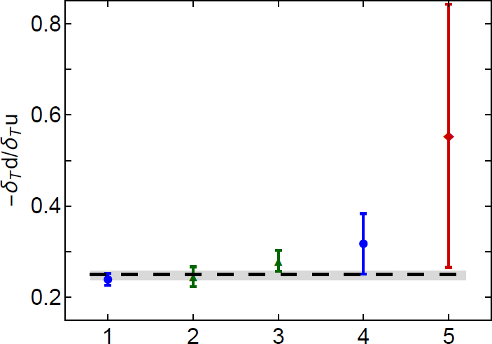
Proton’s Tensor Charges
Scale-invariant ratio
– δ_{T}d/δ_{T}u
Phenomenology [Ye:2016prn] produces ratio that is roughly twice as large
Using simple nonrelativistic quark model spin-flavour wave function this ratio is
– δ_{T}d/δ_{T}u = ¼
Practically the same in MIT bag model
But, in both cases, the individual tensor charges are measurably larger in magnitude
Agreement accidental, like μ_{p}/μ_{n}
phenomenology
This analysis
lQCD
Contact interaction DSE

Slide 59
Hybrids & Exotics

Slide 60
New Window on Hybrids/Exotics
New Perspective on Hybrid Mesons Shu-Sheng Xu, et al.
arXiv:1805.06430 [nucl-th]
C = 1PI gluon-quark scattering amplitude
Question:
Does QCD support bound-states with valence gluons?
Exotic/Hybrid meson = g q q̅
Three valence-body problem in quantum field theory:
Novel formulation based on observation gluon-quark vertex can be represented in terms of a gluon-quark scattering amplitude
Described in Symmetry preserving truncations of the gap and Bethe-Salpeter equations, Binosi, Chang, Papavassiliou, Qin, Roberts, arXiv:1601.05441 [nucl-th], Phys. Rev. D 93 (2016) 096010/1-7
If so, then distinction is lost between force and matter fields

Slide 61
New Perspective on Hybrid Mesons
New Perspective on Hybrid Mesons Shu-Sheng Xu, et al.
arXiv:1805.06430 [nucl-th]
Recall two things …
Textbook derivations of the two-body Bethe-Salpeter equation in analyses of two-particle scattering and relationship between the scattering matrix and kernel
Role that coloured quark-quark (diquark) correlations play in simplifying the baryon three-body problem
Then, reinterpretation of gluon-quark vertex suggests that
gluon-quark [q_{g}=gq] & degenerate gluon-antiquark [q̅_{g}=gq̅]
correlations play important role in solving 3-body problem for hybrids
Conjecture: Hybrids = highly-correlated q_{g}q̅ ↔ qq̅_{g} bound-states

Slide 62
New Perspective on Hybrids
New Perspective on Hybrid Mesons Shu-Sheng Xu, et al.
arXiv:1805.06430 [nucl-th]
q – q̅_{g}
Suppose strong q_{g} and q̅_{g} correlations exist, then …
Hybrids mesons explained by:
Coupled-channels Faddeev-like bound-state equation
Ψ = Ψ₁ + Ψ₂,
Ψ₁ = q_{g}q̅ & Ψ₂ = qq̅_{g}
Challenges:
Confirm existence of tight gluon-quark correlations
Determine their properties
q_{g} – q̅
q_{g} – q̅
q – q̅_{g}
Ψ₁ = Γª_{μ}(l;p_{qg}) S_{gq}(p_{qg}) ψ₁(p;P)
gq correlation amplitude
bystander+correlation Faddeev amplitude
gq correlation propagator

Slide 63
Gluon-Quark Correlations
New Perspective on Hybrid Mesons Shu-Sheng Xu, et al.
arXiv:1805.06430 [nucl-th]
Any kernel that provides good description of π- and ρ-meson properties (masses, decay constants, etc.):
Generates quark+quark correlations in all possible J^{PC} channels
Diquarks play crucial role in determining structure and interactions of baryons
Generates gluon+quark correlations
Dressed valence gluon and valence quark both have running masses, large in infrared
M_{g}^{IR} ≈ ½ m_{proton}
M_{q}^{IR} ≈ ⅓ m_{proton}
Mass_{(g+q)} ≈ m_{proton} ≈ 1 GeV

Slide 64
Hybrid Spectrum
New Perspective on Hybrid Mesons Shu-Sheng Xu, et al.
arXiv:1805.06430 [nucl-th]
lQCD 3
lQCD 4
ACM-I 2
First time
Agreement between continuum analysis and lQCD spectrum
(Dudek et al.:
arXiv:1004.4930 [hep-ph])
Magnitude of continuum results set by
infrared values of the running gluon and quark masses
determined by π- and ρ-meson properties
unrelated to hybrid channels.
Constituent-gluon
= QCD’s dressed gluon
Hybrid states in the framework of DSEs
Friday 11:30 - 12:00
Presenter: Shusheng XU (Nanjing University)
Faddeev equation approach to the valence gluon+quark+atiquark bound-state problem in relativistic quantum field theory
Strong correlations exist the [qg=gq] & [q̅g = gq̅] channels
Hybrid mesons appear as highly-correlated qgq̅ ↔ qq̅g systems
Given role that diquark correlations play in determining baryon properties, existence and importance of kindred correlations within hybrids appears credible

Slide 65
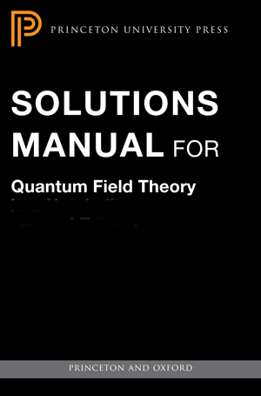
Summary
Quantum
Chromodynamics

Slide 66
Summary … 1
Mass is dynamically generated in QCD: Scale ∼ Λ_{QCD}
Empirically Λ_{QCD} ≈ 0.2 GeV
Standard Model can’t predict this value.
Gluon self-interactions make Λ_{QCD} ≈ 0.2 GeV possible, but don’t guarantee it.
Consequences:
gluons and quarks, massless in perturbation theory, possess mass functions which are large at infrared momenta ∼ 2 Λ_{QCD}
⇒ all bound-states have GeV-scale masses
⇒ except Nambu-Goldstone modes
Owing to DCSB, whilst the constituents are massive, these modes are (nearly) massless
Unique Gell-Mann–Low effective coupling in QCD
Infrared finite … α ≈ π … Landau pole of perturbation theory is screened/eliminated by dynamical gluon mass

Slide 67
Summary … 2
PDAs of ground-state S-wave mesons and baryons are broad, concave functions
End of a 30-year war
Numerous empirical consequences ⇒ empirically verifiable
Example: s-quark defines a boundary:
emergent mass generation dominates for m<m_{s}
but explicit (Higgs) mass is most important for m>m_{s}
s-quark/u-quark comparisons are a sensitive probe of emergent mass and its distribution

Slide 68
Summary … 3
Continuum- and lattice-QCD reveal the presence of strong nonpointlike scalar and axial-vector diquark correlations in the nucleon.
Scalar-diquark-only picture of nucleon structure is ruled-out.
Axial-vector correlation is essential
Empirically verifiable consequences
Example proton’s tensor charges
δTd ≠ 0 ⇒ rules-out scalar-diquark-only nucleon
δTu ≈ 4 | δTd| can be understood as result of highly-correlated proton wave function
Tension between theory and extant phenomenology
Hybrid Mesons
Just like diquark correlations exist in baryons, coloured q_{g}=gq and q̅_{g} =gq̅ correlations can also exist in systems with valence glue.
Hybrid mesons may be highly-correlated q_{g}q̅ ↔ qq̅_{g} bound-states

Slide 69
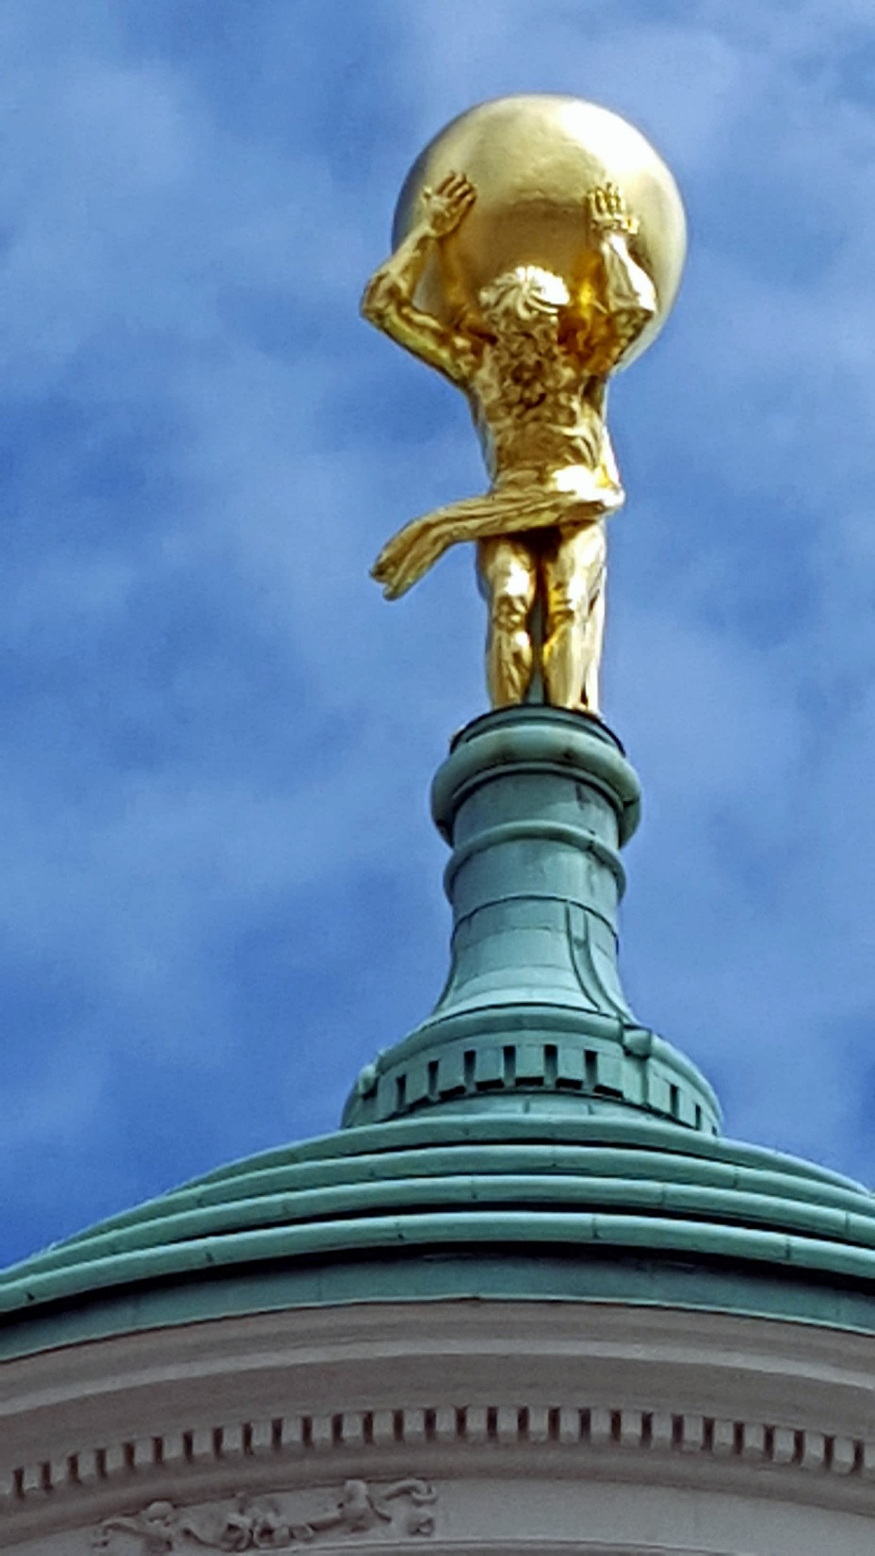
Epilogue

Slide 70
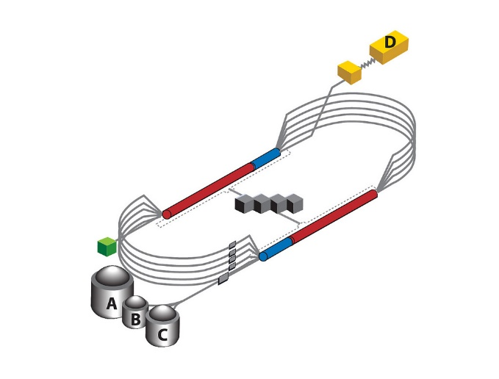
Epilogue
Challenge: Explain and Understand
the Origin and Distribution of the Vast Bulk of Visible Mass
Current Paradigm: Quantum Chromodynamics
QCD is plausibly a mathematically well-defined quantum field theory,
The only one we’ve ever produced
Consequently, it is a worthwhile paradigm for developing Beyond-SM theories
Challenge is to reveal the content of strong-QCD
Tough Problem
Progress and Insights
being delivered by amalgam of
Experiment
Phenomenology
Theory
Must continue into eras of

Slide 71
Epilogue
Challenge: Explain and Understand
the Origin and Distribution of the Vast Bulk of Visible Mass
Current Paradigm: Quantum Chromodynamics
QCD is plausibly a mathematically well-defined quantum field theory,
The only one we’ve ever produced
Consequently, it is a worthwhile paradigm for developing Beyond-SM theories
Challenge is to reveal the content of strong-QCD
Tough Problem
Progress and Insights
being delivered by amalgam of
Experiment
Phenomenology
Theory
Must continue into eras of
Thankyou

Slide 73
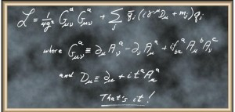
Quantum Chromodynamics (QCD)
One line and two definitions
are responsible for the
origin, mass and size
of essentially all visible matter!

Slide 74
Quantum Chromodynamics (QCD)
One line and two definitions
are responsible for the
origin, mass and size
of essentially all visible matter!

Slide 75
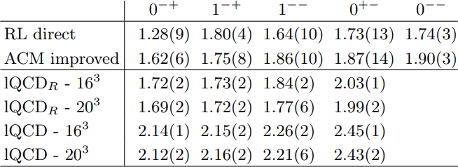
Hybrid Meson Spectrum
New Perspective on Hybrid Mesons Shu-Sheng Xu, et al.
arXiv:1805.06430 [nucl-th]
lQCD. Rows 5, 6: m_{π} > 0.4 GeV … Dudek et al.: arXiv:1004.4930 [hep-ph]
These simulations overestimate mass of pion’s first radial excitation by δ_{π1} = 0.43 GeV
lQCD. Rows 3, 4: = Rows 5, 6 – δ_{π1}

Slide 76
Hybrid Meson Spectrum
New Perspective on Hybrid Mesons Shu-Sheng Xu, et al.
arXiv:1805.06430 [nucl-th]
Faddeev Equation with [gq] correlations
Bound-states exist in all channels
Notably: 0⁻⁺ & 1⁻⁻ hybrids are structurally distinct from those accessible using the 2-body Bethe-Salpeter equation in these channels, as in all such previous studies
However, in comparison with lQCD predictions:
All states too light, especially 0⁻⁺, and 1⁻⁺-1⁻⁻ ordering is reversed.
Wide variations of model parameters do not alter this outcome.
Hitherto, such problems typical of continuum studies

Slide 77
Hybrid Meson Spectrum
New Perspective on Hybrid Mesons Shu-Sheng Xu, et al.
arXiv:1805.06430 [nucl-th]
Mismatch between RL-direct (Row 1) and lQCD results
Reconsider each element in our formulation of hybrid meson problem
Analyses of improvements to RL truncation indicate origin:
[gq] correlation amplitude was computed in RL truncation
RL truncation underestimates DCSB in bound-state amplitudes
Consequently, anomalous chromomagnetic moment (ACM) associated with this correlation is underestimated
ACM enhancement essential to explain, e.g. a₁ – ρ splitting
Introduce correction factor
Multiplication of ACM term in [gq] correlation by constant, κ_{gq}
Ask question: Can any value of κ_{gq} yield match with lQCD?

Slide 78
Hybrid Meson Spectrum
New Perspective on Hybrid Mesons Shu-Sheng Xu, et al.
arXiv:1805.06430 [nucl-th]
YES: κ_{gq} … RL = 1 → 2.4 = ACM
Magnification typical of result obtained with DCSB-improved kernels
ACM-improved calculations in Row 2:
Level ordering identical to lQCD (3, 4)
Absolute values of the masses are commensurate.

Slide 79
New Perspective on Hybrids
New Perspective on Hybrid Mesons Shu-Sheng Xu, et al.
arXiv:1805.06430 [nucl-th]
Faddeev equation approach to the valence-gluon+quark+antiquark bound-state problem in relativistic quantum field theory.
Strong correlations exist in the [q_{g}=gq] & [q̅_{g} = gq̅] channels
Hybrid mesons appear as highly-correlated q_{g}q̅ ↔ qq̅_{g}
Given role that diquark correlations play in determining baryon properties, existence and importance of kindred correlations within hybrids appears credible

Slide 80
Contents

